Slide 1

Assessing Data Management Needs and Practices to Enable Research Data Support Services
UF Graduate Linguistics Society Seminar Series
Plato Smith, Ph.D., Data Management Librarian
Florida Gym, Room 280, 4:05 pm – 4:55 pm
September 7, 2017

Slide 2
ASSESSING DATA MANAGEMENT NEEDS – DEPARTMENT OF LINGUISTICS
How to keep notes about decisions taken about experimental design and analysis such that everybody involved has access?
How to store/structure raw and analyzed data for long-term lab archiving?
How to streamline data analysis such that everybody involved has access and knows what has been done?
How to store/structure raw and analyzed data for long term lab archiving?
How to prepare and store raw data and analyzed data so that other researchers can use data (e.g. raw, aggregate, analyzed)?
How to teach students about data management and have students integrate data management practices in thesis and dissertation projects?

Slide 3
Table of contents
Digital Curation Centre (DCC) Curation Lifecycle Model
Introductory Data Management Plan Guidelines & Processes
Data Management Lifecycle
Data Management Overview
Research Data Management Support Services
Tools
Acknowledgements
References

Slide 4
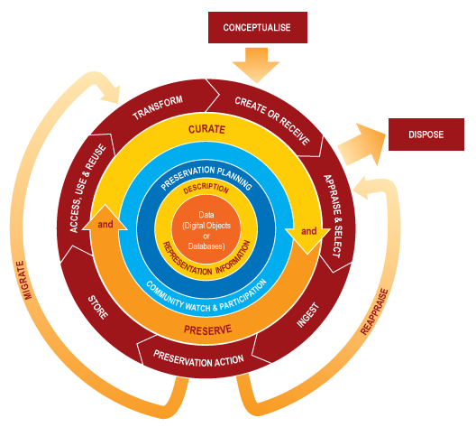
DCC CURATION LIFECYCLE MODEL (CIRCA 2007)
http://www.dcc.ac.uk/resources/curation-lifecycle-model

Slide 5
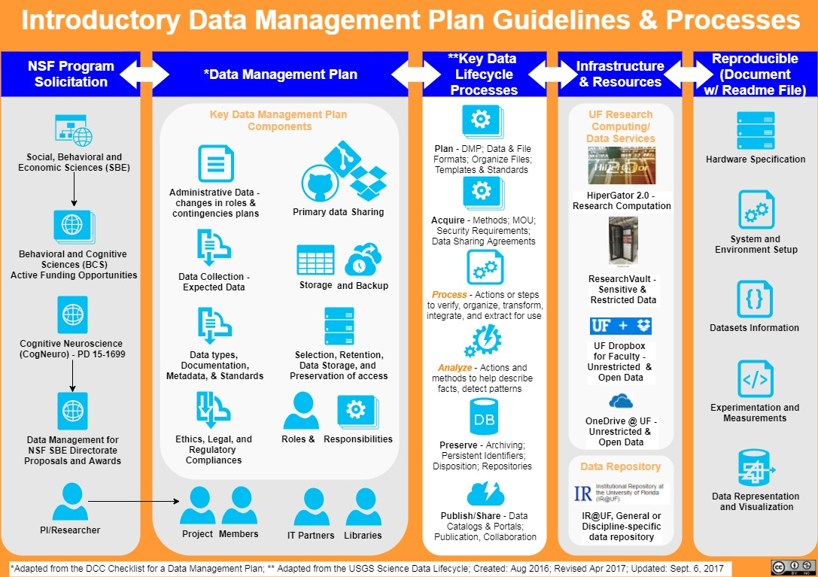

Slide 6
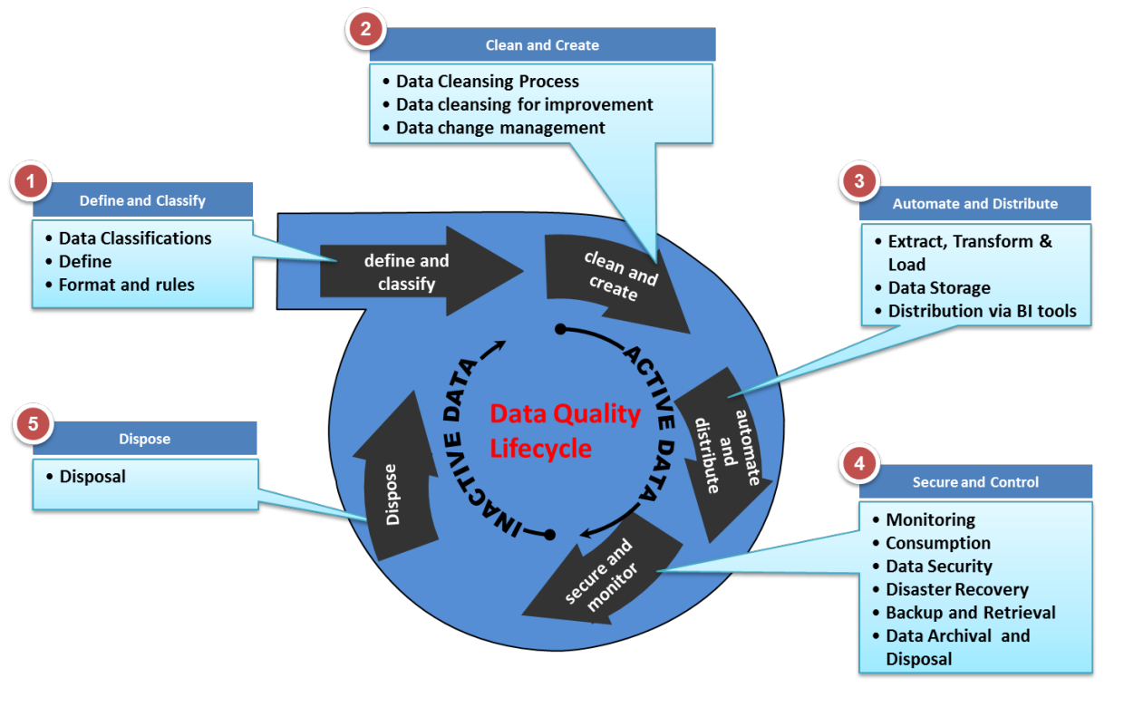
Data Management Lifecycle (UNSW, 2017)

Slide 7
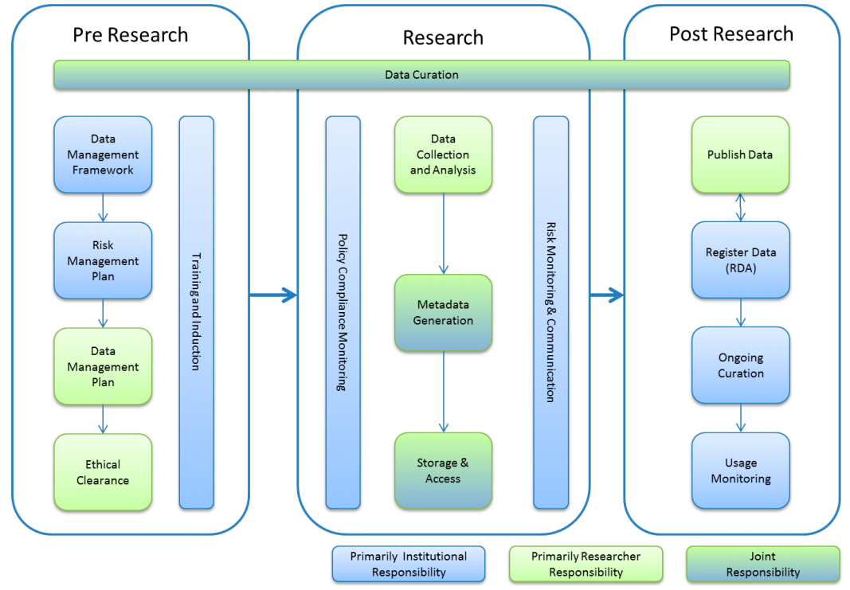
Data Management overview (ANDS, 2017)

Slide 8
Research data management support services* (Jones, Pryor, & Whyte, 2013)
RDM Policy and Strategy
Business Plan and Sustainability
Research Data Management
Active data management and storage
Data appraisal, selection, and transfer
Data archives and repositories
Data access portals and publication
Education, guidance, support, and training
Notes:
Jones, S., Pryor, G. & Whyte, A. (2013). How to Develop Research Data Management Services - a guide for HEIs’. DCC How-to Guides, page 5. Edinburgh: Digital Curation Centre (used with permission). Available online: http://www.dcc.ac.uk/resources/how-guides

Slide 9
Tools (general)
DMPTool – key components of data management planning
LabArchives (ELN) – organizing and managing data projects within/across labs/units (e.g. sciNote and hivebench)
Laboratory of Neuro Imaging (LONI) software
LONI Image and Data Archive (IDA) – a secure online resource for sharing, visualizing, and exploring neuroscience data
ORCID – aggregating and harmonizing scholarly publications
Open Science Framework – allows managing data throughout the research lifecycle
Re3data (registry of research data repositories) Linguistics
ResVault – is a secure computing environment for collaborating and managing restricted or confidential data
Zenodo – enables DOIs for datasets, linking datasets, and developing dataset collections

Slide 10
Tools (technical - domain specific)
Software Carpentry (basic lab skills for research computing) - https://software-carpentry.org/lessons/
Data Carpentry (domain-specific data skills) - http://www.datacarpentry.org/lessons/

Slide 11
acknowledgements
Dr. Edith Kaan, Associate Professor, UF Department of Linguistics
Aleksandra Tomić, PhD Student, LIN 3680 Instructor, GLS Seminar Coordinator, UF Department of Linguistics
Pamir Gogoi, PhD Student, UF Department of Linguistics
Data Management and Curation Working Group
UF Informatics Institute
UF/IFAS Wildlife Ecology & Conservation
UF Research IT Storage Task Force
UF CTSI Roundtable

Slide 12
references
ANDS. (2017). Data management overview. Accessed via http://tinyurl.com/ycgs6mqy.
DASlab, Harvard SEAS. (2017). ACM SIGMOD 2017/2018 Reproducibility. Accessed via http://db-reproducibility.seas.harvard.edu/.
DCC. (2013). Checklist for a Data Management Plan, v.4.0. Edinburgh: Digital Curation Centre. Accessed via http://tinyurl.com/qa4y3om.
Jones, S., Pryor, G. & Whyte, A. (2013). How to Develop Research Data Management Services - a guide for HEIs’. DCC How-to Guides, page 5. Edinburgh: Digital Curation Centre (used with permission). Available online: http://www.dcc.ac.uk/resources/how-guides.
NSF. (2010). Data Management for NSF SBE Directorate Proposal and Awards. Accessed via https://www.nsf.gov/sbe/SBE_DataMgmtPlanPolicy.pdf.
UF Libraries. (2017). Research Data Management at UF Guide. Accessed via http://guides.uflib.ufl.edu/datamanagement.
UF Clinical and Translational Science Institute. (2017). REDCap. Accessed via http://tinyurl.com/y9w37nra; Integrated Data Repository.
UF Research Computing. Technical Help and Documentation. Accessed via http://tinyurl.com/y8xjxy4f; Services.
UNSW. (2017). Data Governance Policy, Appendix 1. Data Management Lifecycle, p. 7. Accessed via http://tinyurl.com/y7dct55o.

Slide 13
Thank you
Questions/Comments
Contact information:
Data Management and Curation Working Group (DMCWG), DATAMGMT-[at]LISTS[dot]UFL[dot]EDU
Plato Smith, Data Management Librarian, plato.smith[at]ufl[dot]edu

