Slide 1
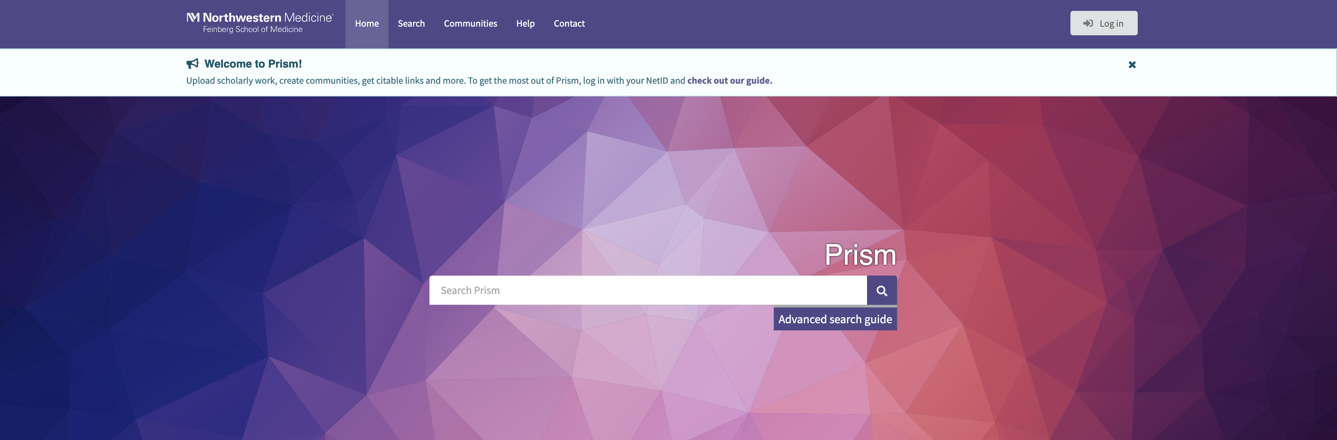


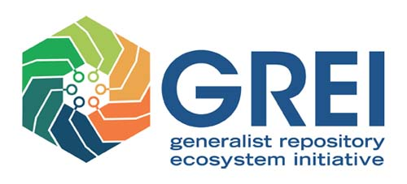




Prism
Northwestern University
Feinberg School of Medicine
Kristi Holmes, PhD
Director, Galter Health Sciences Library kristi.holmes@northwestern.edu
Links!
Prism: https://prism.northwestern.edu/
InvenioRDM: https://inveniosoftware.org/products/rdm/
Invenio Blog: https://inveniosoftware.org/blog/
Invenio documentation: https://inveniosoftware.org/documentation/
Zenodo: https://zenodo.org/
OR23 workshop: https://zenodo.org/communities/inveniordm-workshop-2023/
GREI Community: https://zenodo.org/communities/grei/
Thanks!
Prism team
InvenioRDM open source community
Support: NIH – below and impact of others
ODSS/Office of the NIH Director pursuant to OTA-21-009, “Generalist Repository Ecosystem Initiative (GREI)” through 1OT2DB000013
Northwestern Clinical and Translational Sciences Institute (NCATS UL1TR001422)

Slide 2

Sample Use Cases
Population Health and Health Equity: Our multi-institution health equity project uses InvenioRDM to collaborate with our community-based partners and credit these partnerships. We can share materials from community health events, project materials, training materials, annual reports, and lay summaries of research. InvenioRDM helps us to be better partners, accountable to collaborators and the community. (ChicagoCHEC)
Pre-Clinical: We’re managing a large multi-site project, harmonizing data from numerous sources and managing research projects. We want to create communities of practice to integrate theories, data, techniques, and tools.
Early-Stage Investigators: I’m an early career researcher just getting started on my research career. I want to “put my best foot forward” to showcase my work and demonstrate my expertise and collaborations. Our repository gives me a way to make all my research efforts findable and the metrics are helpful for reporting to leadership.
Clinical Trials: I am a clinical researcher. I need a way to pre-register protocols or research proposals, search on demographics of participants in similar studies, get insights into recruitment, and share portions of study for compliance. I also want an easy way to share materials such as recruitment protocols, and lay summaries of the trials with the community in an organized way.
Basic Science: I lead a large basic science research group. We use the repository to support reproducible science by packaging our data and methods in a combined way. Everything gets a unique identifier and versioning is supported. Our lab prioritizes science communication, so the lab graduate students set up a collection of lay summaries of their research projects to enhance engagement and dissemination, tweeting back to the summaries.
Translation to Practice: My team wants to find out about clinical trial opportunities to better offer patients all options for treatment. It is important to us to openly share the latest research with patients. The InvenioRDM communities give us a way to make these materials openly, packaged in a cohesive and attractive manner. As resources are updated, we can upload the new versions and track access.
Dissemination: Our institute wants a way to publish and disseminate content like handbooks, lay summaries, and more. We want to credit all contributors and produce an attractive and interactive resource that can be easily updated.
Use cases and implementation in collaboration with the Northwestern University Clinical and Translational Sciences Institute [NCATS UL1TR001422] & the Chicago Cancer Health Equity Collaborative (ChicagoCHEC) [NCI U54CA202995, U54CA202997, and U54CA203000].

Slide 3

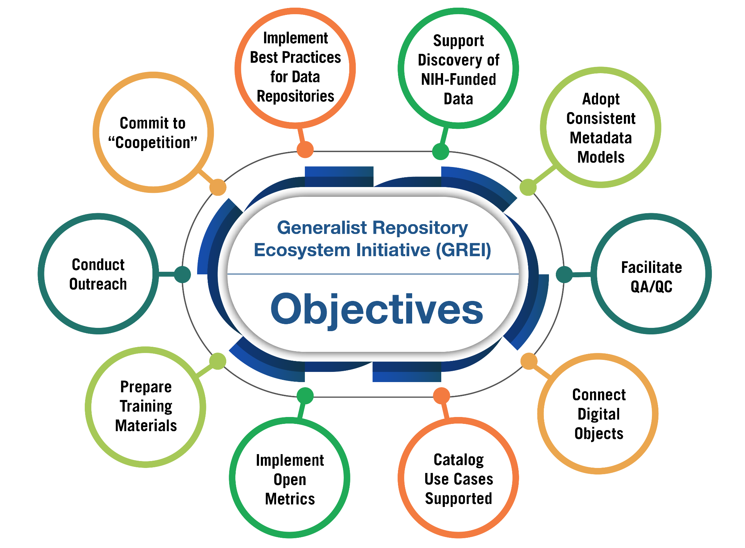
Generalist Repository Ecosystem Initiative (GREI)
https://datascience.nih.gov/data-ecosystem/exploring-a-generalist-repository-for-nih-funded-data

