Slide 1
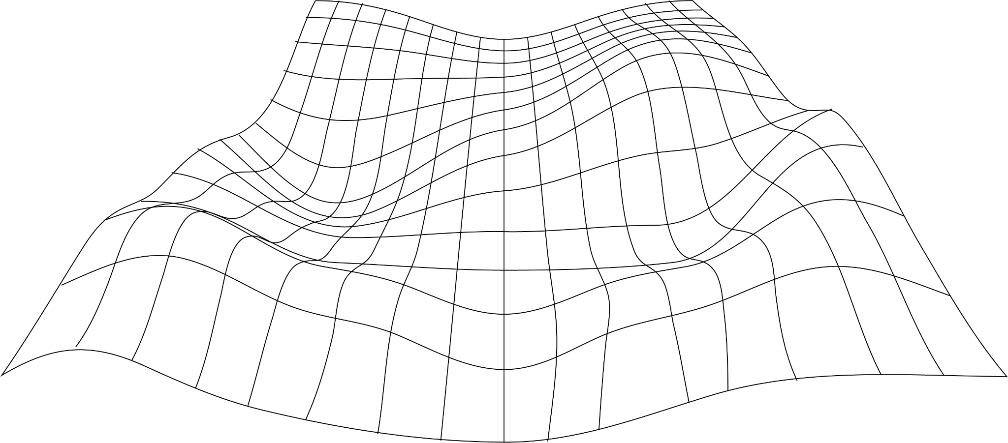



Mia
Ridge
Digital Curator
The British Library

Slide 2
Enriching lives: connecting communities and culture - with the help of machines
Notes:
Thank you for having me; excited to be back; looking forward to learning over the next couple of days…

Slide 3
Have you tried AI?
Hands up in the room / post in chat if you've tried machine learning tools like:
Image generators e.g. DALL•E 2, Midjourney, StableDiffusion
Text generators or search bots e.g. ChatGPT / Bard / Bing
Text or image classifiers
Professional tools that include AI / machine learning
Did trying these tools burst the hype, or get you more excited? Or both?

Slide 4
Have you tried crowdsourcing?
Or citizen science, citizen history, online volunteering…
As a volunteer, or as an organisation?
Hands up in the room / post in chat

Slide 5
My challenge to you: GLAMs should use AI to enrich collections *and* enrich online volunteering
Notes:
Putting my big argument upfront…

Slide 6
What is 'AI'?
Notes:
Setting out some basics…

Slide 7
What do I mean by 'AI'?
'Artificial intelligence' – computers emulating or mimicking human thought. Mostly it means 'machine learning'.
Machine learning algorithms learn from examples or from the data itself.
They build statistical models of images (computer vision), text / speech (natural language processing), audio / video
Used to make decisions – find patterns, predict labels/classifications, transcriptions, translations, summarise existing content
'Generative' uses - creating new images, text, video by mimicking typical human outputs
Notes:
ML was a huge advance because humans don't need to determine the rules for decision making.

Slide 8
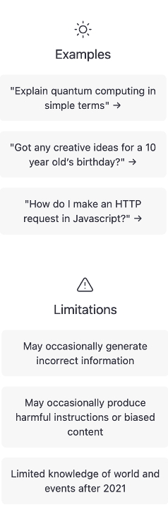
Large language models (LLM)
The current buzzword! ChatGPT, Bard, Bing, etc
Trained on vast amounts of 'acquired' or scraped text
Fancy predictive text – it's great at guessing which words should come next to create plausible sentences
Don't 'know' anything about the world – can't do maths, understand words or concepts, determine 'truth'
Infamous for 'hallucinating' references etc

Slide 9
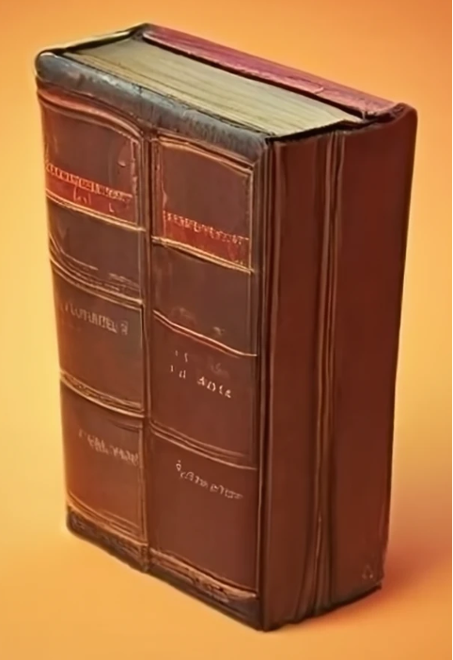
Image generation
The previous hot buzzword!
Trained on vast amounts of 'acquired' or scraped images
Infamous for adding extra limbs, slightly horrific faces (or not understanding how books are constructed)
Can be used for misinformation
Image: craiyon.ai 'rare books and special collections'

Slide 10
What can AI do for GLAMs?
Notes:
Setting out some basics…

Slide 11
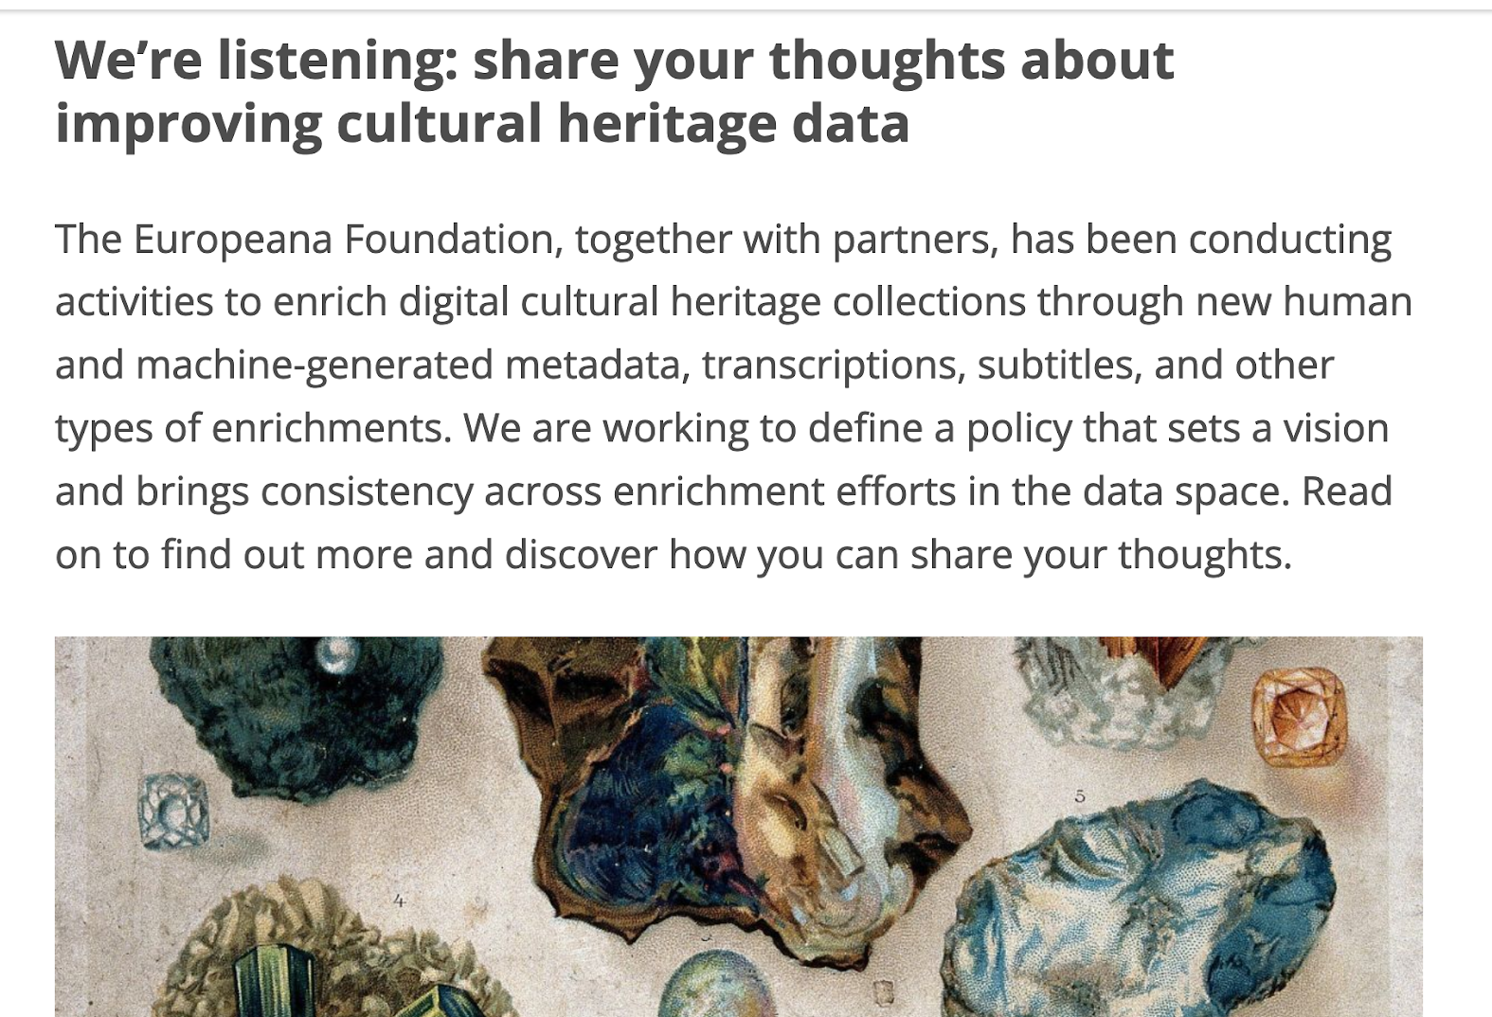
AI for enrichment
AI tools can enrich GLAM collections by:
Transcribing text from images and audio
Layout recognition; relating images and texts
Translating text and speech
Detecting objects in images, writing labels or descriptions
Detecting and linking entities – people, places, dates, concepts
Clustering similar images, texts
Notes:
'new human and machine-generated metadata, transcriptions, subtitles, and other types of enrichments' … Enrichments are data about a cultural heritage object (i.e. metadata) or of the object itself (i.e. its content) that augment or rectify the authoritative data made available by cultural heritage institutions.
https://pro.europeana.eu/post/we-re-listening-share-your-thoughts-about-improving-cultural-heritage-data
A single digitised item could be linked to multiple places, people, concepts
Improving discovery – search by images, expand concept

Slide 12

AI methods for research with collections
AI methods within Living with Machines
Analysing text with Natural Language Processing (NLP), Large Language Models (LLM):
Algorithmic record linkage to find individuals between census years
Linguistic research – finding machines assigned human-like agency; semantic shifts as words change over time
Contextualising data (newspapers) with historical paradata (Mitchells press directories)
'Reading' maps with computer vision models (annotating visual features on images to teach software to find them at scale)
Machine learning for 'fuzzy' search with bad OCR
https://livingwithmachines.ac.uk/achievements https://livingwithmachines.ac.uk/latest/
Notes:
5.5 year project, collaboration with BL and Turing; work of many in the team and supporting organisations

Slide 13
Community participation in Living with Machines

Slide 14
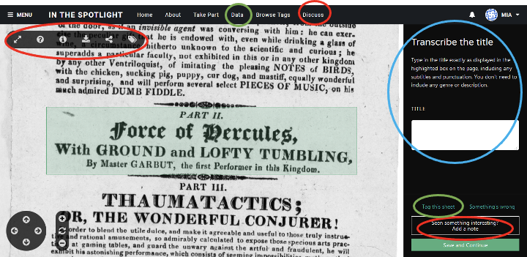
Crowdsourcing as a framework for productivity and engagement
Notes:
Building on previous work I've presented on before…

Slide 15
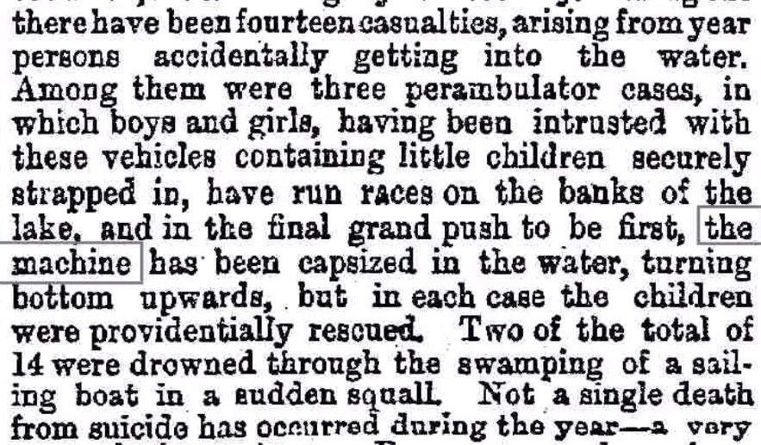
Crowdsourcing and public participation in Living with Machines
Build on crowdsourcing as productive, public engagement with our research – core part of funding bid
Public interest in old newspapers – and data science / machine learning
Tensions between efficiency, predictability and design for engagement
Future: scale up - train ML with volunteer classifications, look for more articles, ask volunteers to confirm ML predictions
http://bit.ly/LivingWithMachines
Notes:
Designed tasks that worked with images of newspaper articles (because OCR text was poor quality) on Zooniverse (didn't have the resources for bespoke infrastructure)
Data limited to public domain material – smaller results sets than ideal
Volunteers had wider impact – inspired new tasks; shaped exhibition narratives. Most had never interacted with the BL before.
Didn't have the resources to do 'human in the loop' within the project

Slide 16
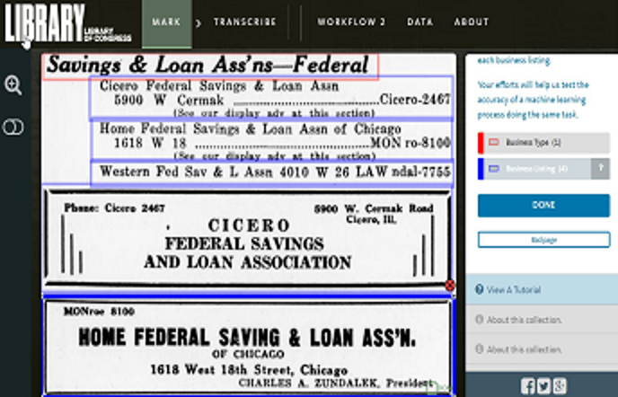
Library of Congress 'human in the loop'
Combined domain expertise and quality assessment with machine learning to extract accurate information from digitised pages
Major takeaways:
Has the potential to be extremely powerful for
maximizing access to LC’s content at scale.
Will require significant investment in staffing and resources
There are ways to generalize approaches, however, there will not be a one-size-fits-all approach
https://labs.loc.gov/static/labs/work/reports/LC-Labs-Humans-in-the-Loop-Recommendations-Report-final.pdf
Notes:
And in fact, LC did something just like that…

Slide 17
But! Does your catalogue support enriched data?
AI and volunteer enriched data and collection management systems don't get along
A single enriched record could be linked to multiple places, people, concepts via metadata or digitised content
    But can you store enriched data with digital object records in your core catalogue?
    Can you build better search interfaces that include AI-based 'search by image' or expanding keywords to related concepts?
    Can you show users a confidence or quality score for generated classifications, transcriptions?
Notes:
Hard topic – current systems aren't great at linking records for physical and digital items; including enriched data
Am I trying to start a fight between metadata standards? Maybe?!

Slide 18
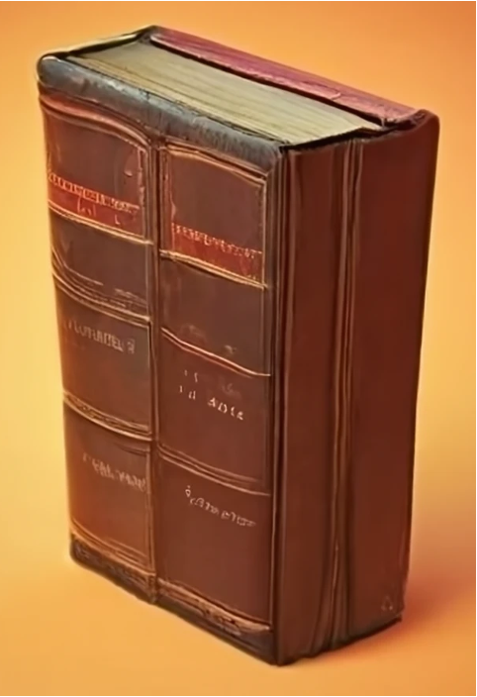
Digitisation is vital
You can't judge read a book by its cover
You can do some interesting things with metadata, but - digitisation is key
ML models are built from text or images.
Doing interesting things with 'AI' requires digitised text (ideally high quality OCR, HTR)
And - cloud storage for 'compute' is expensive at scale – GLAM images can be large
Image: craiyon.ai 'rare books and special collections'

Slide 19
Why do we need to be careful around AI?

Slide 20
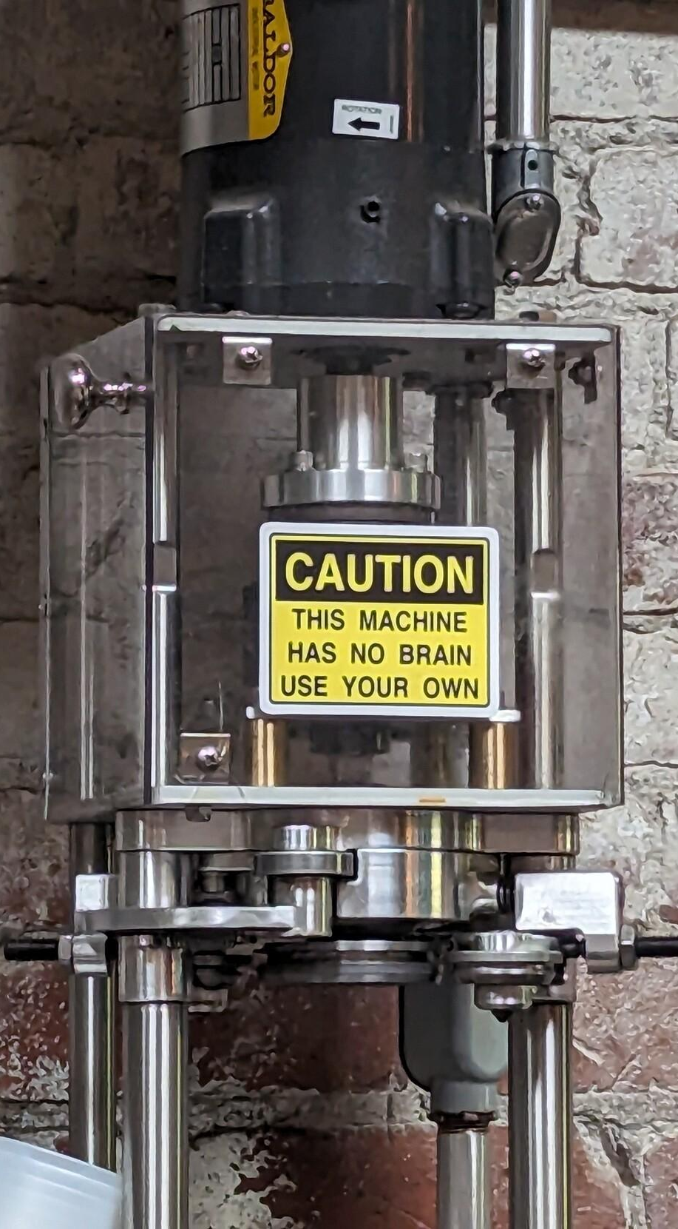
What is AI not?
It's not intelligent.
It's not conscious.
It's not a 'magic wand' that will solve all your problems.
It won't cope with your messy data.
It may not be the right solution for the problems you're trying to solve. (But it might get you funding)
Image https://fediscience.org/@dustinstoltz/111211420966814062 taken at Evil Genius brewery, PA
Notes:
Image https://fediscience.org/@dustinstoltz/111211420966814062, taken at the Evil Genius brewery, Philadelphia

Slide 21
LLMs are what we have, not what we need

Slide 22
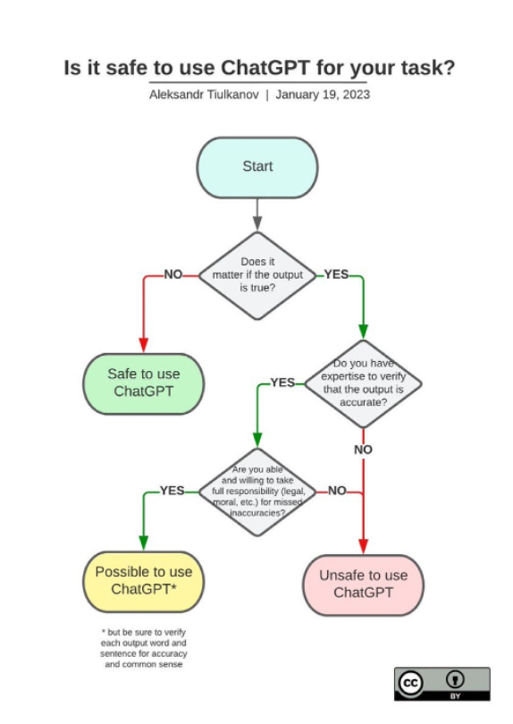
'Is it safe to use ChatGPT for your task?'
Does it matter if the output is true?
Do you have expertise [and resources!] to verify that the output is accurate?
Are you able and willing to take full responsibility (legal, moral, etc.) for missed inaccuracies?

Slide 23
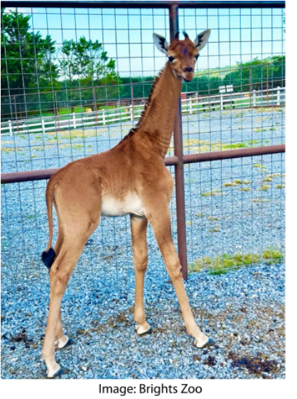
AI isn't great at 'rare' or 'special'
'AI tends to sand away the unusual. It's trained to answer with the most likely answer to your question, which is not necessarily the most correct answer.'
    https://www.aiweirdness.com/ai-vs-a-giraffe-with-no-spots/

Slide 24
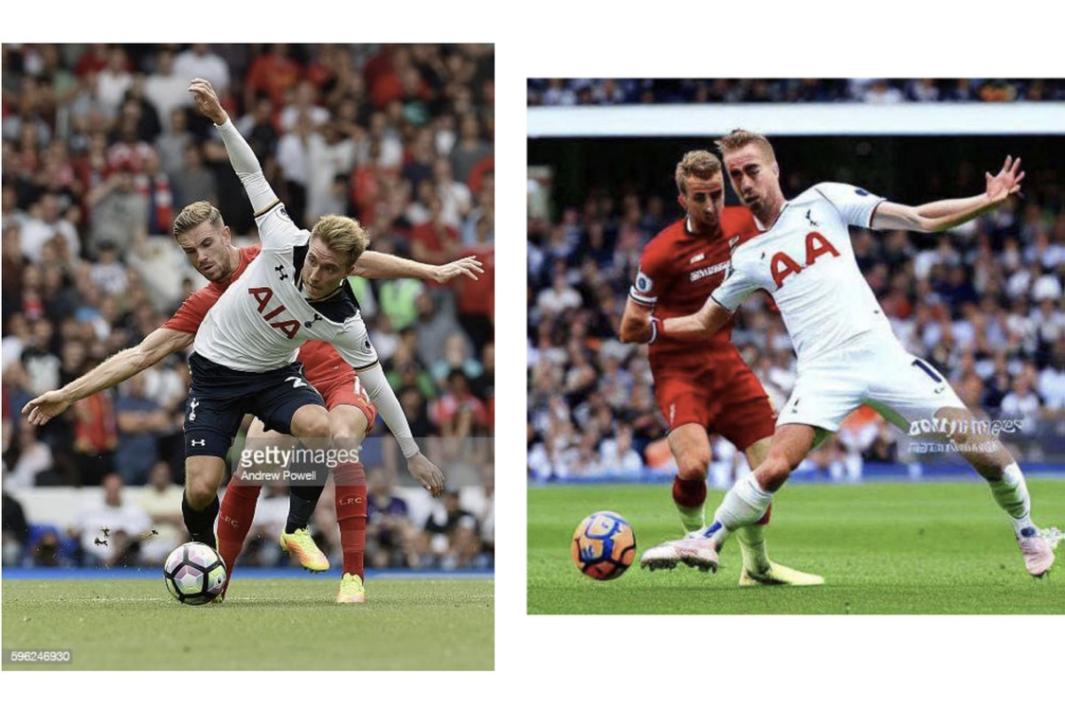
Whose content is 'generative' AI regurgitating? Is that ethical? Legal?
Getty Images vs Stability AI
Notes:
●Via https://www.theverge.com/2023/2/6/23587393/ai-art-copyright-lawsuit-getty-images-stable-diffusion 'Getty Images has filed a case against Stability AI, alleging that the company copied 12 million images to train its AI model ‘without permission ... or compensation.’'

Slide 25
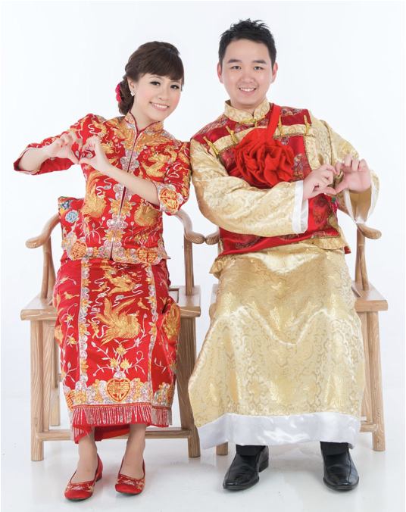
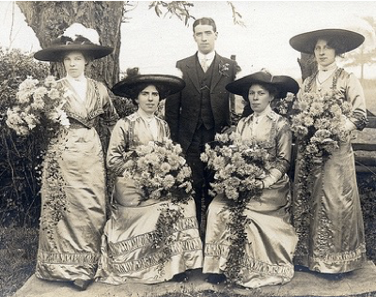
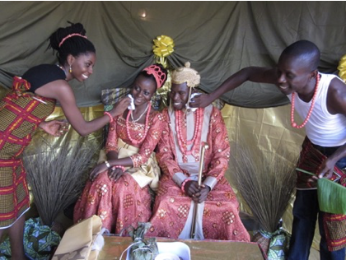
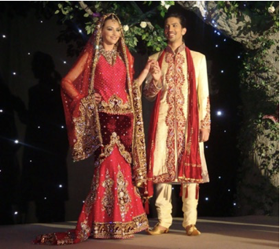
Whose lives and stories are represented?
What do these images have in common?
https://www.vintag.es/2015/09/amazing-vintage-wedding-photos-in.html https://www.flickr.com/photos/147326970@N05/32446909980
https://www.flickr.com/photos/47125576@N00/24108399394 https://www.flickr.com/photos/bokelicious/13981327606/

Slide 26
Will AI destroy crowdsourcing in GLAMs - or enhance it?

Slide 27
AI can compete with volunteers for enjoyable tasks
Online volunteers found pleasure, learning and community in crowdsourcing tasks like:
Transcribing handwritten text
Tagging or classifying pictures
Puzzle-like tasks are a low-pressure first interaction with collections
Enjoyable tasks provide opportunities for learning, curiosity, developing skills and knowledge – they support volunteers trying more complex tasks

Slide 28
Rethink crowdsourcing as 'volunteer enrichment'
Volunteers are enriched while enriching collections
Machine learning and crowdsourcing can both enrich collections
Machine learning can help create better volunteer experiences
'Automate the boring stuff'
Support volunteer learning – provide interactive feedback, tutorials
Volunteers can review and improve machine learning results – it's easier to review than create!

Slide 29
Crowdsourcing as 'volunteer enrichment'
Volunteers are enriched while enriching collections
Less enjoyable tasks – classifying with controlled vocabularies, excessive repetition – and boring items were previously excluded from crowdsourcing
Let AI do the boring stuff! Redesign workflows for the benefit of staff and volunteers

Slide 30
Making good choices about AI
…an opportunity to rethink crowdsourcing and volunteering
Rethink 'authority', build for roundtripping
Reduce the overhead of checking enhanced data – focus staff efforts on areas that need expertise
Where is imperfect AI or volunteer data better than no data at all?
How could crowdsourcing plus AI improve work for staff? How can you involve them in these decisions?

Slide 31
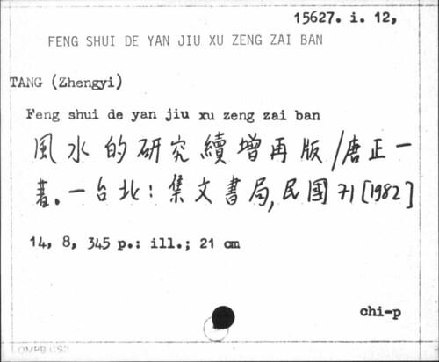
Making good choices about AI
…an opportunity to rethink crowdsourcing and volunteering
Digital objects aren't just 'surrogates' for reading room / gallery access
We don't need to fit catalogue records on a card.
Think beyond MARC! (or your local metadata standard).
Modern collections systems should include ML and volunteer enrichment – transcriptions, folksonomies, community memories and more
Notes:
Image source http://www.libcrowds.com/archived/20221208133408/https://www.libcrowds.com/collection/convertacard/projects/39/z3950

Slide 32
Thank you for listening!
Questions?
Find out more
bl.uk/digital @BL_DigiSchol@techhub.social
livingwithmachines.ac.uk @LivingWithMachines@zirk.us
openobjects.org.uk @mia@hcommons.social
Read and comment on the Collective Wisdom white paper https://collectivewisdomproject.org.uk/new-release-collective-wisdom-white-paper/

Slide 33
Thinking about AI in your GLAM?
Know what problem you're trying to solve
Avoid shiny object syndrome: focus on problems you need to solve
Start with an MVP (minimum viable project) and build in time to document, evaluate and learn
Work with students, researchers to explore new, emergent technologies
Think about how you can manage biases in data generated, and review processes to ensure harms are minimised or removed
Notes:
●Students are looking for case studies; library (and GLAM) data is rich and complex so can make for good, focused student projects. Takes time to manage; results won’t usually be directly applicable but it’s a good way to learn and share what’s possible
●Find ways to work with pace of change / and with biases of systems - eg manual review/spot checks?
●Treat it like a project – define needs, explore possibilities, define metrics for success etc

Slide 34
AI literacy is key
Always begin by asking 'what do you mean by "AI"?'
AI can sneak into products sold to marketing, security, IT, HR and other teams
Increase AI literacy – ideally together with colleagues colleagues from across the organisation – to assess claims, avoid dangers
Try tools for yourself – chat bots, image creation tools, image and text labelling tools. Use items or collections you know well to help assess the quality of results
Try GLAM-specific training AI training resources via AI4LAM, IFLA etc
        https://www.ifla.org/g/ai/23-resources-to-get-up-to-speed-on-ai-in-2023/
        https://sites.google.com/view/ai4lam
Notes:
●Students are looking for case studies; library (and GLAM) data is rich and complex so can make for good, focused student projects. Takes time to manage; results won’t usually be directly applicable but it’s a good way to learn and share what’s possible
●Find ways to work with pace of change / and with biases of systems - eg manual review/spot checks?
●Treat it like a project – define needs, explore possibilities, define metrics for success etc

Slide 35
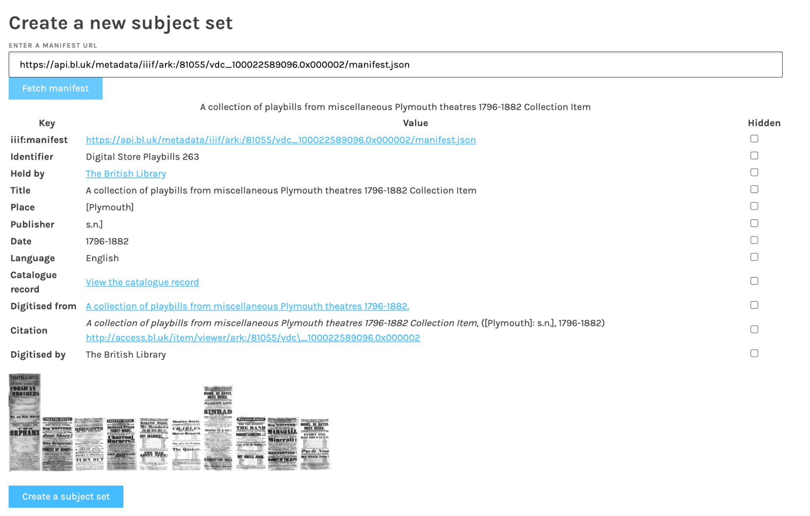
Zooniverse and IIIF collaboration
If you have a IIIF manifest, you can make a Zooniverse project
Any item with a IIIF manifest can be used with Zooniverse's Project Builder – dramatically reduced work for GLAMs
Results as annotated image/canvas or manifest or as Zooniverse dataset
Needs community input to develop further

Slide 36
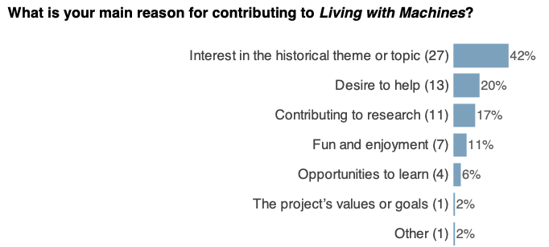
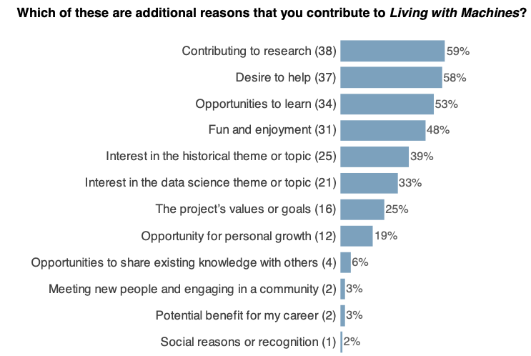
2022 Zooniverse LwM volunteer survey
Questions aligned with previous surveys and BL audience categories
71% had no previous relationship with the British Library
Volunteers most likely to be a retired professional woman, 65 to 74 years old with a degree, living in the UK
Notes:
https://livingwithmachines.ac.uk/whos-who-on-the-zooniverse/

