Slide 1
Comparison of Some NASA Portals for Heliophysics Data
Robert Candey, Bernard Harris, Jack Ireland, Lan Jian, Rita Johnson, Tamara Kovalick, Jennifer Sun, Brian Thomas, Ron Yurow, and the Rest of Heliophysics Digital Resource Library (HDRL) Team
NASA Goddard Space Flight Center
DASH: Data, Analysis, and Software in Heliophysics
2023 October 9-11
Notes:
I’m Robert Candey, project scientist of the Space Physics Data Facility, speaking on behalf of the SPDF team.

Slide 2
Overview
Coordinated Data Analysis Web (CDAWeb) Data Browsing System
https://cdaweb.gsfc.nasa.gov/
  Space Physics Data Facility (SPDF) https://spdf.gsfc.nasa.gov/ (part of HDRL) manages the non-solar data archive and associated services
Heliophysics Data Portal (HDP) https://heliophysicsdata.gsfc.nasa.gov/
  HDRL manages the Space Physics Archive Search and Extract (SPASE) metadata collection effort for describing heliophysics resources, which are searchable via the HDP
Science Discovery Engine (SDE) https://sciencediscoveryengine.nasa.gov/
  Search across NASA's Science Mission Directorate (SMD) divisions, particularly the SPASE records, Heliophysics Events Knowledgebase (HEK) events, and ADS bibliographies for heliophysics metadata
NASA's Heliophysics Digital Resource Library (HDRL) https://hdrl.gsfc.nasa.gov/
  provides data and services for the Heliophysics System Observatory

Slide 3
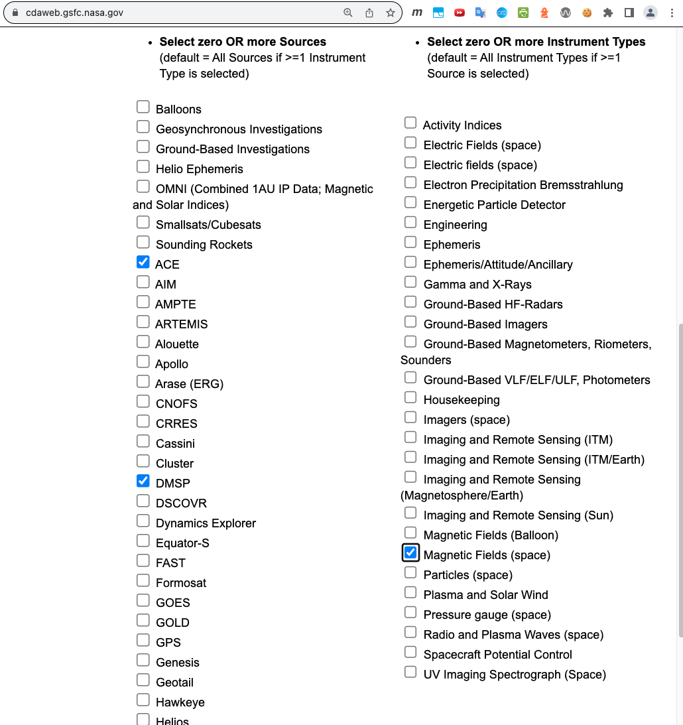
60+ Missions/Sources (Groups)
Coordinated Data
Analysis Web (CDAWeb)

Slide 4
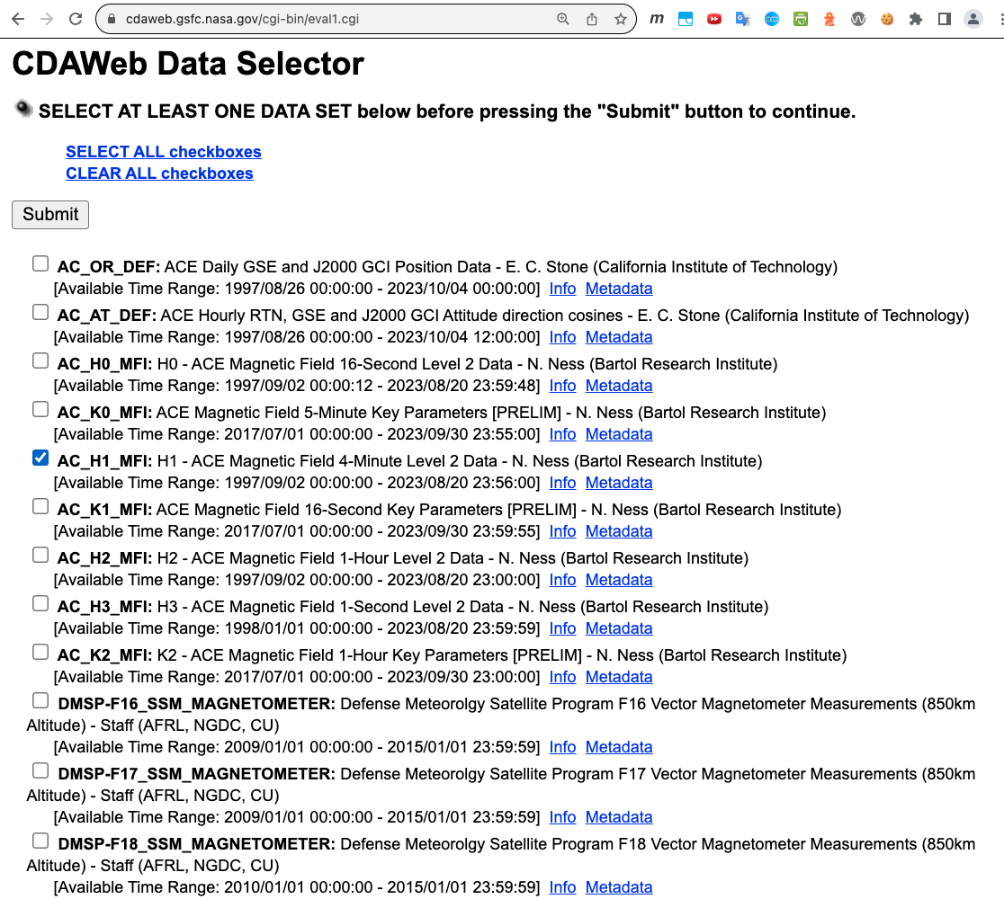

Slide 5
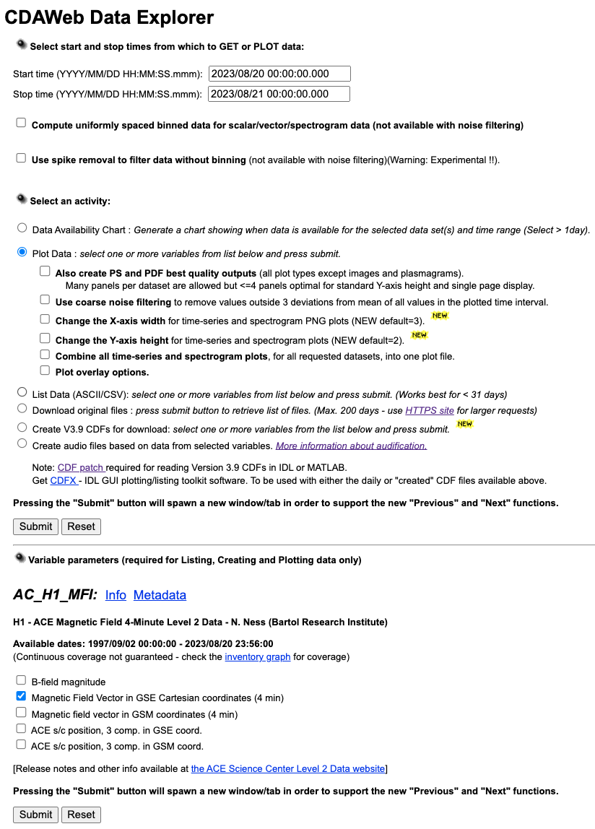

Slide 6
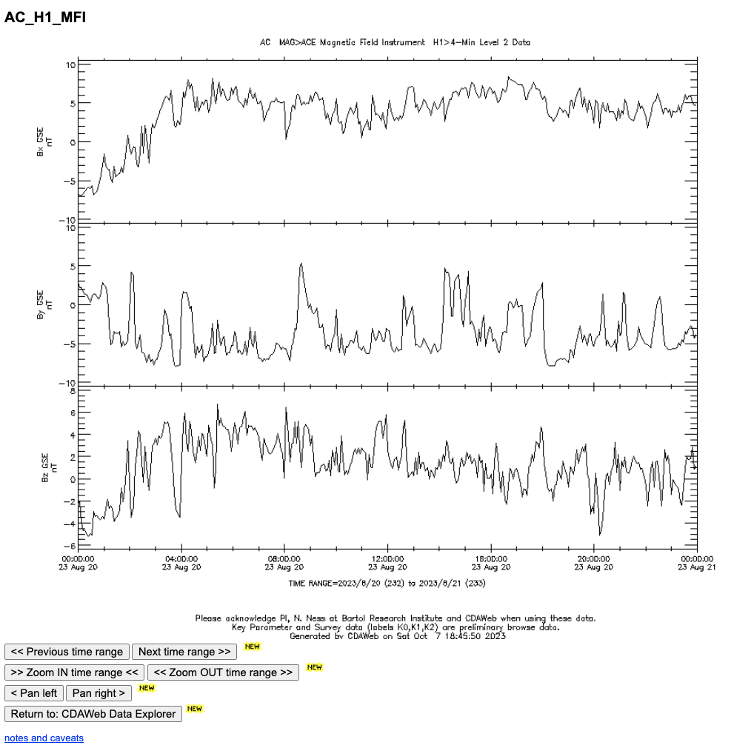

Slide 7
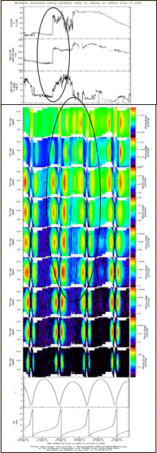
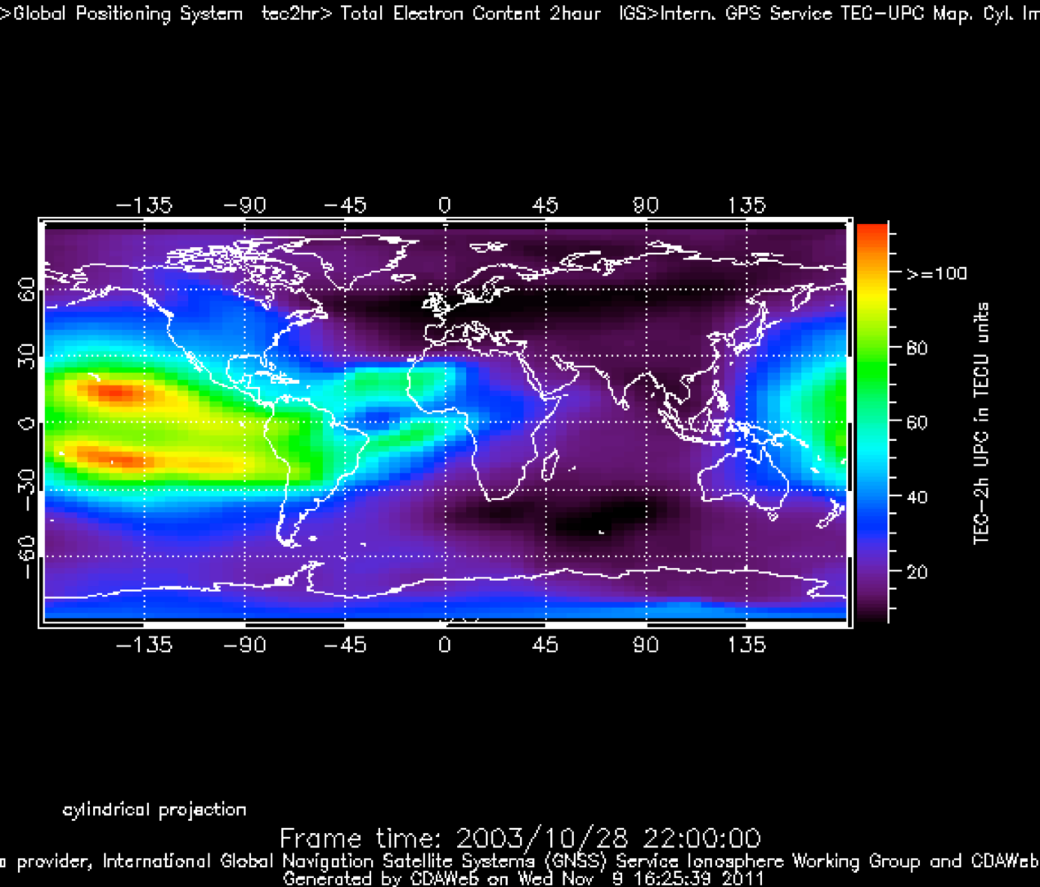
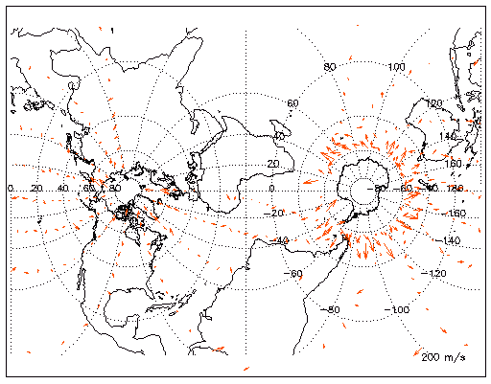
Parameter Displays in CDAWeb
WIND MFI & SWE
Van Allen Probe A ECT & MagEIS
GPS International GNSS Service Total Electron Content
TIMED/TIDI Wind Vectors Movie
Transverse Mercator Projection
Notes:
These services include CDAWeb with its many display and listing formats,

Slide 8
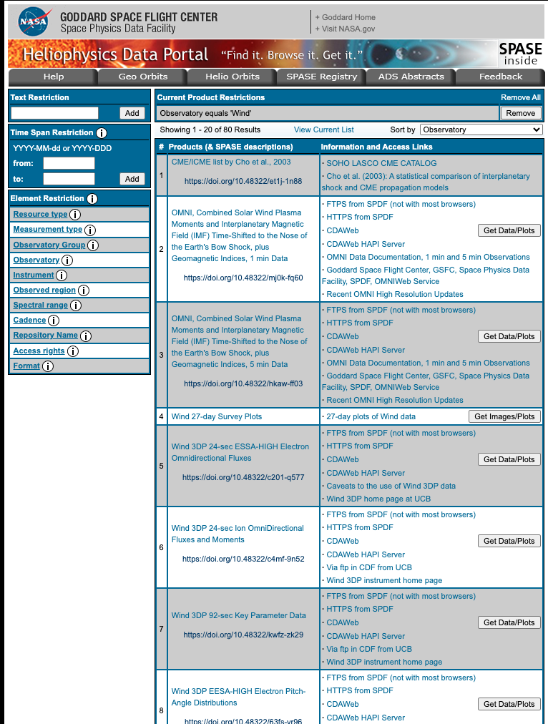
Heliophysics
Data Portal

Slide 9
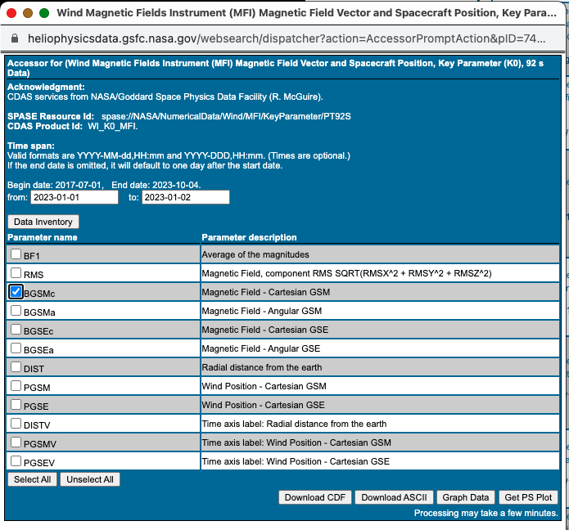

Slide 10
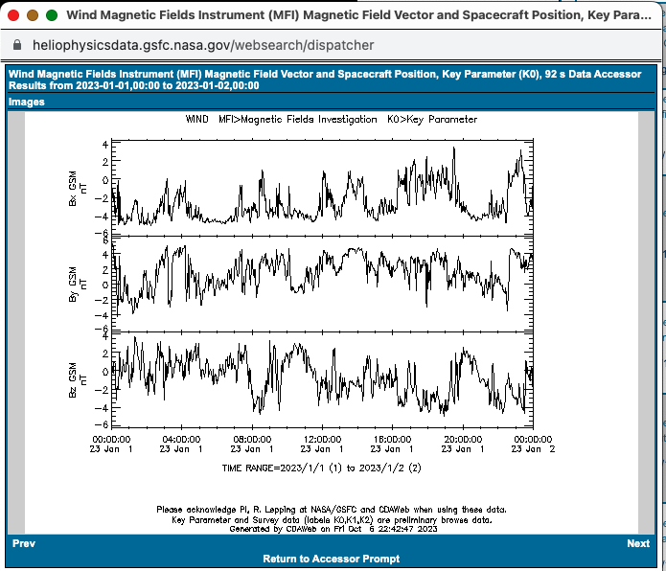

Slide 11
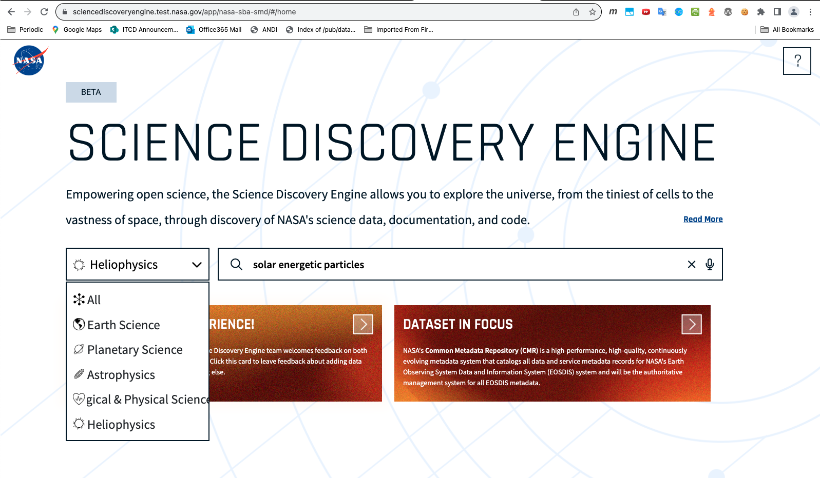

Slide 12
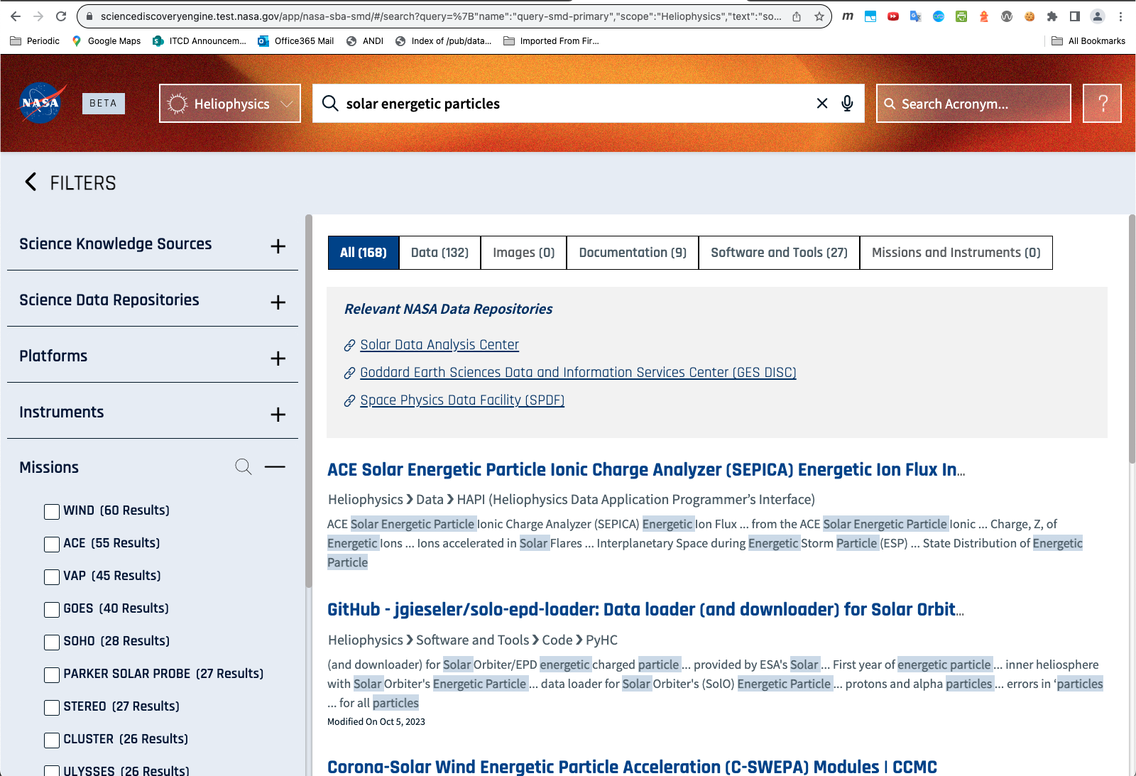

Slide 13
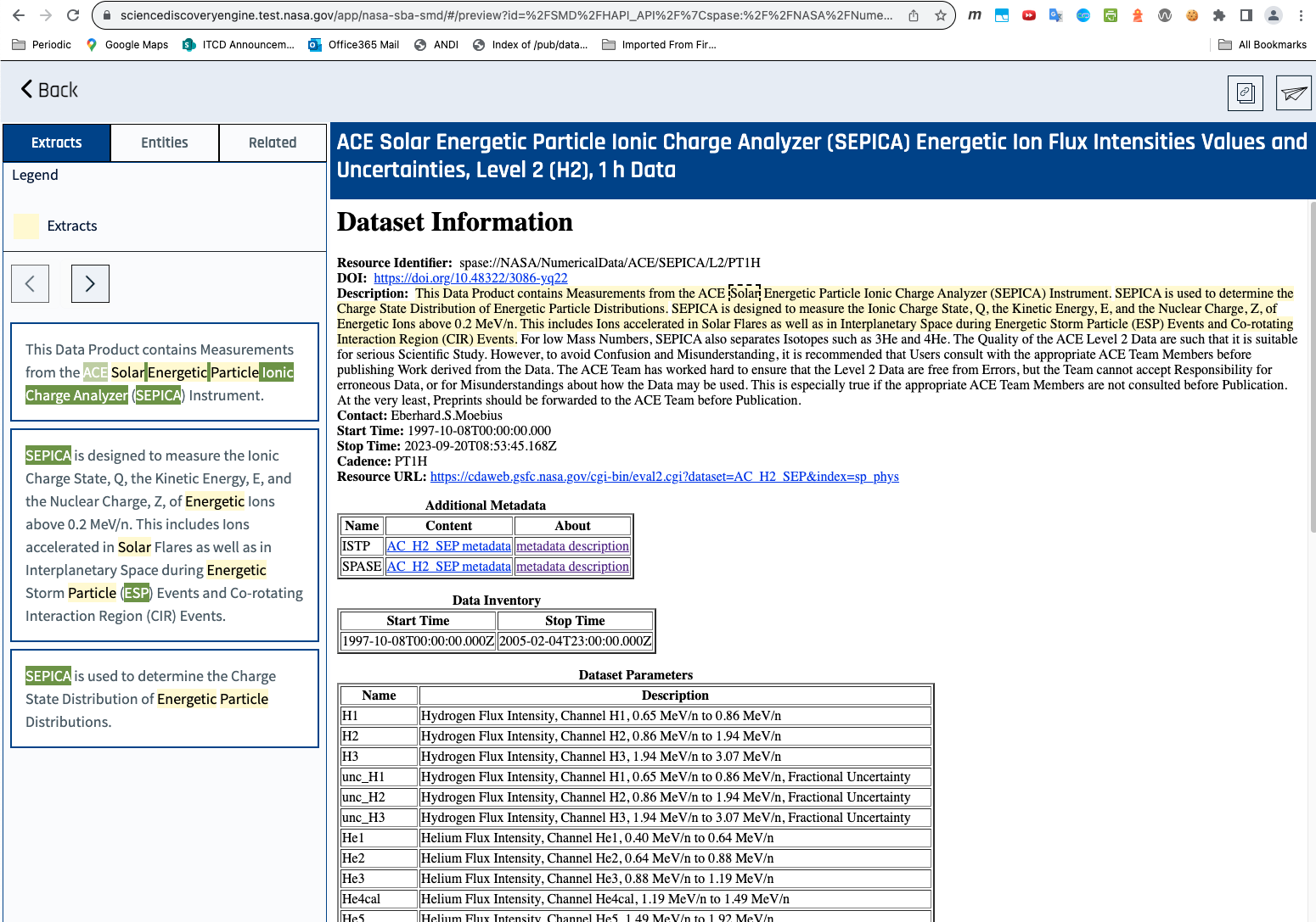

Slide 14
Comparisons: CDAWeb
Overall goals:
  Simple interface that generally guarantees a useful plot or listing
  Entirely driven by standardized ISTP metadata (little specialized code)
  Display each mission data within the context of other missions
  Curation independent of display
Interoperability:
  Web service APIs, HAPI
  ISTP and SPASE metadata standards
  Standardized CDF/netCDF self-describing formats
Maintenance: Continual improvement for new data types, bugs, features
Usability improvements:
  Added options like averaging, outlier removal
  Will add multiple submit buttons
  New Javascript interface to hide complexity, more accessible, responsive
Future/Sustainability:
  Permanent SPDF archive
  Developing Javascript plotting/list interface on top of web service calls
Newcomers vs. experienced users:
  Simple interface, but requires studying dataset/variable info
Metrics: Popularity by dataset and mission over time, calls by each access method

Slide 15
Comparisons: Heliophysics Data Portal (HDP)
Overall goals:
  Search for datasets and other resources of interest across world-wide holdings
  Entirely driven by standardized SPASE metadata
Interoperability:
  Web service API
  SPASE metadata standards
Maintenance:
  Modest changes on a fixed code base to support more SPASE resource types
Usability improvements:
  Needs a rewrite to be more accessible, responsive, easier to maintain
Future/Sustainability:
  Uncertain, could be replaced by a subset of SDE or another metadata search service
Newcomers vs. experienced users:
  Requires some effort to understand, but provides access info to a semi-complete set of public heliophysics data
Metrics: not tracked

Slide 16
Comparisons: Science Discovery Engine (SDE)
Overall goals:
  Rapid discovery of NASA science data, software, documentation
  Open science and interdisciplinary science
  Initial Google-like simple interface, then drilling down with various facets
  Driven by available metadata from the science divisions (SPASE, HEK, ADS biblio for Helio)
  Apply emerging technologies and search techniques, such as Large Language Models (LLMs)
Interoperability:
  Web service APIs for Jupyter notebooks and other applications
Maintenance:
  Continual improvement for new data types, bugs, features
Usability improvements:
  Added more facets
  Adding more sources
  Interfacing with ADS Science Explorer (SciX)
  Exploring LLMs
Future/Sustainability:
  NASA SMD sponsored, new project
Newcomers vs. experienced users: simple interface, with facets for constraining further
Metrics: detailed logs of sessions, queries, most searched terms

Slide 17
