Slide 1


The OEFamily and the
Open Energy Platform (OEP)
A framework for research data management and a community database for energy data
Version-RLI-OEFamily-Public-2023-002
© Reiner Lemoine Institut

Slide 2
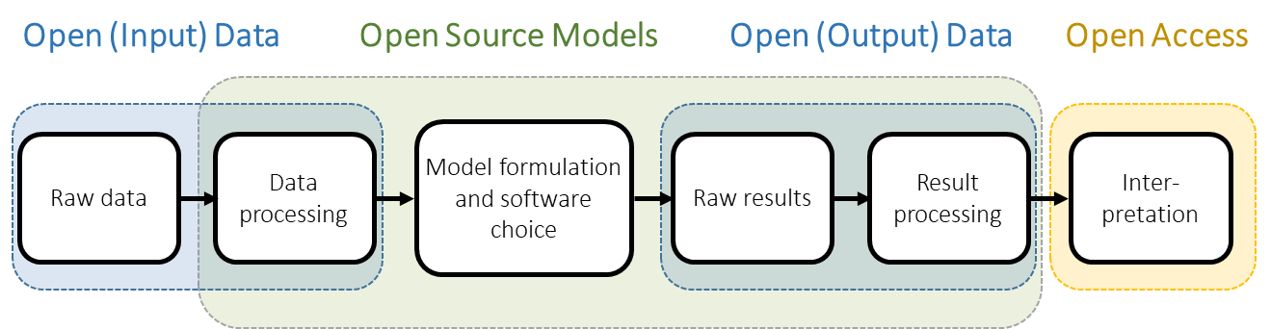
Open Science - Energy System Modelling
„Open data, open source, and open access in relation to the energy modelling process.”
Pfenninger et al. (2018) licensed CC BY 4.0

Slide 3
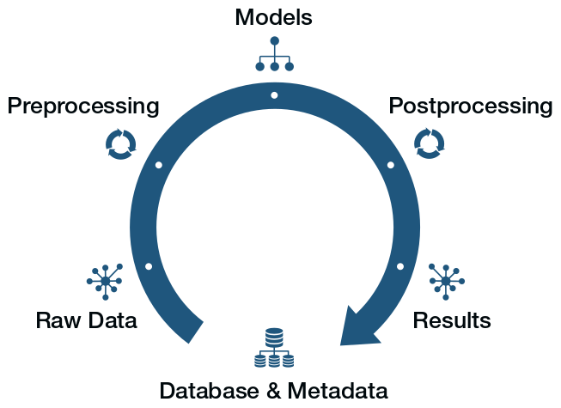
Open Energy Family

Slide 4

Open Energy Family

Slide 5
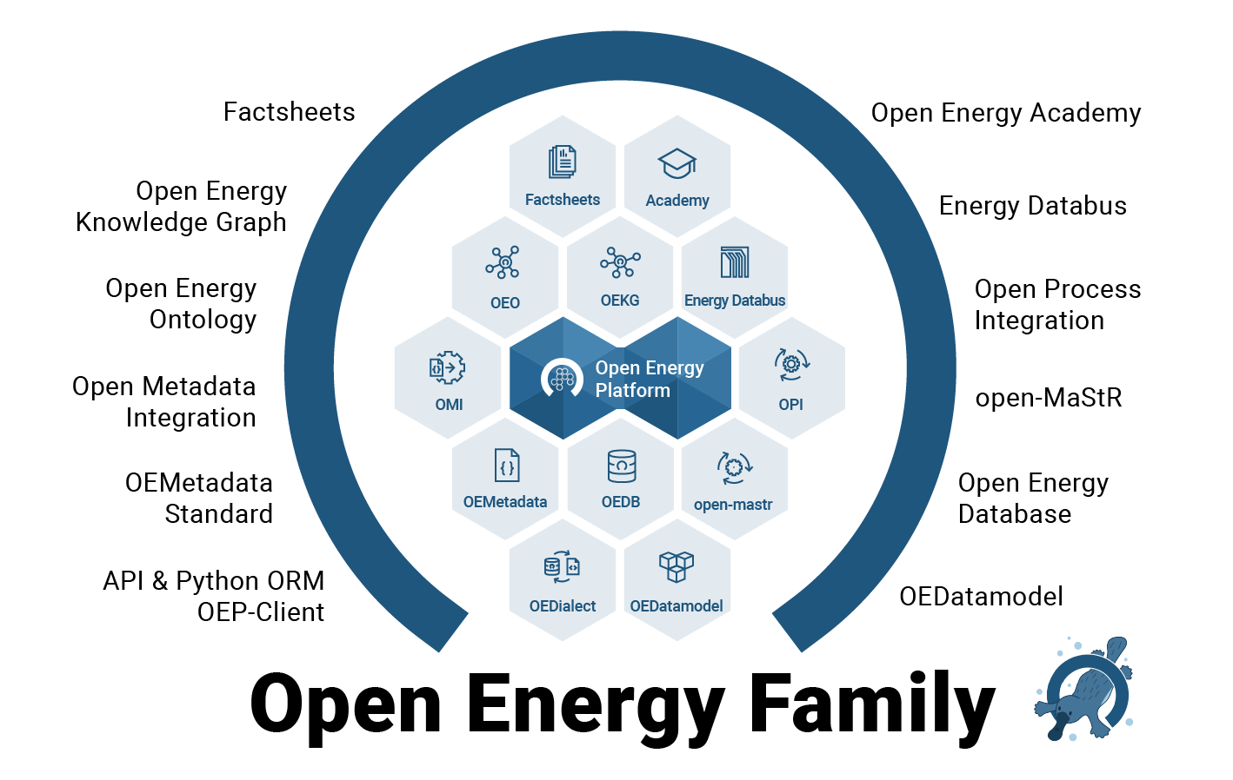
Open Energy Family

Slide 6





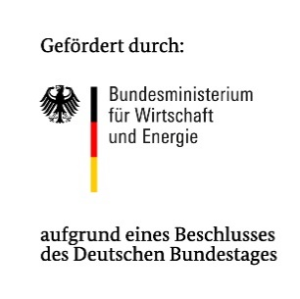

Open Energy Family
openenergy-platform.org
University Magdeburg (OvGU) is host and main developer
Funded projects until 2028
Server deployment for +10 years guaranteed by OvGU
Cross-tier community project
Code available at GitHub
Logos not licensed

Slide 7
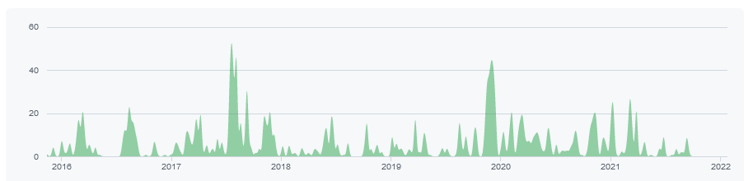
Open Energy Family
Development History:
open_eGo
open_FRED
SzenarienDB
LOD-GEOSS
SIROP
Internal project use of the OEDB
Factsheets
OpenEnergyOntology
Presentation of a commonly used open database at the openmod in London
Start new URL
openenergy-platform.org
Workshop to introduce to OEP
Redesign
API & oedialect
2015
2016
2017
2018
2019
2020
2021
2022

Slide 8
Open Energy Family - History
open_eGo
SzenarienDB
SIROP
open_FRED
LOD-GEOSS
NFDI
open_MODEX
SEDOS
SLE
Internal project use of the OEDB
Factsheets
OpenEnergyOntology
Start new URL
openenergy-platform.org
Workshop to introduce to OEP
Redesign
API & oedialect
2016
2017
2018
2019
2020
2021
2022
2023
2024

Slide 9
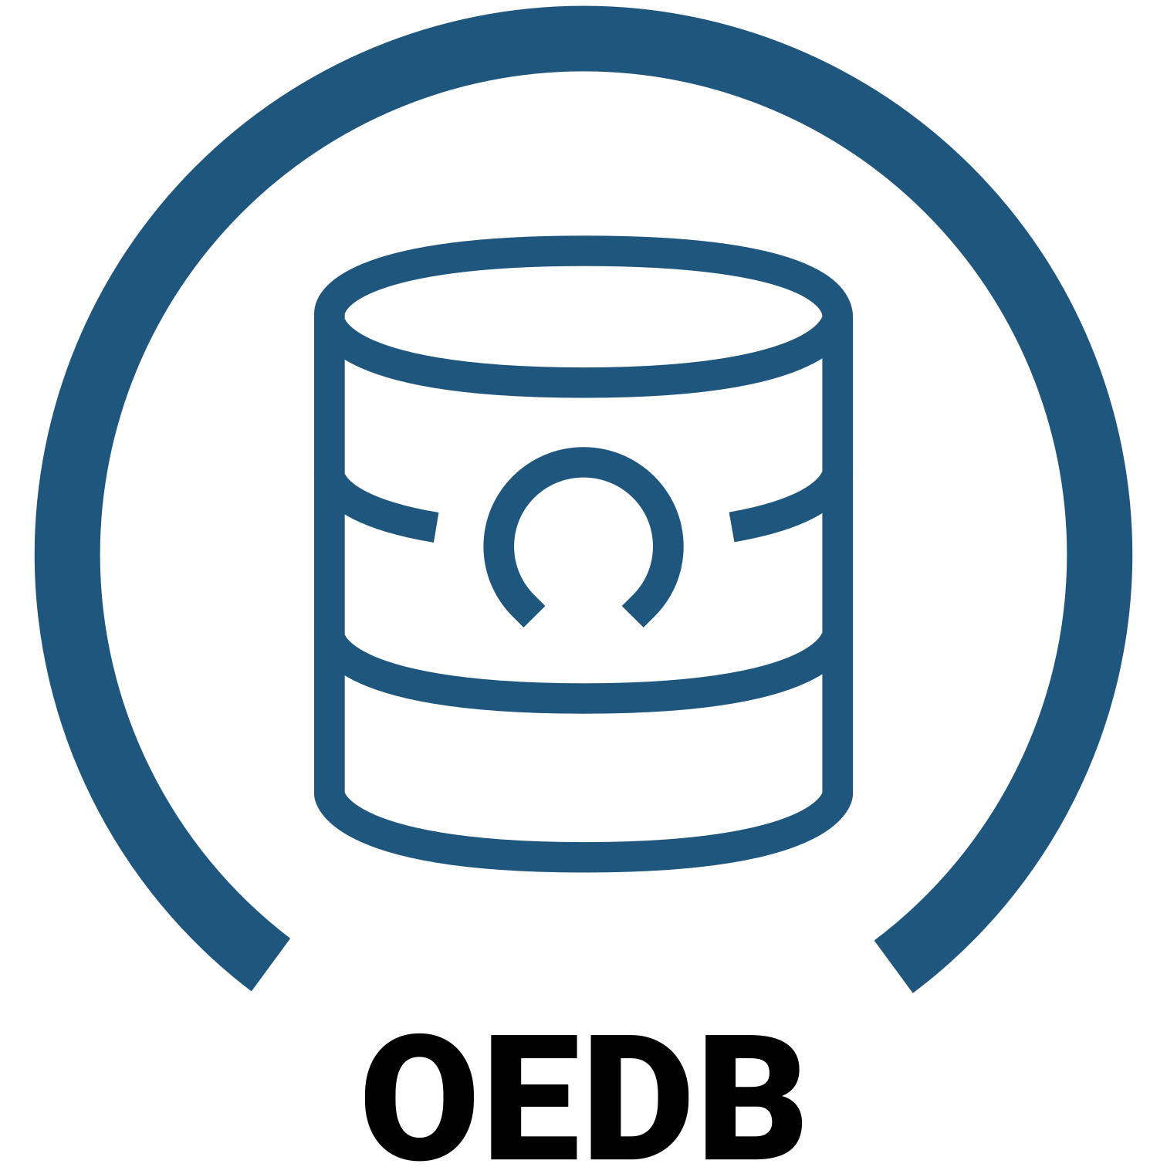
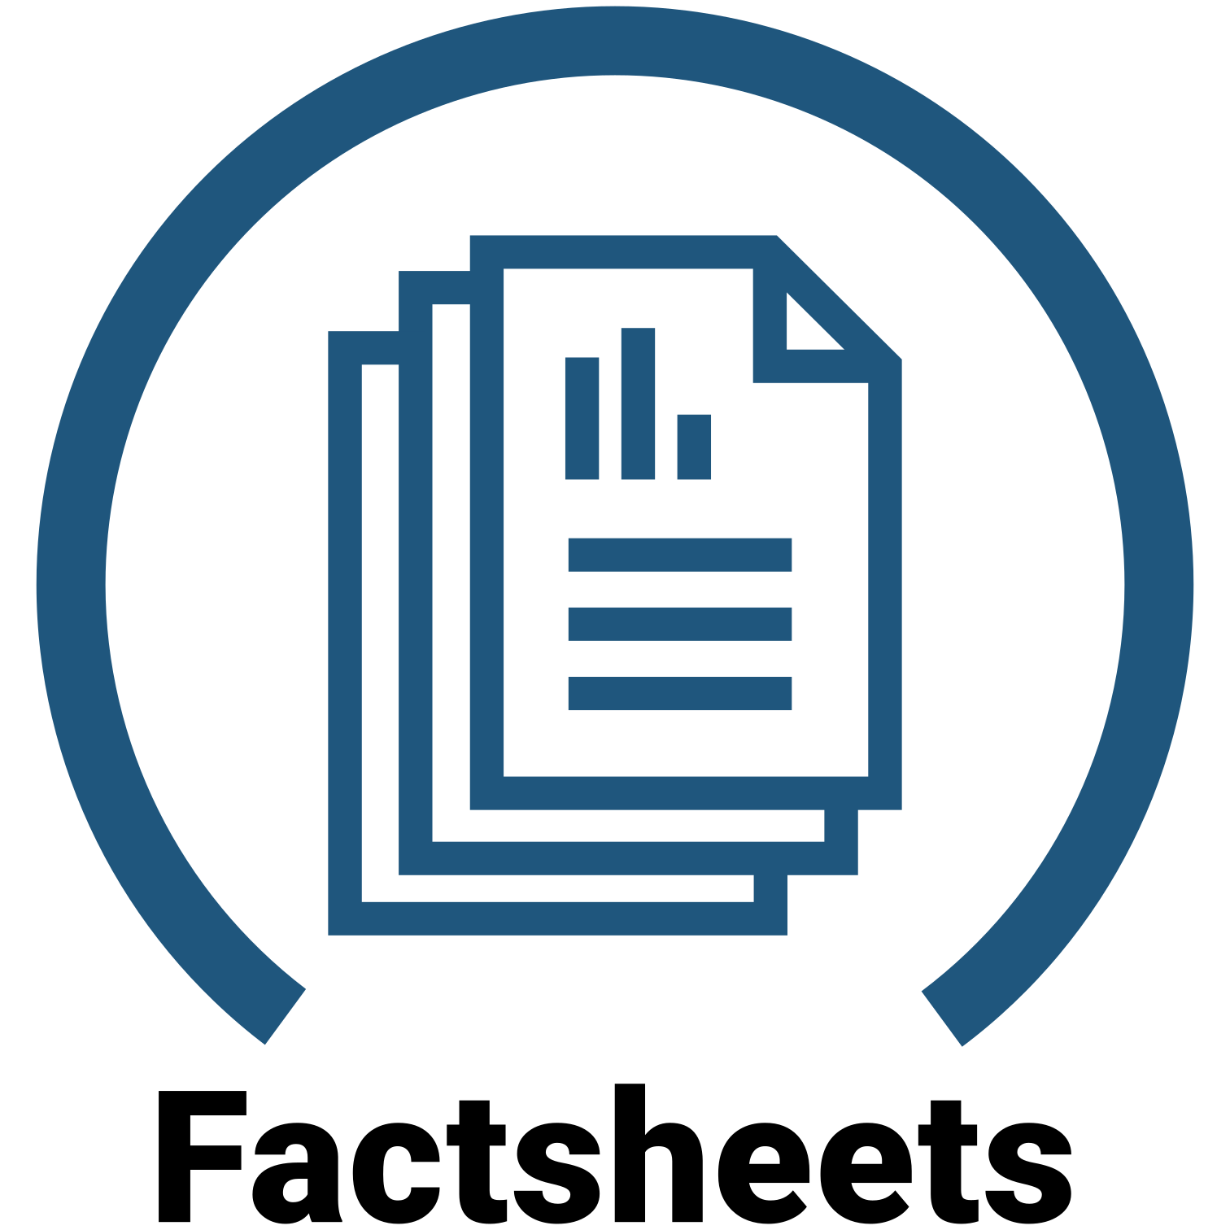
Open Energy Family
Open community database for energy climate and modelling data
  Status: 1000+ data tables
  Planed: Constant maintenance and clean-up
Platform and web interface
  Status: Redesign and usability
  Planed: More frontend for existing tools + OEO
Standardised Fact sheets for frameworks, models and scenarios
  Status: 20+ frameworks and 200+ models
  Planed: Scenarios using the Ontology and Knowledge Graph

Slide 10
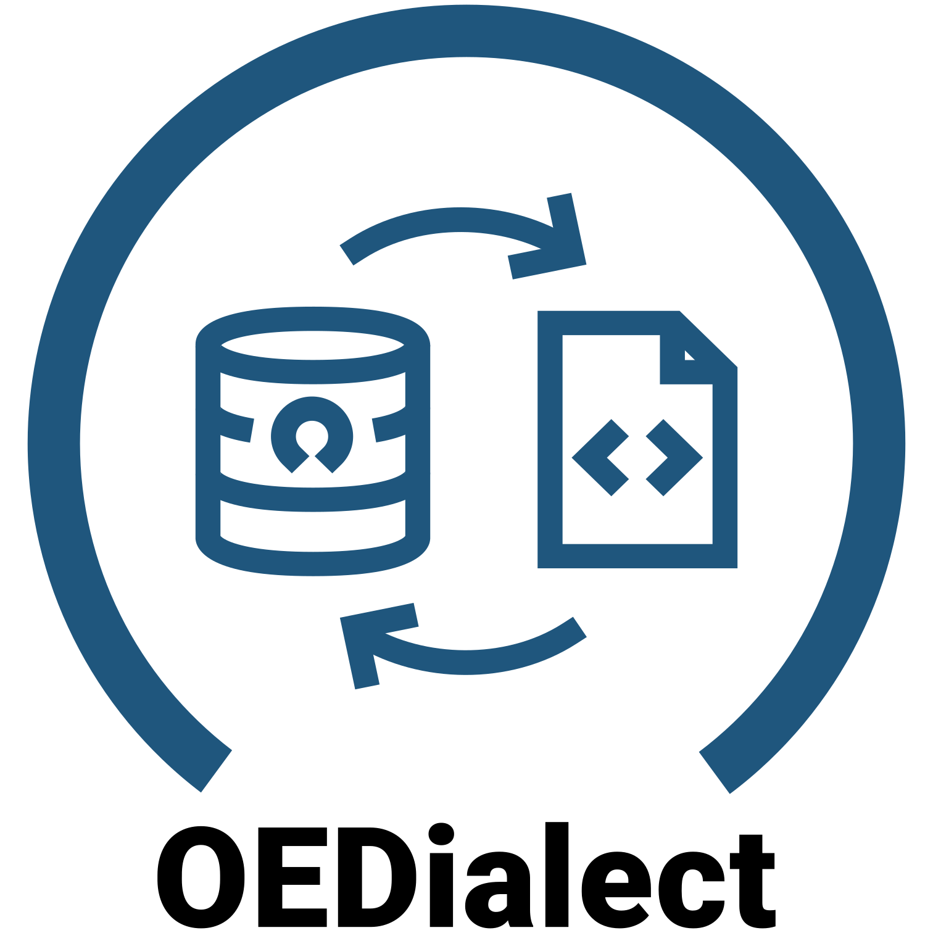

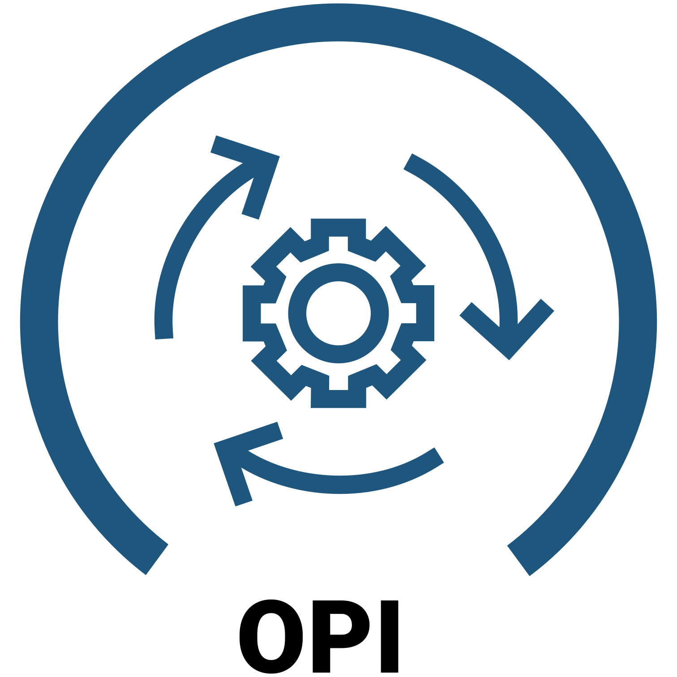
Open Energy Family
SQLAlchemy dialect using the REST-API
  Status: Easy to use; additional tools available (e.g. OEM2ORM)
  Planed: Bugfixes and support of additional data types
Metadata integration to process and translate OEMetadata
  Status: Release of v1.5.1 in progress
  Planed: Mappings to other standards like DCAT-AP
Process integration, data pipelines and data review
  Status: 100+ datasets under review (GitHub process)
  Planed: Move process to the OEP, display with data

Slide 11

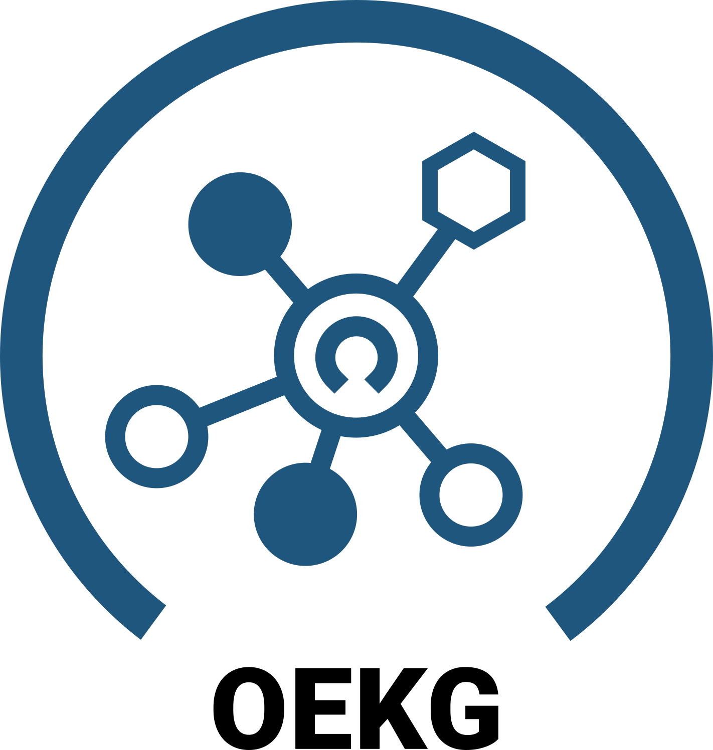

Open Energy Family
Ontology - a formal collection of terms
  Status: 1000+ issues; 2000+ classes (terms)
  Planed: Integrate and improve OEO-Viewer
Open Energy Knowledge Graph (OEKG)
  Status: First prototypes under development
  Planed: Factsheets, Scenario Comparisons
Data pipelines (open_MaStR) and helper toos (OEM2ORM, SAIO)
  Status: Used for automations
  Planed: Update, integrate, and documentation

Slide 12

Open Energy Family
Energy Databus for LOD and federated databases
  Status: 1000+ datasets; OEP Pipeline, MOSS-MOD
  Planed: Redesign, Integration OEP, Usability
  https://energy.databus.dbpedia.org/
  https://moss.tools.dbpedia.org/

Slide 13
Open Energy Family
Conclusion
A robust framework for data management is essential for energy research
The OEFamily has been proven effective and widely adopted
The Open Energy Platform (OEP) and Open Energy Database (OEDB) are ready to publish modelling data for further collaboration and research
A collaborative approach may be more challenging,
but it ultimately leads to better results and outcomes
We welcome other institutes and projects to join us

Slide 14
Open Energy Family
Conclusion
Framework for RDM in energy research
Developed and used by large community
OEP / OEDB ready to publish modelling data
A collaborative approach is more difficult but leads to better results
We are happy to include other institutes and projects

Slide 15



License
Except where otherwise noted, this work and its content (texts and illustrations) are licensed under the Attribution 4.0 International (CC-BY-4.0)
See license text for further information.
Ludwig Hülk
E-Mail: ludwig.huelk@rl-institut.de
Web: http://www.rl-institut.de
Twitter: @LudwigHuelk
Please quote as:
“The OEFamily and the Open Energy Platform (OEP) -
A framework for research data management and a community database for energy data (2023)”
© Reiner Lemoine Institut | CC-BY-4.0

