Slide 1


Spreadsheets
10.5281/zenodo.5053596
Esther Plomp
@toothFAIRy@scholar.social
e.plomp@tudelft.nl
Data Organization in Spreadsheets for Social Scientists

Slide 2
Lesson outline
10.5281/zenodo.5053596
Content
Good data entry practices
Formatting data tables in spreadsheets
  Avoid common mistakes
  Handling dates
Basic quality control and data manipulation in spreadsheets
Importing & exporting data from spreadsheets
You will learn how to think about data organisation to effectively wrangle data later

Slide 3


Software needed
10.5281/zenodo.5053596
Microsoft Excel
Libre Office

Slide 4
Slides
10.5281/zenodo.5053596
Presentation is shared on a data repository!
https://doi.org/10.5281/zenodo.5053596

Slide 5
Question
How many people have used spreadsheets in their research?

Slide 6
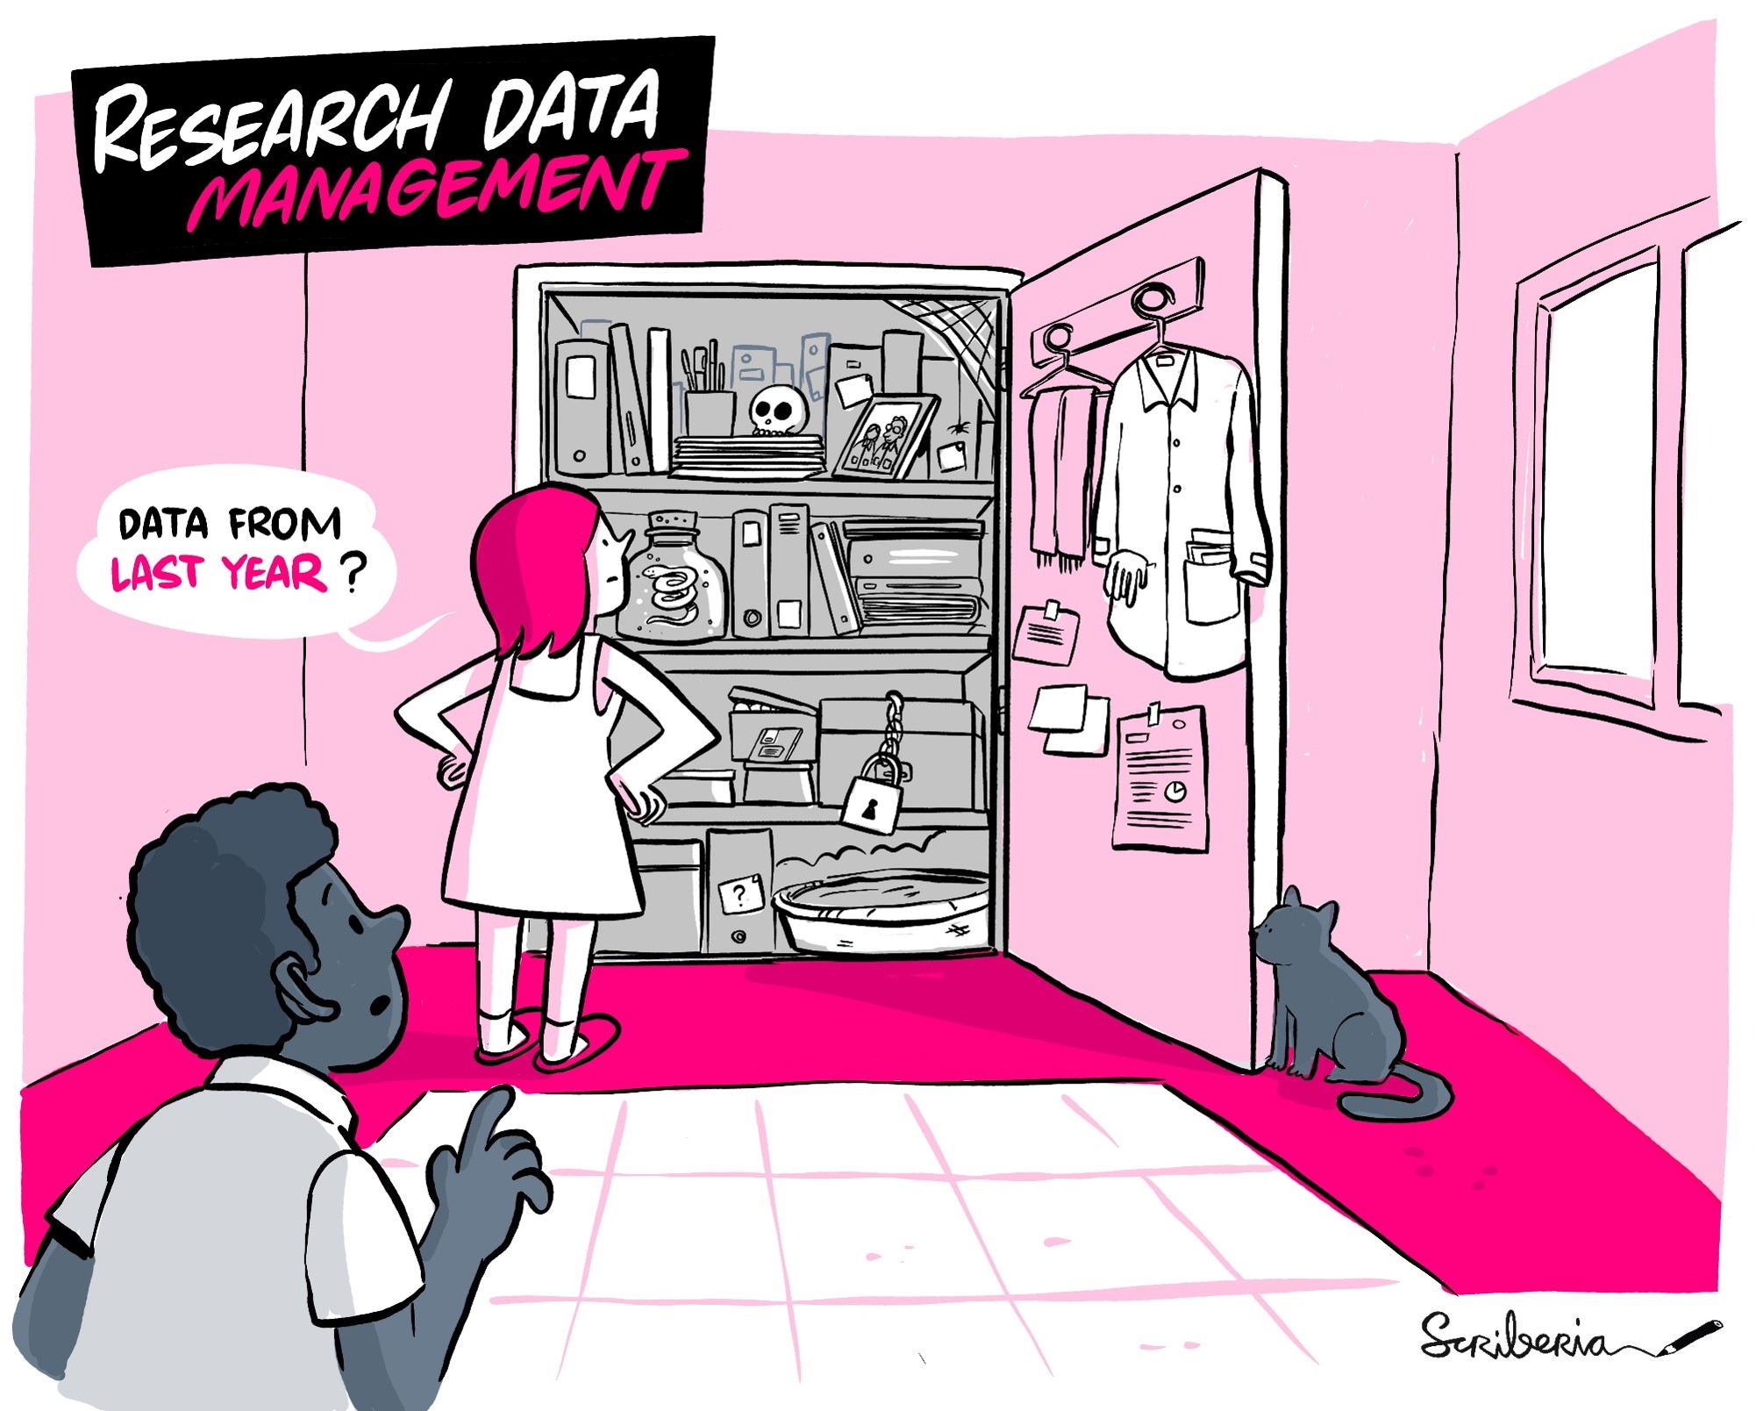
Spreadsheet management
10.5281/zenodo.5053596
This illustration is created by Scriberia with The Turing Way community. Used under a CC-BY 4.0 licence. DOI: 10.5281/zenodo.3332807

Slide 7
Spreadsheets
10.5281/zenodo.5053596
But…
Manual:
  Easy to make mistakes
  Copy pasting the wrong cells
  Messing up formula
  Accidental deletion
  Difficult to reproduce
Data entry
Tables for publications
Generate summary statistics
Figures
Not Machine readable:
  Software can’t process certain information:
  Notes in the margin
  Spatial layout of data
  Field formatting
Notes:
important to be aware of the limitations these data may present, and know how to assess if any problems are present and how to overcome them

Slide 8

Excel & Dates
10.5281/zenodo.5053596
https://9gag.com/gag/ayMQeKM

Slide 9
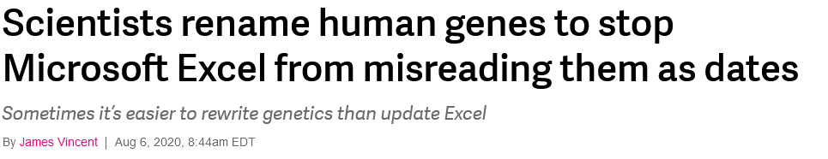
Excel & Dates
10.5281/zenodo.5053596
https://www.theverge.com/2020/8/6/21355674/human-genes-rename-microsoft-excel-misreading-dates
Presentation by Mandhri Abeysooriya on ‘Spreadsheet Problems In Genomic Research’

Slide 10
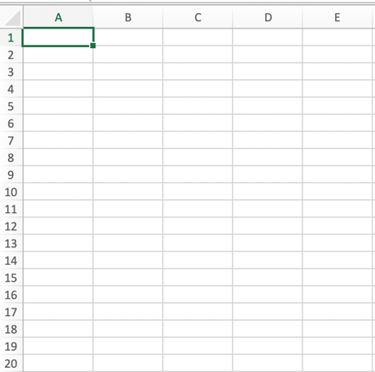
Cells, columns and rows
10.5281/zenodo.5053596
Each box is a cell
Each column is a specific data feature
Each row is an individual item/observation

Slide 11
Spreadsheets that are less error-prone, easier for computers to process, more accessible, and easier to share
10.5281/zenodo.5053596
Be consistent
Write dates like YYYYMMDD
  Always check when there are dates in imported data and consider to split the YYYY, MM, and DD in separate cells
Do not leave empty values (use NA)
Put as few information possible in a single cell and one observation per row
Create a data dictionary that describes the spreadsheet and any cleaning steps you took
Leave the raw data alone!
Avoid formatting (colours, font, bolding)
Use data validation to avoid errors (OpenRefine)
Extended version
Broman and Woo 2018
Carpentries Spreadsheets for Ecologists or Social Scientists
Notes:
This regional variation is one good reason to treat dates, not as a single data point, but as three distinct pieces of data (month, day, and year). Separating dates into their component parts will avoid this confusion, while also giving the added benefit of allowing you to compare, for example data collected in January of multiple years with data collected in February of multiple years.

Slide 12
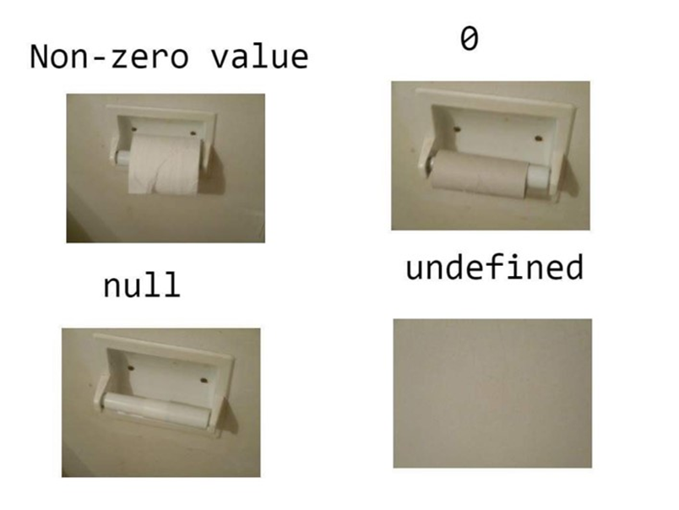
Why use
Not Available / NA?
10.5281/zenodo.5053596
Difficult to know if a value is missing
Blanks can be confusing when spaces/tabs are used as delimiter
Use a consistent null value and indicate it in the metadata/README
Kelly Davis/Heather Froehlich - Introduction to Spreadsheets with Excel

Slide 13
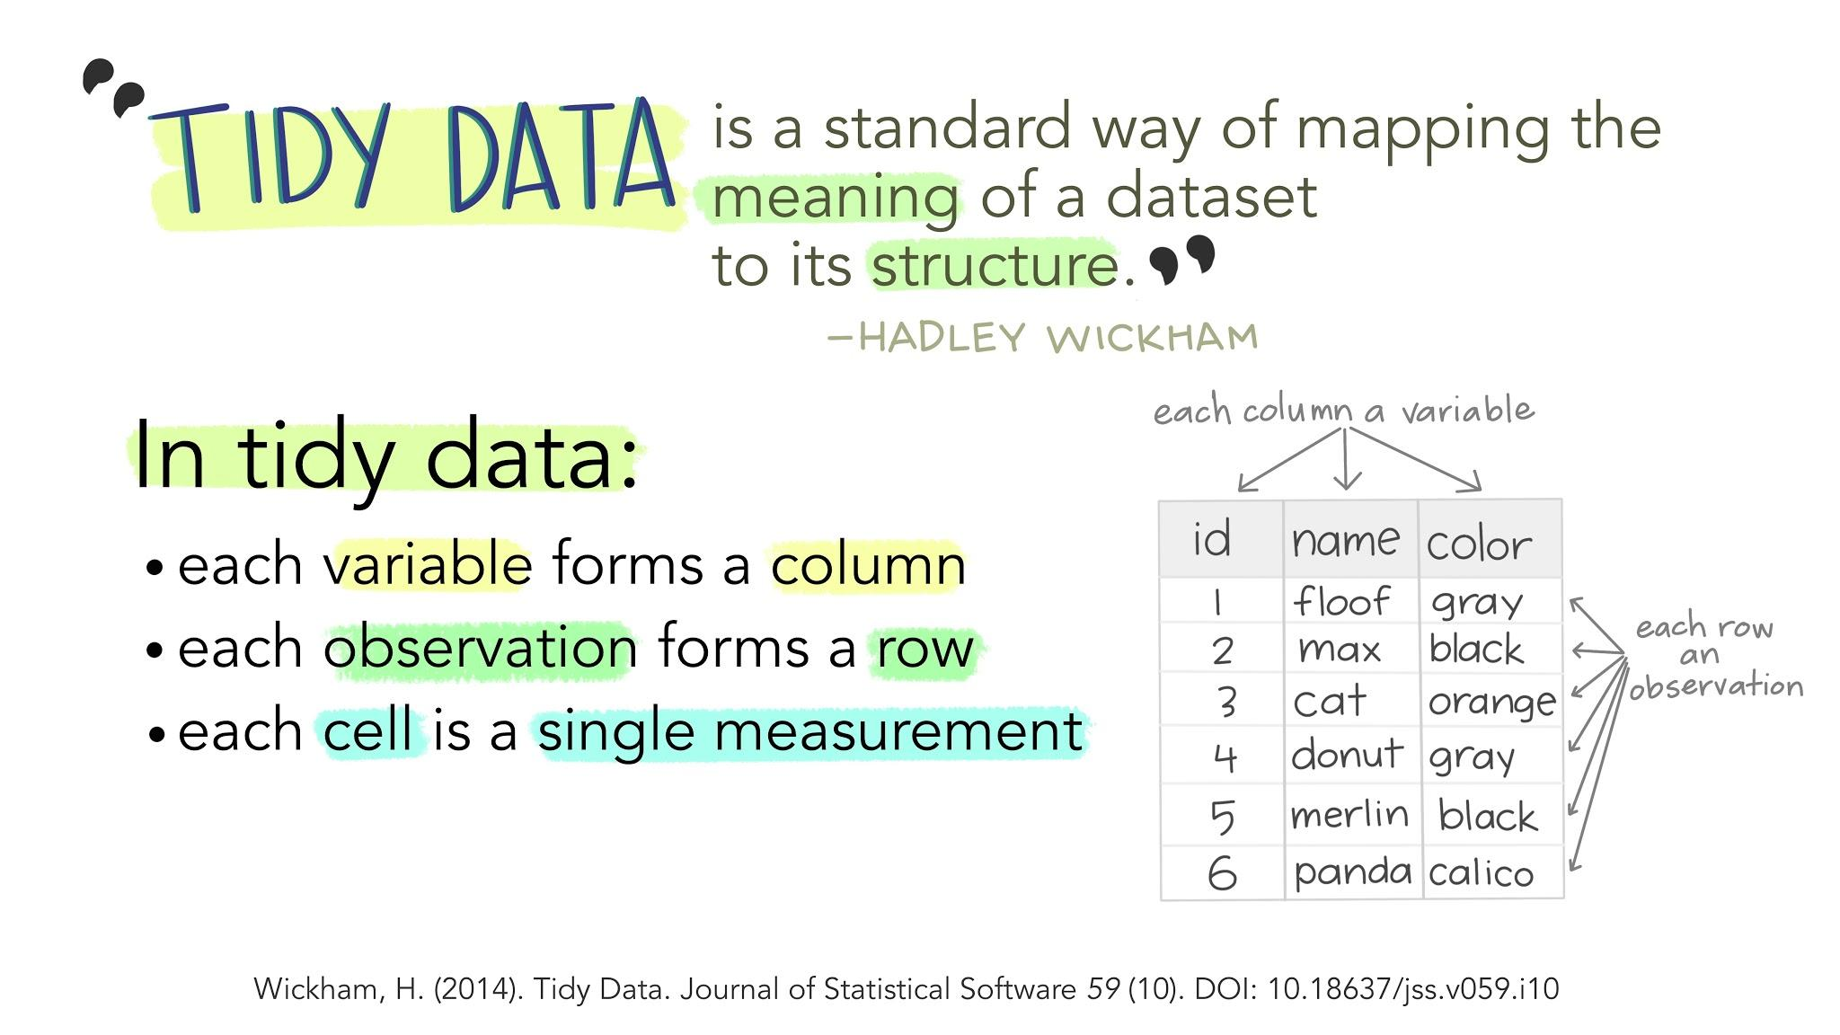
Tidy Data (R)
10.5281/zenodo.5053596
Tidy Data Paper by Wickham (see here for the CRAN code heavy version)
Welcome to the Tidyverse
The Tidyverse style guide
https://www.openscapes.org/blog/2020/10/12/tidy-data/ Illustration by Allison Horst (CC-BY)

Slide 14
Workshop Dataset
10.5281/zenodo.5053596
Studying African Farmer-led Irrigation (SAFI) Dataset
Interviews of farmers in two countries in eastern sub-Saharan Africa (Mozambique and Tanzania, conducted between November 2016 and June 2017)
Topics:
  household features (construction materials used, number of household members)
  agricultural practices (water usage)
  assets (number and types of livestock)
This is a simplified version of a real dataset!

Slide 15
Exercise
7 min
Download the messy data
Open up the data in a spreadsheet program
Notice that there are two tabs. Two researchers conducted the interviews, one in Mozambique and the other in Tanzania. They both structured their data tables in a different way. Now, you’re the person in charge of this project and you want to be able to start analysing the data!
With the person next to you, identify what is wrong with this spreadsheet. Discuss the steps you would need to take to clean up the two tabs, and start cleaning the spreadsheet
! Do not forget
to create a new file (or tab) for the cleaned data & never modify your original (raw) data

Slide 16
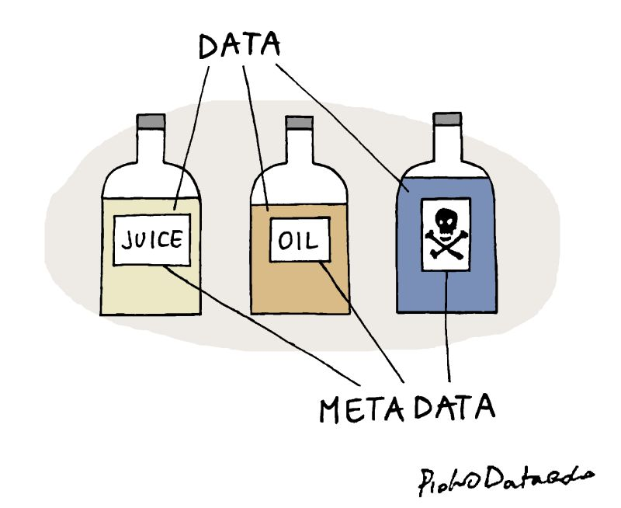
Metadata
10.5281/zenodo.5053596
Data about data
Information to make the data understandable
Image by Piotr Kononow

Slide 17
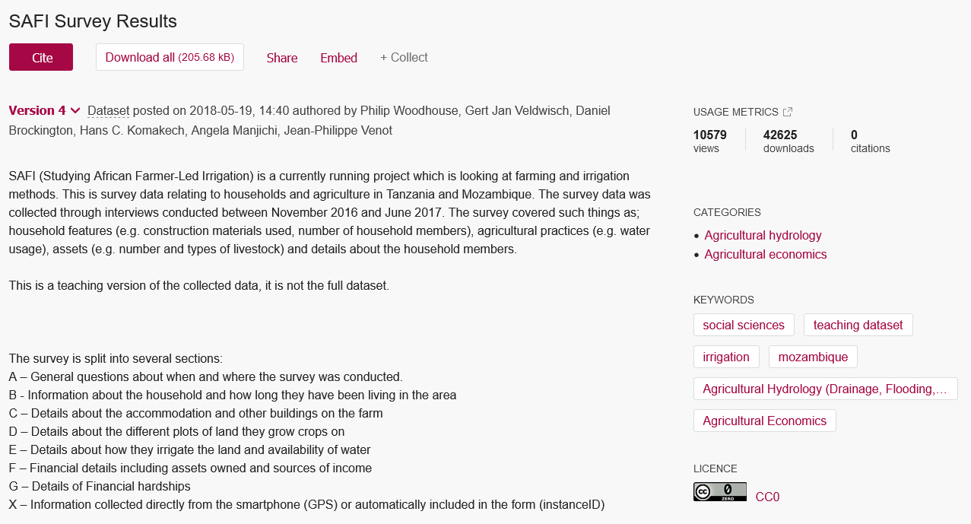
SAFI metadata
10.5281/zenodo.5053596
Studying African Farmer-led Irrigation (SAFI) Dataset

Slide 18
Metadata Standards
10.5281/zenodo.5053596
Ensures interoperability and machine readability
Example: YYYYMMDD = RFC3339
Use FAIRsharing to look for standards in your field

Slide 19
Vocabulary: how to say Female
Slide adapted from Christine Staiger https://doi.org/10.5281/zenodo.2585691
18-day pregnant females
2 yr old female
400 yr. Old female
Adult female
Asexual female
Castrate female
Cf.female
Cystocarpic female
Dikaryon
Dioecious female
Diploid female
F
Famale
Femail
Female
Female – worker
Female (alate sexual)
Female (calf)
Female (lactating)
Female (pregnant)
Female (outbred)
Female parent
Female plant
Female with eggs
Female worker
Female, 6-8 weeks old
Female, virgin
Female, worker
Female(gynoecious)
Femele
Female, pooled
Femalen
Females
Females only
Gynoecious
Healthy female
Probably female
Individual female
Igb*cc females
Mare
Female (worker)
Monosex female
Ovigerous female
Oviparous sexual females
Worker bee
Female enriched
Pseudohermaprhoditic female
Remale
Semi-engorged female
Sexual oviparous female
Sterile female worker
Strictly female
Tetraploid female
Thelytoky
Female (gynoecious)
Worker caste ‘female’
Sex female
Female, other
Female child
Femal
3 female
Female (phenotype)
Female mice
Female, spayed
Femlale
Metafemale
Sterile female
Normal female
Sf
Vitellogic replate female Worker
Hexaploid female
Female (f-o)
Hen

Slide 20

Documentation
10.5281/zenodo.5053596
README files
(Electronic) Labbooks
Guide for data documentation
Data Dictionary
Code Book
  See the dataset info page
https://twitter.com/thecrobe/status/1373590641012322306

Slide 21
Exercise
5 min
Download the clean version of the SAFI dataset
  Excel: Open a new/empty workbook in Excel
  Libre: select the right options in Text Import and click Ok
Select 'Data/Gegevens' on the ribbon, and then ‘Gegevens ophalen’ -> 'From Text/CSV'
Select the SAFI dataset and click Import/Laden
Earlier Excel versions only: In the Text import wizard, ensure the 'Delimited' option (step 1), Tick 'Comma' (step 2) and in step 3, keep ‘General’ ticked and ‘Finish’
Follow along with screenshots or Libre: Importing and Exporting CSV Files

Slide 22
Exercise
5 min
Check out the clean SAFI dataset
  This data has more variables than the messy spreadsheet and is formatted according to tidy data principles
Discuss this data with a partner and make a list of some of the types of metadata that should be recorded about this dataset
  What is not immediately obvious to me about this data?
  What questions would I need to know the answers to in order to analyze and interpret this data?

Slide 23
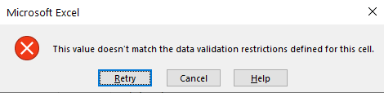
Quality Assurance - data validation
10.5281/zenodo.5053596
Excel allows us to specify a variety of data validations to be applied to cell contents.
If the validation fails, an error is raised and the data we entered does not go into the particular cell.
Excel support page on data validation

Slide 24
Data validation - restricting data to a numeric range
10.5281/zenodo.5053596
column no_membrs = number of people in the household
  positive integer
  reasonable maximum value
Clean version of the SAFI dataset

Slide 25
Exercise
3 min
Data validation numeric range
Use the clean version of the SAFI dataset
Select the no_membrs column
In Data/Gegevens tab select Data Tools and then Data Validation/Gegevensvalidatie (Libre: Data menu, select Validity... )
Select ‘Whole number/Geheel getal’ from the Allow/Toestaan drop down options (Libre: Allow: Whole Numbers and then Data: valid range)
Minimum and Maximum boxes appear (1-30, click Ok)
Enter a message in the Input Message/Invoerbericht tab (Input Help)
(You can change the error/warning in the Style/Stijl option on the Error Alert/Foutmelding tab.)
Follow along with screenshots

Slide 26
Data validation
10.5281/zenodo.5053596
Data validation rules are not applied retroactively (data already in cells)
Existing data will not be flagged with a warning
  In some Excel versions, you can click in the Data tab on Data Validation/Gegevensvalidatie and then “Circle invalid data/Ongeldige gegevens omcircelen”. This will put red circles around invalid data entries.
Set up data validation rules for each column when you set up your spreadsheet (before data collection)
Clean version of the SAFI dataset

Slide 27
Data validation - restricting data to entries from a list
10.5281/zenodo.5053596
drop-down list of the available items
Typing a list of values where only a few possible values exist (like “grass, muddaub, burntbricks, sunbricks, cement”)
OR
Create a small table (in a separate tab of the workbook), and use these cells as the source of acceptable inputs.
  Makes the data entry process more flexible. If you add or remove contents from the table, these are immediately reflected in any new cell entries based on this source. You can also have different cells refer to the same table of acceptable inputs.
Clean version of the SAFI dataset

Slide 28
Exercise
3 min
Data validation lists
Use the clean version of the SAFI dataset
Select the respondent_wall_type column
In Data tab select Data Tools and then Data Validation/Gegevensvalidatie (Libre: Data menu, select Validity... )
Select List/Lijst from the Allow/Toestaan drop-down menu (Libre: choose the List option), to pop up a Source/Bron box
Type a list of all the values that you want to be accepted in this column, separated by a comma (without spaces!) or semicolon
  grass; muddaub; burntbricks; sunbricks; cement
Libre: enter the words on separate lines
Excel: create a meaningful input message, then click OK
Follow along with screenshots

Slide 29
Exporting Data in an open format
10.5281/zenodo.5053596
Tab/Comma delimited
Comma Separated Value files (.csv) are plain text files where the columns are separated by commas

Slide 30
Open Format
- Why?
10.5281/zenodo.5053596
Accessible
Useable by multiple types of software that are freely available (Microsoft requires a paid license)
Publishing
Data repositories, journals and funding agencies may have requirements for open formats
Life expectancy
Open formats are more suitable for long term preservation because they don’t rely on a single software product
Universal format
Interoperable format that produces the same results when it is imported by various software (including plain text editors and R)!

Slide 31
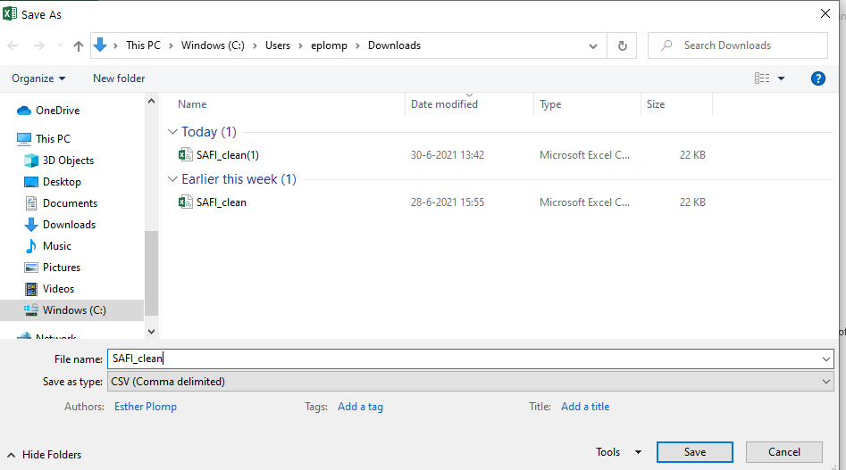
Exercise
2 min export to .csv
From the top menu select File and Save as.
In the Format field, from the list, select Comma Separated Values (*.csv).
Double check the file name and the location where you want to save it and select Save.

Slide 32
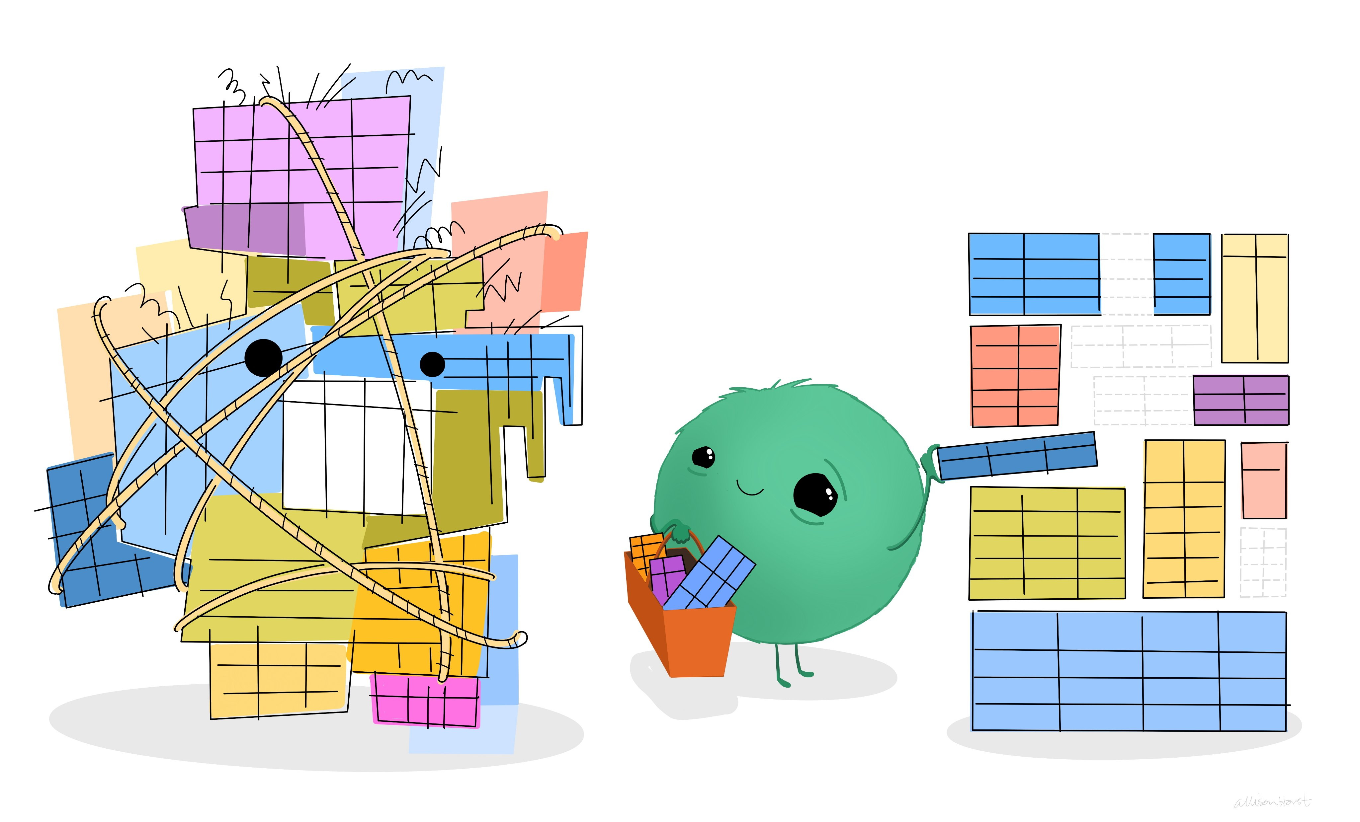
Thank you!
10.5281/zenodo.5053596
Esther Plomp
@toothFAIRy@scholar.social
e.plomp@tudelft.nl
Data Organization in Spreadsheets for Social Scientists
Illustration by Allison Horst (CC-BY)

Slide 33
Data with comma’s
10.5281/zenodo.5053596
Enclose the data fields with double quotes
Double check that the file you are exporting can be read in correctly!

Slide 34
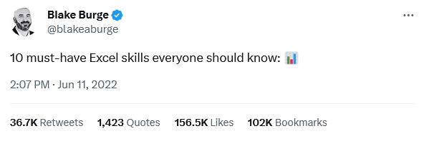
Extra resources
10.5281/zenodo.5053596
Ten Guidelines for Better Tables by Jonathan A. Schwabish
Reproducible RDM workflows for tabular data by Eirini Zormpa
https://twitter.com/blakeaburge/status/1535594636969902081

