Slide 1
Interoperability of PUNCH software in the Python ecosystem
J. Marcus Hughes
PUNCH Science Operations Center Software Lead
DASH 2023
9 October 2023
APL

Slide 2
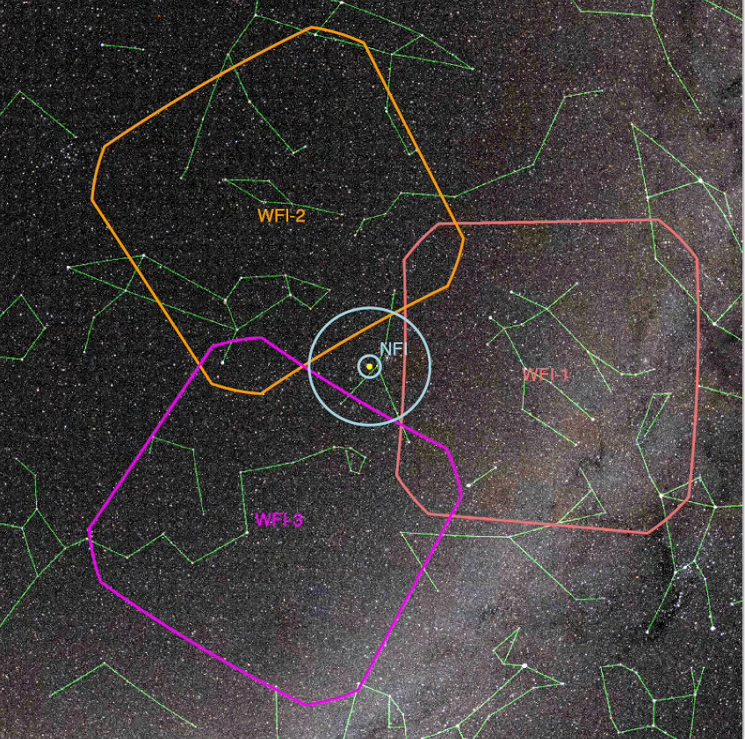
Introduction to PUNCH
PUNCH will be a constellation of four smallsats to study the solar wind
Launch in April 2025
Complicated processing pipeline of stitching together images from multiple satellites
Software will be completely open
Sun
PUNCH will change how we understand the solar wind
PUNCH Software Interoperability: J. M. Hughes

Slide 3
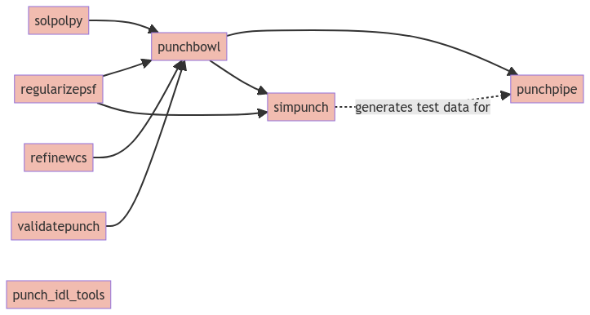
PUNCH Software Packages
Arrows indicate which packages are used by others.
PUNCH software is divided into several packages, emphasizing reusability by isolating functionality
PUNCH Software Interoperability: J. M. Hughes

Slide 4
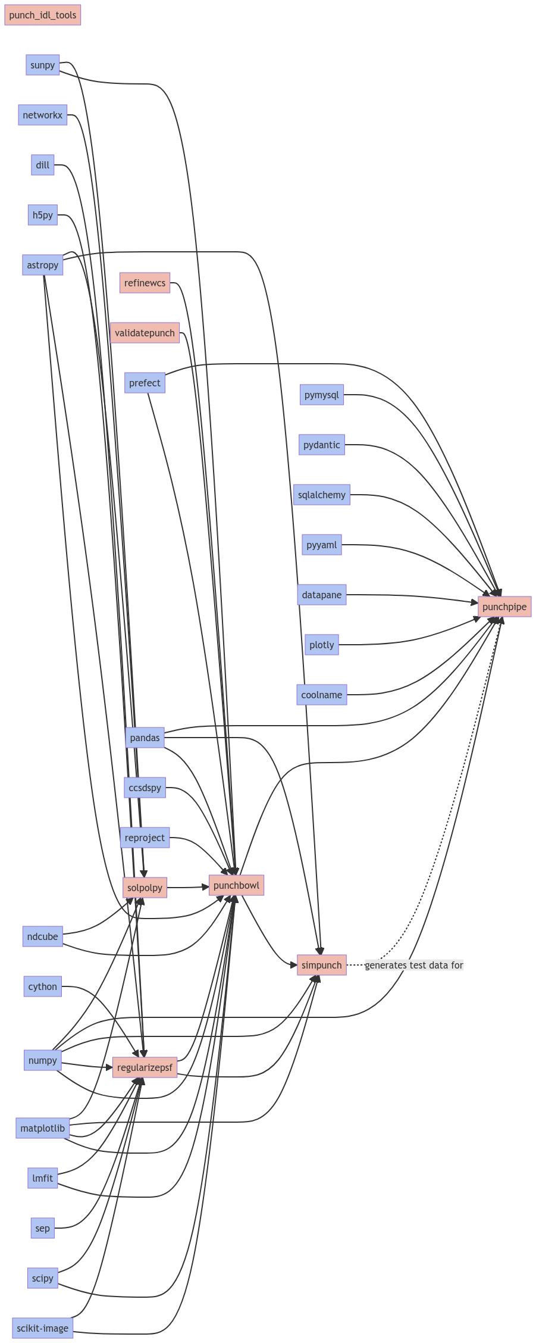
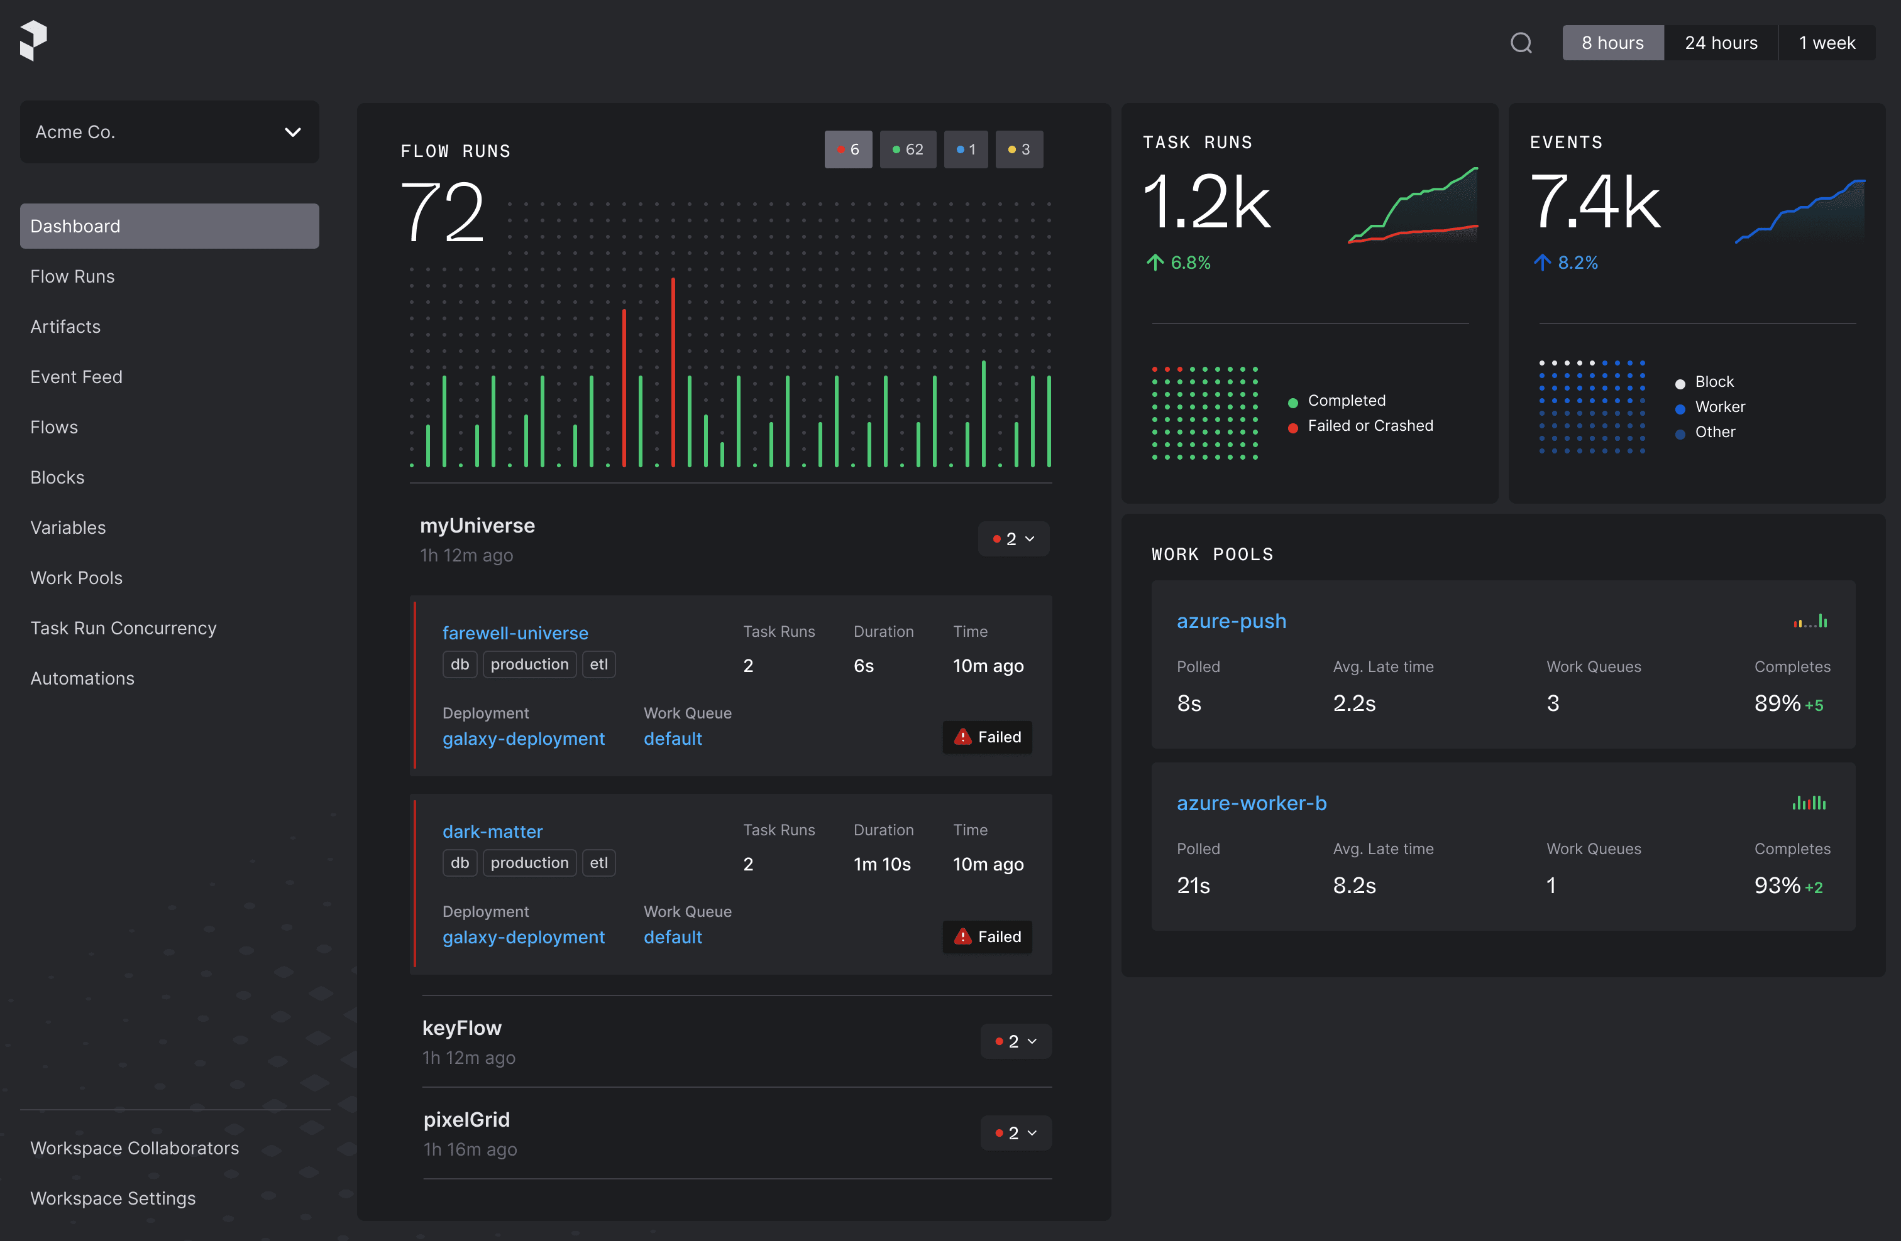
PUNCH Software Dependencies
Difficult to clearly visualize dependencies all at once
Blue are dependencies to external packages
Packages heavily used:
  Prefect
  SunPy
  AstroPy
  reproject
  ndcube
  NumPy
A view of Prefect for monitoring the pipeline’s health
PUNCH software makes use of many external packages
PUNCH Software Interoperability: J. M. Hughes

Slide 5
PUNCH Interoperability Challenges
Maintaining dependencies:
  Automated testing is a must to be confident that new versions of dependencies do not break your software.
  Major version changes can take time to adapt to.
Efficient and flexible algorithms:
  Cannot assume our software will only be run on PUNCH servers.
Consistent data models:
  We use ndcube for our data but other packages expect NumPy arrays or SunPy maps
Clear communication:
  Our documentation must now be clear to a wider diversity of audiences.
  Conveying the state and reliability of our software.
Designing for interoperability poses some challenges alongside the many benefits
PUNCH Software Interoperability: J. M. Hughes

Slide 6
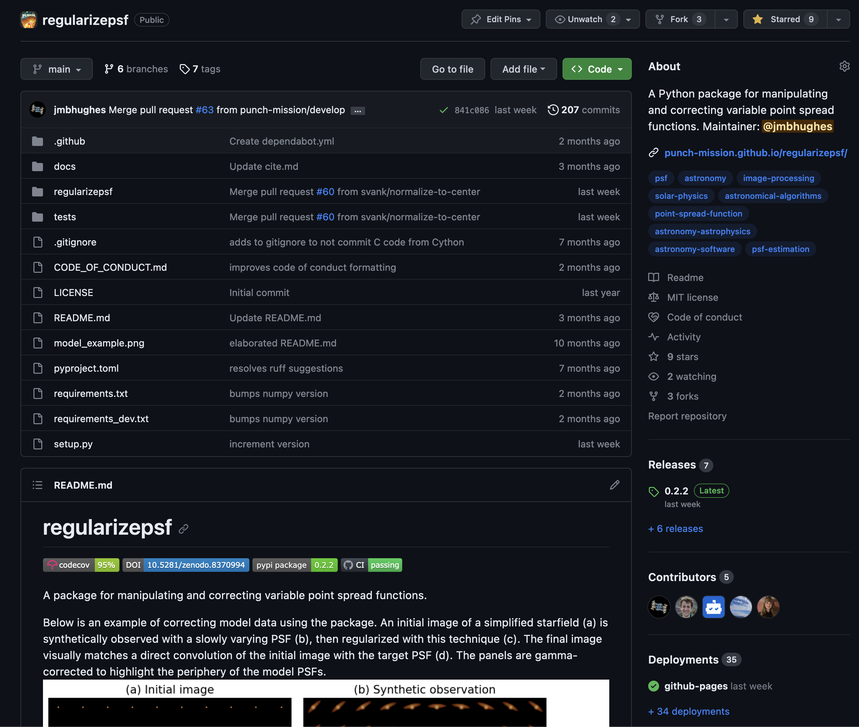
Communication is Paramount
Usage instructions must be clear.
Contribution guide should welcome contributions with a guide to get started.
Code of Conduct defines the culture of respect around the package.
Badges indicate the state of the package.
A point of contact should be identified for further inquiry.
Interoperability is only possible with clear communication
PUNCH Software Interoperability: J. M. Hughes

Slide 7
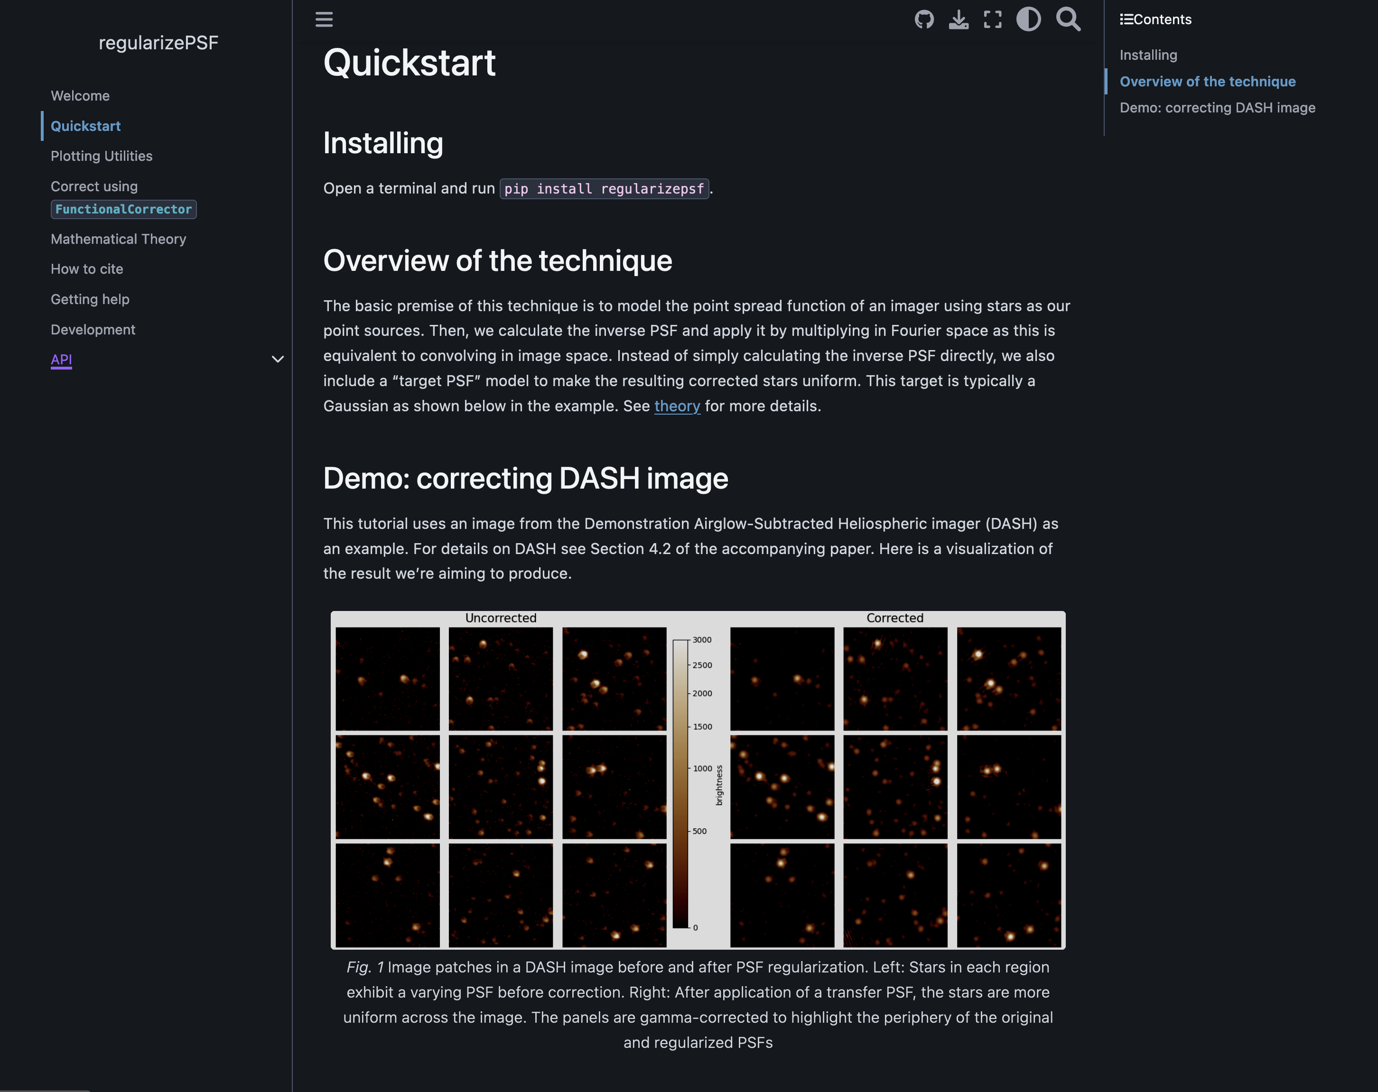
Demo!
We’ll now look at regularizepsf, one of our general purpose packages from PUNCH and discuss how it has interoperability.
DeepNote demo link:
  https://tinyurl.com/hughes-dash23
PUNCH Software Interoperability: J. M. Hughes

Slide 8
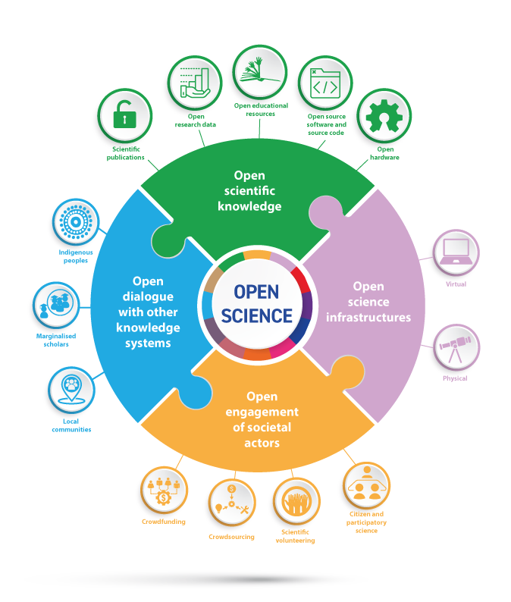
Summary
PUNCH is an upcoming mission with complex data processing.
Designing with interoperability in mind has led us to adopt a policy of small, focused packages that work together.
Being open comes with benefits and challenges.
marcus.hughes@swri.org or create a discussion/issue on GitHub
https://en.wikipedia.org/wiki/Open_science
Design with interoperability in mind from the beginning
PUNCH Software Interoperability: J. M. Hughes

