Slide 1
Challenges in serving data using the HAPI Interface
Carrie Gonzalez
Joey Mukherjee
Umer Salman
Southwest Research Institute

Slide 2
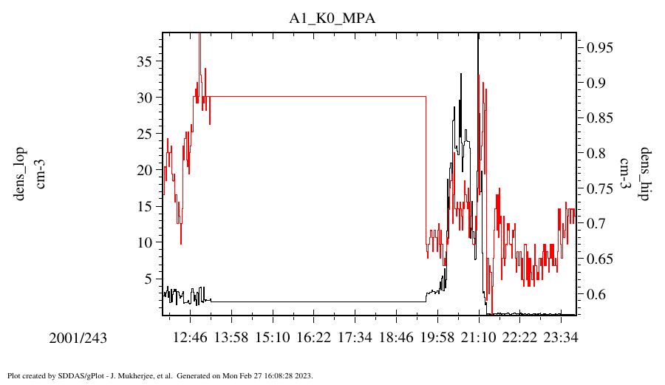
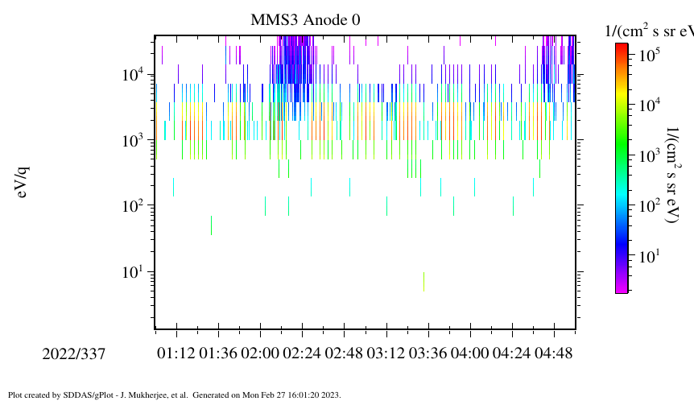

Successful integration of client-side HAPI interface
Integrated using a GUI to allow for the selection of servers / data sets to retrieve.
Currently, allows for the creation of line plots and/or spectrograms.

Slide 3
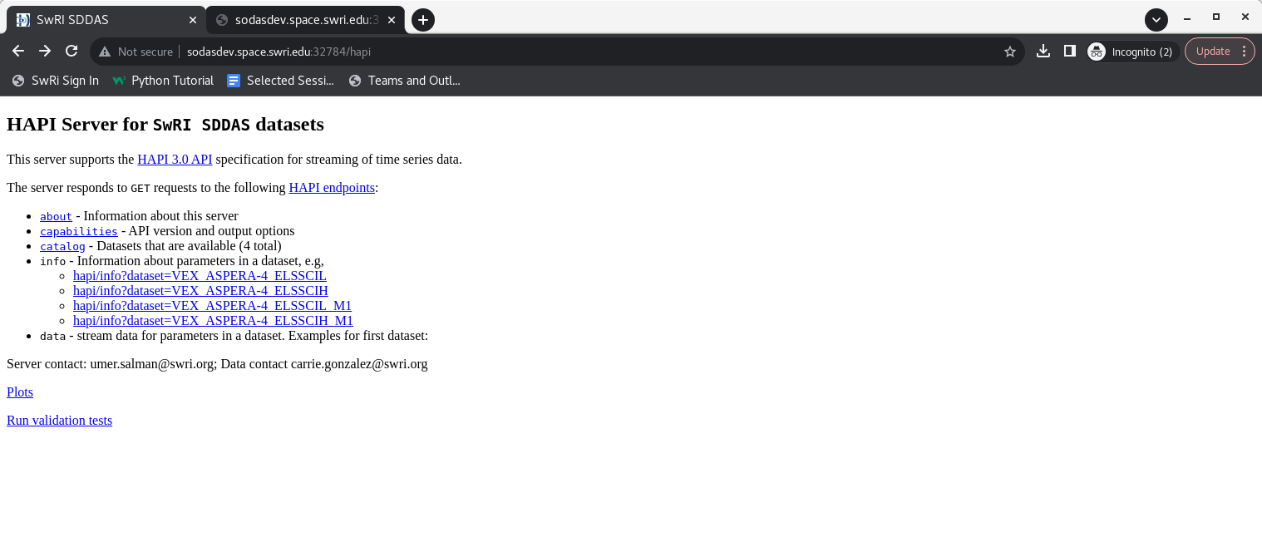
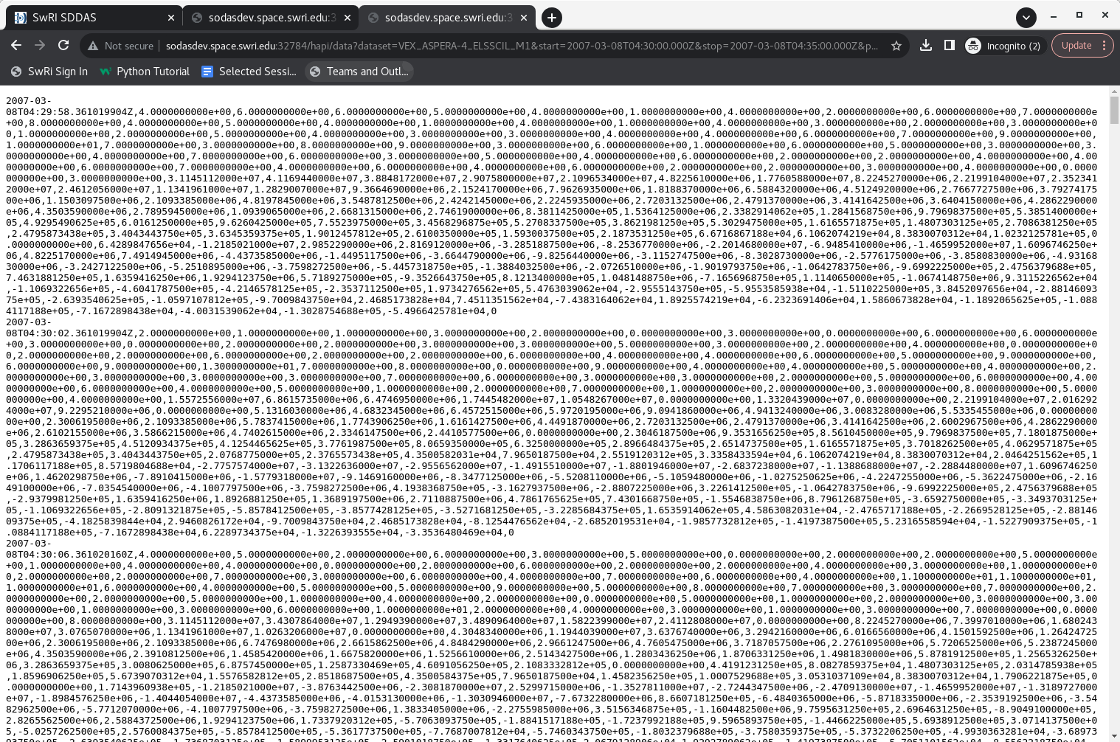
Progress towards the server-side HAPI interface

Slide 4
HAPI server Challenge 1 – Data Parameter timing
Issue: Heritage data format allows for small corrections (milliseconds) to the derived timing for any data parameter(s) within a single data set which may arise due to internal buffering of data or any other effect.
HAPI requires a single time column so each record (row of data) must be associated with 1 time value.
Data Format | Solution | Solution Result
CDF | Definition of multiple Epoch variables and the use of the DEPEND_0 variable attribute | Epoch (No: 0) (Recs: 12) Record # 1: 2009-11-13T02:55:33.720269000 Epoch_1 (No: 1) (Recs: 12) Record # 1: 2009-11-13T02:55:33.730269000 VEx_ELS_Anode_Background (No: 2) (Recs: 12)------------------------ DEPEND_0 (CDF_CHAR/5): "Epoch“ VEx_ELS_00_Background (No: 3) (Recs: 12)--------------------- DEPEND_0 (CDF_CHAR/7): "Epoch_1"
PDS4 CSV | The data for each variable written on a separate row with its’ own time tag | 2009-317T02:55:33.720,2009-317T03:00:35.093,"SENSOR","VEx ELS Anode Background","cnts/sector", 3.541346e+01 2009-317T02:55:33.730,2009-317T03:00:35.103,"SENSOR","VEx ELS-00 Background","cnts/sample", 2.705627e-02
HAPI | (a) Each time resolution could be presented as a separate data set (b) Including time adjustment values | (a) Dividing up the data into separate data sets, expanding the HAPI catalog (b) Adding time adjustment values but these would need to be per data parameter Question: Any way to expand the parameters attribute in the info response object?

Slide 5
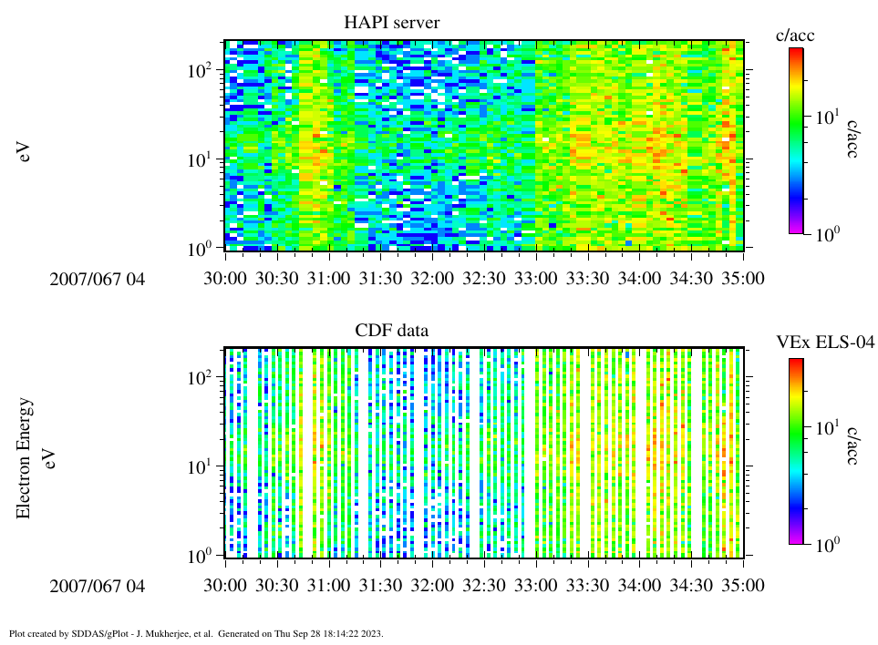
HAPI server Challenge 1 – Data Parameter timing (con’t)
Issue: How to represent time duration / time range for the data parameters.
HAPI requires a single time column, therefore, 1 discrete time value.

Slide 6
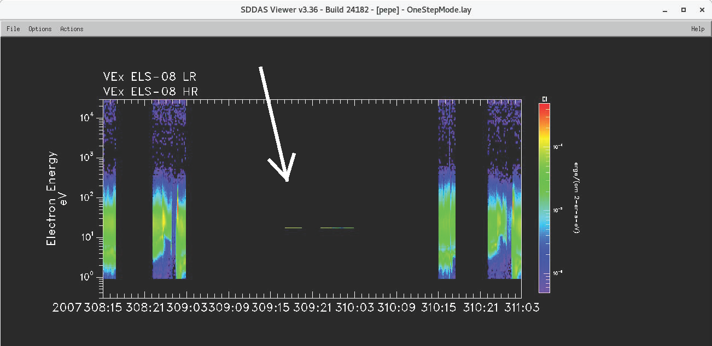
HAPI server Challenge 2 – Instrument mode changes
2 data sets - Low Range (LR) and High Range (HR)
White arrow shows instrument mode change from 4 second sweep (128 values split between the 2 data sets) to 31 millisecond sweep (128 values for LR data set only)
Question: How to return Low Range data set as a single HAPI server response without data manipulation to regularize the data parameter?

