Slide 1
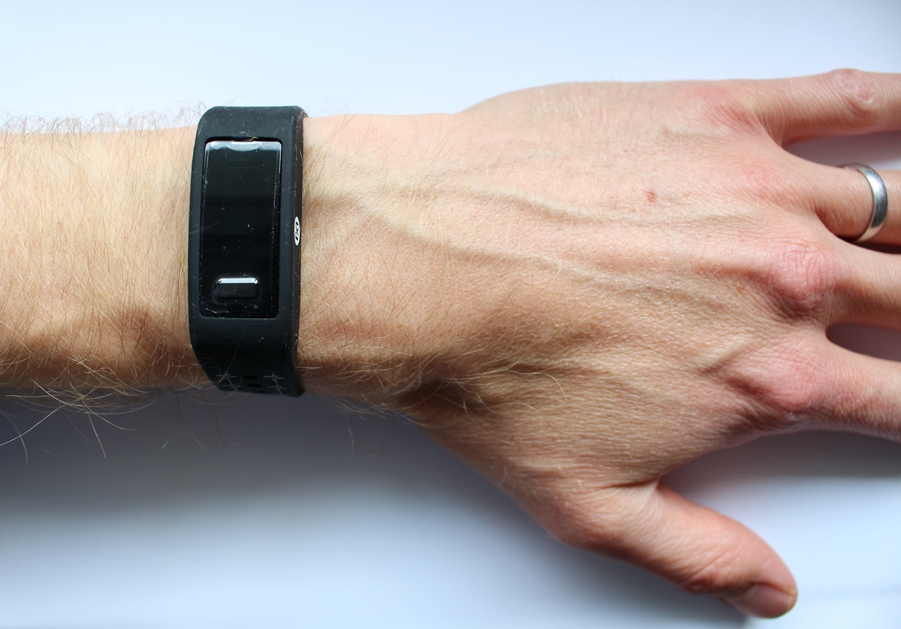
Accelerometry-Guided Inter-Beat-Interval Assessment from Wrist
Photoplethysmography
Peter H. Charlton^{1,2}, Joachim A. Behar³, Marton Aron Goda³, Jonathan Mant¹, Panicos A. Kyriacou²
¹ University of Cambridge
² City, University of London
³ The Faculty of Biomedical Engineering, Technion-IIT, Haifa, Israel
Peter Charlton, Wikimedia Commons, https://commons.wikimedia.org/wiki/File:Max_Health_Band.jpg (CC BY 4.0)

Slide 2
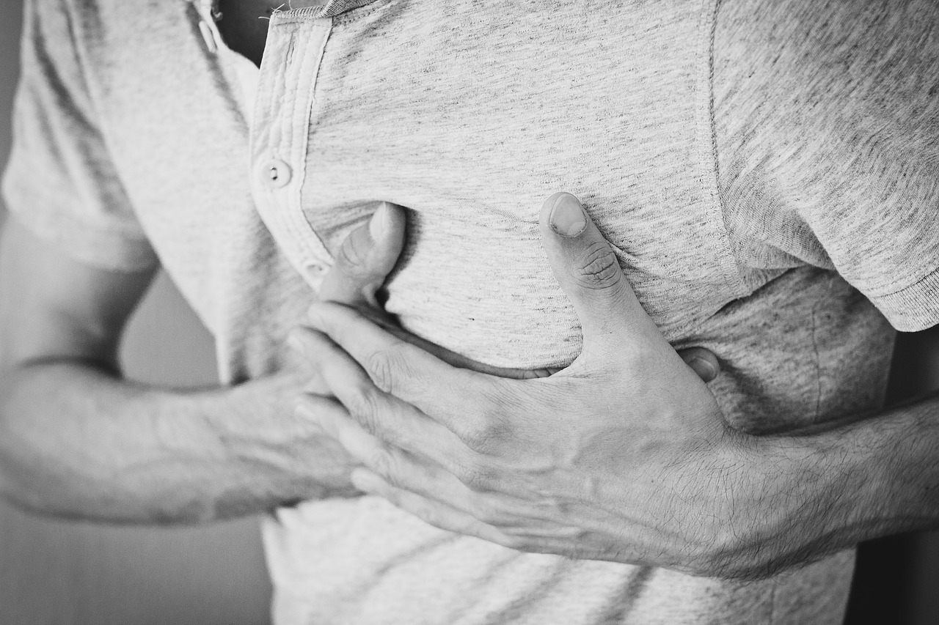
If atrial fibrillation was adequately treated in England:
2,000
Lives saved p.a.
7,000
Strokes prevented
425k
Additional diagnoses
Stroke Association, “State of the Nation,” 2017.
Public Health England, “Atrial fibrillation prevalence estimates in England …”, 2015.
Pexels, https://pixabay.com/photos/man-heartache-chest-pain-hurt-pain-1846050/ (Pixabay Licence)
Notes:
Source: https://www.stroke.org.uk/professionals/atrial-fibrillation-information-and-resources ; “It's estimated that if AF was adequately treated, around 7,000 strokes would be prevented and over 2,000 lives saved every year in England alone.”

Slide 3
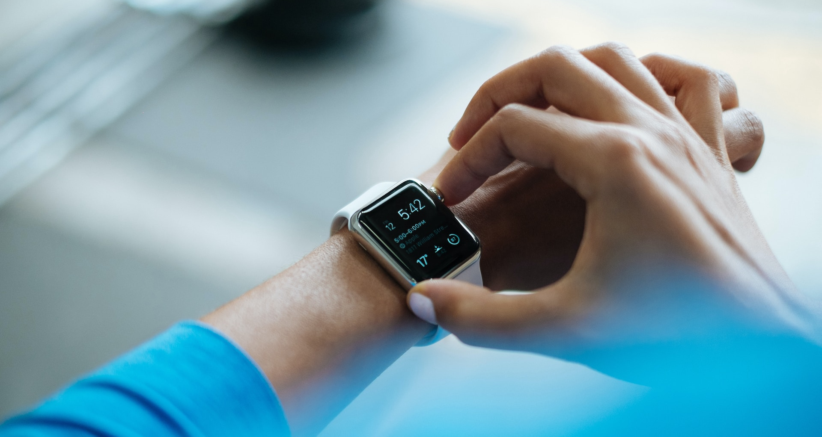
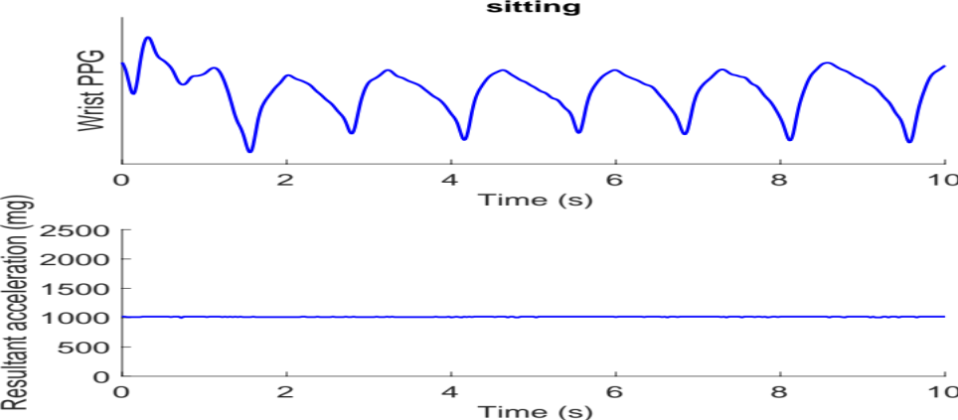
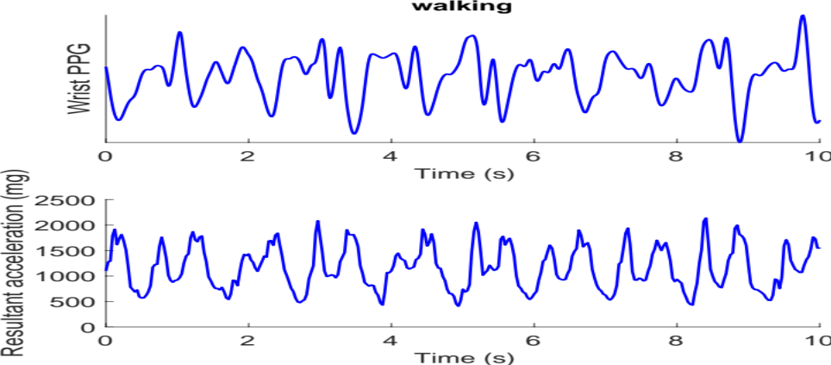
Photo by Luke Chesser on Unsplash
Notes:
smart wearables provide way of detecting possible af in daily life based on IBIs, but ppg signals are highly susceptible to noise, often due to motion artifact which could result in erroneous IBIs and false positives
(add signals with motion artifact and erroneous beat detection)

Slide 4

Notes:
To introduce myself [click], my name's Peter Charlton, and I'm a researcher in Bioinformatics. I develop techniques to analyse physiological signals, such as those acquired by consumer devices, to aid clinical decision making. I initially conducted my research here at St Thomas' Hospital in London, where I looked into using wearables to monitor hospital patients.

Slide 5

Notes:
Since then, I've been working on developing data analysis techniques for use [click] with wearables in daily life.

Slide 6
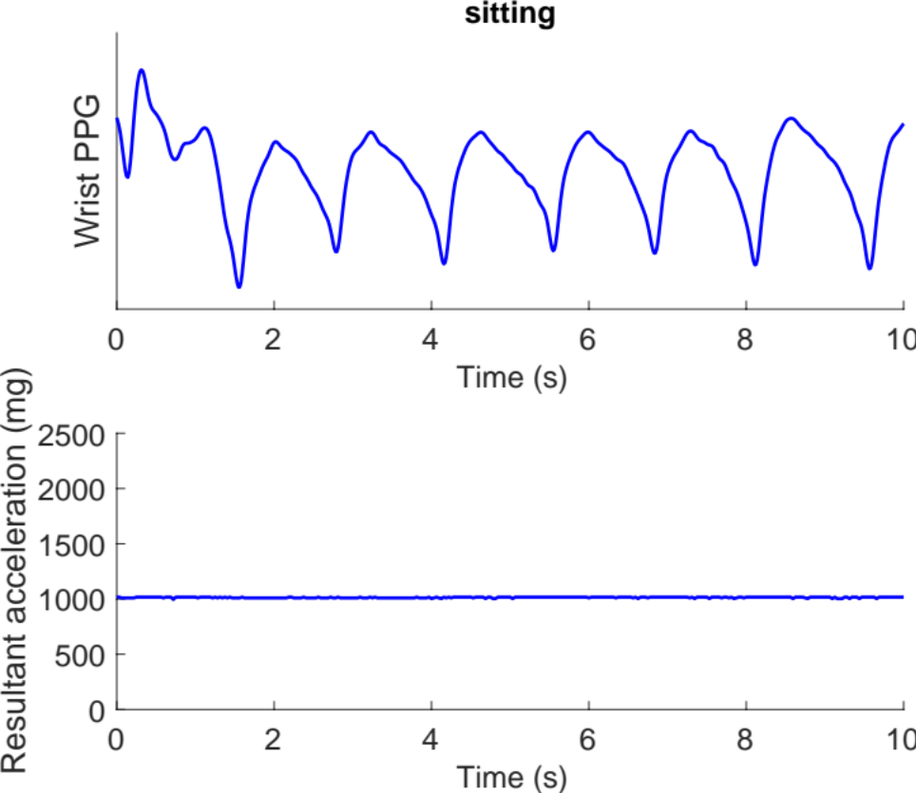
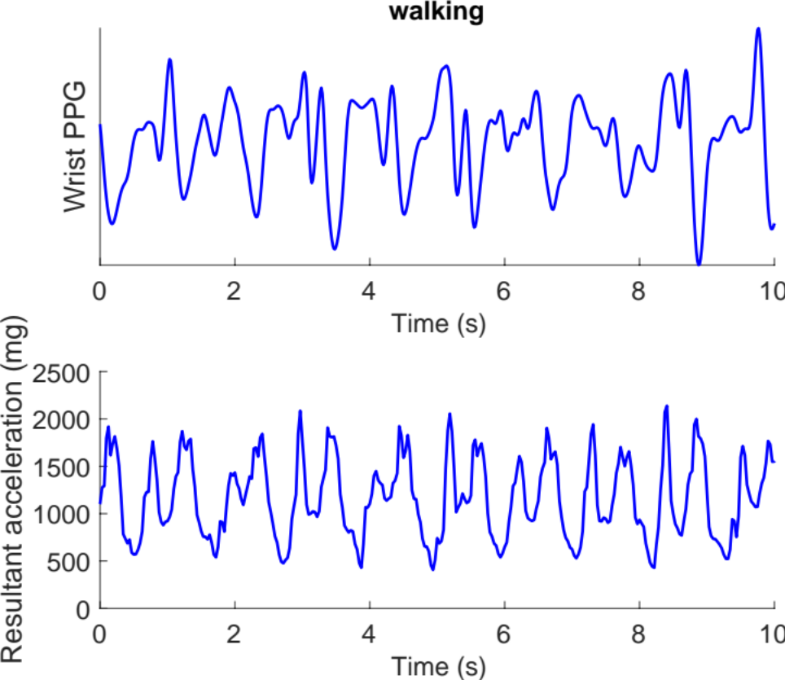
Photo by Luke Chesser on Unsplash
Notes:
smart wearables provide way of detecting possible af in daily life based on IBIs, but ppg signals are highly susceptible to noise, often due to motion artifact which could result in erroneous IBIs and false positives
(add signals with motion artifact and erroneous beat detection)

Slide 7
Aim:
To investigate whether accelerometry signals could be used to predict whether or not IBIs could be accurately measured from simultaneous PPG signals at the wrist.
Objectives:
Assess the classification performance of such an approach
Identify an optimal classification threshold
Assess performance across different activities
Source: Charlton PH et al., Accelerometry-Guided Inter-Beat-Interval Assessment from Wrist Photoplethysmography, CinC 2023 [in press] (CC BY 4.0)

Slide 8
Methods

Slide 9
Datasets
Wrist PPG (from Empatica E4)
Reference chest ECG
Dataset | Phases | No. Subjects
WESAD | Stress protocol: Baseline, Meditation, Amusement, Stress | 15
PPG-DaLiA | Activities of daily living: Sitting, Working, Lunch break, Car driving, Cycling, Table soccer, Walking, Stair climbing | 15
Source: Charlton PH et al., Accelerometry-Guided Inter-Beat-Interval Assessment from Wrist Photoplethysmography, CinC 2023 [in press] (CC BY 4.0)

Slide 10
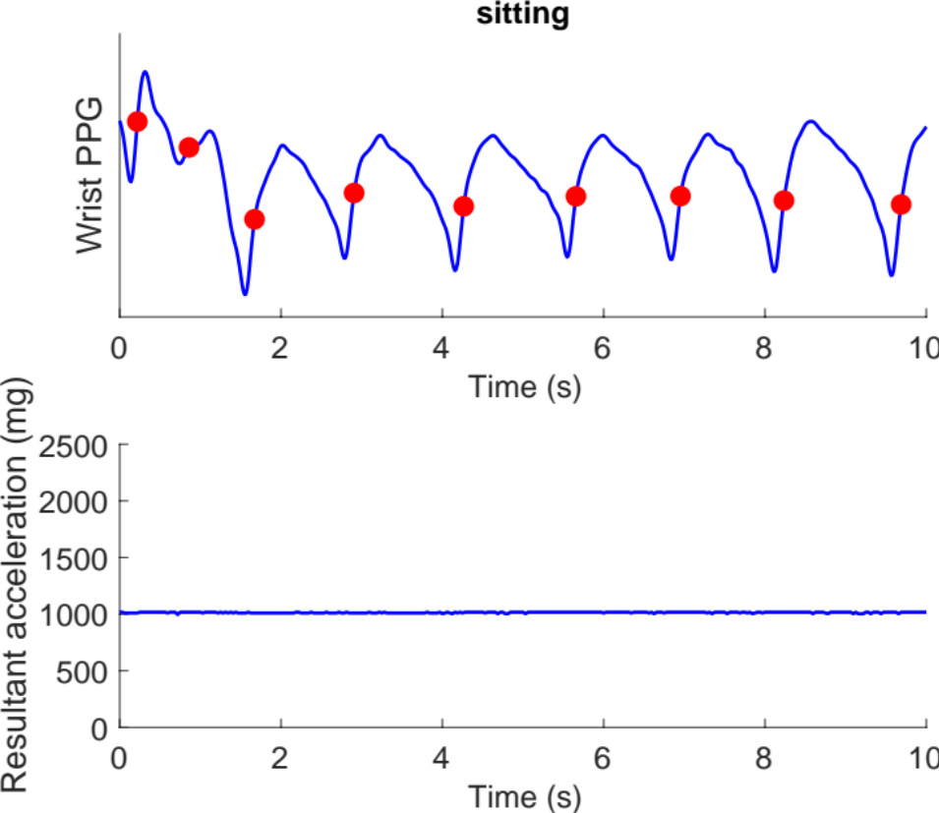
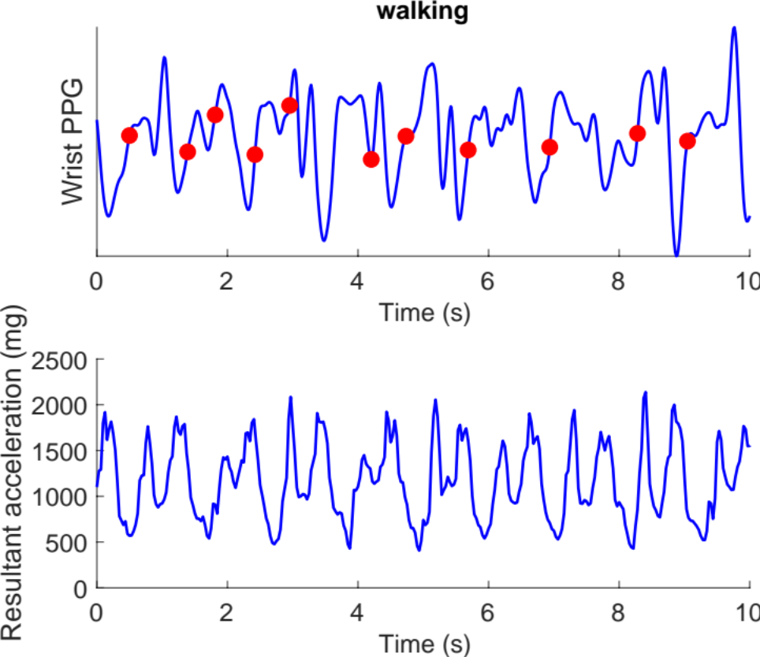
Inter-beat interval estimation from PPG
Open-source ‘MSPTD’ beat detector from ppg-beats: https://ppg-beats.readthedocs.io/
Middle-amplitude points
Source: Charlton PH et al., Accelerometry-Guided Inter-Beat-Interval Assessment from Wrist Photoplethysmography, CinC 2023 [in press] (CC BY 4.0)

Slide 11
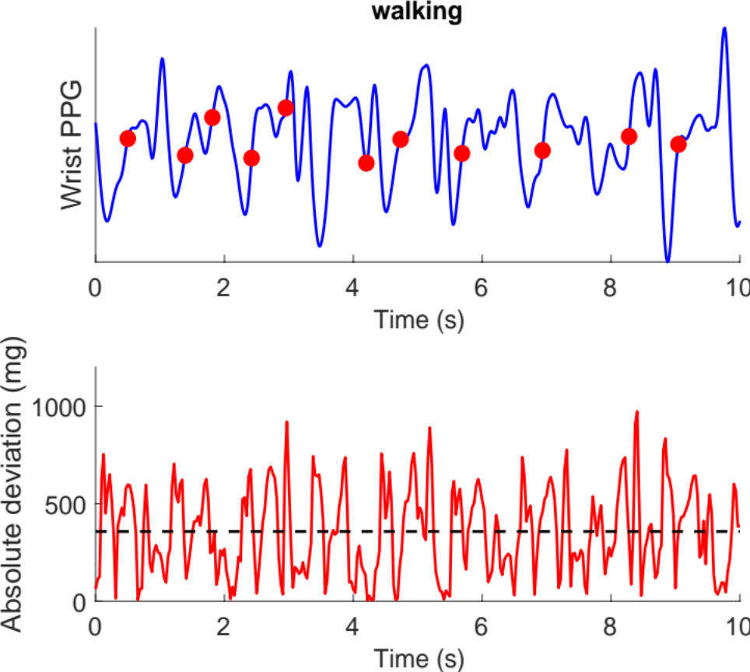
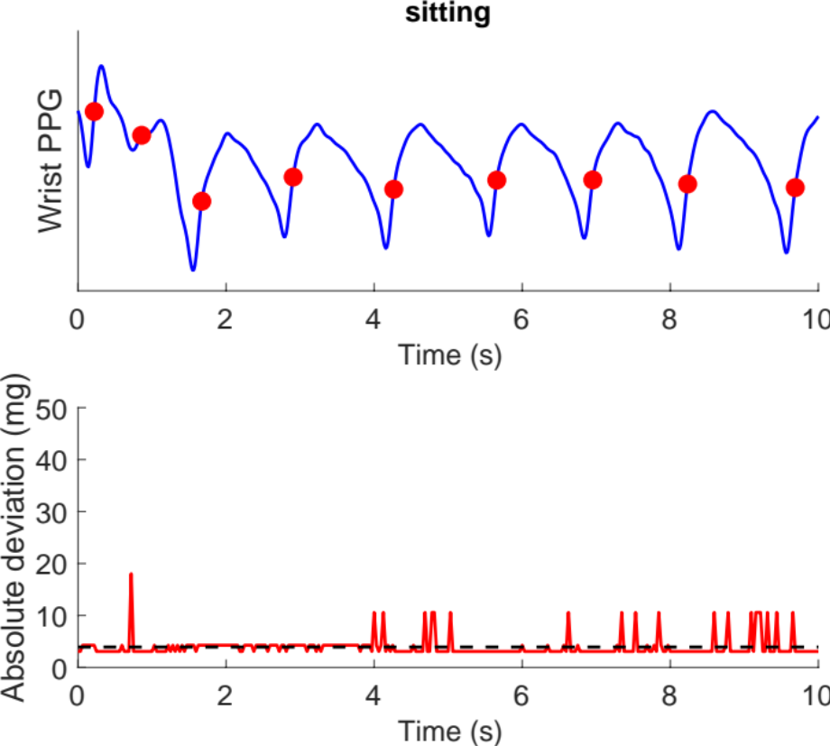
Assessing level of movement
Mean absolute deviation (MAD)
MAD:
357.6 mg
MAD:
3.9 mg
Source: Charlton PH et al., Accelerometry-Guided Inter-Beat-Interval Assessment from Wrist Photoplethysmography, CinC 2023 [in press] (CC BY 4.0)

Slide 12
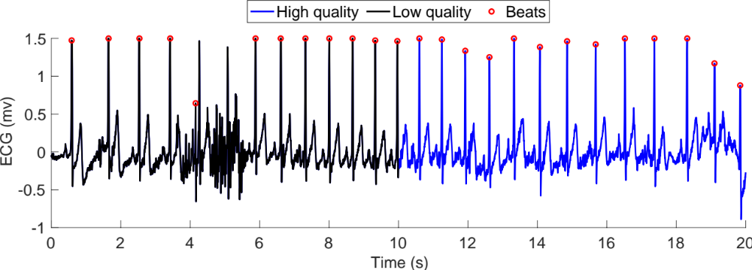
Inter-beat interval estimation from ECG
Two beat detection algorithms
For each 20 s period: deemed to be high quality if beat detectors agree
Charlton P.H. et al., Detecting beats in the photoplethysmogram: benchmarking open-source algorithms, Phys Meas, 2022: https://doi.org/10.1088/1361-6579/ac826d
Source: Charlton PH et al., Accelerometry-Guided Inter-Beat-Interval Assessment from Wrist Photoplethysmography, CinC 2023 [in press] (CC BY 4.0)

Slide 13
Results

Slide 14
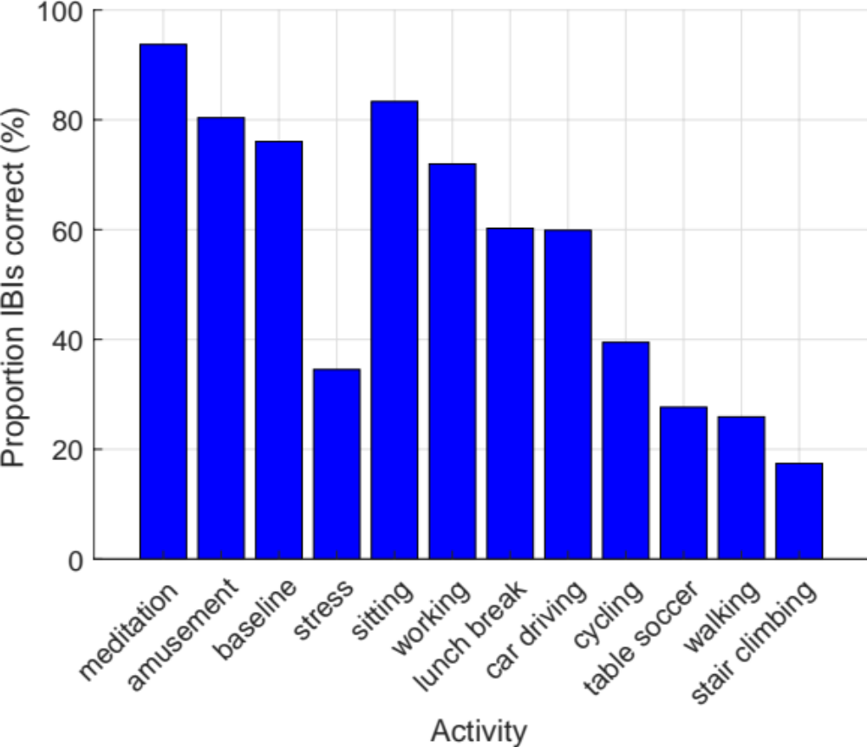
Dataset Characteristics
Source: Charlton PH et al., Accelerometry-Guided Inter-Beat-Interval Assessment from Wrist Photoplethysmography, CinC 2023 [in press] (CC BY 4.0)

Slide 15
Classification Performance
Dataset | Area under receiver operatory curve (AUROC) | Area under precision-recall curve (AUPRC)
Combined dataset | 0.78 | 0.82
Source: Charlton PH et al., Accelerometry-Guided Inter-Beat-Interval Assessment from Wrist Photoplethysmography, CinC 2023 [in press] (CC BY 4.0)

Slide 16
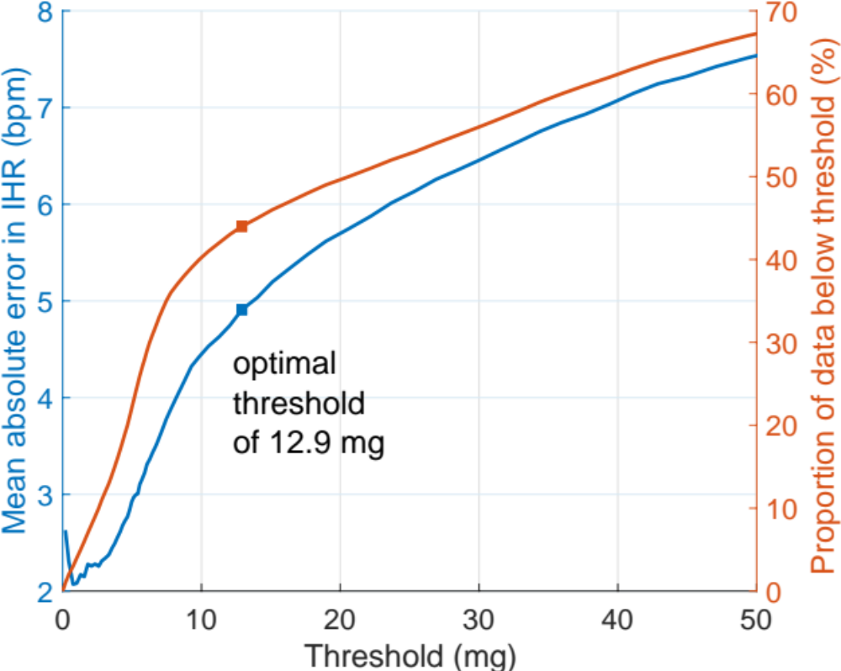
Identifying an Optimal Threshold
MAE < 5 bpm
Source: Charlton PH et al., Accelerometry-Guided Inter-Beat-Interval Assessment from Wrist Photoplethysmography, CinC 2023 [in press] (CC BY 4.0)

Slide 17
Identifying an Optimal Threshold
Activity | MAD, measured using ActiGraph at wrist (mg) Mean (standard error)
Sedentary behaviours: lying, sitting | 6.7 (0.5)
Standing still | 7.5 (1.1)
Washing pots | 100.2 (8.3)
Walking | 151.5 (6.2)
Threshold:
12.9 mg
AF Detection Study | Approach
Apple Heart Study | ”while participants were at rest”
FitBit Heart Study | “participants were stationary (as determined by device accelerometers)”
Source: Bakrania K et al., Intensity thresholds on raw acceleration data: Euclidean norm minus one (ENMO) and mean amplitude deviation (MAD) approaches, https://doi.org/10.1371/journal.pone.0164045 (CC BY 4.0)

Slide 18
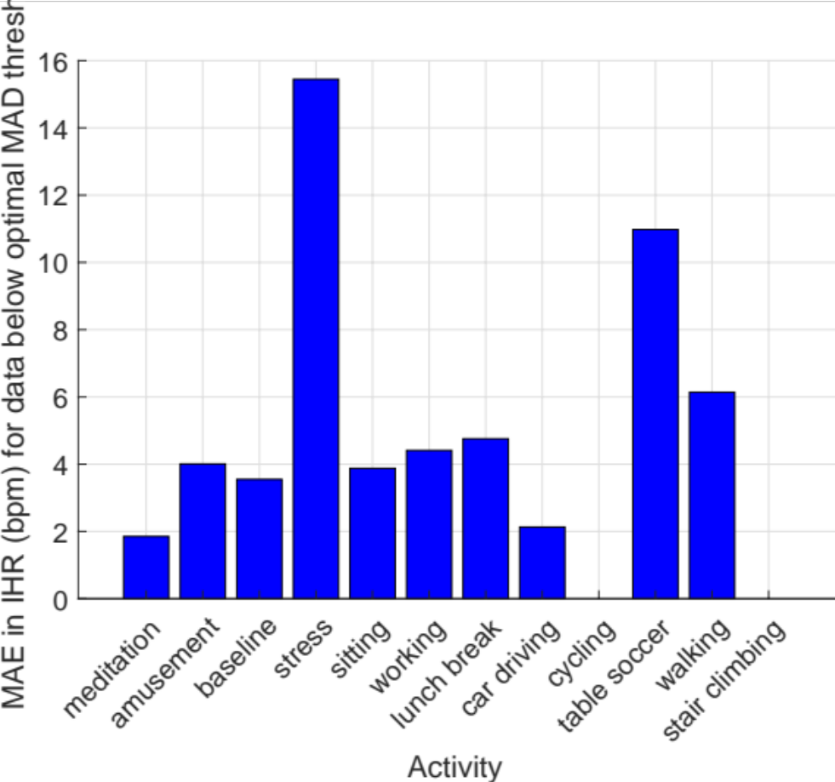
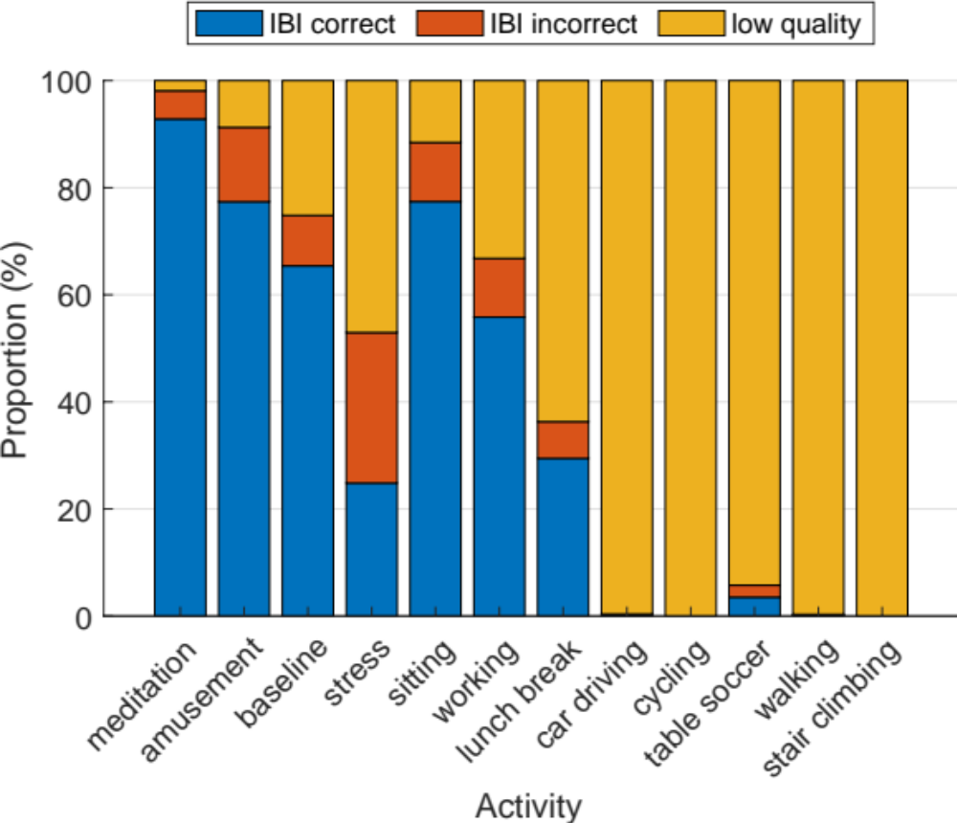
Performance for Different Activities
Accelerometry-based approach performed well during physical activities, but not during mental stress.
Source: Charlton PH et al., Accelerometry-Guided Inter-Beat-Interval Assessment from Wrist Photoplethysmography, CinC 2023 [in press] (CC BY 4.0)

Slide 19
Discussion

Slide 20
Why does it work (or not work)?
It works when noise is due to movement:
MAD:
357.6 mg
MAD:
3.9 mg
Source: Charlton PH et al., Accelerometry-Guided Inter-Beat-Interval Assessment from Wrist Photoplethysmography, CinC 2023 [in press] (CC BY 4.0)

Slide 21
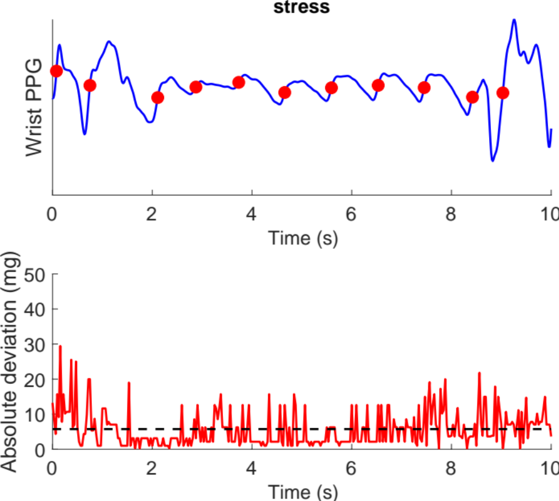
Why does it work (or not work)?
It does not work when noise is not associated with movement:
“Signal quality index (SQI) is generally used to evaluate signal quality, such as signal-to-noise ratio”
Park J et al., Photoplethysmogram Analysis and
Applications:An Integrative Review, 2022
“participants were stationary
(as determined by device accelerometers)”
Lubitz S et al., Detection of atrial fibrillation in a large population using wearable devices: The Fitbit Heart Study, 2022
MAD:
5.7 mg
Source: Charlton PH et al., Accelerometry-Guided Inter-Beat-Interval Assessment from Wrist Photoplethysmography, CinC 2023 [in press] (CC BY 4.0)

Slide 22
With thanks to…
Panicos Kyriacou
Jonathan Mant
Joachim Behar
Marton Aron Goda
University of Cambridge
Technion-IIT
British Heart Foundation
Notes:
... I’d like to thank you for listening, and [click] thank my colleagues …
for their valuable input and guidance as we’ve been developing our understanding of wearables, and my funder, the British Heart Foundation, without whom this work would not have been possible.
[click] I’m always pleased to hear from others – do feel free to get in touch.
… To conclude, [click] Consumer wearables now have a wide functionality [click] …

Slide 23

Accelerometry can be used to identify periods when IBIs can be accurately measured from PPG signals during physical activities with reasonable performance.
A threshold of 12.9 milli-gravitational units corresponds to a cutoff between sedentary and low-intensity activities.
Combining accelerometry and PPG-based assessments may provide improved performance compared to using either approach on its own.
Sonia Sevilla, https://commons.wikimedia.org/wiki/File:Kamar_Zard_Buzhan_-_Nishapur_1.jpg (CC0 1.0)
Notes:
To conclude,
[click] There is great opportunity to use photoplethysmography in public health
[click] Clinical applications are emerging, including detecting atrial fibrillation
[click] And, when used clinically, photoplethysmgoraphy should be like a climbing rope. [click] It should be highly reliable, validated, and used for specified purposes.

Slide 24
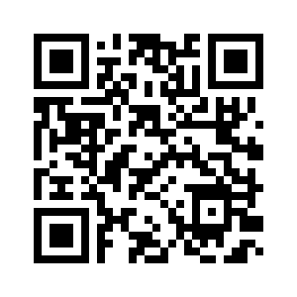
Accelerometry-Guided Inter-Beat-Interval Assessment from Wrist
Photoplethysmography
Dr Peter H. Charlton
https://peterhcharlton.github.io
pc657@cam.ac.uk
Slides available at:
https://doi.org/10.5281/zenodo.8403222
Peter Charlton, Wikimedia Commons, https://commons.wikimedia.org/wiki/File:Max_Health_Band.jpg (CC BY 4.0)
Notes:
Of course, you can’t do justice to the potential of photoplethysmography in just 15 minutes. For more information see my website, and [click] our review of wearable photoplethysmography for cardiovascular monitoring. Thanks for listening.

Slide 25
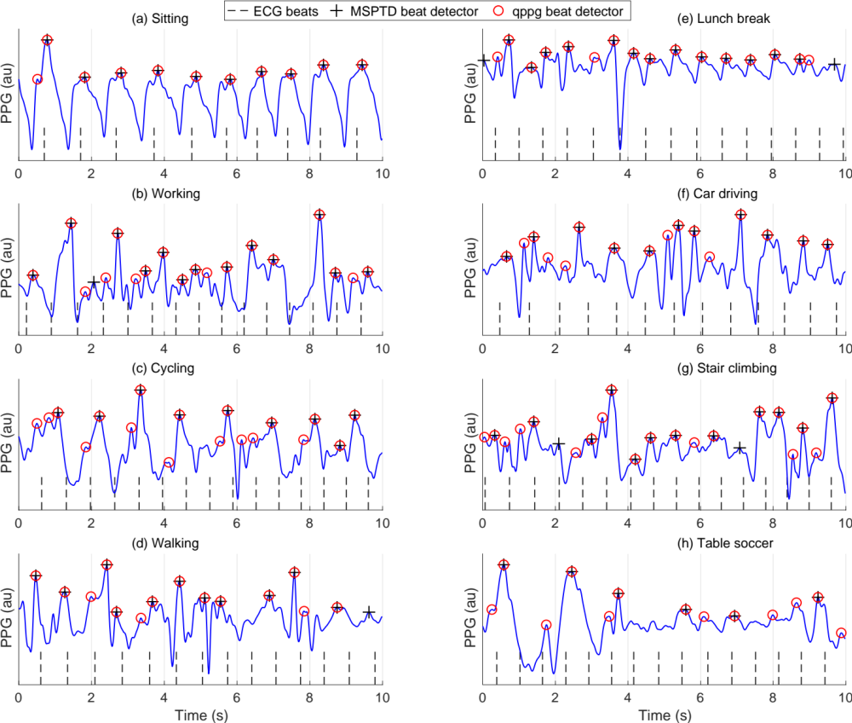
Charlton PH et al., Detecting beats in the photoplethysmogram: benchmarking open-source algorithms, Phys Meas., 2022. https://doi.org/10.1088/1361-6579/ac826d (CC BY 4.0)

