Slide 1

UNESCO Recommendation on Open Science

Slide 2

Lessons learned from COVID 19
Importance of timely and free access to scientific data, publications, information
Importance of science-policy-society dialogue
Importance of scientific collaborations and sharing of information at all levels
Importance of Open Science

Slide 3
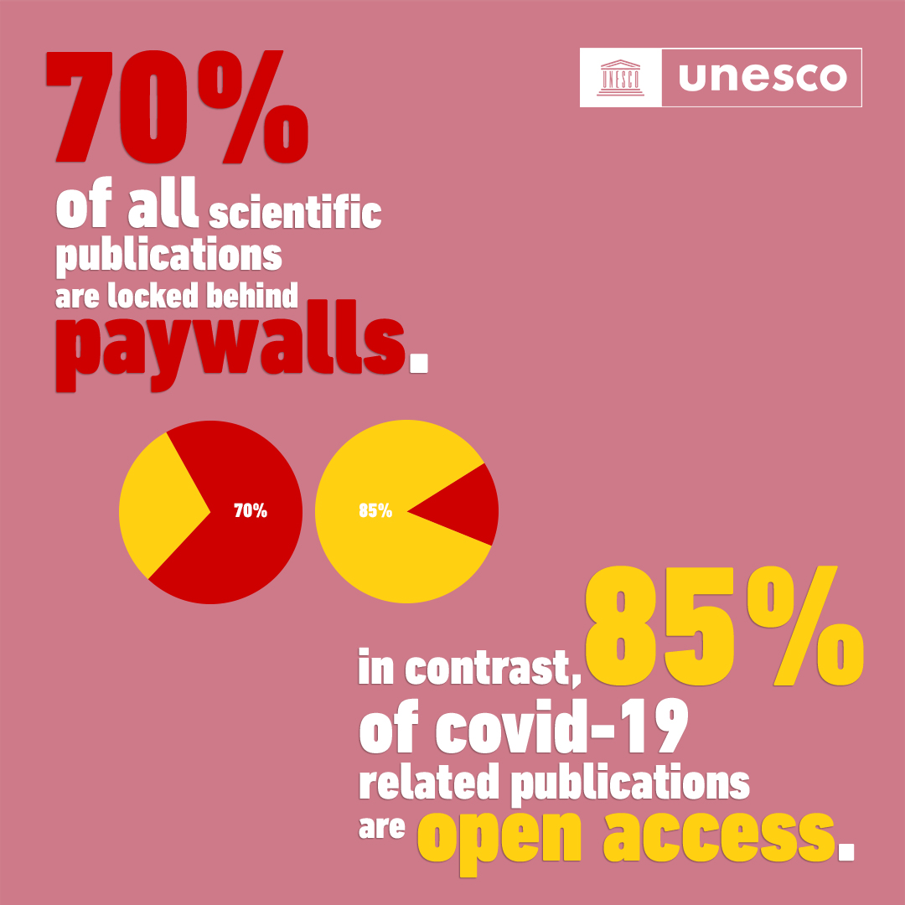
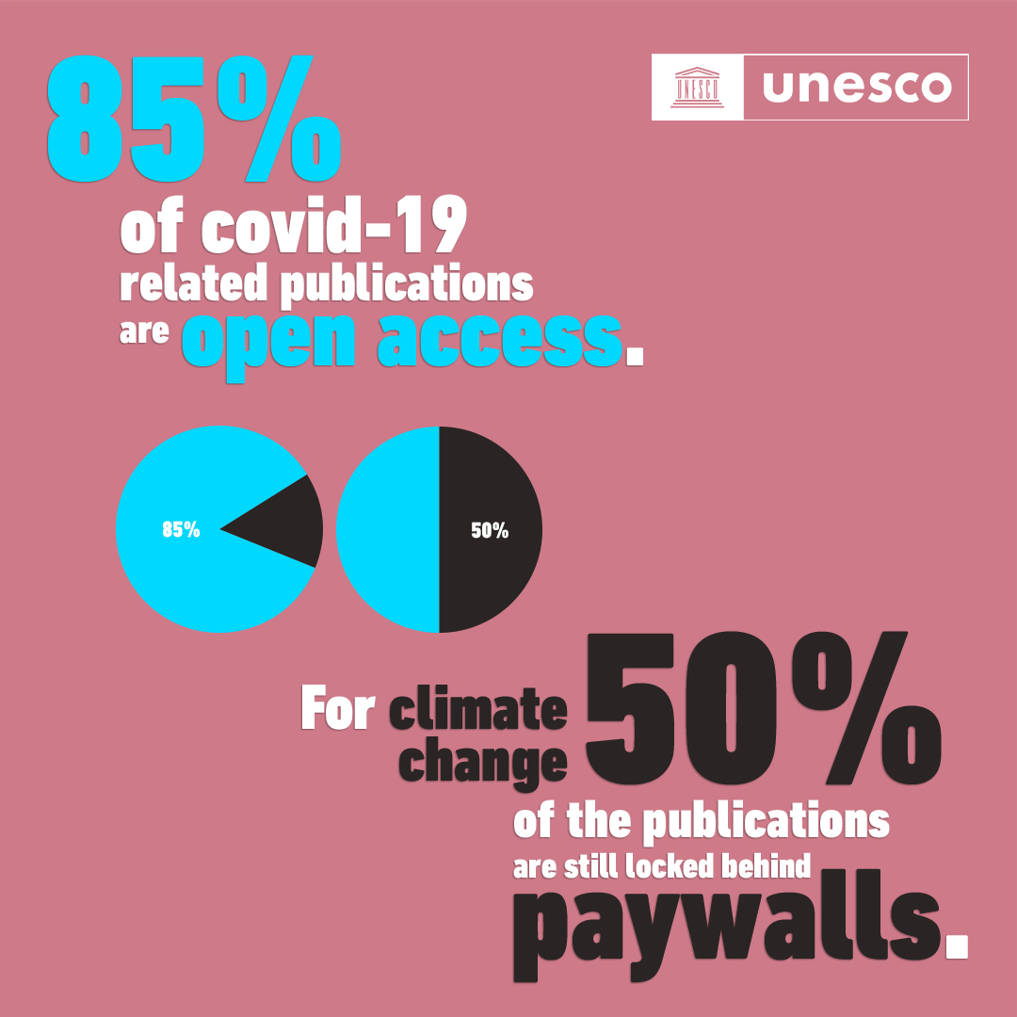
Opening access to knowledge
Source: Dimensions

Slide 4
Why Open Science?
Why Open Science? Open access and much more….
Efficiency, cost-effectiveness, reproducibility
Innovation, networking
Transparency & Impact
Why open science?
Collaboration, visibility, credit, purpose
Quality & integrity
Human rights
& equity
Economic benefits, access to resources
Better-informed decision making
Global goals & benefits
Public engagement & trust
Individual
Institutional
National
Regional
Global
Notes:
Reduced delays (in creation and application)
Open to scrutiny & reproduction
Open to new ideas
Available and applicable by all

Slide 5
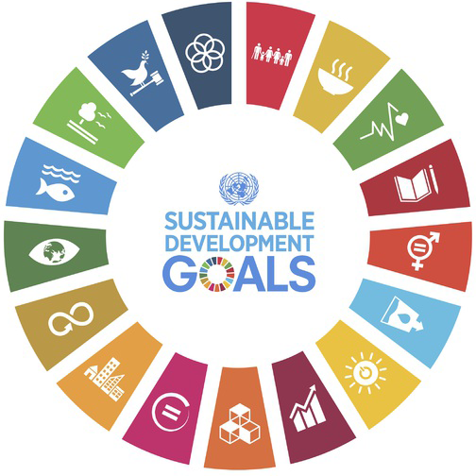

Science for the Global Goals
The achievement of sustainable development relays on STI and innovative solutions that require an efficient, transparent and vibrant scientific community not only stemming from scientists, but from the whole of society.
Need to democratize science and the entire scientific process and make it more efficient, equitable, transparent and inclusive to fulfill the Human Right to Science .
Need for Open Science

Slide 6
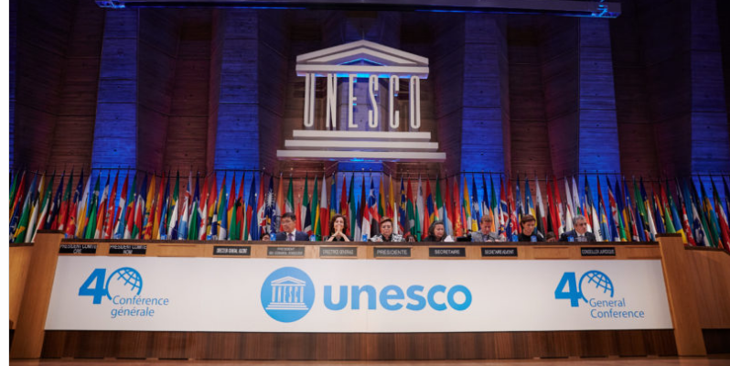
UNESCO Recommendation on Open Science
Need for an international policy and action framework
Need for a common definition of open science, shared set of values and principles
In 2019, at the UNESCO 40th General Conference, 193 Members States tasked UNESCO with the development of an international standard-setting instrument on Open Science in the form of a UNESCO Recommendation on Open Science.

Slide 7
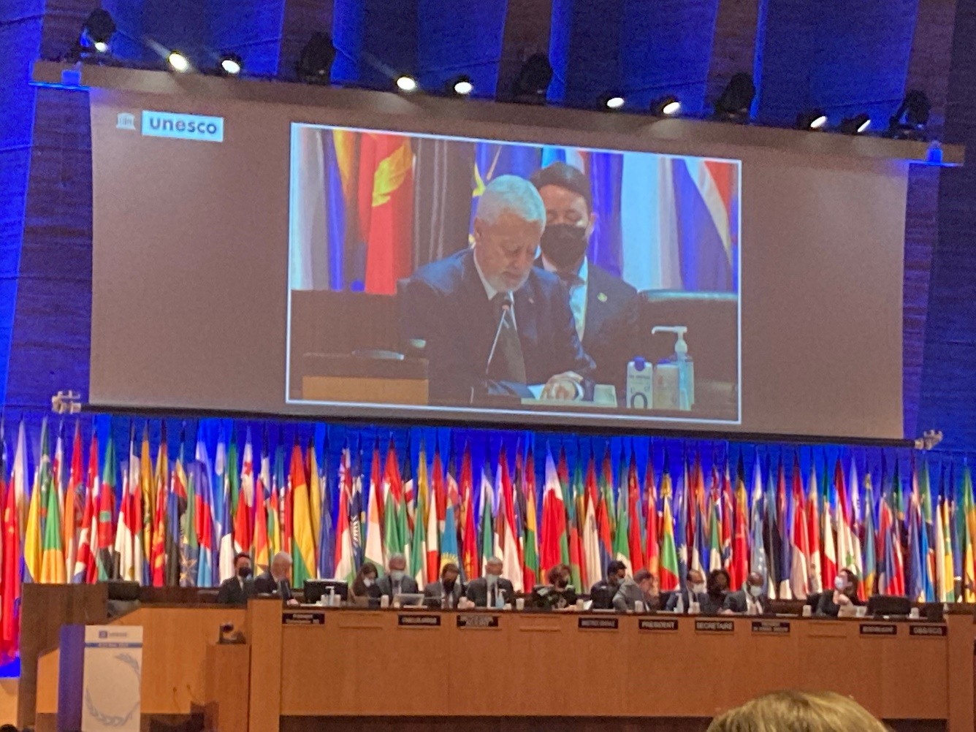
UNESCO Recommendation on Open Science
Text of the Recommendation developed through a broad consultative, inclusive, transparent multistakeholder two-year process
Adopted by 193 countries at the UNESCO General Conference on 23 November 2021

Slide 8
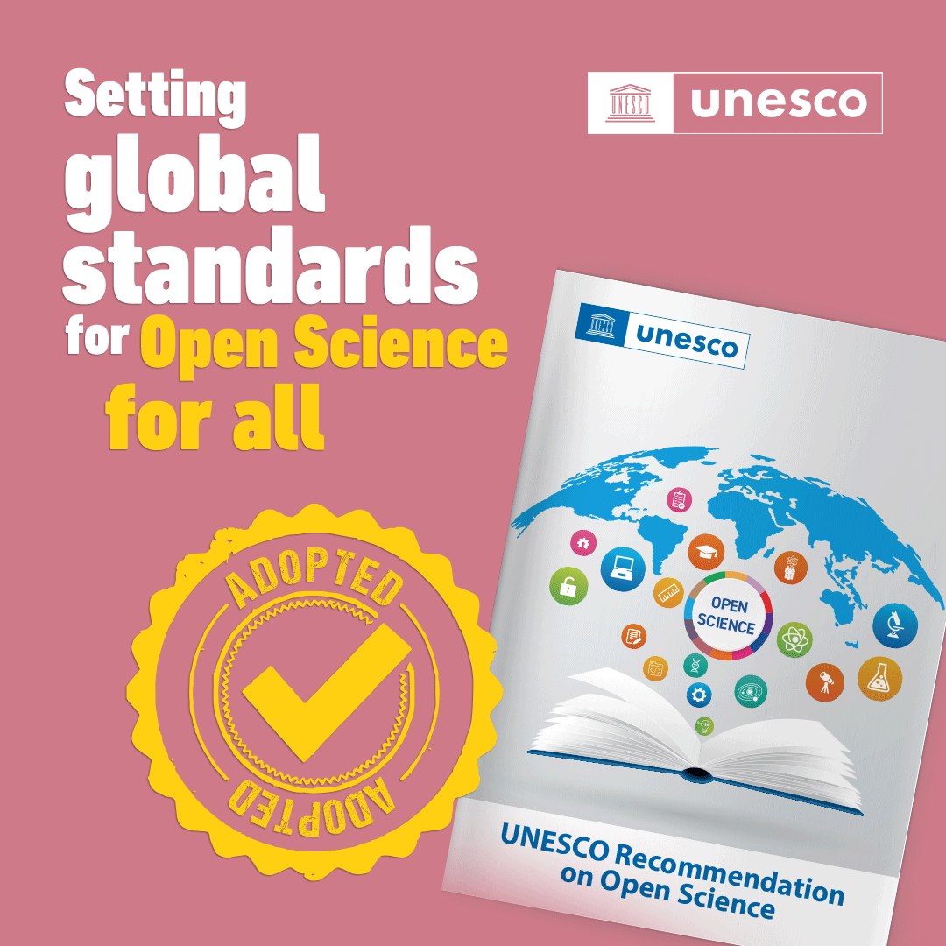
Highlights of the Recommendation
It is the first international normative instrument on Open Science;
it contains the first internationally agreed definition of Open Science;
it spells out the consensus core values and guiding principles of Open Science;
it addresses multiple actors and stakeholders of Open Science;
It recommends actions on different levels to operationalize the principles of Open Science;
it proposes innovative approaches for Open Science at different stages of the scientific cycle;
it calls for development of a comprehensive Open Science monitoring framework.

Slide 9
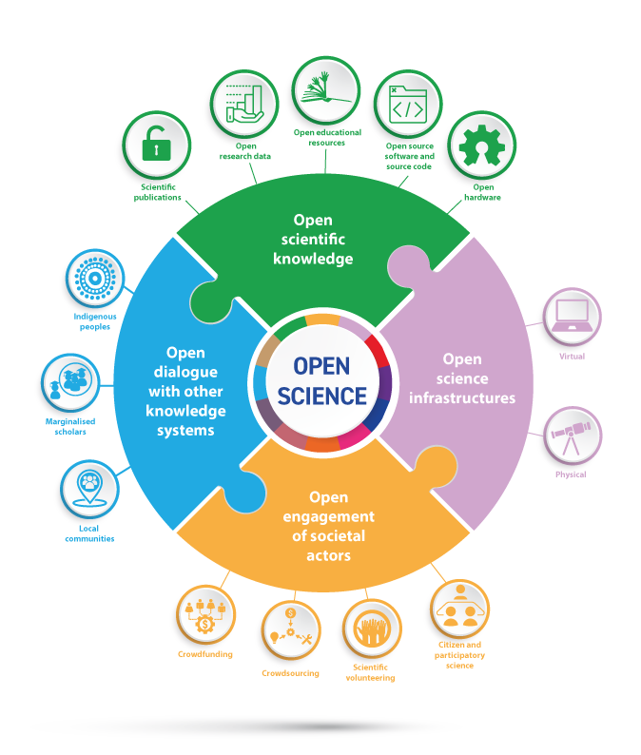
Definition of Open Science
Open Science:
makes scientific knowledge openly available, accessible and reusable for everyone,
increases scientific collaborations and sharing of information for the benefits of science and society,
opens the processes of scientific knowledge creation, evaluation and communication to societal actors beyond the traditional scientific community.
Notes:
The recommendation provides and inclusive definition of open science as a construct that combines various movements and practices aiming to make multilingual scientific knowledge openly available, accessible and reusable for everyone, to increase scientific collaborations and sharing of information for the benefits of science and society, and to open the processes of scientific knowledge creation, evaluation and communication to societal actors beyond the traditional scientific community…

Slide 10
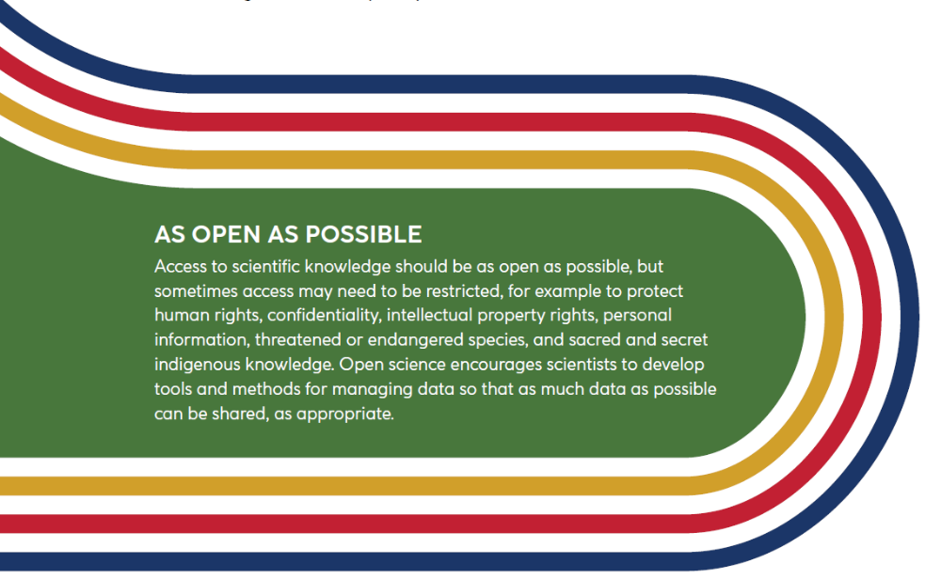
As open as possible and as closed as necessary

Slide 11
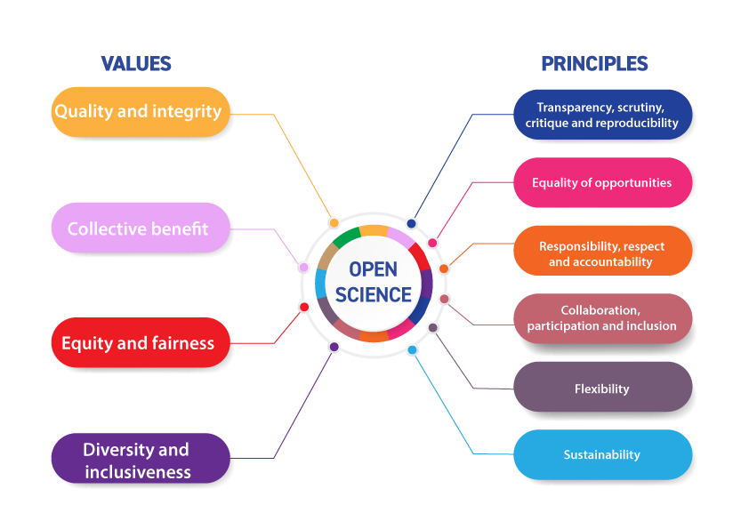
Open Science: Values and Principles

Slide 12
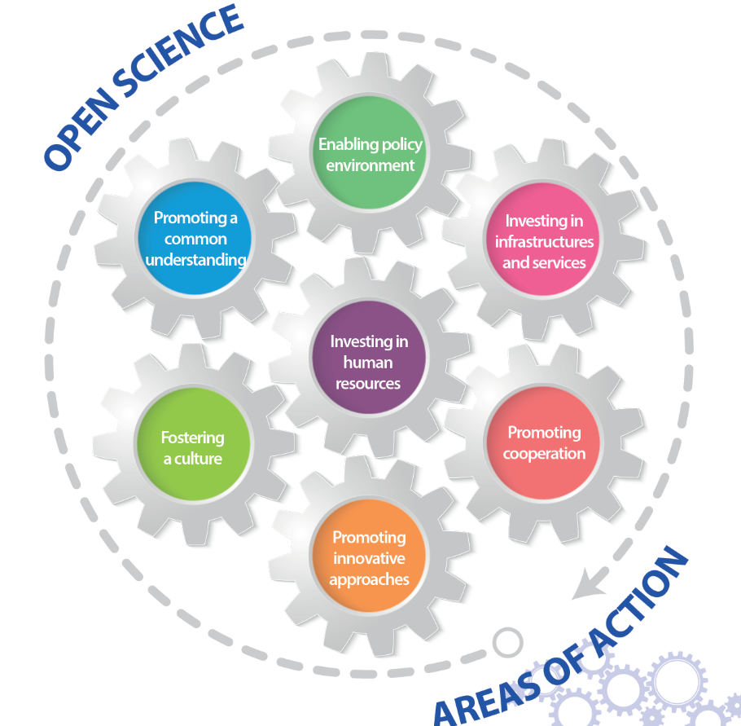
Key Objectives – Key Areas of Action
Member States are encouraged to prioritise seven areas in their implementation of the Recommendation:
Promoting a common understanding of OS and its associated benefits and challenges, as well as the diverse paths to OS
Developing an enabling policy environment for OS
Investing in infrastructure and services which contribute to OS
Investing in training, education, digital literacy and capacity-building, to enable researchers and other stakeholders to participate in OS
Fostering a culture of OS and aligning incentives for OS
Promoting innovative approaches to OS at different stages of the scientific process
Promoting international and multistakeholder co-operation in the context of OS with a view to reducing digital, technological and knowledge gaps.

Slide 13
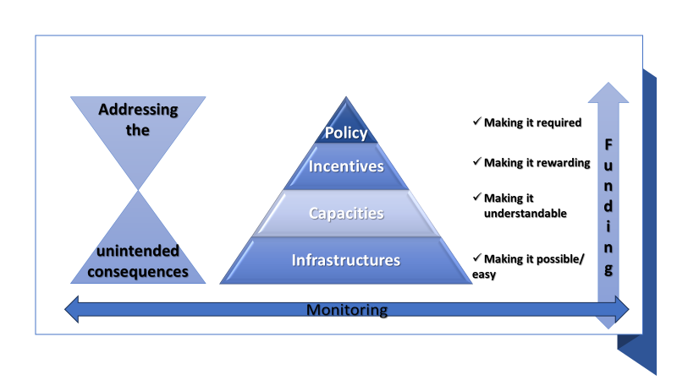
Cultural Change towards Open Science
Based on Centre for Open Science’s strategy for cultural change

Slide 14
Key challenges and high impact areas for the implementation of the UNESCO OSR
Change in the conventional scientific culture
Human and institutional capacity
Adequate infrastructures, including reliable internet connectivity
Alignment of incentives and revision of criteria for evaluation of scientific excellence and scientific careers
Addressing the unintended negative consequences of open science practices
CAPACITY BUILDING POLICIES FINANCING/INCENTIVES INFRASTRUCTURES MONITORING

Slide 15
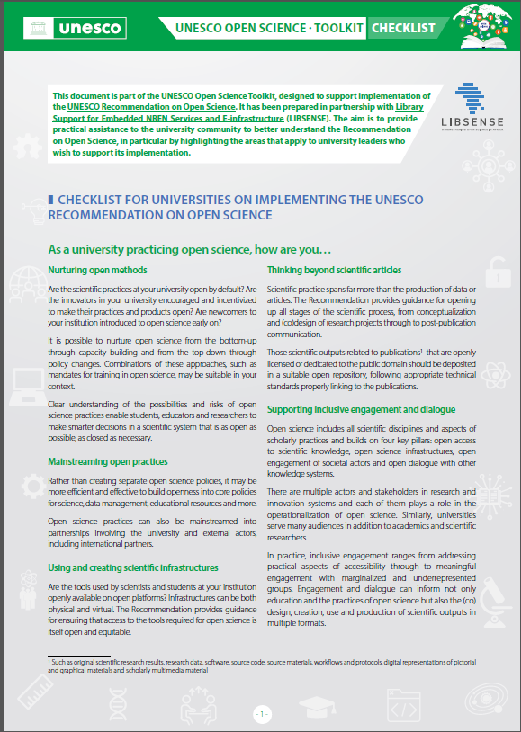
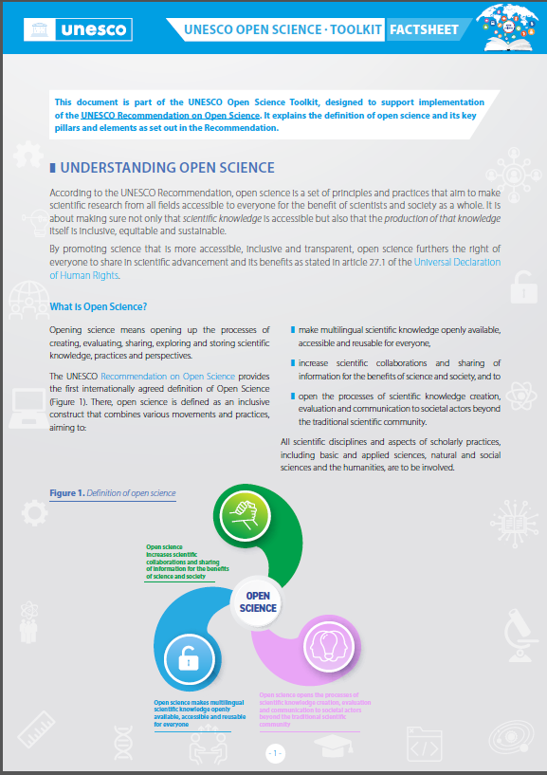
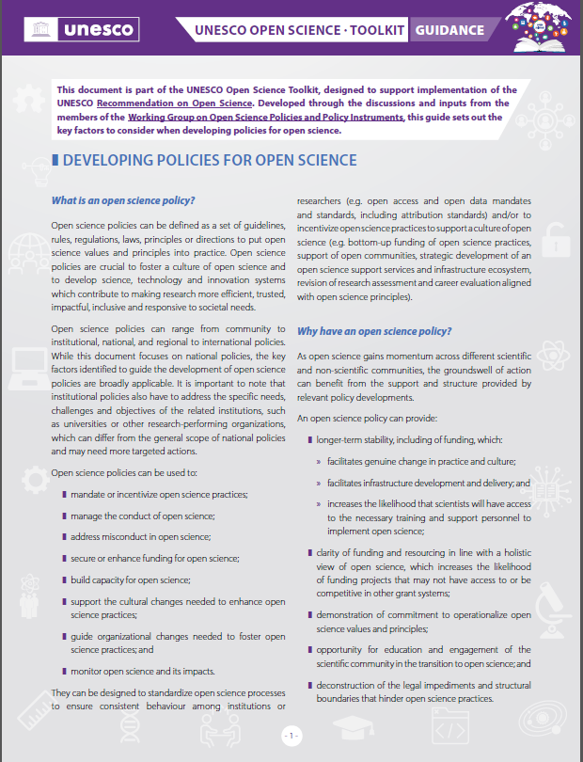
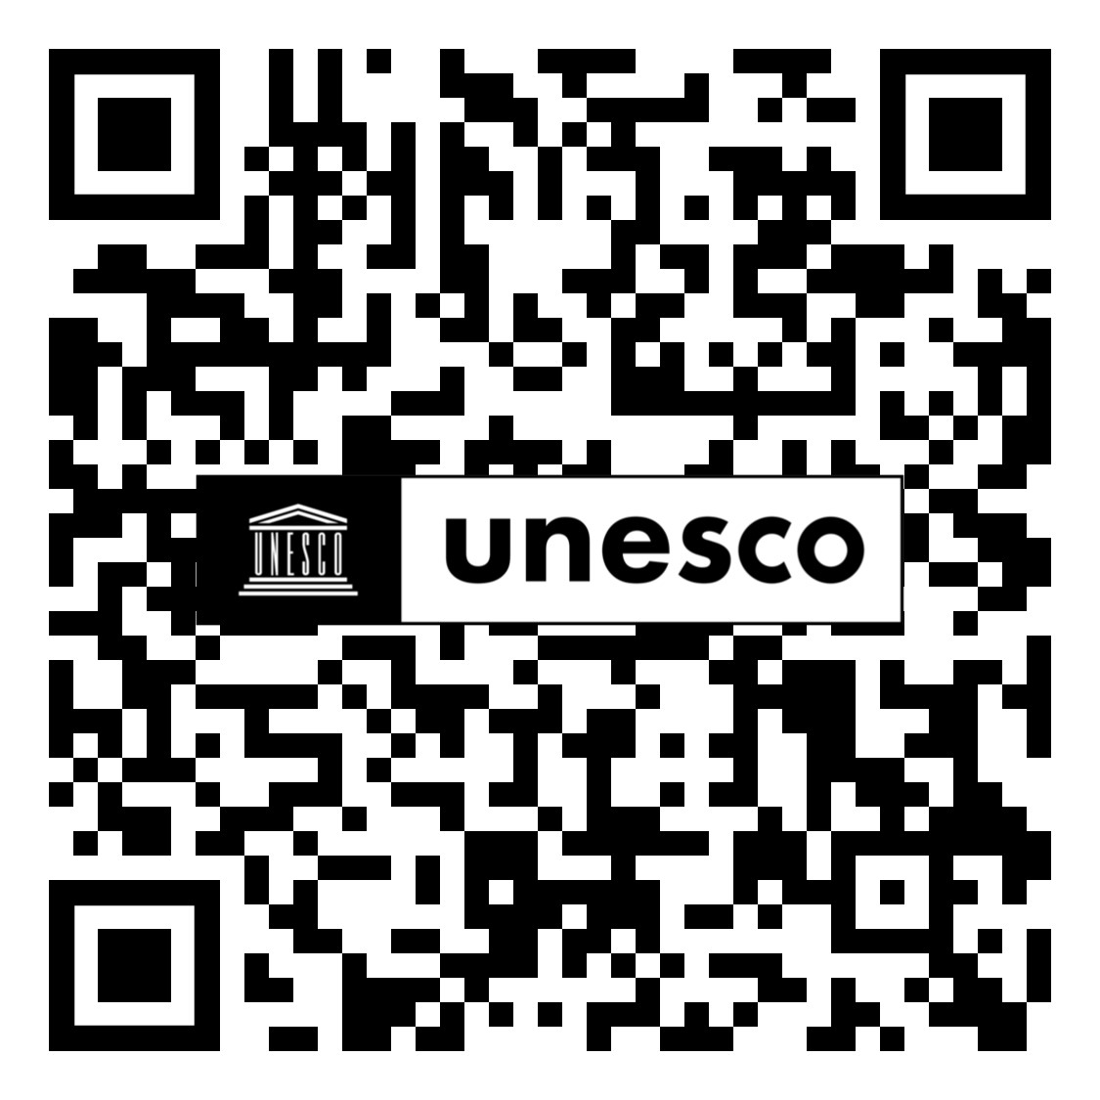
Open Science for Transformation
PROMOTING OPEN SCIENCE AS A KEY FRAMEWORK FOR TRANFORMATIVE INTERNATIONAL EQUITABLE SCIENTIFIC COOPERATION
https://www.unesco.org/en/open-science
UNESCO OPEN SCIENCE TOOLKIT: tools to address the key challenges in transitioning to open science:
understanding the open science paradigm shift/cultural change
building capacity for open science
developing policies for open science
funding and incentivizing open science
investing in infrastructure development
Upcoming UNESCO Open Science Outlook

Slide 16

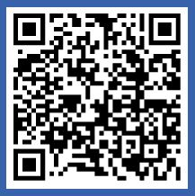
Join the Global Open Science Movement
Join the UNESCO Open Science Partnership!
Contribute to global open science calls !
Engage in the global discussions!
Be in touch!
UNESCO Open science website: https://on.unesco.org/openscience
Contact: openscience@unesco.org
Notes:
UNESCO assist Member

