Slide 1

Open source practices underpinning the SAFE-D principles
Kirstie Whitaker
Pronouns: she/her
@TuringWay @kirstie_j
https://doi.org/10.5281/zenodo.8381378
Notes:
Hi everyone, I’m delighted to follow David and Victoria. My name is Kirstie Whitaker and I’m the programme director for tools, practices and systems at the Alan Turing Institute and I’m also the chair of the TREx Panel that Victoria was just telling you about.
What I’m going to do in this final presentation is – I hope – help you to see how we in the open source community are already following practices that underpin the SAFE-D principles for responsible and ethical AI.
Let me start with a quote that really motivates why I care about open source so much….

Slide 2

“Sunlight is the best disinfectant”
@TuringWay @kirstie_j
https://doi.org/10.5281/zenodo.8381378
Louis Brandeis
https://en.wiktionary.org/wiki/sunlight_is_the_best_disinfectant
Notes:
Here’s the quote: Sunlight is the best disinfectant.
Another way of saying this is that which grows in darkness dies in the light. One of the biggest frustrations that we all have about AI workflows at the moment is how non-transparent their process are. Whether that’s a lack of computational transparency, or where the data came from, or decision making, or the labour related to training the models, I want to put to you that we would build a better, safer, more diverse AI ecosystem if we brought as much of that work and those processes into the open.

Slide 3
Open source practices already deliver safe and ethical AI*
Safety and sustainability
Accountability
Fairness
Explainability
Data stewardship
@TuringWay @kirstie_j
https://doi.org/10.5281/zenodo.8381378
Notes:
So: here’s my bold statement – open source practices already deliver safe and ethical AI!

Slide 4
Open source practices already deliver safe and ethical AI*
(*Depending on how you define open source!)
Safety and sustainability
Accountability
Fairness
Explainability
Data stewardship
@TuringWay @kirstie_j
https://doi.org/10.5281/zenodo.8381378
Notes:
Now that statement is pretty strongly dependent on how you define open source! And that’s why I’m delighted that the OSI is facilitating this Deep Dive and we’re all able to have these discussions as a global community.
Let me take you through the SAFE-D principles again: (read them out)

Slide 5
Open source practices already deliver safe and ethical AI*
(* Depending on how you define open source!)
Safety and sustainability
Accountability
Fairness
Explainability
Data stewardship
@TuringWay @kirstie_j
https://doi.org/10.5281/zenodo.8381378
Notes:
I’ll start with safety and sustainability

Slide 6

“Given enough eyeballs, all bugs are shallow”
@TuringWay @kirstie_j
https://doi.org/10.5281/zenodo.8381378
Eric Steven Raymond, The Cathedral and the Bazaar
Linus’ Law: https://en.wikipedia.org/wiki/Linus%27s_law
Notes:
The quote that I picked here is that given enough eyeballs all bugs are shallow and many of you will know that as Linus’ law that was codified in the cathedral and the bazaar by Eric Steven Raymond.
So this is a fundamental building block of FREE software that came before open source software. It's really been around from the very beginning that having as many people as possible participating in the creation of some tooling makes it easier to keep it safe and keep it moving forwards on track with the needs of the users and developers.

Slide 7
Open source practices already deliver safe and ethical AI*
(* Depending on how you define open source!)
Safety and sustainability
Accountability
Fairness
Explainability
Data stewardship
Having a broad and engaged community involved throughout an AI development workflow keeps infrastructure more secure and keeps the purpose of the work aligned with the needs of the impacted stakeholders.
@TuringWay @kirstie_j
https://doi.org/10.5281/zenodo.8381378
Notes:
So if we're thinking about building a definition of open source AI that is safe and sustainable I would say that we need to have a broad and engaged community involved throughout development workflow and that that will facilitate us in keeping the infrastructure more secure and keeping the purpose of the work aligned with the needs of the impacted stakeholders.
So maybe thinking a bit more broadly than just the users and the developers but actually making sure we’re considering the people who will be affected by the deployed AI model as well as those who are building it and using it.

Slide 8
Open source practices already deliver safe and ethical AI*
(* Depending on how you define open source!)
Safety and sustainability
Accountability
Fairness
Explainability
Data stewardship
@TuringWay @kirstie_j
https://doi.org/10.5281/zenodo.8381378
Notes:
Let me move on to accountability.

Slide 9
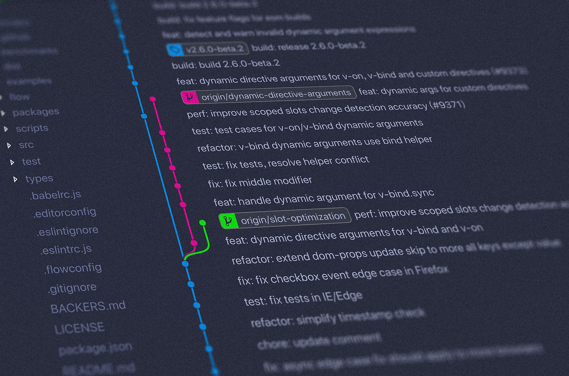
“Anyone could say anything…nothing was official. And to emphasize the point, I labelled the notes ‘Request for Comments.’”
@TuringWay @kirstie_j
https://doi.org/10.5281/zenodo.8381378
Stephen Crocker, Request For Comments (RFC's) History
https://www.livinginternet.com/i/ia_rfc_invent.htm
Notes:
So the quote that I've picked here is actually from a history of request for comments that came from ARPANET which was a precursor of the creation of the Internet that we know and love (??). And Steven Crocker has written about the fact that when they first started of thinking about how to build this sort of system of connections they wrote down some ideas and really tried to reinforce that anyone could say anything. Anyone could participate in the creation, in the design and there was really nothing that was already official. Nothing that was in the document was already decided. And so to emphasise the point he labelled the notes “request for comments”.

Slide 10
Open source practices already deliver safe and ethical AI*
(* Depending on how you define open source!)
Safety and sustainability
Accountability
Fairness
Explainability
Data stewardship
Providing documentation covering how decisions are made, how changes can be suggested through requests for comment, and how concerns can be raised – for example through codes of conduct – facilitates accountability through the AI development workflow.
@TuringWay @kirstie_j
https://doi.org/10.5281/zenodo.8381378
Notes:
And I would say one of the things that we notice that is missing in closed source AI is that there is no documentation covering how decisions are made, how changes could be suggested, how it could be adapted, how it could be improved, and also there are really very few pathways for how concerns can be raised.
So I think we already have some good solutions here: we have asynchronous participation in the development through GitHub / GitLab or other discussion fora, we have requests for comment as a way of capturing the specific technical decisions for changes as they are integrated, and I want to shout out to the really great work around codes of conduct for facilitating participation from a diverse group of people in building and sustaining open source tooling.

Slide 11
Open source practices already deliver safe and ethical AI*
(* Depending on how you define open source!)
Safety and sustainability
Accountability
Fairness
Explainability
Data stewardship
@TuringWay @kirstie_j
https://doi.org/10.5281/zenodo.8381378
Notes:
And actually that point about making sure that there are diverse stakeholders participating in the decision making in in the direction of a project takes me to considerations of fairness

Slide 12

“You don’t need a diversity committee if you have a diverse committee”
@TuringWay @kirstie_j
https://doi.org/10.5281/zenodo.8381378
Teon Brooks, https://teonbrooks.com
Notes:
So this quote you may not have heard you may have heard the sentiment but I want to shout out a friend of mine Tian brooks who is a data scientist and he was a Mozilla fellow for science with me back in 2016 and he made a great point and I always remember this very pithy quote from him that organisations teams don't need a diversity committee if you already have a diverse committee so we're really building a vision of a world where you don't need EDI initiatives because we have already succeeded at embedding inclusion and having diversity and equity across the accountability and across the decision making landscape we are to be clear we are not there yet so we still do need those diversity committees, but we will build a safer and more ethical open source AI ecosystem if we have as much diverse representation at all levels of decision making as possible!

Slide 13
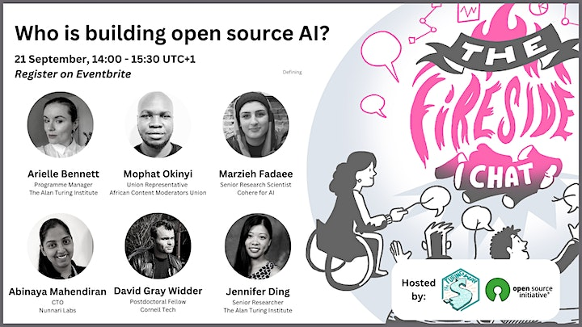
@TuringWay @kirstie_j
https://doi.org/10.5281/zenodo.8381378
Teon Brooks, https://teonbrooks.com
Notes:
And before I go on I want to quickly shout out another OSI Deep Dive webinar that members of my team hosted for The Turing Way project on the people building open source AI where they dig into this point really beautifully. I’m particularly proud to have Mophat representing the African content moderators union because those voices are the most marginalised in our current AI development work flow.
Please do check out that event in this series.

Slide 14
Open source practices already deliver safe and ethical AI*
(* Depending on how you define open source!)
Safety and sustainability
Accountability
Fairness
Explainability
Data stewardship
Open source AI should clearly communicate how the AI model and workflow are considering equity and justice. The open source AI community can embed existing tools for bias reporting into an interoperable open source AI ecosystem.
@TuringWay @kirstie_j
https://doi.org/10.5281/zenodo.8381378
Notes:
Let me go back to what I think having a diverse committee means for thinking about building a definition of open source AI. I think open source AI should clearly communicate how the AI model and the development workflow are considering equity and justice.
The open source AI community can embed existing tools for bias reporting into an interoperable open source AI ecosystem. So we can take those tools that already exist but maybe aren't used by the people building open source AI pipelines. If we are thinking interoperably, if we were thinking collaboratively, if we're thinking about building in solidarity with each other, then we can make sure that diverse perspectives are represented at leadership levels or at strategy defining levels and we can support each other in the re-usability of tools or processes to be applied to the specific AI workflows that are being developed.
This isn’t to say that we can outsource fairness to a statistical solution. But it does mean we can stand on each others’ shoulders and scale the knowledge and expertise that already exists in assessing the inequalities that are perpetuated by current AI workflows. By working together we can really make progress in dismantling and deconstructing the biases that are already baked in to our systems.

Slide 15
Open source practices already deliver safe and ethical AI*
(* Depending on how you define open source!)
Safety and sustainability
Accountability
Fairness
Explainability
Data stewardship
@TuringWay @kirstie_j
https://doi.org/10.5281/zenodo.8381378
Notes:
So interoperabilities brings me to explainability.

Slide 16

“The actual scholarship is the complete software development environment and the complete set of instructions which generated the figures.”
@TuringWay @kirstie_j
https://doi.org/10.5281/zenodo.8381378
Buckheit & Donoho
https://statweb.stanford.edu/~wavelab/Wavelab_850/wavelab.pdf
Notes:
The quote I’ve chosen here appears in so many talks about open science or open source software for science that probably someone somewhere is going to have to drink to the end of their beverage on this slide! Take a shot of espresso now ;)
“An article about computational science in a scientific publication is not the scholarship itself, it is merely advertising of the scholarship. The actual scholarship is the complete software development environment and the complete set of instructions which generated the figures.”

Slide 17
Open source practices already deliver safe and ethical AI*
(* Depending on how you define open source!)
Safety and sustainability
Accountability
Fairness
Explainability
Data stewardship
The ability to interrogate all aspects of a workflow is the foundation of the definition of open source: access to the source code, data, and documentation. Current open source ways of working will enhance transparency and explainability across the AI ecosystem.
@TuringWay @kirstie_j
https://doi.org/10.5281/zenodo.8381378
Notes:
TIMING: 18 Semi pathway into open source came from open science came from thinking about reproducibility and importantly the lack of reproducibility that exists across lots of different areas of computational science and the ability to interrogate all aspects of a workflow is one of the great deep foundations of the definition of open source you have to have access to the source code the data the documentation and I want to sort of highlight here how the current open source ways of working will enhance transparency and therefore enable explain ability across an AI ecosystem if we are not transparent it is very very difficult to hit explain ability. And if we can't reproduce our own work or have somebody else be able to repeat the work it is also very very hard to be reliable and therefore the uncertainty is passed through to explain ability if we don't know what the model is going to do from one moment to a next it's very difficult to be able to explain to people how they will be affected by the model

Slide 18
Open source practices already deliver safe and ethical AI*
(* Depending on how you define open source!)
Safety and sustainability
Accountability
Fairness
Explainability
Data stewardship
@TuringWay @kirstie_j
https://doi.org/10.5281/zenodo.8381378
Notes:
So my last bullet point here is around data stewardship

Slide 19

“Digital assets should be findable, accessible, interoperable, and reusable”
@TuringWay @kirstie_j
https://doi.org/10.5281/zenodo.8381378
Wilkinson, et al; The FAIR Guiding Principles for scientific data management
and stewardship. https://doi.org/10.1038/sdata.2016.18
Notes:
This is a huge huge area and what I want to shout out here are the fair guiding principles for scientific data management and stewardship these were published in 2016 and they've been adopted lots of different areas they've had lots and lots of engagement from the library scientists from people who are thinking about archiving thinking about ontologies in cuba interoperability and it's just a pretty obvious coat quote but digital assets should be

Slide 20
Open source practices already deliver safe and ethical AI*
(* Depending on how you define open source!)
Safety and sustainability
Accountability
Fairness
Explainability
Data stewardship
Metadata standards allow for interoperability even where data can not be made openly available. Documentation, accountability, and transparency around how data is gathered and used are the building blocks of open source AI.
@TuringWay @kirstie_j
https://doi.org/10.5281/zenodo.8381378
Notes:
One of the areas where I think the open source community hasn't necessarily engaged really deeply is around data stewardship. And that's often because the data itself is either fully publicly available - which may or may not be an ethical decision - or the data is closed and therefore not open and therefore open source developers don't engage with its management.
I want to highlight here that metadata standards allow for interoperability and transparency even where data cannot be made openly available. It's rare that the metadata cannot be made openly available in an ethical manner usually it is only kept confidential for the purposes of maintaining a commercially competitive edge and therefore I don’t think that fits into an open source AI definition. There are a couple of examples relating to where data is being used for defence and security purposes, potentially being used to track terrorism or to track bad actors online, but in the vast majority of cases we can share what data is being used even if the actual numbers in the data set aren't made openly available.
We can think about the accountability, the fairness, the explainability of how that data was created and governed, as a way to interrogate what we have going in to an AI development pipeline. Our goal is not to have garbage in and therefore garbage out! Actually we want to have high quality ethically managed and well curated data going in to the open source AI workflow and that will lead us to a much more effective and efficient and just output from the model itself.

Slide 21

Stop
Start
Continue
@TuringWay @kirstie_j
https://doi.org/10.5281/zenodo.8381378
Notes:
So I’ve reached the end of my presentation and I want to just leave you with a few thoughts about what we as an open source community need to stop, start and continue doing.

Slide 22
Stop
Start
Continue
Thinking of ourselves as separate, disconnected, individual people and projects.
Avoiding responsibilities around data governance, and crediting the people who are affected by the tools or models we build.
Building in accountability for decisions across an AI development workflow.
Explicitly connecting data processing responsibilities with bias mitigation reporting frameworks through the tools we build.
Working transparently.
Building diverse communities.
Documenting governance decisions.
Supporting maintenance and infrastructure work.
Scaling access to knowledge worldwide.
@TuringWay @kirstie_j
https://doi.org/10.5281/zenodo.8381378

Slide 23
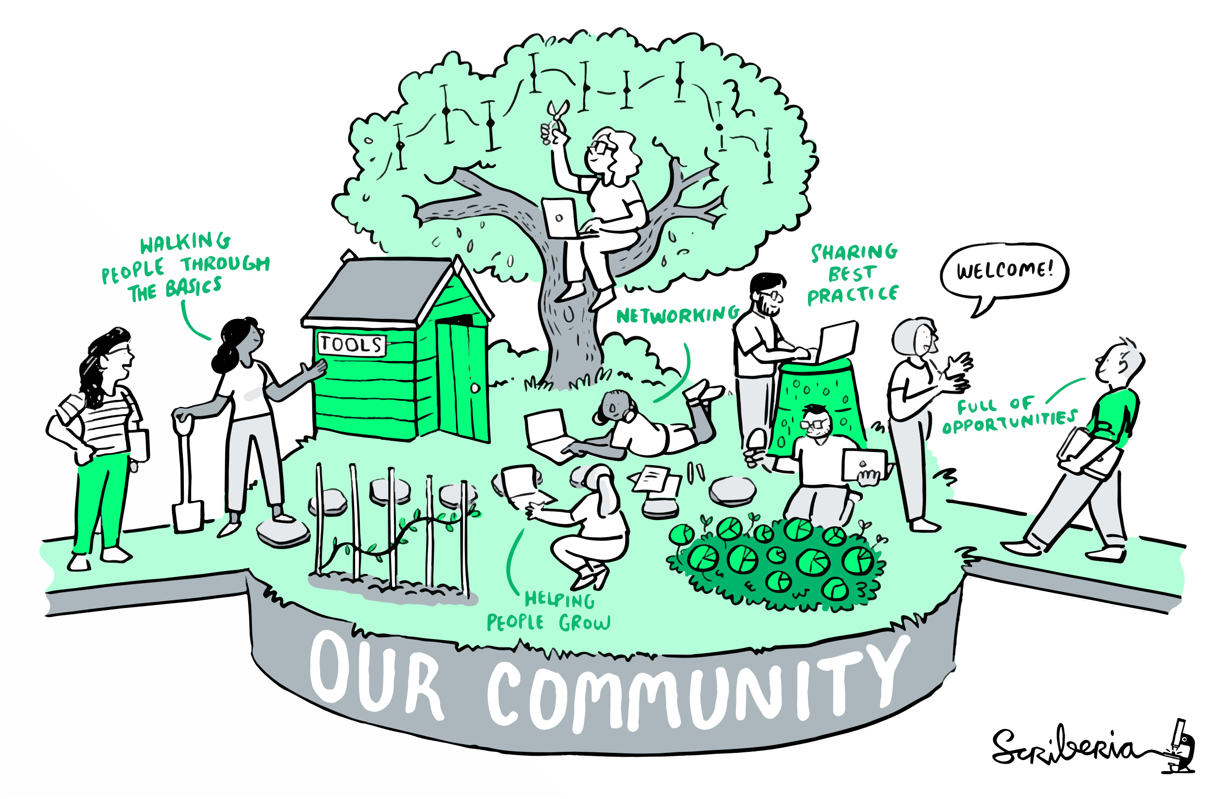
@TuringWay @kirstie_j
https://doi.org/10.5281/zenodo.8381378
https://the-turing-way.netlify.com
Notes:
TIMING: 10

Slide 24
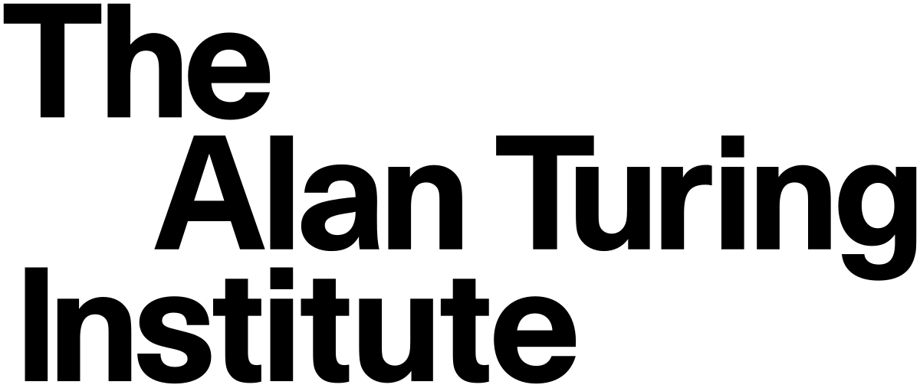

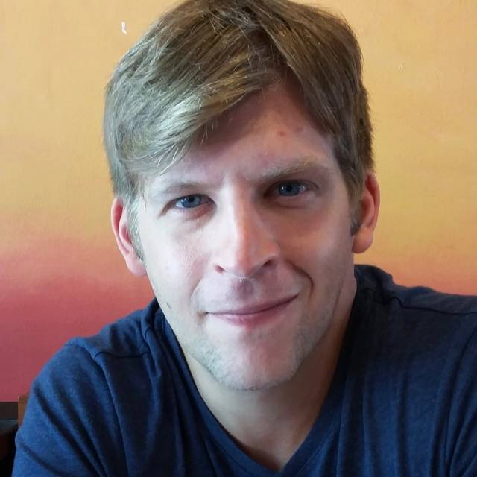

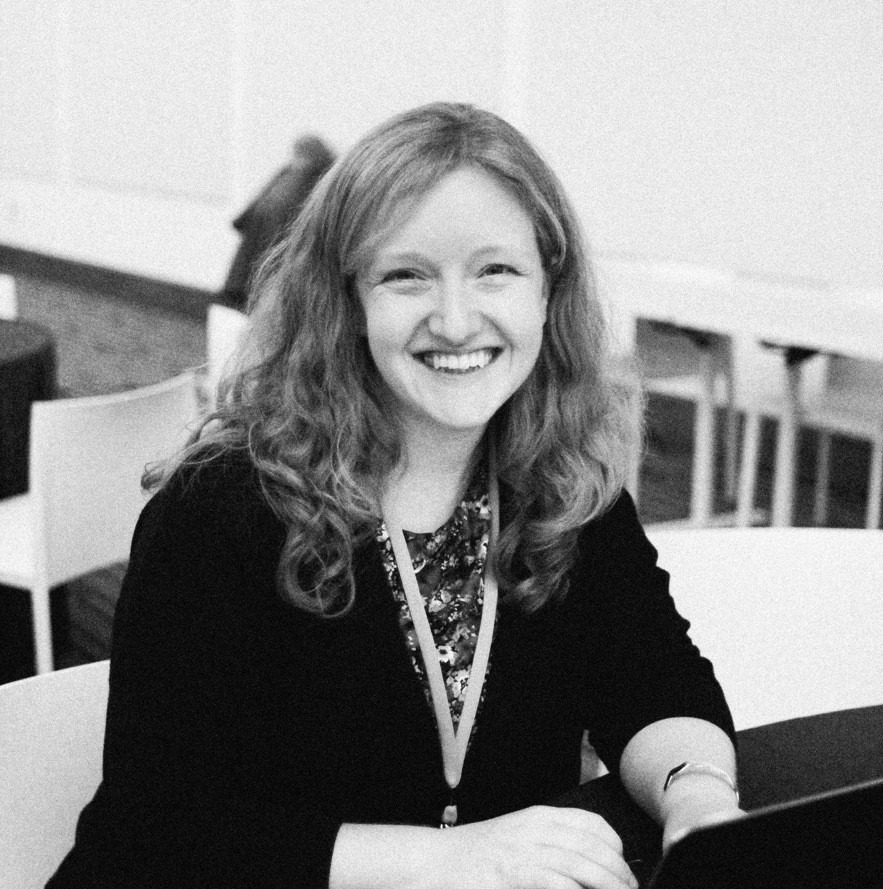

Prof David Leslie
Director of Ethics and Responsible Research and Innovation
Operationalising the SAFE-D principles for Open Source AI
Victoria Kwan
Corporate Governance Research Ethics Manager
Dr Kirstie Whitaker
Director of Tools, Practices and Systems Research Programme
Notes:
TIMING: 18

