Slide 1



Upper respiratory tract microbiota of dairy calves experimentally challenged with BRSV
Stephanie. O’Donoghue^{1, 2}, Bernadette Earley¹, Matthew S. McCabe¹, Dayle Johnston¹, Kerrie Ní Dhufaigh¹, Sarah L. Cosby³ , Derek W. Morris² and Sinead M. Waters¹
¹Teagasc Animal and Bioscience Research Department, Grange, Co. Meath, Ireland
²Discipline of Biochemistry, University of Galway, Galway, Ireland
³Veterinary Sciences Division, Agri-Food and Biosciences Institute, Stormont, Belfast, Northern Ireland
EAAP Annual Meeting, Lyon
30th August 2023

Slide 2
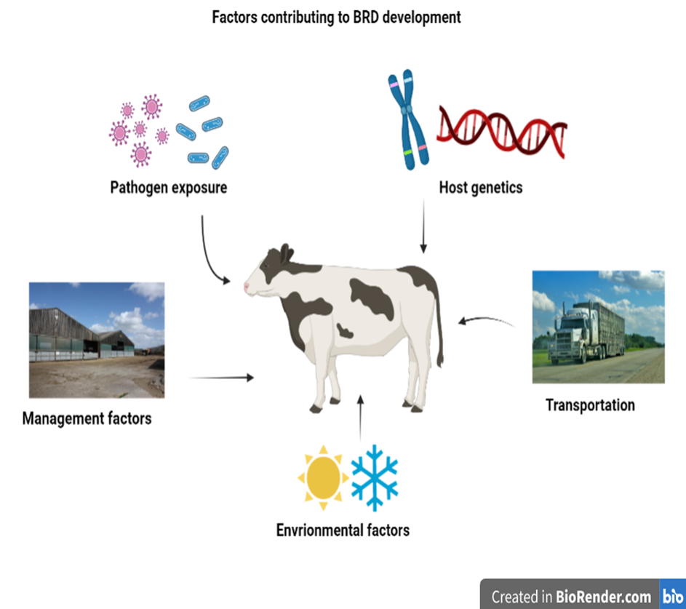
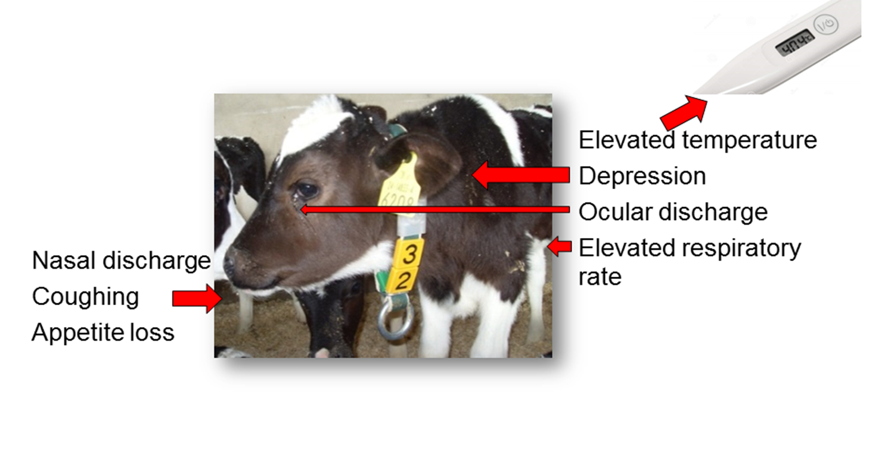
HoloRuminant WP3.2 – Bovine Respiratory Disease Complex
Major health and welfare issue in Irish and international cattle industries.
Responsible for 33.4% mortality in calves (both dairy and beef) aged between 1 and 5 months (DAFM, 2021)
Costs range from approx. €49 – €95 per infected animal
Multifactorial disease
Impacts cattle of all ages – younger calves most vulnerable
Diagnosis largely centred on clinical signs

Slide 3
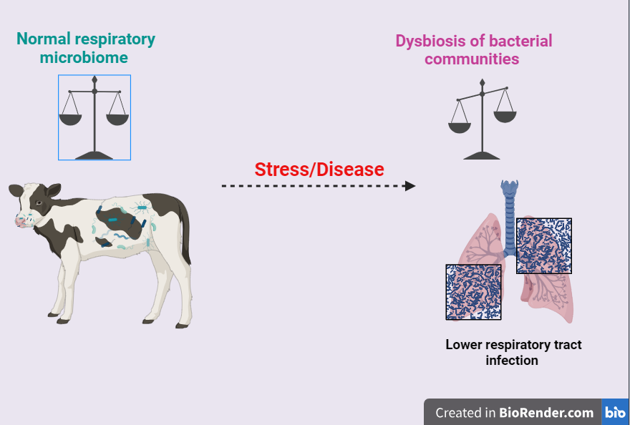
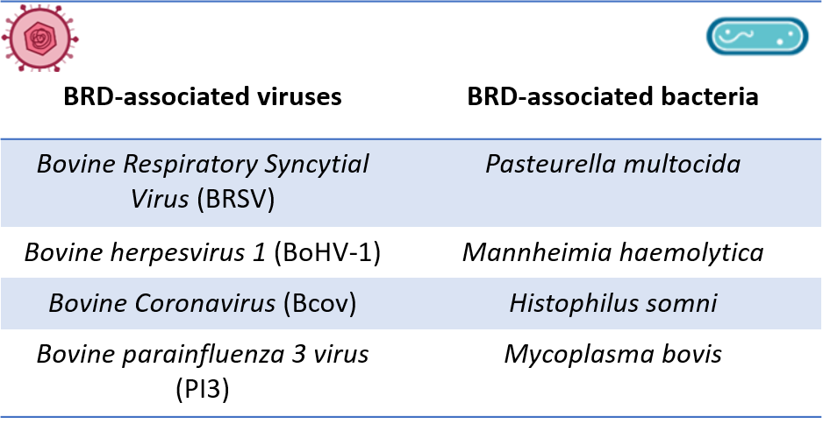
HoloRuminant WP3.2 – BRD pathogens and respiratory micrbiome
Both viral and bacterial pathogens responsible for BRD onset
Initial viral infections can lead to secondary bacterial infections
BRD bacteria can be commensals in URT
Stress/illness can compromise immune system and cause an imbalance in natural communities present

Slide 4
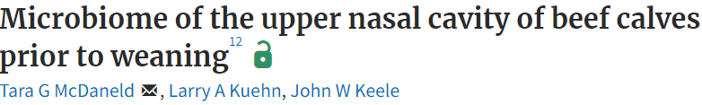
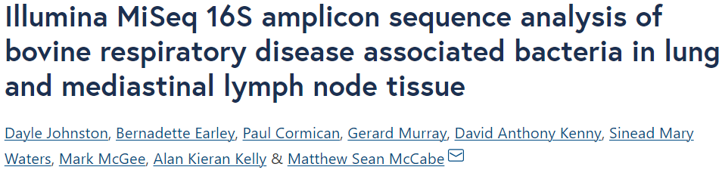
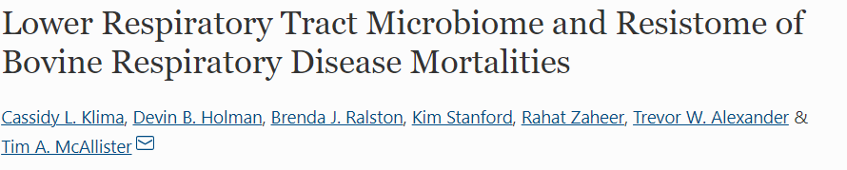
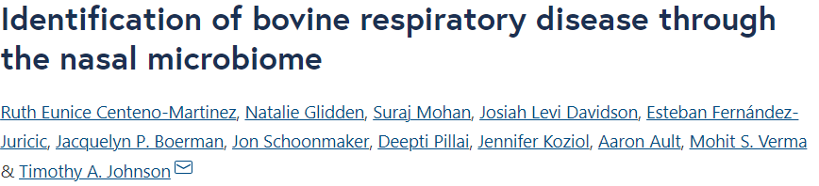
HoloRuminant WP3.2 – Study rationale
Studies to date:
2016
Bacterial microbiota over the course of a known viral infection
?
2017
2019
2022

Slide 5
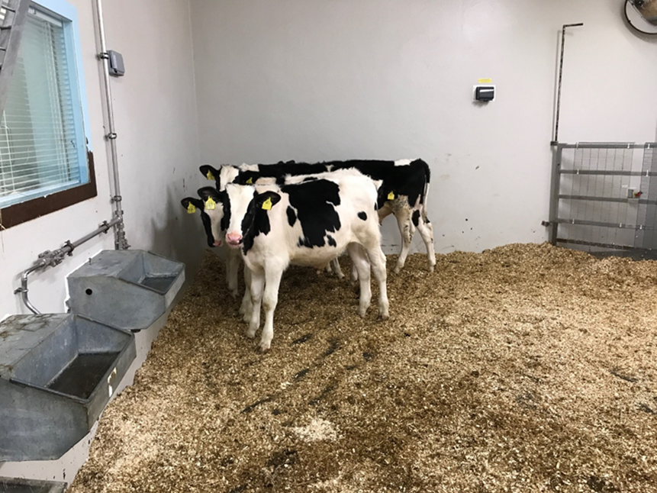
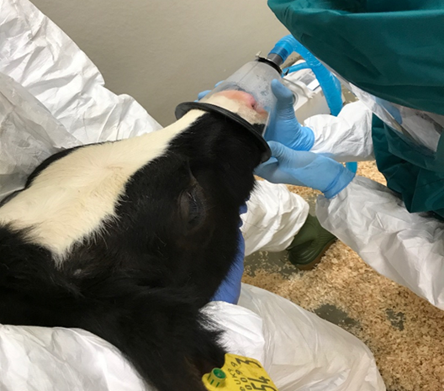
HoloRuminant WP3.2 – Animal model
18 Holstein-Friesian bull calves selected from a pool of 30 animals based on low maternally derived antibodies (MDA) and negative BRSV PCR status.
Two treatment groups:
1. Mock challenged with sterile PBS (n=6)
2. Challenged (n=12) with BRSV(10^{3.5} TCID₅₀/ml × 15 ml)
Clinical signs recorded daily (day (d) 0 to 7)
Nasal swabs collected each day
Euthanised on d 7 post-challenge

Slide 6
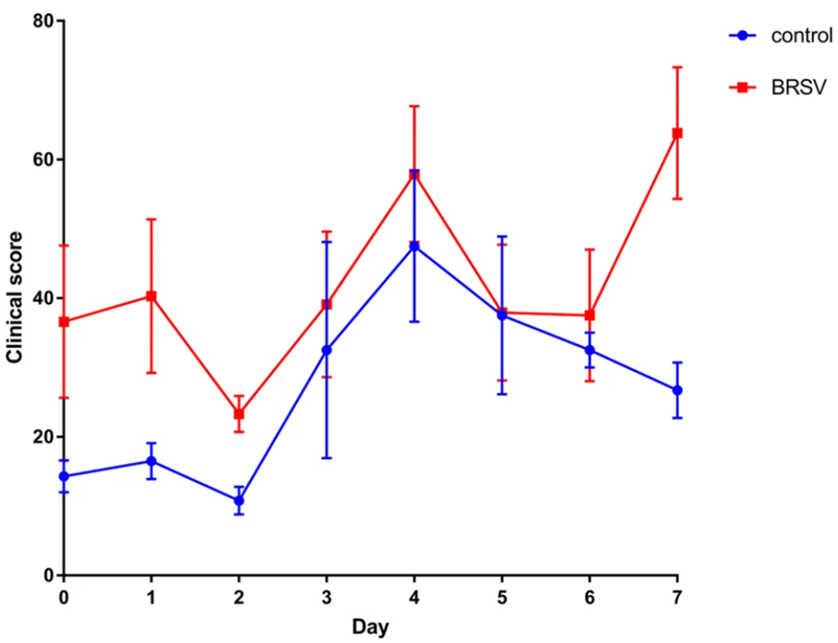
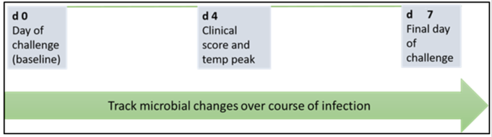
HoloRuminant WP3.2 – Time-point selection
(Johnston et al., 2019)
Time-Point A = d 0
Time-Point B = d 4
Time-Point C = d 7

Slide 7
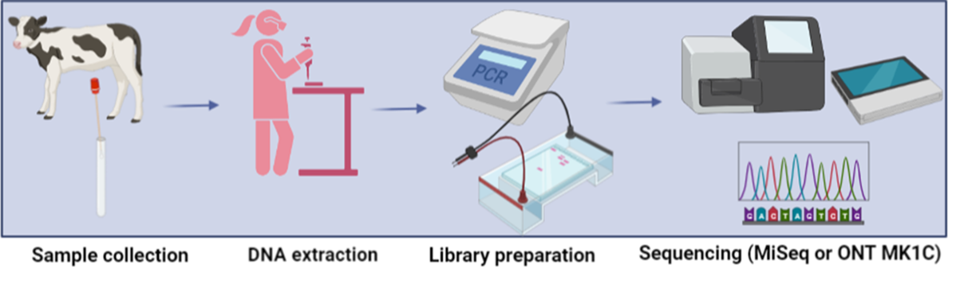
HoloRuminant WP3.2 – DNA extraction and 16S sequencing
DNA from nasal swabs extracted using DNeasy Powerlyzer PowerSoil kit
Sequencing libraries prepared using the Oxford Nanopore Technologies (ONT) 16S Barcoding kit (SQK16S024)
Libraries quantified and quality assessed on the Nanodrop Spectrophotometer
Pooled libraries were sequenced on a ONT MinION MK1C device on a MinION flow cell (9.4 chemistry)
Raw FASTQ reads uploaded to the EPI2ME platform and analysed with the Fastq 16S pipeline (v2022.01.07)

Slide 8
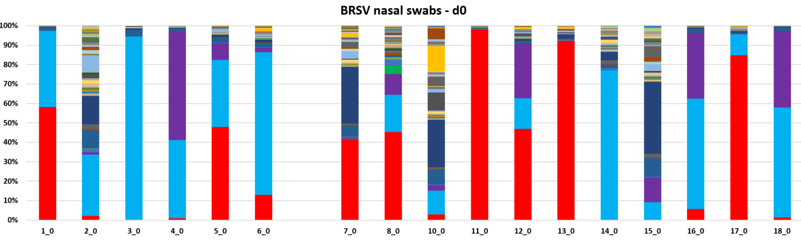
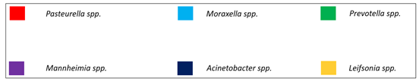
HoloRuminant WP3.2 – Results: Time-point A
Controls
Challenged
No significance difference in any genus between treatments at TP A (P < 0.05, FDR < 0.05)

Slide 9
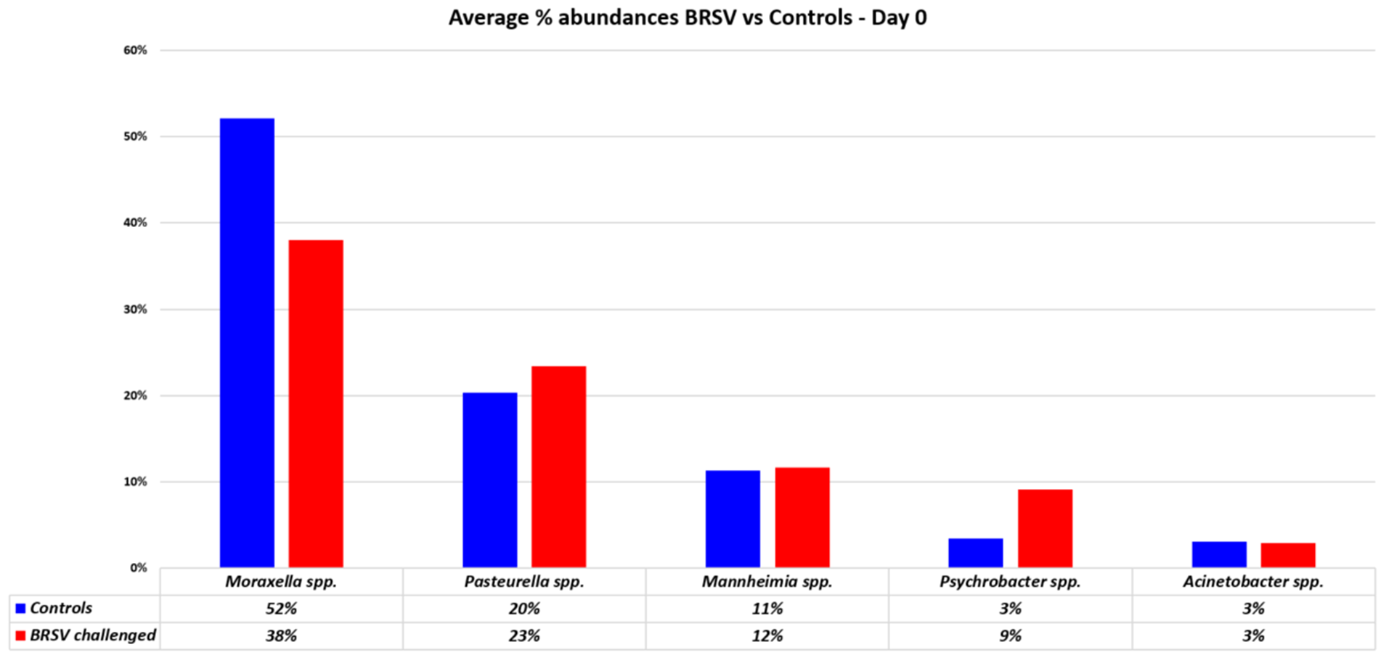
HoloRuminant WP3.2 – Results: Time-point A

Slide 10
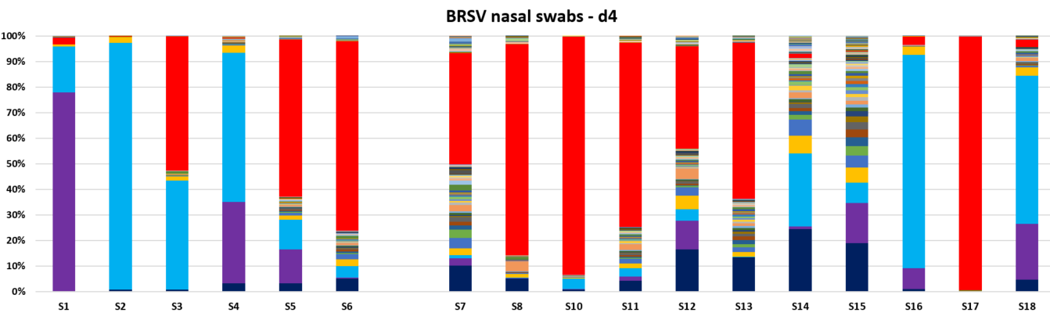
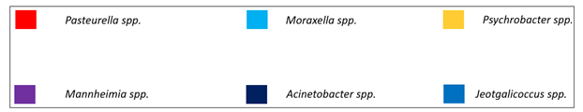
HoloRuminant WP3.2 – Results: Time-point B
Controls
Challenged
No significance difference in any genus between treatments at TP B (P < 0.05, FDR < 0.05)

Slide 11
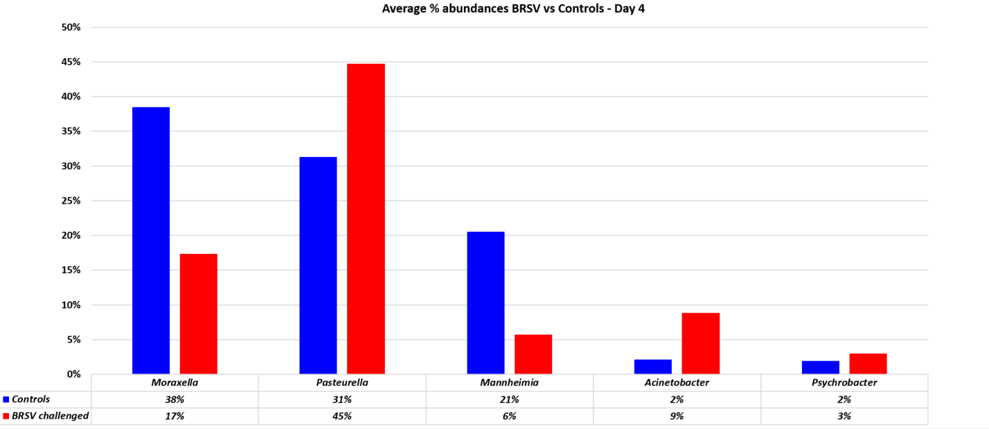
HoloRuminant WP3.2 – Results: Time-point B

Slide 12
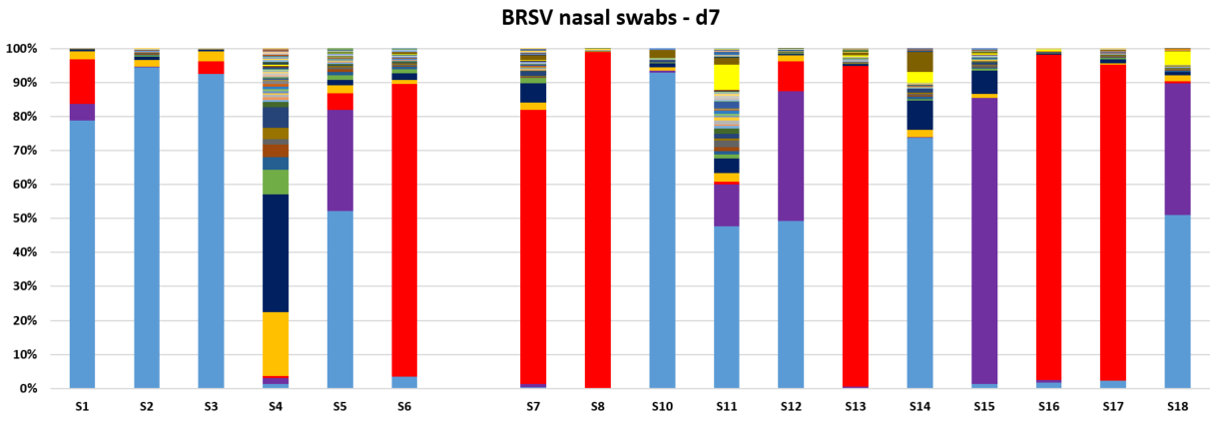
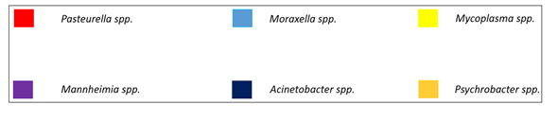
HoloRuminant WP3.2 – Results: Time-point C
Controls
Challenged
No significance difference in any genus between treatments at TP C (P < 0.05, FDR < 0.05)

Slide 13
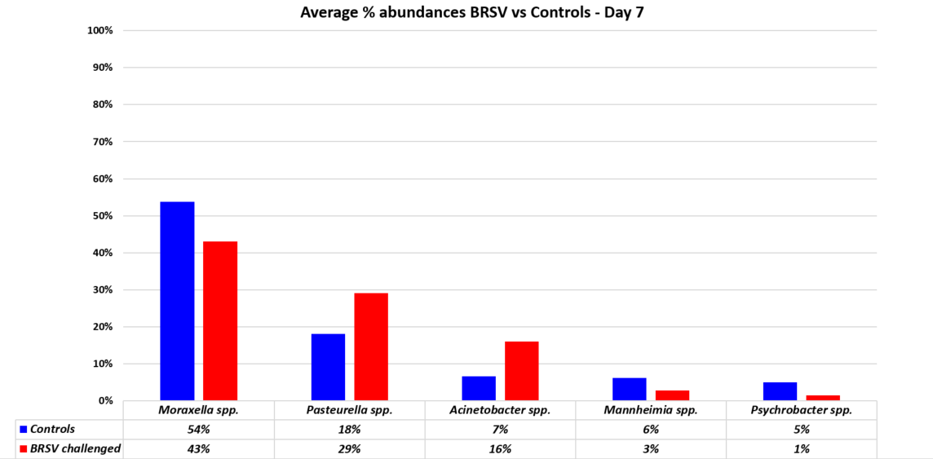
HoloRuminant WP3.2 – Results: Time-point C

Slide 14
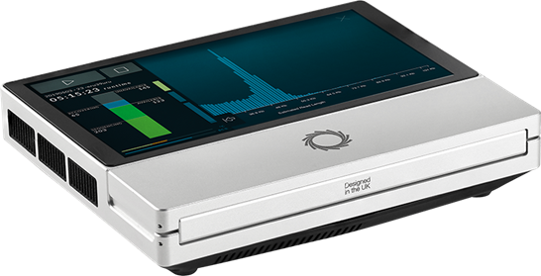

HoloRuminant WP3.2 – Conclusions
Characterised the bacterial nasal microbiome of BRSV infected calves
Top genera identified across all animals include Pasteurella, Moraxella and Mannheimia spp.
BRSV infection seems to alter the bacterial microbiome of the URT in infected calves
Potential for the use of the MinION device as an ‘pen-side’ laboratory testing tool

Slide 15







HoloRuminant WP3.2 – Acknowledgements
Prof Sinéad Waters
Dr Bernadette Earley
Dr Derek Morris
Dr Matthew McCabe
EU Horizons 2020
Grant No. 101000213

Slide 16
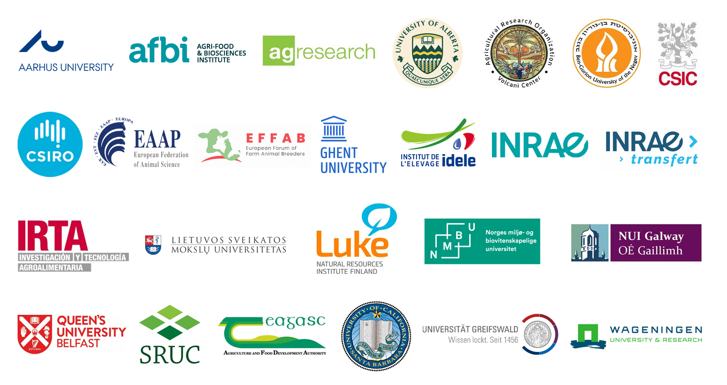
HoloRuminant PARTNERS
Thank you for your attention
www.holoruminant.eu

