Slide 1

UNDERSTANDING AND IMPLEMENTING PREMIS
A 90 minute introduction
Karin Bredenberg
Kommunalförbundet Sydarkivera
Eld Zierau
Royal Danish Library
Micky Lindlar
TIB – Leibniz Information
Centre for Science and Technology

Slide 2
Purpose of the Tutorial
Introduce PREMIS
Set a baseline of common understanding
Introduce you to the PREMIS community

Slide 3
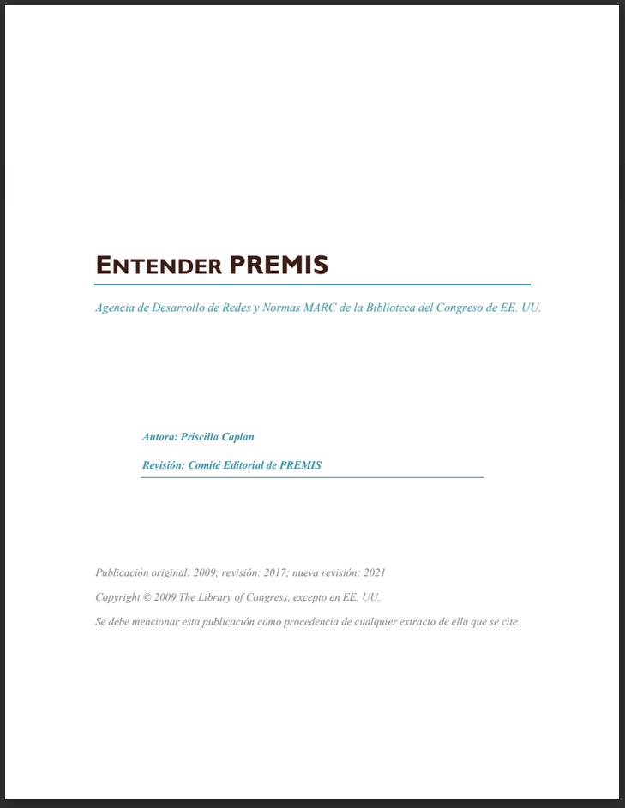
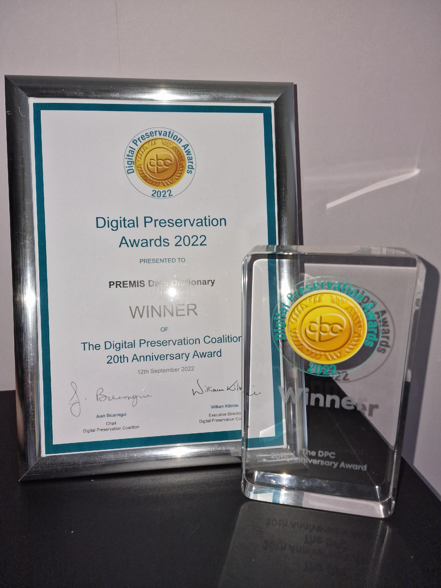
Understanding PREMIS – Entender PREMIS
https://www.loc.gov/standards/premis/understandingPREMIS_spanish_2021.pdf

Slide 4


Who are we?
From the PREMIS Editorial Committee:
Karin
Eld
Micky
We know that this might be true today:
You have just started to know PREMIS
The PREMIS data model is a bit scary
You might have been using PREMIS in practice
You come from
  a library
  an archive
  a university
  or something different

Slide 5

What do we want you to think about?
Think about your use case!
  I want to use PREMIS …???
Example: I’m digitising a number of publications made at my institution and I need to preserve these for the future and making sure they are accessible 50 years from now.

Slide 6
Agenda
 | Introduction to PREMIS
 | Welcome Background (brief history and rationale) On-line presence Benefits of implementing PREMIS
 | Implementation
 | Outline of the main entities and the data model Your use cases
 | Implementation and case studies
 | Data Dictionary PREMIS Conformance & interoperability
 | Wrap Up
 | Introduction to exercise (Objects, Events, Agents, Rights) at home Answers to questions

Slide 7
TODAY WE WONT TALK ABOUT SOME THINGS
Karin Bredenberg
Kommunalförbundet Sydarkivera

Slide 8
Not today
PREMIS in super detail
PREMIS OWL in detail
PREMIS in METS in detail
Environments

Slide 9
DIGITAL PRESERVATION METADATA -
WHY IS IT NEEDED AND WHAT DOES IT LOOK LIKE?
Karin Bredenberg
Kommunalförbundet Sydarkivera

Slide 10
What is digital preservation metadata?
Digital preservation metadata =
    Metadata to ensure long-term accessibility
    of digital resources
Digital objects must be self-descriptive
Must be able to describe, manage and discover independently from the systems that were used to create them
    XML (machine and human readable)
Often bundled with the content files
in an information package

Slide 11




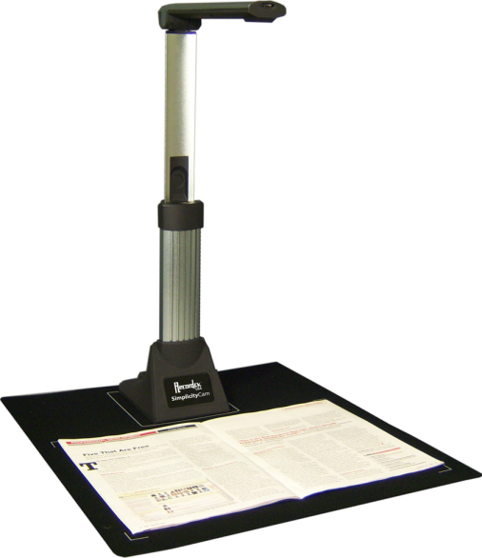
Domain
Born digital
Digitized

Slide 12
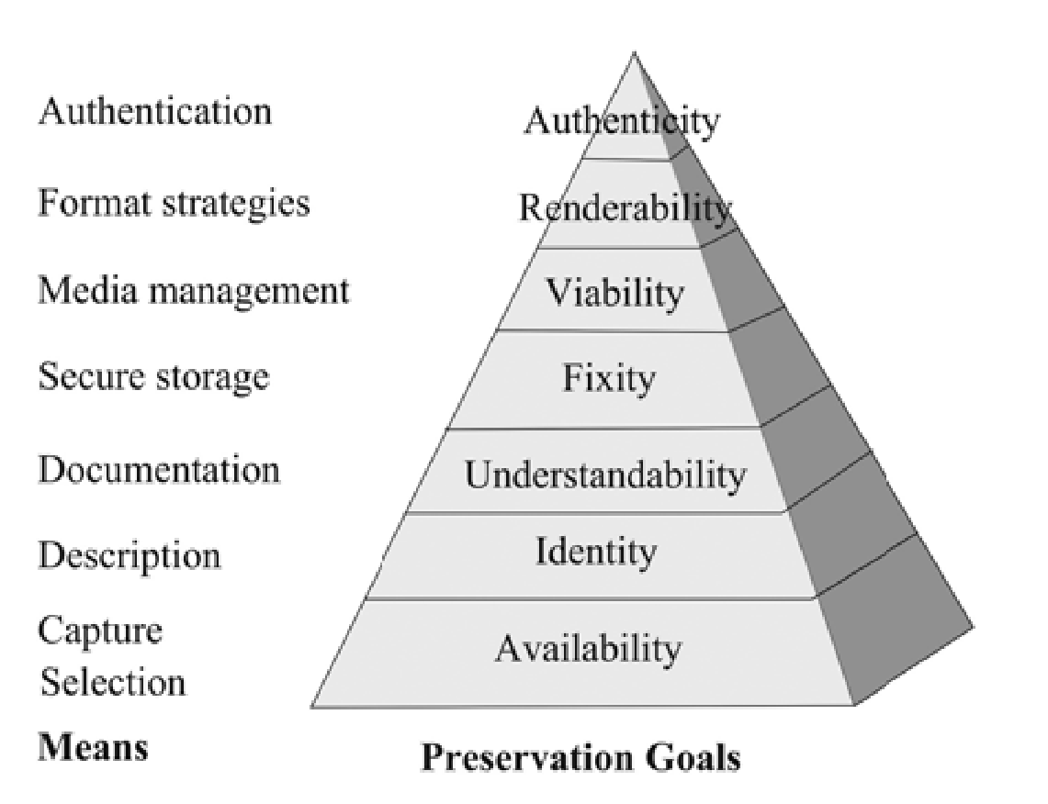
DP metadata supports preservation goals
Preservation Pyramid
(from Priscilla Caplan)

Slide 13
Availability
The object is in our control or in the control of a trusted, accessible repository

Slide 14
Identity
Each relevant entity is persistently and uniquely identifiable
The entities can be File, Work, Person, Organisation, Licence, …
Metadata needed to be known
  Identifier type
  Identifier value

Slide 15
Understandability
The object and entites is possible to understand
Metadata needed to be known
  Physical structure
    Embedded files
    File sequence
  Logical structure
Context needed to be known
  Original source
  Related items
And much more

Slide 16
Fixity
The object is unchanged
Metadata needed to be known
  Checksums
  Message digests
  Hash function
Event creating them needs to give
  Algorithms
  Date/time
  Originator
  Type

Slide 17
Viability
The object is readable
Metadata needed to be known
  Data carrier metadata
    Type of medium
    Its preservation characteristics
    Age of medium
    Date of recording
    Usage patterns

Slide 18
Renderability
The object can be rendered or executed
Metadata needed to be known
  Format information
  Rendering information
      Software
      Hardware
      Other dependencies:
      schemas,
      style sheets,
      encodings, etc.
Technology dependence

Slide 19
Authenticity
Authenticity: The object is what it purports to be
Integrity: The object is whole and unimpaired
Object transformations
  Pre-emptive preservation actions
    Bit migration
    Content migration
    Replacing part of the rendering stack
  Forensic transformation actions

Slide 20
Authenticity
Metadata needed to be known
  Structural metadata (for integrity)
  Digital signatures
  Access rights
  Provenance metadata:
    History of all actions performed on the resource
    (events and dates)
    History of custodianship (agents: decision makers, administrators, tools)
  Significant characteristics
  Lost characteristics
  Business rules (policy, strategy) guiding preservation actions

Slide 21
Rights
Avoid Rights violations during preservation!!!
Metadata needed to be known
  Rights information for preservation actions during copyright / license period

Slide 22
WHAT IS PREMIS?
Karin Bredenberg
Kommunalförbundet Sydarkivera

Slide 23
The PREMIS standard
International de-facto standard for metadata
to support the preservation of digital objects and
ensure their long-term usability.
  Information you need to know for preserving digital objects
      Preservation Metadata: Implementation Strategies
Developed by an international team of experts.
Implemented in digital preservation projects around the world.
Incorporated into commercial and open-source
digital preservation tools and systems.

Slide 24
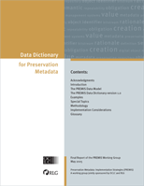
The PREMIS standard
Data Dictionary (PREMIS 3.0)
  http://www.loc.gov/standards/premis/v3/premis-3-0-final.pdf
  Version 3 – major release
XML schema v3.0
  http://www.loc.gov/standards/premis/premis.xsd
OWL ontology
Supporting documentation

Slide 25
Activities
The PREMIS Editorial Committee
  Coordinates revisions and implementation of the standard
PREMIS Implementors' Group forum (pig@loc.gov)
  Email message to listserv@listserv.loc.gov:
  Text: subscribe pig <your name>
Preservation metadata workshop (@iPres)

Slide 26
Scope
What PREMIS DD is:
  Common data model for organizing/thinking about preservation metadata
  Standard for exchanging preservation metadata in information packages between repositories
  Implementable
  Technically neutral
  Core metadata

Slide 27
Scope
What PREMIS DD is not:
  Out-of-the-box solution
  All needed metadata
  Lifecycle management of objects outside repository
  - increasing support for integration with outside
  Rights management standard
  - strong support for rights statements

Slide 28
Scope
What PREMIS DD is not:
  It is not limited to or customized for archives and libraries.
  It does not dictate that you need to use every feature.
    But you should examine for yourself which features you can knowingly ignore.
  It is not only useful if you implement metadata.
  You can use it to assess the metadata quality of systems you use.
  Everyone modeling the digital landscape can and should use the high-level modeling feature.

Slide 29
Tailoring PREMIS to needs
Evolving metadata
  Increasing experience ensuring the longevity of digital objects
  Changing future technical possibilities
  Changing future legal framework
Tailoring solutions
  Varying needs
    Content-types
    Institutional policies
    Intended use
  Off-the-shelf (OS/commercial)
  or custom-built
Off-the-shelf systems
Predefined metadata profiles
Out-of-the-box tools
Predefined metadata profiles
Out-of-the-box tools
Configured, extended, adapted
Metadata profiles and tools
Metadata profiles and tools
Custom-built systems
Metadata profiles and tools

Slide 30
ON-LINE RESOURCES
Karin Bredenberg
Kommunalförbundet Sydarkivera

Slide 31
Webpages
Webpage
  https://www.loc.gov/standards/premis/
Vocabularies
  https://id.loc.gov/vocabulary/preservation.html
Ontology
  https://id.loc.gov/ontologies/premis.html
Tools at COPTR
  https://coptr.digipres.org/index.php/PREMIS_(Preservation_Metadata_Implementation_Strategies)
Zenodo
  https://zenodo.org/communities/premis

Slide 32
E-mail list
PREMIS Implementors' Group forum (pig@listserv.loc.gov)
  Subscribe through the form:
  https://listserv.loc.gov/cgi-bin/wa?A0=PIG

Slide 33
Micky Lindlar
TIB – Leibniz Information Centre for Science and Technology
BENEFITS OF IMPLEMENTING PREMIS

Slide 34
Implementable, core preservation metadata
Supports Preservation Principles
viability, renderability, understandability, authenticity, and identity of digital objects
Core Information
what most preservation repositories need to know to preserve digital materials over the long term
Implementable
rigorously defined, supported by guidelines for creation, management, and use, and oriented toward automated workflows
Technical Neutrality
no assumptions made about preservation technologies, strategies, metadata storage and management, etc.

Slide 35
Benefits of implementing PREMIS (1)
exchange consistency?
hdl="galapagos.6754.1"
IDobj="hdl.galapagos.6754.1"
ID="1"
TYPE="hdl"
GROUPID="galapagos.6754"
ID="6754.1"
GID="galapagos"

Slide 36
Interoperability through implementable preservation metadata
IDobj="hdl.galapagos.6754.1"
hdl="galapagos.6754.1"
premis:objectIdentifier
premis:objectIdentifierType="hdl"
premis:objectIdentifierValue="galapagos.6754.1"
PREMIS
<galapagos.6754.1> a premisOwl:IntellectualEntity ;
premisOwl:identifier <http://hdl.handle.net/galapagos.6754.1> .
<http://hdl.handle.net/galapagos.6754.1> a http://id.loc.gov/vocabulary/identifiers/hdl .
ID="1"
TYPE="hdl"
GROUPID="galapagos.6754"
ID="6754.1"
GID="galapagos"

Slide 37

Benefits of implementing PREMIS (2)
What do I need to know about a digital object I am preserving?
  … today
  … in the future
How can I best capture that information?
Is there a good practice?
How was it created?
What is it?
What has been done to it?
What am I allowed to do with it?

Slide 38
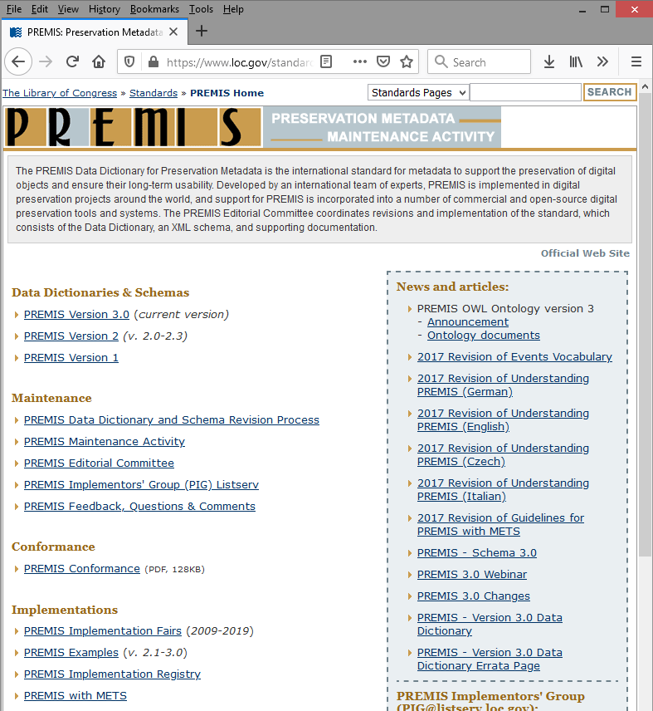
De-facto standard for preservation metadata
PREMIS = “things that most working preservation repositories are likely to need to know in order to support digital preservation” -- PREMIS Data Dictionary
valuable resource to know what you need to capture
a method to model the
information you need
a data model with MANY
implementations in different
institutions
a community of users with
good resources

Slide 39





Eld Zierau
Royal Danish Library
OUTLINE OF MAIN ENTITIES
THE DATA MODEL & KEY CONCEPTS

Slide 40









The PREMIS Data Model
The PREMIS Data Model is created by the
community and experts in digital preservation
Why have a data model?
  Organizational convenience
  (for development and use)
  But: not a formal entity-relationship model;
  not sufficient to design databases
Rights
Object
Agent
Event

Slide 41
The PREMIS Data Model
The PREMIS Data Model includes:
Entities
“things” relevant to digital preservation
Semantic Units
detailed information
of entities
Rights
Rights
Object
Agent
Object
Agent
Event
agentIdentifier
Event
agentIdentifierType
agentIdentifierValue
agentname
Relationships
specifies relations
between entities
agentType
…

Slide 42

Objects
Rights
It is the objects that you preserve
Objects can be intellectual entities, representations or bitstreams (more later)
Implementation choices:
Determine which types of Objects are in scope
Object
Agent
Event
Examples:
A PDF file
An image within a file
A book
A book representation
Different types of objects

Slide 43


Types of objects (objectCategory)
Rights
Object
Agent
Event
intellectual
entity
representation
file
bitstream
TIFF
p1
Image in page
Book
Object
Original TIFFs
TIFF
p2
Derived
e-pub
E-pub
a distinct intellectual that is considered relevant in the context of digital preservation
set of objects, including structural metadata, that, taken together, constitute a complete representation
named and ordered sequence of bytes that is known by an operating system
data within a file with properties relevant for preservation purposes

Slide 44
Events
Rights
An action that involves or impacts at least one Object or Agent
Can document digital provenance, needed to track history of Object
Implementation choices:
Determining which Events are in scope
Determining which Events should be recorded, as well as level of granularity
Object
Agent
Event
Examples:
Validation Event
e.g. using JHOVE
Ingest Event

Slide 45

Rights Statements
Rights to undertake an action(s) associated with an Object(s) in the repository.
Implementation choices :
Can use other schemes
PREMIS form:
Agent X
grants Permission Y
to the repository in regard to Object Z.
Rights
Object
Agent
Event
Example:
Helen Smith
grants FCLA digital repository permission
to the repository in regard to make three copies of metadata_derived.pdf for preservation purposes.

Slide 46
Agents
Rights
Person, organization, or software program/system
Intended only to identify the agent, and to allow linking from other entity types.
Implementation choices:
use richer scheme that may be appropriate.
Object
Agent
Event
Examples:
John Smith (a person)
IIPC (an organization)
JHOVE version 1.5
(a software program)

Slide 47
A digitization example
Rights
Object
Agent
Event
Agent
(digitizer)
Event
(digitization)
Object: file
Identifier,
type (person),
name (Karin Bredenberg)
Identifier,
type (creation),
date/time
etc.
Identifier,
fixity,
file format,
creating application, preservation level etc.

Slide 48
The PREMIS Data Model includes:
Entities
“things” relevant to digital preservation
Rights
Object
Agent
Event
intellectual entity
Representation
File
Bitstream

Slide 49

menti.com

Slide 50
Eld Zierau
Royal Danish Library
DATA DICTIONARY
DESCRIPTION OF DATA MODEL

Slide 51
PREMIS Data model
Entities
“things” relevant to digital preservation
Semantic Units
detailed information
of entities
Rights
Object
Agent
agentIdentifier
Event
agentIdentifierType
agentIdentifierValue
agentname
Relationships
specifies relations
between entities
agentType
…

Slide 52
Semantic Units
…
Properties of Entities
…
…
A piece of information most repositories need to
know in order to carry out their digital preservation functions
Example:
[container]
[semantic component]
[semantic component]
…
Two kinds of semantic unit
objectIdentifier
groups together related semantic units
objectIdentifierType
objectIdentifierValue

Slide 53
Properties of Entities - Semantic units
Rights
Object
Agent
Event

Slide 54

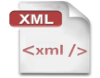

High level semantic units for Objects
what is my preservation strategy for this object?
what technical information on it?
which object is it?
TIFF
10Mb
ark:/12148/btp6k102002g/f1
what software or hardware should be used to handle the object?
what kind of object?
which of its characteristics do I want to preserve in it?

Slide 55
PREMIS Object Entity – Semantic Units
objectIdentifier
mandatory
objectCategory
objectCharacteristics
object
significantProperties
preservationLevel
originalName
storage
signatureInformation
environmentFunction
environmentDesignation
environmentRegistry
environmentExtension
relationship
linkingEventIdentifier
linkingRightsStatementIdentifier

Slide 56
PREMIS Object Entity – Semantic Units
objectIdentifier
objectIdentifierType
objectCategory
objectIdentifierValue
objectCharacteristics
object
significantProperties
preservationLevel
originalName
storage
signatureInformation
environmentFunction
environmentDesignation
environmentRegistry
environmentExtension
relationship
linkingEventIdentifier
linkingRightsStatementIdentifier

Slide 57
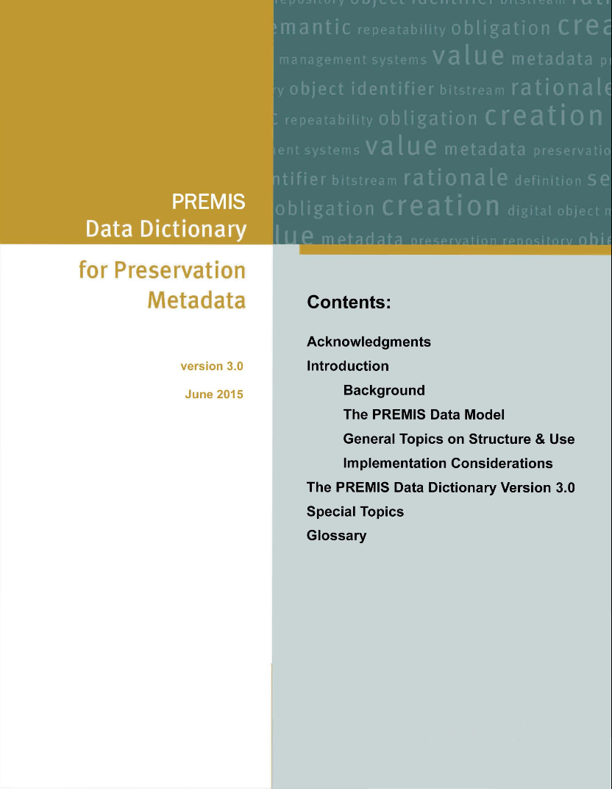
A digitization example
Rights
Object
Agent
Event
Agent
(digitizer)
Event
(digitization)
Object: file
Identifier,
type (person),
name (Karin Bredenberg)
Identifier,
type (creation),
date/time
etc.
Identifier,
fixity,
file format,
creating application, preservation level etc.
Data Dictionary
(PREMIS 3.0)
http://www.loc.gov/standards/premis/v3/premis-3-0-final.pdf

Slide 58
A digitization example
Rights
Data Dictionary
(PREMIS 3.0)
http://www.loc.gov/standards/premis/v3/premis-3-0-final.pdf
Object
Agent
Event
Agent
(digitizer)
Event
(digitization)
Object: file
Identifier,
type (person),
name etc.
Identifier,
type (creation),
date/time
etc.
Identifier,
fixity,
file format,
creating application, preservation level etc.
Data Dictionary
(PREMIS 3.0)
http://www.loc.gov/standards/premis/v3/premis-3-0-final.pdf

Slide 59
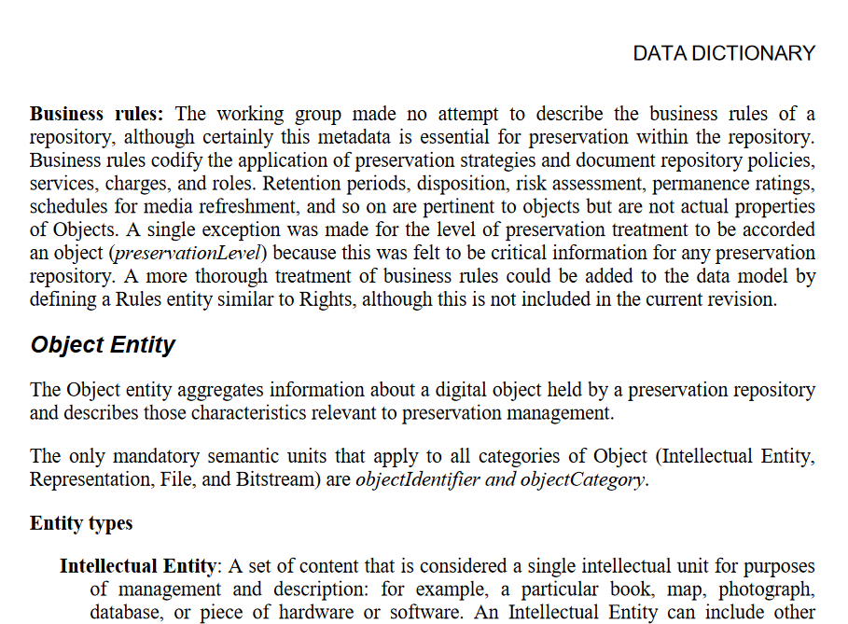
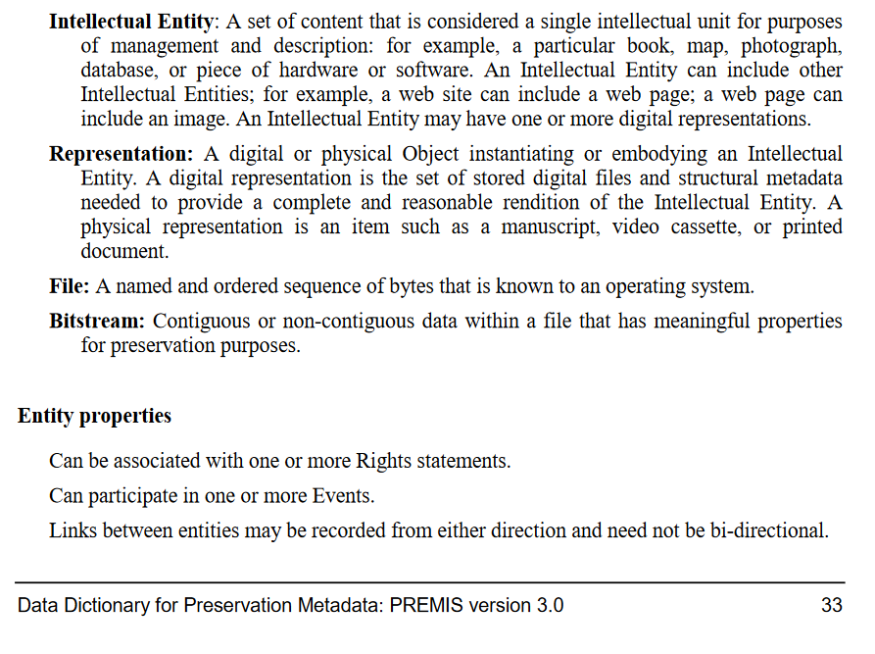
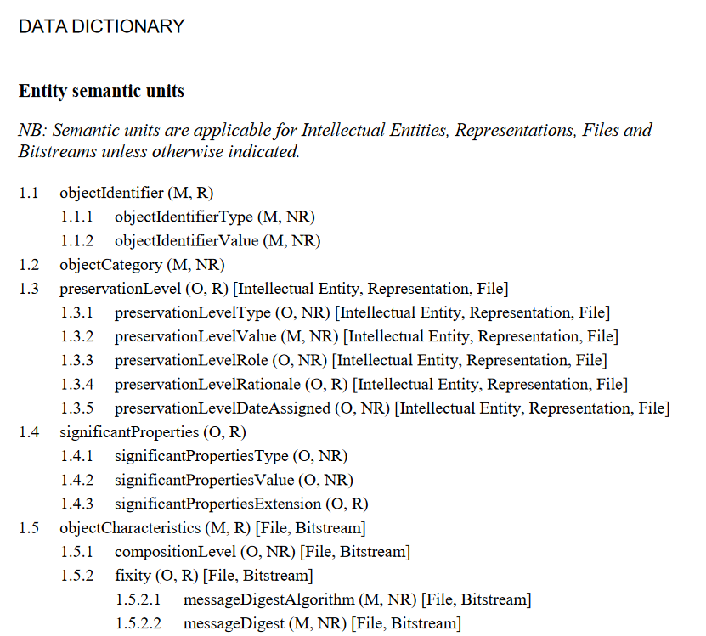
Sample Data Dictionary Entry
Object
objectIdentifier
objectIdentifier
objectIdentifier
objectIdentifier
objectCategory
PreservationLevel
…

Slide 60
Sample Data Dictionary Entry
Object
objectIdentifier
objectIdentifier
objectIdentifierType
objectCategory
objectIdentifierValue
PreservationLevel
Mandatory (M)
Optional (O)
…
Repeatable (R)
Not Repeatable (NR)

Slide 61
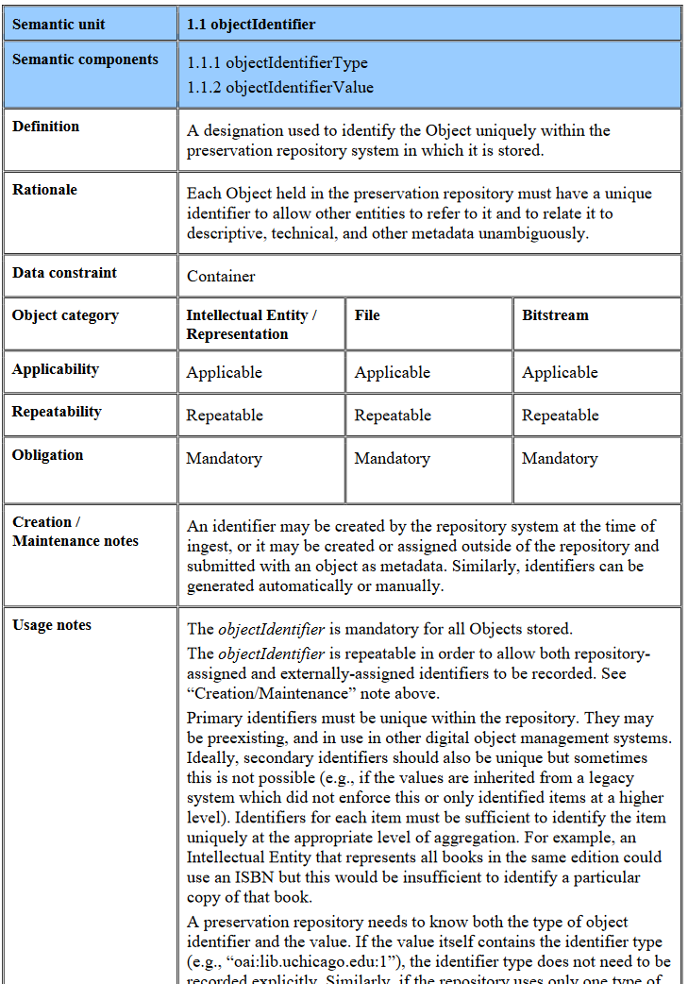
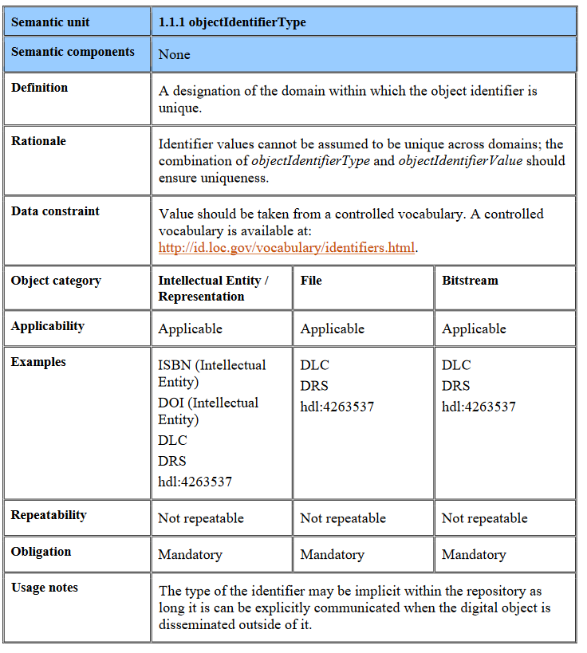
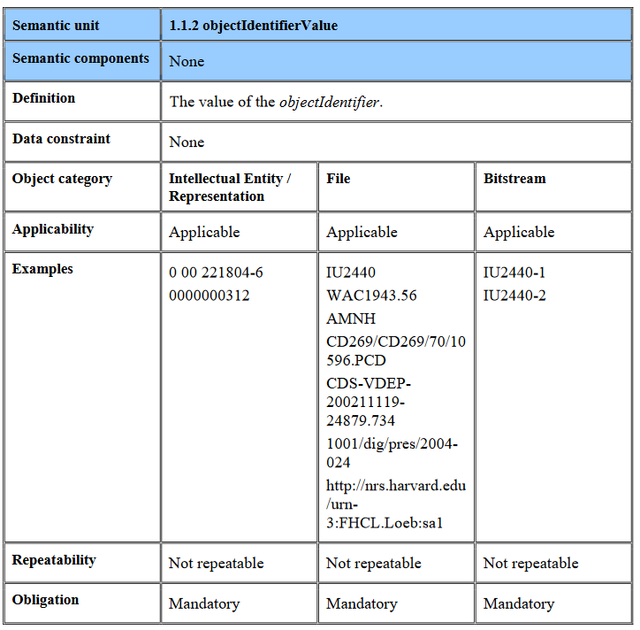
Sample Data Dictionary Entry
Object
objectIdentifier
objectIdentifier
objectIdentifier
objectCategory
PreservationLevel
Mandatory (M)
Optional (O)
…
Repeatable (R)
Not Repeatable (NR)

Slide 62
XML example
ObjectIdentifier
ObjectIdentifierType
ObjectIdentifierValue
Examplified by XML using XML schema v3.0:
http://www.loc.gov/standards/premis/premis.xsd
<premis>
<object
>
... </object>
...
</object>
xsi:type="file">
<objectIdentifier>
<objectIdentifierType>
UUID
</objectIdentifierType>
<objectIdentifierValue>
41d10-099-1e2-9
</objectIdentifierValue>
</objectIdentifier>
...
</object>
<event> ... </event>
<agent> ... </agent>
<rights> ... </rights>
</premis>
Agent
(digitizer)
Event
(digitization)
Object: file
<event> ... </event>
Identifier,
...
<agent> ... </agent>
</premis>

Slide 63
PREMIS Object Entity – Semantic Units
objectIdentifier
objectCategory
objectCharacteristics
object
significantProperties
preservationLevel
originalName
storage
signatureInformation
environmentFunction
environmentDesignation
environmentRegistry
environmentExtension
relationship
linkingEventIdentifier
linkingRightsStatementIdentifier

Slide 64
objectCategory
Values:
  intellectual entity
  representation
  file
  bitstream
Implemented as an xsi:type in PREMIS XML-schema so not explicitly recorded as XML-tag
intellectual
entity
representation
file
bitstream
TIFF
p1
Image in page
Book
Object
Original TIFFs
TIFF
p2
Derived
e-pub
E-pub
<premis>
<object xsi:type="
...
</object>
...
</premis>
representation">
bitstream">
intellectualEntity">
file">

Slide 65
PREMIS Object Entity – Semantic Units
objectIdentifier
objectCategory
objectCharacteristics
specific characteristic
object
significantProperties
mandatory
for file or bitstream
compositionLevel
*
preservationLevel
fixity
originalName
Technical properties
common to all/most
file formats
size
storage
format
signatureInformation
creatingApplication
environmentFunction
Technology
agnostic
environmentDesignation
inhibitors
objectCharacteristicsExtension
environmentRegistry
*
environmentExtension
relationship
linkingEventIdentifier
linkingRightsStatementIdentifier

Slide 66



Composition Level
sometimes there is more than one layer of characteristics
chapter1.pdf
chapter1.pdf.gz
Composition Level 0
Composition Level 1
Or they may be part of other files e.g.
Mail attachments
Images in PDF’s etc

Slide 67
PREMIS Object Entity – Semantic Units
objectIdentifier
objectCategory
objectCharacteristics
specific characteristic
object
significantProperties
compositionLevel
preservationLevel
fixity
originalName
size
storage
format
signatureInformation
creatingApplication
environmentFunction
environmentDesignation
inhibitors
objectCharacteristicsExtension
environmentRegistry
*
environmentExtension
relationship
linkingEventIdentifier
linkingRightsStatementIdentifier

Slide 68


objectCharacteristicsExtension
Container to include external information
– e.g. for more granularity
Might contain format specific metadata for a file
– e.g. technical metadata for still images (MIX)

Slide 69
objectCharacteristicsExtension - example
<premis> ...
<object xsi:type="file"> ...
<objectCharacteristics> ...
<objectCharacteristicsExtension>
<mix:mix xsi:schemaLocation=
"... http://www.loc.gov/standards/mix/mix20/mix20.xsd">
...
<mix:BasicImageInformation>
<mix:BasicImageCharacteristics>
<mix:imageWidth>5894</mix:imageWidth>
<mix:imageHeight>7768</mix:imageHeight>
...
</mix:BasicImageCharacteristics>
</mix:BasicImageInformation>
...
<mix:mix>
</objectCharacteristicsExtension> ...
<objectCharacteristics> ...
</object> ...
</premis>
All semantic units named … Extension works like this

Slide 70
PREMIS Object Entity – Semantic Units
objectIdentifier
objectCategory
objectCharacteristics
specific characteristic
object
significantProperties
compositionLevel
preservationLevel
fixity
originalName
size
storage
format
signatureInformation
creatingApplication
environmentFunction
environmentDesignation
inhibitors
environmentRegistry
objectCharacteristicsExtension
OWL example:
<http://nri.library.ca/0912-0001.xml> a premis:File ;
dct:format <XMLFormat> ;
premis:fixity <0912-0001Fixity> ;
premis:size 58465 ;
premis:compositionLevel 0
environmentExtension
relationship
linkingEventIdentifier
linkingRightsStatementIdentifier

Slide 71
PREMIS Object Entity – Semantic Units
objectIdentifier
objectCategory
objectCharacteristics
object
significantProperties
preservationLevel
*
originalName
more general info
storage
signatureInformation
environmentFunction
environmentDesignation
environmentRegistry
environmentExtension
relationship
linkingEventIdentifier
linkingRightsStatementIdentifier

Slide 72
preservationLevel
What preservation treatment/strategy the repository plans for this object
Varying preservation options dependent on factors such as value, uniqueness, preservability of format
A business rule only relevant in a given repository
preservationLevel
preservationLevelType
e.g. BitSafety
or LogicalStrategy
preservationLevelValue
e.g. high
or migration
preservationLevelRole
e.g. intention or requirement
preservationLevelRationale
Filled when differs from policy
preservationLevelDateAssigned
Time of assignment

Slide 73
PREMIS Object Entity – Semantic Units
objectIdentifier
objectCategory
objectCharacteristics
object
significantProperties
preservationLevel
originalName
more general info
storage
signatureInformation
environmentFunction
environmentDesignation
environmentRegistry
environmentExtension
relationship
linkingEventIdentifier
linkingRightsStatementIdentifier

Slide 74
PREMIS Object Entity – Semantic Units
objectIdentifier
objectCategory
objectCharacteristics
object
significantProperties
preservationLevel
originalName
storage
signatureInformation
environmentFunction
environmentDesignation
environmentRegistry
environments
environmentExtension
relationship
linkingEventIdentifier
linkingRightsStatementIdentifier

Slide 75
Environment example:
An object and its rendering environment
Intellectual Entity
for content Object
Intellectual Entity
hardware
Intellectual Entity
operating system
requires
requires
represents
represents
File Object
ISO image
File
Content Object

Slide 76
PREMIS Object Entity – Semantic Units
objectIdentifier
objectCategory
objectCharacteristics
object
significantProperties
preservationLevel
originalName
storage
signatureInformation
environmentFunction
environmentDesignation
environmentRegistry
environmentExtension
relationship
Later
linkingEventIdentifier
entity linking
linkingRightsStatementIdentifier

Slide 77
Properties of Entities - Semantic units
Rights
Object
Agent
Event

Slide 78
PREMIS Event Entity – Semantic Units
Must be related to one or more Objects.
Can be related to one or more Agents.
event
eventIdentifier
mandatory
eventType
*
Rights
eventDateTime
Object
Agent
eventDetailInformation
eventOutcomeInformation
Event
linkingAgentIdentifier
linkingObjectIdentifier

Slide 79
eventType
Names the event
Recommended to use a controlled vocabulary, e.g.
  http://id.loc.gov/vocabulary/preservation/eventType.html
Could use coded values
Granularity is implementation-specific
Ingestion
Virus check
creation
Validation
Compression
Message digest calculation
…
Decompression
migration
Fixity check

Slide 80
PREMIS Event Entity – Semantic Units
Must be related to one or more Objects.
Can be related to one or more Agents.
event
eventIdentifier
eventType
Rights
eventDateTime
Object
Agent
eventDetailInformation
eventOutcomeInformation
Later
Event
linkingAgentIdentifier
entity
linking
linkingObjectIdentifier

Slide 81
Properties of Entities - Semantic units
Rights
Object
Agent
Event

Slide 82
PREMIS Agent Entity – Semantic Units
May hold or grant one or more Rights.
May carry out, authorize, or compel one or more Events.
May create or act upon one or more Objects through an Event or with respect to a Rights statement.
agentIdentifier
mandatory
agent
agentName
agentType
Rights
*
agentVersion
Object
Agent
agentNote
Event
agentExtension
linkingEventIdentifier
linkingRightsStatementIdentifier
linkingEnvironmentIdentifier

Slide 83
agentType
Can use controlled vocabulary, e.g. http://id.loc.gov/vocabulary/preservation/agentType.html
  hardware
  organization
  person
  software

Slide 84
PREMIS Agent Entity – Semantic Units
May hold or grant one or more Rights.
May carry out, authorize, or compel one or more Events.
May create or act upon one or more Objects through an Event or with respect to a Rights statement.
agentIdentifier
agent
agentName
Rights
agentType
agentVersion
Object
Agent
agentNote
Event
agentExtension
Later
linkingEventIdentifier
entity
linking
linkingRightsStatementIdentifier
linkingEnvironmentIdentifier
environ-
ments

Slide 85
Properties of Entities - Semantic units
Rights
Object
Agent
Event

Slide 86
PREMIS Rights Entity – Semantic Units
rightsStatement
rights
rightsStatementIdentifier
rightsBasis
*
Rights
copyrightInformation
licenseInformation
One of
these
must be present!
Object
Agent
statuteInformation
Event
otherRightsInformation
rightsGranted
*
linkingObjectIdentifier
linkingAgentIdentifier
rightsExtension

Slide 87




Dependent units about rights
Specifying different types of rights
If more than one basis applies, the entire rights entity should be repeated.
rightsBasis
= copyright
copyrightInformation
= license
licenseInformation
= statute
statuteInformation
= other
otherRightsInformation
Other

Slide 88
Example copyrightInformation
rightsBasis = copyright
copyrightInformation
copyrightStatus = copyrighted
copyrightJurisdiction = us
copyrightStatusDeterminationDate = 2008-09-10
copyrightNote = Copyright expiration expected in 2022
copyrightDocumentationIdentifier = [link]

Slide 89
PREMIS Rights Entity – Semantic Units
rightsStatement
rights
rightsStatementIdentifier
rightsBasis
Rights
copyrightInformation
licenseInformation
Object
Agent
statuteInformation
Event
otherRightsInformation
rightsGranted
*
linkingObjectIdentifier
linkingAgentIdentifier
rightsExtension

Slide 90




rightsGranted
What action is allowed?
Under what conditions?
Are there time constraints?
Contains
Act (e.g. migrate, modify)
Restriction (description)
termOfGrant (start and end date)
termOfRestriction (start and end date)
rightsGrantedNote (additional inf.)

Slide 91
PREMIS Rights Entity – Semantic Units
rightsStatement
rights
rightsStatementIdentifier
rightsBasis
Rights
copyrightInformation
licenseInformation
Object
Agent
statuteInformation
Event
otherRightsInformation
rightsGranted
Next
linkingObjectIdentifier
entity
linking
linkingAgentIdentifier
rightsExtension

Slide 92
PREMIS Rights Entity – Semantic Units
rights
…
linkingObjectIdentifier
…
linkingAgentIdentifier
rightsStatement
rights
rightsStatementIdentifier
rightsBasis
Rights
copyrightInformation
licenseInformation
Object
Agent
statuteInformation
Event
otherRightsInformation
rightsGranted
Next
linkingObjectIdentifier
entity
linking
linkingAgentIdentifier
rightsExtension

Slide 93
PREMIS Agent Entity – Semantic Units
agent
…
rights
…
linkingEventIdentifier
linkingObjectIdentifier
linkingRightsStatementIdentifier
…
…
linkingAgentIdentifier
agent
agentIdentifier
Rights
agentName
Object
Agent
agentType
Event
agentVersion
agentNote
agentExtension
linkingEventIdentifier
entity
linking
linkingRightsStatementIdentifier
linkingEnvironmentIdentifier

Slide 94
PREMIS Event Entity – Semantic Units
Event
…
agent
…
rights
linkingAgentIdentifier
linkingEventIdentifier
linkingObjectIdentifier
linkingRightsStatementIdentifier
linkingObjectIdentifier
…
linkingAgentIdentifier
event
Rights
eventIdentifier
eventType
Object
Agent
eventDateTime
Event
eventDetailInformation
eventOutcomeInformation
linkingAgentIdentifier
entity
linking
linkingObjectIdentifier

Slide 95

PREMIS Object Entity – Semantic Units
Relationships: Semantic Unit Identifiers
object
…
Event
…
agent
…
rights
…
linkingEventIdentifier
linkingAgentIdentifier
linkingEventIdentifier
linkingObjectIdentifier
linkingRightsStatementIdentifier
linkingRightsStatementIdentifier
objectIdentifier
linkingObjectIdentifier
…
…
linkingAgentIdentifier
objectCategory
objectCharacteristics
Rights
object
significantProperties
identifiers
identifiers
preservationLevel
Rights
originalName
storage
Object
Object
Agent
Agent
signatureInformation
Event
environmentFunction
environmentDesignation
identifiers
identifiers
environmentRegistry
Event
Still missing
environmentExtension
relationship
linkingEventIdentifier
entity
linking
linkingRightsStatementIdentifier

Slide 96
Relationships: Semantic Unit Identifiers
object
…
Event
…
agent
…
rights
…
linkingEventIdentifier
linkingAgentIdentifier
linkingEventIdentifier
linkingObjectIdentifier
linkingRightsStatementIdentifier
linkingObjectIdentifier
linkingRightsStatementIdentifier
linkingAgentIdentifier
…
…
Rights
linkingRightsStatementIdentifier
linkingRightsStatementIdentifier
Object
Relationship
linkingObjectIdentifier
linkingAgentIdentifier
Object
Agent
linkingObjectIdentifier
linkingAgentIdentifier
Event
linkingEventIdentifier
linkingEventIdentifier

Slide 97
PREMIS Object Entity – Semantic Units
objectIdentifier
objectCategory
objectCharacteristics
significantProperties
object
preservationLevel
originalName
storage
signatureInformation
environmentFunction
environmentDesignation
environmentRegistry
Still missing
environmentExtension
relationship
linkingEventIdentifier
linkingRightsStatementIdentifier

Slide 98
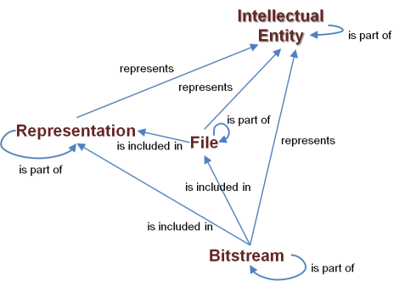
Objects and their interrelations
Object
is part of
Intellectual Entity
is part of
Representation
represents
is included in
is part of
File
is part of
Bitstream

Slide 99

PREMIS Object Entity – Semantic Units
Object
Example:
Representing Intellectual Entity
relationship
relationshipType
structural
relationshipSubType
represents
relatedObjectIdentifier
Identifier of Intellectual Entity
relatedEventIdentifier
relation through an Event
e.g. for migration
relatedEnvironmentPurpose
relatedEnvironmentCharacteristic
environments
Objects can be associated with Events in two ways:
If the Object has an associated Event with relationship
If the Object has an associated Event with no relationship to a second Object, e.g. ingest: use linkingEventIdentifier

Slide 100
Relationships: Semantic Unit Identifiers
PREMIS 3 - Entities
Rights
Object
environments
Agent
Event
Completed

Slide 101

HOW TO USE PREMIS?
The Data Dictionary in action: PREMIS Conformance and repository interoperability
Micky Lindlar
TIB - German National Library of Science and Technology

Slide 102
PREMIS Conformance statement
http://www.loc.gov/standards/premis/premis-conformance-20150429.pdf
Baseline requirements:
For every implemented Entity (Objects, Events, Rights, Agents) mandatory semantic units must be captured
  For those levels of Object that the repository supports (IE, representation, file, bitstream)
Requirements for
Shared name = Shared definition!
Shared definition without shared name -> needs documentation

Slide 103
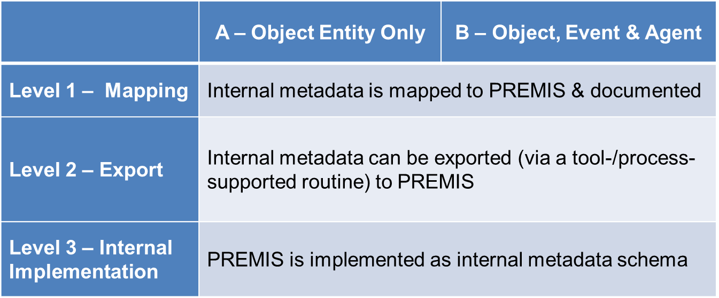
PREMIS Conformance Levels

Slide 104



Example: What‘s conformant and what isn‘t?
None
DOI: 10.5281/zenodo.5569542
Eindeutiger Bezeichner:10.5281/zenodo.5569542
<dc:identifier>https://zenodo.org/record/5569578</dc:identifier> <dc:identifier>10.5281/zenodo.5569578</dc:identifier> <dc:identifier>oai:zenodo.org:5569578</dc:identifier>
<objectIdentifier>fmt/18</objectIdentifer>
premis:objectIdentifier
premis:objectIdentiferType=„doi“
premis:objectIdentifierValtue=„10.5281/zenodo.5569542“

Slide 105
Which Entities to implement?
Object is the core Entity (level A);
Event and Agent are closely related (level B); implementing Agents has strong implications: it means the repository is able to manage and follow the use of its Agents in the Object lifecycle.
The Rights Entity (excluded from the conformance statement) helps a repository tracking the intellectual property rights governing the Object, or some institutional policy.

Slide 106
PREMIS can be used as a(n) …
basis for other standards / locally defined metadata catalogues (no conformance, but inspiration)
  e.g., Netherlands Institute for Sound and Vision
  https://publications.beeldengeluid.nl/pub/389/BIJLAGE-C_Metadatadictionary-English.pdf
self-assessment tool (Conformance Level 1)
  Am I able to provide information about my digital assets following the Data Dictionary structure and requirements?
export format (Conformance Level 2)
  Preferably in a PREMIS-endorsed expression (XML or RDF)
native format of the repository Data Management module (Conformance Level 3)
  Any technology, using a PREMIS-endorsed expression or not, can be used

Slide 107
Examples for different implementations:
RDF and XML
<http://nri.library.ca/5143-026.nrw> a premis:File ;
premis:fixity <5143-026Fixity>
.
<5143-026Fixity> a crypHashFunc:sha256 ;
rdf:value "71f920fa275127a7b60fa4d4d41432a3 ";
dce:creator "hashlib.sha256"
.
<premis:fixity>
<premis:messageDigestAlgorithm>SHA-256</premis:messageDigestAlgorithm>
<premis:messageDigest>
d2bed92b73c7090bb30a0b30016882e7069c437488e1513e9deaacbe29d38d92
</premis:messageDigest>
<premis:messageDigestOriginator>NRI</premis:messageDigestOriginator>
</premis:fixity>

Slide 108
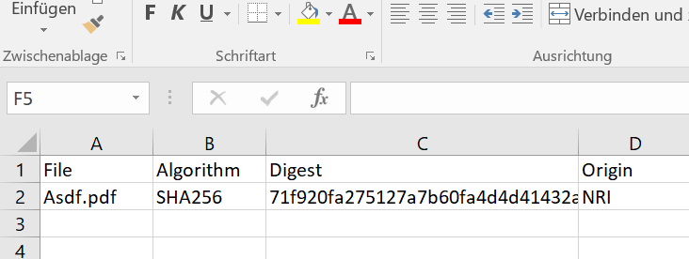
Examples for different implementations:
CSV and spreadsheet
File, Algorithm, Digest, Origin;
Asdf.pdf; SHA-256, 71f920fa275127a7b60fa4d4d41432a3, NRI;

Slide 109
menti.com

Slide 110

WRAP UP
Karin Bredenberg
Kommunalförbundet Sydarkivera
DD
Where to find it and What it is for
Current activity in PREMIS EC
Book
Exercises

Slide 111
But first
Go to Menti, link in the chat and respond to the question we wanted you to think about in the beginning
What kind of digital objects will you use PREMIS for?

Slide 112
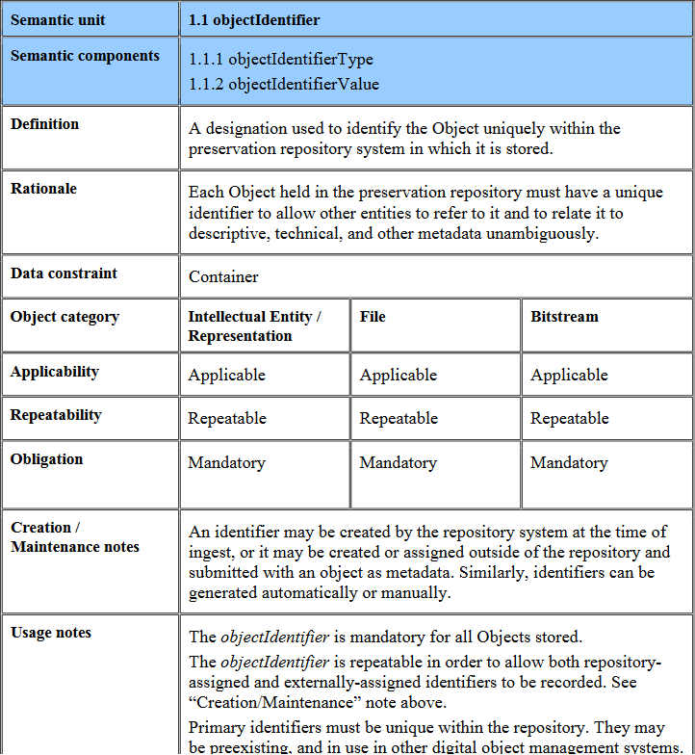
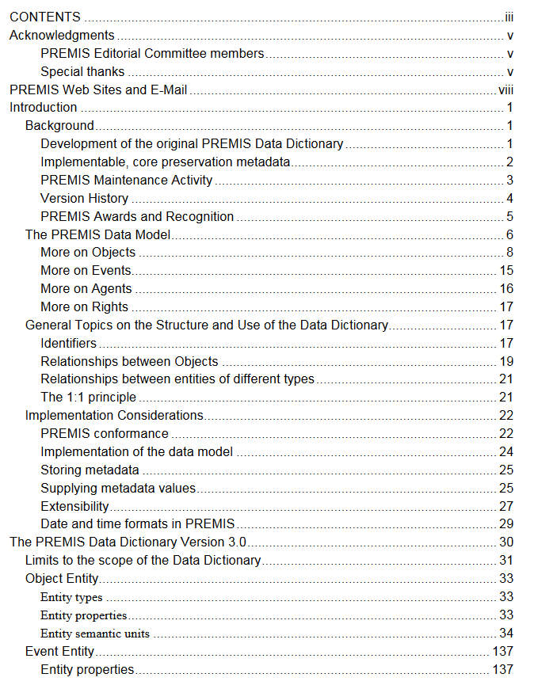
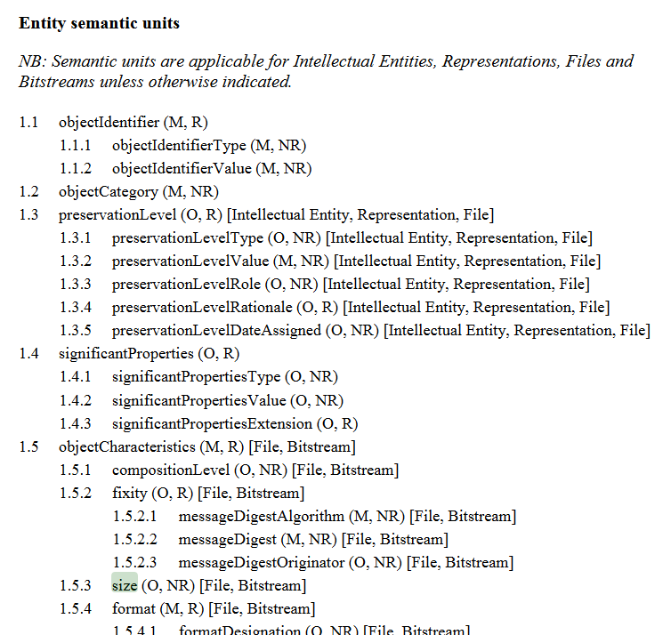
Sum up – Data Dictionary
Lots of other information

Slide 113

Where? and What??
Where
  Resources: http://www.loc.gov/standards/premis/
  PREMIS Implementors Group Forum: PIG@listserv.loc.gov
What PREMIS is for today have given you a good start and you now need to explore it further
Images in this style is taken from digitalbevaring.dk

Slide 114
Resources
Understanding PREMIS
PREMIS-in-METS guidelines
Conformance statement
Examples of implementation
http://www.loc.gov/standards/premis/

Slide 115
Understanding PREMIS – Entender PREMIS
https://www.loc.gov/standards/premis/understandingPREMIS_spanish_2021.pdf

Slide 116
Current activity
Move the DD to a TEI-format to simplify maintenance and transformations to publications
DD updates following the ontology work
Enhance our use of Zenodo
Setup of new wiki
Rights overhaul

Slide 117
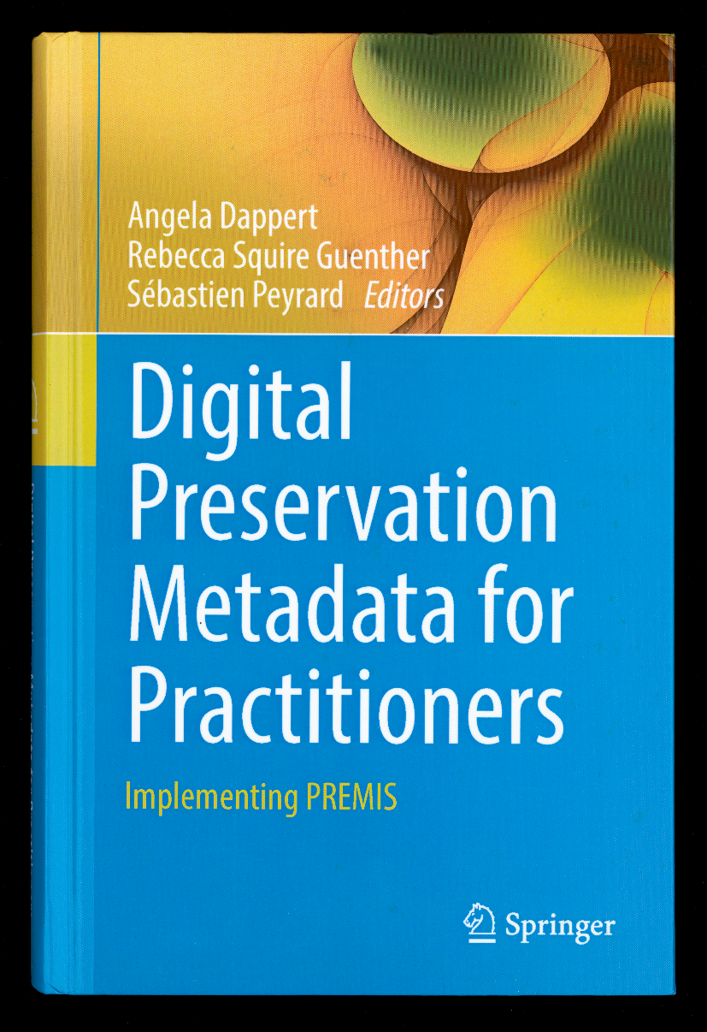
Book
ISBN E-book:
978-3-319-43763-7
ISBN Hardcover:
978-3-319-43761-3
http://www.springer.com/gp/book/9783319437613

Slide 118
Exercises
Today have been really filled!
Three exercises to start working with PREMIS metadata
  Print them out!
Solutions is also published!
The aid is seen on next slide
On your own!

Slide 119
Sample Data Dictionary table of contents
Version 3 Hierarchical listing of semantics units.pdf https://doi.org/10.5281/zenodo.5569578
On your own!

Slide 120
PREMIS Object Entity – Exercise
Exercise and answers to get a feeling for the object!
  https://doi.org/10.5281/zenodo.5569614
Page 1
  Find the different object types!
The rest of the pages
  With the data stated, fill your PREMIS semantic units.
  Take help from the hand-out with all the semantic units!
On your own!

Slide 121
PREMIS Events, Agents and Rights Entity – Exercise
Exercise to get a feeling for the events, agents and rights!
  https://doi.org/10.5281/zenodo.5569644
For the pages
  With the data stated, fill your PREMIS semantic units.
  Take help from the hand-out with all the semantic units!
On your own!

Slide 122
PREMIS Environments – Exercise
Exercise to get a feeling for the environments!
  https://doi.org/10.5281/zenodo.5569651
For the pages
  With the data stated, fill your PREMIS semantic units.
  Take help from the hand-out with all the semantic units!
On your own!

Slide 123
Extra example to look at on your own
Main page: http://id.kb.dk/index_UK.html
Showed example: http://id.kb.dk/metadata/structure.html
Postcard: http://id.kb.dk/metadata/postcardExample.html
Link to paper: https://mfr.de-1.osf.io/render?url=https://osf.io/kfetm/?direct%26mode=render%26action=download%26mode=render

Slide 124
Today
You have had an introduction to PREMIS!
Use the resources to learn more!
Participate in the discussions!

Slide 125
menti.com

Slide 126
Finally…
PREMIS is a community standard.
Send examples
Ask questions
Send suggestions
Take part!

Slide 127
Thank you!
Karin, Eld and Micky

