Slide 1


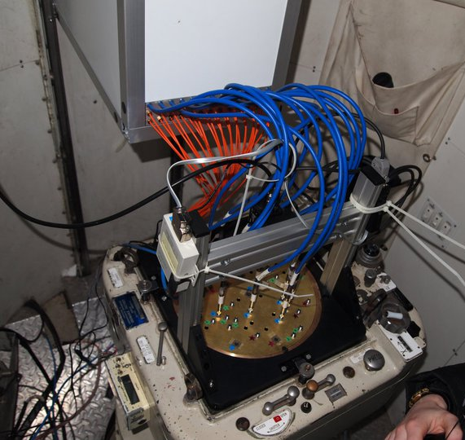
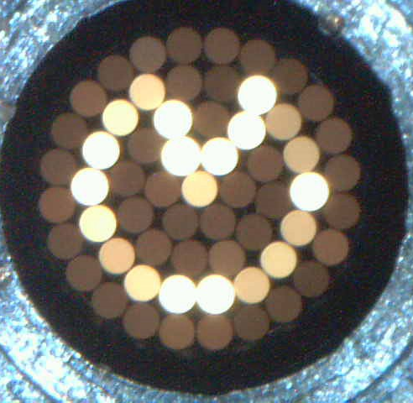


The SAMI Galaxy Survey:
The impact of the cluster environment on the star formation of infalling galaxies
Matt Owers
(Macquarie University and
Australian Astronomical Observatory)
+SAMI Galaxy Survey team
@SAMI_survey

Slide 2
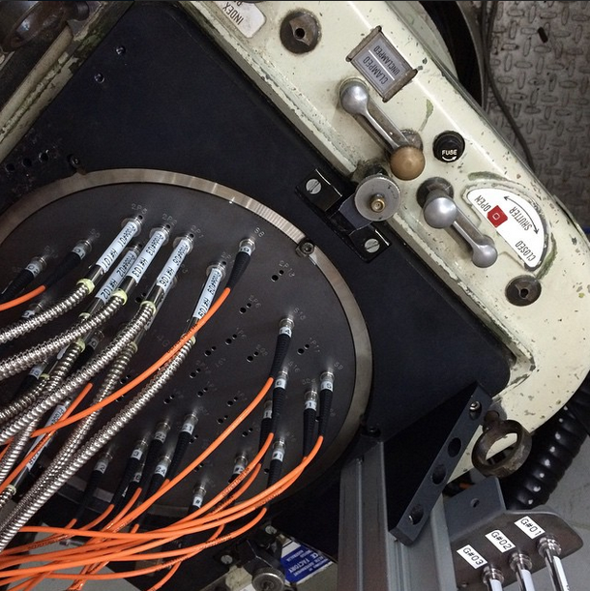
The SAMI Galaxy Survey
SAMI=Sydney-Australian-Astronomical-Observatory Multi-object Integral-Field Spectrograph
Resolved spectroscopy for 3400 galaxies -> 2200 galaxies to date (see Bryant+2015 for survey details)
Primary fields from GAMA (http://www.gama-survey.org).
  Three 4x12 deg equatorial regions at 9hr, 12hr & 15hr
  Deep, complete, spectroscopy to r=19.8
  Robust group catalogue (Robotham et al. 2011).
  21-band photometry: far UV to far IR (Driver+2016).
Wavelength coverage/resolution:
  Blue: 3700-5800A, R~1750, σ=70km/s
  Red: 6300-7400A, R~4500, σ=30km/s
8 Clusters targeted (~880 gals -> ~700 to date).
61 1.6” fibres
15” diameter
1degree FOV
13 hexabundles
Notes:
SAMI instrument houses 13 hexabundles over a 1dge FOV. The bundles are 15” across and harbour 61 1.6” fibres. These fibres feed the AAOmega spectrograph on the AAT
The SAMI galaxy Survey makes use of the upgraded SAMI instrument which was installed on AAT in Feb 2013.
The survey aims to observing 3400 galaxies over 3.5 years and targets galaxies in the GAMA regions.
3 main points separating SAMI GS from surveys like MANGA and Califa: Ancillary data from GAMA, high spectroscopic res at Halpha (disentangle kinematic components of outflows, HII regions, dwarf galaxy kinematics), 8 cluster regions to probe the densest environments.
Emphasis environments.
No clusters in GAMA at z<0.1, so target selected clusters for full range of environments.

Slide 3
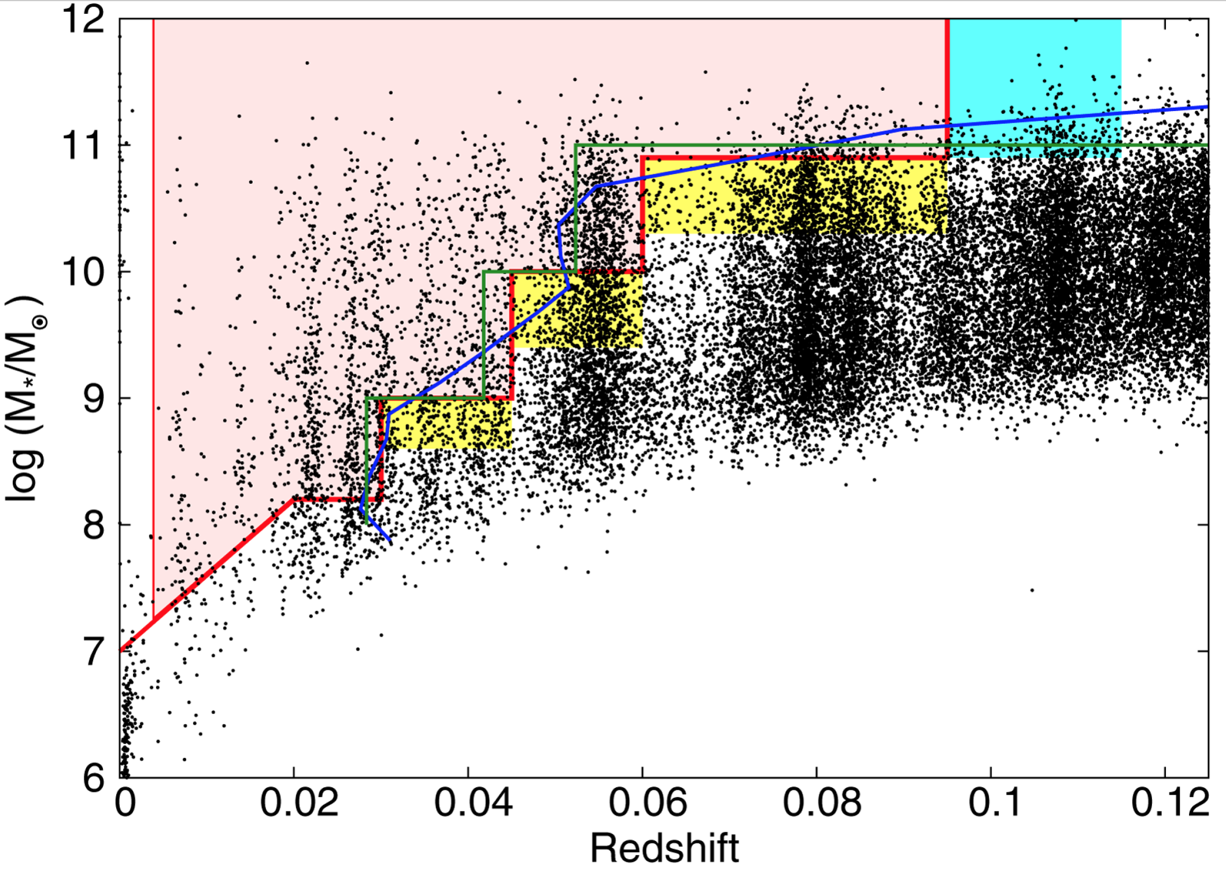
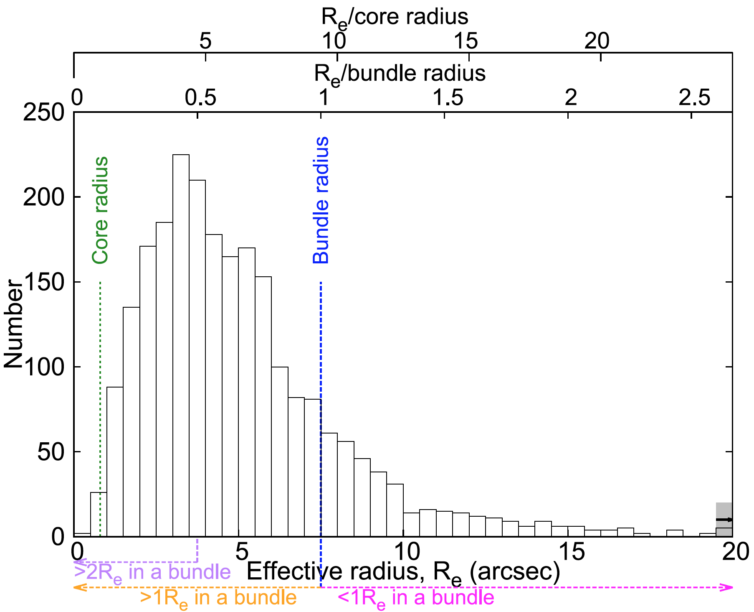
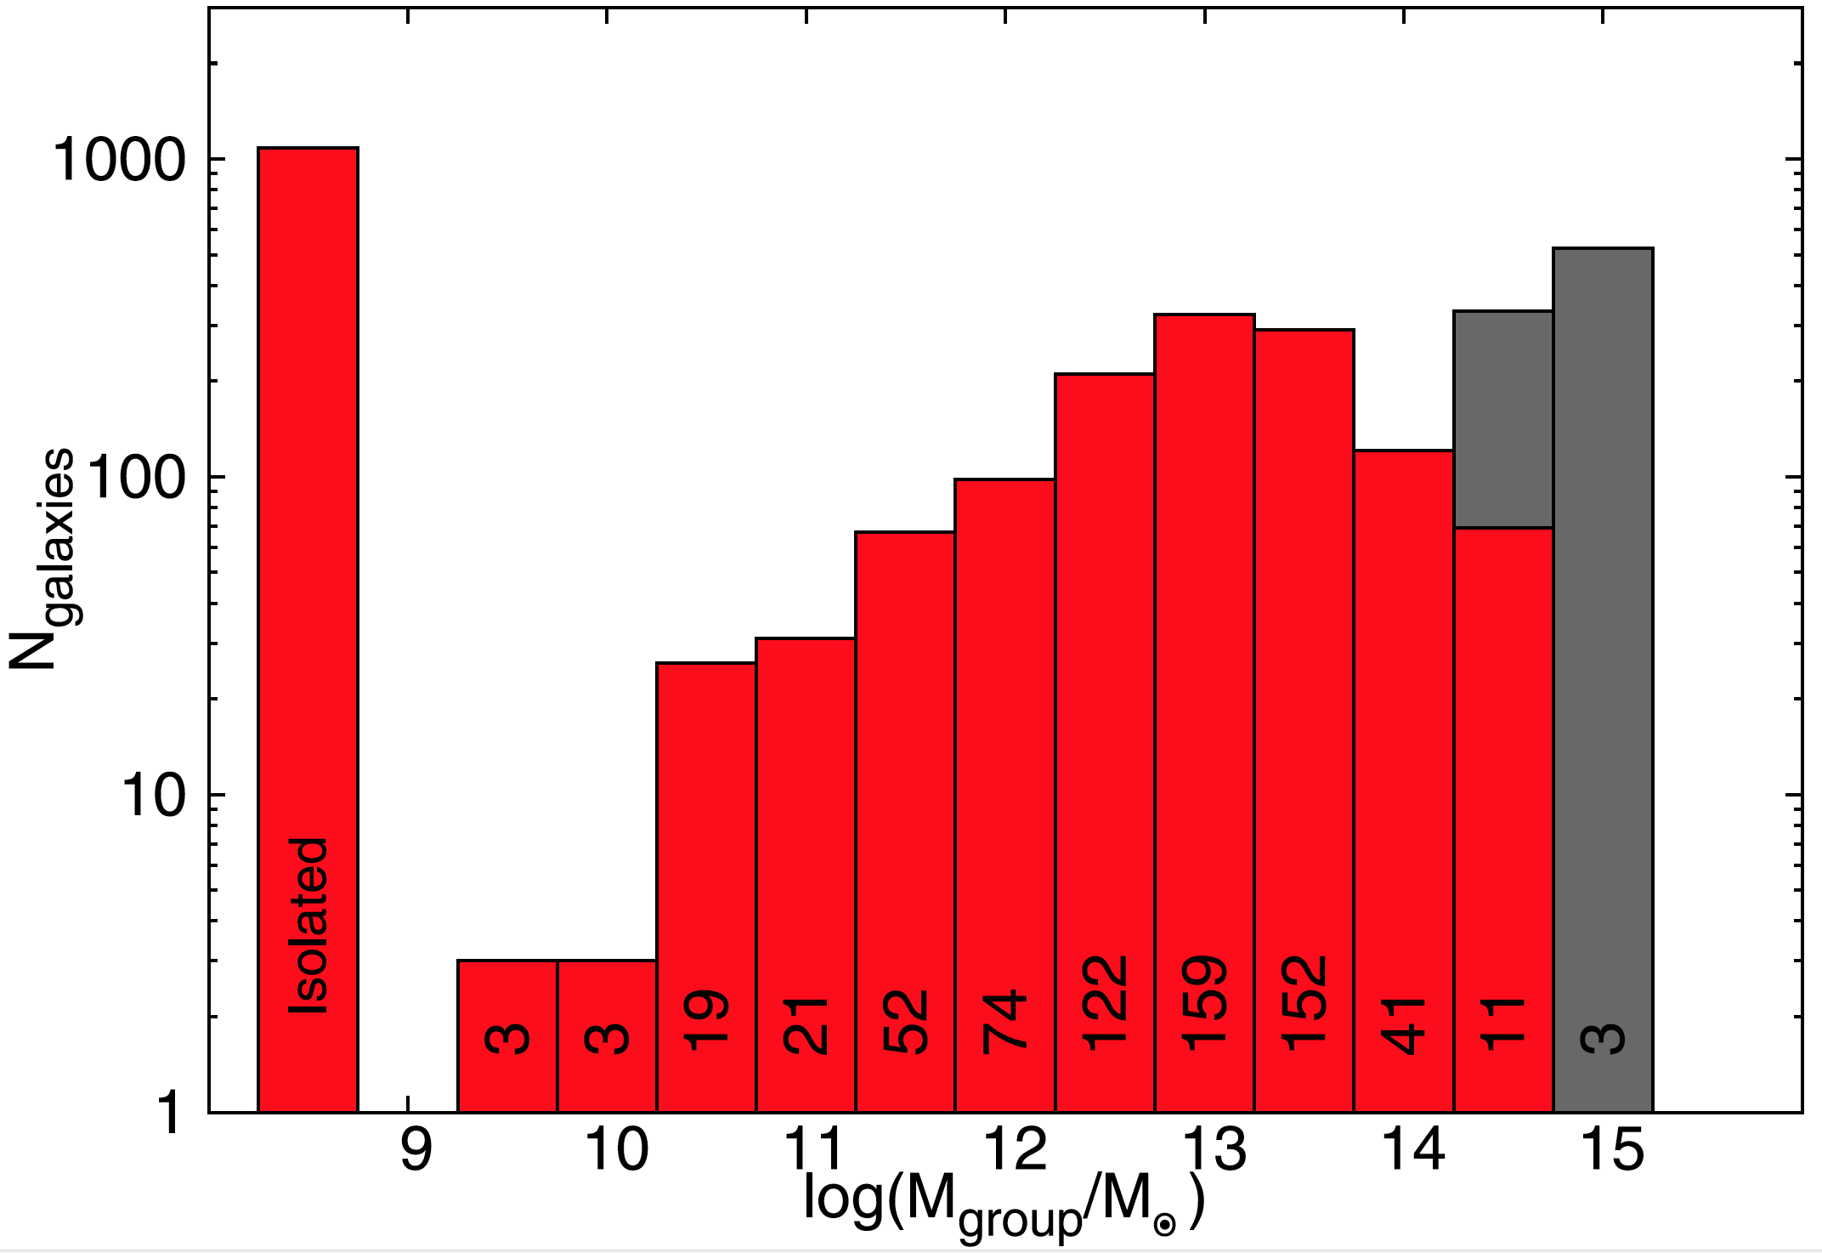
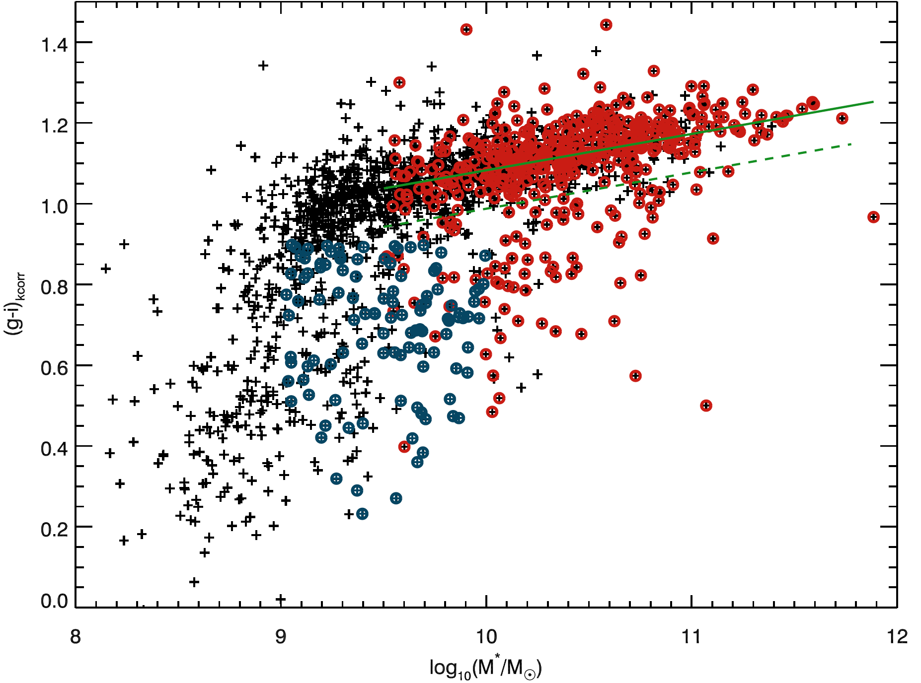
SAMI Galaxy Survey Targets
Bryant+(2015), Owers+(2017)
Median Re ~4.4”
10-90% range=1.8-9.4”
Sample ~1Re for majority
S/N~15/spaxel/Å @ 1Re
M* and volume-limited selection
~2/3 of GAMA galaxies in groups
z<0.045
z>0.045
Notes:
Stellar mass selected and volume limited.
Median major axis Re=4.4” (10-90% range 1.8-9.4”)
IFU samples to median 1.7Re.
~2/3 of galaxies in GAMA group catalogue (Robotham et al. 2011).
Median S/N=15, spaxel⁻¹ Å⁻¹ at 1 Re, V-band continuum S/N=15 (10-90% range 2-37).
Flux calibration: better than 5% over full spectral range.
Sample is stellar mass selected and volume limited.
Target cluster galaxies within R₂₀₀ & with:
M*>10^{9.5}M for z_{clus} < 0.045
M*>10¹⁰M for z_{clus} > 0.045
Blue cloud galaxies with stellar masses 0.5 dex below these limits included as filler targets.
The leads to a typical size of 4.4” in Re, so a median of 1.7Re for IFUs.
The deep group catalogue means that 2/3 of galaxies in “groups”, although some very low mass and just pairs.

Slide 4
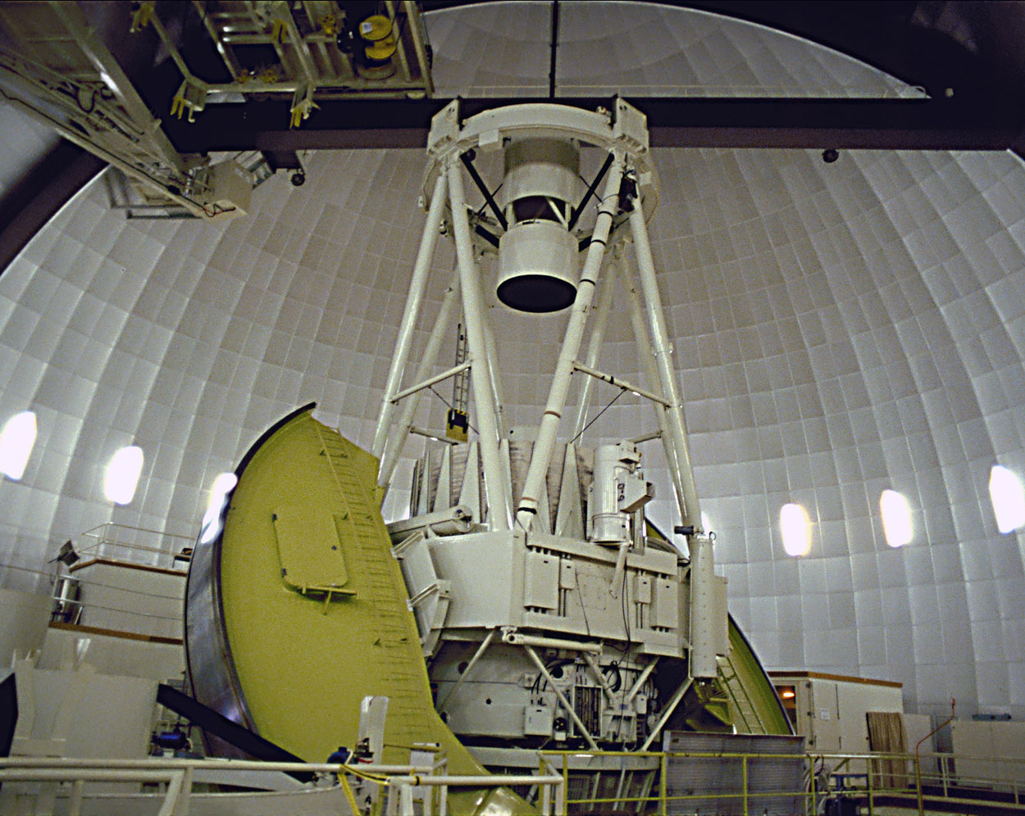
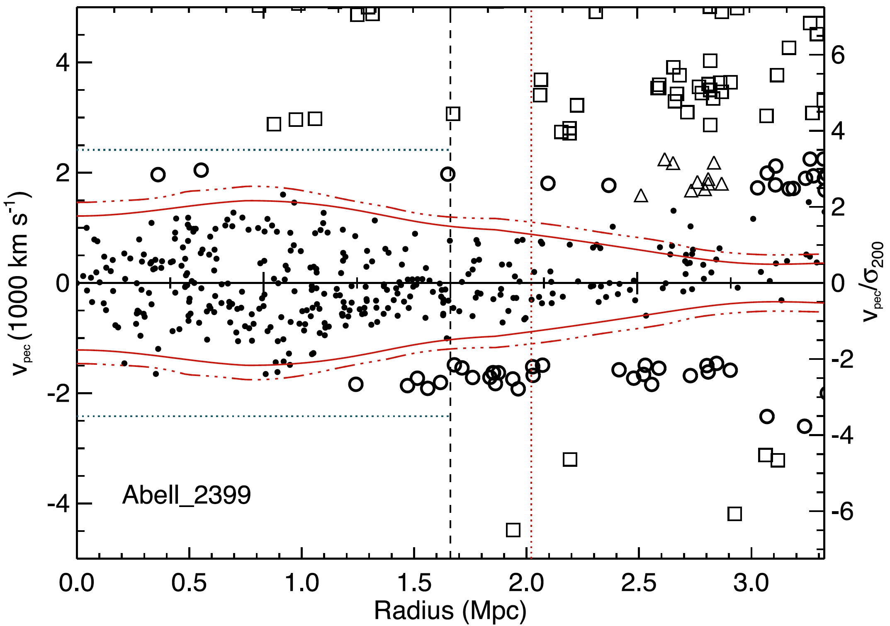
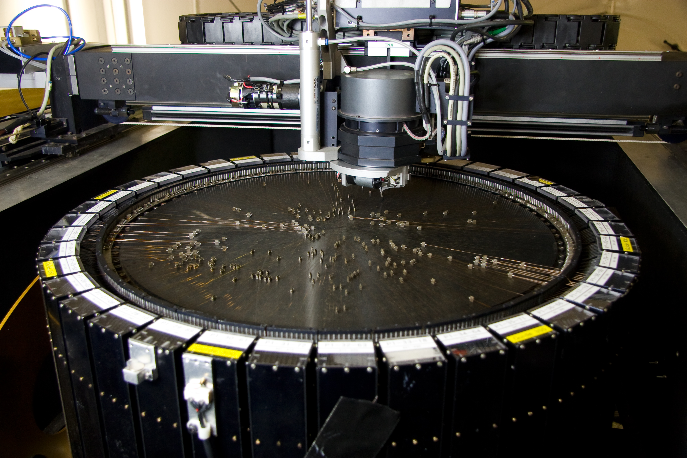
The SAMI Cluster Redshift Survey
(Owers+2017)
7 nights using 2dF/AAOmega on the AAT.
~21,000 spectra to r_{petro} < 19.4, R < 2-3R₂₀₀.
Completeness ~95% to r_{petro} = 19.4, R<R₂₀₀.
Around 2850 cluster members (R<2R₂₀₀).
Cluster members
Caustics trace escape
velocity profile.
Non-members
Notes:
Aim to collect kinematical tracers to probe the environment in a similar manner as the GAMA regions.
(thanks mainly to help from James Allen, Gerald Cecil, Andy Green, Smriti Mahajan, Mike Pracy, Aaron Robotham, Ivan Baldry, Sarah Sweet)
2df AAOmega is awesome for cluster studies!

Slide 5
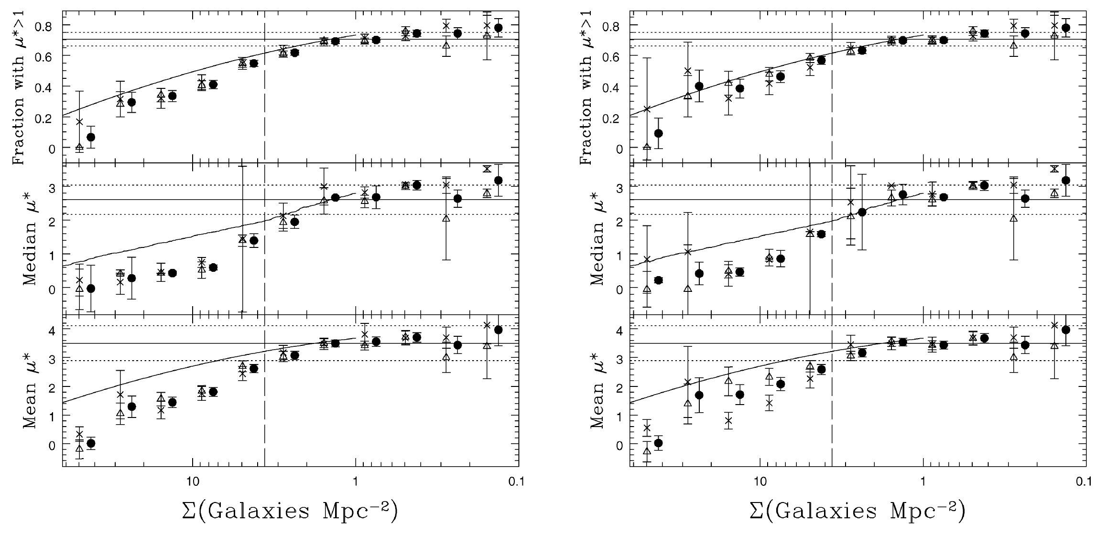
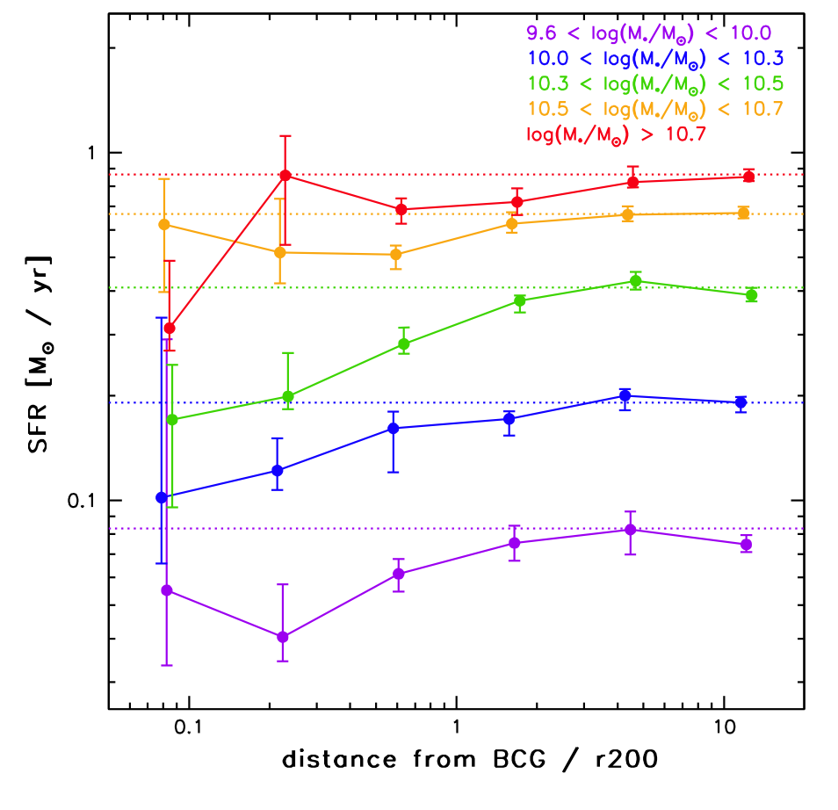
Correlation between galaxy properties and environment.
Fraction of SFR gals lower cf field (Lewis 2002)
Decline in SFR with radius (von der Linden 2010)
R < Rvir
R > 2Rvir
See also Haines+13, Paccagnella+16
Notes:
Two intriguing correlations: morphology-density relation showing field dominated by star forming spirals, clusters by red, dead spheroidals.
SF-density correlation exists too.
Hierarchical structure formation: field galaxies fall into clusters. Some mechanism must act to stop star formation and transform morphology in order to reconcile hierarchical structure formation with these correlations.
Slow decline with few PSB galaxies favours a quenching timescale on the order of the 2.5Gyr cluster crossing time.

Slide 6

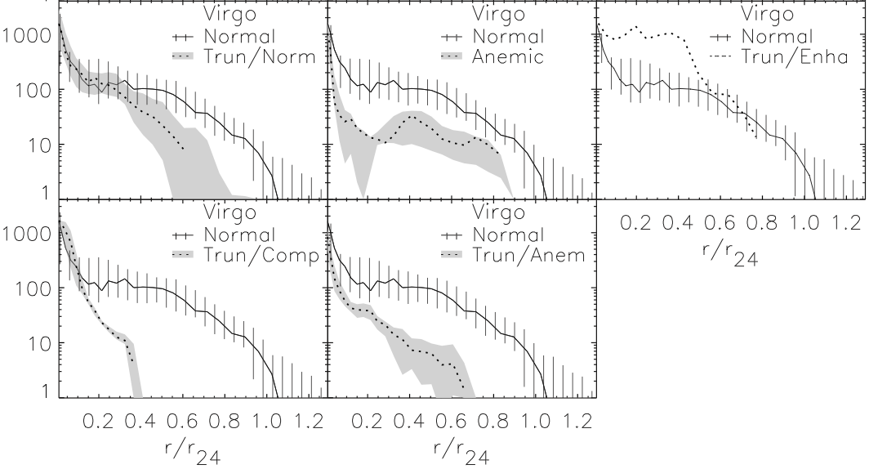
Correlation to Causation: Identifying environment-driven transformation.
Koopmann & Kenney (2004) show 50% of spiral galaxies in Virgo cluster have truncated Hα distribution.
Notes:
Two key results: large scale surveys show us the correlations, more detailed investigations of virgo cluster galaxies tell us that truncation occurs fairly rapidly from the outside in.
Truncated in the outskirts for 50% of spirals, most having normal star formation in the centres. Stellar component relatively smooth and undisturbed. Suggests gas-gas process such as ram pressure stripping. Many of the 50%
Virgo spiral galaxies have mostly sharply truncated radial distributions of Ha (i.e. SF) and the stellar populations outside these truncation radii are consistent with being truncated rapidly within the last 500Myrs.

Slide 7
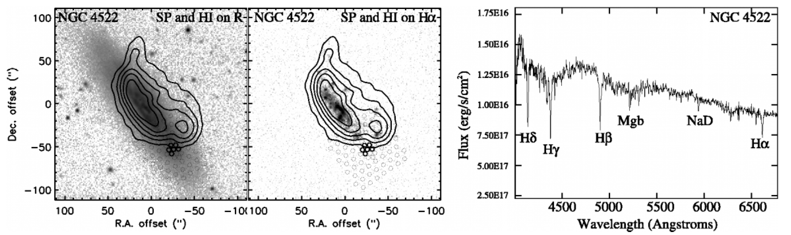
Moving from Correlation to Causation.
Crowl & Kenney (2006, 2008): IFU spectra show stellar pop. ages outside truncation radius <500Myr -> rapid shutdown of star formation.
10 galaxies in Virgo cluster – representative?
Answer with IFU data for large sample across range of clusters.
Notes:
- STAR FORMATION RATES IN THE CENTRE ARE NOT AFFECTED – APERTURE EFFECTS!!
-NEED RESOLVED SPECTROSCOPY.
ONLY BASED ON 10 GALAXIES IN ONE CLUSTER!!!!!
Also found evidence at larger radius. Due to dynamics of Virgo? Need more clusters to understand general picture.
Resolved HI: hard to get Virgo-like data for many clusters.
Optical signatures: handful of galaxies in Virgo – representative?
Is this the dominant mechanism for transformation?
Need IFU data for larger sample across range of clusters to get a better handle on demographic sof these transition galaxies.

Slide 8
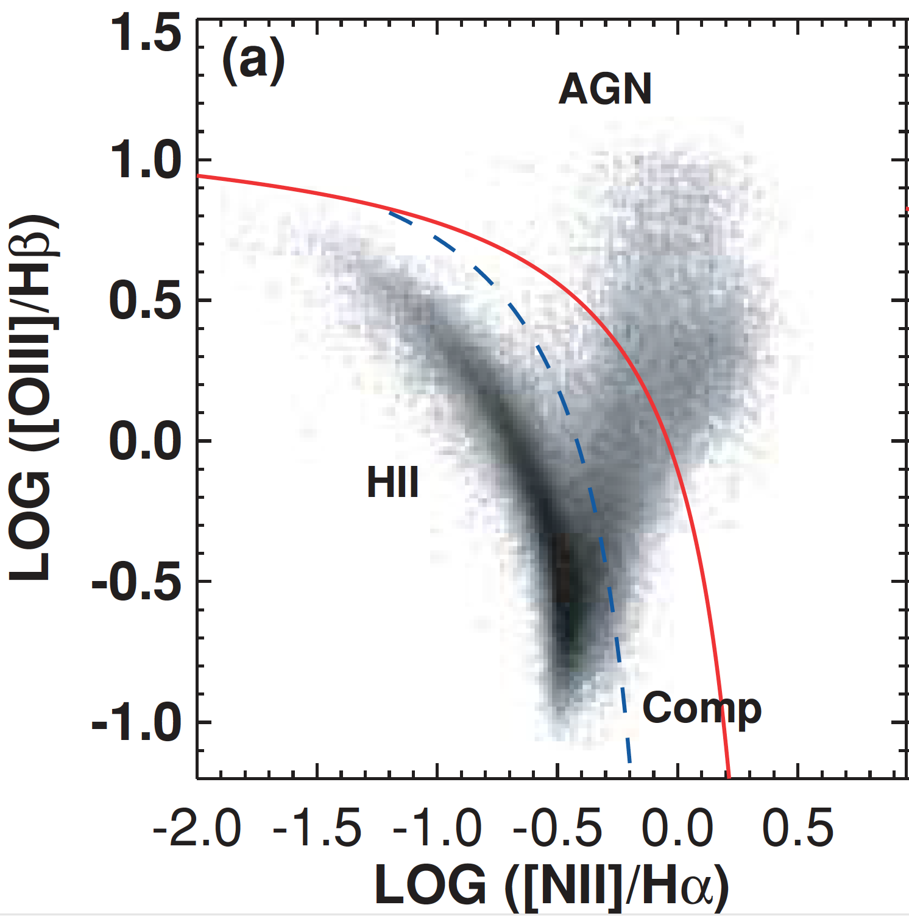
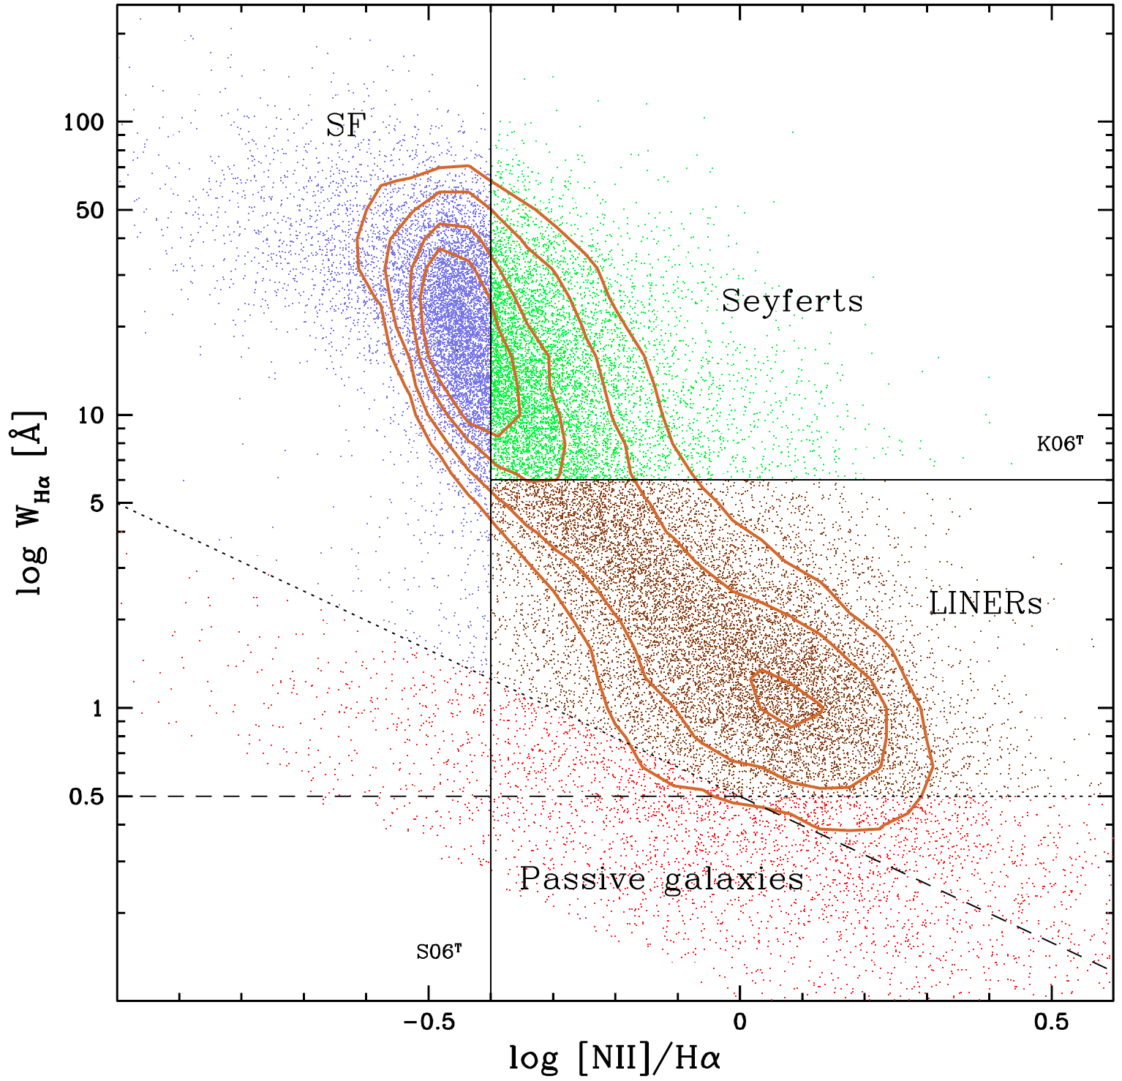
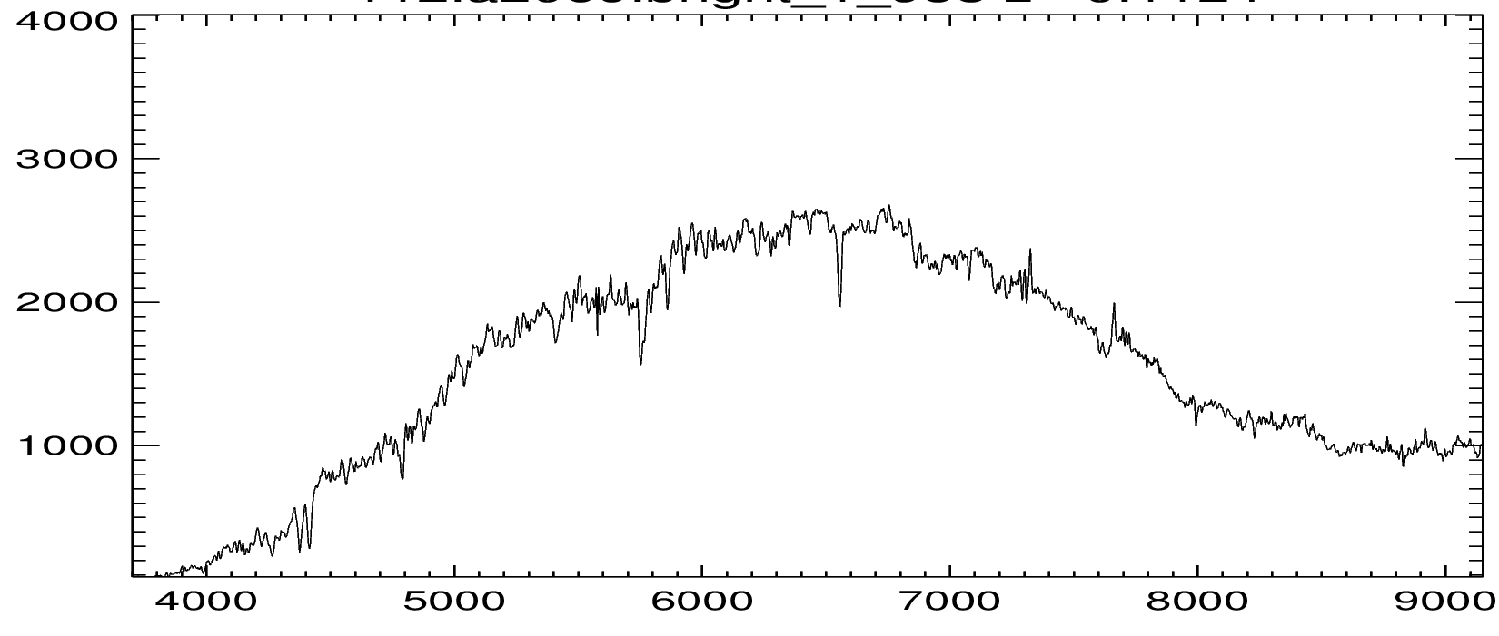
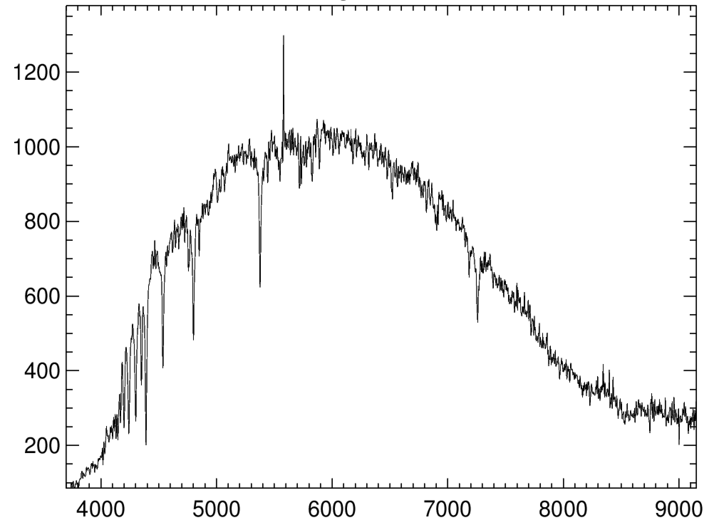
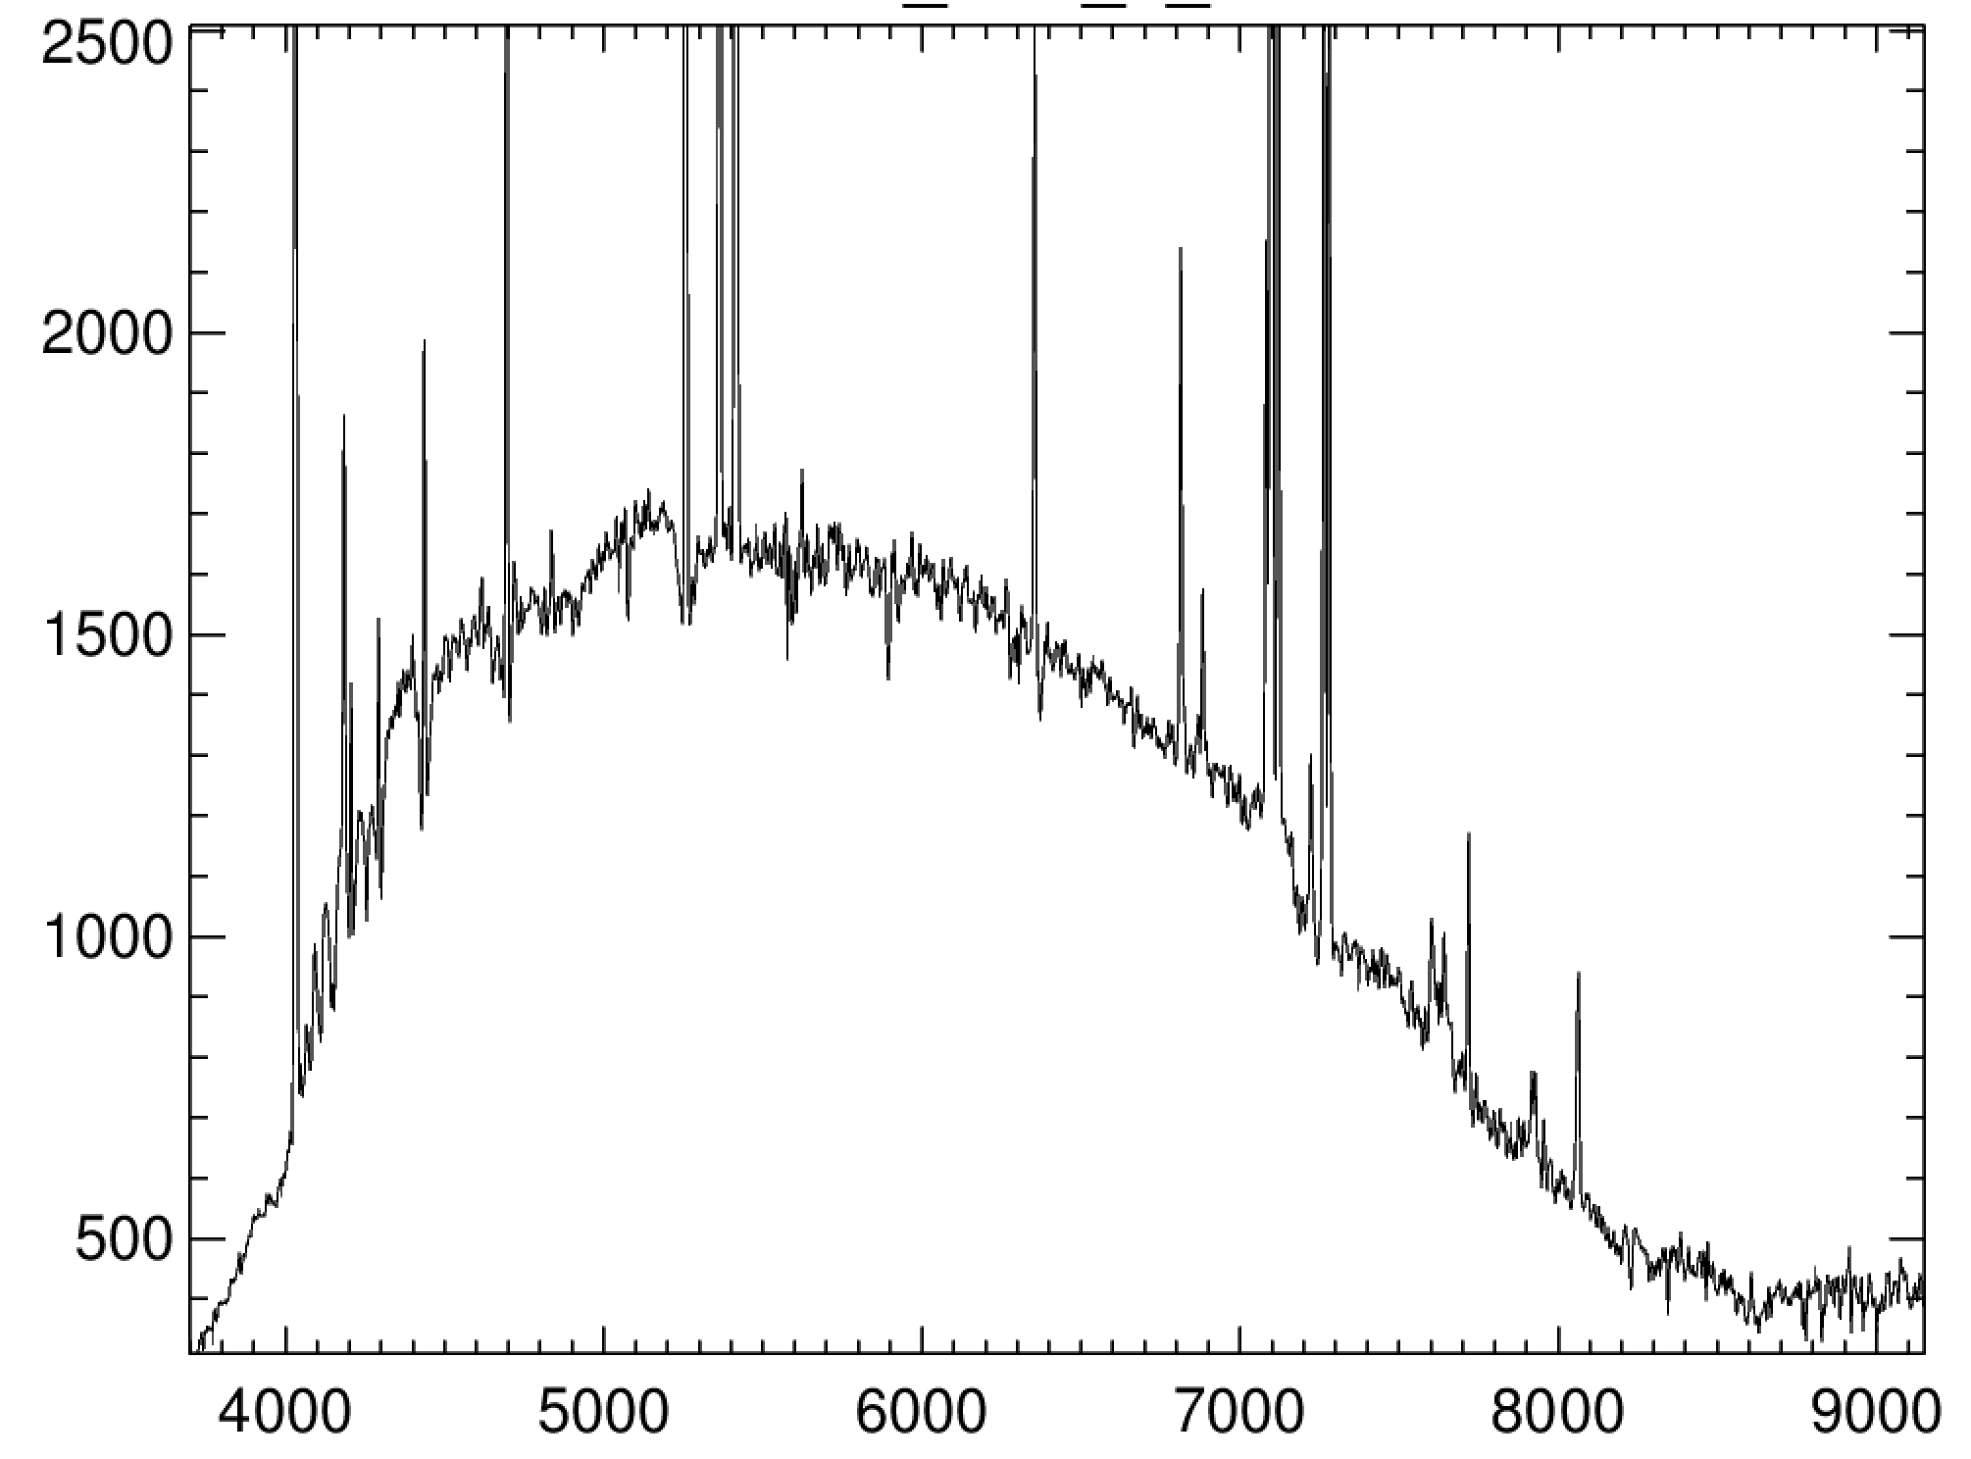
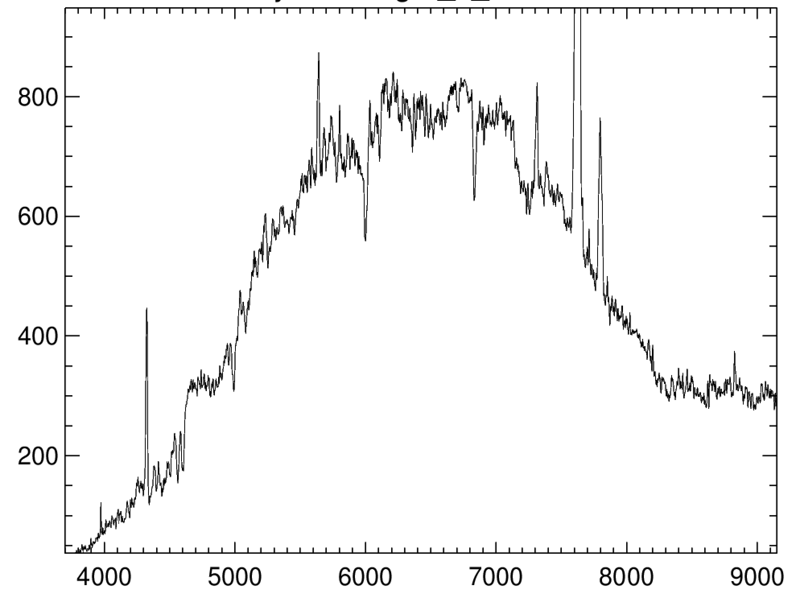
SAMI data: Resolved Spectroscopic Classification
Passive
Hδ strong
Kewley et al. (2006)
Cid Fernandes et al. (2011)
PAS: EW(Hδ) > -3Å
EW(Hδ) < -3Å
Absorption line
Starforming/Starbursting
Non-Starforming
Emission in at least Hα + 1 other
Emission line
NSF
COMP
Line ratio -> SF ionising src
Line ratio -> nonSF ionising src
Notes:
Passive have no emission lines and weak balmer absorption
Emission lines must have Halpha+on other with EW>2A and S/N>3.
HDS have no emission lines and significant absorption in Hd (>3A) with absorption also detected in Hb and Hg
Emission lines have two lines detected with EW < -1 && EW/EW_ERR > 1 for HA and (NII or NII or OIIIR or Hb or OII)
SF and AGNs are classified based on the line ratio NII/Ha and, where available NII/Ha and OIIIR/Hb. Different ionising field produced by SF and AGN produce different ratios in those species.
NonSF emission can be due to AGN, LINER/LIER and shock excited line emission.

Slide 9
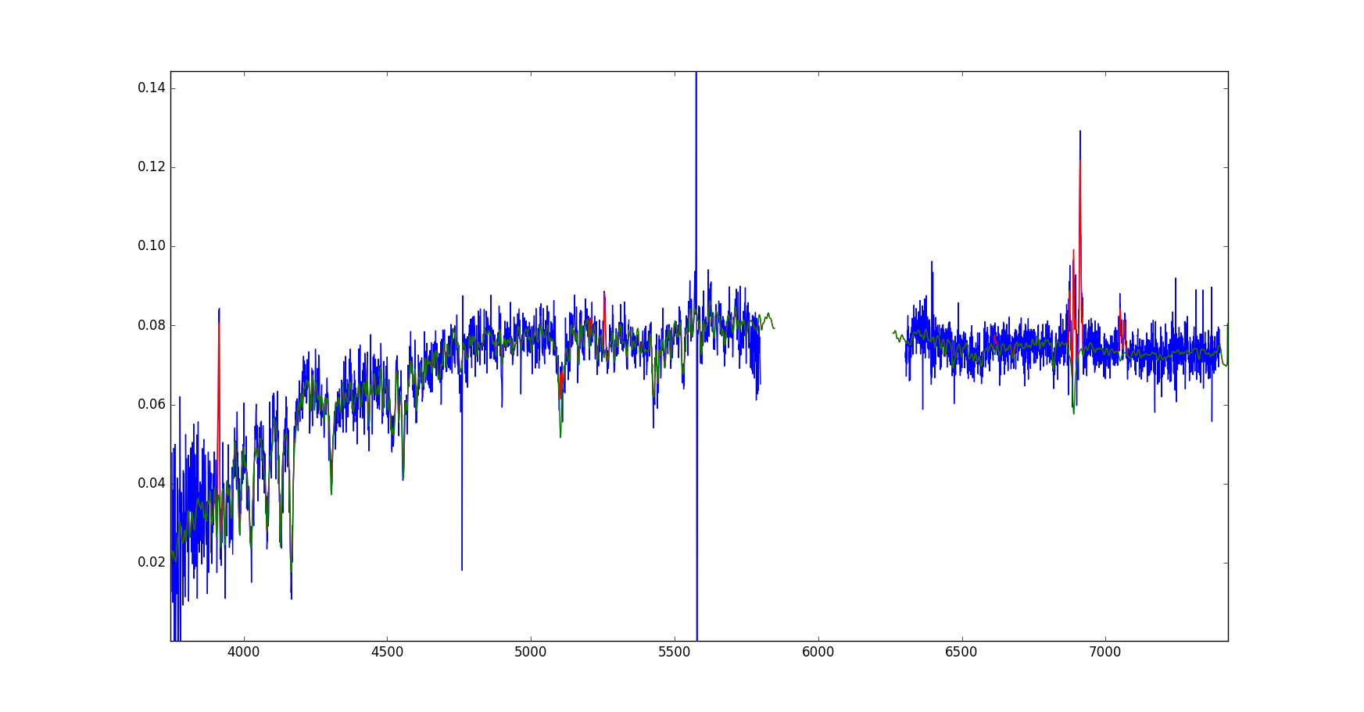
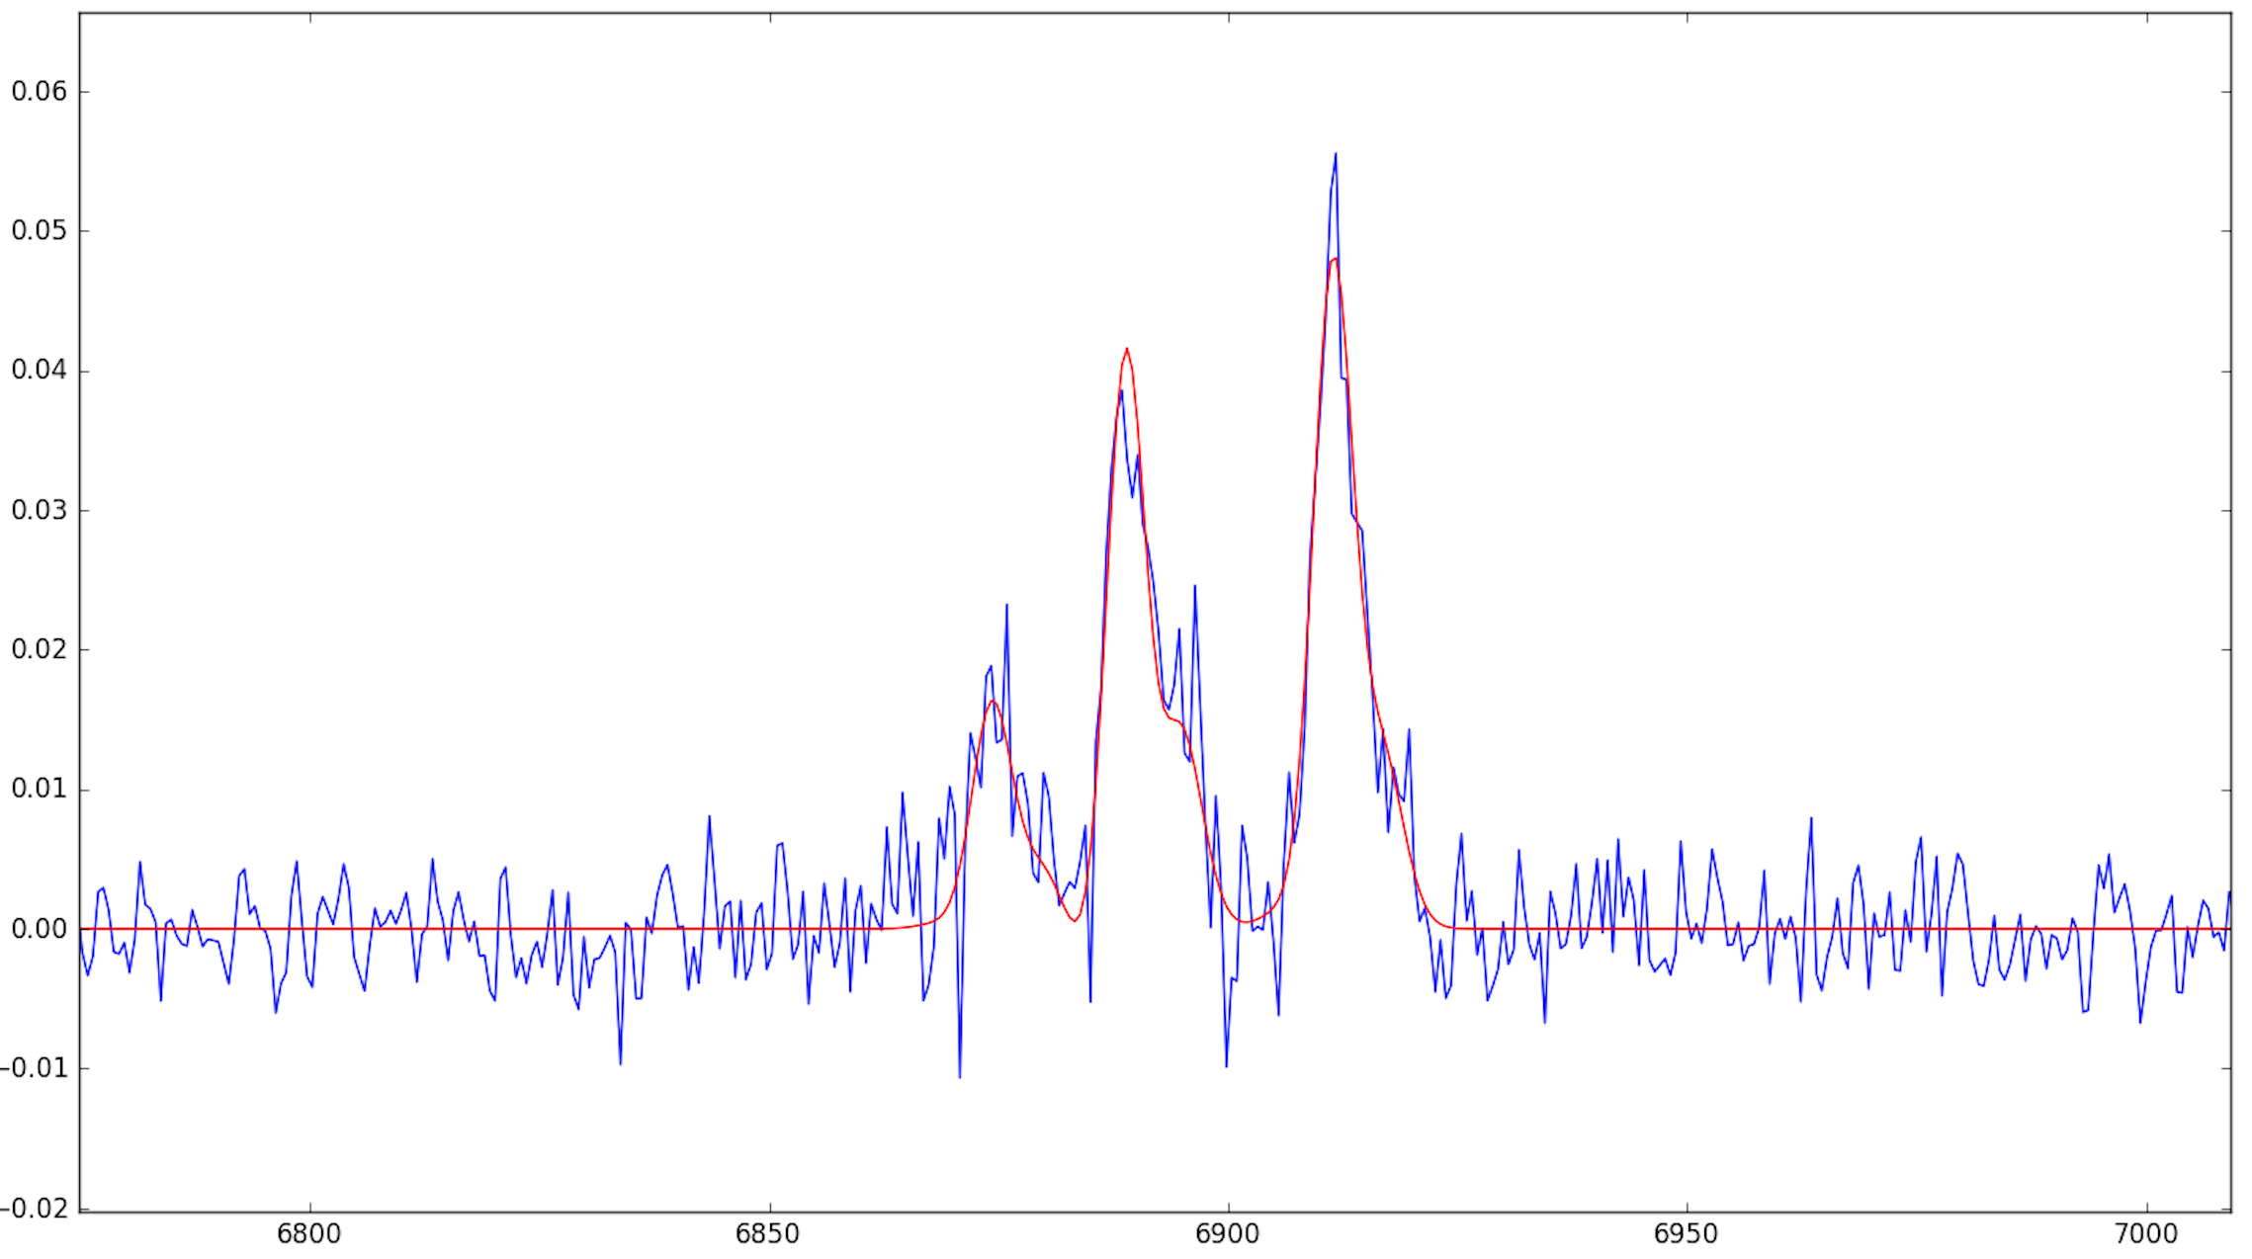
Also, Non-SF HDS
Strong Balmer with non-SF emission lines:
EW (Hδ) = -4.7Å
[NII 6583]/Hα = 1.16
[OIII 5007]/Hβ = 1.00
Notes:
Can also have HDS with emission that is non-starforming. Hybrid classification NSF HDS (non-starforming hdelta strong)

Slide 10
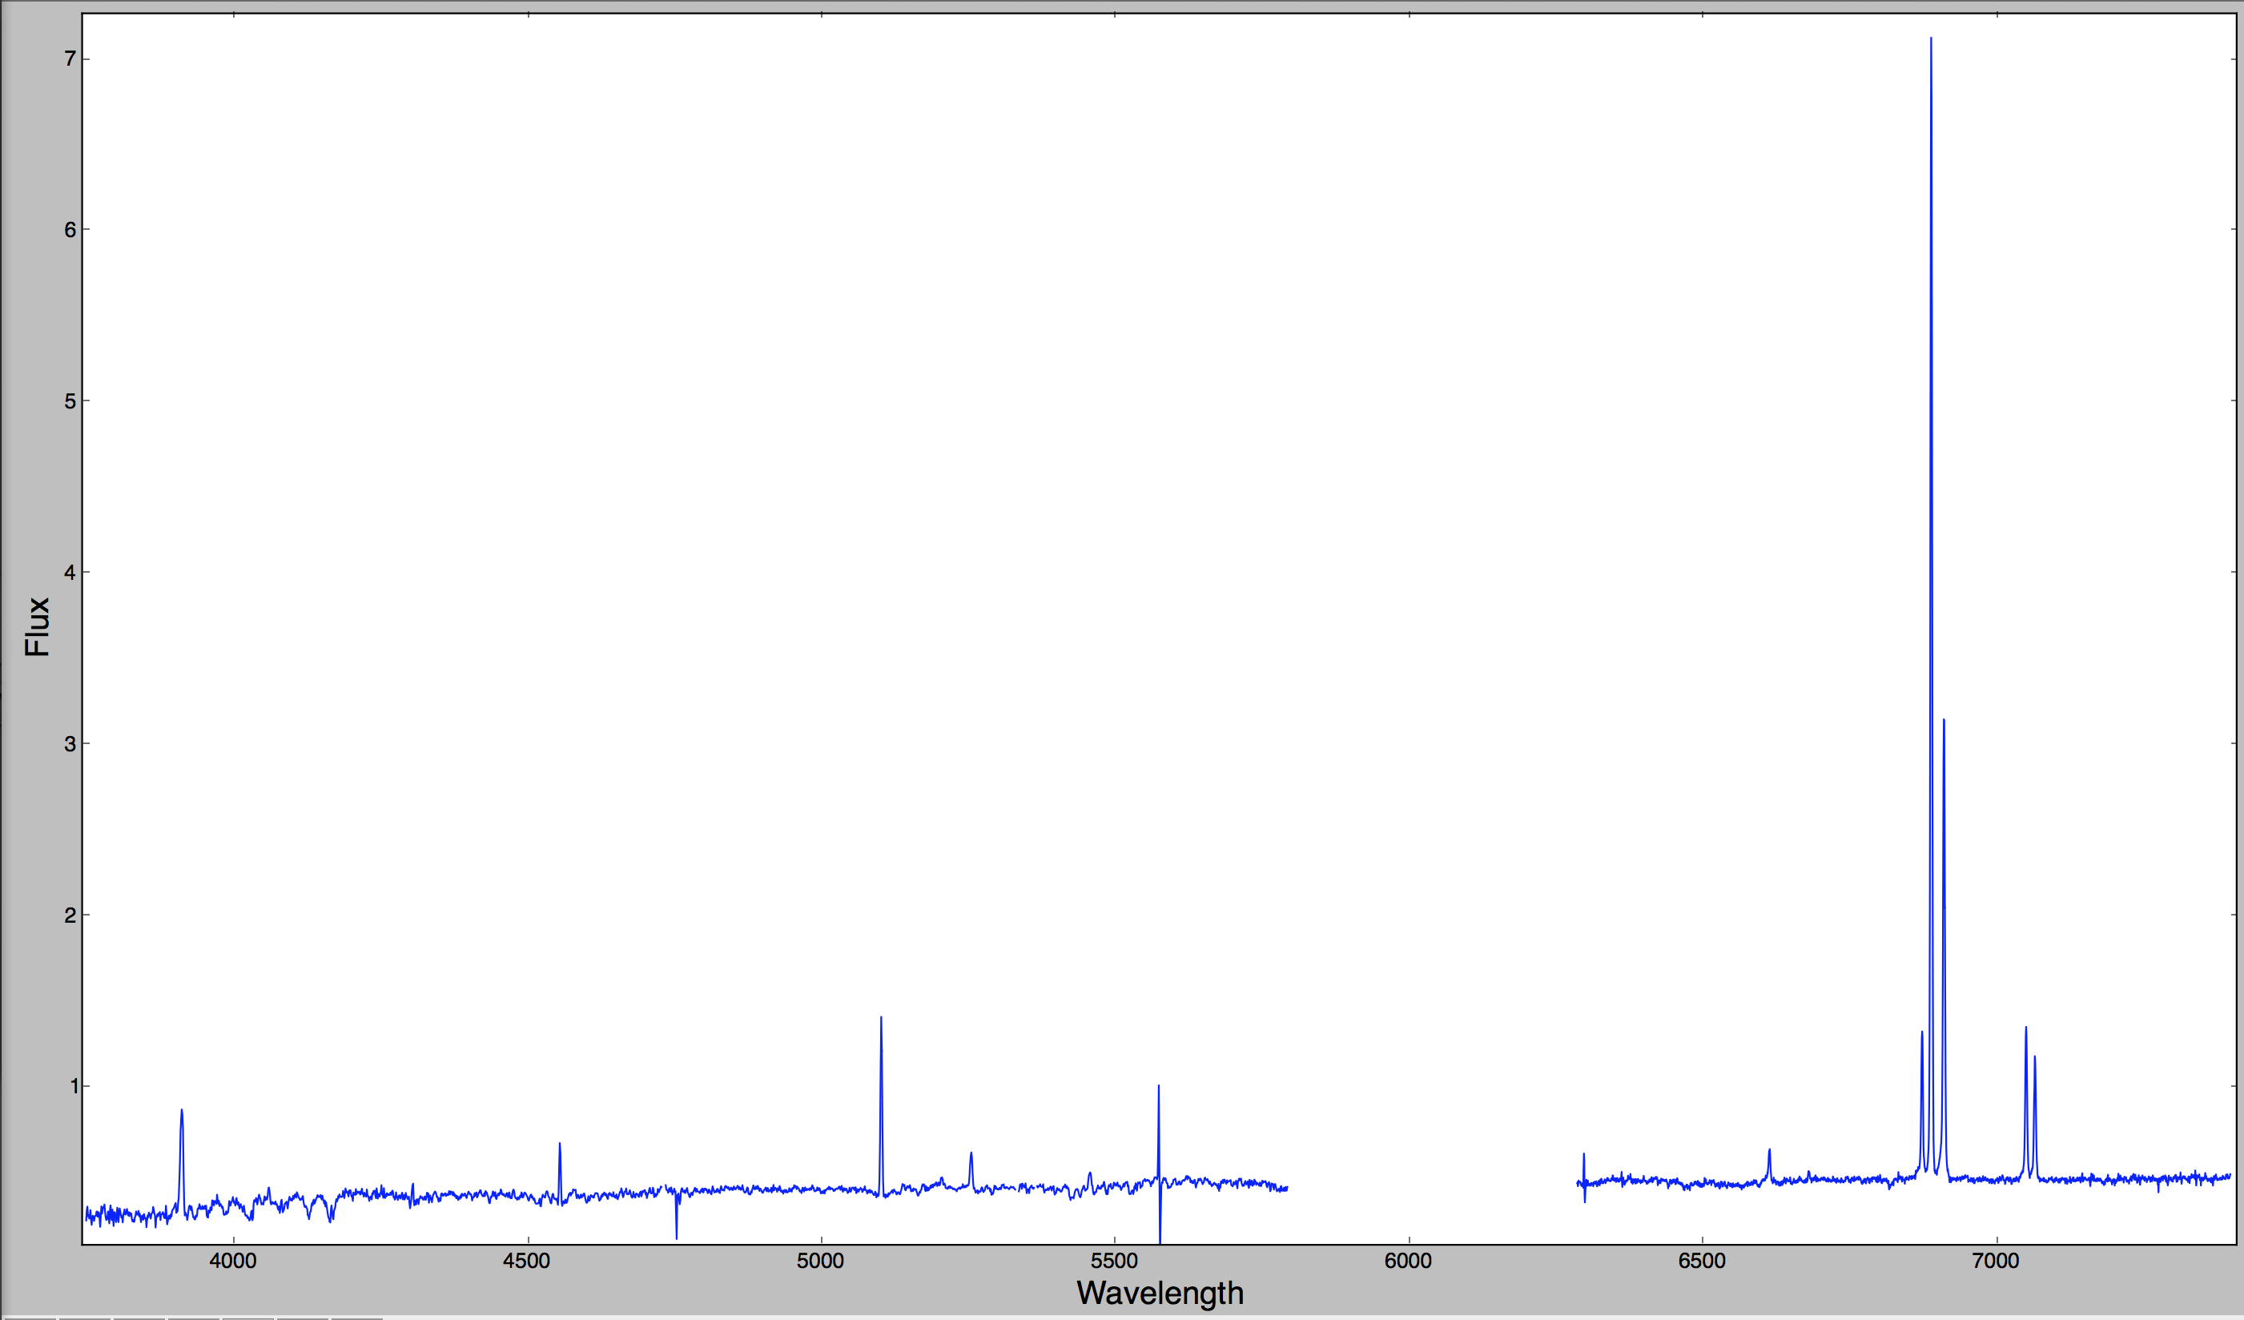
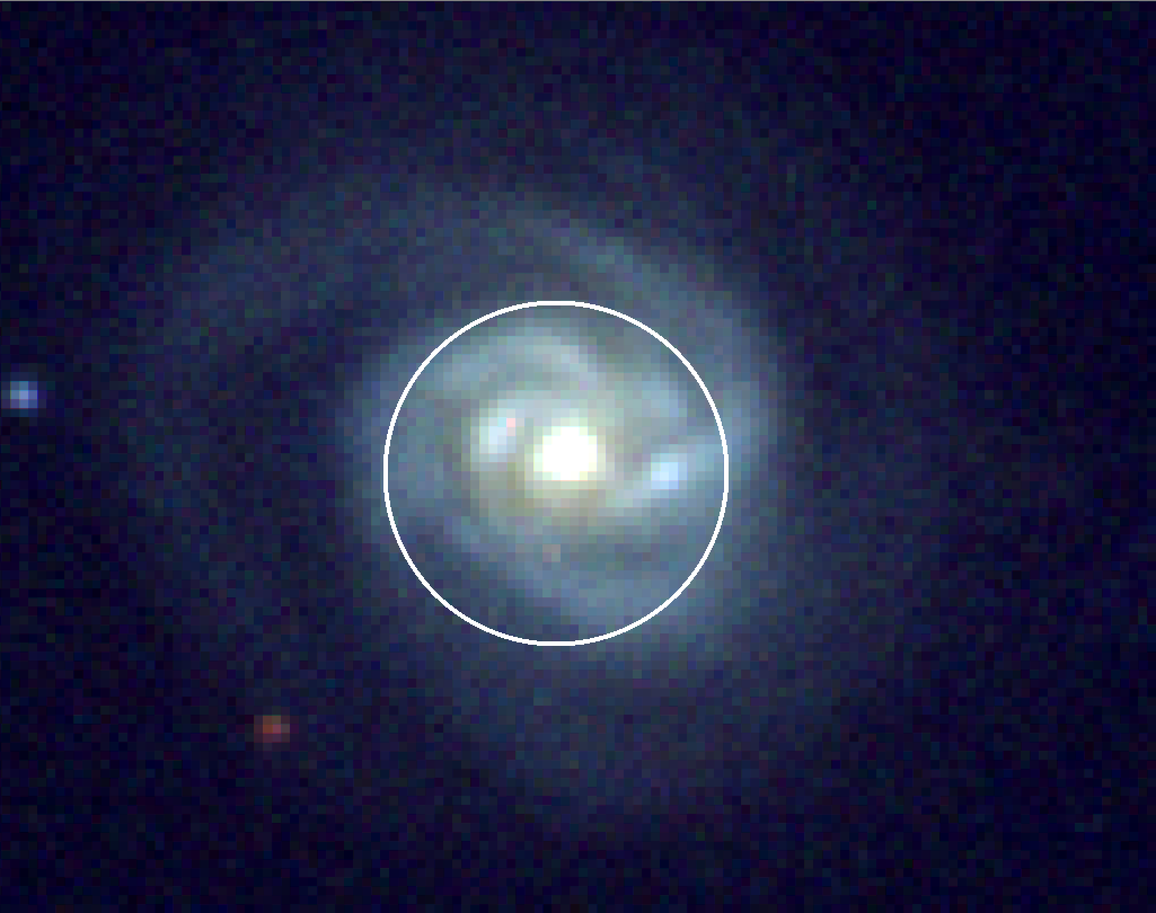
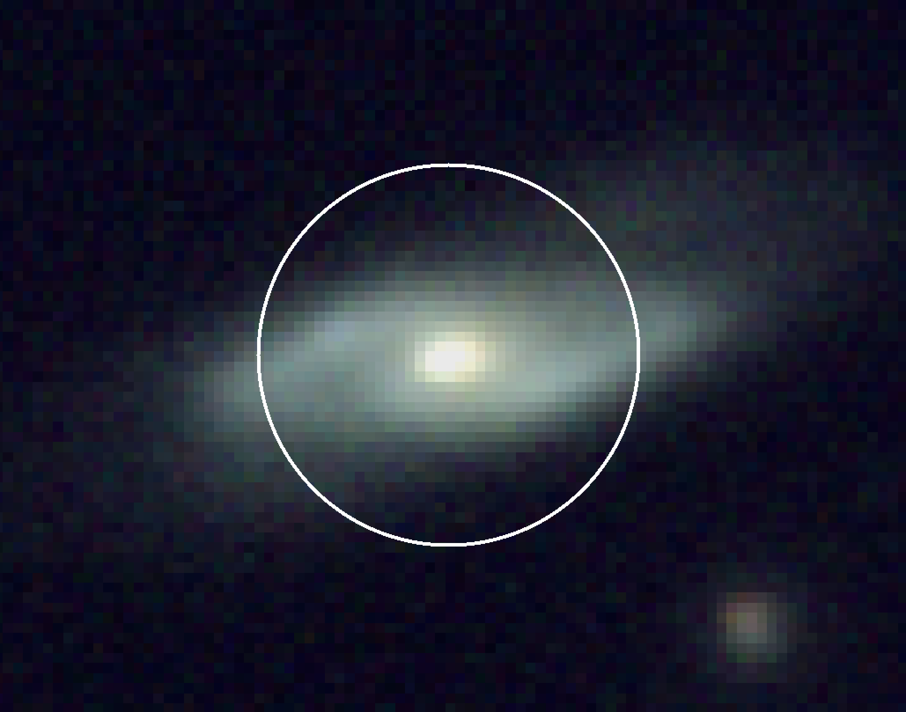
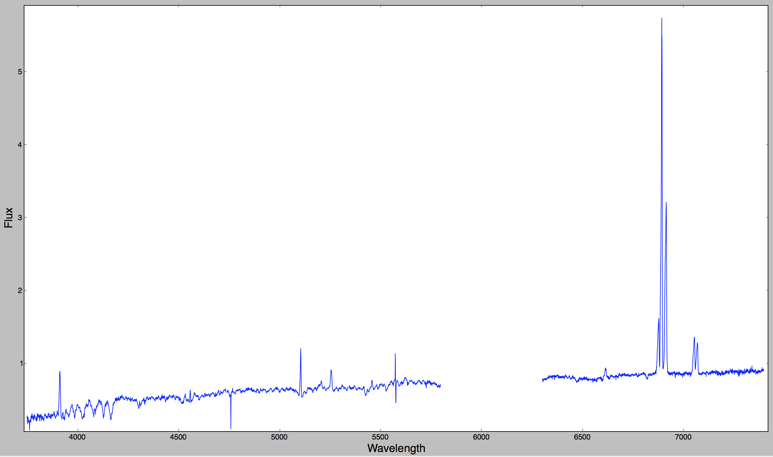
Disk galaxies in A119.
Starforming
Starforming
Notes:
Spectrum from the central part of the galaxies shows starforming classification

Slide 11
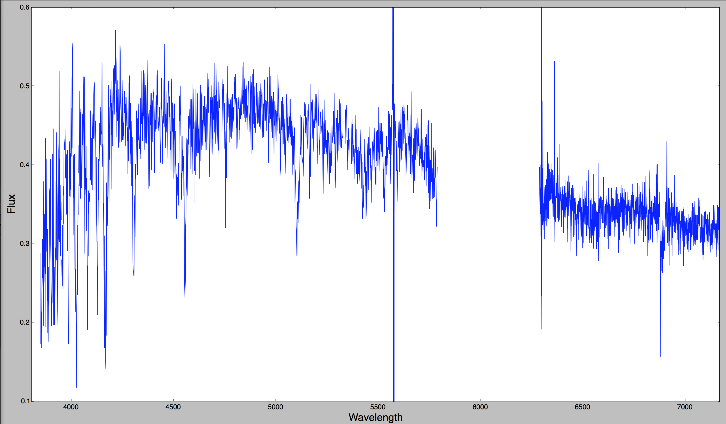
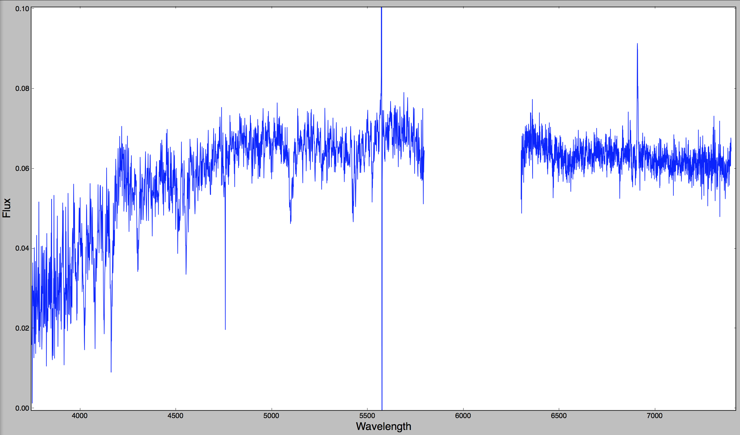
Disk galaxies in A119.
Hδ strong
NSF Hδ strong
Notes:
…but in the outer parts of the disk, we see very young stellar pops with no evidence for starformation.
Would have been classified as normal Sfing galaxy in single fibre survey.

Slide 12
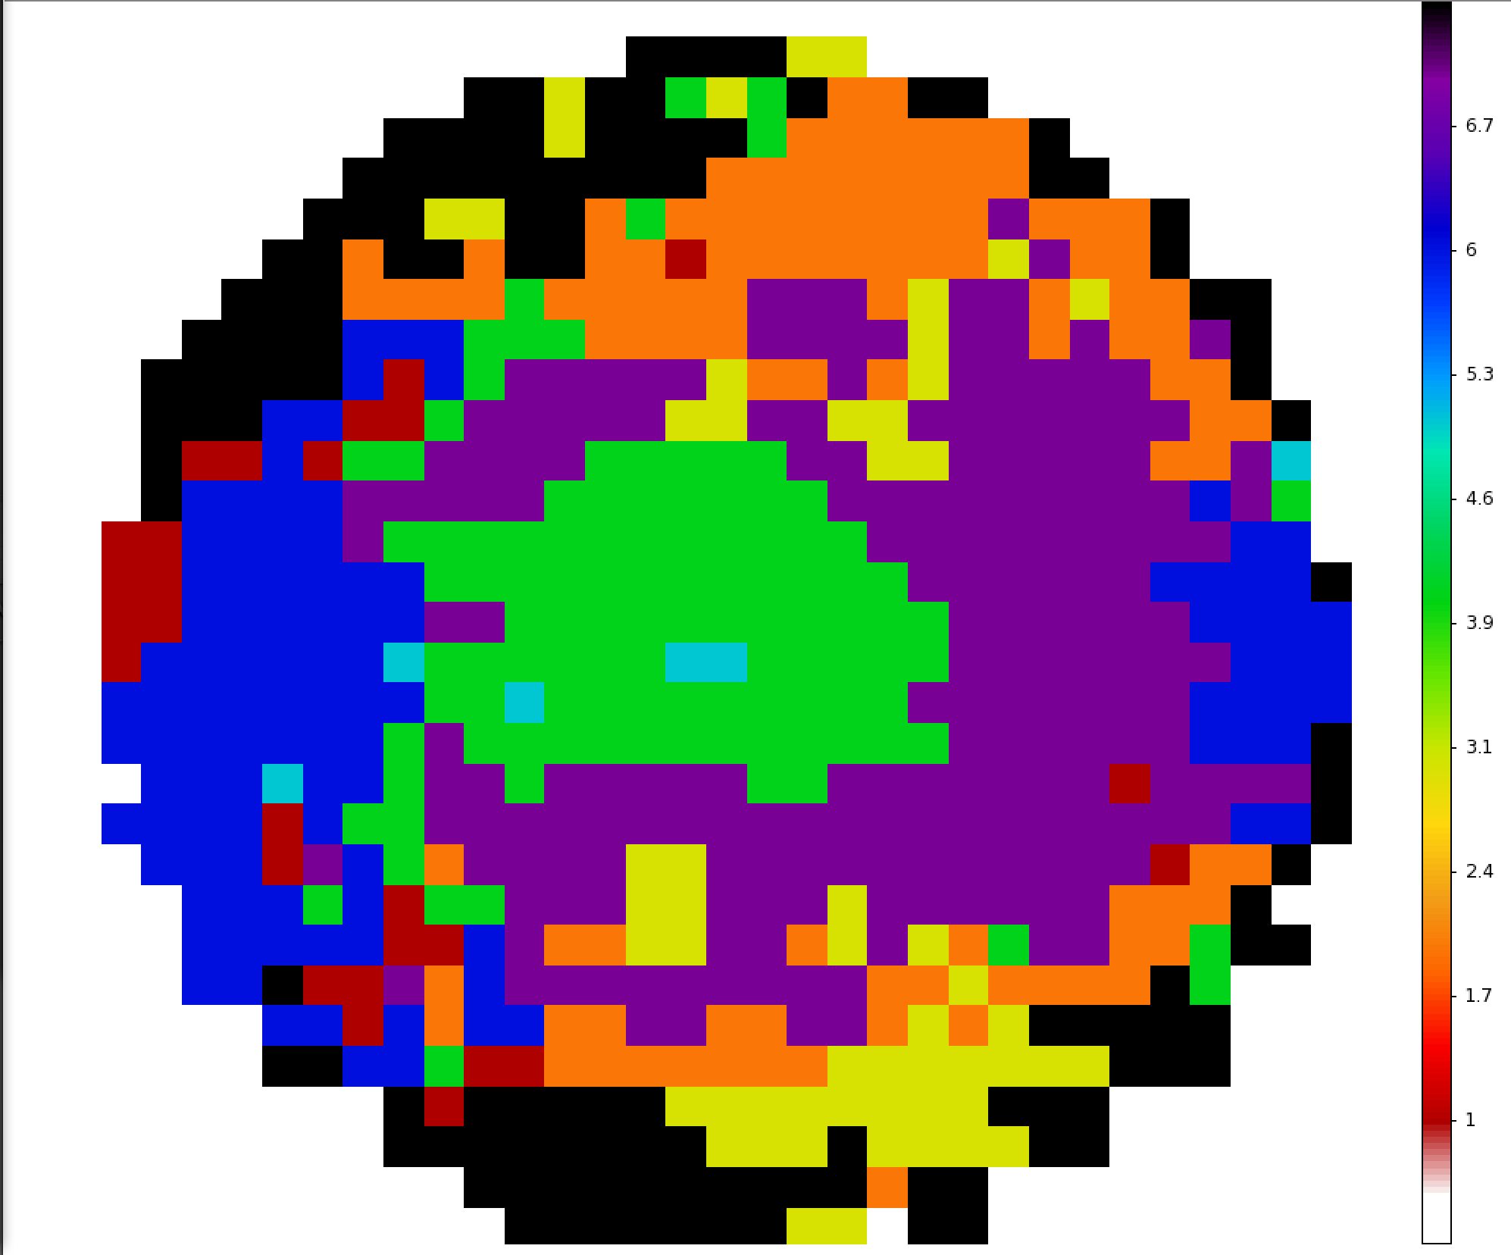
Classification maps: more complicated in 2D!
NSF_HDS
HDS
SF
COMP
NSF
wNSF
PAS
Notes:
We used to just give galaxies one classification, now things are much more complicated!

Slide 13
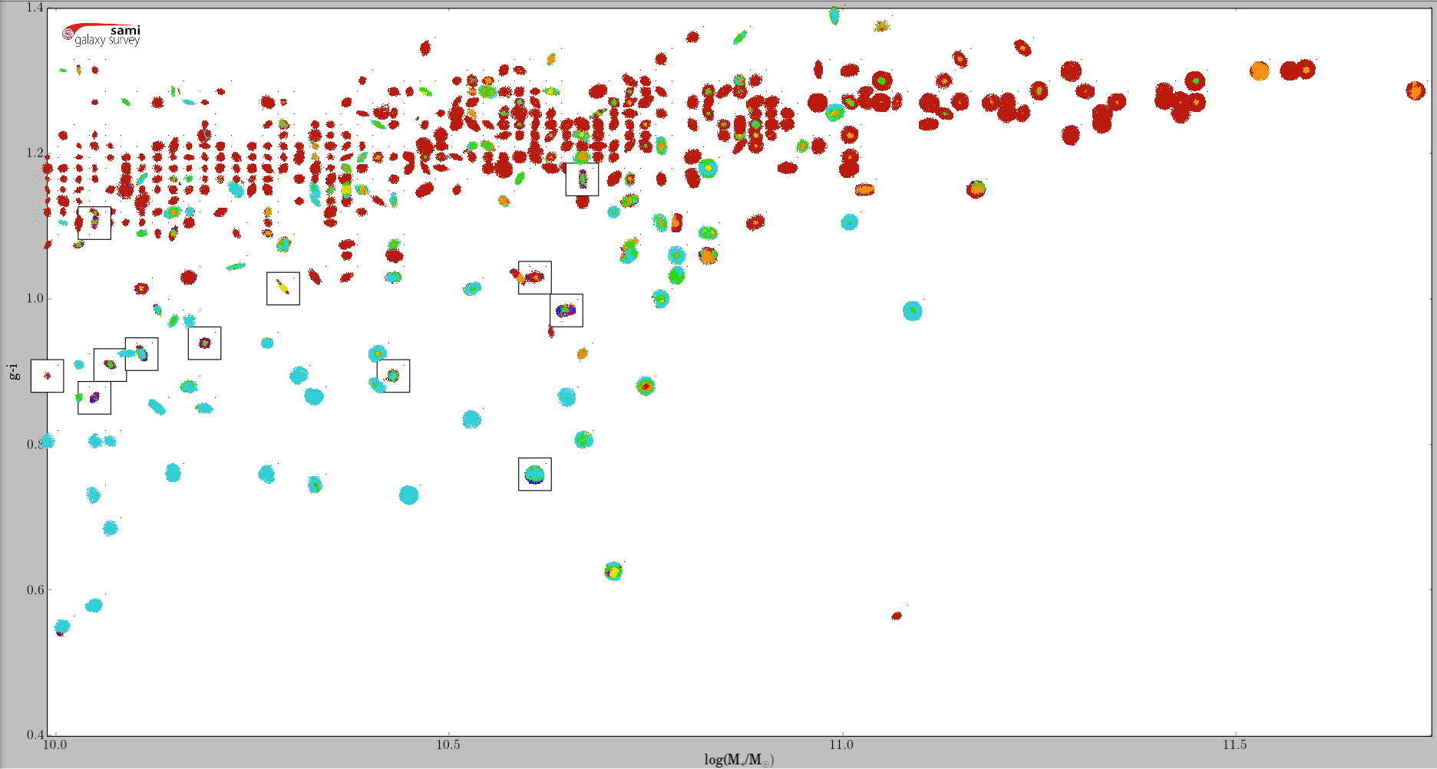
Red-sequence is dominated by spectroscopically passive galaxies.
Passive galaxies: >90% spaxels have passive spectral type
NSF_HDS
HDS
SF
COMP
NSF
Clusters f_{pas}=71%
(29% in GAMA regions)
wNSF
PAS
Cluster galaxies
Notes:
As expected, large fraction of cluster galaxies are passive, red-sequence galaxies. Still have ~30% with some form of non-passive spectra making up their distribution. This gives a sample of ~150 galaxies to play with.
Passive have no emission lines and weak balmer absorption
PSB/PSF have no emission lines and significant absorption in Hd (>3A) with absorption also detected in Hb and Hg
SF and AGNs are classified based on the line ratio NII/Ha and, whewre available NII/Ha and OIIIR/Hb. Different ionising field produced by SF and AGN produce different ratios in those species.
Only compare M*>10^9.5 Msolar

Slide 14
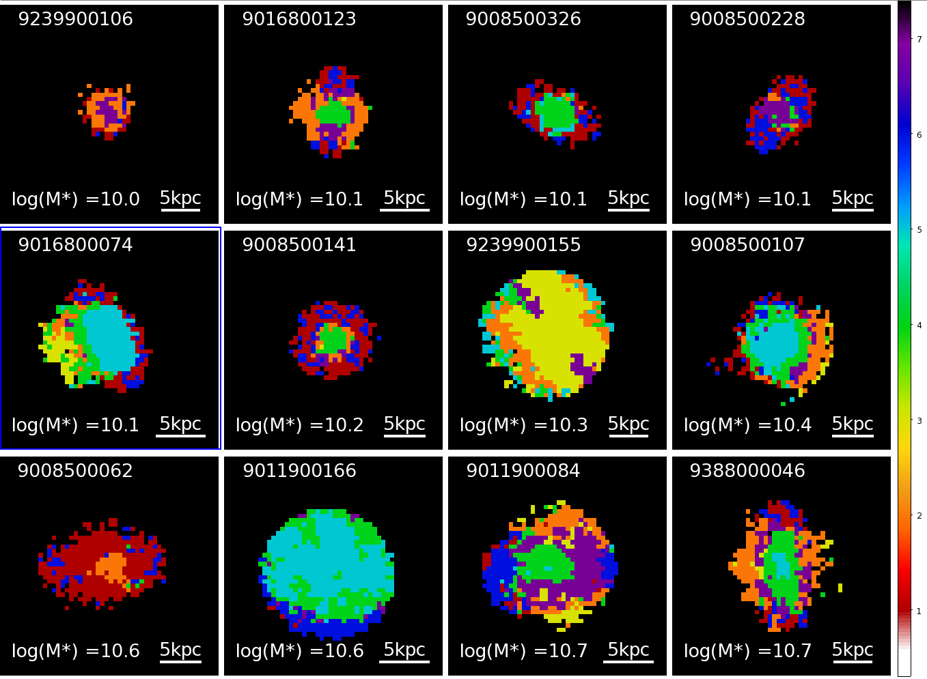
Clusters: 11% of non-passive galaxies have >10% HDS classified spaxels.
NSF_HDS
HDS
SF
COMP
NSF
wNSF
Clusters f_{pas}=71%
(29% in GAMA regions)
PAS
Cluster galaxies
Notes:
Majority have emission at their centre which is classified as star-forming or composite in nature.
The HDS spaxels are generally found in the regions just beyond the Sfing regions, as found by Crowl et al.
However, only 3/10 of Crowl’s galaxies would have made it into this sample, with the others showing weaker Hdelta absorption.
Binomial 68% CLs on percentage: 8.-14%
12/113 z < 0.06, M*>10^10

Slide 15
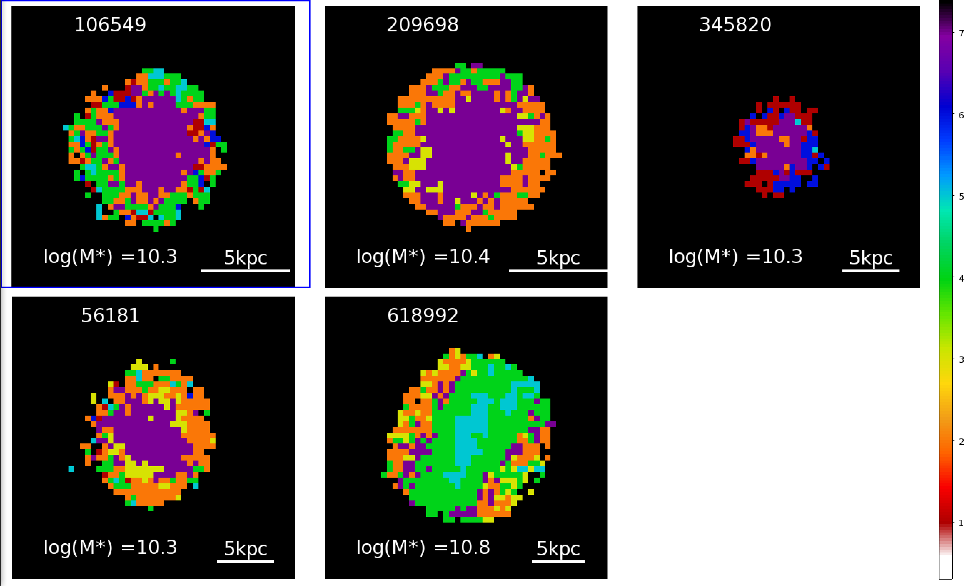
GAMA: Only 2% non-passive galaxies have >10% HDS classified spaxels.
NSF_HDS
HDS
SF
COMP
Mice Analogue
NSF
wNSF
PAS
Notes:
For z<0.06 (same zrange as clusters) and M*>10^10
Majority of cases the HDS is found in the central parts of the galaxy, with little evidence for ongoing SF
Almost all NSF_HDS; i.e.,
Not in massive groups: isolated or found in pairs or small groups
Binomial 68% CLs on percentage: 1.6-3.6%
5/230 z < 0.06, M*>10^10

Slide 16
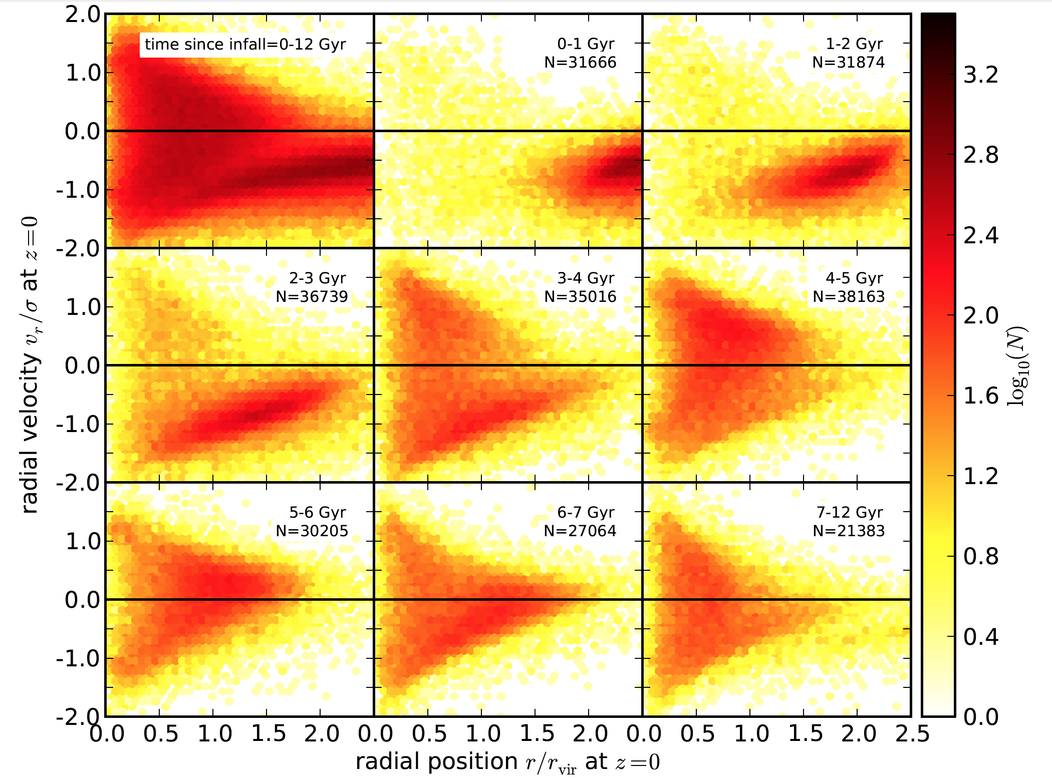
Projected-Phase-Space: a metric for environment.
Oman+13 simulations: infallers inhabit distinct regions of phase space
(also Mahajan+11, Noble+13, Jaffe+15, Muzzin+14, Haines+15, Oman+16).
Infalling galaxies
T₀ at 2.5R_{vir}
T_{cross}~3.5Gyr
Virialised region
Notes:
Can now use the redshift survey information to understand the environment of the SAMI cluster galaxies.
Position in phase space an be used to approximate the time since infall (Oman 2013, Gill 2005).
Infall clock starts at 2.5rvir and the crossing time is 3-4Gyrs.
Here have full 6D information to measure v_rad and rad.

Slide 17
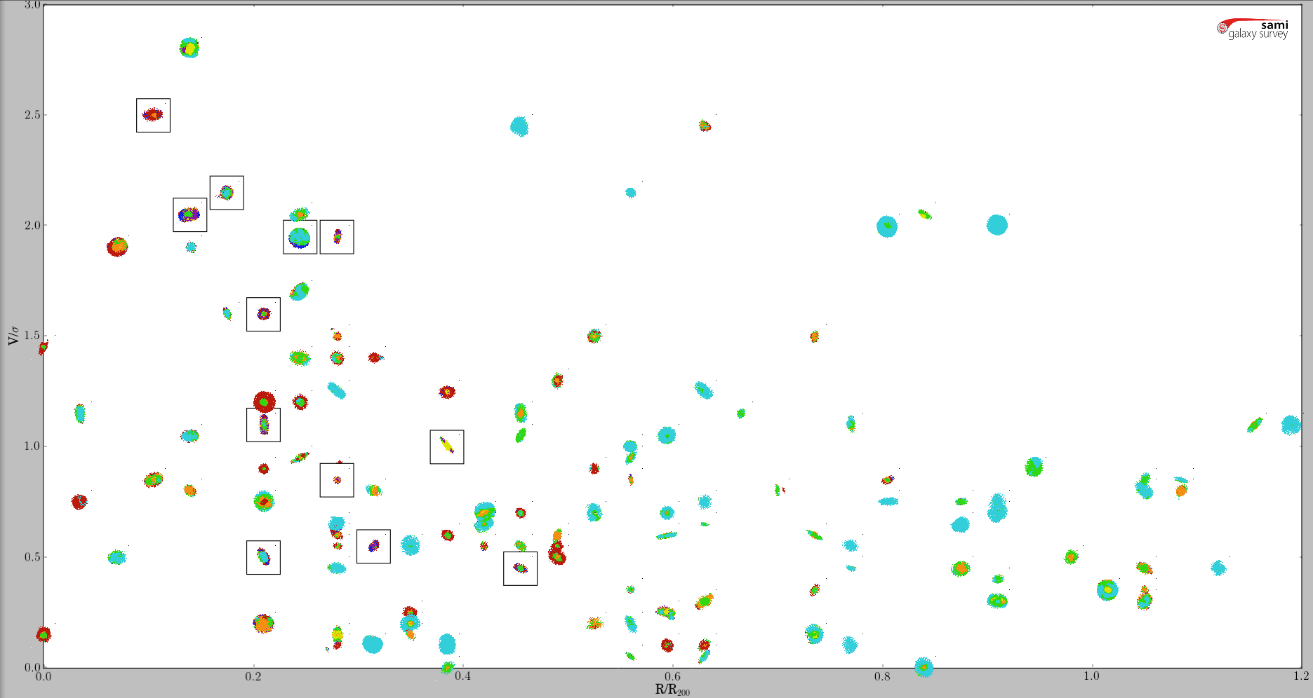
PPS for non-passive cluster galaxies
R/R₂₀₀ < 0.5
|V|/σ > 1.5
6/14 -> 43 (31-56)% HDS
0.5 < R/R₂₀₀ < 1.
|V|/σ > 1.5
0/7 ->0 (0-20)% HDS
|V|/σ
R/R₂₀₀ < 0.5
|V|/σ < 1.5
6/51 -> 12 (9-18)% HDS
0.5 < R/R₂₀₀ < 1.
|V|/σ < 1.5
0/41 -> 0 (0-4)% HDS
R/R₂₀₀
Notes:
All within 0.5R200 18.5(15 – 24): 12/65
High vel, low R galaxies likely to be intereacting with the ICM at first core passage, leading to a higher probabality of RPS -> hint of larger fraction of HDS/PSB galaxies compared with low vel, low R portion.
Low vel, low R more likely has many galaxies interacting with ICM at pericentre, and have high vel perpendicular to our LOS, but also this region probably harbors quite a number of galaxies in projection which are just beginning their descent into the cluster potential. This is because the more of the volume in the low radius cone is at large physical radius where the infall velocity has not peaked.

Slide 18
Summary.
SAMI Galaxy Survey: resolved spectroscopy for ~3400 galaxies finishing 2018A.
11% of non-passive cluster galaxies have evidence for young stellar populations with no ongoing star formation in >10% of their spaxels.
This population is rare (~2-3%) in the non-cluster SAMI galaxies in the GAMA regions.
The HDS galaxies are only found within 0.5R₂₀₀ (~19%) with an increased fraction for high velocity galaxies (~43%) cf. lower velocity galaxies (12%).
Consistent with ram-pressure stripping of gas leading to outside-in truncation of star formation as the galaxy traverses the cluster.
Stayed tuned for full sample!
Notes:
Redshift survey has 2850 cluster members for defining cluster properties.

Slide 19
Extra slides

Slide 20
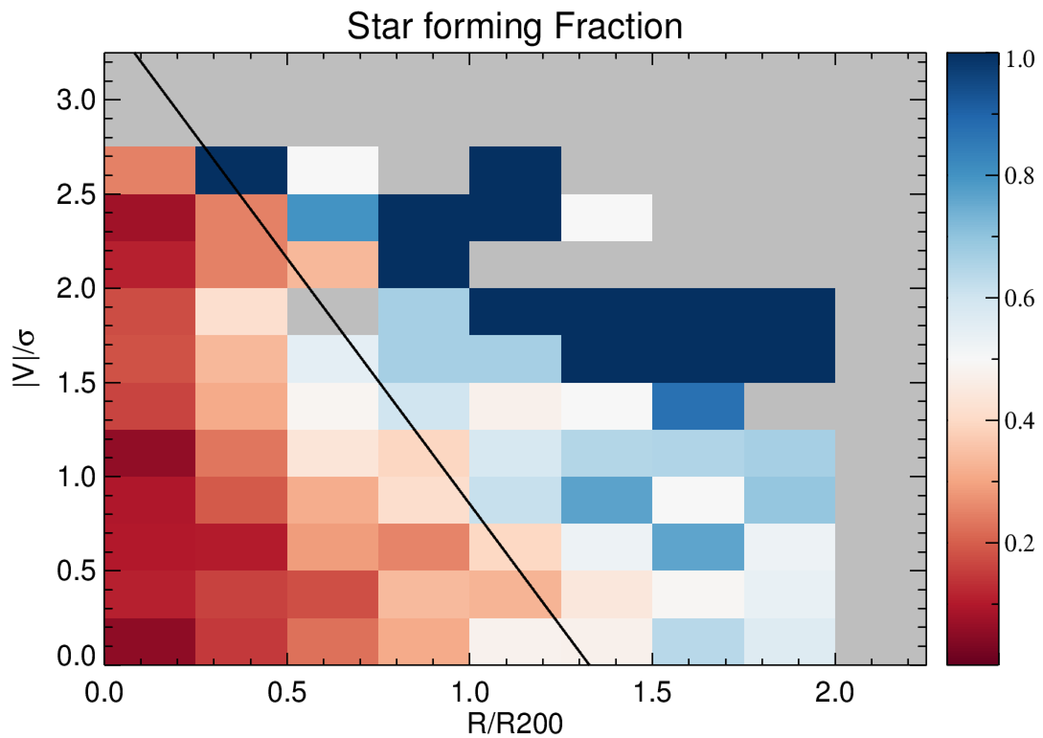
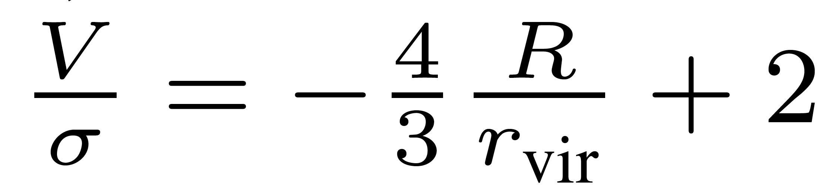
Projected-Phase-Space for SAMI clusters.
Oman+13 simulations: infallers inhabit distinct regions of phase space
(also Mahajan+11, Noble+13&16, Jaffe+14, Muzzin+14, Haines+15, Oman+16).
Infalling galaxies:
Star forming
Virialised region:
Passive galaxies
Notes:
Colours show the fraction of star-formers (as identified from emission in their nuclear spectra from the SAMI-CRS data) in each spatial bin. Prediction of Oman et al. nicely separates regions dominated by star forming galaxies (infalling) from virialised passive galaxies.
Therefore, the phase space diagram really is an excellent tracer of time since infall. The infaller defining line of Oman provides a remarkably good prediction of where to select recent infallers.
What this confirms is that the Sfing galaxies are consistent with being dominated by an infalling population meeting the cluster for the first time.
Simple binomial classification of a galaxy can be extended with resolved spectroscopy – can use partial classifications to look for galaxies that are affected by the environment.

Slide 21
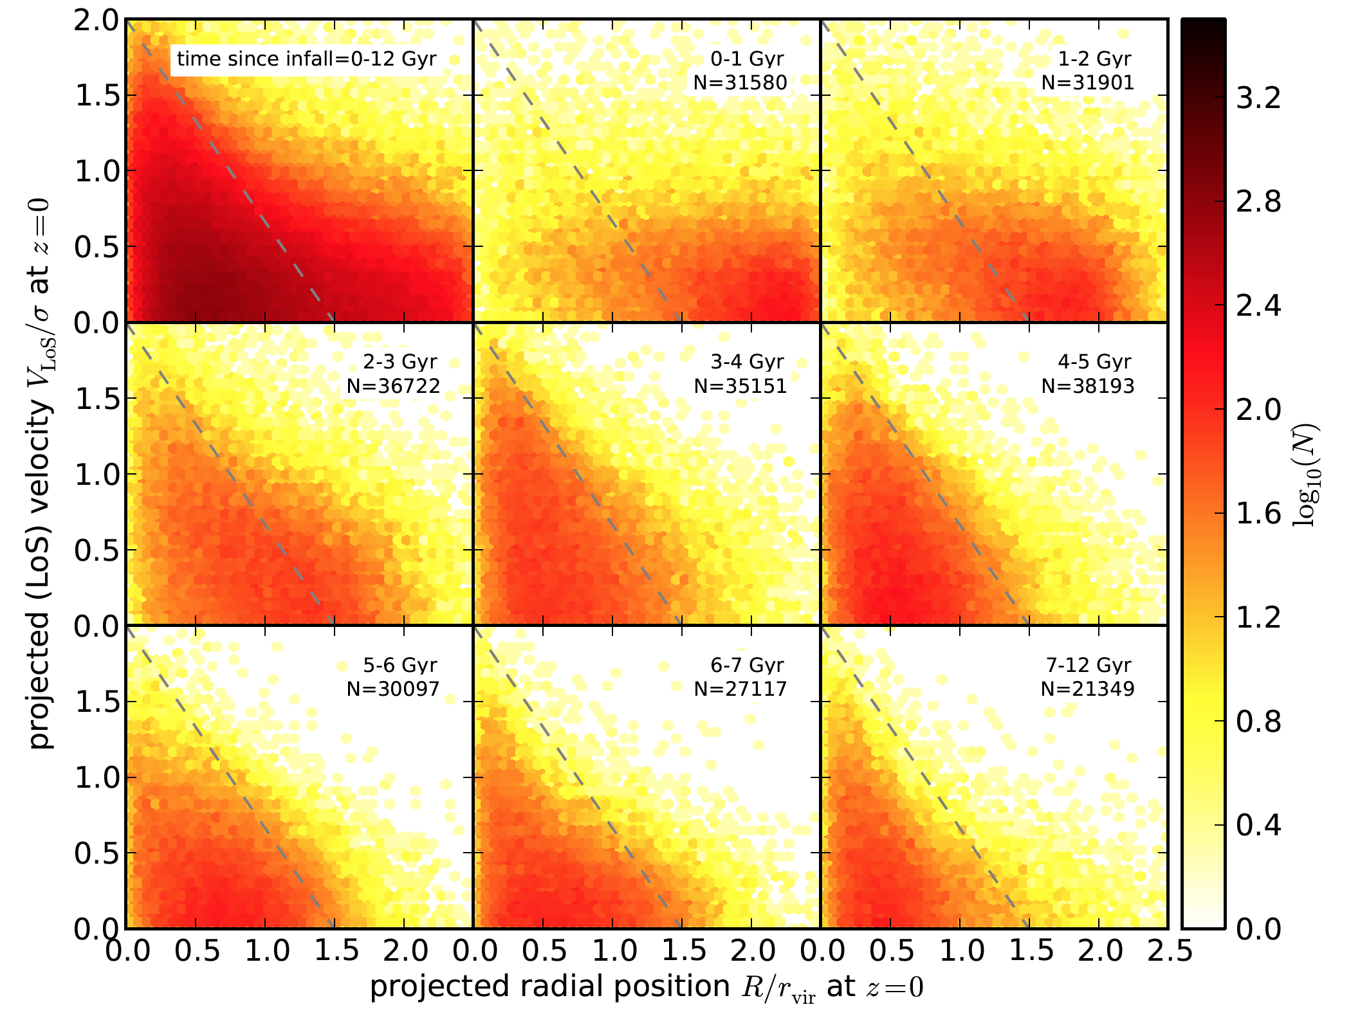
Projected-Phase-Space as metric for environment.
Oman+13 simulations show that infallers inhabit distinct regions of phase space (also Mahajan+11, Noble+13, Jaffe+14, Muzzin+14 and others).
Virialised region
Infalling galaxies
Notes:
Position in pseudo phase space an be used to approximate the time since infall (Oman 2013, Gill 2005).
Show the Oman results
Line shows the cuttoff point splitting the regions dominated by virialised and infalling galaxies.
Galaxies which lie beyond the line are highly likely to be first-time infallers. The line is a by-eye fit to regions where the galaxies have infall times

Slide 22
SAMI Galaxy Survey Key Science Goals
What are the physical processes responsible for galaxy transformations?
  Morphological and kinematic transformations; suppression of star formation; internal vs. external; secular vs. fast; ram pressure stripping; harassment, strangulation; galaxy–group/cluster tides; galaxy-galaxy mergers; galaxy-galaxy interactions…
How does mass and angular momentum build up?
  The galaxy velocity function; stellar mass in dynamically hot and cold systems; galaxy merger rates; halo mass from velocity-field shear; Tully-Fisher relation…
Feeding and feedback: how does gas get into galaxies, and how does it leave?
  Winds and outflows; feedback vs. mass; triggering and suppression of SF; gas inflow; metallicity gradients; the role of AGN…
Notes:
Briefly mention the top level science drivers, as we are all very much aware of them.

Slide 23
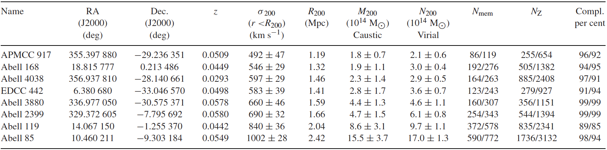
SAMI Cluster Properties
Notes:
Four clusters from the 2dfgrs and four well-known clusters in the SDSS footprint.
Selected to cover the full massrange.
High spectroscopic completeness. Large number of members per cluster allowing good description of underlying cluster kinematics and substructuring.

Slide 24
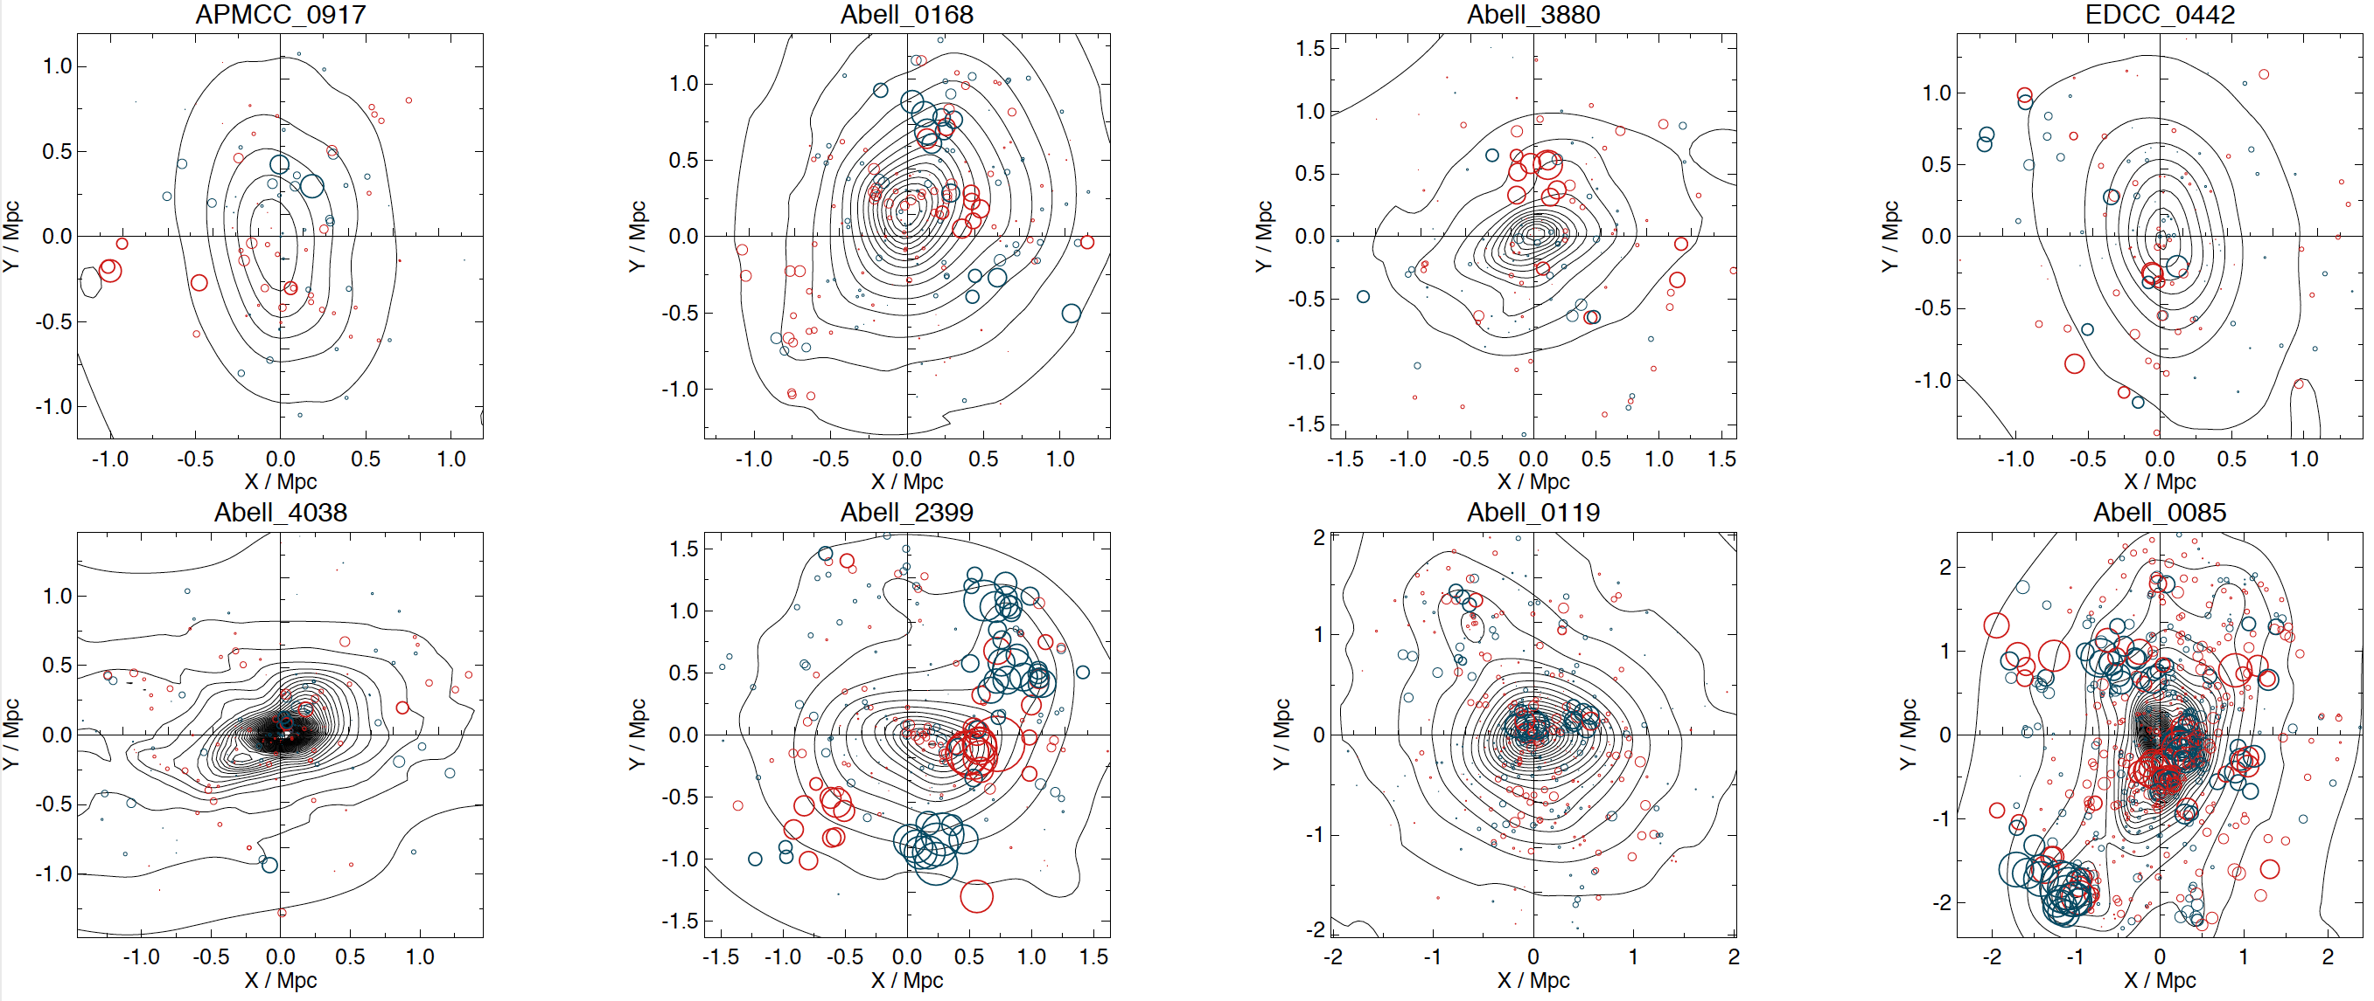
SAMI Clusters: Diversity in structure
Notes:
Have a good mix notonly across the mass range, but also in clusters of various dynamical states.
A85, A168 and A2399 have a lot of structure whereas the others have minor structures or a re very relaxed.

Slide 25
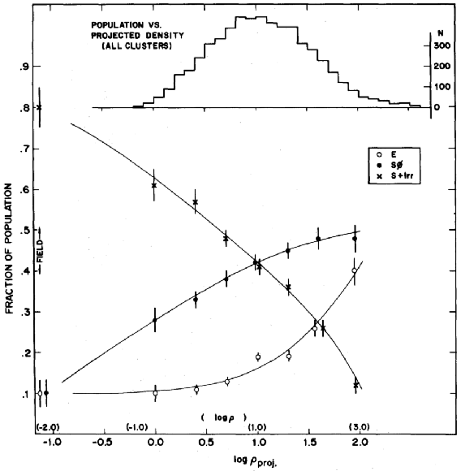
Correlation between galaxy properties and environment.
Morphology-Density relation (Dressler 1980)
Fraction of SFR gals lower cf field (Lewis 2002)
R < Rvir
R > 2Rvir
<---Field/Groups---><---Clusters--->
Notes:
Onto the science I am interested in for SAMI. How does the cluster environment affect the star-forming properties of infalling galaxies?
Two intriguing correlations: morphology-density relation showing field dominated by star forming spirals, clusters by red, dead spheroidals.
Hierarchical structure formation: field galaxies fall into clusters. Some mechanism must act to stop star formation and transform morphology in order to reconcile hierarchical structure formation with these correlations.

Slide 26
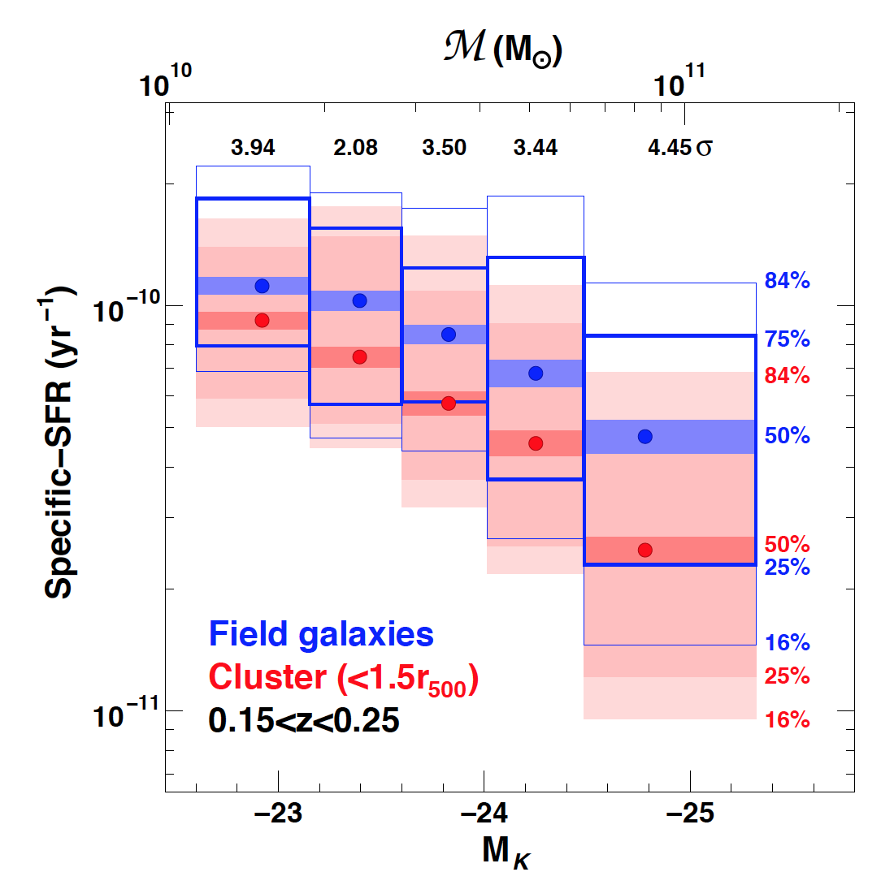
Correlation between galaxy star formation clustercentric distance.
Decline in SFR with radius (von der Linden 2010)
sSFR lower cf field
Haines et al. (2013)
Notes:
Specific star formation rate of galaxies within the virial radius of clusters is lower when compared with like-galaxies in the field.
Haines: Spitzer derived SFRs

