Slide 1

Thinking data management on different scales
Susanne Kunis
These slides can be reused under the CC BY-SA 4.0 license unless mentioned otherwise

Slide 2
Research Data Management
Logistical necessity
Ensures Integrity, reproducibility and transferability
Protects data loss
Fosters collaboration
Provides transparency

Slide 3
INDIVIDUAL
INTERNATIONAL
04
05
03
OPTIMIZED
02
DEVELOPMENT
MANAGED
01
BASIC
INITIAL
Status:
Disorganised, ad hoc
Deploy inter domain crosswalks
Management:
Different data structures, subjective documentation; unnecessary data duplication, transfer, conversion; no central data storage and access interface; no objective/strategy
Data are rich on context (full semantic);
Standardised API; harmonized and interoperable data; coherence in format and context
Data silo level:
local
Data value level:
Interoperability:
single use
low
Asset to answer future questions
high
„If I want to share data, I coordinate it directly with my colleague”
„ I find that I can easily discover, access, combine and publish data".

Slide 4

Important spokes in the wheel
EXPERTISE
Raise awareness of research data management importance;
Teaching data management technics and tools
EDUCATION
Support and customized solutions for specific problems in the management of research data
CURATION
Technical infrastructure and related services that support researcher in data management throughout the research cycle
INFRASTRUCTURE
Ensure quality, add metadata, and ensure compliance with standards and policies.

Slide 5
Important spokes in the wheel
EXPERTISE
Raise awareness of research data management importance;
Teaching data management technics and tools
EDUCATION
Support and customized solutions for specific problems in the management of research data
STANDARDS
CURATION
Technical infrastructure and related services that support researcher in data management throughout the research cycle
INFRASTRUCTURE
Ensure quality, add metadata, and ensure compliance with standards and policies.
Data standards are necessary to break down data silos and create interoperability and coherence. They ensure that data retain their value and meaning and are usable, consistent and accurate.

Slide 6
Integration of data management in an existing ecosystem

Slide 7




Department Biology
Research groups
Animal Physiology
Behavioural Biology
Bioanalytical Chemistry
Biochemistry
Biodiversity and Landscape Ecology
Biology Didactics
Biophysics
Botany
Cellular Communication
Ecology
Genetics
Microbiology
Molecular Cell Biology
Molecular Cell Biophysics
Molecular Infection Biology
Neurobiology
Plant Physiology
Structural Biology
Zoology
19

Slide 8

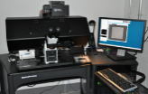
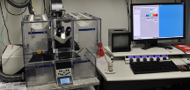
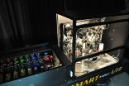
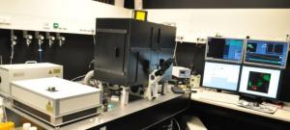
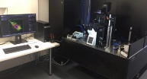

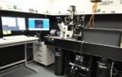
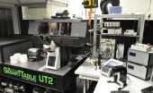
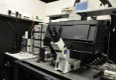

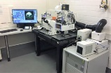
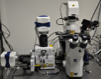
Department Biology
Research groups
Facility & Service
12 Light Microscopy
6 Electron Microscopy
5 Cytometry & FACS
19
iBiOs
DeltaVision
Leica SP5
Lattice
Light-Sheet
Olympus
FV 1000
Olympus
FV 3000
Olympus
TIRF 1-LINE
Mass
Spectrometry
Olympus
TIRF 3-LINE
Olympus
TIRF 4-LINE
FRAP
Olympus
TIRF 4-LINE
PAINT
Zeiss LSM
510
Zeiss 880
AiryScan
Zeiss
Spinning Disk

Slide 9

Department Biology
Research groups
Facility & Service
Research Center
19
iBiOs
CellNanOs
Mass
Spectrometry

Slide 10

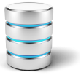

Ecosystem 2015
…
Research group member
and desktop system
Research group specific server
Community/External Collaborators
Parts of graphics from Autor: Seobility - Lizenz: CC BY-SA 4.0

Slide 11
Ecosystem 2015
…
Research group member
and desktop system
Research group specific server
Analysis
workstations
Microscopy
workstations
Community/External Collaborators
Parts of graphics from Autor: Seobility - Lizenz: CC BY-SA 4.0

Slide 12

Ecosystem 2015
…
Research group member
and desktop system
Research group specific server
Analysis
workstations
Microscopy
workstations
Multiple data
formats
Community/External Collaborators
Parts of graphics from Autor: Seobility - Lizenz: CC BY-SA 4.0

Slide 13




Ecosystem 2015
…
Research group member
and desktop system
Research group specific server
Analysis
workstations
Microscopy
workstations
Multiple data
formats
MyShare
Community/External Collaborators
Parts of graphics from Autor: Seobility - Lizenz: CC BY-SA 4.0

Slide 14
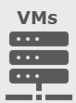

OMERO productiv server
Ecosystem 2016
NFS
1.4 PB
…
OMERO backup
Nightly backup
on tape
4xdaily snapshots
Research group member
and desktop system
Research group specific server
Analysis
workstations
Microscopy
workstations
Central OMERO repository
Community/External Collaborators
Parts of graphics from Autor: Seobility - Lizenz: CC BY-SA 4.0

Slide 15

+ Metadata input forms
Ecosystem 2022
+ Public group
+ File sharing functionality
+ fast and unlimited webdownload
…
+ Web import
+ Central OMERO.insight instance
Research group member
and desktop system
Research group specific server
Analysis
workstations
Microscopy
workstations
Central OMERO repository
with extensions
Community/External Collaborators
Parts of graphics from Autor: Seobility - Lizenz: CC BY-SA 4.0

Slide 16
Ecosystem 2022
…
Research group member
and desktop system
Research group specific server
Analysis
workstations
Microscopy
workstations
Central OMERO repository
-> Linking of different data types
Community/External Collaborators
Parts of graphics from Autor: Seobility - Lizenz: CC BY-SA 4.0

Slide 17

Ecosystem 2023
…
Research group member
and desktop system
Research group specific server
Analysis
workstations
Microscopy
workstations
Central OMERO & ELN instance
-> Linking of different data types
Community/External Collaborators
Parts of graphics from Autor: Seobility - Lizenz: CC BY-SA 4.0

Slide 18
INDIVIDUAL
PROJECT/GROUP
INSTITUTIONAL
Change management and continious improvements
02
03
01
BASIC
DEVELOPMENT
INITIAL
Status:
Disorganised, ad hoc
Deploy basic structures and tools
Deploy standards
Management:
Different data structures, subjective documentation; unnecessary data duplication, transfer, conversion; no central data storage and access interface; no objective/strategy
Reorganisation, definition of responsibilities, transfer of knowledge; definition, establishment, development and documentation of management and exchange processes; application of metadata to key data sets.
Processes are standardised and integrated;Training on standards; rich metadata
Data silo level:
local
working group
local infrastructure
Data value level:
Interoperability:
single use
low
single use
low
Resource to validate decisions
middle
„If I want to share data, I coordinate it directly with my colleague”
„My project/group has agree to use a specific platform for data management“
„ I should manage data and strive to use appropriate standards and tools.”

Slide 19
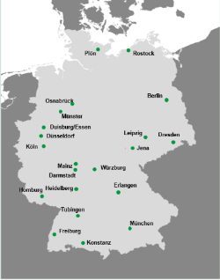
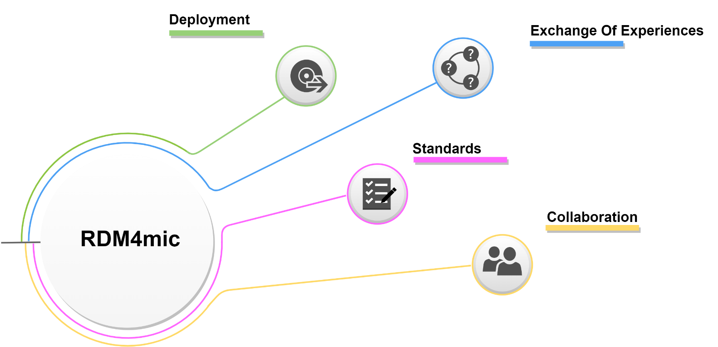
What about the others…
2017
Notes:
&

Slide 20

RDM4mic
“Research Data Management for Microscopy”
Open for all
>20 facilities involved
Exchange of experience and knowledge
transfer in terms of data management
2017
2019

Slide 21

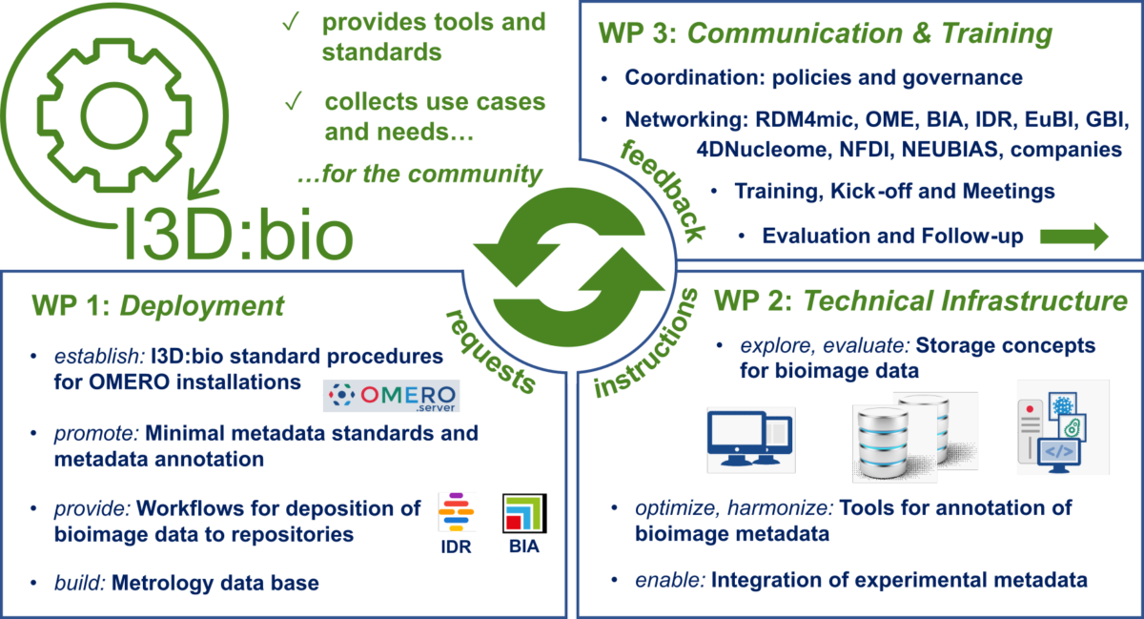
I3D:bio
Information Infrastructure for BioImage Data
2022-2024
Man power to implement the needs of tools, support and
training with focus on OMERO and light microscopy
2017
2019
2021

Slide 22
INDIVIDUAL
PROJECT/GROUP
INSTITUTIONAL
NATIONAL
Change management and continious improvements
RDM4mic
03
04
02
DEVELOPMENT
MANAGED
01
BASIC
INITIAL
Status:
Disorganised, ad hoc
Deploy basic structures and tools
Deploy standards
Deploy validation and verification processes, intra domain crosswalks
Management:
Different data structures, subjective documentation; unnecessary data duplication, transfer, conversion; no central data storage and access interface; no objective/strategy
Reorganisation, definition of responsibilities, transfer of knowledge; definition, establishment, development and documentation of management and exchange processes; application of metadata to key data sets.
Processes are standardised and integrated;Training on standards; rich metadata
Validation and verification processes; metadata described with consistent vocabulary
Data silo level:
local
working group
local infrastructure
National and domain specific infrastructure
Data value level:
Interoperability:
single use
low
single use
low
Resource to validate decisions
middle
Resource to make decisions
high
„If I want to share data, I coordinate it directly with my colleague”
„My project/group has agree to use a specific platform for data management“
„ I should manage data and strive to use appropriate standards and tools.”
„ I have learnt how to apply data management policies and sharing has become much easier.”

Slide 23
Research Data Management
Value of data
Asset to answer future questions
„The sky is the limit“– implicit knowledge leads discovery efforts
Integral to desision making (must have)
Use explicit knowledge from data
Resource to make decisions (good to have)
Meta analysis using aggregated data
Resource to validate decisions
Defend decisions by reanalysing data
*Semantic:
the description of the meanings of values and of the names of data components
Single use
Verify null hypothesis
Minimal metadata
Rich metadata
+ Consistent vocabulary
+ Semantics*
+ Full Semantic interoperability
Degree of interoperability
„On the road to FAIR …lessons learnt.“, Saritha V Kuriakose

Slide 24

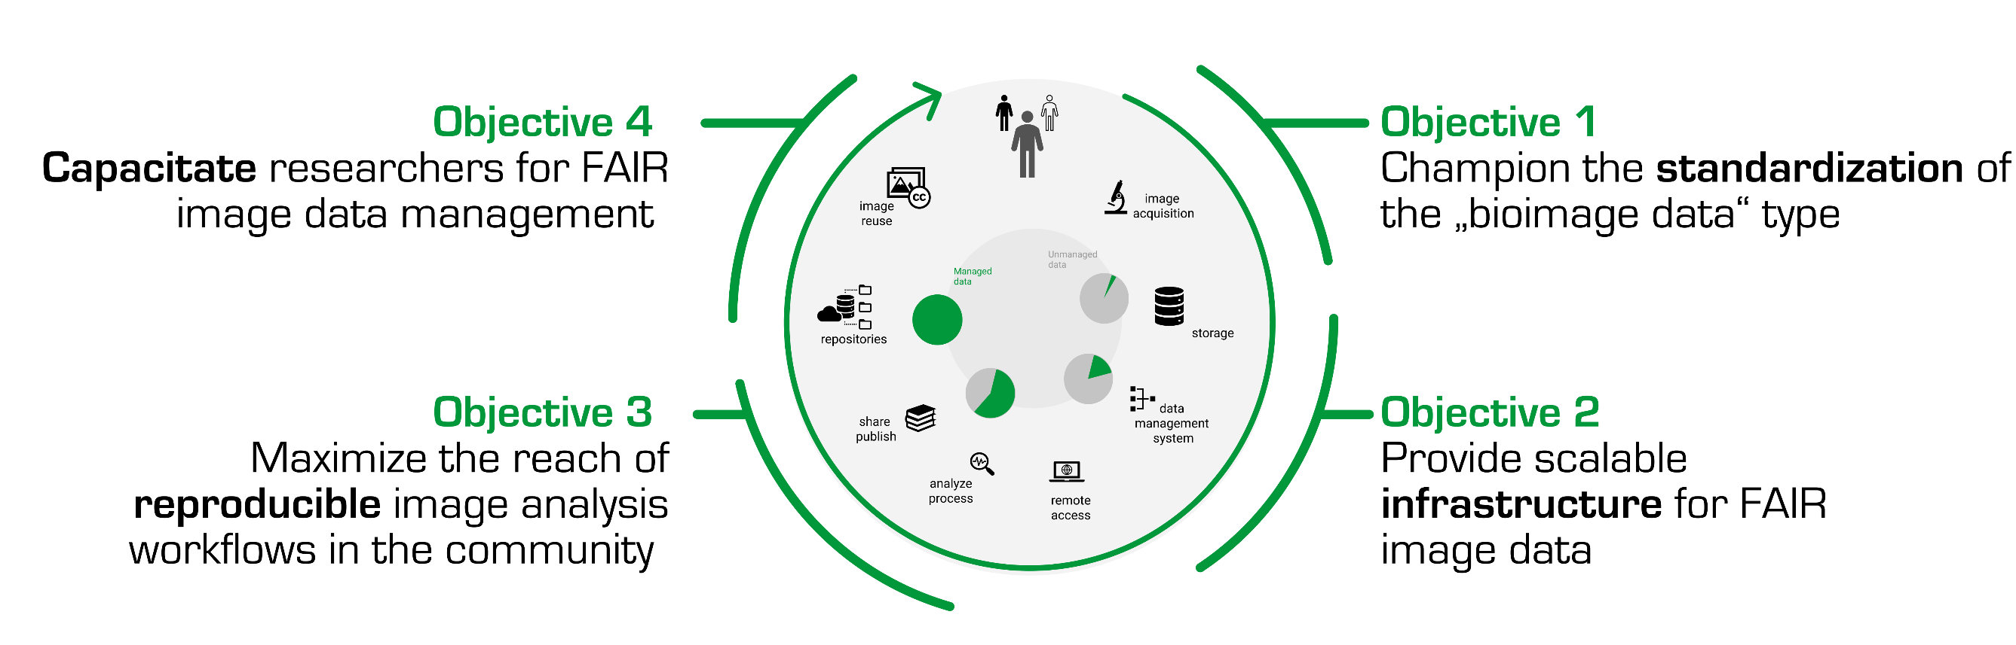



NFDI4BIOIMAGE
2023-2028
3
1
1
2
1
1
1
2
2
1
4
1
2
2
1
2
1
2
1
1
1
4
2
3
3
1
National Researchdata Infrastructure for BioImaging:
Implement national infrastructure and standards
Stefanie Weidtkamp-Peters. (2023, June 22). NFDI4BIOIMAGE - National Research Data Infrastructure for Microscopy and BioImage Analysis - Online Kick-Off 2023. Zenodo. https://doi.org/10.5281/zenodo.8070038
2017
2019
2021
2023

Slide 25
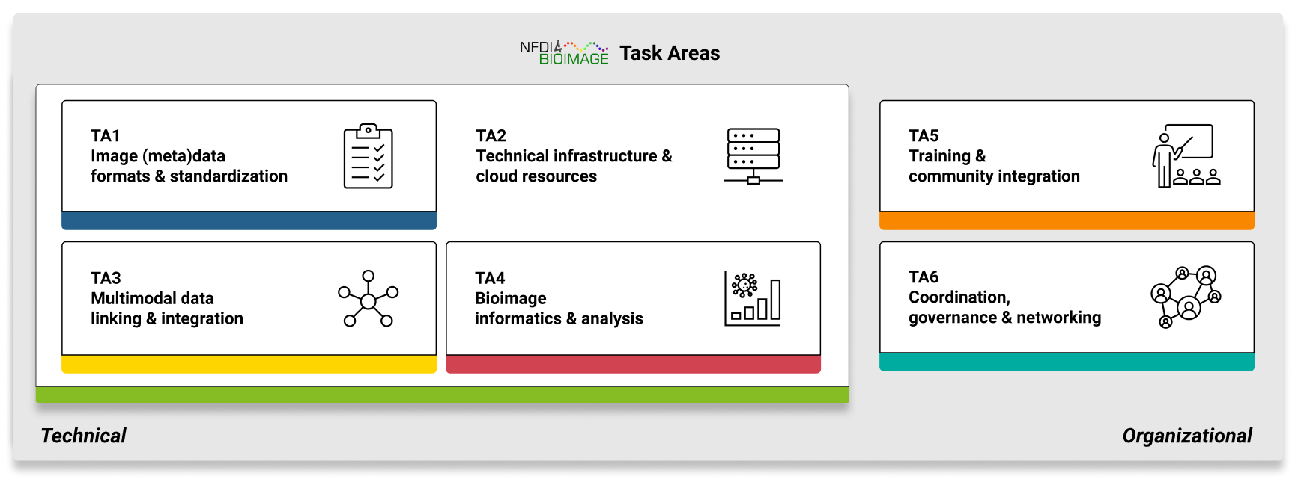
NFDI4BIOIMAGE
2023-2028
3
1
1
2
1
1
1
2
2
1
4
1
2
2
1
2
1
2
1
1
1
4
2
3
3
1
2017
2019
2021
2023

Slide 26
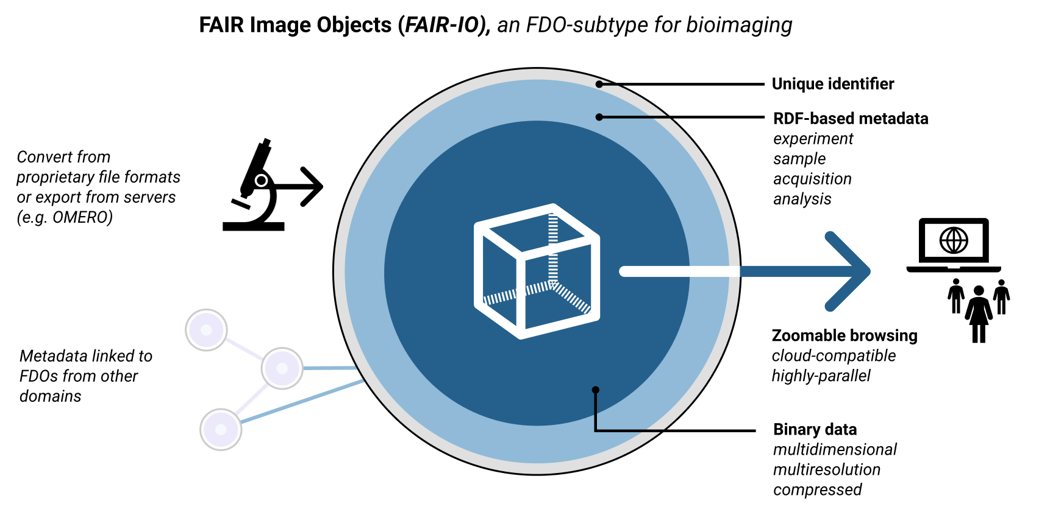
NFDI4BIOIMAGE
2023-2028
3
1
1
2
1
1
1
2
2
1
4
1
2
2
1
2
1
2
1
1
1
4
2
3
3
1
NFDI4BIOIMAGE Consortium. (2021). Section 5.1 "Task Area 1: Image (meta)data formats and standardization)" Figure 8 (1.0.0). Zenodo. https://doi.org/10.5281/zenodo.7394675
2017
2019
2021
2023

Slide 27









NFDI4BIOIMAGE
2023-2028
The success of NFDI highly depends on an institutional commitment.
3
1
1
2
1
1
1
2
2
1
4
1
2
2
1
2
1
2
1
1
1
4
2
3
3
1
National Researchdata Infrastructure for BioImaging:
Implement national infrastructure and standards
2017
2019
2021
2023

Slide 28
INDIVIDUAL
PROJECT/GROUP
INSTITUTIONAL
NATIONAL
INTERNATIONAL
Change management and continious improvements
RDM4mic
05
03
04
OPTIMIZED
02
DEVELOPMENT
MANAGED
01
BASIC
INITIAL
Status:
Disorganised, ad hoc
Deploy basic structures and tools
Deploy standards
Deploy validation and verification processes, intra domain crosswalks
Deploy inter domain crosswalks
Management:
Different data structures, subjective documentation; unnecessary data duplication, transfer, conversion; no central data storage and access interface; no objective/strategy
Reorganisation, definition of responsibilities, transfer of knowledge; definition, establishment, development and documentation of management and exchange processes; application of metadata to key data sets.
Processes are standardised and integrated;Training on standards; rich metadata
Validation and verification processes; metadata described with consistent vocabulary
Data are rich on context (full semantic);
Standardised API; harmonized and interoperable data; coherence in format and context
Data silo level:
local
working group
local infrastructure
National and domain specific infrastructure
Data value level:
Interoperability:
single use
low
single use
low
Resource to validate decisions
middle
Resource to make decisions
high
Asset to answer future questions
high
„If I want to share data, I coordinate it directly with my colleague”
„My project/group has agree to use a specific platform for data management“
„ I should manage data and strive to use appropriate standards and tools.”
„ I have learnt how to apply data management policies and sharing has become much easier.”
„ I find that I can easily discover, access, combine and publish data".
adapted from Medyckyj-Scott, David et al. (2016). Our Land and Water National Science Challenge - A Data Ecosystem for Land and Water Data to Achieve the Challenge Mission.

Slide 29



https://german-bioimaging.github.io/RDM4mic.github.io/
RDM4mic
https://gerbi-gmb.de/i3dbio/i3dbio-about/
I3D:bio
https://nfdi4bioimage.de/en/start/
NFDI4BIOIMAGE

Slide 30
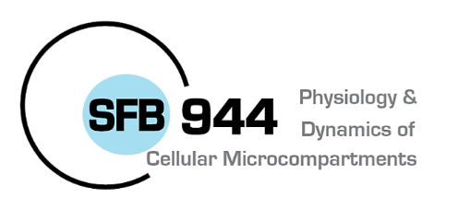
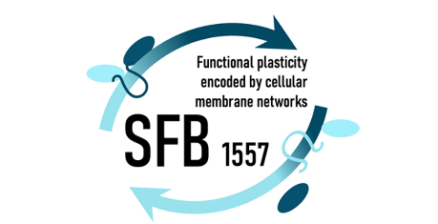

Acknowledgements
Karen Bernhardt (IT UOS, I3D:bio)
Tom Boissonnet (I3D:bio)
Roland Brandt (I3D:bio, QUAREP-LIMI)
Jean-Marie Burel (OME)
Julia Dohle (UOS, I3D:bio)
Elisa Ferrando-May (I3D:bio, NFDI4BIOIMAGE)
Jan Gelwer (IT UOS)
Michael Hensel (CRC 944 UOS)
Rainer Kurre (iBiOs UOS)
Victoria Liss (CRC 1557 UOS)
Josh Moore (OME, RDM4mic, NFDI4BIOIMAGE)
Andreas Müller (IT UOS)
Stefanie Weidtkamp-Peters (GerBi, RDM4mic, I3D:bio, NFDI4BIOIMAGE)
Tobias Wernet (I3D:bio)
Thomas Zobel (RDM4mic, GerBi)

