Slide 1
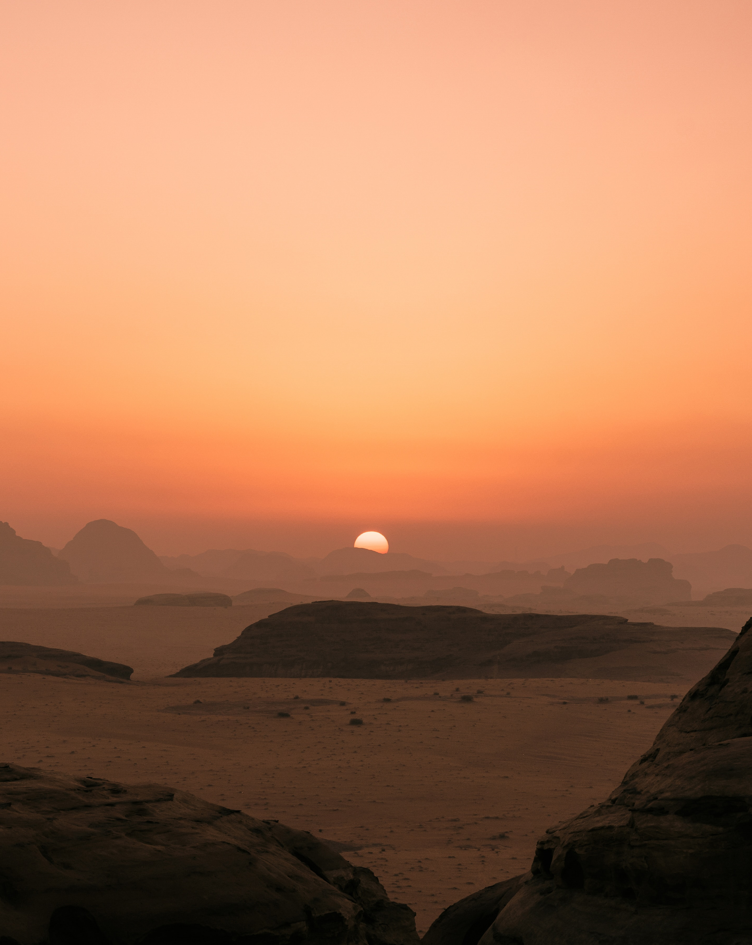
Inclusion in open science: Moving beyond participant diversity
Photo by NEOM on Unsplash
Ana Barbosa Mendes, Dominique Troost, Dom Weinberg (EUR)
31 August, 2023

Slide 2
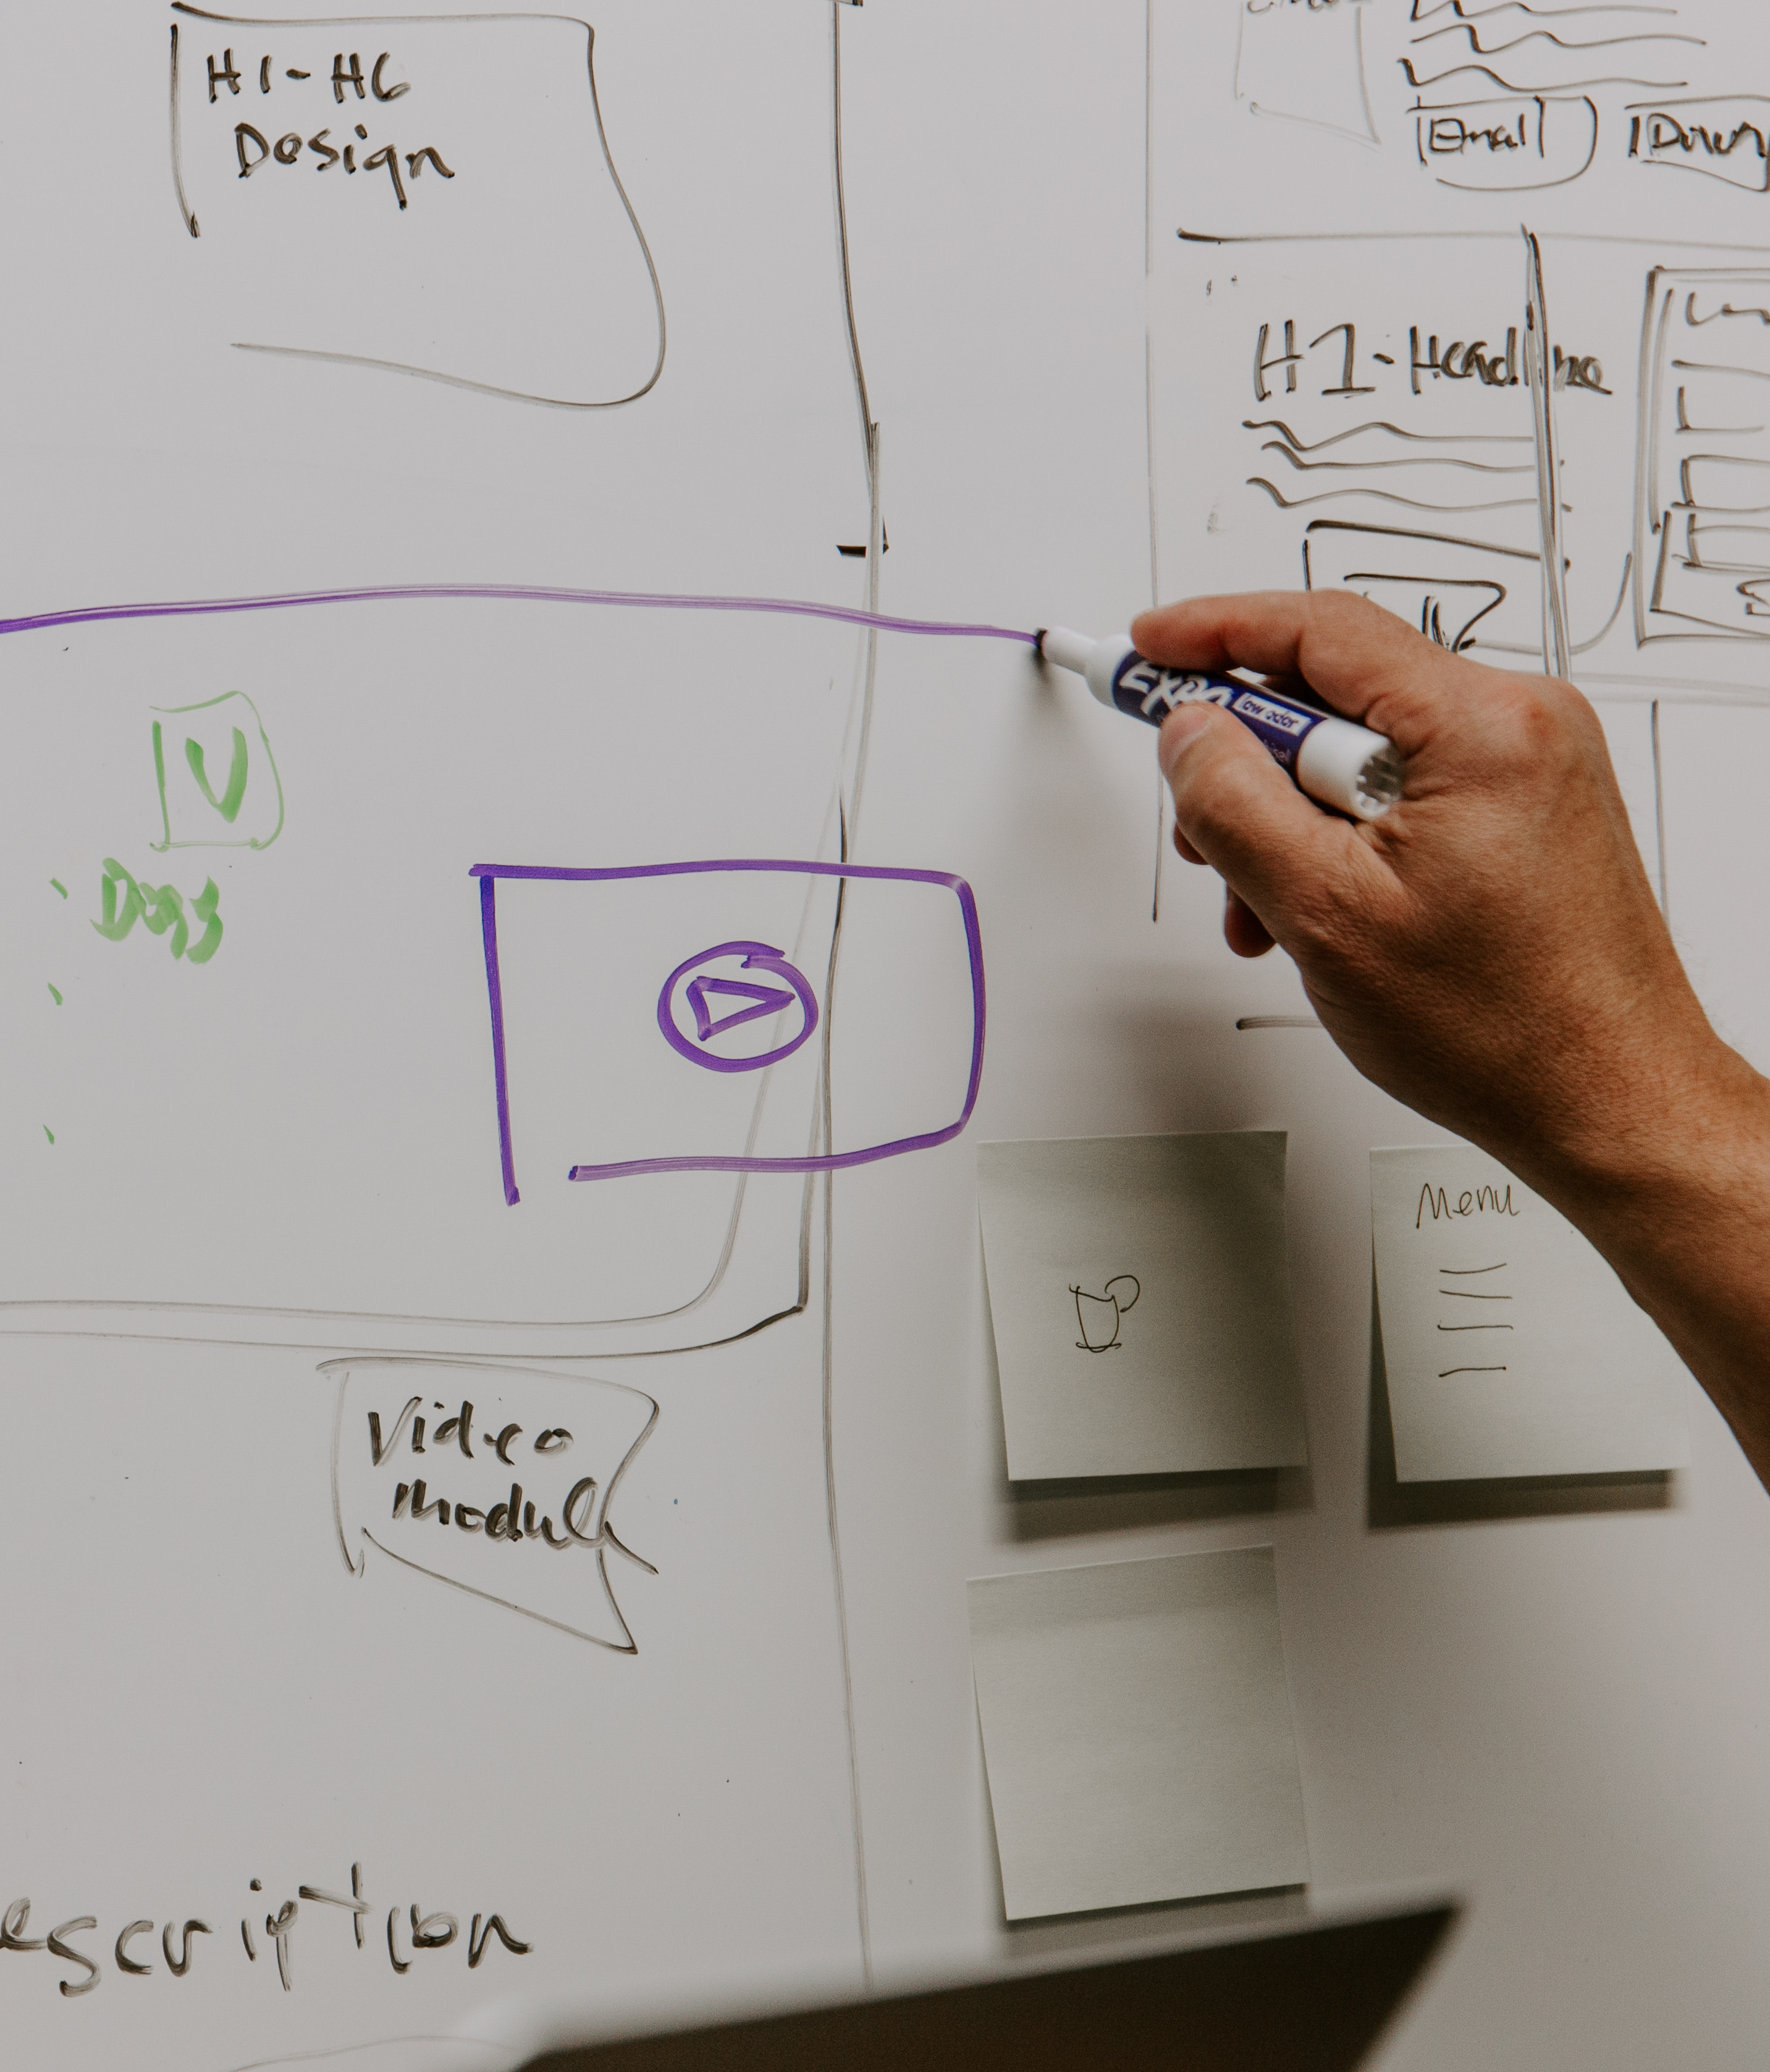
Today’s session
01
Introduction
02
Diversity & inclusion in research
03
Goals of science
04
Conclusion
Getting to know each other, first reflection
Syed & Kathawalla’s framework, second reflection, plenary discussion + break
Third reflection
Fourth reflection and wrap-up
Photo by Kaleidico on Unsplash

Slide 3

Getting to know each other
Photo by Vladislav Klapin on Unsplash

Slide 4
What does openness in research mean for you?

Slide 5
Three types of D&I in research:
Representation of researchers
Representation of samples
Representation of perspectives
“The [Open Science] movement, if implemented in accordance with its underlying principles, has the real power to create a more democratic approach to science. But there is good reason to think that it will not. Without intentional action, any movement will likely reproduce any existing power imbalances that it was not designed to break down.”(p. 5)
“The fact remains that the vast majority of research is conducted in the U.S. and Western Europe and, within those countries, the vast majority of research is conducted with White people” (p. 7)
"[we must] diversify our thinking about psychological science... we all are—or should be—cultural psychologists who take seriously the potential for systematic human variation in psychological phenomena" (p. 10)
Syed & Kathawalla (2022)

Slide 6
What do these ideas of openness and inclusion mean for your research (in the way it is planned and conducted)?

Slide 7
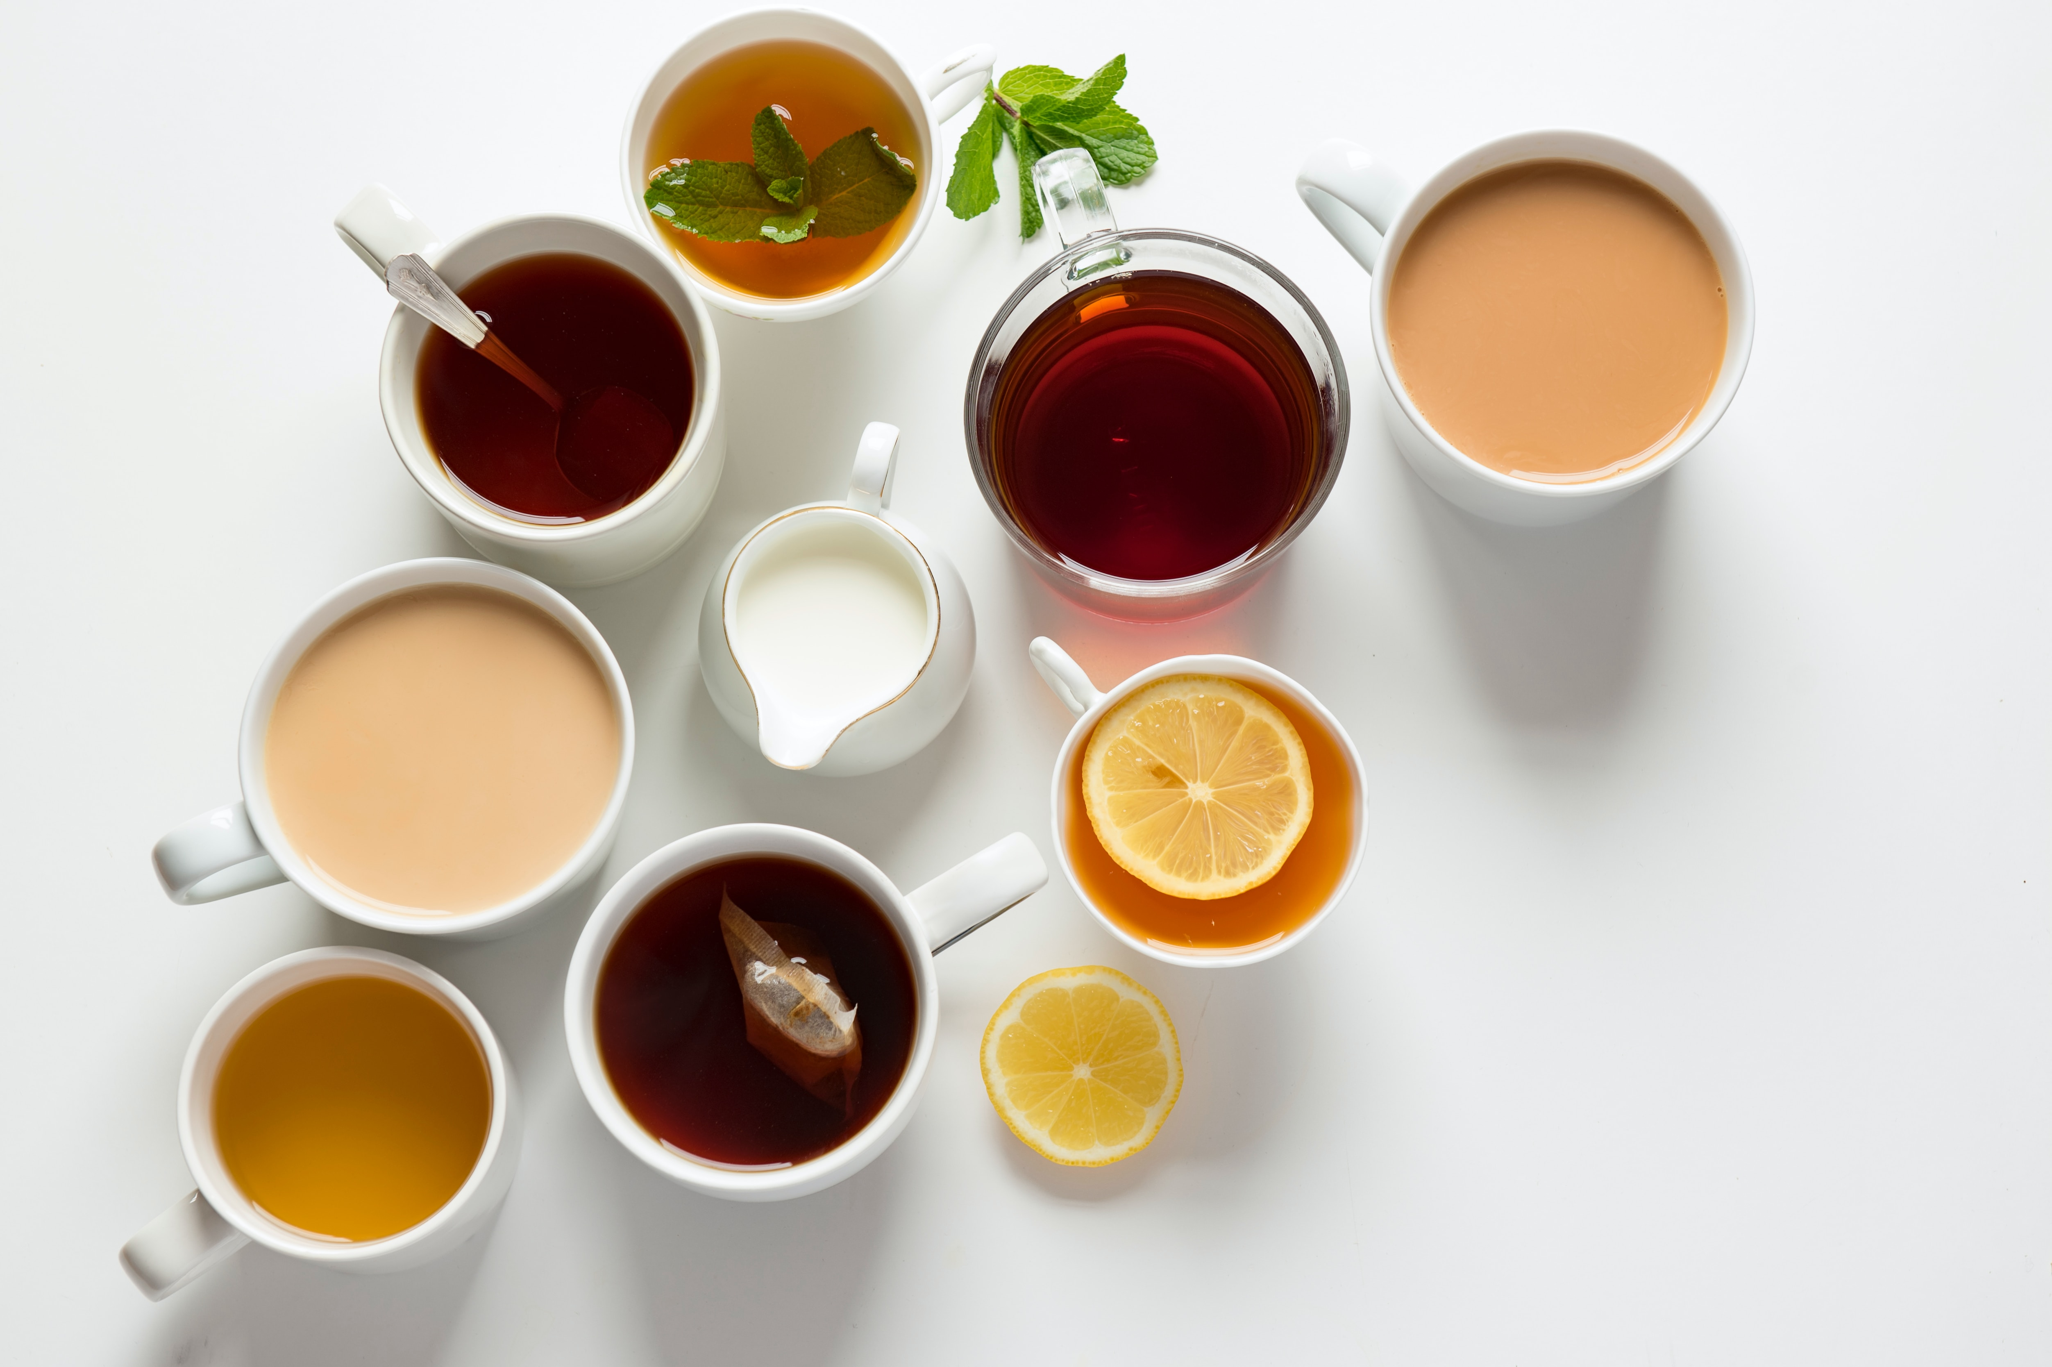
Photo by Joanna Kosinska on Unsplash

Slide 8
Do these goals reflect what we want science to be for?
If not: what goals do we want science to have?
What kind of openness would be needed to achieve these goals?

Slide 9
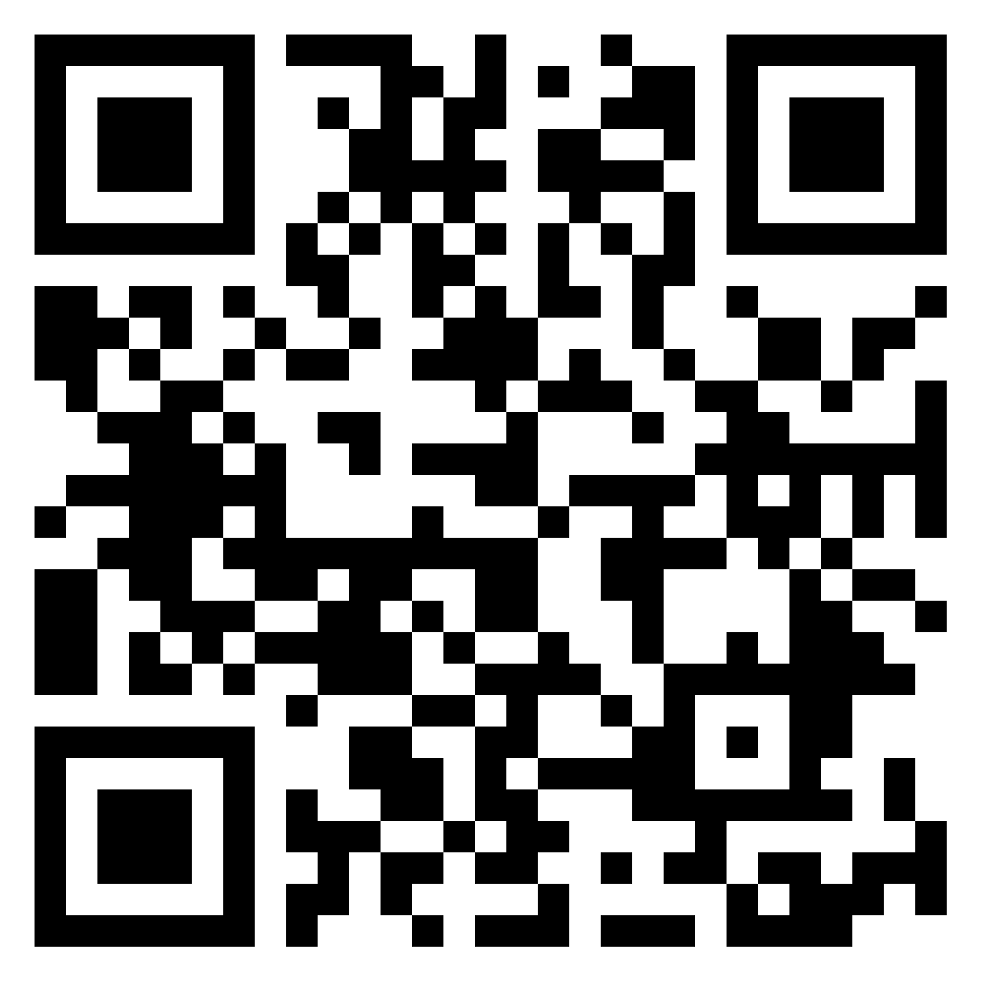
What practices would fit into these ideas of openness?
https://tinyurl.com/inclusionosf23

Slide 10

Thank you!
Get in touch with us!
barbosamendes@esphil.eur.nl
troost@essb.eur.nl
weinberg@essb.eur.nl
If you have anything to add or want to revisit our session later, visit the Padlet board: https://tinyurl.com/inclusionosf23
Photo by Junseong Lee on Unsplash

