Slide 1

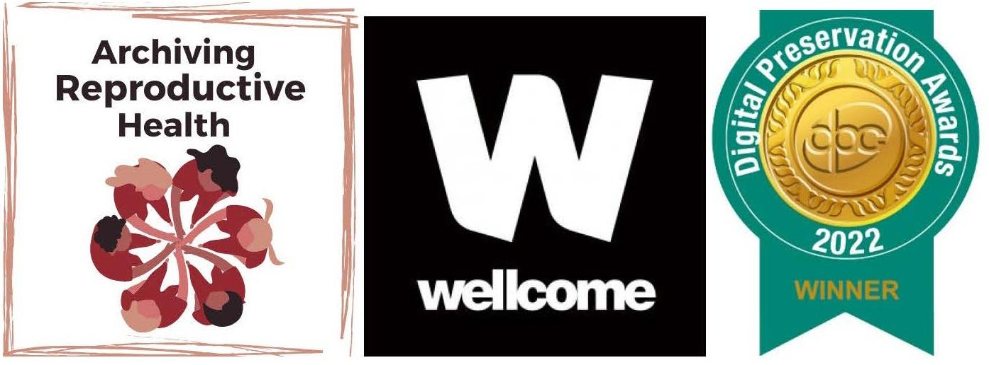


Archives and Records Association Conference 2023
Archiving activist communities: The Archiving Reproductive Health project's work building relationships with grassroots feminist organisations.
Clare Lanigan, Digital Archivist and Coordinator
Date: 31 August 2023

Slide 2
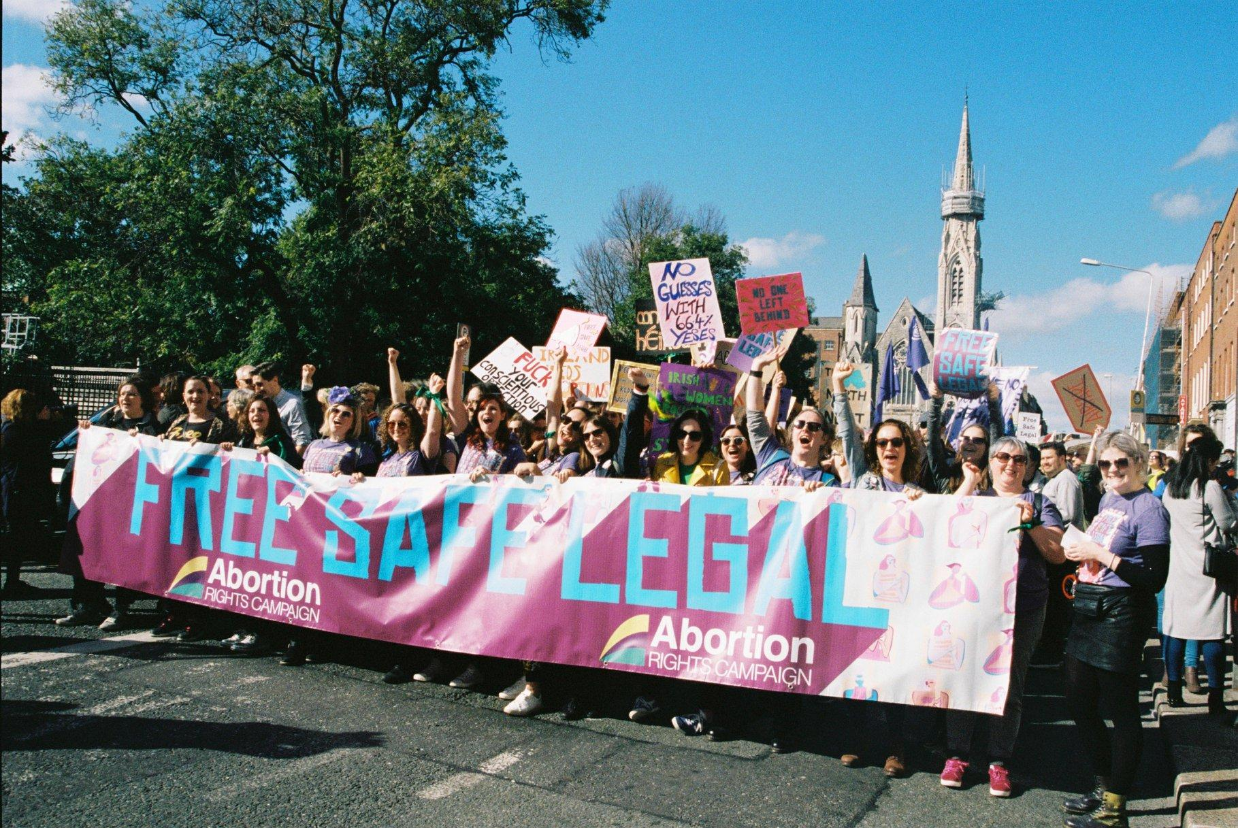



Archiving Reproductive Health - Overview
Notes:
Archiving Reproductive Health is a Wellcome-funded project coordinated by the Digital Repository of Ireland, which is working to preserve digital material created by grassroots organisations working for reproductive justice in Ireland, especially during the 2018 referendum to repeal the Eighth Amendment of the Irish constitution. To date, Archiving Reproductive Health has published collections from key organisations that were involved with the campaign, and a range of oral history interviews with feminist and reproductive rights activists working in Ireland over the last 40 years.3 In September 2022, Archiving Reproductive Health won a Digital Preservation Award in the category of ‘Safeguarding the Digital Legacy’.4 The project will continue until the end of 2023 and the collections it creates are safely deposited in the Digital Repository of Ireland for the long term. In 2023, Archiving Reproductive Health will extend its public engagement remit by holding a Public Collection Day at which members of the public will be invited to bring their personal ephemeral material relating to the history of reproductive health and activism and Ireland, to be digitised and preserved in the Digital Repository of Ireland.
The Digital Repository of Ireland is a national Trustworthy Digital Repository (TDR) for Ireland’s humanities, cultural heritage, and social sciences data. DRI has been certified by the CoreTrustSeal since 2018, building on our established role as a TDR. We support best practice in digital archiving, digital preservation, Open Access, Open Research, and FAIR data sharing. The DRI has pioneered the implementation of FAIR (Findable, Accessible, Interoperable, Reusable) data principles in Ireland in the context of a trustworthy and certified repository for social sciences and humanities data.
Some FAIR data policies used by DRI and ARH include: consistent application of persistent identifiers including DOIs and ORCIDs, rich and standardised metadata that is indexed and searchable, promoting the use of vocabularies, and licences for reuse.

Slide 3

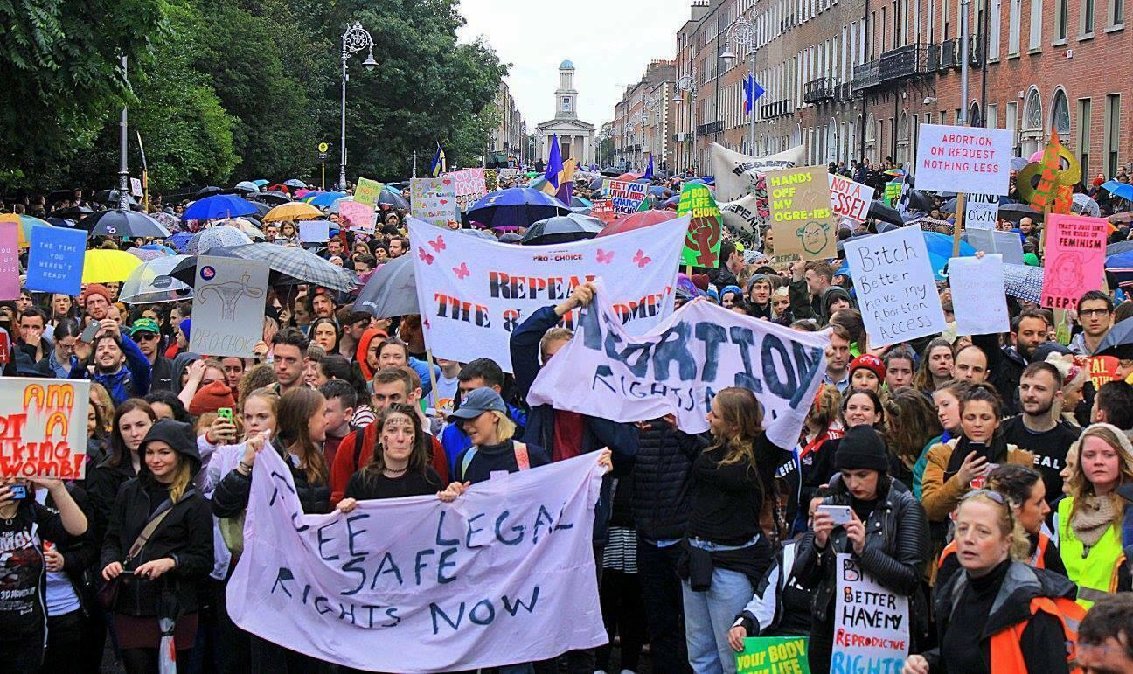
Context: The Eighth Amendment
Photo from 2016 March for Choice by Renee Summers. Collection: Abortion Rights Campaign. CC BY-SA 4.0
Notes:
Many countries around the world have seen mobilisations of people for progressive
change in recent years, and Ireland is no exception. In 2018, the Irish public voted in
a referendum to repeal the Eighth Amendment to the Irish Constitution. The Eighth
Amendment, enacted by another referendum in 1983, placed a constitutional block
on the right to legal abortion care in Ireland (although women in Ireland continued to
travel to Britain and other places to access abortion care).
When the referendum took place, on 25 May 2018, it passed by
66.4%, with every constituency but one returning a majority Yes vote. Together for Yes
disbanded after the referendum, and the various groups focused on the implementation of
legislation. In January 2019, the Health (Regulation of Termination of Pregnancy) Act 201817
was enacted, making elective abortion care legal in Ireland for the first time in the nation’s
history.

Slide 4

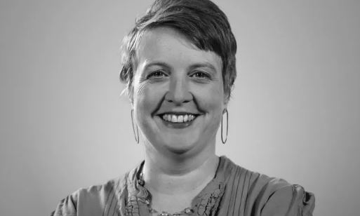

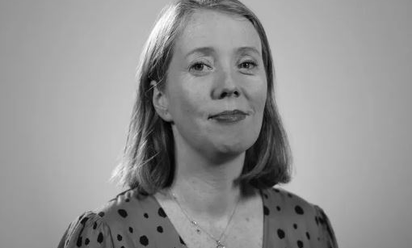
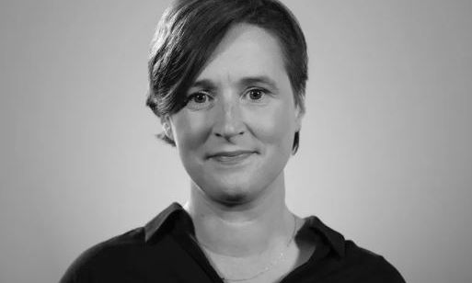
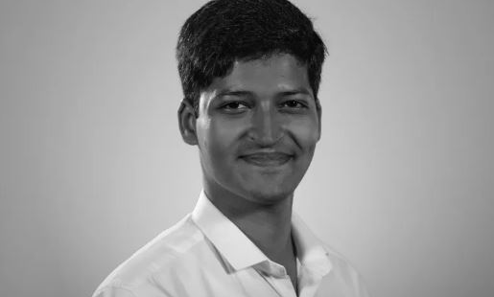
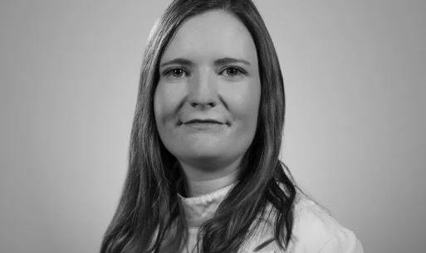
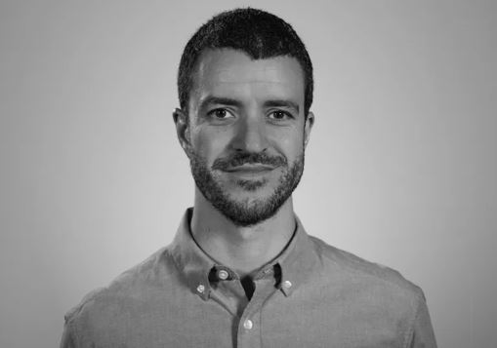
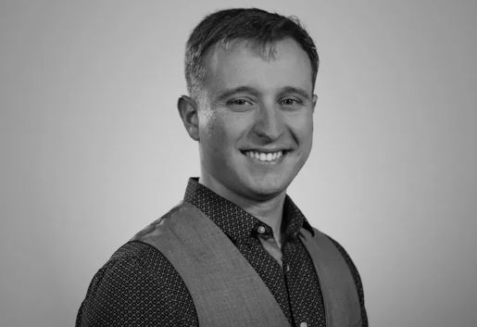
ARH Team
Dr Aileen O’Carroll
Dr Kathryn Cassidy
Dr Lisa Griffith
Clare Lanigan
Preetam Singhvi
Dr Lorraine Grimes
Kevin Long
Murilo Dias
Notes:
Principal investigators
Dr Aileen O’Carroll, Maynooth University
Dr Kathryn Cassidy, Trinity College Dublin
Dr Lisa Griffith, DRI Director
Clare Lanigan
Digital Archivist and Coordinator
Lorraine Grimes
Postdoctoral Researcher and Digital Archivist
Preetam Singhvi
Junior Software Developer
Murilo Dias
Junior Software Developer
Kevin Long
DRI Digital Archivist

Slide 5

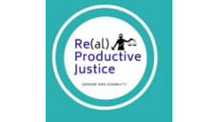
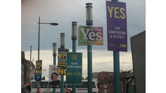






Stakeholder organisations
Research data
Notes:
The material ARH is working with comes from a number of Stakeholder Organisations who have donated their digital records to us, and qualitative data from researchers, primarily in the social sciences.
Stakeholder organisations
Abortion Rights Campaign (ARC): an all-Ireland campaign for free, safe and legal abortion
Terminations for Medical Reasons (TFMR): a group that supports women, parents and families following diagnosis of a foetal anomaly during pregnancy
Coalition to Repeal the 8th: a broad umbrella organisation intended to bring together a wide range of civil society organisations that supported the repeal of the Eighth Amendment.
Together for Yes: The national campaign for a Yes vote in the 2018 referendum, made up of ARC, the Coalition and the National Women’s Council of Ireland
InHerShoes: Women of the Eighth: Personal accounts from women in Ireland who sought abortion prior to the repeal of the Eighth Amendment
Research data
Re(al)productive Justice: Gender and Disability: a disability rights and reproductive justice project based in Galway University.
Physician Advocacy and Reproductive Rights in Ireland: interviews with current and former committee members of Doctors for Choice, an Irish pro-choice physician advocacy group.
Posters and City Streets: The Linguistic Landscape of the Eighth Amendment: This is a visual collection created by researcher Louis Strange, containing 432 images of signage from the 2018 referendum.
Mixed-Methods Research Findings from Repeal Activists. This collection contains qualitative data collected through questionnaire responses. The questionnaires were conducted in 2015, 2020 and 2021. Each provides an insight into activist's thinking on campaigning pre and post the 2018 referendum.
The Pro-Choice Movement in Ireland from 1983-2010. This is a collection of interviews carried out by historian Mary Muldowney in 2010. The interviews are with pro-choice activists who were involved in the movement at different stages from 1983 to 2010.
Voices of the Irish Women’s Movement: Second wave feminism in Ireland. This collection comprises of legacy qualitative interviews conducted by Professor Linda Connelly in the course of completing her PhD project in 1997. The interviews were conducted with key feminist activists and examined their experience of activism, their political approaches, and the methods used by the groups they were involved in.
retweetthe8th: This dataset contains the tweet ids of 2,108,782 tweets related to the referendum to repeal the 8th Amendment of the Constitution of Ireland. They were collected between March 9th, 2018 and May 30th, 2018 from the Twitter filter stream API using various terms related to the referendum.

Slide 6

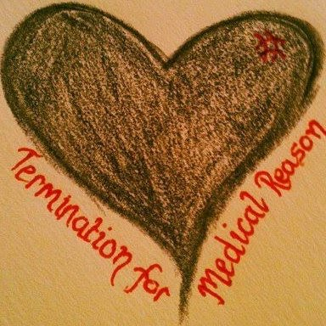
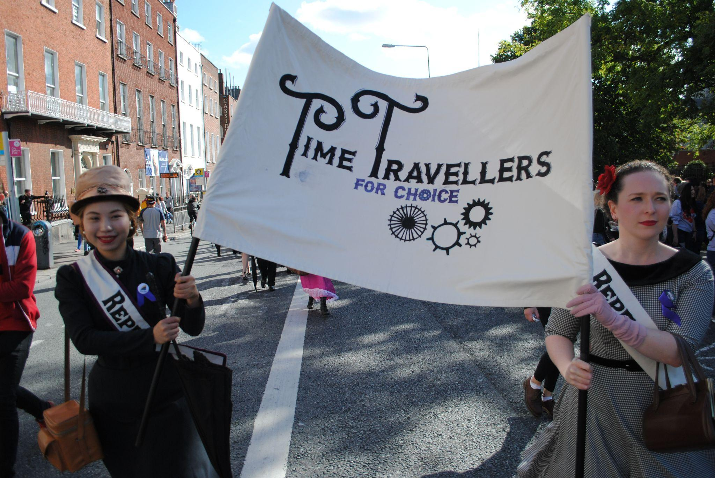
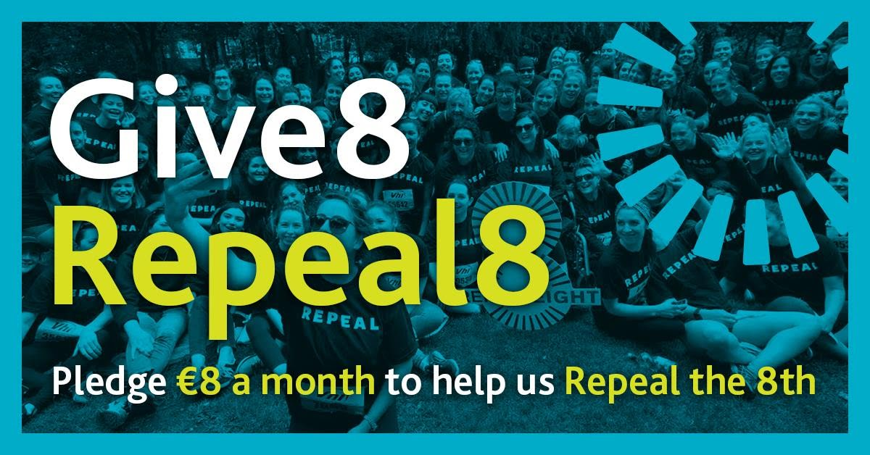

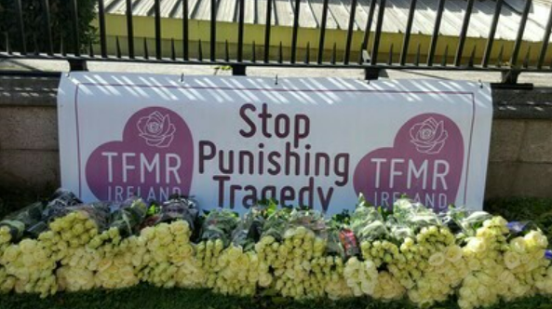
ARH collections
TFMR
drawn
heart
logo
Banner for 2016 March for Choice
Photograph from 2017 March for Choice
Together
for Yes infographic “I’ve
Voted”
Coalition to Repeal the 8th infographic
TFMR banners at 2017 March for Choice
Notes:
Clockwise from left: Banner for the 2016 March for Choice, designed by ARC; early version of logo used by TFMR; photograph of activists in costume at 2017 March for Choice; donation infographic created by the Coalition to Repeal the Eighth; an infographic used by Together for Yes on the day of the referendum; and a TFMR banner from the 2017 March for Choice.
Much of the material is already familiar to the Irish public from the 2018 referendum campaign, especially the design and publicity materials of Together for Yes, the national organisation campaigning for a Yes vote. The In Her Shoes Facebook page was very well-known and is still updated today.
Quick link to the collections: Click here

Slide 7
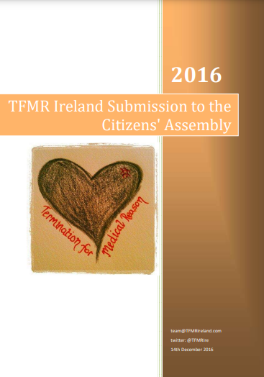

ARH collections
Terminations for Medical Reasons Submission to the Citizens’ Assembly on the Eighth Amendment
Abortion Rights Campaign (ARC) Regional Toolkit.
Notes:
Publications and reports by the Abortion Rights Campaign, Terminations for Medical Reasons, and Together for Yes. These include annual reports, submissions to transnational entities such as the United Nations, and submissions to the Irish Government.
Left: Abortion Rights Campaign (ARC) Regional Toolkit. This was a booklet developed by ARC in 2017 to help and support the network of regional groups that went on to become the backbone of canvassing teams around the country in 2018.
Right: The submission to the Citizens’ Assembly on the Eighth Amendment published by Terminations for Medical Reasons in 2016. The submission outlines the ways in which the Eighth Amendment affected people who receive fetal anomaly diagnoses, and how many were forced to travel to access abortion care without the support of their doctors at home. Personal testimony from women and couples affected by fetal anomaly diagnoses are a key part of the document.

Slide 8
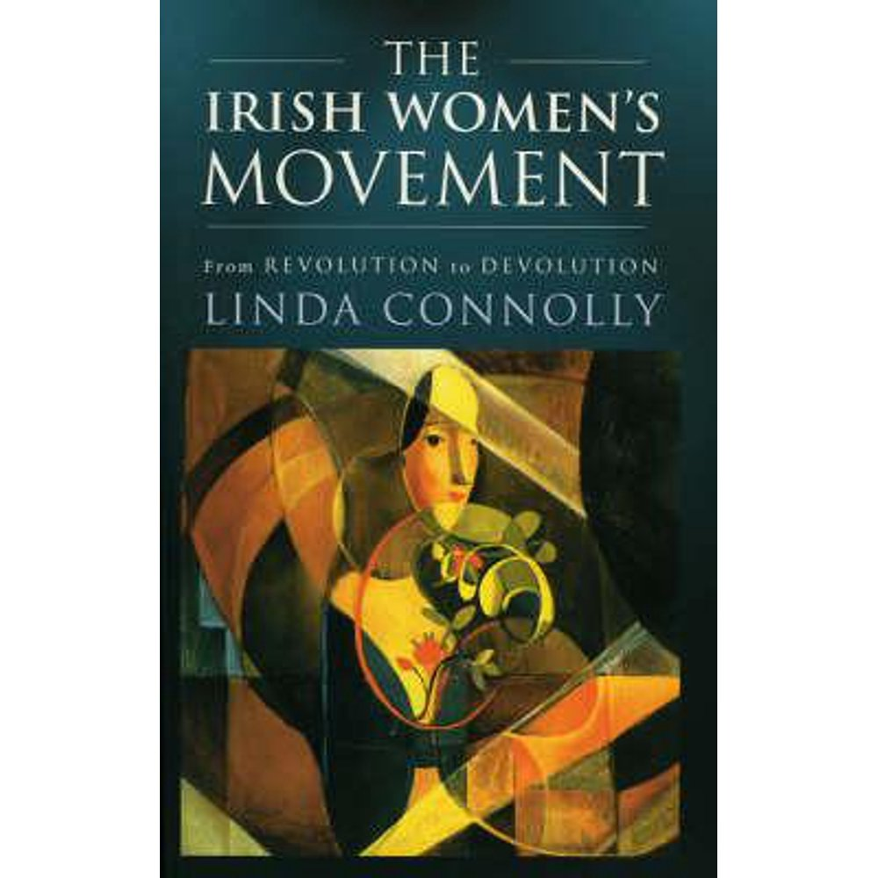

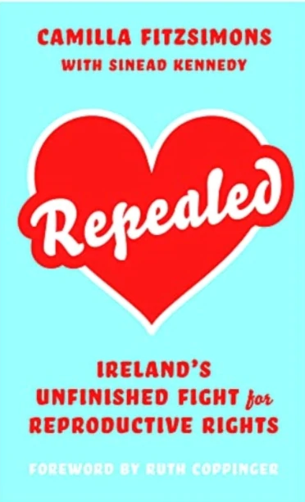
ARH collections - Research data
Linda Connolly
20 interviews
Voices of the Irish Women’s Movement, 1970-80s
Mary Muldowney
11 interviews
The Pro-Choice Movement in 1983-2010 Ireland
Camilla Fitzsimons,
Survey data 2015, 2020 & 2021
Experiences from the Repeal Campaign
Notes:
Research data collections in the form of oral history interviews with campaigners and women’s rights activists from the 1970s to the 1990s were also recently published. These provide important records of the lived experiences of activists and people affected by issues of reproductive inequality in Ireland.

Slide 9
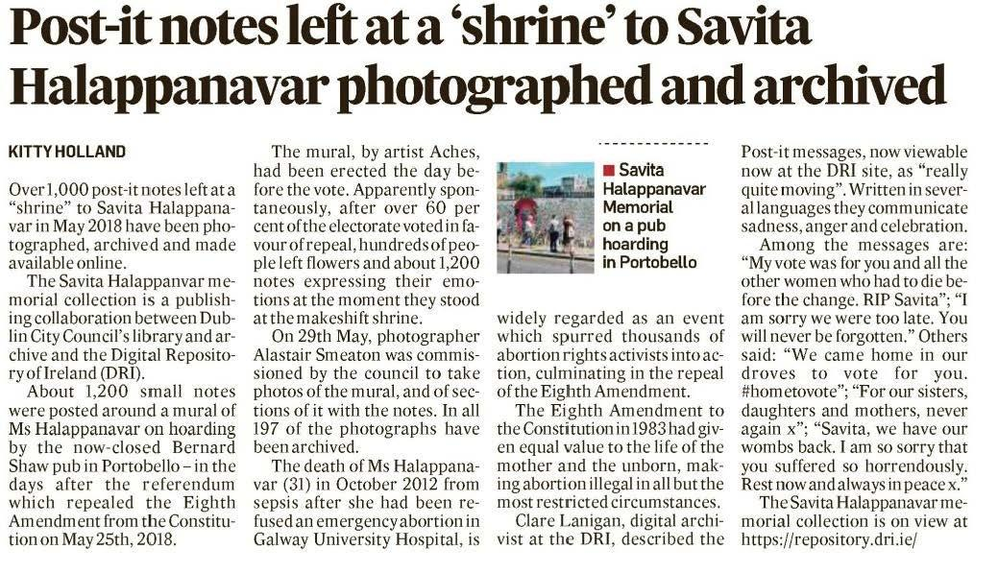
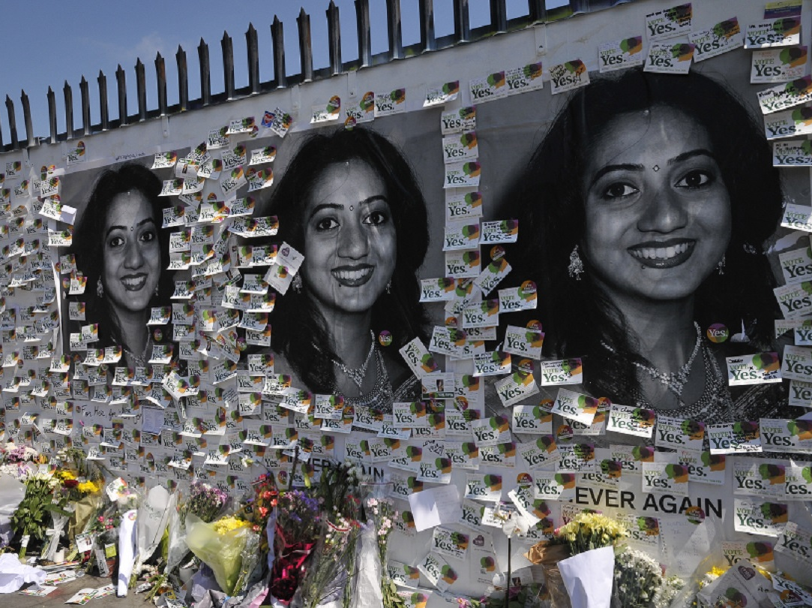
ARH collections: Savita Halappanavar Memorial
News story in the Irish Times, March 2023
Notes left at the memorial to Savita Halapannavar. Original mural by artist Aches visible. Copyright: Dublin City Library and Archive. Licensed for reuse under a Creative Commons Attribution ShareAlike licence (CC BY-SA 4.0)
Notes:
A collection of images of notes left at the mural of Savita Halappanavar during the 2018 referendum to repeal the Eighth Amendment will now be available long term as a digital archive.
DRI Member Dublin City Library and Archive (DCLA) have published the Savita Halappanavar Memorial Collection on the Digital Repository of Ireland (DRI). This collection brings together photographs commissioned by DCLA in May 2018 of the hundreds of personal notes left by the public at the mural of Savita Halappanavar.

Slide 10
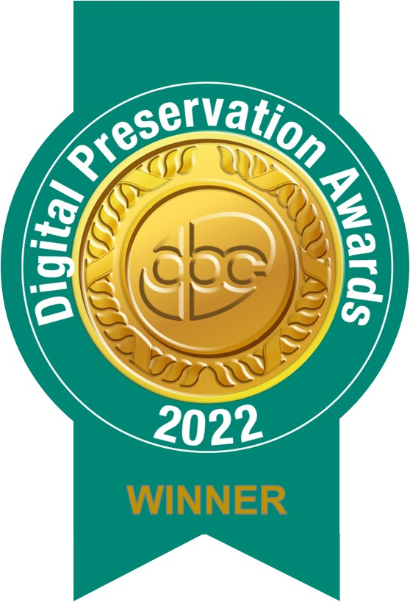

Awards and Milestones
Digital Preservation Award 2022 for Safeguarding the Digital Legacy.
Open Scholarship Prize 2022.
Public Collection Day
Notes:
In June 2022 Archiving Reproductive Health was shortlisted for a Digital Preservation Awards 2022, the prestigious National Records of Scotland Award for Safeguarding the Digital Legacy. This award celebrates initiatives for the practical application of tools to protect at-risk digital objects. In September 2022, Archiving Reproductive won the award in this category, at the iPres conference in Glasgow.
In April 2022 Archiving Reproductive Health won third place in the Open Scholarship Prize 2022. The Open Scholarship Prize, run as part of Open Scholarship Week, recognises the substantial contribution that Open Scholarship makes to the betterment of science and society. The aim is to award research and researchers that improve society and research generally through making research more accessible, transparent and reproducible.

Slide 11
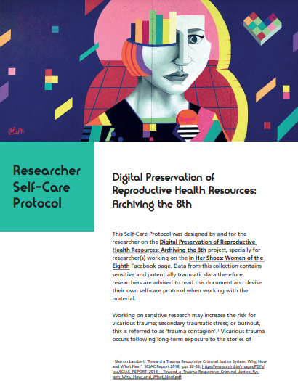
ARH publications
ARH Researcher Self-Care Protocol:
It focuses on the potential to harm the researcher when working with sensitive data on reproductive health.
It provides practicalities for working with sensitive or traumatic data.
Notes:
ARH Researcher Self-Care Protocol:
It focuses on the potential to harm the researcher when working with sensitive data on reproductive health.
It provides practicalities for working with sensitive or traumatic data.

Slide 12
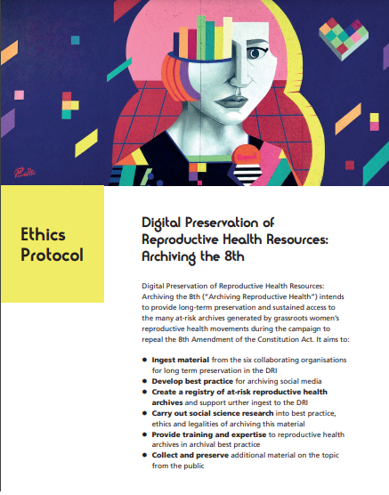
ARH publications
ARH Ethics Protocol:
To ensure the quality and integrity of our research and archiving processes
To outline the ethical issues which arise from the project, and to ensure transparency in the project.
Notes:
ARH Ethics Protocol:
To ensure the quality and integrity of our research and archiving processes
To outline the ethical issues which arise from the project, and to ensure transparency in the project.

Slide 13

Community engagement
ARH would not be possible without buy-in from volunteer groups.
Core collections from stakeholder organisations.
Vkw.studiogood, CC BY-SA 4.0 via Wikimedia Commons

Slide 14
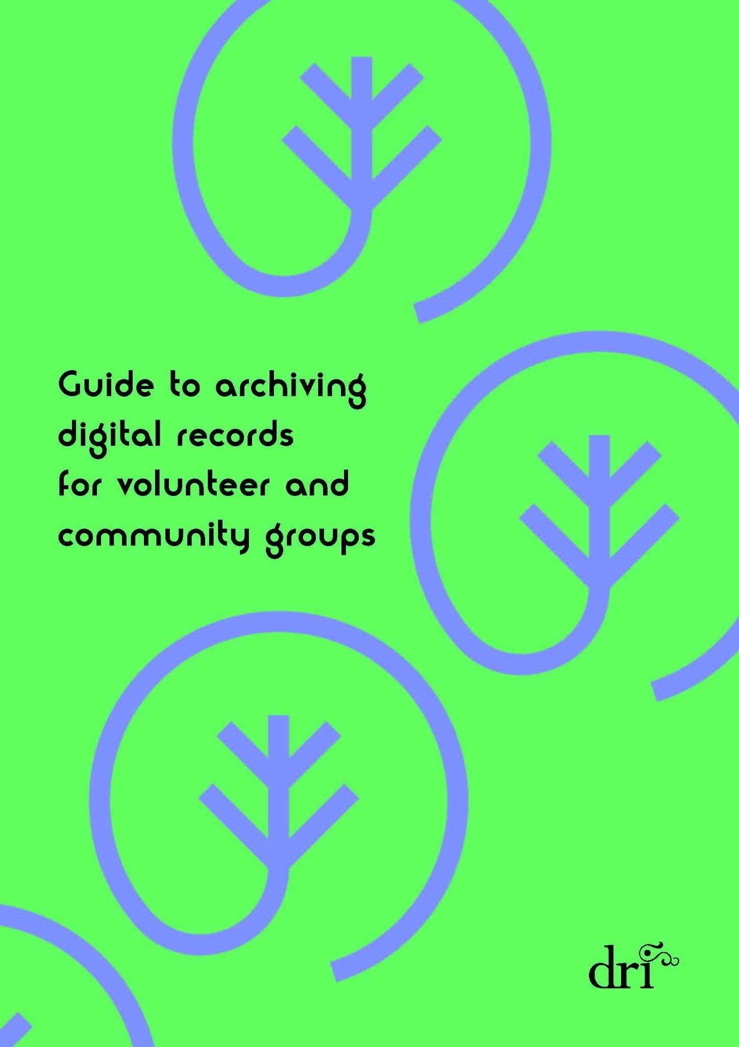
Community guidelines
ARH Guide to digital archiving for community groups:
A guide for non-specialists outlining the basics of digital archiving, aimed at volunteer and community groups.
Notes:
This is a guide for volunteer, grassroots and community groups, created to assist them with cataloguing and preserving their digital records. Although the focus of this guide is primarily digital records, it also provides information on cataloguing and organising physical records.
The guide is informed by the Archiving the 8th E-guide, produced by the Wellcome Trust-funded project ‘Archiving the 8th’, and by the findings of the ‘Archiving Reproductive Health’ project to date.
The guide intends to provide clear, easy to follow and accessible instructions and advice for small organisations with limited resources, enabling them to make the best use of what resources they have and to preserve a cross-section of their digital records. It aims to enable small groups to organise their materials in such a way that if they have the opportunity to deposit them in a trusted digital repository such as the Digital Repository of Ireland, they will have well-organised collections in accessible and interoperable formats.
The guide also draws on the Community Archive Training resources developed over the last number of years by the Digital Repository of Ireland.

Slide 15

Community engagement - training
Digital archiving training in the form of DRI Community Archive Training Course - an overview of the principles of archiving in general and digital archiving in particular, and an introduction to using the DRI.

Slide 16
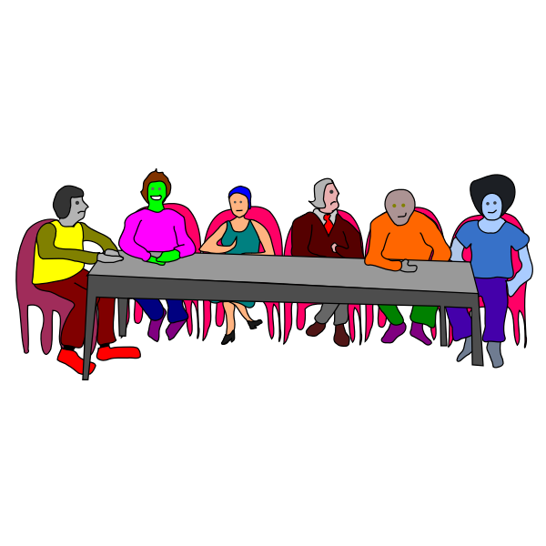
Stakeholder advisory group - creation
Sought out representatives from:
Activist groups
Social science data researchers
Medical activists
Notes:
This forum consists of representatives of each of the organisations whose data is collected and ingested to DRI. The aim of the forum is for us to get feedback from stakeholders about the ARH project and the digital collections we are creating. We want to ensure that we are collecting and archiving this material in the best way possible, and we feel that people involved with the organisations whose material we are archiving, either as volunteers or as researchers, are best placed to give us this feedback.
Over the course of the project we will hold three Stakeholder Advisory Forum meetings, in order to get essential feedback and advice on the progress of the ingested collections.

Slide 17
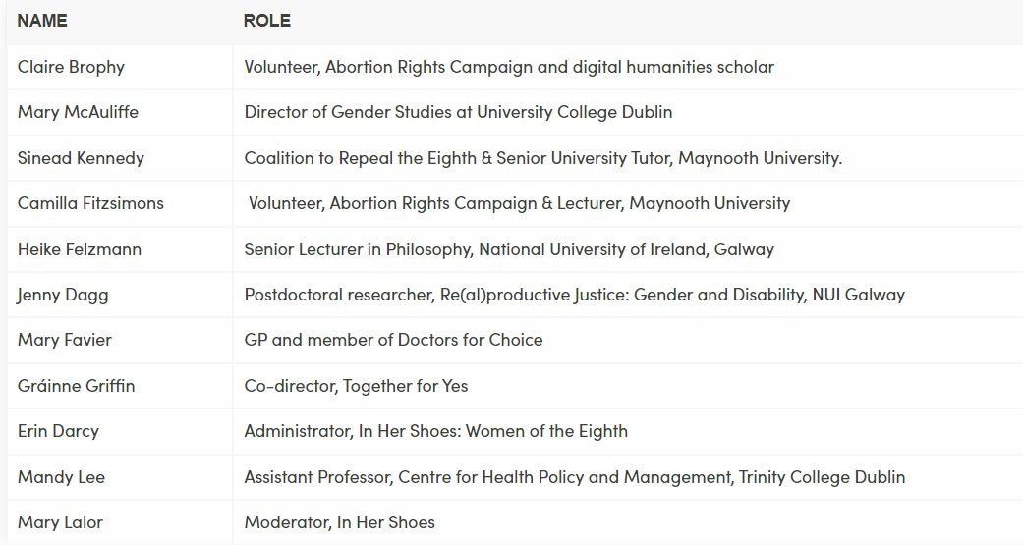
Stakeholder advisory group - membership
Notes:
This forum consists of representatives of each of the organisations whose data will be collected and ingested to DRI. The aim of the forum is for us to get feedback from stakeholders about the ARH project and the digital collections we are creating. We want to ensure that we are collecting and archiving this material in the best way possible, and we feel that people involved with the organisations whose material we are archiving, either as volunteers or as researchers, are best placed to give us this feedback.
Over the course of the project we will hold three Stakeholder Advisory Forum meetings, in order to get essential feedback and advice on the progress of the ingested collections.

Slide 18
Stakeholder advisory group - first meeting
Discussion of Archiving Plan
Policies for archiving internal documents - group agreed on making documents available and anonymising names.
Notes:
From meeting minutes:
Mandy Lee (ML): Remembers a former PHD project archiving organisational
documents from Department of Health (possibly including recent minutes
docs).
● Sinead Kennedy (SK): Minutes of Coalition, can’t see a problem publishing
them, decision was taken early on that the minutes would be decisions, not a
transcript of the discussion. Widely distributed to member organisations, so
minutes were already semi-public. List of attendees and those responsible for
certain tasks included, but not expecting that to be an issue (can anonymise
or request consent).
● Mary McAuliffe (MMcA): Semi-restricted Attic Press archive contains meetings
and minutes from many labour & women’s groups from the 90s. Archive is
physical, but the catalogue is online.
● Camilla Fitzsimins (CFS): Concern about retrospective consent, would prefer
to redact names, individuals may feel pressured to give consent, especially if
everyone else is consenting.
● Heike Felzmann (HF): Makes sense where minutes were taken carefully with
assumption that they would be seen, but could be a problem for smaller
organisations who maybe didn’t consider this so carefully. HK would agree
maybe anonymisation would be the best.
● SK: 1983 Referendum campaign - not a lot of work out there, one book “The
Second Partitioning of Ireland” published in 1990-91. The author had access
to the material from the original campaign (both sides). He quotes people, etc.
From a research point of view it’s better to have the names.
● CFS: A lot of the policy submissions are already in the public domain, so
minutes and agendas seem more important.
● Aileen O’Carroll (AOC): Submissions are in the public domain, but not being
preserved for the long-term, even government sites could be taken offline
over time.
● NOTE: All members are broadly supportive of the idea of focusing on these
types of materials and of anonymising names.

Slide 19
Stakeholder advisory group - first meeting
Discussion of In Her Shoes
Useful advice from group about best practice in archiving this data legally and ethically.
Notes:
Legal advice
● At a meeting in February, DRI’s legal advisor advised that the In Her Shoes
Facebook collection has three main potential legal issues associated with it:
○ A copyright issue because copyright is with the original authors of the
posts.
○ A GDPR issue. The material falls under special category data. As such,
we do not fall under the archiving exemption, according to the legal
advisor. This is contested by DRI Policy Manager.
○ The potential to open the DRI to a defamation charge. The reason for
this is: In preparing the data for ingest we had included subject terms
such as intimate partner violence and sexual assault, where they were
relevant. Even though the stories are mostly anonymous, we are still
open to potential defamation lawsuits under the law because these
descriptions implicate third parties. Any allegation about a third party is
potentially defamatory if untrue.
DRI Strategy to safeguard the data
The measures we will undertake to safeguard the fundamental rights and interests of
the data subject are as follows:
● Restricting access to the stories to those engaged in teaching in research.
● Publicising widely our intention to archive the material.
● A notice and action policy which ensures we will remove material on request
from the data subject (we assume good faith on behalf of the applicant).
● The majority of the stories have been posted anonymously. Any identifiable
data that remains has been removed.
● Archive the remainder of In Her Shoes stories as restricted (not as
preservation-only) assets. This means that:
○ Anyone wishing to view the stories will have to request access.
○ Access will be granted to those engaged in teaching and research.
○ Open metadata will be retained on all objects.
○ In each object, we provide a quote from the story and an open and
unrestricted link to the FB page, as part of the metadata.
● We do apply the search/subject term Sexual Assault where relevant. This is a
Subject Term from HASSET, a social science vocabulary:
https://hasset.ukdataservice.ac.uk/hasset/en/page/8dc87447-4a07-4406-bb66
-4351316b0dd4
● Opinion sought on anonymisation - should we leave the names of people who
signed their stories, for example?
● Should we use certain metadata terms eg “rape” even if the storyteller doesn’t
describe their experince as such?
Discussion on InHerShoes
● Question: should we decide subject terms regarding things like probable
sexual assualt?
● MMcA: We shouldn’t impose subject terms, if the woman doesn’t use these
terms. Stories from women who left their names should be anonymised. In the
heat of the campaign people were happy to have their names included, but in
hindsight they might not be happy for that to be preserved.
● CFS: why do we want to apply these terms? (A: for searchability for future
researchers). What’s the broadest term we could use to enable the
searchability?
● AOC: We prefer to use a vocabulary where possible, as it is standardised.
● Kathryn Cassidy (KC): Important to balance benefit to future researchers with
duty of care to the original author
● ML: Purpose of archive it to be able to find and use these materials, have to
be able to add controversial terms. DRI needs an ethical framework to allow
us to move forward with these questions.
● Lorraine Grimes (LG): Not just question of consent, also partner violence,
child sexual abuse, parental abuse/neglect, etc. Most obvious situation is
rape, but many other possible scenarios where we have to carefully select the
terms.
● HF: ‘Consent’ seems the best subject term to use, but what terms have we
looked at for other scenarios?
● Jenny Dagg (JD): Agree re term ‘consent’, and using multiple vocabularies to
try to find commonality/best term. Suggests “Intergenerational violence”,
check if it is in the vocabularies.
● CFS: Abortion didn’t happen in a vacuum, don’t be afraid to capture the
socio-cultural context. Makes the point that anonymisation is not just removing
names, also geographical details, speech patterns, etc.
● AOC: The stories on the repository include a link to the original story on FB,
so even if we anonymise, at least in the short term, viewers will be able to see
the original.
● HF: What is the anonymisation protocol?
● AOC: We follow IQDA anonymisation protocol.These stories are not so
difficult to anonymise compared to life-histories where the subject talks about
their lives from childhood through to being a grandparent. Many more
identifiable points there.
● LG: Because these stories were going to be published on FB, the authors
themselves were usually fairly careful and semi-anonymised the stories (e.g.
didn’t name friends or other third parties)
● CL: Has the specific defamation issue come up for others before?
● SK: Around the 8th Amendment there is a sense of anxiety about it. E.g.
Canadian Journal of Irish Studies commissioned a special issue, but then
dropped it because their legal advice was that collectively the submissions
were potentially defamatory. Unclear if this was under Canadian or Irish law.
● JD: In the Re(al)Reproductive Justice project, we anonymised names of
consultants and professionals named in the stories even though participants
chose not to be anonymous. Chose to name organisations, but not any
individuals working in those organisations.
● LG: In Her Shoes used the term “Medical Professionals” for both negative and
positive experiences with medical professionals.

Slide 20
Stakeholder advisory group - second meeting
Feedback on how best to make the Guide to digital archiving more accessible.
Included moving some information to appendices, and simplifying language.
Notes:
From meeting minutes:
Community Archiving Guide
● Asking the group for feedback on the Community Guide to Archiving
Digital Material. (document emailed separately).
Discussion
AOC: GDPR table seems to refer to business records - This is to do with
archiving. Suggestion: Put the word archiving in front of it
KC: Change rights statement to ‘archived material’ rather than ‘stuff’.
GG: Use the same example in both examples of rights statements.
Example of finding aid lists.
CF: Note that it seems long to the reader.
Put the example in an appendix, and link.
KC: Use phrasing ‘Open Formats’
Slim down suggested metadata fields
Might remove financial data section, more a business records thing.

Slide 21
Accessible and reusable data - rights and open licensing
All objects in the Repository require a Rights statement which provides information about the rights holder and permitted reuse. Each object also has a Licence associated with it which can be selected from any of the supported DRI licences.
All of the descriptive metadata is reusable under a CC-BY licence.
Notes:
All objects in the repository require a Rights statement which should give information about the rights holder and permitted reuse. Each object must also have a Licence associated with it which can be selected from any of the supported DRI licences. The Licences specify under what conditions the digital assets can be reused. All of the descriptive metadata is reusable under a CC0 licence.
Where appropriate, information about how the data was gathered is also ingested along with the main dataset. This is uploaded as documentation for a collection, or sub-collection of digital objects. A link to the Documentation is displayed on the object or dataset’s landing page.
Technical metadata about the file format and other significant properties is automatically generated, as is provenance metadata relating to actions carried out on the file after it has been ingested. This additional metadata is stored with the object.

Slide 22
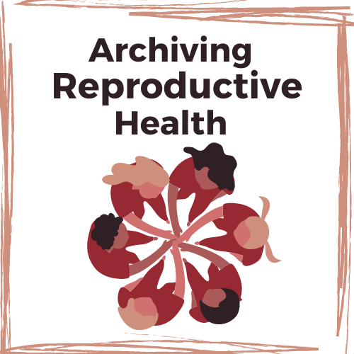
Links
Project page: https://dri.ie/archiving-reproductive-health/
Research protocols: https://dri.ie/archiving-reproductive-health/#research-protocols
Stakeholder group: https://dri.ie/archiving-reproductive-health/#stakeholder-advisory-forum

