Slide 1
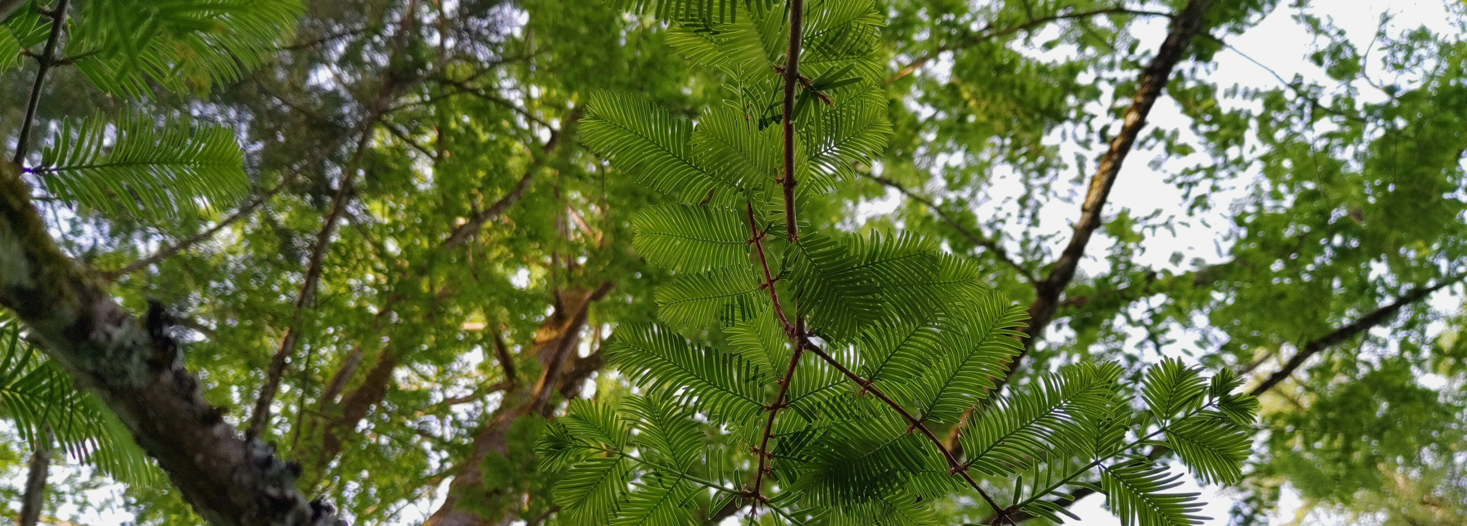








The Digital Botanical Garden Initiative
DBGI
A brief presentation of the initiative
30.08.2023
Pierre-Marie Allard & Emmanuel Defossez

Slide 2



Slide 3

A massive undertaking ...
Profile the metabolic content of all currently known species on Earth.
... with three objectives
EARTH
METABOLOME
INITIATIVE
Explore and understand the chemical foundations of the biosphere
Benefit human society
Protect biodiversity

Slide 4



Wildlife ecosystems
Diversity
(species)
Sampling
(easiness of)
Functions
(understanding of)
Conditions
(control of environmental)
Botanical gardens
Diversity
(species)
Sampling
(easiness of)
Functions
(understanding of)
Conditions
(control of environmental)
Laboratory plants
Diversity
(species)
Sampling
(easiness of)
Functions
(understanding of)
Conditions
(control of environmental)

Slide 5
Wildlife ecosystems
Diversity
(species)
Sampling
(easiness of)
Functions
(understanding of)
Conditions
(control of environmental)
Botanical gardens
Diversity
(species)
Sampling
(easiness of)
Functions
(understanding of)
Conditions
(control of environmental)
Laboratory plants
Diversity
(species)
Sampling
(easiness of)
Functions
(understanding of)
Conditions
(control of environmental)

Slide 6
Wildlife ecosystems
Diversity
(species)
Sampling
(easiness of)
Functions
(understanding of)
Conditions
(control of environmental)
Botanical gardens
Diversity
(species)
Sampling
(easiness of)
Functions
(understanding of)
Conditions
(control of environmental)
Laboratory plants
Diversity
(species)
Sampling
(easiness of)
Functions
(understanding of)
Conditions
(control of environmental)

Slide 7


Swiss
Digital Botanical
Gardens Initiative

Slide 8

Establish chemical extracts libraries of
Swiss botanical
gardens
Swiss
Digital Botanical
Gardens Initiative

Slide 9

Establish chemical extracts libraries of
Swiss botanical
gardens
Digitize, through mass spectrometry, the chemodiversity of
Swiss botanical
gardens
Swiss
Digital Botanical
Gardens Initiative

Slide 10
Establish chemical extracts libraries of
Swiss botanical
gardens
Digitize, through mass spectrometry, the chemodiversity of
Swiss botanical
gardens
Swiss
Digital Botanical
Gardens Initiative
Gather chemical information and relevant samples metadata in a knowledge graph

Slide 11

Establish chemical extracts libraries of
Swiss botanical
gardens
Digitize, through mass spectrometry, the chemodiversity of
Swiss botanical
gardens
Swiss
Digital Botanical
Gardens Initiative
Gather chemical information and relevant samples metadata in a knowledge graph
Connect to existing ontologies (bio, chemo) and biodiversity
digitization
projects

Slide 12

Establish chemical extracts libraries of
Swiss botanical
gardens
Digitize, through mass spectrometry, the chemodiversity of
Swiss botanical
gardens
Swiss
Digital Botanical
Gardens Initiative
Gather chemical information and relevant samples metadata in a knowledge graph
Connect to existing ontologies (bio, chemo) and biodiversity
digitization
projects
Establish web and programmatic
interfaces

Slide 13

Establish chemical extracts libraries of
Swiss botanical
gardens
Digitize, through mass spectrometry, the chemodiversity of
Swiss botanical
gardens
Swiss
Digital Botanical
Gardens Initiative
Gather chemical information and relevant samples metadata in a knowledge graph
Illustrate the feasibility
and advantages
of an end-to-end
Open Science
project
Connect to existing ontologies (bio, chemo) and biodiversity
digitization
projects
Establish web and programmatic
interfaces

Slide 14

Establish chemical extracts libraries of
Swiss botanical
gardens
Digitize, through mass spectrometry, the chemodiversity of
Swiss botanical
gardens
Establish robust and
scalable workflows
for the digitization of
wildlife ecosystems
biodiversity
Swiss
Digital Botanical
Gardens Initiative
Gather chemical information and relevant samples metadata in a knowledge graph
Illustrate the feasibility
and advantages
of an end-to-end
Open Science
project
Connect to existing ontologies (bio, chemo) and biodiversity
digitization
projects
Establish web and programmatic
interfaces

Slide 15

Establish chemical extracts libraries of
Swiss botanical
gardens
Provide "molecular arguments" for biodiversity conservation policies
Digitize, through mass spectrometry, the chemodiversity of
Swiss botanical
gardens
Establish robust and
scalable workflows
for the digitization of
wildlife ecosystems
biodiversity
Swiss
Digital Botanical
Gardens Initiative
Gather chemical information and relevant samples metadata in a knowledge graph
Illustrate the feasibility
and advantages
of an end-to-end
Open Science
project
Connect to existing ontologies (bio, chemo) and biodiversity
digitization
projects
Establish web and programmatic
interfaces

Slide 16
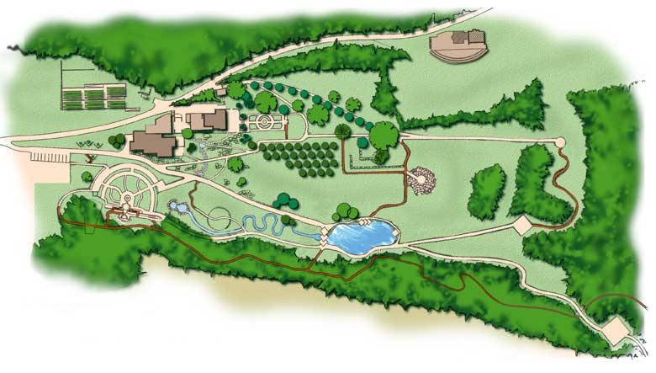
Overall protocol

Slide 17


Plant Z

Slide 18
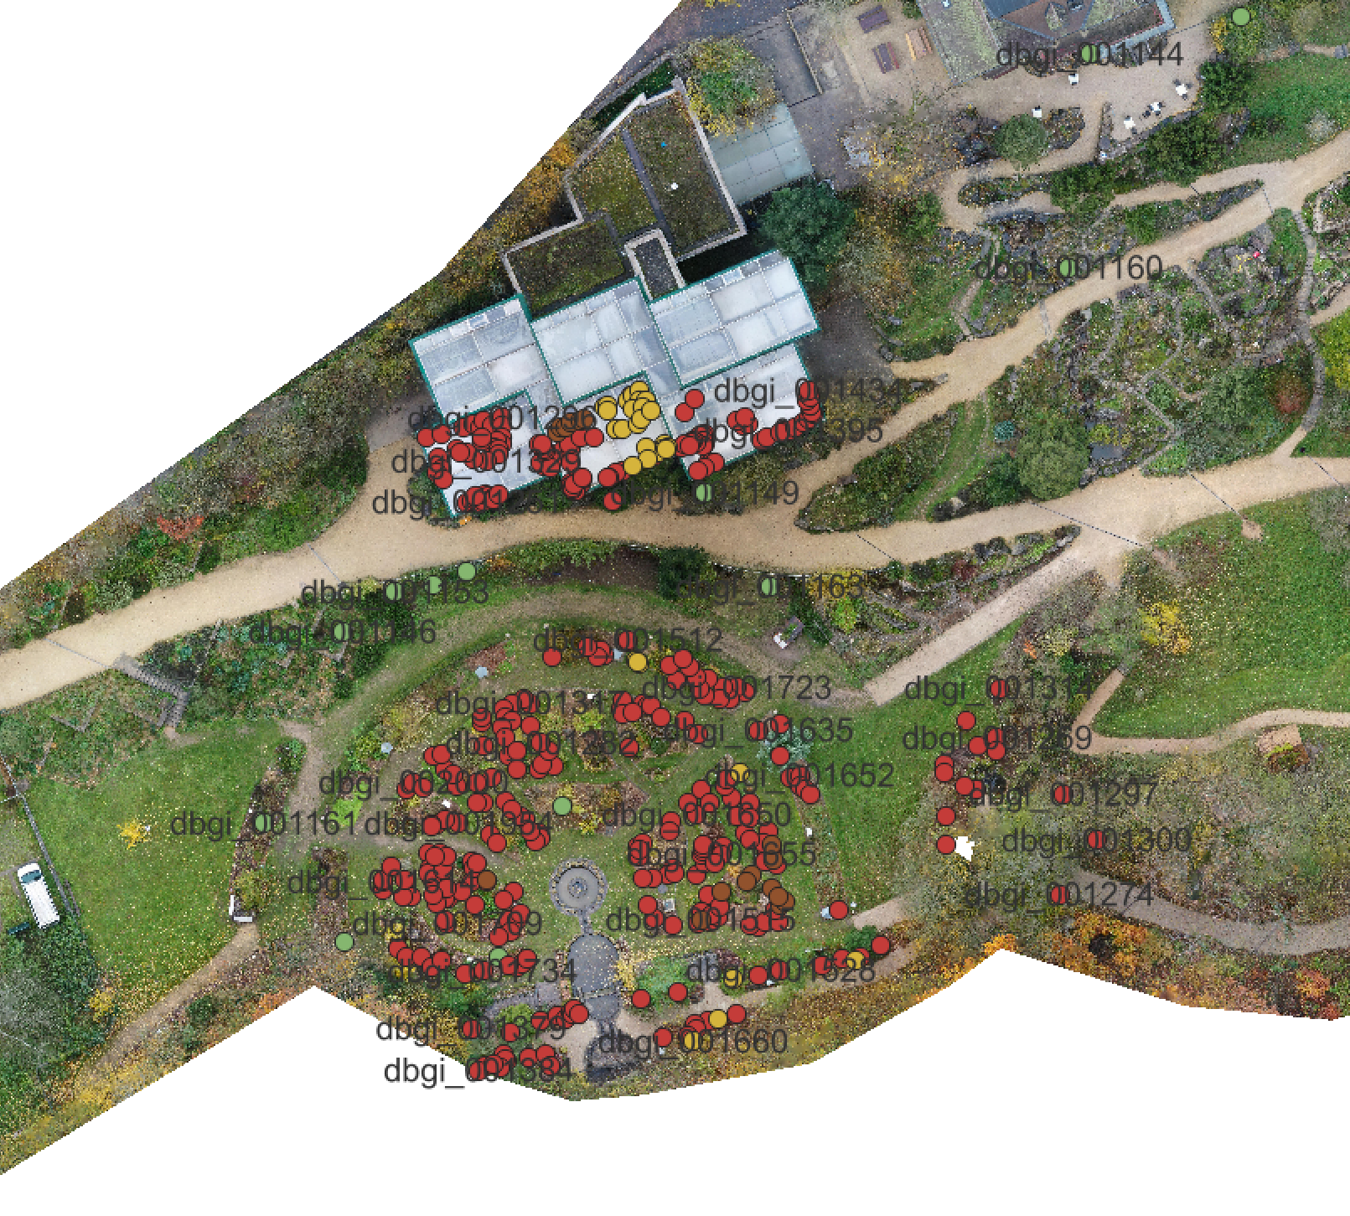
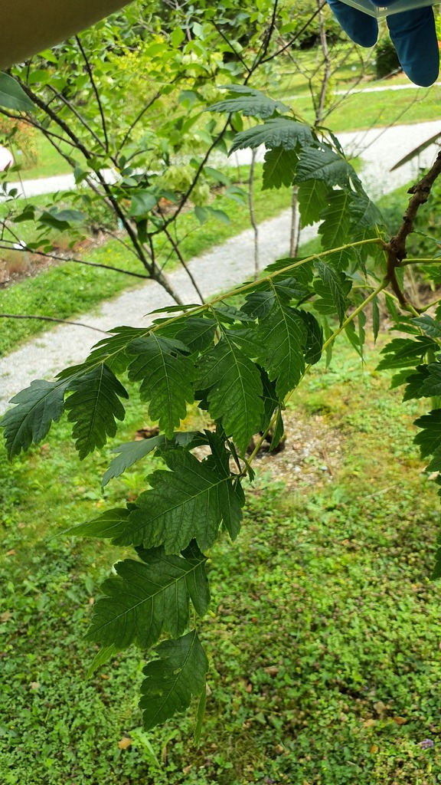
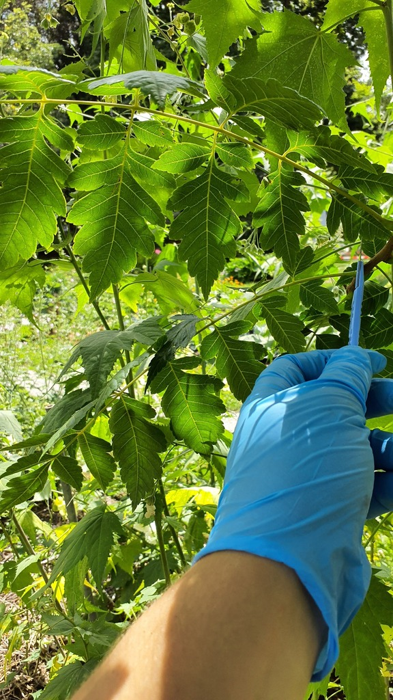
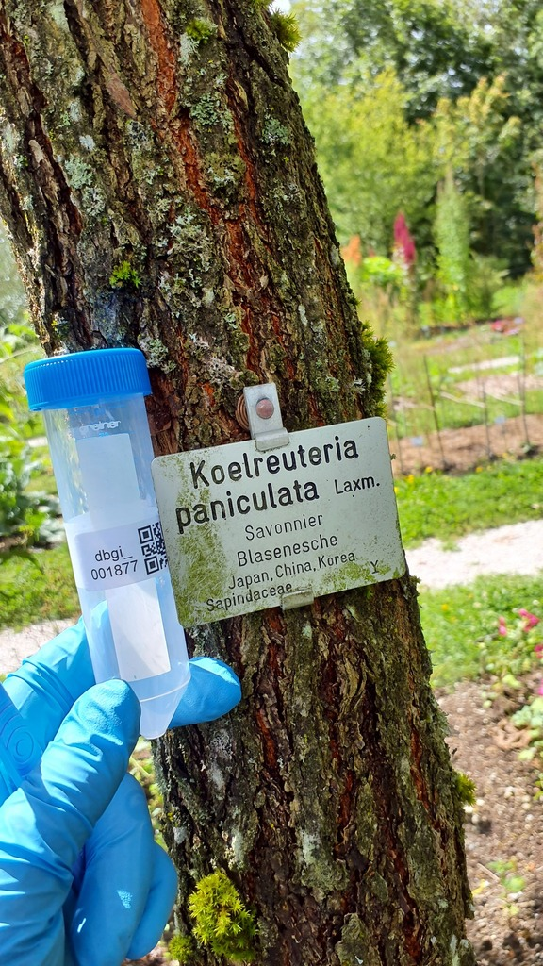

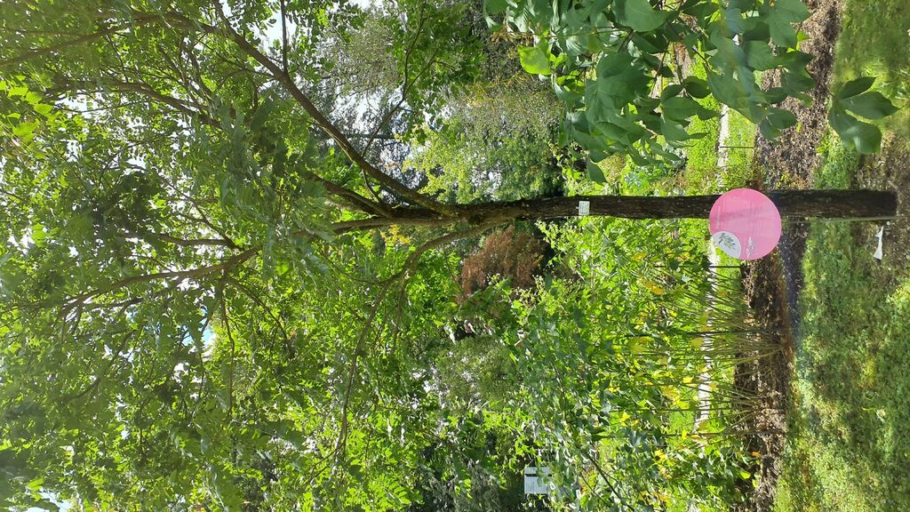


Plant Z
Large
Close
Sample
Label
~1 Leaf
Species identity, location, IPEN, iNaturalist…

Slide 19
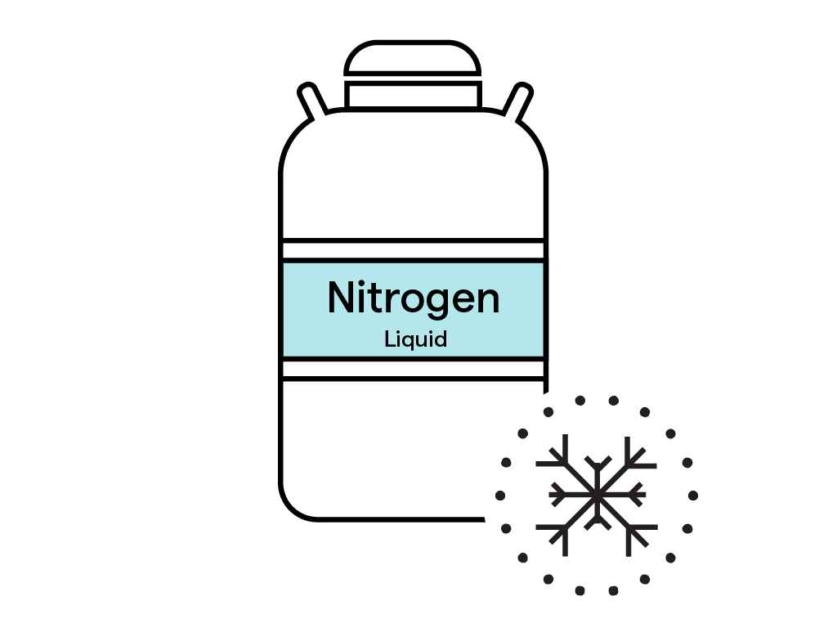
Plant Z
Large
Close
Sample
Label
~1 Leaf

Slide 20
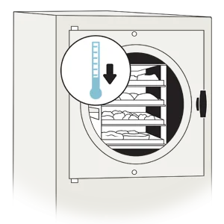
Plant Z
Large
Close
Sample
Label
freeze-drying
~1 Leaf

Slide 21

Grinding and Extraction
Plant Z
Large
Close
Sample
Label
freeze-drying
~1 Leaf

Slide 22

Grinding and Extraction
Profiling and bioinformatic
Plant Z
Large
Close
Sample
Label
Collection storage
freeze-drying
~1 Leaf

Slide 23
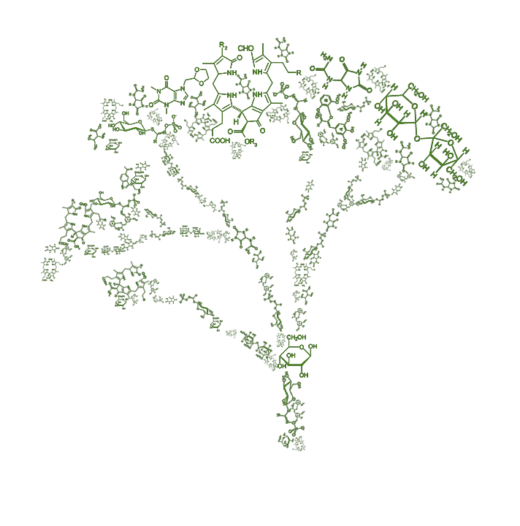
Grinding and Extraction
Profiling and bioinformatic
Plant Z
Large
Close
Sample
Label
Collection storage
freeze-drying
~1 Leaf
Plant metabolome

Slide 24
Grinding and Extraction
Profiling and bioinformatic
Plant Z
Large
Close
Sample
Label
Collection storage
freeze-drying
~1 Leaf
Plant metabolome
MDR
bacteria
Living
Things
Ecuador
target
is
Molecule
Antibiotic
Plants
endemic of
Endangered
is
is
has activity
is
Molecule
A
Molecule
B
found in
Plant
Z
status
Open Knowledge Graph base

Slide 25
MDR
bacteria
Living
Things
Ecuador
Knowledge management
(acquisition, organization and sharing )
target
is
Molecule
Antibiotic
Plants
endemic of
Endangered
is
is
has activity
is
Molecule
A
Molecule
B
found in
Plant
Z
status
What is a Knowledge Graph ?

Slide 26



MDR
bacteria
Living
Things
Ecuador
Knowledge management
(acquisition, organization and sharing )
target
is
Molecule
Antibiotic
Plants
endemic of
Endangered
is
is
has activity
is
Molecule
A
Molecule
B
found in
Plant
Z
status
What is a Knowledge Graph ?

Slide 27
Living
Things
is
is
Animals
Plants
is
is
is
eat
Dogs
Cows
Herbs

Slide 28
Living
Things
is
Molecule
Plants
is
is
is
found in
Molecule A
Molecule B
Plant Z

Slide 29
Plant
Z
Molecule
B
found in

Slide 30
Plant
Z
Molecule
B
found in
Botanical
Garden
JBN
cultivates

Slide 31
Ecuador
endemic of
Endangered
status
Plant
Z
Molecule
B
found in
Botanical
Garden
JBN
cultivates

Slide 32
Living
Things
Ecuador
is
Tracheophyta
endemic of
Endangered
is
status
Plant
Z
Molecule
B
found in
Botanical
Garden
JBN
cultivates

Slide 33
Living
Things
Ecuador
is
terpenoid
Tracheophyta
Antibiotic
endemic of
Endangered
is
is
has activity
status
Plant
Z
Molecule
B
found in
Botanical
Garden
JBN
cultivates

Slide 34
MDR
bacteria
Living
Things
Ecuador
target
is
cause of
SPHP
(serious public health problems)
Tracheophyta
terpenoid
Antibiotic
endemic of
Endangered
is
is
has activity
status
Plant
Z
Molecule
B
found in
Botanical
Garden
JBN
cultivates

Slide 35
MDR
bacteria
Living
Things
Ecuador
is
Prioritise species conservation
cause of
target
SPHP
(serious public health problems)
Tracheophyta
terpenoid
The "Z" plant species cultivated at the Neuchâtel Botanical Garden originates from Ecuador and is currently endangered. It produces an antibiotic that has an impact on multi-resistant bacteria, which are implicated in major health problems.
Antibiotic
endemic of
Endangered
is
is
is
has activity
status
Plant
Z
Molecule
A
Molecule
B
found in
Botanical
Garden
JBN
culitvate

Slide 36
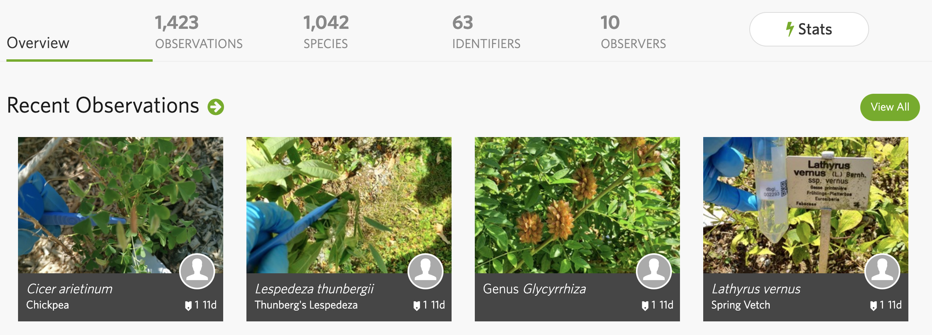
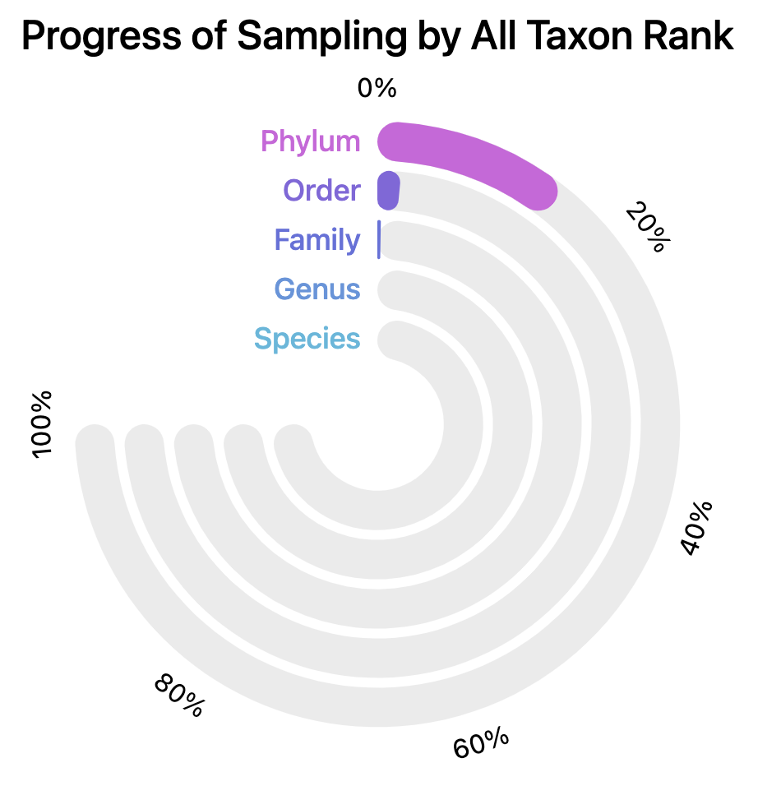
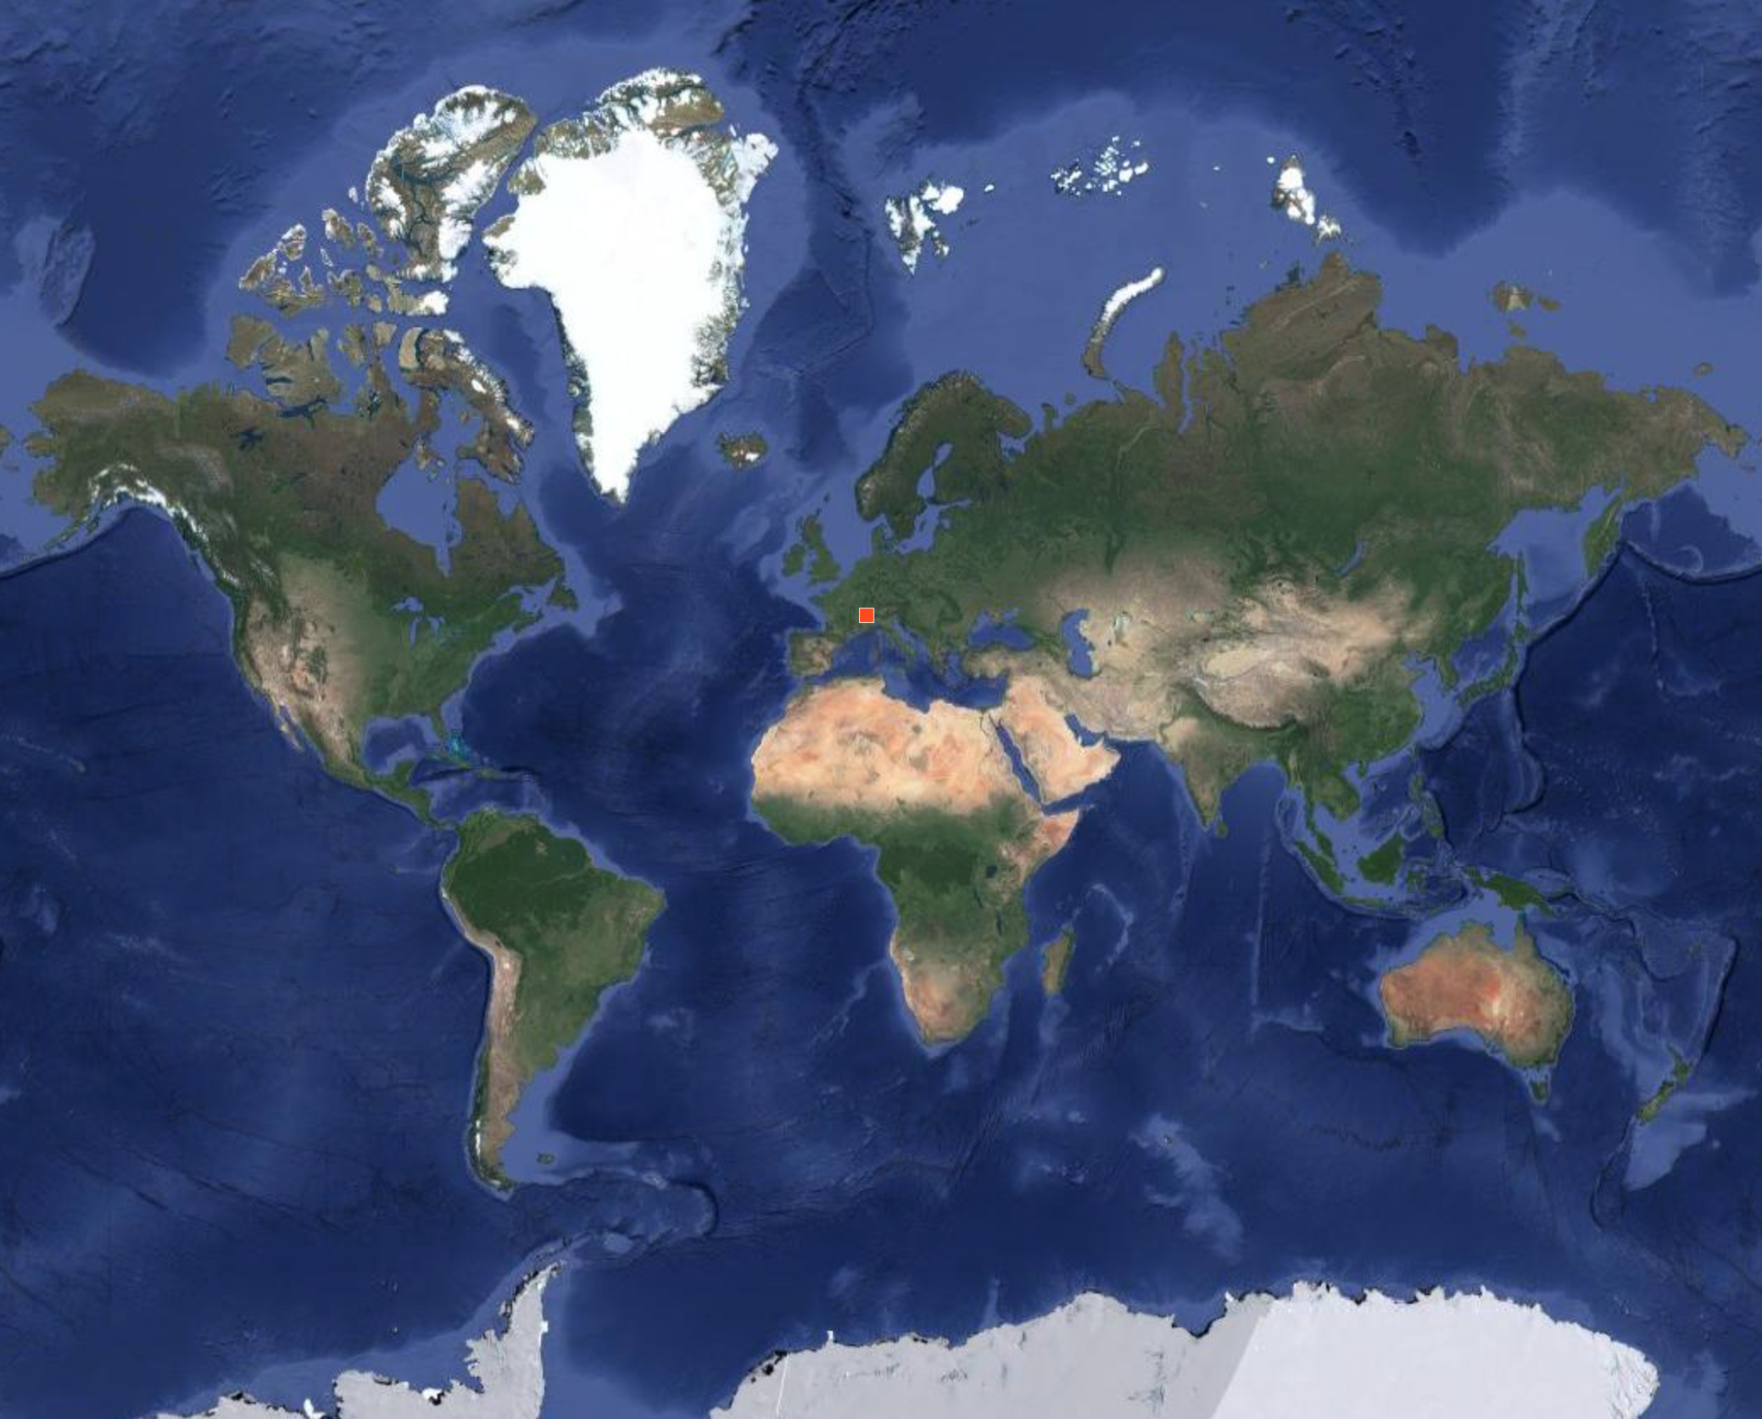

Slide 37
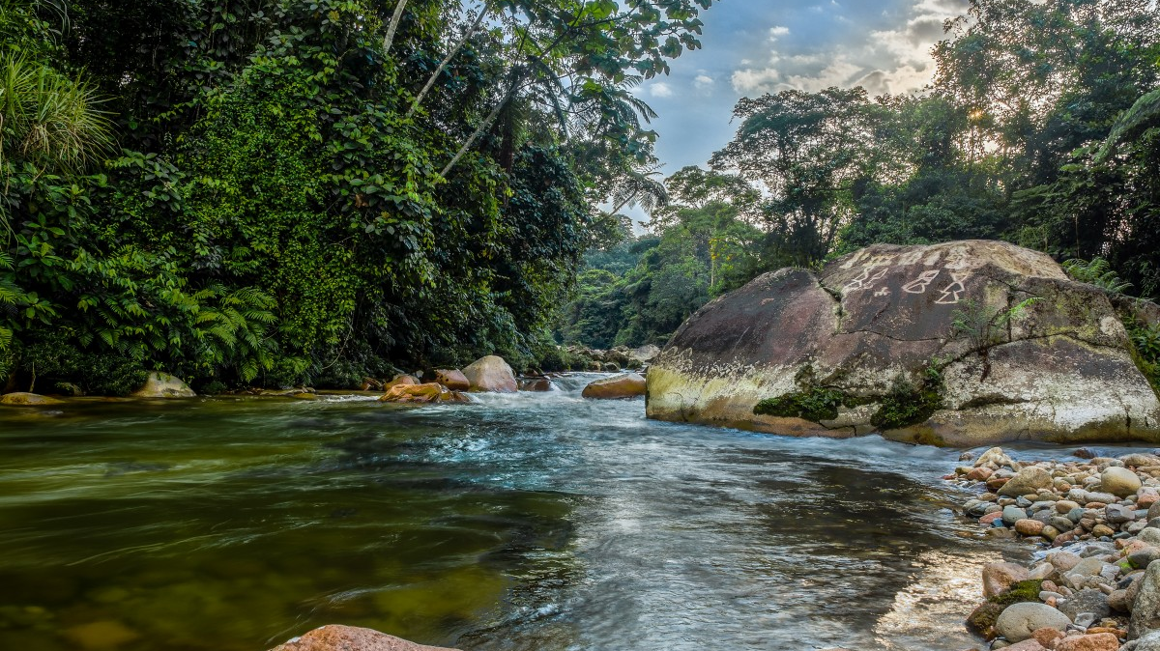

Slide 38

We need help !
Get in touch :)
www.dbgi.org
dbgi@protonmail.com

