Slide 1
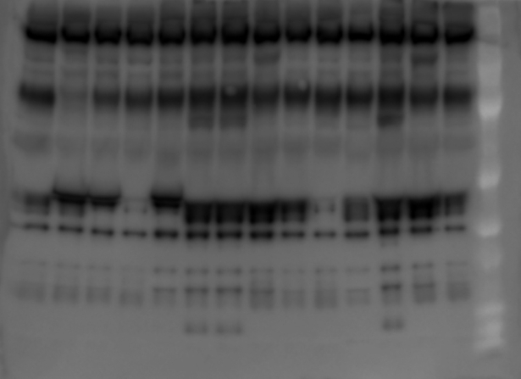
Uncropped Figure 6, panel E

