Slide 1
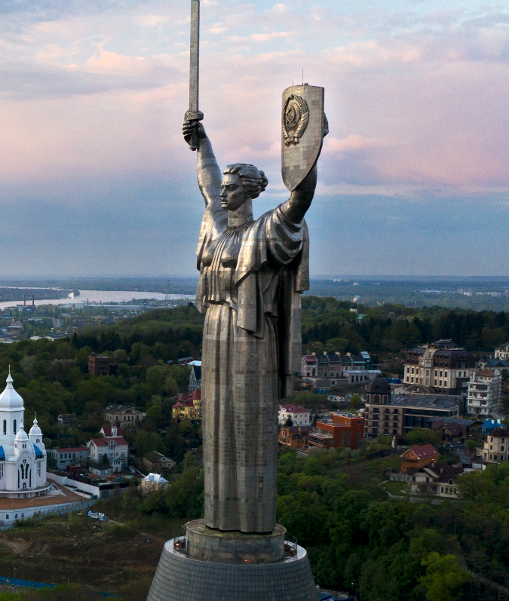


LECTURE COURSE
В FULFILLMENT OF THE CONTRACTUAL OBLIGATIONS IN WARTIME
23
ANATOLIY KOSTRUBA
PROFESSOR OF THE DEPARTMENT OF CIVIL LAW

Slide 2


23
FULFILLMENT OF THE CONTRACTUAL OBLIGATIONS IN WARTIME
UKRAINE’S EXPERIENCE
ANATOLIY KOSTRUBA
Contractual researcher IRJS
Professor of Civil Law of Ukraine, Dr. habil.
LECTURE COURSE

Slide 3





І. FORCE MAJEURE IN WARTIMES
01
WHAT IS
The introduction of the martial law by the Presidential Decree as of
24th February, 2022 No. 64/2022 significantly affected the traders, in
particular, the opportunity of due and timely fulfillment of obligations
FORCE
MAJEURE ?
Force majeure
Force majeure is a contractual term that exempts the
party from the liability to fulfill its obligations, if an
extraordinary event prevents directly from fulfilling the
obligations
According to sec. 141 of the Ukrainian Act on Chambers of Commerce
and Industry of Ukraine, the force majeure (Act of God) shall include, in
particular:
hostilities, declared and undeclared war, general military mobilization, etc
This means that the person shall not be liable for the violation of the
contractual obligations, separate tax and/or other obligations within the
martial law period
23

Slide 4





THE FOLLOWING ELEMENTS ARE
SIGNS OF FORCE MAJEURE
they are not contingent upon the will of participants’ civil (business) relations
holds an extraordinary character
make the fulfillment of the obligations under the given conditions of business activity impossible
are irreversible
(Resolution of the Supreme Court in case №904/3886/21 dd. 25th January 2022)
THERE MUST BE:
However, simple impossibility or unforeseen
difficulties in fulfillment is not enough to justify
non-fulfillment
a causal connection between the force majeure and
the impossibility of fulfilling the contractual terms

Slide 5






02
WHAT DOES FORCE MAJEURE ACKNOWLEDGMENT MEANS?
Acknowledgement of the fact that non-
fulfillment of the contract took place due to
force majeure circumstances shall not
exempt from the liability whatsoever
THIS ONLY:
exempts from paying the
penalties under the contract:
penalty, fine, fee etc.
may be the reason for contract
termination

Slide 6



03
WHAT IS THE EVIDENCE OF FORCE MAJEURE?
The Letter of 28th February 2022
No. 2024/02.0-7.1 of CCI has acknowledged
force majeure circumstances – the military
aggression of the Russian Federation against
Ukraine, which has become a reason for
introduction of the martial law
Force majeure circumstances shall be acknowledged by
the certificate of the Chamber of Commerce and
Industry of Ukraine (CCI)
It was further confirmed that as of 24th February, 2022
the above circumstances shall be considered as force
majeure, irreversible und objective for business
entities and/or natural persons under the contract

Slide 7




RESOLUTION OF THE SUPREME COURT IN CASE
NO. 904/3886/21 DD. 25th January 2022
point out that:
Force Majeure circumstances have nonprejudicial (established in advance) character,
and the concerned party shall prove the fact of their occurrence and led the fact that the circumstances are force majeure for the certain case
Based on force majeure features, it is
necessary to prove their exceptionality and
irreversibility as well
At the same time, the certificate of the Chamber of
Commerce and Industry confirming the existence of force
majeure circumstances cannot be considered as an
indisputable proof of their existence, but shall be estimated
by the court critically taking into account the established
particulars of the case and together with other evidences
Force majeure cannot be an automatic reason for
exemption from the obligations, a party to the
contract shall confirm the fact of occurrence of such
circumstances, specifically their ability to affect the
real possibility of fulfilling the obligations
(Resolutions of the Supreme Court dd. 21st September , 2022 in case No. 911/589/21, dd. 14th February 2018 in case No. 926/2343/16, dd. 16th July2019 in case No. 917/1053/18, dd. 25th November 2021 in case No. 905/55/21).
(The Supreme Court made the similar conclusions in its Resolutions dd. 16th July 2019 in case No. 917/1053/18 and dd. 09th Novenber 2021 in case No. 913/20/21).

Slide 8




FOR INCTANCE
1
The Commercial Court for Khmelnytsk Region in its
Ruling dd. 13th May, 2022 in case No. 924/183/22 did
not take into account the defendant’s arguments in
Respect to force majeure circumstances certified by
The CCI Letter No. 2024/02.0-7.1 dd. 28th February 2022
“… Since this evidence in no way confirms the fact that
specifically due to the military aggression of the Russian
Federation against Ukraine, and this is the reason why the
martial law was introduced, the defendant was unable to
fulfill its contractual obligations…”
“… The defendant did not provide any evidences that the company
stopped working due to martial law, that the employees (or their part),
company director, other officials are mobilized and are in the Armed
Forces of Ukraine, temporarily do not perform their professional
obligations due to military actions, entire or part of
the company's movable property is used during
certain activities that would prevent the business
entity from carrying out business activities
under martial law…”
2
The Commercial Court for Dnipropetrovsk
Region in its Ruling dd. 29th July 2022 in
case No. 904/1250/22, indicated that the
martial law in Ukraine does not mean that
the defendant cannot carry out its
business activity und acquire funds

Slide 9






II. ALTERATIONS IN THE TERMS
OF SPECIFIC CONTRACTS
In particular, the creditor shall NOT
LOAN CONTRACTS
increase the interest rate
(except for cases when the variable interest rate is fixed by the contract)
The most significant changes among contractual legal
relations during the legal regime of martial law were relations
under loan contracts
charge penalties, fines, 3% per annum, inflationary losses or impose other types of liabilities in case of late payments
The Act No. 2120-IX dd. 15th March 2022 introduced a
number of amendments to the Civil Code of Ukraine, as
well as Acts on Banks and Banking Operations, on
Consumer Crediting and on Mortgages
demand full or, even worst, early debt settlement
(when the contract provides certain specific settlement terms)
During the martial law and within 30 days after its
termination (cancel), the creditor is significantly
limited in its rights.
the mortgagee shall not acquire title to the mortgaged property, sell the respective real estate property, or evict its tenants during this period
In fact, the borrower is given the option of not servicing its loan
(not making scheduled payments), and there will be no
penalties for this

Slide 10




EMPLOYMENT CONTRACT
A NEW DEFINITION OF
EMPLOYMENT CONTRACT SUSPENSION
The outbreak of armed aggression against Ukraine and introduction
of the martial law throughout its territory significantly affected the
regulation of labor relations
is a temporary termination by an employer of providing
an employee with work and a temporary cessation by
the employee of performing work under the concluded
employment contract due to armed aggression against
Ukraine that excludes the possibility of both parties to
the labor relations to perform their obligations stipulated
by the employment contract
In particular, in order to adapt labor laws to the realities of war, the
Act on the Organization of Labor Relations under Martial Law No.
2136 of 15th March 2022 was adopted
As a general rule, the Code of Labor Laws of Ukraine
specifies that an employee may terminate an
employment contract concluded for an indefinite
period by providing two weeks' written notice to the
employer (section 38)
The employment contract may be suspended at the initiative of either party for the period not exceeding the period of martial law.
If the employer decides to cancel the suspension of the employment contract before the termination or cancellation of martial law, the employer shall notify the employee of the need to return to work 10 calendar days before the resumption of the employment contract
Whereas during martial law, according to Act No.
2136, an employee may terminate an employment
contract at his/her own initiative at any time
!
!
!
During the martial law period, an employee may be dismissed at the initiative of the employer during the period of his/her temporary disability, as well as during vacation period
Suspension of the employment contract shall not entail the termination of labor relations

Slide 11





REAL ESTATE CONTRACTS
Since the beginning of the war, the access to the state registers, including to the State
Register of Real Property Rights has been blocked, which is used to certify real estate
contracts in Ukraine. Taking into account the fact that title to real estate by its alienation or
acquisition are subject to registration in the above register, it has become impossible to sell,
buy or otherwise dispose of an apartment or other real estate
Resolution of the Cabinet of Ministers of Ukraine No.
480 dated 19th April, 2022 introduced a number of
amendments to the laws aimed at opening the real
estate market in Ukraine with the specific features
established for wartime
As long as martial law is in force and within one
month after its termination, contracts involving real
estate (including sales and purchase, donation, life
estate, exchange, division, mortgage contracts,
lease contracts of a building for a period of at least
3 years) may not be certified by all notaries, just by
those included in the List of Notaries who may
perform notarial acts in respect of valuable
property under martial law
PLACE OF CONTRACT
In peacetime, you have a choice of which notary to apply to
for notarial certification of the transaction – at the property
location or at the place of residence of one of the parties
At the time of war, this procedure will remain unchanged only for Kyiv and Kyiv Region. For other settlements, the contracts may be certified only at the place of property location.
Some administrative units expressly prohibit notarial acts in relation to valuable property

Slide 12


IS THE RESALE OF REAL ESTATE ALLOWED
Among new changes aimed at exclusion of illegal real estate fraud during the
war is a ban on certifying contracts if less than 1 month has passed since the
acquisition and registration of title to the property by the alienator
1 month
Exception thereof are the cases when the alienator
(seller, donor etc.):
inherited real estate
*
In other words, this means that if you
purchased or otherwise acquired an apartment,
you can resell it (donate, etc.) no sooner than a
month later
allocated a share in the joint
property
(most often this means the division of the spouses' joint property under agreement or under court decision)

Slide 13
2023 © Anatoliy Kostruba
Produced at Viewmark presentations

