Slide 1
Introduction to version control systems

Slide 2
Today…
We are going to talk about a life-changing event for me…
It happened in the year 2021…
When I discovered GitHub!

Slide 3
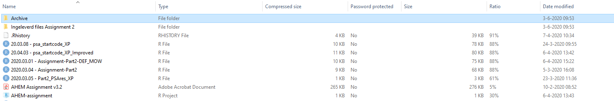
Short check
Raise your hand if your files also look like this
Notes:
Ask students:
Why is this not optimal?
No naming conventions >> knowledge of last time
Unnecessary duplication of files
Which one is the definitive version or the most up to date version
What has been changed between the different version of a file?
How to avoid this?
VERSION CONTROL!
Check who is already known with version control system

Slide 4
Short check
How do you keep track of changes you make in source code / script?
Do you have experience with collaborating on a script?
  How did you prevent conflicts and ensured the possibility to work simultaneously?

Slide 5
Prerequisite
Basic knowledge of the statistical software ‘R’ and R-studio

Slide 6
Learning objectives
After this lecture, you should be able to:
  Explain what are version control systems
  Explain why using version control systems
  Explain the (dis)advantages of using version control systems
Notes:
Notice: I will focus on R, R-studio, and github, but these principles can also be applied to other software languages

Slide 7
Version control – what?
System to:
  Systematically track changes made in scripts (and files)
  Build a history of changes made
Notes:
Not only changes within a file but also file addition and deletion.

Slide 8
Version control – why?
Allows checking adaptations
Allows to re-use previous versions
Avoid files’ duplication
Prevent (damages of) deleting the ‘wrong’ files
Facilitate collaboration on a project

Slide 9
Version control – how?
Log table
Notes:
Will focus on Git and Github

Slide 10
Log table
Keep track manually of:
  Version number
  Sometimes: file of each version number
  Changes made
  Person who made changes
  Date of changes
  Status, eventually (e.g., draft, revised, final)

Slide 11
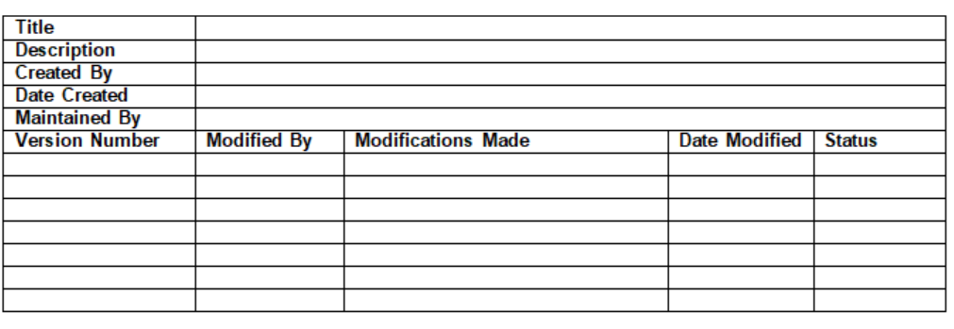
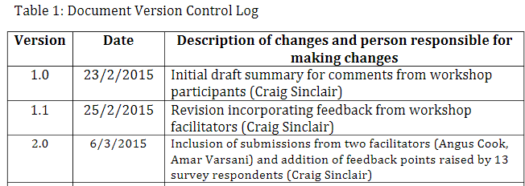
Log table examples
Source: The University of Sydney
Source: Sinclair et al. 2015
Notes:
Ask students:
What are the potential drawback of this way of working?
Still multiple files eventually
If you do not save each version of the file >> difficult to ‘go back’ to a previous version
Time consuming
You may have to ‘wait’ for the next version your colleague is working on in order to make your adaptation >> limited possibility to work simultaneously

Slide 12
What are the drawback of such approach?
Time consuming
Still: save multiple version of a file
  If not: you cannot go back to a previous version
  If yes: takes up disc space
You can still delete / update the wrong files
Collaboration?
  Wait for the most up-to-date file!
Solution?
Let a software do this for you = version control system!
Notes:
Ask students: what the drawbacks are of log tables

Slide 13
Version control – how?
Log table
Version control systems
  Local, centralized, distributed
  Softwares, such as ‘Git’, Mercurial
  https://en.wikipedia.org/wiki/List_of_version-control_software
Notes:
Will focus on Git and Github

Slide 14
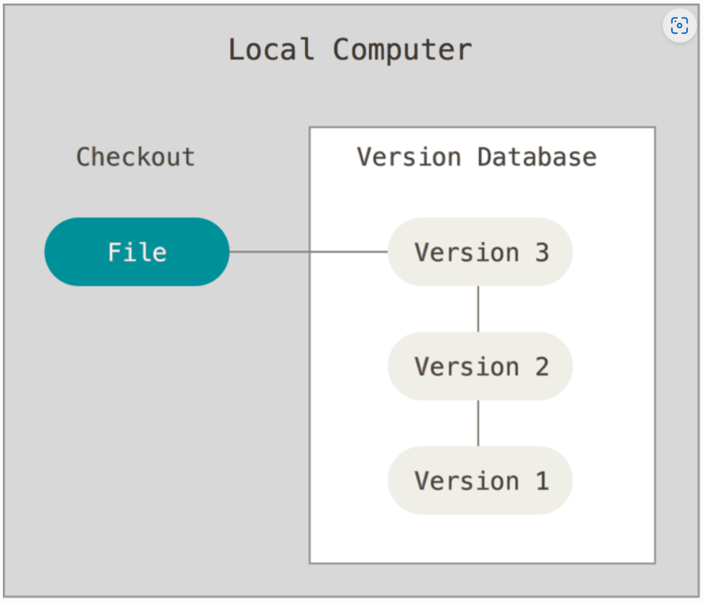
Local version control system
Source: Chacon & Straub
Licence: CC BY-SA 3.0
Notes:
Allows to ‘go back’ >> restore previous version of files, hence a bit better than log table, but still not optimal, why:
- collaboration?

Slide 15
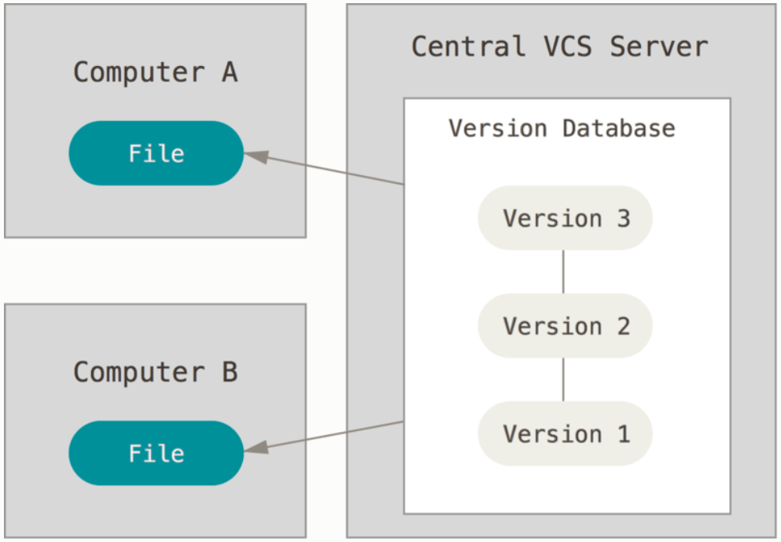
Centralised version control system
Source: Chacon & Straub
Licence: CC BY-SA 3.0
Notes:
Centralisation offers several advantages:
server acts as the main centralized repository which stores every version of code
You directly commit to the main repository
Everybody knows what the latest version is at some point in time
More control and easier to manage a central copy than a lot of local copies
Works well with small teams
Conflicts resolved on the main branch
Drawback:
If the server is down, you cannot collaborate anymore or save versioned changes
Sources:
https://git-scm.com/book/en/v2/Getting-Started-About-Version-Control
https://about.gitlab.com/topics/version-control/what-is-centralized-version-control-system/

Slide 16
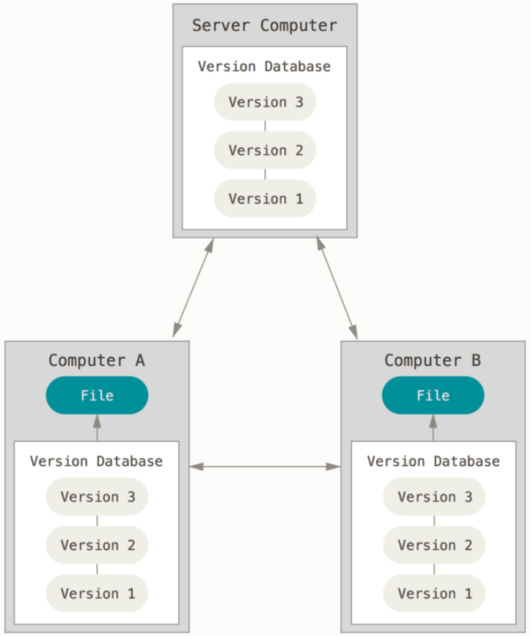
Distributed version control system
Source: Chacon & Straub
Licence: CC BY-SA 3.0
Notes:
Here every collaborator, in this case computer A and B have a full copy of the repository and its changes (they mirror the repository), so the repository can be restored if it dies at some point from one of the local copy.
This distributed version control system also allow easy collaboration of developers, even of developers’ team simultaneously.

Slide 17
Software – git
Git
  Open-source distributed version control system / software
  Make a local copy of a repository
  Multiple people can work simultaneously on the same project
  Allows remote and offline repository / code adaptation
  Synchronisation with repository on server
  Integrated in all major script-based development softwares (such as R)
  Components:
    repos - repositories
    branches
    commits
    push / pull
    ...
Notes:
Decentralise means multiple people can work on a single piece of code at the same moment.

Slide 18
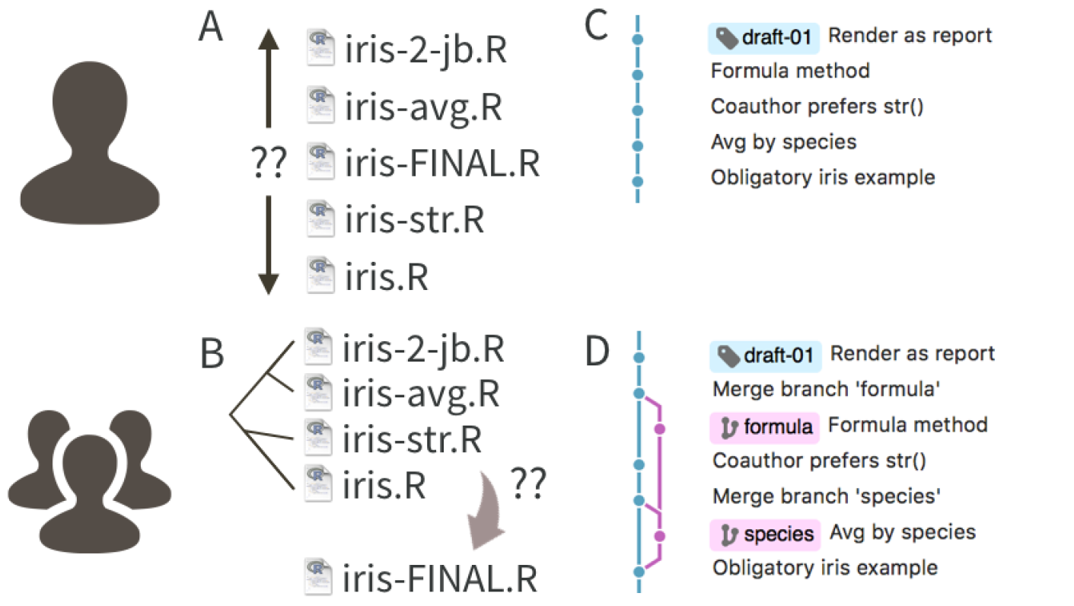
What is github?
https://www.youtube.com/watch?v=pBy1zgt0XPc
Advantages of Git & GitHub >> integration in R!
Difference Git & GitHub
  Git = software
  GitHub = web-host Git system
Alternatives to GitHub:
  GitLab
  Codeberg (European)
Source: Bryan – 2017
Notes:
Show video here (3 minutes)

Slide 19
Git(hub) basics
Repos – repositories
  Contains all the files of your project
  ‘Equal’ to R-project
Branch
  A (local) copy of the (main) repository
Commit
  A stamped version of a branch
Pull
  Action to ‘download’ a version (commit) of the online repository
Push
  Action to ‘upload’ your version (commit) of the repository

Slide 20
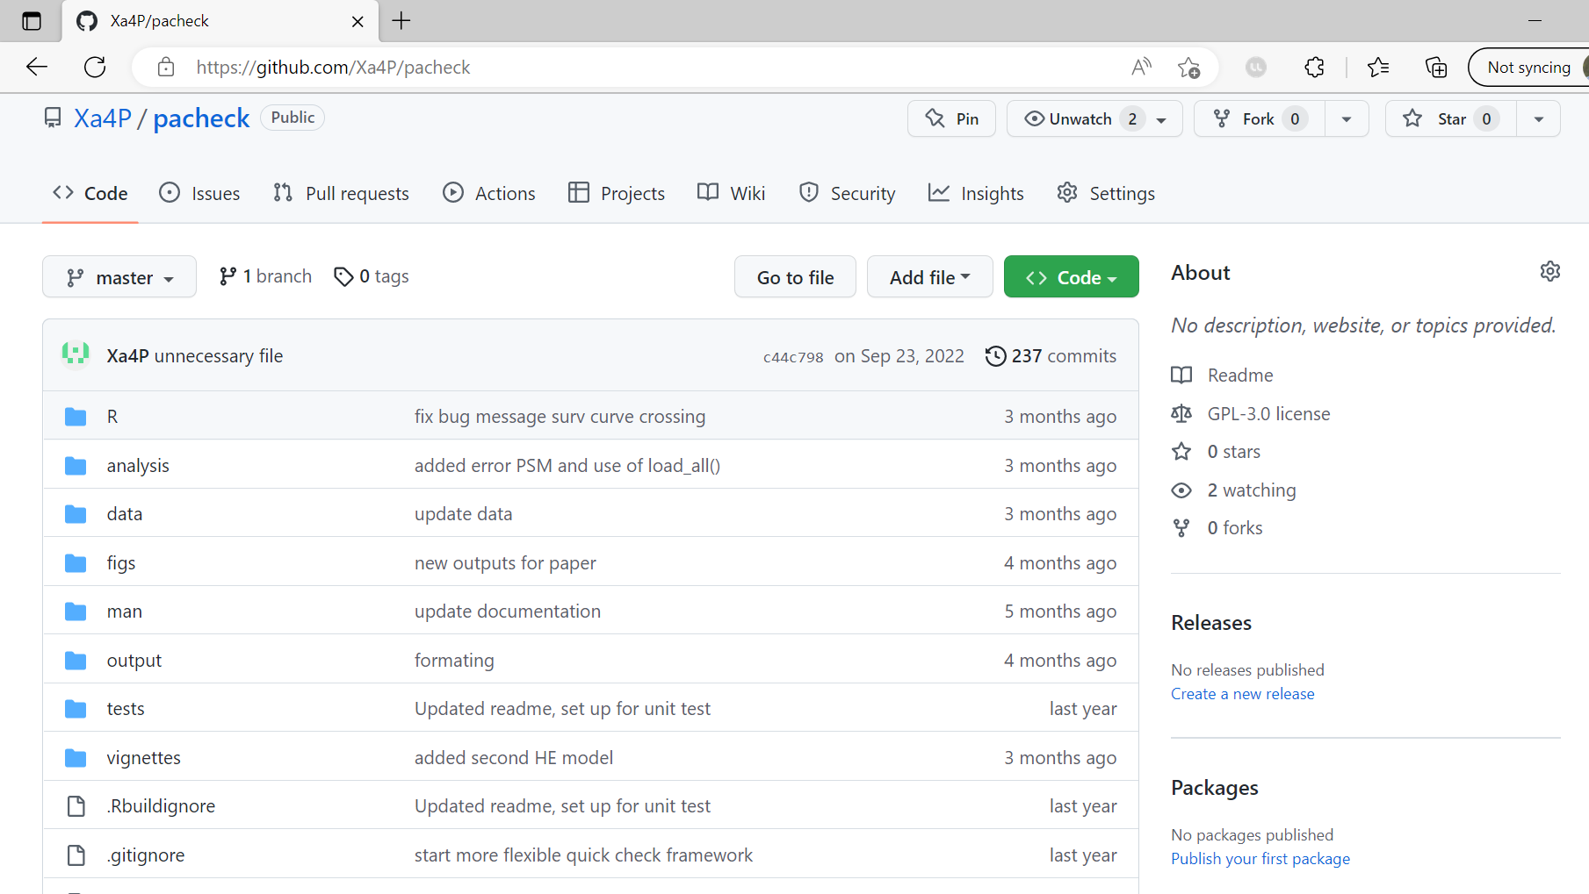
How does it look like? repository
Notes:
This repository is available, anybody can use, review, improve, comment. >> part of Open Science principles >> transparency of what you do.
>> This is only the sate of the repository at that moment in time!

Slide 21
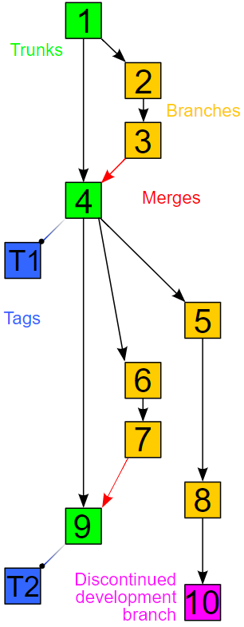
How does it look like? branches
Source: https://commons.wikimedia.org/wiki/File:Revision_controlled_project_visualization-2010-24-02.svg
Licence: CC BY-SA 3.0
Notes:
Repository I just showed it quite simple, only 1 branch were I develop alone, but a repository can also look like this.
Here:
The main branch in green,
Multiple subbranches in orange, also simultaneous branches, which are merged in the main branch (changes are incorporated in the main branch again)
That is what distributed version control system allow you to do!

Slide 22
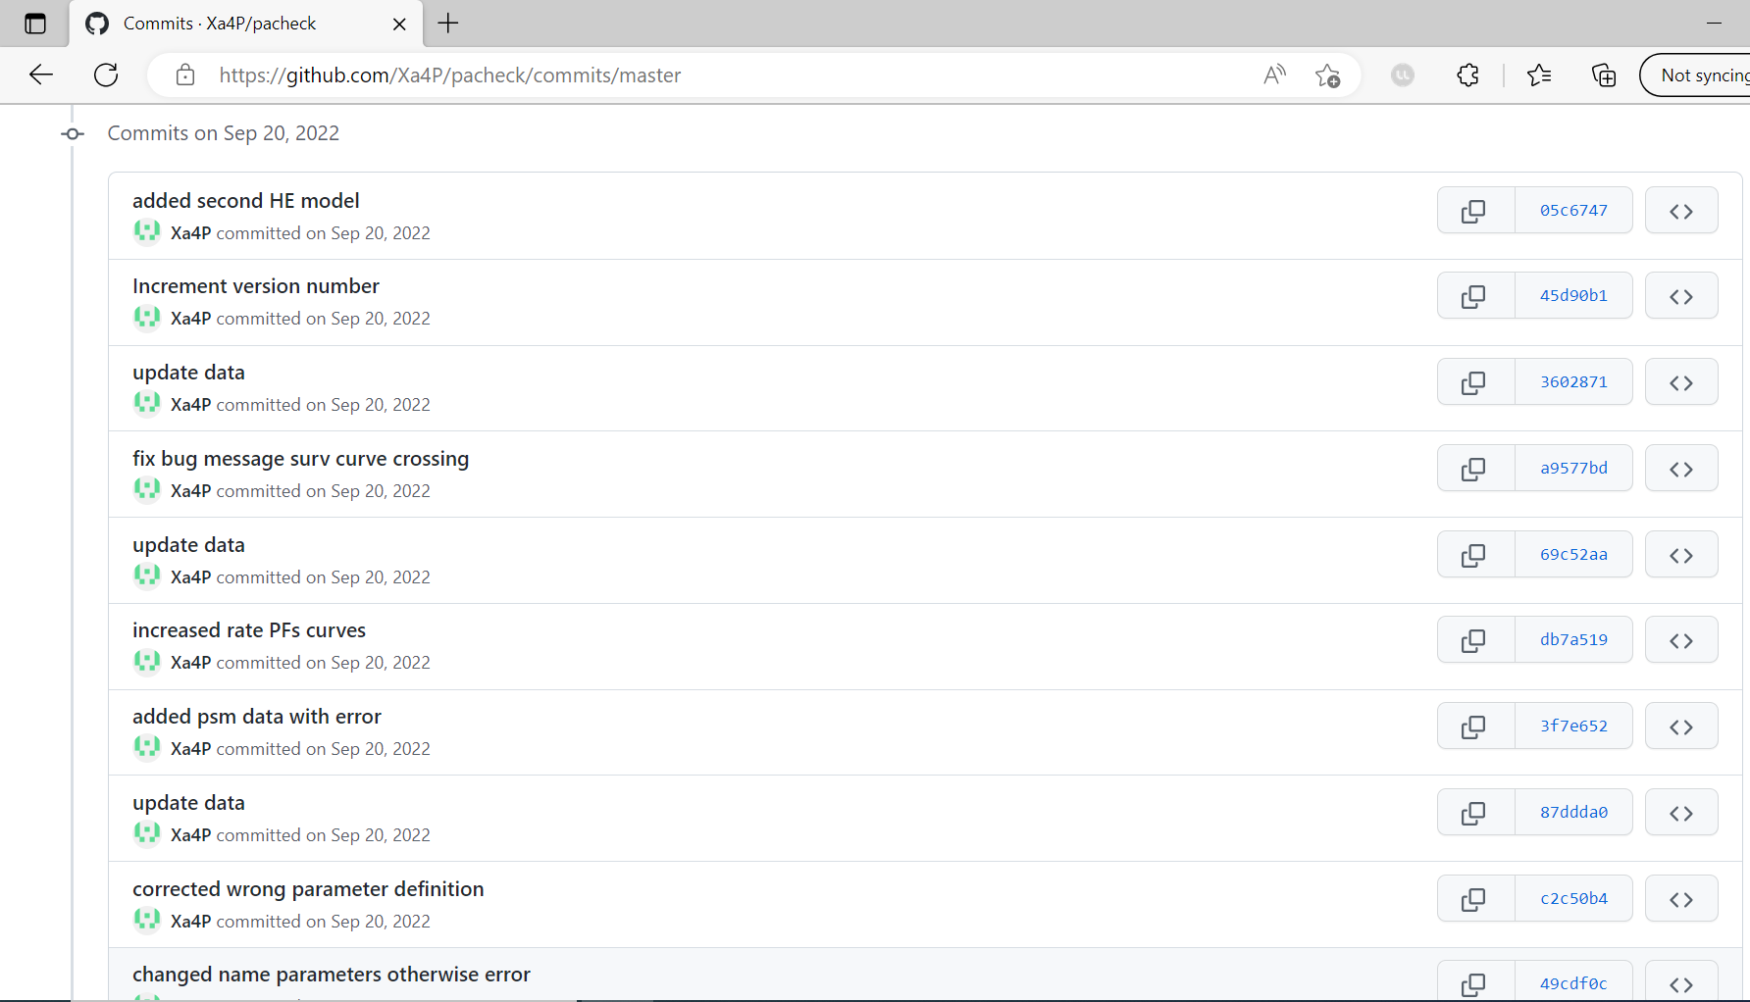
How does it look like?
Commit history
Notes:
Emphasise:
Unique commit identifier
Comment added to commit
Date
You can have a look at the state of the entire repos at a specific commit

Slide 23
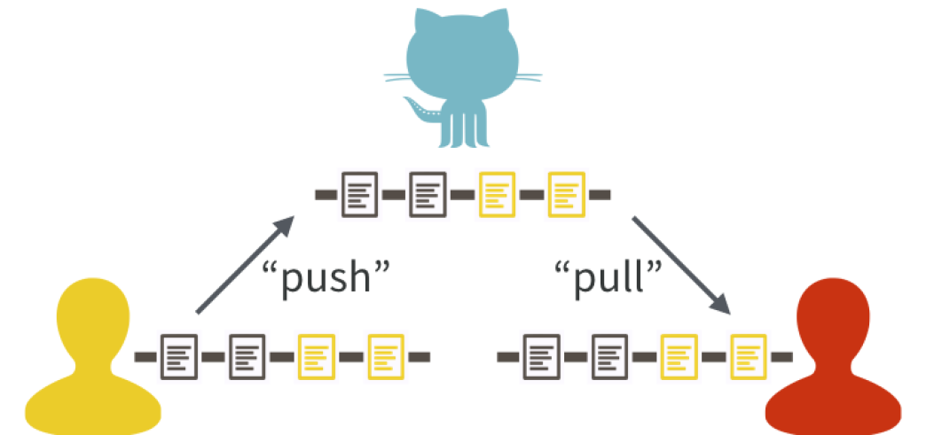
Git(hub) & collaboration
Users of your repo can:
Download your version of the repo
Use it
Raise issues
Create pull requests
  Make changes and discussing it before merging in main branch
Source: Bryan – 2017
Notes:
What if two people work

Slide 24



Git(hub) & collaboration
Server / original version
Pull
Pull
Local copy
Local copy
Jut
Jul
Notes:
Jut & Jul have both a copy of the main file

Slide 25

Git(hub) & collaboration
Jut
Jul
Notes:
Jut made some adaptations and wants to commit them to the repository
Jul is still busy making some adaptations.

Slide 26

Git(hub) & collaboration
Push
Jut
Jul
Notes:
Jut pushes these adaptations, consequently, the server version is updated as well, because he was just a slightly bit faster than Jul.

Slide 27
Git(hub) & collaboration
Push
Jut
Jul
Notes:
Now Jul is also ready with her adaptations and wants to push them as well.

Slide 28
Git(hub) & collaboration
Push
Jut
Jul
Notes:
But that doesn’t work because Jul adapted the same part of the code as Jut.

Slide 29
Git(hub) & collaboration
Resolve conflict
Jut
Jul
Notes:
Thus Jul first needs to resolve the conflicts between her version and the one from Jut before pushing it to the server.

Slide 30

Git(hub) & collaboration
Jut
Jul
Notes:
Which results in a new version that can be pushed!

Slide 31
Git(hub) & collaboration
Push
Jut
Jul
Notes:
Which can finally be pushed on the server

Slide 32
Git(hub) & collaboration
Jut
Jul
Notes:
And the server version is adapted!

Slide 33
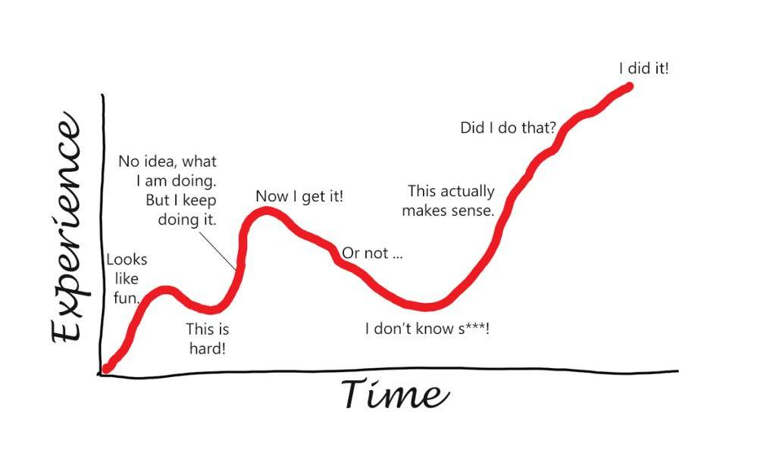
Warning!
Source: https://sascha-kasper.com/the-bumpy-learning-curve/
Notes:
Additional warning: doesn’t work well with word / excel files and figures

Slide 34
Git(Hub) & R
Create a Github / GitLab / Codeberg / … account
(Install or upgrade R and Rstudio)
Install Git (if it is not already)
Connect GitHub with R(studio)
Preferred approach when working with github:
  Github first, then R studio
Explanation of the Github – R interaction: Bryan, J. Happy Git and GitHub for the useR: https://happygitwithr.com/index.html

Slide 35
Wrap up
Reasons why version control system will change YOUR life:
  No more worries about:
    Deleting, loosing, or overwriting (CRUCIAL) files
    File duplication
  It creates a history of changes
    You can review these changes
    You can always go back!
  It facilitates collaboration
But… there is a steep learning curve!

Slide 36
One final note
If you use GitHub (or other) for this course, please keep the repository private

Slide 37

Any question?

Slide 38
DO it yourself!
Start using git(hub)
GitHub official starting guide: https://docs.github.com/en/get-started/quickstart/hello-world

Slide 39
Some he – related examples
DARTH: https://github.com/DARTH-git
IVI: https://github.com/InnovationValueInitiative
Synthea: https://github.com/synthetichealth/synthea

Slide 40
Resources
Introductions to version control system:
  https://www.youtube.com/watch?v=zbKdDsNNOhg
  https://www.youtube.com/watch?v=gY2JwRfin1M
Git workflow
  https://www.youtube.com/watch?v=3a2x1iJFJWc

Slide 41
Resources
Chacon, Scott, and Ben Straub. Pro git (2nd editopm) Apress. Accessed at https://git-scm.com/book/en/v2 on 3 August 2023
Bryan, J. Excuse me, do you have a moment to talk about version control? (2017). PeerJPreprints. https://doi.org/10.7287/peerj.preprints.3159v2
Github Foundation. GitHub & Git Foundations videos playlist. (2014). https://www.youtube.com/playlist?list=PL0lo9MOBetEHhfG9vJzVCTiDYcbhAiEqL
Microsoft. DevOps resource center: What is version control? (2022). https://learn.microsoft.com/en-us/devops/develop/git/what-is-version-control accessed on 16-12-2022
Microsoft. DevOps resource center: What is git? (2022). https://learn.microsoft.com/en-us/devops/develop/git/what-is-git accessed on 16-12-2022
Sinclair C et al. Healthy Futures Forum 2015: Regional Health Research Priorities Workshop. (2015). Great Southern Science Council: Albany. [Available from http://www.greatsouthernsciencecouncil.org.au]. PDF accessed on 16-12-2022 at https://www.researchgate.net/publication/277511404_Healthy_Futures_Forum_Regional_Health_Research_Priorities_Workshop
The University of Sydney. Version control document. https://view.officeapps.live.com/op/view.aspx?src=https%3A%2F%2Fwww.library.sydney.edu.au%2Fresearch%2Fdata-management%2Fdownloads%2Fversion-control.docx&wdOrigin=BROWSELINK accessed on 16-12-2022

