Slide 1
open science & health economic evaluations

Slide 2
Why introducing open science in this course?
Comenius Teaching Fellow grant
Discrepancy between how researchers (and practitioners) should produce scientific knowledge and teaching these skills
  Creating awareness concerning Open Science
  Providing some tools to become an ‘open practitioner’
More details on the project:
  Presentation: https://doi.org/10.5281/zenodo.7372278
  Grant application: https://doi.org/10.3897/rio.8.e97853

Slide 3
Learning objectives
After this lecture, you should be able to:
Define what Open Science entails and its importance
Explain how Open Science principles and practices can be applied to health economic models

Slide 4
Outline
Why open science?
What is open science?
Open Science in HTA
Why should I care?

Slide 5
1. Why open science?

Slide 6
Publish or perish
“The prevailing pragmatism forced upon the academic group is that one must write something and get it into print. Situational imperatives dictate a 'publish or perish’ credo within the ranks”
(Source: Wilson, Logan. The academic man: A study in the sociology of a profession. Transaction Publishers, 1964.)
Academic achievement = #publications, citations, H-index, …
Measurable
Pressure to publish
‘Primeur’ acknowledgement by peers
Recognition
Kind of patent
Career advancements
Academic tenure position
Beneficial for grant acquisition

Slide 7
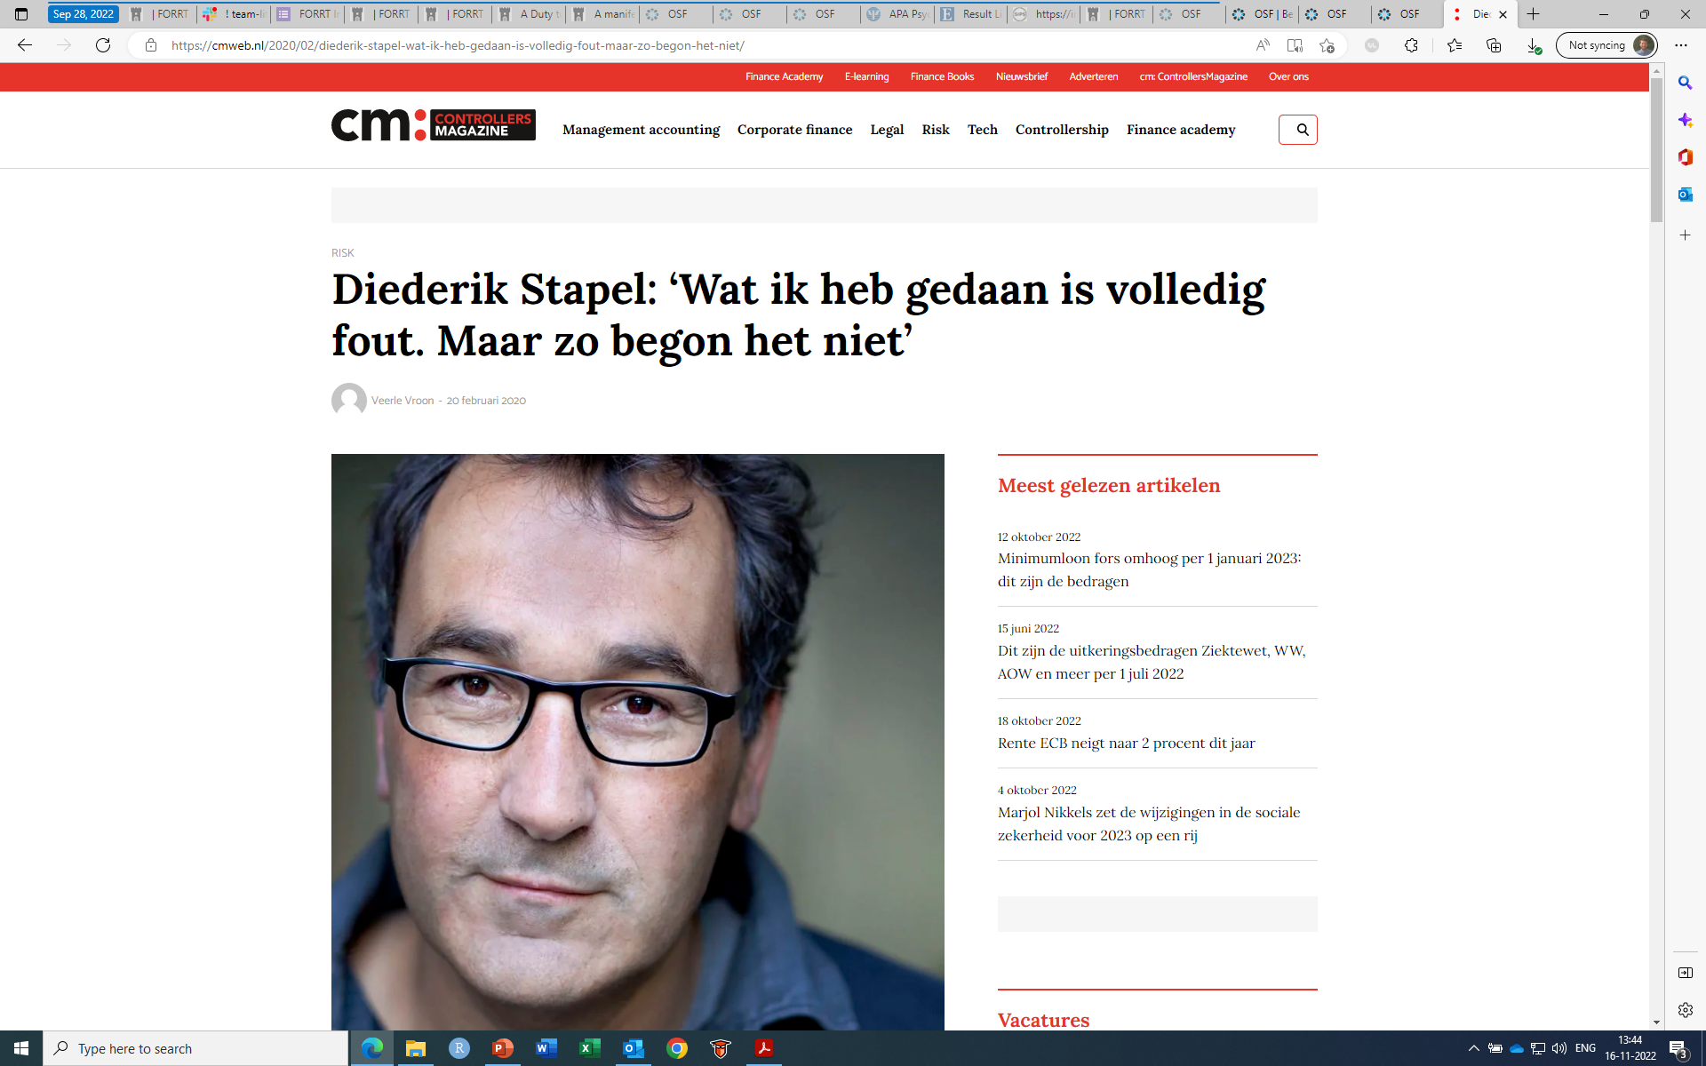
System can lead to fraud
“... I think it is important to emphasize that I never informed my colleagues of my inappropriate behavior. I offer my colleagues, my PhD students, and the complete academic community my sincere apologies. I am aware of the suffering and sorrow that I caused to them. I did not withstand the pressure to score, to publish, the pressure to get better in time. I wanted too much, too fast. In a system where there are few checks and balances, where people work alone, I took the wrong turn. I want to emphasize that the mistakes that I made were not born out of selfish ends.”
Source: Brabants Dagblad. 31 October 2011. Translated from Dutch
Source: https://cmweb.nl/2020/02/diederik-stapel-wat-ik-heb-gedaan-is-volledig-fout-maar-zo-begon-het-niet/
Notes:
Diederik Stapel: ‘Wat ik heb gedaan is volledig fout. Maar zo begon het niet’ - CM Web
The Surgisphere Scandal: What Went Wrong? | The Scientist Magazine® (the-scientist.com)
Previously Professor in Social Psychology @ Tilburg university, until 2011
Well known, prominent in his field, active in the public debate
Committed fraud in 55 papers, 3 young researcher whistle blowers
Fabricated data
Negative consequences for credibility of his research field, but also science in general.

Slide 8
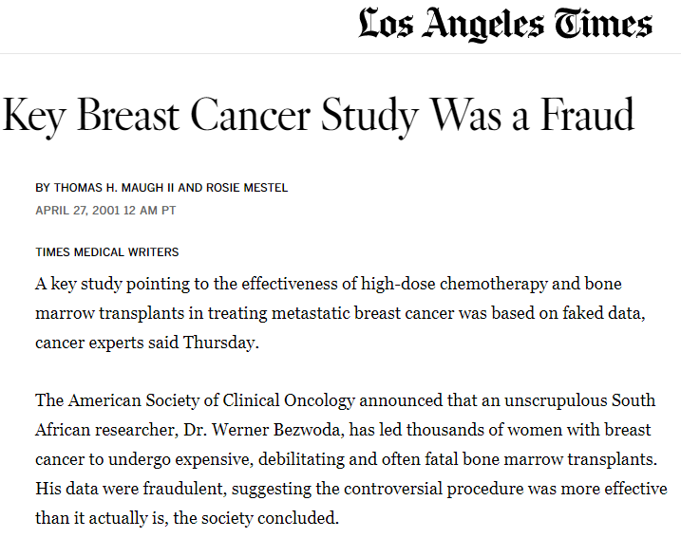
It’s not only about psychology…
Dr. Werner Bezwoda
Faked data
Potential population harm!
  Intervention administered without actual proof of effectiveness
Source: https://www.latimes.com/archives/la-xpm-2001-apr-27-mn-56336-story.html. Consulted on 12-04-2023
Notes:
https://www.latimes.com/archives/la-xpm-2001-apr-27-mn-56336-story.html
2001
Effectiveness of high-dose chemotherapy and bone marrow transplants in treating metastatic breast cancer was based on faked data
This treatment can be fatal!
Data was fraudulent because overly optimistic about the effectiveness of it
Response rate of 95% for the combination treatment…
Positive results led to the use of this treatment in metastatic breast cancer patients
Prescription to patients who may not benefit from it!
At least 30,000 American women have undergone the procedure at an average cost of about $100,000. In the initial studies, at least, 10% to 20% of the women died as a direct result of the treatment.
Population harms, harms to trust in science…

Slide 9
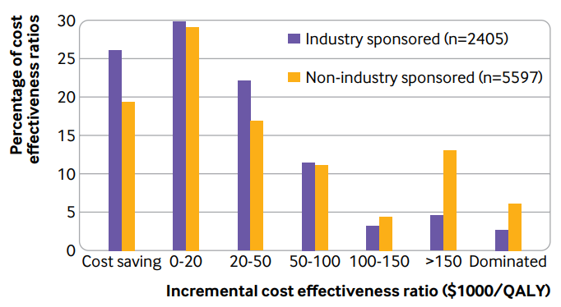
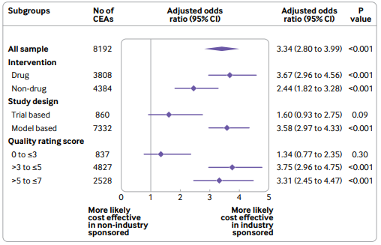
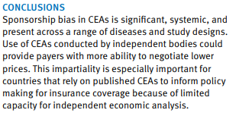
HEALTH ECONOMIC evaluationS CAN ALSO BE BIASED
Source: Xie & Zhou. BMJ 2022;377:e069573
License: Creative Commons CC-BY-NC 4.0
Notes:
Incentives also influence health economic evaluations’ results!
Ask students why is it important to have such positive health economic results??

Slide 10
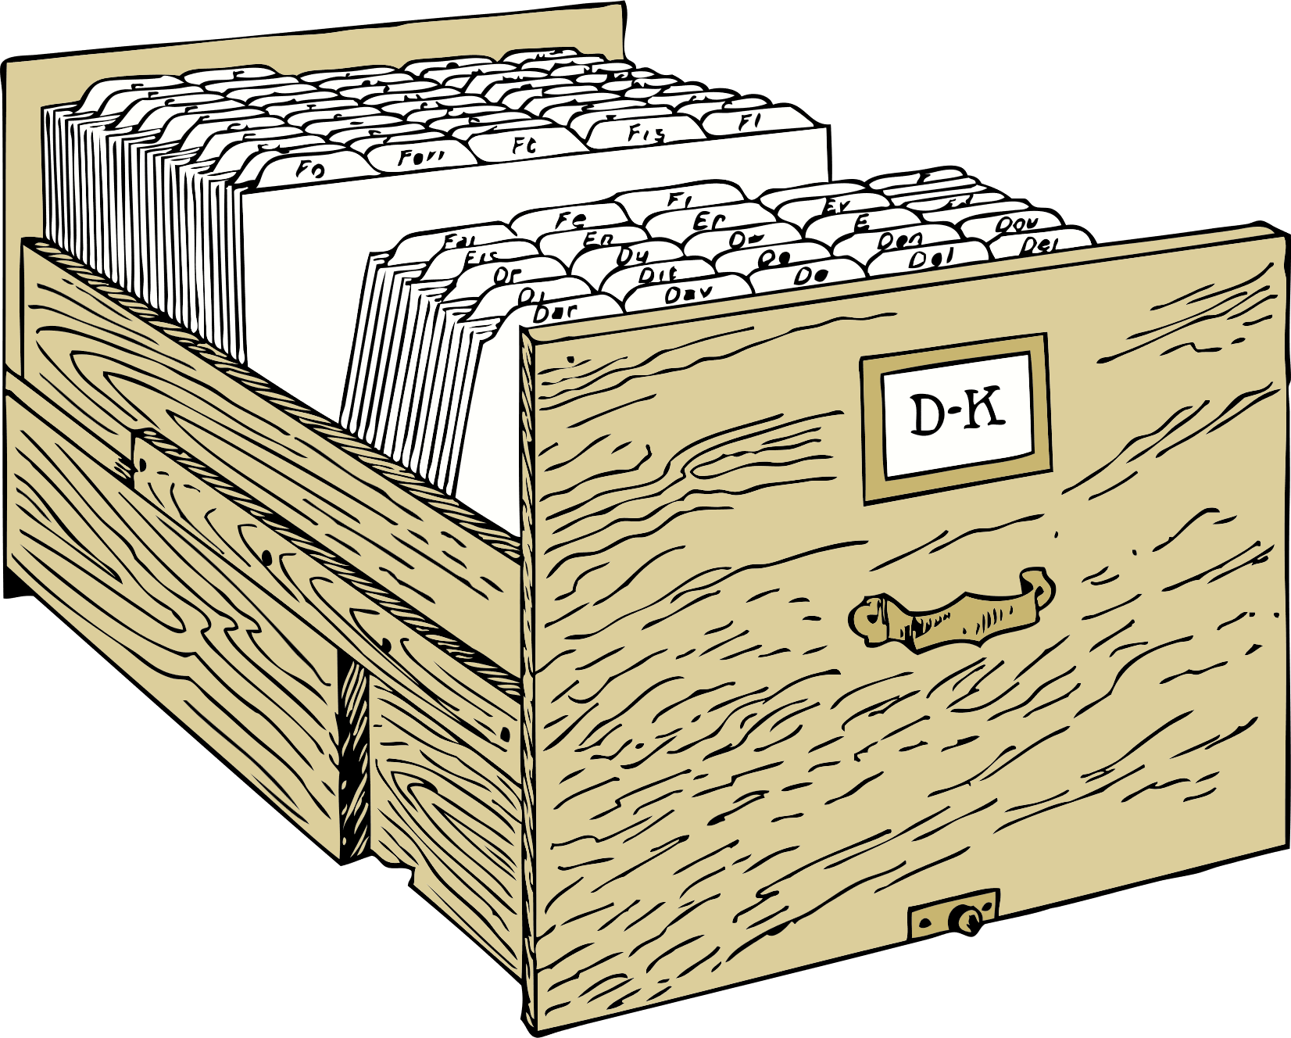
The file drawer effect
The file drawer effect
  Negative results are not submitted
  Selective/ distorted reporting
But negative results are as important as positive results!
  Unnecessary duplication of work
    Decrease efficiency of research
Source: https://pixabay.com/vectors/file-cabinet-office-equipment-file-146152/?download
Notes:
Selective / distorted reporting:
Not reporting all outcomes
Use a statistical method(s) that leads to the answer you want.
Image by <a href="https://pixabay.com/users/openclipart-vectors-30363/?utm_source=link-attribution&amp;utm_medium=referral&amp;utm_campaign=image&amp;utm_content=146152">OpenClipart-Vectors</a> from <a href="https://pixabay.com//?utm_source=link-attribution&amp;utm_medium=referral&amp;utm_campaign=image&amp;utm_content=146152">Pixabay</a>

Slide 11
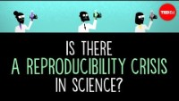
A reproducibility crisis?
Matt Anticole Is there a reproducibility crisis in science?
Link: https://www.youtube.com/watch?v=FpCrY7x5nEE
License: CC BY-NC-ND
Notes:
https://www.youtube.com/watch?v=FpCrY7x5nEE

Slide 12
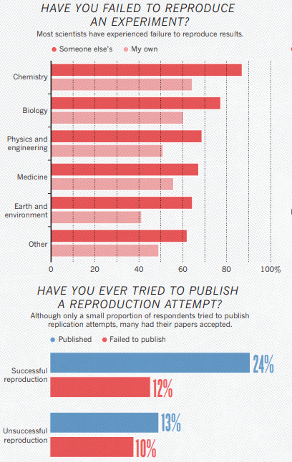
A reproducibility crisis?
“More than 70% of researchers have tried and failed to reproduce another scientist's experiments, and more than half have failed to reproduce their own experiments.”
Source: Baker, Nature 533, 452–454 (2016) https://doi.org/10.1038/533452a
Notes:
Survey 1,500 researchers from different fields.
Respondents were also asked what the cause was of lack of reproducibility: pressure to publish and selective reporting.
Time investment for making research reproducible is often mentioned as a barrier!

Slide 13
What about health economic models?
HE model replication
Uncommon
Aim:
  Important for research integrity & transparency
  New & update model conceptualisation (‘bypass’ de novo development)
Berjemo et al. 2017
  5 health economic models using publicly available information
  1 replication stopped, 2 replicated, 2 not replicated
McMannus et al. 2019
  5 health economic models using publicly available information
  Comparison with original outcomes: -4.54% to 108.00% for costs; -3.81% to 0.40% for outcomes
Notes:
These are the two recent examples of model replications studies.
HE model replication is quite uncommon if you compare it to the number of replication in psychology for instance.
McMannus: selected model with a high quality according to HE guidelines / checklist
Difficult to define what a successful replication is since there is no single definition of what it should entail.
Source:
Berjemo et al. 2017. Replicating Health Economic Models: Firm Foundations or a House of Cards? Pharmacoeconomics. 35:1113–1121
McMannus et al. 2019. Barriers and Facilitators to Model Replication Within Health Economics. Value in Health22(9):1018–1025
McMannus: “Another finding of the aforementioned replications was the tendency for greater variation in the replicated costs than outcomes, for example, costs ranged from 24.54% to 108.00%, whereas outcomes
varied by 23.81% to 0.40%. This might suggest that additional emphasis is needed when reporting the unit costs and assumptions about resource use to assist with greater accuracy in model replication.”

Slide 14
HE model replication
Barriers and facilitators
Barriers
Incomplete inputs reporting
Use of ambiguous language
(e.g. concerning assumptions)
Confidentiality of model inputs
Errors
Conflicting information concerning model structure and inputs
No clarification from original author
(clear annotations are important!)
Facilitators
Clear model structure
Provide example calculations
Clear reporting of (inputs) tables and assumptions
Journal data sharing policies, word limits, and the use of supplementary materials
Source: McMannus et al. 2019
Notes:
McMannus: “Although these recommendations may be feasible when describing state-transition models, transparent reporting is likely to be far more challenging with complex models such as discrete event simulations.”

Slide 15
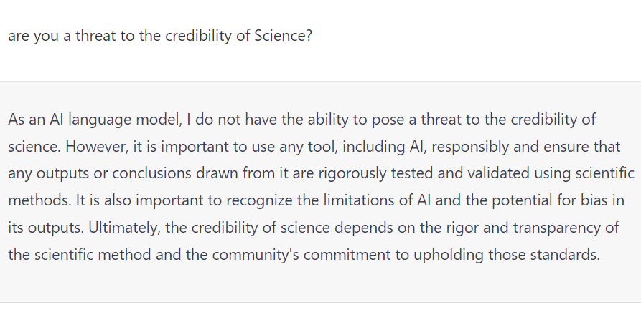
Other threats to the credibility of science?
Notes:
Can you think of other potential threats to the credibility of science?
chatGPT >> can be used to write approximately anything but cannot make the distinction between what are correct or uncorrect facts!
Remain critical when using the output of such tool, always double check!

Slide 16
2. What is open science?

Slide 17
Give your opinion
Based on the information you’ve just heard: what is open science to your opinion or what does it entail?
  Write it on a piece of paper (1 minute)
Discuss with your neighbour (2 minutes)
Share! (2 minutes)

Slide 18
Open science
“[O]pen science is defined as an inclusive construct that combines various movements and practices aiming to make multilingual scientific knowledge openly available, accessible and reusable for everyone, to increase scientific collaborations and sharing of information for the benefits of science and society, and to open the processes of scientific knowledge creation, evaluation and communication to societal actors beyond the traditional scientific community. It comprises all scientific disciplines and aspects of scholarly practices, including basic and applied sciences, natural and social sciences and the humanities, and it builds on the following key pillars: open scientific knowledge, open science infrastructures, science communication, open engagement of societal actors and open dialogue with other knowledge systems.”
UNESCO Recommendations on Open Science: https://unesdoc.unesco.org/ark:/48223/pf0000379949.locale=en accessed on 12-04-2023
License: CC BY-SA 3.0 IGO
Notes:
Open Science is:
Inclusive
Openly available, accessible and reusable
Sharing information about the results but also the process, open it up!
Share information in language everybody can understand, beyond your peers
Open science is not only about data but all product of scientific endeavour

Slide 19

What is Open science?
Doing science right
Opening the research process
Inclusive
Transparent and accountable
Reproducible and allowing verification
Science that is (more) relevant to society
Source: B. Kramer & J. Bosman, Utrecht University Library. Utrecht University Summer School (August 26-30, 2019)
Link: https://docs.google.com/presentation/d/1V5iJarksQIzJNBM0T8FrrbgGrEhthScY585JEfx7eCk/edit#slide=id.g3d88e11ed5_3_67
Notes:
Source: SummerSchool Powerpoint
First point: there is of course sloppy open science, but that is hopefully easier to spot…
Last point: that is a goal, but of course, some scientific endeavour, which may not be useful, may still be performed. This point relates as well to the engagement of society / citizens in scientific endeavour.

Slide 20
Open science affects the entire Research cycle
Preparation
Discovery
Publication
Outreach
Assessment
Analysis
Writing
Adapted from: B. Kramer & J. Bosman, Utrecht University Library. Utrecht University Summer School (August 26-30, 2019)
Link: https://docs.google.com/presentation/d/1V5iJarksQIzJNBM0T8FrrbgGrEhthScY585JEfx7eCk/edit#slide=id.g3d88e11ed5_3_67
Notes:
Preparation: pre-registration
Discovery: data reuse
Analysis: use of open source software (R) and provide insights in code (OSM)
Writing: collaborative, using GoogleDocs for instance
Publication: pre-prints, Open Access publishing
Outreach: social media, lay-individual summary,…
Assessment: new metrics, not only number of publication and citations

Slide 21





























Open science is not only about open access publishing!
adding alternative evaluation, e.g. with altmetrics
communicating through social media, e.g. Twitter
sharing posters & presentations, e.g. at FigShare
using open licenses, e.g. CC0 or CC-BY
publishing open access, ‘green’ or ‘gold’
using open peer review, e.g. at journals or PubPeer
sharing preprints, e.g. at OSF, arXiv or bioRxiv
using actionable formats, e.g. with Jupyter or CoCalc
open XML-drafting, e.g. at Overleaf or Authorea
sharing protocols & workfl., e.g. at Protocols.io
sharing notebooks, e.g. at OpenNotebookScience
sharing code, e.g. at GitHub with GNU/MIT license
sharing data, e.g. at Dryad, Zenodo or Dataverse
pre-registering, e.g. at OSF or AsPredicted
commenting openly, e.g. with Hypothes.is
using shared reference libraries, e.g. with Zotero
sharing (grant) proposals, e.g. at RIO
assessment
outreach
publication
writing
analysis
search
B. Kramer & J. Bosman https://101innovations.wordpress.com
Source: Kramer, Bianca, & Bosman, Jeroen. (2018, January 14). Rainbow of open science practices. Zenodo. https://doi.org/10.5281/zenodo.1147025
Notes:
Data sharing in health care: be careful with informed consent…!
Note on altmetrics: still measurement of the online activity of your publication!

Slide 22
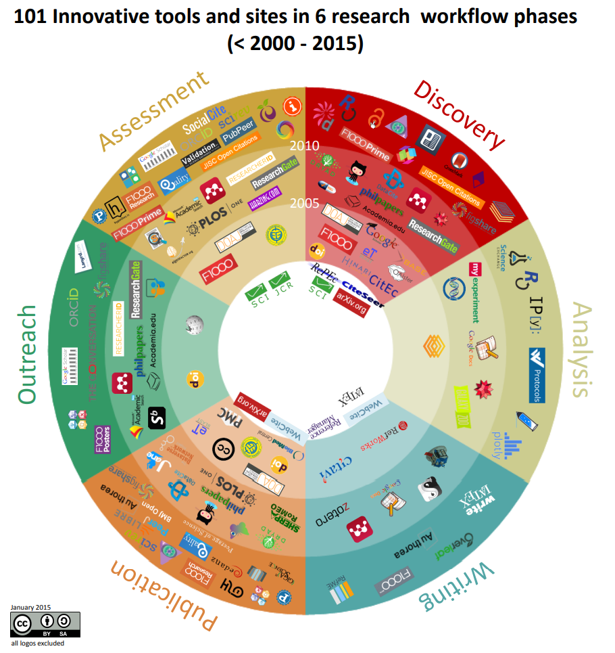
Tools for OPEn scholarly communication
400+ tools for open scholarly communication!
Source: Kramer, Bianca; Bosman, Jeroen (2015): 101 Innovations in Scholarly Communication - the Changing Research Workflow. figshare. Poster. https://doi.org/10.6084/m9.figshare.1286826.v1

Slide 23
promises of open science
Improve quality of research
  More transparent and reproducible
Efficiency of research
  Secondary data use
  Reduce costs of research
  New hypotheses generation
Knowledge exchange and impact
  Increased visibility
  Credits for the entire work you performed (e.g. software code)
Source: Whyte & Pryor 2011

Slide 24
Barriers to open science
Paywalls to consult AND share scientific knowledge
Time requirement
Lack of awareness
Lack of institutional motivation
Funding
Lack of incentives
Notes:
Examples:
Still lot of publication in subscription-based journals. However, NL institutions had a deal with publishers to enhance OA publishing. In other countries with less resources, paying to publish open access is not always feasible!
Making your research transparent and reproducible requires you to go the extra mile, if you do not know how to do it efficiently. For instance, it requires you to annotate your code and more or less extensively document is, as well as archiving it according to FAIR principles…
Researchers do not always know how to address / apply OS principles
Open Science is not ‘pushed’ in all institutions >> that may not be the case in NL where OS is getting more attentions
There is no additional time budgetted in your research projects to make your research open, transparent, and reproducible
You are still not rewarded for performing Science openly. For instance, if you apply for a job, being an Open Scientist may not always be taken into account. Further, you do not always get additional credits by being an open scientist.

Slide 25
Risks Of open science
Data misuse and misinterpretation
Loss of privacy
Ethical concerns:
  Different legislations address data sharing and confidentiality differently
  Ethically controversial studies may lead to decreased willingness to participate in research
Source: Lakomý et al. 2019

Slide 26
Open science is about science & society
Performing relevant research for and with society
Public outreach and engagement
Mitigate misinformation
Citizen science
  Citizen as contributors and collaborators in research project
  Citizens’ active participation in different stage of the research cycle
  ECSA 10 Principles of Citizen Science
    https://www.ecsa.ngo/ecsa-guidelines-and-policies/
Notes:
One slide over citizen science
Citizens are not only ‘research subject’
Citizens formulate research questions, review research proposal, help during interpretation of findings.
Source: ecsa_ten_principles_of_citizen_science.pdf (citizen-science.net)

Slide 27
Open science initiatives
Open repositories
  Open Science Framework
  ZENODO
  DANS-EASY
  …
Fostering the practical implementation of Open Science (FOSTER)
Framework for Open and Reproducible Research Training (FORRT)
Open Science Communities
  Student Initiative on Open Science
FAIR data
European Citizen Science Association
And many more…

Slide 28

Fair principles
Findability
  Meta-data
  Easy for both human and machines
  Unique persistent identifier (e.g. doi)
Accessibility
  Clear on how to access the data (authorization?)
Interoperability
  With other applications and workflows
Reusability
  Ultimate goal of FAIR
  (meta)data should be clearly described
  Allow replication and combination with other data
Source: GO FAIR https://www.go-fair.org/fair-principles/ accessed on 12-04-2023
Notes:
FAIR is not equal to OPEN!
FAIR Principles - GO FAIR (go-fair.org)

Slide 29
Recognition and rewards
Assessment
Goal:
  Broader recognition of academic staff’s work (e.g. education, research, impact, leadership and patient care)
  More diversity in academic career paths
  Focus on quality, creativity and content instead of quantity of research results
  Stimulating Open Science
  Stimulating academic leadership
It will take some time!
In NL: https://recognitionrewards.nl/
@UT: https://www.utwente.nl/en/service-portal/topics/recognise-reward-talent/#recognition-and-rewards-room-for-everybody-s-talent
Notes:
Not all researchers can excel in education, research, impact, leadership and patient care
This is about ‘changing the system’.

Slide 30
Open science @ut
UT Shaping 2030:
  Embrace Open Science
  By 2023: Open Access and FAIR data as the new norm
Open Science Community Twente
  Events & Newsletter
Digital Competence Centre, supports
  Improving open, reproducible, and transparent research
  Open Access publication
  Adhering to FAIR principles
4TU FAIR data Fund
BMS Open Access Fund
Recognition & Rewards: Shaping Expert Group Individuals and Teams

Slide 31
3. Open science in hta

Slide 32
TO your opinion
Why is Open Science relevant in the context of HTA / HE modelling?
How does the Open Science principles and practices affect HTA/ HE modelling?

Slide 33
Why Open-source modelling?
HE models inform public health decisions
HE models are generally not publicly available
  Lack of transparency
  Difficult to get insights in how HE models work
Lack of systematic (reporting of) model validation
  Risk of errors → harmful decisions
→ ‘Black box’ feeling
“an article about computational result is advertising, not scholarship. The actual scholarship is the full software environment, code and data, that produced the result.”
Source: Donoho DL. An invitation to reproducible computational research. Biostatistics. 2010;11(3):385–8. pmid:20538873

Slide 34

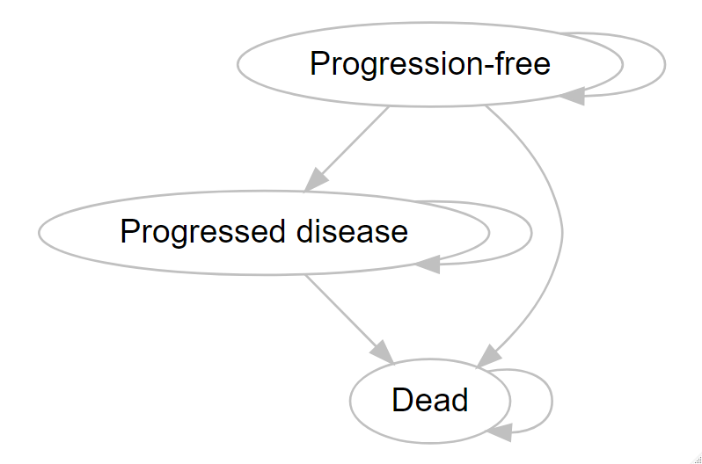
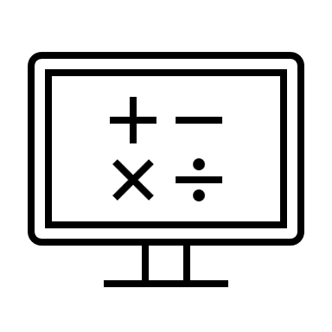
Health economic model transparency
What is (health economic) model transparency?
Eddy et al. 2012: transparency = “clearly describing the model structure, equations, parameter values, and assumptions to enable interested parties to understand the model”
Figure:
Own material & logo’s are used with permission from Microsoft
Notes:
Transparency requirements are different for different stakeholder’s groups.
Do you think this definition is complete? Would you miss something?

Slide 35
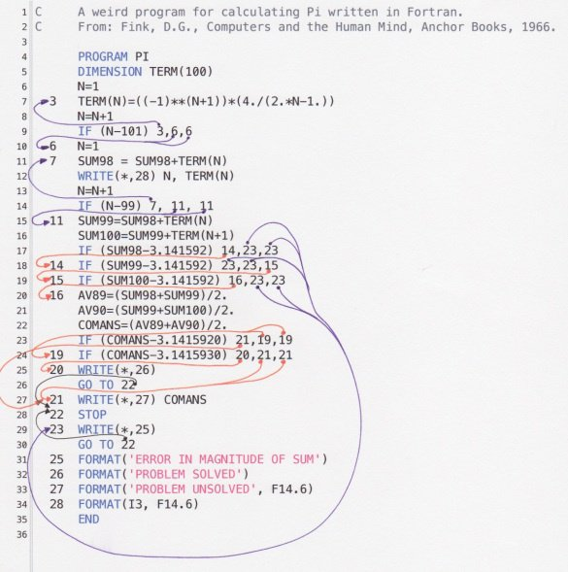
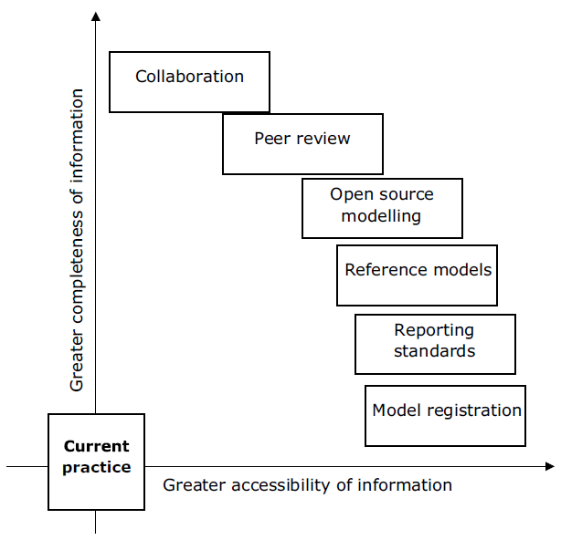
transparency is not only about programming
Source: https://www.quora.com/What-do-you-mean-for-IT-spaghetti-code
Source: Sampson et al. 2019
Notes:
Transparency is not only about your code, that is one aspect of it
In HE, the definition of transparency is broad and transparency may mean something different / can be operationalized differently by different stakeholders
One way to categorise transparency is by looking at the completeness of information provided (‘depth’) and how accessible the information is for people (‘breadth’)
There can be a trade-off between this depth and breadth (technical information can be complete for fellow modellers but inaccessible to patients and clinicians because it is complex)
The effort listed are not mutually exclusive but may complement each other
In this course and during the remaining of this lecture, I will focus more on open source modelling
https://en.wikipedia.org/wiki/The_Elements_of_Programming_Style >> for guiding principles on software development

Slide 36
Model transparency – Eddy et al. 2012
‘What does the model do and how?’
Purpose:
  Allow review of the model’s structure, equations, parameter values and assumptions
  In order to understand model accuracy, limitations and potential applications
Documentation is crucial:
  Non-technical: for any interested reader, to understand the model results
  Technical: for reviewers and modellers, to be able to review/replicate the model
Notes:
Non-technical documentation: understand the context, and provide enough information to correctly interpret the results!

Slide 37
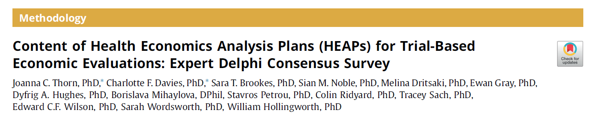
Transparency of intended methods
Why? Lack of consistency!
58 items divided in 8 sections (administrative data, method of data collection & analysis, reporting, …)
You can still deviate from the plan → justify why
Source: Thorn et al. 2021

Slide 38
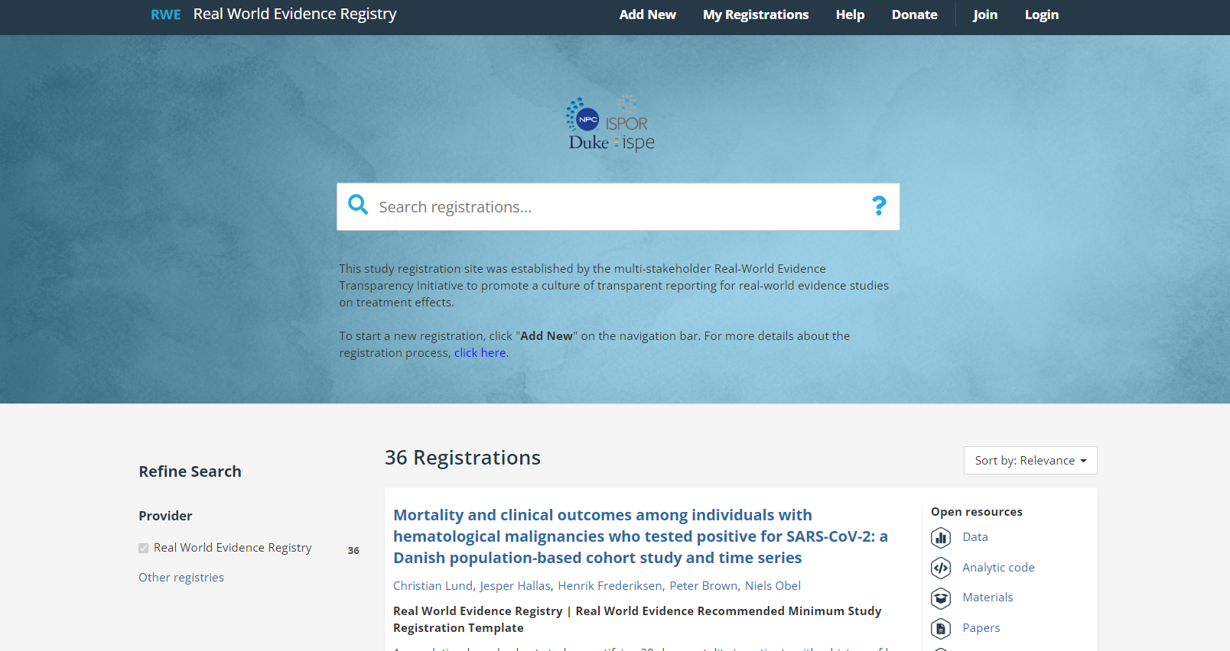
Transparency through Registration
Real world evidence registry
  Improve transparency of reporting of studies using real-world evidence
36 registrations since 2021…
Source: https://osf.io/registries/rwe/discover
accessed on 12-04-2023
Notes:
→ Low uptake!

Slide 39
Transparency through Open-source models (OSM)
OSM Clearinghouse (https://cevr.shinyapps.io/Clearinghouse/)
  Repository of OSM
PeerModels Network (https://www.peermodelsnetwork.com/)
  Improve model accessibility
  Stakeholders’ involvement
Innovation and Value Initiative (https://thevalueinitiative.org/)
  OSM development
  Stakeholders’ involvement and iterative model development
ISPOR Open Source Models Special Interest Group
Notes:
One way to improve transparency is developing OSMs

Slide 40
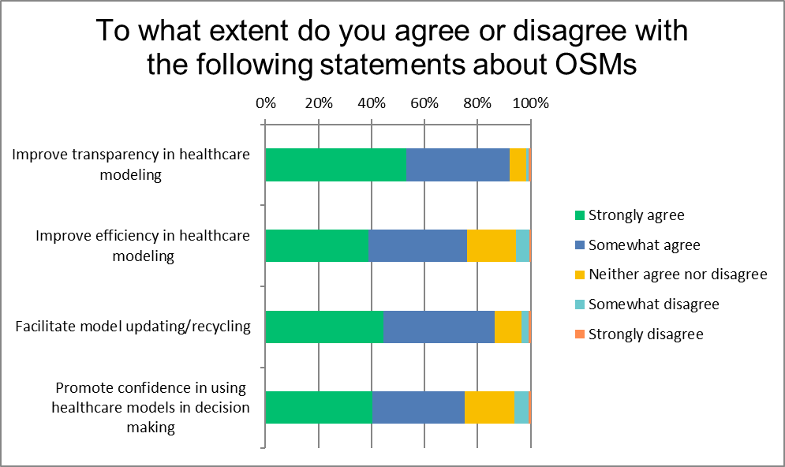
Why open-source models?
Source: Pouwels et al. 2022

Slide 41
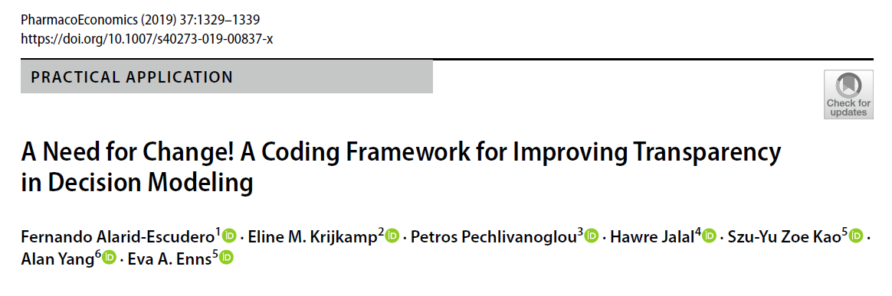
Improving practice through osm
Framework using open source software R
Coding recommendations
  Map structure
  Variable names
Why?
→ Not all health economists are not software engineers!
Notes:
>> Not all health economics are software engineer (some are)
Everybody can have his/ her own style but if you structure code documentation, then you know where to look for the information you need, and that helps to understand models and increase their re-use

Slide 42
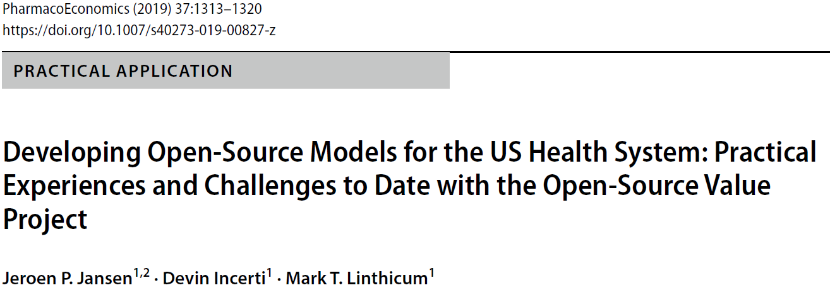
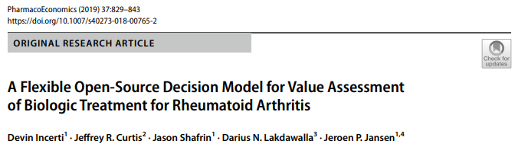
Osm in practice
Accessibility
  Different stakeholders require different (level of) information (e.g. web-interface)
  Requires more resource than traditional HE models
Iterative development based on stakeholders’ feedback
  Challenging to include clinical expert feedback

Slide 43
open-source HE models
Any idea why health economic models are not routinely publicly accessible?

Slide 44
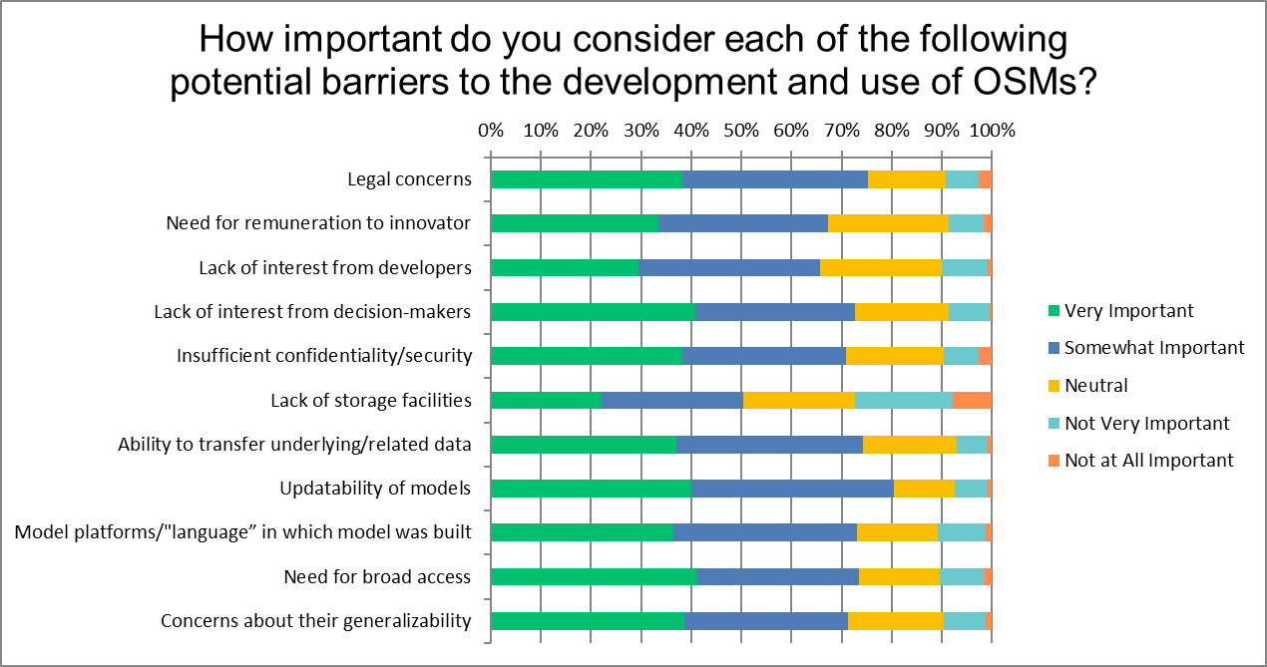
barriers to open-source HE models
Source: Pouwels et al. 2022
Notes:
Most important barriers:
perceived the updatability of OSMs,
legal concerns surrounding OSMs,
and the ability to transfer underlying/related data (in a secure way to permit the execution of the model) as somewhat or very important barriers to the development and use of OSMs.

Slide 45
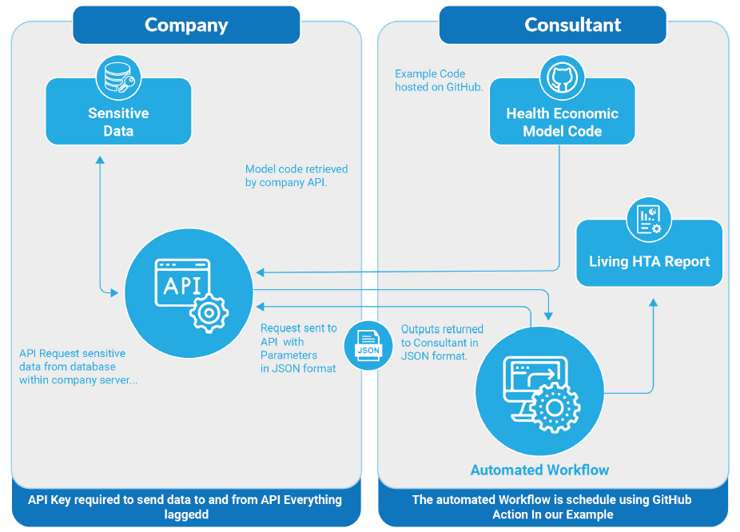
Overcoming barriers – confidentiality living hta’s
Avoid sending / sharing data
Data separated from model
  Transparency & validation
Automatic update of results
  New data
BUT
  Not yet 100% safe
  Running model remotely is still a ‘black box’
  Still complex to set up
  Working without the underlying data is challenging
Source: Smith et al. 2020
Notes:
By means of API (Application Programming Interface)
API allow communication between two applications / digital objects, in this case the data and the health economic model.
Hence, the query of the model is sent to the API and the analyses are performed using the data but the HE model developers has not accessed to the data.

Slide 46
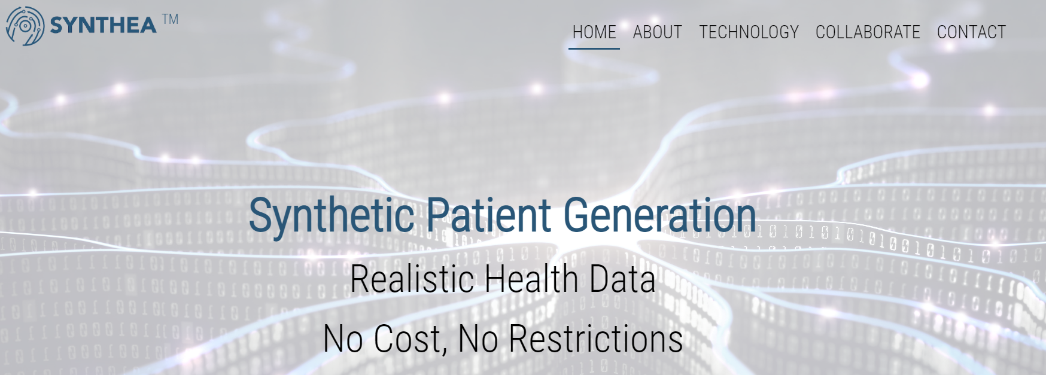
Overcoming barriers – confidentiality synthetic data
Source: https://synthetichealth.github.io/synthea/#home
accessed on 12-04-2023
Notes:
SyntheaTM is an open-source, synthetic patient generator that models the medical history of synthetic patients. Our mission is to provide high-quality, synthetic, realistic but not real, patient data and associated health records covering every aspect of healthcare. The resulting data is free from cost, privacy, and security restrictions, enabling research with Health IT data that is otherwise legally or practically unavailable.
DUTCH EXAMPLE: Dutch Cancer Registry >> you can ask a synthetic data set. >> can be used to guide your data query to the Dutch cancer registry!

Slide 47
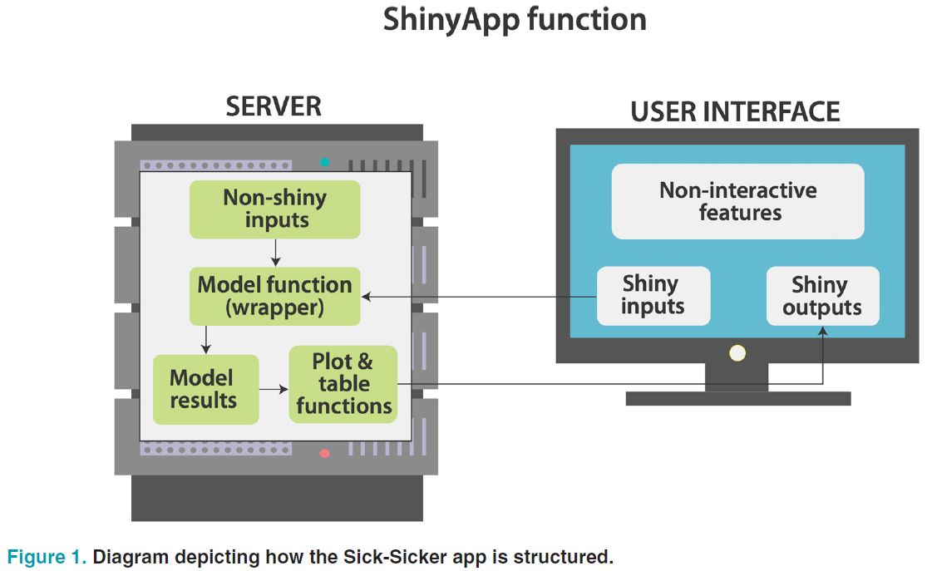
broadening access making he models shiny
Allows non-technical users to interact with HE model
  Useful for communication and validation
Requires additional skills
Shortcut:
  ShinyQuickStarter (https://cran.r-project.org/web/packages/ShinyQuickStarter/index.html)
Source: Smith & Schneider. 2020
Notes:
“Easily” implemented in R
Requires to code the user interface and the server aspect of the app.

Slide 48
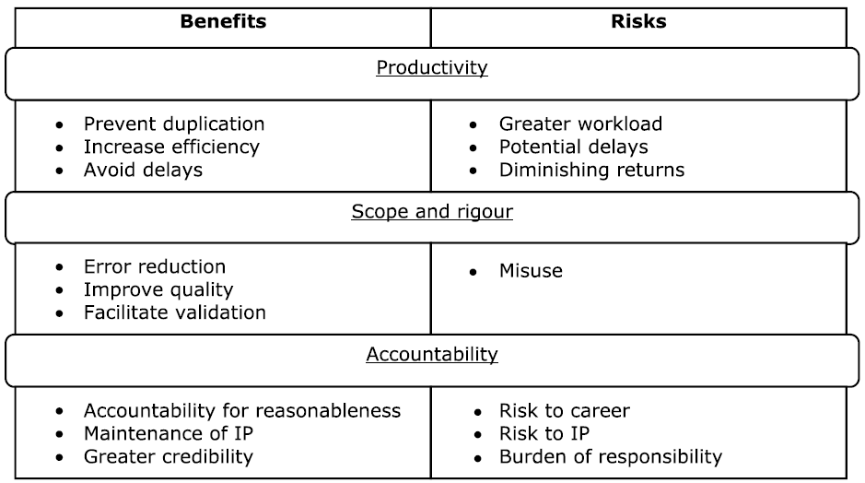
Benefits & risks of transparency
Source: Sampson et al. 2019
Notes:
Transparency >> different stakeholders may have different incentives (not) to be transparent
For example: company heeft misschien/ vaak geen incentives om transparent te zijn >> bang voor competitie
Analysts: what’s the point of being transparent if this model is going to be used once only? >> this only requires extra time before it becomes available.

Slide 49
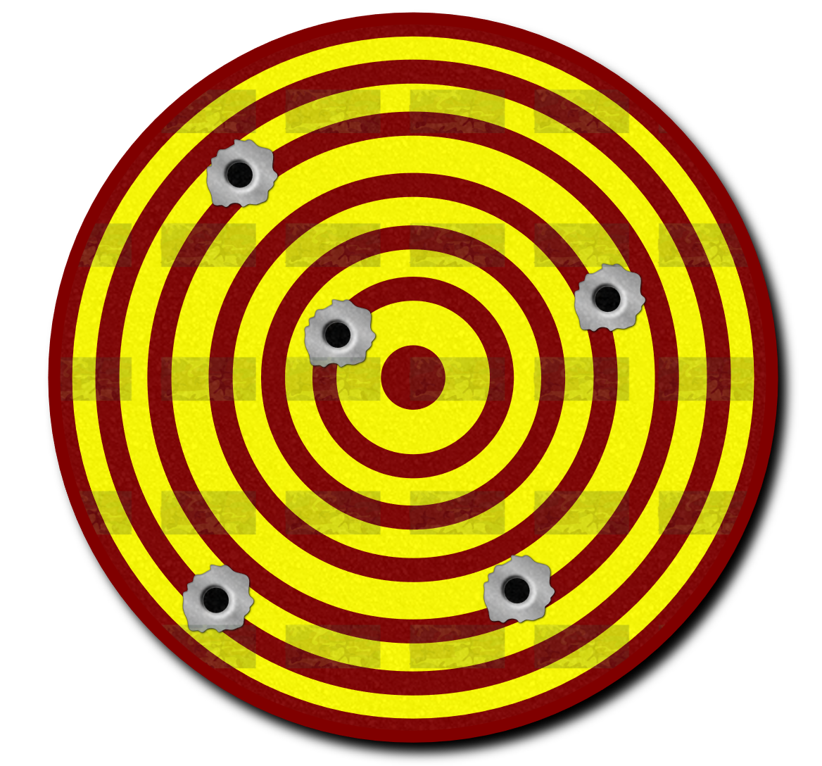
He model validity (Eddy et al. 2012)
Reliability: Are the results reproducible?
More technical issue
Validity: Is the model fit-for-purpose?
Non-technical, requires judgement
Source: https://pixabay.com/vectors/tiro-target-butt-shot-gun-bullet-160574/

Slide 50
He model validity (eddy et al. 2012)
‘How well does the model represent reality?’
  Purpose: judging the accuracy of a model in making suitable/relevant predictions
  Can we ‘trust’ the model and model outcomes?
Consider
  Simplifications
  Assumptions
  Different sources
  Extrapolations
Progression-free
Progressed disease
Dead
Figure:
Own material

Slide 51
Types of validity (eddy et al. 2012)
Face validity
  Corresponding to current science & evidence
Verification / internal validity
  Behave as intended / implemented correctly
Cross validity
  Comparing the model with others
External validity
  Model outcomes compared with real world outcomes
Predictive validity
  Model forecasts compared with actual outcomes

Slide 52
Assessing the validity of he models
AdviSHE (Vemer et al. 2015): Tool to help describe validation efforts :
  Validation of the conceptual model
  Input data validation
  Validation of the computerised model
  Operational validation
  Other validation techniques
TECH-VER checklist (Büyükkaramiki et al. 2019): comprehensive checklist for the technical verification of decision analytical models

Slide 53
4. Why should I care?
Adapted from: Student Initiative for Open Science. SIOS LECTURE “Introduction TO open science” Retrieved from https://osf.io/2qsd6 on 30-11-2022

Slide 54
Your opinion is needed
Discuss in pairs (3 minutes)
  Why do you think Open Science is relevant to you?
  How do you think Open Science may affect your daily working life?
Share (2 minutes)

Slide 55
First
Source: SIOS 2019
You are the future researcher
  Perform research relevant for society
  Moral ‘obligation’ to perform open, transparent, and reproducible research
  Adherence to Open Science is gaining attention for academic careers
You are the future practitioners
  Best practices informed by Open research
You are (future) citizens
  Be critical, not cynical!
  Don’t believe everything you read
Notes:
Be a good consumer of Science.
If we do not teach you how to produce and consume open scientific knowledge, we will not advance as society
Source: https://osf.io/2qsd6/?view_only=
SIOS. SIOS Lectures . Retrieved from osf.io/2qsd6 on 30-11-2022

Slide 56
second
You may benefit from Open Science endeavours:
  Find and re-use open data and software
    Efficiency gain!
  Facilitate collaboration
  Enhance quality of your work
  Enhance visibility of your work

Slide 57
Wrap up
Open Science is a movement promoting research that is more:
  Transparent
  Valid
  Reproducible
  Reusable
  Accessible
  Inclusive
Within HTA, Open Science is mostly championed through open-source modelling, public outreach, stakeholder involvement during HE model development
You may benefit from practicing Open Science!

Slide 58
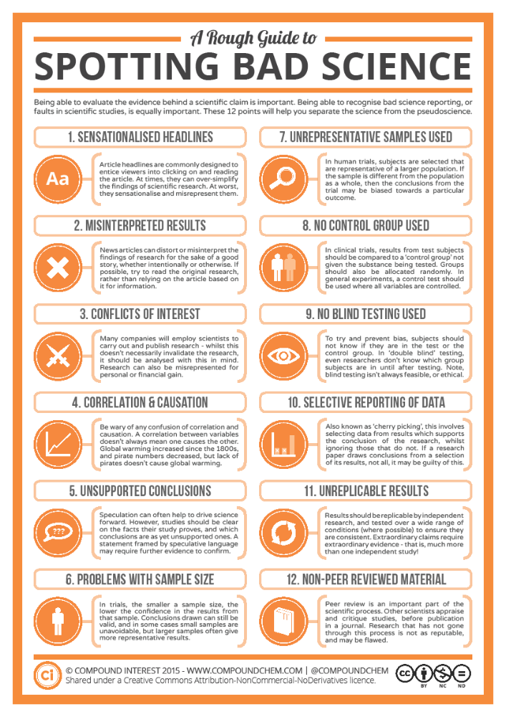
Any Question?
Source: Compound of Interest. 2014. A Rough Guide to Spotting Bad Science.
https://www.compoundchem.com/wp-content/uploads/2014/04/A-Rough-Guide-to-Spotting-Bad-Science-20151.pdf accessed on 12-04-2023

Slide 59

Any question on the hta-related literature?

Slide 60
References
Berjemo et al. (2017). Replicating Health Economic Models: Firm Foundations or a House of Cards? Pharmacoeconomics. 35:1113–1121
Büyükkaramikli NC, Rutten-van Mölken MPMH, Severens JL, Al M. TECH-VER: A Verification Checklist to Reduce Errors in Models and Improve Their Credibility. Pharmacoeconomics. 2019 Nov;37(11):1391-1408. doi: 10.1007/s40273-019-00844-y. PMID: 31705406; PMCID: PMC6860463.
Chopik et al. (2018). How (and Whether) to Teach Undergraduates About the Replication Crisis in Psychological Science. Teaching of Psychology. 45(2) 158-163. https://doi.org/10.1177/0098628318762900
Eddy DM, Hollingworth W, Caro JJ, Tsevat J, McDonald KM, Wong JB; ISPOR−SMDM Modeling Good Research Practices Task Force. Model transparency and validation: a report of the ISPOR-SMDM Modeling Good Research Practices Task Force--7. Value Health. 2012 Sep-Oct;15(6):843-50. doi: 10.1016/j.jval.2012.04.012. PMID: 22999134.
Harvard S, Adibi A, Easterbrook A, Werker GR, Murphy D, Grant D, Mclean A, Majdzadeh Z, Sadatsafavi M. Developing an Online Infrastructure to Enhance Model Accessibility and Validation: The Peer Models Network. Pharmacoeconomics. 2022 Oct;40(10):1005-1009. doi: 10.1007/s40273-022-01179-x. Epub 2022 Jul 30. PMID: 35907178.
Incerti D, Curtis JR, Shafrin J, Lakdawalla DN, Jansen JP. A Flexible Open-Source Decision Model for Value Assessment of Biologic Treatment for Rheumatoid Arthritis. Pharmacoeconomics. 2019 Jun;37(6):829-843. doi: 10.1007/s40273-018-00765-2. PMID: 30737711.

Slide 61
References
Jansen JP, Incerti D, Linthicum MT. Developing Open-Source Models for the US Health System: Practical Experiences and Challenges to Date with the Open-Source Value Project. Pharmacoeconomics. 2019 Nov;37(11):1313-1320. doi: 10.1007/s40273-019-00827-z. PMID: 31392665; PMCID: PMC6860458.
Kramer, Bianca; Bosman, Jeroen (2015): 101 Innovations in Scholarly Communication - the Changing Research Workflow. figshare. Poster. https://doi.org/10.6084/m9.figshare.1286826.v1
Lakomý et al. (2019). Open Science and the Science-Society Relationship. Society. 56:246-255. https://doi.org/10.1007/s12115-019-00361-w
McMannus et al. (2019). Barriers and Facilitators to Model Replication Within Health Economics.
Value in Health. 22(9):1018–1025
Pouwels, X. et al. (2022). Opportunities and Barriers to the Development and Use of Open Source Health Economic Models: A Survey. Value in Health. 25 (4): 473-479.
Sampson C. et al. (2019). Transparency in Decision Modelling: What, Why, Who and How? PharmacoEconomics. 37:1355–1369. https://doi.org/10.1007/s40273-019-00819-z
SIOS (Student Initiative for Open Science). (2019, October 16). SIOS Lectures . Retrieved from osf.io/2qsd6
Smith R, Schneider P. Making health economic models Shiny: A tutorial. Wellcome Open Res. 2020 Jul 31;5:69. doi: 10.12688/wellcomeopenres.15807.2. PMID: 32904933; PMCID: PMC7459889.
Smith RA, Schneider PP, Mohammed W. Living HTA: Automating Health Economic Evaluation with R. Wellcome Open Res. 2022 Oct 11;7:194. doi: 10.12688/wellcomeopenres.17933.2. PMID: 36320450; PMCID: PMC9593025.

Slide 62
References
Thorn JC, Davies CF, Brookes ST, Noble SM, Dritsaki M, Gray E, Hughes DA, Mihaylova B, Petrou S, Ridyard C, Sach T, Wilson ECF, Wordsworth S, Hollingworth W. Content of Health Economics Analysis Plans (HEAPs) for Trial-Based Economic Evaluations: Expert Delphi Consensus Survey. Value Health. 2021 Apr;24(4):539-547. doi: 10.1016/j.jval.2020.10.002. Epub 2020 Nov 28. PMID: 33840432; PMCID: PMC8024512.
Vemer P, Corro Ramos I, van Voorn GA, Al MJ, Feenstra TL. AdViSHE: A Validation-Assessment Tool of Health-Economic Models for Decision Makers and Model Users. Pharmacoeconomics. 2016 Apr;34(4):349-61. doi: 10.1007/s40273-015-0327-2. PMID: 26660529; PMCID: PMC4796331.
Walonoski J, Kramer M, Nichols J, Quina A, Moesel C, Hall D, Duffett C, Dube K, Gallagher T, McLachlan S. Synthea: An approach, method, and software mechanism for generating synthetic patients and the synthetic electronic health care record. J Am Med Inform Assoc. 2018 Mar 1;25(3):230-238. doi: 10.1093/jamia/ocx079. Erratum in: J Am Med Inform Assoc. 2018 Jul 1;25(7):921. PMID: 29025144; PMCID: PMC7651916.
Whyte, A., & Pryor, G. (2011). Open Science in Practice: Researcher Perspectives and Participation. The International Journal of Digital Curation. 1(6):199-213
Wilson, L., & Altbach, P.G. (1995). The Academic Man: A Study in the Sociology of a Profession (1st ed.).
Routledge. https://doi.org/10.4324/9781315130804
Xie F, Zhou T. Industry sponsorship bias in cost effectiveness analysis: registry based analysis. BMJ. 2022 Jun 22;377:e069573. doi: https://doi.org/10.1136/bmj-2021-069573.

