Slide 1
Is An Upper Ontology Useful?
Peter Winstanley

Slide 2

Upper? What does that mean?
More
  Abstract
  Coarse-grained
  Generalised
  Remote from experience
  Difficult to understand
  Vague
  Flexible
https://en.wikipedia.org/wiki/Up_(2009_film)

Slide 3

Is there a “Goldilocks” level of abstraction?
Too Abstract
Too Detailed
https://digitalcollections.nypl.org/items/69b7beff-1641-5768-e040-e00a18061dc2

Slide 4

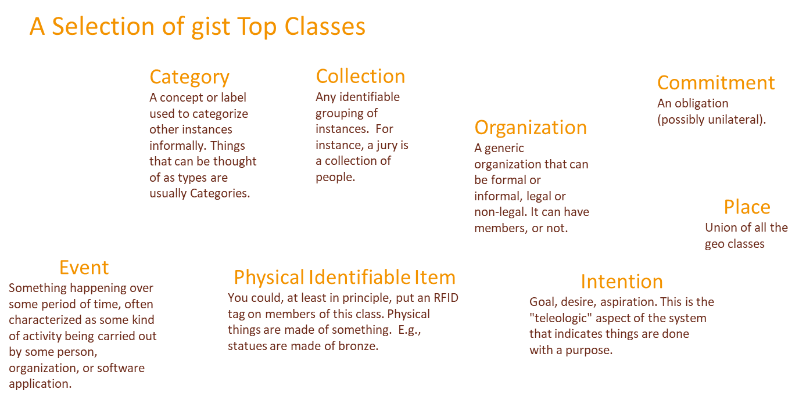
What is an upper-level ontology useful for?
A Starter Palette of Classes and Properties
By Mlaoxve - http://en.wikipedia.org/wiki/Image:Oil_painting_palette.jpg,

Slide 5
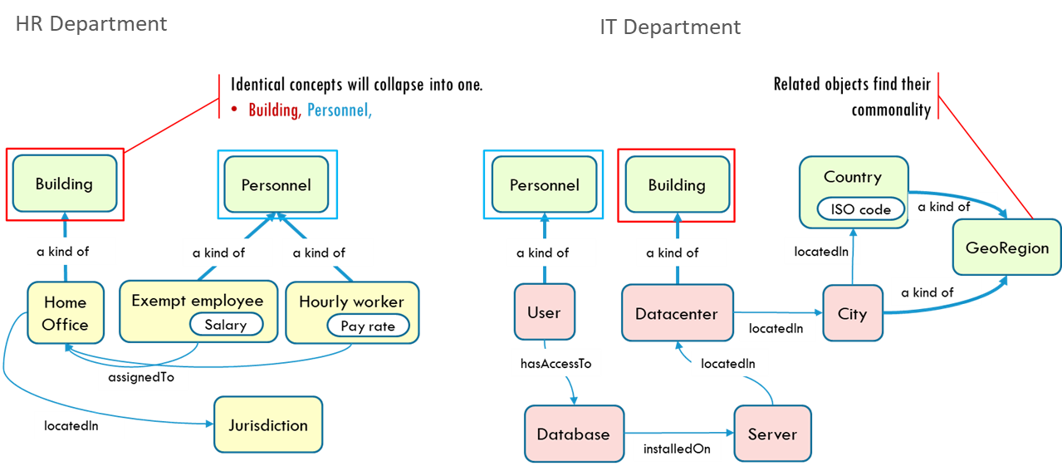
What is an upper-level ontology useful for?
Commonality Between Domain Ontologies

Slide 6
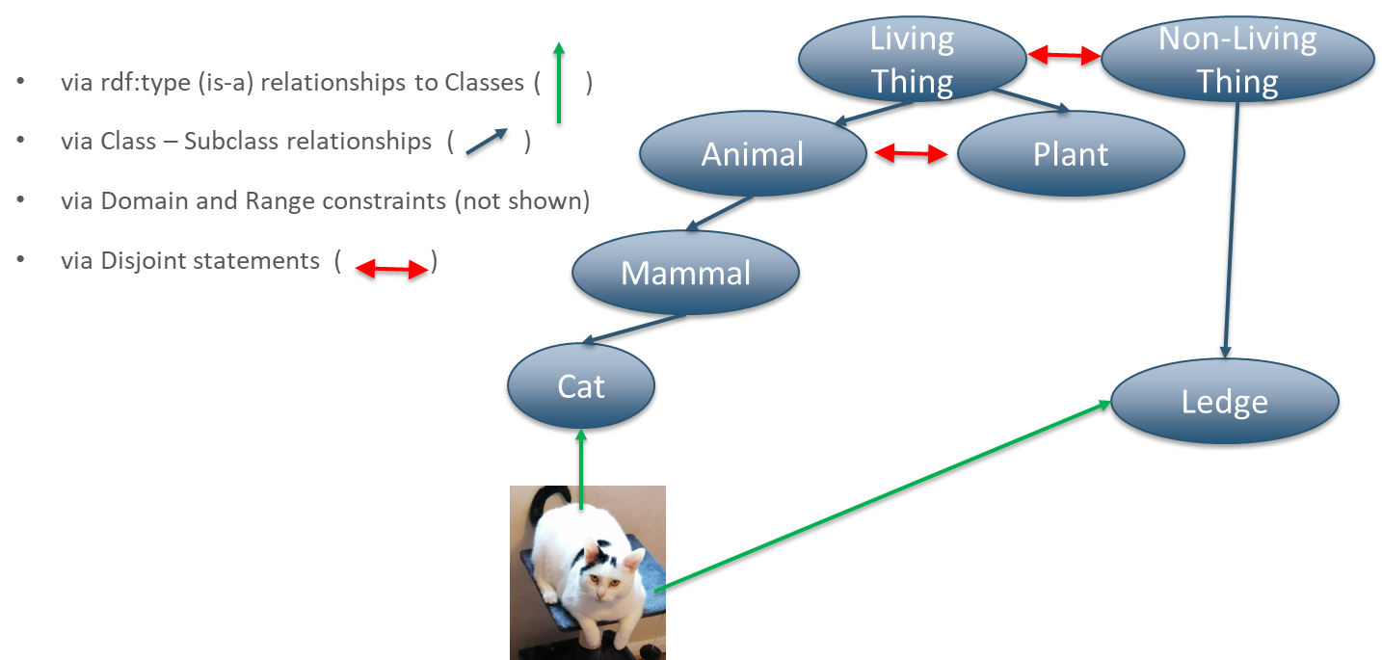
What is an upper-level ontology useful for?
Logical Consistency of Models

Slide 7


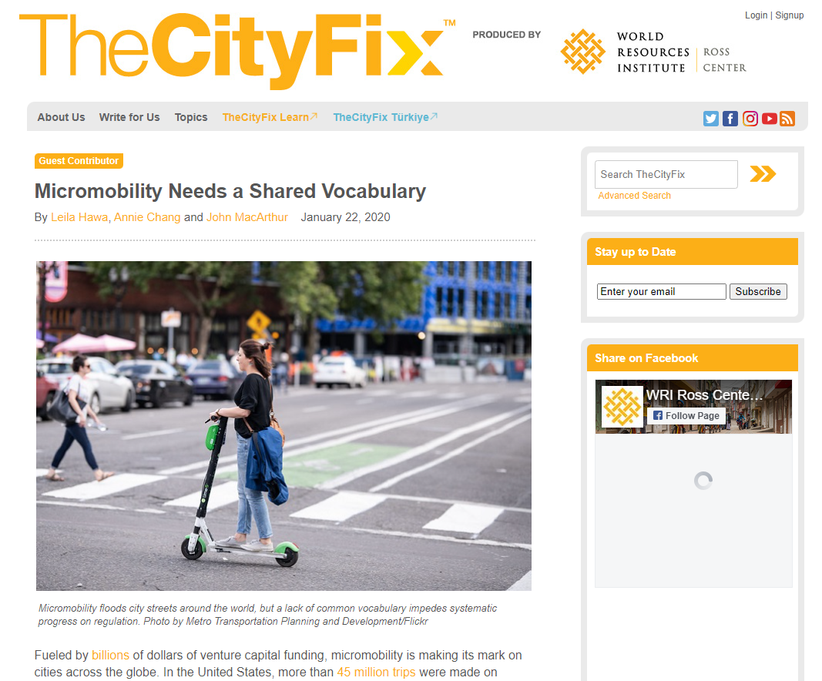
What is an upper-level ontology useful for?
A Common Vocabulary

Slide 8

What is an upper-level ontology useful for?
A Tool for Thought
Chunking of ideas in line with the shared vocabulary of the upper ontology is an effective way to improve collaborative problem-solving within enterprises and other communities.

Slide 9

What is an upper-level ontology useful for?
A Rule of Thumb to Size Domain Ontologies
An upper ontology gives you an idea about the size of components that you should be modelling. These fit with the ‘goldilocks’ size of abstraction.
It is an indication of a scale of concept that others have found helpful in modelling.
‘gist’, all-in, has in the low 100s of concepts (classes and properties) and a domain ontology, by rule of thumb, is usually 2x the ‘gist’ size.

Slide 10
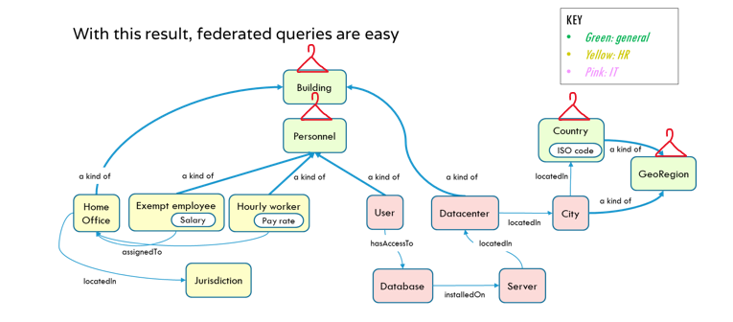
What is an upper-level ontology useful for?
Integrated Data

Slide 11

What is an upper-level ontology useful for?
Partitioning Data
Using an upper ontology ensures that our data are connected via thick branches and a shared trunk. This makes for easier isolation and speedier querying.

Slide 12
Is An Upper Ontology Useful?
Yes, absolutely!
Don’t start any ontology work without one
Try to use the same one for all your ontologies

