Slide 1
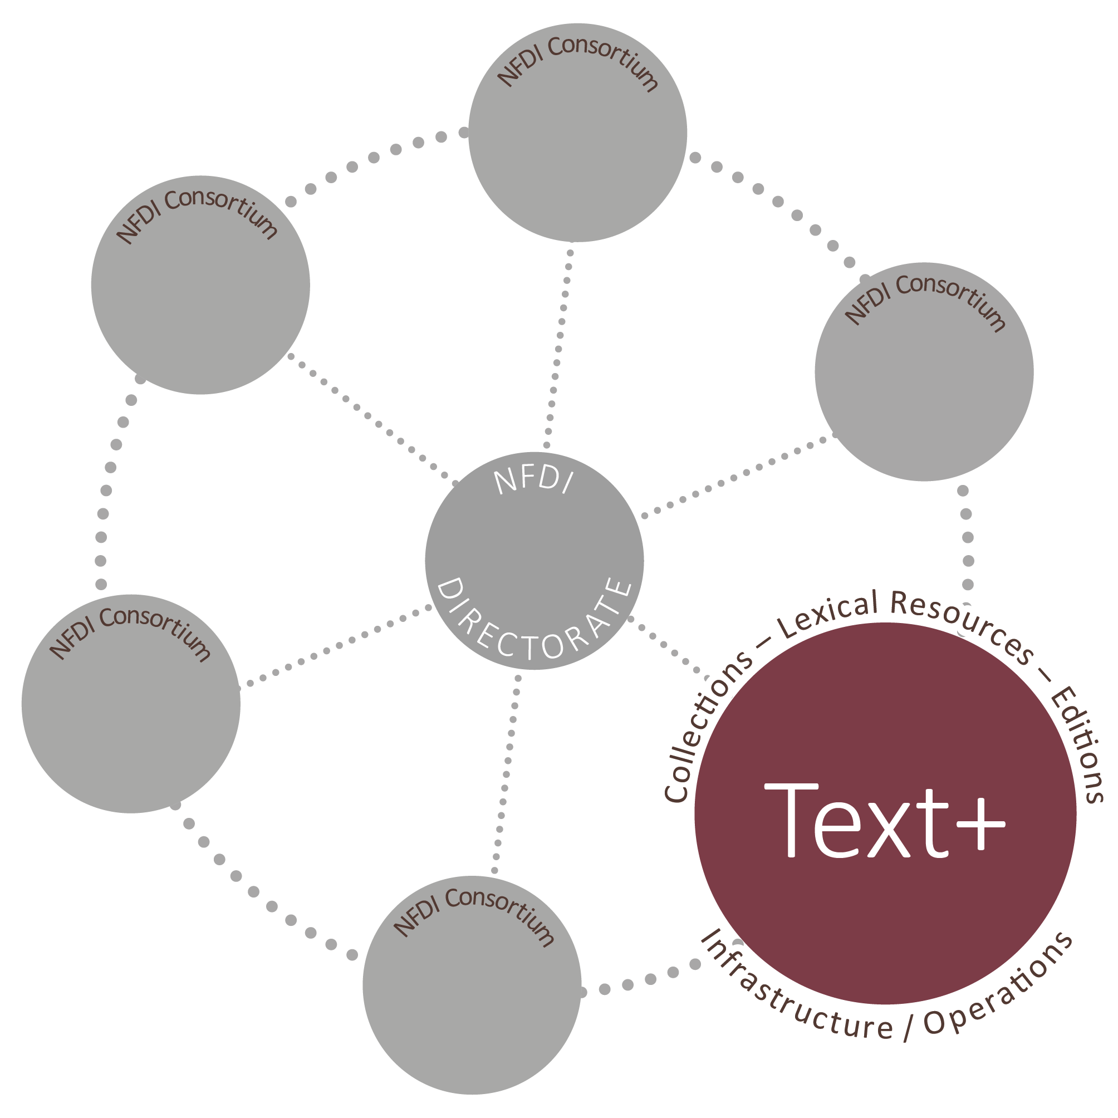
"Text as data?" – The diversity of humanities research data
Thorsten Trippel
ORCID: 0000-0002-7211-7393

Slide 2
Text+ objectives
Text+ aims at constructing a language and text oriented research data infrastructure.
Focus: digital collections lexical resources and editions

Slide 3
Data domains and disciplines
Highly relevant for all language and text based disciplines.
101-02 | Classical Philology
104 | Linguistics
105 | Literary Studies
106 | Social and Cultural Anthropology, Non-European Cultures, Jewish Studies and Religious Studies
108 | Philosophy
According to DDFG

Slide 4

Text Collections (literary texts, non-fictional texts, newspaper- und magazine texts, interviews, inscriptions, manuscripts, prints etc.)
mono- and multimodal recordings e. g. of spontaneous and formal speech (speeches, dialogues, news, interviews, everyday interaction, etc.)
Sensor data (EEG, eyetracking, articulography etc.)
Questionnaires, reaction times
Collection

Slide 5
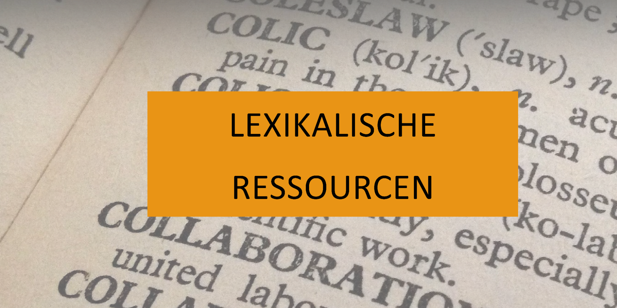
Dictionaries:
monolingual/bilingual
diachronic/synchronic
standard language/dialect
Encyclopaedia
Authority data
Terminological databases
Ontologies
Word nets
Word lists
Wort maps and linguistic atlases
Lexical Resources

Slide 6
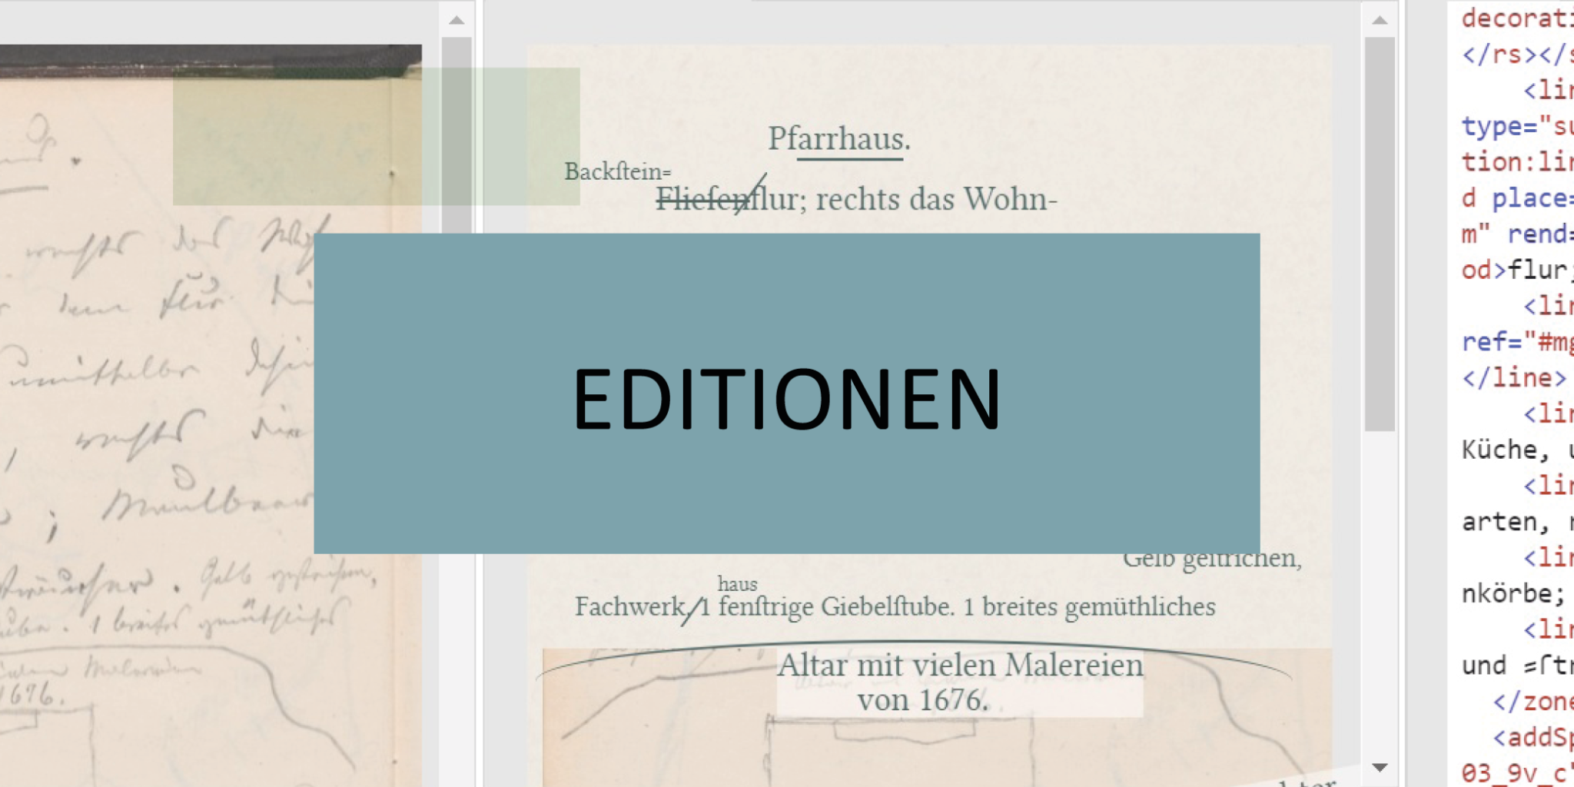
diplomatic editions
genetic editions
historic-critical editions
Editions

Slide 7
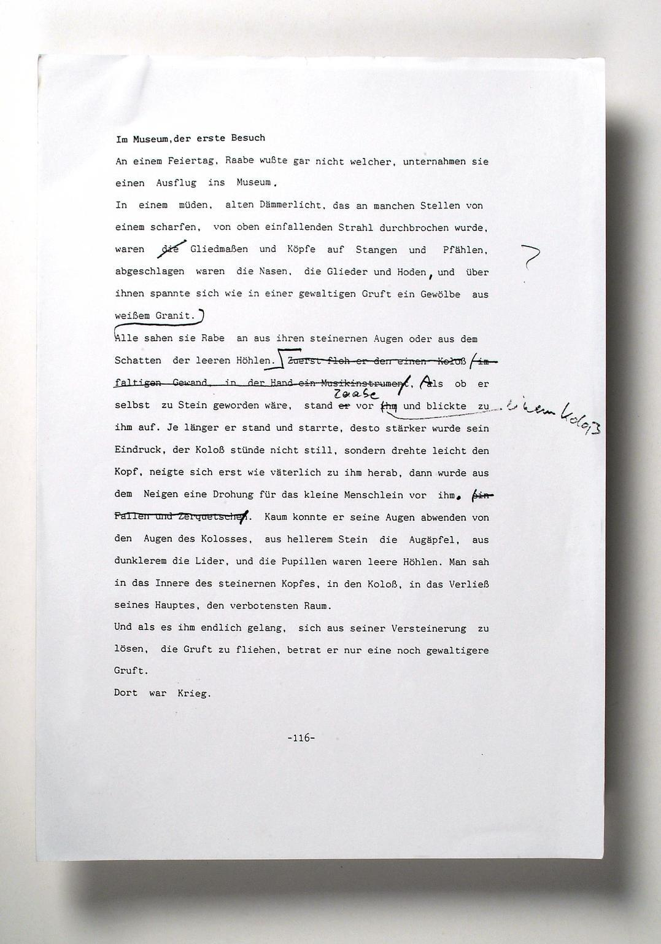
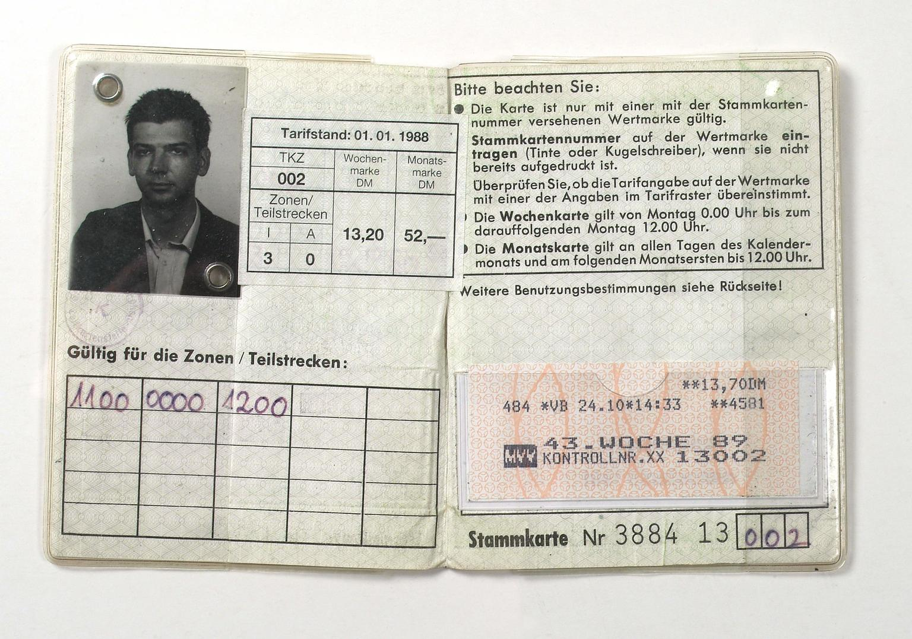
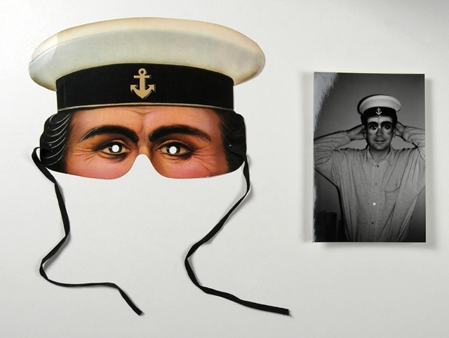
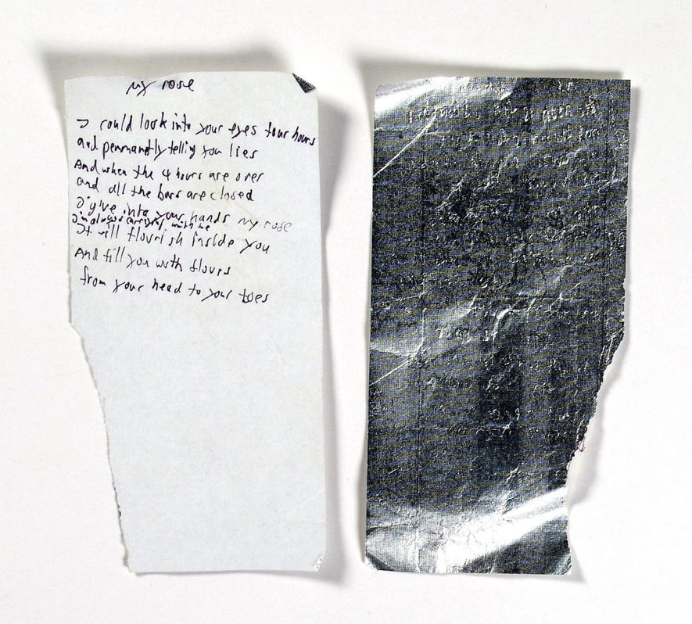
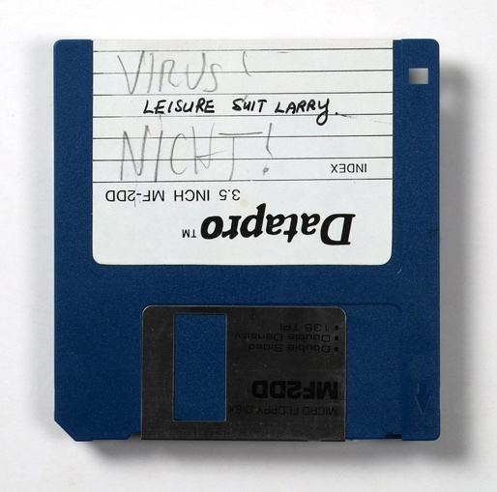
Born-digitals: Authors and their Heritage
Deutsches Literaturarchiv Marbach
Thomas Strittmatter (1961-1995)
Drama author with a large digital legacy
Collection: - digital unique material - digitized analog material - digital documents published on- and offline
Challenges: - reconstruct texts from old hard- and software - filter legally sensitive material

Slide 8
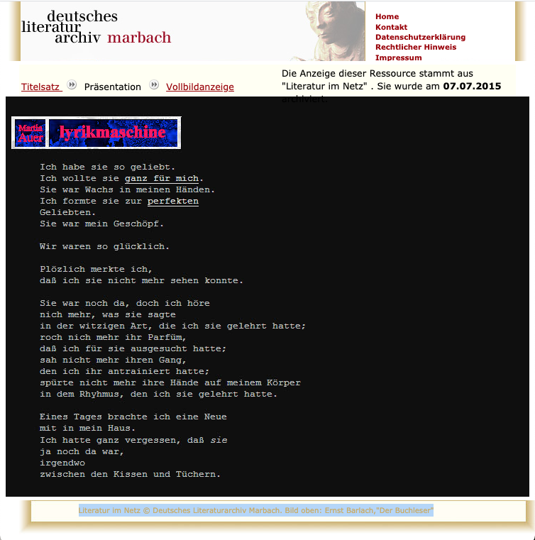
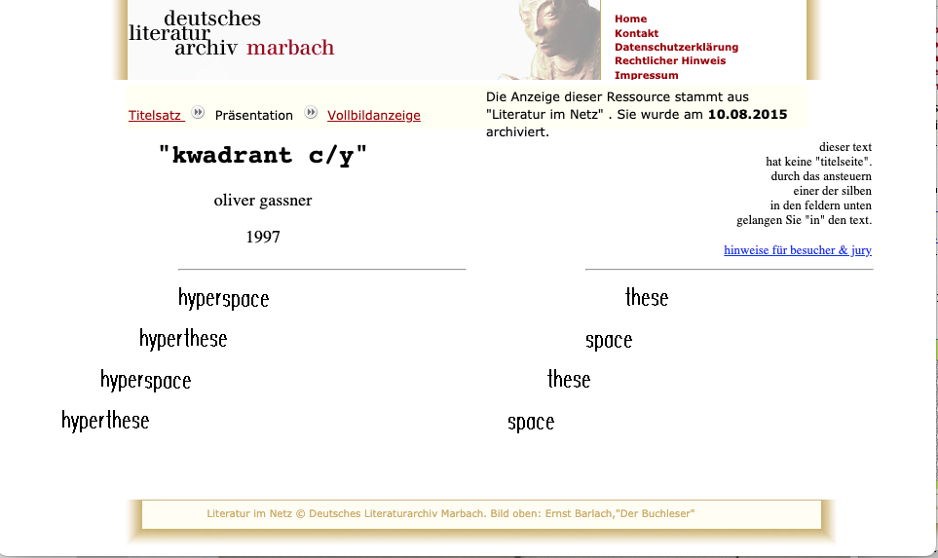
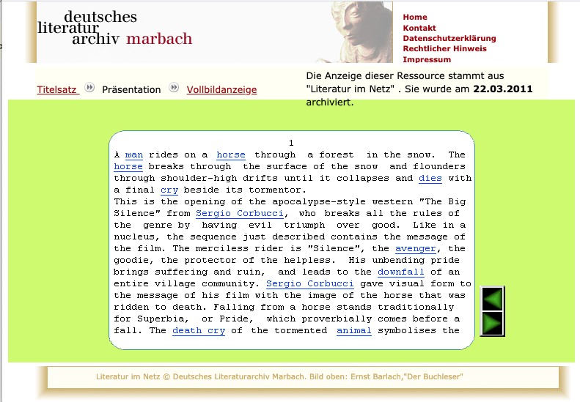
Born-digitals: Multimodal Data
Deutsches Literaturarchiv Marbach
Internet literature since 2008
highly heterogeneous type of texts: journals, weblogs, electronic literature, … often with icons, pictures, sound, overlap with games
Challenges
archive and emulate such literature
study its interactive forms and media overlap
Question:
What about AI generated texts?
http://literatur-im-netz.dla-marbach.de/

Slide 9

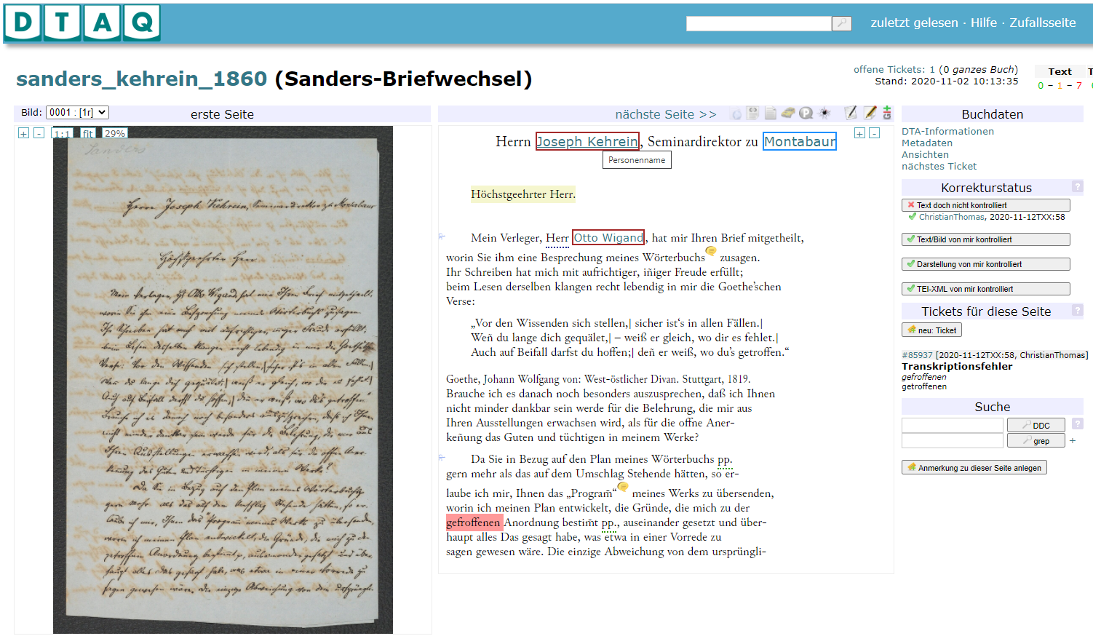
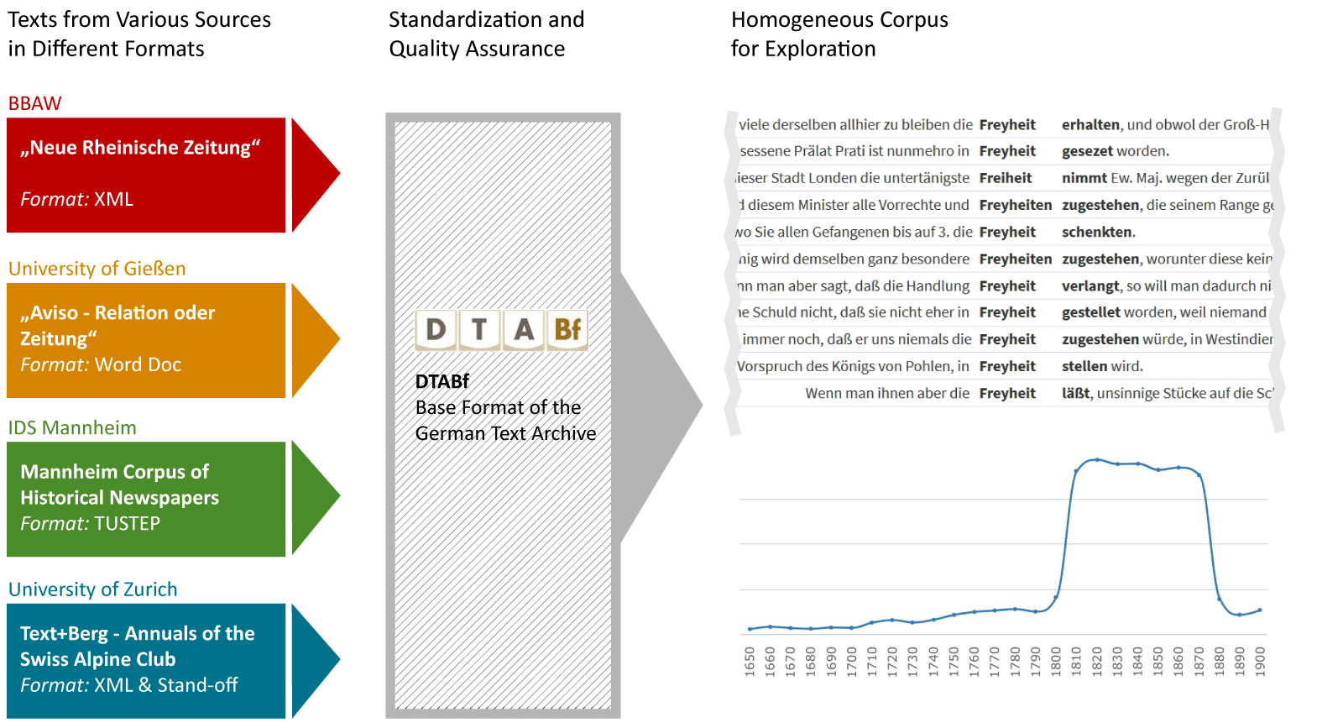
German Text Archive www.deutschestextarchiv.de
Berlin-Brandenburgische Akademie der Wissenschaften
active archive of 17th-20th c. German texts with a large community
platform for collaborative quality assurance
standardized: via DFG-recommended DTA-Base format
wide re-use due to analysis tools and download packages

Slide 10

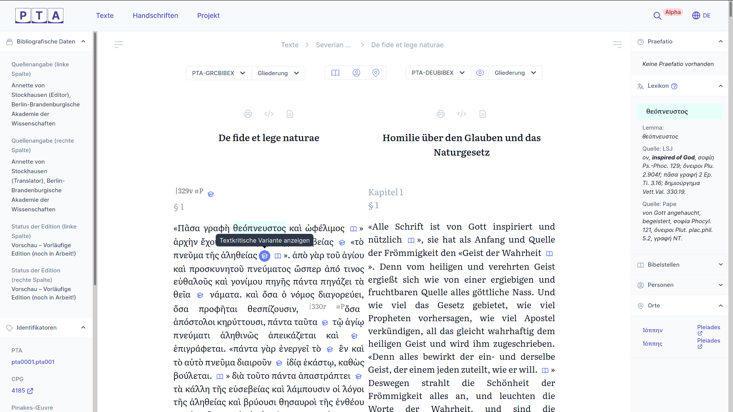
Patristic Text Archive https://pta.bbaw.de
Berlin-Brandenburgische Akademie der Wissenschaften
collaborative platform for critical digital editions of antique Christian texts (regardless of which ancient language)
open access
standardized: via a TEI-based standard
tools for analysis

Slide 11
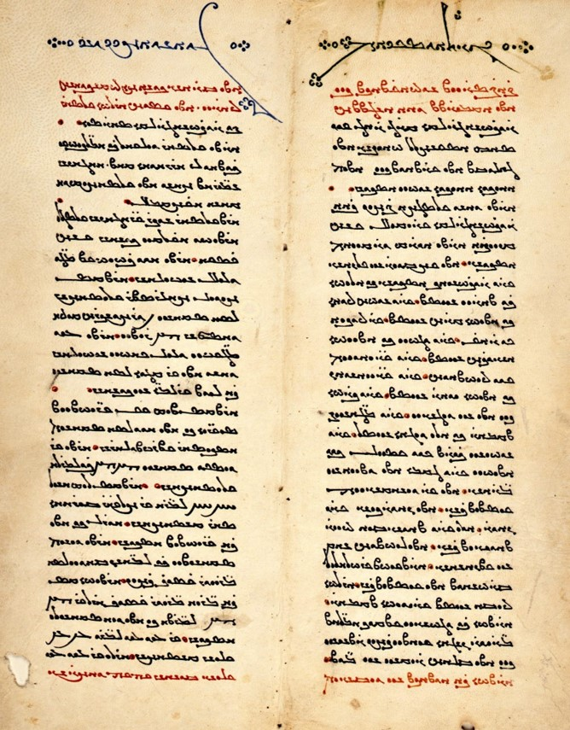
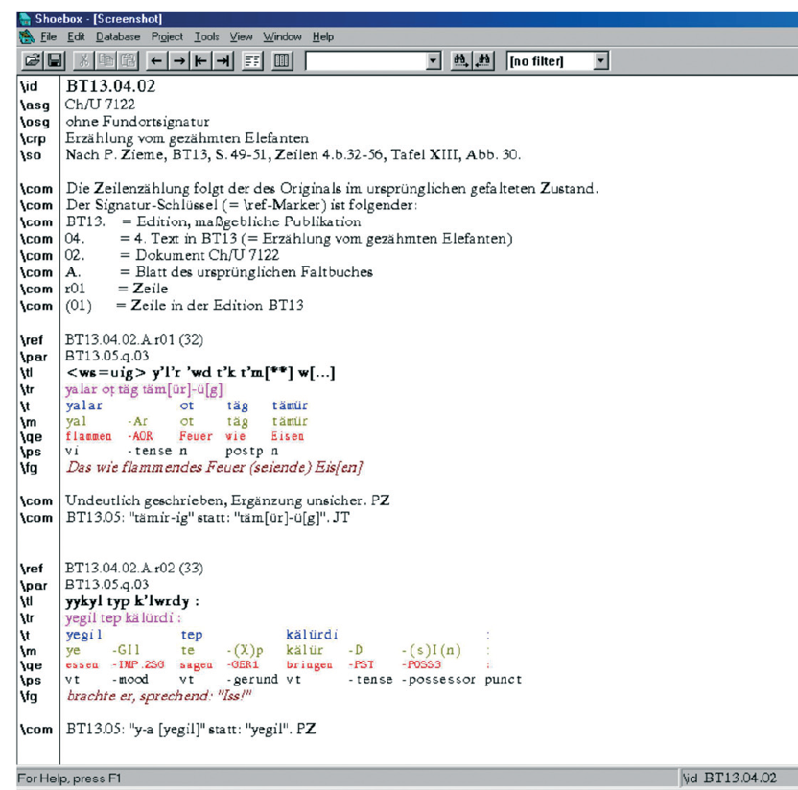
Digitale Turfan Archive
Berlin-Brandenburgische Akademie der Wissenschaften
non-Western writing systems: ~ 40,000 fragments in more than 20 different languages and scripts
focus: Middle Iranian and Old Uyghur Buddhist, Manichaeean and Christian texts (4th c. - 14th c.)
Digital Turfan Archive: international cooperation including China, Great Britain, Japan, Russia
Vatec-Database
Sogdian manuscript on the Manichean cosmogony

Slide 12
Example: parliamentary debates
Pre-processed data from plenary minutes of German parliaments
Further processing using tools in Text+
Provision for the scientific community
In catalogues of research data
Indexing with special search tools, e.g. for syntactic analyses
Contributed by Andreas Blätte, Faculty of Social Sciences, Institute of Political Science, University of Duisburg-Essen

Slide 13
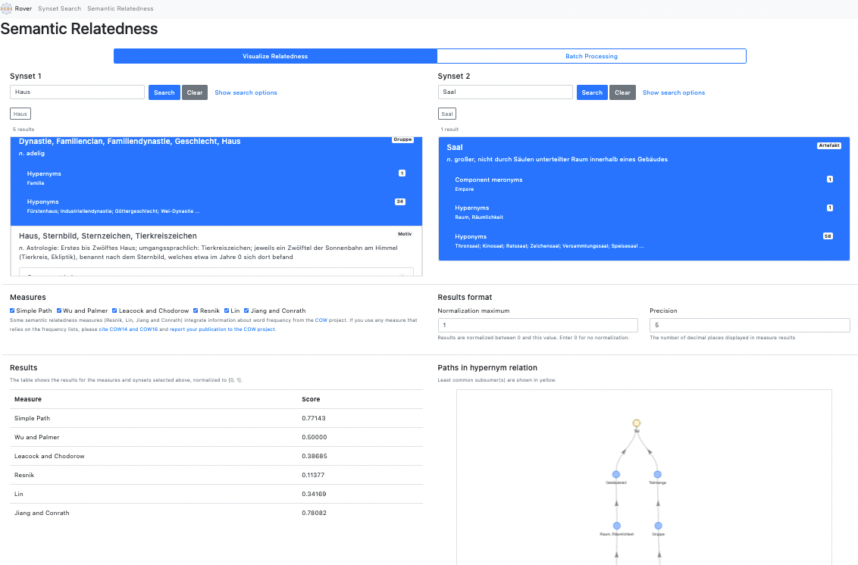
Example: wordnets
Used
as light weight ontologies in AI
For language learning
Psychological experiments (related words)
…
Available in different languages

Slide 14
Selected objectives for sharing data
Access to data
Reproducibility of results
Reusability for further/new questions
Co-use of data and results
Preservation of knowledge - and culture (!)
Credit for data creators
Citation possibility
CVs
www.text-plus.org

Slide 15
FAIR und CARE
Findable
Accessible
Interoperable
Reusable
Wilkinson, Mark D et al. (2016). “The FAIR Guiding Principles for scientific data management and stewardship”. In: Scientific data 3.
Collective Benefit
Authority to control
Responsibility
Ethics
Carroll, Stephanie Russo, Edit Herczog, Maui Hudson, Keith Russell, and Shelley Stall (Apr. 2021). “Operationalizing the CARE and FAIR Principles for Indigenous data futures”. In: Scientific Data 8.1, p. 108. url: https://doi.org/10.1038/s41597-021-00892-0 .
www.text-plus.org

Slide 16
How to Make a Black Hole FAIRer?
„Was ist mit den Werken des 20. und den gedruckten Werken des 21. Jahrhunderts – dem gerne so genannten »Schwarzen Loch des 20. und 21. Jahrhunderts«? Eine digitale Bibliothek, die blind ist für die Werke des 20. Jahrhunderts, ist unbrauchbar.“
Zeitpunkte: Julius-Campe-Preis der Kritik 2009 für Elisabeth Niggemann. Dialog mit Bibliotheken 2010/1, p. 165.
www.text-plus.org

Slide 17
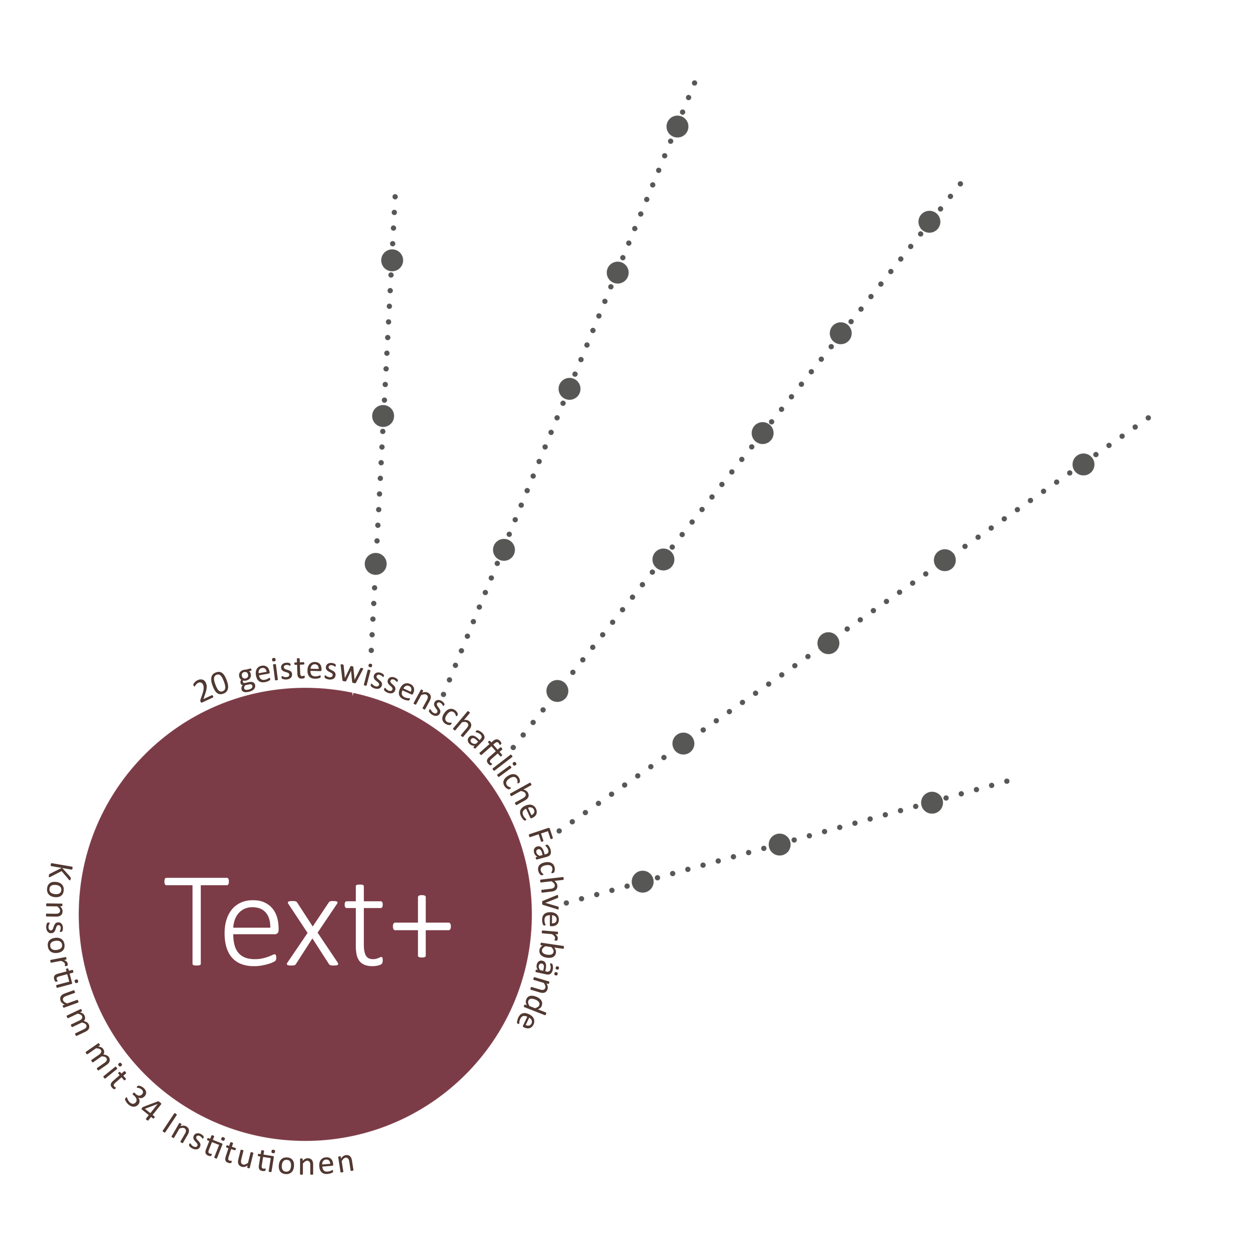

Consortium of 34 institutions
Universities
Non university research institutions
Research libraries
Computing centres
Contribution of 20 learned societies in the humanities and von 9 specialised information services (FID)
ANTRAGSTELLENDE INSTITUTIONEN

Slide 18
The following projects contributed to the Text+ activities in Tübingen:
BMBF funded project CLARIAH-DE www.clariah.de
BMBF project CLARIN-D www.clarin-d.net
DFG SFB 833 project INF
MWK Baden-Württemberg SDC BioDATEN
MWK support for CLARIN-D
Collaboration within the NFDI-initiative Text+

Slide 19
More information
Website https://www.text-plus.org/
Text+ User Stories: https://www.text-plus.org/forschungsdaten/user-stories/
Text+ Call for Data: https://www.text-plus.org/forschungsdaten/daten-aus-der-community/
Memorandum of Understanding of the NFDI initiatives for the humanities: DOI 10.5281/zenodo.3265762

