Slide 1








The Galaxy Platform and its Applications to Materials Science
Leandro Liborio¹, Alejandra González-Beltrán² , Patrick Austin^{1,2} Eli Chadwick^{1,3}
¹Theoretical and Computational Physics Group, SCD, STFC
²Data and Software Engineering Group, SCD, STFC
³ Now at “The Carpentries”
PSDI Technical Meeting, January 18-19th 2023, Coseners House, Abingdon, UK

Slide 2
Why?
Developing software and methods to help experimental scientists, in the field of muon spectroscopy, understand and better interpret their results with the help of state-of-the-art computational techniques that are sustainable, user-friendly, and reproducible
Notes:
Why Galaxy?
The problem we wanted to solve - user-friendly access to simulations, interface available from anywhere
Workflows, reproducibility
AIIDA -

Slide 3
Why?
Developing software and methods to help experimental scientists, in the field of muon spectroscopy, understand and better interpret their results with the help of state-of-the-art computational techniques that are sustainable, user-friendly, and reproducible
Muon
Notes:
Why Galaxy?
The problem we wanted to solve - user-friendly access to simulations, interface available from anywhere
Workflows, reproducibility
AIIDA -

Slide 4
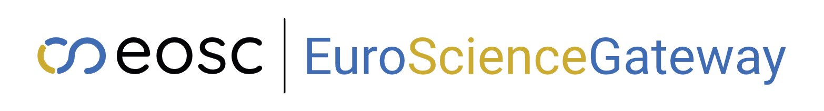
Why?
Developing software and methods to help experimental scientists, in the field of materials science, understand and better interpret their results with the help of state-of-the-art computational techniques that are sustainable, user-friendly, and reproducible
Muon
Materials
and beyond
Notes:
Why Galaxy?
The problem we wanted to solve - user-friendly access to simulations, interface available from anywhere
Workflows, reproducibility
AIIDA -

Slide 5
Why ?
Galaxy: mature open source web platform for FAIR data intensive research​
Use tools from various domains, which can be combined in complex workflows through its graphical user interface (without programming experience and minimal technical impediments​)
Manage data, supporting sharing and publish results, workflows, and visualisations​
Run code in interactive environments (e.g. RStudio, Jupyter) along with other tools or workflows
Ensure reproducibility by the capturing necessary information to repeat and understand data analysis
Scalable computation by exploiting existing computing resources (from a standard laptop to institutional clusters and cloud-based platforms)
A vibrant and growing global Galaxy community
https://galaxyproject.org/
https://doi.org/10.1093/nar/gkac610

Slide 6
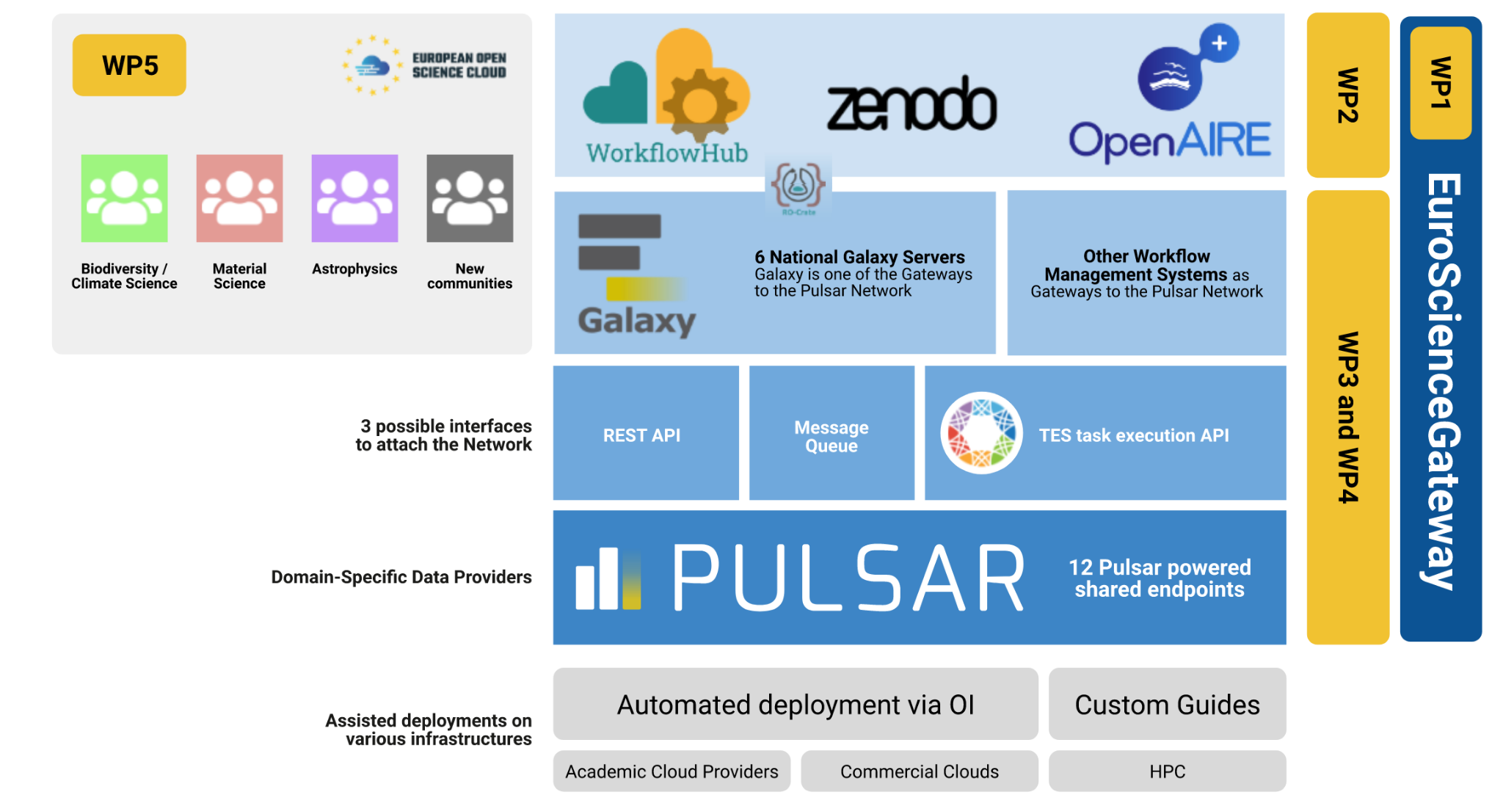
https://galaxyproject.org/projects/esg
Key objectives:
Provide an accessible e-Infrastructure resources for European scientists to enable pioneering data-driven research across scientific domains
Adoption of the proposed EuroScienceGateway e-Infrastructure by researchers in diverse scientific disciplines
  Biodiversity and Climate Science
  Astrophysics
  Material Science: Muon Science and potential expansions to Neutron and X-Ray science
EU project that started in October 2022

Slide 7



Muon Spectroscopy Computational Project
https://muon-spectroscopy-computational-project.github.io
Sustainable, User-friendly and Reproducible Software Tools for Interpreting Muon Experiments

Slide 8
Muon Spectroscopy Computational Project
Sustainable, User-friendly and Reproducible Software Tools for Interpreting Muon Experiments
MuDirac
treat muonic atoms
Martin Plummer – TCPG
Toluwalase Agora – MSc Student
Leandro Liborio – TCPG
Adrian Hillier – Muon Group
pymuon-suite
muon stopping sites
Leandro Liborio – TCPG
Patrick Austin – SEG
Stephen Cottrell – Muon Group
Francis Prat – Muon Group
Muspinsim
spin dynamics of systems of a muon plus other spins
Joel Davies – Graduate@TCPG
Eli Chadwick - TCPG
John Wilkinson – Muon Group
Leandro Liborio – TCPG
Stephen Cottrell – Muon Group
Francis Prat – Muon Group
pm-nq
muon quantum effects
Leandro Liborio – TCPG
Patrick Austin – SEG
Muon Galaxy Leandro Liborio-TCPG, Patrick Austin-DSEG, Eli Chadwick-TCPG, Alejandra G. Beltran-DSEG

Slide 9
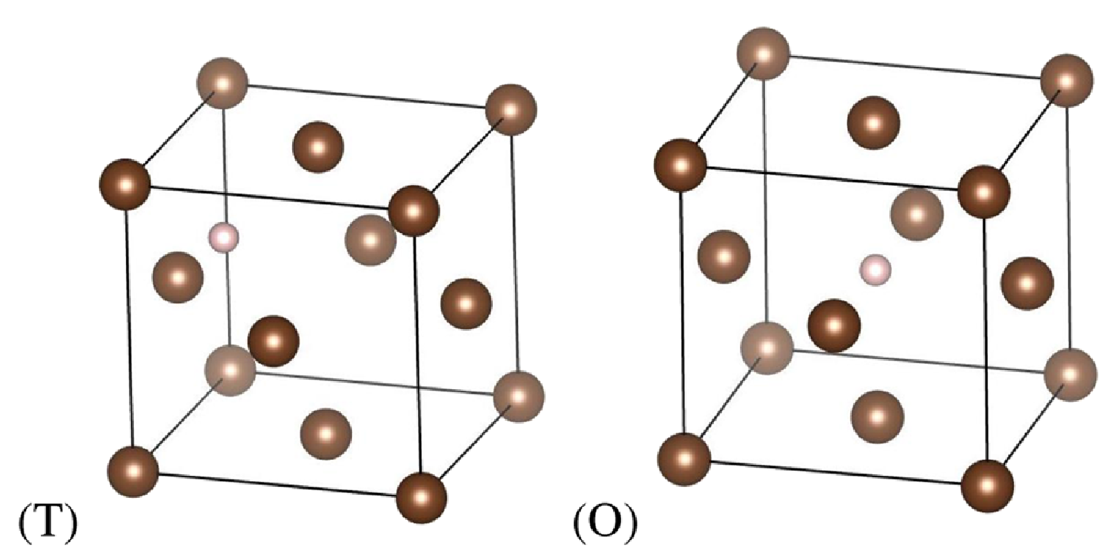

pymuon-suite: finding the muon stopping site
-----------
Cluster 1
-----------
Structures: 36
Energy (eV):
Minimum Average StDev
-7.34 -7.34 0.00
Minimum energy structure: Cu_82
Structure list:
Cu_3 Cu_8 Cu_9 Cu_10
Cu_12 Cu_15 Cu_22 Cu_24
Cu_25 Cu_30 Cu_34 Cu_39
Cu_41 Cu_47 Cu_49 Cu_51
Cu_52 Cu_54 Cu_62 Cu_71
Cu_73 Cu_75 Cu_79 Cu_80
Cu_81 Cu_82 Cu_83 Cu_85
Cu_87 Cu_90 Cu_92 Cu_93
Cu_98 Cu_100 Cu_101 Cu_102
-----------
Cluster 2
-----------
Structures: 67
Energy (eV):
Minimum Average StDev
-7.96 -7.96 0.00
Minimum energy structure: Cu_78
DFT
pm-muairss
pymuon-suite
workflow
pm-uep-opt
pm-muairss
µ⁺ stopping site
S. Sturniolo and L. Liborio, The Journal of Chemical Physics, 153, 044111 (2020)

Slide 10
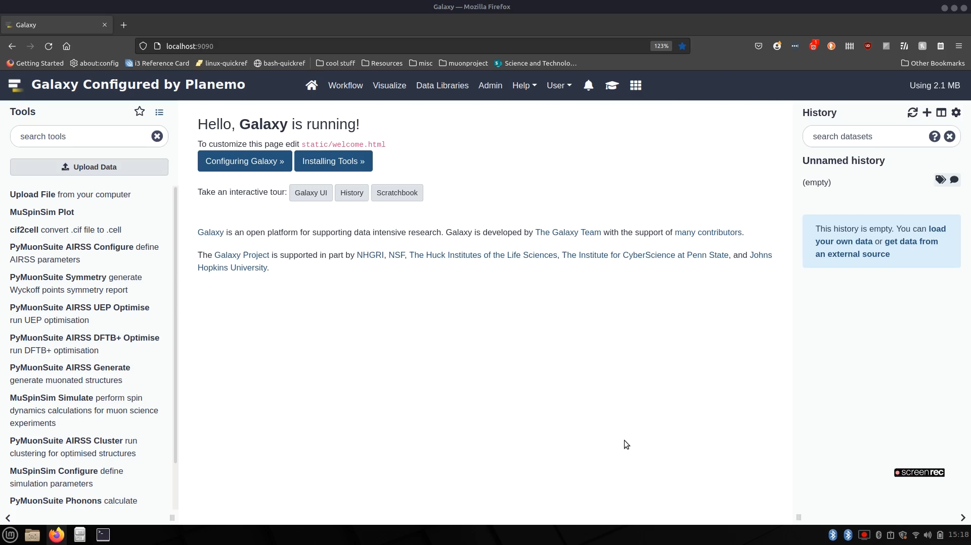
pymuon-suite in Muon Galaxy
DFT
pm-muairss
pm-uep-opt
pm-muairss
µ⁺ stopping site
Slide: SCD graduate Anish Mudaraddi’s talk at RSECon_22

Slide 11
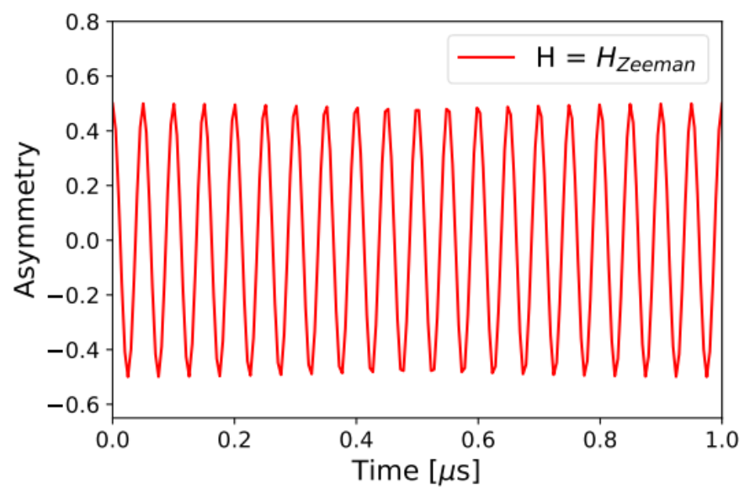
muspinsim: spin dynamics of the system of a muon + Software Implementation
Released in the Python Package Index PyPI:
https://pypi.org/project/muspinsim/
https://pypi.org/project/PyMuonSuite/
Can install in Linux or Mac using pip:
pip install muspinsim
pip install pymuonsuite
Can be Installed in Windows using conda
and miniconda:
conda install muspinsim
muspinsim and pymuon-suite
can be run from the command line.
MuSpinSim can be run in parallel.
Input and output file in text format .
Need cluster to run DFT calculations
name
zeeman
spins
mu
time
range(0, 1, 200)
zeeman 1
0 0 20.0/muon_gyr
Build input file
Run MuSpinSim
Plot MuSpinSim

Slide 12
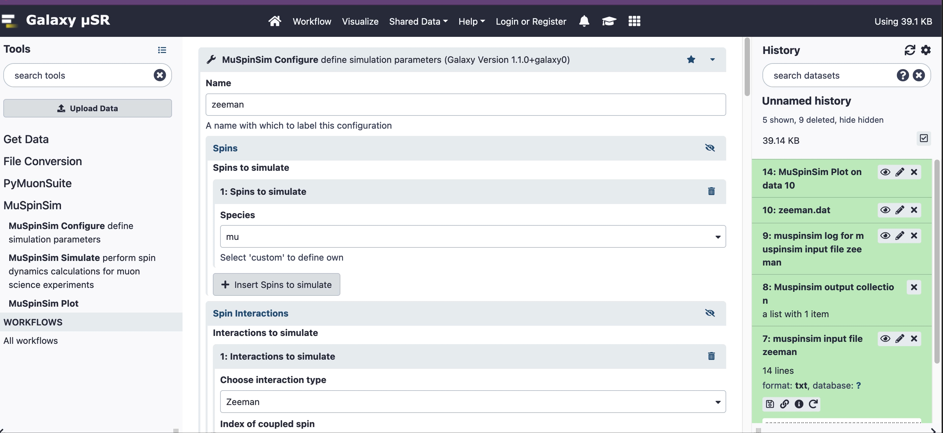
MuSpinSim in Muon Galaxy
Build input file
Run MuSpinSim
Plot MuSpinSim
Galaxy is an open, web-based platform for accessible, reproducible, and transparent computational research.
Accessible: programming experience is not required to easily upload data, run complex tools and workflows, and visualize results.
Reproducible: Galaxy captures information so that you don't have to; any user can repeat and understand a complete computational analysis, from tool parameters to the dependency tree.
Transparent: Users share and publish their histories, workflows, and visualisations via the web.
Community centered: Our inclusive and diverse users (developers, educators, researchers, clinicians, etc.) are empowered to share their findings.
https://galaxyproject.org/

Slide 13
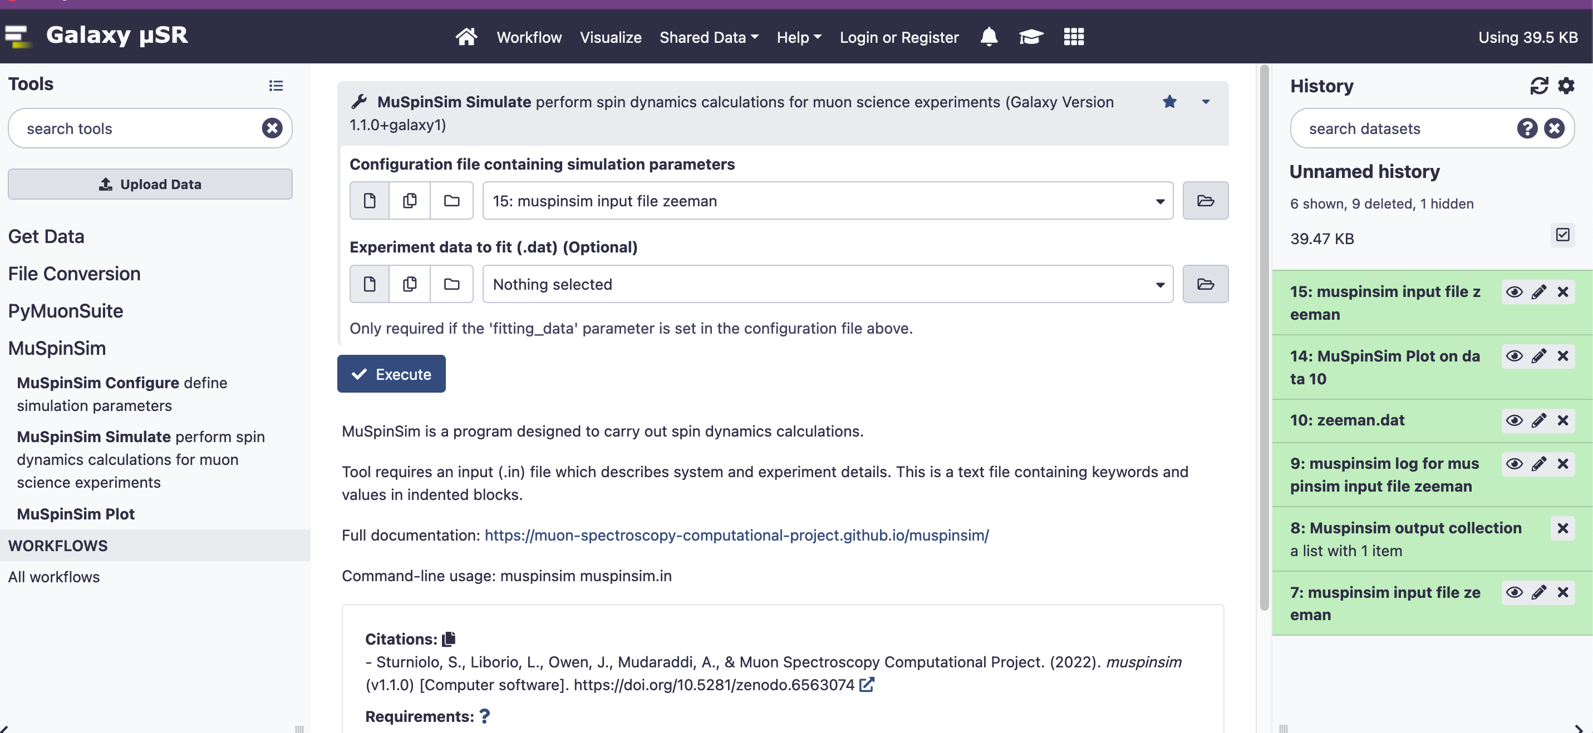
MuSpinSim in Muon Galaxy
Build input file
Run MuSpinSim
Plot MuSpinSim
Galaxy is an open, web-based platform for accessible, reproducible, and transparent computational research.
Accessible: programming experience is not required to easily upload data, run complex tools and workflows, and visualize results.
Reproducible: Galaxy captures information so that you don't have to; any user can repeat and understand a complete computational analysis, from tool parameters to the dependency tree.
Transparent: Users share and publish their histories, workflows, and visualisations via the web.
Community centered: Our inclusive and diverse users (developers, educators, researchers, clinicians, etc.) are empowered to share their findings.
https://galaxyproject.org/

Slide 14
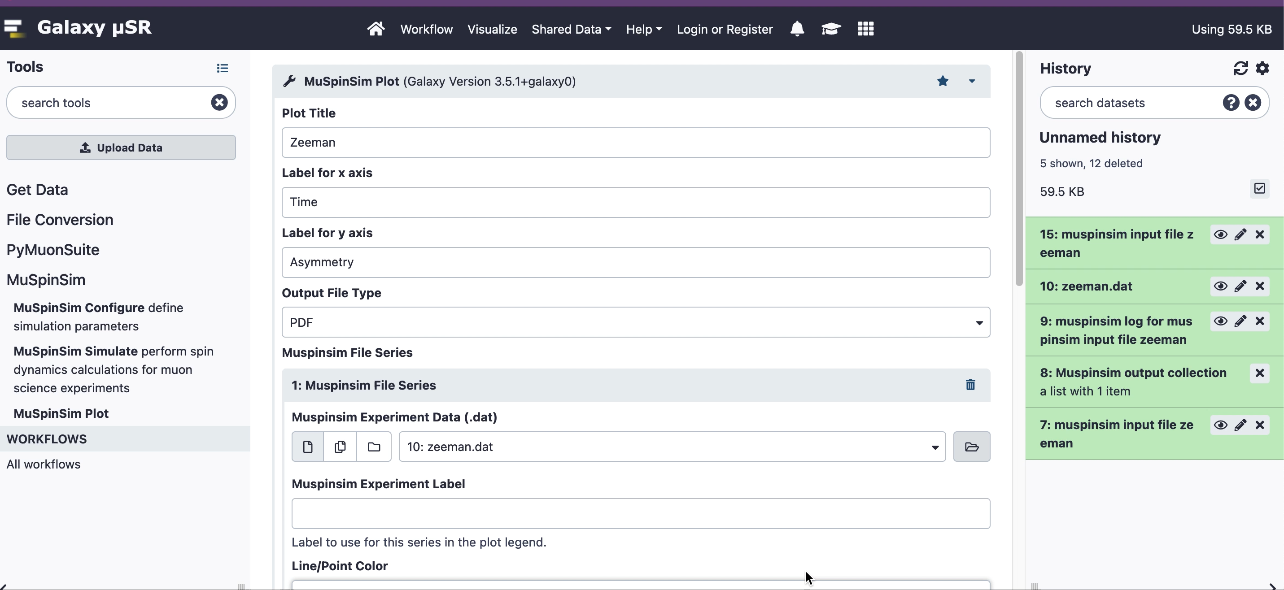
MuSpinSim in Muon Galaxy
Build input file
Run MuSpinSim
Plot MuSpinSim
Galaxy is an open, web-based platform for accessible, reproducible, and transparent computational research.
Accessible: programming experience is not required to easily upload data, run complex tools and workflows, and visualize results.
Reproducible: Galaxy captures information so that you don't have to; any user can repeat and understand a complete computational analysis, from tool parameters to the dependency tree.
Transparent: Users share and publish their histories, workflows, and visualisations via the web.
Community centered: Our inclusive and diverse users (developers, educators, researchers, clinicians, etc.) are empowered to share their findings.
https://galaxyproject.org/

Slide 15
Conclusions and Future Work
  Why? Sustainable, user-friendly, reproducible computational tools for materials science
  Galaxy is a powerful web-based platform that enables scientists to perform FAIR data intensive computational research
  Further development of Muon Galaxy and community building activities for muon spectroscopy research
    Work in progress: connecting our Galaxy instance to SCARF
  Onboarding new materials science and physics-related communities into the Galaxy platform
    Collaboration with ORNL on neutron data and with Cornell on X-Ray data
  Engagement with the Physical Science Data Infrastructure
    Considering micro-project for Galaxy adoption

Slide 16
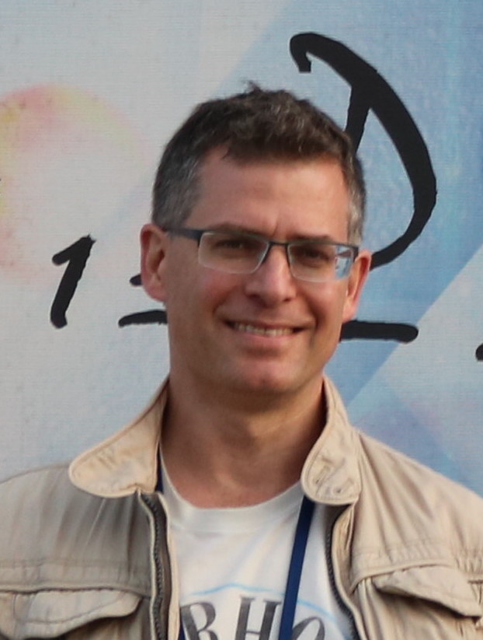
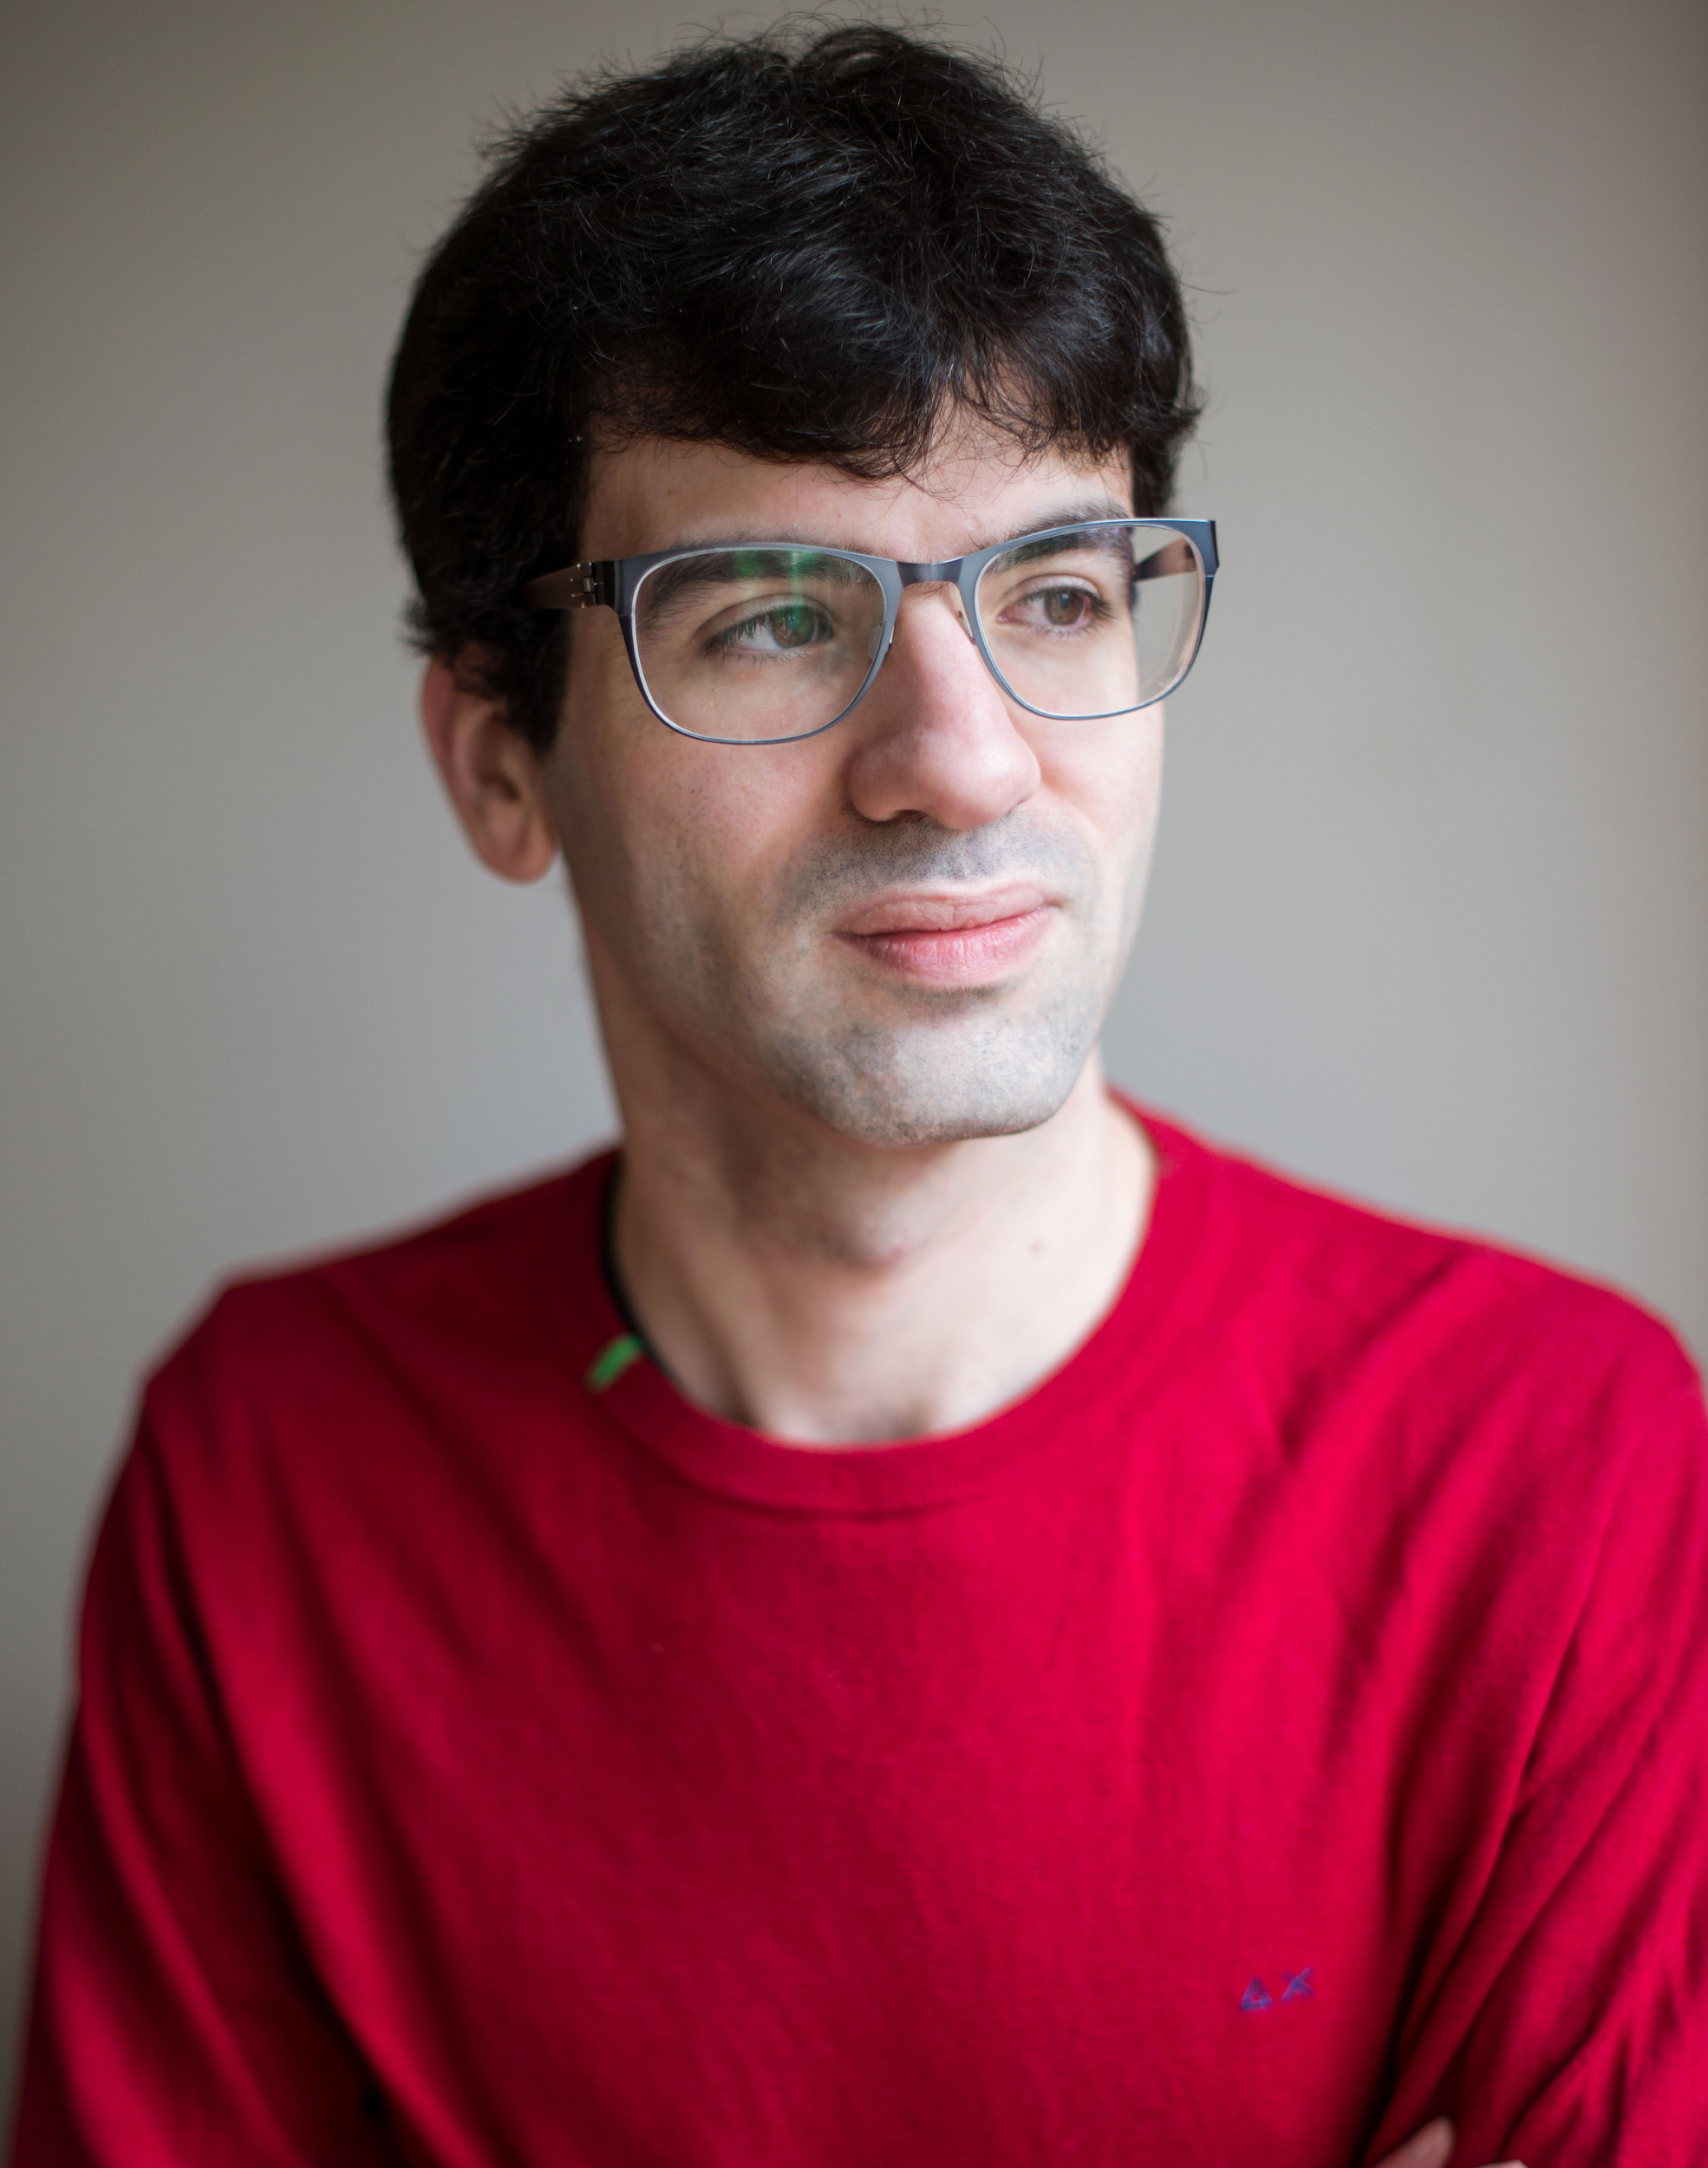
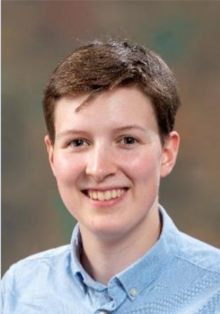
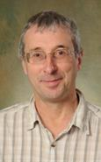
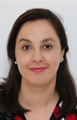
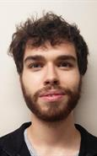
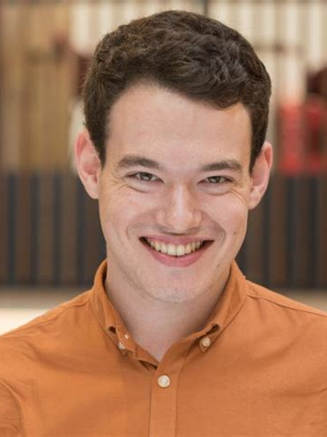
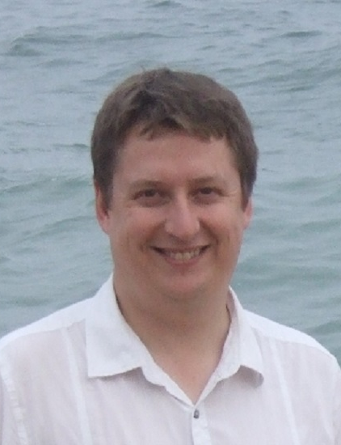
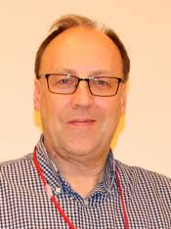
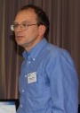
Muon Spectroscopy Computational Project
https://muon-spectroscopy-computational-project.github.io/
Theoretical and Computational Physics Group - SCD
Data & Software Engineering Group SCD
SCD Graduates:
Joel Davies
Anish Muddaradi
Jyothish Thomas
Samuel Jackson
Adam Laverack
Thomas Dack
Josh Owen
Laura Murgatroyd
Sarah Byrne
LIBORIO
STURNIOLO
CHADWICK
PLUMMER
GONZALEZ-BELTRAN
AUSTIN
Now @ comindTM
Now @ The Carpentries
Muon Group - ISIS
HILLIER
PRATT
COTTRELL
WILKINSON

