Slide 1








Computing Simulations for Large Scale Experiments: the Case of Muons
Leandro Liborio¹, Patrick Austin^{1,2}, Alejandra Gonzalez-Beltran^{1,2}, Joel Davies³
¹Theoretical and Computational Physics Group, SCD, STFC
²Data and Software Engineering Group, SCD, STFC
³ SCD Graduate, Currently @ MSCP
March 3rd 2023, Catalysis Hub

Slide 2
Summary
Muon Spectroscopy or µSR (Muon Spin Rotation, Relaxation or Resonance)
  The ISIS beamlines @RAL
  How are muons generated?
  What is a muon? The muon implantation site
  Muonium
  Muon technique
  Muons for Catalysis
    Avoided level crossing experiments
    Catalytic reduction of hydrogen with hydrogenases
    Galaxy and MuonGalaxy
      Muspinsim
      Muspinsim in MuonGalaxy
      Conclusions and Future Work

Slide 3
Summary
Muon Spectroscopy or µSR (Muon Spin Rotation, Relaxation or Resonance)
  The ISIS beamlines @RAL
  How are muons generated?
  What is a muon? The muon implantation site
  Muonium
  Muon technique
  Muons for Catalysis
    Avoided level crossing experiments
    Catalytic reduction of hydrogen with hydrogenases
    Galaxy and MuonGalaxy
      Muspinsim
      Muspinsim in MuonGalaxy
      Conclusions and Future Work

Slide 4
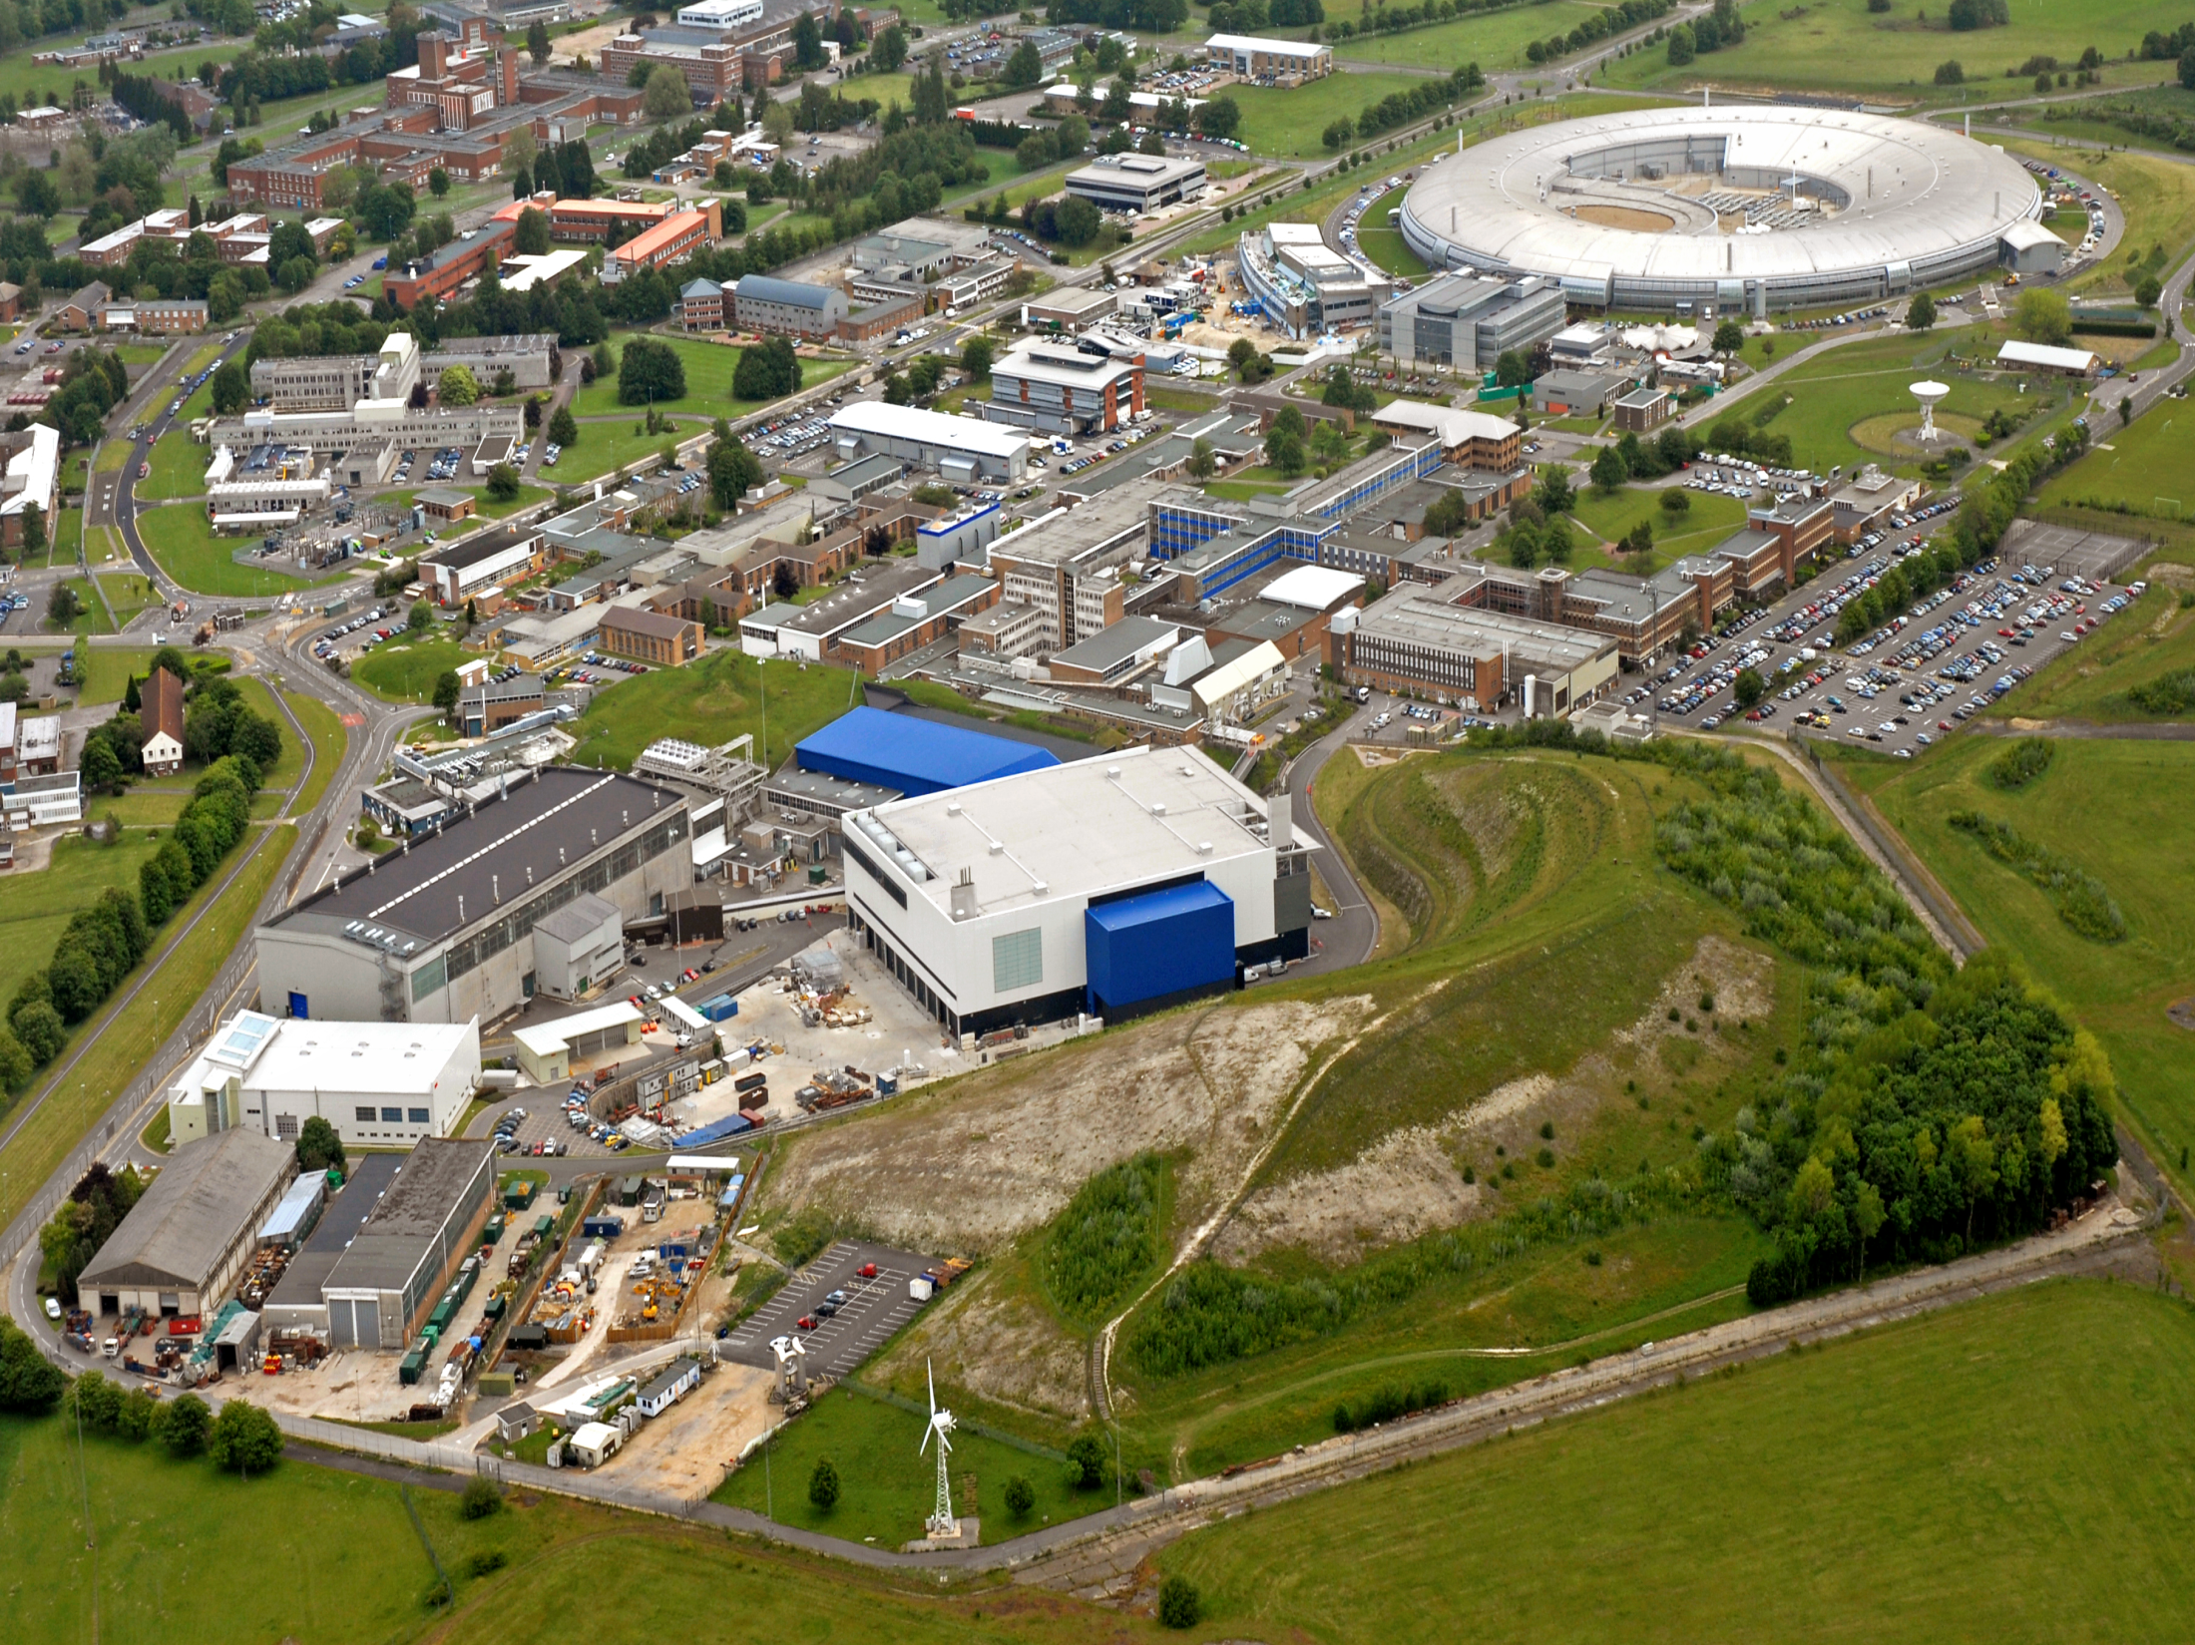

Aceleradores de partículas
The ISIS beamlines @RAL
TS2
Target Stations
TS1

Slide 5
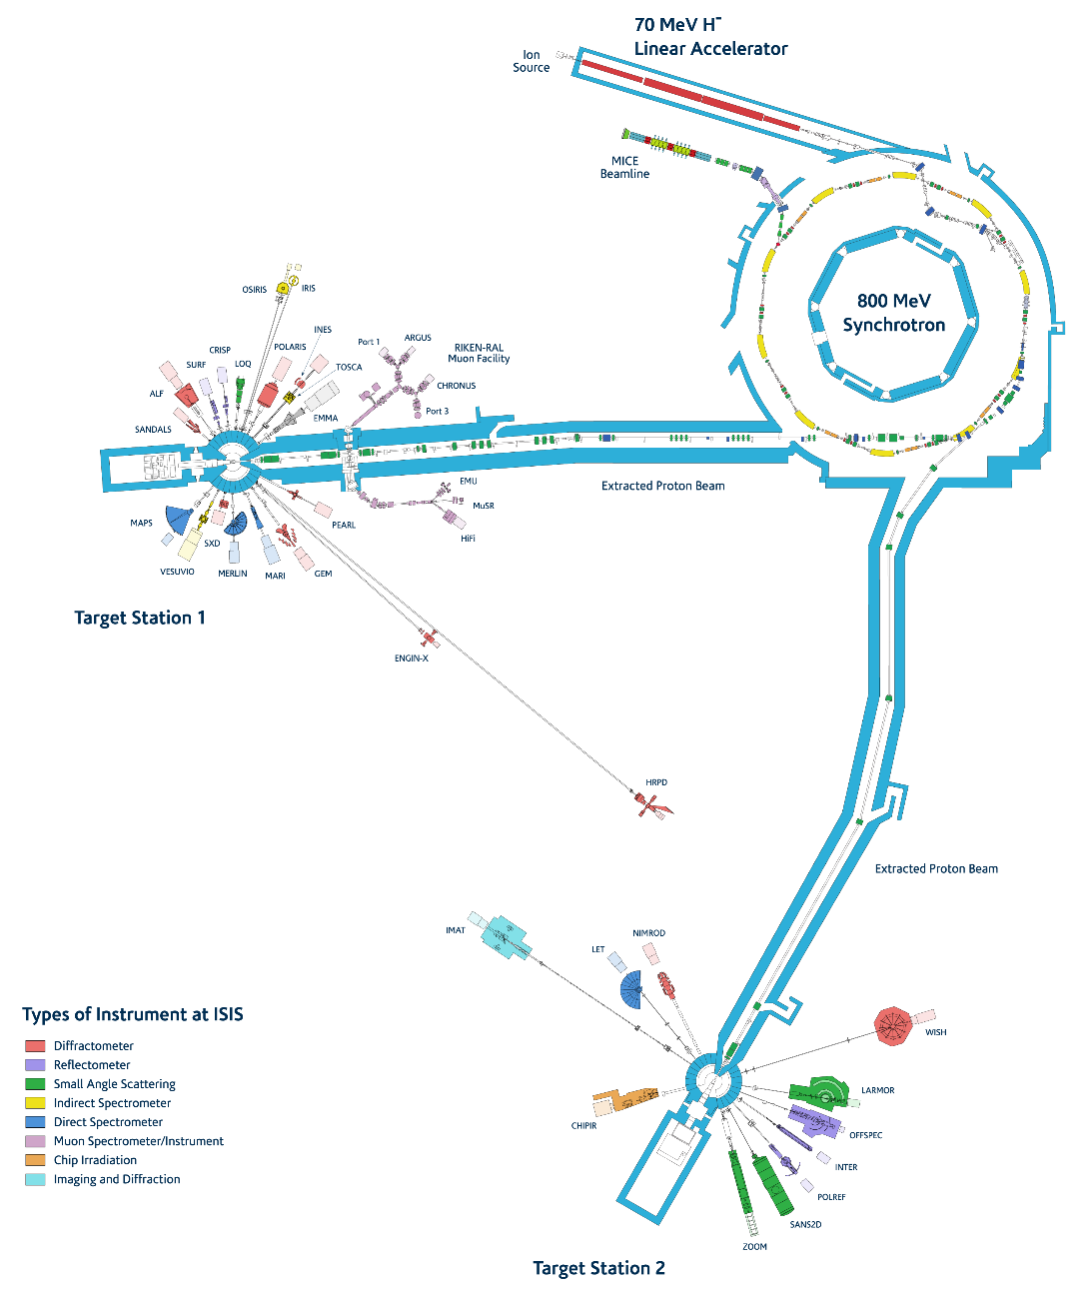
The ISIS beamlines @RAL

Slide 6
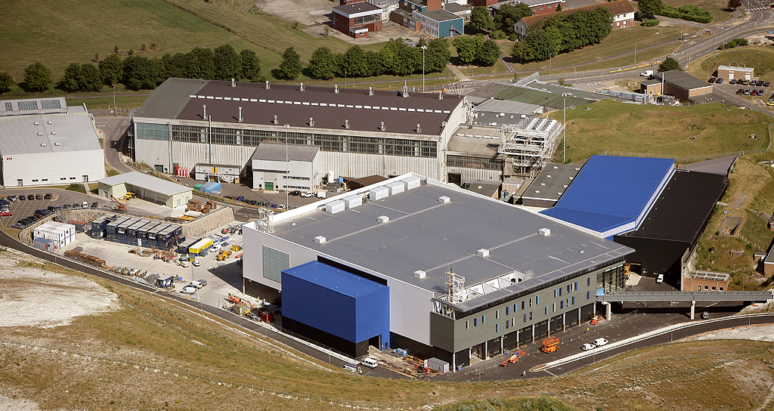
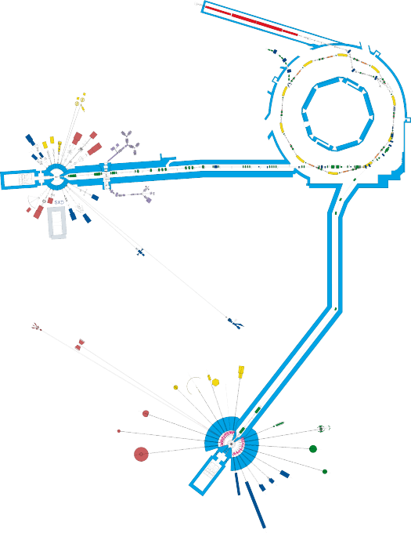
The ISIS beamlines @RAL
TS1
TS2

Slide 7
How are muons generated?
Beam focus
Protons
Target
Pions and muons

Slide 8
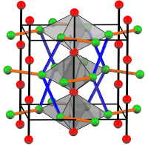
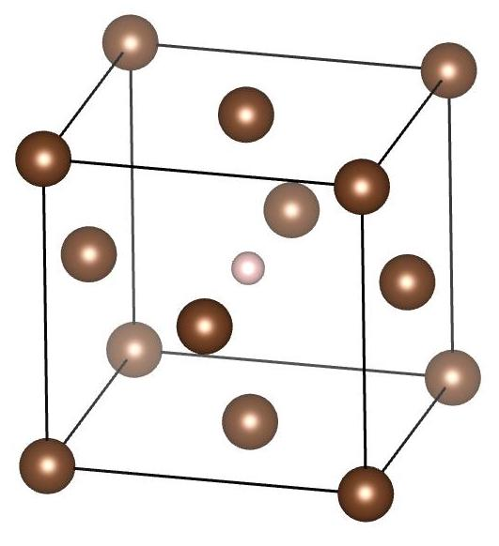
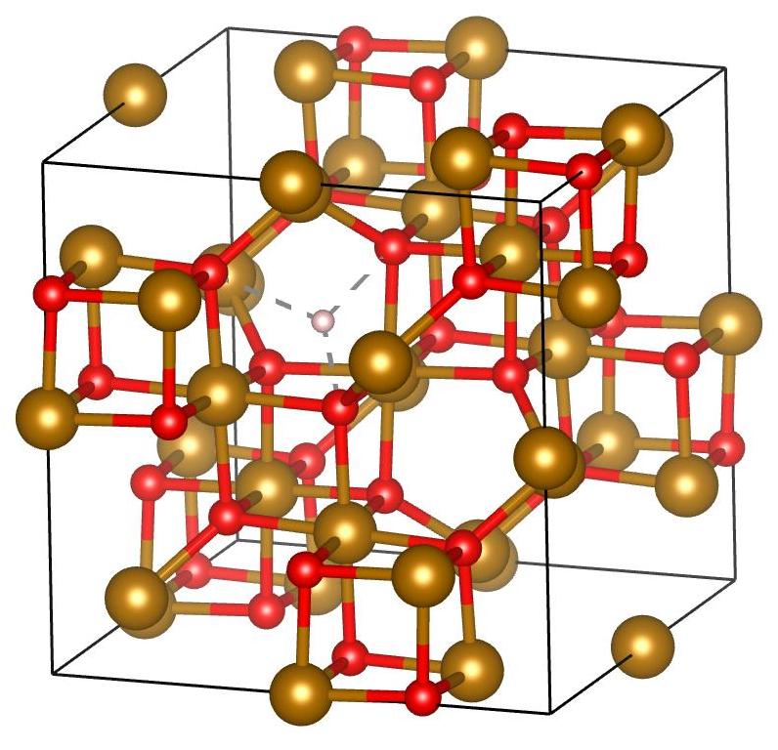
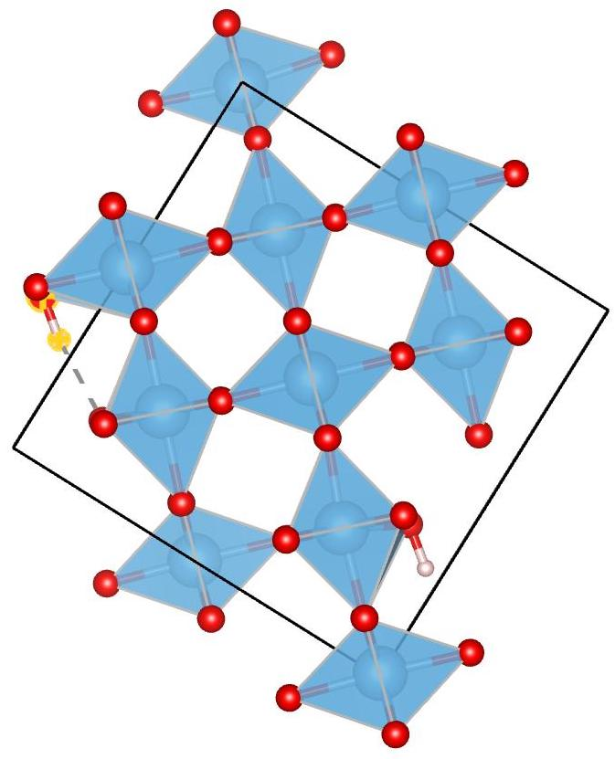
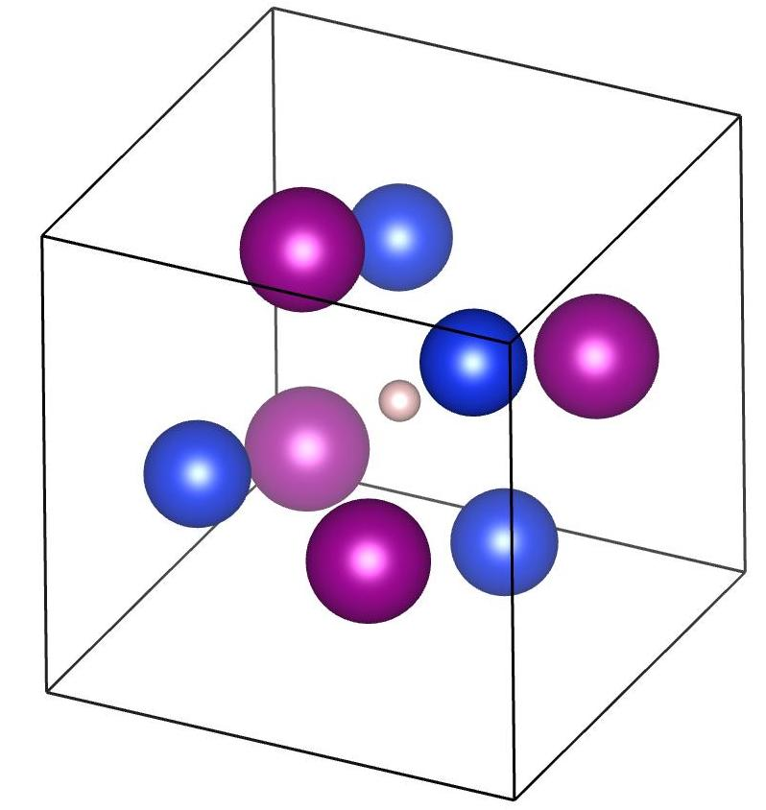
What are muons? The muon implantation site
Positive muon: µ⁺
Cu⁴
Fe₃O₄-magnetite²
μ⁺
Heavy electrons or light protons
Mass 0.11 x m_{p}
Spin 1/2
Charged fundamental particles
The muon beam is 100% spin polarised
The muon is implanted in the sample
Once implanted, the muon could grab an e and
Become muonium
Mean life of 2.2 µs
Muons decay into positrons that are
emitted in the spin direction.
TiO2-rutile¹
MnSi³
1. Phys. Rev. B 92, 081202 (2015)
2. Phys. Rev. B 33, 7813 (1986)
3. Phys. Rev. B 89, 184425 (2014)
4. Phys. Rev. B 43, 3284–3297 (1991)

Slide 9
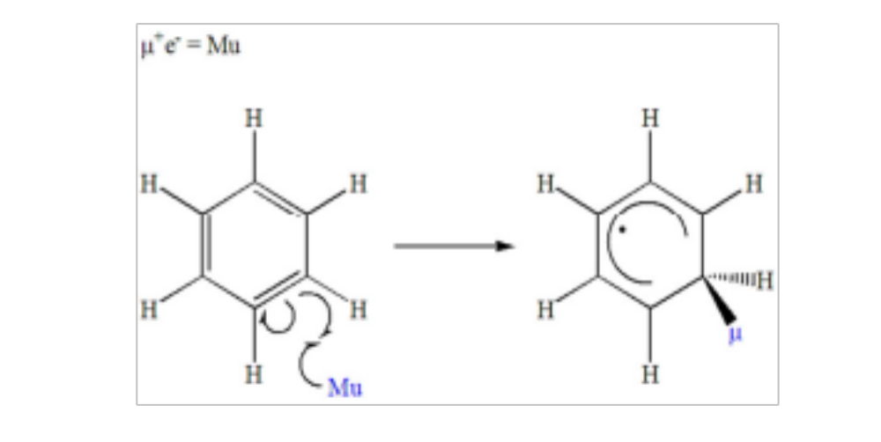
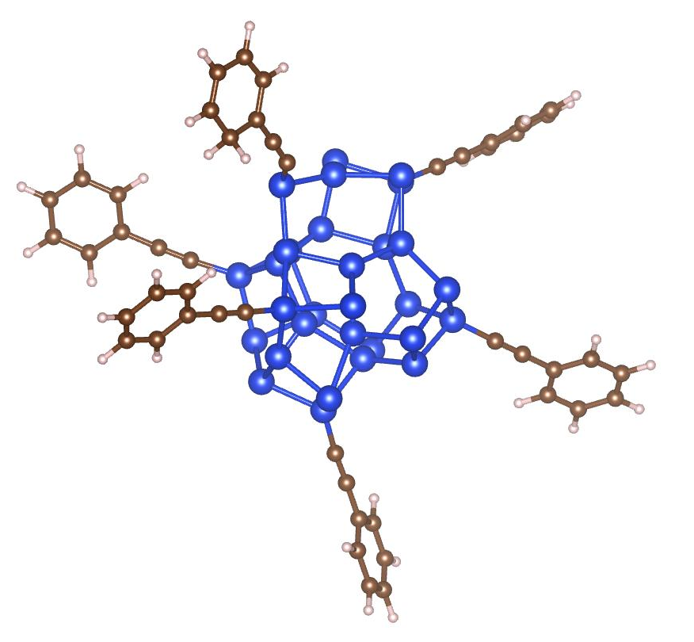
Muonium: Mu (H isotope)
Delocalized unpaired electron
A_{P}
H
Mu
Mu
Muon adds across double bond
A_{µ}
Neutral muon (muonium): Mu
The Journal of Physical Chemistry C 124 (18), 9656-9664
Notes:
Why need hfcc? Conection with experiments. Expression for the isotropic coupling constat. Conection with paper? Anisotropy usually present in muoniated radicals in the solid phase, but averages to zero in liquid and gas phases (reorientation rate larger than dipolar interaction). Discuss TF-µSR Transition between muons of different spins. What can and cannot do with TF-µSR. Transitions between states with different muons spins.

Slide 10
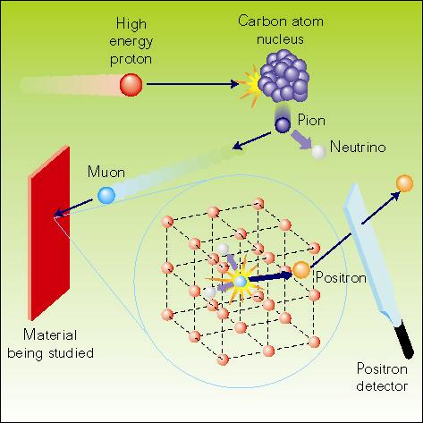
The Muon Technique
High energy protons
(800 MeV at ISIS)
collide with carbon nuclei
producing pions
π⁺ → μ⁺ + ν_{μ}
4 MeV muons are 100% spin polarised
Decay, lifetime 2.2μs
μ⁺ → e⁺ + ν_{e} + ν_{μ}
we detect decay positrons
Implantation,
(stopped in ~1mm water)
The positrons are preferentially emitted in muon spin direction
Muons interact with local magnetic environment
Monitor the positron distribution to infer the muons’ polarisation after implantation. Learn about the muons’ local environment or the muon behaviour itself.
The technique is labelled µSR, which stands for muon spin rotation, relaxation and resonance
Slide by Dr Adrian Hillier, head of the muon Group at ISIS

Slide 11
Summary
Muon Spectroscopy or µSR (Muon Spin Rotation, Relaxation or Resonance)
  The ISIS beamlines @RAL
  How are muons generated?
  What is a muon? The muon implantation site
  Muonium
  Muon technique
  Muons for Catalysis
    Avoided level crossing experiments
    Catalytic reduction of hydrogen with hydrogenases
    Galaxy and MuonGalaxy
      Muspinsim
      Muspinsim in MuonGalaxy
      Conclusions and Future Work

Slide 12
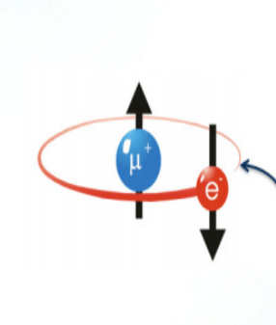
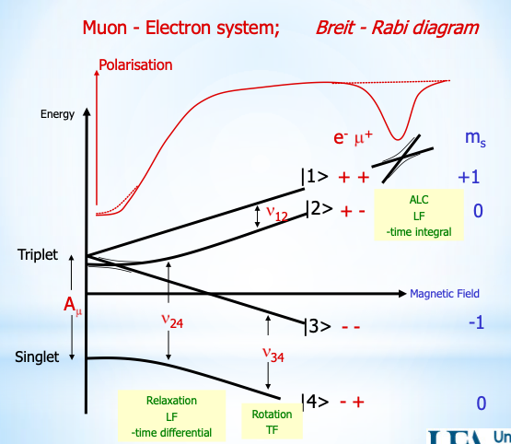
Avoided Level Crossing (ALC)
H
Mu
Muon 100% spin-polarized
Know direction of spin at time of implantation.
Muon experiments with ZF, TF, LF applied
Breit-Rabi diagram represents energy levels of Mu in B -> levels split
ALC experiments are at high B
There are values of B where levels “avoid crossing”
There is a resonance peak there associated with the muon spin
The peak is associated with the muonium HFCC and with the structure of the organic radical
A_{P}

Slide 13
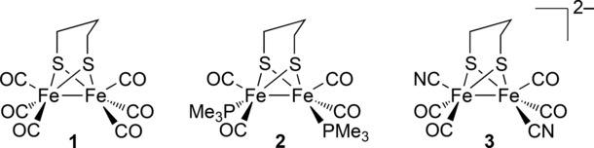
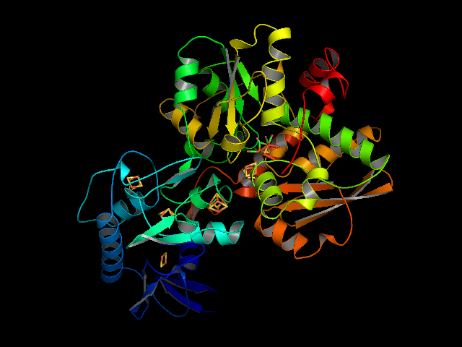
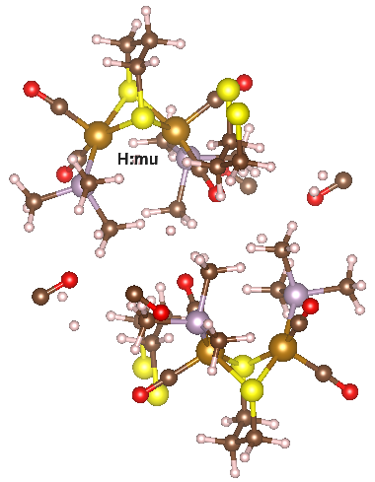
Catalysis example : muspinsim and the ALC of Muonated Crystalline 2-Fe₂(pdt)CO₄(PMe₃)₂
Active metal sites for metallo-enzyme Fe-Fe hidrogenase
Metallo-enzyme Fe-Fe hidrogenase
Understand the chemistry of transient hydride intermediaries, to understand the reaction mechanisms for catalytic reduction of protons to di-hydrogen.
J. Wright et. Al., Angew. Chem. Int. Ed. 2016, 55, 14580 –14583

Slide 14
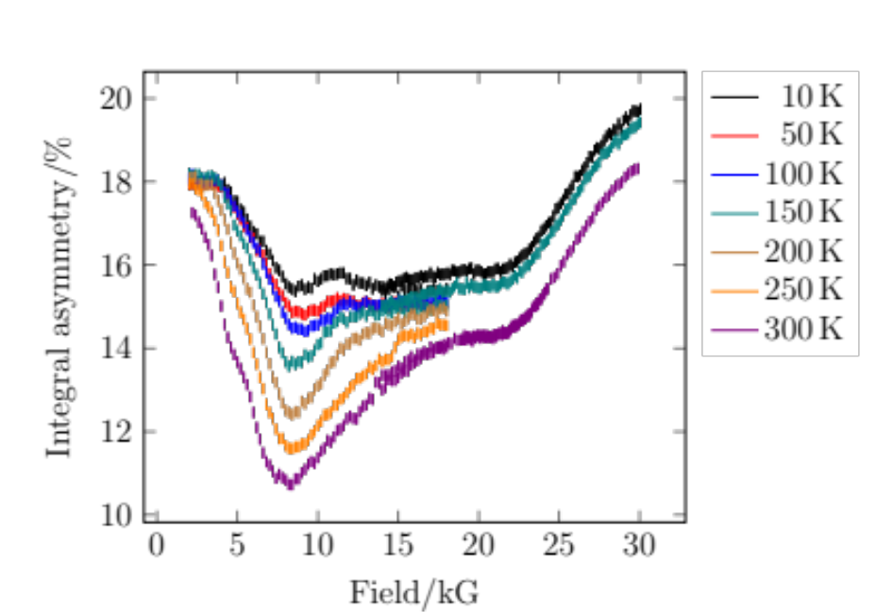
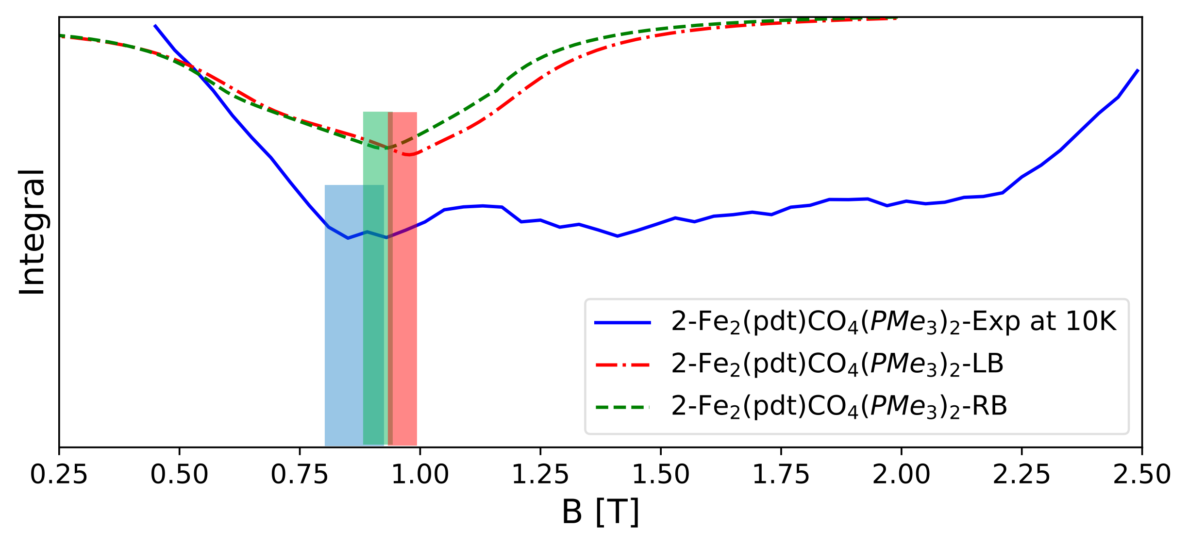
Catalysis example : muspinsim and the ALC of Muonated Crystalline 2-Fe₂(pdt)CO₄(PMe₃)₂
System | A_mu[MHz] | B[T]
RB | 242.53 | 0.89
LB | 253.33 | 0.93
J. Wright et. Al., Angew. Chem. Int. Ed. 2016, 55, 14580 –14583

Slide 15
Summary
Muon Spectroscopy or µSR (Muon Spin Rotation, Relaxation or Resonance)
  The ISIS beamlines @RAL
  How are muons generated?
  What is a muon? The muon implantation site
  Muonium
  Muon technique
  Muons for Catalysis
    Avoided level crossing experiments
    Catalytic reduction of hydrogen with hydrogenases
    Galaxy and MuonGalaxy
      Muspinsim
      Muspinsim in MuonGalaxy
      Conclusions and Future Work

Slide 16
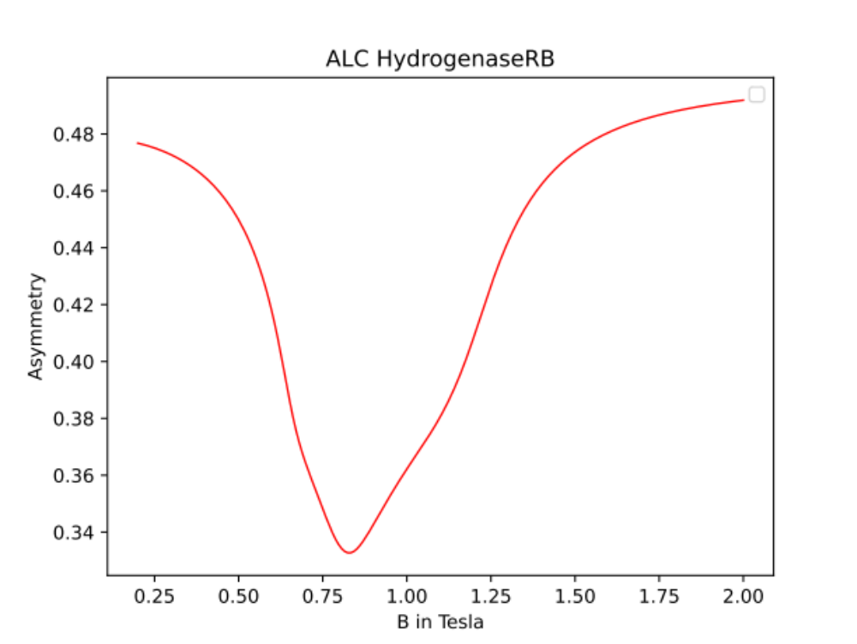
muspinsim
Install in Windows using conda:
conda install muspinsim
MuSpinSim can be run from the command line as:
muspinsim input_file.in
Released in the Python Package Index PyPI:
https://pypi.org/project/muspinsim/
Can install in Linux or Mac using pip:
pip install muspinsim
name
HydrogenaseRB
spins
mu e
hyperfine 1
226.0231 18.2510 62.8243
18.2510 239.7670 37.4381
62.8243 37.438 261.8144
average_axes
orientation
field
range(0.2,2.0,200)
orientation zyz
zcw(30)
experiment
alc

Slide 17
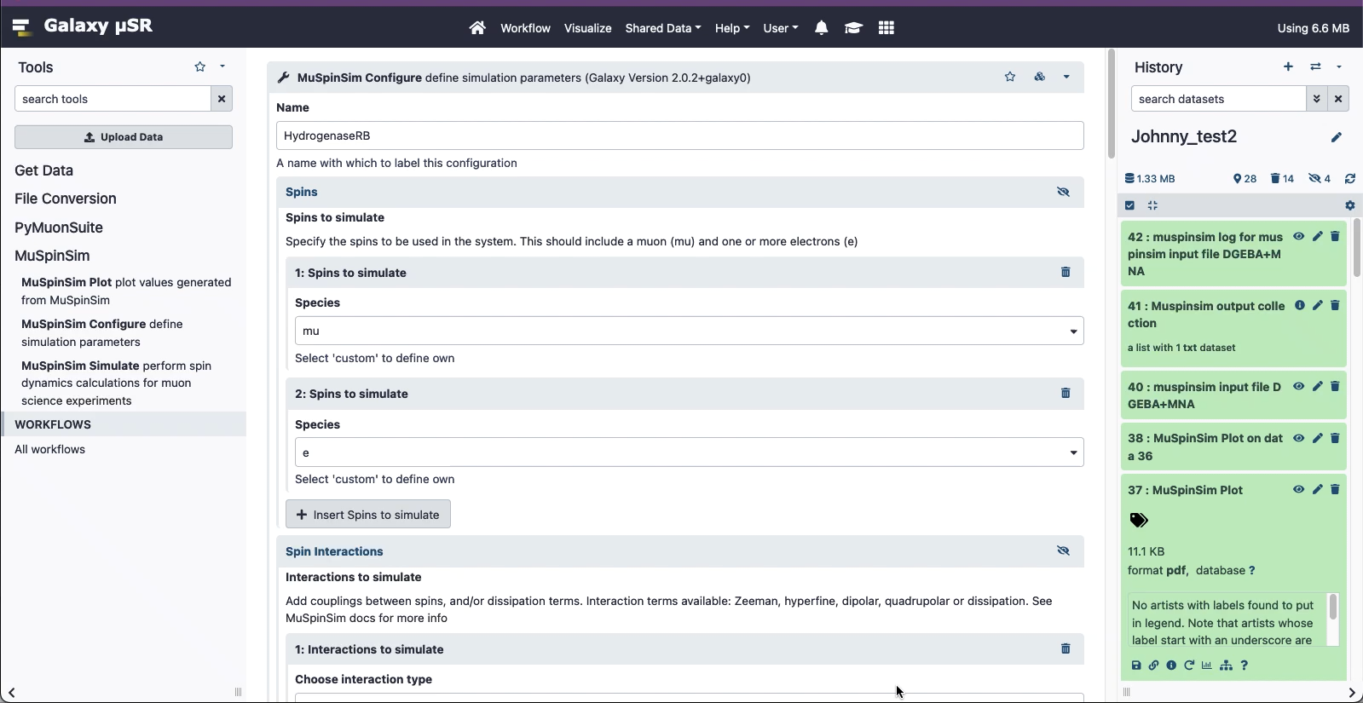
MuSpinSim in Muon Galaxy
Build input file
Run MuSpinSim
Plot MuSpinSim
Galaxy is an open, web-based platform for accessible, reproducible, and transparent computational research.
Accessible: programming experience is not required to easily upload data, run complex tools and workflows, and visualize results.
Reproducible: Galaxy captures information so that you don't have to; any user can repeat and understand a complete computational analysis, from tool parameters to the dependency tree.
Transparent: Users share and publish their histories, workflows, and visualisations via the web.
Community centered: Our inclusive and diverse users (developers, educators, researchers, clinicians,
etc.) are empowered to share their findings.
https://galaxyproject.org/

Slide 18
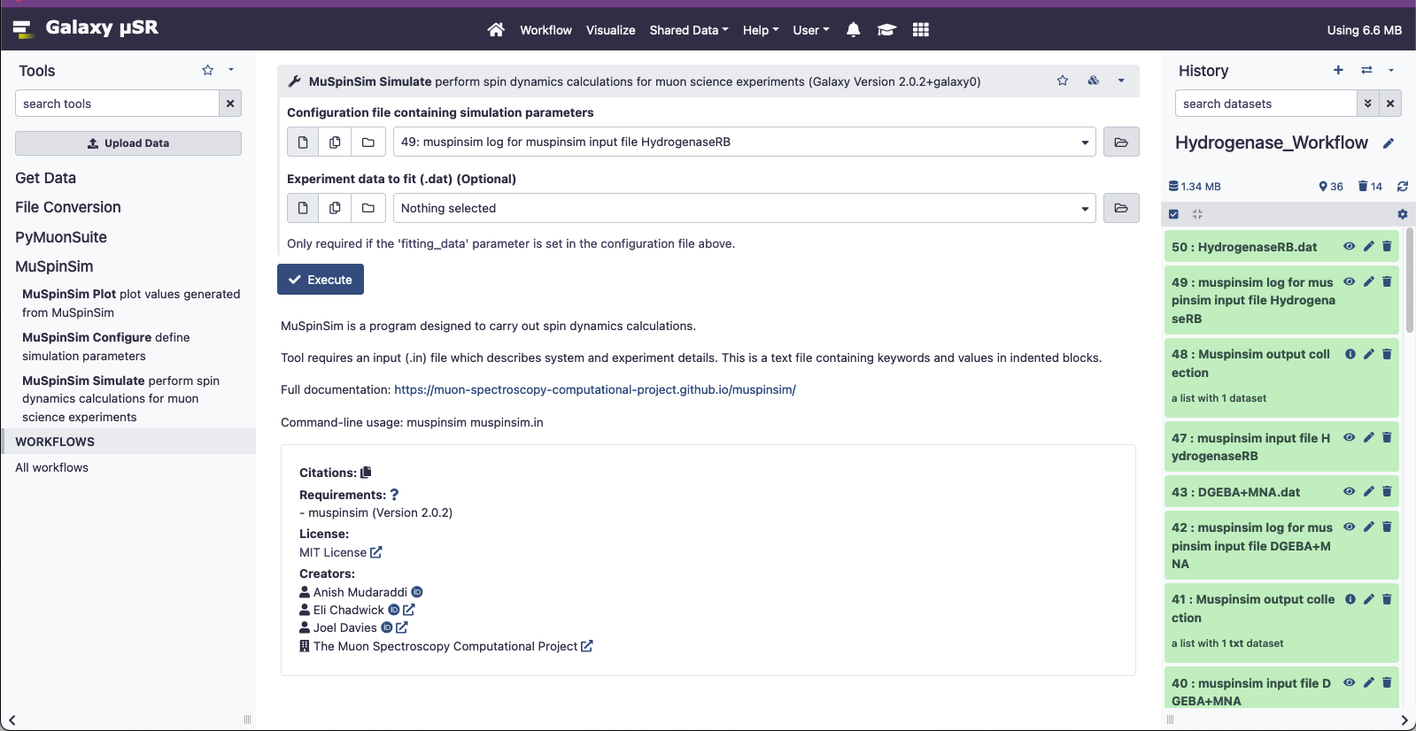
MuSpinSim in Muon Galaxy
Build input file
Run MuSpinSim
Plot MuSpinSim
Galaxy is an open, web-based platform for accessible, reproducible, and transparent computational research.
Accessible: programming experience is not required to easily upload data, run complex tools and workflows, and visualize results.
Reproducible: Galaxy captures information so that you don't have to; any user can repeat and understand a complete computational analysis, from tool parameters to the dependency tree.
Transparent: Users share and publish their histories, workflows, and visualisations via the web.
Community centered: Our inclusive and diverse users (developers, educators, researchers, clinicians, etc.) are empowered to share their findings.
https://galaxyproject.org/

Slide 19
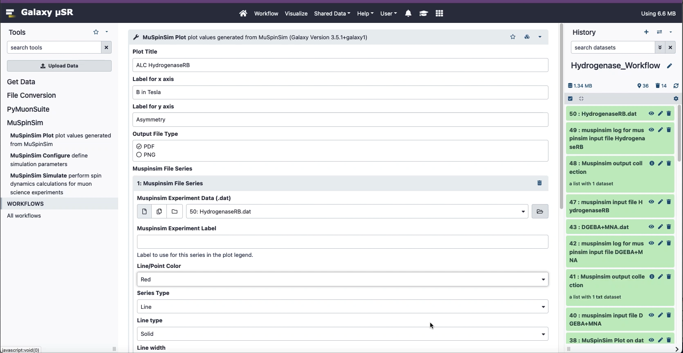
MuSpinSim in Muon Galaxy
Build input file
Run MuSpinSim
Plot MuSpinSim
Galaxy is an open, web-based platform for accessible, reproducible, and transparent computational research.
Accessible: programming experience is not required to easily upload data, run complex tools and workflows, and visualize results.
Reproducible: Galaxy captures information so that you don't have to; any user can repeat and understand a complete computational analysis, from tool parameters to the dependency tree.
Transparent: Users share and publish their histories, workflows, and visualisations via the web.
Community centered: Our inclusive and diverse users (developers, educators, researchers, clinicians, etc.) are empowered to share their findings.
https://galaxyproject.org/

Slide 20
Summary
Muon Spectroscopy or µSR (Muon Spin Rotation, Relaxation or Resonance)
  The ISIS beamlines @RAL
  How are muons generated?
  What is a muon? The muon implantation site
  Muonium
  Muon technique
  Muons for Catalysis
    Avoided level crossing experiments
    Catalytic reduction of hydrogen with hydrogenases
    Galaxy and MuonGalaxy
      Muspinsim
      Muspinsim in MuonGalaxy
      Conclusions and Future Work

Slide 21
Conclusions and Future Work
  I hope that I managed to give you a basic idea of how muons are produced and used at the ISIS muon source in RAL.
  Muons are implanted in a sample.
  They can be applied in catalysis and, more generally, in chemistry o study reaction mechanisms.
  The Muon Spectroscopy Computational Project has developed tools to model muon experiments: muspinsim is one of these tools.
  MuonGalaxy: open, web-based platform for accessible, reproducible, and transparent computational research to support muon experiments. muspinsim are already installed there
  Further improve training material for MuonGalaxy
  Galaxy is being adopted by other member of the materials science community via the EuroScienceGateway project
  We are working now on implementing a XAS workflow that is used for catalysis, into Galaxy.

Slide 22


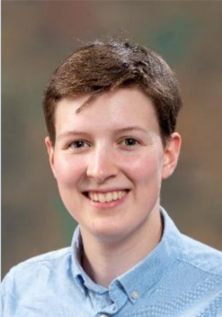



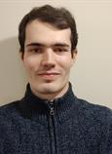
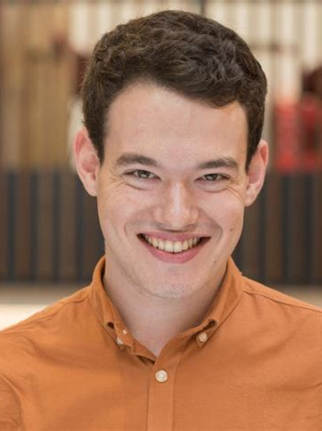
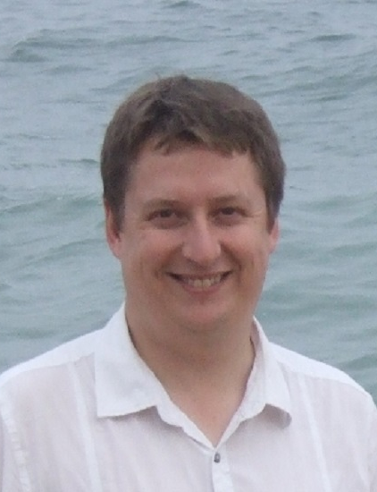
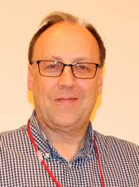
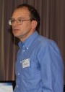
Muon Spectroscopy Computational Project
https://muon-spectroscopy-computational-project.github.io/
Data & Software Engineering
Group SCD
Theoretical and Computational Physics Group - SCD
SCD Graduates:
Joel Davies
Anish Muddaradi
Jyothish Thomas
Samuel Jackson
Adam Laverack
Thomas Dack
Josh Owen
Laura Murgatroyd
Sarah Byrne
LIBORIO
STURNIOLO
CHADWICK
PLUMMER
DAVIES
GONZALEZ-BELTRAN
AUSTIN
Now @ comindTM
Now @ The Carpentries
Muon Group - ISIS
HILLIER
PRATT
COTTRELL
WILKINSON

