Slide 1
Global Biodiversity Information Facility
Erik Kusch – Machine Readable Nature (MANA)
Natural History Museum, University of Oslo
Illustration: GBIF data portal
Living Norway Colloquium | 24th May 2023
Notes:
CC BY 4.0 Global Biodiversity Information Facility; GBIF.org & GBIF.no, Illustration: GBIF data portal, https://www.gbif.org
2022-11-16 Open data course, Living Norway at Finse Alpine Research Station

Slide 2
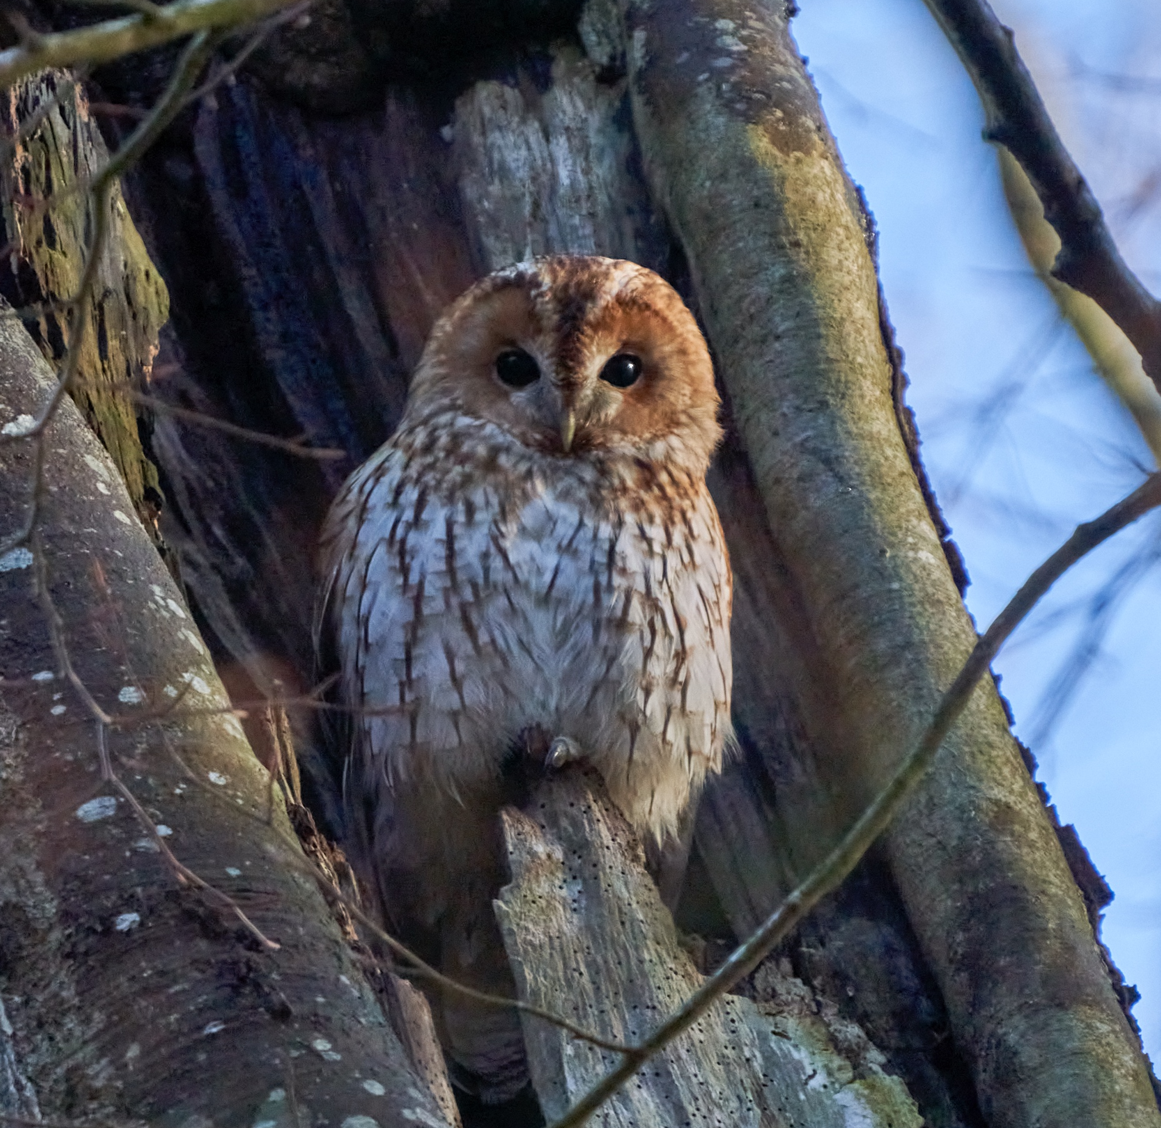
What is GBIF?
Trondheim | 24/05/2023

Slide 3
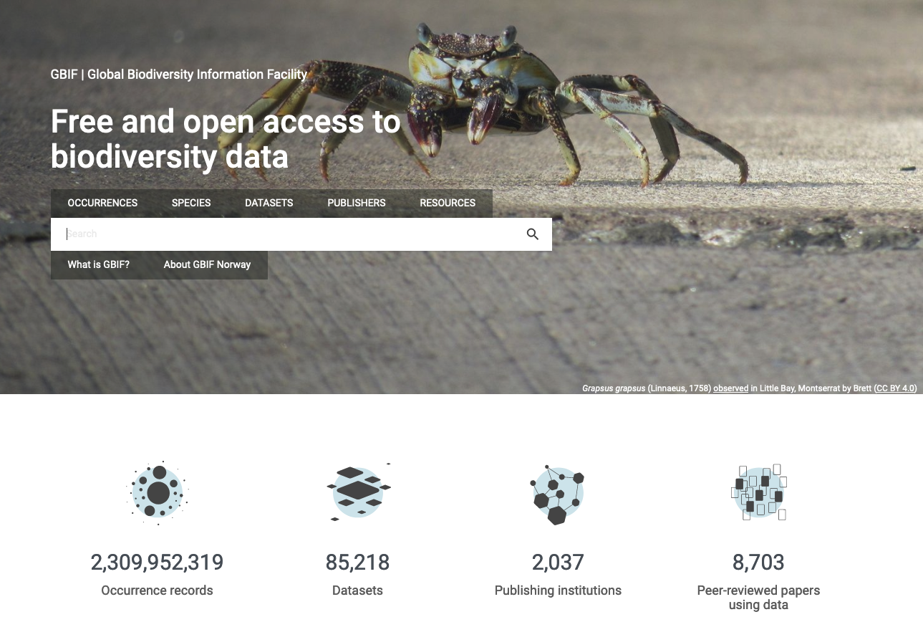
What is gbif?
Intergovernmental network and research infrastructure
Provides anyone, anywhere, free and open access to data about all types of life on Earth
Voluntary collaboration through Memorandum of Understanding (MoU)
Participant nodes, Secretariat in Copenhagen, Denmark
https://www.gbif.org
Notes:
https://www.gbif.org/

Slide 4


BY THE NUMBERS | 3rd May 2023
2 309 951 275
85 215
Datasets
Species occurrence records
2 479
8 703
Peer-review papers
using data
64
43
Country Participants
Organizational Participants
>119 billion
Records downloaded per month in 2022
Publishers
Notes:
A window on biodiversity
An informatics infrastructure focused on tools and standards in service to science and society
A global network on bioinformatics
---
Number of:
Occurrences: https://www.gbif.org/occurrence/search
Participants: https://www.gbif.org/the-gbif-network
Downloads: https://analytics-files.gbif.org/2023-04-01/download/csv/download_fromCountry_year.csv
Datasets: https://www.gbif.org/dataset/search?q=
Publishers: https://www.gbif.org/publisher/search?q=
Peer-review papers: https://www.gbif.org/resource/search?contentType=literature&literatureType=journal&relevance=GBIF_USED&peerReview=true

Slide 5
BY THE NUMBERS | 3rd May 2023
2 309 951 275
85 215
Datasets
Species occurrence records
2 479
8 703
Peer-review papers
using data
64
43
Country Participants
Organizational Participants
>119 billion
Records downloaded per month in 2022
Publishers
Notes:
A window on biodiversity
An informatics infrastructure focused on tools and standards in service to science and society
A global network on bioinformatics
---
Number of:
Occurrences: https://www.gbif.org/occurrence/search
Participants: https://www.gbif.org/the-gbif-network
Downloads: https://analytics-files.gbif.org/2023-04-01/download/csv/download_fromCountry_year.csv
Datasets: https://www.gbif.org/dataset/search?q=
Publishers: https://www.gbif.org/publisher/search?q=
Peer-review papers: https://www.gbif.org/resource/search?contentType=literature&literatureType=journal&relevance=GBIF_USED&peerReview=true

Slide 6
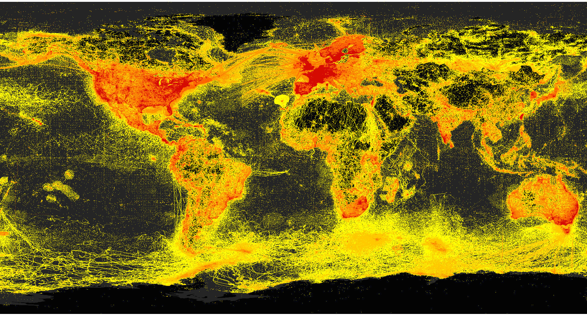
Data From the GBIF Network 3rd May 2023

Slide 7
BY THE NUMBERS | 3rd May 2023
2 309 951 275
85 215
Datasets
Species occurrence records
2 479
8 703
Peer-review papers
using data
64
43
Country Participants
Organizational Participants
>119 billion
Records downloaded per month in 2022
Publishers
Notes:
A window on biodiversity
An informatics infrastructure focused on tools and standards in service to science and society
A global network on bioinformatics
---
Number of:
Occurrences: https://www.gbif.org/occurrence/search
Participants: https://www.gbif.org/the-gbif-network
Downloads: https://analytics-files.gbif.org/2023-04-01/download/csv/download_fromCountry_year.csv
Datasets: https://www.gbif.org/dataset/search?q=
Publishers: https://www.gbif.org/publisher/search?q=
Peer-review papers: https://www.gbif.org/resource/search?contentType=literature&literatureType=journal&relevance=GBIF_USED&peerReview=true

Slide 8
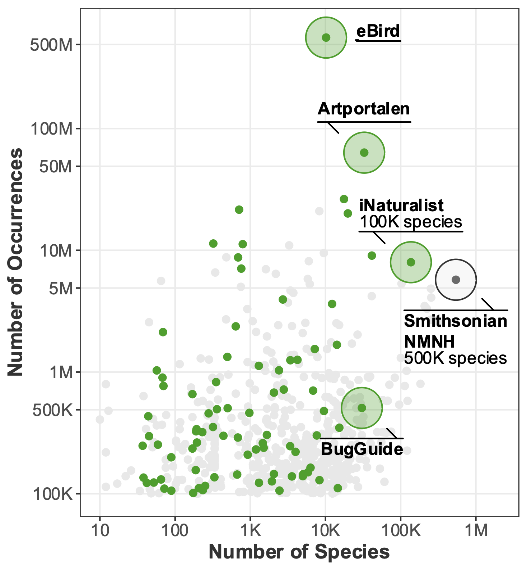
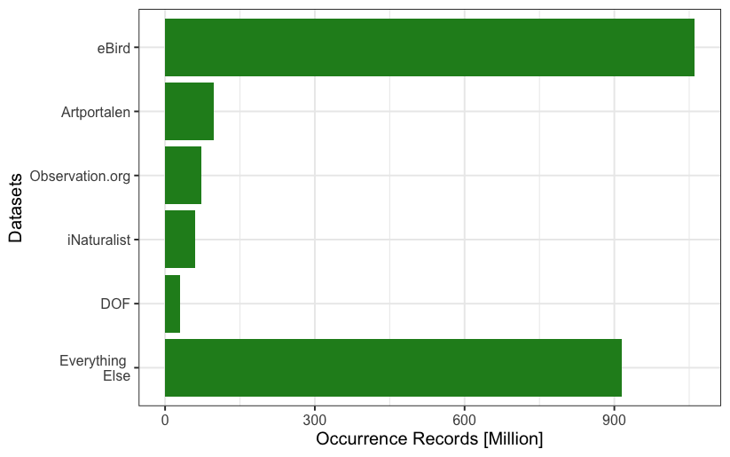
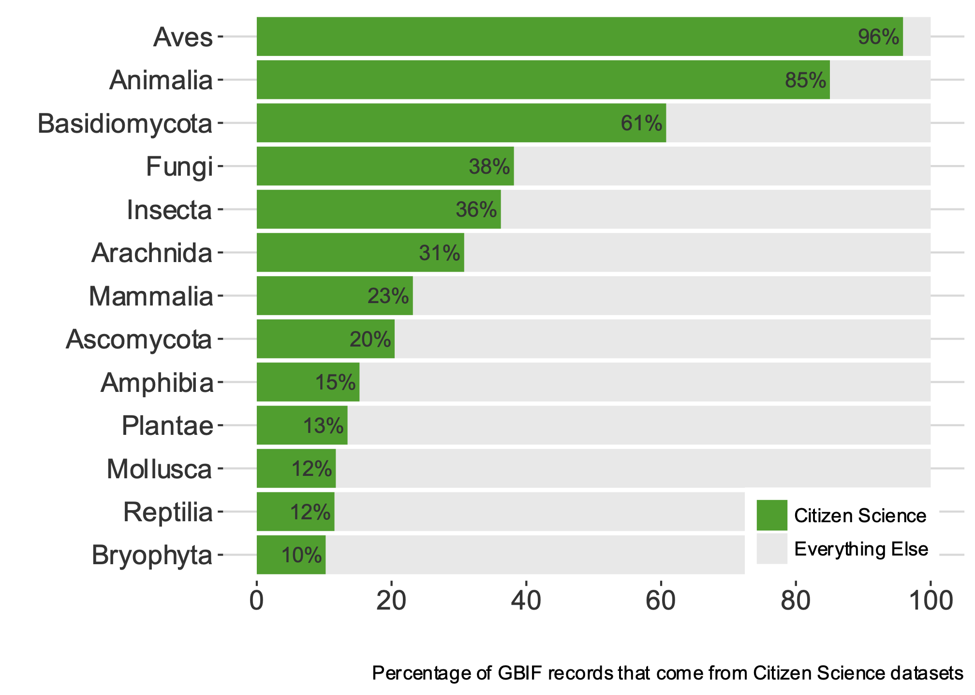
DataSets in GBIF
Notes:
Right-hand panel: https://data-blog.gbif.org/post/citizen-science-on-gbif-2019/
Left-hand panel: download occurrence data set .tsv and make barplot in ggplot2

Slide 9
BY THE NUMBERS | 3rd May 2023
2 309 951 275
85 215
Datasets
Species occurrence records
2 479
8 703
Peer-review papers
using data
64
43
Country Participants
Organizational Participants
>119 billion
Records downloaded per month in 2022
Publishers
Notes:
A window on biodiversity
An informatics infrastructure focused on tools and standards in service to science and society
A global network on bioinformatics
---
Number of:
Occurrences: https://www.gbif.org/occurrence/search
Participants: https://www.gbif.org/the-gbif-network
Downloads: https://analytics-files.gbif.org/2023-04-01/download/csv/download_fromCountry_year.csv
Datasets: https://www.gbif.org/dataset/search?q=
Publishers: https://www.gbif.org/publisher/search?q=
Peer-review papers: https://www.gbif.org/resource/search?contentType=literature&literatureType=journal&relevance=GBIF_USED&peerReview=true

Slide 10
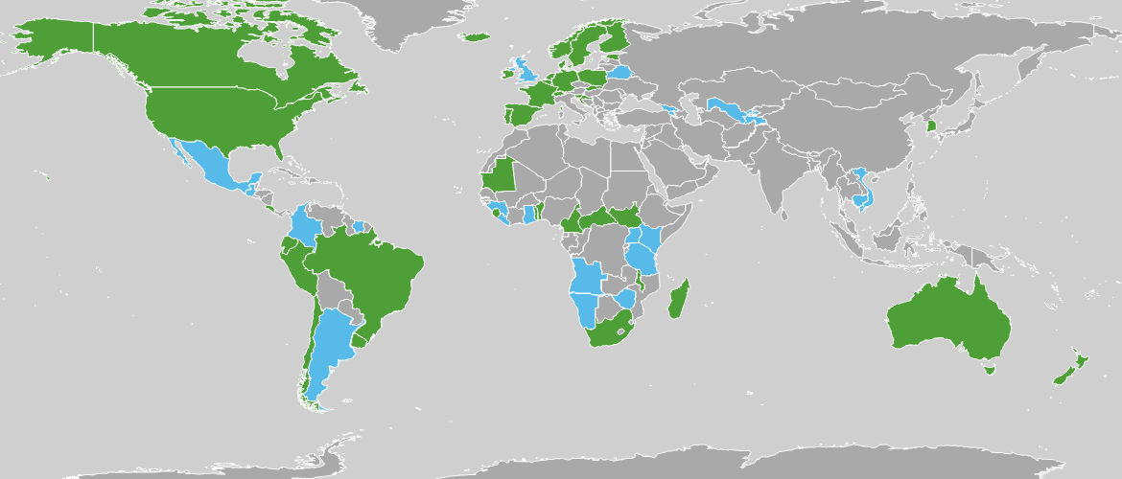

GBIF Participant countries
Map updated 2023-05-03
Notes:
Participation, https://www.gbif.org/the-gbif-network
This map is fully editable. This map is a grouped element of all the countries in the world. All the countries are named correctly and can be accessed and selected via the Selection Pane. There are ways you can edit and make changes to the map. But please remember to always make a copy of the map on your slide and never make changes to the toolkit version. Please take a look at the next few slides to find out different ways of editing this map.

Slide 11

Notes:
https://www.gbif.org

Slide 12

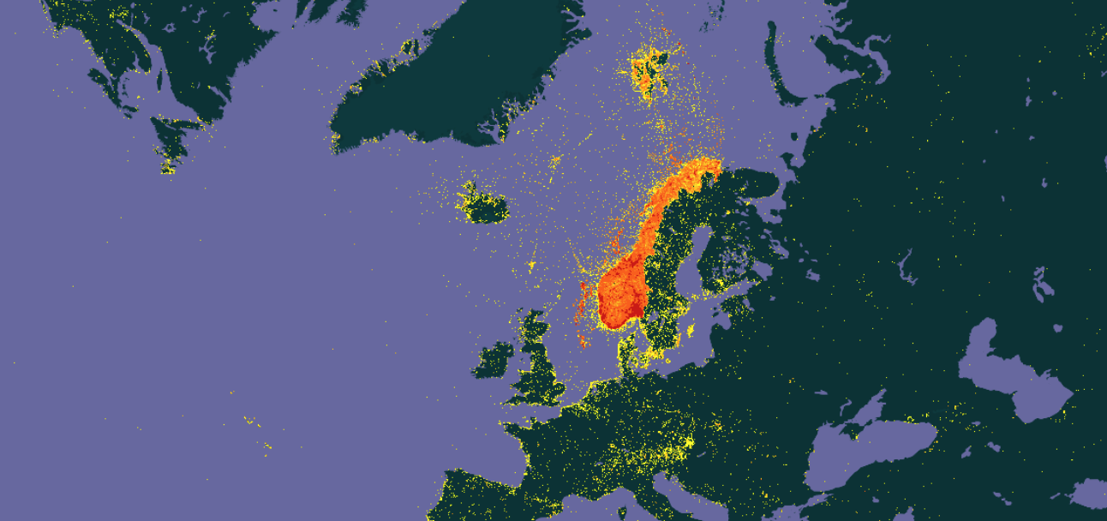
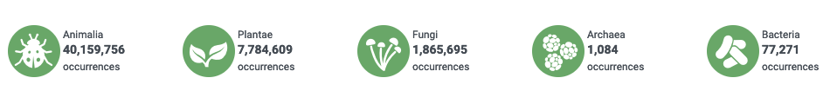

BY THE NUMBERS | 3rd May 2023 - Norway
51 204 452
399
Datasets (published from)
Species occurrence records (published from)
38
213
Peer-review papers
using data (co-author from Norway
Publishers
(from Norway)
Notes:
https://www.gbif.org/country/NO/publishing
https://www.gbif.org/resource/search?contentType=literature&literatureType=journal&relevance=GBIF_USED&countriesOfResearcher=NO&peerReview=true

Slide 13
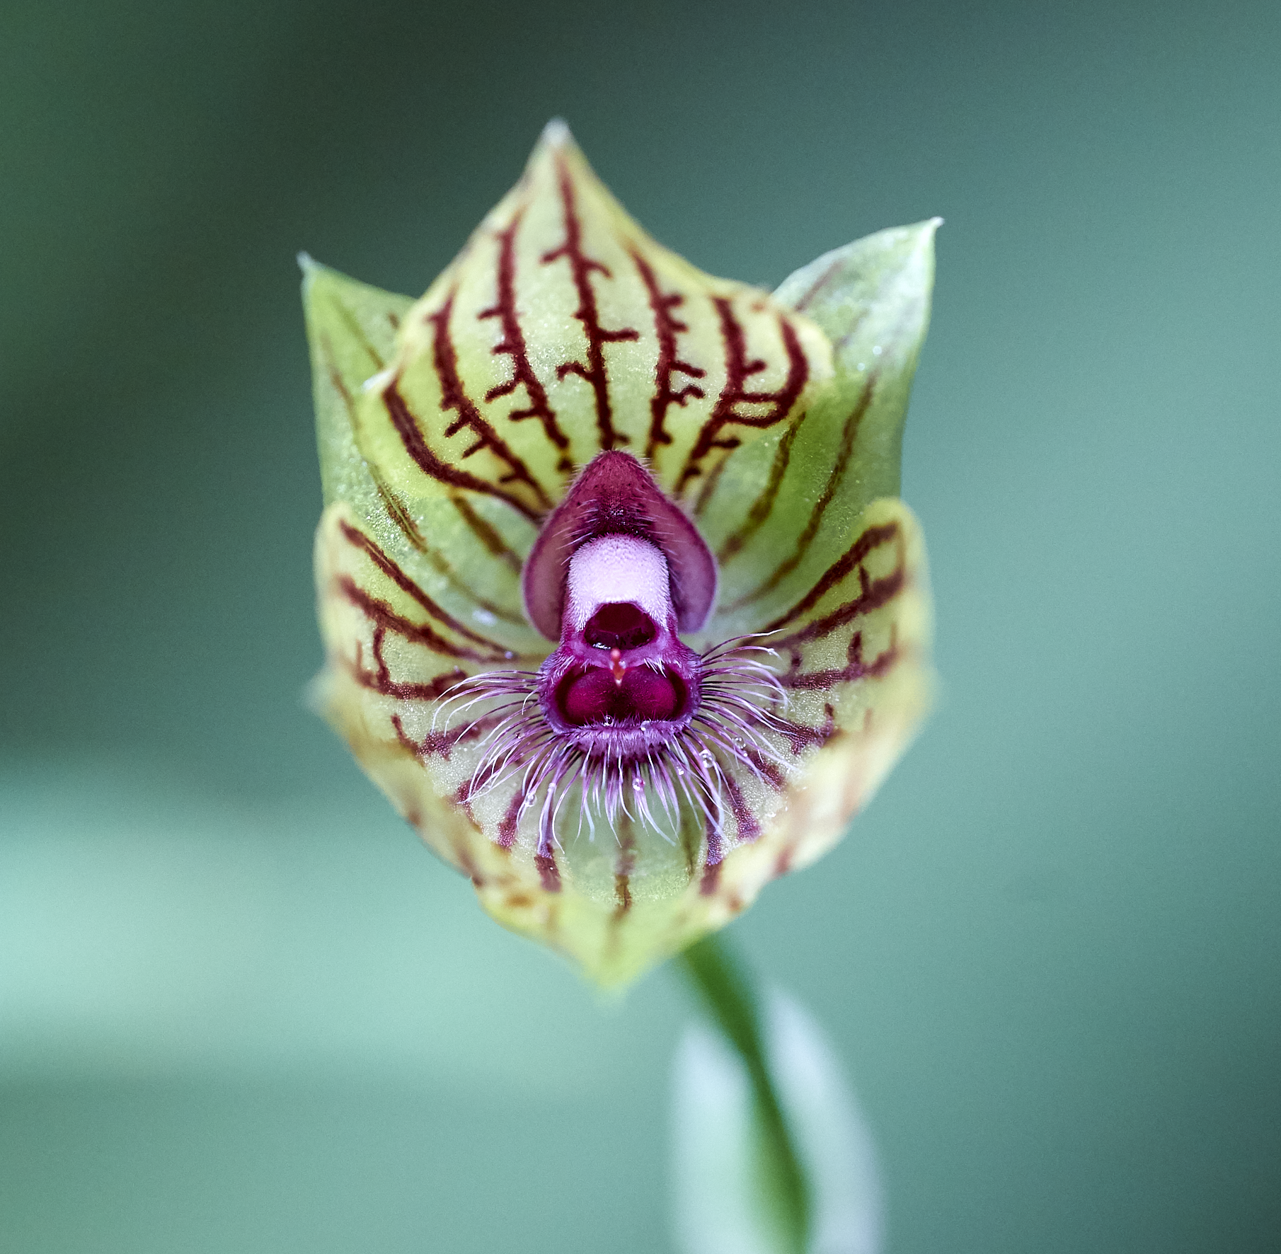
What Data is in GBIF?
Trondheim | 24/05/2023

Slide 14
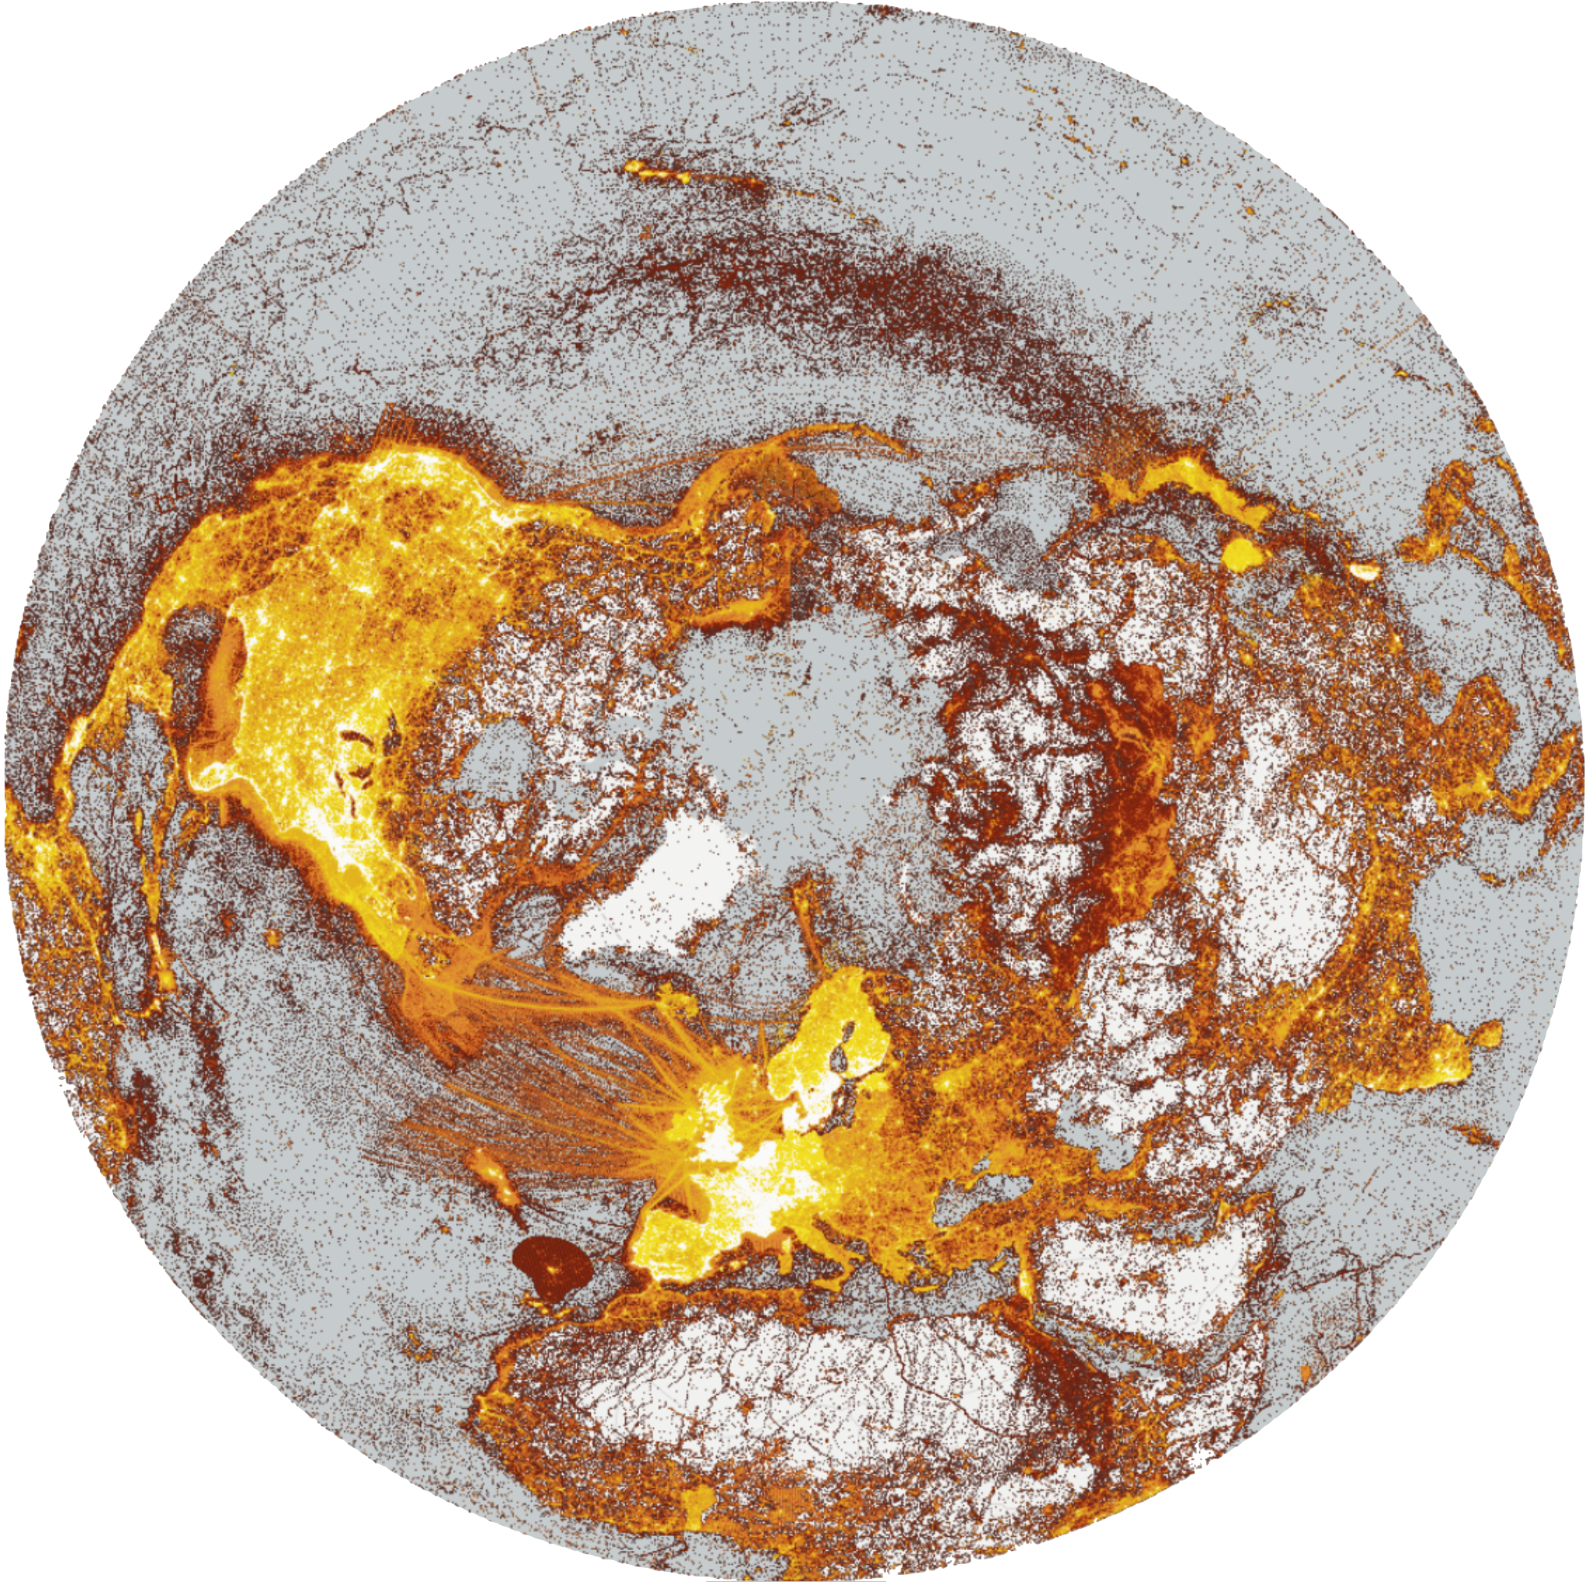







A window on evidence about where species HAVE lived, and when
Observations
Digitized specimens
Data publishing and indexing
Literature
Common standards (DwC)
Remote-sensing
Environmental DNA
Data discovery and use

Slide 15
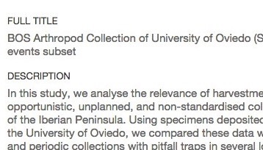
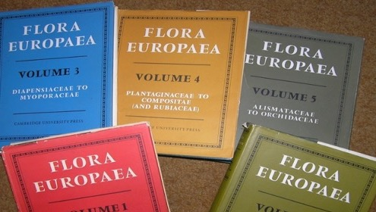

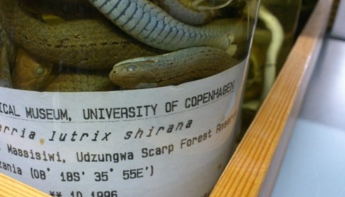
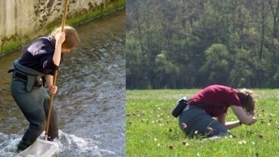
Data richness levels supported by Gbif
Dataset description,
taxonomic/geographic/temporal scope
List of taxa
regional or thematic (e.g. invasive, medicinal)
M
C
Dataset metadata
Species checklists
Species occurrences
dates, coordinates, basis of record
Species occurrences and sampling events
dates, coordinates, sampling effort / protocol, abundance
O
SE
Occurrence-only data
Sampling-event data
Notes:
Four richness levels -- https://www.gbif.org/dataset-classes

Slide 16
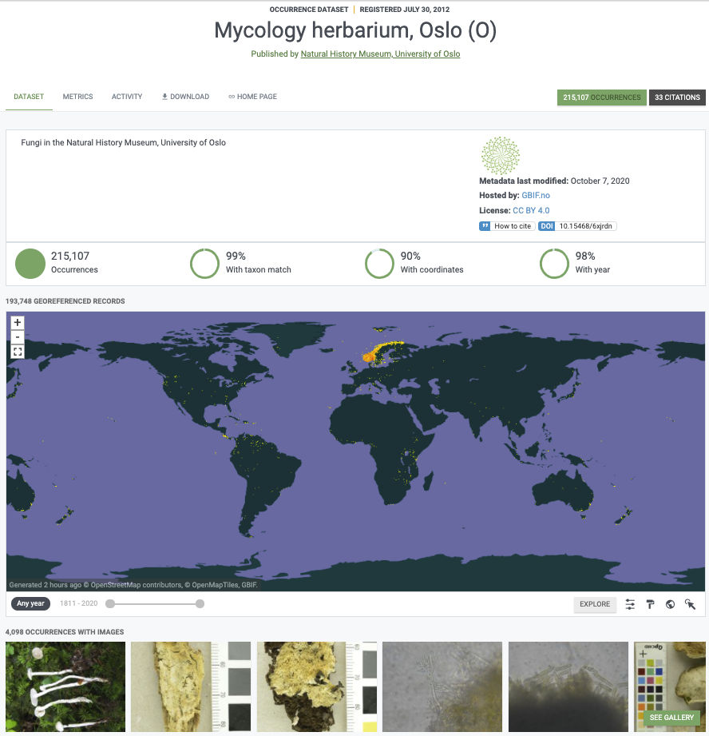
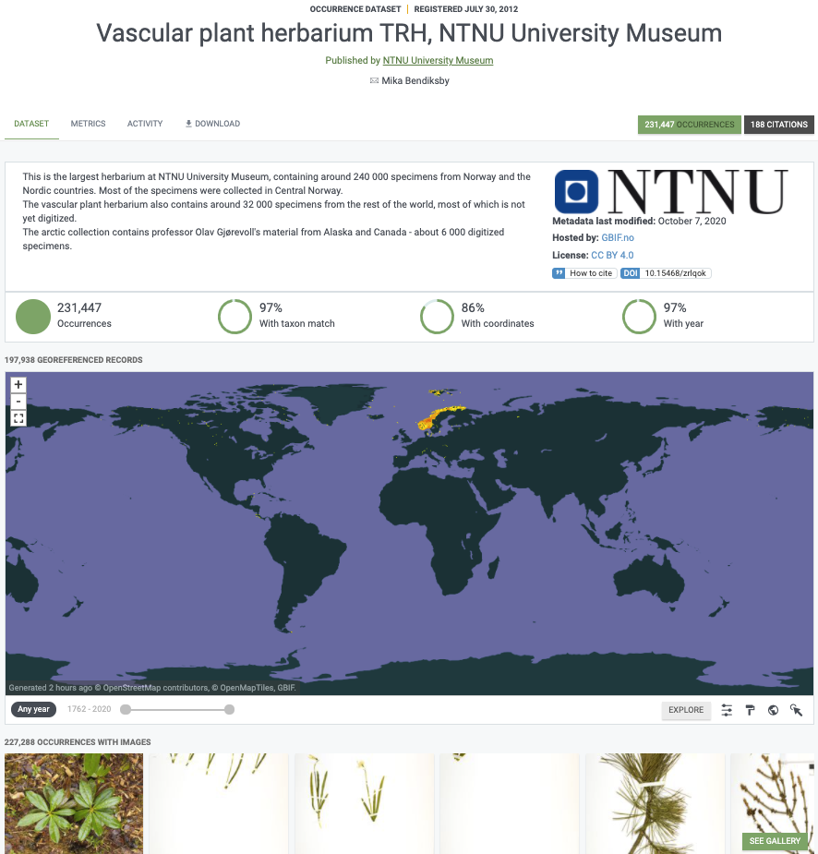
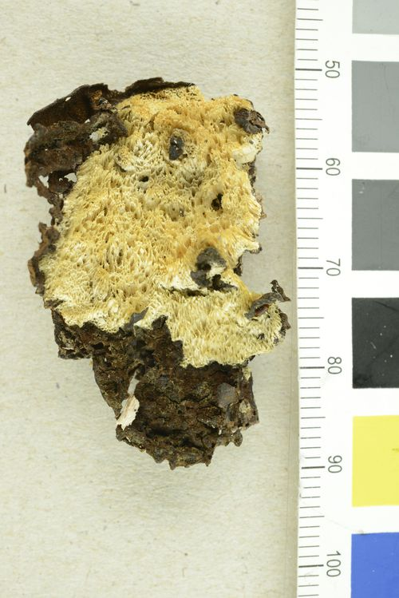
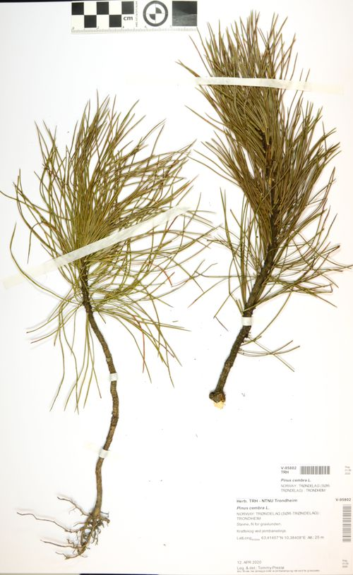
Sources of data in gbiF: digitized Museum collection specimens
Notes:
Museums and other collections
UiO Mycology collection: https://doi.org/10.15468/6xjrdn
NTNU Vascular plants: https://doi.org/10.15468/zrlqok

Slide 17
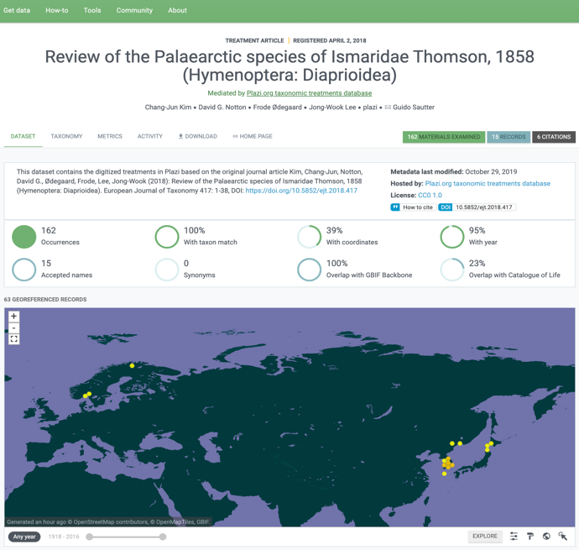
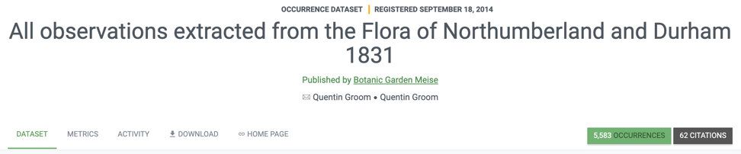
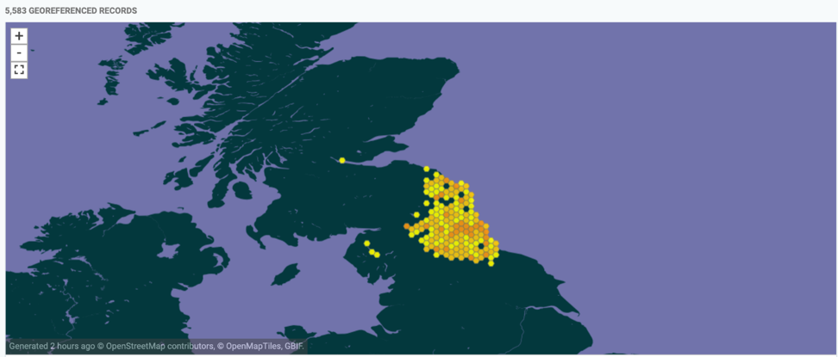
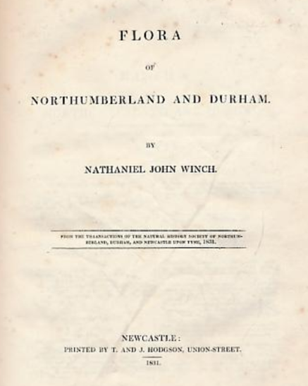



Sources of data in gbiF: taxonomic literature, old and new
Data liberation
Notes:
Taxonomic literature and data liberation
Palaearctic Dataset: https://doi.org/10.5852/ejt.2018.417

Slide 18
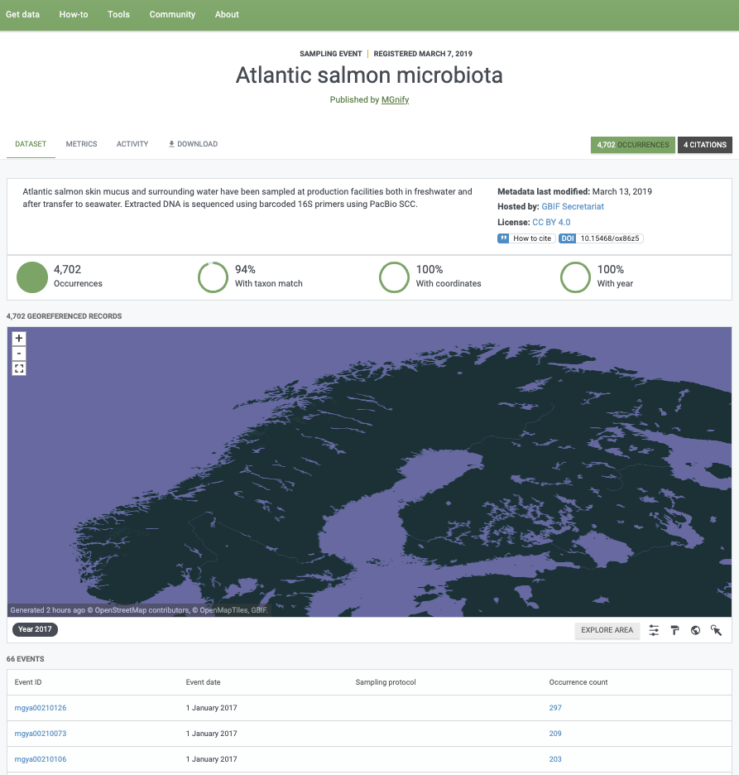



Sources of data in gbiF: DNA sequence-derived occurrence data
Notes:
eDNA, a promise of speed and coverage
MGnify -- Atlantic salmon microbiota: https://doi.org/10.15468/ox86z5
MGnify data publisher: https://www.gbif.org/publisher/ab733144-7043-4e88-bd4f-fca7bf858880

Slide 19
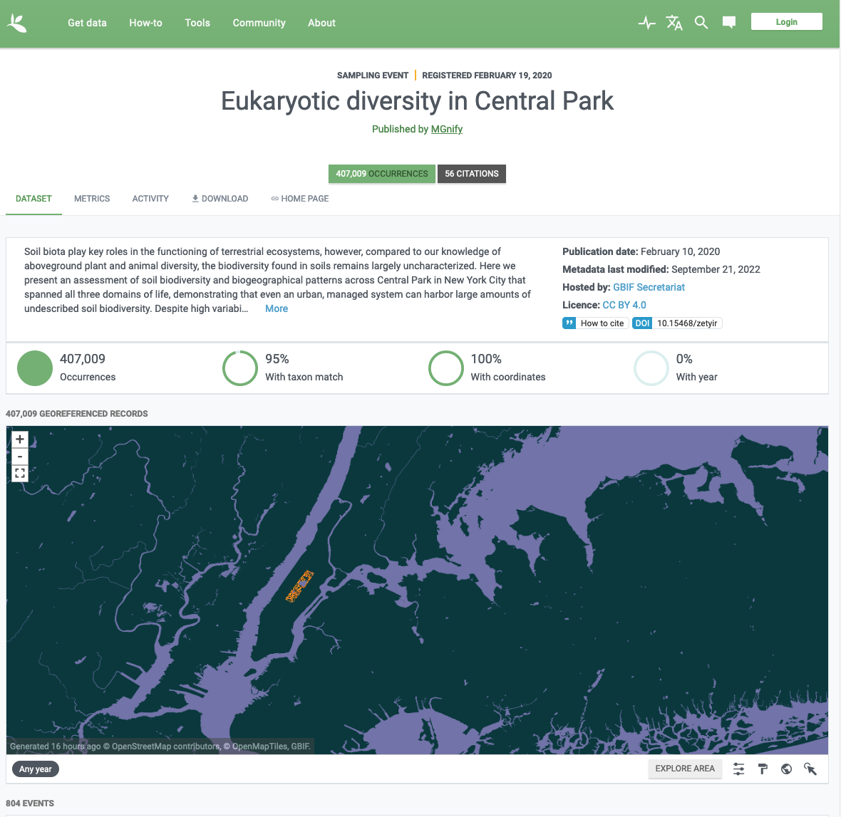
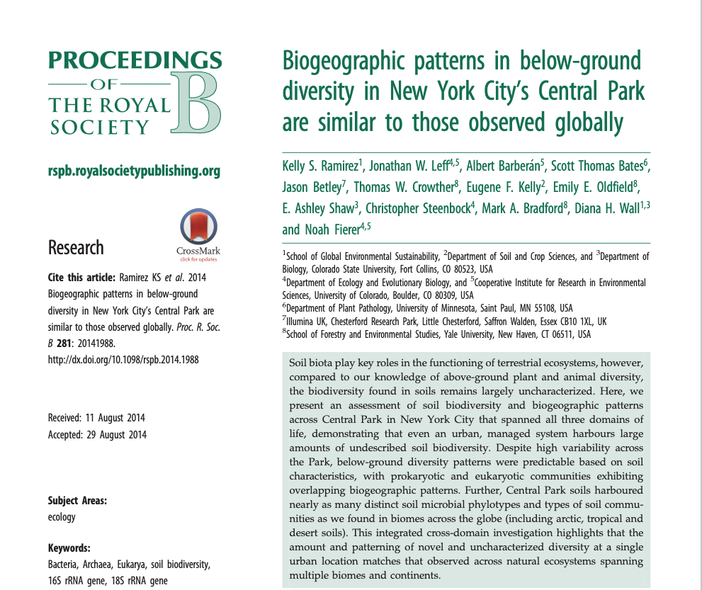
Sources of data in gbiF: Peer-Reviewed Publications
Notes:
https://www.gbif.org/dataset/b57c2b3d-4b95-425a-a324-e11e81d4caf3#description
https://royalsocietypublishing.org/doi/epdf/10.1098/rspb.2014.1988

Slide 20



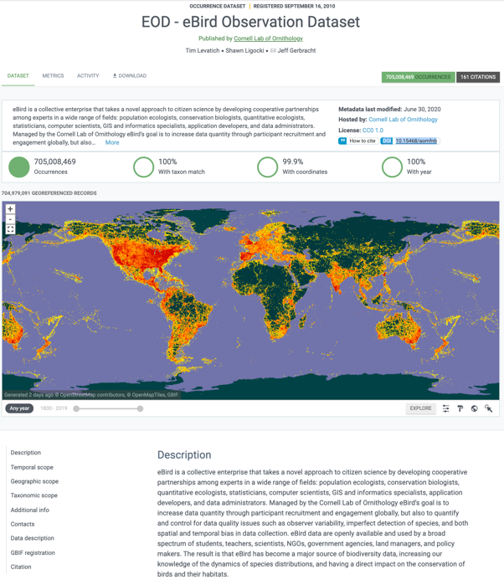
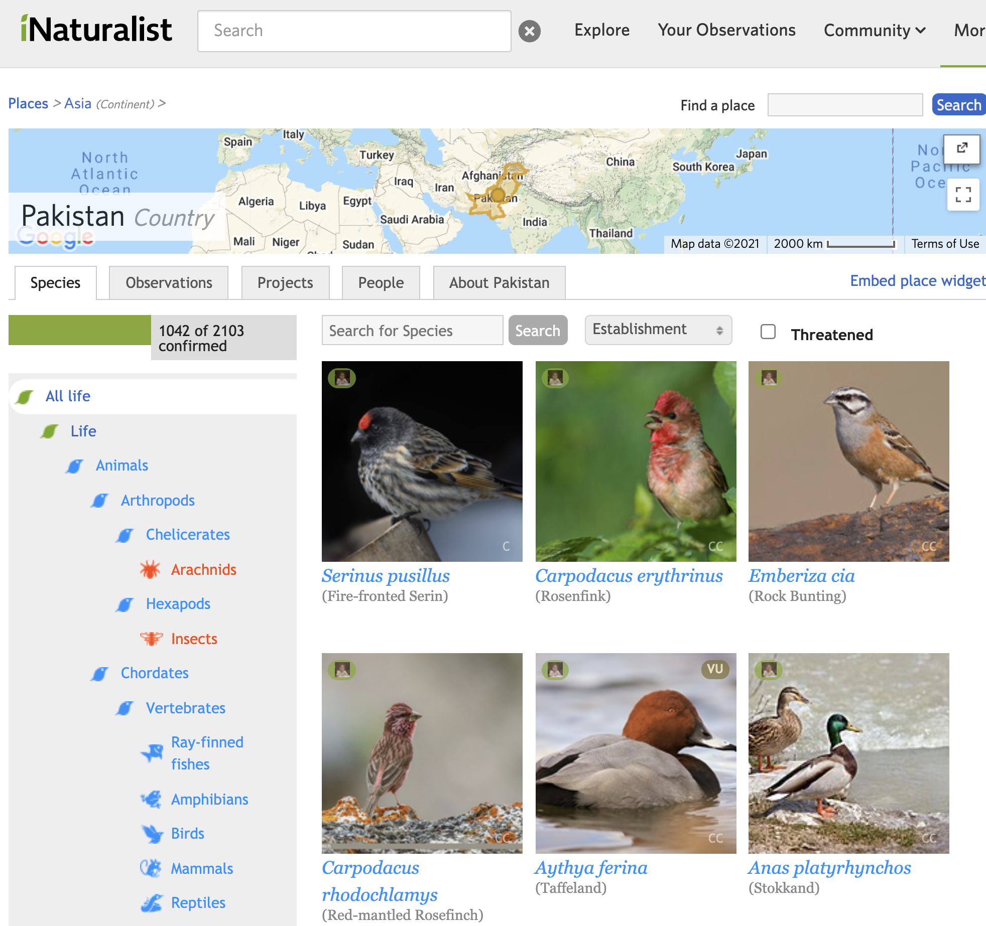
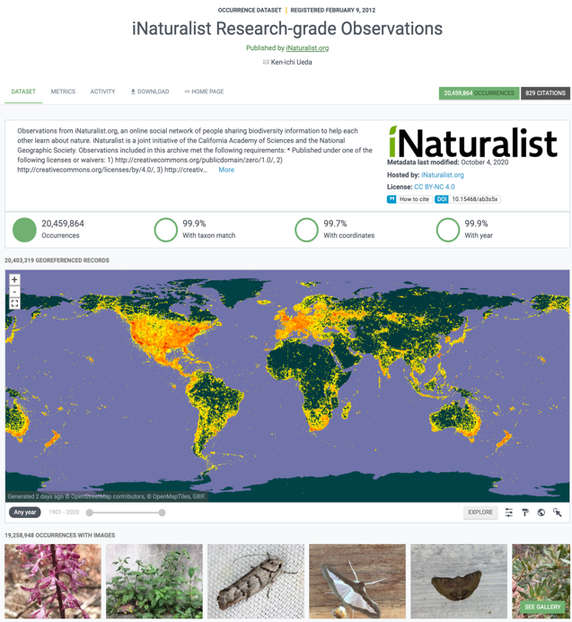
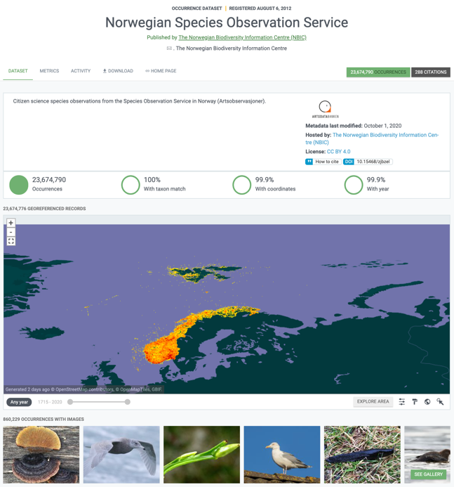
Sources of data in gbiF: citizen science observations
International crowd-sourcing portals
National crowd-sourcing portals
Notes:
Citizen science
eBird: https://doi.org/10.15468/aomfnb
iNaturalist: https://doi.org/10.15468/ab3s5x
iNaturalist Pakistan: https://www.inaturalist.org/places/pakistan
NBIC Artsobservasjoner: https://doi.org/10.15468/zjbzel

Slide 21
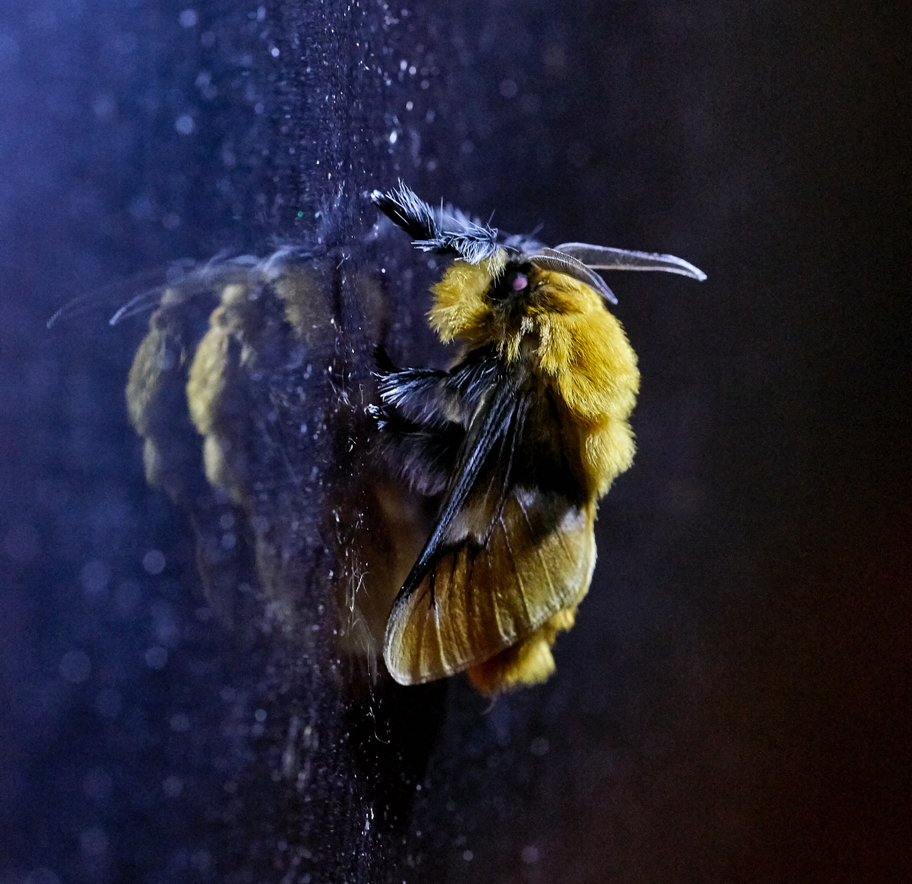
Using GBIF Data
Trondheim | 24/05/2023

Slide 22





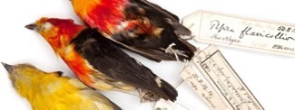












GBIF: Multiple-purpose data publishing services
Environment directive reporting
Darwin Core
Bio-Collections
& ecology datasets
Research data portals
portal
Notes:
One-stop data publishing for data-flow into multiple information systems

Slide 23
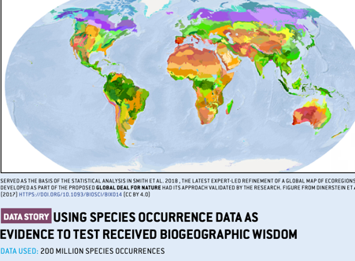
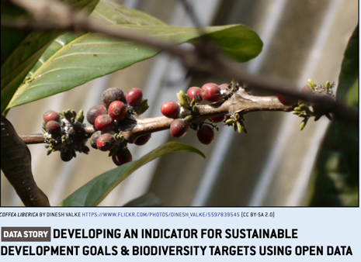
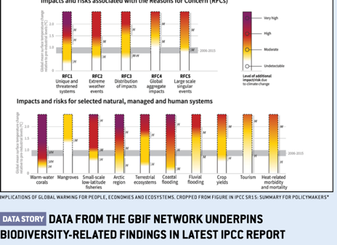
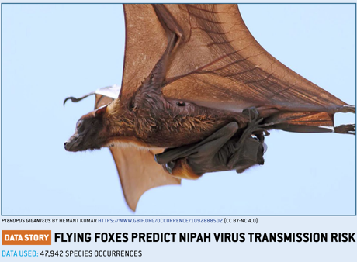
A data resource to support research and sustainable development
Conservation
Protected areas
Threatened species
Invasive species risk
Food Security
Crop wild relatives
In situ, ex situ conservation of genetic diversity
Fisheries planning
Climate change
Modelling impacts on species ranges
Adaptation strategies
Mitigation benefits, risks
Human health
Disease risk based on occurrence of vectors, hosts, reservoirs
Medicinal plants
Hazards e.g. snakebite
Notes:
So we've brought all of this data together, but for what purpose? Through tracking the citations of GBIF in research, and its onward relevance to policy and decisions, we can build up a picture of how all of those involved in sharing standardized data, from the volunteer wildlife observer to researchers and museum curators, are contributing to the knowledge that supports better decisions for our planet and our societies. Just some examples:
- Data shared through GBIF supports CONSERVATION, by helping to identify the most important sites for protected areas; by underpinning assessment of species extinction risk through the Red Listing process; and by tracking the actual and predicted spread of invasive alien species.
- Data shared through GBIF supports FOOD SECURITY, by mapping the distribution of the wild relatives of the most important food crops, and therefore the location of the genetic resources that need to be conserved for future plant breeding; and by providing information on both marine and freshwater fish species - along with other wild species important for nutrition.
- Data shared through GBIF supports action on CLIMATE CHANGE, through helping to model how species ranges will change under different climate change scenarios, informing strategies to adapt to climate change, and assessing the impacts of measures to mitigate climate change, for example increased production of biofuels and hydropower.
- And finally, data shared through GBIF supports HUMAN HEALTH, by tracking the distribution of species that act as vectors, hosts and reservoirs of human diseases; by helping to map medicinal plant species, and by assessing risks posted by significant public health hazards such as snakebite.

Slide 24
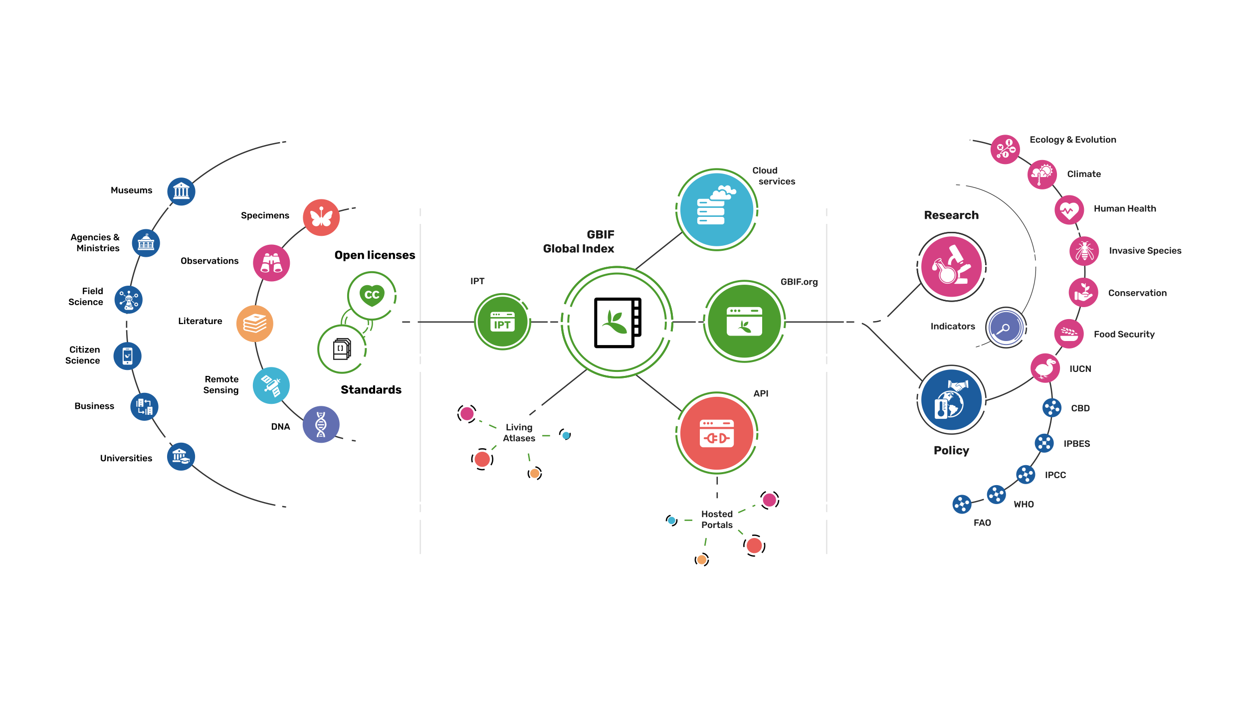
Providing biodiversity Evidence for research and policy

Slide 25
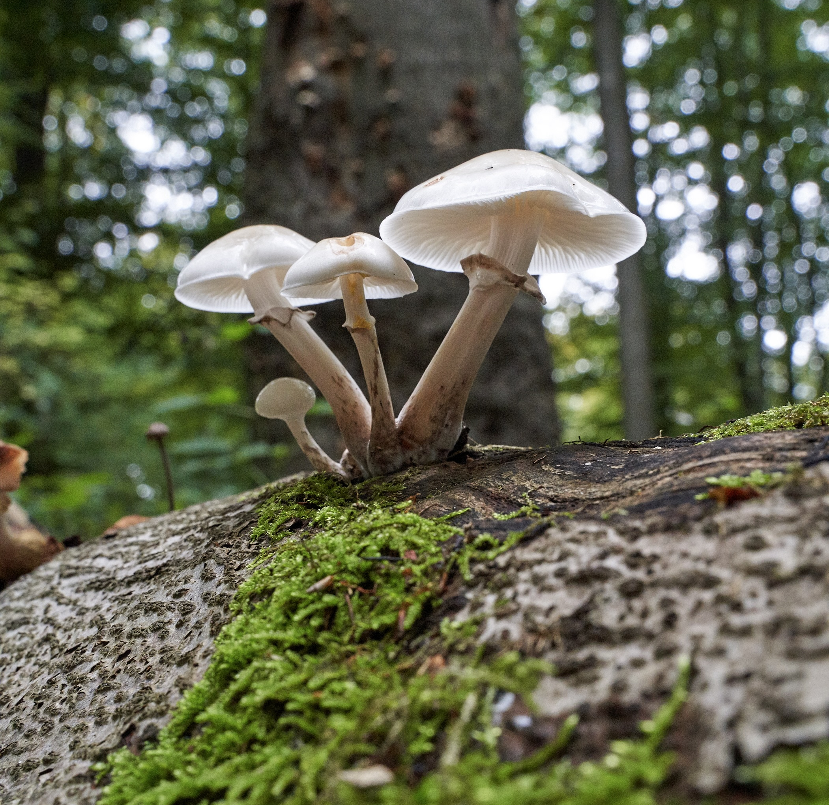
GBIF Data Considerations
Trondheim | 24/05/2023

Slide 26
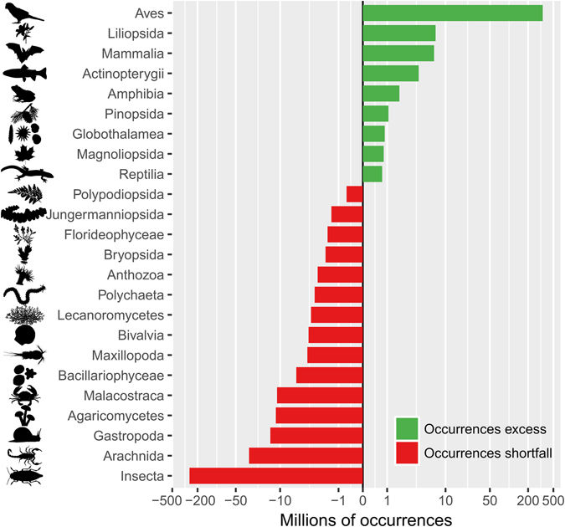


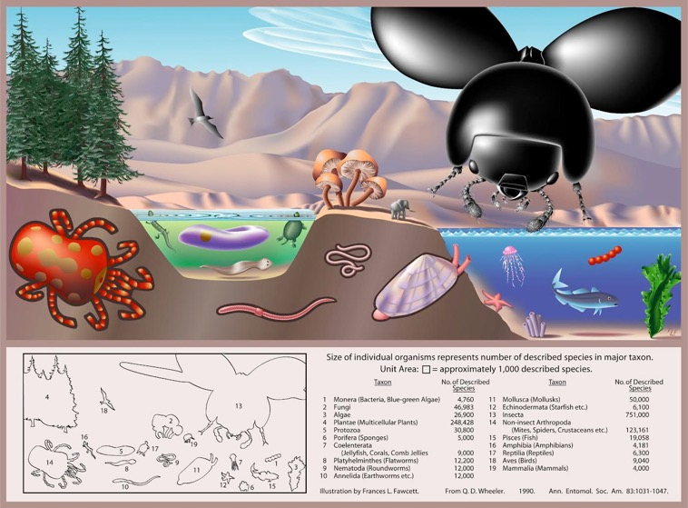
Global biodiversity vs. digitally available data
1200 mill.
animals
300 m
plants
20 m
fungi
16 m
bacteria
0,04 m
virus
Troudet et al. Nature Scientific Reports 2017
Image: FL Fawcett in Wheller Ann. Entomol. Soc. Am. 1990
Taxonomic bias towards birds and against insects and small organisms

Slide 27
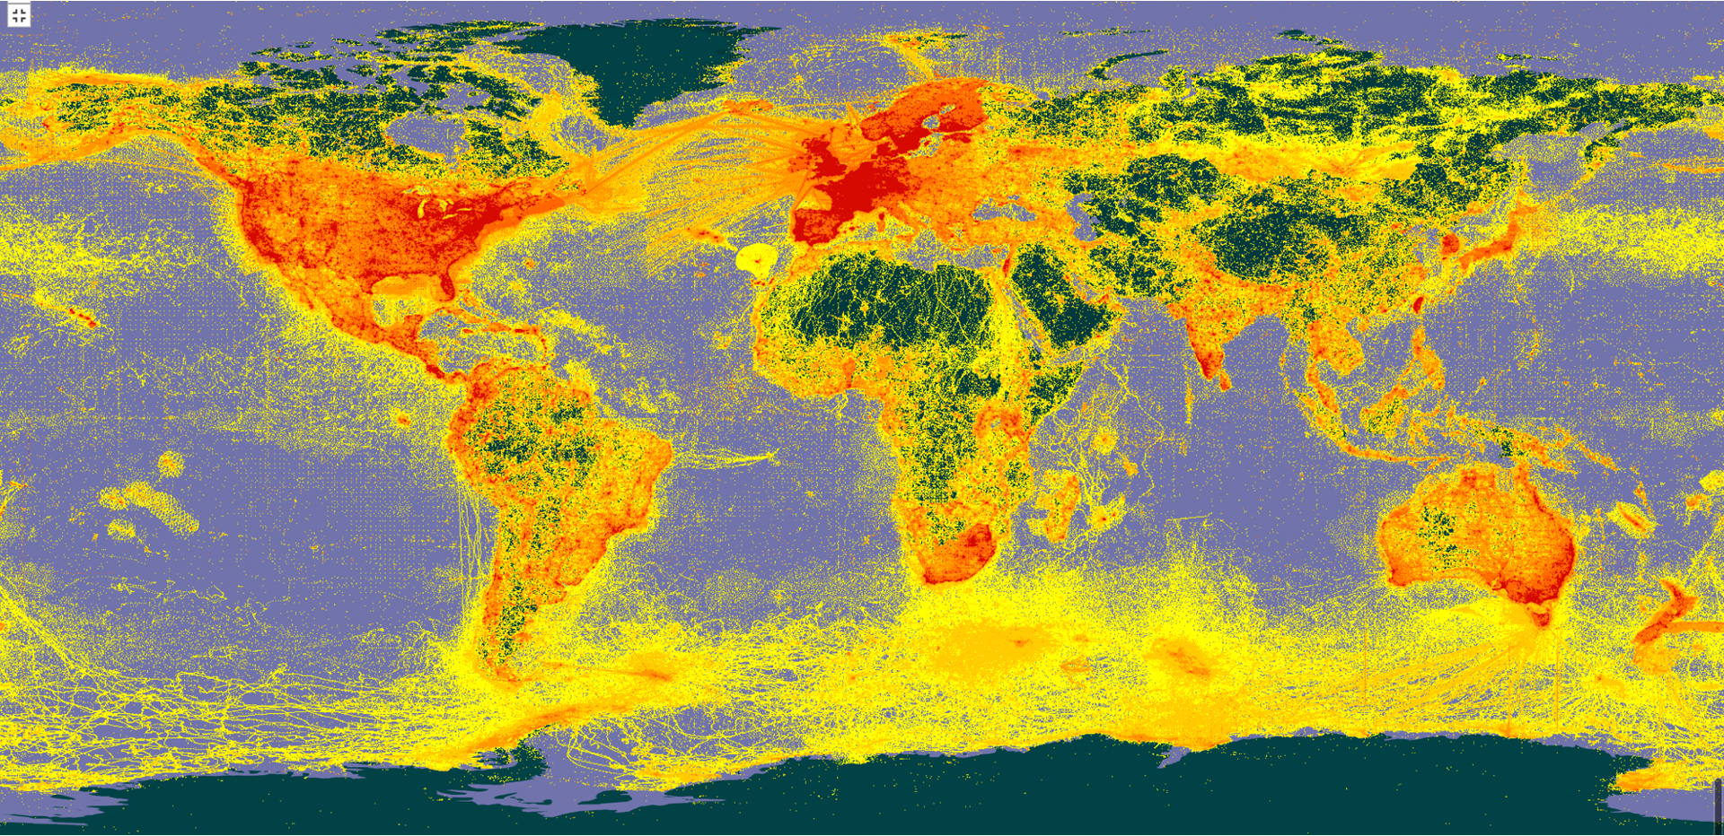
DATA BIASES
taxonomic bias: some species being more reported than others
temporal bias: more data from certain periods
sampling bias: some areas being sampled more than others

Slide 28
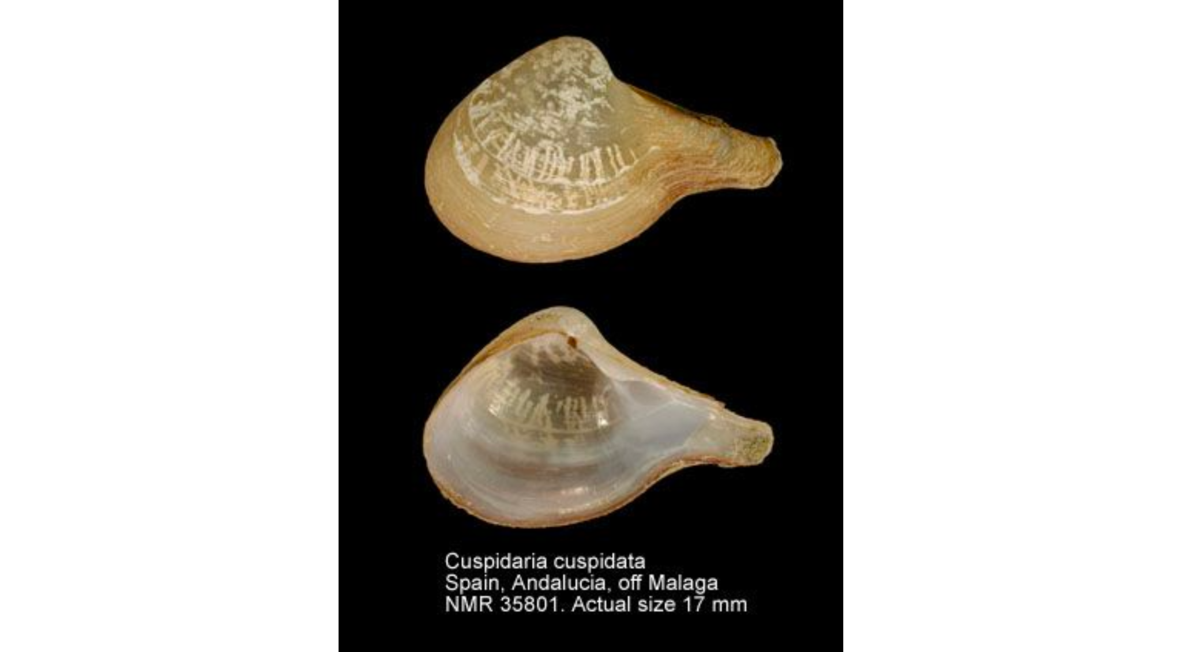
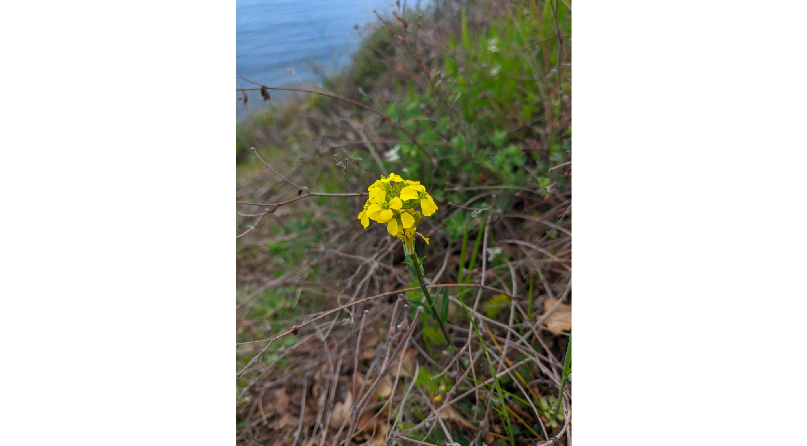
(ART AND SCIENCE) OF TAXONOMY
Taxonomic homonyms: when filtering based on scientific name, check if all the results are in the same part of taxonomic tree (at least kingdom)
Cuspidaria cuspidata (Olivi, 1792)
Cuspidaria cuspidata (M. Bieb.) Takht.

Slide 29
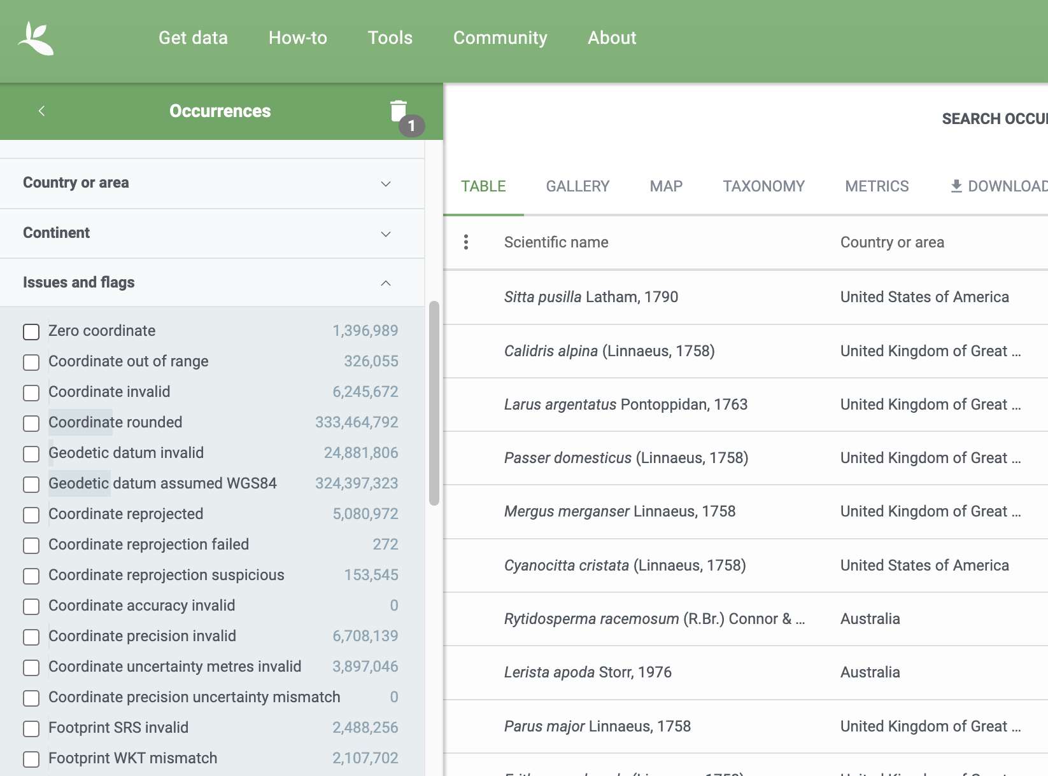
DATA ISSUES AND FLAGS
Suite of flags for determining data quality
The ones to look for especially
  Taxon match fuzzy
  Taxon match higherrank
  Coordinate rounded

Slide 30
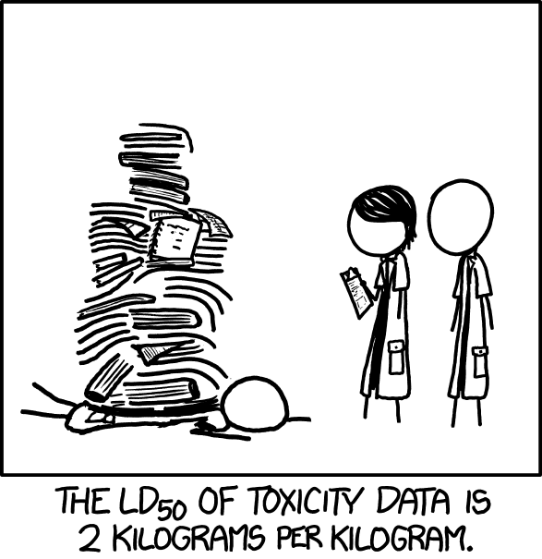
DATA SIZE
The size of the dataset you download can be substantial, depending on the extent of your query. Ensure you have the necessary storage and computational resources to handle the data.
Consider using BigQuerry or Apache Spark for interactions with really big data

Slide 31
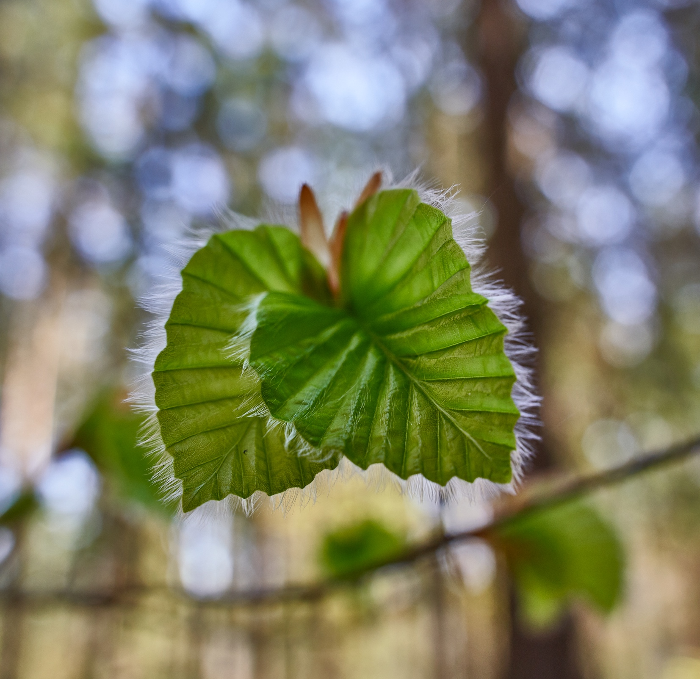
Accessing GBIF Data
Trondheim | 24/05/2023

Slide 32
BY THE NUMBERS | 3rd May 2023
2 309 951 275
85 215
Datasets
Species occurrence records
2 479
8 703
Peer-review papers
using data
64
43
Country Participants
Organizational Participants
>119 billion
Records downloaded per month in 2022
Publishers
Notes:
A window on biodiversity
An informatics infrastructure focused on tools and standards in service to science and society
A global network on bioinformatics
---
Number of:
Occurrences: https://www.gbif.org/occurrence/search
Participants: https://www.gbif.org/the-gbif-network
Downloads: https://analytics-files.gbif.org/2023-04-01/download/csv/download_fromCountry_year.csv
Datasets: https://www.gbif.org/dataset/search?q=
Publishers: https://www.gbif.org/publisher/search?q=
Peer-review papers: https://www.gbif.org/resource/search?contentType=literature&literatureType=journal&relevance=GBIF_USED&peerReview=true

Slide 33
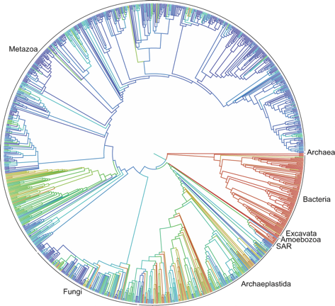
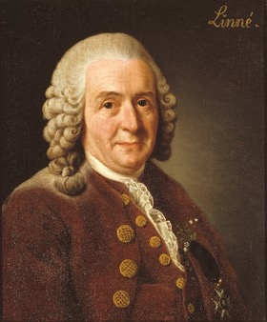
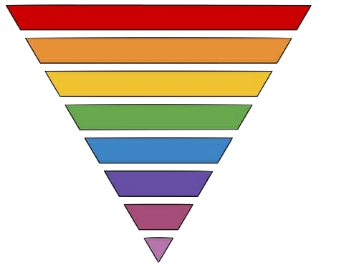
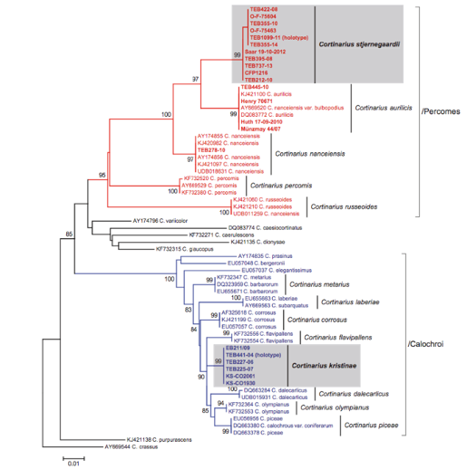
How are Data indexed in GBIF?
PhyloCode
Domain (Eukarya)
Phylum (Chordata)
Order (Primates)
Genus (Homo)
Species (Homo sapiens)
Family (Hominidae)
Class (Mammalia)
Kingdom (Animalia)
GBIF translates traditional nomenclature into Operational Taxonomic Units (OTUs)
Notes:
From Codes to OTUs
Algae, Fungi and Plants – International Code of Nomenclature for algae, fungi, and plants (ICN), which in July 2011 replaced the International Code of Botanical Nomenclature (ICBN) and the earlier International Rules of Botanical Nomenclature.
Animals – International Code of Zoological Nomenclature (ICZN)
Bacteria and Archaea – International Code of Nomenclature of Prokaryotes (ICNP), which in 2008 replaced the International Code of Nomenclature of Bacteria (ICNB)
Cultivated plants – International Code of Nomenclature for Cultivated Plants (ICNCP)
Plant associations – International Code of Phytosociological Nomenclature (ICPN)
Viruses – The International Code of Virus Classification and Nomenclature (ICVCN); see also virus classification
PhyloCode

Slide 34





OTUs and the GBIF Backbone
Species Hypothesis (SH) numbers [DOI]
Barcode Identification Number (BIN)
GBIF
backbone taxonomy
SH ABC0001
BIN DEF0002
Notes:
GBIF is integrating OTUs to the taxonomic backbone. OTU = Operational Taxonomic Unit
https://www.gbif.org/news/2UfGq1L6iXbSu0ElamvVlH/gbif-introduces-new-version-of-the-backbone-taxonomy (News item 2019-09-25)
https://www.gbif.org/news/2LrgV5t3ZuGeU2WIymSEuk/adding-sequence-based-identifiers-to-backbone-taxonomy-reveals-dark-taxa-fungi (News item 2018-08-29)
https://data-blog.gbif.org/post/gbif-molecular-data/ (Blog post 2019-04-24)
https://data-blog.gbif.org/post/gbif-molecular-data-quality/ (Blog post 2019-04-26)
UNITE OTU SH checklist: https://doi.org/10.15468/mkpcy3 (2018)
iBOL BIN checklist: https://doi.org/10.15468/wvfqoi (2019)

Slide 35


Machine-Readability requires persistent identifiers
The purpose of identifiers is
… to name things
… making it possible to refer to them
To uniquely identify something it needs a persistent identifier, a PID.
A Persistent Identifier is globally unique, persistent, and resolvable“.
A PID is resolvable when it allows both human and machine users to access an object or its representation, and its Kernel Information.
Kernel Information is a structured record that contains information (metadata) about the referred object, such as a pointer to the location where the data for the object can be found.

Slide 36

FAIR data is about machine-readable data
researchers & museums need to do more than simply post their data on the web for it to be re-usable.
Notes:
Wilkinson et al. 2016 doi:10.1038/sdata.2016.18
Global Biodiversity Information Facility (GBIF) provides certified FAIR data sharing for all biodiversity datasets
Distributed System of Scientific Collections (DiSSCo) will implement FAIR data principles for natural history collections

Slide 37



GBIF & Identifiers
Dataset: Vascular Plant Herbarium, Oslo (O) UiO
Publisher: University of Oslo
Catalogue number: 2007334

Slide 38


Discovering DatA in GBIF – The Data Portal
GBIF trawling for data via GBIF Data Portal
Search can be refined via filters
Dataset metadata
Occurrence-only data
Sampling-event data
Species checklists

Slide 39



Downloading GBIF Data – The Data Portal
Download through the GBIF Data Portal is a three-step process:
Select desired data
Stage download & wait for GBIF to finish processing
Download final product

Slide 40



Discovering & Downloading GBIF Data – Programmatic Solutions
Discovery & Download takes four R function calls:
occ_search(…)
occ_download(…)
occ_download_get(…)
occ_download_import(…)

Slide 41

We store all download files as long as possible.
The download metadata page will always resolve, but the file itself might be removed in the future.
We strive to store all downloads, but prioritize downloads that have been cited.

Slide 42

Accrediting GBIF Data
Trondheim | 24/05/2023

Slide 43
BY THE NUMBERS | 3rd May 2023
2 309 951 275
85 215
Datasets
Species occurrence records
2 479
8 703
Peer-review papers
using data
64
43
Country Participants
Organizational Participants
>119 billion
Records downloaded per month in 2022
Publishers
Notes:
A window on biodiversity
An informatics infrastructure focused on tools and standards in service to science and society
A global network on bioinformatics
---
Number of:
Occurrences: https://www.gbif.org/occurrence/search
Participants: https://www.gbif.org/the-gbif-network
Downloads: https://analytics-files.gbif.org/2023-04-01/download/csv/download_fromCountry_year.csv
Datasets: https://www.gbif.org/dataset/search?q=
Publishers: https://www.gbif.org/publisher/search?q=
Peer-review papers: https://www.gbif.org/resource/search?contentType=literature&literatureType=journal&relevance=GBIF_USED&peerReview=true

Slide 44
How to cite Data mediated by GBIF ata citation
Download data from GBIF.org
and receive recommended citation with a download DOI
Cite the DOI in published research or other work
Example: GBIF.org (9 November 2021) GBIF Occurrence Download https//doi.org/10.15468/dl.xxxxxx
#CiteTheDOI
Notes:
How to cite data

Slide 45


DOWNLOADS AND DATASETS ARE AUTOMATICALLY ASSIGNED DOIs
Citing the data download DOI will resolve to the dataset DOIs assigned for each dataset contributing data records to the download set.
This way, all data publishers contributing data records will be accredited!

Slide 46


Incentive for data reuse
To incentivize the sharing of useful data, the scientific enterprise needs a well-defined system that links individuals with reuse of data sets they generate
Pierce et al. Credit data generators for data reuse, Nature 6 June 2019
Notes:
Pierce HH, Dev A, Statham E, Bierer BE. (2019) Credit data generators for data reuse. Nature. 2019 Jun;570(7759):30-32. doi: 10.1038/d41586-019-01715-4. https://doi.org/10.1038/d41586-019-01715-4

Slide 47


#CiteTheDOI
GBIF started issuing DOIs on 3 February 2015
Notes:
#CiteTheDOI
GBIF started issuing DOIs on 3 February 2015
https://www.gbif.org/citation-guidelines

Slide 48






















Dataset DOIs
Download DOI
Bibliographic DOI
institutionID
Source dataset #1
collectionID
GBIF download
Publish datasets in GBIF
Analyze & publish
Filter & download
Source dataset #2
materialSampleID
Process & archive
Source dataset #3
Final state of data
identifiedByID
Notes:
Data matrix specimen QR code example = urn:catalog:O:V:588570 | https://www.gbif.org/occurrence/1995319615 | urn:uuid:7EF1DC56-E74D-11E4-99DF-00155D012A60

Slide 49
Dataset DOIs
Download DOI
Bibliographic DOI
institutionID
Source dataset #1
collectionID
GBIF download
Publish datasets in GBIF
Analyze & publish
Filter & download
Source dataset #2
materialSampleID
Process & archive
Source dataset #3
Final state of data
identifiedByID
Notes:
Data matrix specimen QR code example = urn:catalog:O:V:588570 | https://www.gbif.org/occurrence/1995319615 | urn:uuid:7EF1DC56-E74D-11E4-99DF-00155D012A60

Slide 50
Dataset DOIs
Download DOI
Bibliographic DOI
institutionID
Source dataset #1
collectionID
GBIF download
Publish datasets in GBIF
Analyze & publish
Filter & download
Source dataset #2
materialSampleID
Process & archive
Source dataset #3
Final state of data
identifiedByID
Notes:
Data matrix specimen QR code example = urn:catalog:O:V:588570 | https://www.gbif.org/occurrence/1995319615 | urn:uuid:7EF1DC56-E74D-11E4-99DF-00155D012A60

Slide 51




ROR for museums
ORCID for curators
DOI for datasets
(GRSciColl UUID for collections)
will enable the linking of museum collection specimens to scientific litterature and scientific actors (authors, curators, etc)
Digital Object Identifier (DOI)
Open Researcher and Contributor ID (ORCID)
Research Organisation Registry (ROR)
Notes:
Digital Object Identifier (DOI) - https://doi.org/
Open Researcher and Contributor ID (ORCID) - https://orcid.org/
Research Organisation Registry (ROR) - https://ror.org/ (start in early 2019)
https://dissco.tech/2020/04/11/identifiers-for-our-institutes-grid-and-ror/
https://en.wikipedia.org/wiki/Research_Organization_Registry
http://www.wikidata.org/entity/Q63565260

Slide 52

Erik Kusch | erik.kusch@nhm.uio.no
Senior Engineer Machine Readable Nature Research Group - MANA Department of Research and Collections Natural History Museum University of Oslo

