Slide 1
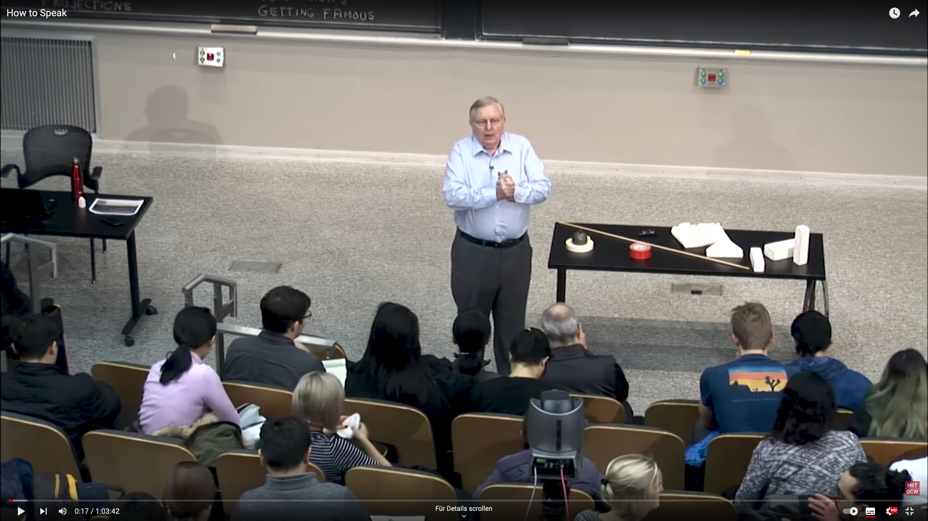

Slide 2





Deformation forecasts from the SIDFEx database
V. Ludwig, H. Goessling and the SIDFEx team*
IGS 2023
Bremerhaven
June 6th, 2023
*Helge Goessling, Ed Blockley, Axel Schweiger, Valentin Ludwig, Ed Blanchard-Wrigglesworth, Thomas Krumpen, Marcel Nicolaus, Ignatius Rigor, Bob Grumbine, Frank Kauker, Simon Reifenberg, Wendy Ermold, François Massonnet, Quentin Dalaiden, Pam Posey, Joe Metzger, Michael Phelps, Rick Allard, Laurent Bertino, Malte Müller, Maxime Beauchamp, Amy Solomon, Janet Intrieri, Frédéric Dupont, Yukie Hata, Jean-François Lemieux, Nick Szapiro, Mario Hoppmann, Steffen Tietsche, Jennifer Hutchings, Thomas Rackow, Till Rasmussen, Cyril Palerme, Suman Singha, Antonia Jost

Slide 3
Deformation forecasts from the SIDFEx database
V. Ludwig, H. Goessling and the SIDFEx team*
*Helge Goessling, Ed Blockley, Axel Schweiger, Valentin Ludwig, Ed Blanchard-Wrigglesworth, Thomas Krumpen, Marcel Nicolaus, Ignatius Rigor, Bob Grumbine, Frank Kauker, Simon Reifenberg, Wendy Ermold, François Massonnet, Quentin Dalaiden, Pam Posey, Joe Metzger, Michael Phelps, Rick Allard, Laurent Bertino, Malte Müller, Maxime Beauchamp, Amy Solomon, Janet Intrieri, Frédéric Dupont, Yukie Hata, Jean-François Lemieux, Nick Szapiro, Mario Hoppmann, Steffen Tietsche, Jennifer Hutchings, Thomas Rackow, Till Rasmussen, Cyril Palerme, Suman Singha, Antonia Jost

Slide 4
Deformation forecasts from the SIDFEx database
*Helge Goessling, Ed Blockley, Axel Schweiger, Valentin Ludwig, Ed Blanchard-Wrigglesworth, Thomas Krumpen, Marcel Nicolaus, Ignatius Rigor, Bob Grumbine, Frank Kauker, Simon Reifenberg, Wendy Ermold, François Massonnet, Quentin Dalaiden, Pam Posey, Joe Metzger, Michael Phelps, Rick Allard, Laurent Bertino, Malte Müller, Maxime Beauchamp, Amy Solomon, Janet Intrieri, Frédéric Dupont, Yukie Hata, Jean-François Lemieux, Nick Szapiro, Mario Hoppmann, Steffen Tietsche, Jennifer Hutchings, Thomas Rackow, Till Rasmussen, Cyril Palerme, Suman Singha, Antonia Jost

Slide 5
Deformation forecasts from the SIDFEx database
*Helge Goessling, Ed Blockley, Axel Schweiger, Valentin Ludwig, Ed Blanchard-Wrigglesworth, Thomas Krumpen, Marcel Nicolaus, Ignatius Rigor, Bob Grumbine, Frank Kauker, Simon Reifenberg, Wendy Ermold, François Massonnet, Quentin Dalaiden, Pam Posey, Joe Metzger, Michael Phelps, Rick Allard, Laurent Bertino, Malte Müller, Maxime Beauchamp, Amy Solomon, Janet Intrieri, Frédéric Dupont, Yukie Hata, Jean-François Lemieux, Nick Szapiro, Mario Hoppmann, Steffen Tietsche, Jennifer Hutchings, Thomas Rackow, Till Rasmussen, Cyril Palerme, Suman Singha, Antonia Jost

Slide 6
SIDFEx deformation forecasts
*Helge Goessling, Ed Blockley, Axel Schweiger, Valentin Ludwig, Ed Blanchard-Wrigglesworth, Thomas Krumpen, Marcel Nicolaus, Ignatius Rigor, Bob Grumbine, Frank Kauker, Simon Reifenberg, Wendy Ermold, François Massonnet, Quentin Dalaiden, Pam Posey, Joe Metzger, Michael Phelps, Rick Allard, Laurent Bertino, Malte Müller, Maxime Beauchamp, Amy Solomon, Janet Intrieri, Frédéric Dupont, Yukie Hata, Jean-François Lemieux, Nick Szapiro, Mario Hoppmann, Steffen Tietsche, Jennifer Hutchings, Thomas Rackow, Till Rasmussen, Cyril Palerme, Suman Singha, Antonia Jost

Slide 7
SIDFEx deformation forecasts
*Helge Goessling, Ed Blockley, Axel Schweiger, Valentin Ludwig, Ed Blanchard-Wrigglesworth, Thomas Krumpen, Marcel Nicolaus, Ignatius Rigor, Bob Grumbine, Frank Kauker, Simon Reifenberg, Wendy Ermold, François Massonnet, Quentin Dalaiden, Pam Posey, Joe Metzger, Michael Phelps, Rick Allard, Laurent Bertino, Malte Müller, Maxime Beauchamp, Amy Solomon, Janet Intrieri, Frédéric Dupont, Yukie Hata, Jean-François Lemieux, Nick Szapiro, Mario Hoppmann, Steffen Tietsche, Jennifer Hutchings, Thomas Rackow, Till Rasmussen, Cyril Palerme, Suman Singha, Antonia Jost

Slide 8
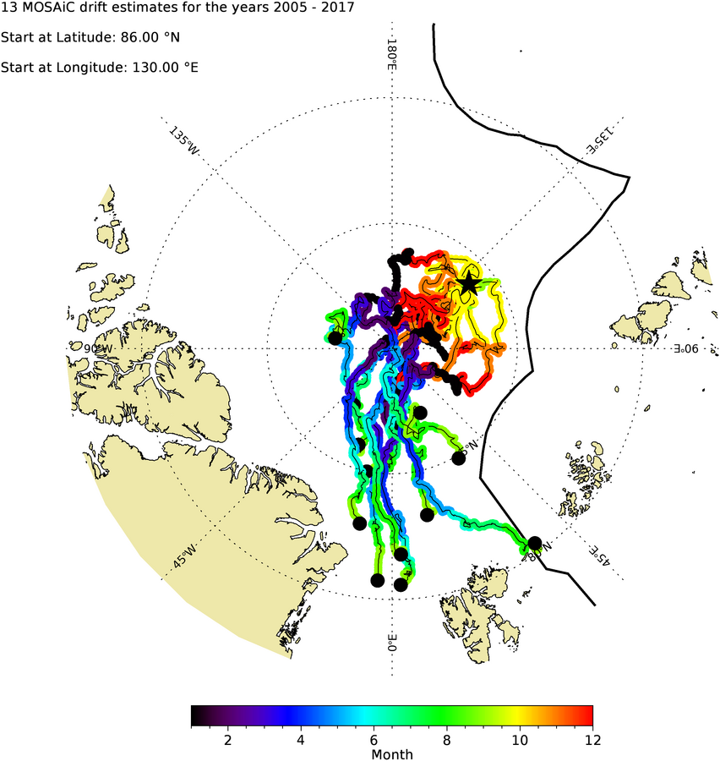
Where to start MOSAiC?
© T. Krumpen

Slide 9
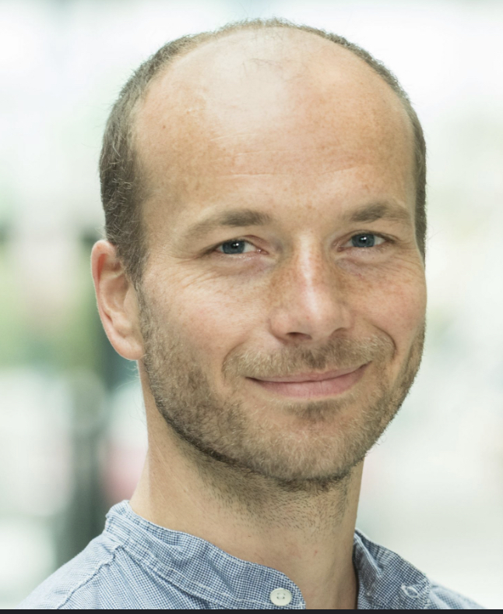
Where to start MOSAiC?
© T. Krumpen

Slide 10
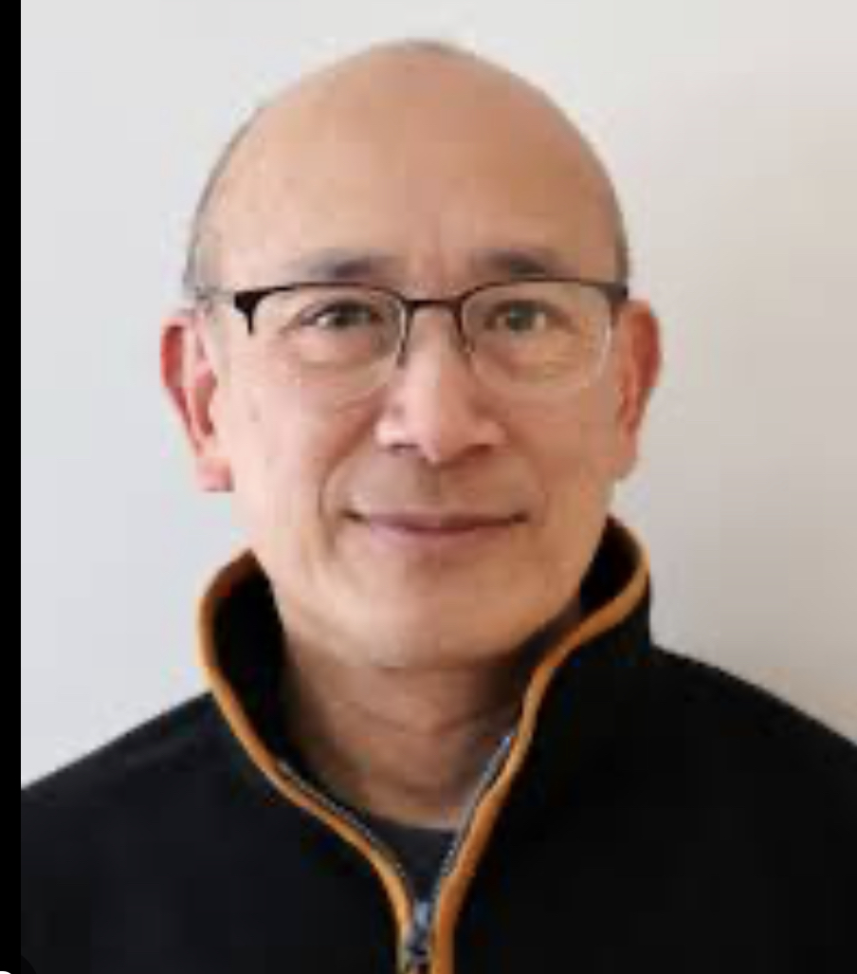
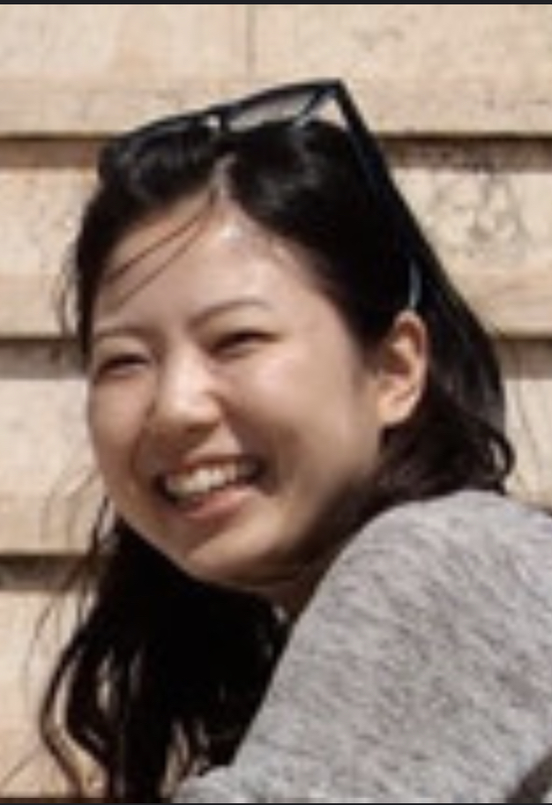
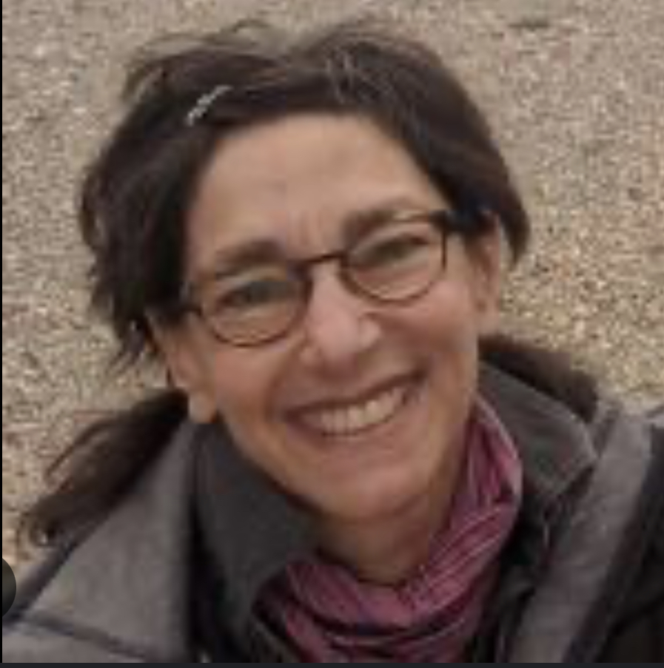
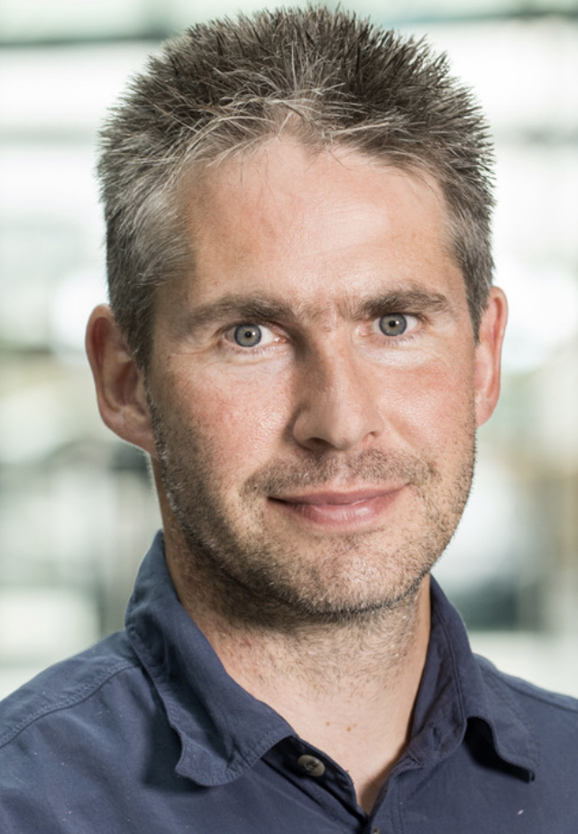
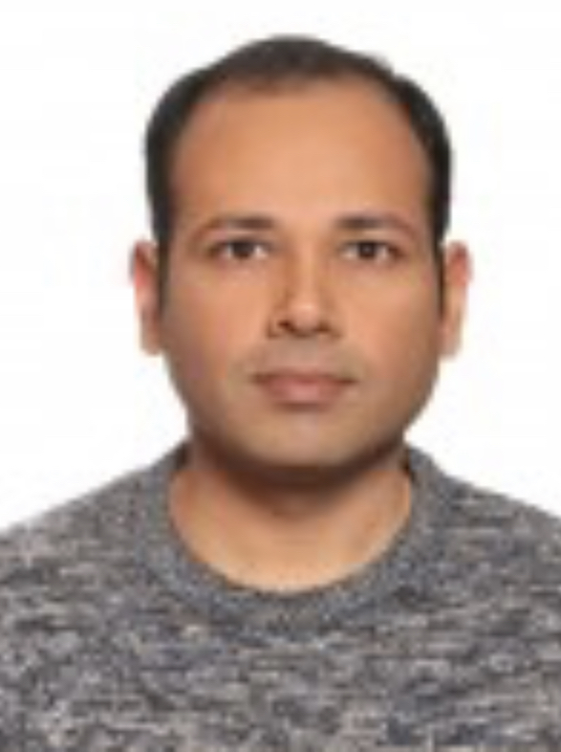
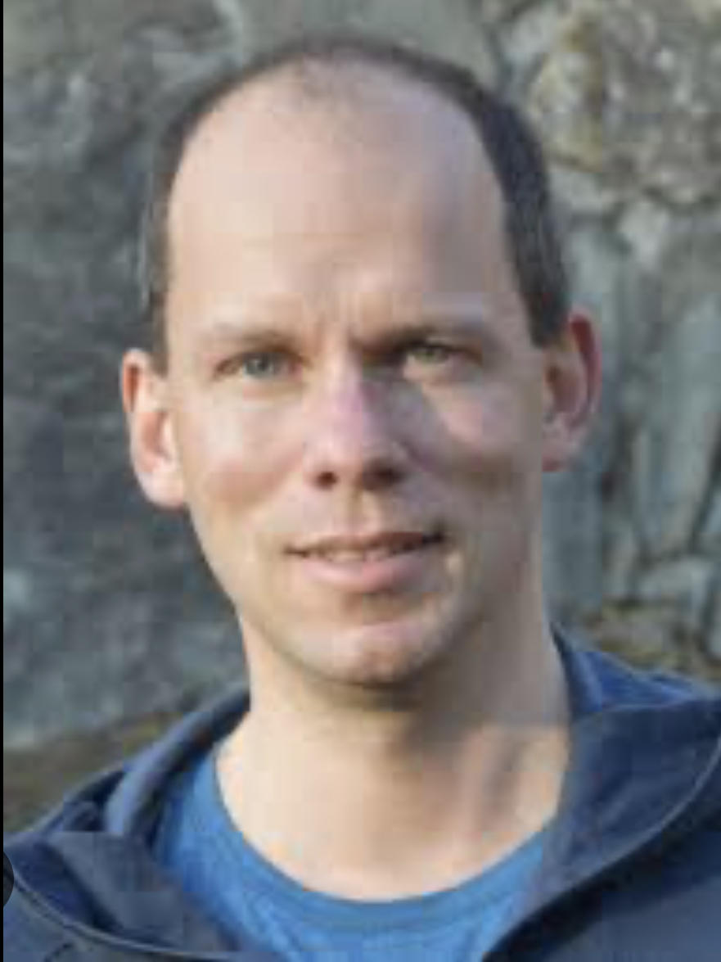
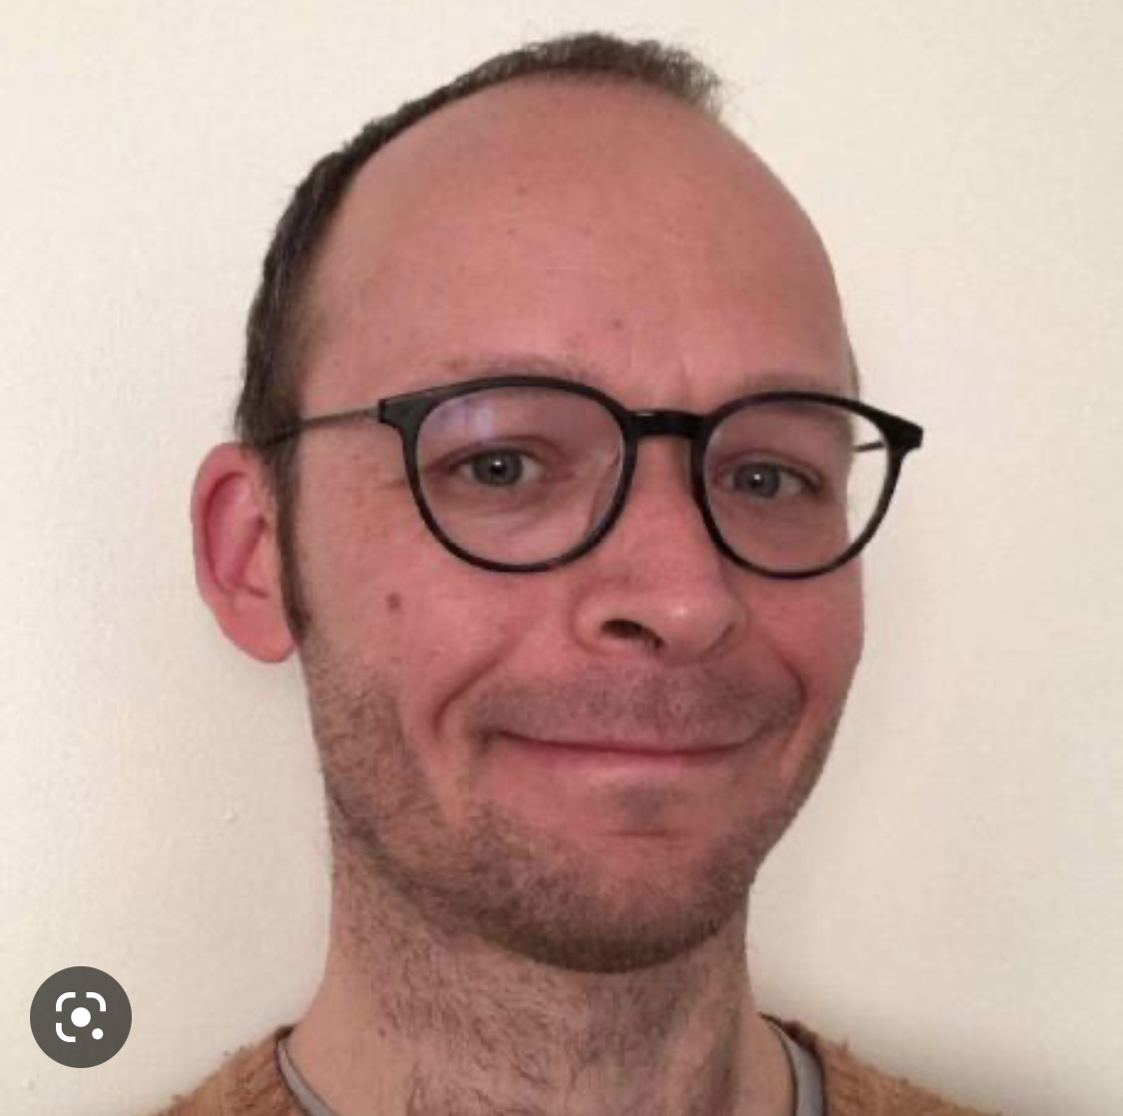
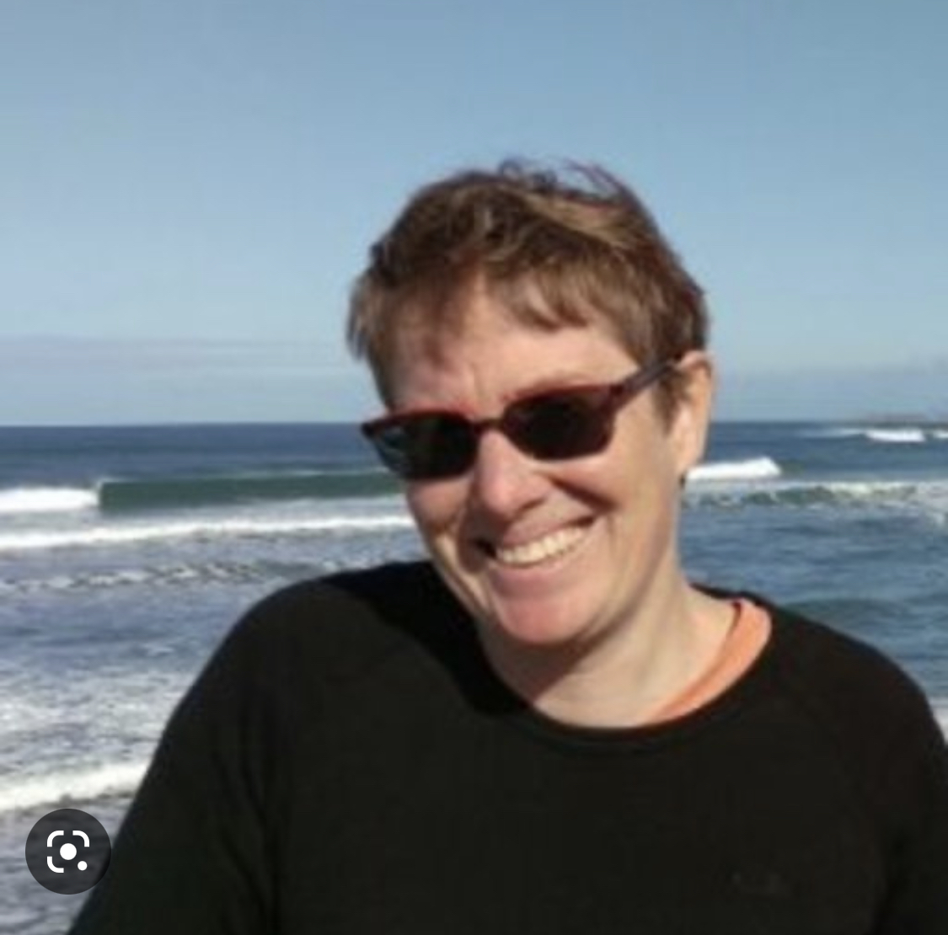
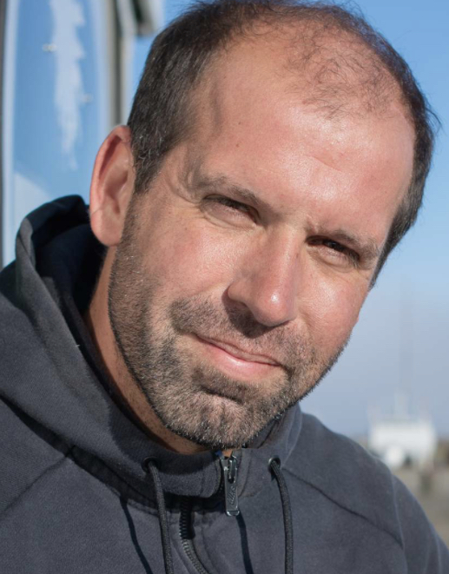
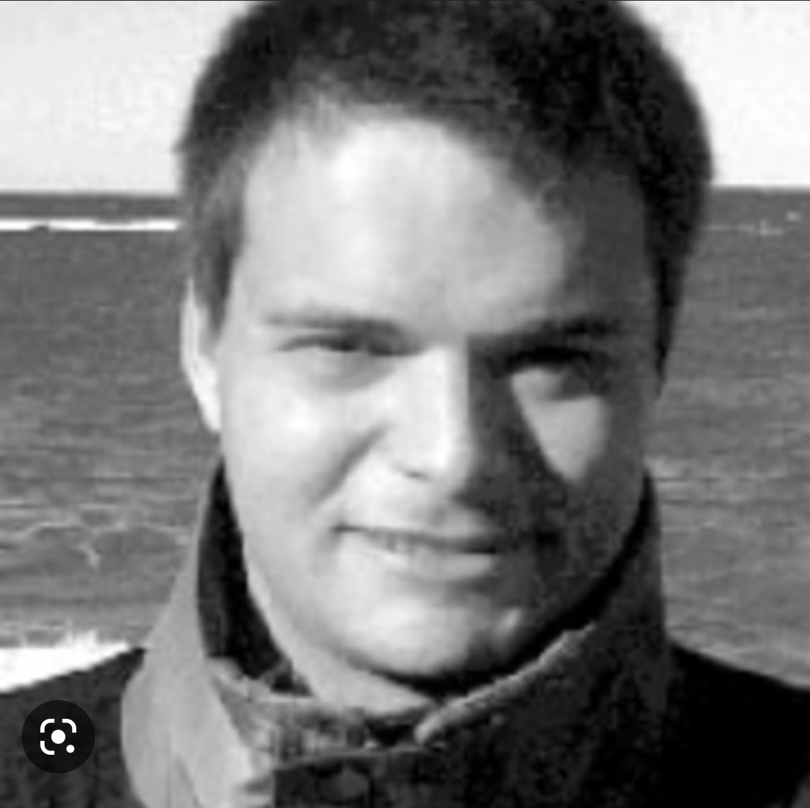
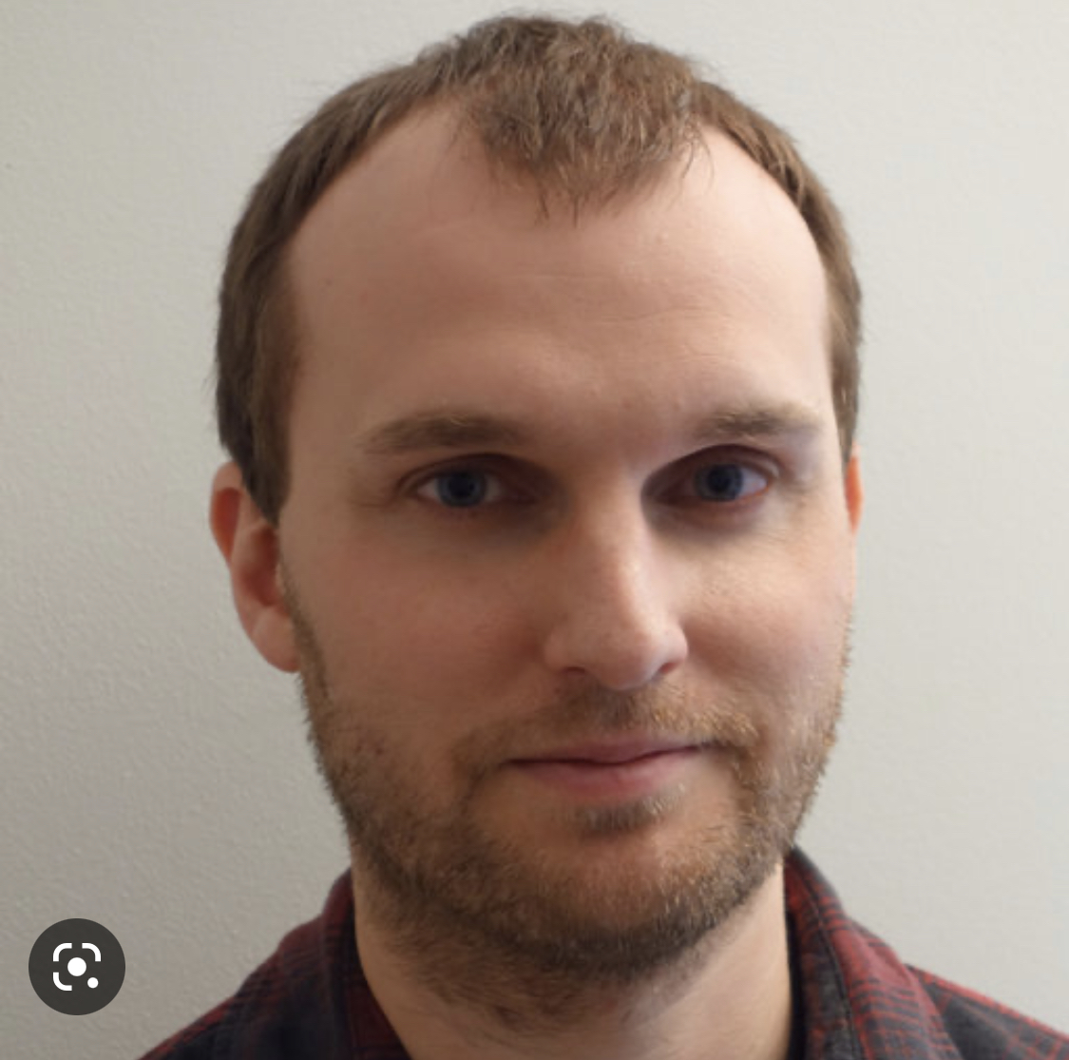
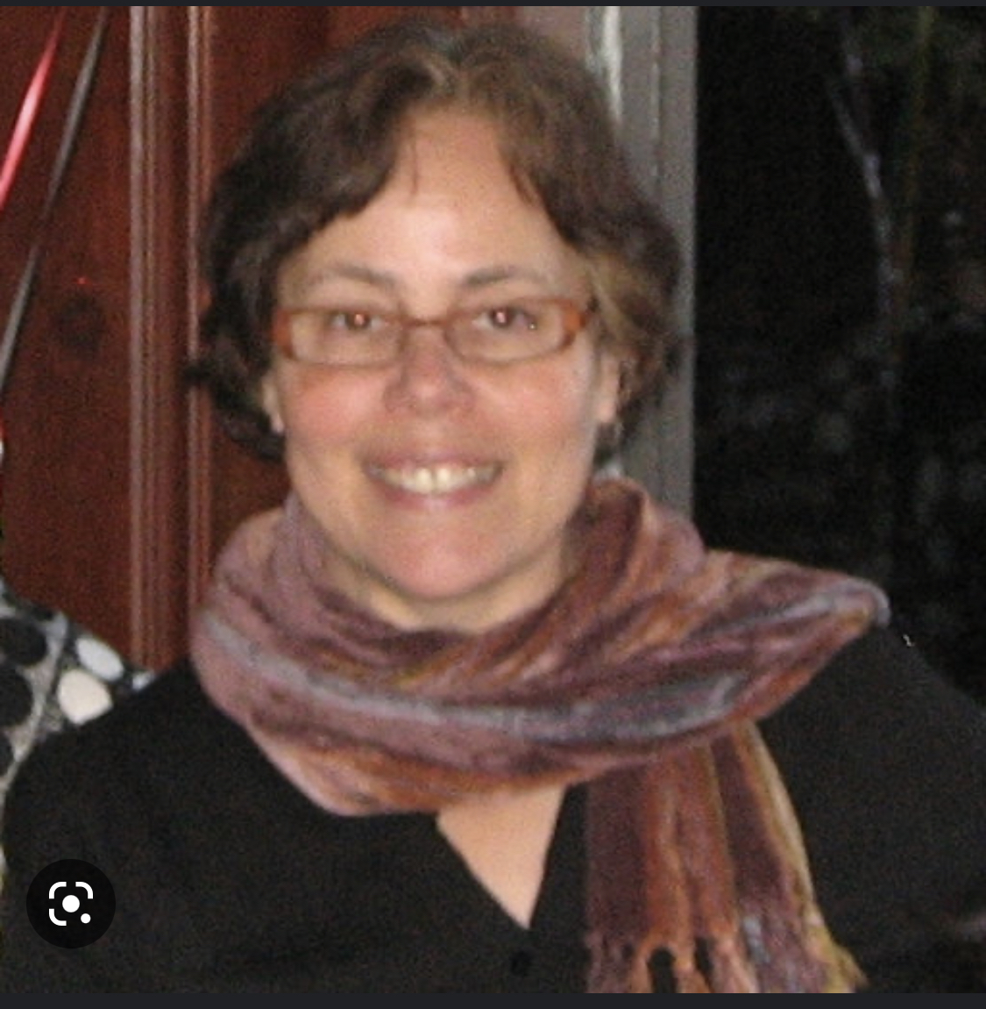
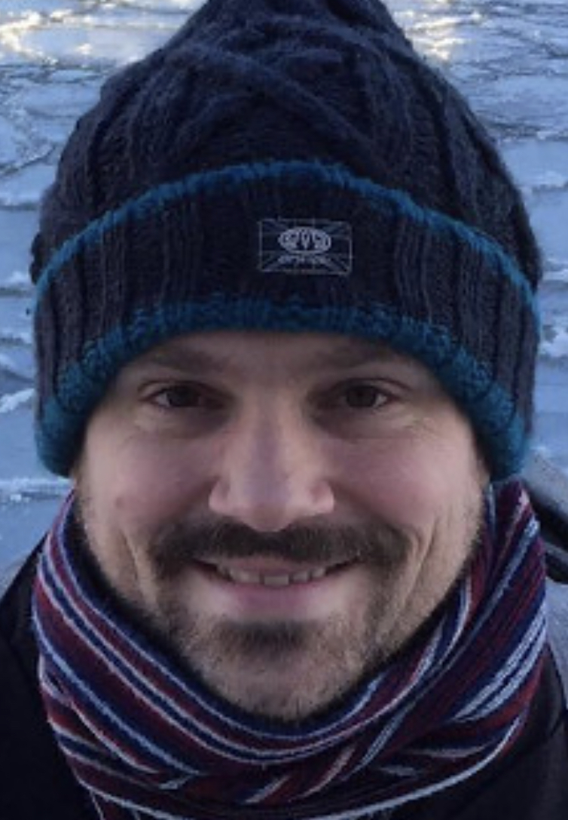
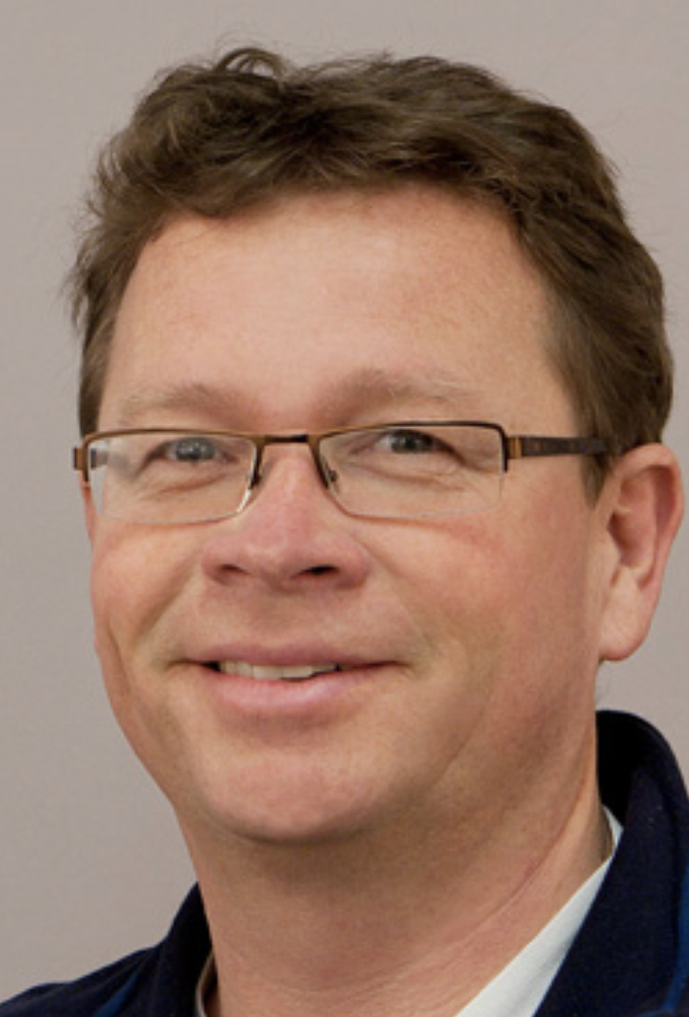

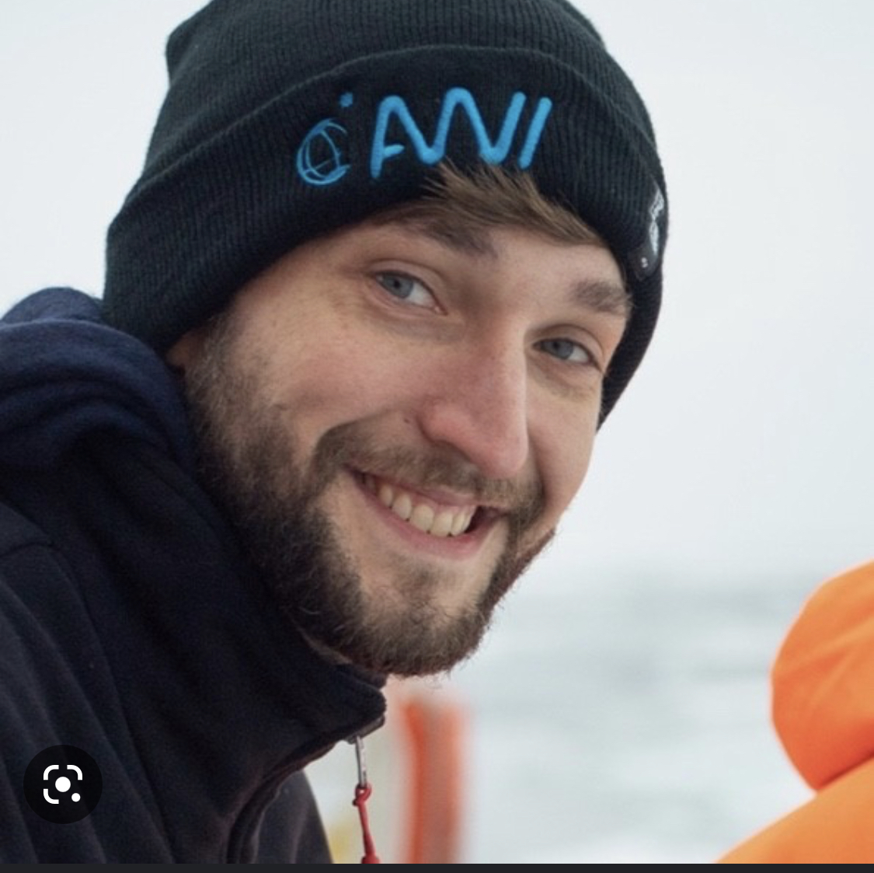
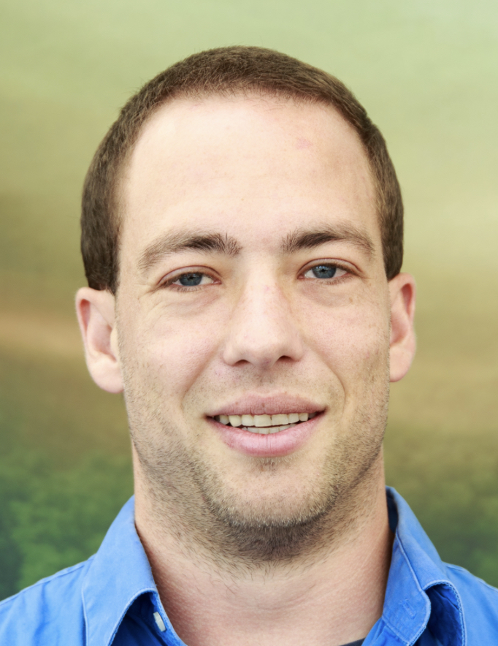
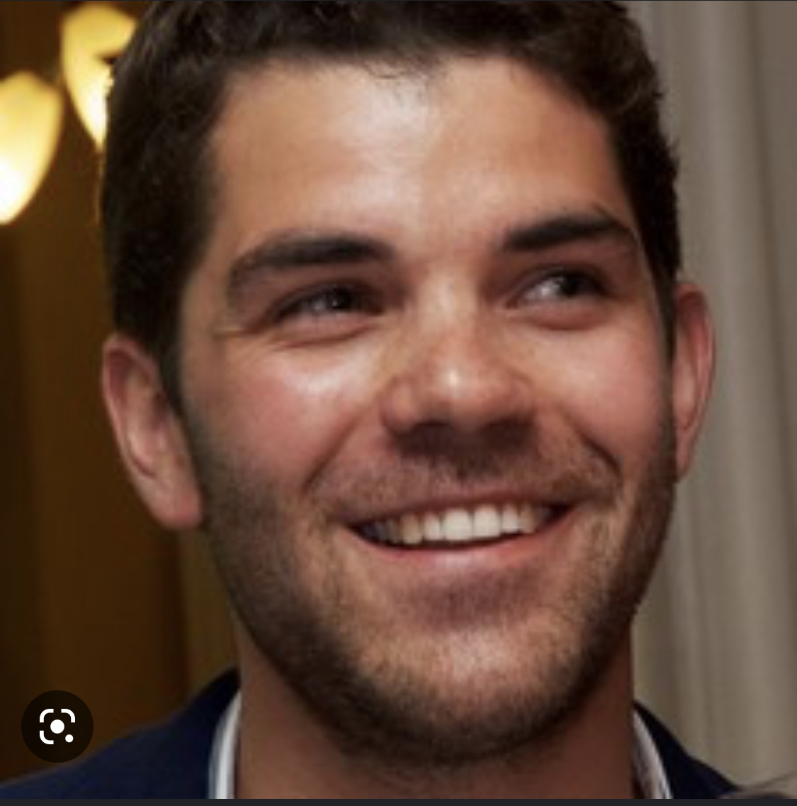
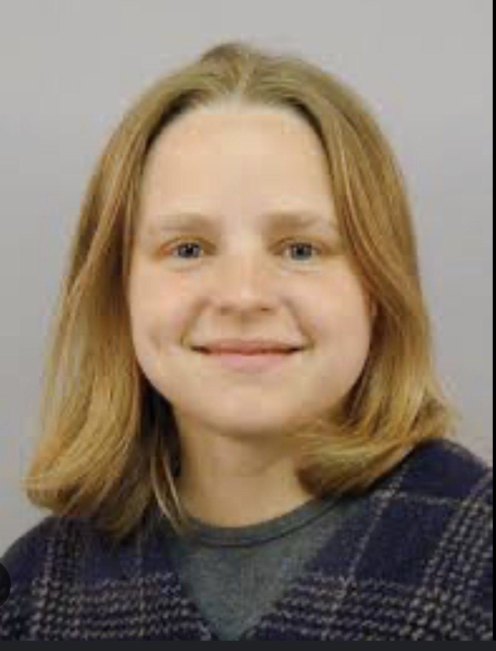
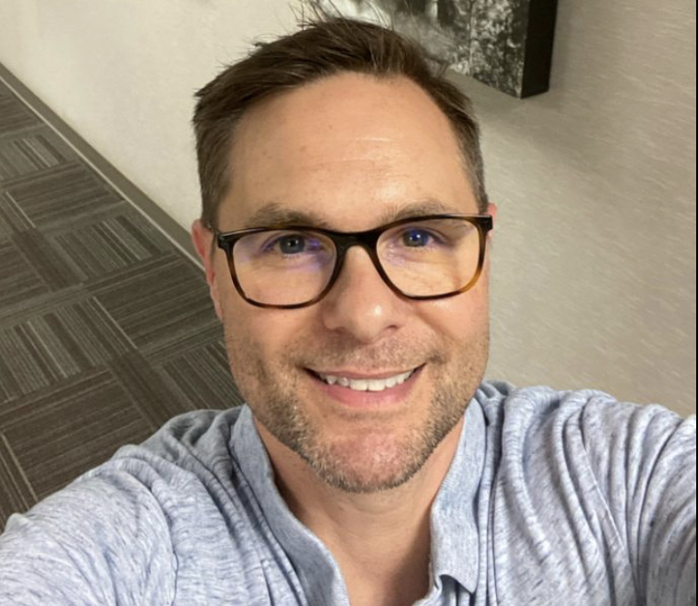
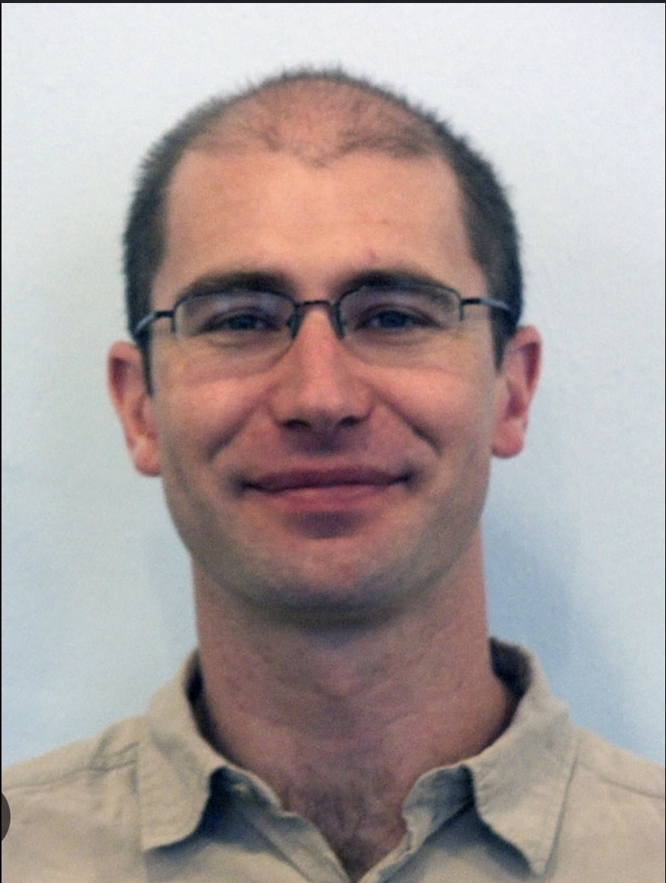
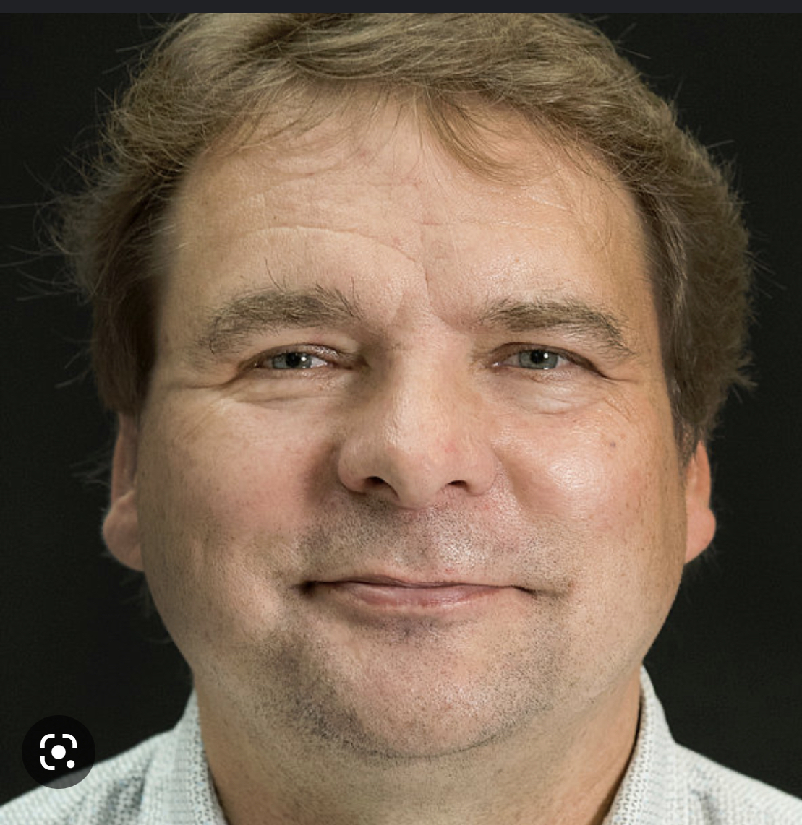
Where to start MOSAiC?
© T. Krumpen

Slide 11
The Sea Ice Drift Forecast Experiment

Slide 12










The Sea Ice Drift Forecast Experiment

Slide 13
The Sea Ice Drift Forecast Experiment
„SIDFEx is a community effort to collect and analyse Arctic
sea-ice drift forecasts at lead times from days to a year.
Forecasts are made with various methods for drifting sea-ice buoys and
the trans-Arctic MOSAiC drift campaign.“

Slide 14

The Sea Ice Drift Forecast Experiment
„SIDFEx is a community effort to collect and analyse Arctic
sea-ice drift forecasts at lead times from days to a year.
Forecasts are made with various methods for drifting sea-ice buoys and
the trans-Arctic MOSAiC drift campaign.“
HI…
… or AI?
Notes:
Make relevnt text bold, less slides, x

Slide 15
The Sea Ice Drift Forecast Experiment
„SIDFEx is a community effort to collect and analyse Arctic
sea-ice drift forecasts at lead times from days to a year.
Forecasts are made with various methods for drifting sea-ice buoys and
the trans-Arctic MOSAiC drift campaign.“
HI…
… or AI?
Notes:
Make relevnt text bold, less slides, x

Slide 16
The Sea Ice Drift Forecast Experiment
„SIDFEx is a community effort to collect and analyse Arctic
sea-ice drift forecasts at lead times from days to a year.
Forecasts are made with various methods for drifting sea-ice buoys and
the trans-Arctic MOSAiC drift campaign.“ (© Helge Goessling)
Use cases:
  MOSAiC starting position
  Ordering of SAR images
“Because of SIDFEx, our hitting rate was about 80 - 85%.
Without SIDFEx my expectation was below 50%.” (S. Singha)
  Operational support

Slide 17
The SIDFEx CV
2017
2018
2019
2020
2021+
pre-
MOSAiC
YOPP Core Phase
MOSAiC Drift
Legacy
First buoys
Operational support
Drift variability
Phase IV)
Analyses, publications, legacy
© H. Goessling

Slide 18
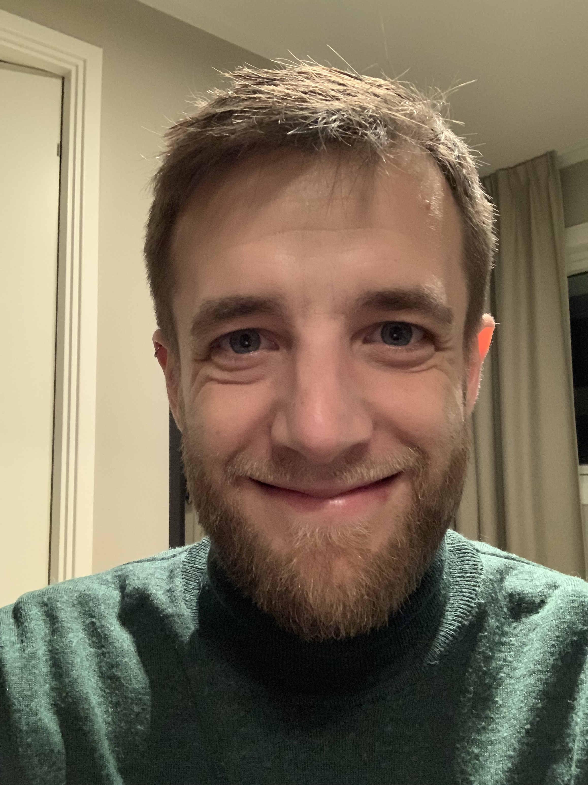
The SIDFEx CV
2017
2018
2019
2020
2021+
pre-
MOSAiC
YOPP Core Phase
MOSAiC Drift
Legacy
First buoys
Operational support
Drift variability
Phase IV)
Analyses, publications, legacy
© H. Goessling

Slide 19
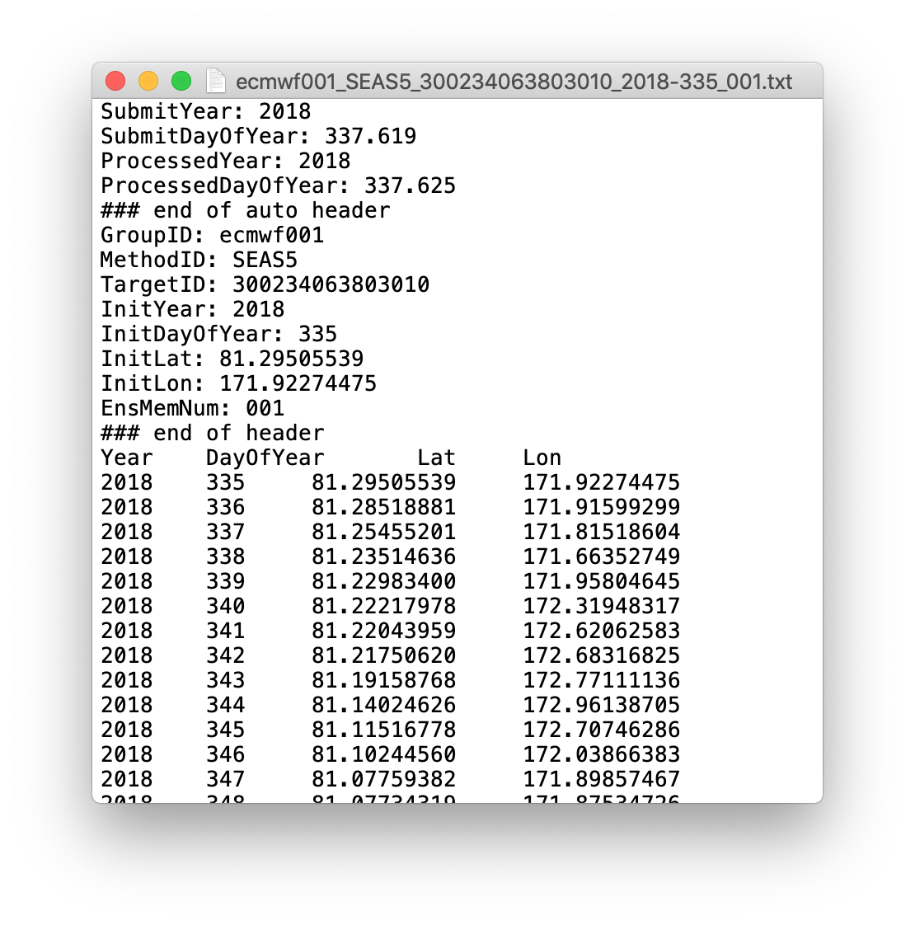


SIDFEx is growing up

Slide 20
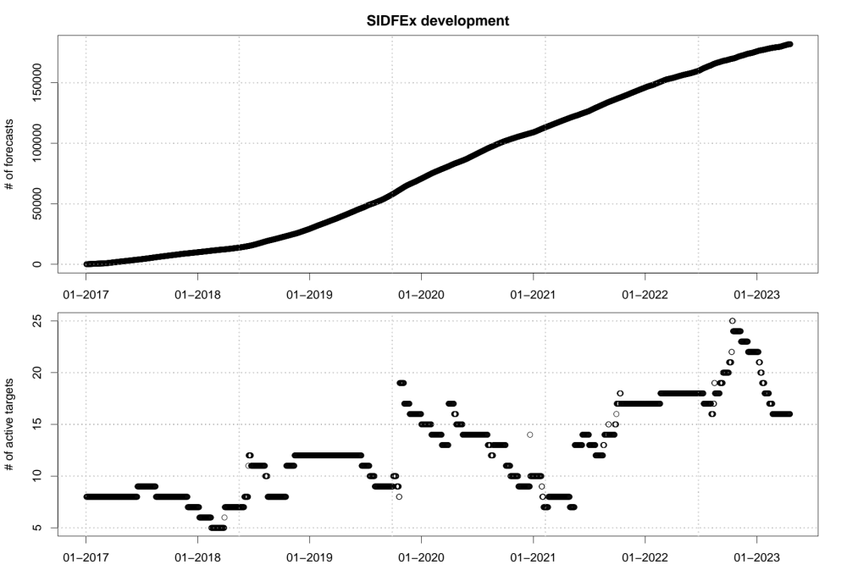
SIDFEx is growing up

Slide 21
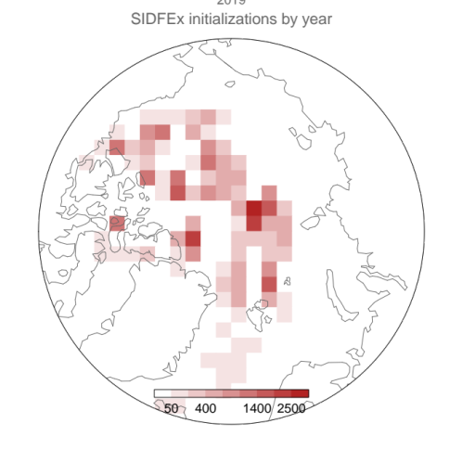
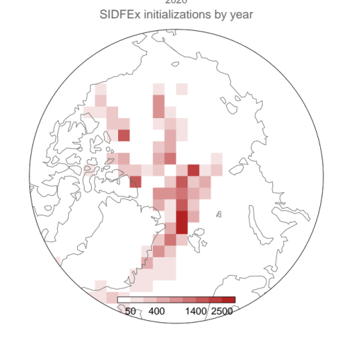
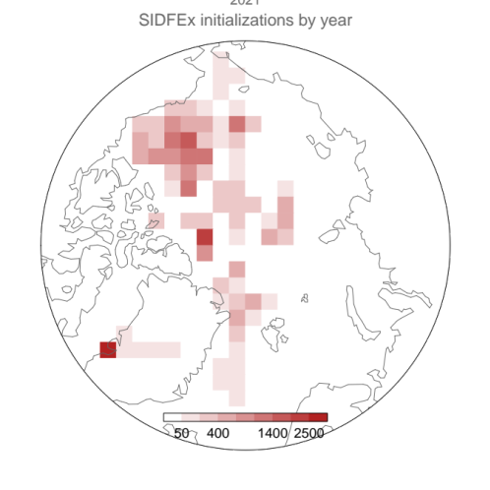
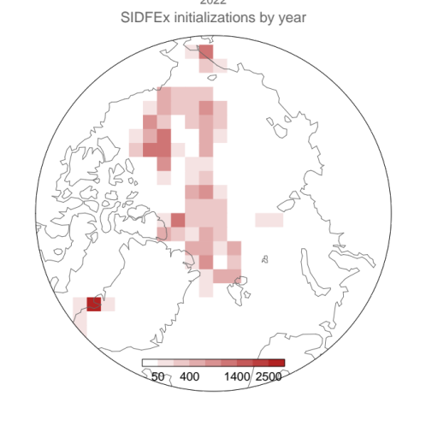
SIDFEx is growing up
2019
2020
2021
2022
©Simon Reifenberg

Slide 22
SIDFEx consensus forecast
Observed track
System A
System B
System C
System D
... ... ...
System X
✓
✗ latest initial time >3d old
Daily short-term forecasts
✓
✗ not >3d remaining lead time
Monthly seasonal
ens-forecast
-3
-2
-1
+1
+2
+3
+10
+90
T_{init}
...
...
Time (days)
© H. Goessling

Slide 23
SIDFEx consensus forecast
Observed track
System A
System B
System C
System D
... ... ...
System X
adjust
position
truncate
adjust
position
Daily short-term forecasts
truncate
adjust
positions
adjust
positions
truncate
Monthly seasonal
ens-forecast
-3
-2
-1
+1
+2
+3
+10
+90
T_{init}
...
...
Time (days)
© H. Goessling

Slide 24
How close to the North Pole
will Polarstern drift?

Slide 25
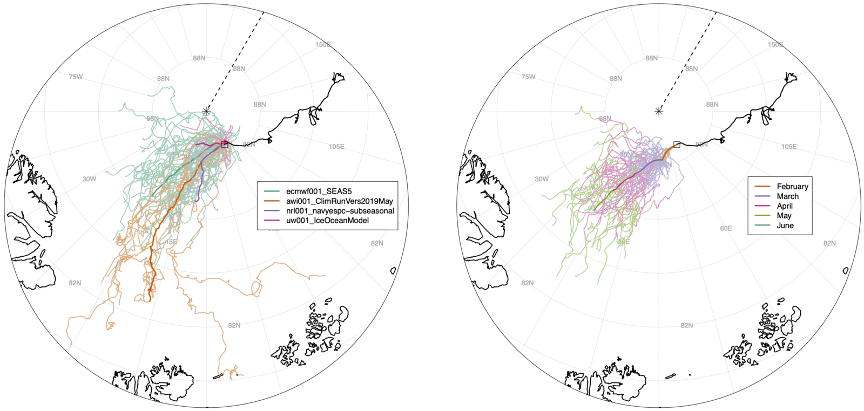
How close to the North Pole
will Polarstern drift?
without short-term forecasts
© H. Goessling

Slide 26
How close to the North Pole
will Polarstern drift?
with short-term forecasts
© H. Goessling

Slide 27
Support for research cruises

Slide 28
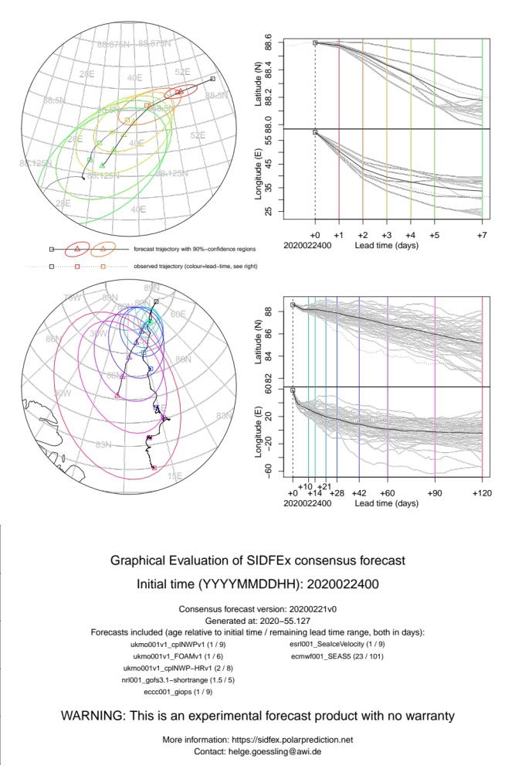
Support for research cruises
© H. Goessling

Slide 29
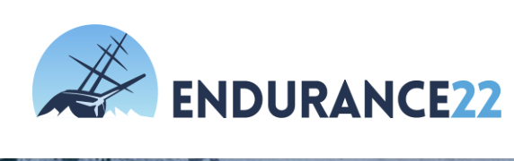
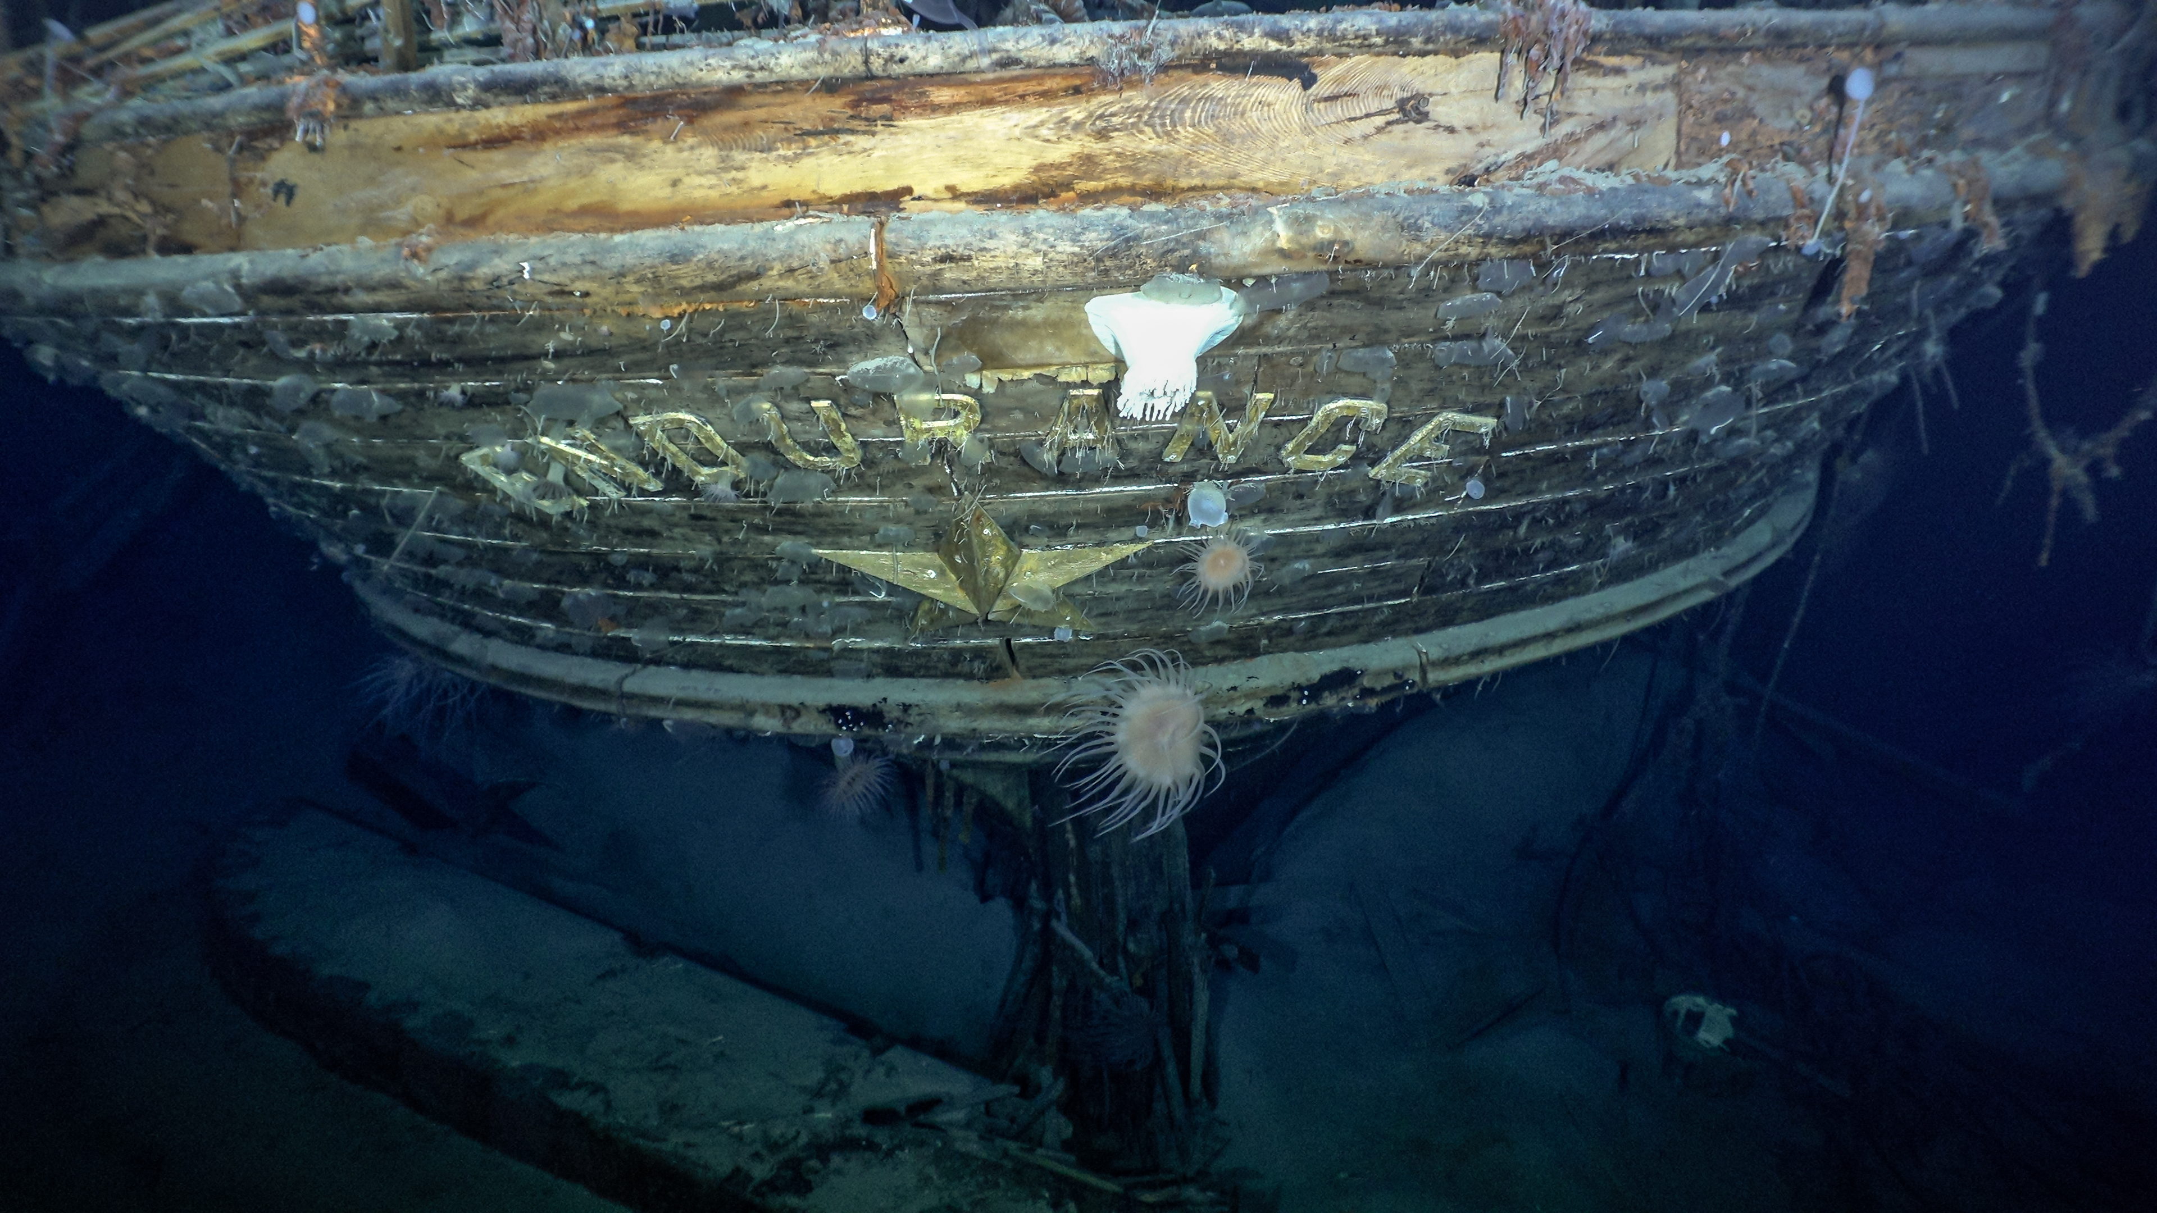
Support for research cruises
Photo: Falklands Maritime Heritage Trust, National Geographic
© H. Goessling

Slide 30
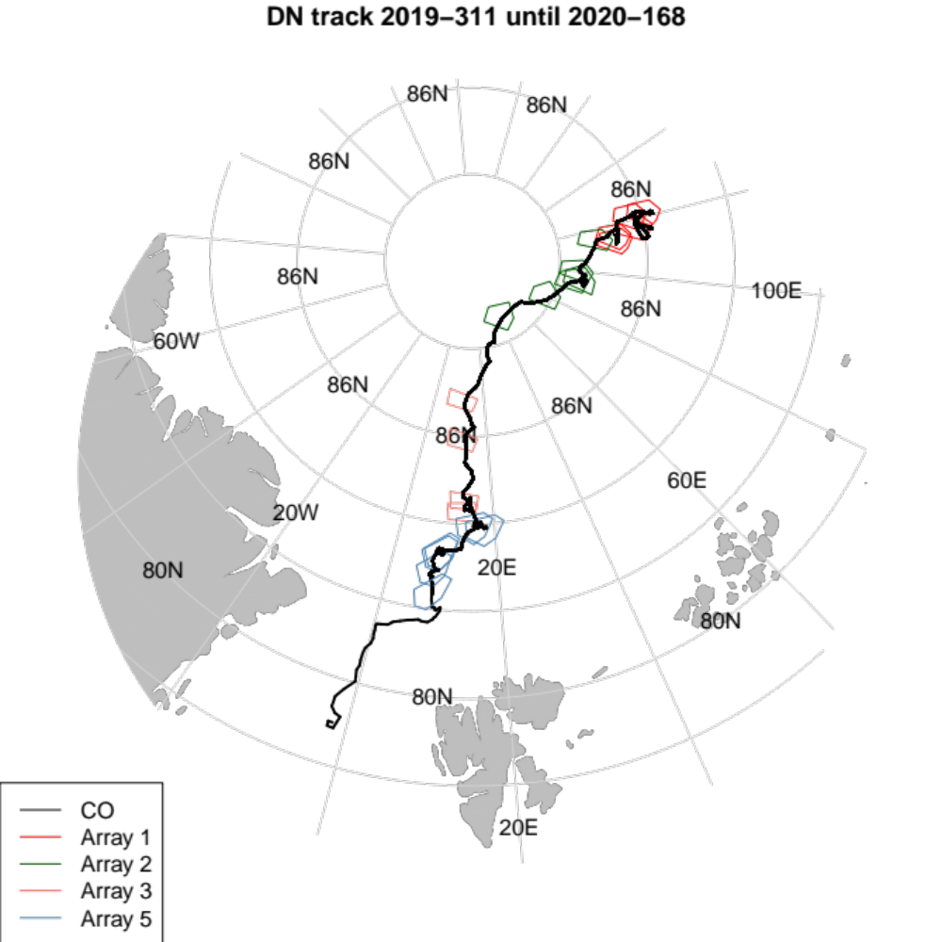
Tracking the DN
Buoys 35 km apart
November 2019 – June 2020
Endgame: derive deformation of buoy array

Slide 31
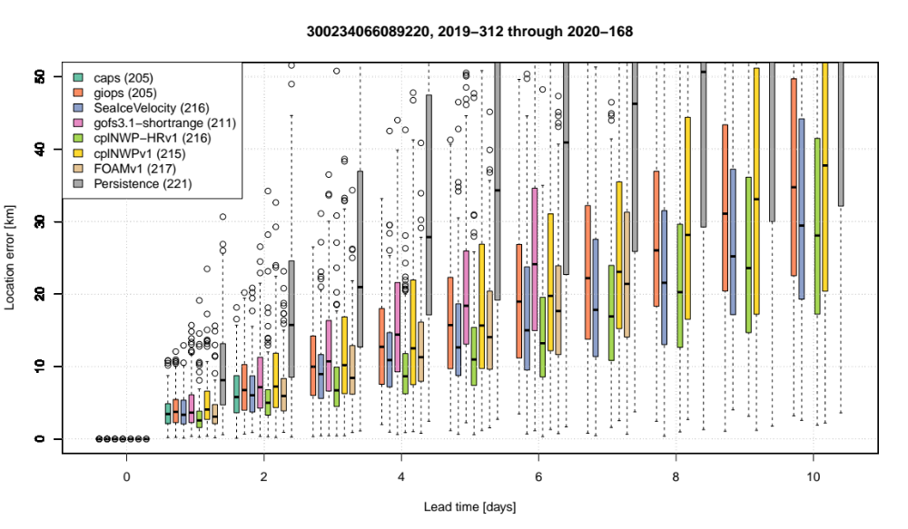
Forecast evaluation
Take-Home 1: All systems beat persistence
Take-Home 2: Inter-system spread increases after 3 days
Next: all buoys together and relative to each other (deformation)

Slide 32
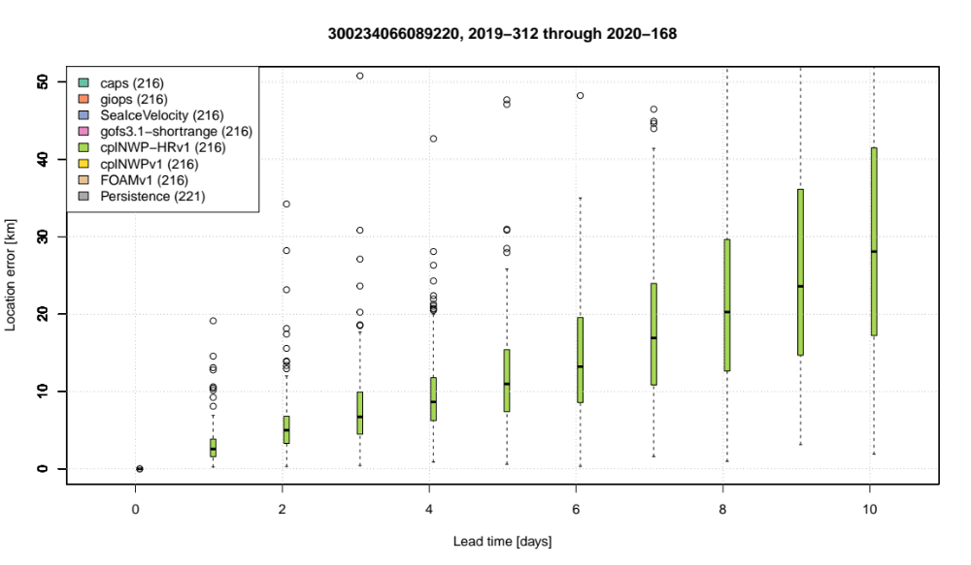
Forecast evaluation
Numerical weather prediction model
UK Met Office
Atmosphere: 10km, Ocean: 12 km

Slide 33
SIDFEx deformation forecasts
*Helge Goessling, Ed Blockley, Axel Schweiger, Valentin Ludwig, Ed Blanchard-Wrigglesworth, Thomas Krumpen, Marcel Nicolaus, Ignatius Rigor, Bob Grumbine, Frank Kauker, Simon Reifenberg, Wendy Ermold, François Massonnet, Quentin Dalaiden, Pam Posey, Joe Metzger, Michael Phelps, Rick Allard, Laurent Bertino, Malte Müller, Maxime Beauchamp, Amy Solomon, Janet Intrieri, Frédéric Dupont, Yukie Hata, Jean-François Lemieux, Nick Szapiro, Mario Hoppmann, Steffen Tietsche, Jennifer Hutchings, Thomas Rackow, Till Rasmussen, Cyril Palerme, Suman Singha, Antonia Jost

Slide 34

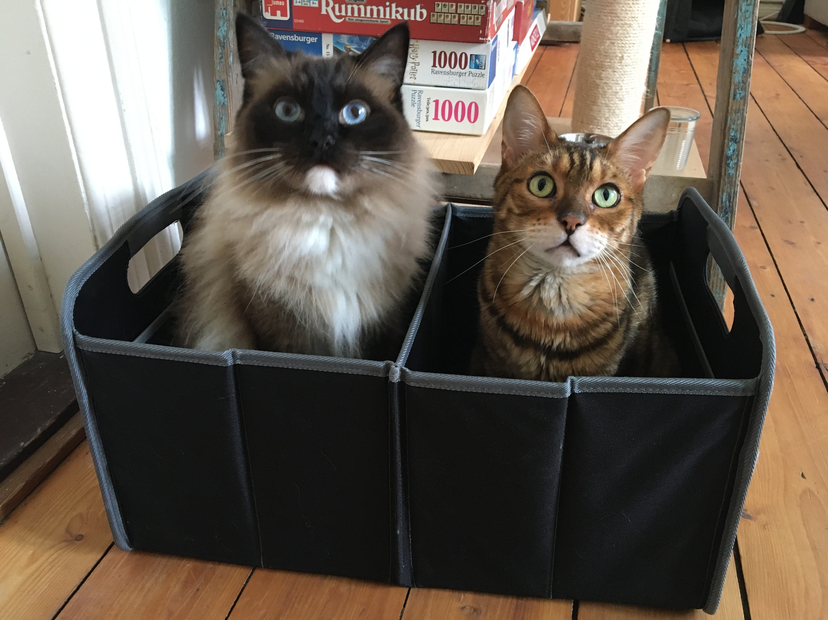
Research questions
Can we use a numerical
weather prediction
model to forecast
sea-ice deformation…
…and does the skill
depend
on the spatial scale?

Slide 35
Research questions
Can we use a numerical weather prediction model to forecast sea-ice deformation?
Does the skill depend on the spatial scale?

Slide 36
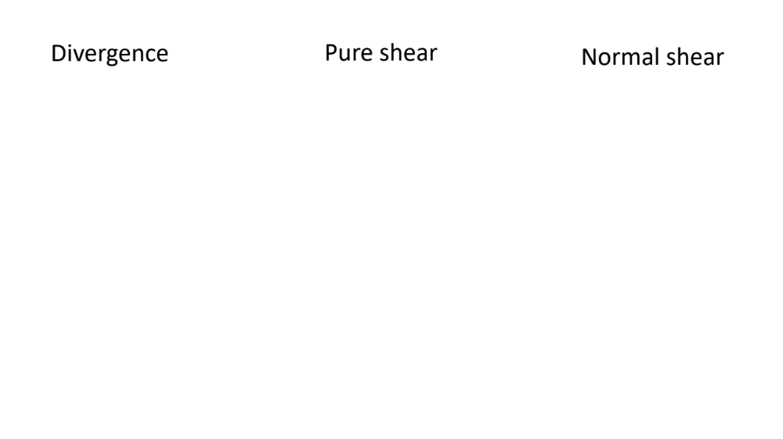
Bending the ice

Slide 37
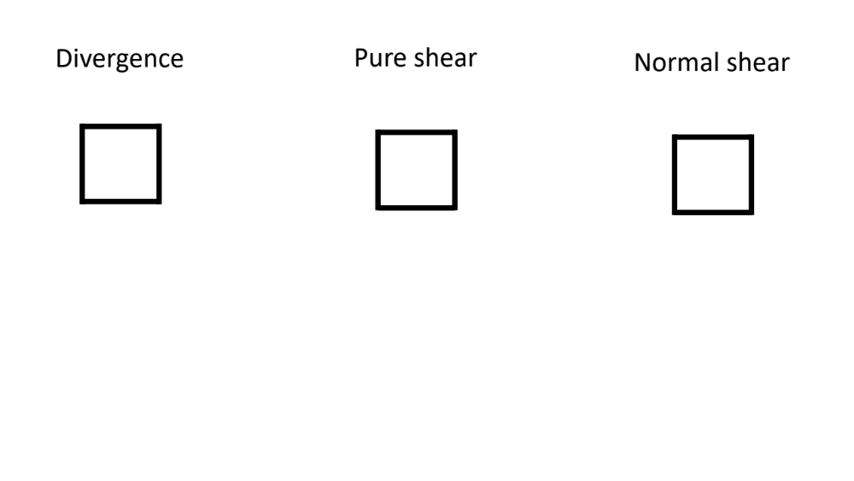
Bending the ice

Slide 38
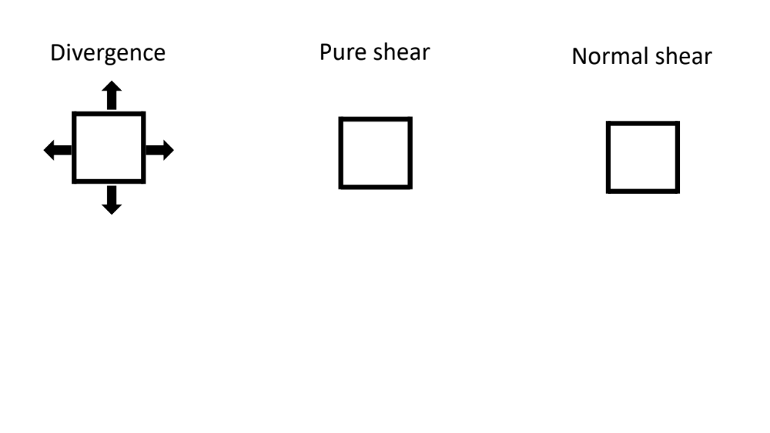
Bending the ice

Slide 39
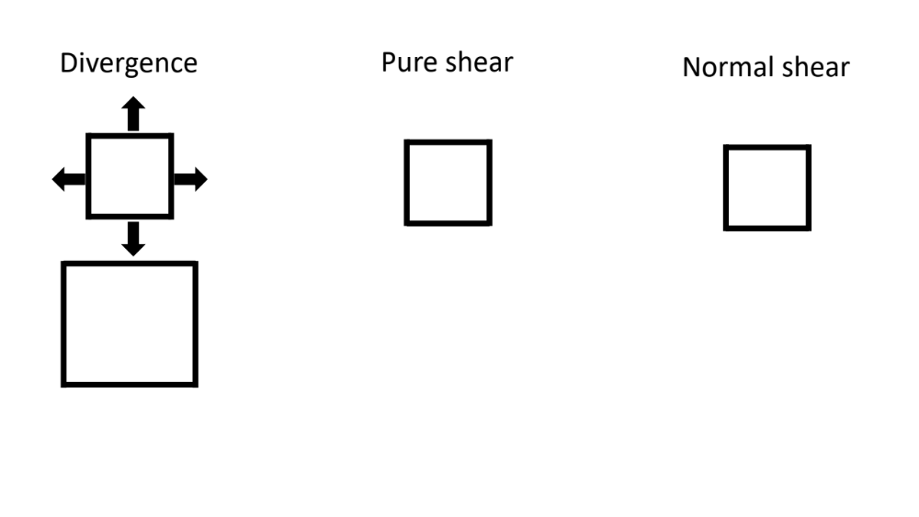
Bending the ice

Slide 40
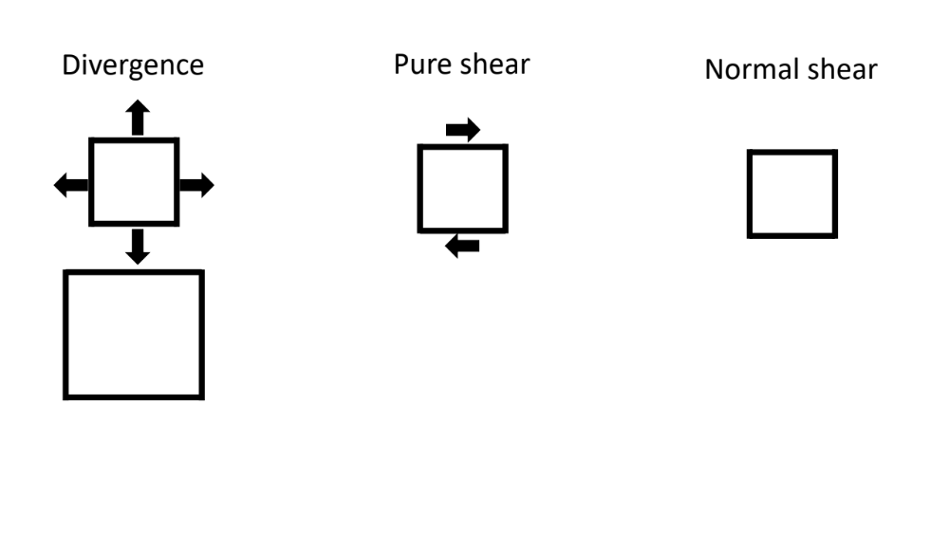
Bending the ice

Slide 41
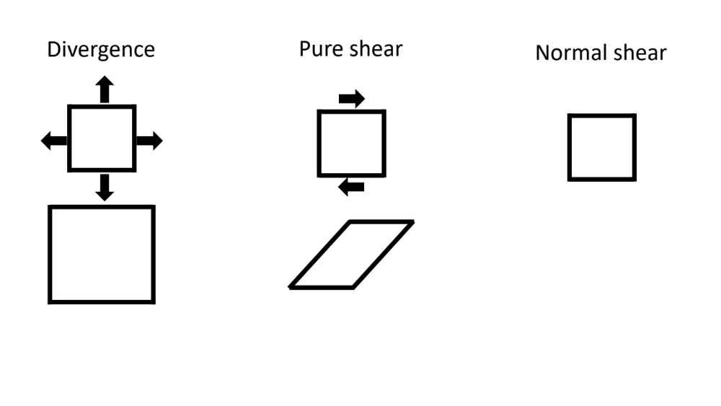
Bending the ice

Slide 42
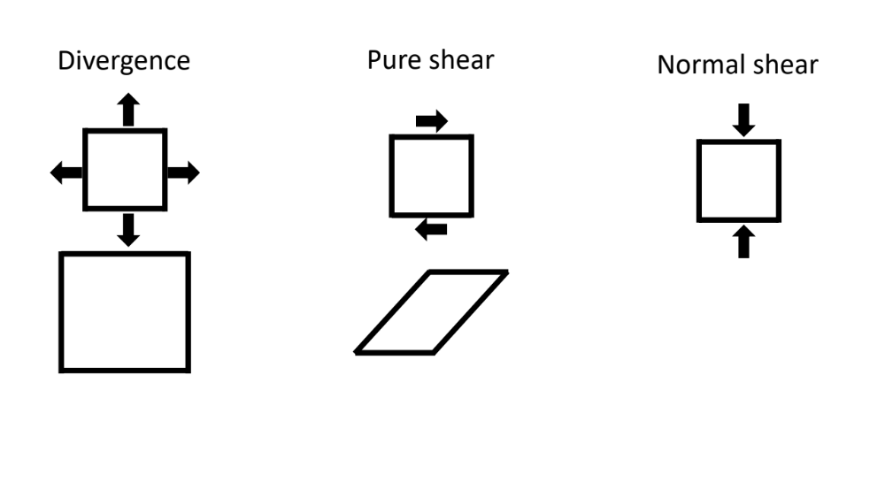
Bending the ice

Slide 43
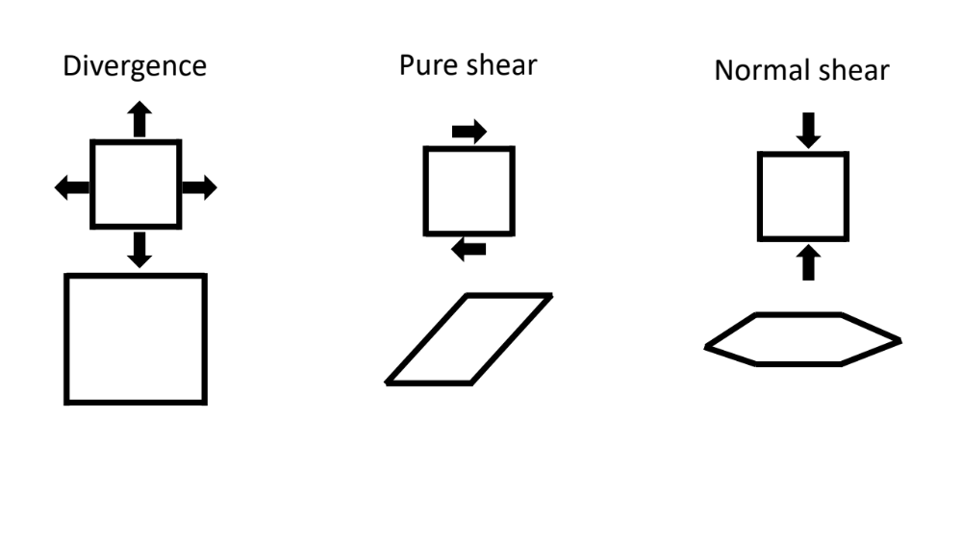
Bending the ice

Slide 44
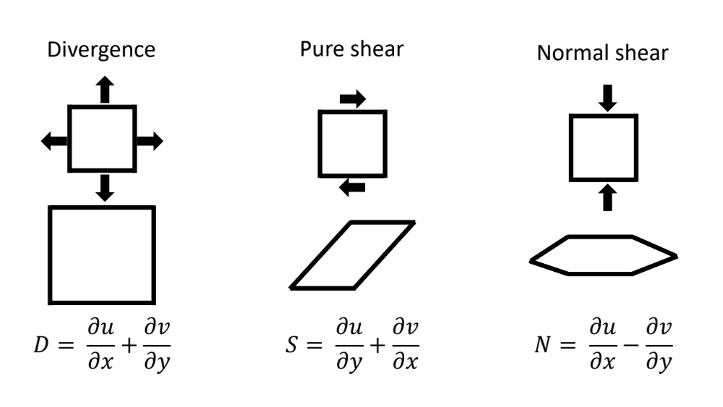
Bending the ice

Slide 45
Bending the ice

Slide 46
Bending the ice

Slide 47
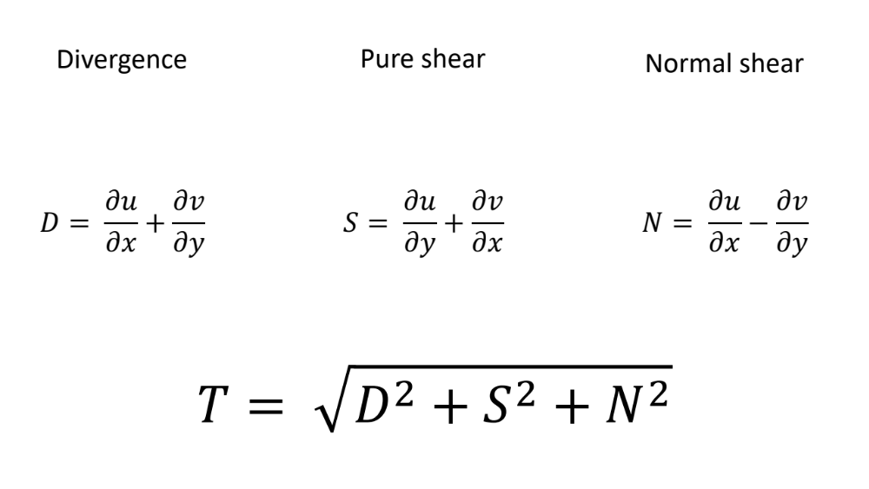
Bending the ice

Slide 48
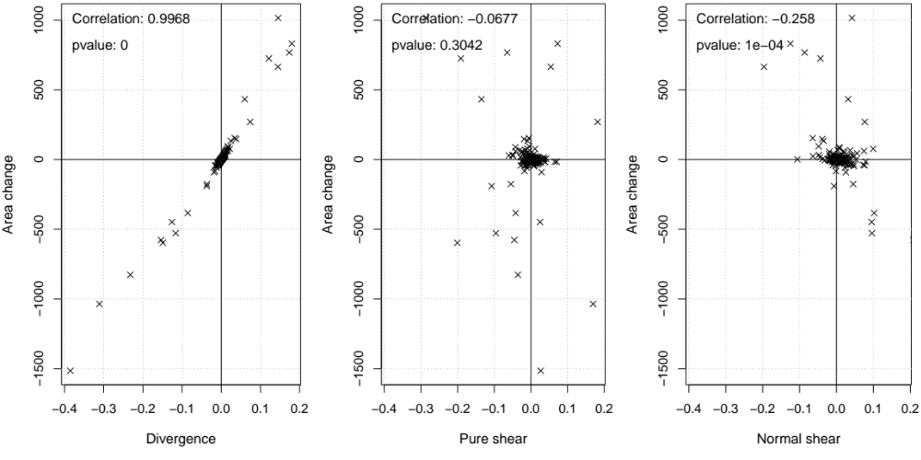
Sanity check

Slide 49

Forecast evaluation
Area roughly 4000km
Compare forecast and observations at 1d lead time
Total deformation: Means agree within 10%, variability is captured
Divergence: correlation lower, distribution too narrow
Pure and normal shear with higher correlations

Slide 50
Forecast evaluation
Take-Home 1: Better than expected
Take-Home 2: Means for total deformation agree within 10 %
Take-Home 3: Divergence has low correlation, shear has high correlation
Keep in mind: Models designed for larger scales/representation of mean states
Time for the large scale!

Slide 51

Forecast evaluation
Take-Home 1: Better than expected
Take-Home 2: Means for total deformation agree within 10 %
Take-Home 3: Divergence has low correlation, shear has high correlation
Keep in mind: Models designed for larger scales/representation of mean states
Time for the large scale!

Slide 52

Forecast evaluation
Area roughly 4000 km²
Compare forecast and observations at 1 d lead time
Total deformation: Means agree within 10 %, variability captured
Divergence: correlation lower, distribution too narrow
Pure and normal shear with higher correlations
Models designed for larger scales/representation of mean states
Still, there is skill even at small scales
Correlation: 0.61
p-value: 0
Let’s go large!

Slide 53


Going for the large scale

Slide 54


Going for longer lead times

Slide 55


Going for multiple systems

Slide 56

In a nutshell

Slide 57

In a nutshell
We provide skillful drift forecasts

Slide 58
In a nutshell
We provide skillful drift forecasts
We look at sea-ice deformation

Slide 59


In a nutshell
We provide skillful drift forecasts
It works ok at DN scales
We look at sea-ice deformation

Slide 60



In a nutshell
We provide skillful drift forecasts
It works ok at DN scales
We look at sea-ice deformation
It works even better at pan-Arctic scales

Slide 61

Up next

