Slide 1


StarDist
Jakub Soukup
Adapted from Martin Schätz

Slide 2
How can we count objects?

Slide 3
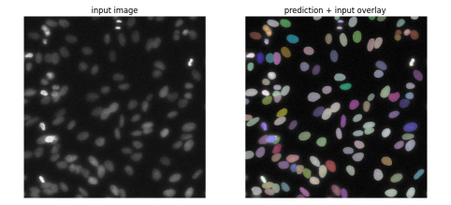
What is StarDist?
Deep learning tool designed to localize cell nuclei.
Available as:
  Package for training custom prediction model (Python).
  Pretrained model ready to use.
  Plugin(s) using pre-trained models.

Slide 4
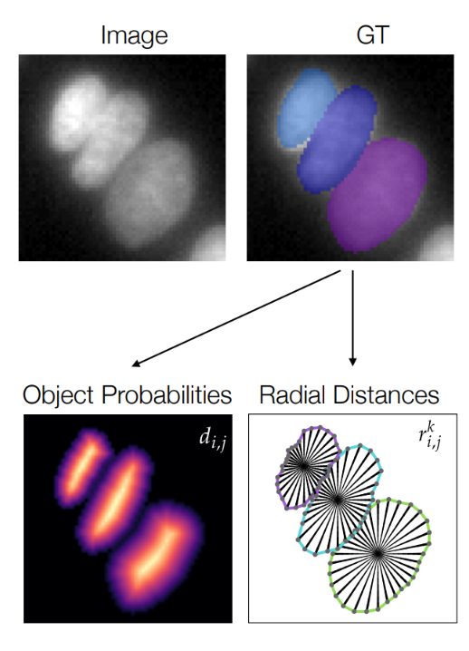
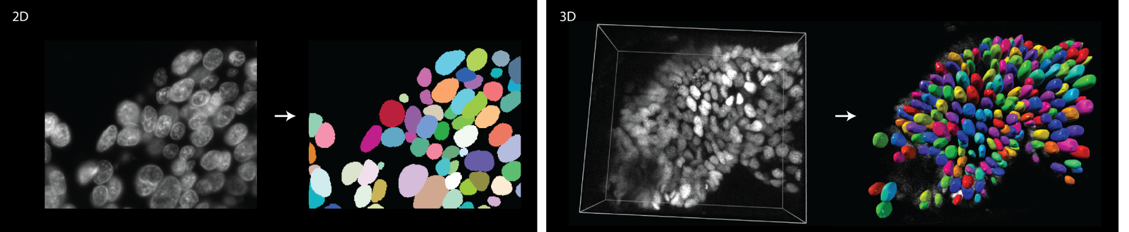
How it works?
Tool designed to localize cell nuclei via star-convex polygons.
Similar to methods that directly predict shapes for each object of interest.

Slide 5
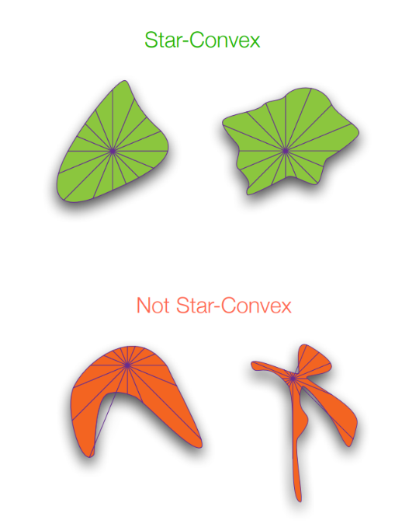
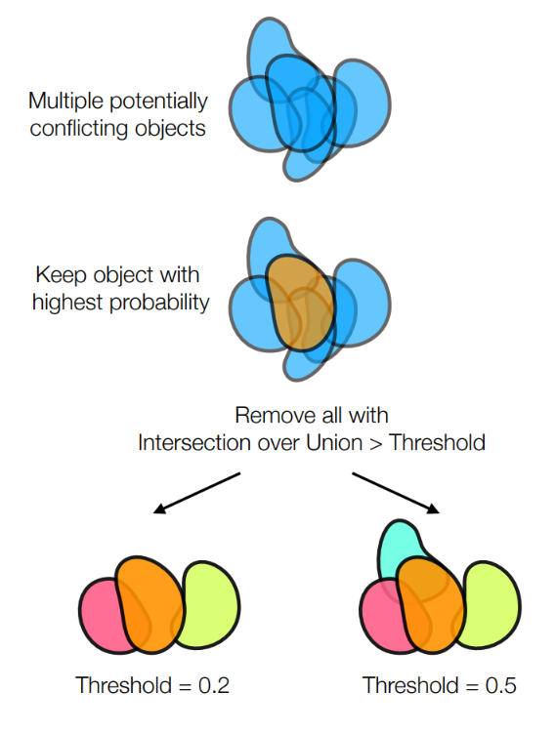
How it works?
Segmentation based on Star-Convex objects.
Capability to handle intersection/overlapping objects.

Slide 6
What is the advantage?

Slide 7
What is the advantage?
Easy to use.
Can detect overlapping objects.
Robust to intensity changes.
Usable for both 2D and 3D data.
Available as plugin.
Available models are widely usable.
Possibility to retrain model for specific data.

Slide 8
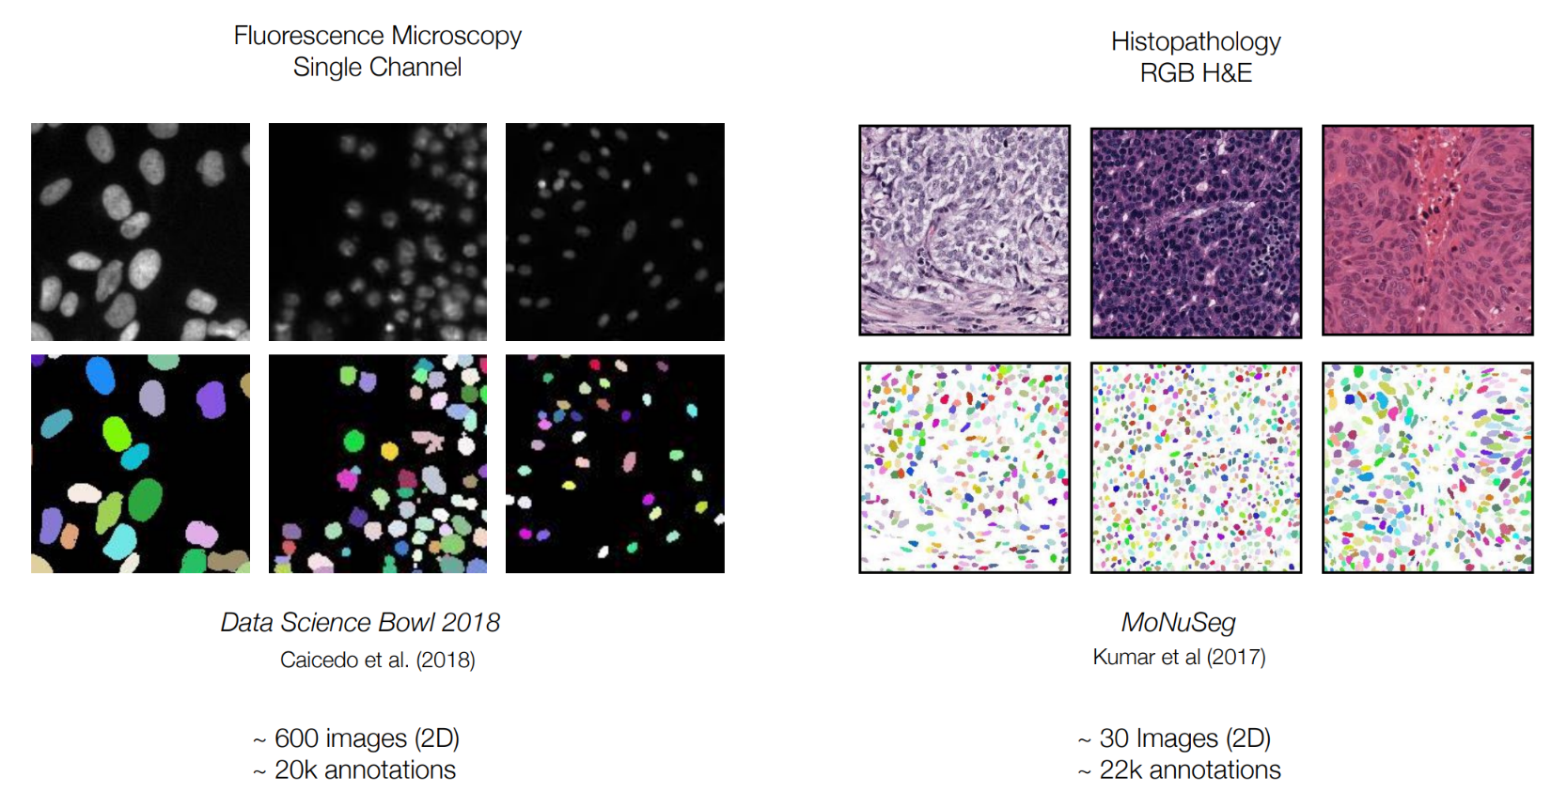
Pretrained models

Slide 9
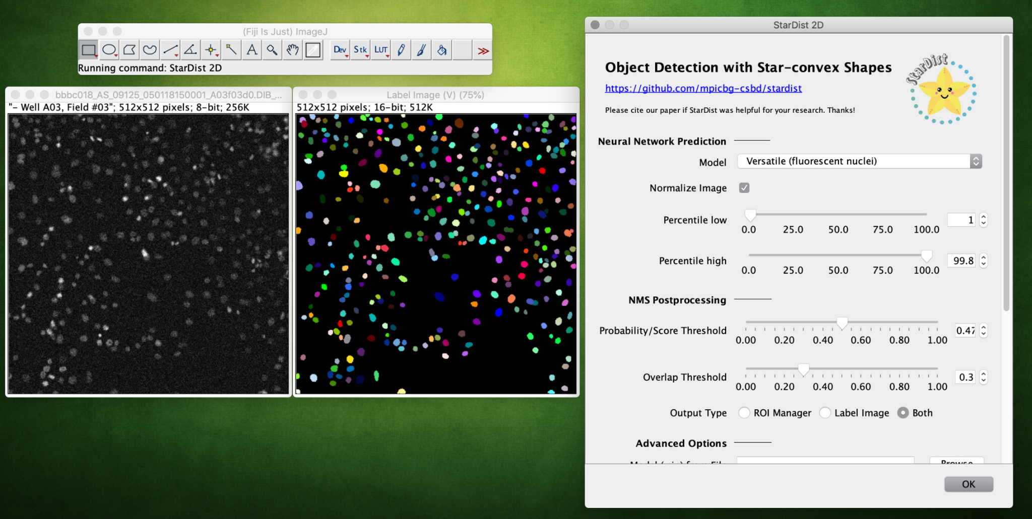
StarDist in FIJI

Slide 10
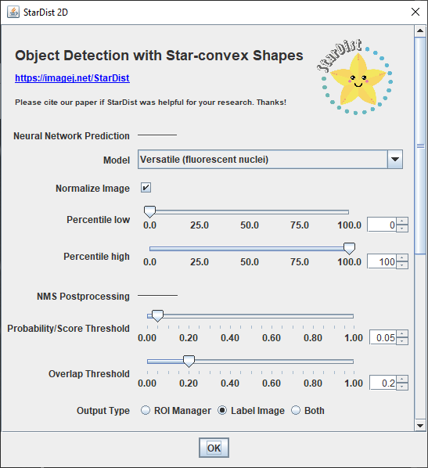
Settings
Preprocessing settings
  Normalization of image values.
  Correction of “underexposure”.
  Correction of “overexposure”.
StarDist settings
  Probability Threshold - how sure we want to be in detection of object.
  Overlap Threshold - how much overlap we want to allow.

Slide 11
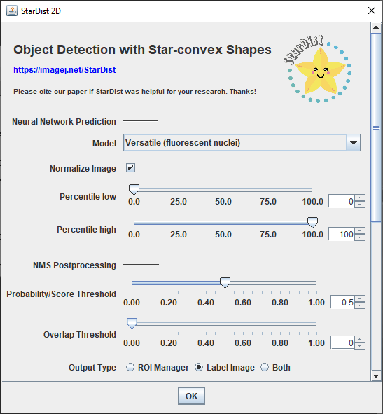
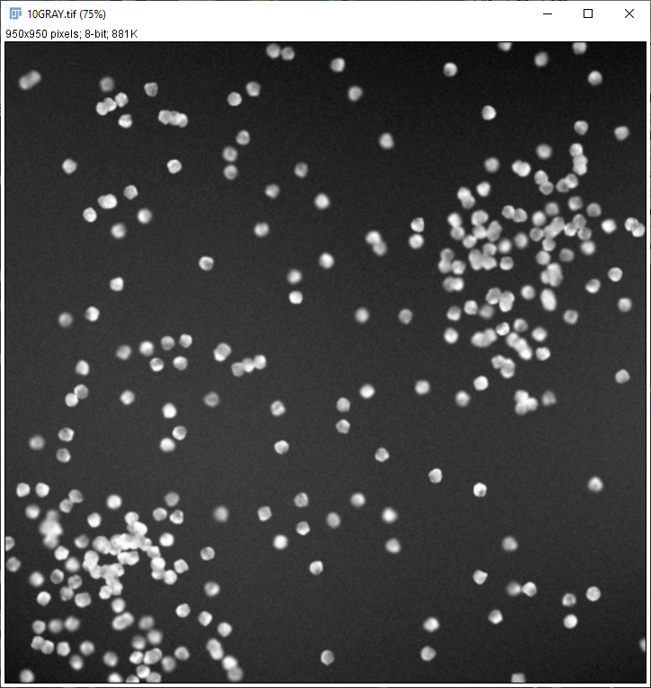
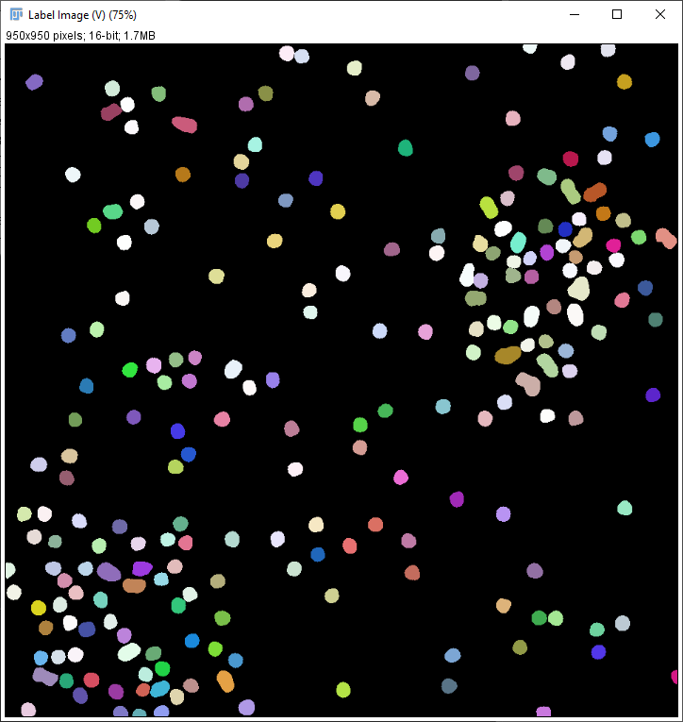
Settings - Overlap

Slide 12
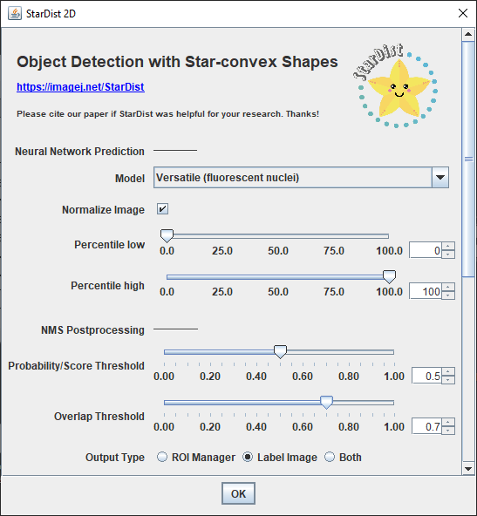
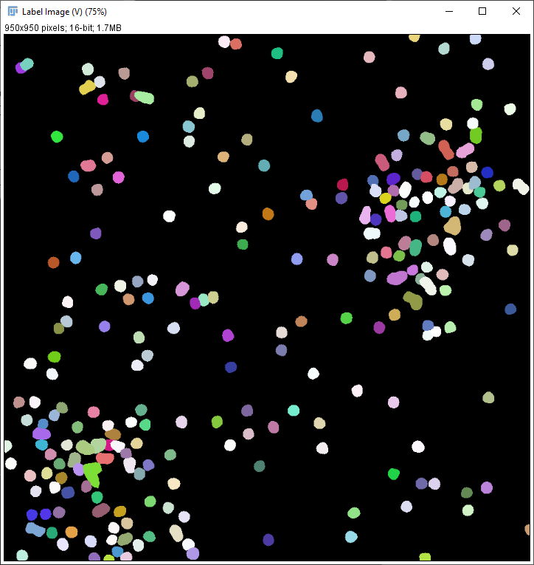
Settings - Overlap

Slide 13
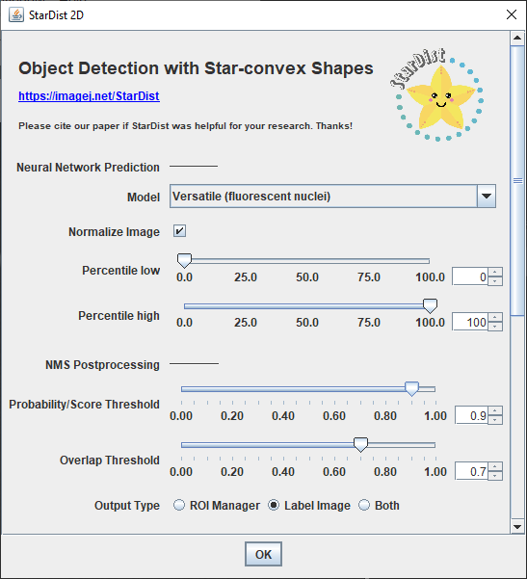
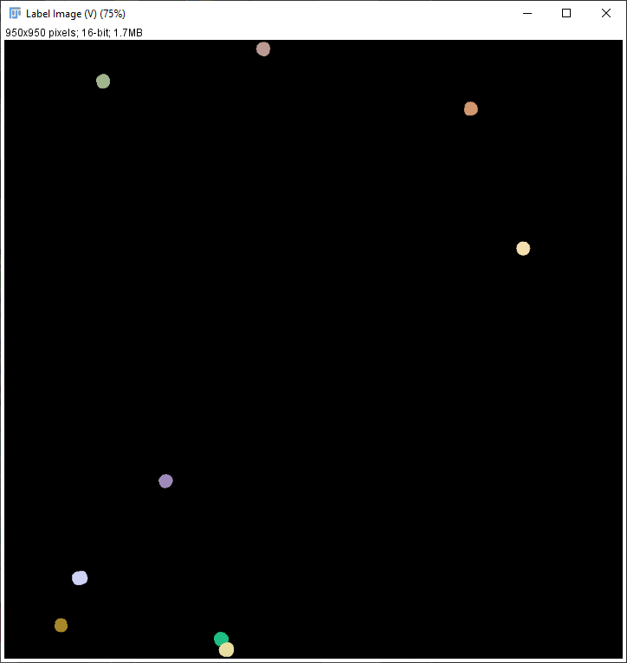
Settings - Overlap + Probability

Slide 14
Plugins available for:
ImageJ/Fiji
Scriptable ImageJ/Fiji plugin that can be used to run pretrained StarDist models on 2D or 2D+time images.
Napari
Plugin for the Python-based multi-dimensional image viewer napari. It directly uses the StarDist Python package and works for 2D and 3D images.
QuPath
Inspired by the Fiji plugin, Pete Bankhead made a custom implementation of StarDist 2D for QuPath to use pretrained models.
Icy
Based on the Fiji plugin, Deborah Schmidt made a StarDist 2D plugin for Icy to use pretrained models.
KNIME
Stefan Helfrich has modified the Fiji plugin to be compatible with KNIME.

Slide 15
References
Uwe Schmidt, Martin Weigert, Coleman Broaddus, and Gene Myers.
Cell Detection with Star-convex Polygons.
International Conference on Medical Image Computing and Computer-Assisted Intervention (MICCAI), Granada, Spain, September 2018.
Martin Weigert, Uwe Schmidt, Robert Haase, Ko Sugawara, and Gene Myers.
Star-convex Polyhedra for 3D Object Detection and Segmentation in Microscopy.
The IEEE Winter Conference on Applications of Computer Vision (WACV), Snowmass Village, Colorado, March 2020
ImageJ/Fiji plugin for StarDist: https://imagej.net/plugins/stardist

Slide 16
Data and Citation
We used image set BBBC038v1, available from the Broad Bioimage Benchmark Collection [Caicedo et al., Nature Methods, 2019].

