Slide 1


Introduction to Light Microscopy
Zdenek Svindrych, PhD
BioImage Analysis in Superresolution Microscopy Workshop 2023
Dartmouth College, 6/6/2023
Notes:
By “light” I mean FLUORESCENCE

Slide 2
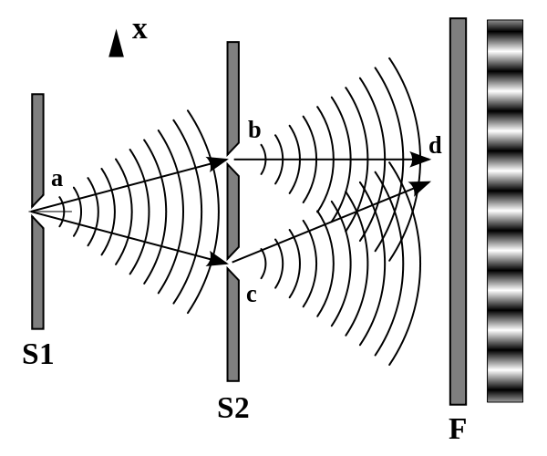
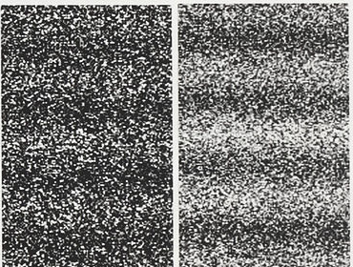
What is light?
Electromagnetic wave
  simple to observe (Thomas Young, 1801)
  described by Maxwell Equations
  diffraction
  very important in microscopy!
Wikipedia.org
Particle (photon)
  “quantum” of light (quantum mechanics)
  predicted theoretically (Albert Einstein, 1905)
  stable, uncharged, boson
  important in microscopy as well!
“one photon at a time”
Notes:
For those of you who are not familiar with light … light can be viewed as an electromagnetic wave … or particle …
But these are just simplification of the quantum-mechanic nature of light.

Slide 3

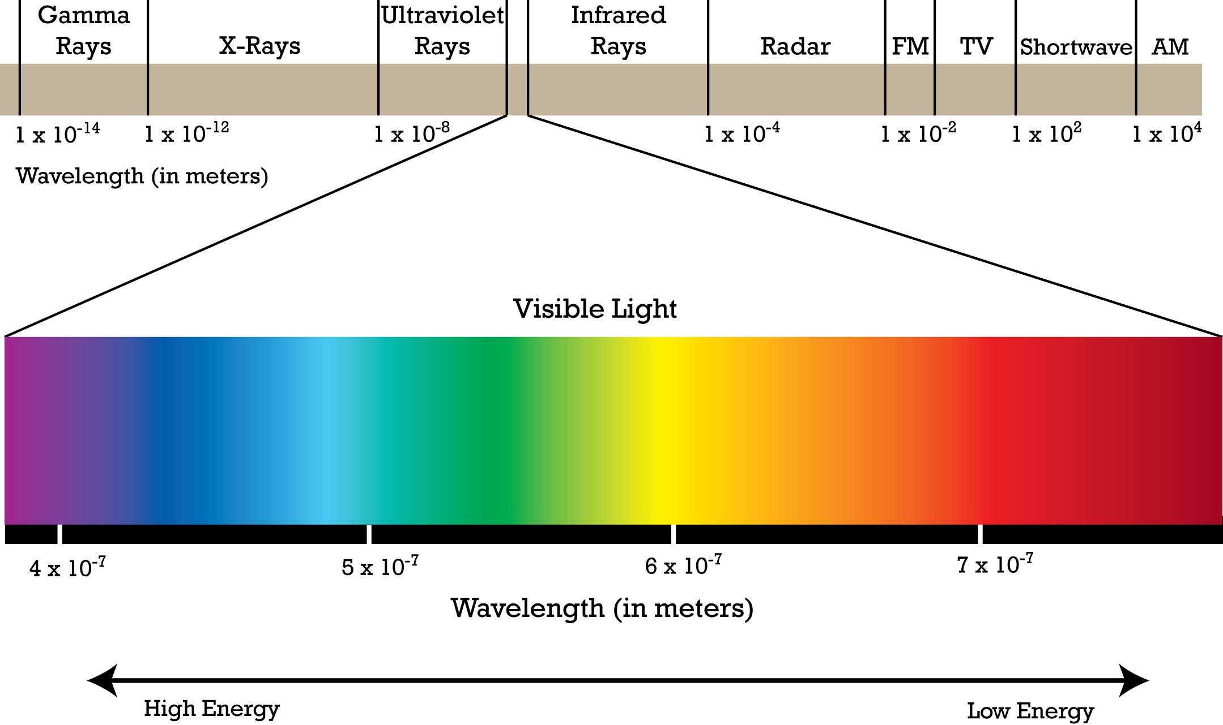
Electromagnetic spectrum
1 m | 1 | -
mm | 10⁻³ | mili
µm | 10⁻⁶ | micro
nm | 10⁻⁹ | nano
pm | 10⁻¹² | pico
fm | 10⁻¹⁵ | femto
400 nm
700 nm
Notes:
Range of wavelengths quite limited
Why is it important? The resolution is commensurate with the size of the probe (like tip of the phono pickup); with light the probe size is the wavelength…

Slide 4
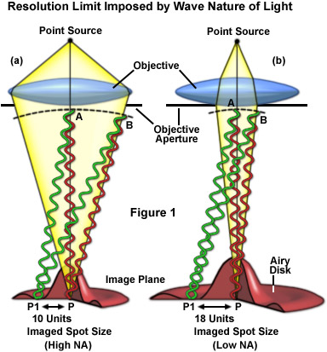
Image of Point Source
Imagine a point source of light...
Light passes through objective lens...
After the lens use Huygens principle...
Do the math (not trivial, let’s skip it)
In focus the profile is “Airy disc”
Back-project into the sample -> Point Spread Function (PSF)
Note, smaller aperture (NA) results in larger PSF (lower resolution)
Nikon microscopyU
Notes:
First, we need to know who are we dealing with: the Image Formation Process
...note on Airy disc: a blurry spot with rings of zero intensity...
.......
(at the end) Magnification plays some role in the size of the Airy disk. But we can back-project the Airy disk through the lens to a small “Airy disc” in the sample.

Slide 5
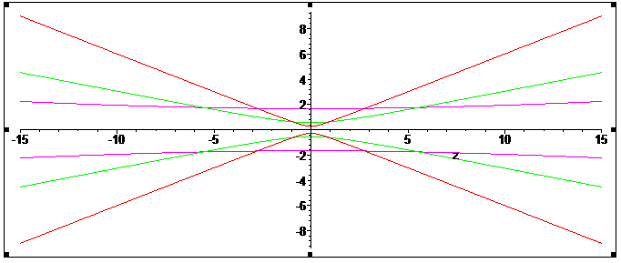
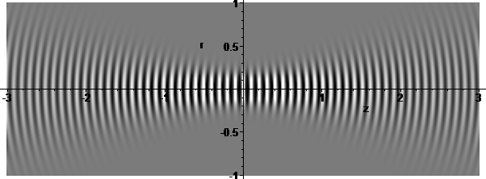
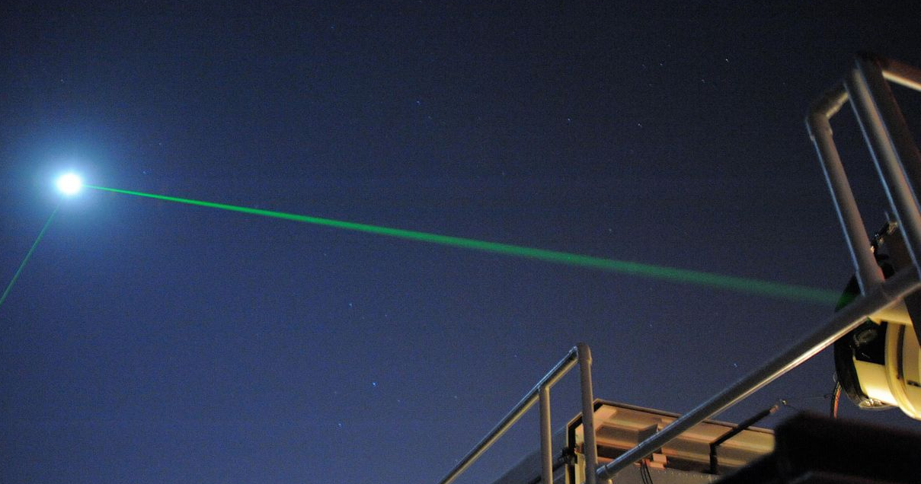
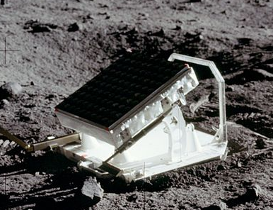
Diffraction and propagation of light
10 cm diameter “collimated” single-mode laser beam @ 532 nm
650 m diameter illuminated area on the Moon
Notes:
The diffraction of light dictates that the narrower a gaussian beam is, the faster it spreads
And conversely, if we want to focus a light to a small spot, the beam must converge with high angles

Slide 6



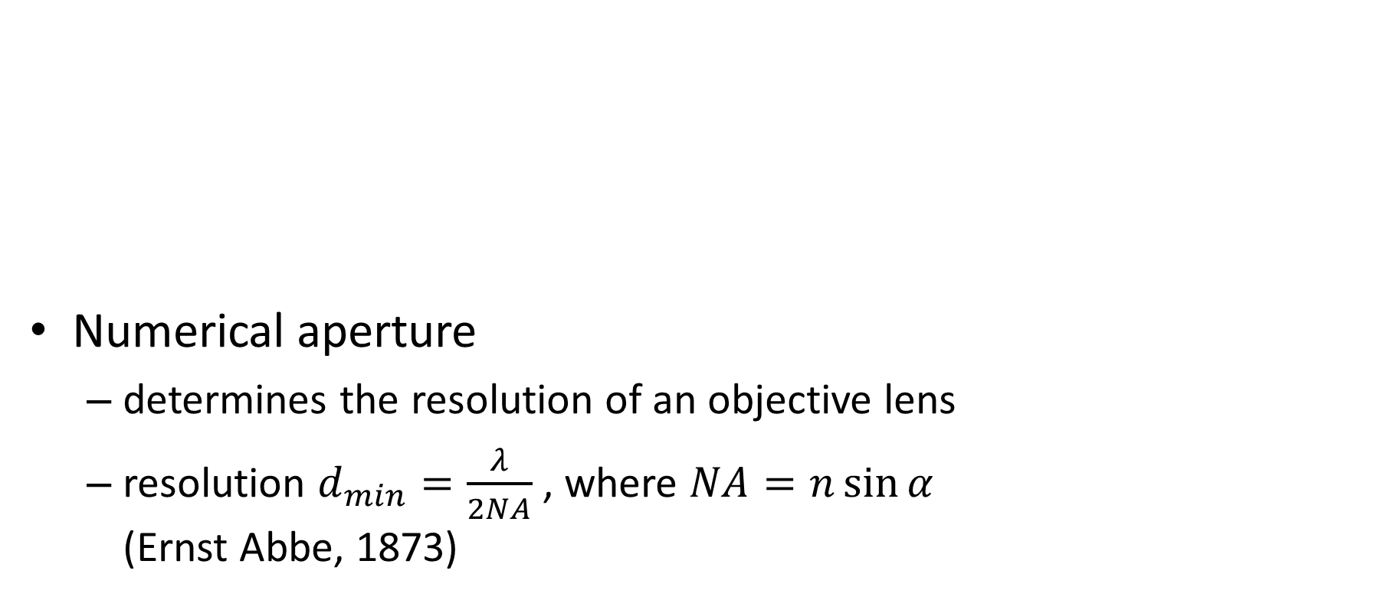
Diffraction and microscopy
Numerical aperture
  determines the resolution of an objective lens
  resolution $d_{min}=\frac{λ}{2NA}$ , where $NA=n\sin{α}$
  (Ernst Abbe, 1873)
NA = 0.6
NA = 0.3
NA = 0.1
α
µm
d_{min}
Notes:
Whereas in astronomy we look at the far field, in microscopy, the resolution can be expressed as “how small spot can we illuminate with a laser beam?”
The same diffraction rules say, that to illuminate a small spot the light has to converge from a large range of angles!
Practically, the best achievable resolution is around 200 nm. Absolutely no details finer than the resolution limit can pass the objective lens!
That also means that small objects below the resolution limit are imaged as blurry blobs – the PSF.

Slide 7

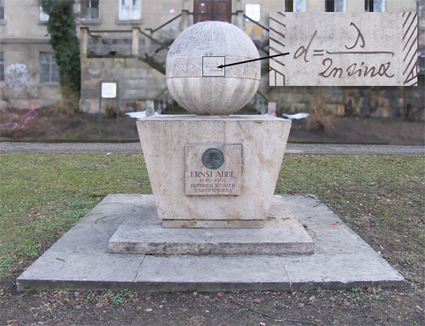
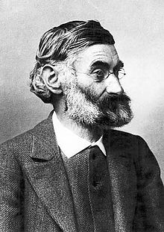
Optical resolution limit
Ernst Abbe memorial in Jena, Germany
Notes:
The resolution limit is so fundamental, it is literally carved in stone…

Slide 8
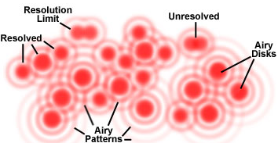

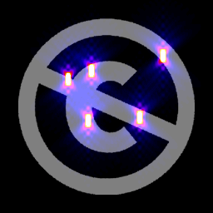
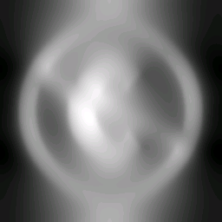
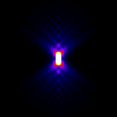
Image formation, PSF
Every point of the sample is replaced by the corresponding Airy Disc
  mathematically this is ‘convolution’
  result is blurred image
Reality is, however, more complicated…
  world is 3D
  3D convolution with PSF (Point Spread Function)
  PSF = 3D ‘image’ of a point source
  can be reverted to some extent (deconvolution)
Nikon MicroscopyU
sample
widefield PSF
convolution
result
⊗ → →
z
x
Notes:
Convolution – very nice linear integral operation, beautiful properties, especially together with Fourier Transform ☺ This only works for incoherent light = FLUORESCENCE…
image formation happens in real world = 3D
PSF can be measured on sub-resolution (100 nm) fluorescent beads
there are complicated models to calculate PSF as well…
PSF is usually rotationally symmetric around z-axis
remember, these are x-z sections

Slide 9
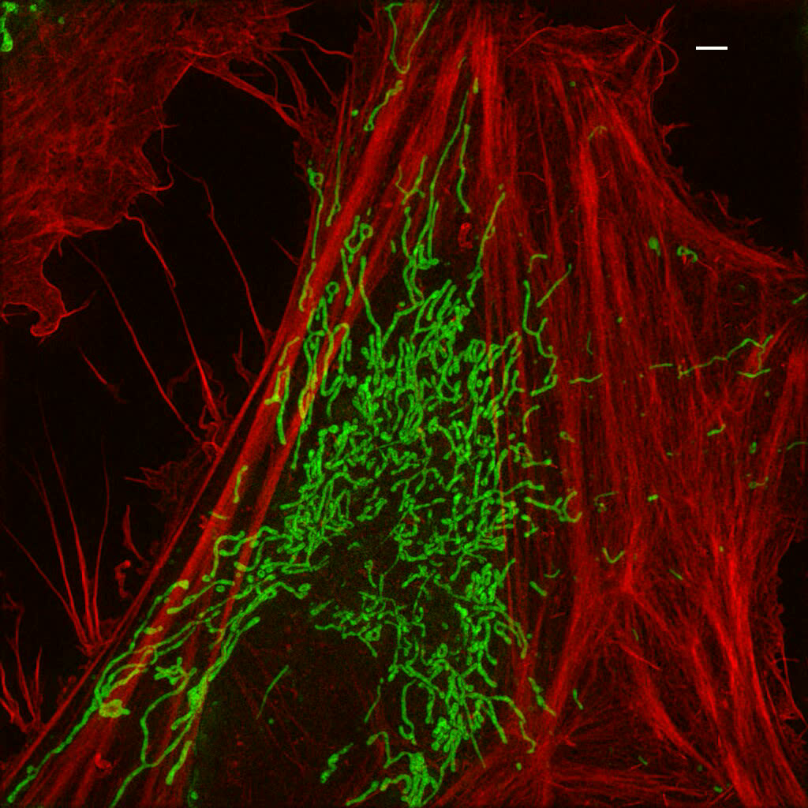
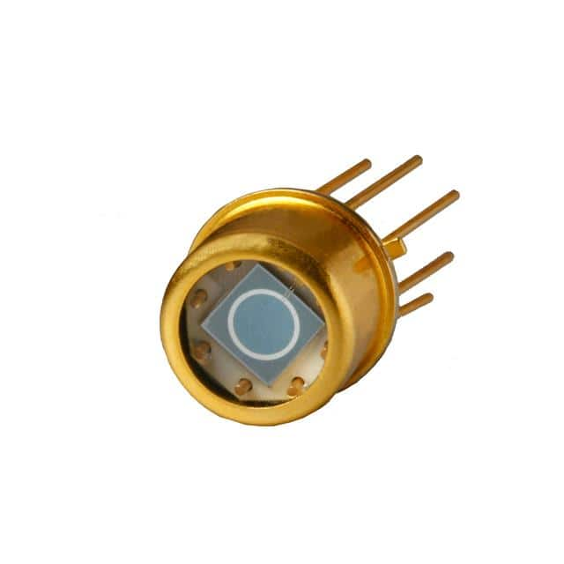

Photons

Slide 10
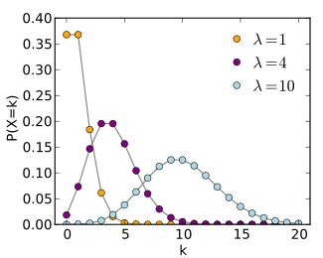
Photon statistics
the localization accuracy depends critically on the intensity of blinking event and the background intensity
light is quantized into photons (λ = c/ν, E = hv = hc/λ)
photons are arriving randomly
  the probability of photon arrival is independent of the time since last arrival
  Poisson distribution = the probability of given number of photons arriving in a fixed time interval (e.g. exposure time)
  single parameter: λ = average number of photons in fixed interval
  mean = λ, std. deviation = √ λ
  photon-limited systems are noisy…
Notes:
the fluorescent background causes lot of noise…
we are photon-limited – each blink has only 1000-10000 photons, no averaging can help us…

Slide 11
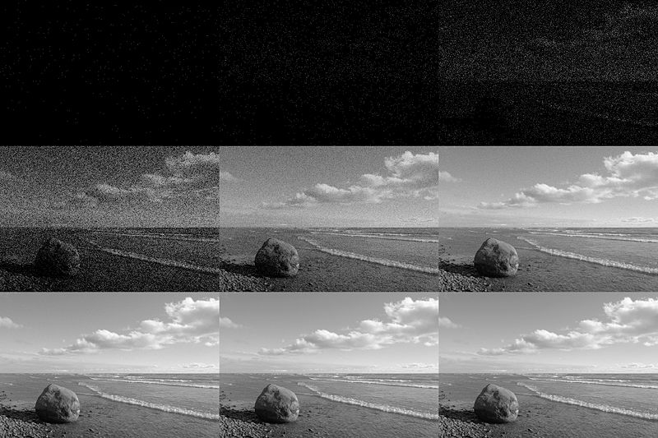

Photon statistics
0.1
1
10
100
wikipedia.com
Notes:
Mean photons per pixel
Remember, photons come with noise!

Slide 12
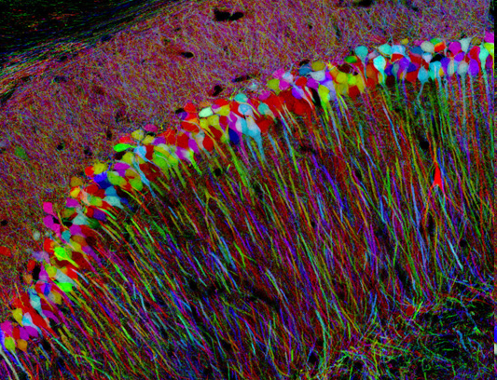
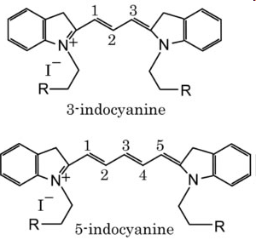
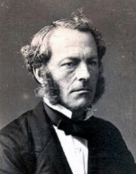
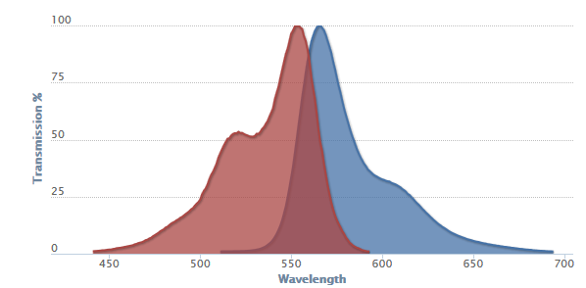
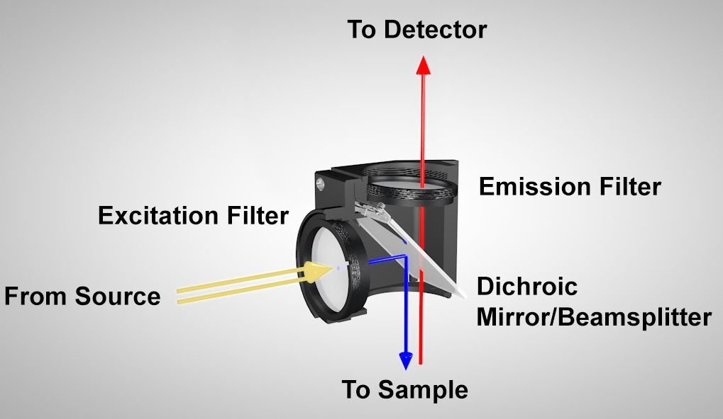
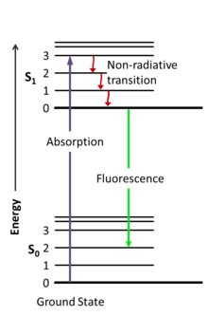
Fluorescence
Cy3
(3 carbons)
Stokes’ Shift
thorlabs.com
absorption
emission
Absorption spectrum
Emission spectrum
The spectra are mirror images (roughly)
Notes:
There are many sources of contrast in microscopy, we’ll consider fluorescence only, as it’s the most powerful tool.

Slide 13
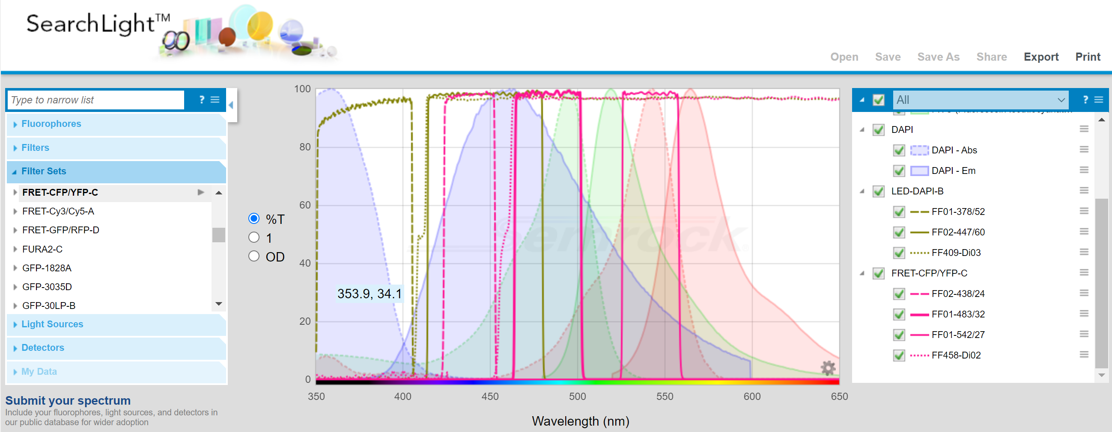
Fluorescence Spectra
Numerous online tools, e.g. Semrock Searchlight
Notes:
Just as a useful tip, …
… but back to microscopy!

Slide 14
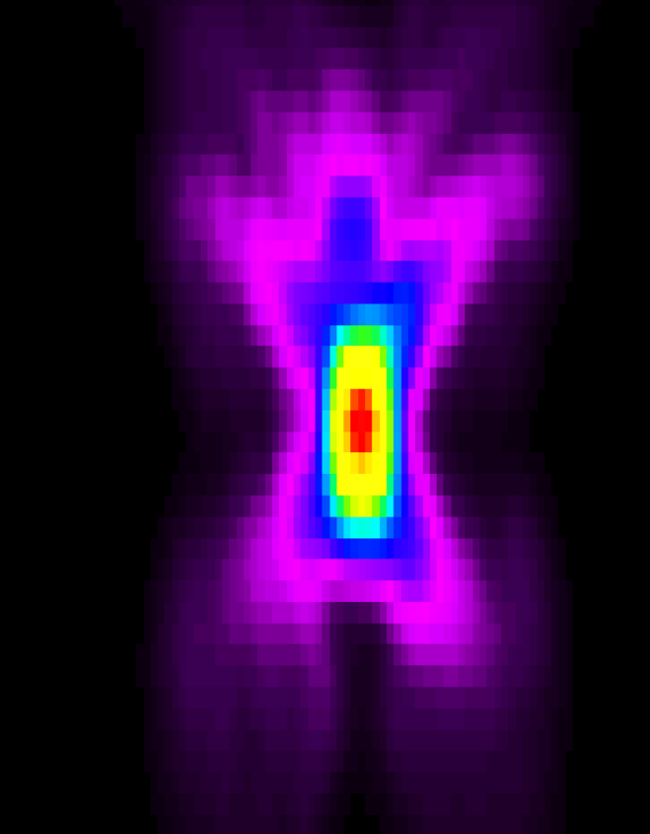
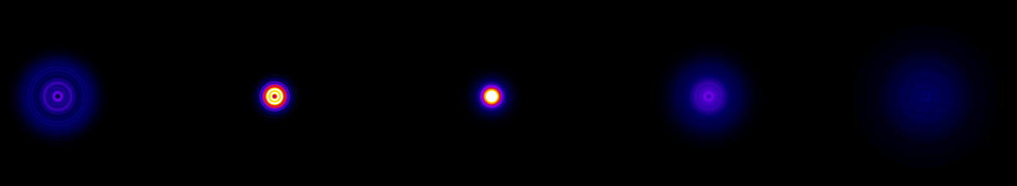
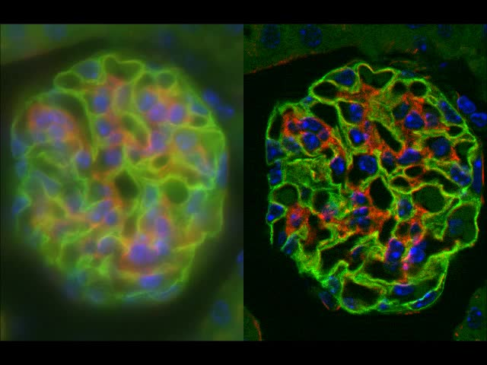
Fluorescence Microscopy in 3D
The PSF is a 3D “object”
Infinite extent in the z-direction!
Conserved intensity along z -> out of focus blur!
y
x
z
x

Slide 15
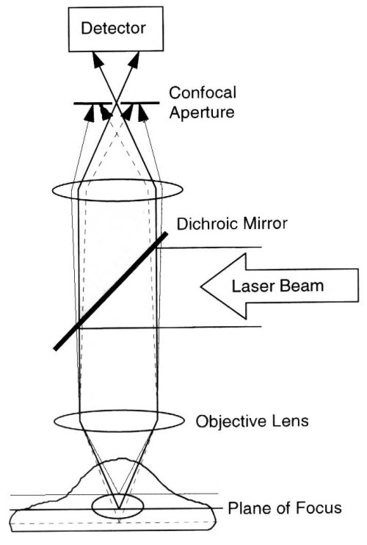
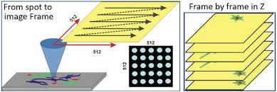
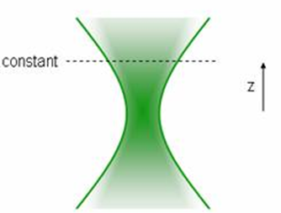
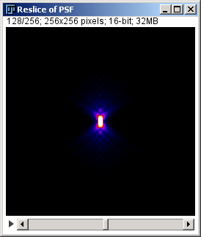
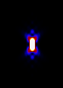
Confocal Microscopy
Confocal pinhole
Excitation
Detection
Confocal
x
=
750 nm
optical
section
z
x
Notes:
Solves the out-of-focus blur problem.
Here: raster scanning…
Mathematically, we multiply two PSF profiles – exc and det
Does not seem like much, but the effect is profound!

Slide 16
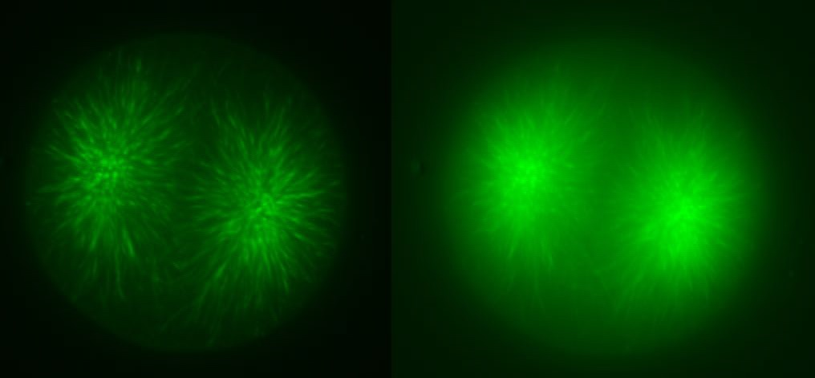
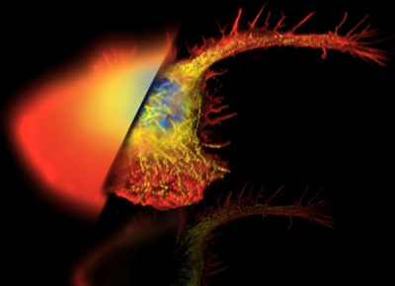
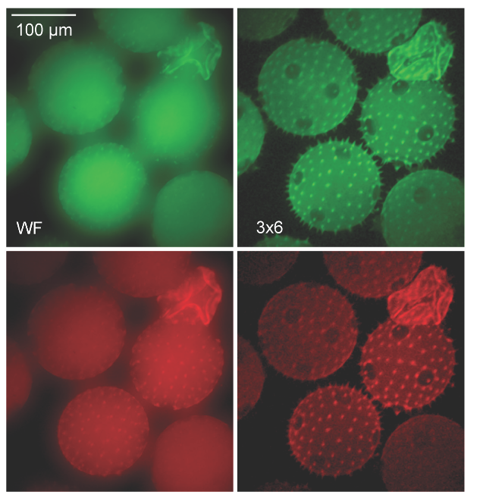
Confocal Microscopy
Remember:
Photons -> Noise
Background signal -> More noise
Notes:
It is not just nicer images. Remember, photons come with noise, background photons = background noise!
More can be appreciated from the point of view of Fourier images…

Slide 17
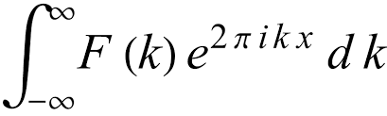
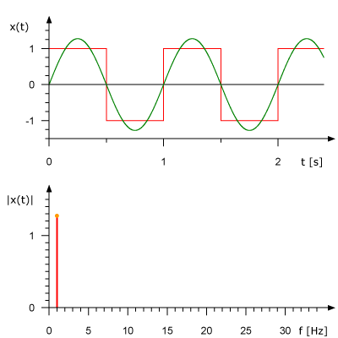
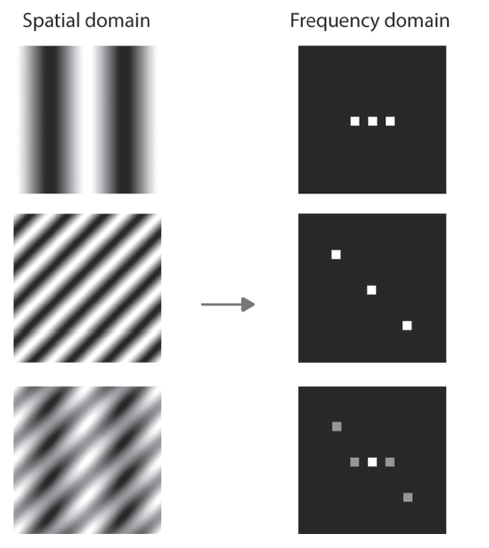
Fourier transform
Signal Image
Spatial domain
Frequency domain
https://www.researchgate.net/publication/323073291_An_introduction_to_optical_super-resolution_microscopy_for_the_adventurous_biologist
Notes:
Adding harmonic (sin, cos) functions of equally spaced frequencies approximates the original signal

Slide 18
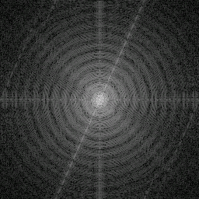
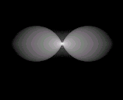
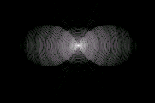
Fourier transform
Another integral transform (between “real” space and “Fourier” space)
Linear, complex (not necessarily complicated)
Simple inverse transform exists
Convolution in real space = multiplication in Fourier space!
F
z
F
F⁻¹
x
x →
High spatial frequencies = high detail
k_{z}
Detail lost...
k_{x}
Notes:
More math, of course
FT = another integral transformation, super useful! But I won’t go into any detail. Mention only, that high spatial frequencies (high details) are far from the center).
... ft – convolution theorem
Remember: convolution = image formation.
Note the shape of the widefield PSF and it’s FT!

Slide 19
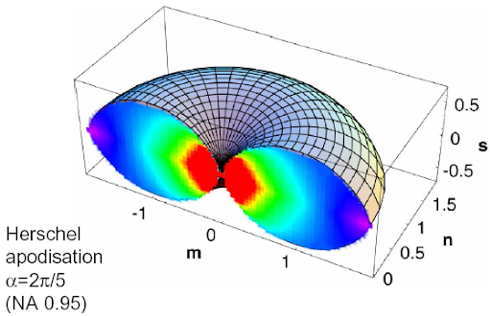
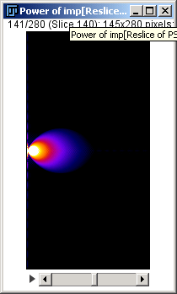
Widefield PSF and OTF (Optical Transfer Fn.)
Widefield PSF has some seriously nasty features
Total intensity at every z-section is the same
  Total intensity of the whole 3D PSF is infinite
  There is the “missing cone problem” in the OTF
The OTF is zero outside the 3d “donut” shape
  Information is lost!
Arnison, Optics Comm., 211, 53-63 (2002)
F
z
x
OTF
PSF
Notes:
Back to the Widefield PSF and it’s FT, the OTF
....

Slide 20
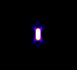
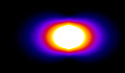
Confocal PSF and OTF
widefield
z
x
Confocal – no missing cone problem!
Notes:
Missing problem solved!

Slide 21
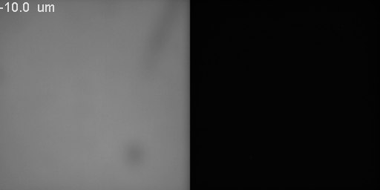
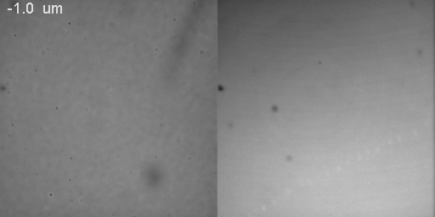
Extreme example: thin fluorescent layer
Both the constant “PSF sections” and the missing cone can be demonstrated easily...
Widefield vs Confocal (spinning disk)
thin fluorescent layer, z-stack
Notes:
Back to the Widefield PSF and it’s FT, the OTF
Now that I’ve mentioned Spinning Disk Confocal…
....

Slide 22
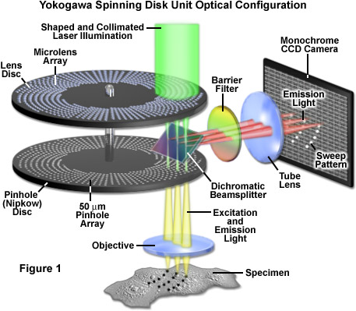

Spinning Disk Confocal Microscope
Highly parallelized image acquisition
Optical sectioning degraded slightly by pinhole crosstalk
Detector
Yokogawa.com
Olympus-licescience.com

Slide 23




Nyquist–Shannon sampling theorem
Critical sampling frequency
Incorrect sampling ->
Aliasing artefacts
Loss of resolution
Practically: pixel size ~ 1/2.3 d_{min}
Notes:
With 500 nm light, 1.4 NA the pixel size should be around 80 nm

Slide 24


Magnification Matters
Cameras (CMOS, CCD) have fixed pixel size!
Effective pixel size = Real pixel size / magnification
Notes:
Magnification does not matter so much in point-scanning confocal microscope, where we can adjust the pixel size freely.

Slide 25

Questions?
Hagen Lab @ LF1
Guy M. Hagen
Pavel Křížek
KONFMI @PrF UK
Zuzana Burdikova
Martin Schatz
BioMT @ Dartmouth
Zdenek Svindrych
NIH: NIGMS COBRE award P20-GM113132

