Slide 1

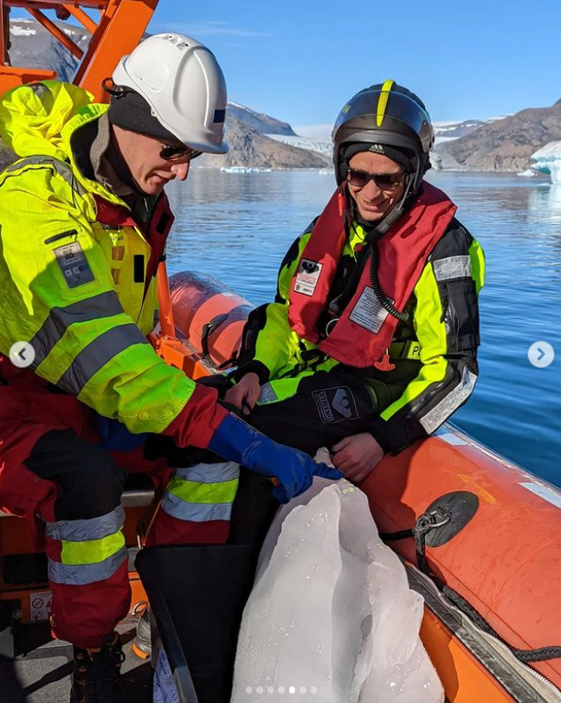
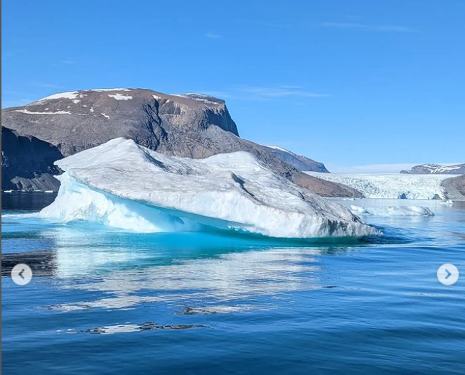
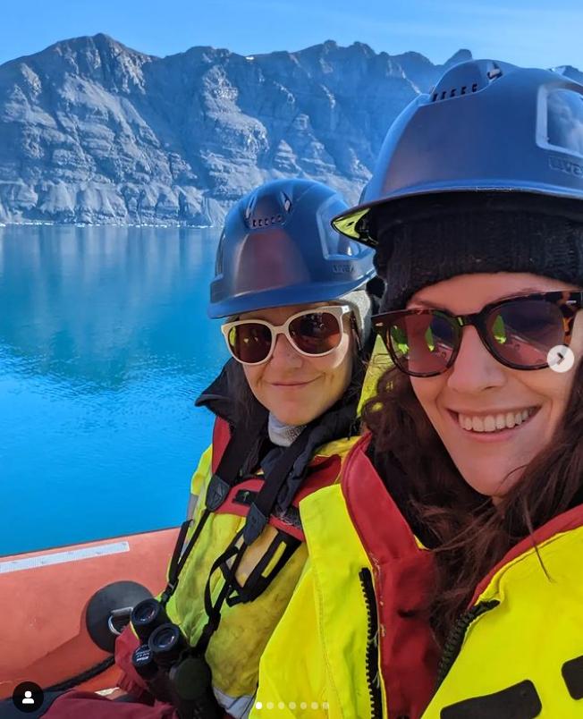
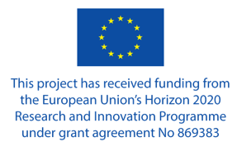


Investigations of seafloor biodiversity and their roles in arctic marine ecosystems.
Phoebe Armitage
Supervisors: Anna Törnroos & Marie Nordström

Slide 2
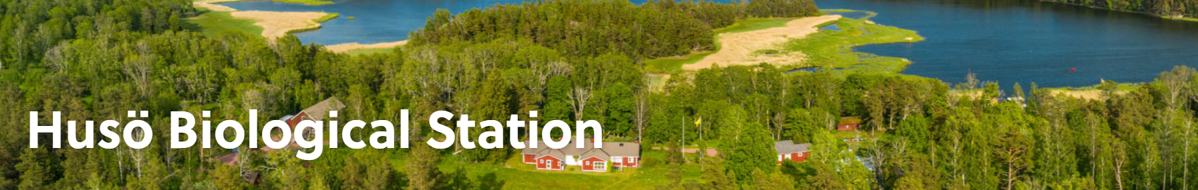
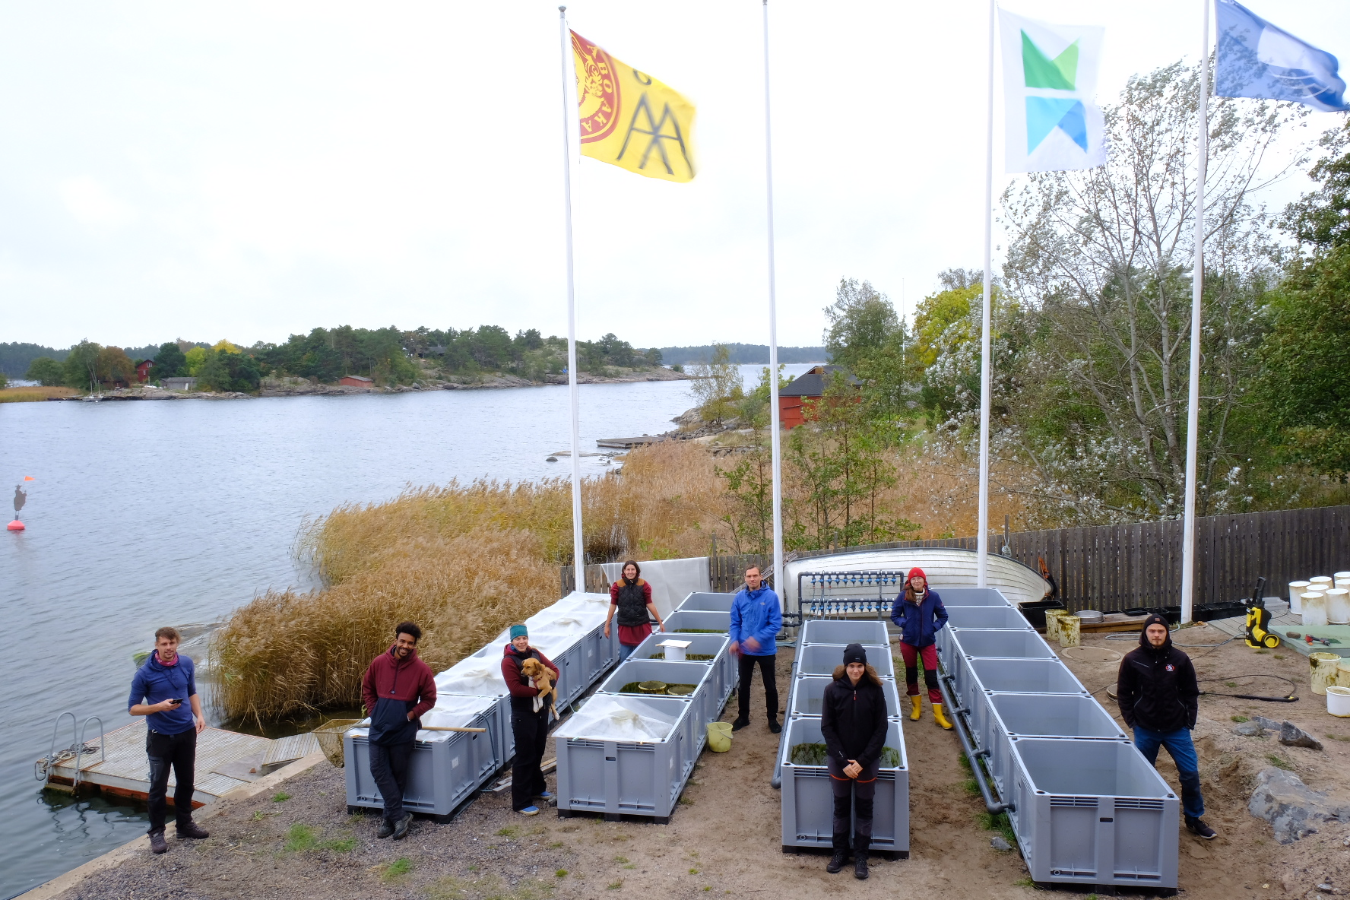

Environmental and Marine Biology
Specialising in:
  Seagrass meadows and gulfs
  The deep bottom areas of the Baltic Sea
  Island vegetation
  Benthic (seafloor) fauna, fish & flora
  The behaviours of fish and birds
  Evolutionary biology
  … and more!
Korpoström Marine Station

Slide 3
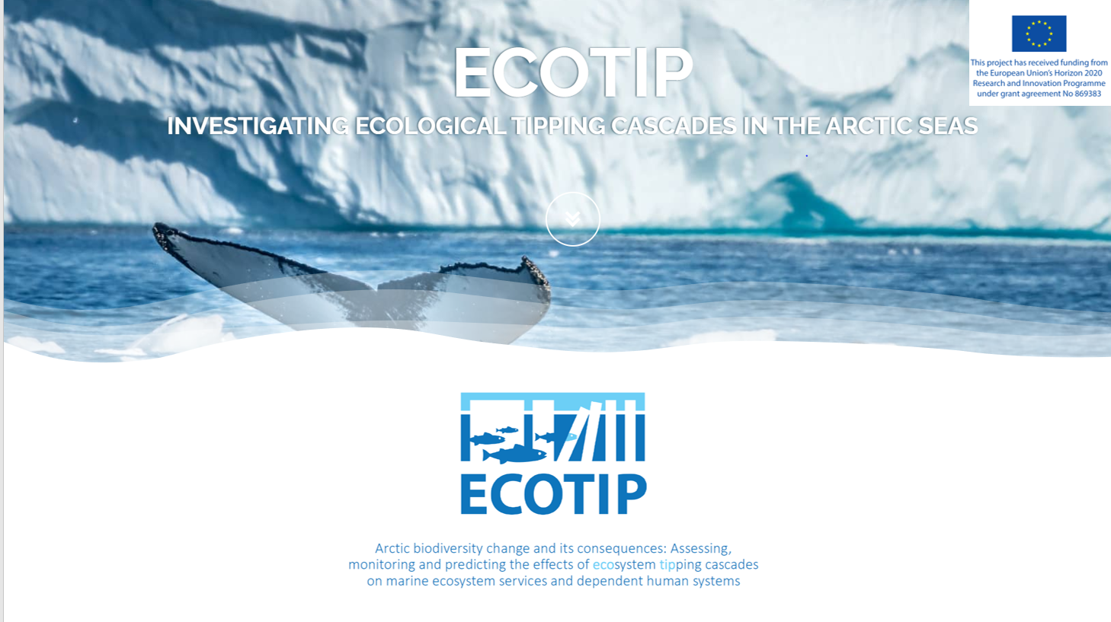
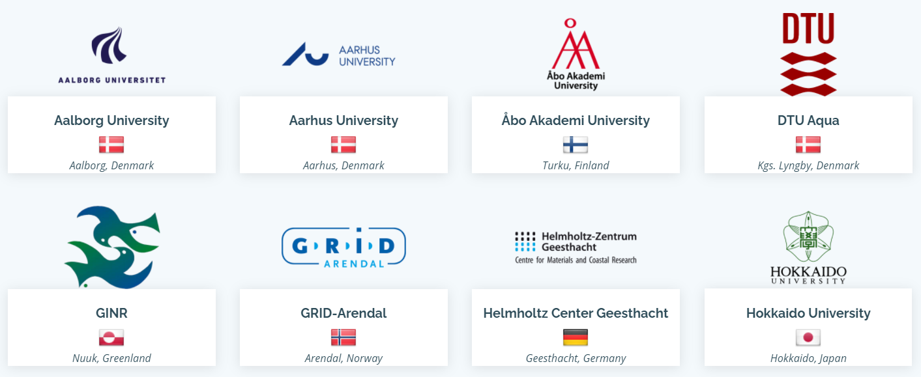
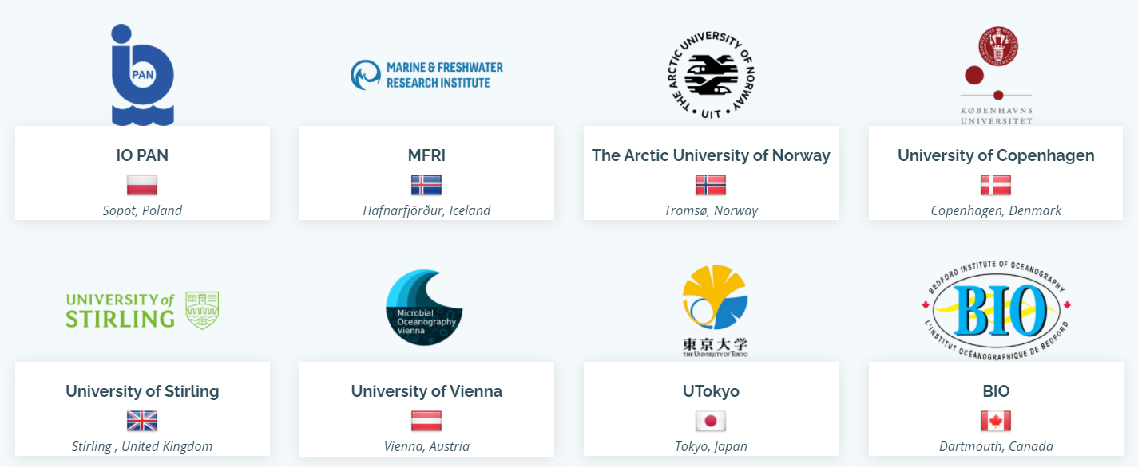

Slide 4
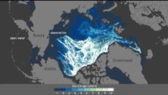
NOAA, 2020; https://www.youtube.com/watch?v=c6jX9URzZWg

Slide 5
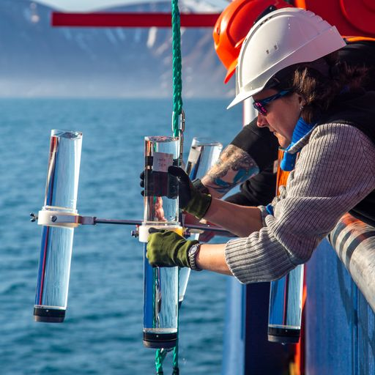
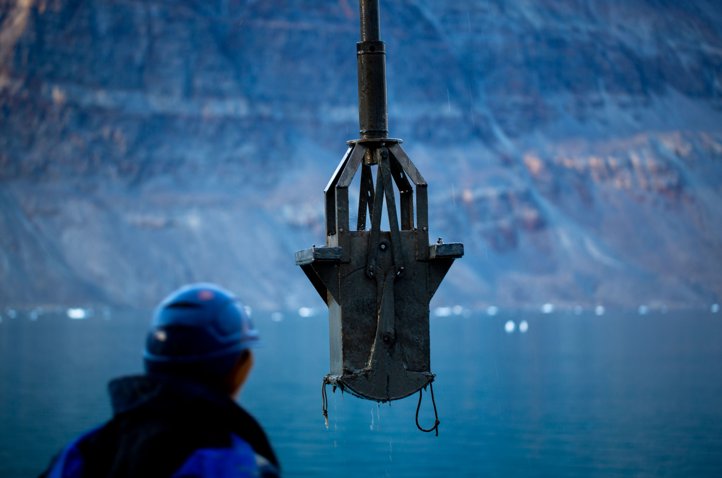
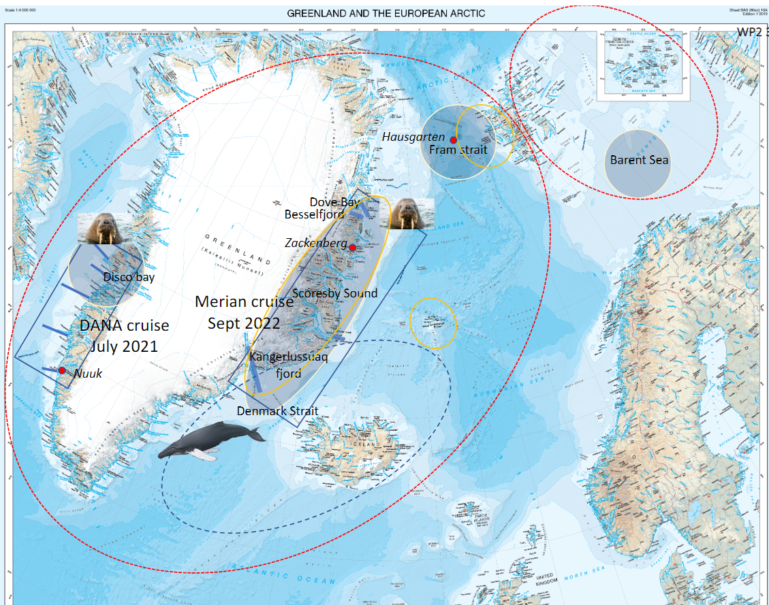
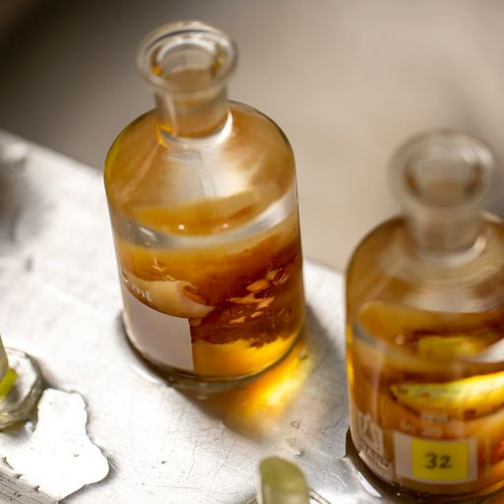
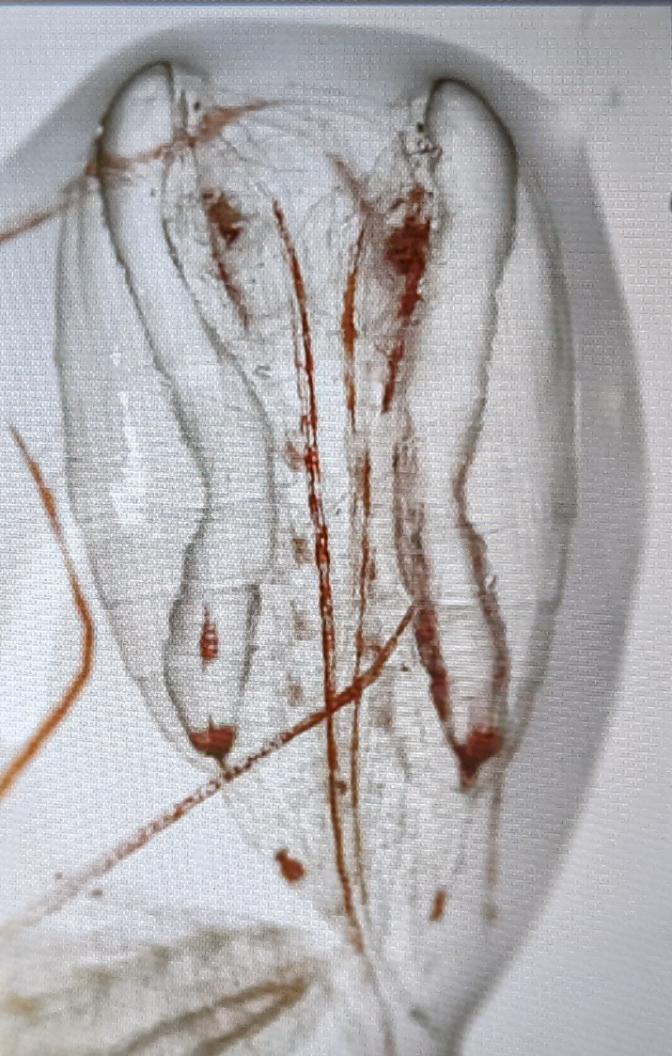
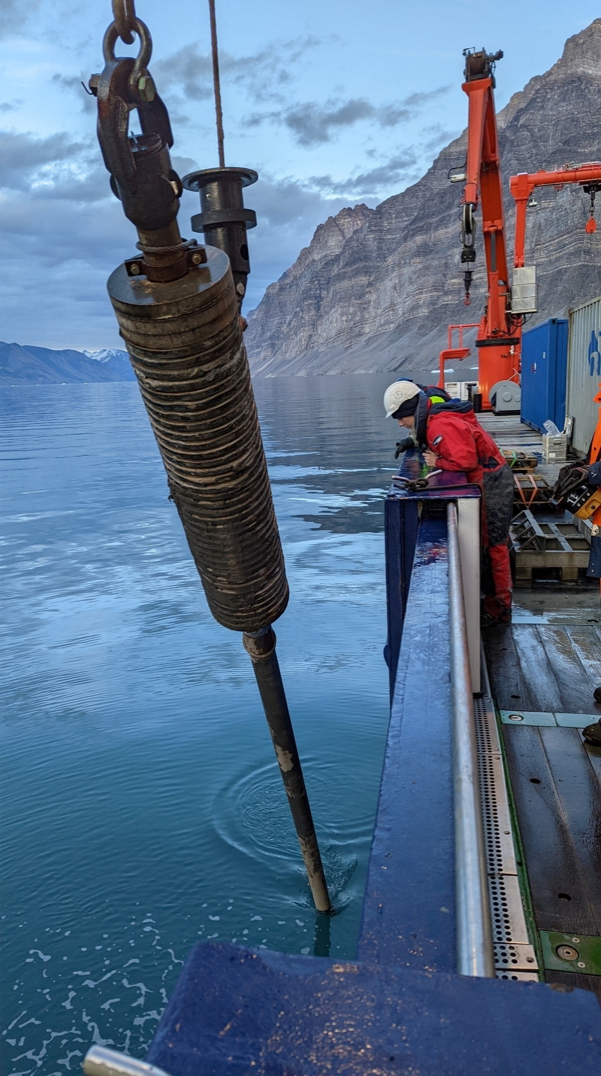
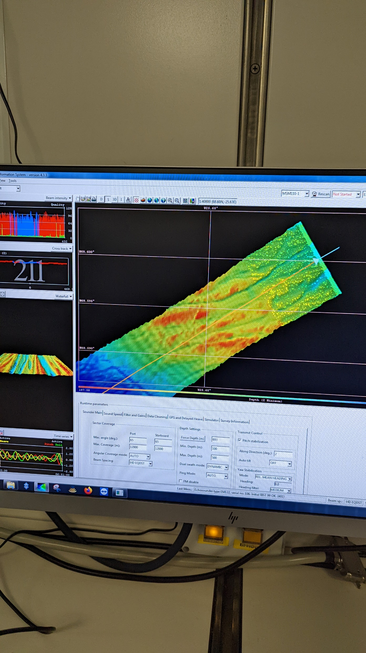
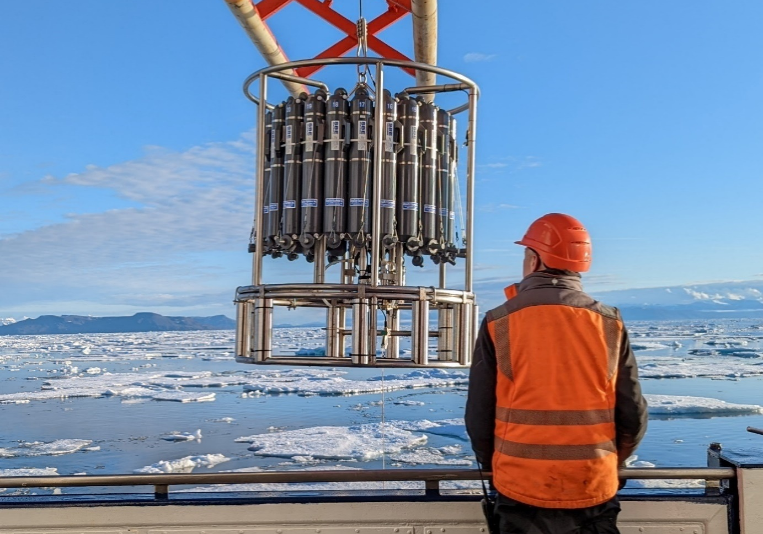
ECOTIP study area
Notes:
Multidisciplinary sampling:
Zooplankton sampling (nets)
Macroplankton and fish larvae
CTD casts including water sampling for:
Nutrients, chl-a, water chemistry, phytoplankton abundance, prokaryotic and fungal abundance, biomass, production, and respiration.
eDNA
Δ 13C of CO2 and CH4
Benthic samples
Sediment traps
1) Investigate the climate-induced changes in biodiversity and the resulting changes in the major biological processes in the Arctic marine ecosystem.
2) Estimating the sensitivity of functional traits at different trophic levels to environmental conditions, and to link the observed traits of the natural communities to ecosystem functions and services.
The aim of the zoobenthic sampling during the cruise was to assess the soft-bottom macrofaunal community structure (species composition, abundance and biomass) and function (trait composition) along environmental gradients
Soft-bottom macrofauna was sampled using a box-core, sieved (1mm mesh size) and stored in 70% alcohol for further processing and analysis in the laboratory. Furthermore, organic content, P/N ratio and sediment grain size was also sampled at each station (except one: station # 26).
10 stations, 33 replicates. Approx 2 per transect. Key stations with sediment traps.

Slide 6
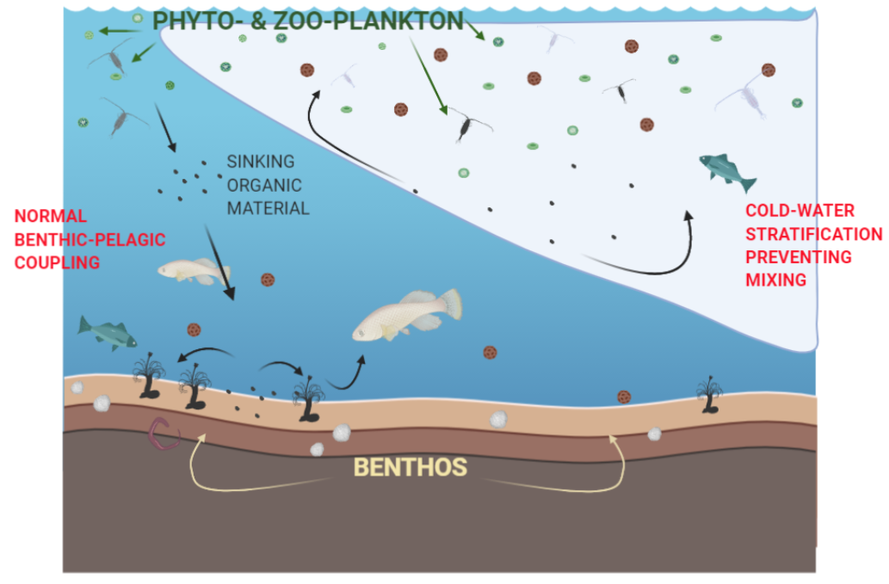
What’s ice got to do with it?
Climate change effects in the Arctic
Threats include water stratification, warming, fresh water, etc.
A change in the transfer of nutrients and organic matter to the seafloor.
Figure by Armitage, 2021
Notes:
Reduced sea-ice
Sea level rise
Increased water
temperatures
Species invasions / migrations

Slide 7
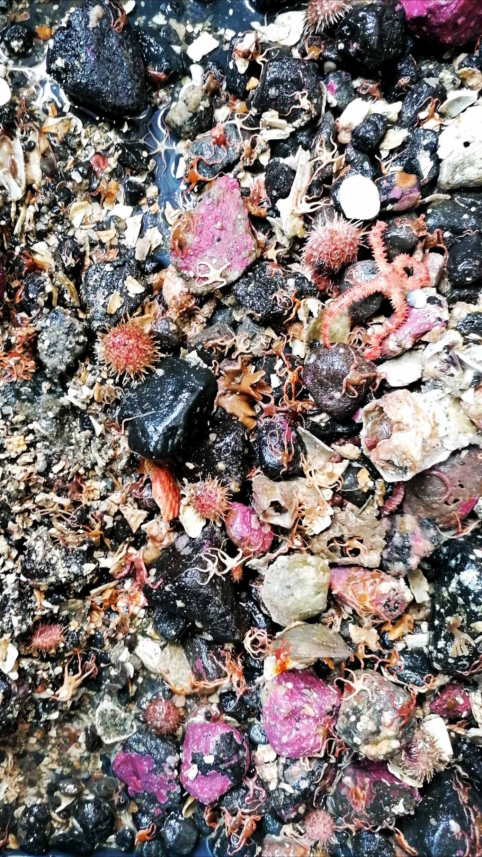
Arctic seafloor diversity
Rich in species diversity and abundance
Important for ecosystem functioning
  Nutrient cycling
  Carbon sequestration
  Important role in food-web
Good ecological indicators. Disturbance can alter community structure impacting ecosystem processes.

Slide 8
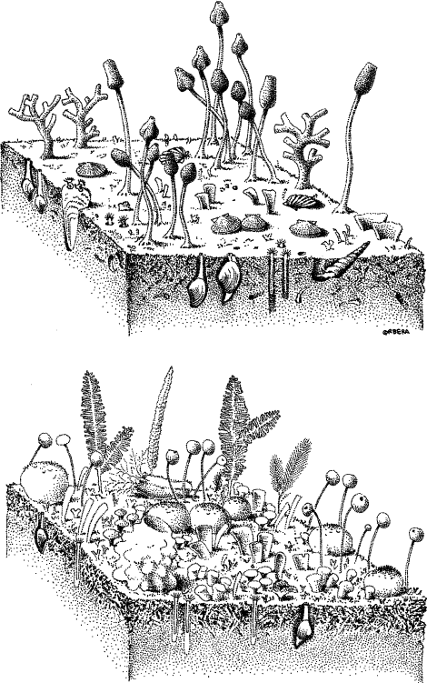
The Trait Approach
Species are highly diverse in shape, form, and function.
Using traits can link species to the environment and ecosystem functioning.
Can further our understanding of ecological communities through functional indices and analyses.
Various epibenthic assemblages.
Image Ref: Gili et al., 2006
Notes:
Categorical or continuous
Tell us if there is high spread in functions (richness or diversity) and things like redundancy.
How many species can we remove before we loose function

Slide 9
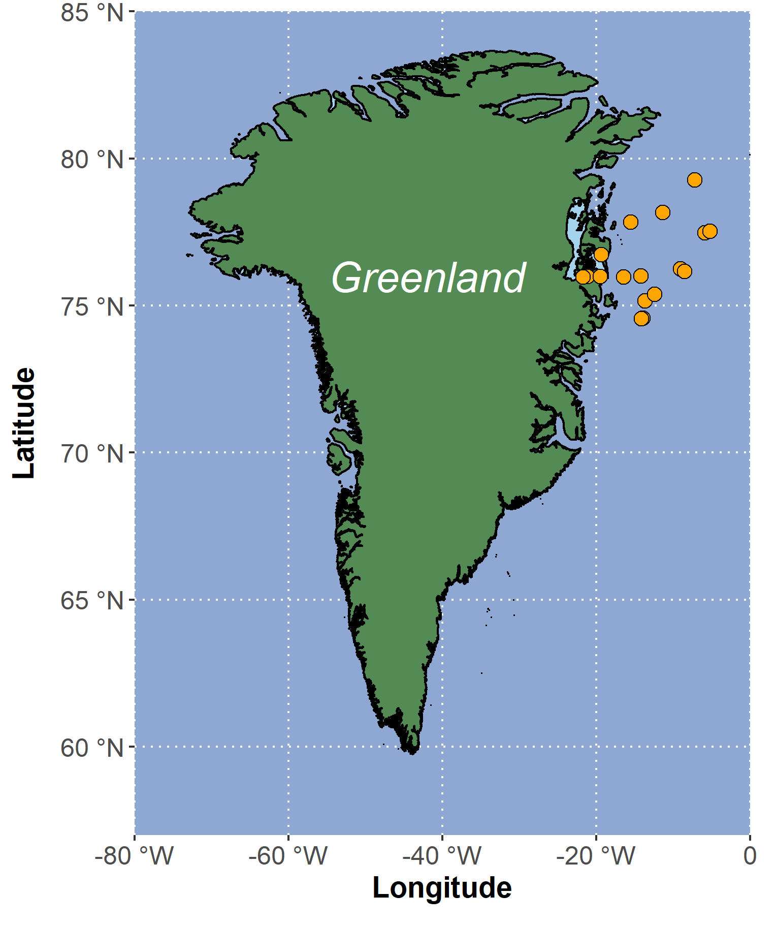
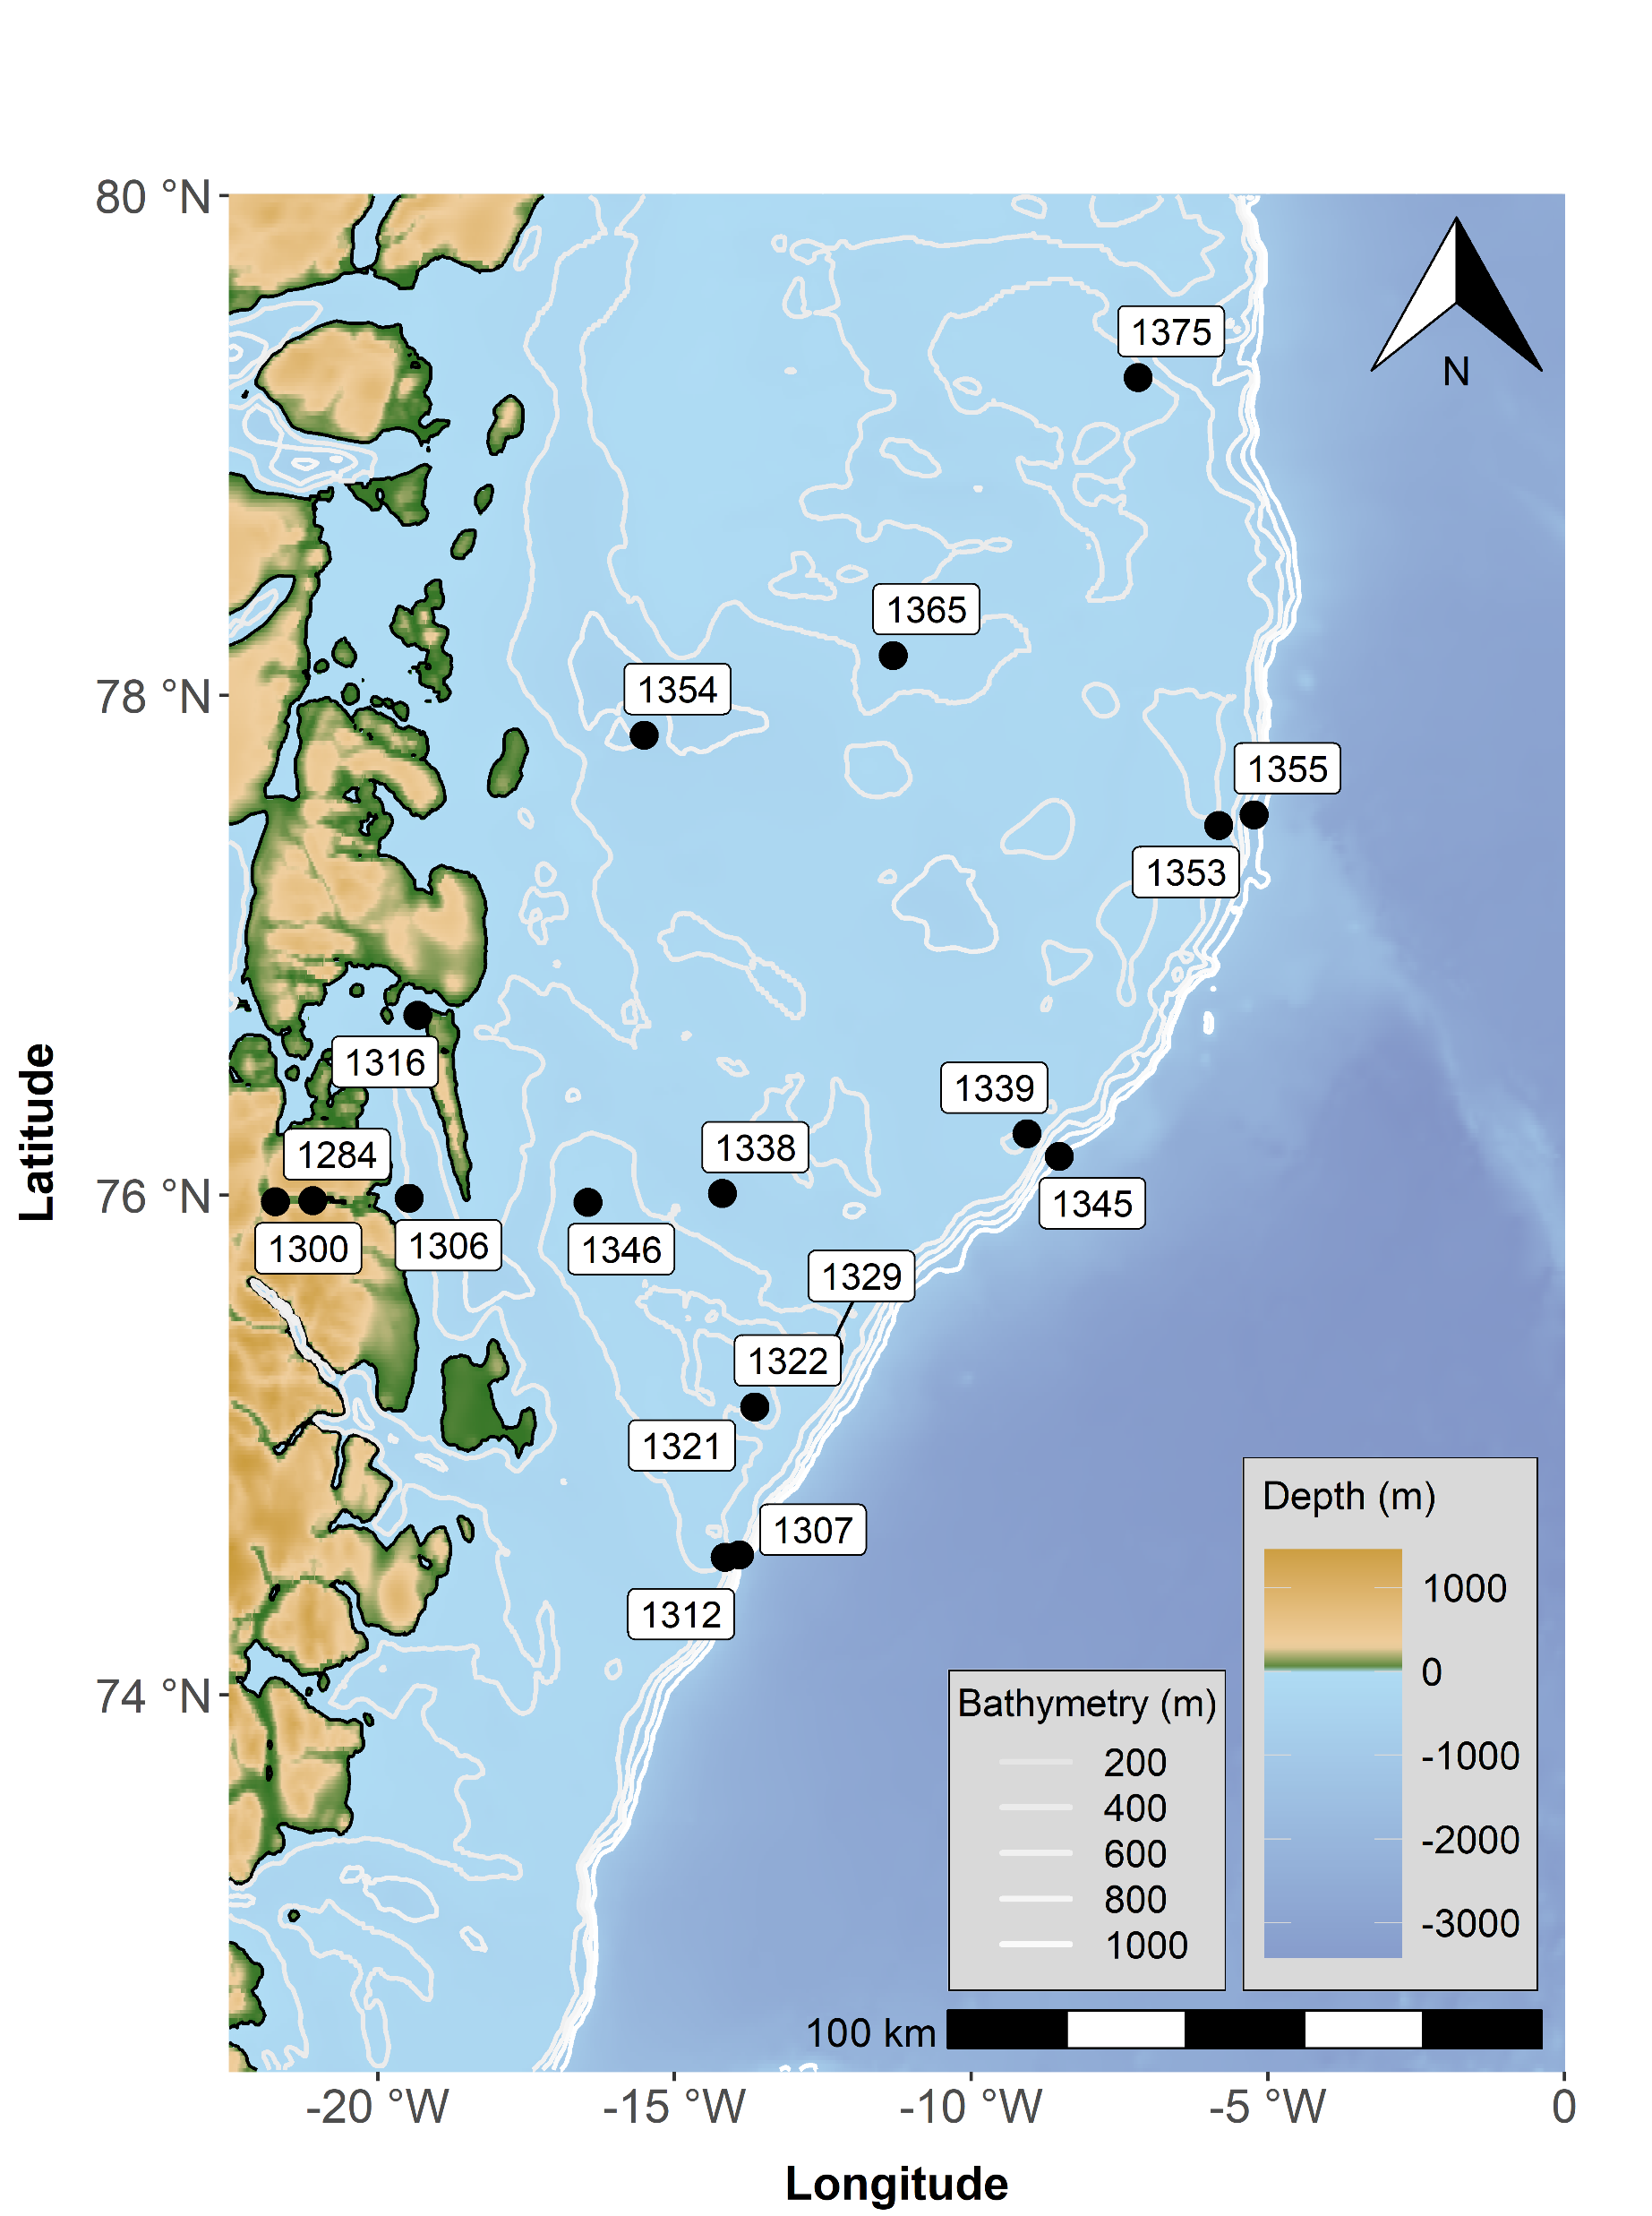
Distinct functional diversity patterns across a high Arctic continental shelf.
Epibenthic dataset across Northeast Greenland
Functional indices and functional structure was assessed.
Combination of traits, taxonomic relatedness, and environmental covariates were analysed (HMSC).
Working progress:
Armitage et al.

Slide 10
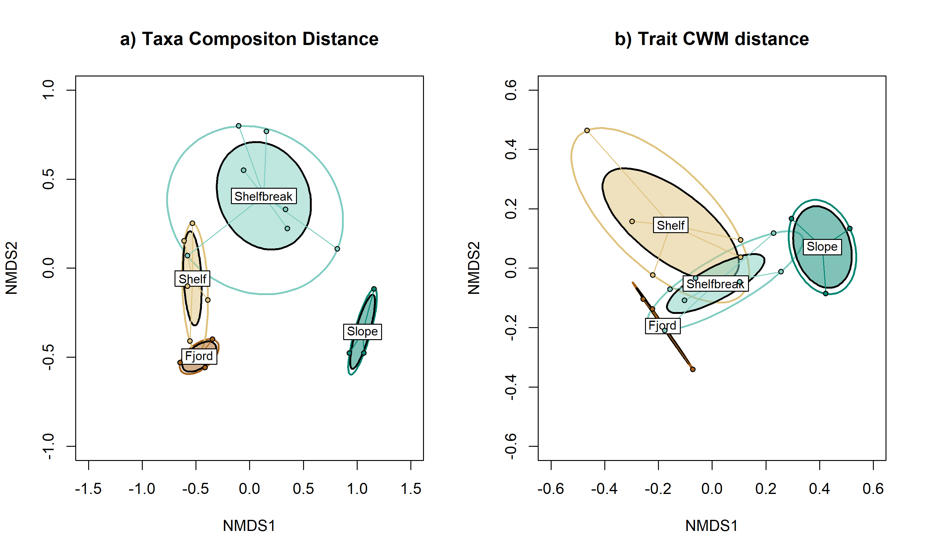
Results:
Community composition
Distinctive compositions of taxa and trait groups across the continental shelf area.

Slide 11
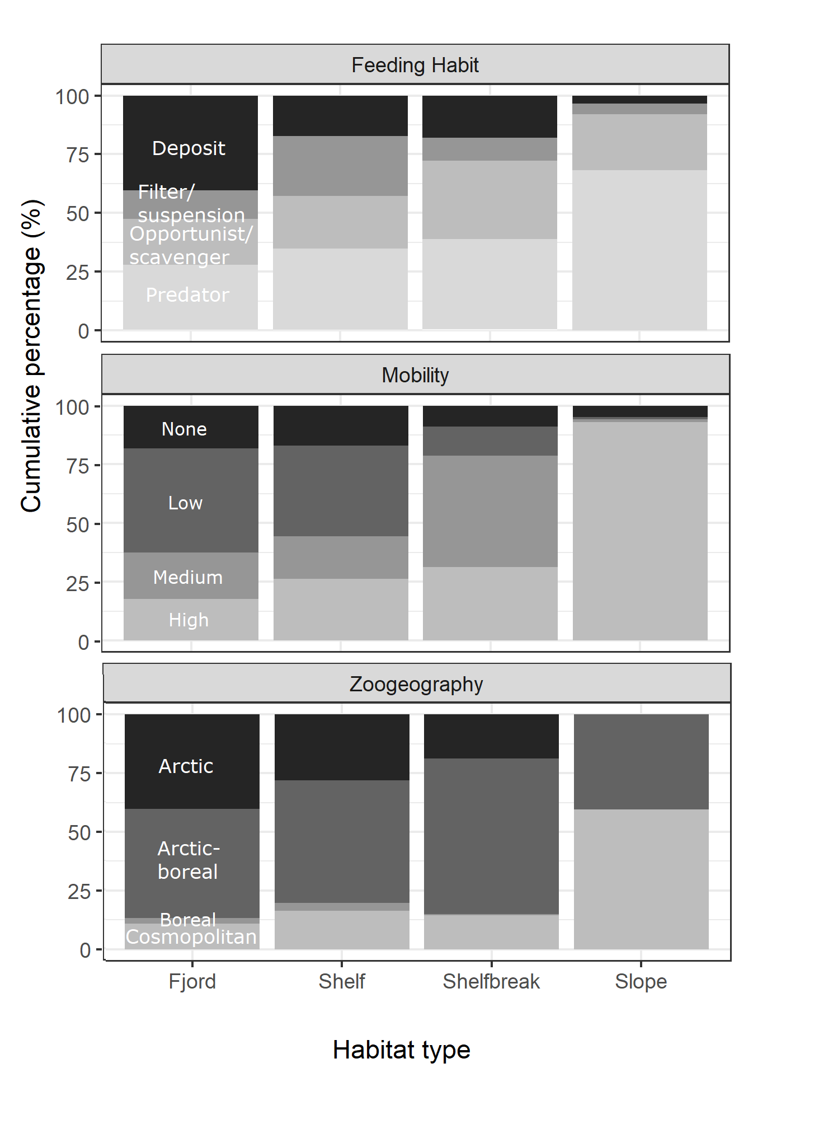
Spatial distribution of traits
There are clear spatial patterns in the trait groups across fjord to slope habitats.
Notes:
- And then we have a really nice spatial gradient in Zoogeography: seeing much more arctic and boreal species closer to the sea ice and cosmopolitan species on the slope – which might show us pathways of species invasions especially fi we can link it with currents and these pelagic larve development strategies aswell as links in benthic-pelagic coupling from the deep to the water column.

Slide 12
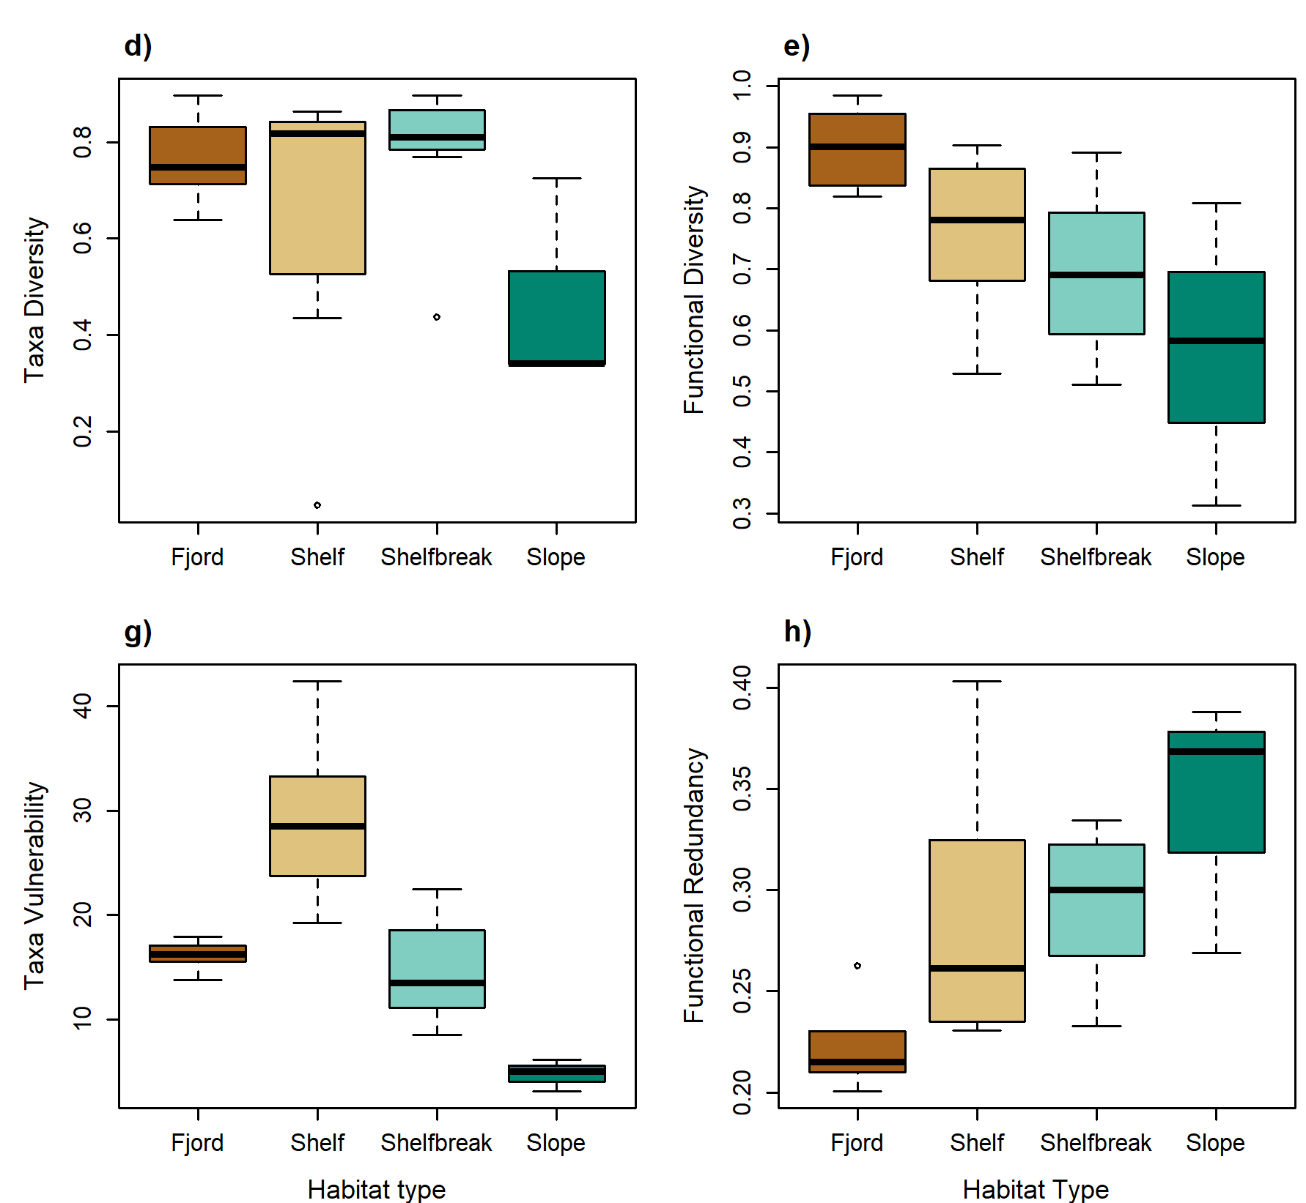
Results:
Functional structure
Functional diversity is highest at the fjord and decreases to the slope.
There is greater taxa vulnerability on the shelf but the fjord has the lowest functional redundancy.
Notes:
There are clear spatial patterns in biodiversity indices across fjord to slope habitats.

Slide 13
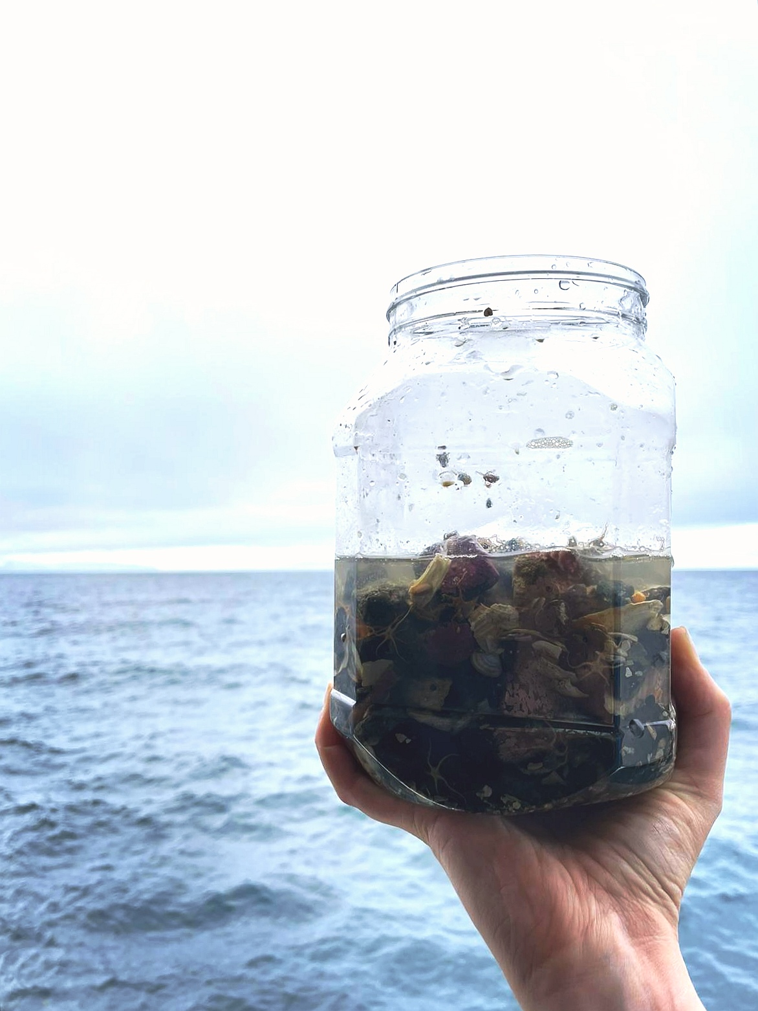

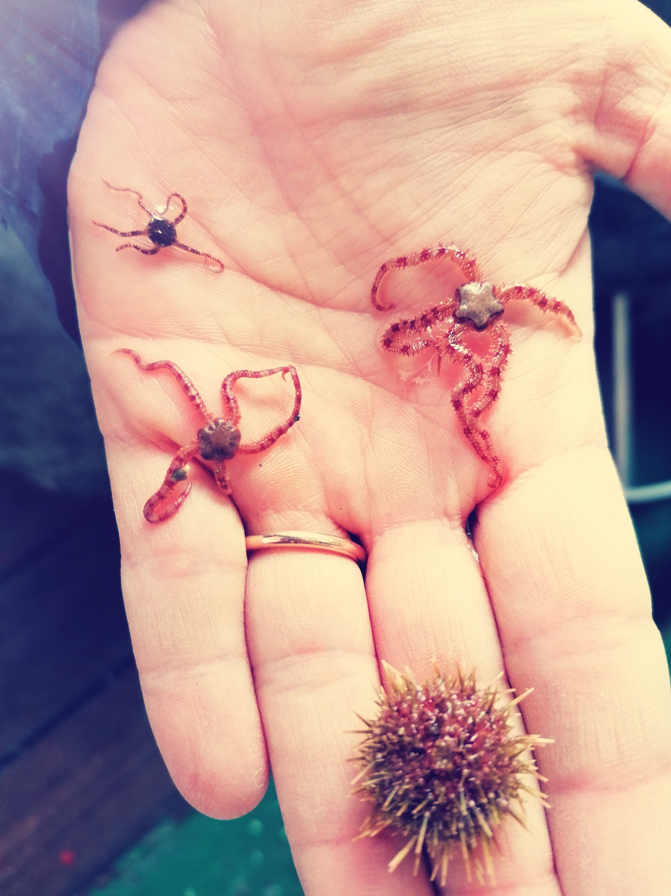
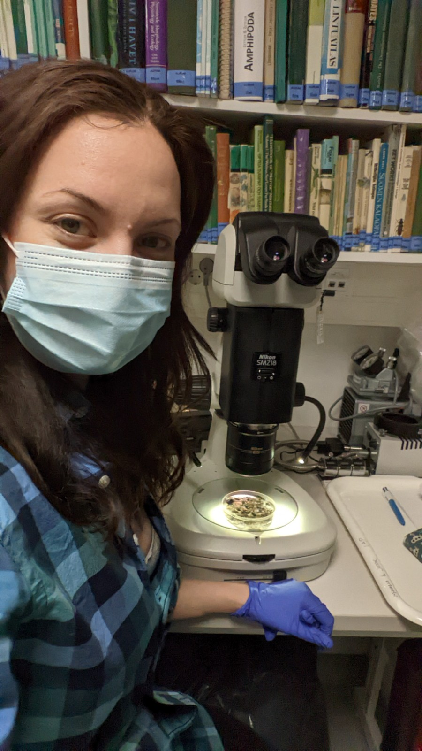
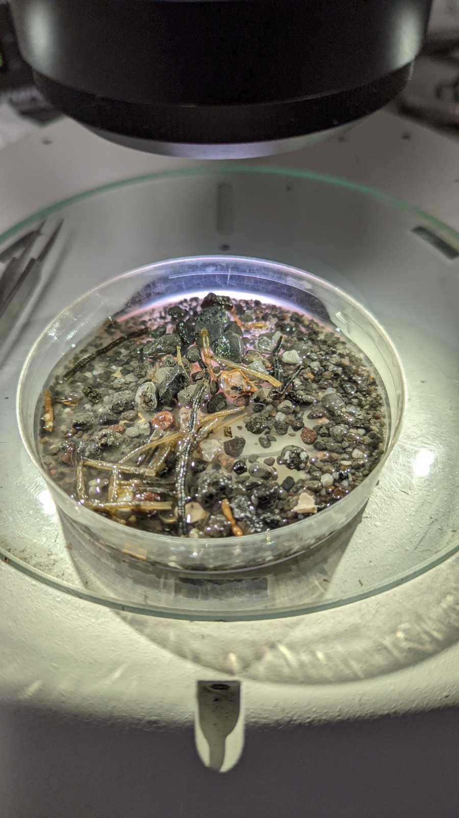
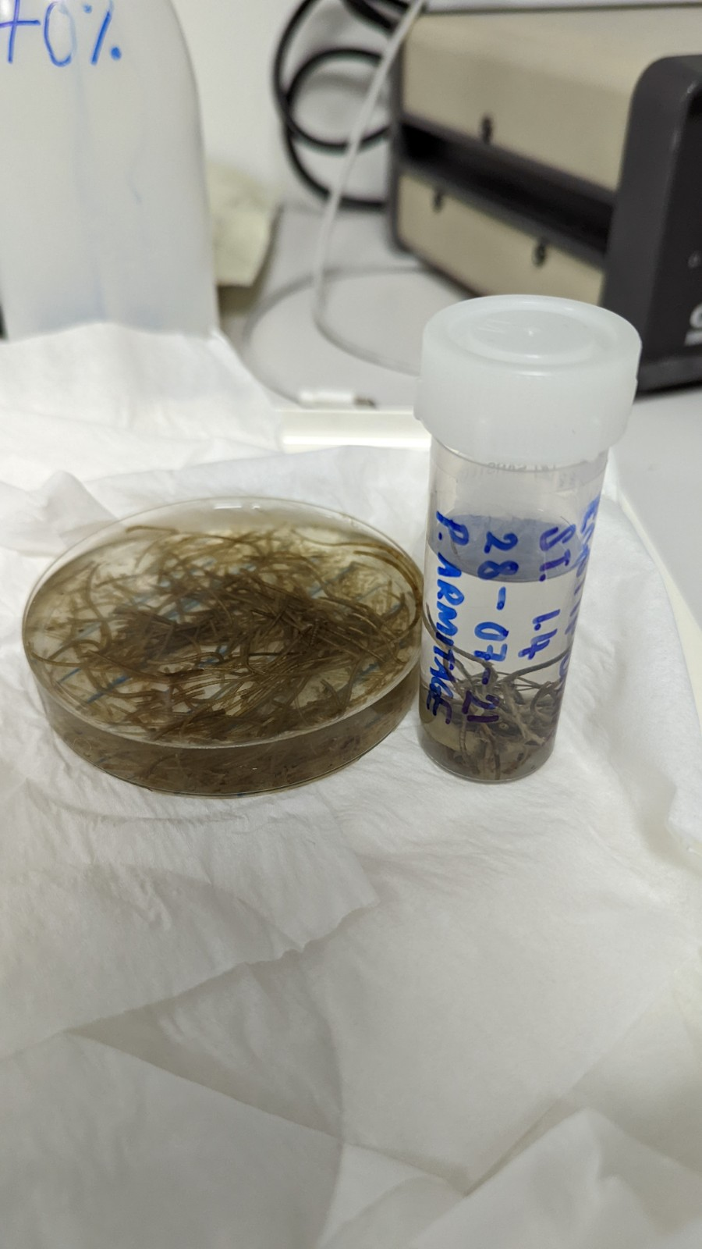
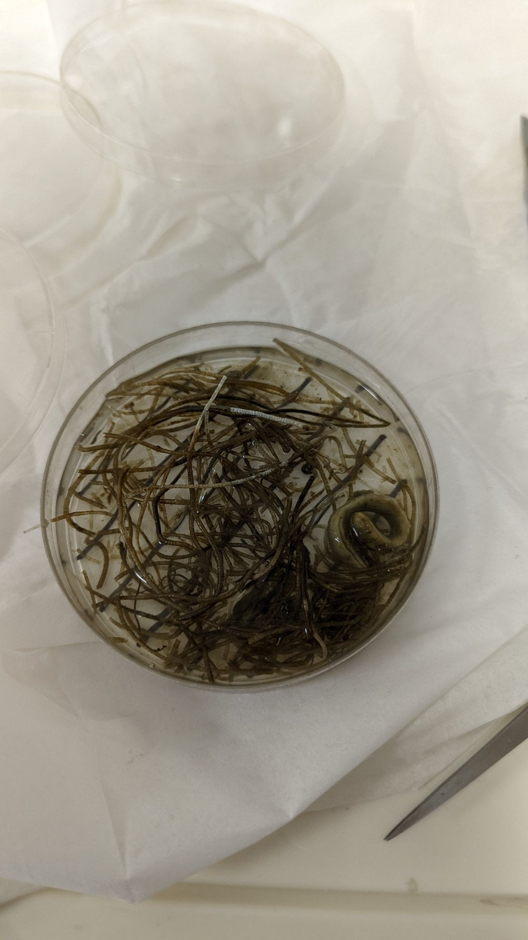
Next steps…
Linking sediment traps to how much organic material is sinking to the seafloor.
Notes:
Macrobenthos composition
Grain size
Organic content
C:N ratio
Sediment traps
Capture how sinking org m might impact benthic composition and function roles.

Slide 14
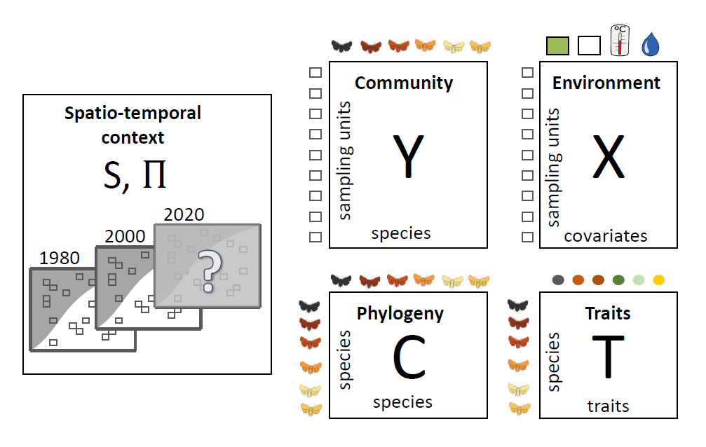
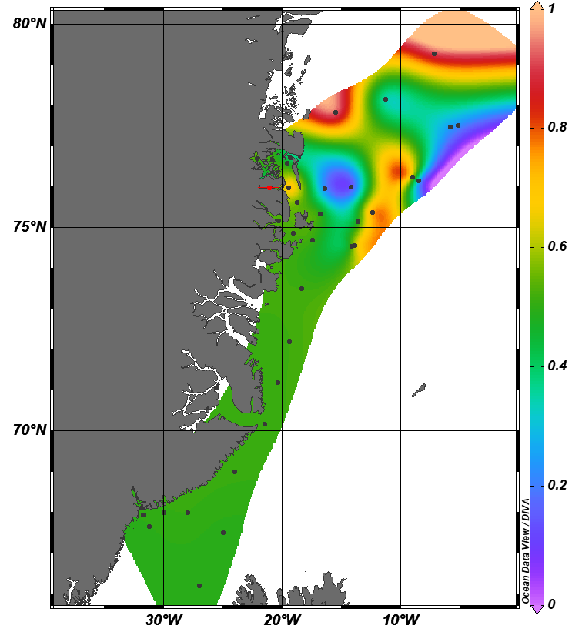
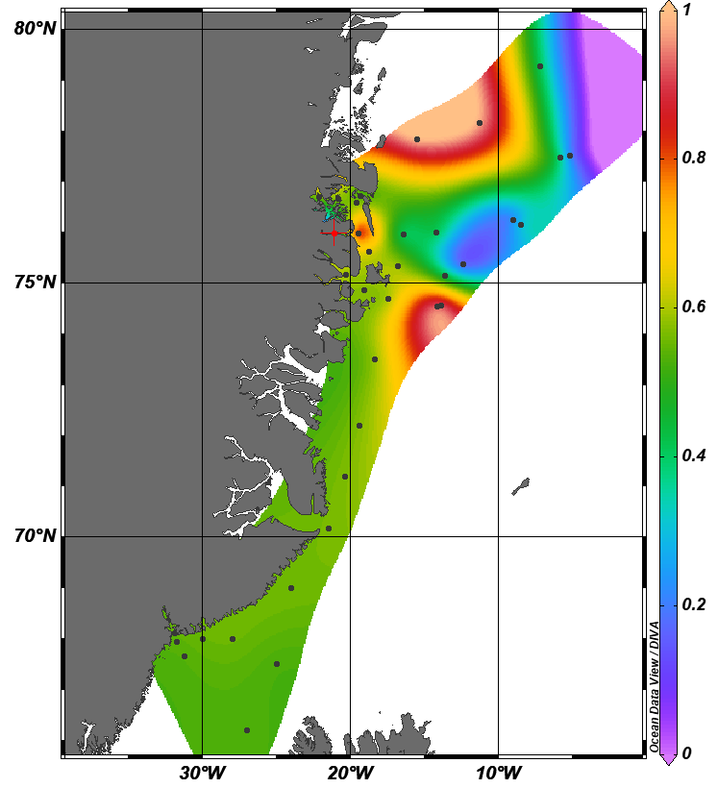
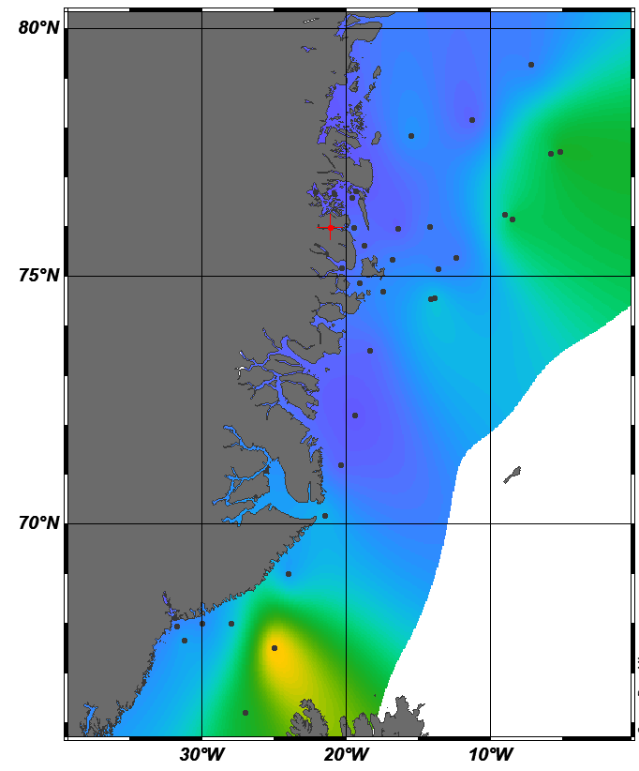
Example: Benthic nutrient recycling with modelling to help determine tipping points
HMSC – modelling
framework
High orgC
Current OrgC
Low OrgC
2) To map areas of ecological functioning from benthic organisms and how they relate to environmental changes.

Slide 15
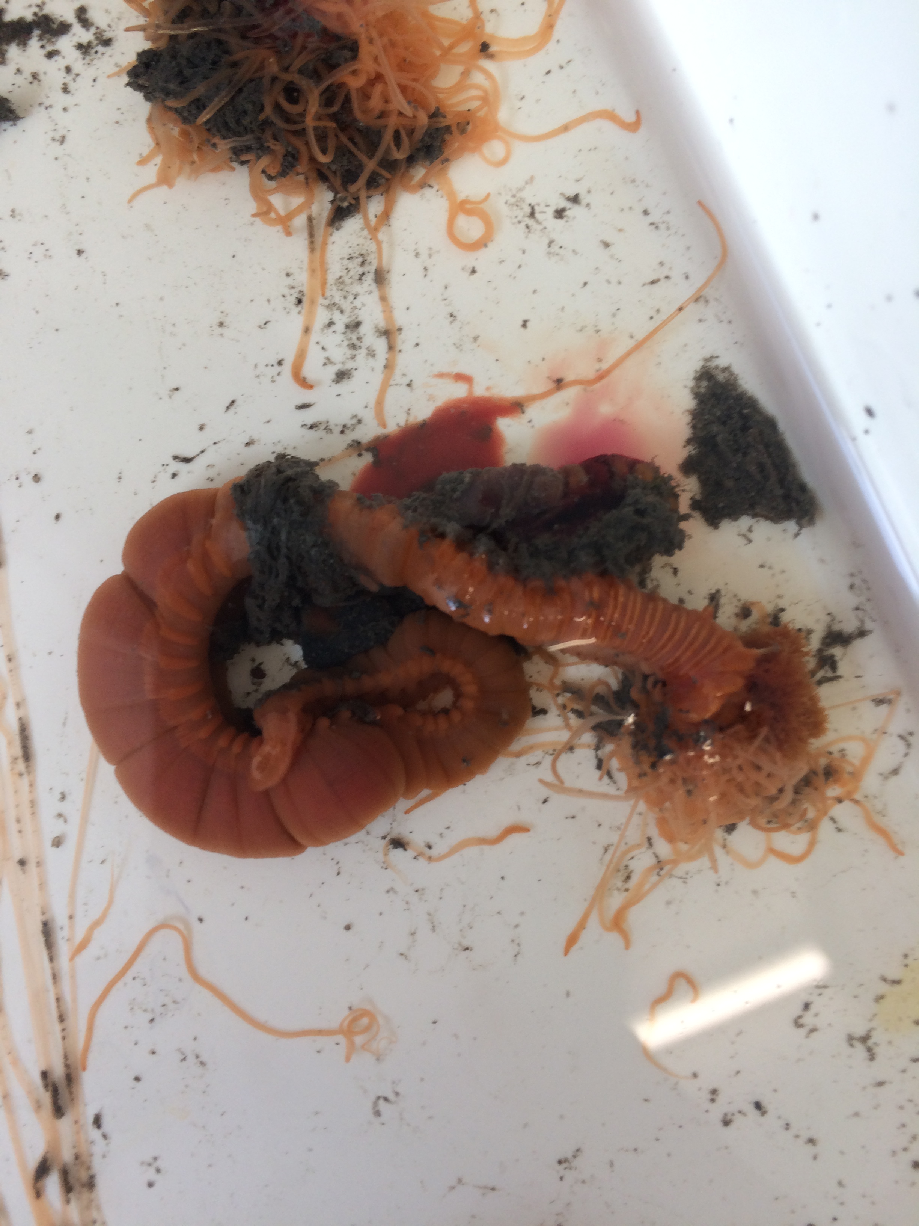
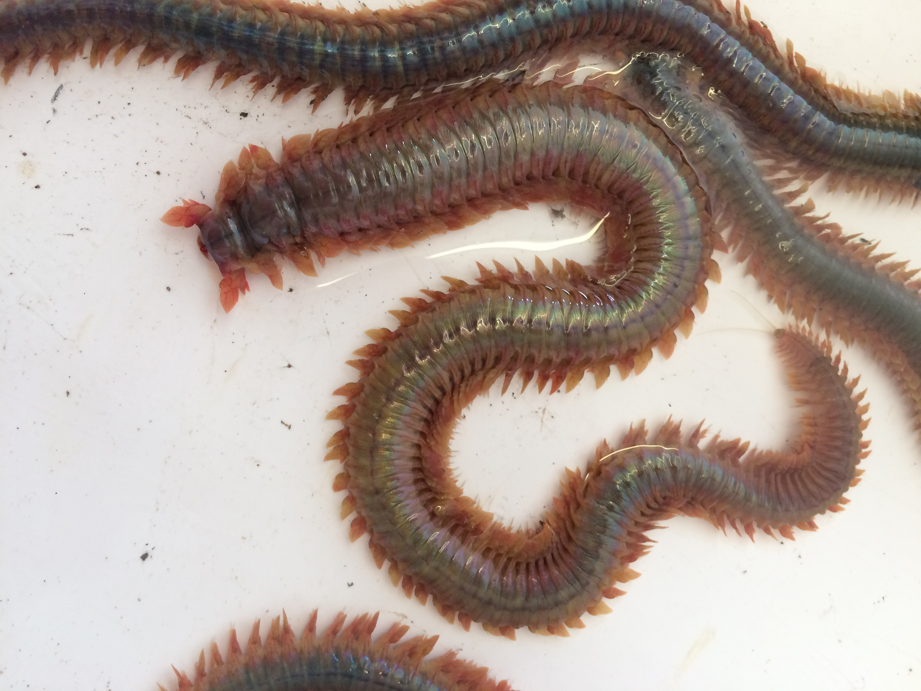
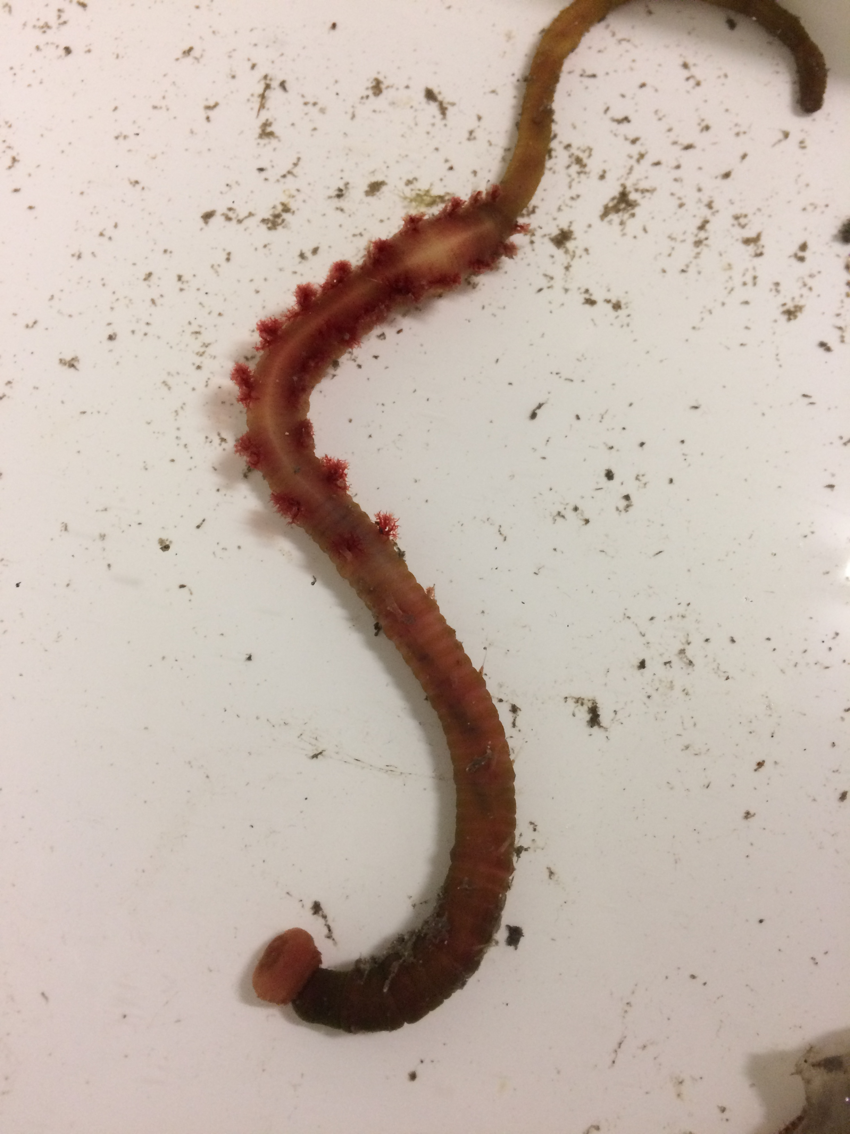
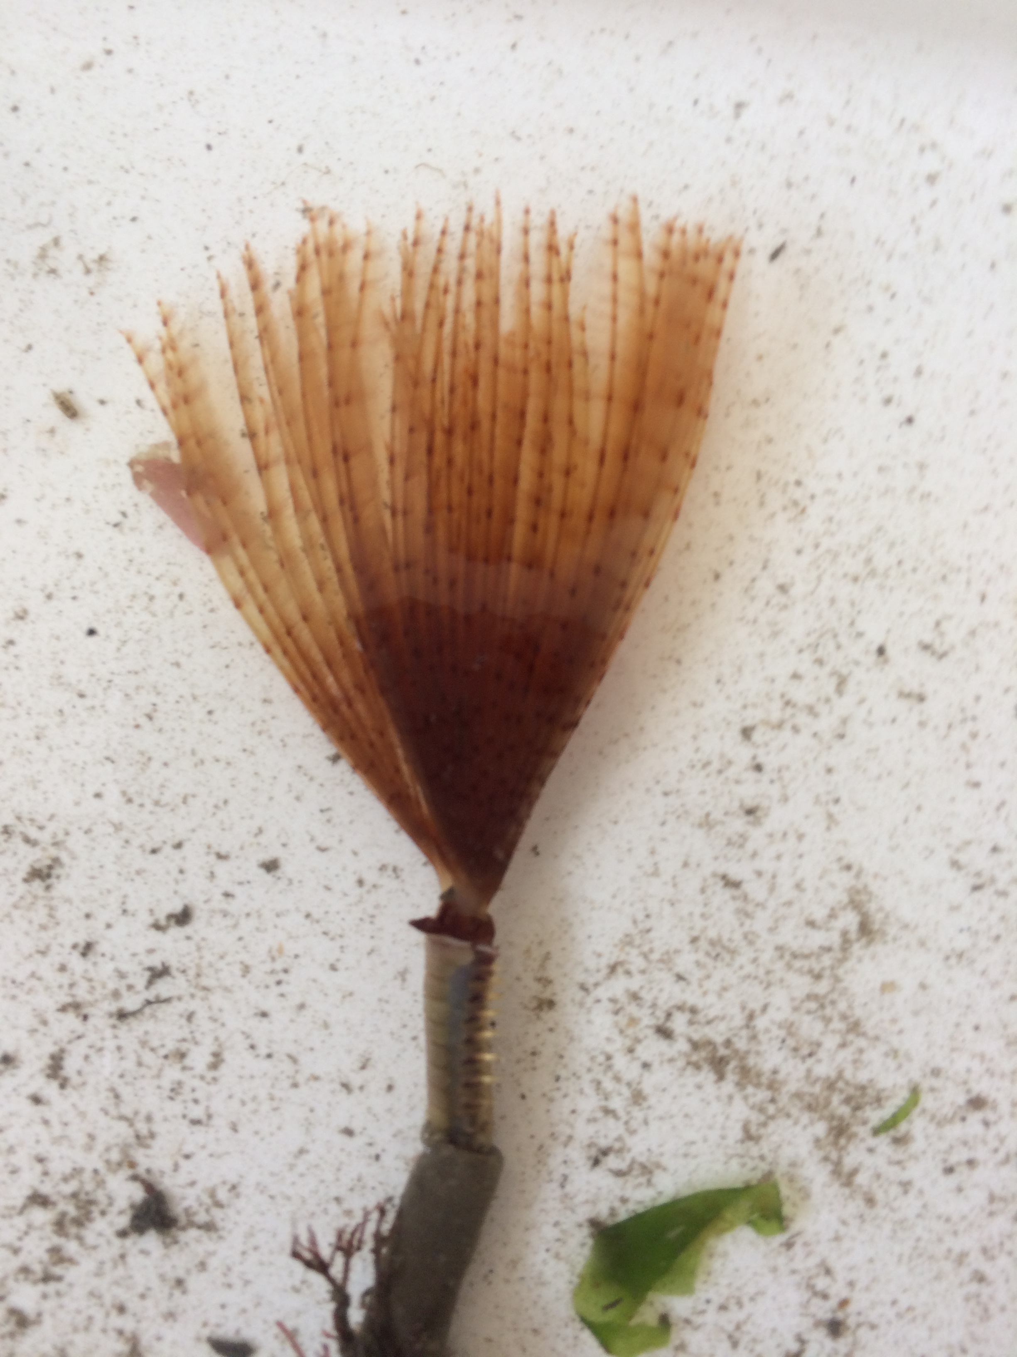
Thank you for listening!
Phoebe.Armitage@abo.fi
Questions?

Slide 16
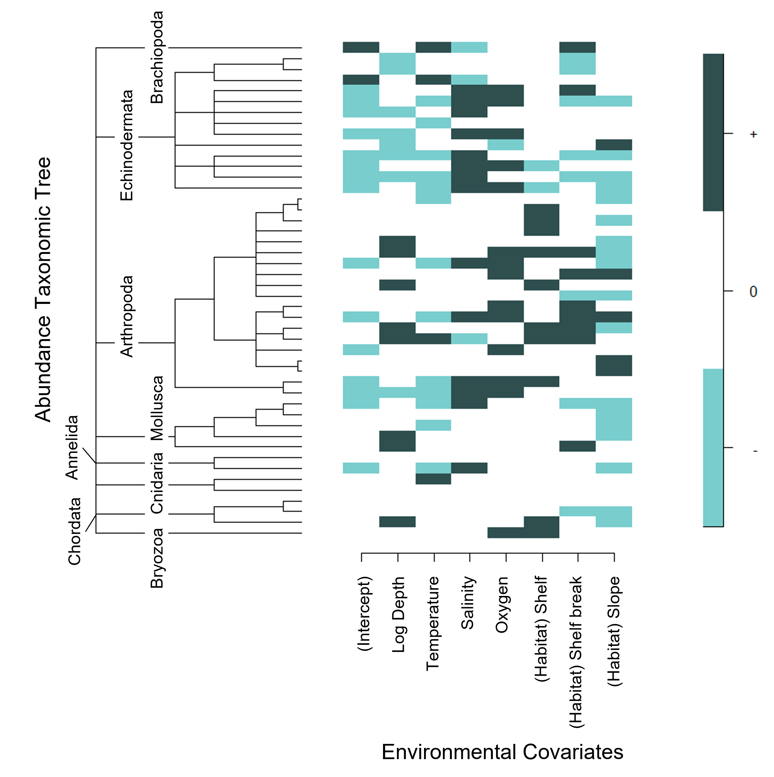

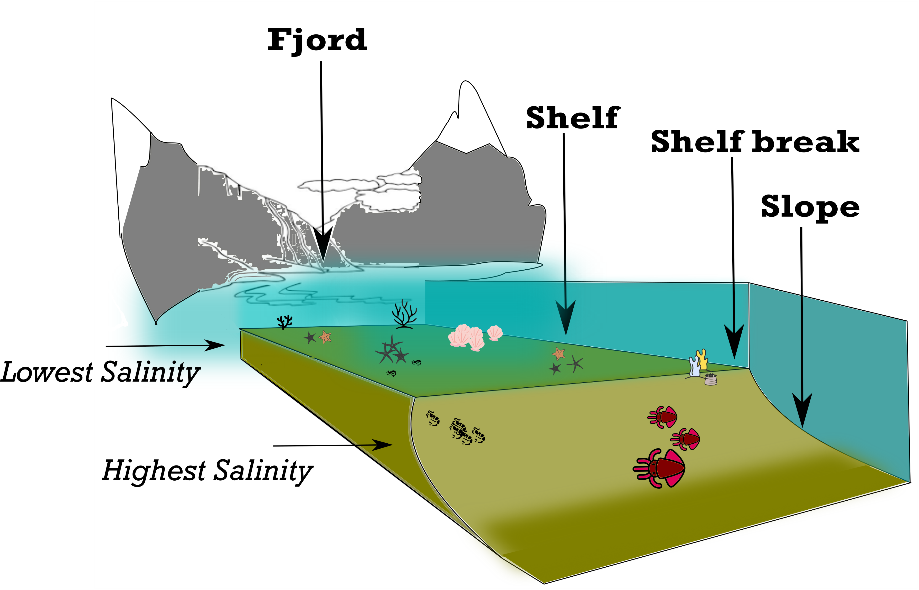
Results:
Functional structure
High in biodiversity and
taxa vulnerability but low in functional redundancy
Low in biodiversity but high in functional redundancy
Notes:
There are clear spatial patterns in biodiversity indices across fjord to slope habitats.

