Slide 1
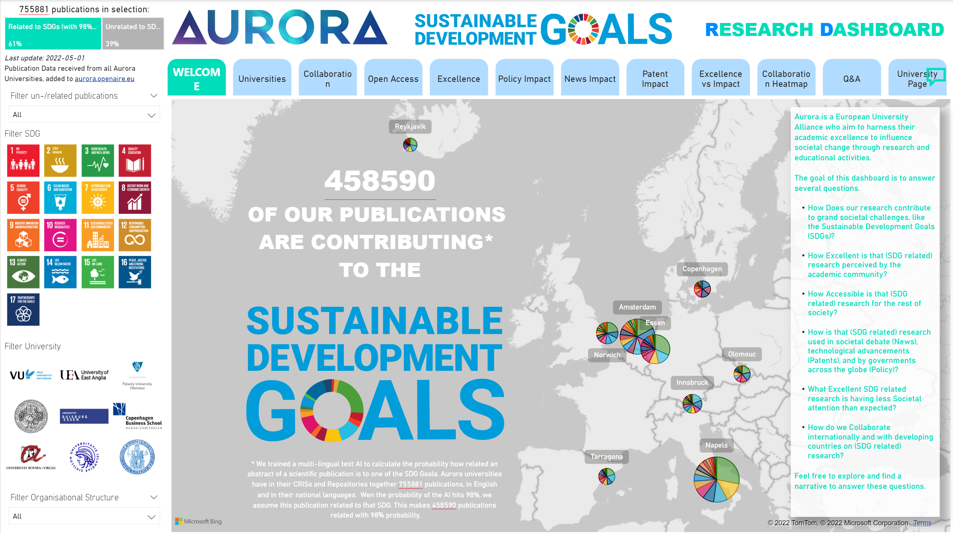



AURORA SDG DASHBOARD
FOR RESEARCH
DEMONSTRATING THE SOCIETAL INFLUENCE OF OUR RESEARCH
http://bit.ly/aurora-sdgs
27th of Sept 2022 | UNGA77 Science Summit | Maurice Vanderfeesten | Vrije Universiteit Amsterdam
Photo by: Cpl. Jesus Sepulveda Torres
https://www.mcbhawaii.marines.mil/Photos/igphoto/2001813560/

Slide 2

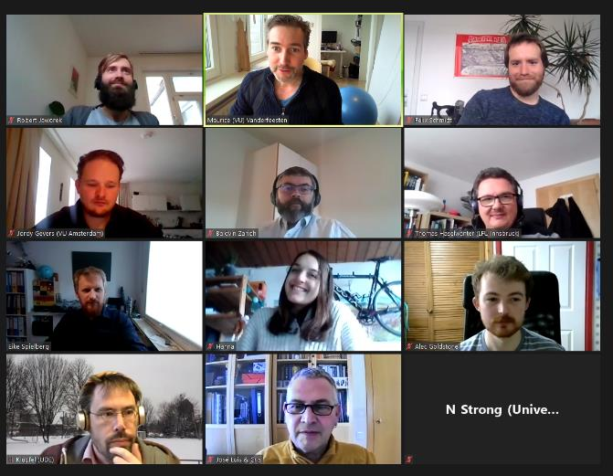
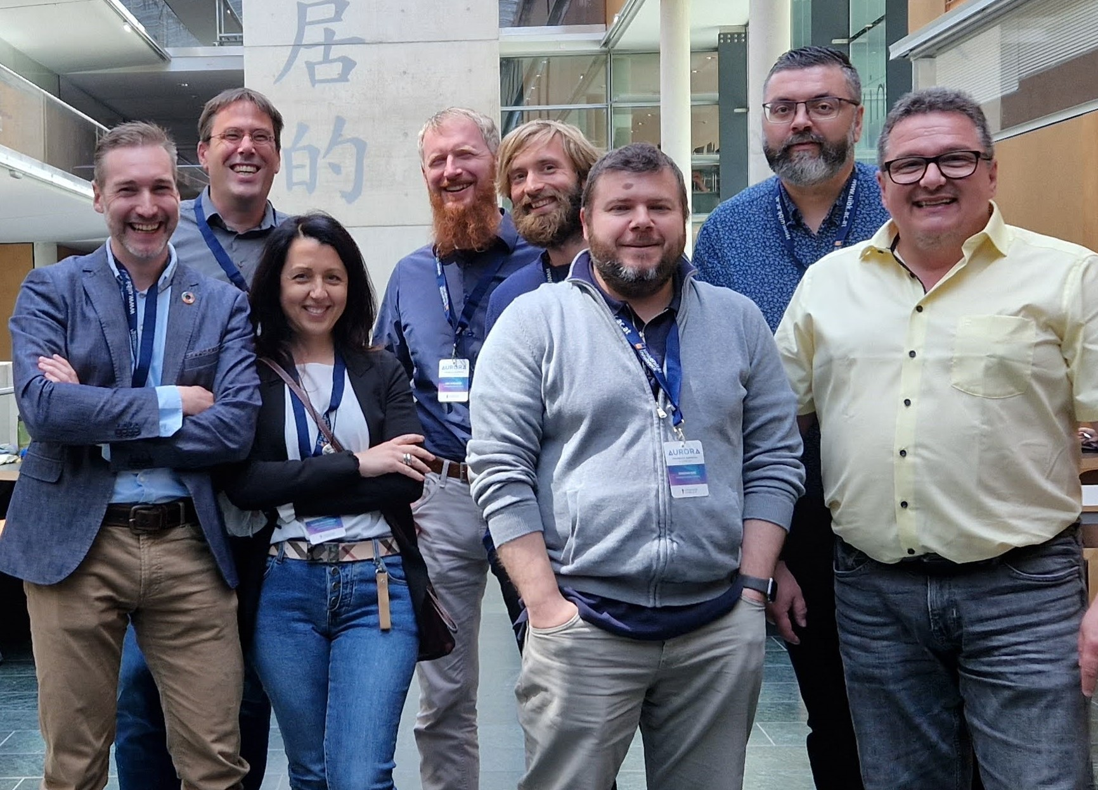


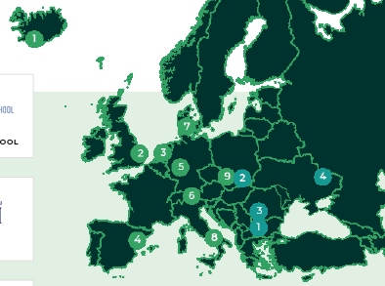





MEET OUR PROJECT TEAM | TASK 5.1: SDG RESEARCH DASHBOARD
(ONE OF THE 20+ PROJECT TEAMS IN THIS UNIVERSITY ALLIANCE)
UNITING
260.000
Students
30.000
Staff
673.922
Alumni
813
Research Groups
112
Faculties
Work package 5: Aurora Sustainability Pioneers
Task 5.1 Aurora SDG Research Dashboard
Task 5.2 Aurora Sustainability Education
Task 5.3 Aurora Sustainable Campus
Action plan ASCA

Slide 3





Aurora’s Collaborative Statement
Aurora is a partnership of like-minded and closely collaborating
research intensive (1) European universities,
who use their academic excellence (2)
to drive societal change (3)
and contribute to the sustainable development goals (4).

Slide 4
Proxy Indicators
research intensive (1): publications as research output
academic excellence (2): field weighted citation impact
drive societal change (3): open accessible,
used in policy documents,
used in patents,
used in news
sustainable development goals (4): filter SDG related research

Slide 5
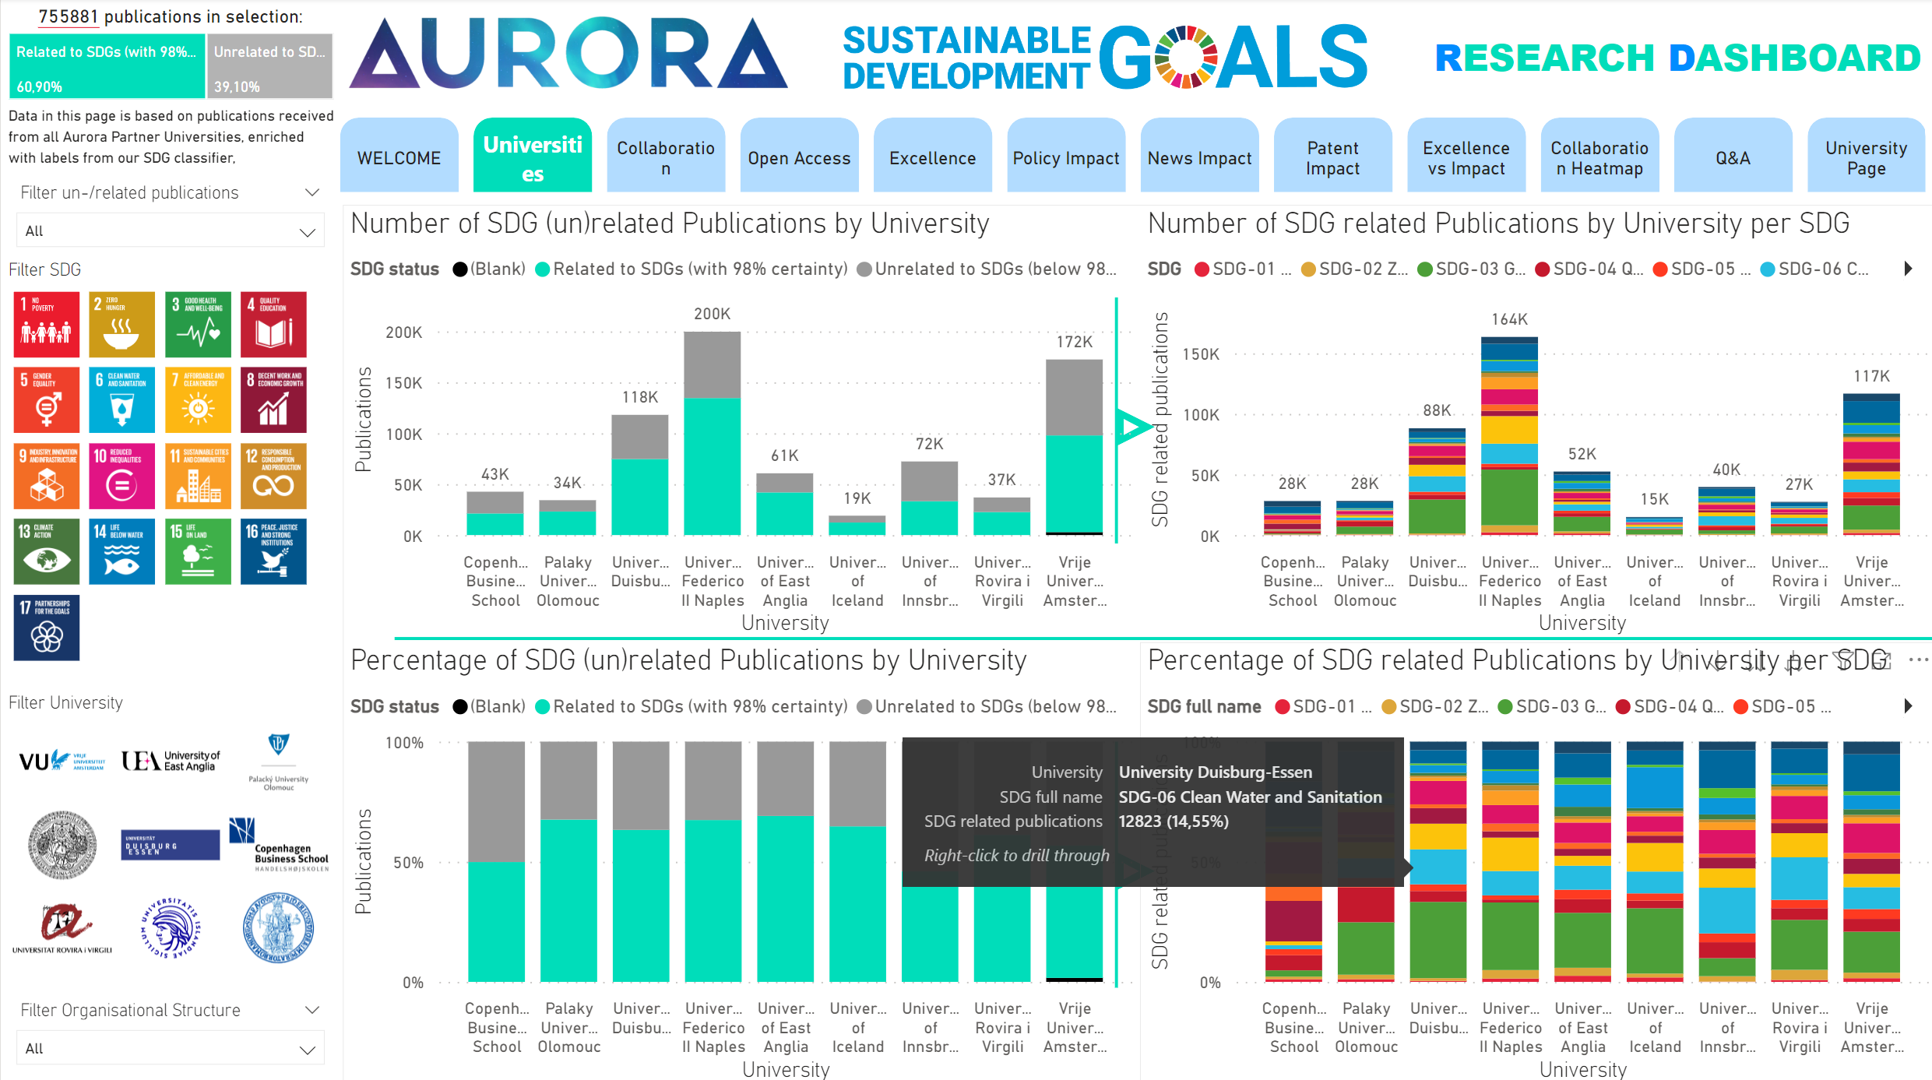
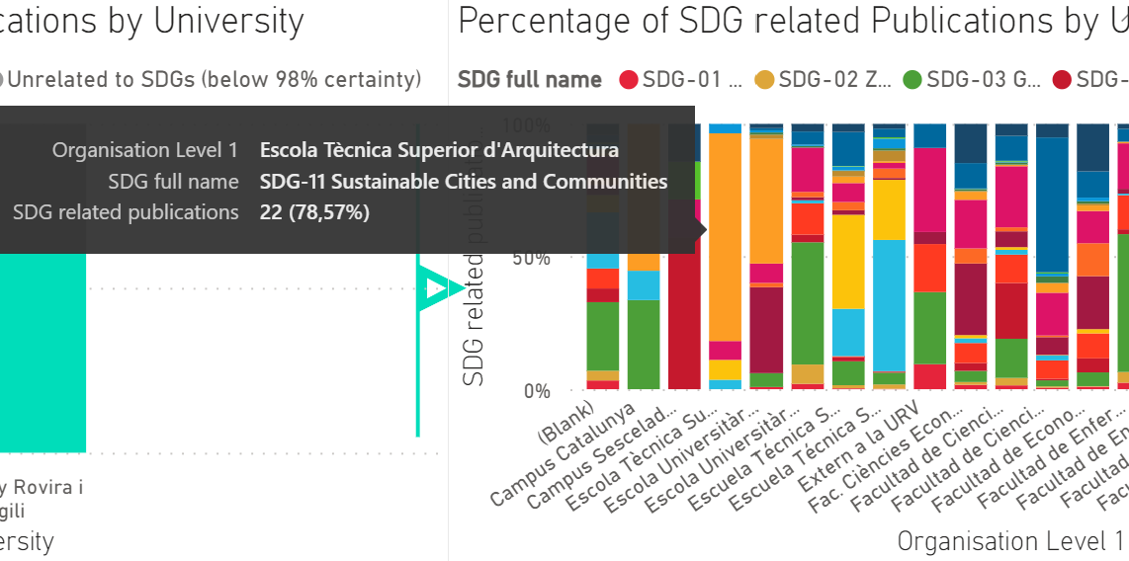
Proxy Indicators: research intensive (1): publications, segmented by SDGs (4)
(source: university research information systems)

Slide 6
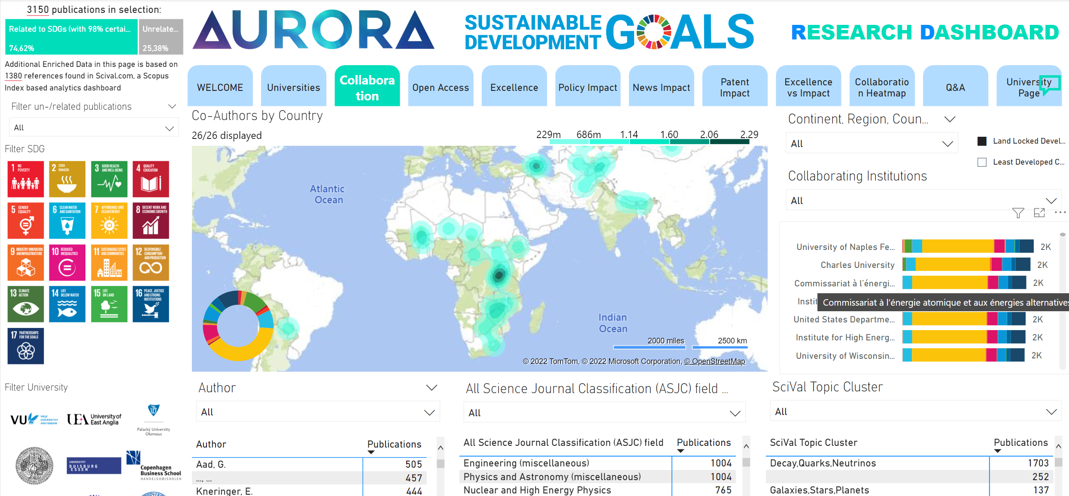
Co-author Collaboration: research intensive (1): publications, segmented by SDGs (4) in example: co-authorship with institutes in Land Locked Developing Countries (LLDC)

Slide 7
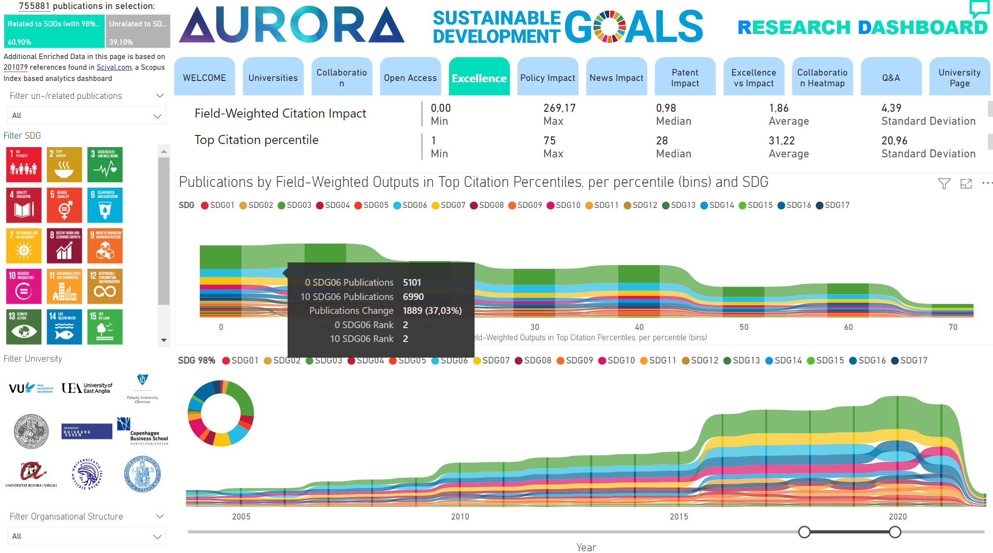
Research excellence (2): field weighted citation impact
(data source: scival.com)

Slide 8
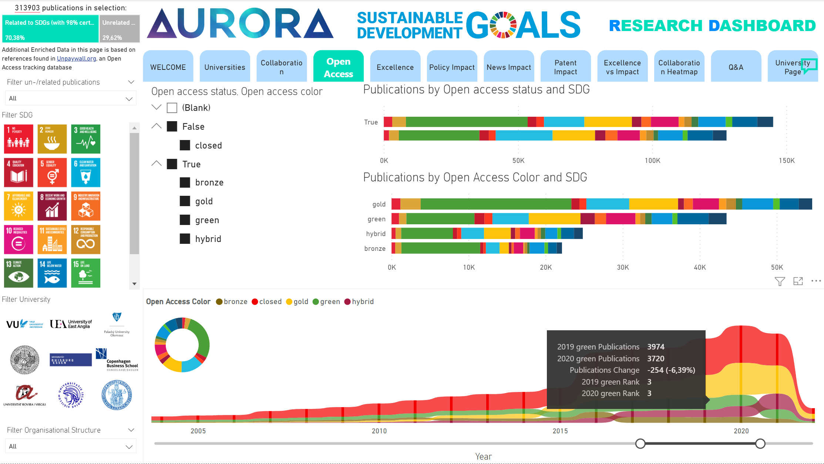
Drive societal change (3): open accessible
(data source: unpaywall.org)

Slide 9
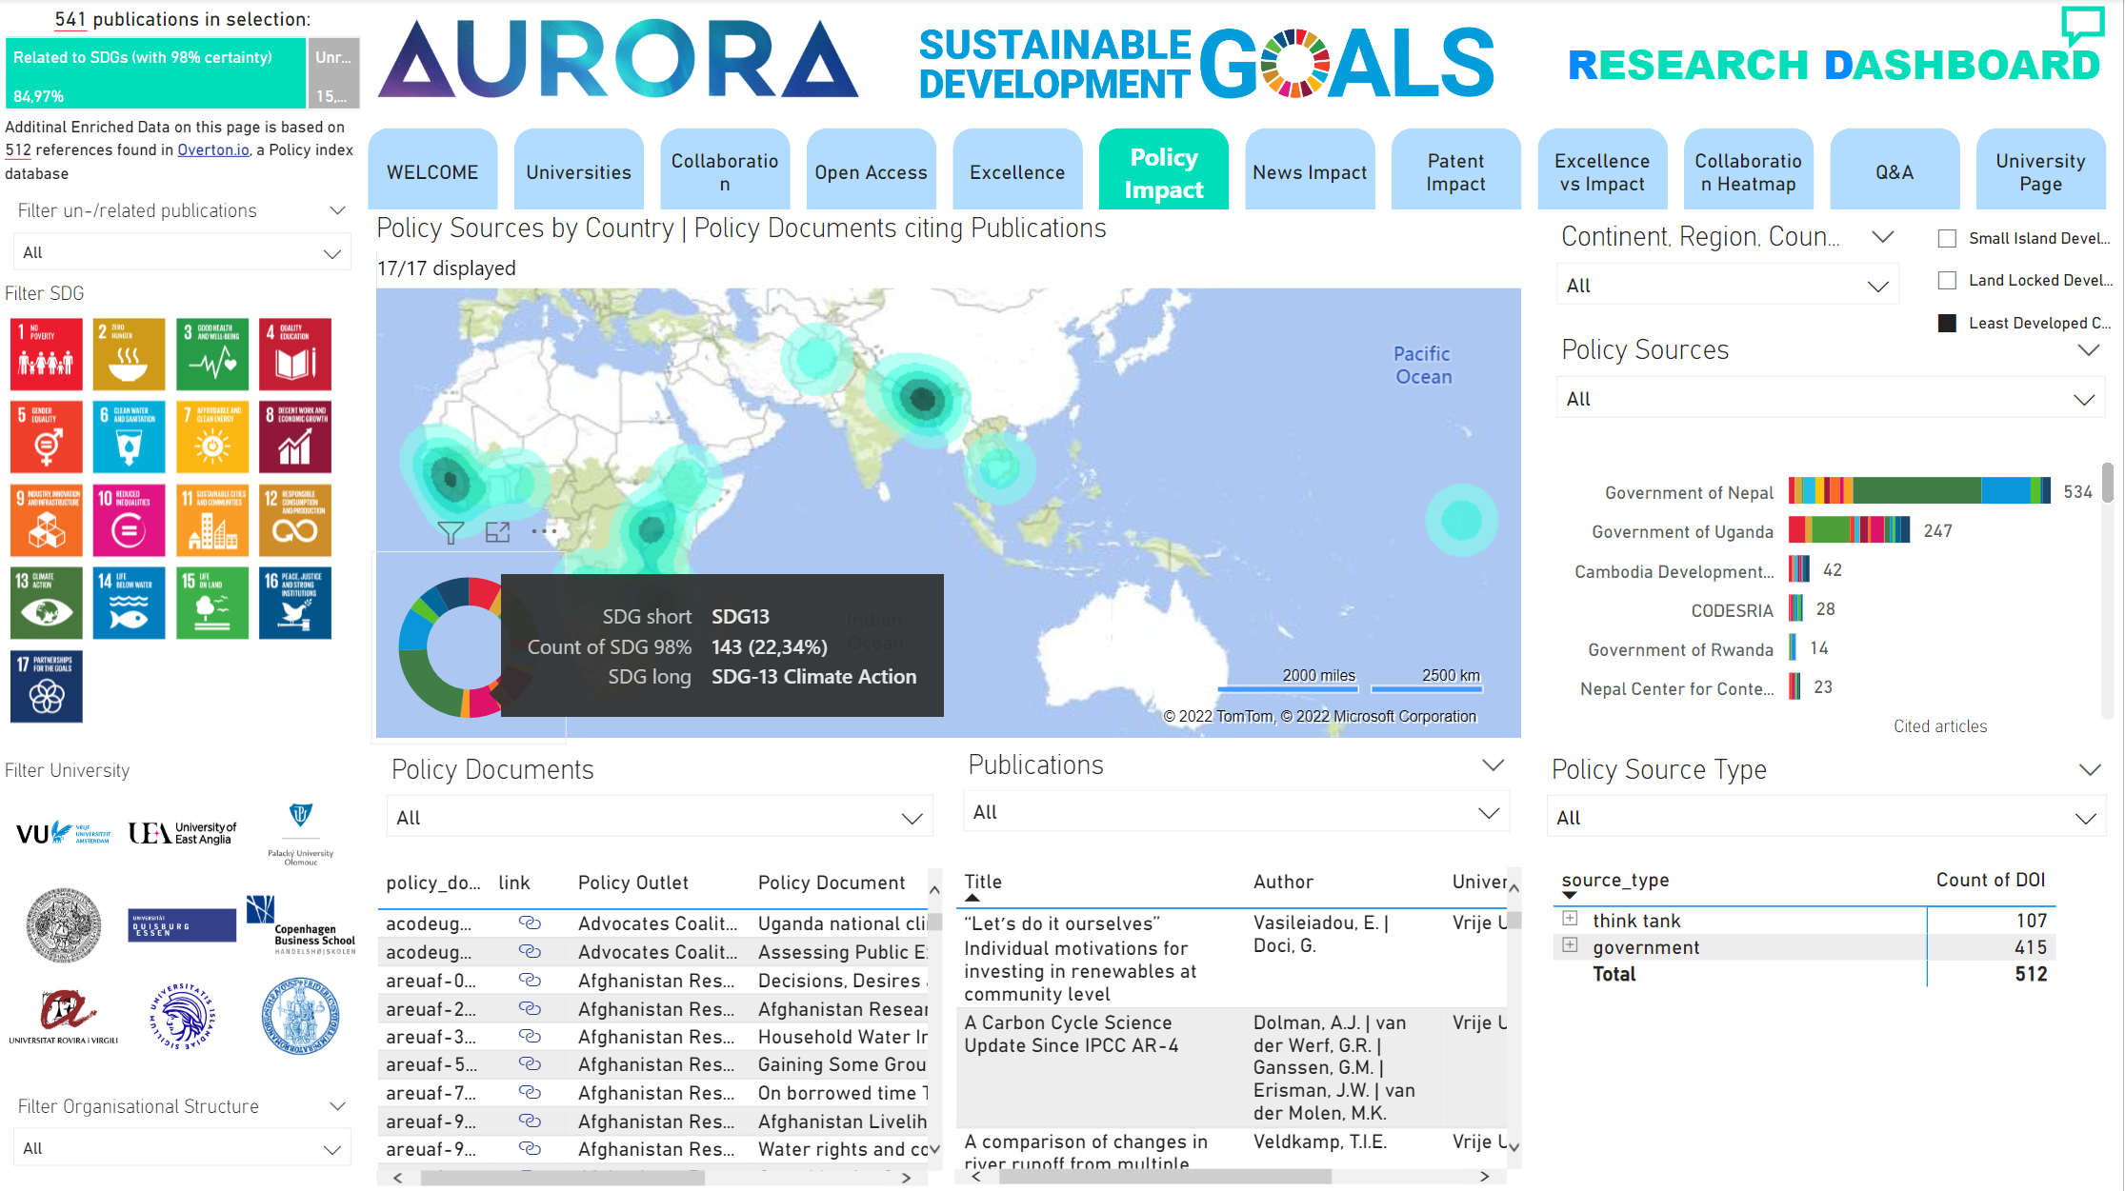
Drive societal change (3): used in policy documents
(data source: overton.io) in example: used by governments in Least Developed Countries (LDC)

Slide 10
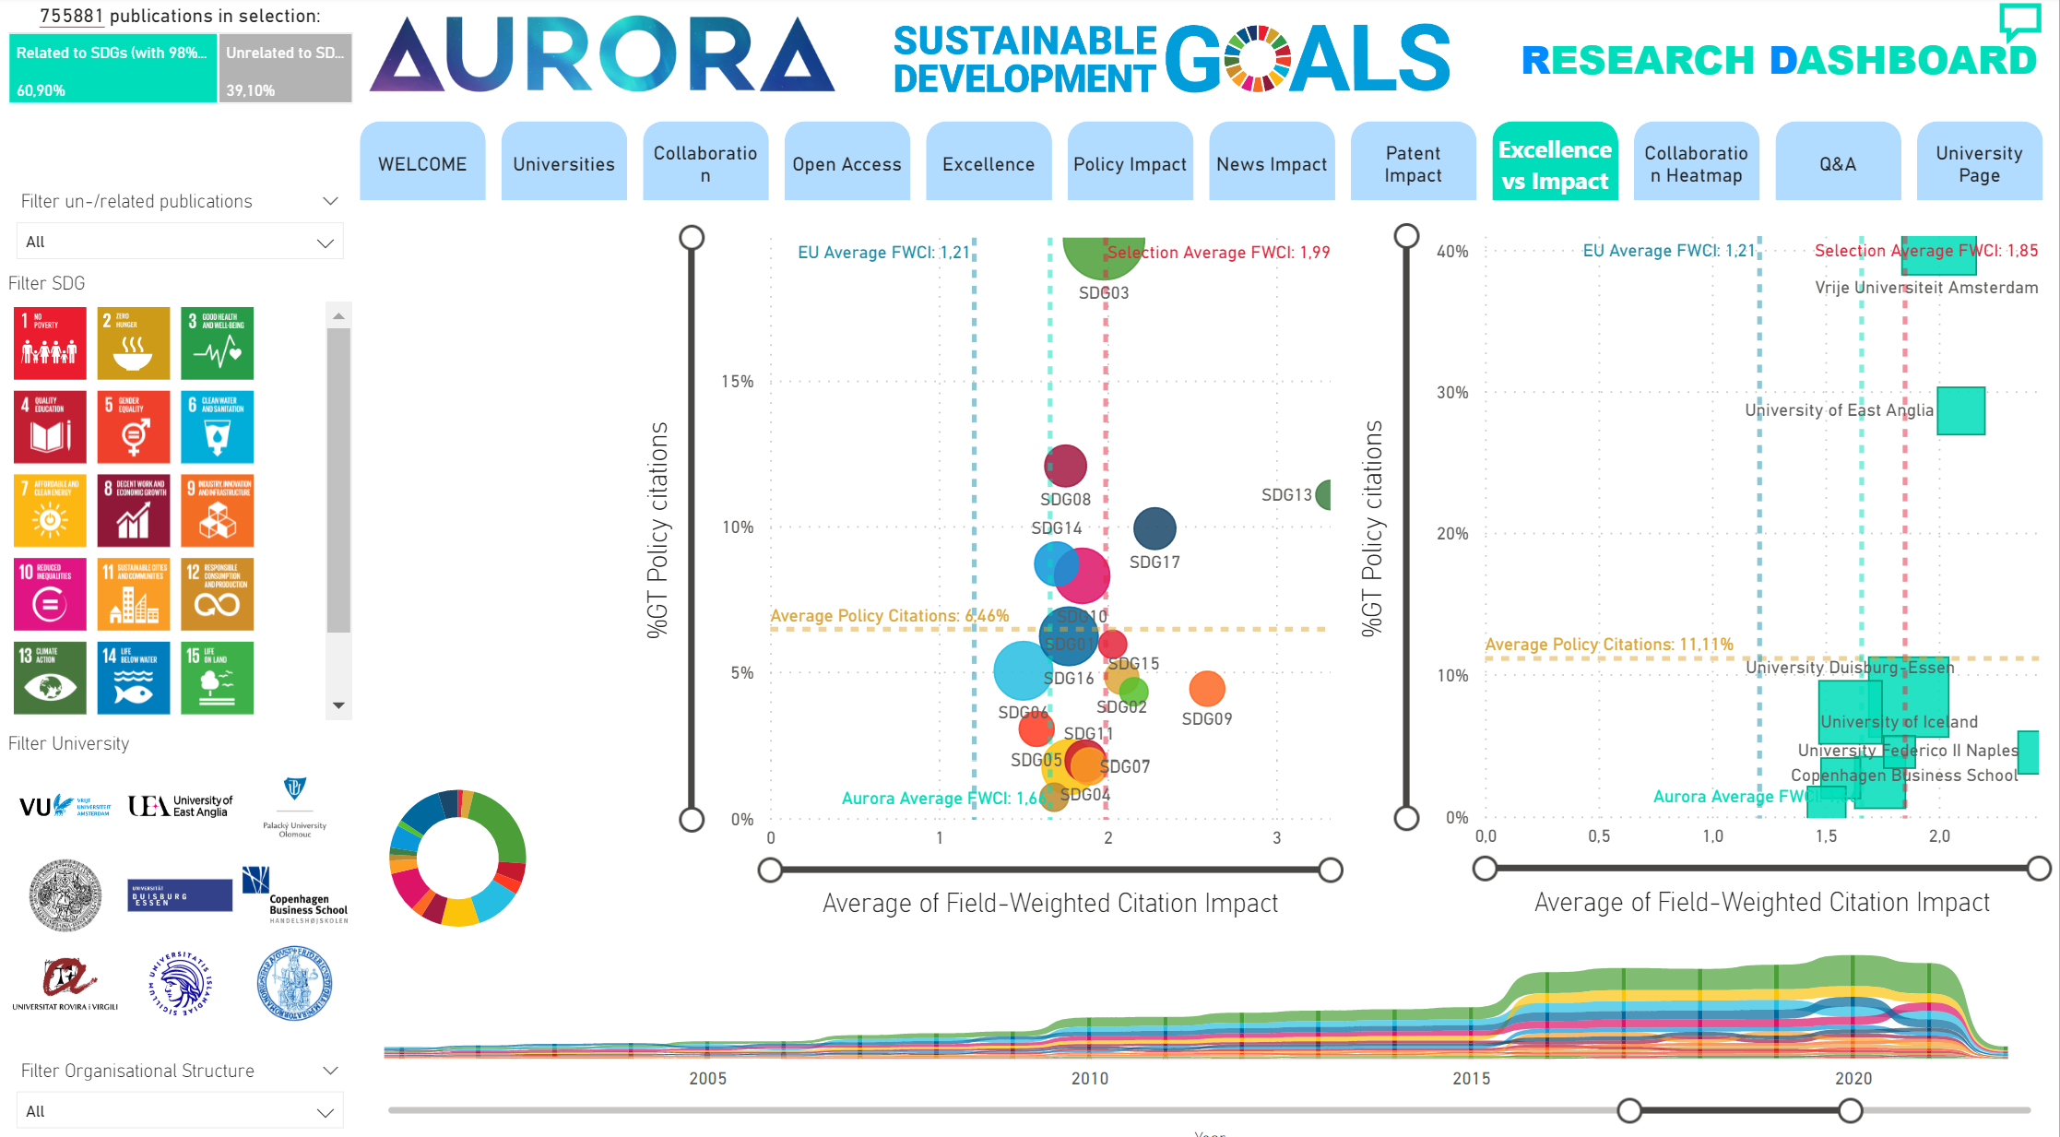
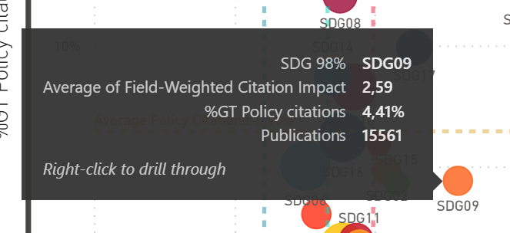
Spotting untapped potential: Excellent research (2), left unused by policy makers (3)
(data sources: overton.io& scival.com) in example: SDG 9 > high FWCI, low policy citations

Slide 11


5.1 AURORA SDG RESEARCH DASHBOARD
WHAT IS THE OBJECTIVE FOR THIS TASK?
Chairs
To turn the SDGs into a leading narrative for research in the Aurora Alliance.
Results in 2023:
The SDG Research Dashboard to become a robust and operational tool.
The SDG Research Dashboard is available for other universities and networks.
Task 5.1 Aurora SDG Research Dashboard
Task 5.2 Aurora Sustainability Education
Task 5.3 Aurora Sustainable Campus
Action plan ASCA

Slide 12
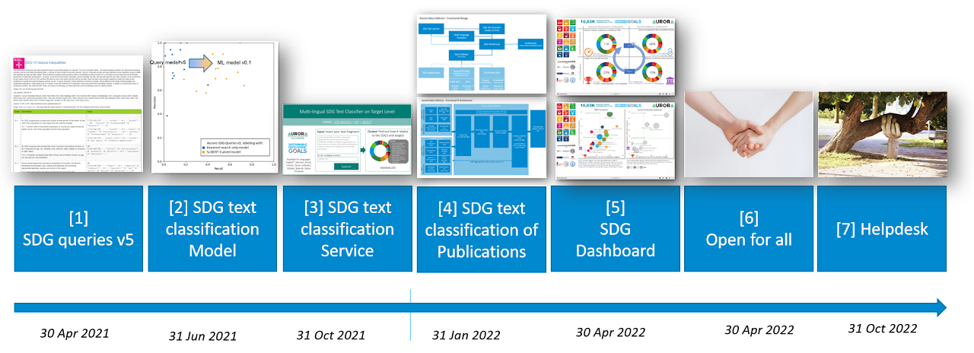
PROJECT TIMELINE
Task 5.1 Aurora SDG Research Dashboard
More at https://alliance.aurora-network.global/work-packages/aurora-sdg-research-dashboard/
Source: https://sites.google.com/vu.nl/aurora-sdg-research-dashboard/deliverables

Slide 13
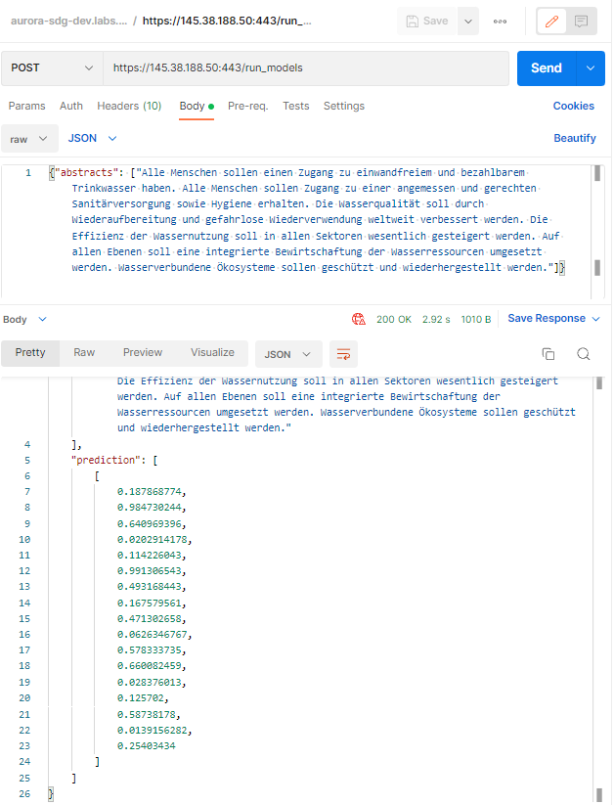
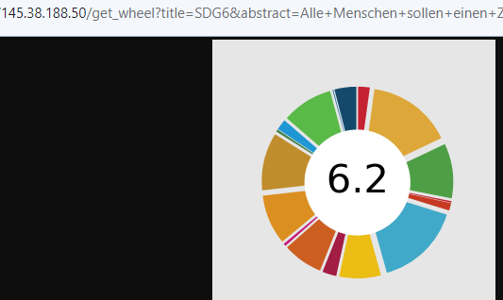
SDG classification service (multi-lingual): SDG API | SDG Badges in example: classifies a German text; outputs 17 prediction percentages, and an SDG wheel

Slide 14
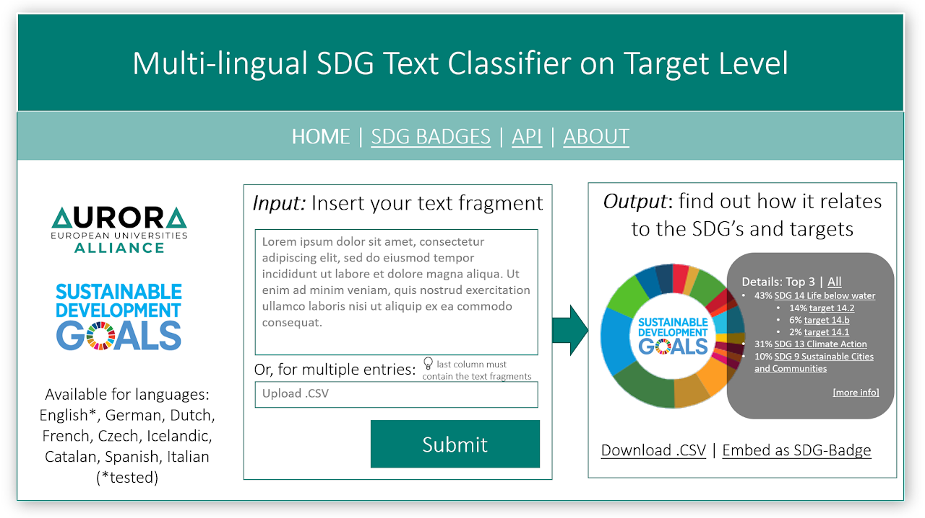
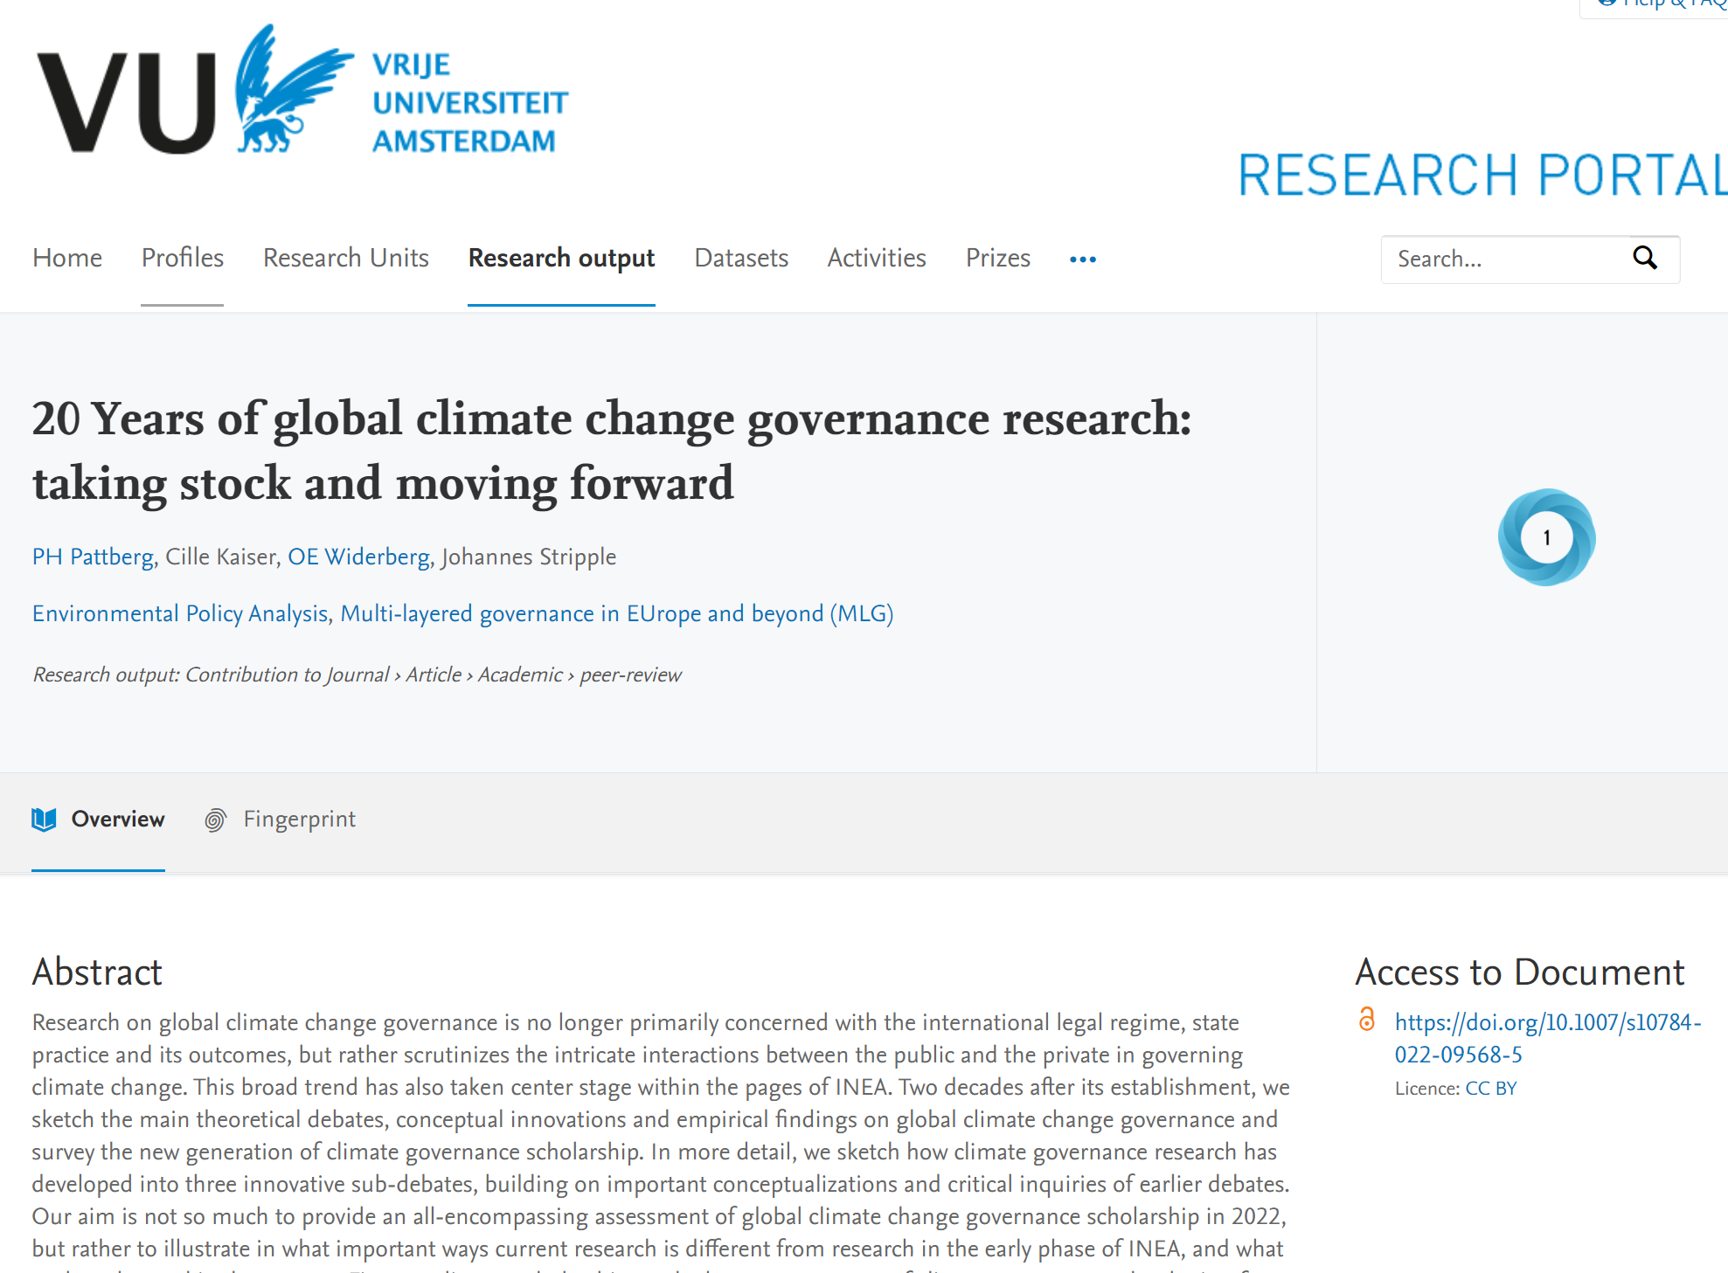

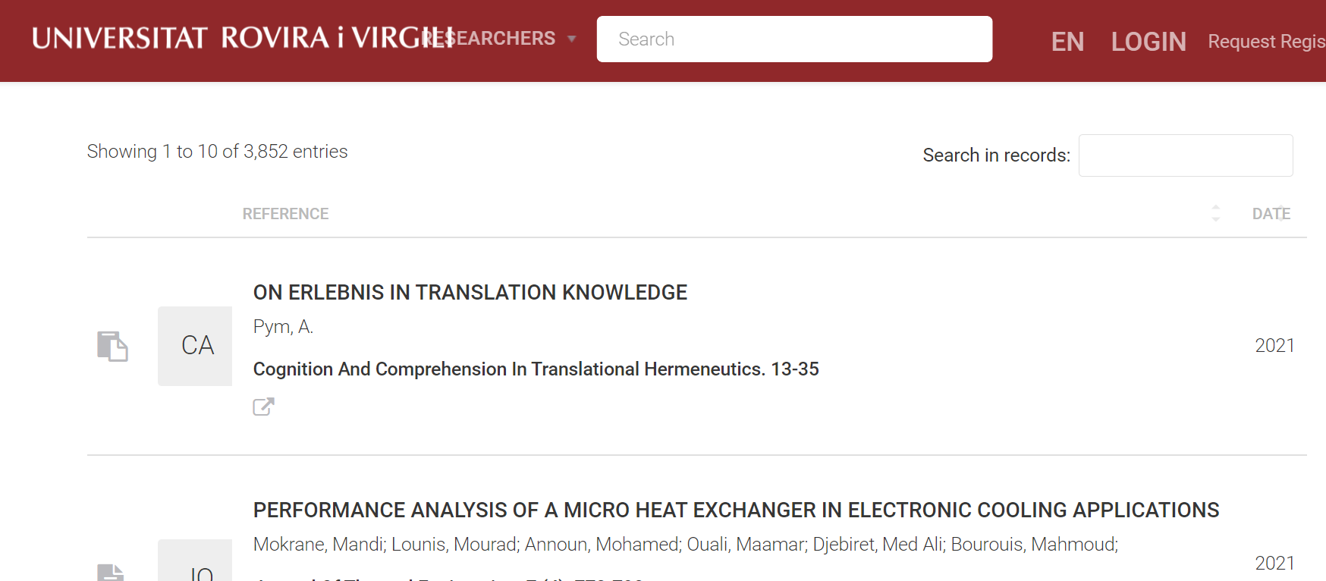
Turning SDGs as a Leading Narrative:
SDG classification as a Service | Multi-lingual | SDG Badges | Research, Courses and more

Slide 15
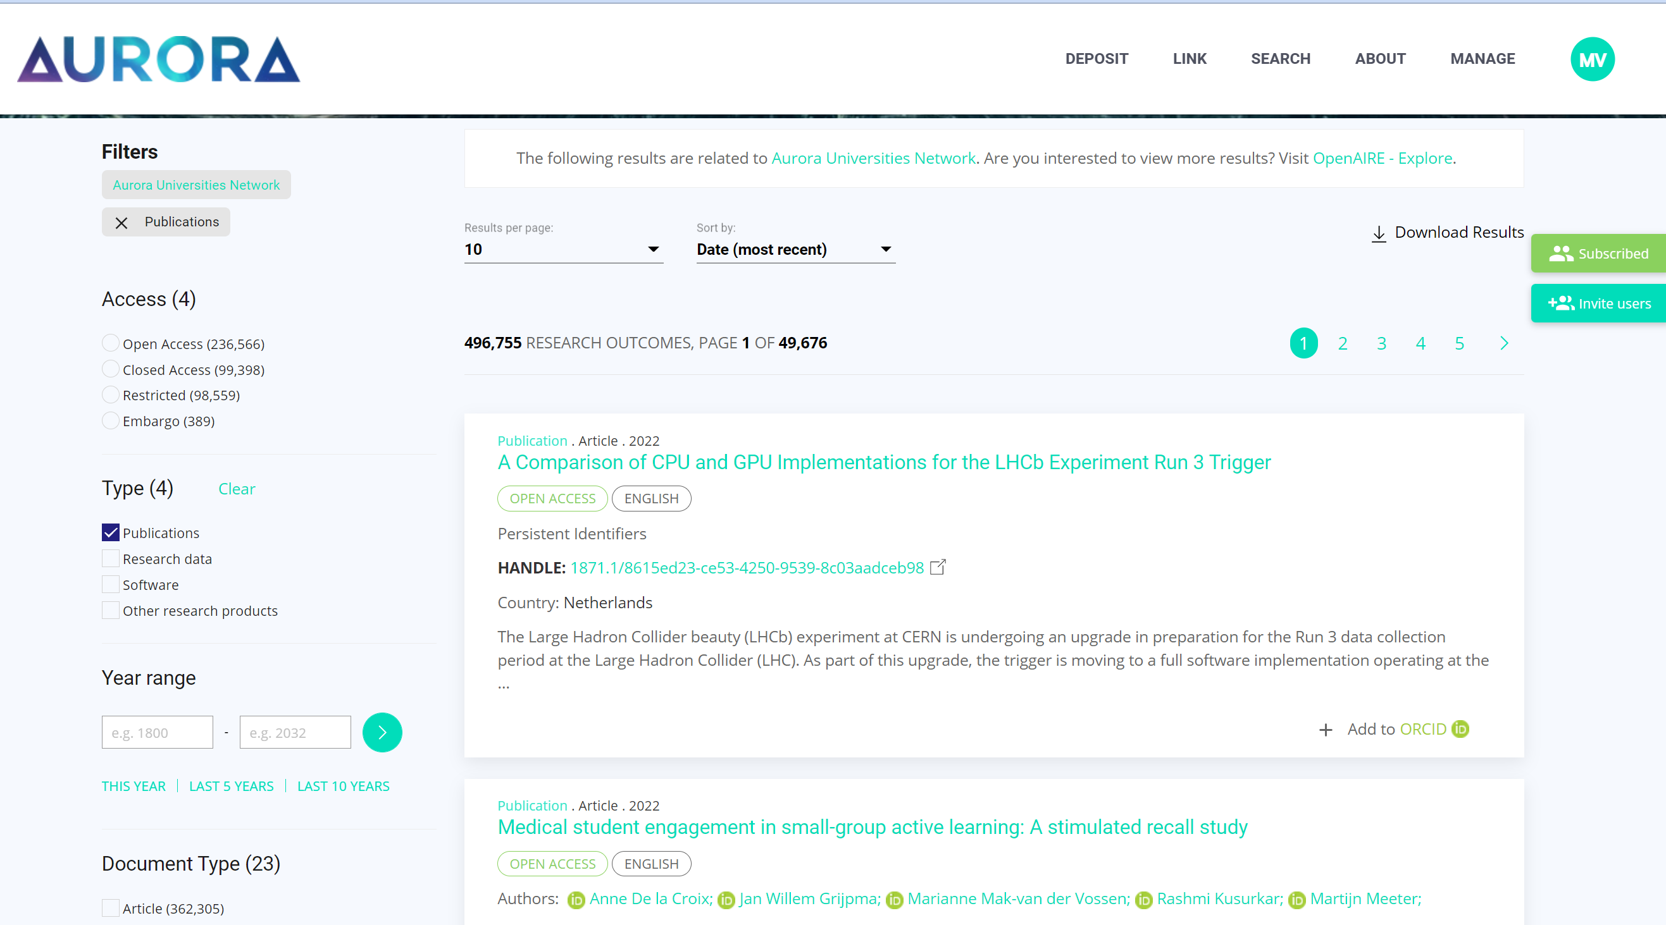
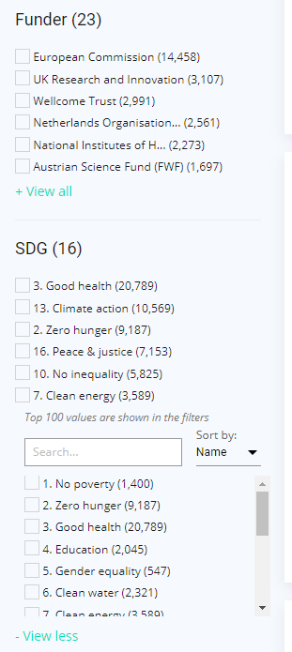

Slide 16
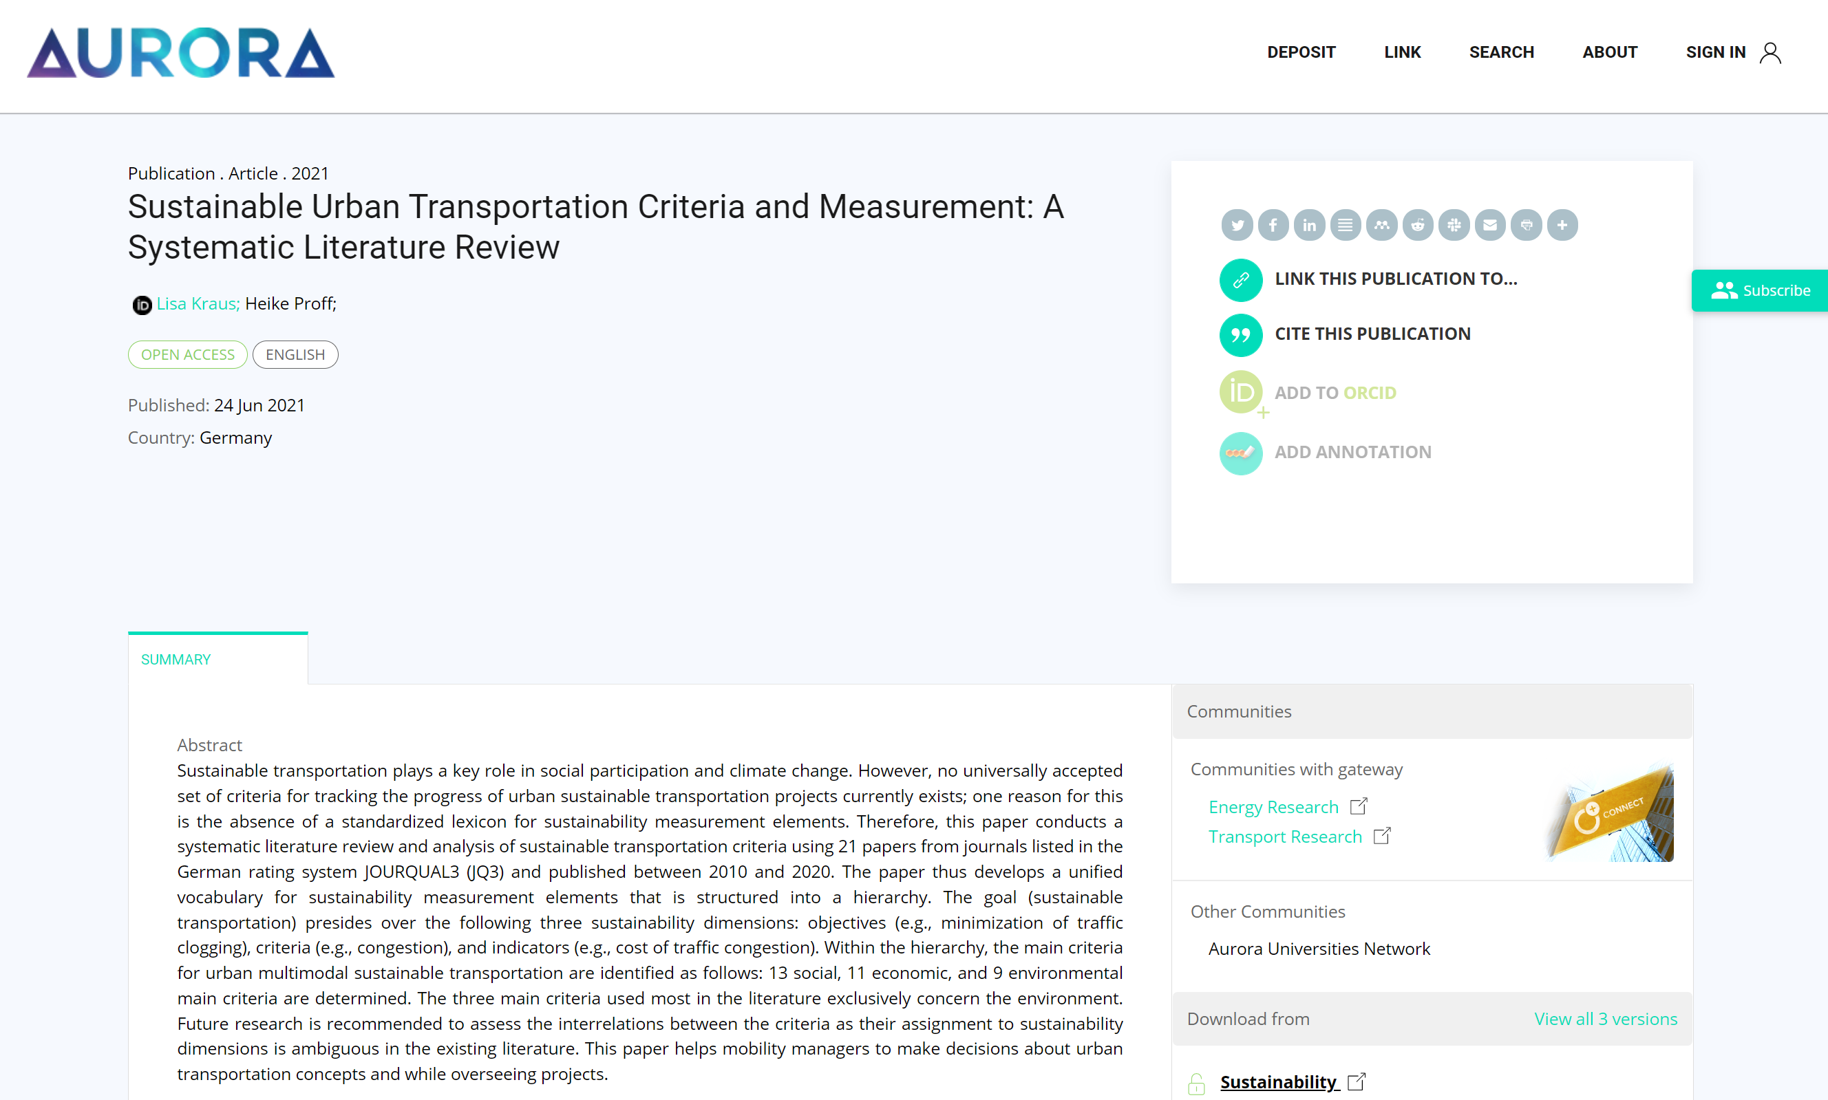



Top 3 SDG Matches
97%
83%
67%

Slide 17
Our struggles
  Issue: Completeness -> 40% of our publications is not represented in commercial in indexes like Web of Science and Scopus.
    Solution: get publications from our research information systems (CRIS), repositories and catalogues.
      Issue: universities are struggling to deliver that data; took months.
  Issue: Multi-lingual SDG classification -> Current SDG classification methods by using keyword searches, exclude publications in other languages, and semantic concept similarity ( e.g. hunger ~ starvation ~ food deprivation )
    Solution: Re-Train advanced AI model (BERT) that is pretrained for 100 languages, with a concept vector graph. (tip from computational linguistics researchers)
      Issue: get large quantities of training data.
        Solution: get Scopus metadata (title + abstracts) with Aurora SDG queries for SDG’s.
          Issue: How do we know the Aurora SDG queries are any good?
            Solution: Evaluate outcomes by 244 senior researchers across Aurora University Network.
      Issue: Scopus download restrictions
        Solution: Join partnership with Elsevier SDG mapping initiative to temporarily lift limitations and get data in bulk.
      Issue: get lots of compute power (GPU) for retraining this AI.
        Solution: using cloud computing resources from University of South Denmark (is other partner in mapping initiative).
      Issue: how do we know the AI outcomes is any good? What about West-European bias?
        Solution: calculate scores with outcomes from previous 244 researchers, and with sets in SDG Mapping partnership.
        Solution: make explicit not to use SDG dashboard for Research Evaluation!

Slide 18
Our struggles
  Issue: dashboard design fit for use -> how do we know the dashboard provides information people can use?
    Solution: survey to different roles in organization, evaluate previous dashboard designs with University’s Policy office, Grant office, Communication office, Research Managers, etc., And adjust according outcomes.
  Issue: awareness and usage -> how do we make sure people are familiar with the dashboard
    Solution: Communication & instruction guides
  Issue: replication and re-building -> how do we make sure others are able to duplicate these SDG dashboards for their own purposes?
    Solution: Open source every step; methods, evaluation, data, code, software. And make guides for developers.
  Issue: sustainability of project results -> how do we keep the dashboard up to date year after year.
    Solutions: Move towards Open Research Information Infrastructures. Connect our systems with existing European Research Infrastructure; OpenAIRE; aurora.openaire.eu

Slide 19

OpenAIRE | New Partnership | Societal Impact & Open Science
SDG Classification Service & Knowledge
Aurora Gateway
aurora.openaire.eu
Open Science Monitor
Users
Open Science Services & Training
www.openaire.eu/newsletters
Societal Impact
Open Science

Slide 20

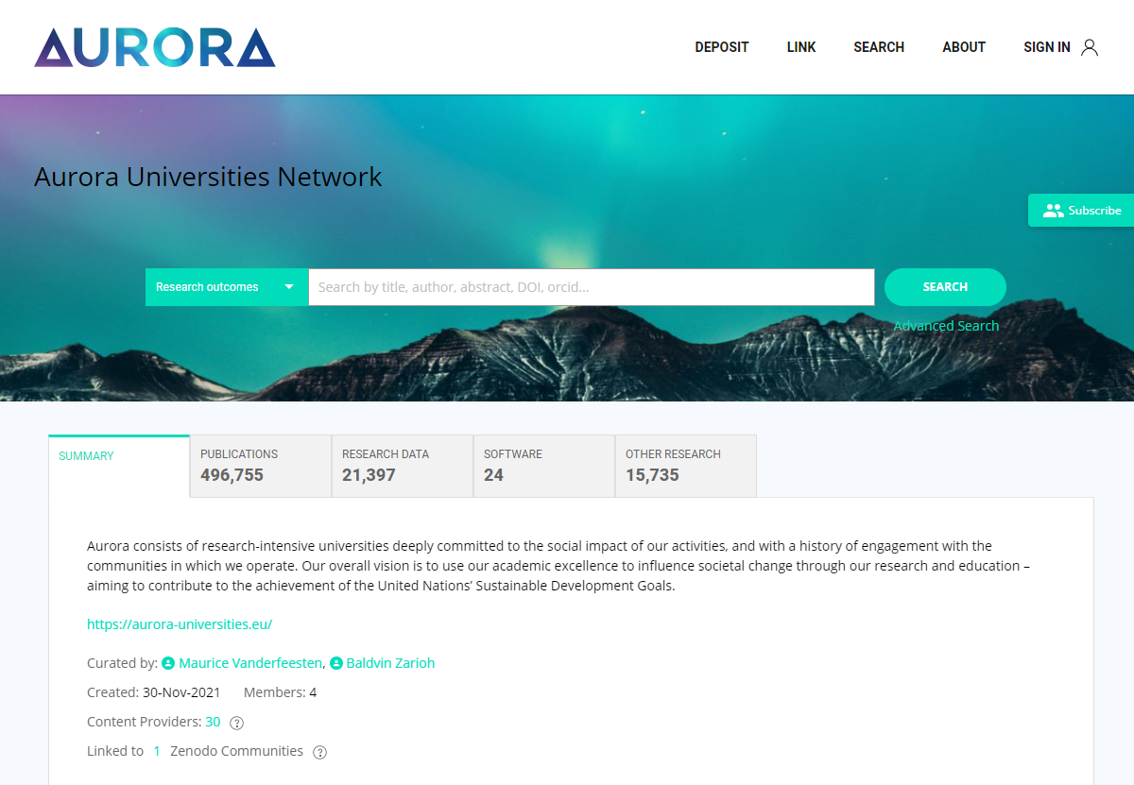



AURORA.OPENAIRE.EU | Aurora Research Output Gateway | Looking ahead
Combining
Repositories
&
Research Information Systems (CRIS)
of all
Aurora Universities
Enables the
Open Science Monitor
Including the SDGs, Funding data, etc.
As up-to-date as your own Repository / CRIS
The SDG Research Dashboard to become a robust and operational tool.
The SDG Research Dashboard is available for other universities and networks.

Slide 21
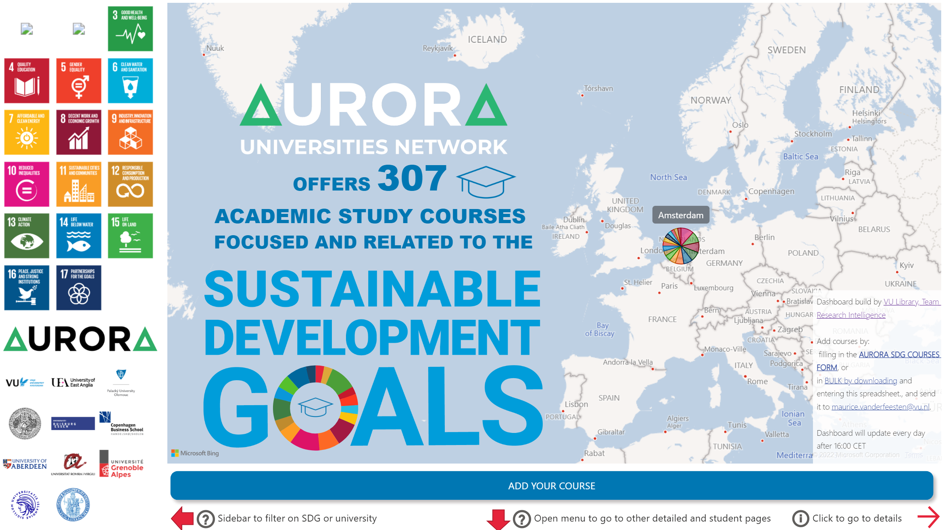
SDG courses (BETA) https://bit.ly/aurora-sdg-courses | https://bit.ly/vu-sdg-courses

Slide 22
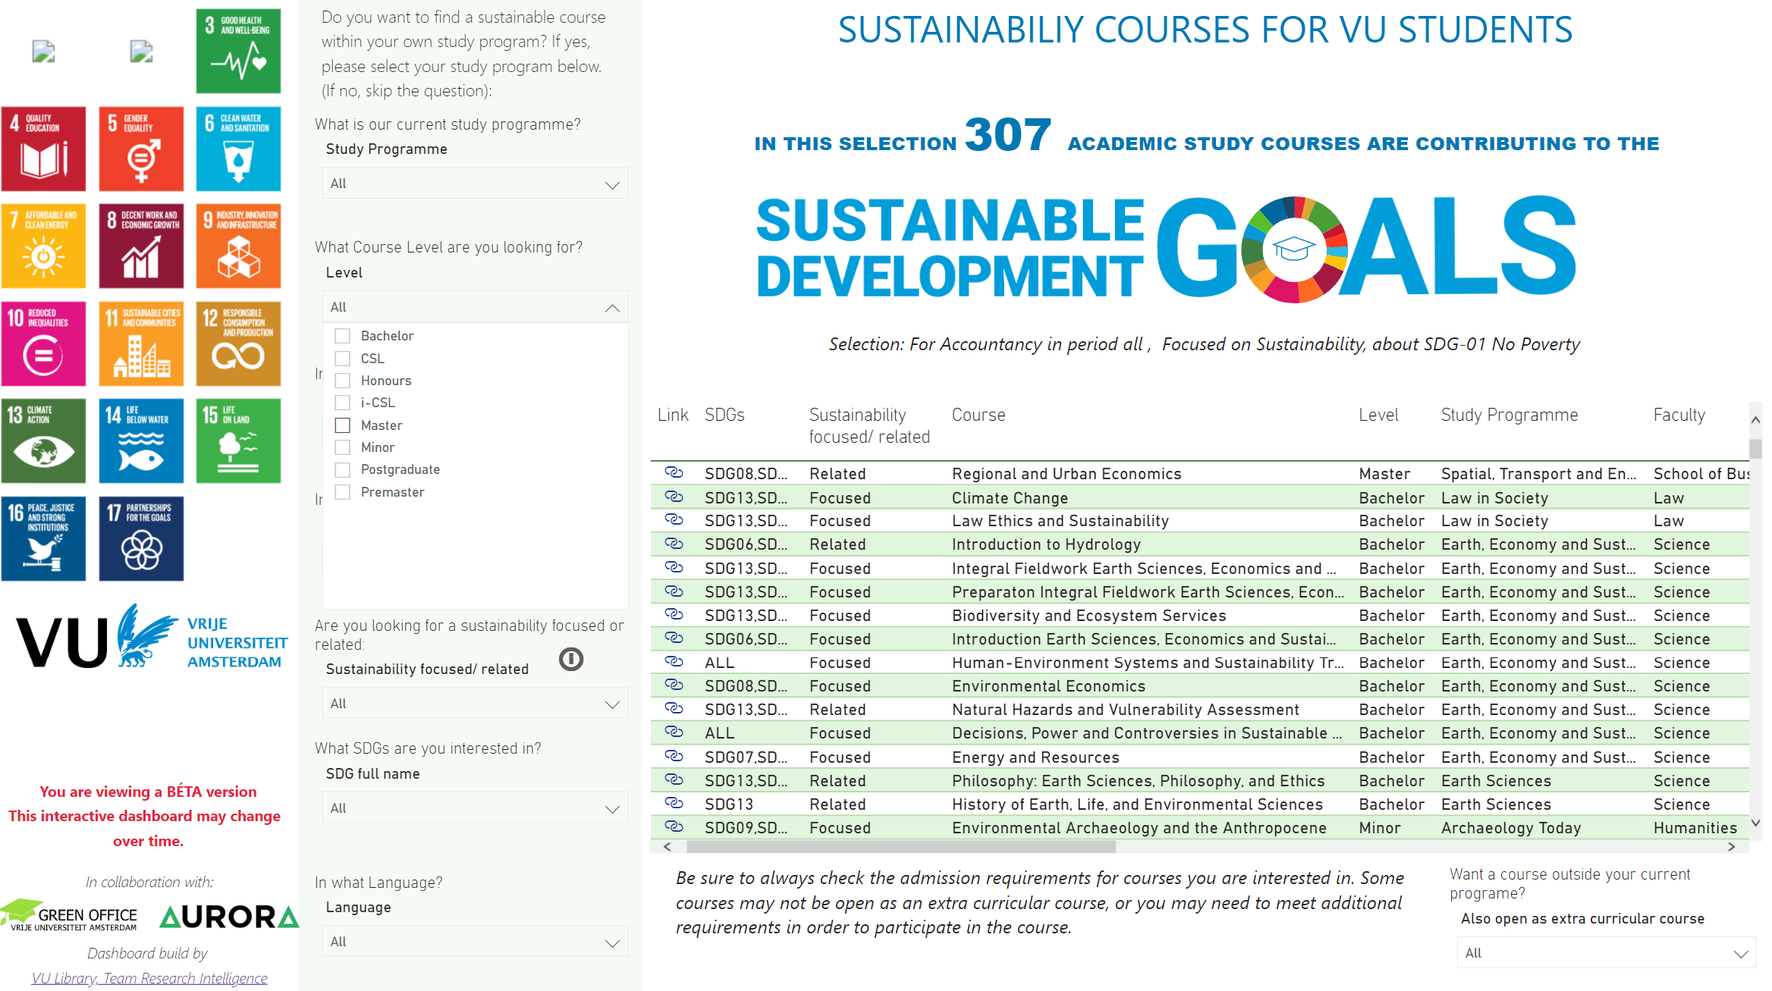
SDG courses (BETA) https://bit.ly/aurora-sdg-courses | https://bit.ly/vu-sdg-courses

Slide 23
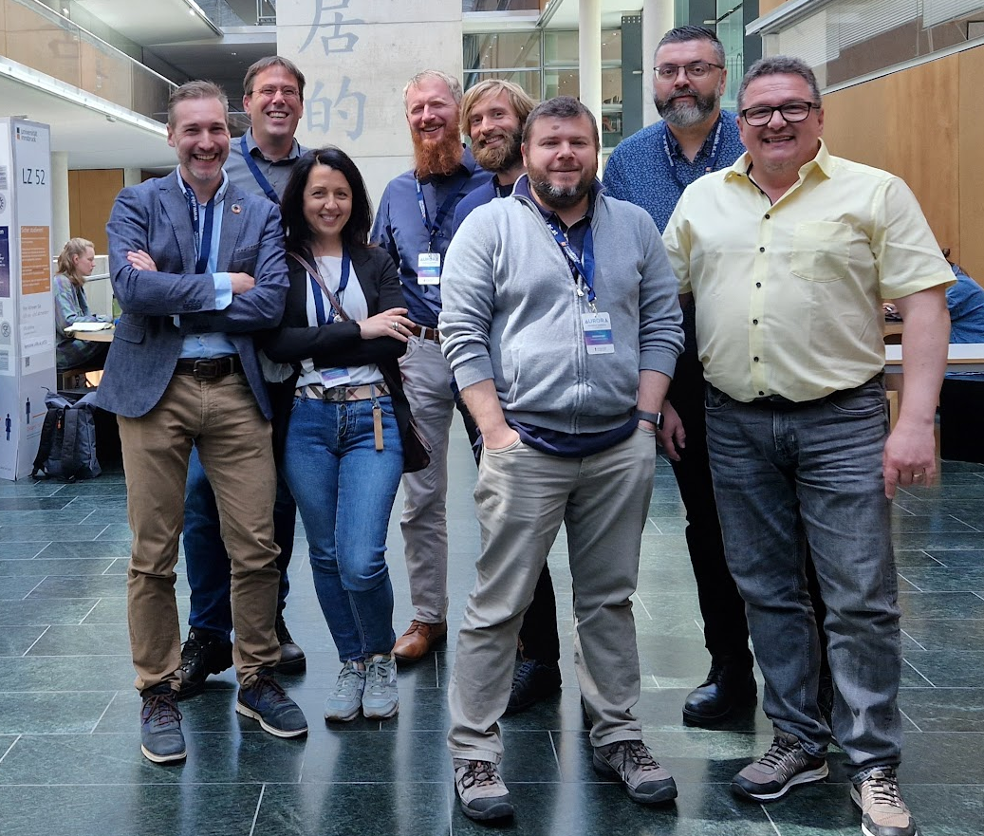
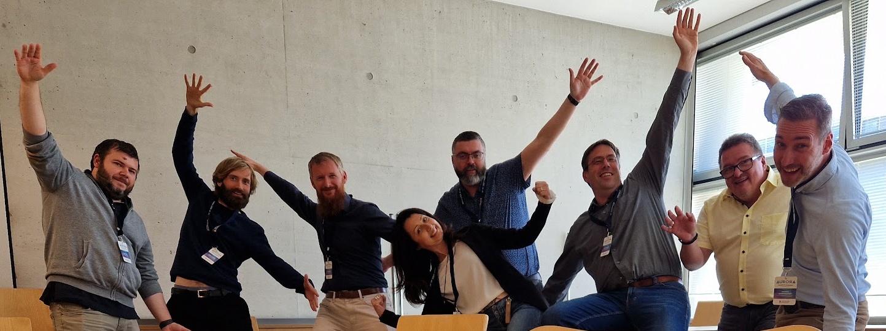
Thank you

