Slide 1
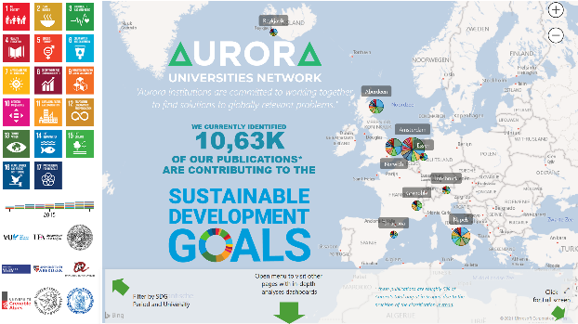


AURORA SDG DASHBOARD
FOR RESEARCH
DEMONSTRATING THE SOCIETAL INFLUENCE OF OUR RESEARCH
http://bit.ly/aurora-sdg
2nd of March 2021 | UBVU MT| Maurice Vanderfeesten | Vrije Universiteit Amsterdam | Twitter: @maurice_
Photo by: Cpl. Jesus Sepulveda Torres
https://www.mcbhawaii.marines.mil/Photos/igphoto/2001813560/

Slide 2
Agenda
  Current SDG demo dashboard
  progress of the SDG project
  Partnership with Elsevier
  MoU with OpenAIRE

Slide 3

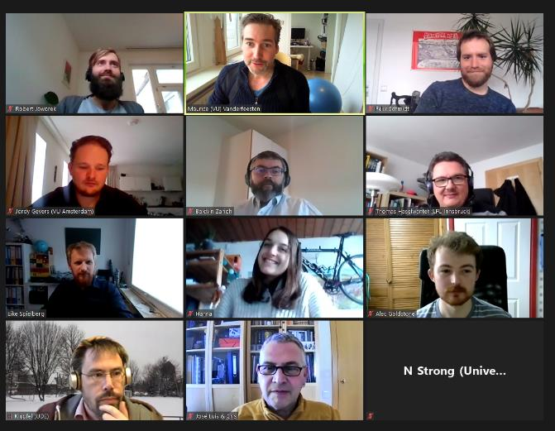


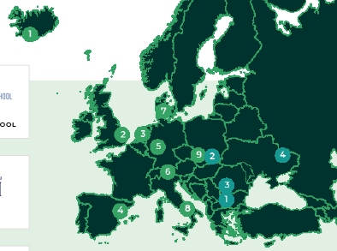




MEET OUR PROJECT TEAM | TASK 5.1: SDG RESEARCH DASHBOARD
(ONE OF THE 20+ PROJECT TEAMS IN THIS UNIVERSITY ALLIANCE)
UNITING
260.000
Students
30.000
Staff
673.922
Alumni
813
Research Groups
112
Faculties
Work package 5: Aurora Sustainability Pioneers
Task 5.1 Aurora SDG Research Dashboard
Task 5.2 Aurora Sustainability Education
Task 5.3 Aurora Sustainable Campus
Action plan ASCA

Slide 4


5.1 AURORA SDG RESEARCH DASHBOARD
WHAT IS THE OBJECTIVE WITH THIS TASK?
Chairs
To turn the SDGs into a leading narrative for research in the Aurora Alliance.
Results in 2023:
The SDG Research Dashboard to become a robust and operational tool.
The SDG Research Dashboard is available for other universities and networks.
Task 5.1 Aurora SDG Research Dashboard
Task 5.2 Aurora Sustainability Education
Task 5.3 Aurora Sustainable Campus
Action plan ASCA

Slide 5
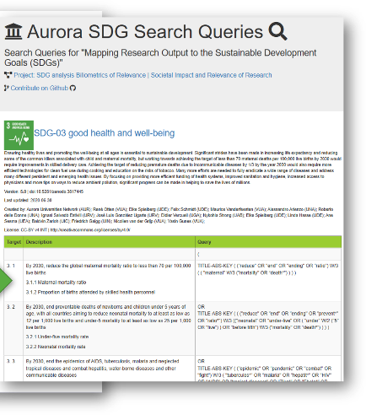
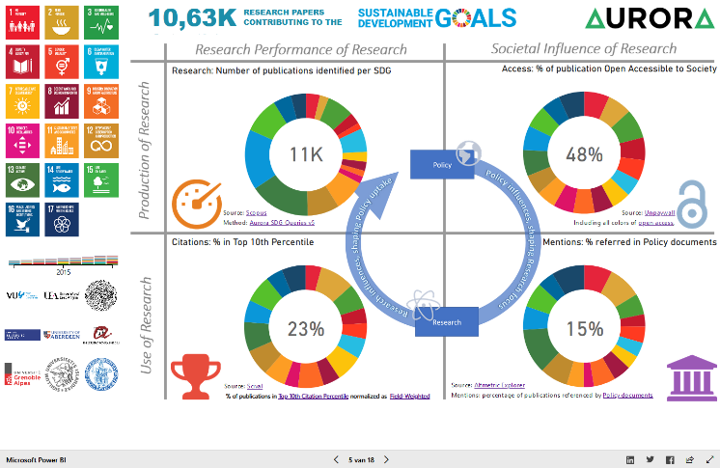
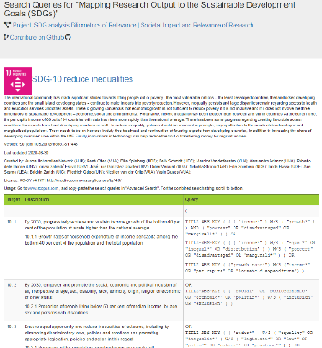
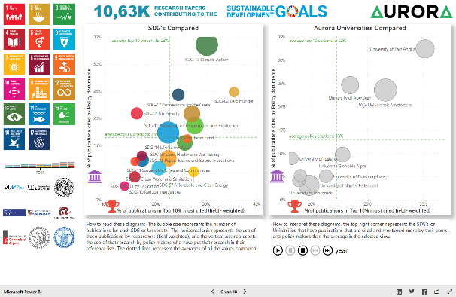
CURRENT SDG-RESEARCH DASHBOARD
BASED ON KEYWORD SEARCHES
https://bit.ly/aurora-sdg-dashboard-v3

Slide 6
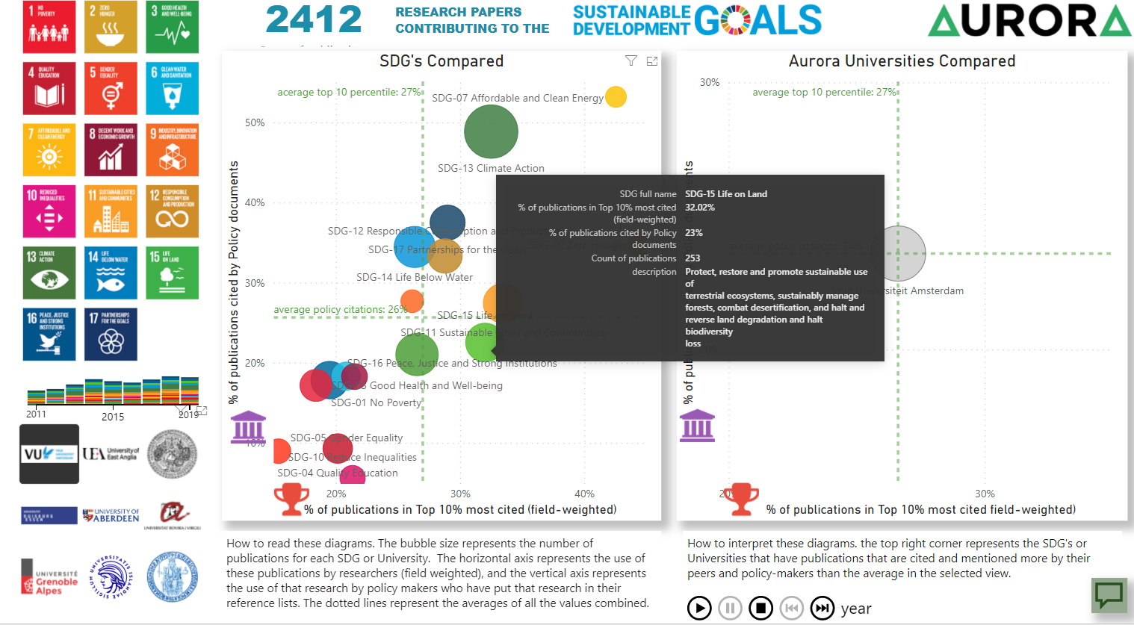
POTENTIAL: DISCOVER WHAT EXCELLENT RESEARCH IS UNKNOW TO POLICY MAKERS

Slide 7
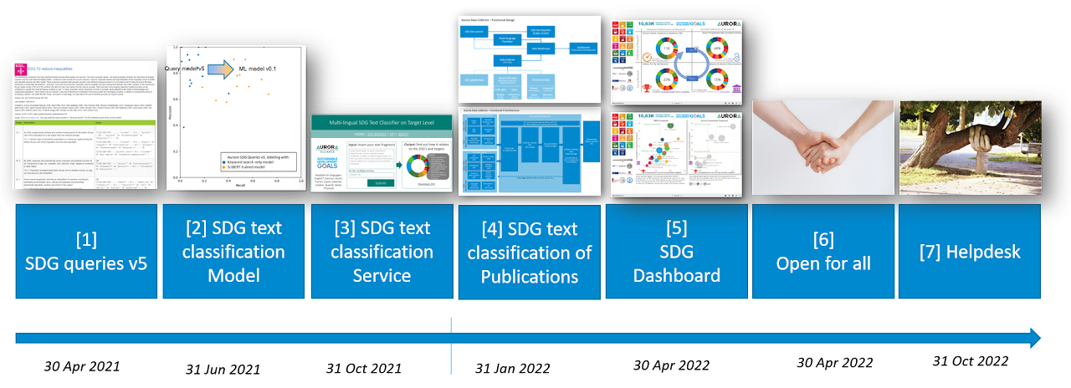
PROJECT TIMELINE
WE
ARE
HERE
SHOULD
BE
HERE
Task 5.1 Aurora SDG Research Dashboard
More at https://alliance.aurora-network.global/work-packages/aurora-sdg-research-dashboard/
Source: https://sites.google.com/vu.nl/aurora-sdg-research-dashboard/deliverables

Slide 8
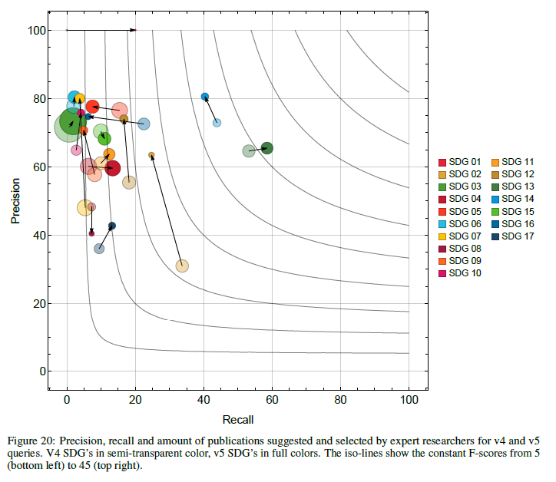
D1: Evaluation of the AURORA SDG QUERIES v5 | DONE
Average Recall: 14%
Accuracy (F1-score) of the queries increased 5% after feedback Survey from 244 Senior Researchers.
doi:10.5281/zenodo.3813230 (608 views, 195 downloads on 2021-11-12)
Precision: 70% of the papers found by the queries were in fact related to the evaluated SDG, according to the Aurora researchers.
      Meaning; a 70% chance a paper is related to an SDG using the Aurora SDG Queries v5.
Recall: 14% of the papers suggested by Aurora researchers were found back in the SDG result sets of the queries.
      Meaning; the Aurora SDG queries v5 miss 86% of the papers that are related to an SDG.
Tradeoff: The higher the Recall, the lower the Precision will be.
Advantage: High Precision data can be used to train machine learning models.
Further reading: Evaluation report
doi:10.5281/zenodo.4917107 (213 views, 92 downloads on 2021-11-12)
Average
Precision: 70%
v5
v4

Slide 9
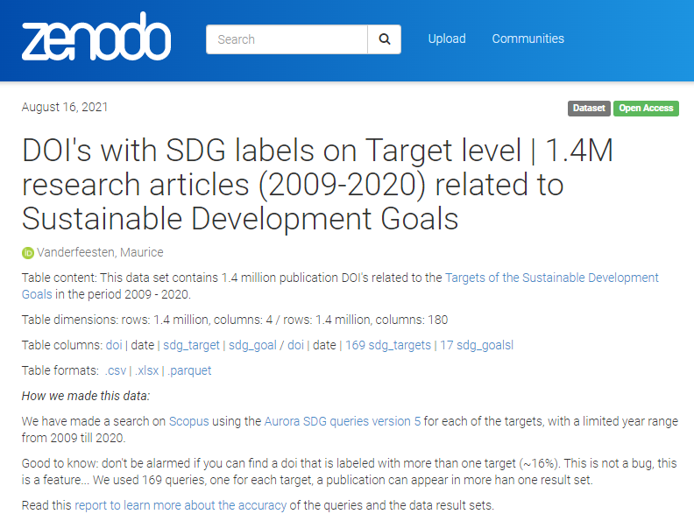
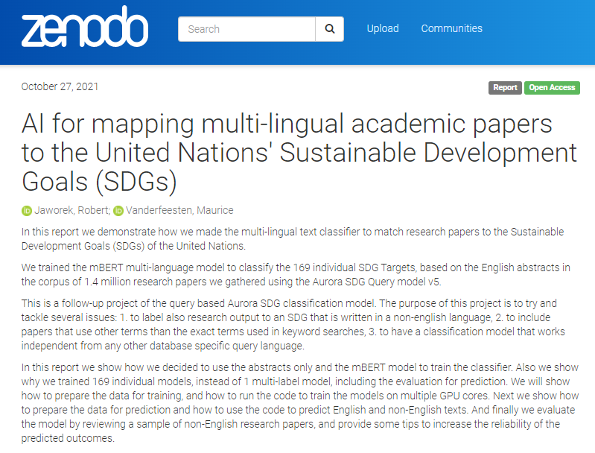
D2: SDG text classification model (multi-lingual) | ALMOST DONE
1.4 million abstracts used to train machine learning models
doi:10.5281/zenodo.5224005 (views 68, downloads 101 on 2021-11-12)
Using High Performance Computing (GPU’s) facilities and budget from University of South Denmark, in partnership with Elsevier
Trained 169 multi-language models (for each SDG-Target) with high accuracy scores (>95%).
Uploaded soon on https://zenodo.org/communities/aurora-universities-network/
Evaluation Report at end of year
doi:10.5281/zenodo.5603019 (placeholder)

Slide 10
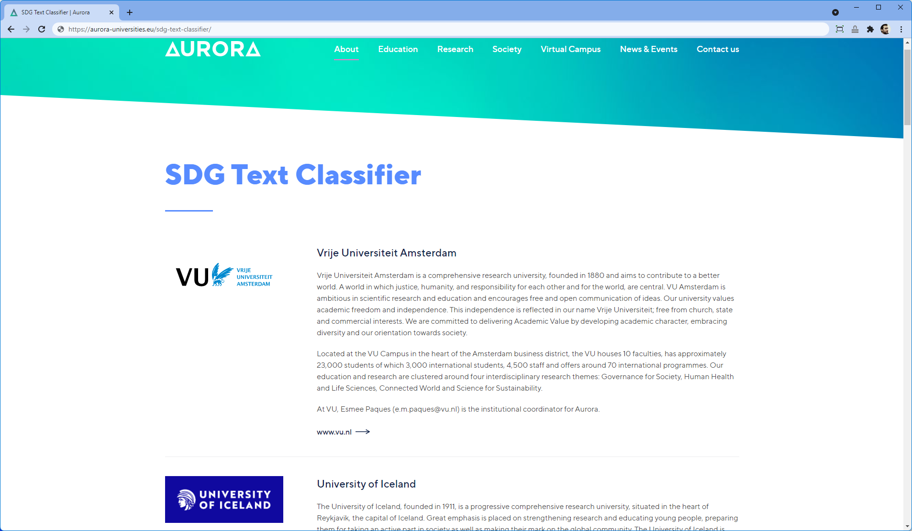
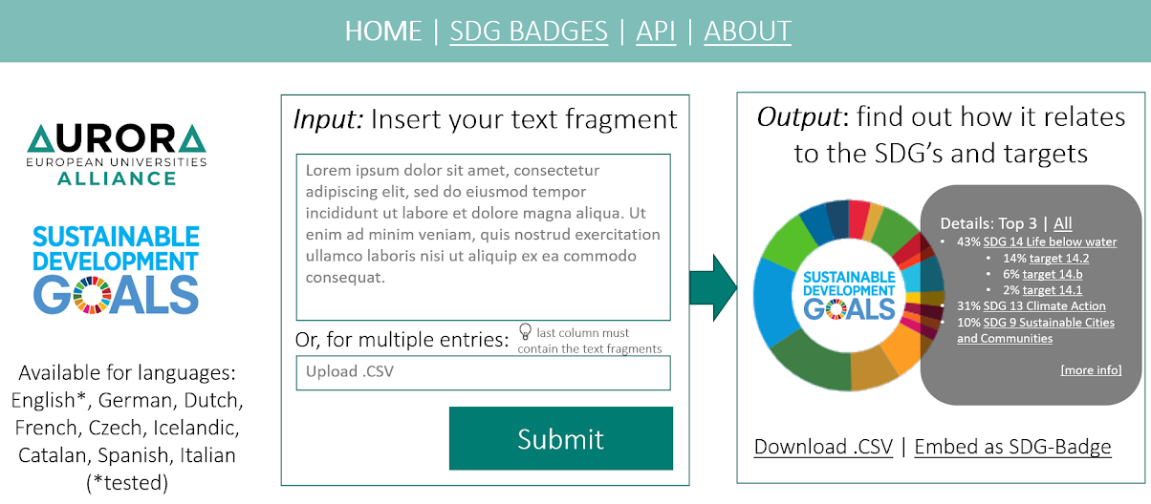
D3: SDG CLASSIFICATION SERVICE | NEXT UP
MOCKUP

Slide 11
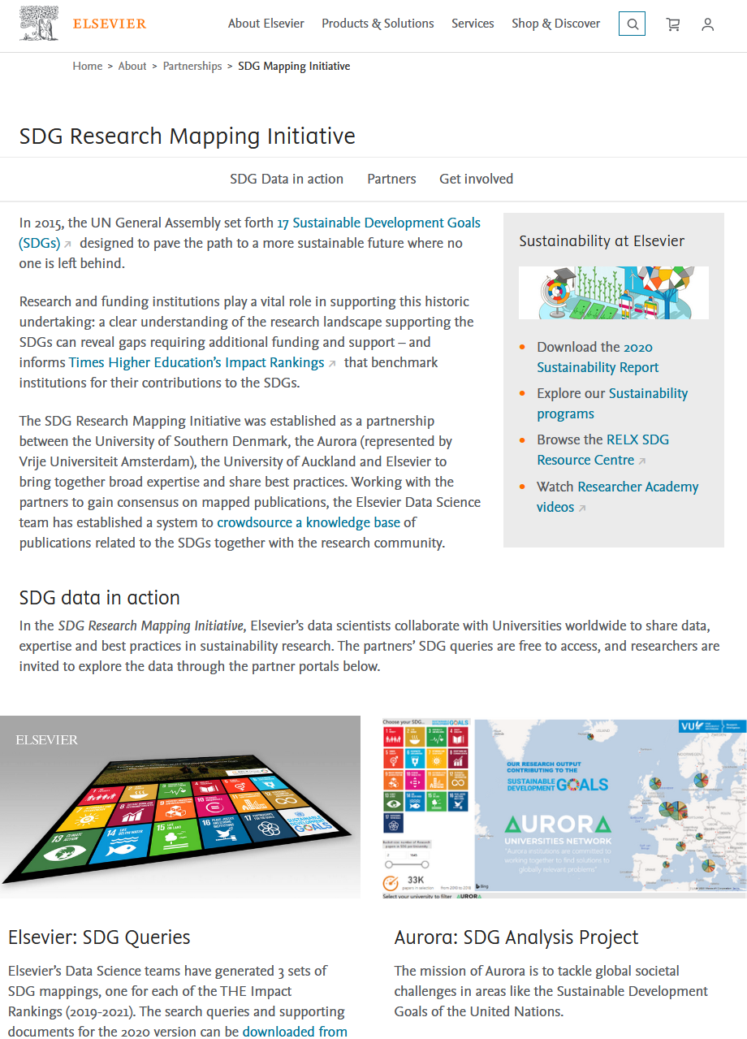
ELSEVIER PARTNERSHIP | almost ending
  https://www.elsevier.com/about/partnerships/sdg-research-mapping-initiative
  Our goals:
    👍Transparent about quality? Pushing market to adopt Aurora standards on transparency,
    👍 Fine grained? … and define queries on target level (but not explicitly)
  Make Aurora SDG queries obsolete and eliminate regular maintenance
    👎Re-Usable? Elsevier queries are not directly re-usable in Scopus. Works only in Elsevier’s back-end system.
    👎 Maintained? Elsevier has no plans to update / maintain the queries.
  Make use of Elsevier’s resources to build a multi-lingual text classifier.
    😕 Data? We got some sample data from Elsevier, but we needed more for machine learning on target level and collected our own 1.4 million abstracts.
    😕 Compute? ended up using HPC resources from University of South Denmark👍, because Elsevier’s Data Lab did not contain abstracts.
  Publishing together a paper on results
    🤞Writing. Elsevier SDG queries (heavy focus) vs Aurora queries vs Aurora text classifier (Queries and ML)

Slide 12



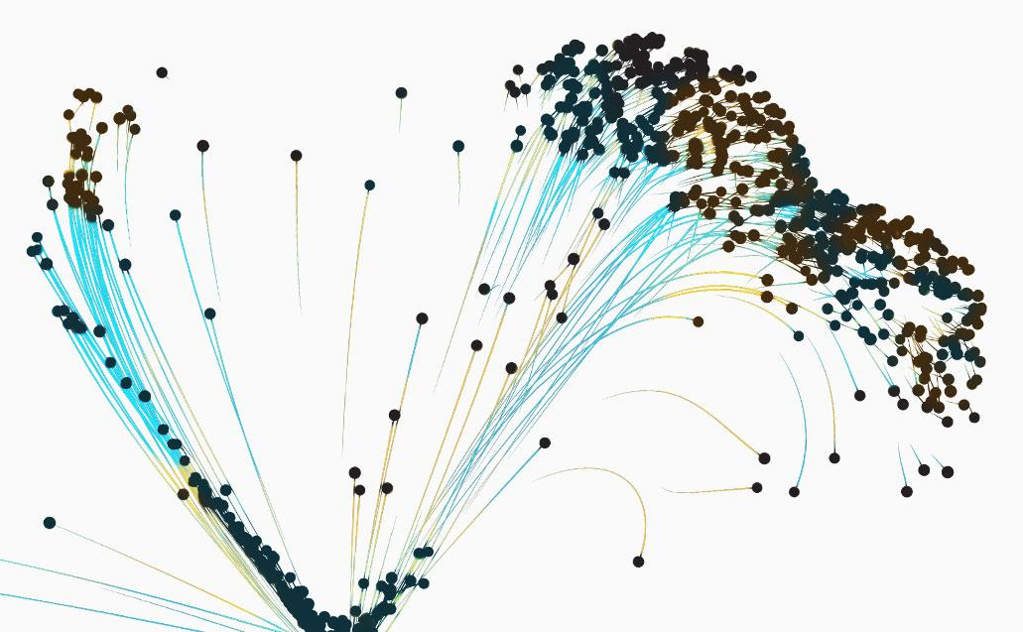

OpenAIRE | New Partnership
  WHY:
    Mutual benefits;
      align complementary project activities, reaching greater impact than acting in solitude
      Increased visibility, EU projects collaborating.
    OpenAIRE provides:
      Freely available auto-curated (meta)data on Publications, Grants, Datasets, affiliated to Aurora universities beyond Scopus and Web of Science.
      Support on using open standards making institutional repositories OpenAIRE compliant.
      Training on using OpenAIRE Open Science services.
    Aurora provides:
      SDG text classifier knowledge and models to be applied on the OpenAIRE Research Graph
      Metadata content from our institutional repositories
      Sharing Open Science practices

Slide 13
OpenAIRE
OpenAIRE is a European project supporting Open Science, and Part of the European Open Science Cloud
On the one hand OpenAIRE is an network of dedicated Open Science experts promoting and providing training on Open Science.
On the other hand OpenAIRE is a technical infrastructure collecting, connecting and re-distributing research output metadata from connected data providers.

Slide 14
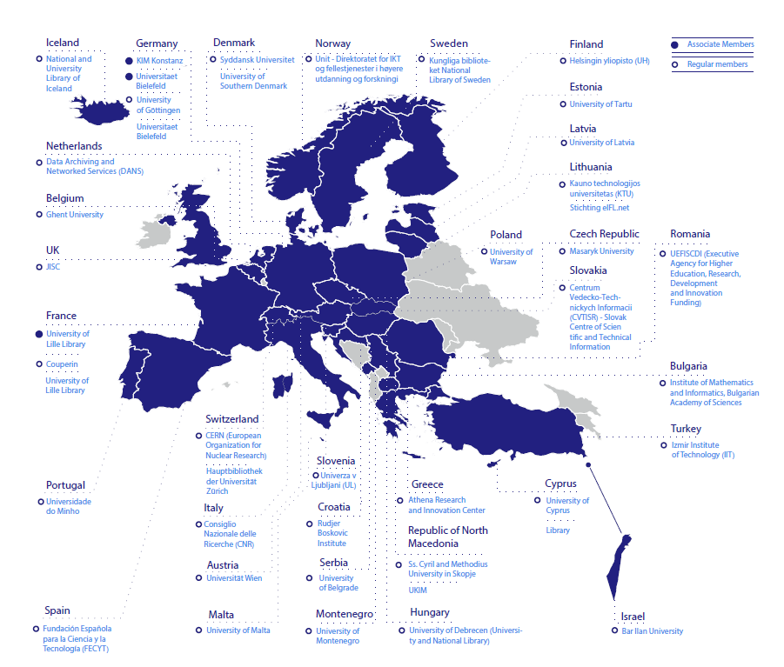



OpenAIRE non-profit at a glance
Mission: Establish, maintain and operate an open and sustainable scholarly communication infrastructure and provide the necessary services, resources and network for supporting a common European e-science environment.
Organization:
Non-profit
Incorporated in 2018
36 regular members
11 Associate members
From 34 countries

Slide 15
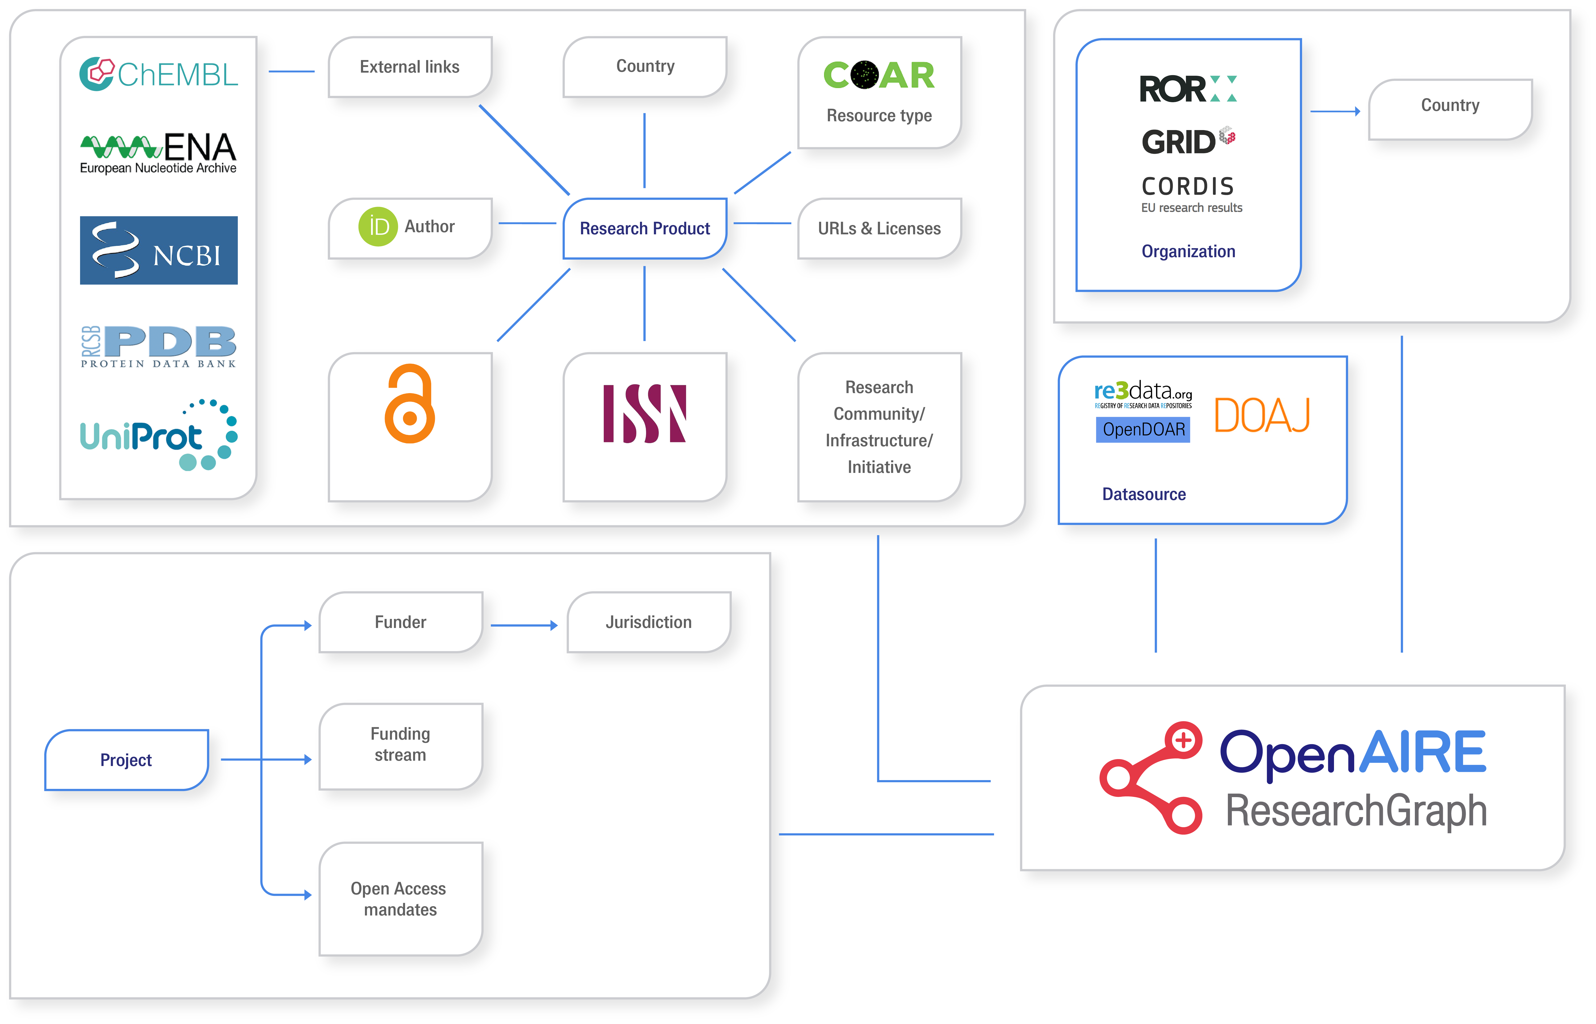
















OpenAIRE serving Open Science
3
Global sources
1
Guidelines
Setting compliance of EOSC data sources
EOSC scientific product catalogue
5
OpenAIRE Guidelines
for SOFTWARE Repositories
OpenAIRE Guidelines
for LITERATURE Repositories v4.0
Register
Validate
Funder - Institution – Community OS Monitoring
Data Source
OpenAIRE Guidelines
for USAGE statistics
OpenAIRE Guidelines
for DATA Repositories
OpenAIRE Guidelines
for OTHER research products
OpenAIRE Guidelines
for CRIS
4
2
Research Community Gateways

Slide 16
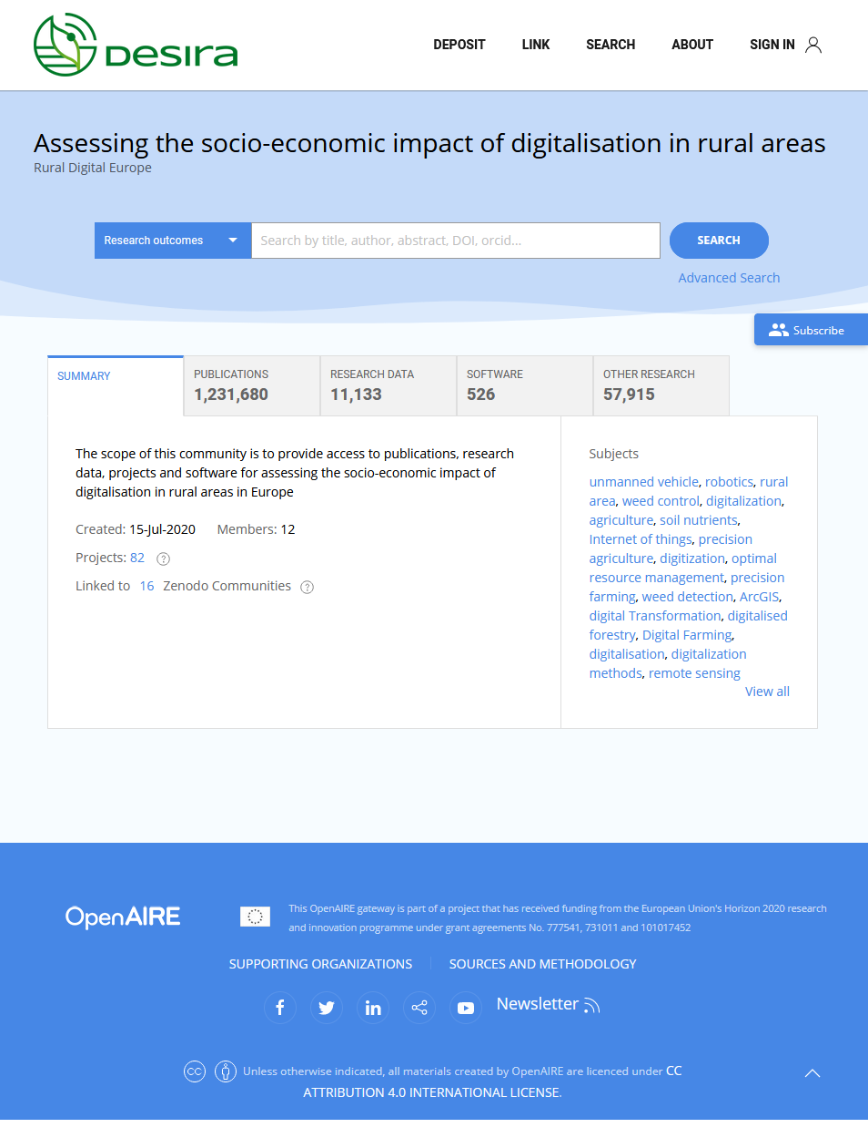


OpenAIRE Connect | an On-demand Open Research Gateways for research communities
Closely collaborating research‑intensive European universities, who use their academic excellence to drive societal change.
A ”community view” of the OpenAIRE Research Graph (publications, data, grants, software, etc.)
  Available via a web portal, API and dumps published on Zenodo
An Open Science Toolkit: entry point to tools for the implementation of Open Science publishing and FAIR-data practices
MOCKUP

Slide 17
OpenAIRE Partnership | Memorandum of Understanding (MoU)
  WHAT:
    [M1] GATEWAY: OpenAIRE CONNECT Gateway for Aurora Universities
    [M2] OS-MONITOR: OpenAIRE Open Science Monitoring Dashboard + Aurora Open Science
    [M3] SDG-ADDON: Aurora SDG classifier for Research publications added to gateway and os-monitor
    [M4] OS-ENGAGEMENT: Open Science training, services and best practices
    [M5] Communication

Slide 18
OpenAIRE Partnership | MoU TIMELINE
Critical path
Aurora
SDG project
MODELS
Additional paths
DATA
M1 Gateway
M3 SDG-addon
Used in
Aurora SDG project
Used in
Aurora SWAFS project
M5 Comms
DATA
M5 Comms
M5 Comms
M5 Comms
DATA
M2 OS-Monitor
M4 OS-Engage
2021 Q3 Q4 2022 Q1 Q2 Q3 Q4 2023 Q1 Q2

Slide 19
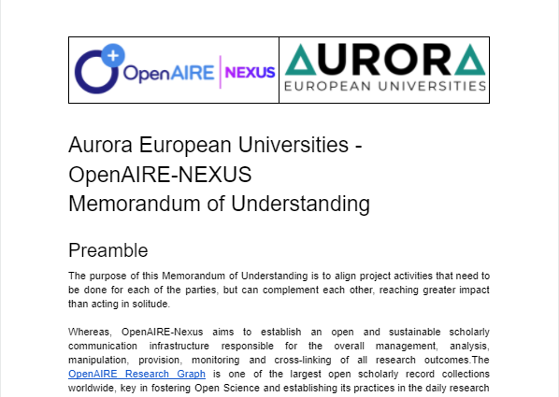

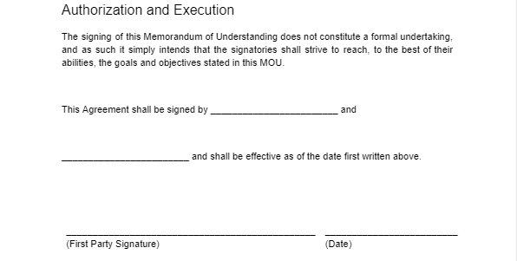
OpenAIRE Partnership | signing MoU
  Obligations?
    No formal undertaking
    Reach goals to the best of our abilities.
  Signing:
    WHO?
      Chair VRR?
      Sec. General?
    WHEN?
      Preferably end of this week.

