Slide 1
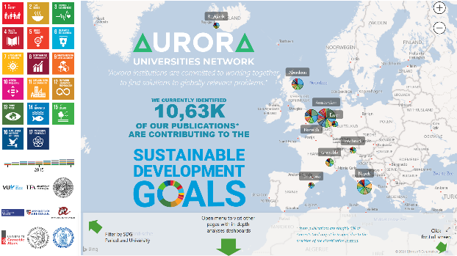


AURORA SDG DASHBOARD
FOR RESEARCH
DEMONSTRATING THE SOCIETAL INFLUENCE OF OUR RESEARCH
http://bit.ly/aurora-sdg
2nd of March 2021 | UBVU MT| Maurice Vanderfeesten | Vrije Universiteit Amsterdam | Twitter: @maurice_
Photo by: Cpl. Jesus Sepulveda Torres
https://www.mcbhawaii.marines.mil/Photos/igphoto/2001813560/

Slide 2
Agenda
  Visually; the demo dashboard; showing the potential of excellent research to be used by policy makers.
  Current progress of the project
  Partnership with Elsevier
  MoU with OpenAIRE

Slide 3

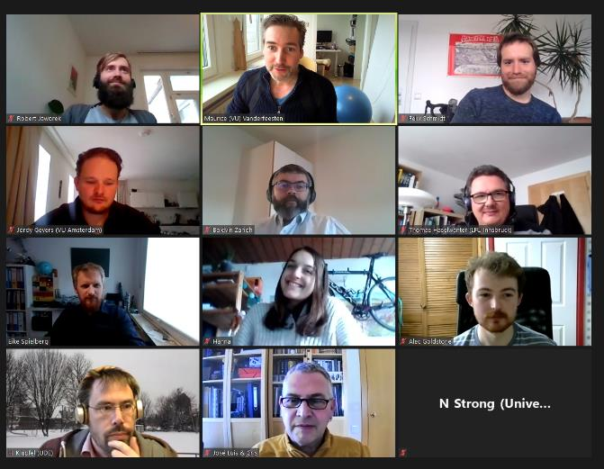


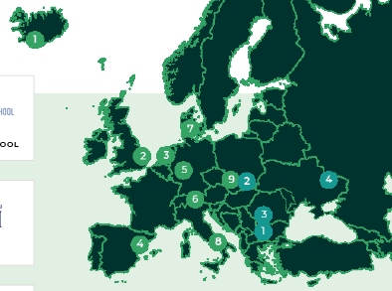




MEET OUR PROJECT TEAM | TASK 5.1: SDG RESEARCH DASHBOARD
(ONE OF THE 20+ PROJECT TEAMS IN THIS UNIVERSITY ALLIANCE)
UNITING
260.000
Students
30.000
Staff
673.922
Alumni
813
Research Groups
112
Faculties
Work package 5: Aurora Sustainability Pioneers
Task 5.1 Aurora SDG Research Dashboard
Task 5.2 Aurora Sustainability Education
Task 5.3 Aurora Sustainable Campus
Action plan ASCA

Slide 4


5.1 AURORA SDG RESEARCH DASHBOARD
WHAT IS THE OBJECTIVE WITH THIS TASK?
Chairs
To turn the SDGs into a leading narrative for research in the Aurora Alliance.
Results in 2023:
The SDG Research Dashboard to become a robust and operational tool.
The SDG Research Dashboard is available for other universities and networks.
Task 5.1 Aurora SDG Research Dashboard
Task 5.2 Aurora Sustainability Education
Task 5.3 Aurora Sustainable Campus
Action plan ASCA

Slide 5
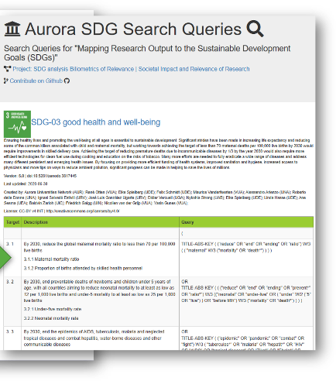
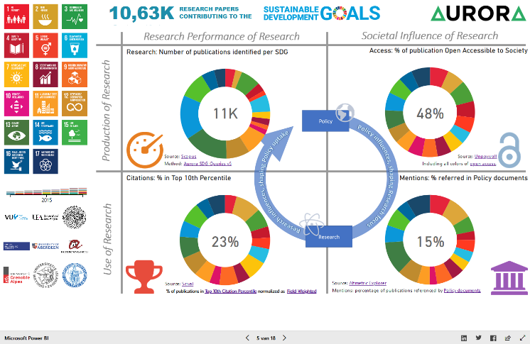
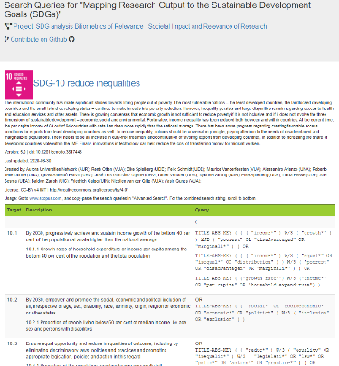
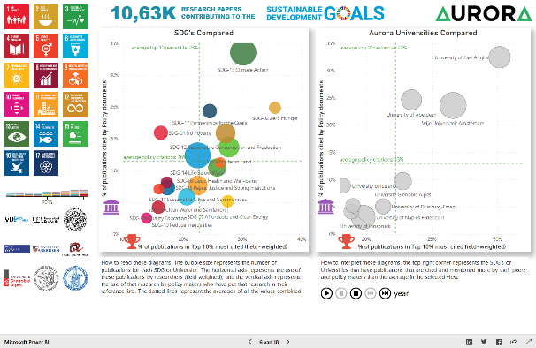
CURRENT SDG-RESEARCH DASHBOARD
BASED ON KEYWORD SEARCHES
https://bit.ly/aurora-sdg-dashboard-v3

Slide 6
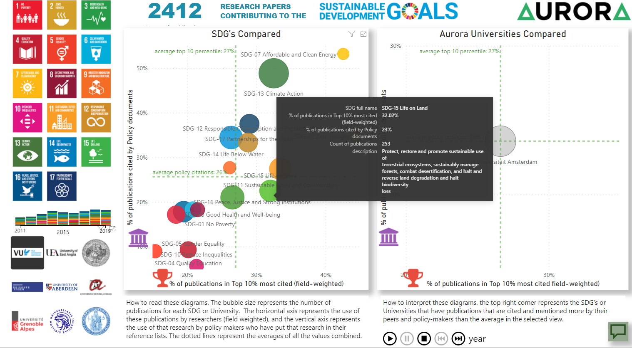
POTENTIAL: DISCOVER WHAT EXCELLENT RESEARCH IS UNKNOW TO POLICY MAKERS

Slide 7
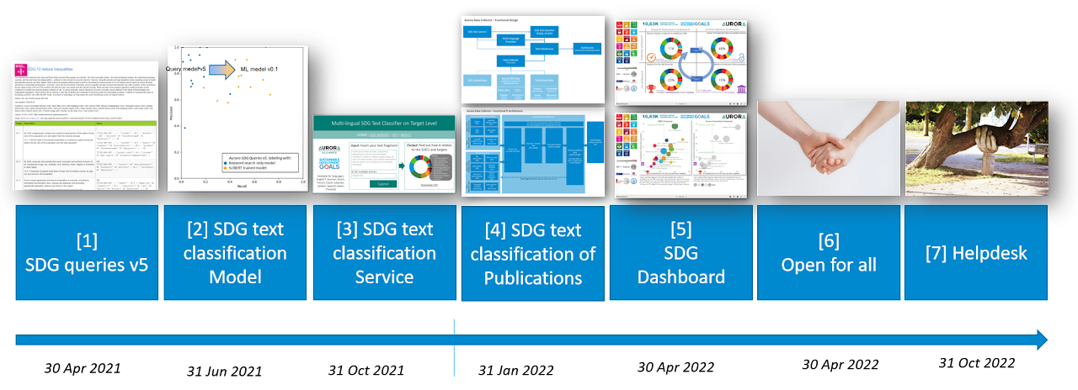
PROJECT TIMELINE
Task 5.1 Aurora SDG Research Dashboard
delivered
Source: https://sites.google.com/vu.nl/aurora-sdg-research-dashboard/deliverables

Slide 8
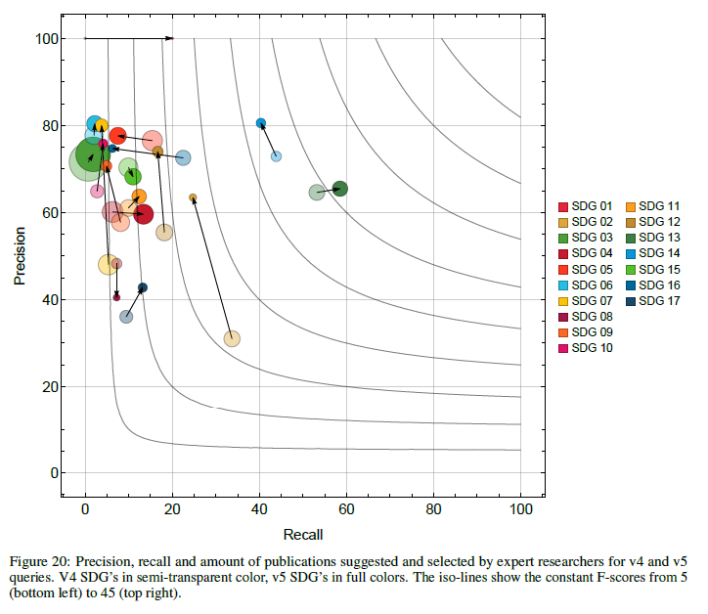
D1: Evaluation of the AURORA SDG QUERIES v5
Average Recall: 14%
Accuracy (F1-score) of the queries increased 5% after feedback Survey from 244 Senior Researchers.
doi:10.5281/zenodo.3813230 (608 views, 195 downloads on 2021-11-12)
Precision: 70% of the papers found by the queries were in fact related to the evaluated SDG, according to the Aurora researchers.
      Meaning, a 70% chance a paper is related to an SDG using the Aurora SDG queries v5.
Recall: 14% of the papers suggested by Aurora researchers were found back in the SDG result sets of the queries.
      Meaning, the Aurora SDG queries v5 miss 86% of the papers that are related to an SDG.
Tradeoff: The higher the Recall, the lower the Precision will be.
Advantage: High Precision data can be used to train machine learning models.
Further reading: Evaluation report
doi:10.5281/zenodo.4917107 (213 views, 92 downloads on 2021-11-12)
Average
Precision: 70%
v5
v4

Slide 9
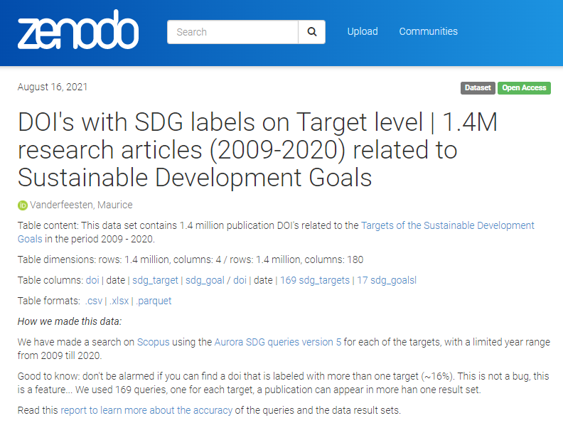
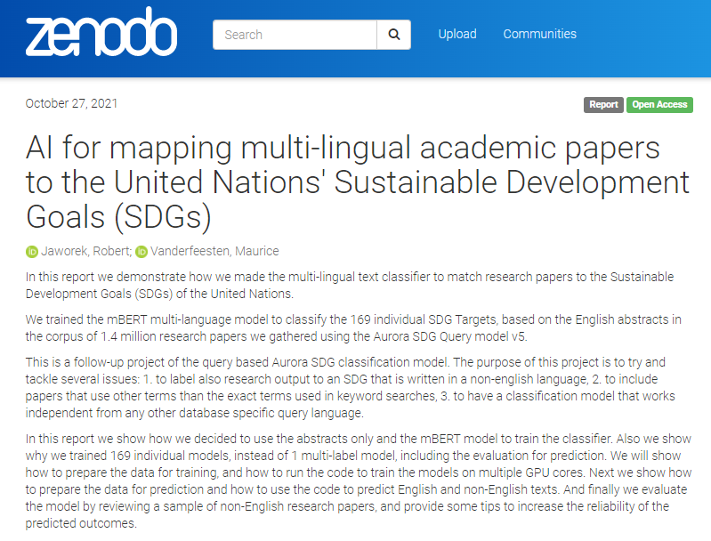
D2: SDG text classification model (multi-lingual)
1.4 million abstracts used to train machine learning models
doi:10.5281/zenodo.5224005 (views 68, downloads 101 on 2021-11-12)
Using High Performance Computing (GPU’s) facilities from University of South Denmark, in partnership with Elsevier
Trained 169 multi-language models (for each SDG-Target) with high accuracy scores (>95%).
Uploaded soon on https://zenodo.org/communities/aurora-universities-network/
Evaluation Report at end of year
doi:10.5281/zenodo.5603019 (placeholder)

Slide 10
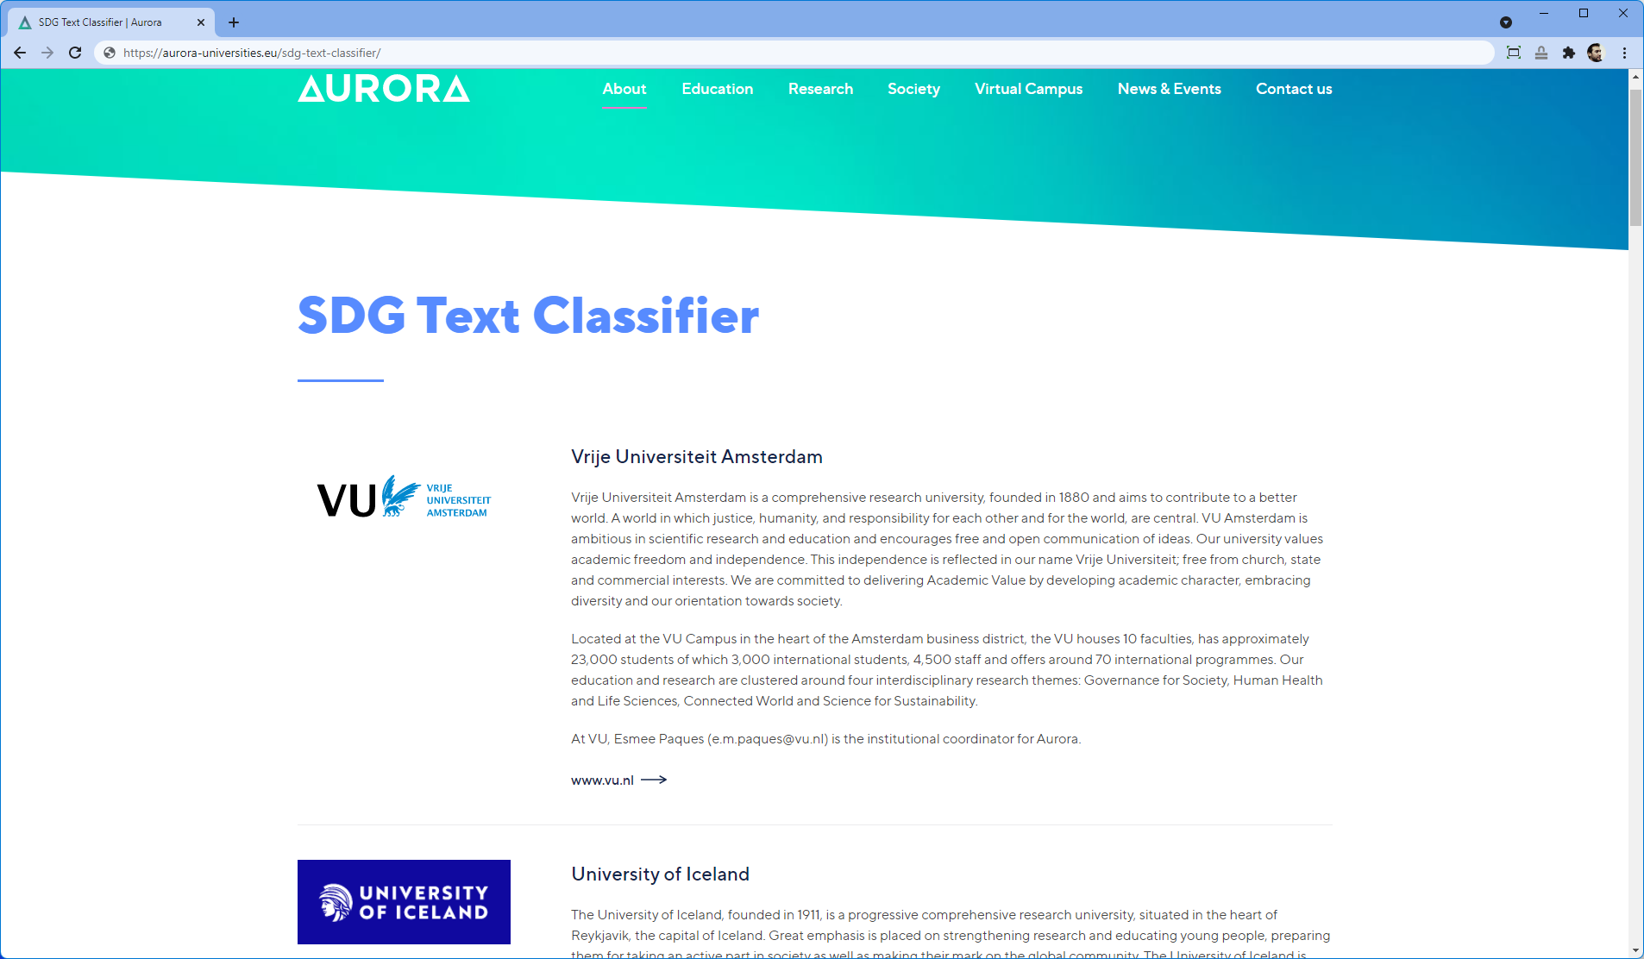
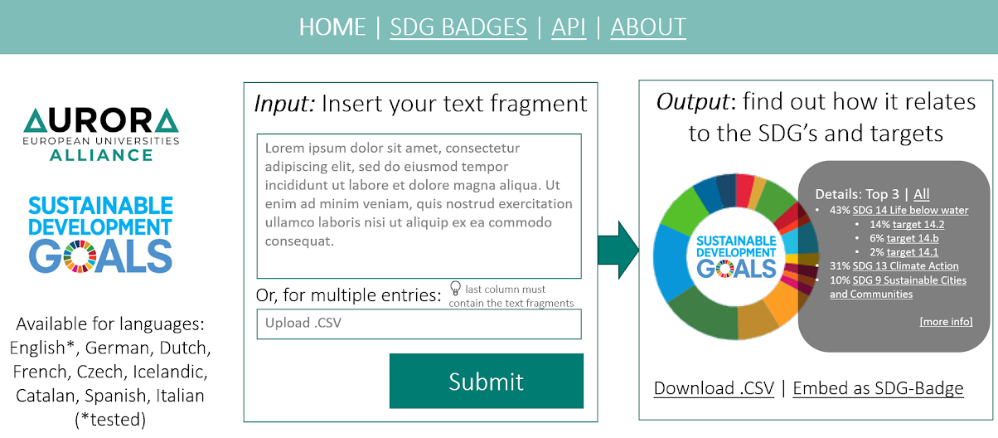
NEXT STEP | D3: SDG CLASSIFICATION SERVICE

Slide 11
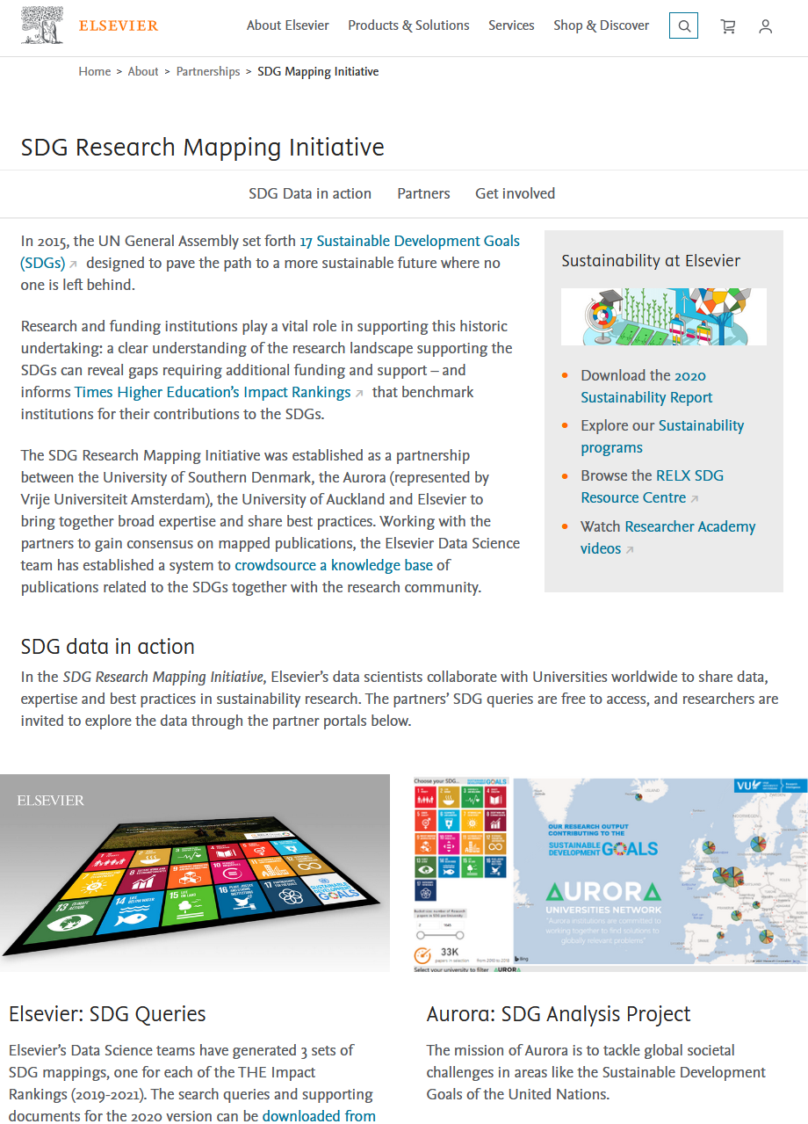
ELSEVIER PARTNERSHIP | almost ending
  https://www.elsevier.com/about/partnerships/sdg-research-mapping-initiative
  Our goals:
    Pushing market to adopt Aurora standards on transparency and define queries on target leve
      (Done, done)
  Make Aurora SDG queries obsolete and eliminate regular maintanance
    Elsevier queries are not usable; scopus will break when queries are used. Works only in Elsevier’s back-end system
    Elsevier has no plans to update / maintain the queries
  Make use of Elsevier’s resources to build a multi-lingual text classifier.
    we got some sample data from Elsevier, but needed more and collected our own 1.4 million abstracts.
    ended up using HPC resources from University of South Denmark, because Elsevier’s Lab data did not contain abstracts.
  Publishing together a paper on results
    Elsevier SDG queries vs Aurora queries vs Aurora text classifier

Slide 12


OpenAIRE
OpenAIRE is a European project supporting Open Science.
On the one hand OpenAIRE is an network of dedicated Open Science experts promoting and providing training on Open Science.
On the other hand OpenAIRE is a technical infrastructure collecting, connecting and re-distributing research output metadata from connected data providers.

Slide 13
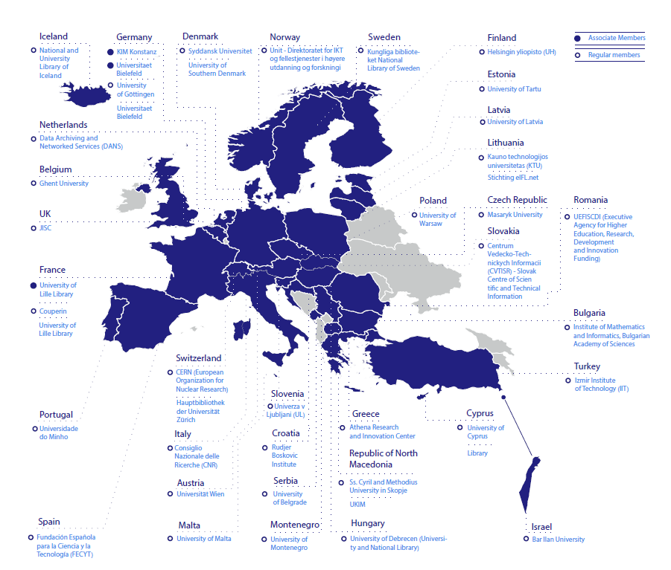



OpenAIRE non-profit at a glance
Mission: Establish, maintain and operate an open and sustainable scholarly communication infrastructure and provide the necessary services, resources and network for supporting a common European e-science environment.
Organization:
Non-profit
Incorporated in 2018
36 regular members
11 Associate members
From 34 countries

Slide 14
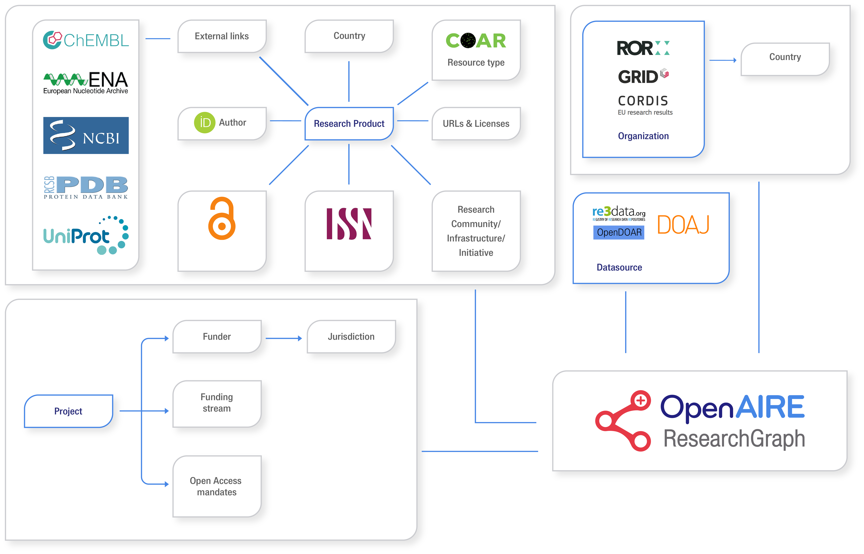
















OpenAIRE serving Open Science
3
Global sources
1
Guidelines
Setting compliance of EOSC data sources
EOSC scientific product catalogue
5
OpenAIRE Guidelines
for LITERATURE Repositories v4.0
Register
Validate
Funder - Institution – Community OS Monitoring
OpenAIRE Guidelines
for SOFTWARE Repositories
Data Source
OpenAIRE Guidelines
for USAGE statistics
OpenAIRE Guidelines
for DATA Repositories
OpenAIRE Guidelines
for OTHER research products
OpenAIRE Guidelines
for CRIS
4
2
Research Community Gateways

Slide 15

OpenAIRE connect | an On-demand Open Research Gateways for research communities
A ”community view” of the OpenAIRE Research Graph
  Available via a web portal, API and dumps published on Zenodo
An Open Science Toolkit: entry point to tools for the implementation of Open Science publishing practices

Slide 16
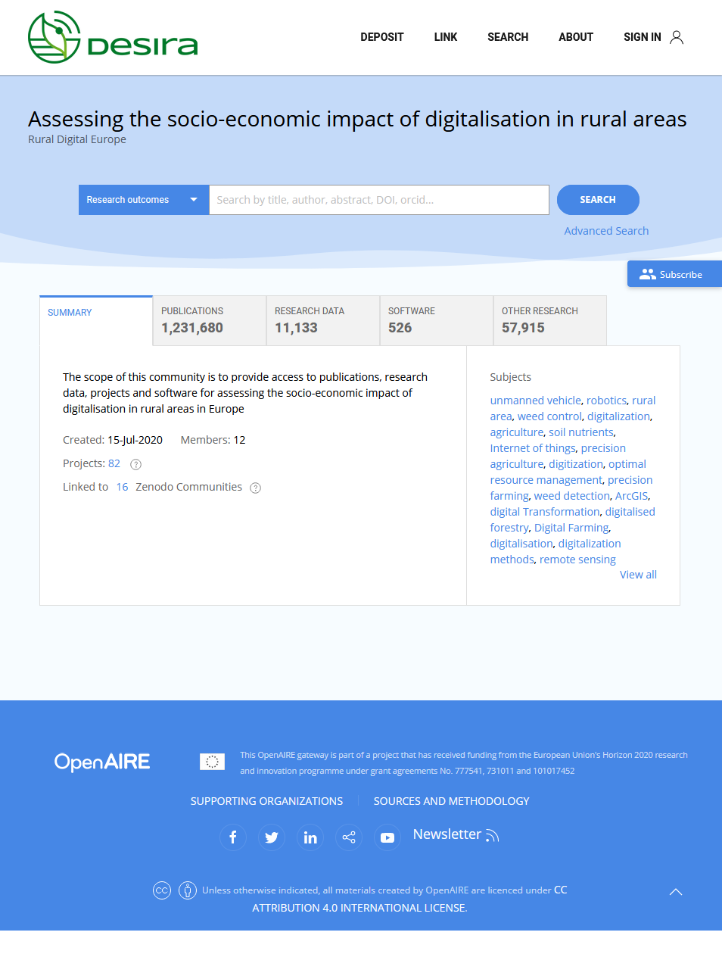

OpenAIRE Partnership | signing MoU
  [M1] GATEWAY: OpenAIRE CONNECT Gateway for Aurora Universities
  [M2] OS-MONITOR: OpenAIRE Open Science Monitoring Dashboard + Aurora Open Science {for SWAFS project}
  [M3] SDG-ADDON: Aurora SDG classifier for Research publications added to gateway and os-monitor
  [M4] OS-ENGAGEMENT: Open Science training, services and best practices {for SWAFS project}
  [M5] Communication
closely collaborating research‑intensive European universities, who use their academic excellence to drive societal change.

Slide 17
MoU TIMELINE
MODELS
DATA
M1 Gateway
M3 SDG-addon
Used in
Aurora SDG project
Used in
Aurora SWAFS project
M5 Comms
DATA
M5 Comms
M5 Comms
M5 Comms
DATA
M2 OS-Monitor
M4 OS-Engage
2021 Q3 Q4 2022 Q1 Q2 Q3 Q4 2023 Q1 Q2

Slide 18

THANK YOU FOR YOUR ATTENTION!
http://bit.ly/aurora-sdg
Maurice Vanderfeesten | Vrije Universiteit Amsterdam |
Twitter: @maurice_
E-mail: maurice.vanderfeesten@vu.nl

Slide 19
NEXT SLIDES: LEARN MORE ABOUT THE CONTEXT AND BACKGROUND

Slide 21
PROJECT UPDATE : MAY 2021
  323 Views, 112 Downloads of Aurora SDG Survey data (for baselining SDG classification models) [zenodo]
  281 Views, 24 Downloads and 5 Forks of Aurora SDG queries v5 [zenodo] [github]
  88 Views of SDG Dashboard Explainer Video [youtube]
  4 partnerships (Elsevier (private) with University of South Denmark (public) and Aukland University (public), U-multi-rank/Strings project (public), Idfuse (private), OpenAire (public))
  [1] SDG basic classification; Robustness report of Aurora SDG queries
    1.5 million publications classified to SDG with Scopus
    Increase in precision; excellent condition for machine learning applications
    Minimizing overlap; excellent condition for machine learning applications
    Overlap with Elsevier queries 2021
  [2] SDG extended classification enabling multi-lingual support; Experiments with BERT language model
    Tests with IDfuse show increase in recall, without reducing precision
    Test with students show high accuracy for trained models
    Including research in multiple languages
  [4] Scaling IT infrastructure
    Plan to Ingest & SDG-classify 126 million publications from OpenAIRE Research Graph.

Slide 22
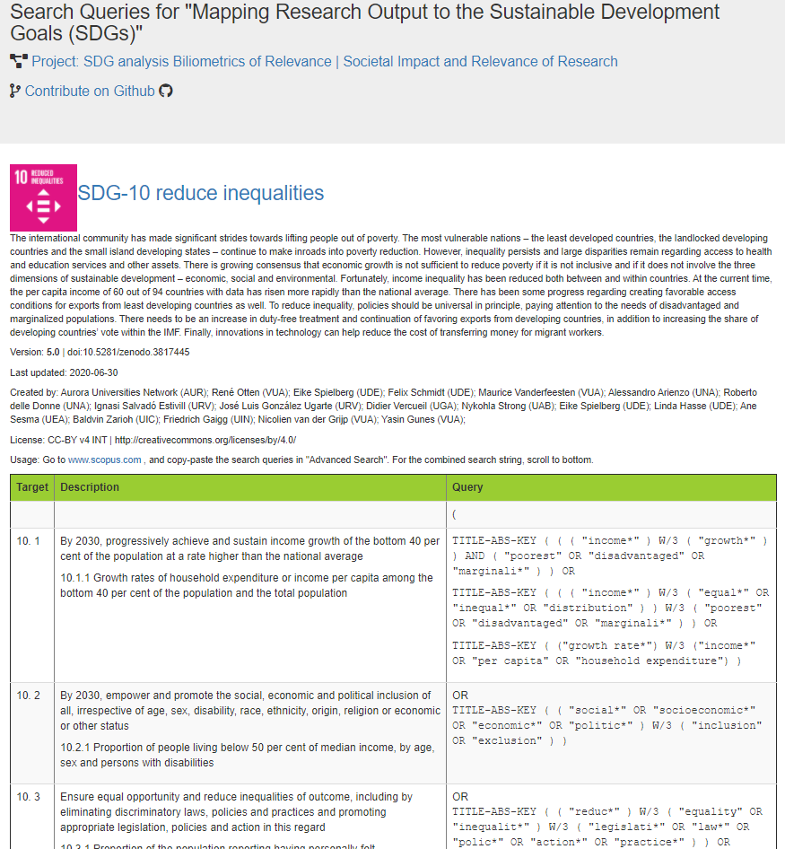
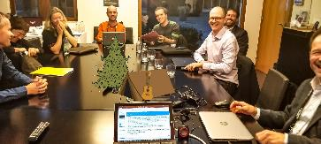
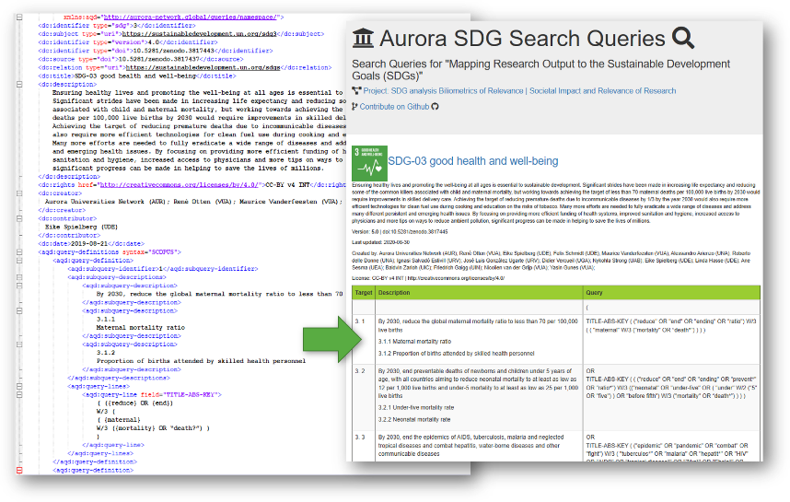



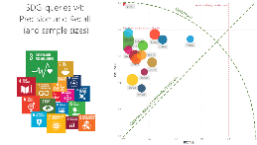
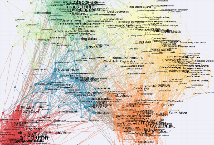
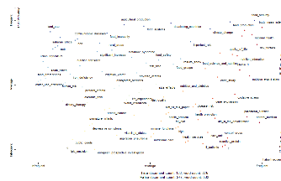
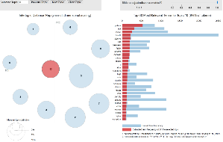
D1: ROBUST QUERY CLASSIFICATION MODEL FOR SDG RESEARCH
VALIDATED SEARCH QUERIES ON EACH SDG GOAL | AND IN PARTS PER TARGET
Free & Transparent on GitHub: https://aurora-network-global.github.io/sdg-queries/

Slide 23
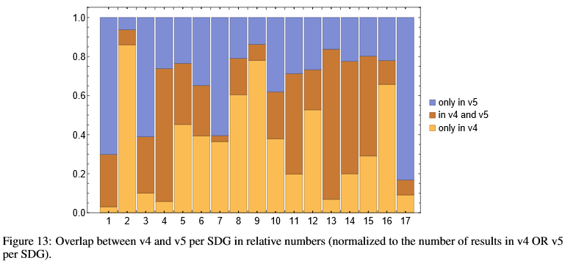
D1. ROBUSTNESS REPORT
What is the effect of that change from v4 to v5, in term of Precision and Recall?
Precision (% of the SDG labeled publications are relevant to that SDG),
Recall (% of all relevant SDG papers we have given the right SDG label)
The higher the number, the better. Semi-transparent color = v4
How much did the publications in the result sets change for each SDG of query version 4 compared to version 5?
The smaller the brown bar, the bigger is the change.

Slide 24
ISSUES AND SOLUTION DIRECTIONS
Current issues
Our current corpus is Scopus for academic content, which does not contain all our publications, in all fields of research, in all our (EU) languages.
Our current query model retrieves English-only papers, and excludes papers where keywords are absent for related concepts, synonyms and antonyms (e.g. hunger vs. malnutrition, food security vs. food insecurity, etc)
Our current query model is tightly linked with the Scopus corpus, making immediate use outside this proprietary corpus useless.
We need
A new corpus containing all our publications in all fields of research in all our languages.
A classifier able to classify to the SDG Goals and Targets in all languages.
A classifier that works with text fragments, decoupling the use of a specific corpus.

Slide 25
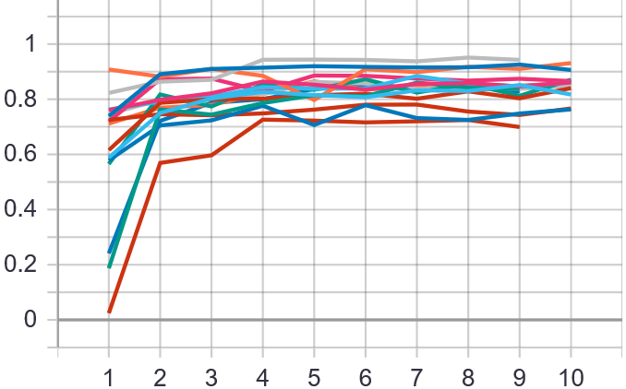
D2: MACHINE LEARNING SDG-TEXT CLASSIFIER | MULTI-LINGUAL
Multi-language model
SDG queries v5
Publications metadata
(title, abs, keyw)
= Training data (1.5 mln records)
State of art
Linguistic
Machine Learner
Multi-language SDG Classifier
Model prototyping
(exploring best methods)
Model production
(upscaling best method to other SDG’s)
F1-score (1=better)
SDG’s
Master Students Computational Linguistics:
Text Mining Domains
Data Scientists
@Impacter.eu
(Start-up in Utrecht)
Data analyst
University Palacky Olumoc
Elsevier + Uni South Denmark HPC Cloud
Training sessions

Slide 26
TMD ASSIGNMENT
What has already been done
We have a Scopus corpus of 1.5 million English research papers labeled to the Goals and Targets, retrieved with query model.
Hand picked publications by domain experts, surveyed from 150+ researchers at universities in aurora.
SDG-Tracker: (ML approach) Previous work by text mining students.
Linked-SDG: (linked ontologies approach) Previous work by the UN library and Official Statistics office.
We intend to use the OpenAIRE Research Graph to classify all our publications, in all research fields, in all languages.
We need you to
build a solid foundation for our project to continue with
develop a classifier that automatically labels research papers with sustainability development goals, on the level of the goals and on the level of the targets.
transfer the classification model to other languages, especially English, German, French, Italian, Spanish, Catalan, Czech, Dutch, Icelandic, Danish.
investigate the approaches that delivers the best results based on optimal quality, accuracy, explain-ability and re-usability of the model.
    Therefore, focus on least two or three SDG's, not all SDG’s.
document the results in a way that the Aurora project group is able replicate the work for the other SDG’s in the months to come after the investigative work of the TMD assignment.
We are not asking you to :
build a model for all SDG’s
deploy the model in a webservice
collect and classify all the papers in the OpenAIRE research graph.

Slide 27
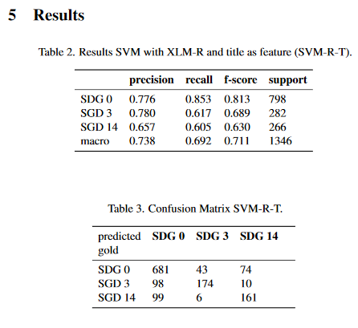
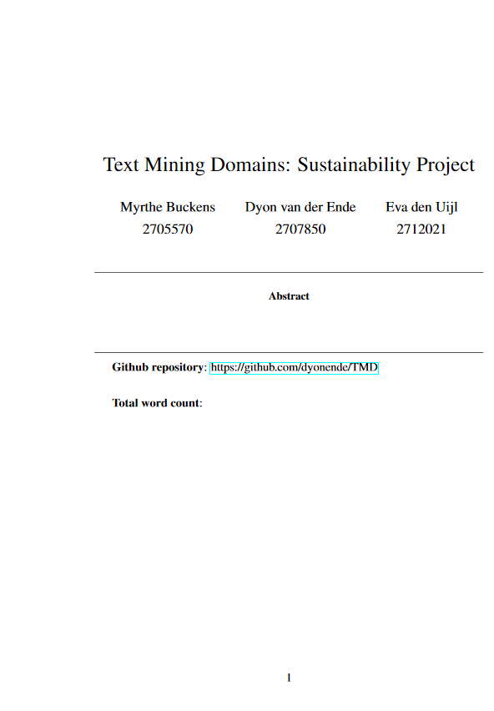
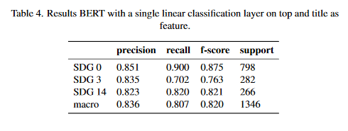
VU STUDENTS TEX MINING DOMAINS -
TESTING BERT LANGUAGE CLASSIFICATION MODELS ON AURORA SDG CORPUS V5 IN DIFFERENT CONFIGURATIONS
Report: https://www.overleaf.com/project/601d5fd79ef58b7a128e63f5
Code: https://github.com/dyonende/TMD
Aurora Code Repository: https://github.com/Aurora-Network-Global
Idfuse code: Scopus to Elastic Search translator: https://github.com/martijnvanbeers/booque

Slide 28
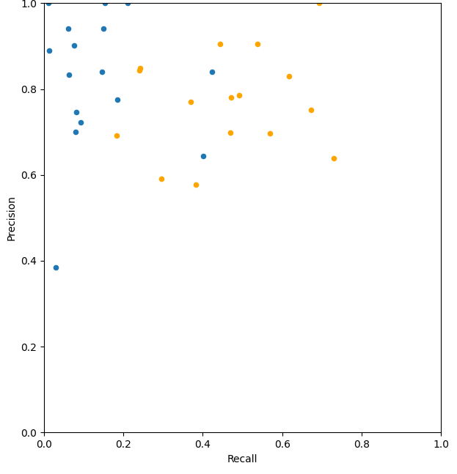
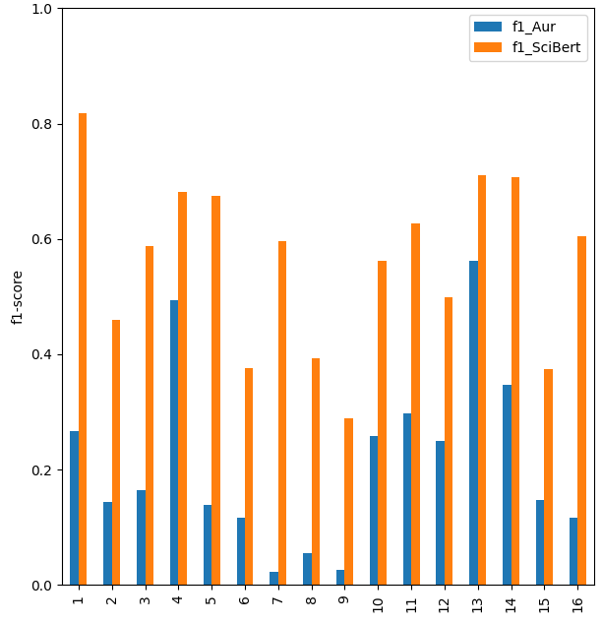
IDFUSE – TESTING SCIBERT LANGUAGE CLASSIFICATION MODEL ON AURORA SDG CORPUS V5
Aurora SDG Queries v5, labeling with:
Keyword search only model
SciBERT trained model
Aurora SDG Queries v5, labeling with:
The Keyword search only model shows high precision (less false positives) and low recall (limited number of papers)
The SciBERT trained model shows a big increase of recall (higher number of papers, with a slight decrease of recall (at the cost of the number of relevant papers decreases a little), Resulting in a steep increase of the accuracy (F1-score)
Aurora SDG Queries v5, labeling with:
Keyword search only model
SciBERT trained model
Idfuse code: Scopus to Elastic Search translator: https://github.com/martijnvanbeers/booque
for creating training corpus with OpenAIRE Research Graph

Slide 29
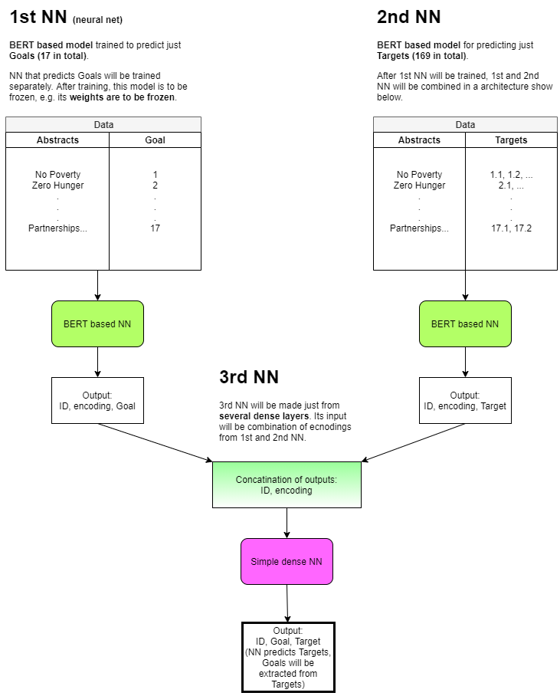
Architecture for SDG multi-lingual text classifier model – multi-label
on level of Goals and on Targets
Plan A
Plan B

Slide 30
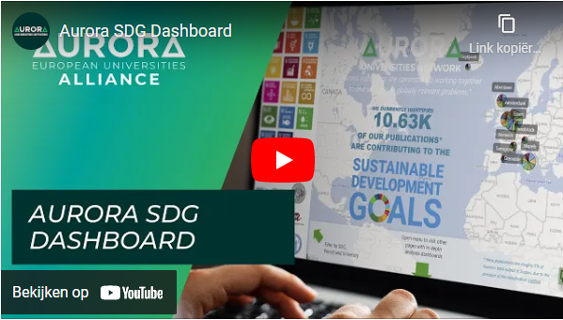
SDG DASHBOARD, EXPLAINER VIDEO, FEEDBACK FORM, PROJECT TEAM SPACE
SDG dashboard voor de VU
  explainer video
  project pagina
Project Team online space video
Explainer video

Slide 31
Integration and embeddings in other places

Slide 32
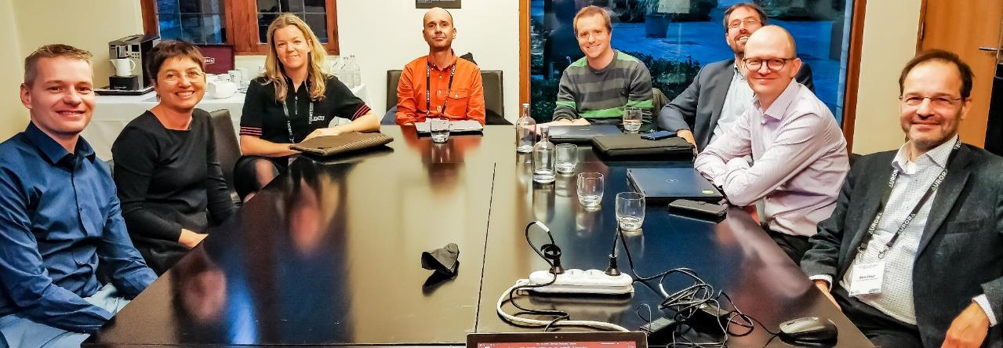
THANK YOU FOR YOUR ATTENTION!
http://bit.ly/aurora-sdg
Maurice Vanderfeesten | Vrije Universiteit Amsterdam |
Twitter: @maurice_
E-mail: maurice.vanderfeesten@vu.nl

Slide 33
NEXT SLIDES: LEARN MORE ABOUT THE CONTEXT AND BACKGROUND

Slide 34






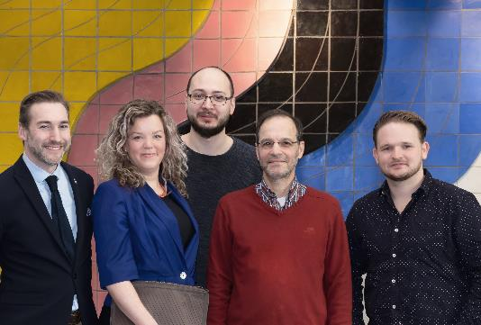

WHO AM I?
  Maurice Vanderfeesten
    Innovation Manager Research Services
    University Library, Vrije Universiteit Amsterdam
  Topics:
    Scholarly Communication
    Open Science
    Research Intelligence
  Projects:
    Data tools for strategic decision making
    Frictionless Open Access experience
    [future: nano publications, blockchain4science, librarAI]
  Background:
    Information Science MSc, SURF, EU-DRIVER, EU-OpenAIRE, TUDelft | OA repositories, Enhanced publications, RDM, Linked data, Semantic web
SC
Teams:
Research Support & Research Intelligence
OS
RI
@maurice_

Slide 35

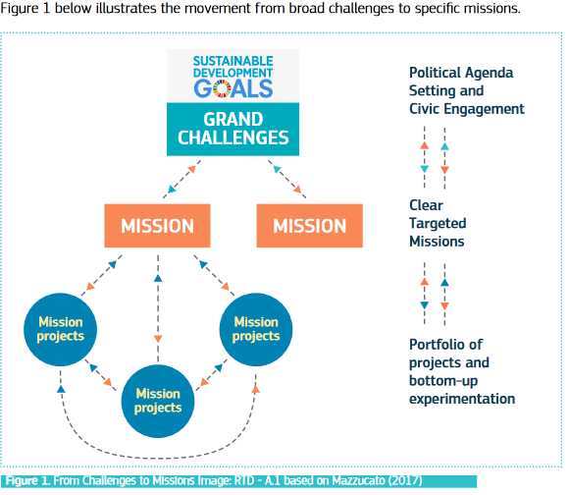
RESEARCH FUNDING INCREASINGLY FOCUS ON MISSION-ORIENTED INNOVATIONS
[RELEVANT FOR SOCIETY, ACROSS DISCIPLINES]
Source: https://ec.europa.eu/info/sites/info/files/mazzucato_report_2018.pdf

Slide 36
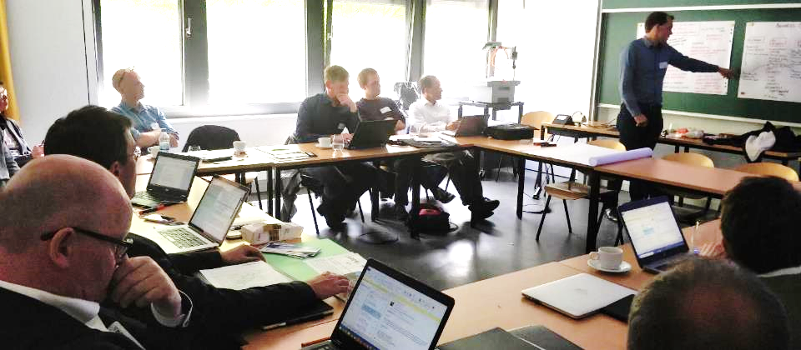
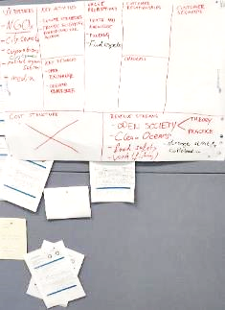
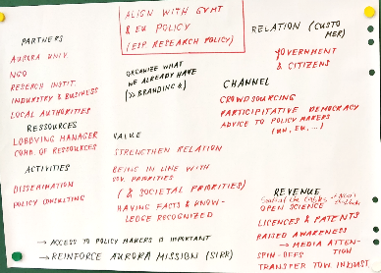
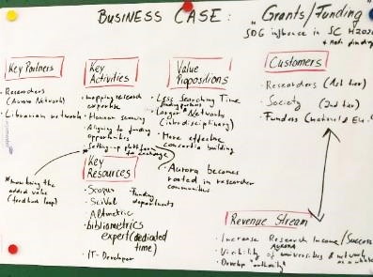


USER BENEFITS: HOW CAN WE POTENTIALLY USE THIS KIND OF INFORMATION?
As a Public Policy advisor I can see what our SDG strengths and weaknesses are, and use that to get our researchers to have a seat on the table at (N)GO’s.
As a Grant officer I can use the tool to quickly map research expertise in the Aurora network and align them with funding opportunities targeting SDG XYZ.
University Public Policy Adviser / Lobbyist
Grant officer

Slide 37
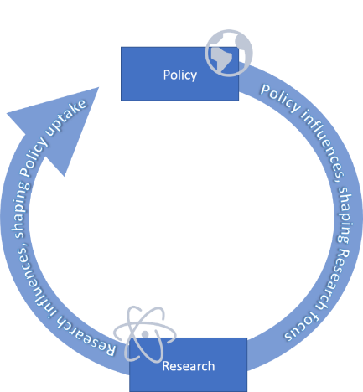
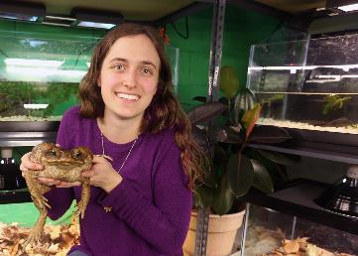
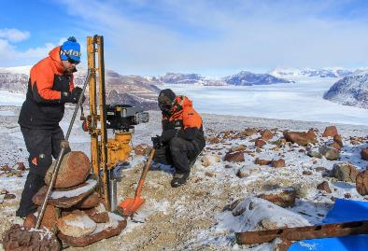
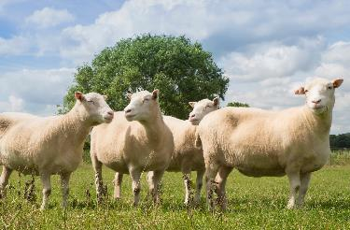
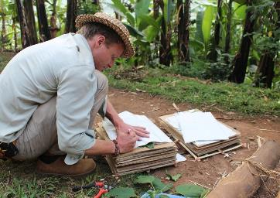
“HOW CAN WE SHOW SOCIETAL IMPACT ON SOCIETALLY RELEVANT TOPICS?”
1. What research are we doing within these societally relevant topics (SDGs)?
2. How is this research on societally relevant topics
influencing policy of societal relevant organisations (WHO, IPCC, etc) ?

Slide 38
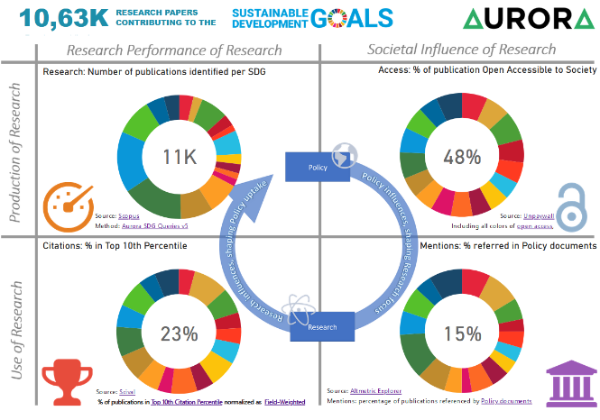
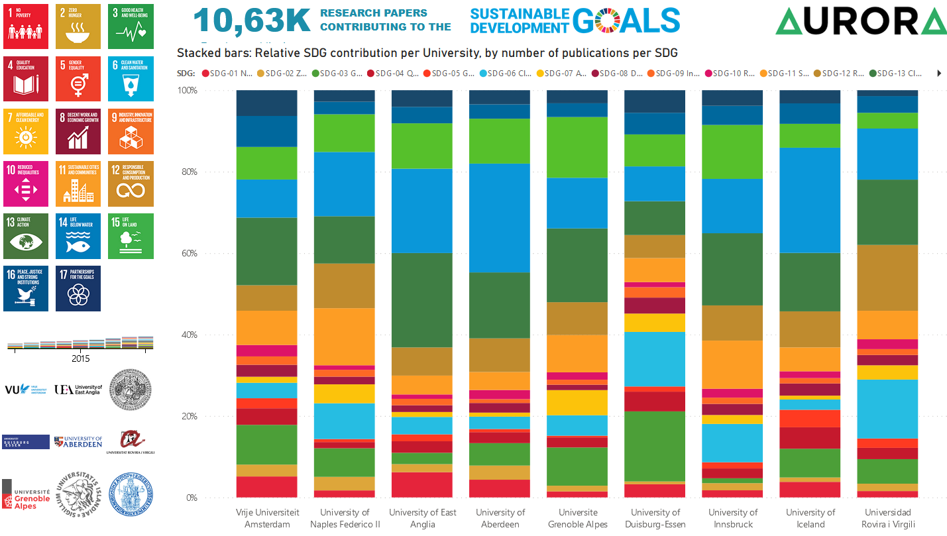
SDG-RESEARCH DASHBOARD
https://bit.ly/aurora-sdg-dashboard-v3

Slide 39
D2: MACHINE LEARNING SDG-TEXT CLASSIFIER
ISSUES AND SOLUTION DIRECTIONS
Current issues
Our current corpus is Scopus for academic content, which does not contain all our publications in all fields of research in all our languages.
Our current query model retrieves English-only papers, and excludes papers where keywords are absent for related concepts, synonyms and antonyms (e.g. hunger vs. malnutrition, food security vs. food insecurity, etc)
Our current query model is tightly linked with the Scopus corpus, making immediate use outside this proprietary corpus useless.
We need
A new corpus containing all our publications in all fields of research in all our languages.
A classifier able to classify to the SDG Goals and Targets in all languages.
A classifier that works with text fragments, decoupling the use of a specific corpus.

Slide 40
D2: MACHINE LEARNING SDG-TEXT CLASSIFIER
TMD ASSIGNMENT
What has already been done
We have a Scopus corpus of 1.5 million English research papers labeled to the Goals and Targets, retrieved with query model.
Hand picked publications by domain experts, surveyed from 150+ researchers at universities in aurora.
SDG-Tracker: (ML approach) Previous work by text mining students.
Linked-SDG: (linked ontologies approach) Previous work by the UN library and Official Statistics office.
We intend to use the OpenAIRE Research Graph to classify all our publications, in all research fields, in all languages.
We need you to
build a solid foundation for our project to continue with
develop a classifier that automatically labels research papers with sustainability development goals, on the level of the goals and on the level of the targets.
transfer the classification model to other languages, especially English, German, French, Italian, Spanish, Catalan, Czech, Dutch, Icelandic, Danish.
investigate the approaches that delivers the best results based on optimal quality, accuracy, explain-ability and re-usability of the model.
    Therefore, focus on least two or three SDG's, not all SDG’s.
document the results in a way that the Aurora project group is able replicate the work for the other SDG’s in the months to come after the investigative work of the TMD assignment.
We are not asking you to :
build a model for all SDG’s
deploy the model in a webservice
collect and classify all the papers in the OpenAIRE research graph.

Slide 41

5.1 AURORA SDG RESEARCH DASHBOARD
OUR TEAM

Slide 42
MORE SLIDES, JUST FOR FUN…

Slide 43
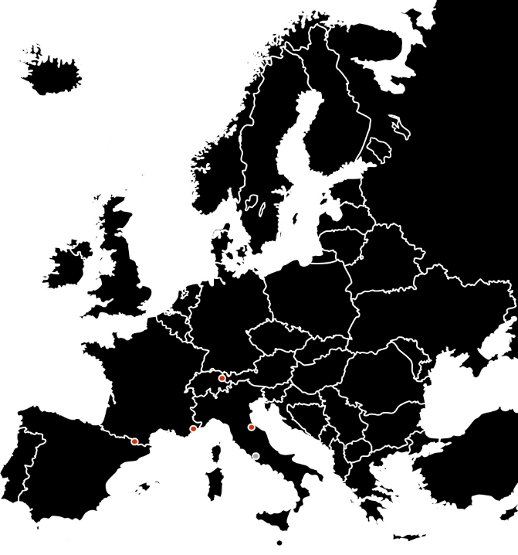
















UNIVERSITY NETWORK
“Aurora institutions are committed to working together to find solutions to
globally relevant problems”

Slide 44
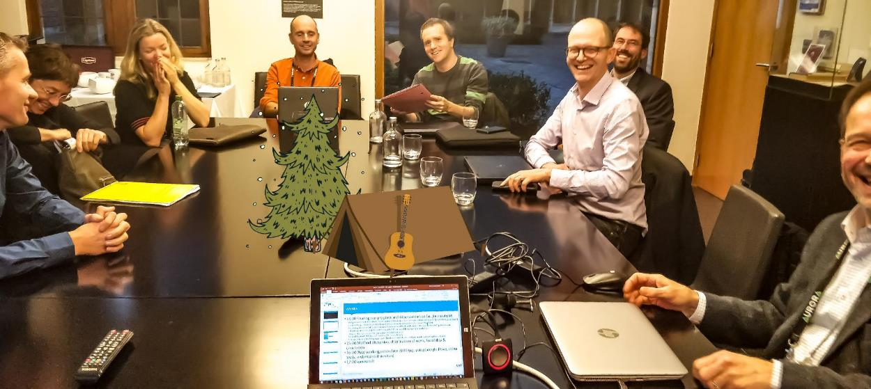

Collaboration with group of Bibliometricians from Aurora Universities
Antwerp Dec 2018; Joeri, Susanne, Pam, Lars, Felix, Hubert, Raf, René.
Not is picture: Eike, Susana, Nykohla, Jaqui, Baldvin

Slide 45





Collaborative effort in converting UN policy texts to bibliometric search strings,
reviewing & testing results, and data acquisition
UN goal & target indicators

Slide 46

CREATED AND SHOWCASING THE PROOF OF CONCEPT DASHBOARD

Slide 47

THIS PROJECT WAS COMMUNICATED, AND AN INSPIRATION FOR OTHER INITIATIVES

Slide 48








TWO YEARS LATER, WE ARE NOT THE ONLY INITIATIVE ANYMORE
BUT MANY FOLLOWED OUR EXAMPLE
Linked SDG
http://linkedsdg.apps.officialstatistics.org
Open SDG Classifier
https://technote.ai/osdg
Digital Science: free SDG reports for institutions
https://reports.dimensions.ai/org-SDG/index.html?grid=grid.5718.b
Elsevier: SDG’s in Scival
https://scival.com/sdg
Science 4 sdgs
http://science4sdgs.sirisacademic.com/

Slide 49

INCREASE DATA QUALITY > DATA MUST REPRESENT AN INSTITUTION
[GREEN DOT MUST GO UP]

Slide 50




INCREASE DATA QUALITY > DATA MUST REPRESENT AN INSTITUTION
[GREEN DOT MUST MOVE TO OPTIMUM]
0 Precision 1
(Soundness)
(Completeness)
Measuring the Validity of a Search Query,
by Evaluating the Search Results
0 Recall 1
Precision vs Recall Trade-off
Sources: https://en.wikipedia.org/wiki/Precision_and_recall | https://machinelearning-blog.com/2018/04/03/evaluation-metrics-for-classification/

Slide 51







THE PROJECT TEAM MADE AN ELABORATE PLAN TO INCREASE THE DATA QUALITY
Query Crafting
SDG Experts pool : Researcher Respondents
Preparation
Survey
Improvement
Subject area filter
Precision v1:
(TPos in RS)/RS
Run Query v4
Publication Set
(PS)
Generate Random Set
(RS)
Screening of Random Set
(TPos)
Analyses and Learn
Design of a Query Validation process
Frequency lists for : Keywords & Journals
Screening of Frequency lists
F-measure
Query v1
Not References (technical limitations)
List Expected Publications
(EP)
Baseline for
robustness
Not Authors (test audience said no)
Improve
Query v5
Recall v1:
(EP in PS)/EP
iterate

Slide 52


WE SENT-OUT A BIG SURVEY TO AURORA RESEARCHERS, THAT WILL HELP US:
1. ESTABLISH A QUALITY MEASUREMENT BASE LINE
2. GAIN IMPROVEMENT SUGGESTIONS

Slide 53

255 SURVEY RESPONSES, DURING IN 2 MONTHS (DEC 2019 – JAN 2020)

Slide 54

SURVEY DATA FREELY AVAILABLE – AND ALREADY USED BY OTHER INITIATIVES FOR MACHINE LEARNING

Slide 55

ESTABLISHED A QUALITY BASELINE
(SOMETHING ALL OTHER INITIATIVES LACK, SO FAR)

Slide 56



ANALYSING THE SURVEY DATA
SDG TEXT ANALYSIS DASHBOARD

Slide 57
PRIMARY DELIVERABLE
VALIDATED SEARCH QUERY ON EACH SDG | AND IN PARTS PER TARGET
Free & Transparent on GitHub: https://aurora-network-global.github.io/sdg-queries/

Slide 58






PROCESSING SDG QUERIES & COLLECTING DATA
Software on GitHub https://github.com/Aurora-Network-Global
Query Crafting
Data Collection
UN SDG Targets and iwith indicators
Affiliation IDs / University
Scopus
SDG publications metadata
EID
Scival
Performance data
(top percentiles, field weighted impact, citescore, sjr, snip)
SDG query
DOI
Keyword Selection
Altmetric
Mentions data
(policy docs, blogs, news, patents, tweets)
Data Visualisation
Unpaywall
Open Access data
(is_oa, oa_journal, pdf_url)
PowerBI
SDG data
metadata
+ indicators

Slide 59

A BIT OF DATA MODELLING

Slide 60

WE’RE JUST BUILDING THE NEW DASHBOARD
TRY IT HERE: HTTPS://BIT.LY/SDG-AURORA

Slide 61

WE’RE JUST BUILDING THE NEW DASHBOARD
TRY IT HERE: HTTPS://BIT.LY/SDG-AURORA

Slide 62

WE’RE JUST BUILDING THE NEW DASHBOARD
TRY IT HERE: HTTPS://BIT.LY/SDG-AURORA

Slide 63





PROJECT DELIVERABLES – NEATLY PACKAGED TOGETHER
NOW REUSED BY OTHER SIMILAR INITIATIVES
  An IMPROVED/MATURE v2 bibliometric tool
  Primary deliverable
    New SDG queries (rigorously improved SDG classification model).
  Secondary Deliverables
    Aurora SDG Data Collection on Zenodo
    (including the “golden set”)
      The old SDG classification models
      (reworked in XML)
      The SDG survey data (“golden set”)
      The SDG text analysis data
      The new SDG classification model
    SDG query Baseline Measurement
    SDG Text Analysis dashboard
    SDG queries Co-creation platform on GitHub
New SDG queries
  SDG query Baseline Measurement
Aurora SDG Data Collection
SDG queries Co-creation platform
  SDG Text Analysis dashboard
https://aurora-network.global/project/sdg-analysis-bibliometrics-relevance/

Slide 64
SPECIAL THANKS FOR RENÉ OTTEN, NOW RETIRED,
FOR HIS EXPERTISE AND HARD WORK ON BALANCING THE SDG SEARCH QUERIES
HE WAS ESSENTIAL FOR THE PROJECT AND WILL BE MISSED

Slide 65

WHAT’S NEXT
Aurora Alliance: Ambition of WP5 – Sustainability Pioneers
“Our target is that the SDGs become a leading narrative for education, research service and campus operation.”
Deliverables of WP5.1 the SDG dashboard for research
Robust research classification model for all SDGs created.
Machine Learning Text Classifier trained and operational.
SDG classification of Aurora research output completed.
Aurora SDG Research classification model available online – based Fair Use policy.

Slide 66
QUERY CRAFTING
Old query
Evaluation
Analysis
New query
Aurora SDG queries v5
Aurora SDG queries v4
Survey data
Suggested & Selected:
  Papers
  Journals
  Keywords
  Glossaries
  Query suggestions
Text Analysis
Topic extraction
Contrast analysis
Topic modelling
Network mapping
Contingency matrix
Robustness
Precision & Recall

Slide 67

DATA
CONNECTIONS

Slide 68

BUILD YOUR OWN INTERACTIVE VISUALIZATION (RAPID PROTOTYPING IN POWER BI)

Slide 69

CONCEPTS FRAMED AROUND THE
DUTCH STRATEGIC RESEARCH EVALUATION PROTOCOL (SEP)
SEP: research production
SEP: production for society
Research mapped to Societally Relevant topics
SEP: use of products by peers
SEP: use of products by public

Slide 70

IT’S INTERACTIVE, GO TO BIT.LY/AURORA-SDG AND PLAY

Slide 71

SDG13

Slide 72

SDG13+VU

Slide 73


VU

Slide 74

SDG13-ALTMETRICS

Slide 75


Slide 76



2015: OCCUPATION/STRIKE; AGAINST THE PERFORMANCE DELIVERY CULTURE OF SCIENCE AND EDUCATION | SPARKED DISCUSSION IN ALL DUTCH UNIVERSITIES
Photo by: Jos van Zetten
https://www.at5.nl/artikelen/142130/UvA%20raamt%20schade%20Maagdenhuisbezetting%20op%20460.000%20euro

Slide 77











OVER THE YEARS: TRANSITION IN VALUING RESEARCH: METRIC TIDE, LEIDEN MANIFESTO, …
April 2018
Nov 2019, VSNU position Paper:
June 2017
http://ec.europa.eu/research/openscience/pdf/report.pdf
https://rio.jrc.ec.europa.eu/en/library/mle-open-science-altmetrics-and-rewards-final-report
    1) Quantitative evaluation should support qualitative, expert assessment.
    2) Measure performance against the research missions of the institution, group or researcher
    3) Protect excellence in locally relevant research.
    4) Keep data collection and analytical processes open, transparent and simple.
    5) Allow those evaluated to verify data and analysis.
    6) Account for variation by field in publication and citation practices.
    7) Base assessment of individual researchers on a qualitative judgement of their portfolio
    8) Avoid misplaced concreteness and false precision.
    9) Recognize the systemic effects of assessment and indicators
    10) Scrutinize indicators regularly and update them.
April 18th 2019,
NWO, ZonMW, KNAW
Sign the DORA agreement
http://sfdora.org/
Knowledge ecosystem
https://www.rathenau.nl/nl/kennisecosysteem/balans-van-de-wetenschap-2018
https://www.vsnu.nl/en_GB/Recognition-and-rewards-of-academics.html
https://responsiblemetrics.org/the-metric-tide/
http://www.leidenmanifesto.org/

Slide 78

SDG SURVEY - FIRST RESULTS: PAPERS ACCEPTED / REJECTED PER SDG

Slide 79



PREPARATIONS FOR
RELEASE OF QUERIES AND SURVEY DATA : MAY 2020
https://zenodo.org/communities/aurora-universities-network/

Slide 80



Slide 81
QUERY CRAFTING
Input information
Analysis
Query improvement & testing
New query
Aurora SDG queries v5
Aurora SDG queries v4
Topic extraction
(Cortext, VOS, etc)
Testing new queries: Increasing Recall,
without reducing Precision
Elsevier SDG queries v1
Survey data
Suggested & Selected:
  Papers
  Journals
  Keywords
  Glossaries
  Query suggestions
Precision & Recall
CWTS New Horizon keywords

Slide 82

ANALYSIS: SDG 03 ACCEPTED PAPERS ON GOOD HEALTH AND WELL-BEING

Slide 83
ANALYSIS: SDG02 – ZERO HUNGER :
CO-TERMS EXTRACTED FROM PAPERS TRULY AND FALSELY RELATED TO SDG02
https://documents.cortext.net/dabc/dabc6ae78789eb626b6fbb1c9a3cec7c/171307/Contrast_Visualization.html

Slide 84


DATA EXAMPLE: NETWORK MAP OF CO-TERMS IN ACCEPTED RESEARCH PAPERS
RELATED TO SDG 3 – GOOD HEALTH AND WELLBEING

Slide 85


POTENTIAL SECONDARY USES OF THE SURVEY DATA :
MACHINE LEARNING WITH SURVEY DATA AS INPUT FOR TRAINING &
SEEDING TRAINING DATA WITH RELATED AND MULTI-LINGUAL TERMS USING WORD-CONTEXT-VECTOR-MODEL “BERT” FROM GOOGLE

Slide 86







CUSTOM TOOLING AND ALTERNATIVE METHODS [AUTOMATION, ELASTIC SEARCH, MACHINE LEARNING]
FOR SPEEDING-UP THE VALIDATION OF DATA QUALITY AND DATA COLLECTION
https://github.com/Aurora-Network-Global

Slide 87

SDG6 – OUR PUBLICATIONS PARSED THROUGH
DAVID’S SDG-TEXT-CLASSIFIER

Slide 88

POSSIBLE USE OF SDG TEXT CLASSIFIER WIDGETS ON PAPERS, PROJECTS, ETC.

Slide 89



AURORA DATA COLLECTION (INCL GOLD SET)
FOR EVALUATING SDG CLASSIFIERS

Slide 90



Slide 91


AURORA MAPPING
RESEARCH TO SDGS

Slide 92




SCIENCE 4 SDGS
http://science4sdgs.sirisacademic.com/

Slide 93




LINKED SDG HTTP://LINKEDSDG.APPS.OFFICIALSTATISTICS.ORG

Slide 94



OPEN SDG CLASSIFIER HTTPS://TECHNOTE.AI/OSDG

