Slide 1
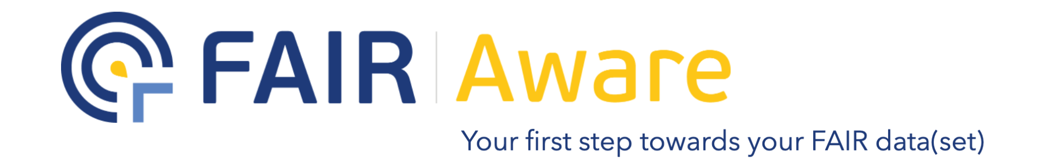

a tool to aid you in your open data adventure
Kim Ferguson (RDM Specialist)
w/ materials from: Maaike Verburg (RDM Specialist)
Cees Hof (Data Station Manager Life, Health and Medical Sciences)
May 2023 – NWO Life 2023 – Egmond aan Zee
10.5281/zenodo.7962359

Slide 2


Who am I?
Kim Ferguson
→ Research Data Management Specialist at DANS-KNAW
DANS - Data Archiving & Networked Services
Database: EASY (Data Stations soon)
→ PhD in insect genetics, postdoc in metabarcoding
→ Open Science advocate
depositing data sets,
publishing preprints,
open access publishing, and
sharing posters & presentations

Slide 3
The process
Answer 10 simple FAIR questions
Read the guidance texts to develop FAIR knowledge and skills
Leave feedback to improve the tool
Spread the word!
Create more FAIR data!
Receive your FAIR assessment scores

Slide 4
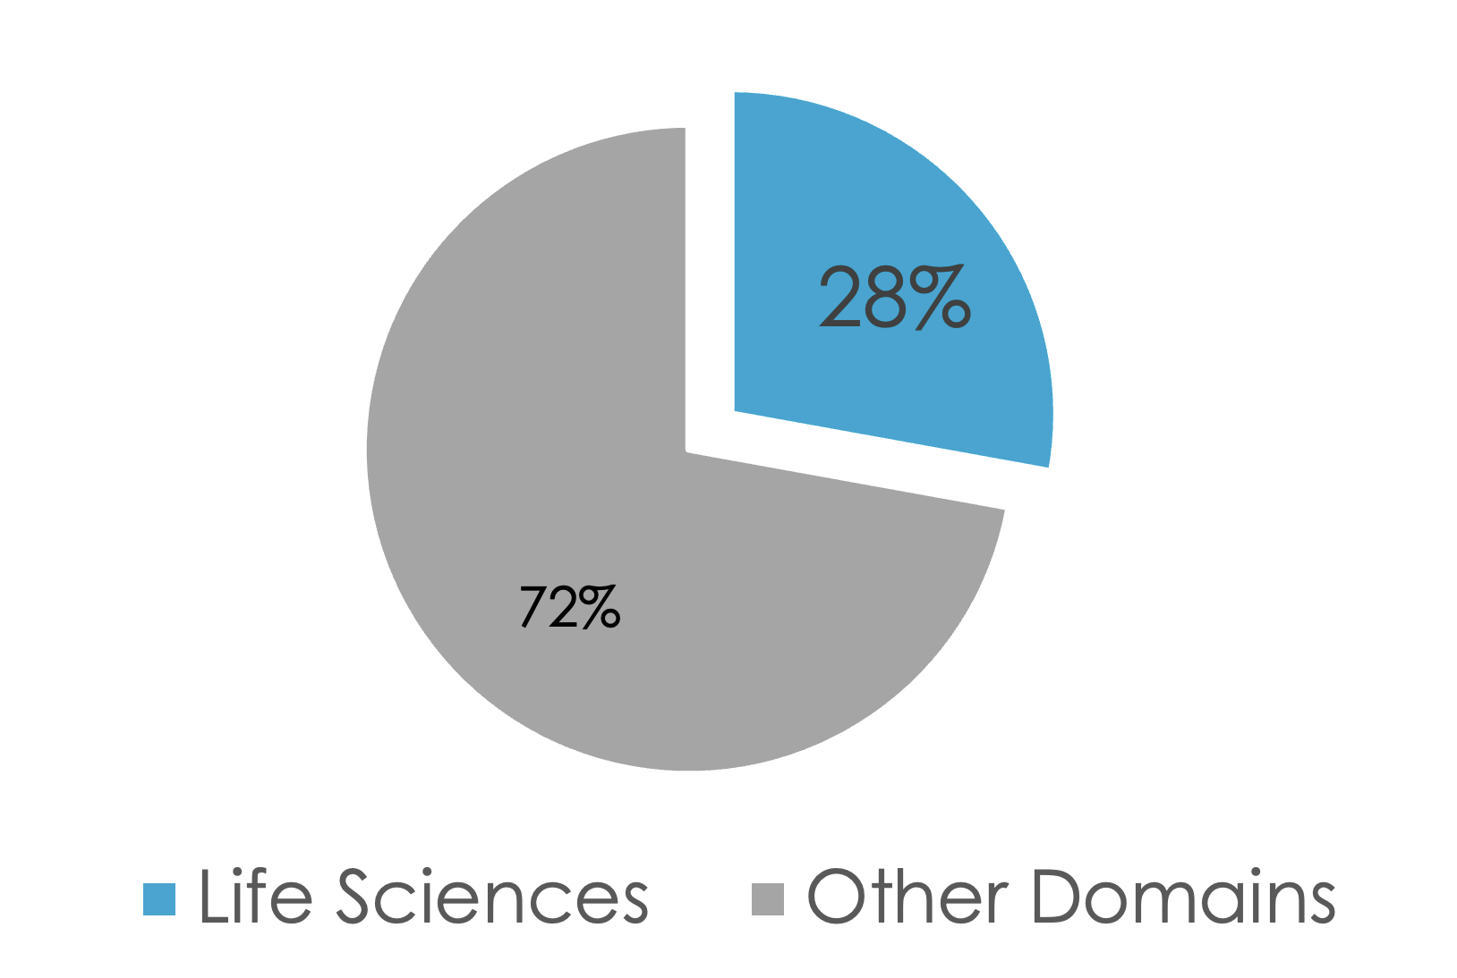
Results so far
Over 900 users with a 81% usability rating!
“The FAIR principles were not familiar to me at the time when I was trying to get published. The FAIR-Aware tool is informative and easy to use as a point of reference for my further publication career”
- Researcher from the life science domain

Slide 5
So what does it do?
→ Let’s take a look at FAIR Aware
Note 1: The tool works best when you’re about to deposit a data set, but can be useful to think about what you need to consider or when you’re writing a data management plan
Note 2: A lot of the elements can be taken care of by a trustworthy repository, which we will look at shortly after

Slide 6
Data repositories: good for finding data, good for storing data
What is archiving? What about publishing a dataset?
Internal shared drives are useful for colleagues, but aren’t the same as publishing a dataset in a repository.

Slide 7

Repositories & FAIR
A good repository:
Provides a Persistent Identifier (PID) to your dataset = Findable
Enables the inclusion of rich metadata = Reusable
Allows for human and machine findable and readable metadata = Findable + Accessible
Uses Knowledge Organisation Systems (KOS), such as vocabularies, to improve the quality of metadata = Reusable
Provides long term and easy access to your data = Accessible + Reusable
.......
A good repository means FAIR data

Slide 8
Where to deposit data, or find data for re-use
Depositing sequence data:
ENA <> GenBank <> DDBJ (share sequences, trustworthy, all use MIBBI)
Organism domain or species/family-specific databases? In addition, never only
Depositing everything else, or finding (non-sequence) data for re-use?
Domain-specific repositories likely have more applicable metadata or keywords
Some institutions or universities have their own repositories, making it easier for you to deposit
National repositories like DANS-EASY are also good options, but you need to bring in your supervisor
So what else is out there? Browse-by-subject in Re3Data is a great starting point.

Slide 9
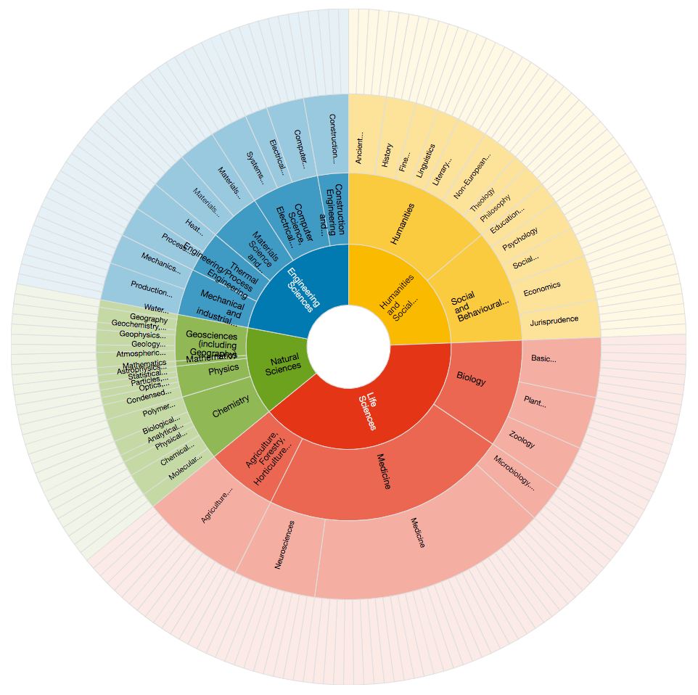
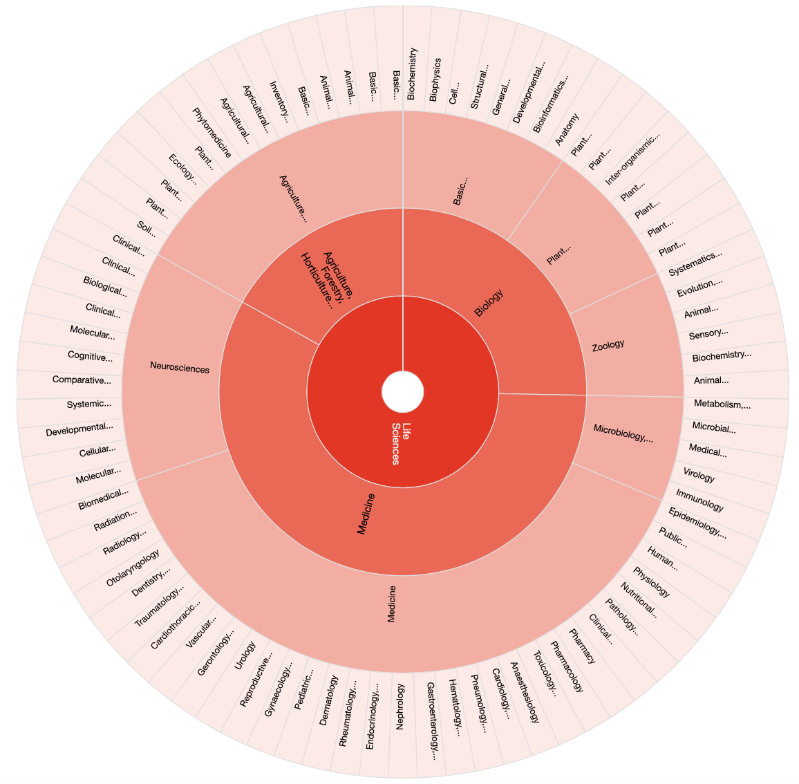
A convenient tool/site: re3data.org
https://www.re3data.org
Over 2600 international repositories for a wide spread of domains
Plentiful filters to find appropriate repositories
Life Science Repositories
Categories
All Categories

Slide 10
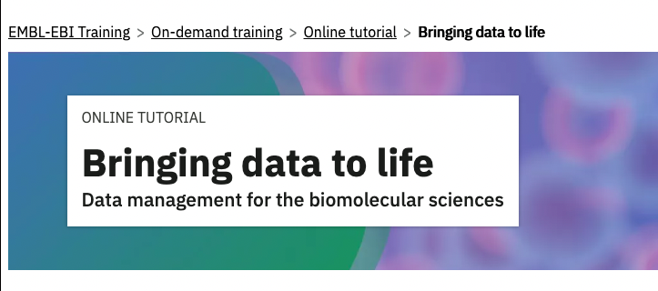
But how much can we cover in 25 minutes?
This online tutorial from EMBL-EBI is self-paced and can provide a great structure for learning data management, but you don’t necessarily need it.
.: recommended for those who want to know more.

Slide 11
References/Further Reading
FAIR Aware: https://fairaware.dans.knaw.nl/
Re3Data: https://www.re3data.org/
All emojis designed by OpenMoji – the open-source emoji and icon project. License: CC BY-SA 4.0
Additional resources
BioSB - Netherlands Bioinformatics and Systems Biology research school: https://www.dtls.nl/biosb/
Additional courses/workshops:
  EMBL-EBI Course on Research Data Management in Bioinformatics: https://www.ebi.ac.uk/training/online/courses/bringing-data-to-life-data-management/
  DTL page for training: https://www.dtls.nl/training-and-education/
  eScience Center for training: https://www.esciencecenter.nl/digital-skills/

Slide 12
Thanks for your attention!
kim.ferguson@dans.knaw.nl
Twitter: @DANS_knaw_nwo
dans.knaw.nl/en
FAIR Aware slides: Maaike Verburg
Re3Data slides: Cees Hof
All emojis designed by OpenMoji – the open-source emoji and icon project. License: CC BY-SA 4.0

