Slide 1





A journey to FAIR microscopy data – part I
DOI: 10.5281/zenodo.7890311
Stefanie Weidtkamp-Peters
Heinrich-Heine-Universität Düsseldorf
stefanie.weidtkamp-peters@hhu.de
Except for the used logos and the cited journal covers, the content of these slides is shared under the terms of Creative Commons Attribution License (CC-BY 4.0) unless the content is marked otherwise.

Slide 2
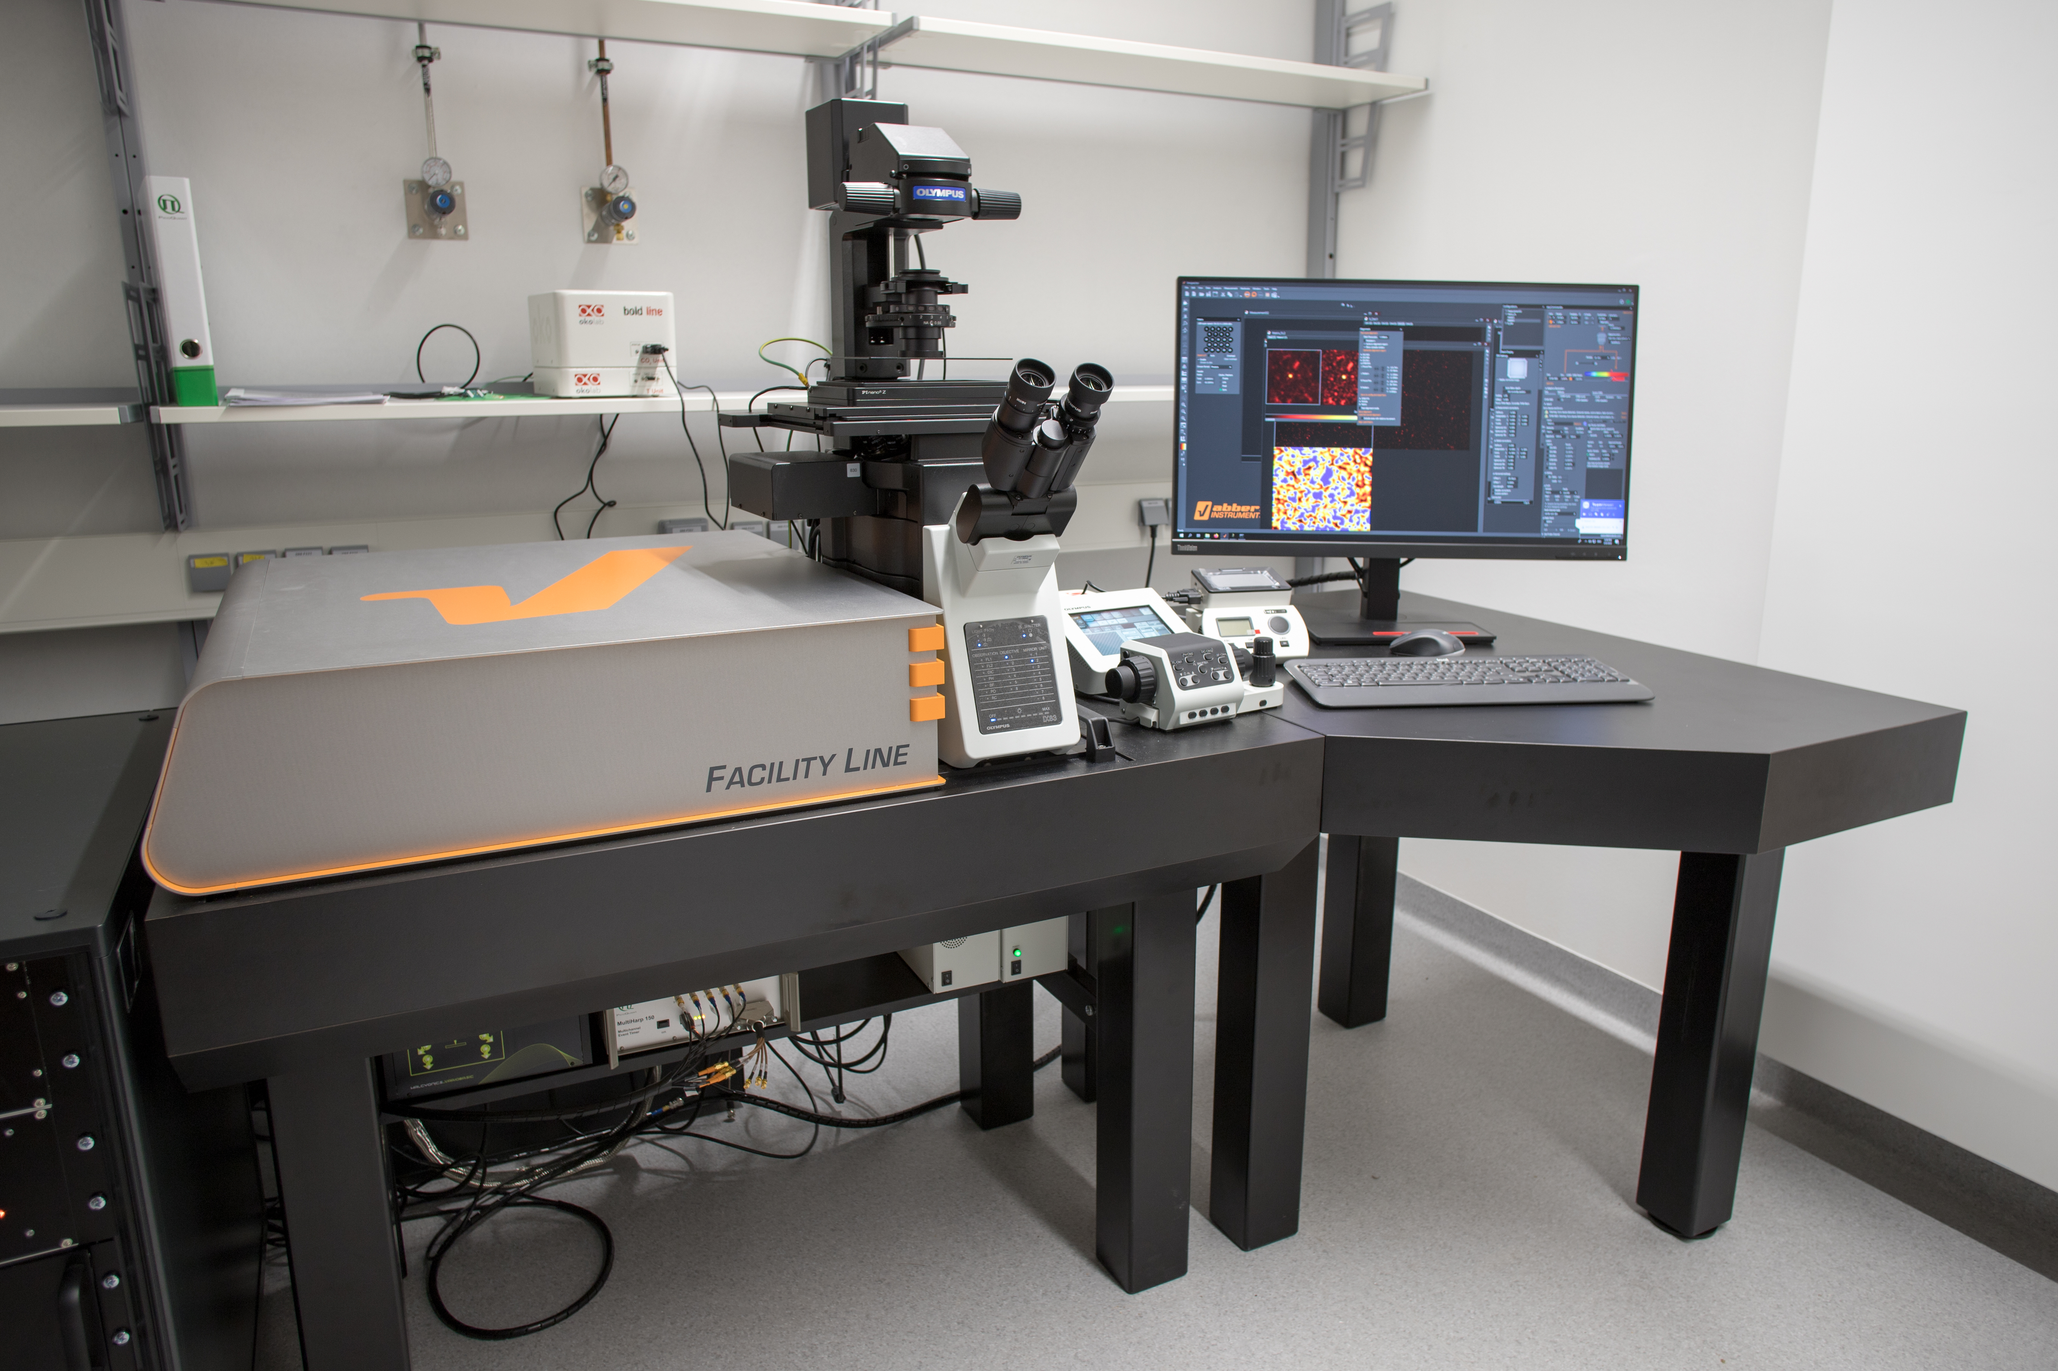
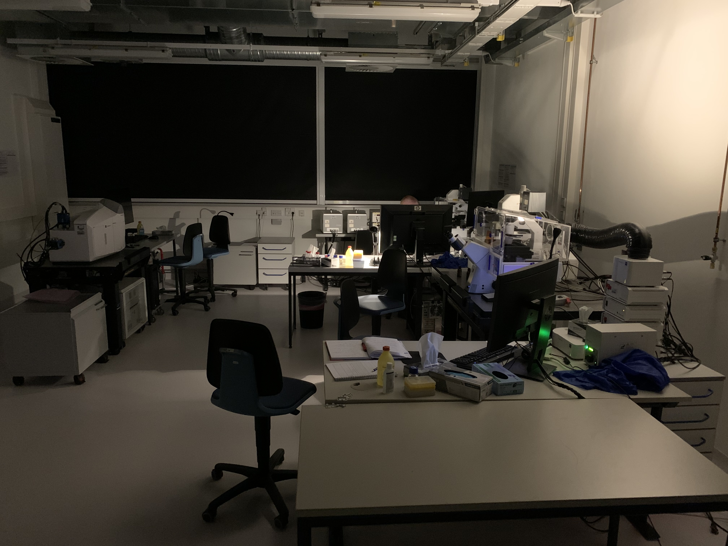
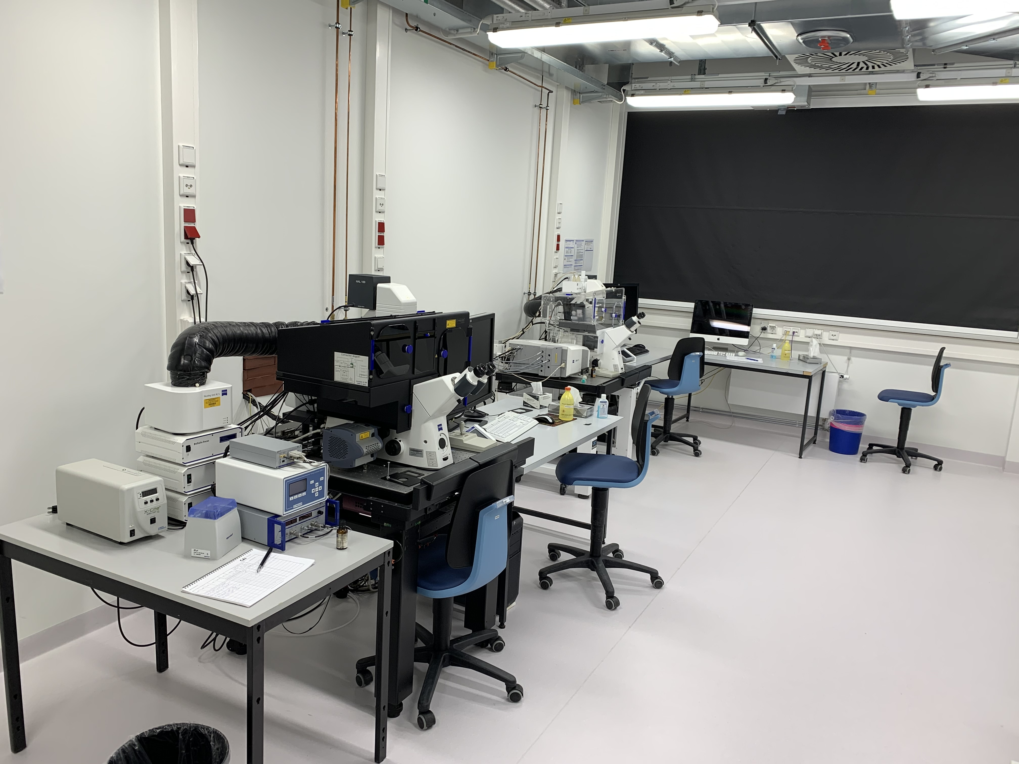
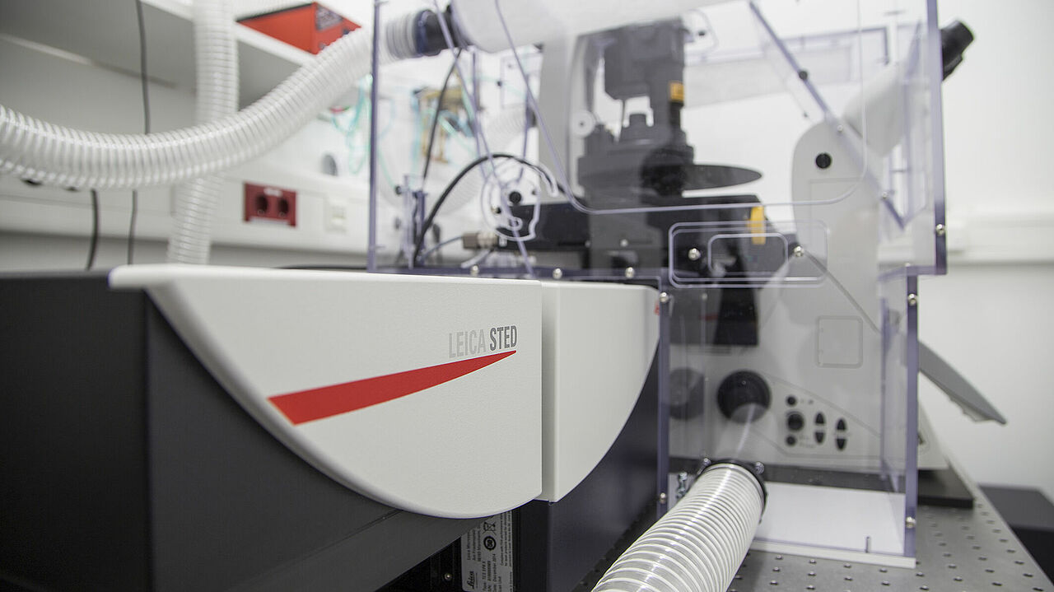
Motivation for FAIR microscopy data
head of the imaging core facility Center for Advanced imaging (CAi) at the University of Düsseldorf
Zeiss LSM 780 PQ FLIM
Zeiss Z1 lightsheet
Abberior Facility Line STED
Zeiss LSM 880 Airyscan
Zeiss LSM 710
…thousands of image data
Zeiss ELYRA PS
Leica SP8 STED

Slide 3
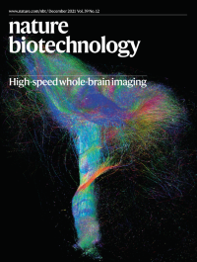
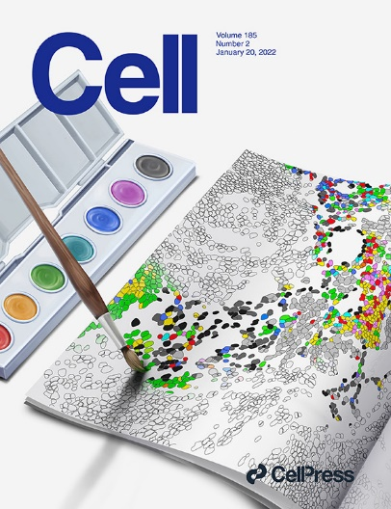
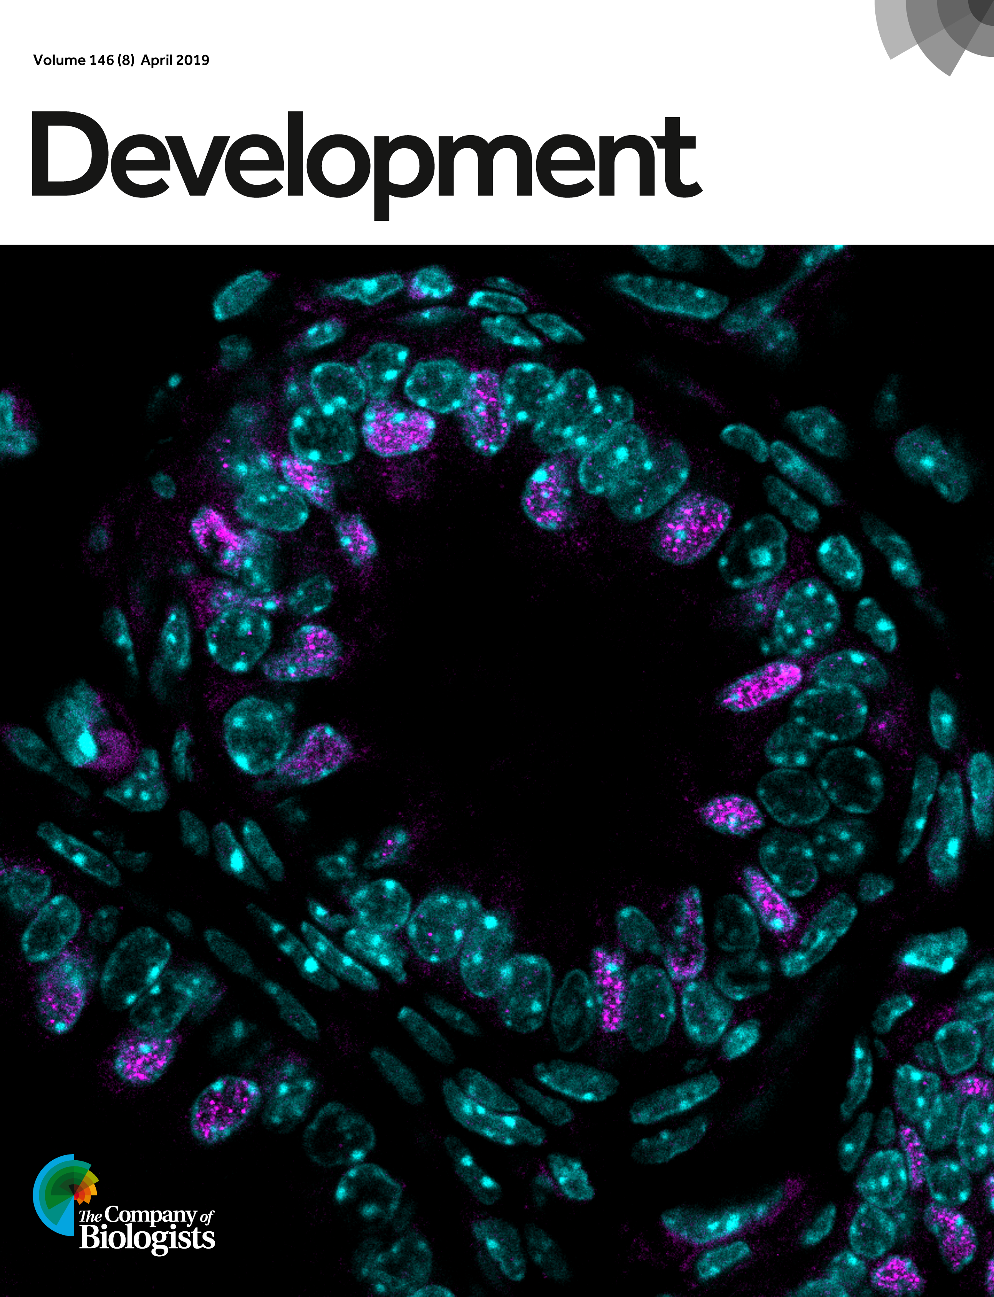
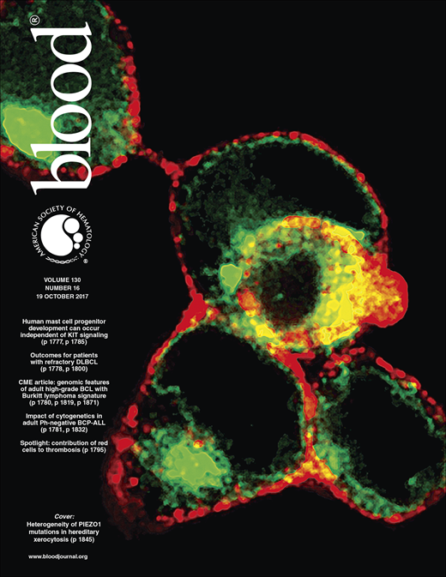
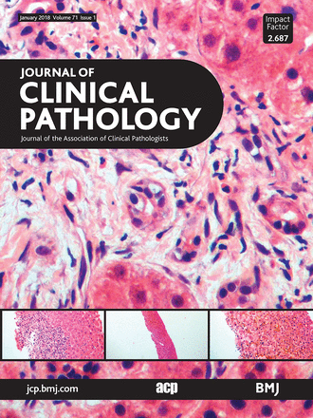
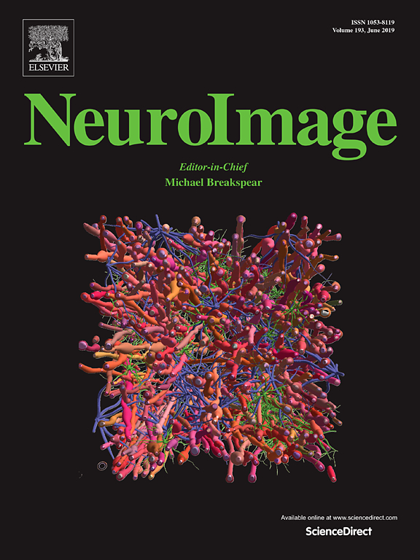
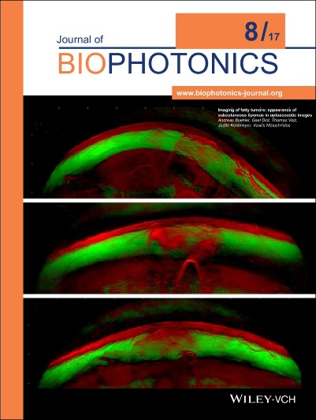
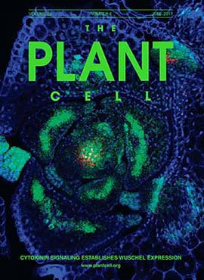
… a few are published – what about re-use?
Xu, et al.
Nature Biotechnology, Vol. 39 (12)
2021
Risom, et al.
Cell, Vol. 185 (2)
2022
Terré, et al.
Development, Vol. 146 (8)
2019
Glogowska, et al.
Bloog, Vol. 130 (16)
2017
J Clin Path, Vol. 71 (1)
2018
NeuroImage, Vol. 193
2019
Buehler, et al.
Biophotonics, Vol. 10 (8)
2017
Wang, et al.
Plant Cell, Vol. 29 (6)
2017

Slide 4
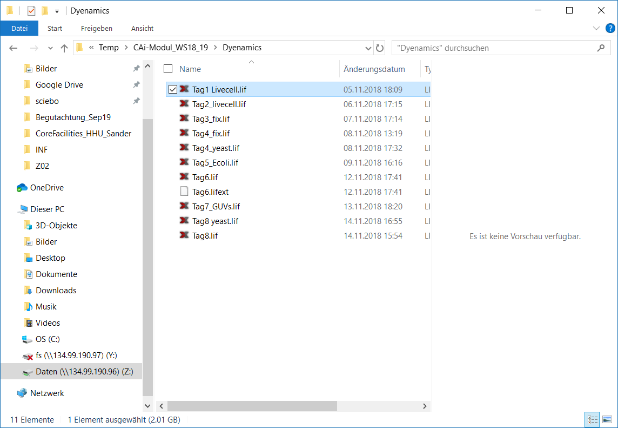
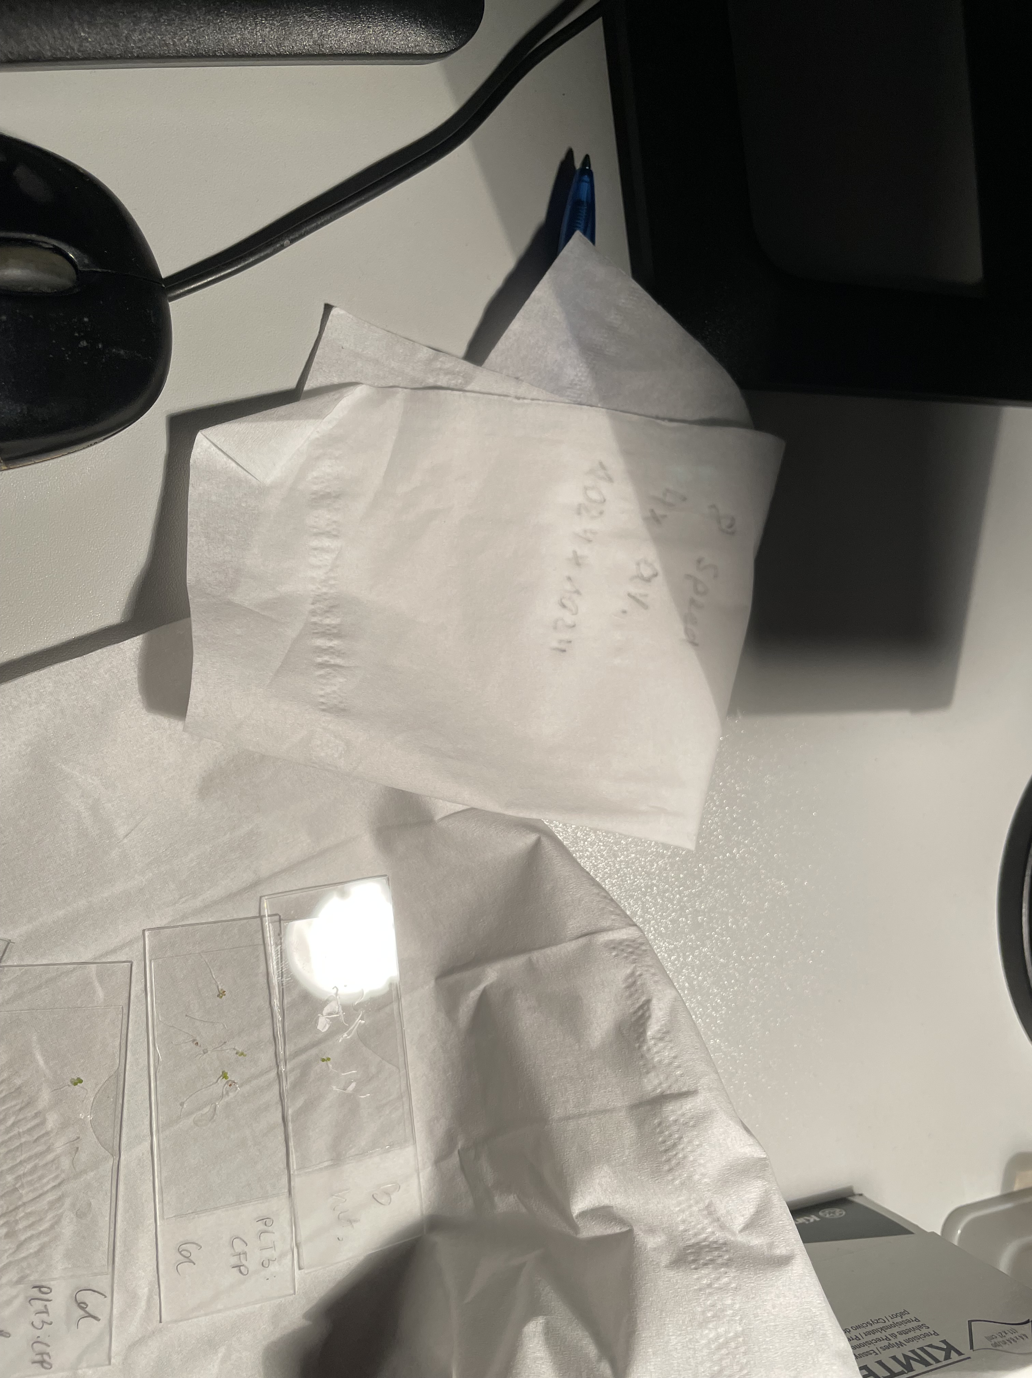
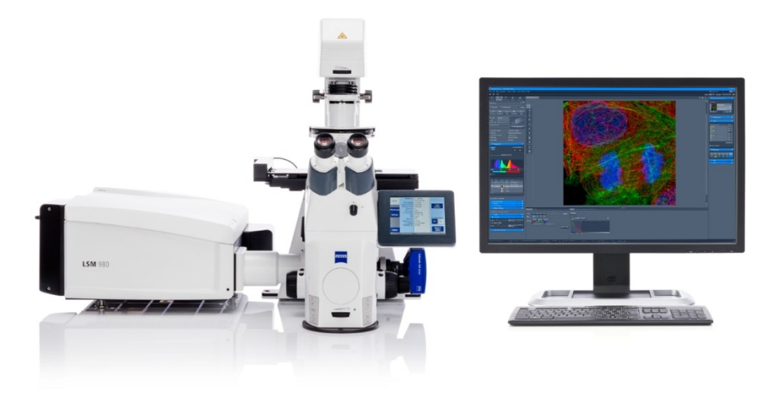
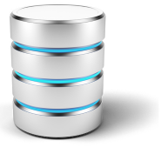
Local information infrastructure
Where is the metadata?
Network
Image acquisition
No preview available.
File store
Not searchable.
…usually it is in a hardcover lab notebook
Would be beneficial to make image data better accessible!
Image database ①
Notes:
Problem, dass Bilddaten so komplex und groß sind

Slide 5
FAIR image data management is the prerequisite for re-use
Xu, et al.
Nature Biotechnology, Vol. 39 (12)
2021
Risom, et al.
Cell, Vol. 185 (2)
2022
Terré, et al.
Development, Vol. 146 (8)
2019
Glogowska, et al.
Bloog, Vol. 130 (16)
2017
?
J Clin Path, Vol. 71 (1)
2018
NeuroImage, Vol. 193
2019
Buehler, et al.
Biophotonics, Vol. 10 (8)
2017
Wang, et al.
Plant Cell, Vol. 29 (6)
2017

Slide 6


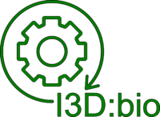

Motivation for FAIR microscopy data
head of the imaging core facility Center for Advanced imaging (CAi) at the University of Düsseldorf
initiator of an OMERO user group in Germany, the RDM4mic group → „powerful subunit“…
…integrated into GerBI-GMB work group 6 „Image analysis and management“ (chair of GerBI GMB)
  → Janina Hanne, part II
partner of the i3D:bio project for information infrastructure for bio-image data
spokesperson of NFDI4BIOIMAGE, the national research data management consortium for (bio)image data
  → Christian Schmidt, part III

Slide 7
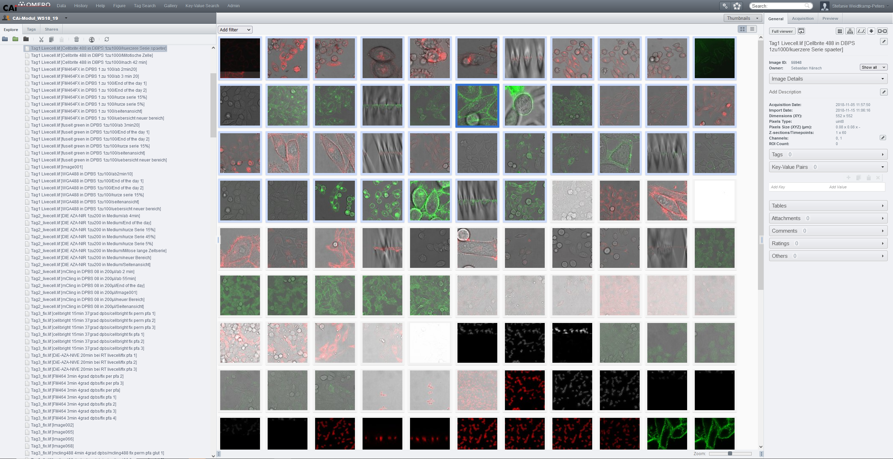
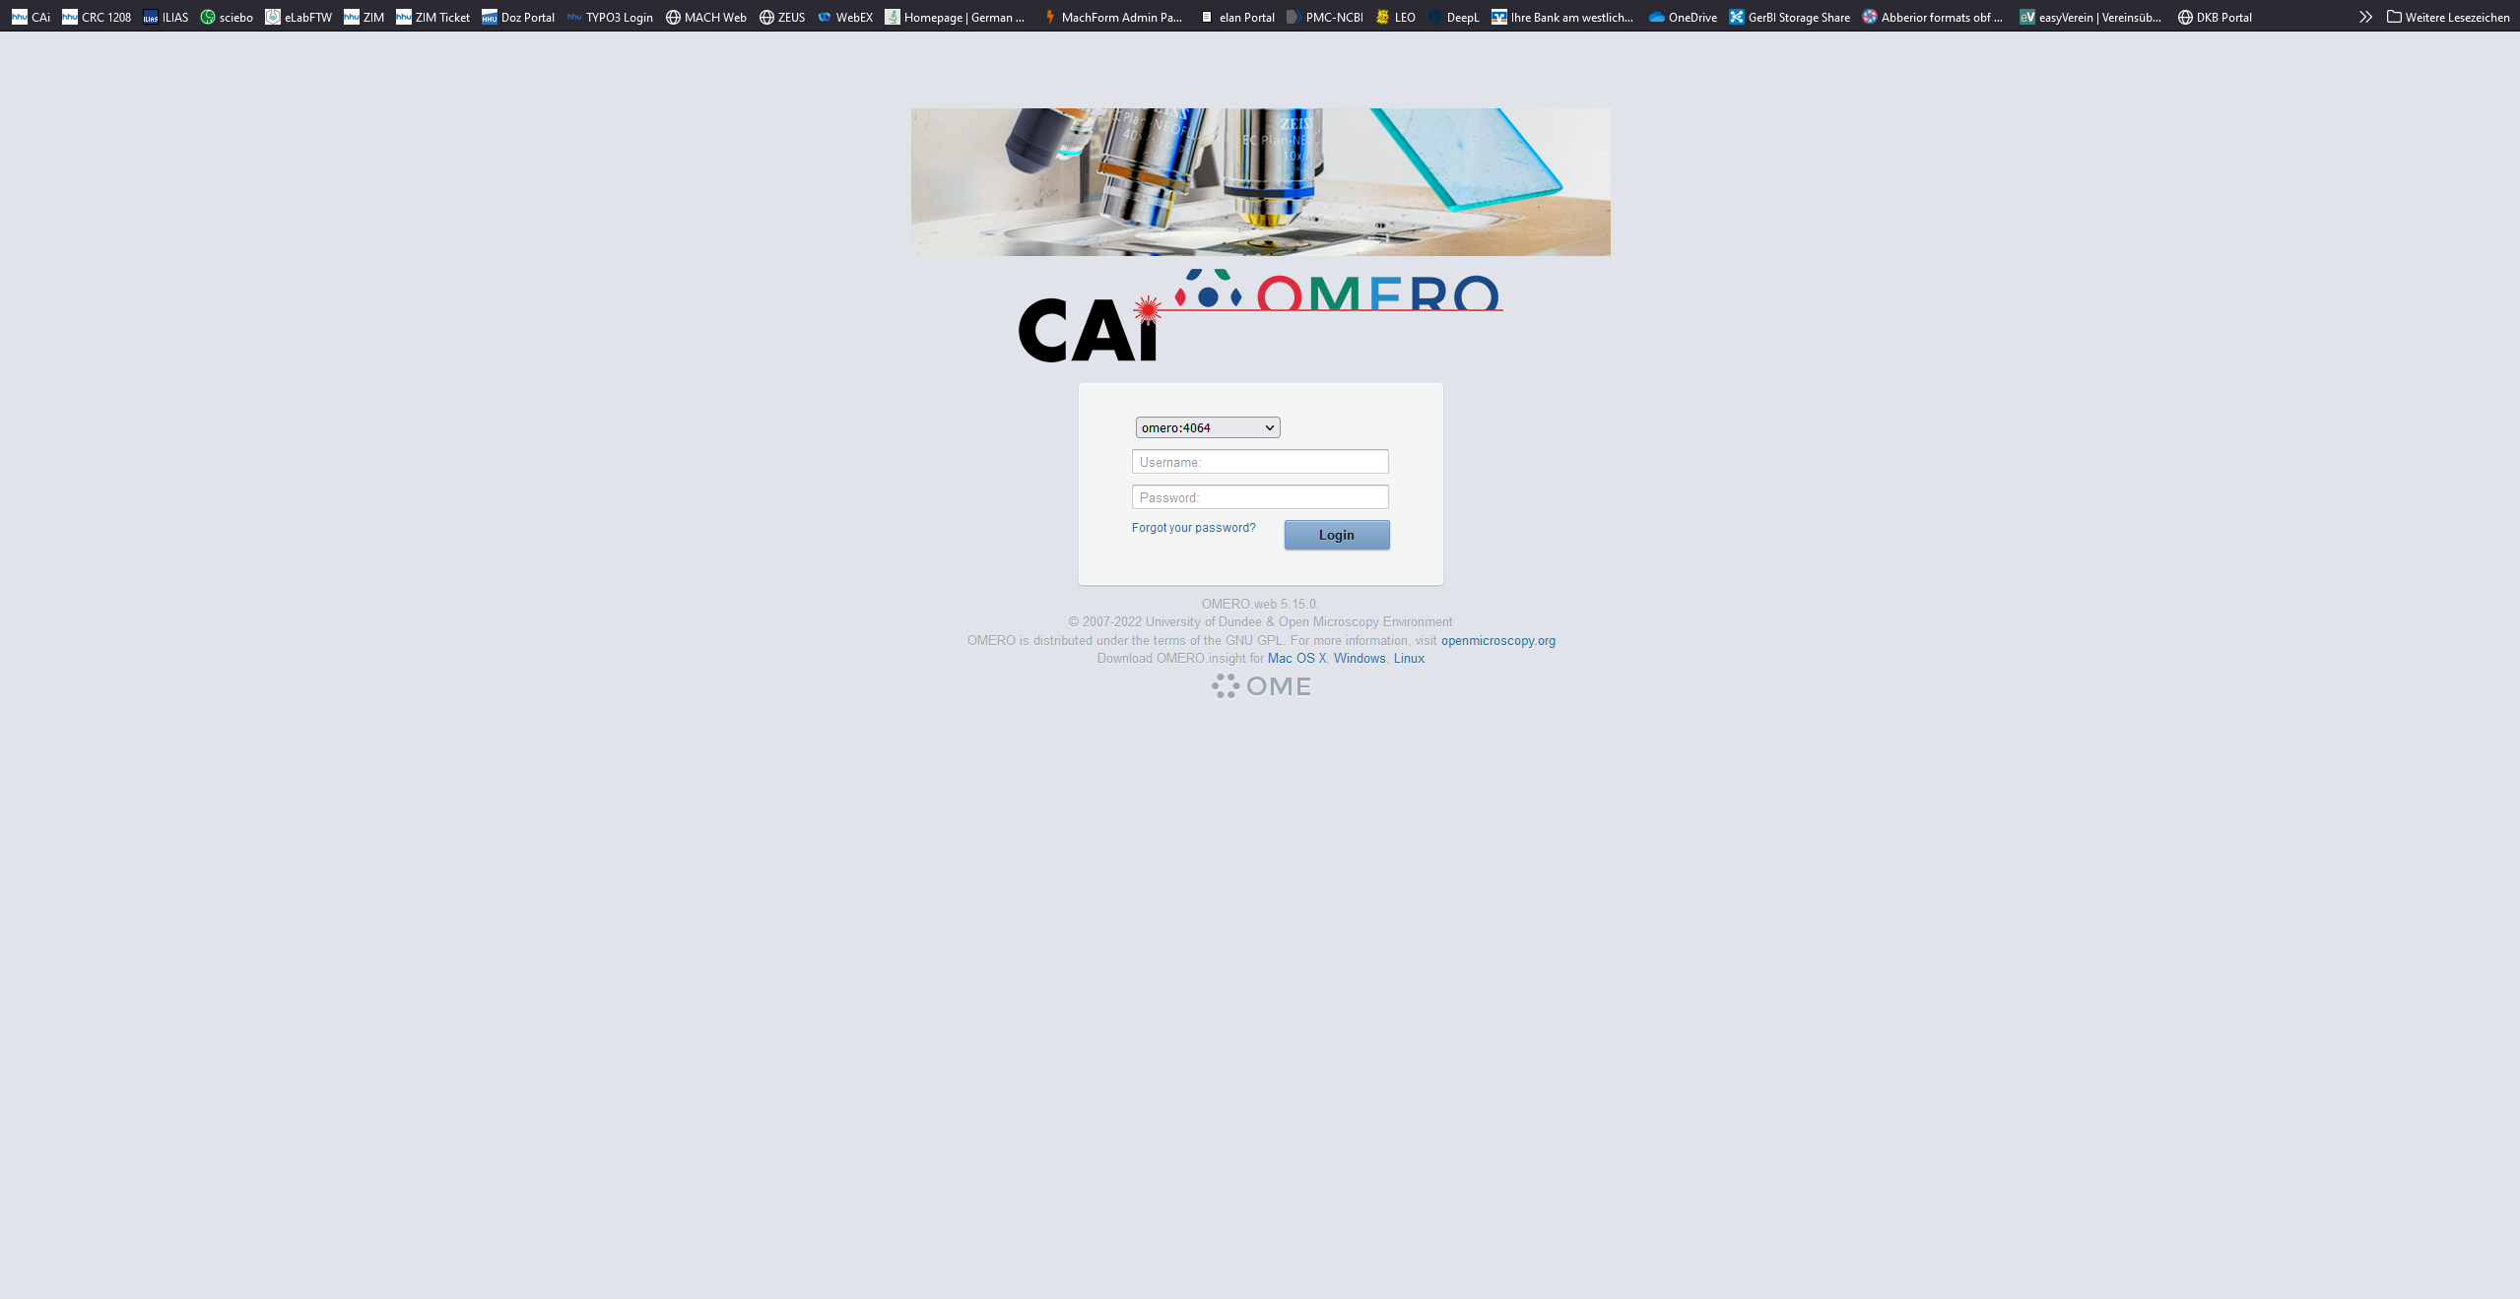
Local information infrastructure w/ OMERO
Image database
preview is available
data is findable
Image acquisition
File store
data is sharable
metadata is interoperable

Slide 8
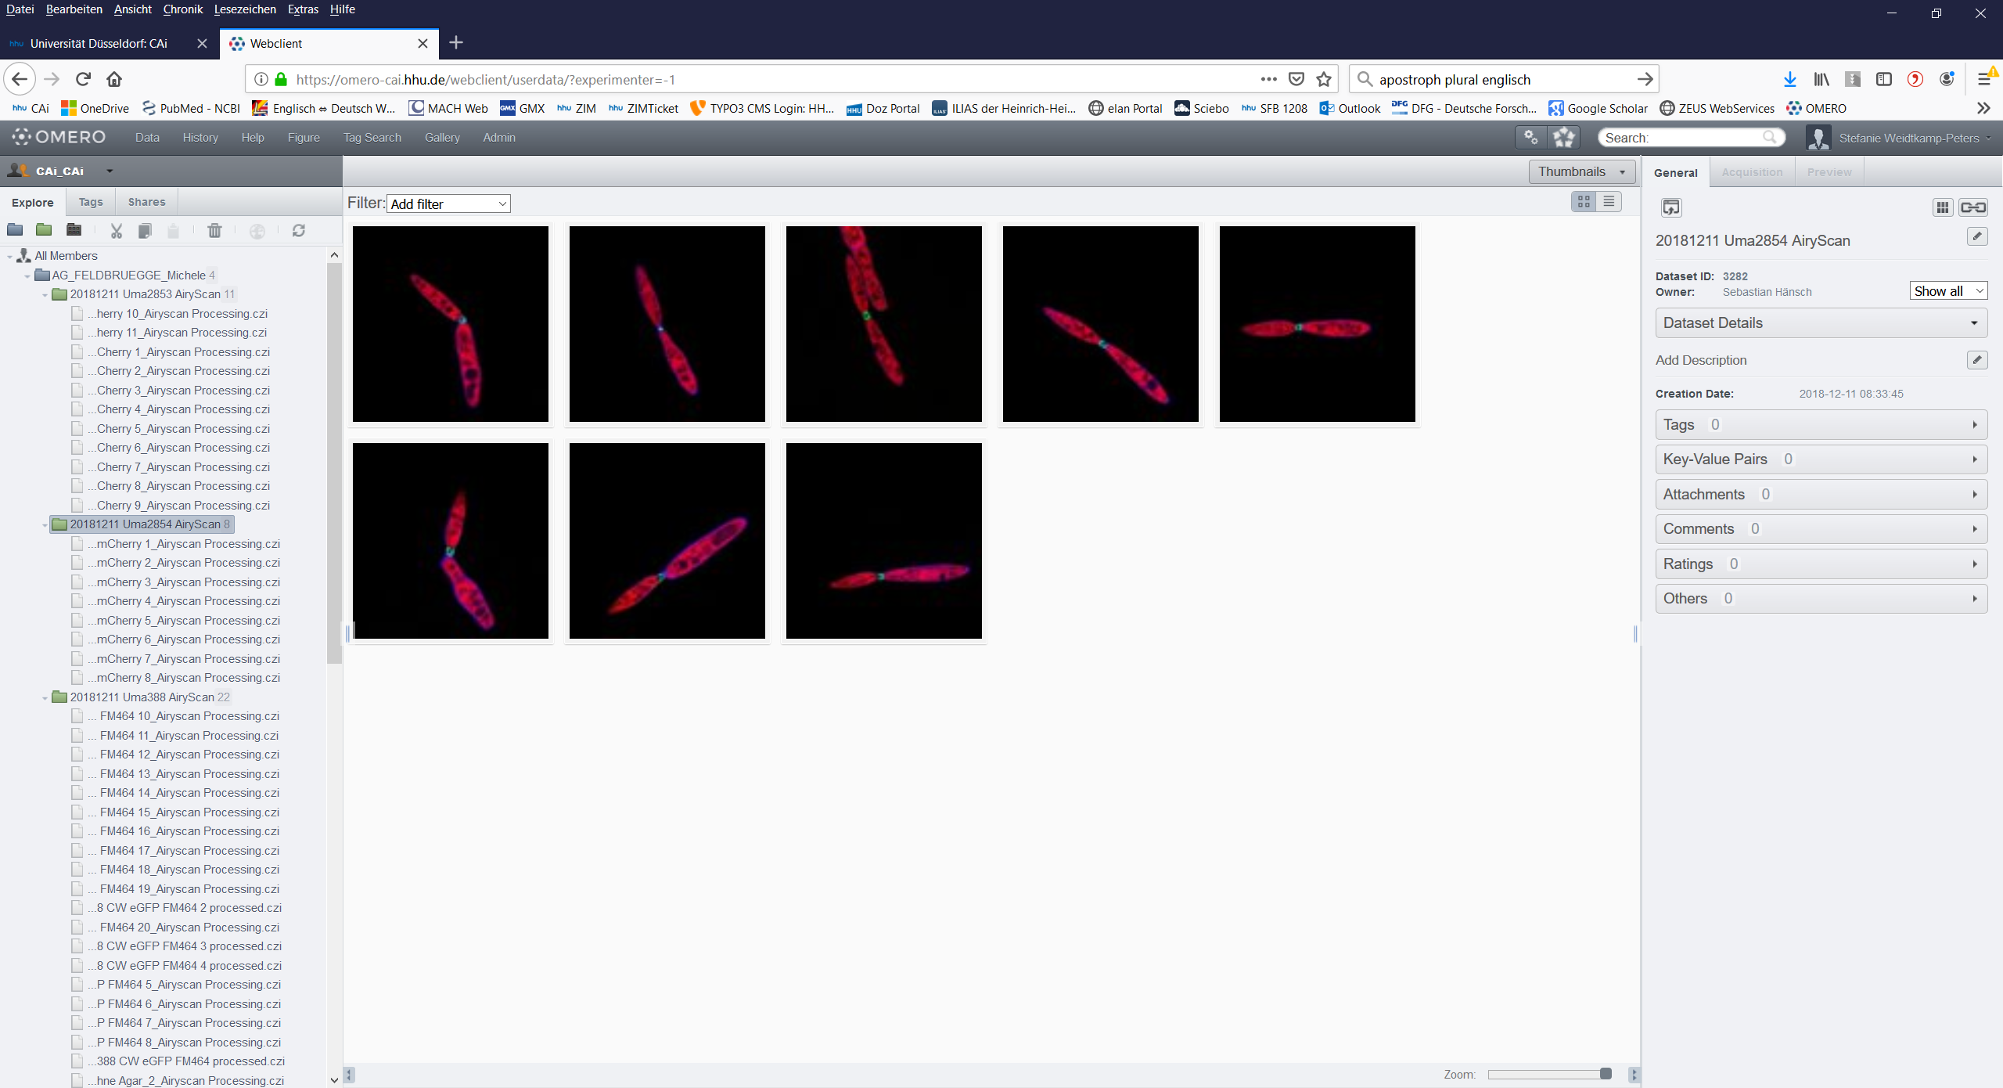
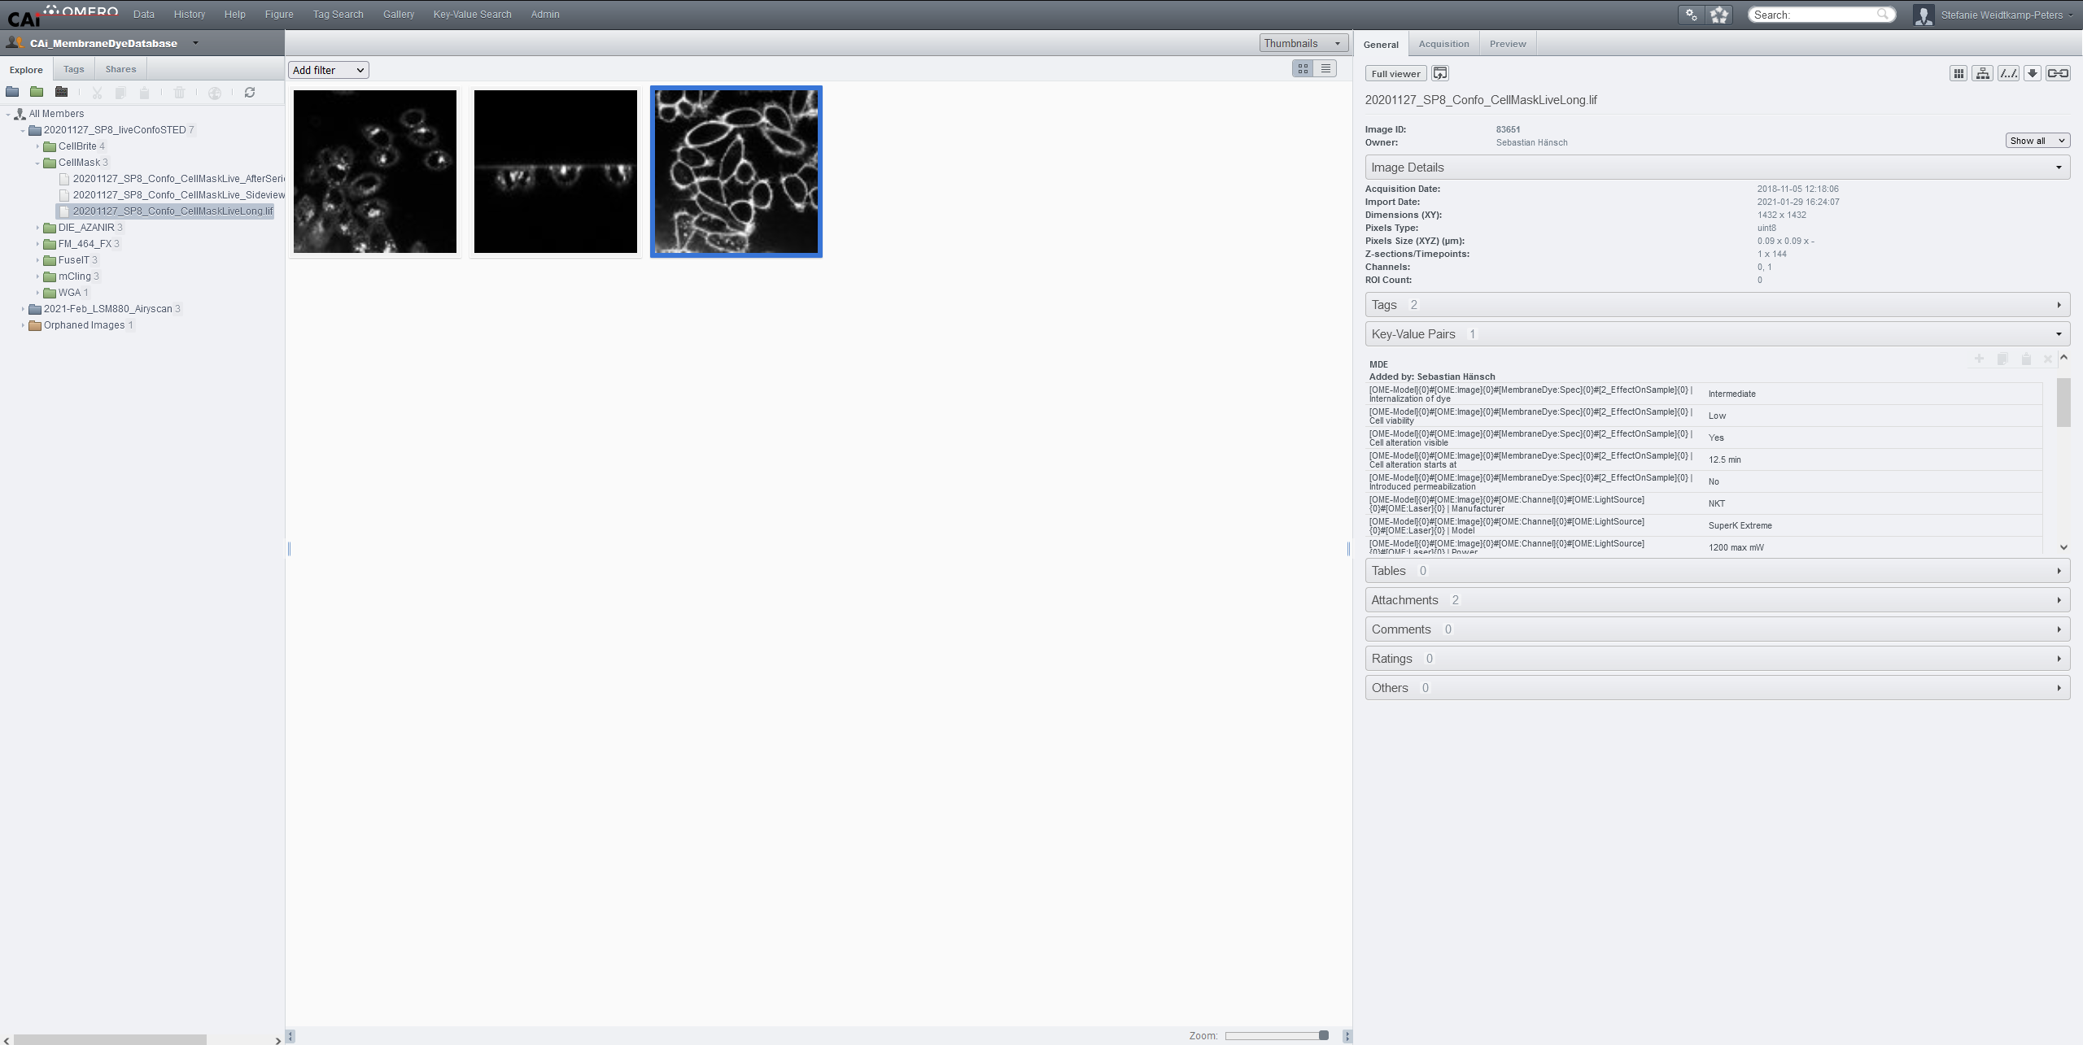
OMERO in use: sharing of image data
PhD student Anna: „We need a green membrane dye, what can you recommend?“
Sebastian: „Kerstin, please analyze and select the images we should process for publication!“
CAi staff Sebastian: „Have a closer look at our collection in OMERO!“
Kerstin (PI): „Please take images no. 5 and 8. They have similar signal intensities at the fragmentation zone!“

Slide 9
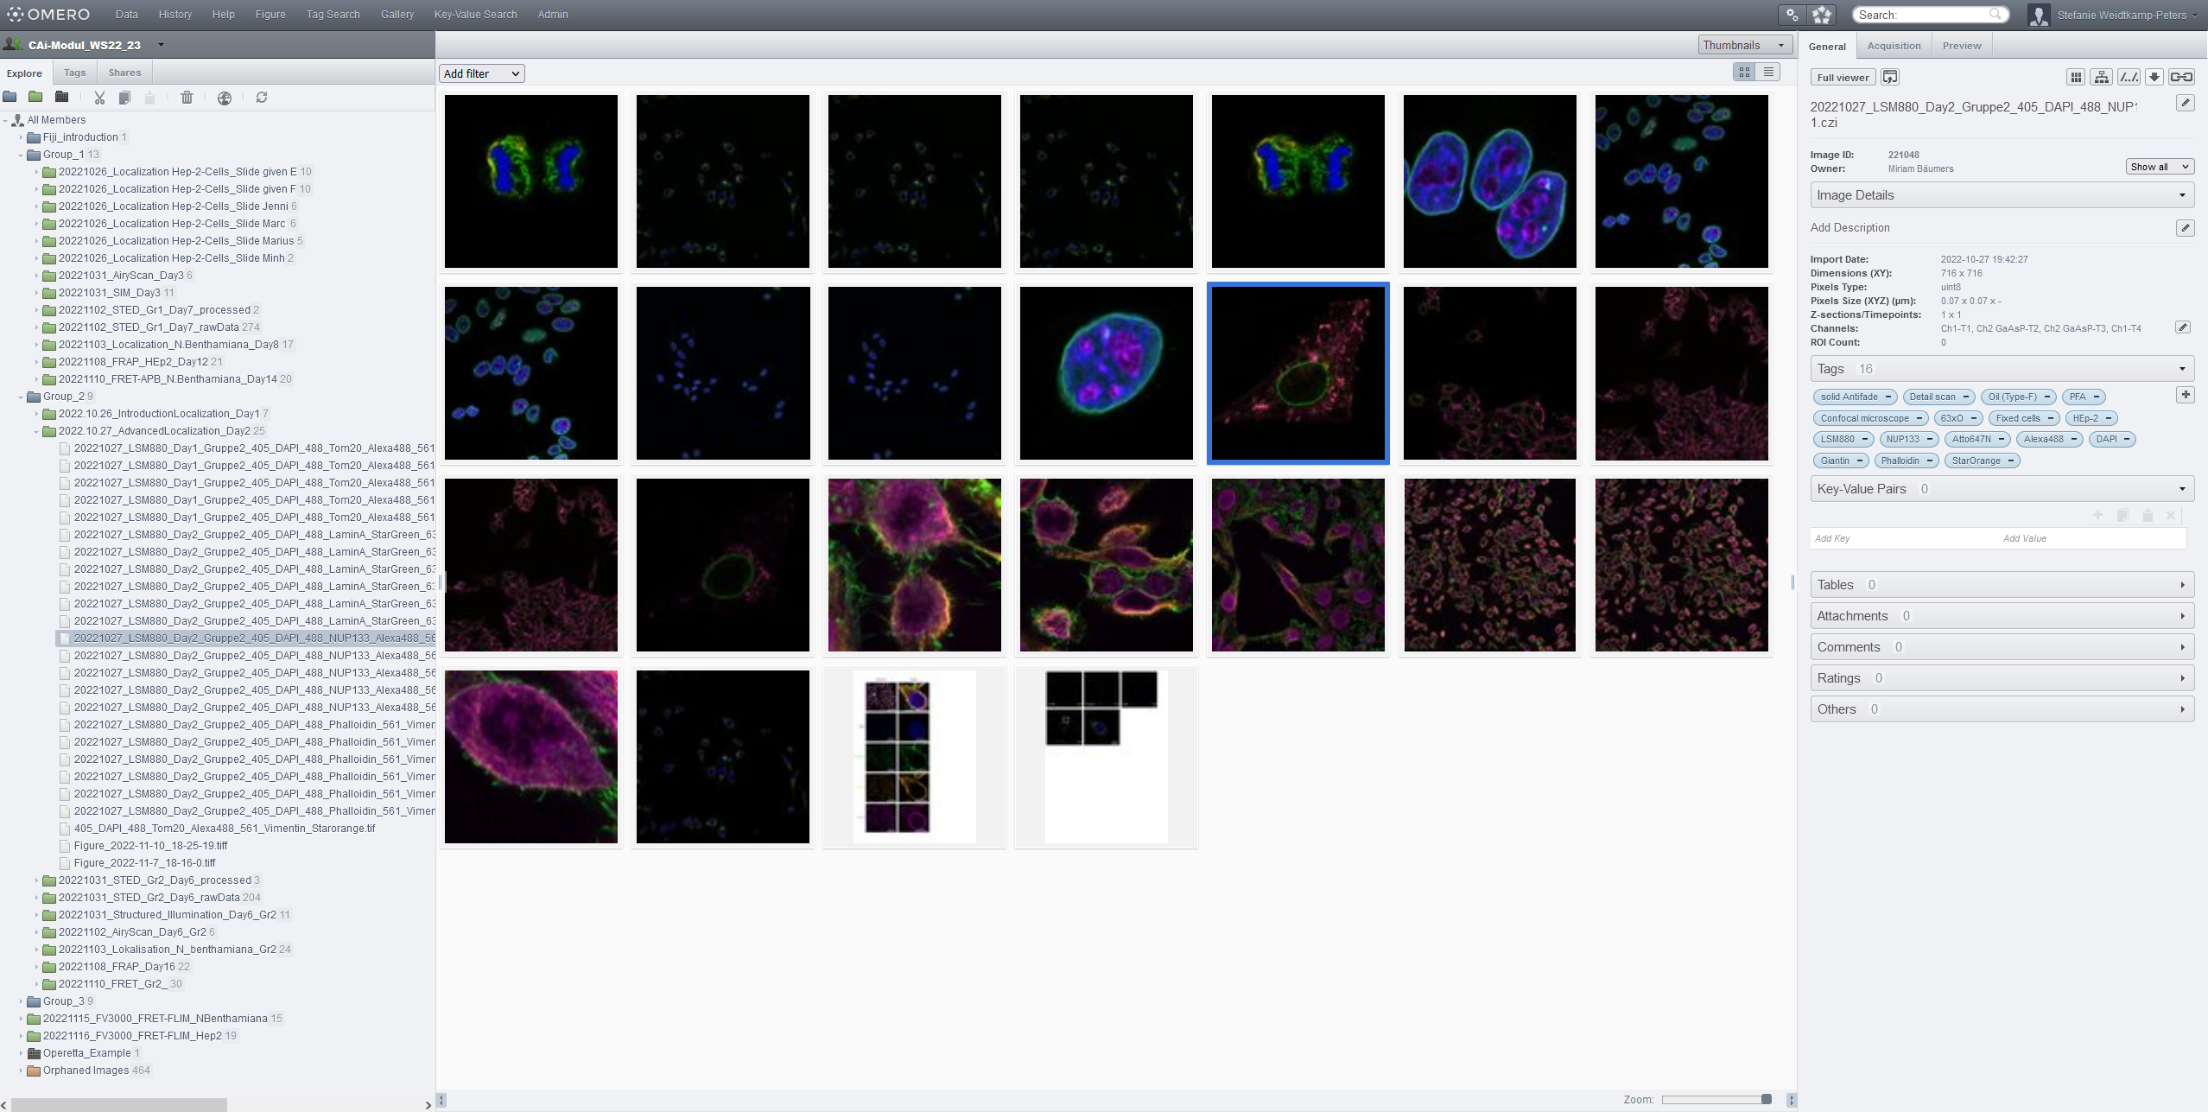
OMERO in use: tagging and searching
link
data set
metadata
annotations

Slide 10
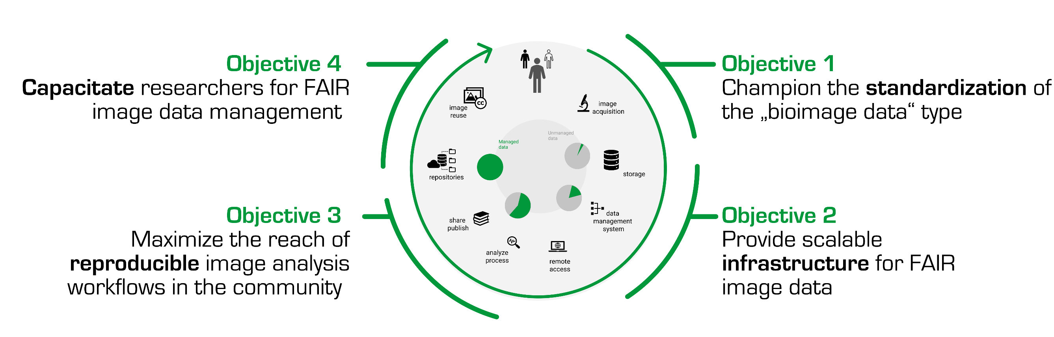
Towards a FAIR bioimage workflow
Information infrastructures are needed to establish a FAIR bioimage workflow
Training and education, show benefits, tell success stories
To do‘s:
International networking and alignment with the community
User-friendly tools for metadata annotation e.g., MDEmic, Micro-Meta App, MethodJ2
Best practices for submission
Comprehensive sets of metadata
Data file formats – FAIR Image Objects
Integration into the local IT infrastructure
Integration with other data management systems
Guidance & training
Accessibility of services e.g., to AI based methods
Import and export of data and operation
Copyright: J. Moore

Slide 11
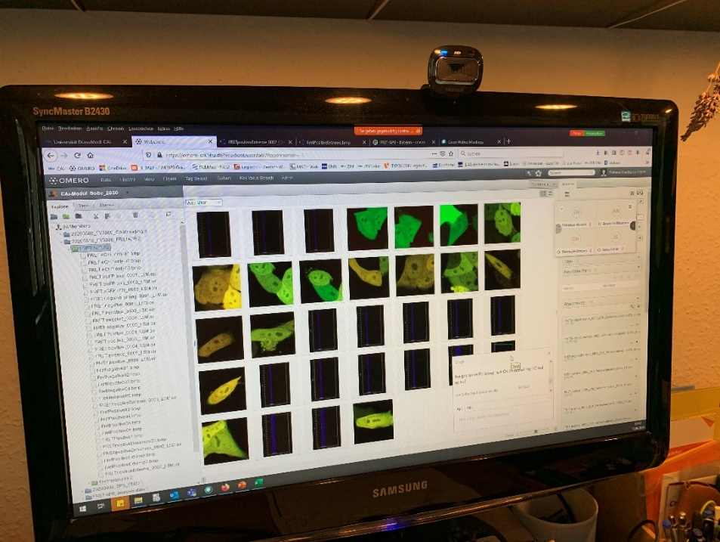
Where is the entry point into the bioimage workflow?
intellectually:
evaluation of existing images
technically:
acquisition of your new images
researcher
in an image database
(local database, IDR, BIA, EMPIAR...)
Copyright: J. Moore
@ your local institutions
Notes:
Researchers feed image data into the system, they do not so much consider the consumption of imaging data
…but this is not the status quo. The status quo is (next slide)

Slide 12





Usage of information infrastructures
technically:
How to use the infrastructure?
intellectually:
Why?
Training & educational tools ③
Extra capacity is needed!
Notes:
If we want our colleagues to consider using information infrastrutcures, we need to show why they are beneficial.
Who has the capacity and knowledge to build those infrastructures?

Slide 13
Summary & take home
information infrastructures are needed to establish a FAIR bioimage workflow
local infrastructures have to be established in parallel with „higher order infrastructures“
however, if possible, avoid isolated solution → constant exchange between all stakeholders
acquire the „extra capacities“
use all mechanisms to motivate researchers for RDM: training, education, some pressure (funders, publishers), start early
Copyright: J. Moore

Slide 14







The journey to FAIR image data management
2023-2028
Bringing FAIR biomage RDM to the (German) scientific community
RDM4mic
NFDI 3rd Call
2022
„Research Data
Management
for Microscopy“
2021
ready to become the central community repository
BIA
2020
(OME-NGFF to be
adopted by BIA)
becomes a non-profit
Community call for data standards
(Swedlow, 2021)
funds
German
BioImaging
Network
2019
SSBD:database
2018
funding for OME-NGFF
awarded to GerBI/J. Moore
2017
BioImage Archive
technical launch
Swedlow et al.
found OME
2016
2000
2012
2014
Community call for a public image archive

Slide 15

A journey to FAIR microscopy data – part II
Except for the used logos and the cited journal covers, the content of these slides is shared under the terms of Creative Commons Attribution License (CC-BY 4.0) unless the content is marked otherwise.
Janina Hanne
Managing Director German BioImaging – GMB e.V.
janina.hanne@gerbi-gmb.de

Slide 16
GMB?
German BioImaging - Gesellschaft für Mikroskopie und Bildanalyse e.V.
= Society for Microscopy and Image Analysis
… and image data management.

Slide 17
GerBI‘s Journey
2023-2028
Bringing FAIR biomage RDM to the (German) scientific community
RDM4mic
NFDI 3rd Call
2022
„Research Data
Management
for Microscopy“
2021
ready to become the central community repository
BIA
2020
(OME-NGFF to be
adopted by BIA)
becomes a non-profit
Community call for data standards
(Swedlow, 2021)
funds
German
BioImaging
Network
2019
SSBD:database
2018
funding for OME-NGFF
awarded to GerBI/J. Moore
2017
BioImage Archive
technical launch
Swedlow et al.
found OME
2016
2000
2012
2014
Community call for a public image archive

Slide 18
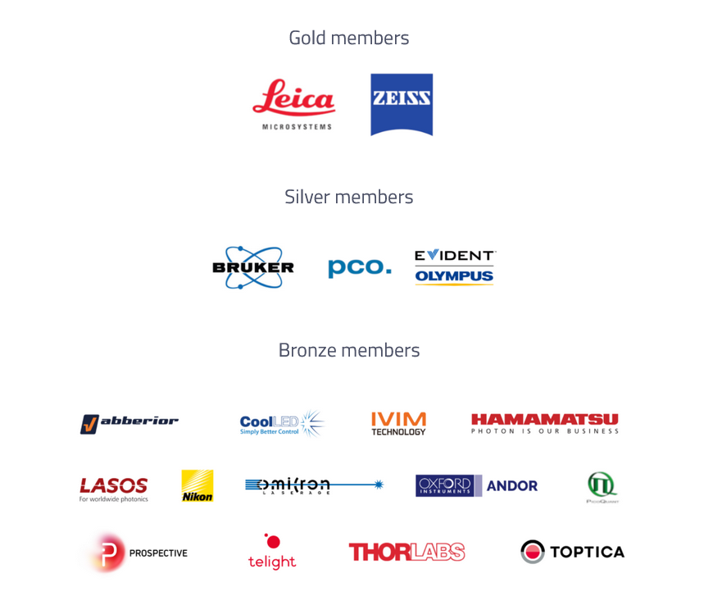
Members
~200 members
Personal members
Institutional members
Corporate members
Join us:
www.gerbi-gmb.de/society/members/

Slide 19
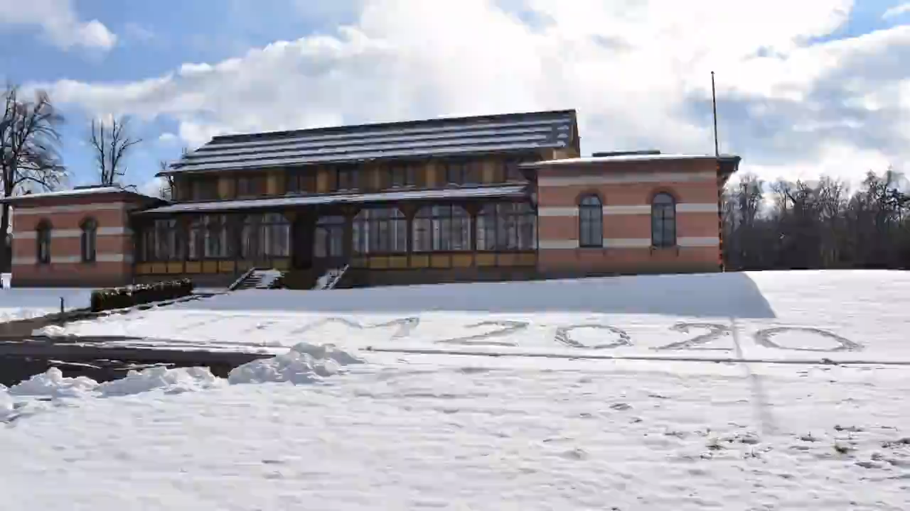

RDM test event
20.-24.3.2023
Albgut, Münsingen
www.gerbi-gmb.de/events/tim2023
Booked out

Slide 20
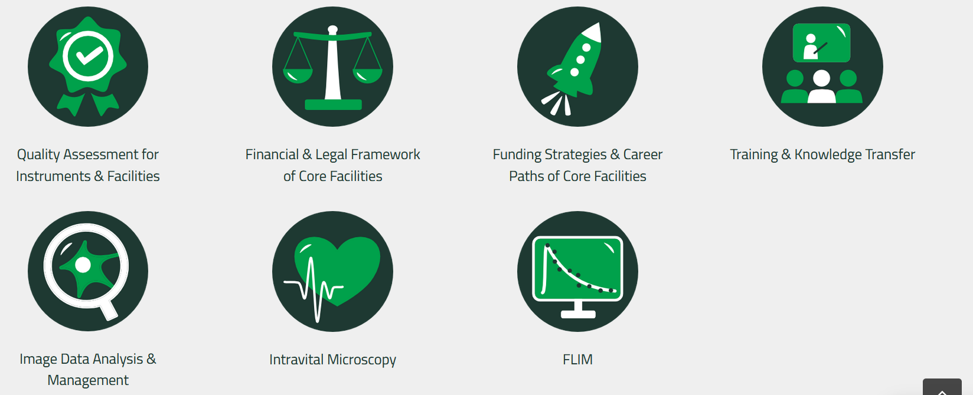
GerBI Teams
Industry Cooperation
Young microscopists & image analysts (YMIA)

Slide 21
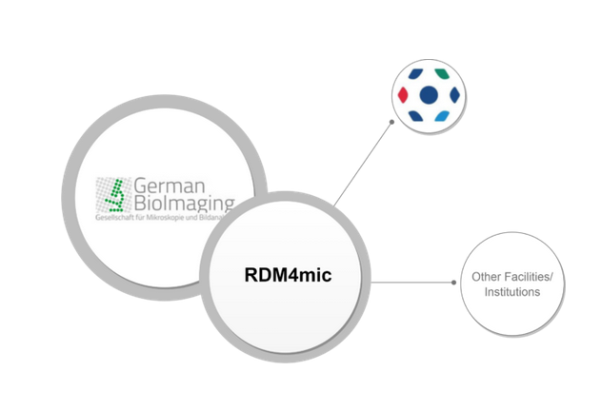
RDM4mic
Strategies for image data management
Requirements and resources needed to set up a local image repository
Available software, tools, workflows and standards
Handling of change management
https://german-bioimaging.github.io/RDM4mic.github.io/

Slide 22
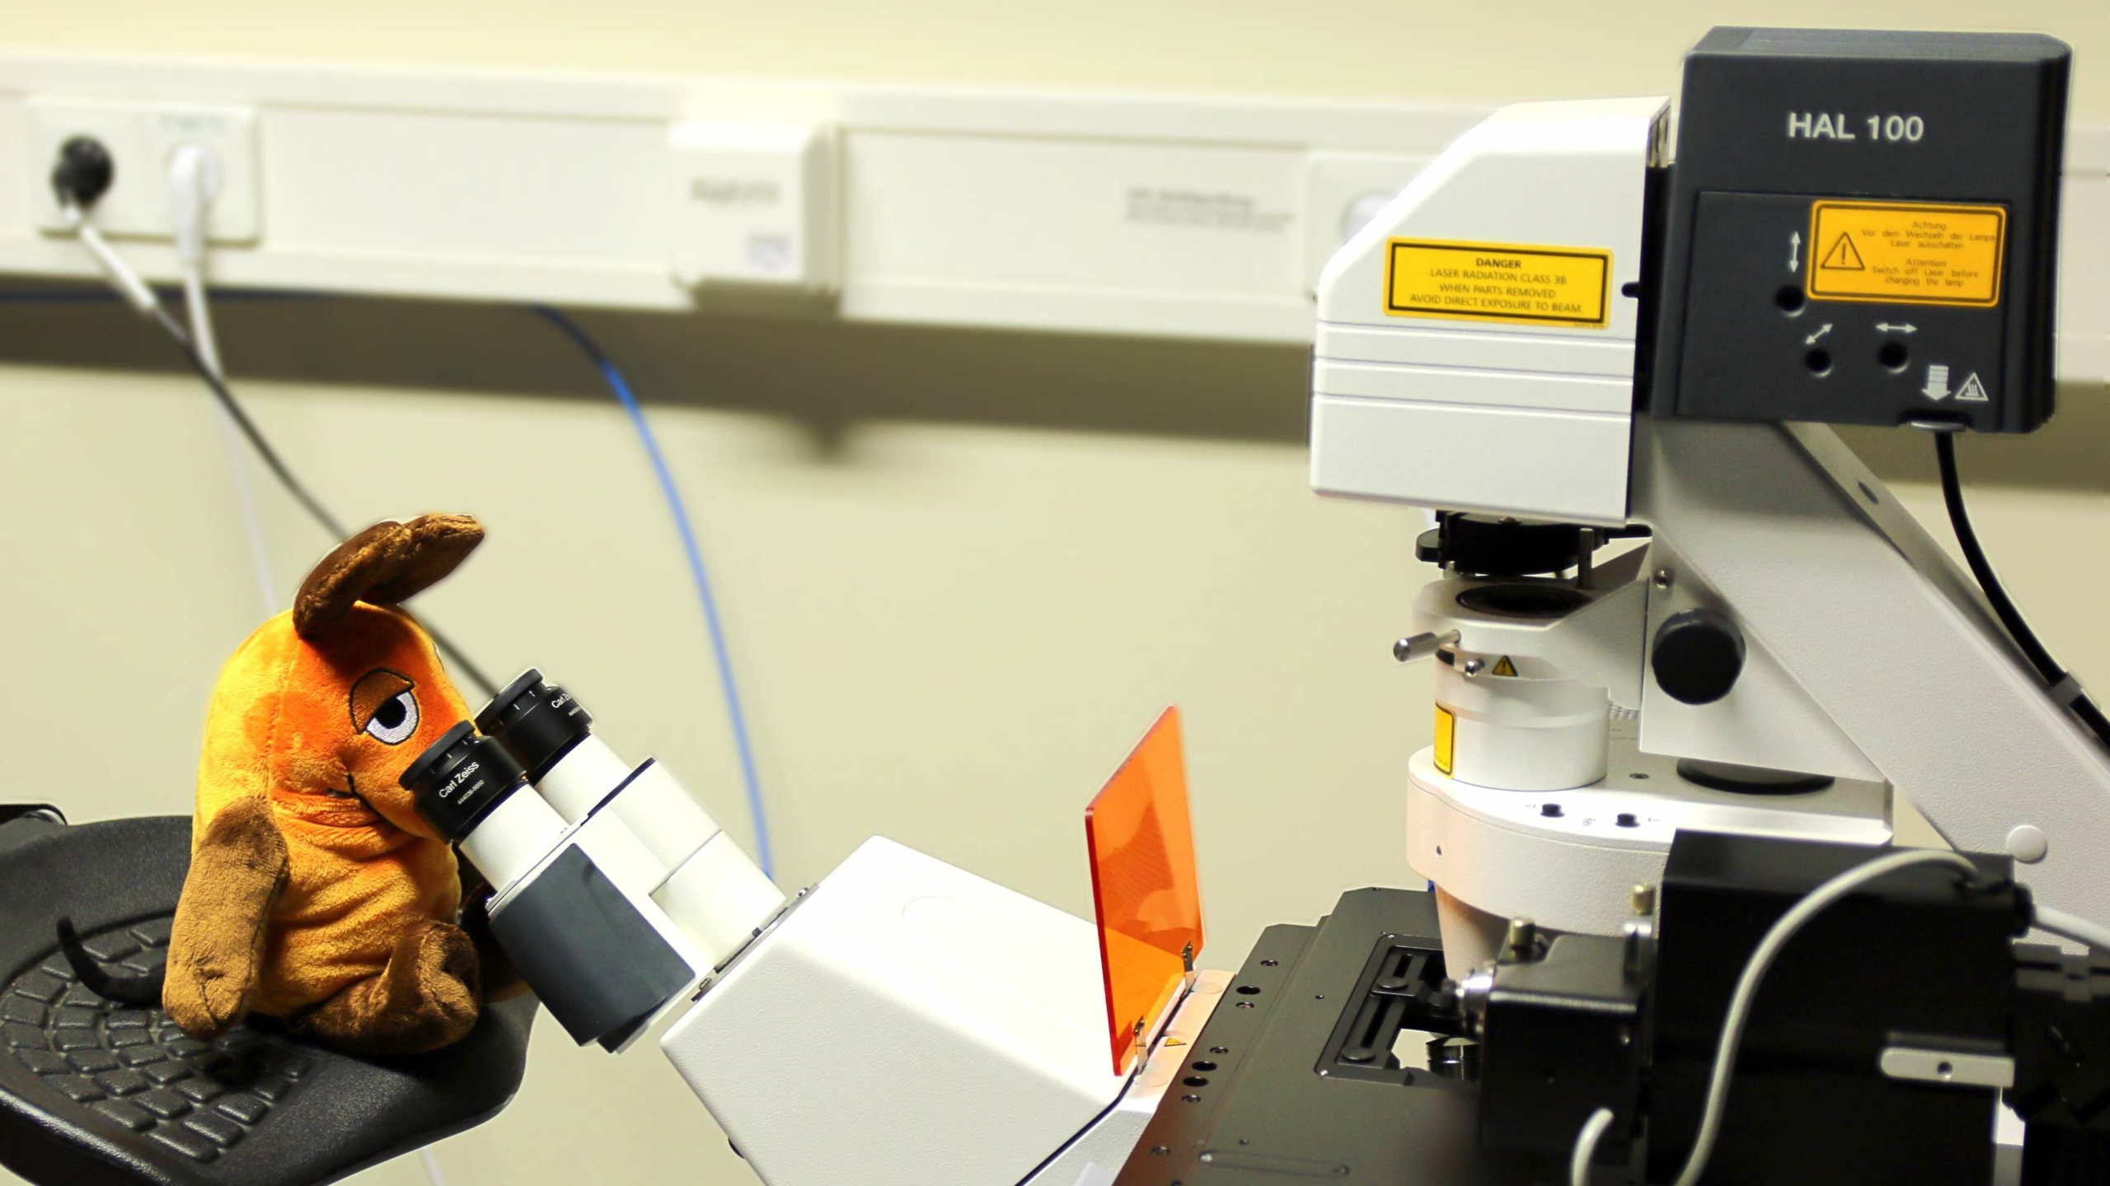
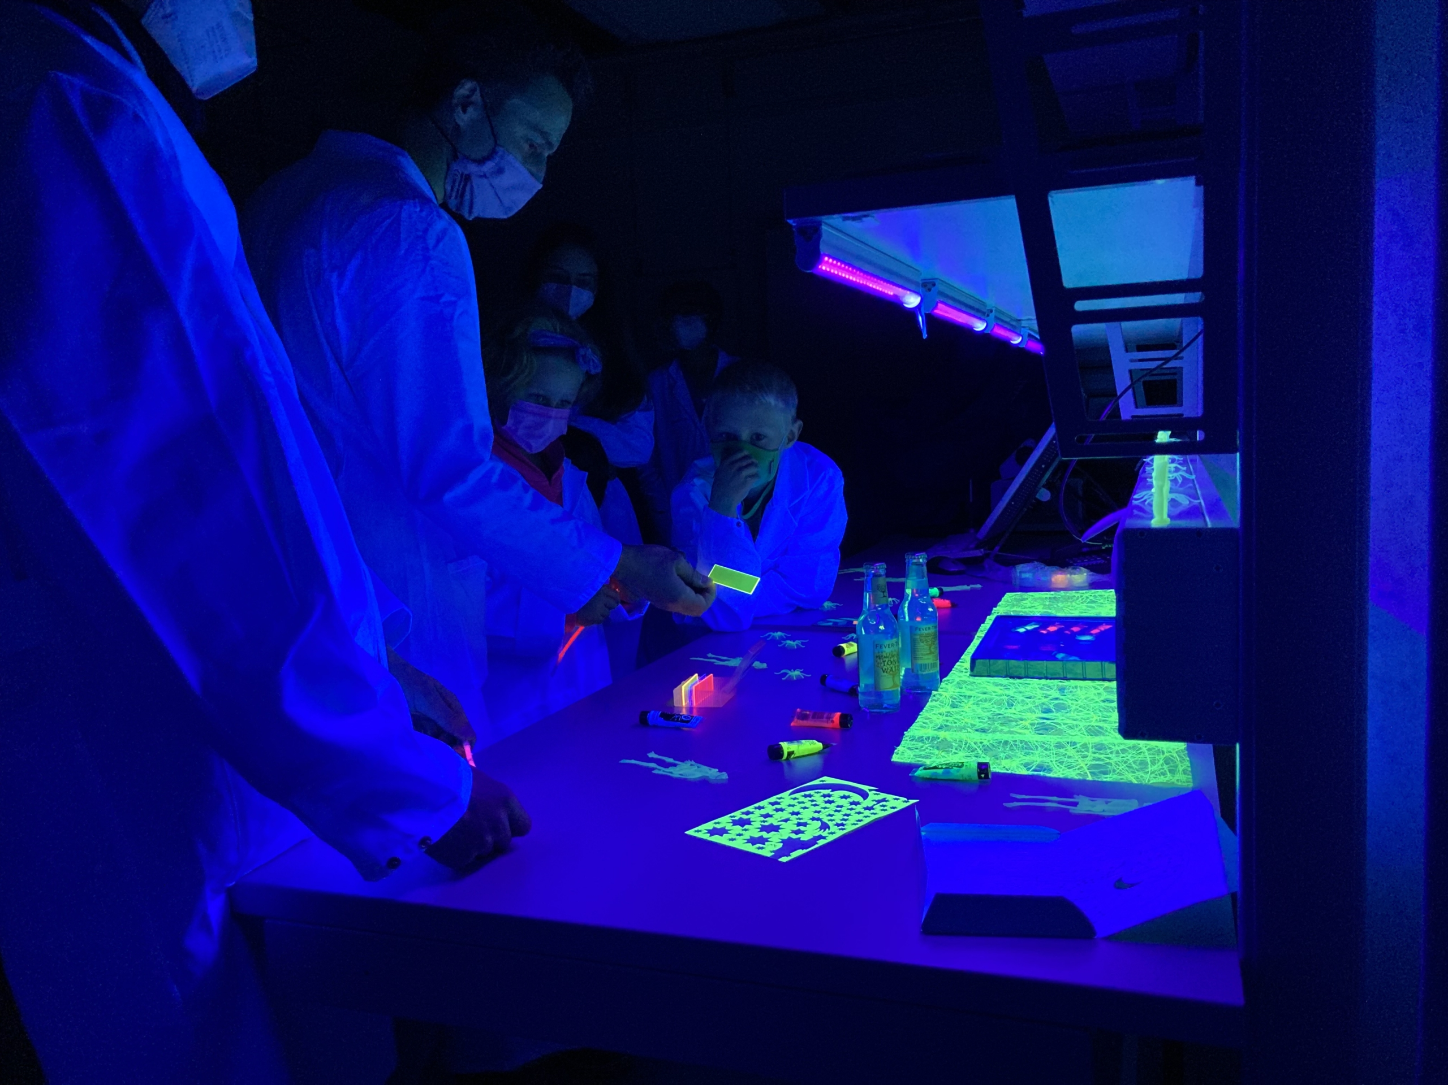
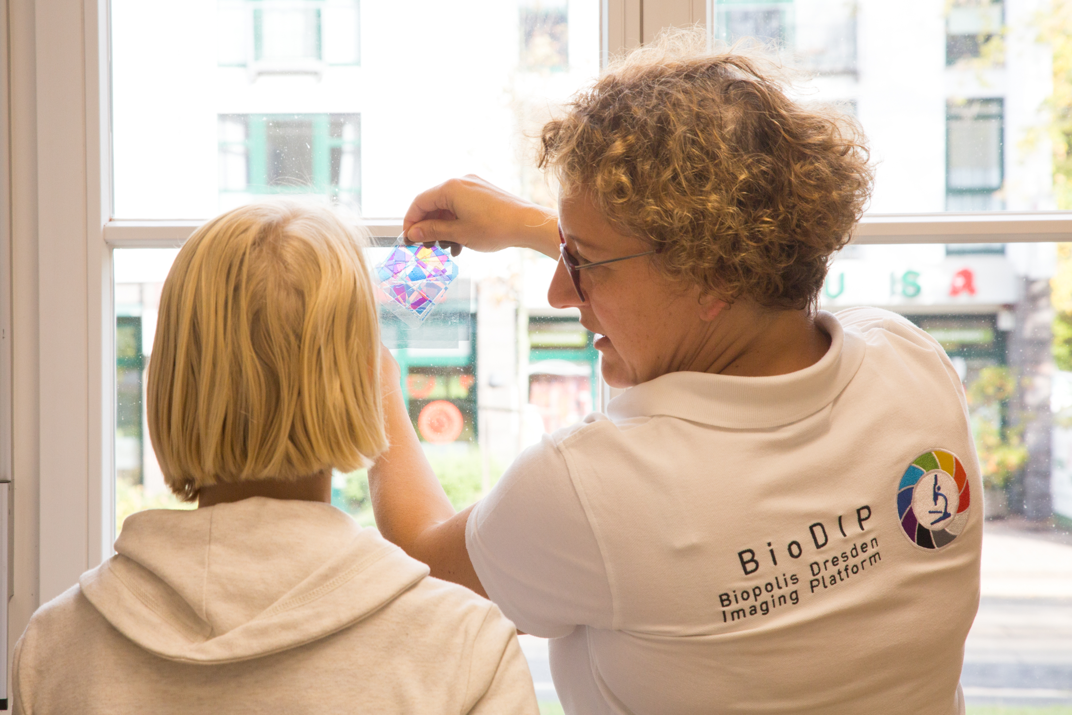
Maus Türöffner Tag
©S.Wiegand, Medizinische Fakultät TU Dresden

Slide 23
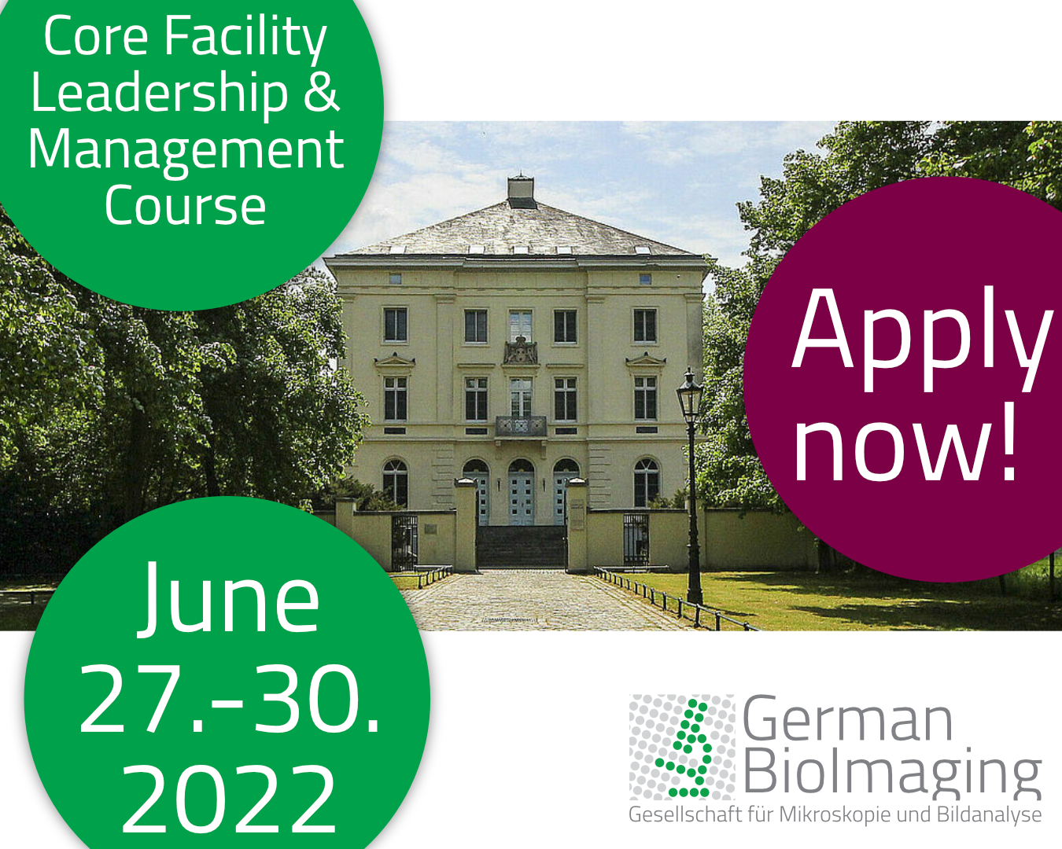

CF Leadership & Management course
Balance your different roles
Build a productive team culture
Deal with conflicts constructively
Manage your time better
Delegate tasks more effectively
Deal with different personalities in the team
Negotiate more effectively
Hire the right people
Manage your budget

Slide 24
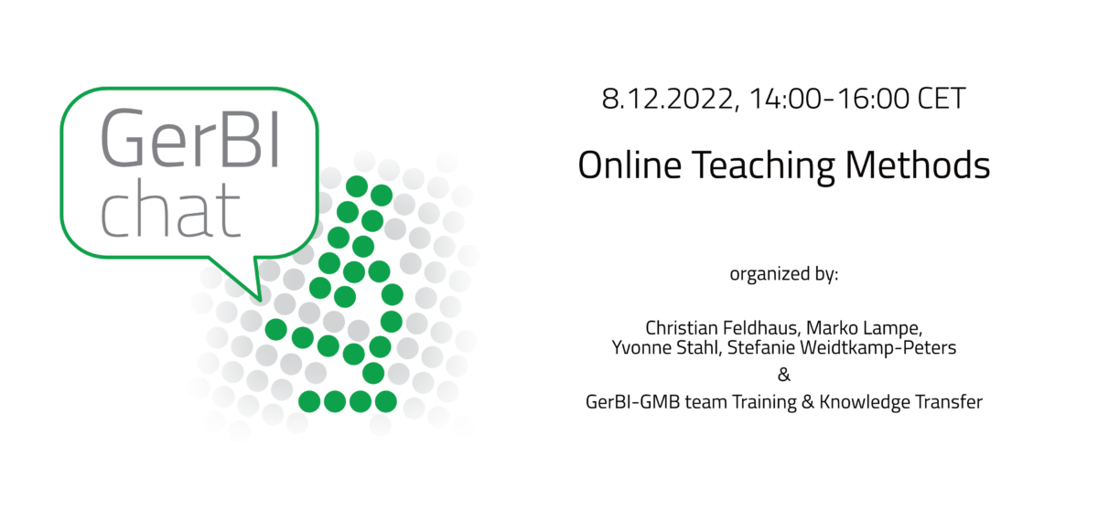
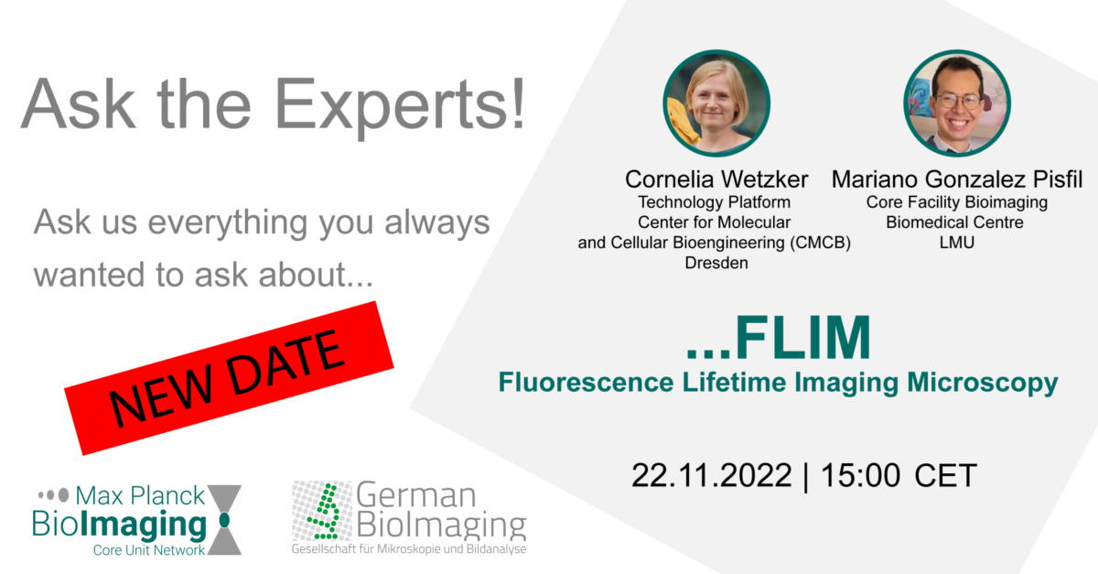
GerBI online Events

Slide 25
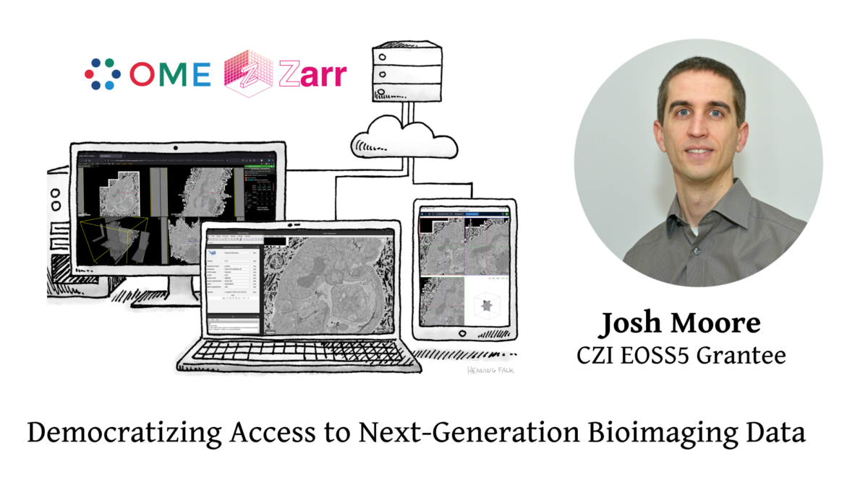
Funding: CZI
Image: “Multiple clients” by Henning Falk, ©2022 NumFOCUS, is used under a CC BY 4.0 license

Slide 26
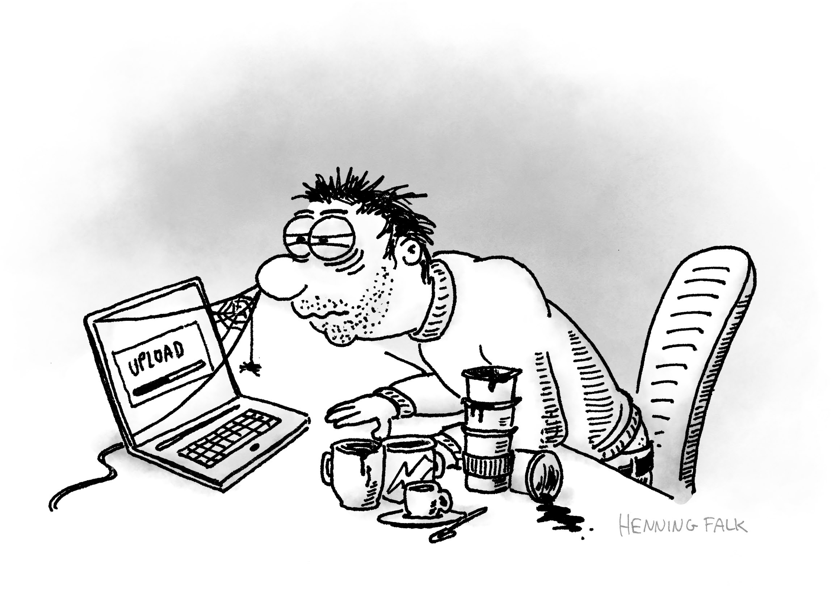
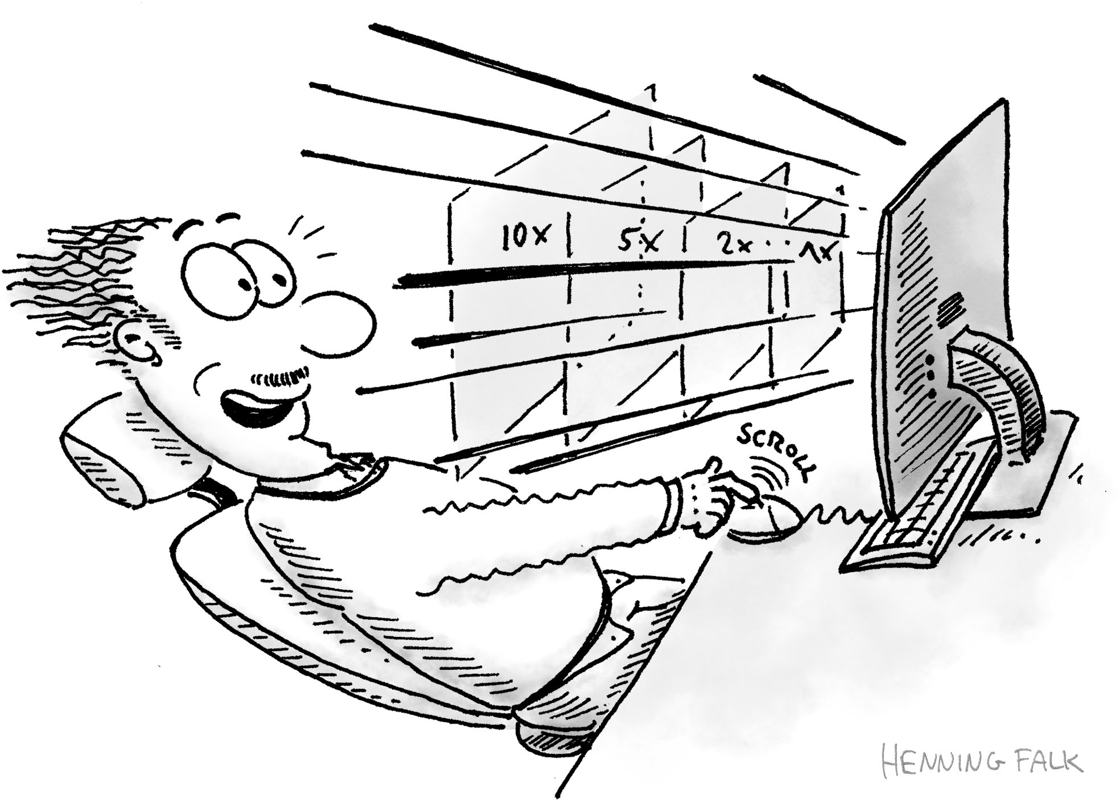
Funding: CZI
Images: “Adam uploads” & “Navid zooms” by Henning Falk, ©2022 NumFOCUS, is used under a CC BY 4.0 license

Slide 27
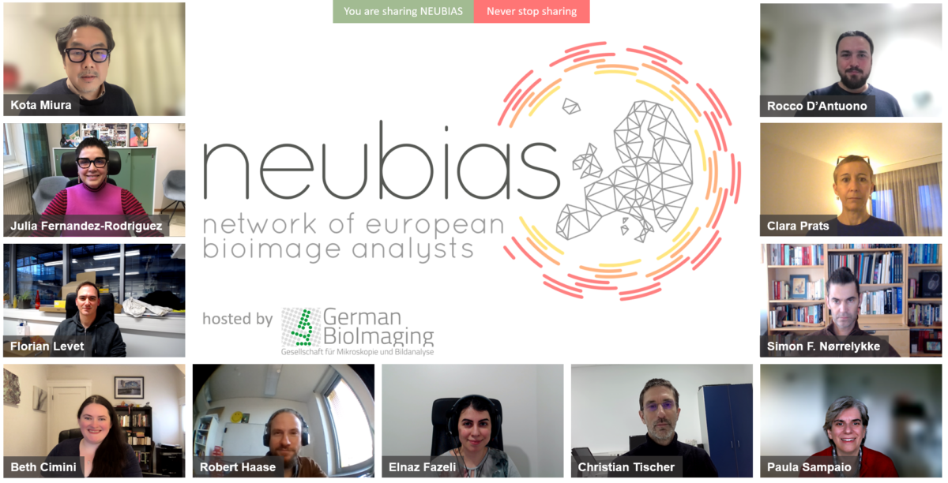
Funding: NEUBIAS 2.0
https://twitter.com/haesleinhuepf/status/1617989601645449220?s=20&t=DjAkRcZ9qSAr9qHHHZ_GkA

Slide 28
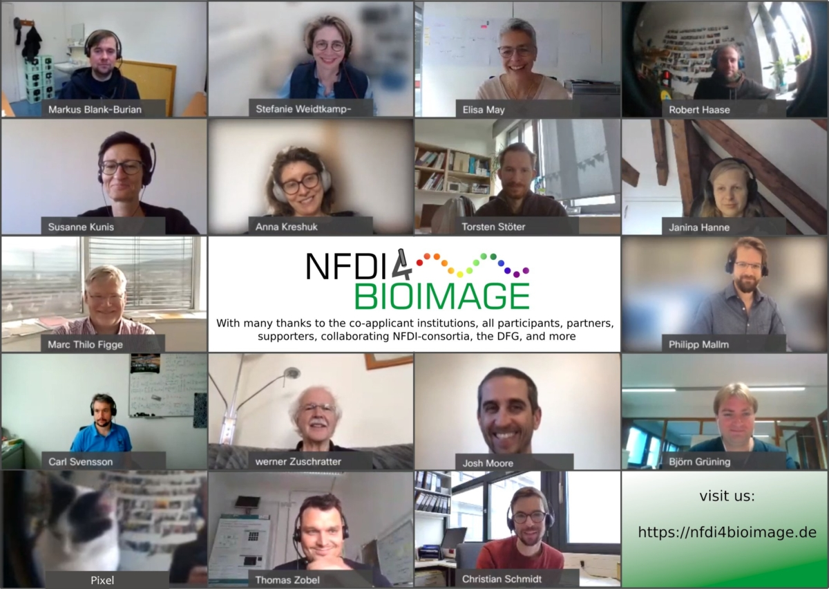
Funding: NFDI4BIOIMAGE
https://twitter.com/SchmChristian/status/1463153232470020100?s=20&t=PRbtBrmf4mDre9wUOLOJXg
Image: “Multiple clients” by Henning Falk, ©2022 NumFOCUS, is used under a CC BY 4.0 license

Slide 29


GerBI Journey – a FAIR Journey
RDM4mic
2023-2028
NFDI 3rd Call
2022
„Research Data
Management
for Microscopy“
2021
ready to become the central community repository
BIA
2020
(OME-NGFF to be
adopted by BIA)
becomes a non-profit
Community call for data standards
(Swedlow, 2021)
funds
German
BioImaging
Network
2019
SSBD:database
2018
funding for I3D:bio (2022-2024)
2017
BioImage Archive
technical launch
Swedlow et al.
found OME
2016
2000
2012
2014
Community call for a public image archive (Swedlow, 2018)
funding for OME-NGFF
awarded to GerBI/J. Moore

Slide 30
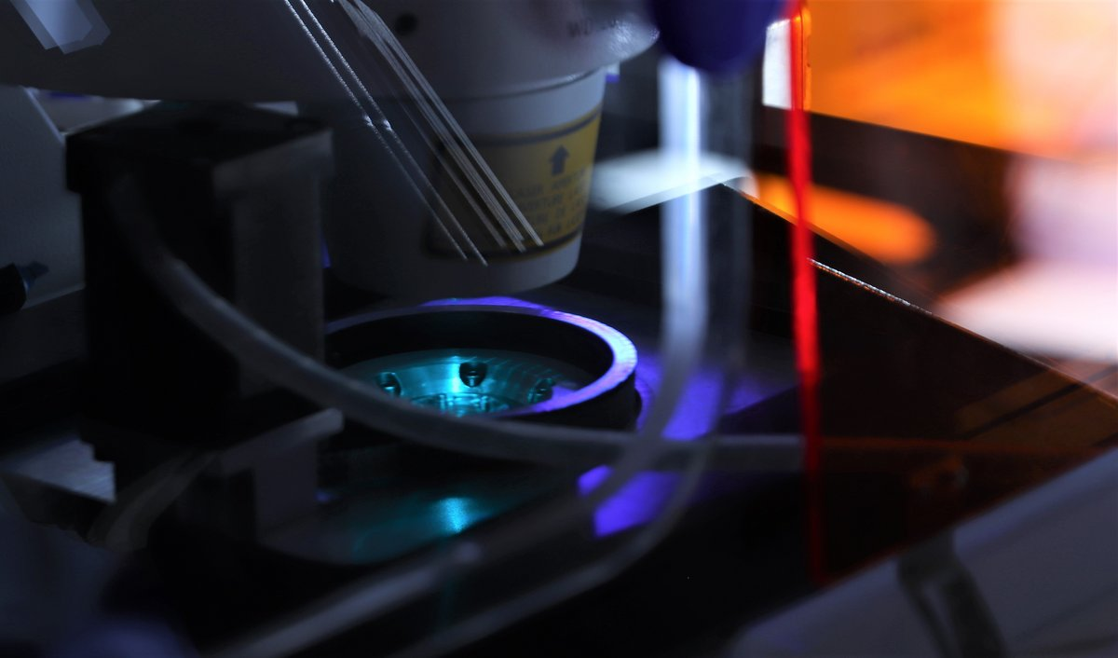
PART III
Except for the used logos and the cited journal covers, the content of these slides is shared under the terms of Creative Commons Attribution License (CC-BY 4.0) unless the content is marked otherwise.
A journey to FAIR microscopy data – part III
NFDI4BIOIMAGE and I3D:bio
Christian Schmidt
Project Coordinator
German Cancer Research Center (DKFZ)
Heidelberg
christian01.schmidt@dkfz-heidelberg.de
Notes:
Institutional members: who will vote??

Slide 31
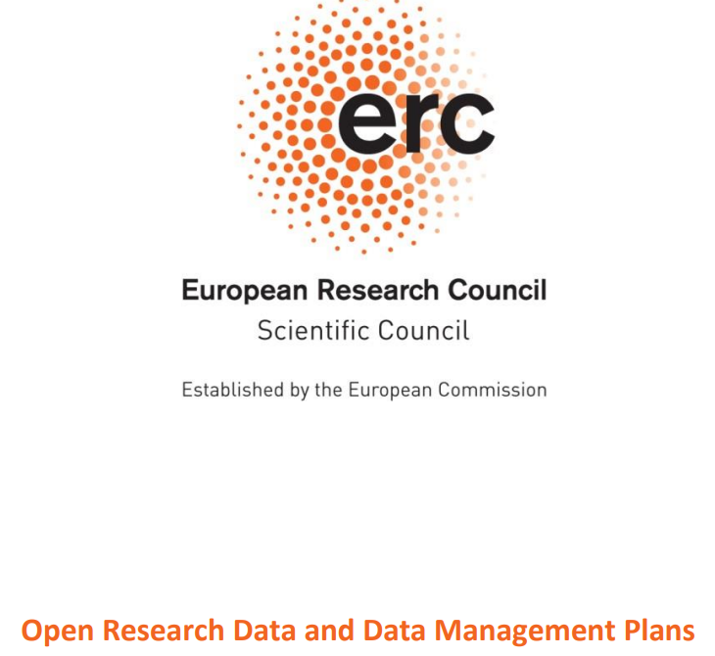
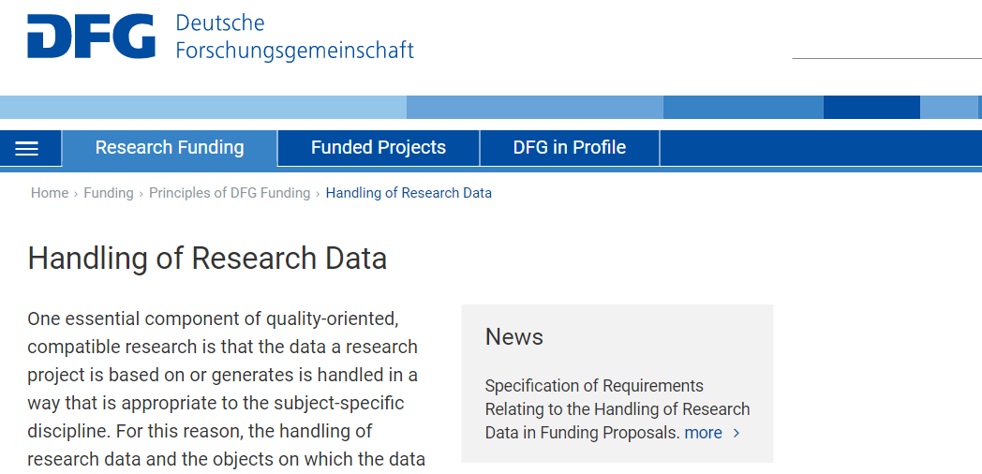
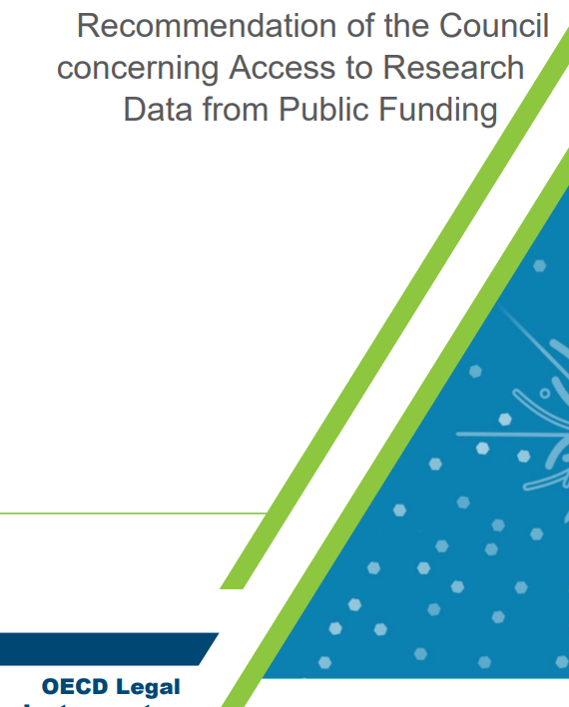
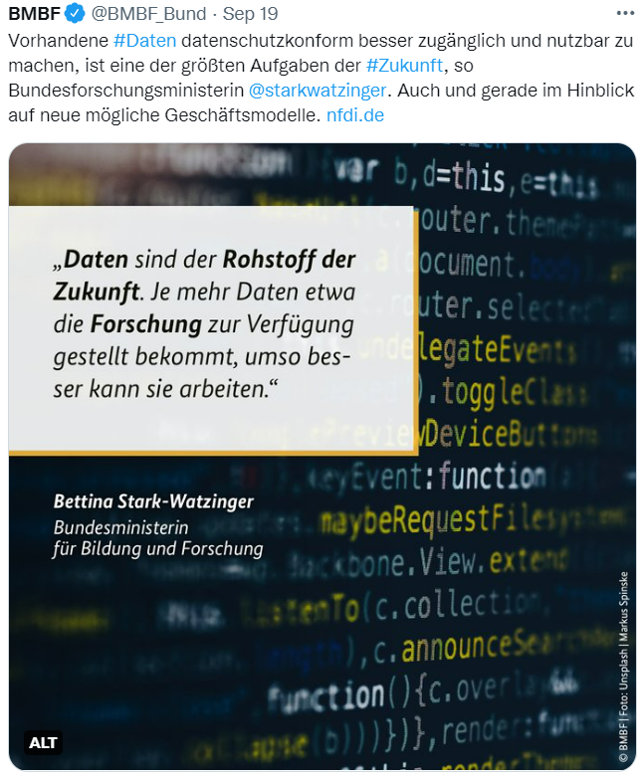
Significance of research data management
Intrinsic motivation
Impact and efficiency of my research
Extrinsic factors
Funding agency demands
Good Scientific Practice
Ethical aspect
Make science more sustainable
Promote Open Science and data sharing
& political momentum
https://www.dfg.de/en/research_funding/principles_dfg_funding/research_data/index.html
https://erc.europa.eu/sites/default/files/document/file/ERC_info_document-Open_Research_Data_and_Data_Management_Plans.pdf
https://twitter.com/BMBF_Bund/status/1571801906074337280?s=20&t=krDcwOPMuPwjs-VisYBgVg
https://legalinstruments.oecd.org/en/instruments/OECD-LEGAL-0347
Notes:
Institutional members: who will vote??

Slide 32
Research data ecosystems emerging
How to promote sharing and reuse?
      Guiding principles for data (FAIR)
Germany
2002
2006
2008
2012
2016
2018
2020
2022
„FAIR“
OECD:
Open Access
Europe (& beyond)
Notes:
Institutional members: who will vote??

Slide 33
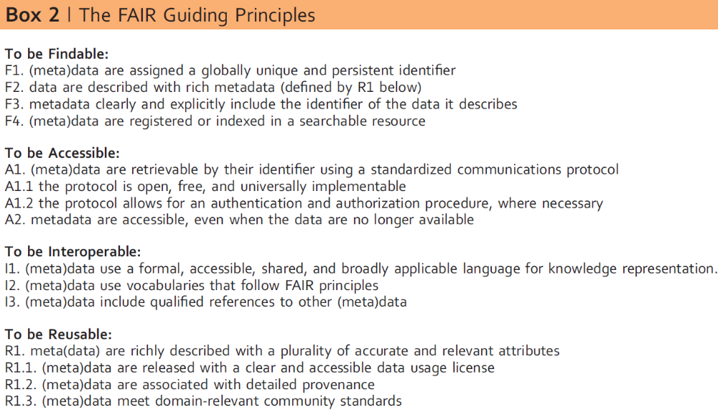
The FAIR principles
Findable Accessible Interoperable Reusable
Metadata is very important
Guiding principles
(not a dictation of technical solutions)
Goal is machine-readability
(not only human ability to reuse)
FAIR is not
the same as „open“
a standard
Wilkinson et al., 2016, Scientific Data, DOI: 10.1038/sdata.2016.18, CC-BY 4.0 (http://creativecommons.org/licenses/by/4.0)
Jacobsen et al., 2020, FAIR Principles: Interpretations and Implementation Considerations. Data Intelligence, DOI: 10.1162/dint_r_00024
Notes:
Institutional members: who will vote??

Slide 34
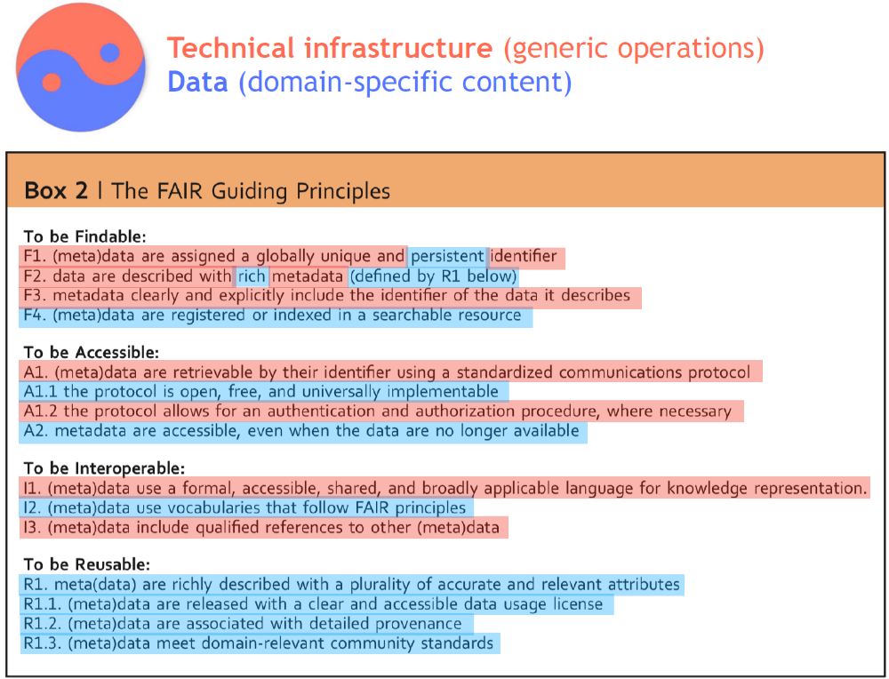
The FAIR principles
FAIR requires collaboration:
infrastructure providers
(IT, libraries, publishers, etc.)
stakeholder community members
(researchers, core facility specialists, research support staff)
Schultes E, 2020, GO FAIR conversion matrix – slides, https://osf.io/ceyvj/, (CC-BY 4.0: http://creativecommons.org/licenses/by/4.0)
Notes:
Institutional members: who will vote??

Slide 35
Research Data Ecosystems emerging
How to promote sharing and reuse?
      Guiding principles for data (FAIR)
In practice?
Data ecosystem at the European level (→ EOSC)
Data ecosystem at the German level (→ NFDI)
Germany
Nationale Forschungsdateninfrastruktur (NFDI)
2002
2006
2008
2012
2016
2018
2020
2022
„FAIR“
OECD:
Open Access
European Council:
European Open Science Cloud (EOSC)
Europe (& beyond)
Notes:
Institutional members: who will vote??

Slide 36

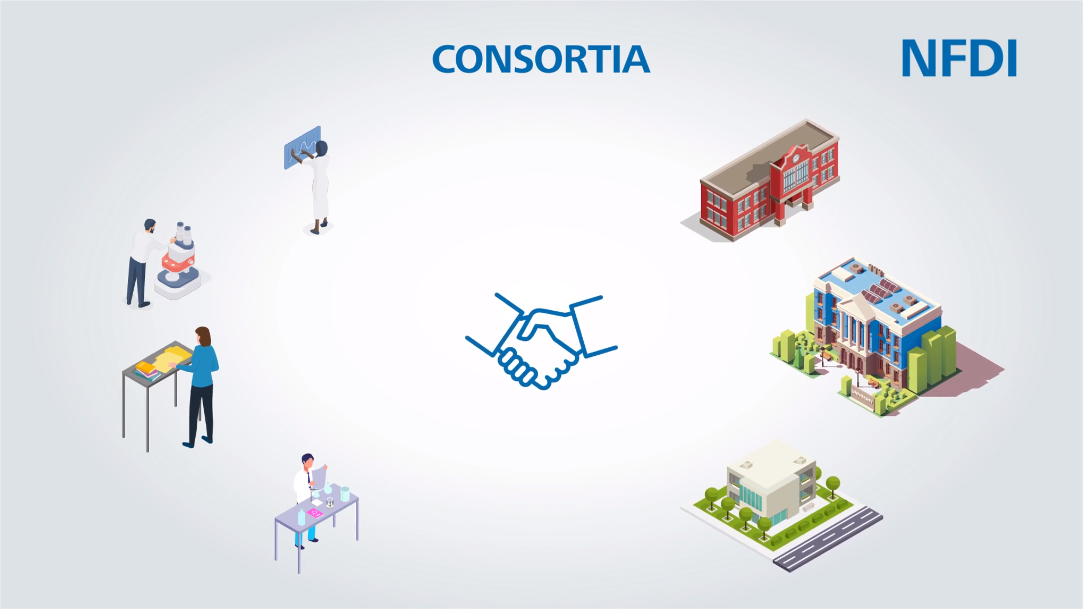
Nationale Forschungsdateninfrastruktur
“The aim (…) is to systematically manage scientific and research data, provide long-term data storage, backup and accessibility, and network the data both nationally and internationally.”
Science-driven (bottom-up)
“Invest into people, not into metal”
3 calls for application
(2019 – 2021)
→ 26 consortia
& 1 cross-consortia project
Network of
collaborating
CONSORTIA
(scientific discipline or method)
+ Consortia Assembly
+ NFDI Directorate
+ Scientific Senate
Adapted from: https://www.dfg.de/foerderung/programme/nfdi/informationsmaterialien/index.html, copyright: Deutsche Forschungsgemeinschaft
Notes:
Institutional members: who will vote??

Slide 37

The NFDI4BIOIMAGE network
co-applicant institutions (Task Area Leaders)
IT
IT infrastructure (storage & playground: @WWU & @ALU-FR)
But not: a central data archive for all bioimaging data
participating institutions
IT
data stewards (DaSts) & research software engineers
2
2
community use cases
~ 20 FTE: work on practical RDM solutions & training
Help Desk
Collaborate
  with other NFDI consortia
  with industry (via Quarep-LiMi, GerBI & others)
  internationally
2
IT
Notes:
Institutional members: who will vote??

Slide 38
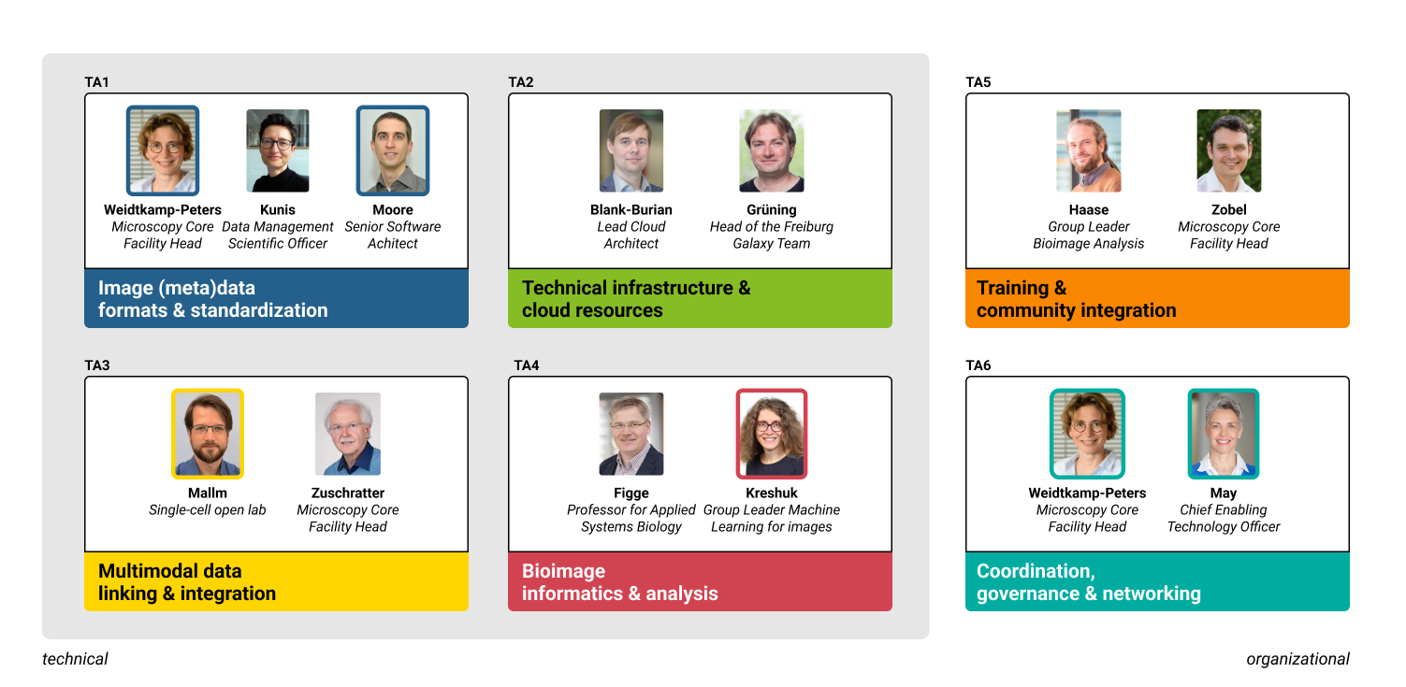
Task Areas: Goals
TA1
TA2
TA5
FAIR Digital Objects for Bioimaging
Cloud-ready, open file formats
Metadata standards & tools
(Community) Software & Infrastructure as a Service
Virtual Desktop Infrastructure
Workflows and pipelines in the cloud
Training & Community Engagement
Data Stewardship and HelpDesk (operational level)
TA3
TA4
TA6
Sample tracking and identification
Integrative file structure for multimodal data
Multimodal graph database
Increase reproducibility of bioimage analysis
Better interoperability & scaling of popular analysis tools
Better community access to state-of-the-art tools
Communication channels, outreach, Administration, governance
Networking
Data Stewardship and HelpDesk
(administrative level)
Notes:
Institutional members: who will vote??

Slide 39
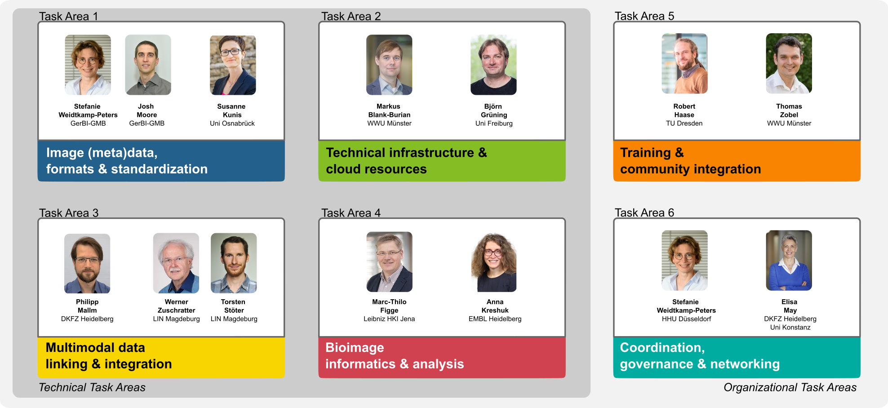

NFDI4BIOIMAGE Task Areas
Notes:
Institutional members: who will vote??

Slide 40
The main objectives in a nutshell
Notes:
Institutional members: who will vote??

Slide 41
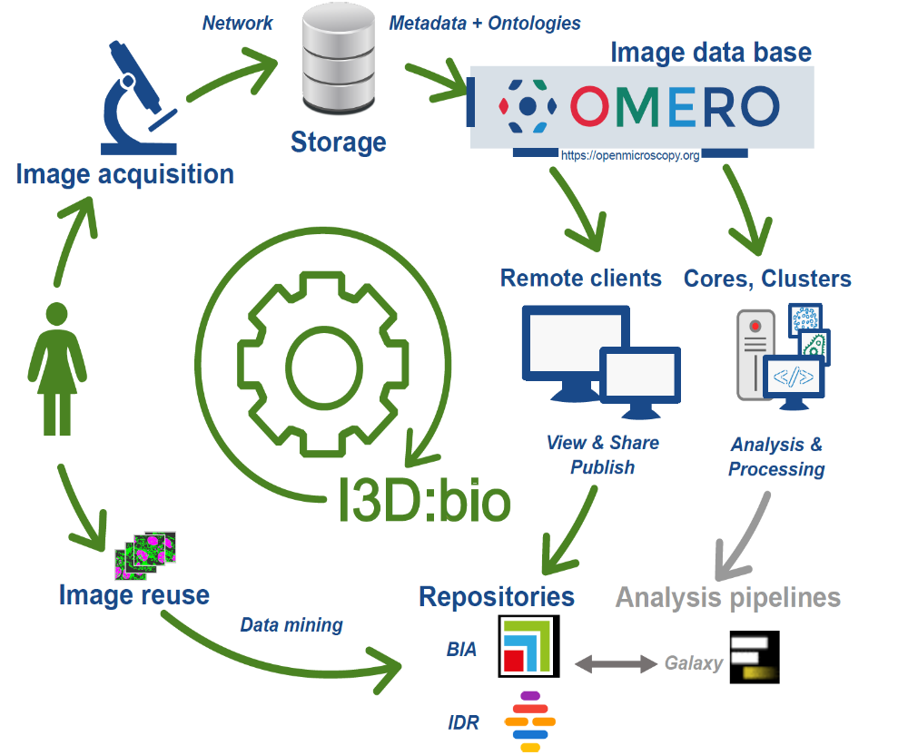



Smaller-scale initiative: I3D:bio
WG6 of GerBI-GMB (Image Analysis) started focussing on RDM
OMERO user group (with OME-team members)
RDM4mic group
Exchange about common needs
Limited or no capacity to work on solutions
Information Infrastructure for BioImage Data (I3D:bio) (DFG LIS programme)
Focus on
  OMERO & metadata
Capacitate the RDM4mic group
2022-2024; 3.5 FTE; HHU, ALU-FR, DKFZ, UOS
Notes:
Institutional members: who will vote??

Slide 42


Why OMERO and Metadata?
OMERO = most widely used & best known RDM system
Metadata guidelines and tools are requested
Schmidt C, Hanne J, Moore J et al. Research data management for bioimaging: the 2021 NFDI4BIOIMAGE community survey [version 2; peer review: 2 approved]. F1000Research 2022, 11:638 (https://doi.org/10.12688/f1000research.121714.2)
CC-BY 4.0 (http://creativecommons.org/licenses/by/4.0)
Notes:
Institutional members: who will vote??

Slide 43


The importance of metadata
Poster presentation by Susanne Kunis, Uni Osnabrück
Nature 609, 222 (2022) https://doi.org/10.1038/d41586-022-02820-7
https://gerbi-gmb.de/i3dbio/i3dbio-resources/metadata-guide/
Notes:
Institutional members: who will vote??

Slide 44



Useful links and resources
https://www.i3dbio.de (under development)
Knowledge base
HelpDesk
Tangibles
https://nfdi4bioimage.de (preliminary, under development)
Project overview, general information
NFDI4BIOIMAGE newsletter (soon moving to NFDI listservers)
To be developed into a single point of entry for bioimaging RDM matters
https://nfdi.de
Overview of the NFDI as a whole
Links to events and job opportunities
Information on sections and cross-cutting topics
Notes:
Institutional members: who will vote??

Slide 45





Getting started with Bioimaging RDM
https://rdmkit.elixir-europe.org/ (with contributions from GerBI et al.)
Overview and links to repositories, ontologies, etc.
https://openmicroscopy.org
Developers of OMERO, Bio-Formats, and other tools
Installation guidelines, client downloads, and more
Community events and talks
https://www.nature.com/collections/djiciihhjh
https://f1000research.com/articles/11-638
- Results of the NFDI4BIOIMAGE community survey 2021
Notes:
Institutional members: who will vote??

Slide 46

Contact
Christian Schmidt
German Cancer Research Center,
Heidelberg
Project Coordinator NFDI4BIOIMAGE
https://nfdi4bioimage.de
nfdi4bioimage@uni-konstanz.de
Project Office I3D:bio (WP 3)
https://www.i3dbio.de
christian01.schmidt@dkfz-heidelberg.de
+49 6221 42 2657
Elisa May
German Cancer Research Center, Heidelberg
Co-spokesperson NFDI4BIOIMAGE (TA 6)
Co-applicant I3D:bio (WP 3)
Elisa.May@dkfz.de
Stefanie Weidtkamp-Peters
Heinrich Heine University Düsseldorf
Spokesperson NFDI4BIOIMAGE (TA 1, TA 6)
Co-applicant I3D:bio (WP 1)
Stefanie.Weidtkamp-Peters@hhu.de
Special thanks to
German BioImaging,
the I3D:bio team,
the NFDI4BIOIMAGE members,
and the RDM4mic group
Funded by the Deutsche Forschungsgemeinschaft (DFG, German Research Foundation) - 462231789
Notes:
Institutional members: who will vote??

Slide 47


The value of #imaging data multiplies when we work together as a community, and the base for this: research data management #RDM. We are proud to be part of #NFDI4BIOIMAGE hoping to shape this future. Image credit: @DrHenningFalk
https://twitter.com/GerBI_GMB/status/1491039495524732928?s=20&t=7L7Xlu6eqULgS4VEQRM5kQ
Notes:
Institutional members: who will vote??

Slide 48


Acknowledgments
CAi team Düsseldorf
Sebastian Hänsch
Miriam Bäumers
Tom Boissonnet
Anna Hamacher
Jessica Hausmann
Steffen Köhler
Sarah Loeck
CRC 1208 teams
Yvonne Stahl & team
(our local early adopters)
I3D:bio – NFDI4bioimage - GerBI
Collaborators
Elisa May
Roland Nitschke
Susanne Kunis
Karen Bernhardt
Josh Moore
Björn Grüning
Markus Blank-Burian
Jan-Philipp Mallm
Werner Zuschratter
Torsten Stöter
Anna Kreshuk
Marc-Thilo Figge
Carl-Magnus Svensson
Robert Haase
Thomas Zobel
& participating partners and community use cases
Jason Swedlow
OME team
Caterina Strambio De Castillia
4DNucleome
QUAREP-LiMi
BioImaging North America
Euro-BioImaging ERIC
Global BioImaging
EMBL-EBI - BIA
CRC 1208
https://nfdi4bioimage.de
Twitter: @nfdi4bioimage
www.gerbi-gmb.de
Twitter: @GerBI_GMB
https://www.i3dbio.de
Notes:
Institutional members: who will vote??

