Slide 1



Building a Large-Scale Community Data Portal with Commodity Hardware
https://klacansky.com/open-scivis-datasets
https://github.com/sci-visus/open-scivis-datasets
Notes:
I am excited to be part of this meeting to learn about new approaches to data management.
This data portal is labor of love. It started at a hackathon while interning in Lawrence Livermore National Laboratory.
I am grateful for NSDF and SCI that provide the network and hardware to host the datasets.

Slide 2
Motivation
Why do we need public datasets repository?

Slide 3
Visualization and Data Analysis Research is Largely Driven by Available Datasets
Input (dataset)
Algorithm
Output (picture)
Unavailable
Somewhat available
Available
Notes:
Data analysis or often research in visualization or data analysis algorithms starts with a motivating problem and datasets.
A new technique is developed or existing techniques are combined in novel ways to analyze a dataset.
The output ranges from a picture for volume rendering algorithms to per feature statistics from topological data analysis techniques.

Slide 4
Benefits of Public (Contemporary) Datasets
Level playing field by making large and interesting datasets available
Benchmark techniques against state-of-the-art datasets
Compare algorithms across publications
Reproduce published results
“I couldn’t have made it without your website. Thank you. It is a valuable resource and would like to help and contribute.” TAJO
“Thanks for sharing the volumetric datasets… It is an excellent resource.” Andreas
Notes:
The benefits are multifold…
I work on this repository out of principle, and it is heart warming to hear from people that used the website how it helped when working on new algorithms.

Slide 5
Open Scivis Datasets Repository
Overview of the repository and demo.

Slide 6
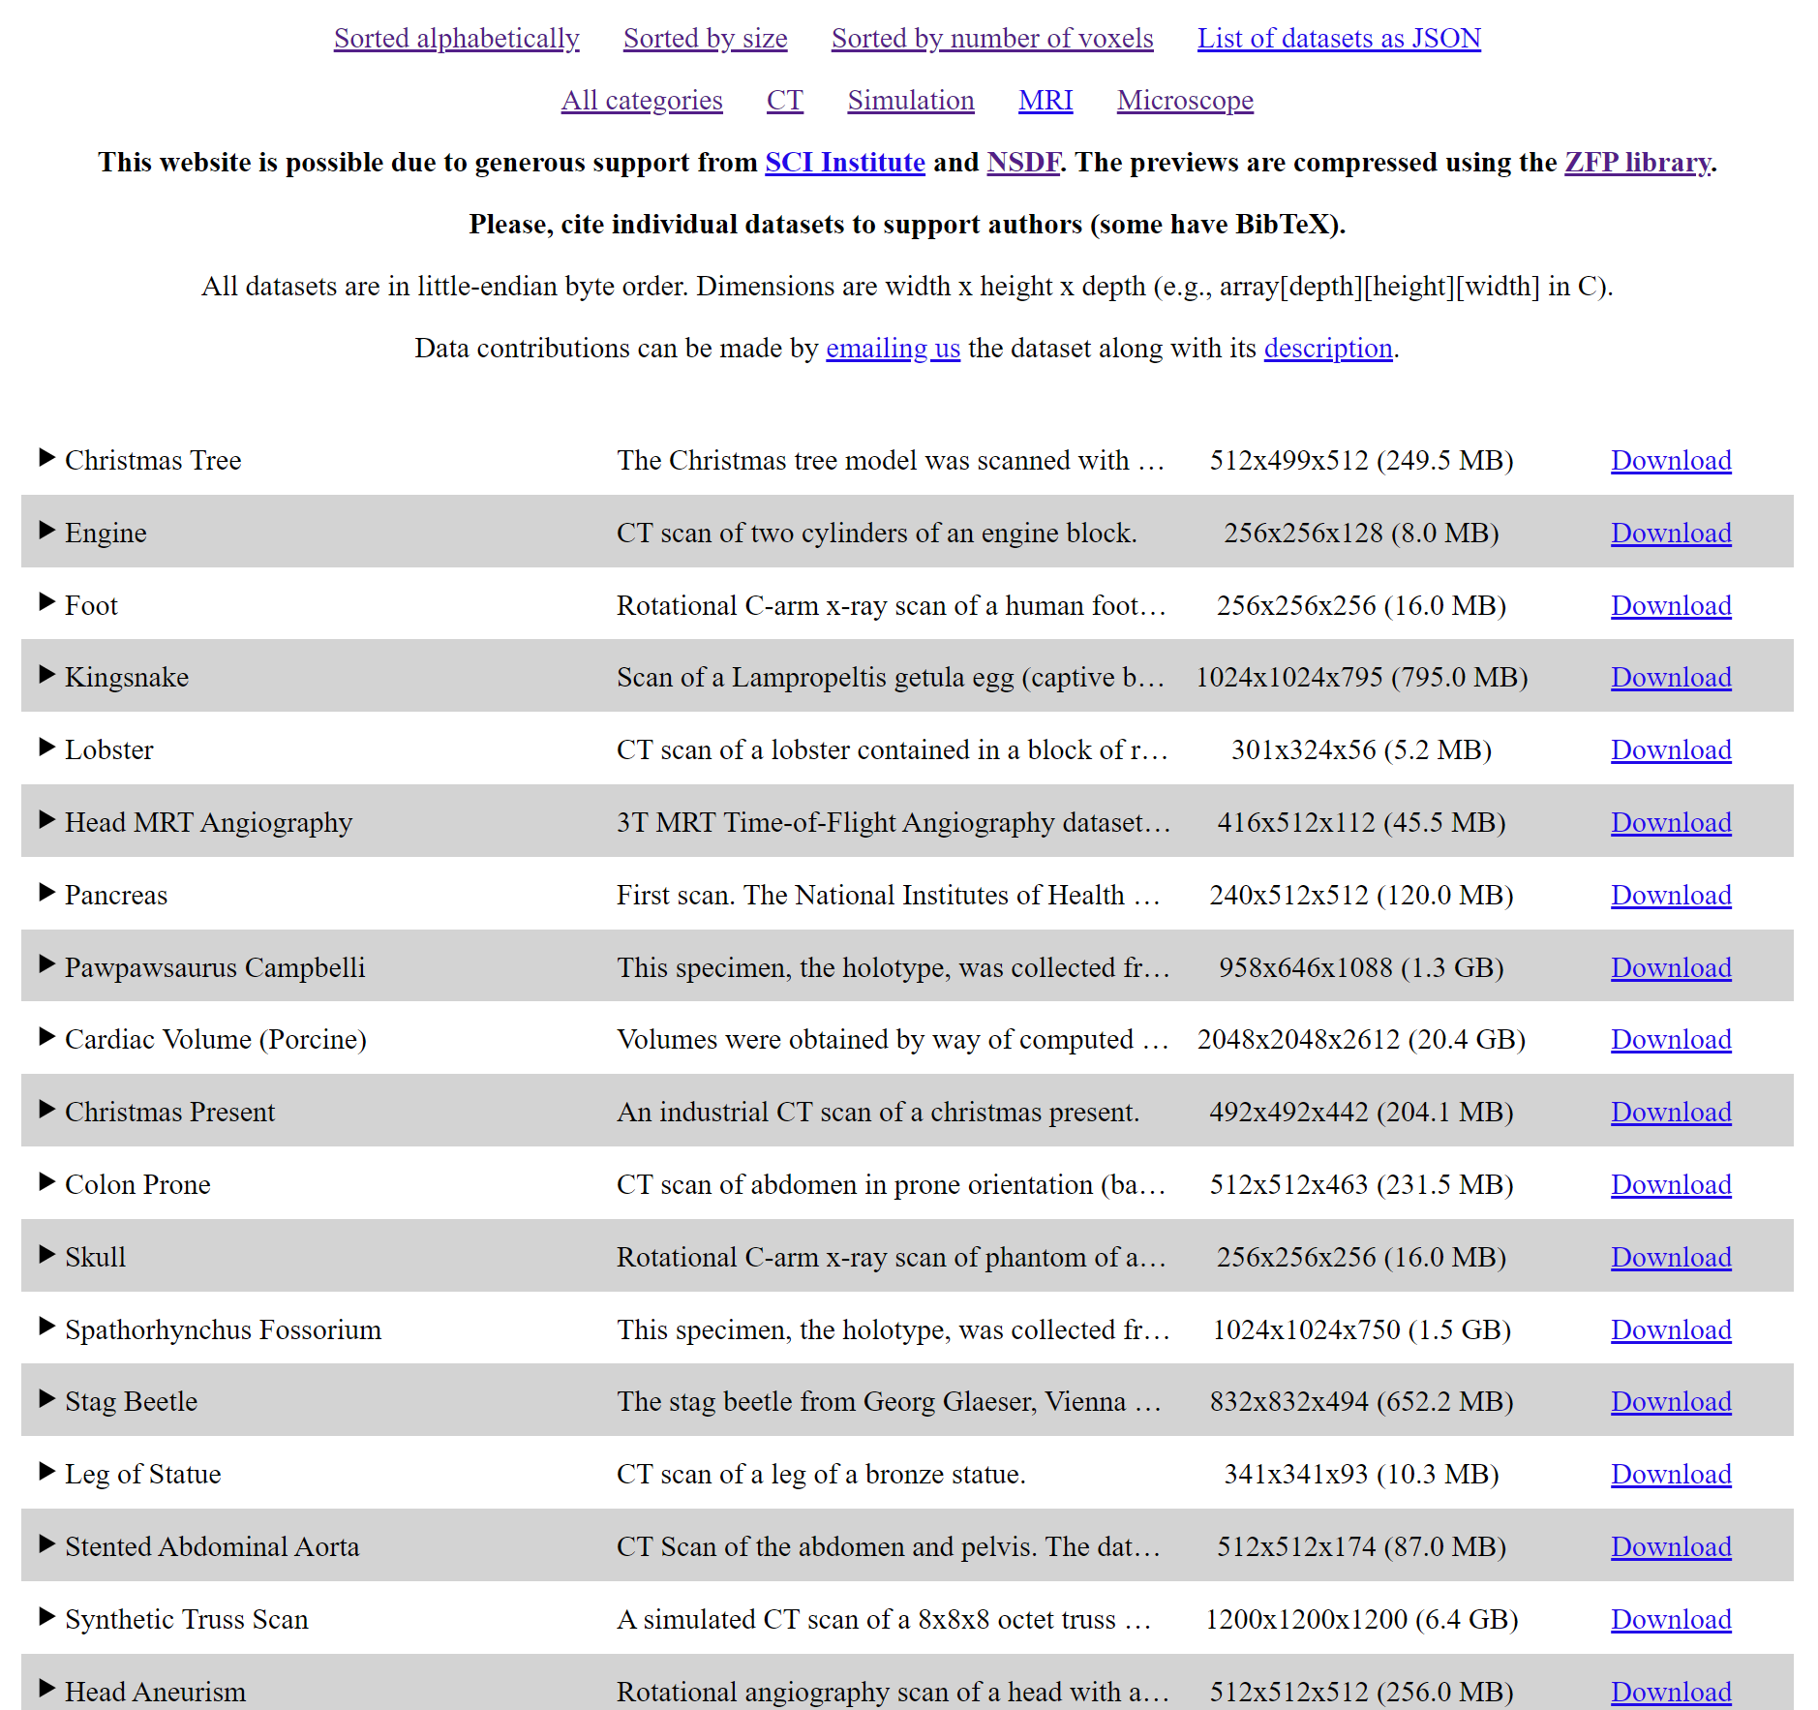
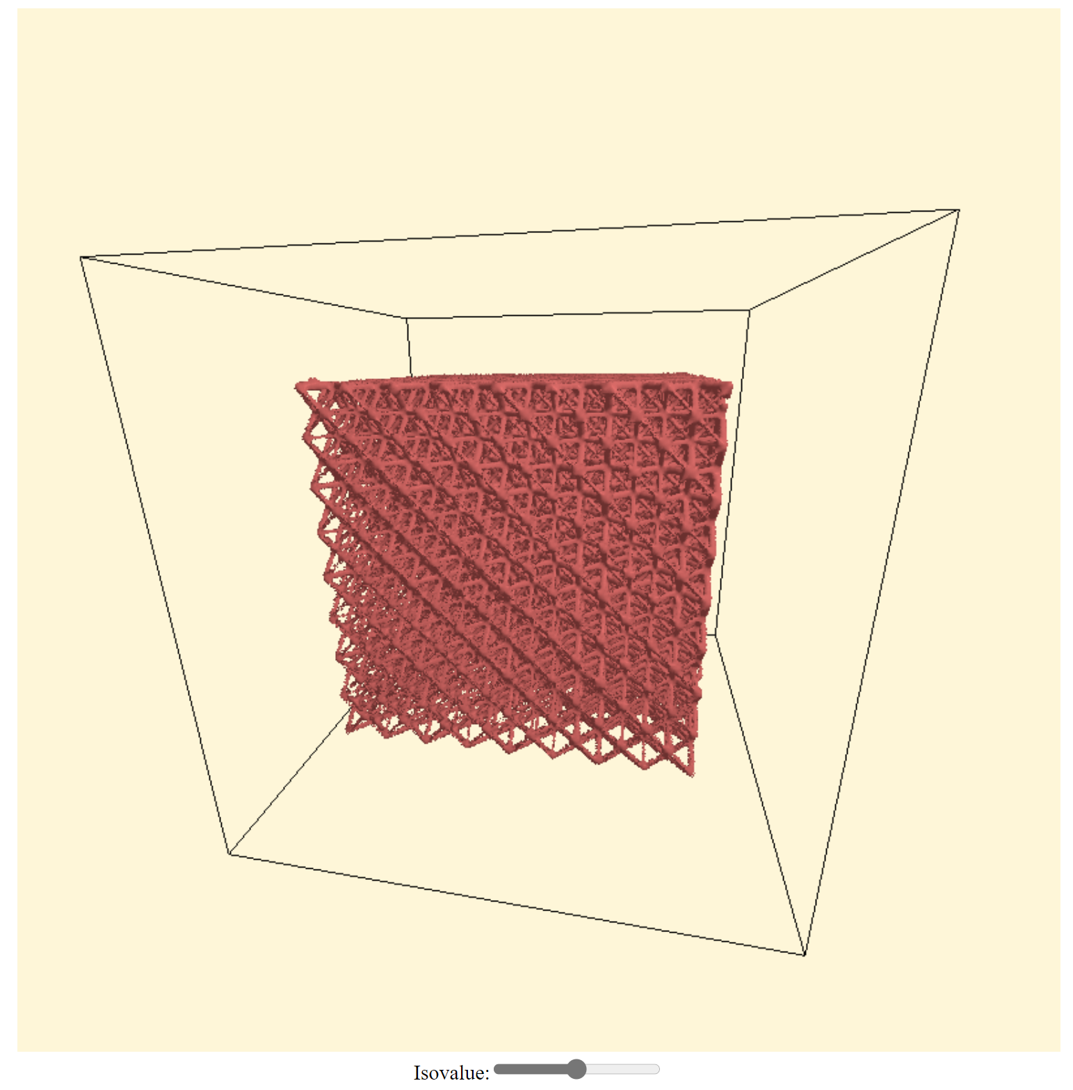
Curated Repository Provides Research Community with Variety of Volumetric Datasets
Notes:
TODO: change preview to Truss

Slide 7
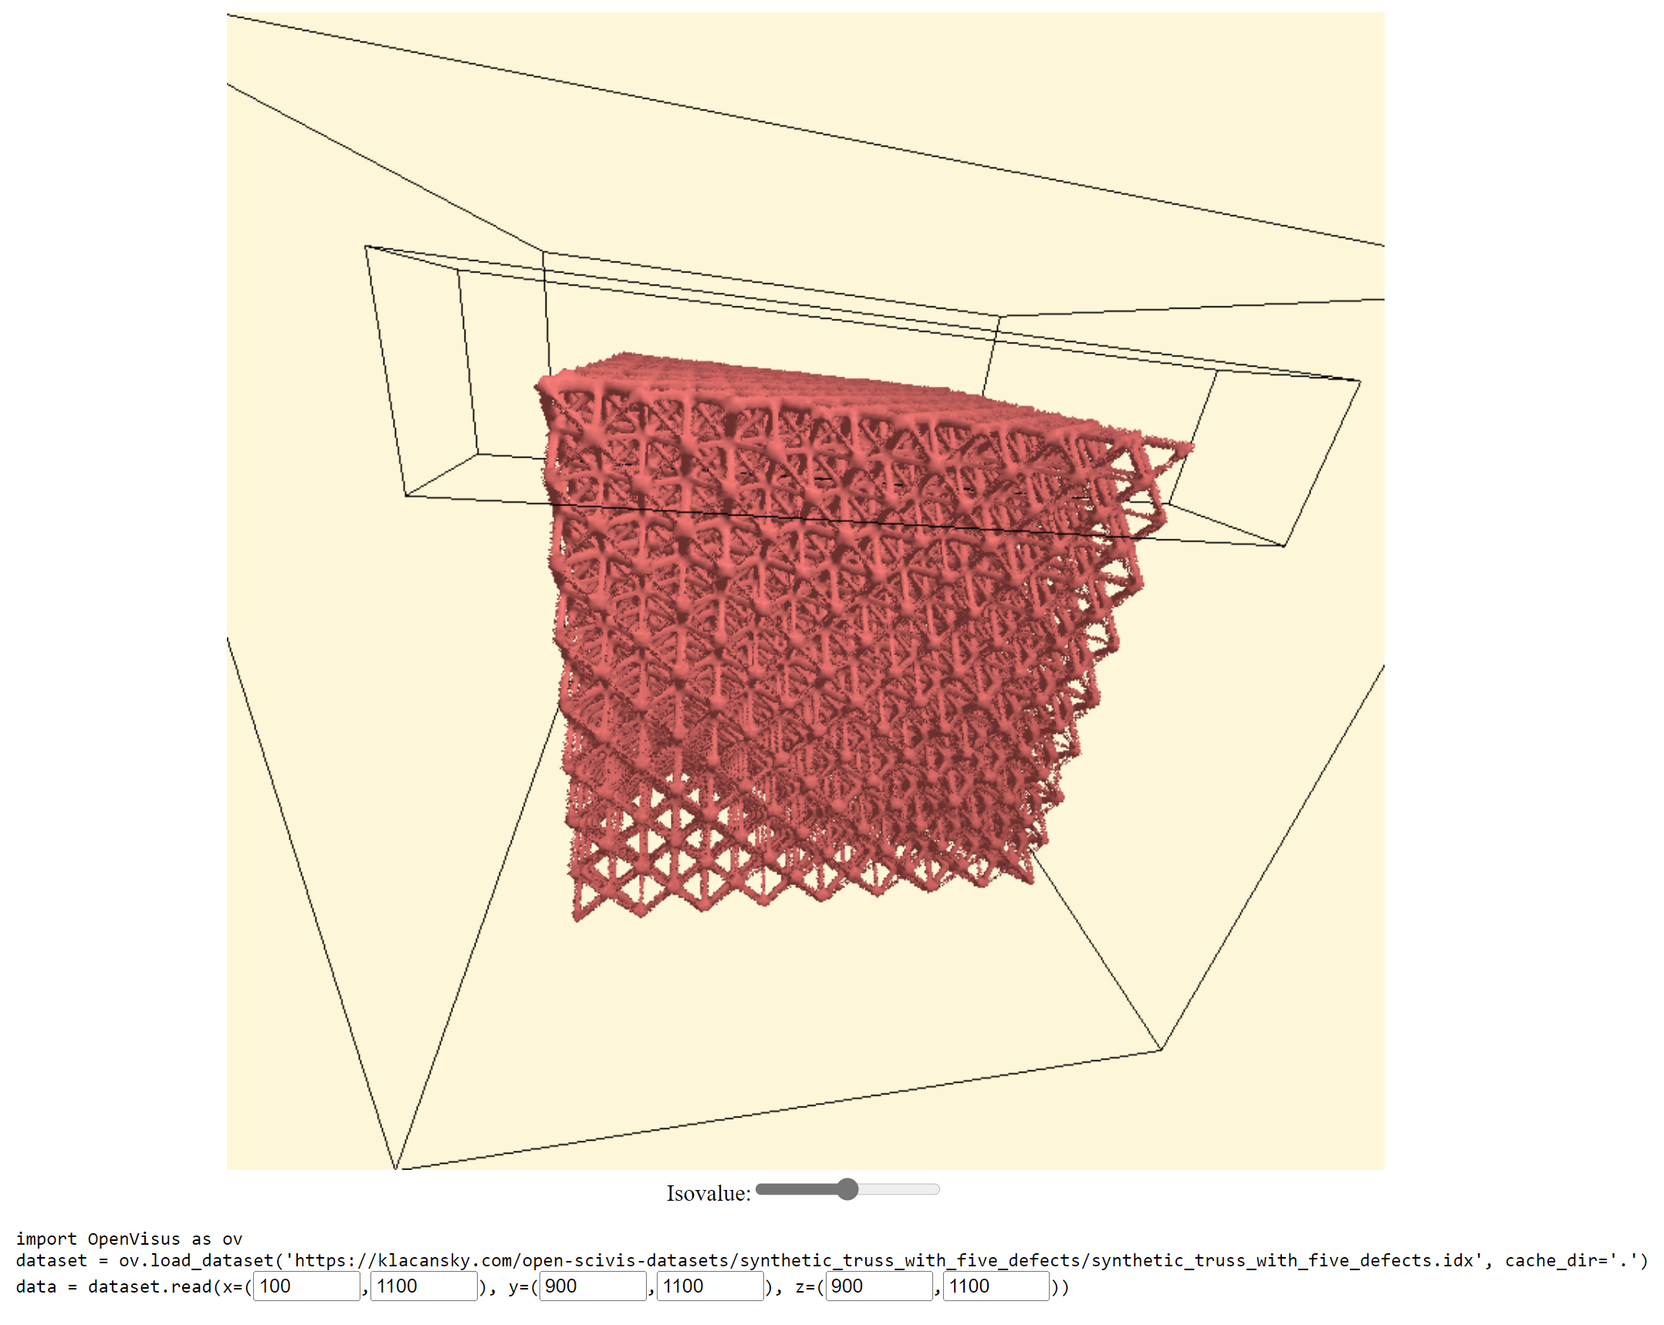
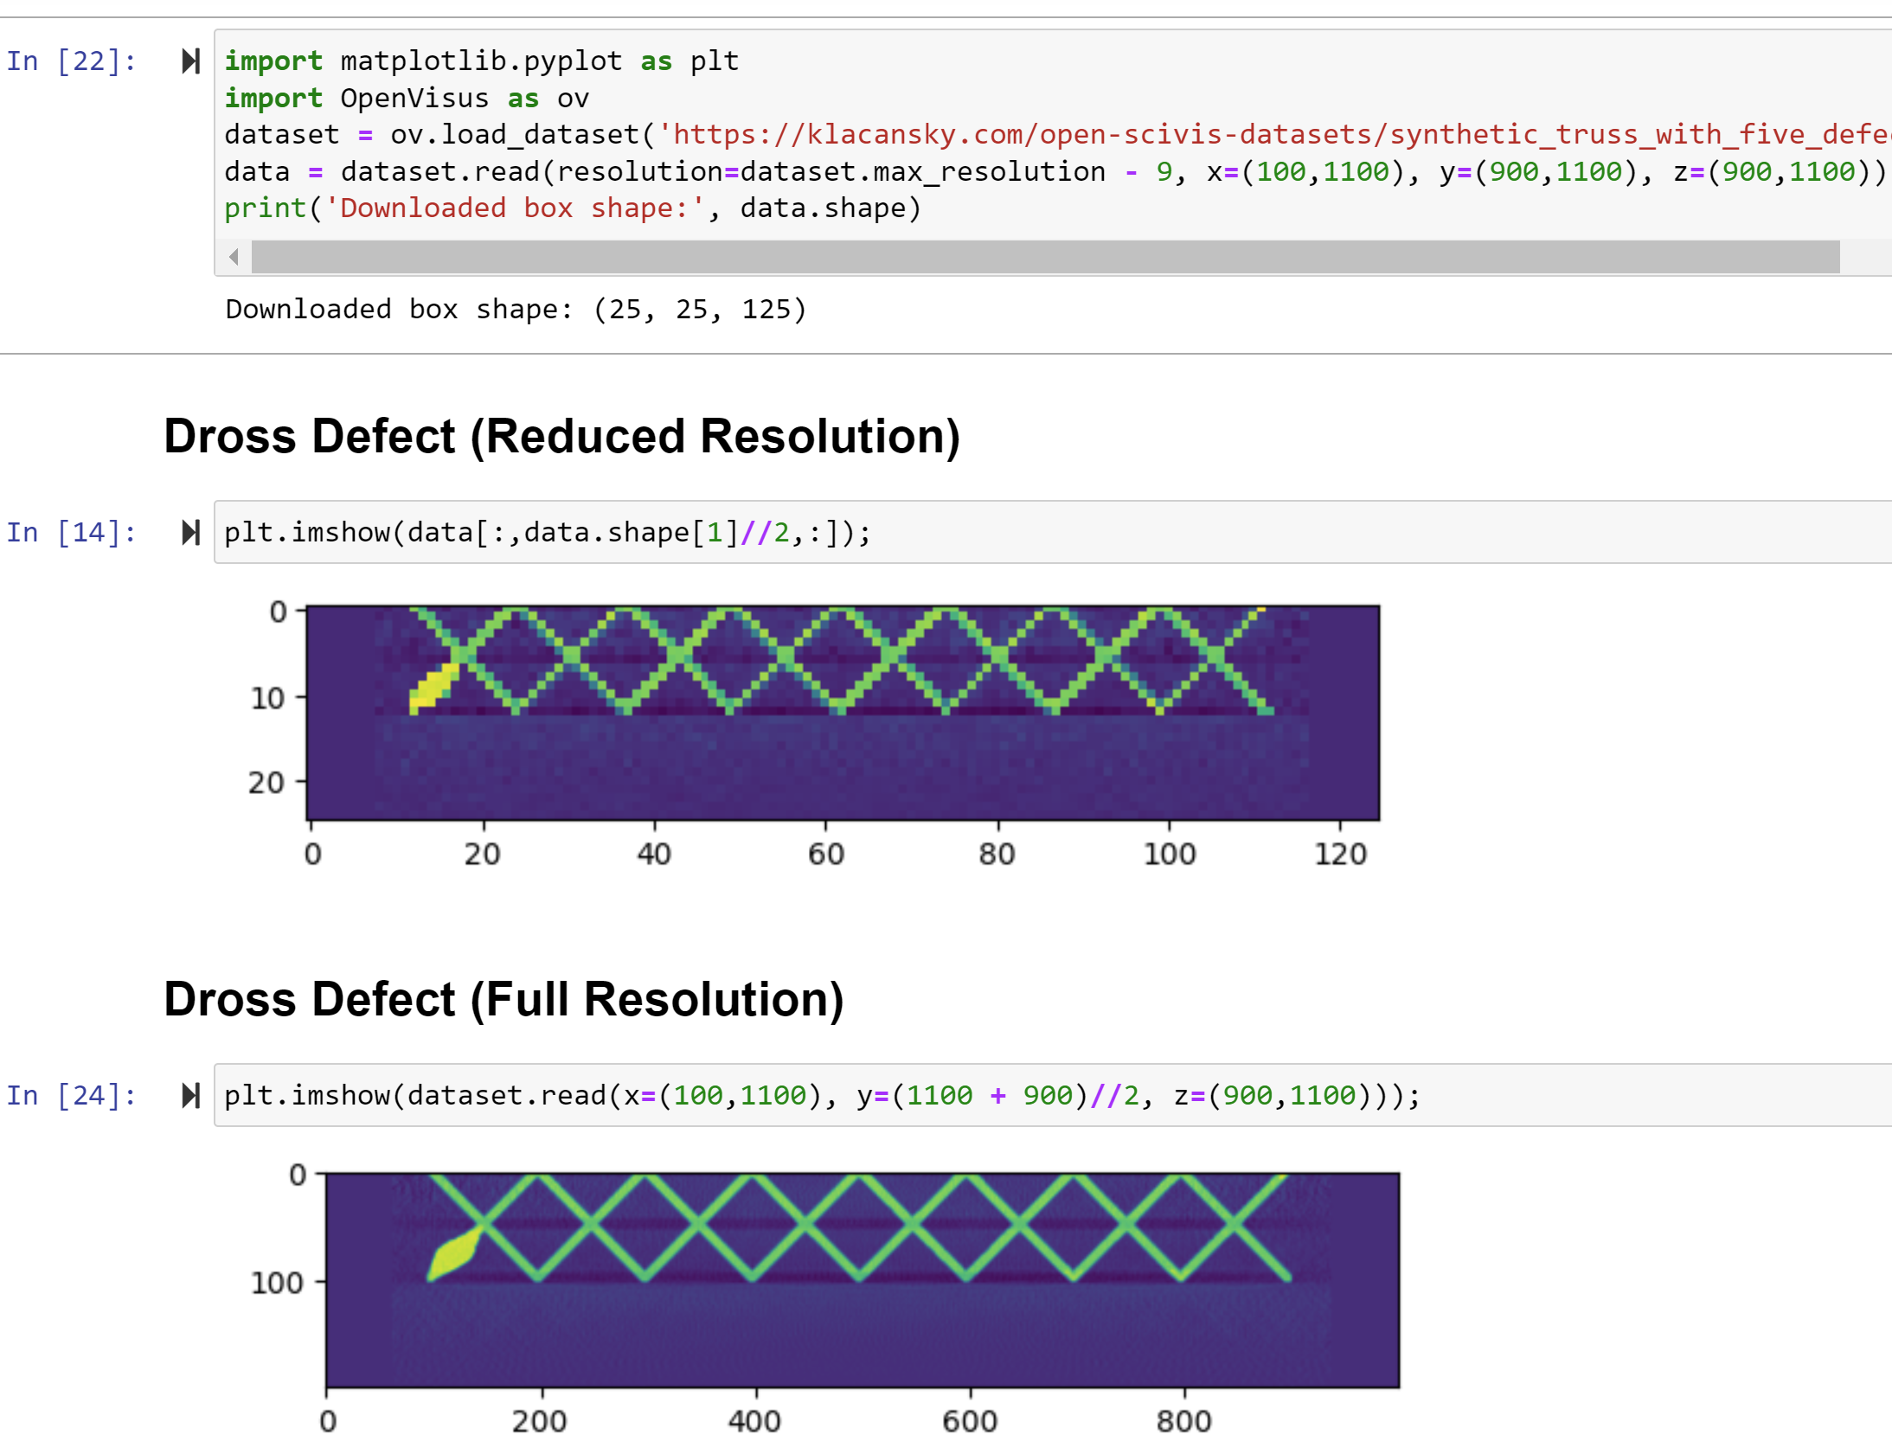
Fast Remote Dataset Access May Change How We Work with Data
Notes:
TODO: change preview to truss

Slide 8
Demo
Navigate website
Show a preview of the truss dataset
Determine region of interest
Query dataset in a notebook
Visualize defects in the notebook

Slide 9
Design and Infrastructure
Process of creating the repository. Simplicity, time commitment, and cost.

Slide 10
Bottom-up Design by Observations/Feedback
Publication used most of the datasets
  Provide machine readable metadata file
Publication used previews in figures
  Working on adding isovalue, resolution, and precision text to preview
  Thinking how to improve quality
Publications do not cite individual datasets at times
  Plan to list publications citing a dataset (win-win)
Slower internet connections in developing countries
  Compress previews

Slide 11
Examples of Design Choices
Simple (short term)
Simple (long term)
Dynamic content
Apache, Python server
2D image previews
Server box queries
VTK.js rendering
Static content
Go server
3D volume previews
Client box queries
Custom rendering
Move code to the client.
Notes:
Saying no is essential.

Slide 12
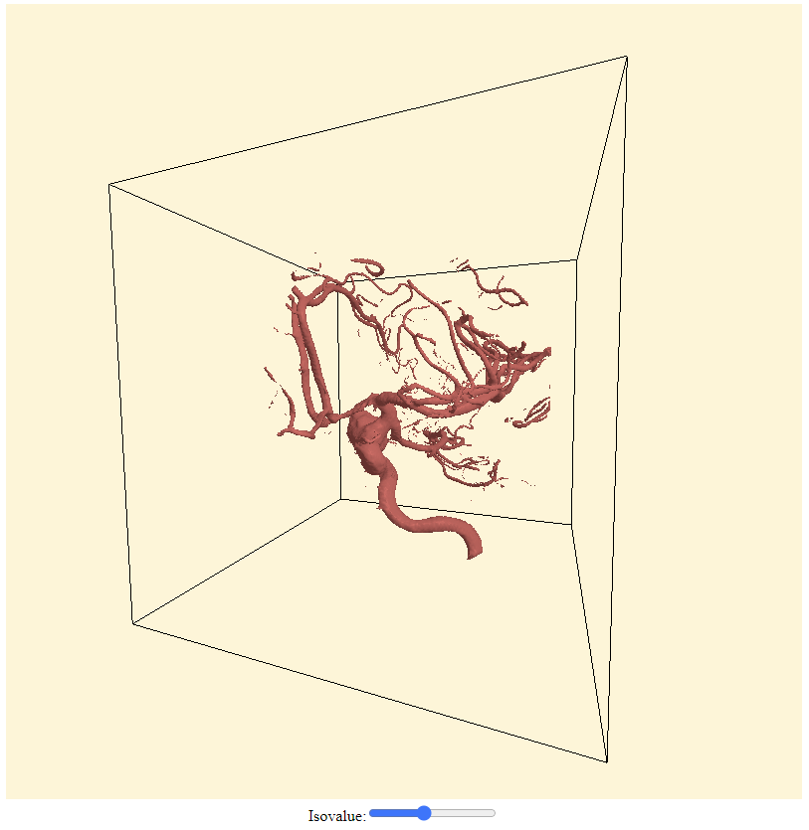
Case Study: Precomputed Previews are Simple and Robust
Computing previews on demand on server is not robust
Precomputed previews:
  Simple deployment (only file server)
  Predictable performance
  Predictable memory usage
Notes:
Previews can use too much memory and crash, they can hog down the server. The code computing previews can crash due to bugs (as we have seen). We need to run more complicated server.

Slide 13
Raw File Format and Checksums for Data Integrity
Raw format: aneurism_256x256x256_uint8.raw
Easy to read in any programming language
Directory per dataset to enforce unique identifiers
SHA 512 checksum per dataset (the real identifier)
Identifier
Width, height, and depth
Data type

Slide 14
We Commit to Maintain Links Indefinitely
People refer online to raw files using the links
Solution:
  All links go through fixed domain
  Server redirects requests to backing server
Test checking links
Notes:
Go server instead of using third-party provider.

Slide 15
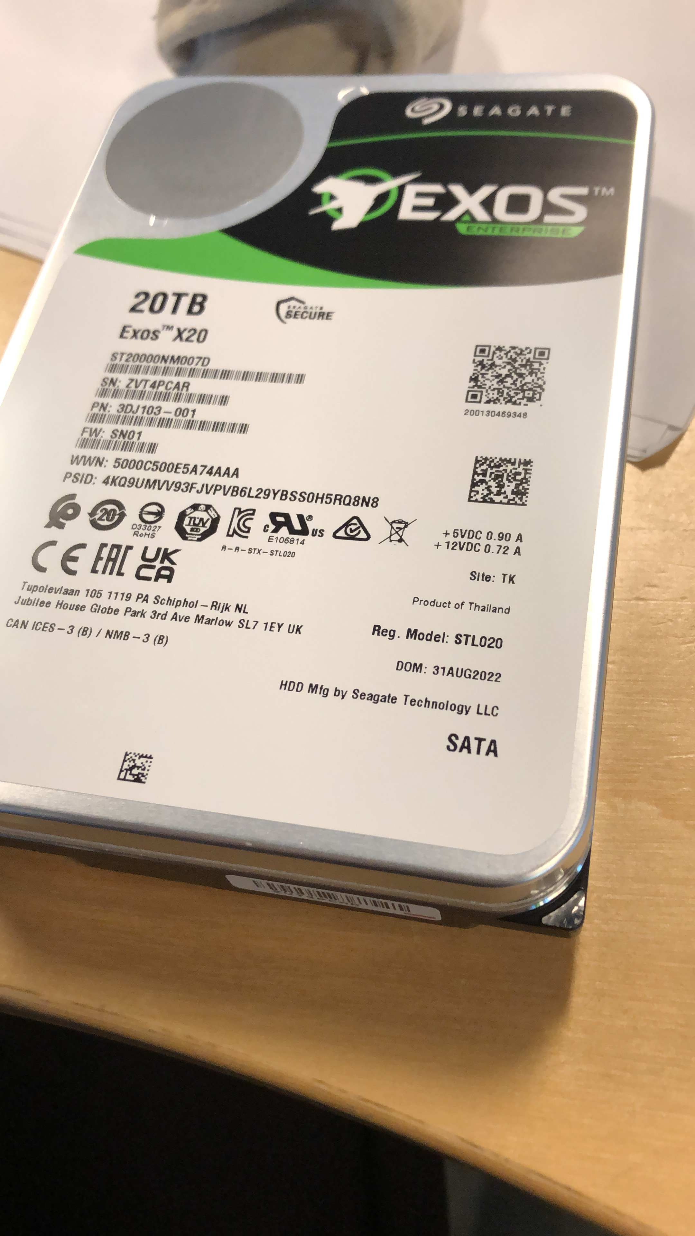
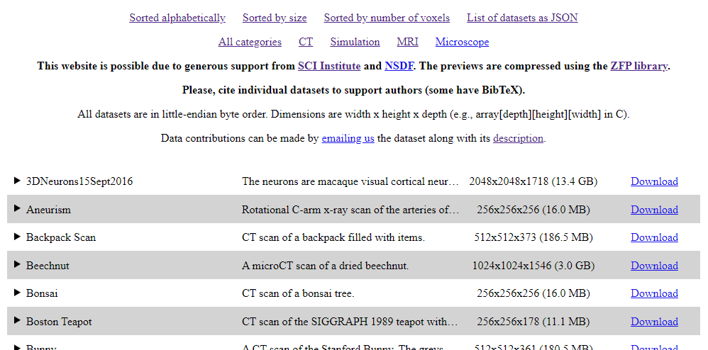
Repository on AWS Server and File Server
SCI file server (desktop in Valerio’s office)
AWS instance for fixed domain.
Downnotifier on both servers
Notes:
Hosting large amount of data is expensive in cloud, and SCI generously hosted data for us.
However, we want to keep control over the links (in case we move the data).
Little more complex than having everything on one server. We chose to optimize for the cost here.

Slide 16
Future Improvement to the Repository
Unique global identifier per dataset
  Need to be short to be cited (maybe first N characters of SHA 512?)
Incentive needed for researchers to cite individual datasets
  Manually add papers citing each dataset to the website
  Form for researchers to submit paper and cited datasets
Mixed resolution-precision data access
Multifield and time varying data

Slide 17
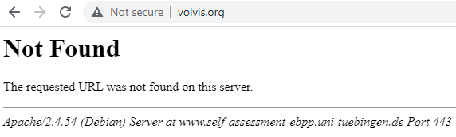
By Simplicity We Hope to Avoid Death
Actively working on reducing complexity of deployment
Ideally multiple repositories running
https://github.com/sci-visus/open-scivis-datasets
When does Open Scivis Datasets die?

Slide 18
Acknowledgements
People who provided datasets
LLNL for hackathons
SCI for hosting the data
NSDF for storage
Zfp and OpenVisus libraries

