Slide 1
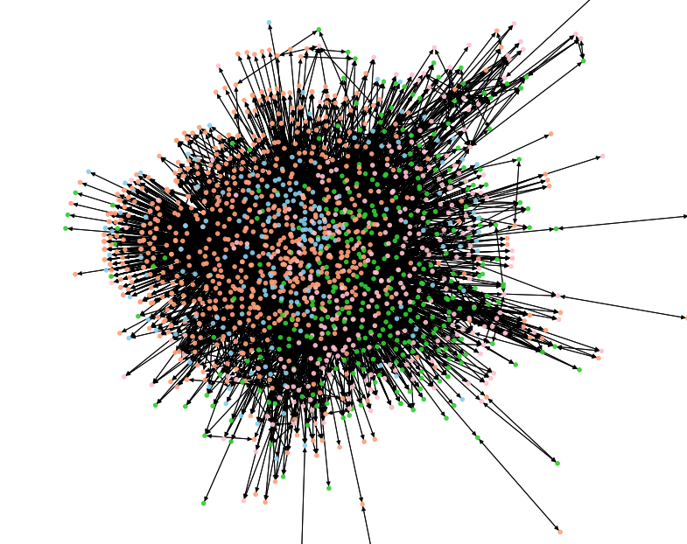

Data and Knowledge in
Material Science
Vineeth Venugopal, Elsa Olivetti
Vineeth Venugopal
05/11/2023

Slide 2
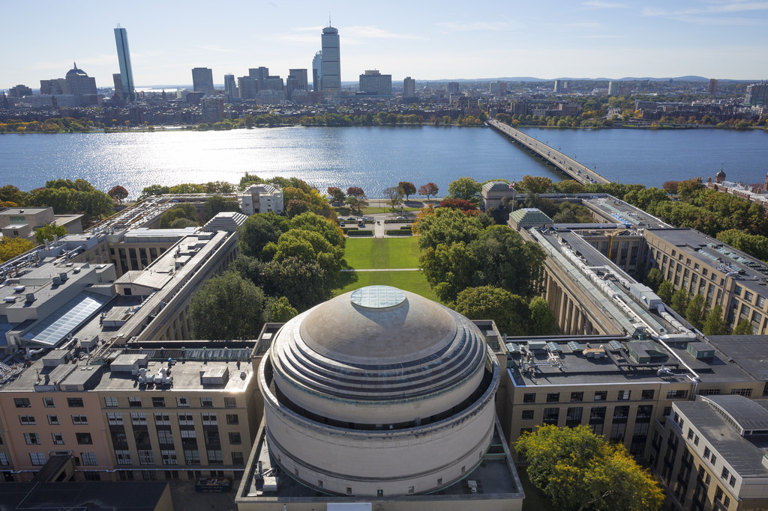

Elsa A. Olivetti
Esther and Harold E. Edgerton Associate Professor in Materials Science and Engineering

Slide 3
MatKG
Triples: 6,517, 505
Nodes: 112,419
Avg Degree: 103.25
Weighted Degree: 7672.46
Type of Entity | Number of Entities
Property | 37,344
Material | 26,814
Characterization Method | 16,671
Applications | 11,772
Synthesis Method | 11,161
Descriptor | 6001
Symmetry Phase Label | 2284
APL: skyblue, CMT: pink, DSC: yellow, PRO: limegreen, SMT: Orange, SPL: peachpuff, MAT: salmon

Slide 4
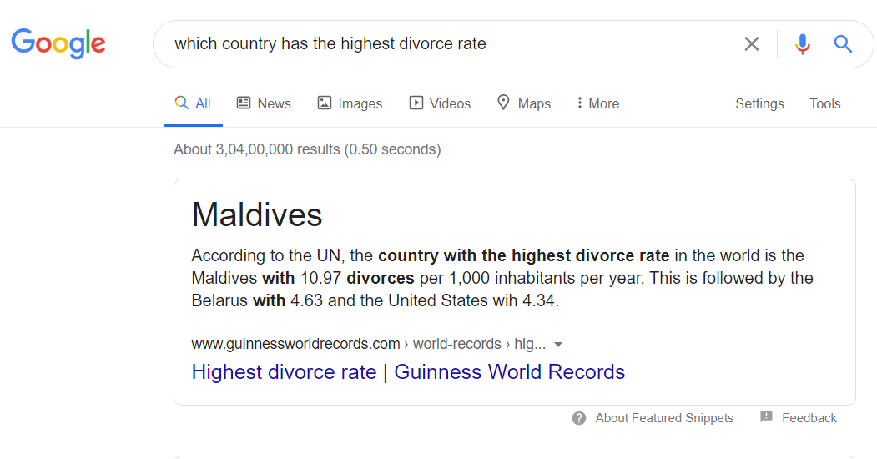
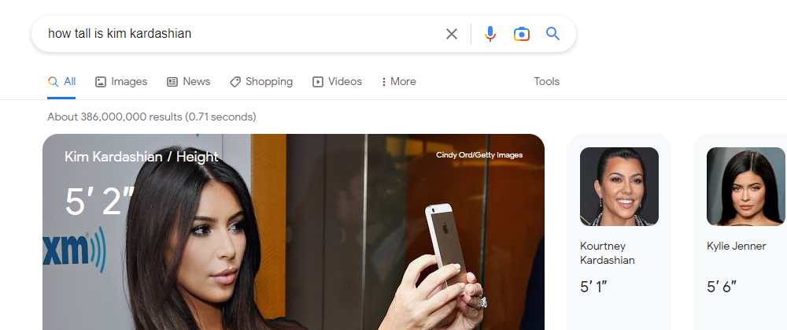
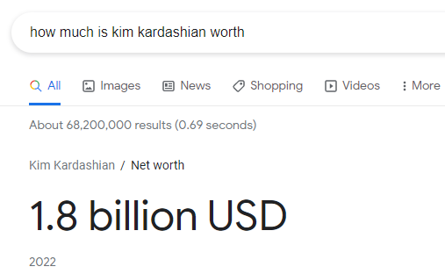

Slide 5
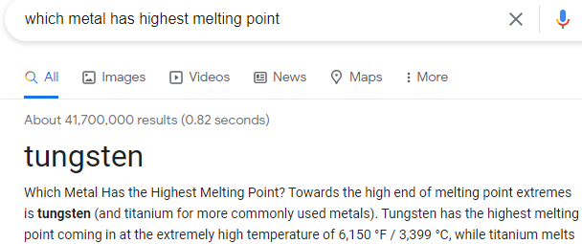
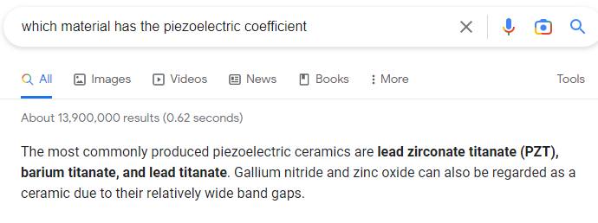
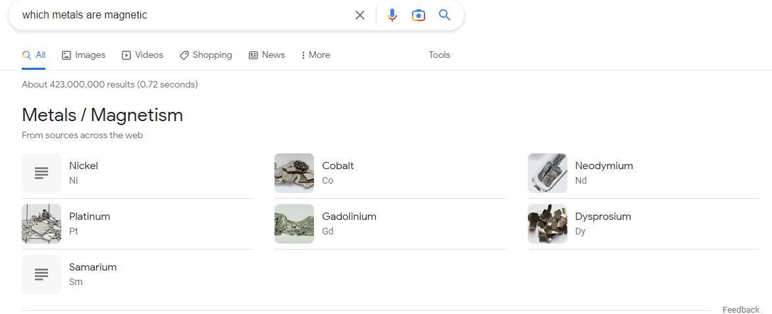
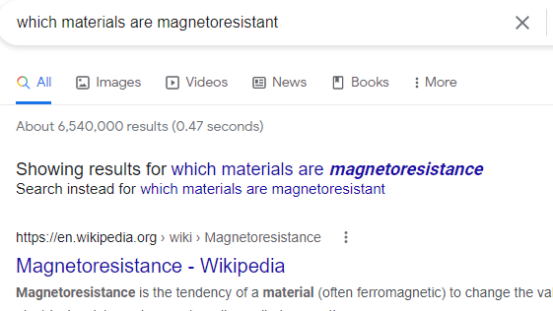

Slide 6
What would we like to know but can’t?
What is the most common synthesis method for oxide ferroelectrics?
What are the thermoelectric properties of a given material? Has it been studied?
What materials have been studied for magnetoresistance?
What are the common defects in a sintered PZT? (ceramic, thin film, screen printed)
  Has a high temperature AFM study been conducted on Material X?
Data in material science is very diverse – applications, chemical information, properties, numerical parameters, phase information etc.
No “one stop” database of experimental results

Slide 7
What is required to create a semantic search engine?
Data – Named Entity Recognition, Relationship Extraction
Database architecture – Tabular Databases, Knowledge Graphs

Slide 8

Data
Experimental results
Total number of scientific publications is around 100 million
Extract information according to a given ontology:
  Synthesis “recipes” – eg: solid state sintering, sol gel, hydrothermal
  Steps in the recipe - mixing, forming, drying, heating, annealing, cooling
  Parameters - temperature of heating, rpm of spin coater, time for cooling etc
Recipe
NLP
Steps
Parameters

Slide 9
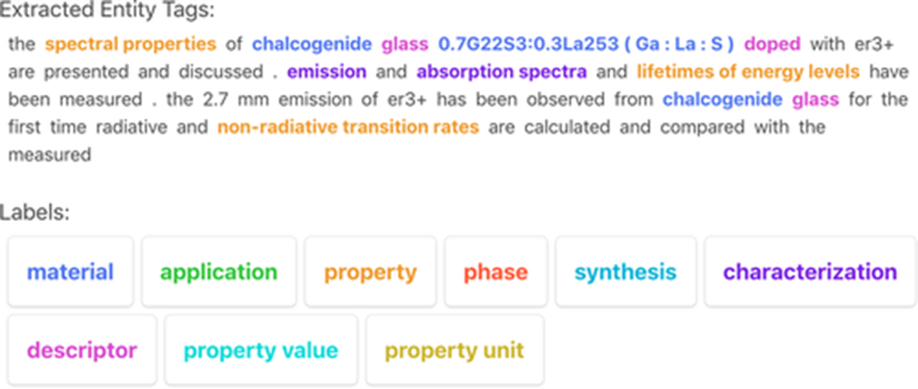
Named Entity Recognition
Identify quantities in a text according to a predetermined schema
<CHM> - material
<PRO> - property
<APL> - application
<CMT> - characterization method
<DSC> - descriptor
<SPL> - symmetry phase labels
<O> - other
(From Weston et al, American Chemical Society, 2019)

Slide 10
Extracting data is not enough, …

Slide 11
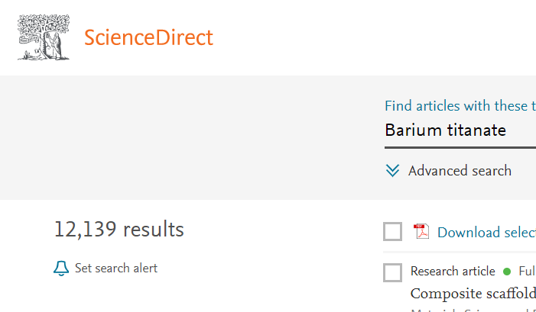
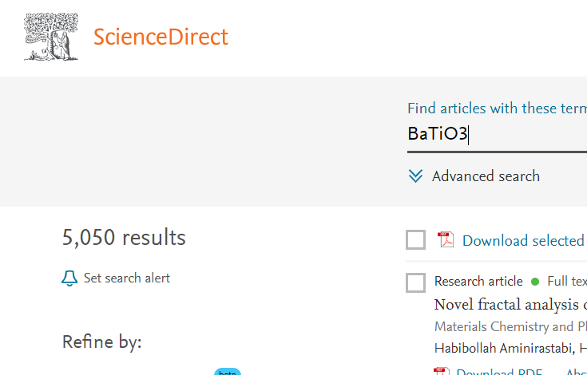
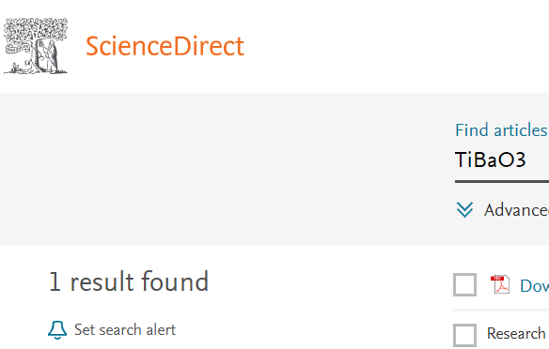
Entity Normalization

Slide 12
How is data stored?
Tabular Databases
Material | Property1 | Property2 | Application 1
Material 1 | Value 1 | Value 1 | Yes
Material 2 | Value 2 | Value 2 | No
Material 3 | Value 3 | Value 3 | Yes
Material 4 | Value 4 | Value 4 | No
Material 5 | Value 5 | Value 5 | No
Material 6 | Value 6 | Value 6 | No
Property | Application | Material
Property 1 | Application 1 | Material 1
Property 2 | Application 2 | Material 2
Property 3 | Application 3 | Material 3
Property 4 | Application 4 | Material 4
Property | Application | Material
Property 1 | Application 1 | Material 1
Property 2 | Application 2 | Material 2
Property 3 | Application 3 | Material 3
Property 4 | Application 4 | Material 4
Property | Application | Material
Property 1 | Application 1 | Material 1
Property 2 | Application 2 | Material 2
Property 3 | Application 3 | Material 3
Property 4 | Application 4 | Material 4
Given (Material), Find(Property)

Slide 13
Graph Database
M1
“has property”
A2
“is related to”
M2
P2
P3
“is subclass of”
P1
A1
M4
A4
M3
M5
A3
Highly scalable
Easier to featurize for ML

Slide 14
Relational versus Knowledge Graph databases
Relational Database | Knowledge Graph Database
Data stored as rows and columns | Data stored as nodes and links
Data is in rigid tabular schema | Relatively unstructured
Difficult to scale | Easy to scale
Slow performance | Fast performance
Difficult to maintain | Easier to maintain
Fairly homogenous data | Can store heterogenous fields
Not as easy | Easier to mine for insights
Not easy to represent hierarchies | Can capture hierarchical information
Position in table does not carry information | Local topology is easier to featurize

Slide 15
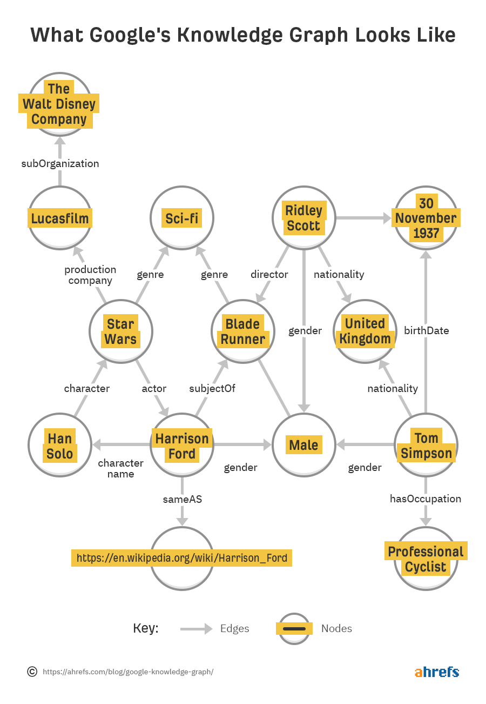
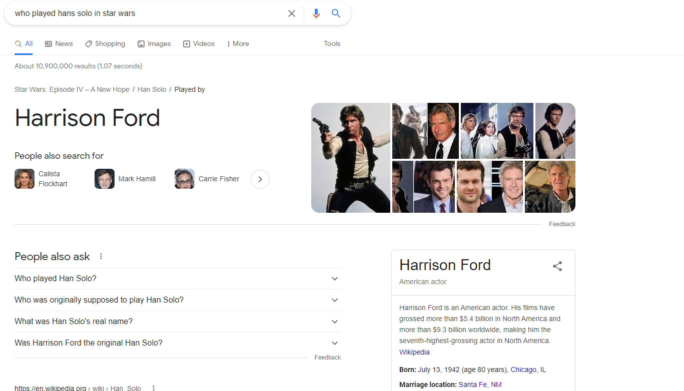

Slide 16
Existing Knowledge graphs
Knowledge Graph | Statements | Entities | Citation
Nanomine | ? | 337 | McCusker et al, 2020
Propnet | 69 x 115 | 115 | Mrdjenovich et al, 2020
MOF-KG | ? | 4 (types) | An et al, 2022
Yago | 120 million | 10 million | Suchanek et al, 2007
DBpedia | 1.3 Billion | 6 million | Lehmann et al, 2013
Existing KGs in material science are small
Capture sub-domain specific information
Customized ontology

Slide 17
How do we create knowledge Graph for Material Science?
Entities
Links/Relations

Slide 18
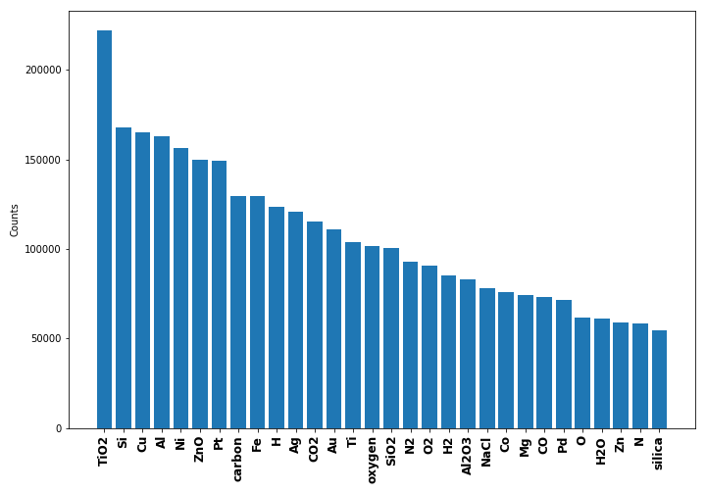
Extract Captions + Abstracts from Scientific Articles
Olivetti Scientific Database
5 Million Articles from Elsevier, Wiley, RSC, AIP, Springer on Material Science
Parse captions, abstracts
HTML, XML files were parses using identifier tags for image captions
17 Million captions
From
2.1 Million documents
4.0 Million abstracts
From
4.0 Million documents
Identify chemicals mentioned in captions:
Custom pipeline extracts materials using BiLSTM based token classification

Slide 19
Named Entity Recognition on Documents using LLM
Named Entity Recognition (NER) classifies each token in a text into one of predefined categories
Annotated text
(From Weston et al, American Chemical Society, 2019)
<CHM> - material
<PRO> - property
<APL> - application
<CMT> - characterization method
<DSC> - descriptor
<SPL> - symmetry phase labels
<O> - other
Large Language Model (LLM)
(MatBERT)
(From Walker et al, Patterns, 2021)
Add token classification head
Micro F1: 93.4 %
Decoder layer for transformer architecture
sentence
comparison
of
calculated
temperature
-
dependent
viscosity
of
bulk
bitumen
NER tag
O
O
O
PRO
PRO
PRO
PRO
O
DSC
MAT

Slide 20
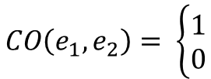


Relationships
Entities: (Fe₂O₃, catalyst)
CHM
APL
CHM_APL
$$CO\left(e_{1}, e_{2}\right)= \left\{\begin{aligned}1 \\ 0\end{aligned}\right.$$
Co-occurrence frequency:
The frequency at which two terms co-occur in the corpus.
If both e₁ and e₂ present in a document
$$υ\left(e_{1}, e_{2}\right)= \frac{\sum{CO(e_{1},e_{2})}}{N}$$
Co-occurrence frequency
$$Triple= <e_{1},T[e_{1}]_T[e_{2}],e_{2},υ\left(e_{1}, e_{2}\right)>$$
If both $υ\left(e_{1}, e_{2}\right)$ > 10

Slide 21
Data Cleaning Challenges
Types of Challenges:
  Syntactic variations:
    ['electrodes.', 'electrodes,’, 'Electrode’, 'electrodes:’, 'electrodes;’, 'Electrodes’, 'electrodes)’, 'Electrodes:’, "electrode’s”, "electrodes’”]
    'nano-hybrid','nano-hybrids','nanohybrid','nanohybrids'
    Microtwins, Microtwins, Microtwins
  Incomplete phrases:
    -nitrate, -nitride, -nitrides, -methane
  Semantic variations:
    Dry Reforming Of Ch4, Dry Reforming Of Methane, Dry Reforming Of Methane Reaction
    Light-Harvesting Ability, Light-Harvesting Capability, Light-Harvesting Capability
  Non Ascii entities:
    Phi, rho, mu, etc
  Equivalent entities:
    CH4, Methane, NH3, Ammonia, SEM, Scanning Electron Microscope

Slide 22
Strings
Electrode, co oxidation, chemical age, chemical image,
CO2 oxidation
[electrode, electrodes],
[CO Oxidation, CO2 Oxidation],
[Chemical Image, Chemical Age]
Sort by Levenshtein Distance
{electrode: Electrode,
Electrodes: Electrode,
Co oxidation: CO Oxidation,
CO2 oxidation : CO2 Oxidation,
Chemical Image: Chemical Image,
Chemical Age: Chemical Age}
X 5
Club similar entities
Replace

Slide 23
ChatGPT
prompt="""
Find the most acceptable form of these strings. Follow these general guidelines:
1. If multiple strings point to the same concept or entity, find a form that is the most general.
2. Convert chemical formulas to a form where the number of atoms of each elements follows the atomic symbol in braces.
3. Remove unnecssary punctuation marks like hyphens, slashes etc when they are not necessary.
4. Remove '\n' if present in a string
Here are some examples:
T: ['Fatigue Crack', 'Fatigue Cracking']
H: ['Fatigue Crack', ''Fatigue Crack']
T: ['Semiconductor-Metal Transition', 'Semiconductor-to-Metal Transition']
H: ['Semiconductor-Metal Transition', 'Semiconductor-Metal Transition']
T: ['Adsorbent', 'Adsorbents']
H: ['Adsorbent', 'Adsorbent']
T: ['OPV Cell', 'OPV Cells', 'PV Cell', 'PV Cells', 'TPV Cell', 'TPV Cells']
H: ['OPV Cell', 'OPV Cell', 'PV Cell', 'PV Cell', 'TPV Cell', 'TPV Cell']
T: ['Tomographic', 'Topographic', 'Topographical', 'Topographically']
H: ['Tomographic', 'Topographic', 'Topographic', 'Topographic']
T: {}
H: """

Slide 24
ChatGPT
Examples:
  Microwave Absorbing : 'Microwave Absorbing'
  Microwave Absorption : 'Microwave Absorption'
  Microwave Absorption Ability : 'Microwave Absorption'
  Microwave Absorption Applications : 'Microwave Absorption Applications’
  Heat Flux Method : 'Heat Flux'
  Heat Flux Profile : 'Heat Flux'
  Heat Flux Vectors : 'Heat Flux'
HgCl : 'Hg(1)Cl(1)‘
HgF : 'Hg(1)F(1)‘
H2O2 : 'H(2)O(2)'

Slide 25
MatKG
Triples: 6,517, 505
Nodes: 112,419
Avg Degree: 103.25
Weighted Degree: 7672.46
Average Degree of some networks
Power grid : 2.50
WWW : 4.60
Internet : 6.33
Science collaborations : 8.08
Citation Network : 10.43
Facebook : 43.70
(Martin , 2021)
APL: skyblue, CMT: pink, DSC: yellow, PRO: limegreen, SMT: Orange, SPL: peachpuff, MAT: salmon

Slide 26
Applications
As a graph database

Slide 27
(a)
Electrode
(b)
Garnet
Photoanode
TiO₂
Anatase
DSSCs
Brookite
Coating
Perovskite
Catalytic Degradation
Monoclinic
Applications
Symm Phase
Cubic
Photocatalyst
Rutile
Dye-sensitized solar cell
Tetragonal
Hexagonal
Electrolyte
Catalyst
Orthorhombic
Solar cells
CdTe
(d)
(c)
Solar cells
Morphology
Electrode
Optoelectronic device
Bandgap
Structure
Back Contact
Module
Fluorescence Intensity
Voc
Applications
Window layer
Properties
Contact
Semiconductor
Optical Properties
Thin Film solar
Cell
Composition
Stability
Absorber
Efficiency

Slide 28
As property – Application – material – processing graphs
Application
Material
Application
Property
(a)
(b)
Catalyst
Catalyst
Activity
Platinum
Electrode
Cycling Performance
Electrode
Aluminum
Coating
Coating
Composition
Electrolyte
LiPF₆
Sensor
Resistance
H2 Evolution
SnO2
Reactor
pH
Sensor

Slide 29

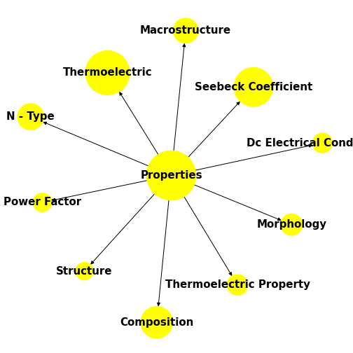
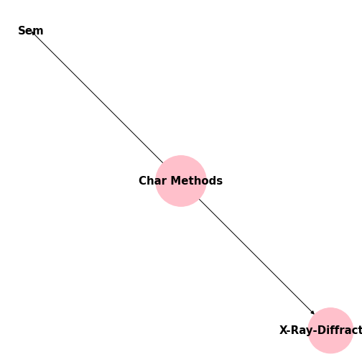
Data is incomplete
Bismuth Telluride

Slide 30
Graph Representation Learning
Learn a unique vector for every entity and relationship
Use these vectors to predict new links

Slide 31
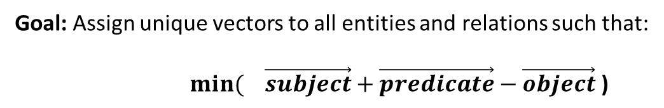
Graph Representation Learning
Goal: Assign unique vectors to all entities and relations such that:
$\underset{}{min(}{\vec{subject}+\vec{predicate}−\vec{object} \text{)}}$
1. [BiTe, CHM_APL, Catalyst]
2. Individual scoring function
3. Loss Function
1. BiTe
Catalyst
_CHM_APL_
For all triples in train
set: Minimize Σ(score)
2. Catalyst
Score
3. _CHM_APL_
BiTe

Slide 32
Graph Representation Learning
 | Model | FocusE | Dim | Test_mrr | Delta | hits@1 | hits@3 | hits@10
1 | TransE | NoFocusE | 100 | 0.01664 | 0.01041 | 0.00621 | 0.01115 | 0.02624
2 | ComplEx | NoFocusE | 100 | 0.19426 | 0.14350 | 0.13730 | 0.20425 | 0.31085
3 | DistMult | NoFocusE | 100 | 0.09908 | 0.06445 | 0.05380 | 0.10598 | 0.18030
4 | ComplEx | FocusE | 100 | 0.39735 | 0.09570 | 0.24104 | 0.47157 | (0.71671
5 | TransE | FocusE | 100 | 0.49366 | 0.38824 | 0.40088 | 0.53881 | 0.66076
6 | DistMult | FocusE | 100 | 0.39287 | 0.16273 | 0.25300 | 0.45388 | 0.67599
7 | ComplEx | NoFocusE | 150 | 0.18220 | 0.13346 | 0.12697 | 0.19254 | 0.28898
8 | TransE | NoFocusE | 150 | 0.01879 | 0.01125 | 0.00640 | 0.01395 | 0.03378
9 | DistMult | NoFocusE | 150 | 0.11413 | 0.07715 | 0.06824 | 0.12096 | 0.19553
10 | TransE | FocusE | 150 | 0.49549 | 0.38863 | 0.40138 | 0.54169 | 0.66561
11 | ComplEx | FocusE | 150 | 0.41278 | 0.07035 | 0.25794 | 0.48838 | 0.72463
12 | DistMult | FocusE | 150 | 0.38691 | 0.11420 | 0.24305 | 0.44854 | 0.68480

Slide 33
Link Prediction
Sort and Rank the triples
Given: Head, Relation, Find: Tail
[BiTe, CHM_APL, thermoelectric device]
0.7
BiTe, CHM_APL, X]
[BiTe, CHM_APL, optoelectronic device]
0.6
X = every ‘APL’ in MatKG
[BiTe, CHM_APL, Thermoelectric generator]
0.4
[BiTe, CHM_APL, transparent electrode]
0.4
[BiTe, CHM_APL, backcontact]
0.2
[BiTe, CHM_APL, dye]
0.1

Slide 34
Bismuth Telluride
(After)
Semiconductor device
Heterojunction solar cell
Optoelectronic device
(Before)
Macrostructure
Thermoelectric
Seebeck Coefficient
Thermoelectric generator
Back Contact
DC Electrical conductivity
Applications
N-type
Applications
Absorber
Thermoelectric device
Properties
Power Factor
Morphology
Transparent Electrode
Thin film solar cell
Structure
Thermoelectric applications
Thermoelectric property
Hall measurements
Composition
Four-point probe
SIMs
Spectroscopic Ellipsometry
Characterization
Method
SEM
Characterization
Method
Electrical studies
Sem
X-ray diffraction
Hall Effect measurements
TEM
AFM

Slide 35
Similar Entity matching
Similarity measure = cosine similarity
Entities | Similarity measure
(‘qspr’, ‘quantitative structure property relationship’) | 0.90
('Ca concentration', 'Ca/P ratio’) | 0.87
('lipid biosynthesis', 'lipid synthesis’) | 0.89
('CO2 recovery', 'CO2 concentration’) | 0.92
('qmom', 'quadrature method of moments') | 0.91
('electromagnetic acoustic resonance', 'emar') | 0.89
('ner', 'net energy ratio') | 0.92

Slide 36
Quantitate Property Prediction
ElemNet predicted Formation energy of 175 compounds
5-Fold cross validated
ML Models
Averaged R2
 | Models | RF | LR | XG | GB
TransE_FocusE_150dim | TransE_FocusE_150dim | 0.655250 | -0.288 | 0.568 | 0.628
TransE_FocusE_350dim | TransE_FocusE_350dim | 0.607705 | 0.328 | 0.434 | 0.627
TransE_FocusE_100dim | TransE_FocusE_100dim | 0.627972 | -3.398 | 0.622 | 0.621
TransE_FocusE_250dimpickle | TransE_FocusE_250dimpickle | 0.586797 | 0.106 | 0.596 | 0.589
TransE_FocusE_300dim | TransE_FocusE_300dim | 0.593310 | 0.290 | 0.614 | 0.583
RF – Random Forest,
LR – Linear Regression,
XG – XGBoost,
GB - AdaBoost

Slide 37
If a node is not present during training, it does not have a graph representation

Slide 38
SEM
Ice
Water
SEM
Water
Random
Ice
Metal
Thermal
Thermal
Random
Metal
Graph Embedding space
Word vector space

Slide 39
Encoder Decoder Generation of Graph Embeddings
Encoder
Decoder
Word Vector
Graph Embedding
768 dimensional WVs from MatBert
300 dimensional GVs from DisMult graph model

Slide 40
Methodology
Create a dictionary of word and graph embeddings
Split into Test/Train set
Train on Encoder – Decoder
Substitute reconstructed graph vector into original graph model
Recalculate test_mrr.
Original MRR : 0.495
Reconstructed MRR : 0.200

Slide 41
Some reconstructions will be better than others..
Cosine loss (V) = $\sum_{1}^{N}{\cos\left(Original, All_Vectors\right) −\sum_{1}^{N}{\cos\left(Reconstructed,All_Vectors\right) }}$
V2
V2
V1
V1
θ2
θ2
θ1
θ1
θ3
θ3
Original
Reconstruction
V3
V3
Lower the cosine loss, better is the reconstruction

Slide 42
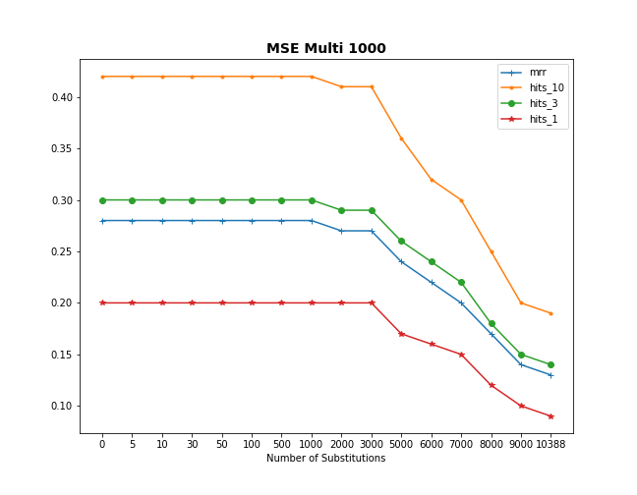
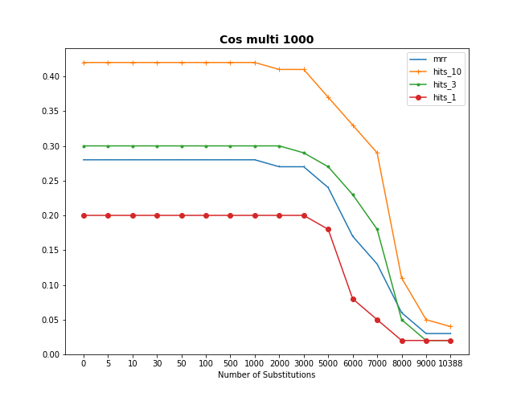
Number of random vectors = 1000

Slide 43
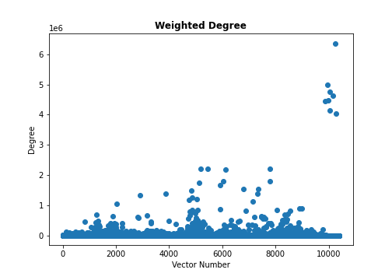
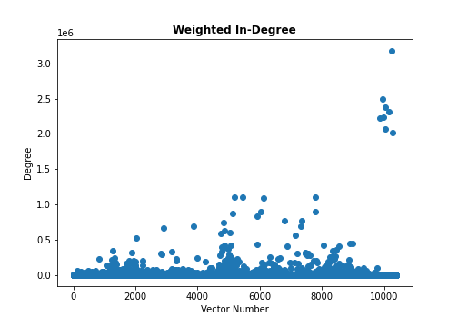
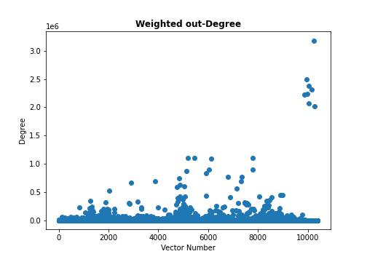
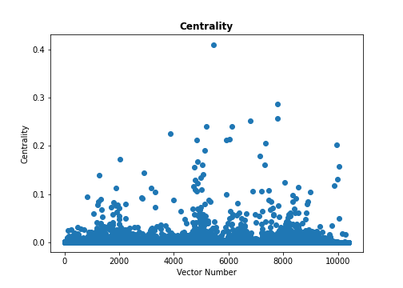
Why do these values reconstruct so well?

Slide 44
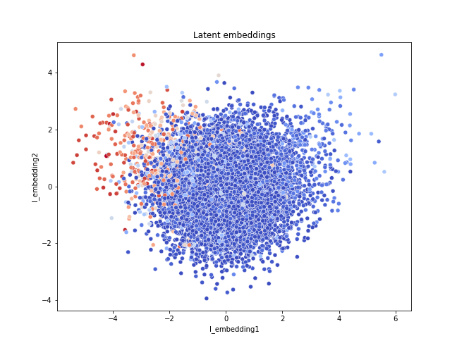

Slide 45
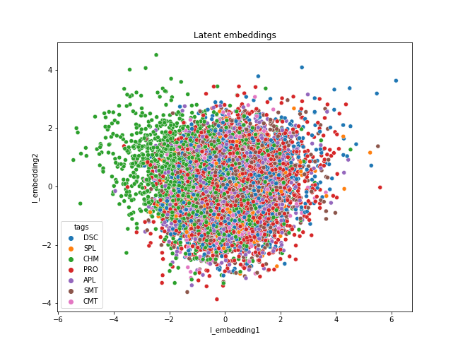

Slide 46
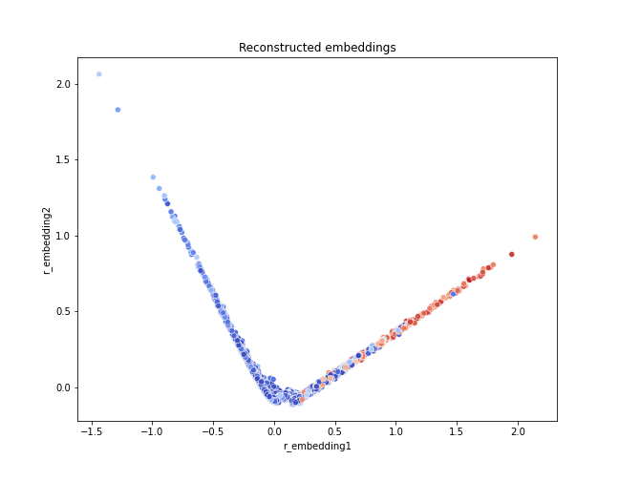
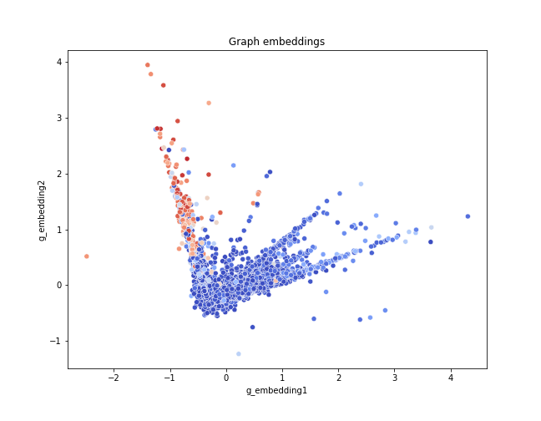

Slide 47
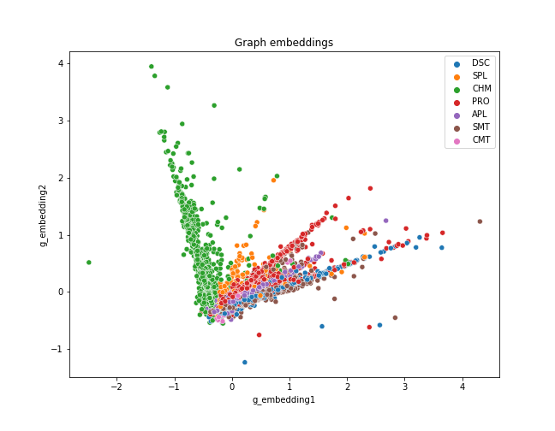
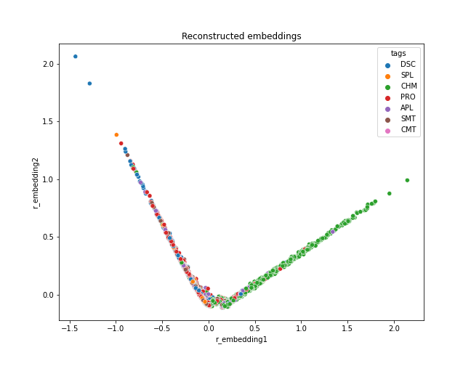

Slide 48
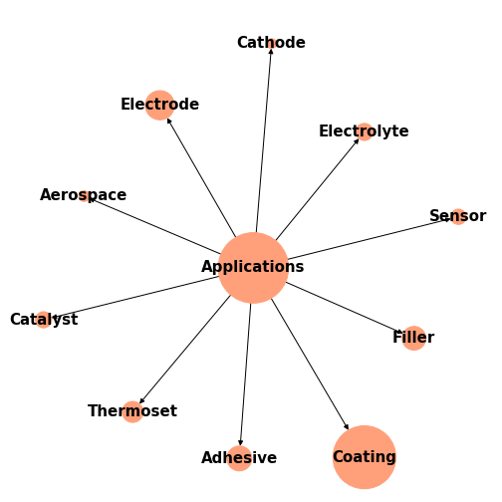
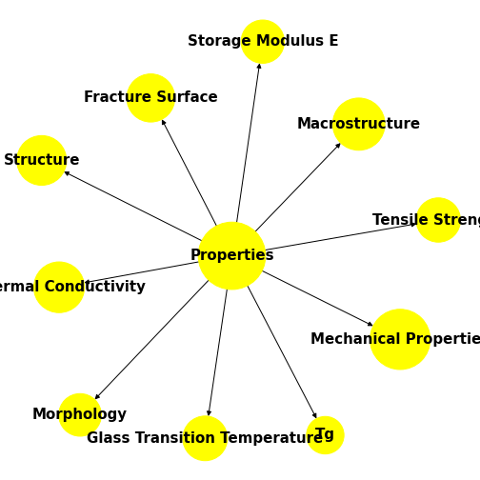
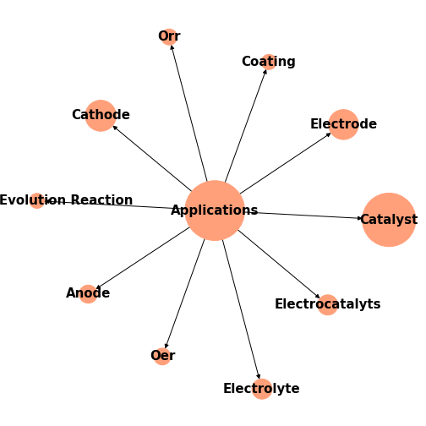
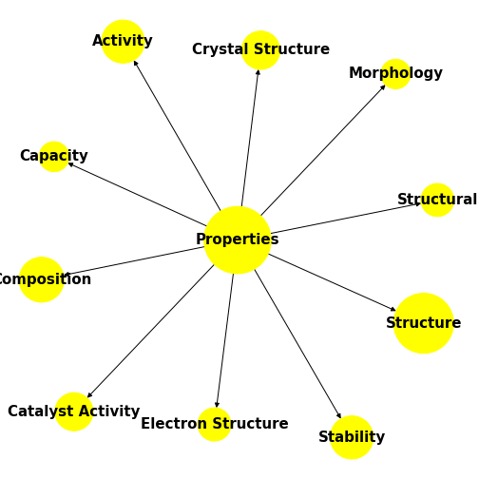
Epoxy
Transition Metal

Slide 49




Learning paradigm
Read a paper
Discuss with an expert
New graduate student
New project
Attend a paper
Online lectures

Slide 50
There is so much information today that we will only read a fraction of ALL published literature in any given field in our lifetime.

Slide 51
Thank You!

Slide 52

Weighted : < $e_{1},T[e_{1}]_T[e_{2}],e_{2},υ\left(e_{1}, e_{2}\right)$>
Total Number of Entities : 112,419
Total Number of Triples : 6.5 Million
Type of Entity | Number of Entities
Property | 37,344
Material | 26,814
Characterization Method | 16,671
Applications | 11,772
Synthesis Method | 11,161
Descriptor | 6001
Symmetry Phase Label | 2284
Relation | Count
Material - Material | 706, 523
Property - Property | 701,776
Material - Property | 430,501
Property -Descriptor | 234,047
Material - Characterization Method | 218,077
Property - Characterization Method | 203,590
Descriptor - Material | 187,999

Slide 53
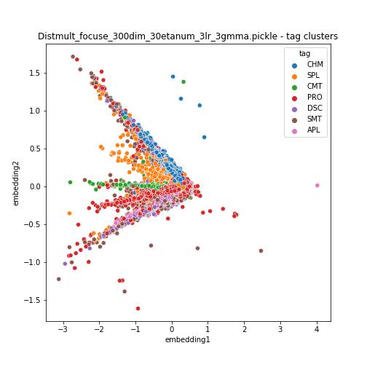
Cluster Embeddings

Slide 54
Named Entity Recognition – A quick History
Select a Model
2000 - 2010
2010 - 2020
2020 - Now
Bi-LSTMs
BERT
GPT
Create training examples
Small Model
Large Model
330 Million
V Large Model
175 billion parameters
Train the Model
> 100 training data
> 500 training data
> 5 training data
Evaluate the Model
Fast training
Slow training
V Slow training
Prepare your data
Decent Performance
Very Good Performance
Excellent Performance
Single Task
Task specific Training
Finetuning
Extract Information

Slide 55
Extra slides

Slide 56
All our data:
Train : 3,210,346 triples
Val : 401, 293 triples
Test : 401, 293 triples
For every test triple, generate corruptions
Rank the triple against the corruptions
Model Validation
Triple 1
Triple 2
Triple 3
[Fe2O3, _CHM_APL, Li Battery]
0.8
[CdTe, _CHM_APL, Solar Cell]
0.7
[Catalyst, _APL_PRO_, Activity]
0.7
0.6
0.5
[Catalyst, _APL_PRO_, Mesoporous]
0.6
[Fe2O3, _CHM_APL, Catalyst]
[CdTe, _CHM_APL, Catalyst]
[Fe2O3, _CHM_APL, Thermoelectric]
0.4
[Fe2O3, _CHM_APL, Aeronautical]
[Catalyst, _APL_PRO, Strength]
0.5
0.4
[Fe2O3, _CHM_APL, Dye]
0.4
[Fe2O3, _CHM_APL, H2 sensor]
0.2
[Catalyst, _APL_PRO_, Structure]
0.3
Rank: 2
Rank: 1
Rank: 4
Mean Rank : Sum of Ranks / No of Triples = 7/3 = 2.33
Mean reciprocal Rank (MRR): Sum of reciprocal Ranks / No of Triples = (1/2 + 1+ ¼)/3 = 0.283
Hits@1 = 0.33
Hits@3 = 0.66
Hits@4 = 1.00

Slide 57
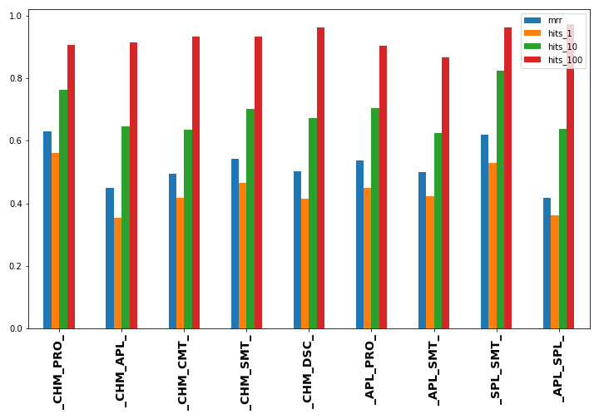
Model
TransE_FocusE , 150 dimensions
Test_MRR : 0.495
Hits@1 : 0.40
Hits @3 : 0.54
Hits@10 : 0.66
Hits@1000 : 0.98

Slide 58
Link Validations
Ontological category
optical material | _APL_CHM_ | In2O3 | 5.566453 | 1 | https://en.wikipedia.org/wiki/Indium(III)_oxide
optical material | _APL_CHM_ | CdO | 5.278056 | 1 | https://en.wikipedia.org/wiki/Cadmium_oxide
optical material | _APL_CHM_ | Zinc Oxide | 5.261776 | 1 | https://en.wikipedia.org/wiki/Zinc_oxide
“is an instance of”
anodic electrode | _APL_CHM_ | Graphite | 3.00931 | 1 | 10.1016/j.ensm.2020.12.027
anodic electrode | _APL_CHM_ | carbon-fibre | 2.955466 | 1 | 10.1016/C2015-0-00574-3
anodic electrode | _APL_CHM_ | LiClO4 | 2.897102 | 2 | https://en.wikipedia.org/wiki/Lithium_perchlorate
“is an instance of”
nuclear reactor | _APL_CHM_ | Beryllium | 7.023957 | 1 | https://www.energy.gov/ehss/about-beryllium
nuclear reactor | _APL_CHM_ | Carbide | 6.411347 | 2 | https://en.wikipedia.org/wiki/Uranium_carbide#:~:
nuclear reactor | _APL_CHM_ | Tungsten | 6.383205 | 1 | 10.1016/j.ijhydene.2016.02.019
“is a part of”
smes | _APL_PRO_ | dmain | 0.340325 | 3
smes | _APL_PRO_ | transmitted current | 0.281468 | 1 | https://en.wikipedia.org/wiki/Superconducting_magnetic_energy_storage
smes | _APL_PRO_ | u11 | 0.206723 | 3
“is useful for”
reverse water gas shift reaction | _APL_CHM_ | C6H5OH | 5.227993 | 3
reverse water gas shift reaction | _APL_CHM_ | Naphtha | 5.227993 | 3
reverse water gas shift reaction | _APL_CHM_ | diethylether | 4.79556 | 3
SKOS: Simple Knowledge Organization System
Relationships: broad, narrow

