Slide 1
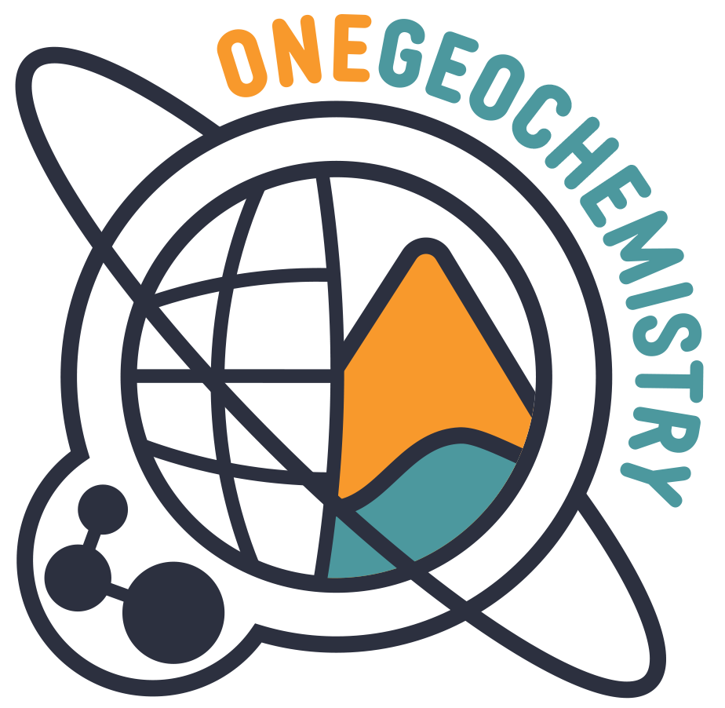



Developing Vocabularies for the International OneGeochemistry Initiative: Specifying Locally, Harmonising Globally
Marthe Klöcking, Göttingen University, Germany, ORCID; Lucia Profeta, Columbia University, USA, ORCID; Alexander Prent*, AuScope, ORCID; Rowan Brownlee, ARDC, ORCID; Lesley Wyborn, Australian National University, ORCID; Kirsten Elger, GFZ German Research Centre for Geosciences, ORCID; Manja Luzi-Helbing, GFZ German Research Centre for Geosciences, ORCID; Kerstin Lehnert, Columbia University, USA, ORCID; Dominik Hezel, Frankfurt University, Germany, ORCID

Slide 2
Developing Vocabularies for the International OneGeochemistry Initiative: Specifying Locally, Harmonising Globally
Marthe Klöcking, Göttingen University, Germany, ORCID; Lucia Profeta, Columbia University, USA, ORCID; Alexander Prent*, AuScope, ORCID; Rowan Brownlee, ARDC, ORCID; Lesley Wyborn, Australian National University, ORCID; Kirsten Elger, GFZ German Research Centre for Geosciences, ORCID; Manja Luzi-Helbing, GFZ German Research Centre for Geosciences, ORCID; Kerstin Lehnert, Columbia University, USA, ORCID; Dominik Hezel, Frankfurt University, Germany, ORCID

Slide 3
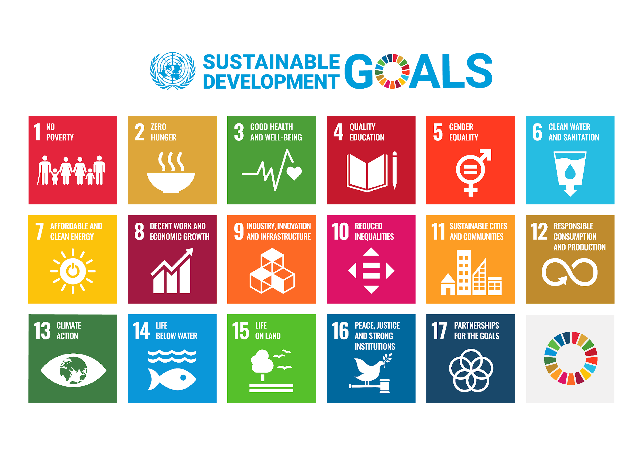
Geochemistry Data – Relevance to Society

Slide 4
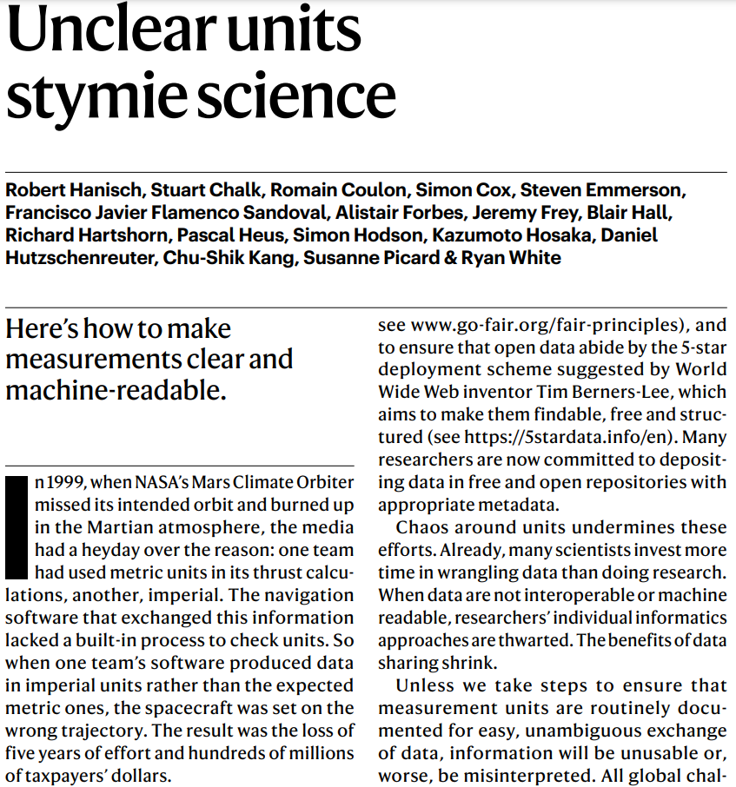
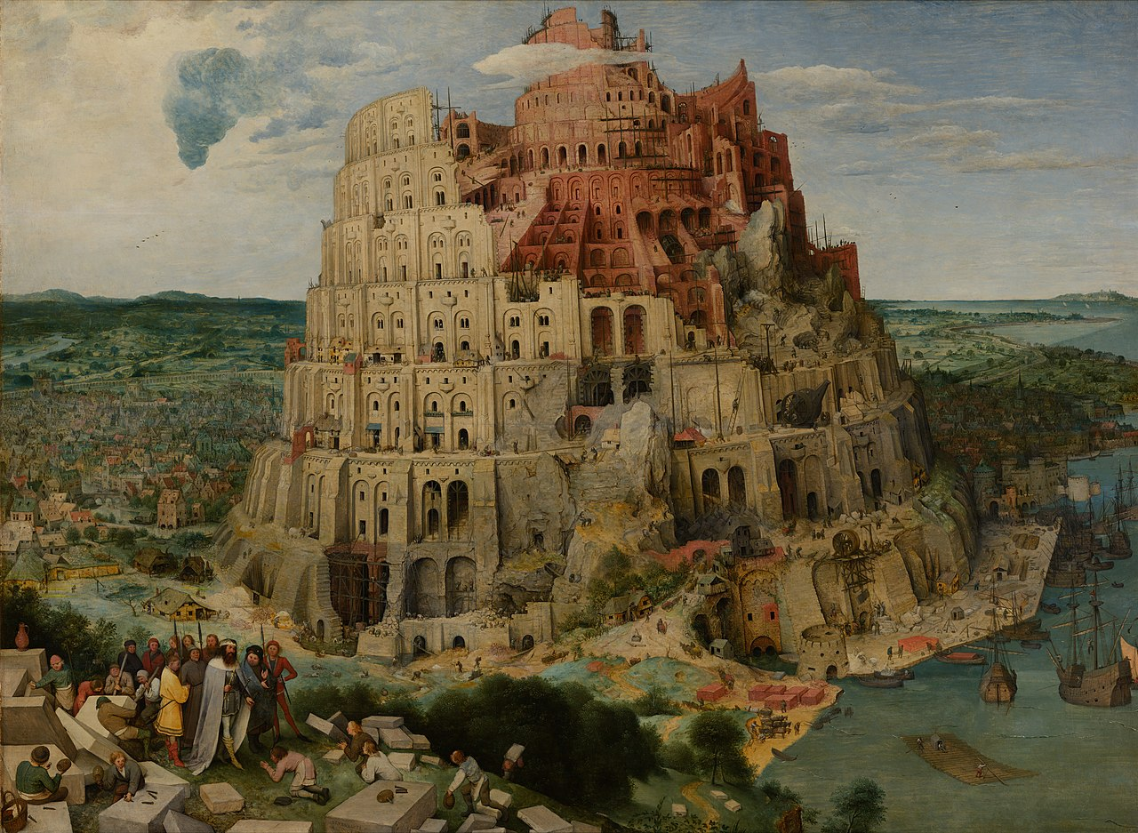
Geochemical Data Needs Standardisation
Nature Comments (2022), doi.org/10.1038/d41586-022-01233-w
Fewer Mistakes, Failures, Catastrophes

Slide 5
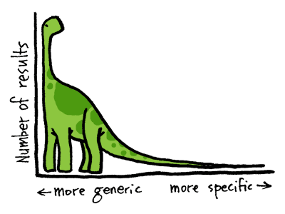
Geochemistry Data – LongTail
The Head:
Astronomy,
Climate,
High Energy,
Physics,
Genomics
Long Tail Characteristics
More specialised
Low volume
On C drives
Hard to find
Heterogeneous
Collected by many people
Citizen science
Etc…
Long Tail:
Environmental and Earth Sciences
http://juliegood.wordpress.com/tag/long-tail

Slide 6



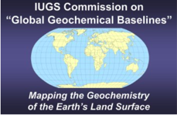
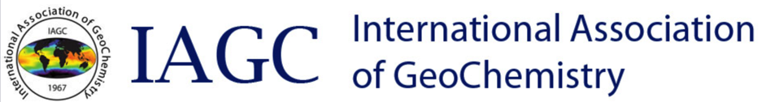

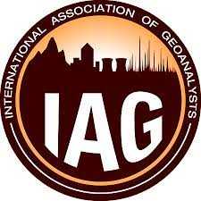
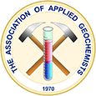






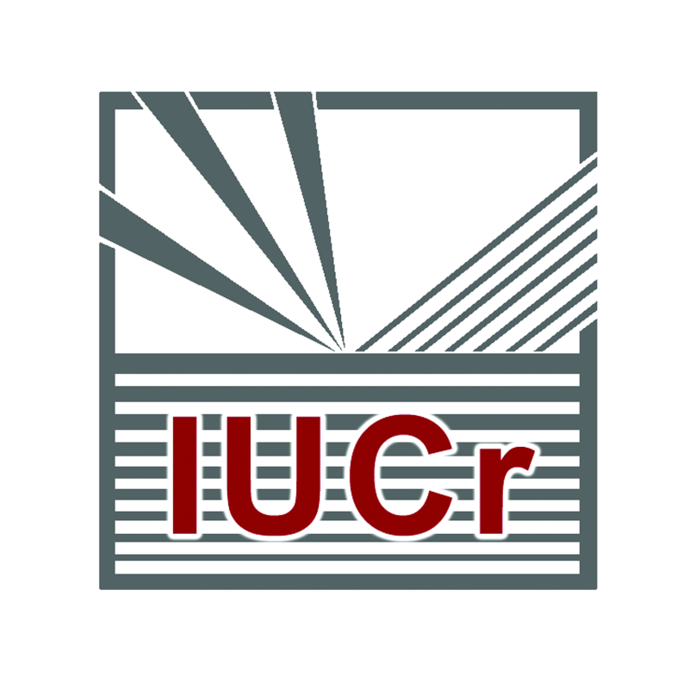


No single authority: 5 Unions and ~40 Societies
Societies/Associations
Science Unions

Slide 7
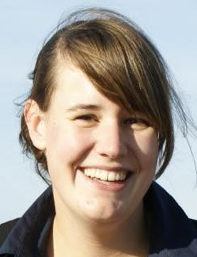
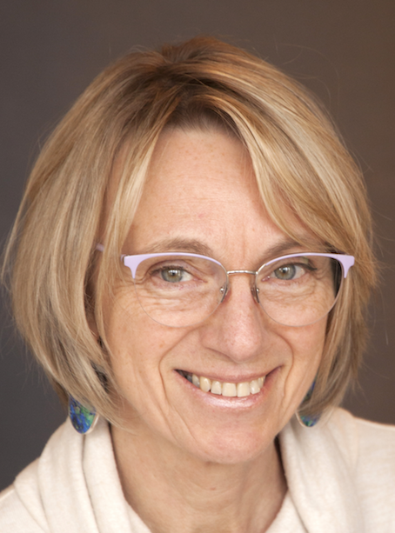
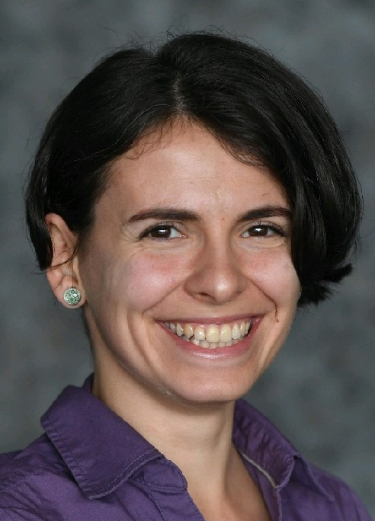
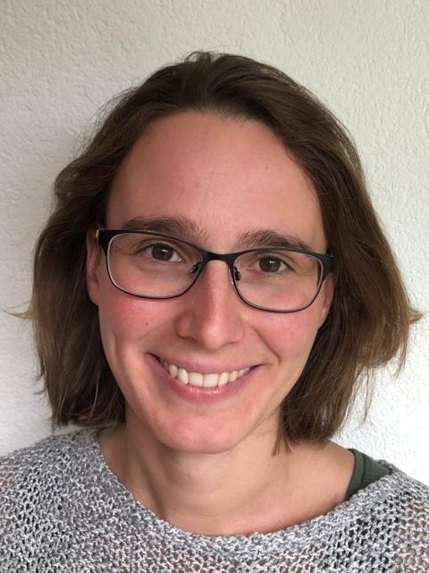
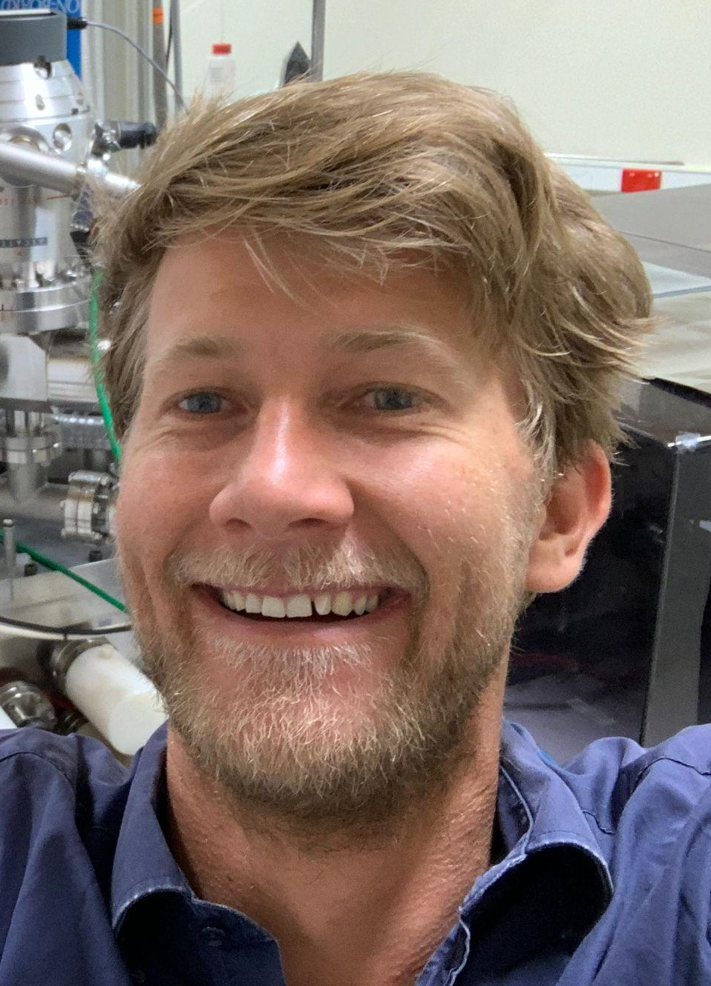
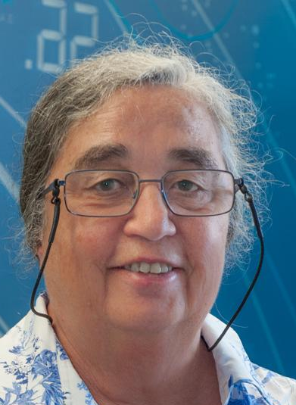
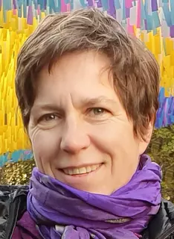
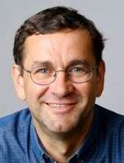
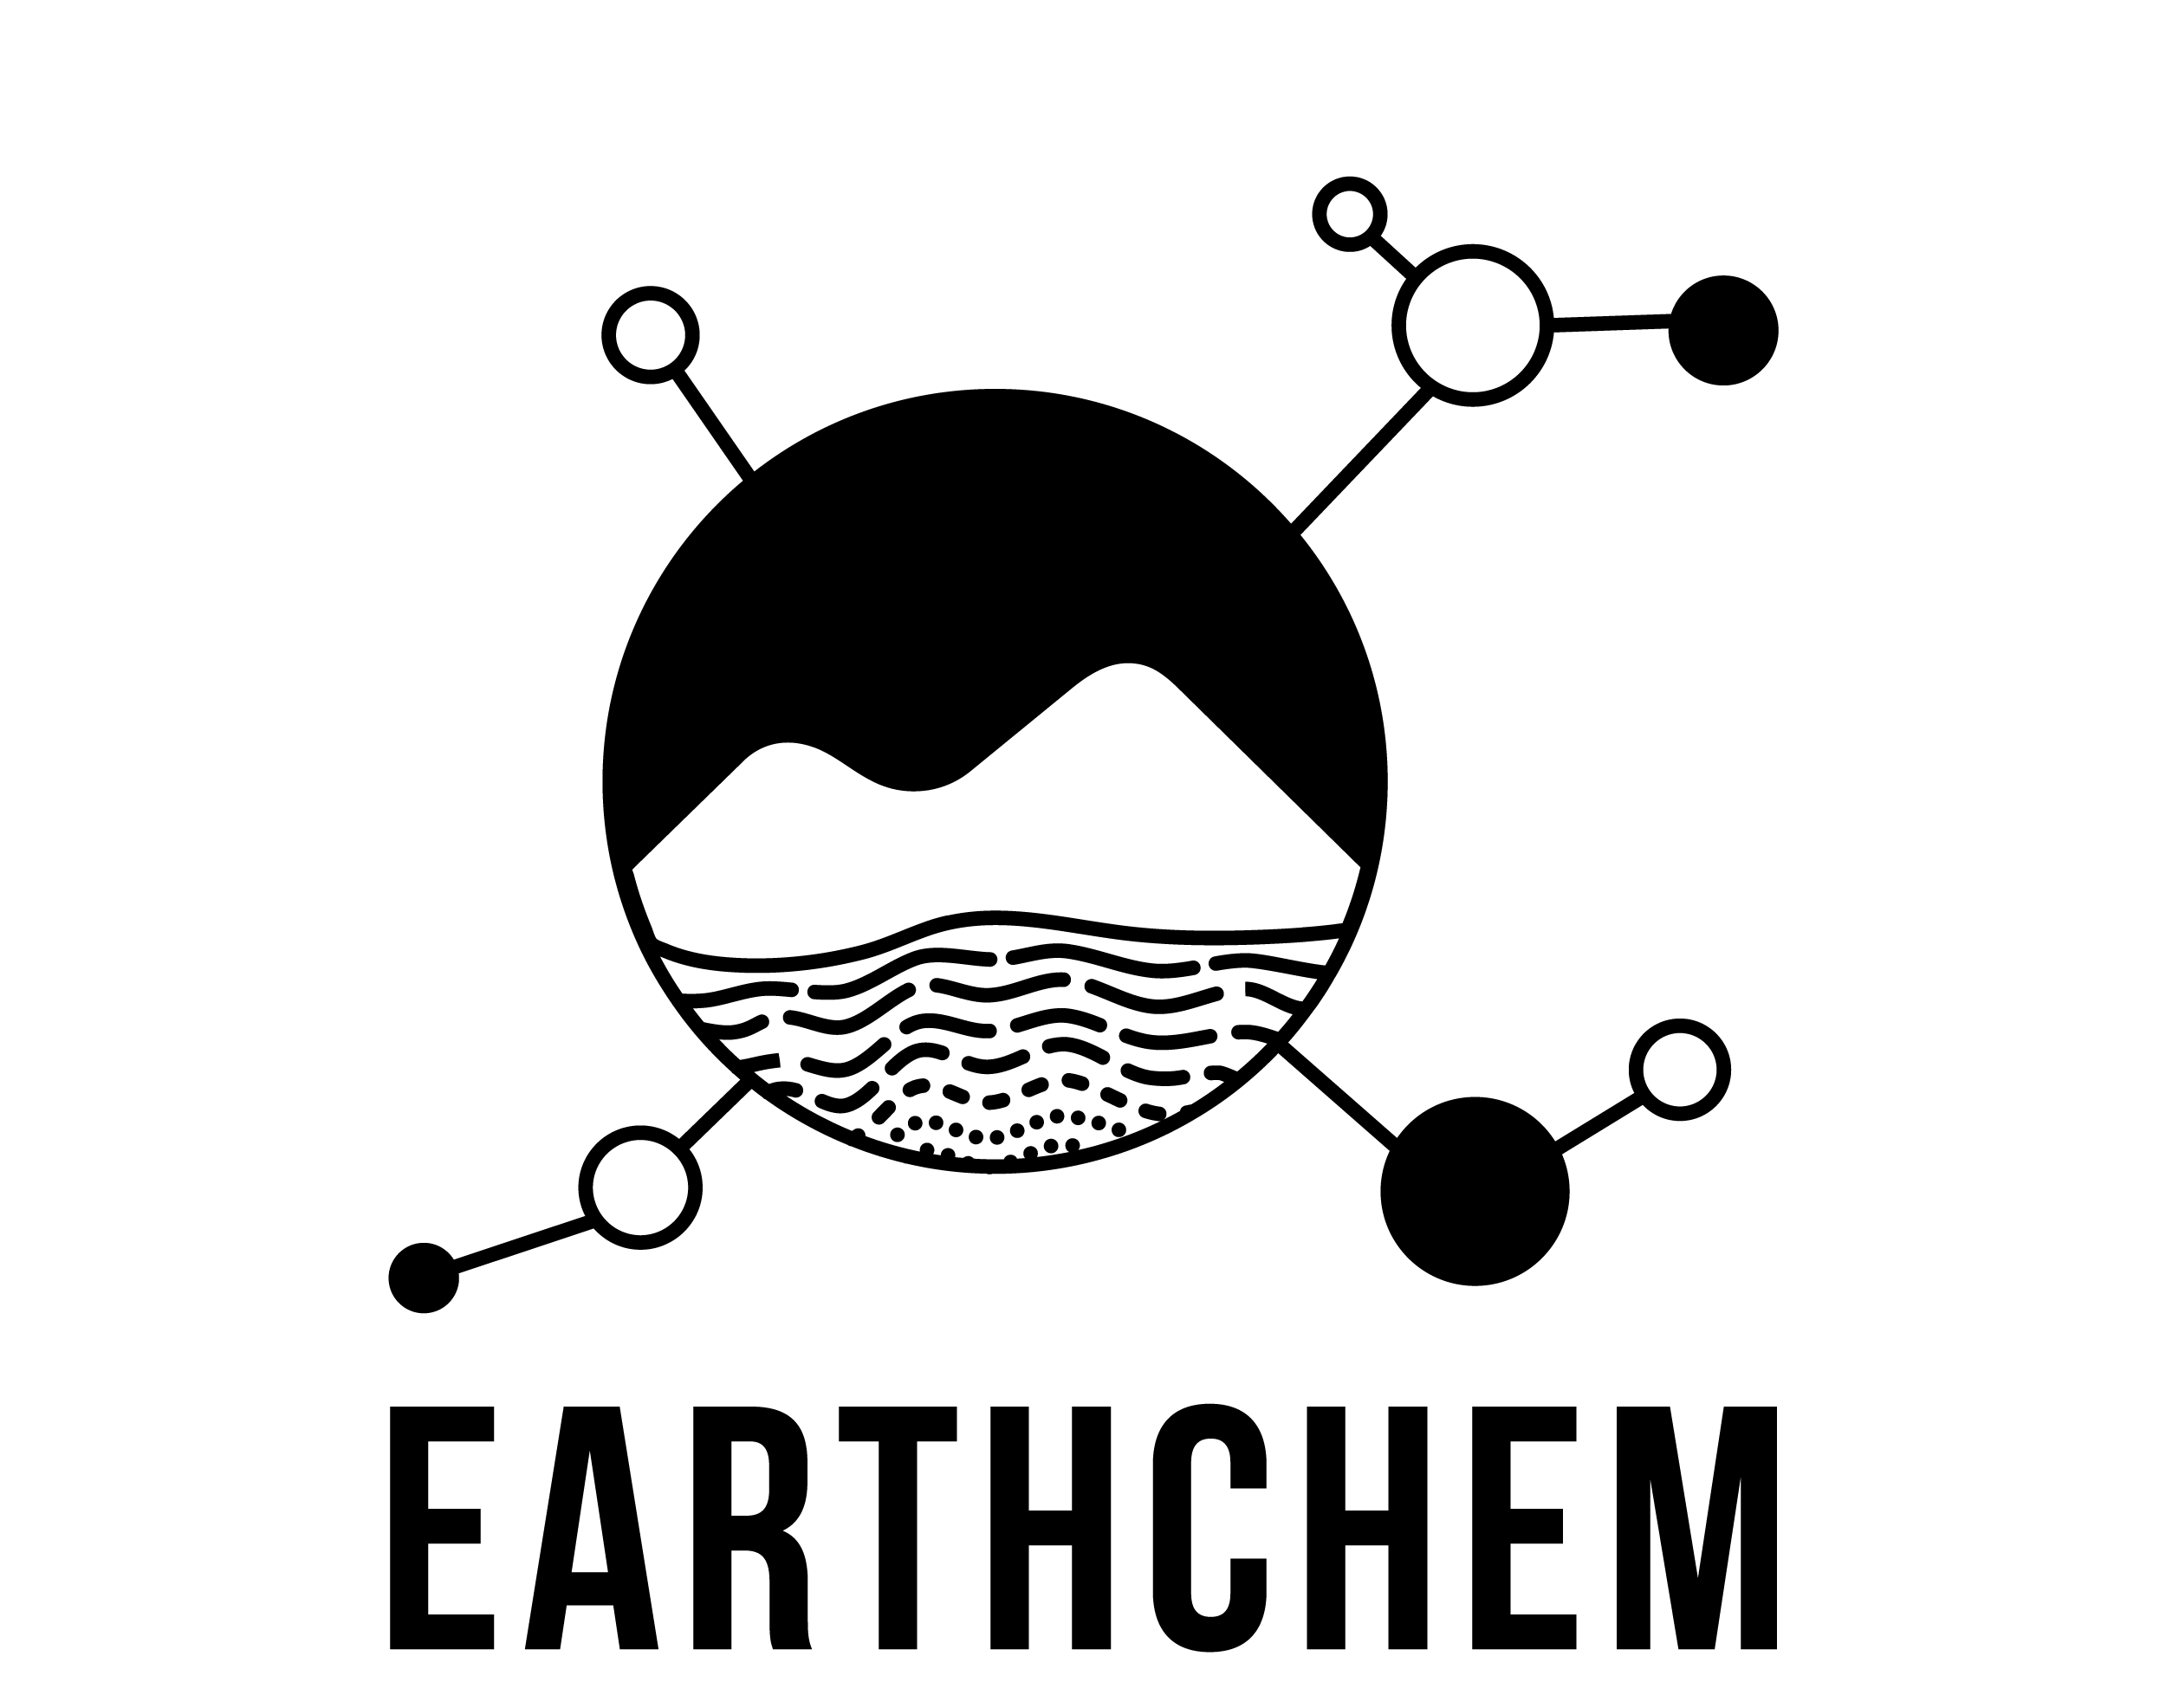

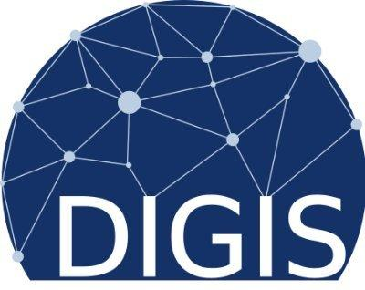





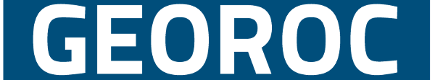
An international collaboration
ASTROMAT

Slide 8
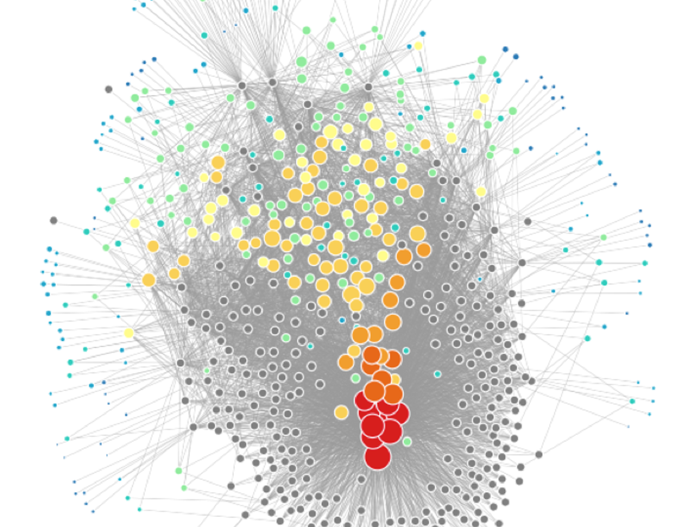
Facilitating Science through Data Standardisation
OneGeochemistry is an international collaboration between multiple organisations that support geochemistry capability and data production
Enabling and simplifying the (re)use of geochemical data in order to facilitate acceleration of the generation of new geoscientific knowledge and discoveries.
When provenance, methodology and a measure of data quality are consistently documented others will be enabled to trust, interpret and reuse data.
https://hazen.carnegiescience.edu/research/mineral-network-analysis

Slide 9
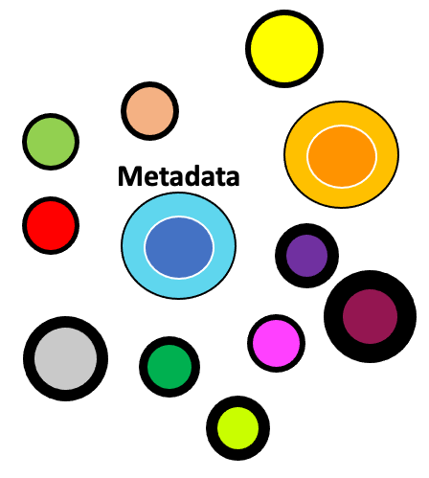

First steps – How?
Community
Communication
Enabled
?
! controlled vocabularies !
1st need = overview

Slide 10
First Steps – Controlled Vocabularies
Harmonisation of controlled vocabularies for geochemical data between GEOROC, PetDB/EarthChem, Astromat and AGN and registration with RVA
sample descriptions (materials, lithologies, sampling techniques)
geospatial location
analytical methods
mineral names: new profile: Mindat mineral names for AusGeochem
analytical instruments
Joint effort between:
EarthChem, Georoc, Astromat, EPOS Multi-scale laboratories, Geo.X, AusGeochem
Registration of agreed vocabularies with RVA and provision in SKOS-aligned RDF format

Slide 11
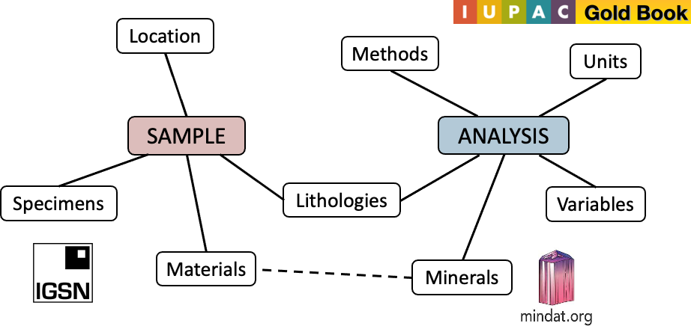
Separate, Connected Vocabularies

Slide 12
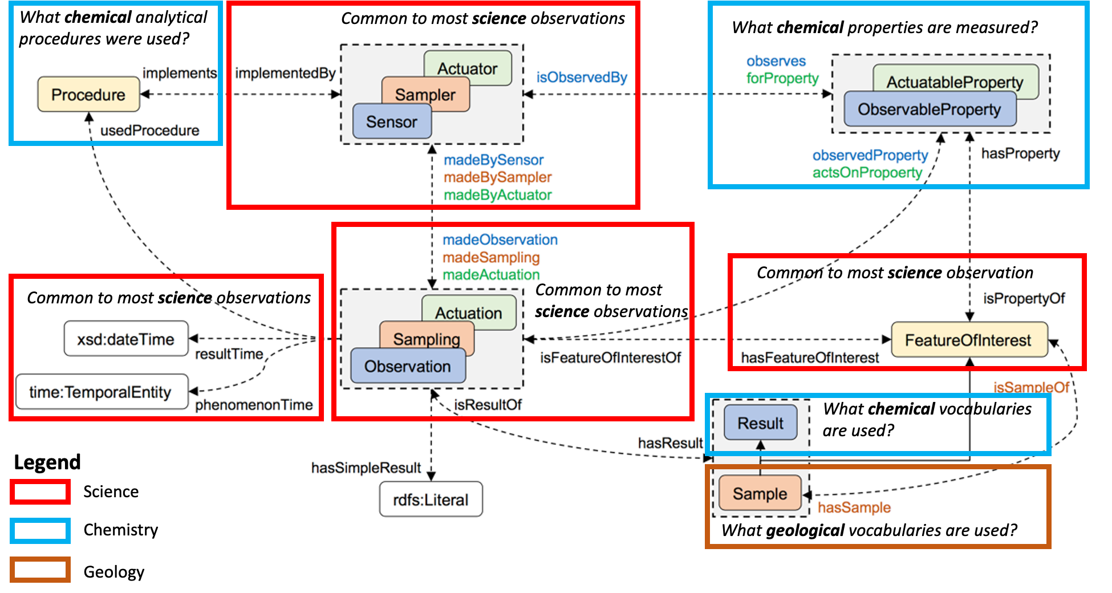
Components to Address
Source: Haller, A, Janowicz, K, Cox, SJD, Lefrançois, M, Phuoc, DL, Lieberman, J, García-Castro, R, Atkinson, RA and Stadler, C. 2019. The Modular SSN Ontology: A Joint W3C and OGC Standard Specifying the Semantics of Sensors, Observations, Sampling, and Actuation. Semantic Web, 10(1): 9–32. DOI: https://doi.org/10.3233/SW-180320

Slide 13
Components Available for Reuse
Instrument /
PIDS for instruments
IUPAC
Colour Books
Method
Location
ISO 19115
ISO Time
Units of Measure
IUGS / MINDAT

Slide 14
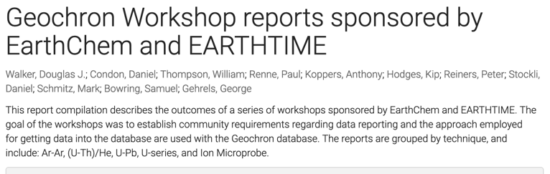
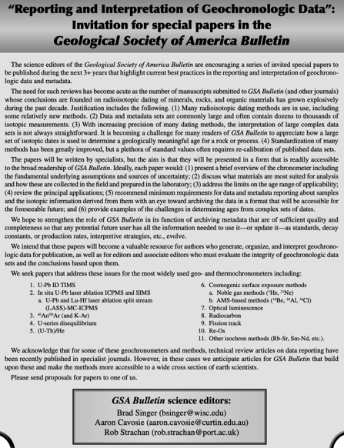
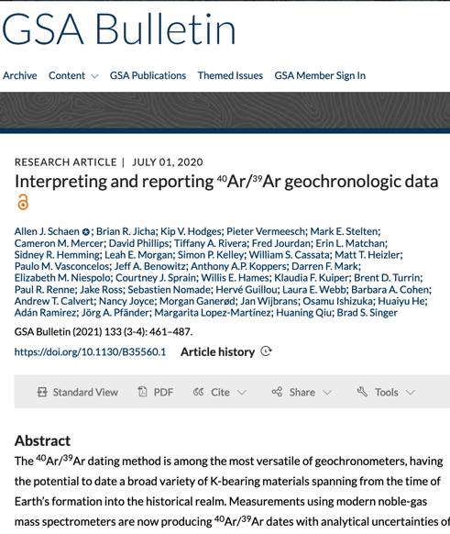
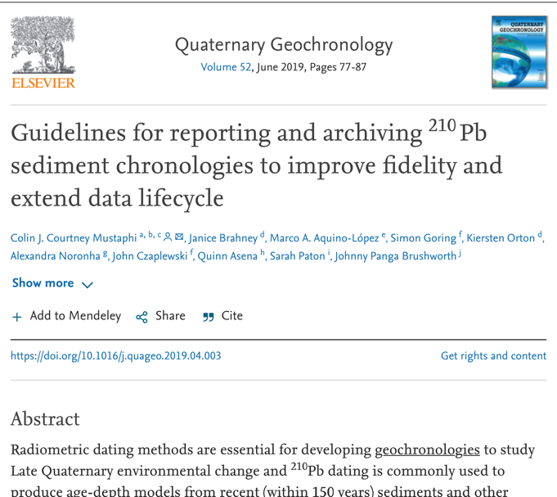
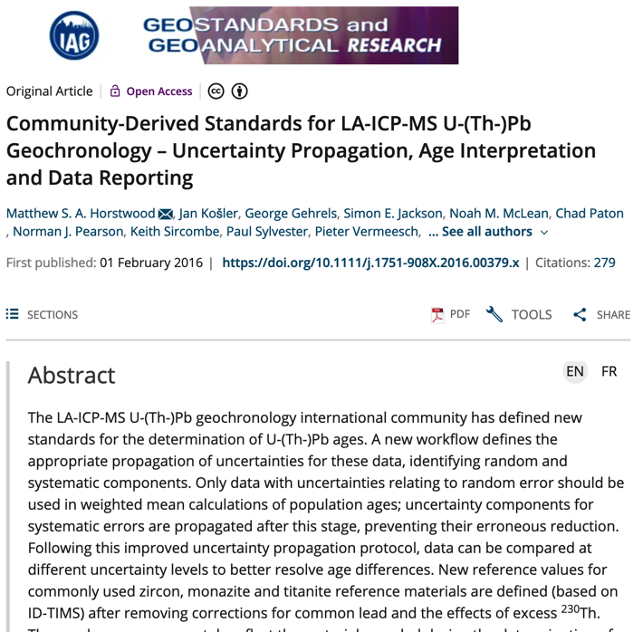
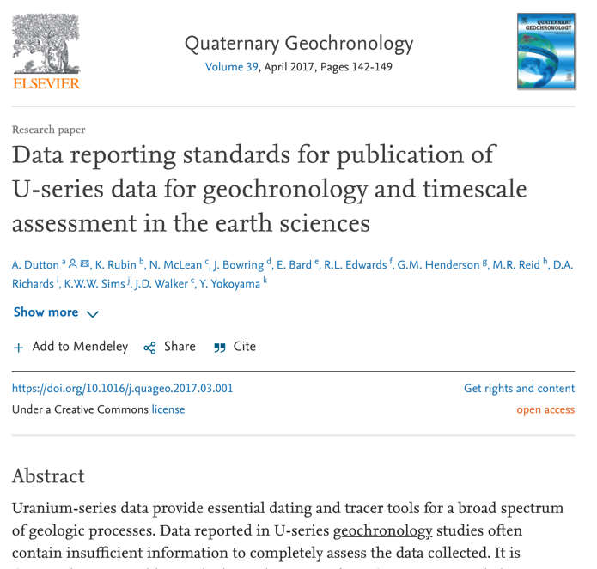
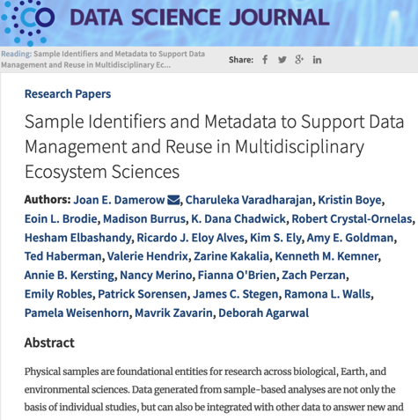
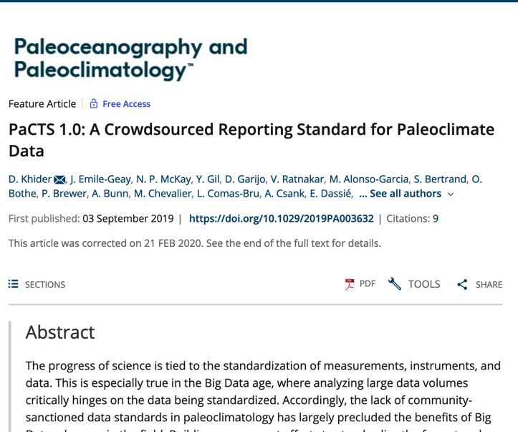
Methods Toward FAIR – Best Practices
Notes:
A collection of FAIR implementation choices

Slide 15
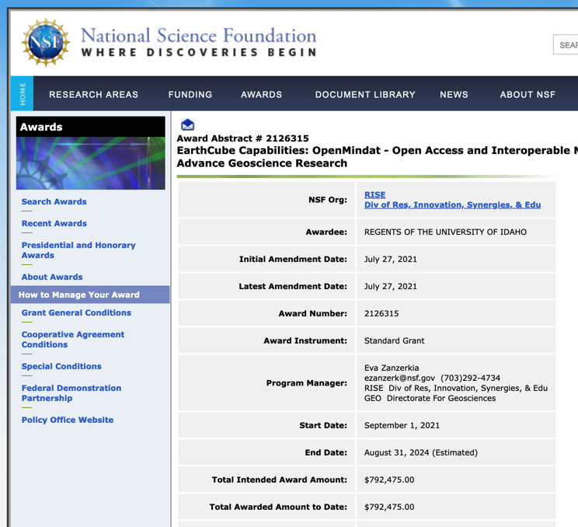
OpenMindat: Harmonising globally on mineral and rock names
Mindat is a community-driven, free-access, online database:
Is one of the largest mineral and rock databases in the world. provides access to 5,800 approved Mineral names, ~45,000 alternative mineral names and 3,049 rock names.
In 2021 had 44.3M page views (10.1M unique visitors from 246 countries).
As of July 2022 has 64,726 registered users.
Has a management team of 53 mineralogical experts from around the world who oversee the review process and manage directions.
OneGeochemistry is collaborating in the NSF OpenMindat project: Open Access and Interoperable Mineralogy Data to Broaden Community Access and Advance Geoscience Research
OpenMindat seeks to make Mindat FAIR compliant and will develop a fully open access and interoperable architecture including machine-friendly interfaces for data query and access.
But not all our required terms are in Mindat…
https://www.nsf.gov/awardsearch/showAward?AWD_ID=2126315&HistoricalAwards=false

Slide 16
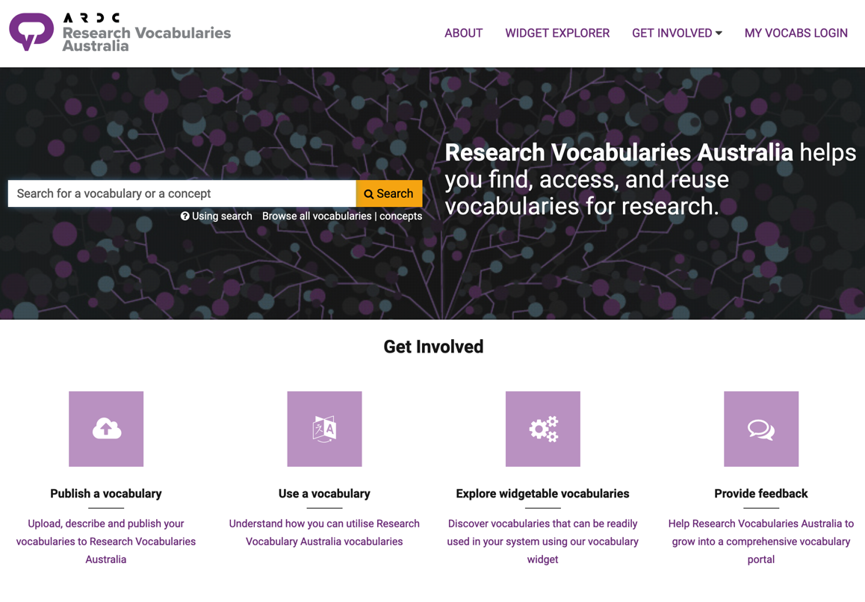
Specifying Locally: Harmonising Globally
EarthChem, GEOROC, AGN, Astromat all have additional requirements for mineral and rock names that are not in MINDAT, as well as other data types (e.g., analytical methods).
Extras will be stored in Research Vocabularies Australia and will compliment Mindat and other international vocabularies (DRUM, IUPAC, etc)
All terms will have URIs - for a specific vocabulary within a dataset, individual terms could come from multiple global sources.
Each vocabulary profile will be registered as a FAIR enabling resource (FER)

Slide 17
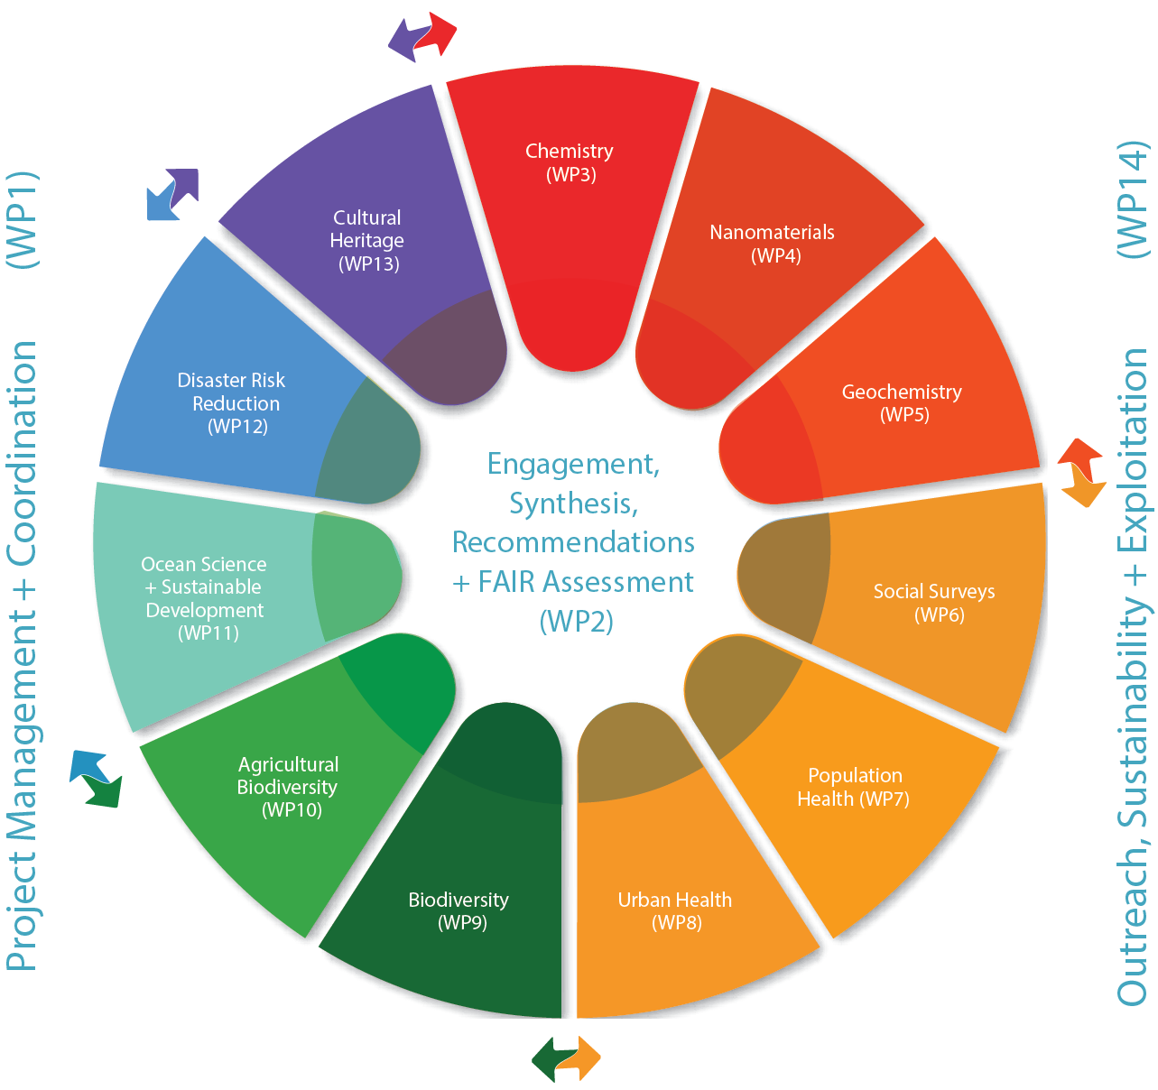

FERs and FIPs – CODATA WorldFAIR

Slide 18
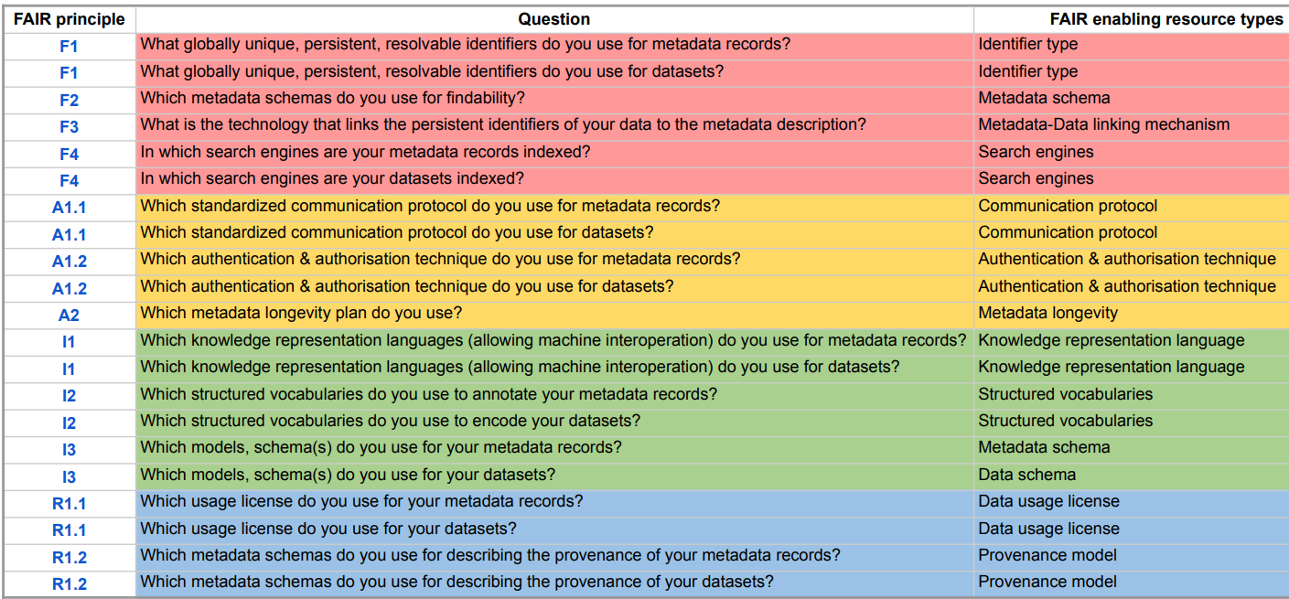
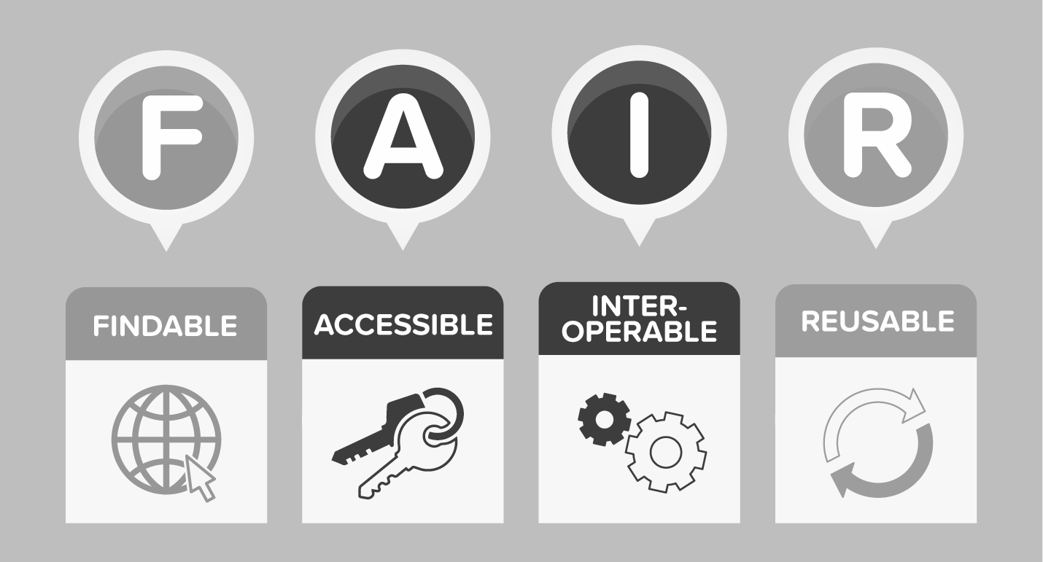
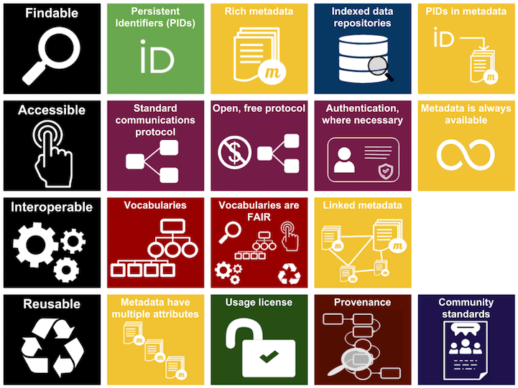
Methods Toward FAIR – FAIR Implementation Profiles
Notes:
A collection of FAIR implementation choices

Slide 19
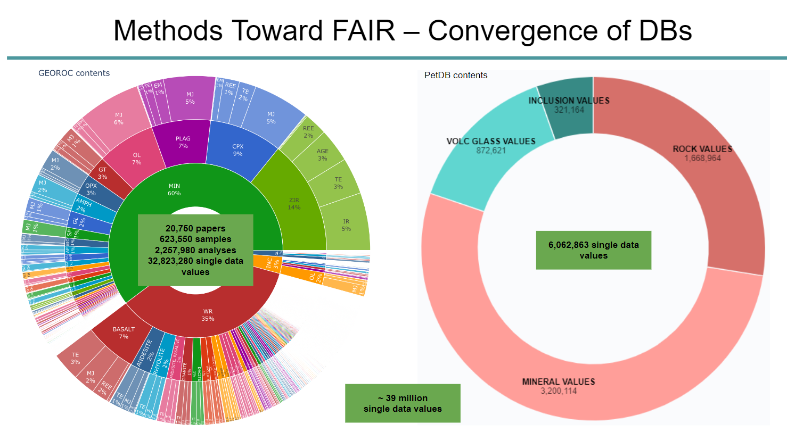
Methods Toward FAIR – Convergence of DBs
GEOROC + PetDB
~ 39 million
single data values

Slide 20

FIPs 4 Repository / Platform / Database
https://img.freepik.com/premium-vector/gear-wheels…g?size=626&ext=jpg&ga=GA1.2.1254696273.1668346327

Slide 21
OneGeochemistry CODATA Working Group
OneGeochemistry as a CODATA Working Group:
Bringing together geochemistry community around data organization via collaboration with existing initiatives in the world.
Working with groups that have invented the wheel and collaborating around making such resources available to a wider community in an integrated manner.
DRUM + IUPAC + OneGeochemistry + … →
FAIR Geochemical Data

Slide 22
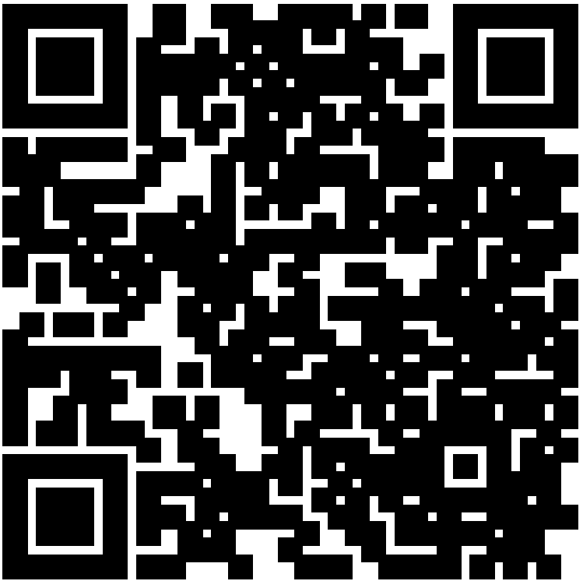
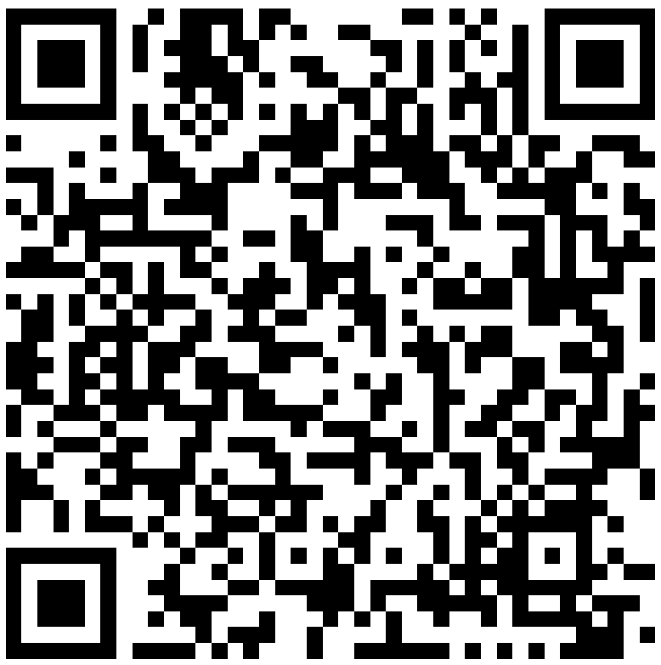
Thank you FAIRy much
Webpage
Slack Channel
alexander@auscope.org.au

Slide 23
Thank You

Slide 24
RVA abstract: Developing Vocabularies for the International OneGeochemistry Initiative: Specifying Locally, Harmonising Globally
Abstract
Over the last century enormous volumes of geochemical data have been acquired and thousands of globally distributed geochemical databases across the academic, government and industry sectors now exist. Unfortunately, there have been few efforts to standardise data or the diverse approaches for processing and modelling them, making it difficult to harness these data assets and contribute to global societal challenges (e.g. the UN Sustainable Development Goals).
OneGeochemistry is a new initiative that seeks to build and maintain consensus-driven standards to create a global network of findable and accessible geochemical data that is truly interoperable and reusable to both humans and machines. The highest priority is the development of internationally shared FAIR, machine-actionable vocabularies.
Progressing towards community-agreed vocabularies, as well as their endorsement and governance, is difficult because geochemistry is spread across four science unions and tens of international/national societies. Fortunately, geochemistry is one of eleven discipline case studies of the CODATA-led EU H2020 WorldFAIR project, which is exploring implementation of the FAIR principles across these case studies as well as leading the development of a global international framework for interdisciplinary interoperability and reusability of digital research objects.
To start this process, four international geochemical databases (Astromat, AusGeochem, EarthChem, GEOROC) are now collaborating on a modular approach to develop shared terminologies. Where possible, terms from existing international vocabularies will be utilised (e.g., MINDAT, IUPAC chemical terminologies, DRUM). For remaining terms, local profiles will be published in Research Vocabularies Australia. The creation of a vocabularies record to be used by each database can converge databases to interoperability, with a vocabulary being a FAIR enabling resource (FER). FAIR Implementation Profiles are a tool to capture each of these FERs, and FER nanopublication URIs can help to enhance the machine readability and interoperability of local databases within a global network of geochemical data resources
By: Marthe Klöcking, Göttingen University, Germany, ORCID; Lucia Profeta, Columbia University, USA, ORCID; Alexander Prent*, AuScope, ORCID; Rowan Brownlee, ARDC, ORCID; Lesley Wyborn, Australian National University, ORCID; Kirsten Elger, GFZ German Research Centre for Geosciences, ORCID; Manja Luzi-Helbing, GFZ German Research Centre for Geosciences, ORCID; Kerstin Lehnert, Columbia University, USA, ORCID; Dominik Hezel, Frankfurt University, Germany, ORCID

