Slide 1
Session 7a: Chemical Features, classes and substructures
March 23, 2023
NPLinker eScience Genome and Metabolome Mining Workshop

Slide 2
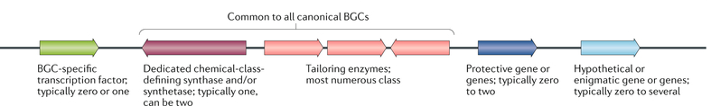
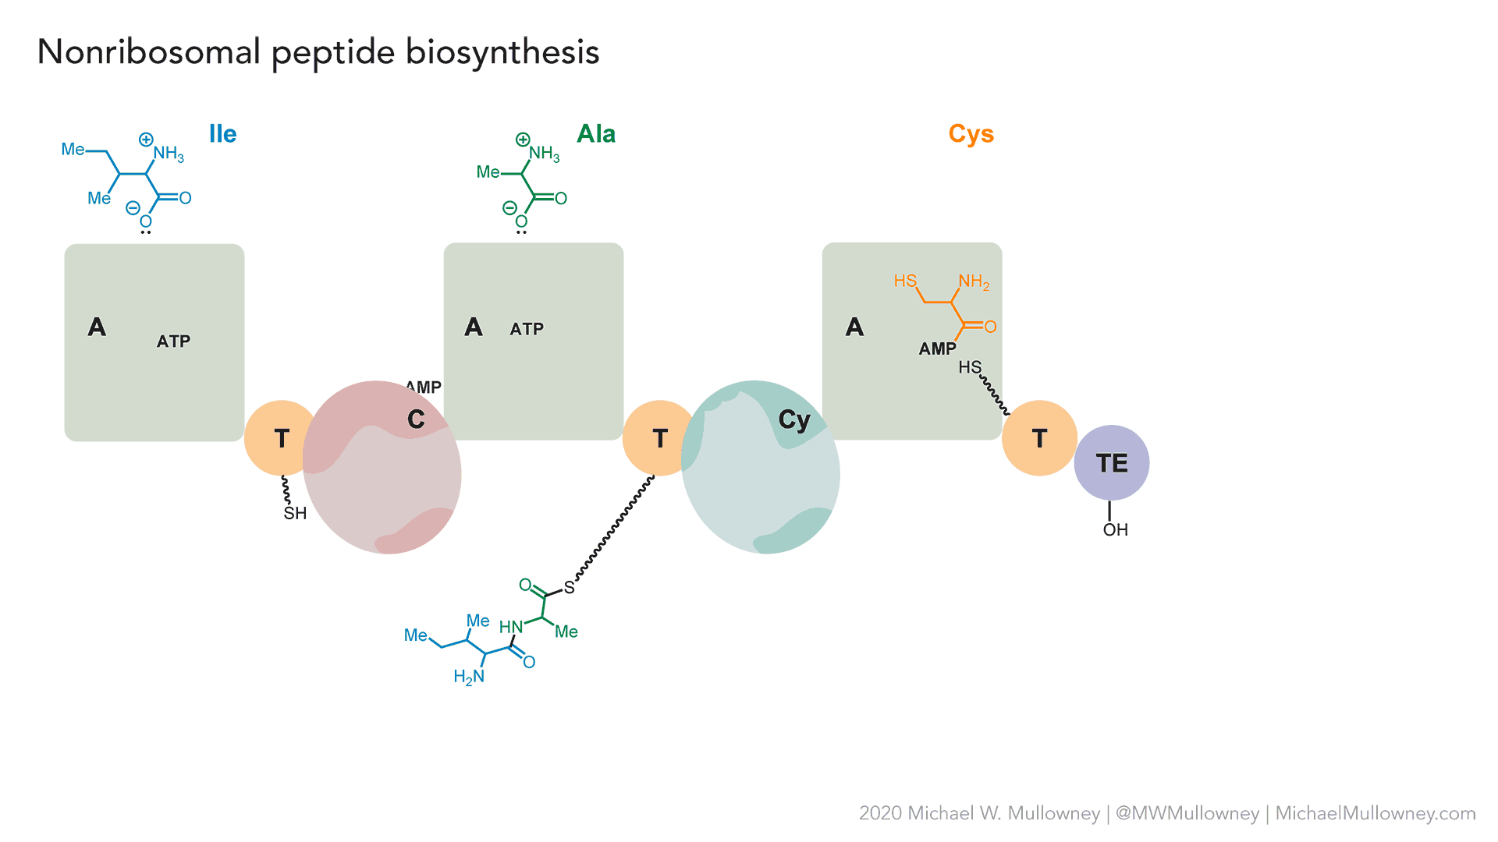
What can a gene cluster tell us?
Protective genes: serve to protect organism from toxic product by duplicating the enzymatic target. Can give insight into mechanism of action
Backbone enzyme: chemical class defining. Can tell us if the gene cluster encodes production of peptides, polyketides, terpenes, or another type of molecule
Tailoring enzymes: modify the chemical scaffold. Tells us if the final product is decorated with methyl groups, hydroxyl groups, or other chemical modifications
Keller NP.,Nat Reviews Microbiology,2019;17, 167–180

Slide 3
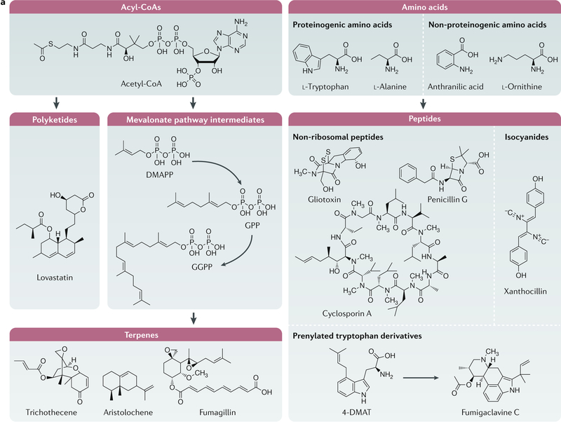
Keller NP.,Nat Reviews Microbiology,2019;17, 167–180
3

Slide 4
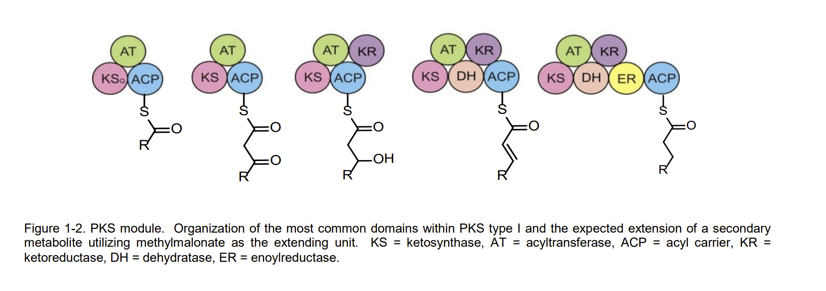
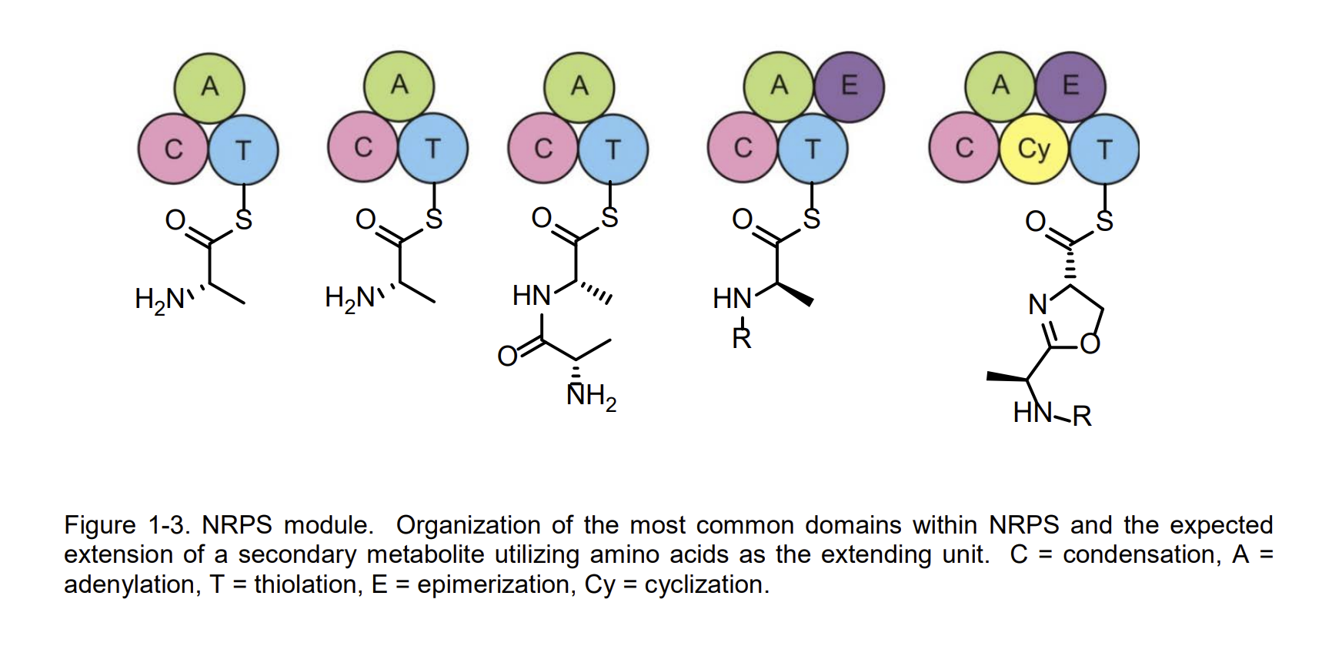
4

Slide 5
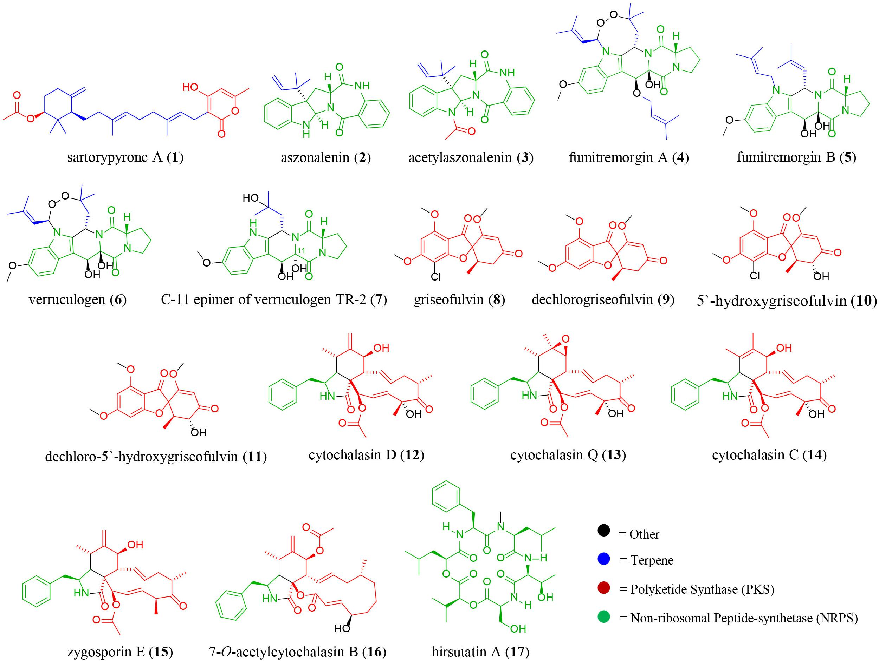
Knowles et al. (2019) Frontiers in Microbiology. 10.3389/fmicb.2019.00285
5

Slide 6
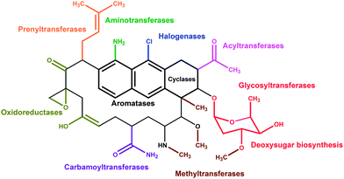
Olano, C., et al. Nat Prod Rep, 2010; 27, 571-616.
6

Slide 7
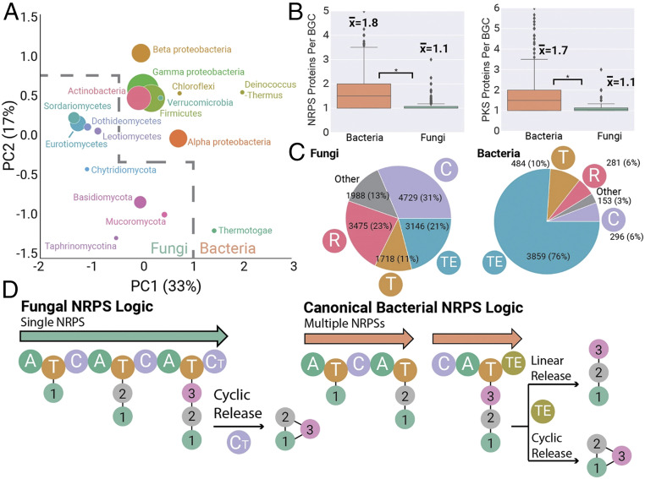
Distinct Differences in Biosynthetic Logic between Fungi and Bacteria
Robey, M.T., et al, PNAS, 2021; 118(19): e2020230118.
7
Notes:
Fungal BGCs are distinct from their canonical bacterial counterparts. (A) PCA of 36,399 fungal and 24,024 bacteria BGCs, with points sized according to the number of BGCs analyzed. Fungal and bacterial taxonomic groups occupy distinct regions of this biosynthetic space. (B) Fungal and bacterial BGCs differ in backbone enzyme composition, with fungal NRPS and PKS clusters typically encoding only a single backbone, compared to multiple-backbone enzymes found in bacterial BGCs. (C) Fungal and bacterial NRPS BGCs differ dramatically in their use of termination domains for release of peptide intermediates. (D) Fungal NRPS logic is distinct from bacterial canon. Most fungal NRPS pathways involve a single NRPS enzyme that utilizes a terminal condensation domain to produce a cyclic peptide. In contrast, bacterial NRPS enzymes contain multiple NRPS enzymes that operate in a colinear fashion and typically utilize thioesterase domains to produce linear or cyclic peptides.

Slide 8
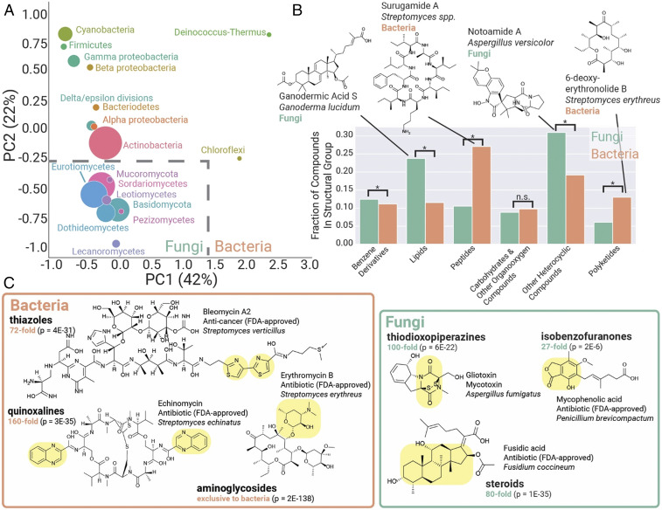
Robey, M.T., et al, PNAS, 2021; 118(19): e2020230118.
8
Notes:
Bacteria and fungi are distinct sources for natural product scaffolds. (A) PCA of 24,595 known bacterial and fungal compounds, with points sized according to the number of compounds. Fungal and bacterial taxonomic groups occupy distinct regions in this representation of chemical space for natural products. (B) Quantitative comparison of structural classifications in bacterial versus fungal compounds. (C) Bacteria and fungi represent distinct pools for bioactive compounds and scaffolds. Selected chemical moieties enriched and characteristic of each taxonomic group are highlighted in yellow. The fold enrichment of the chemical moiety is indicated in green, with P values from a chi-squared test indicated.

Slide 9
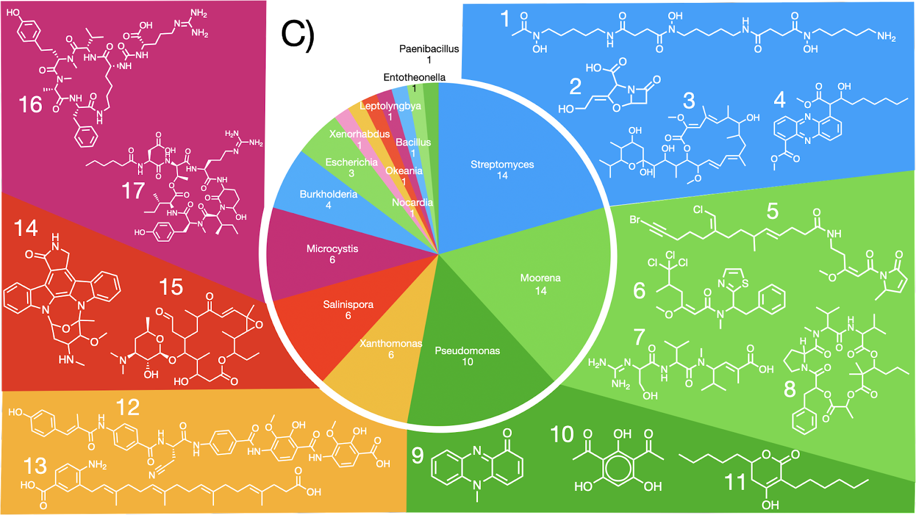
Exercise: what classes and moieties these metabolites contain?

Slide 10
Session 7a: part 2 (pdf file)

Slide 11
Session 7b: Structural annotation in the omics science

Slide 12
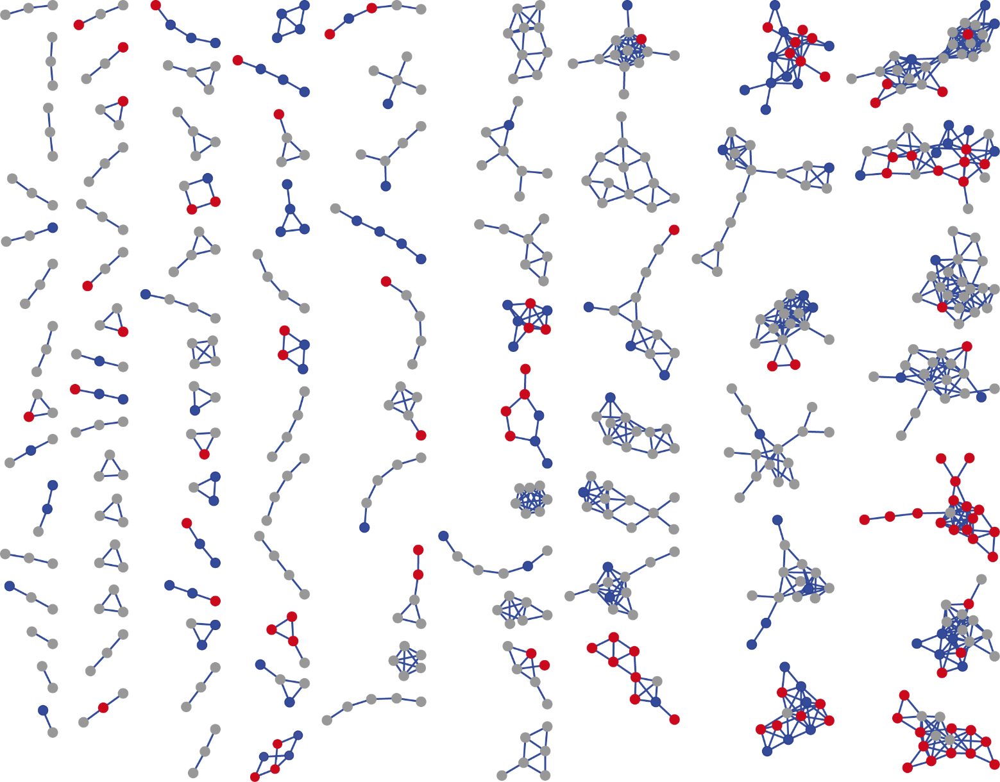
GNPS library hits can give us information about some molecular families, but what’s next ?
Polyketides
Library Hit B
Diterpenes
* DOI: 10.1073/pnas.1516878112
Macrolides
5–10% of spectral annotation rate*

Slide 13
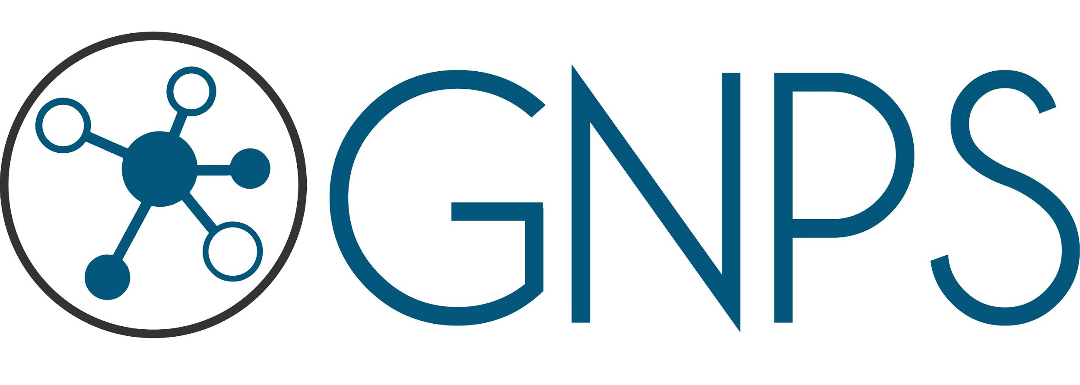
Enriching molecular networks annotation
MULTI-OMICS INTEGRATION
STATISTICAL ANALYSIS
PUTATIVE ANNOTATION
Rel. quantification
Structure annotation
Feature-Based
Molecular
Networking GNPS
NAP @GNPS
Microbial molecules
DEREPLICATOR @GNPS
SIRIUS
(MS-DIAL, MZmine2,
OpenMS, XCMS)
Annotating unknown
MetaMiner
MetWork
Integration
Statistics
MetaboAnalysist.ca
Qiime2.org
Mass2LDA @GNPS
MolNetEnhancer
Notes:
https://github.com/mohimanilab/MetaMiner/releases/tag/metaminer-2.4.0

Slide 14
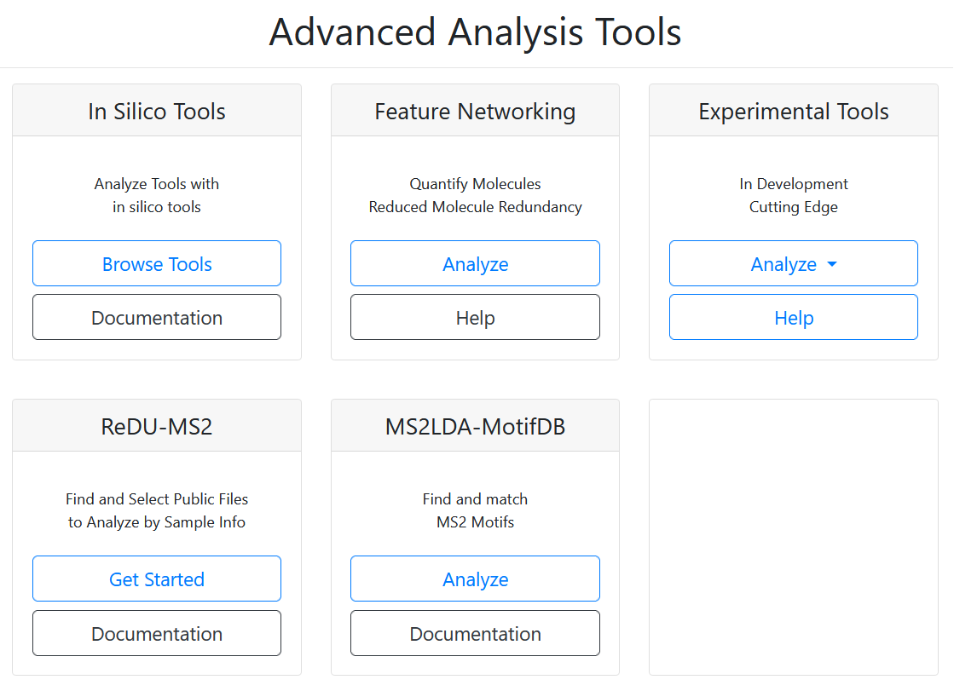
https://gnps.ucsd.edu/ProteoSAFe/static/gnps-splash.jsp

Slide 15
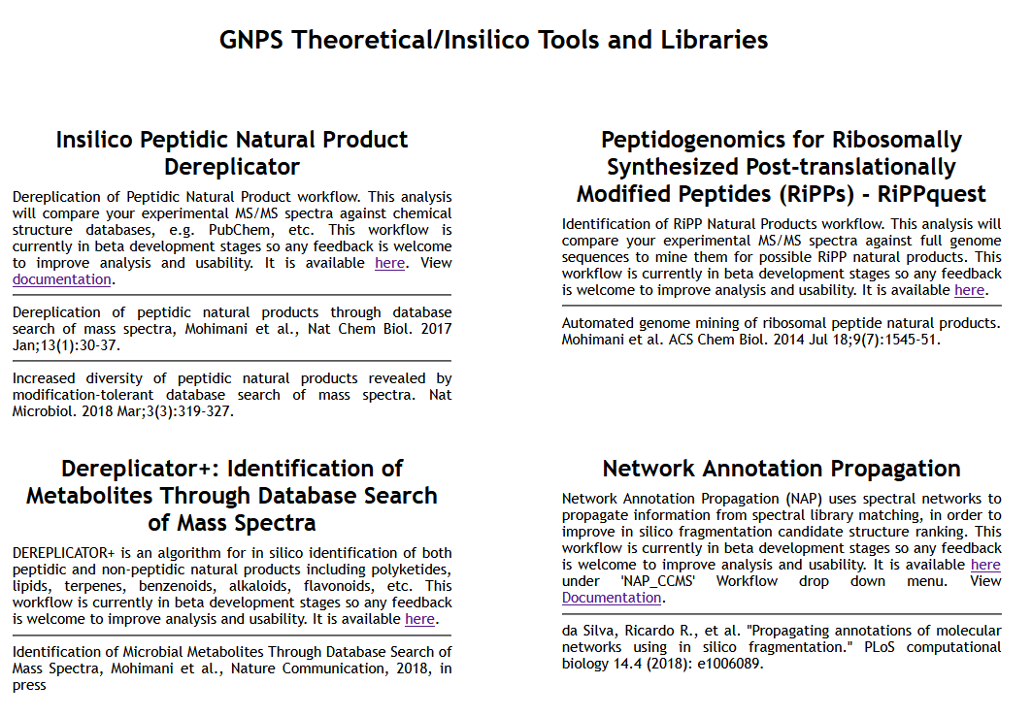
Mohimani, H. et al. Nat Chem Biol 2017, 13, 1, 30-37

Slide 16
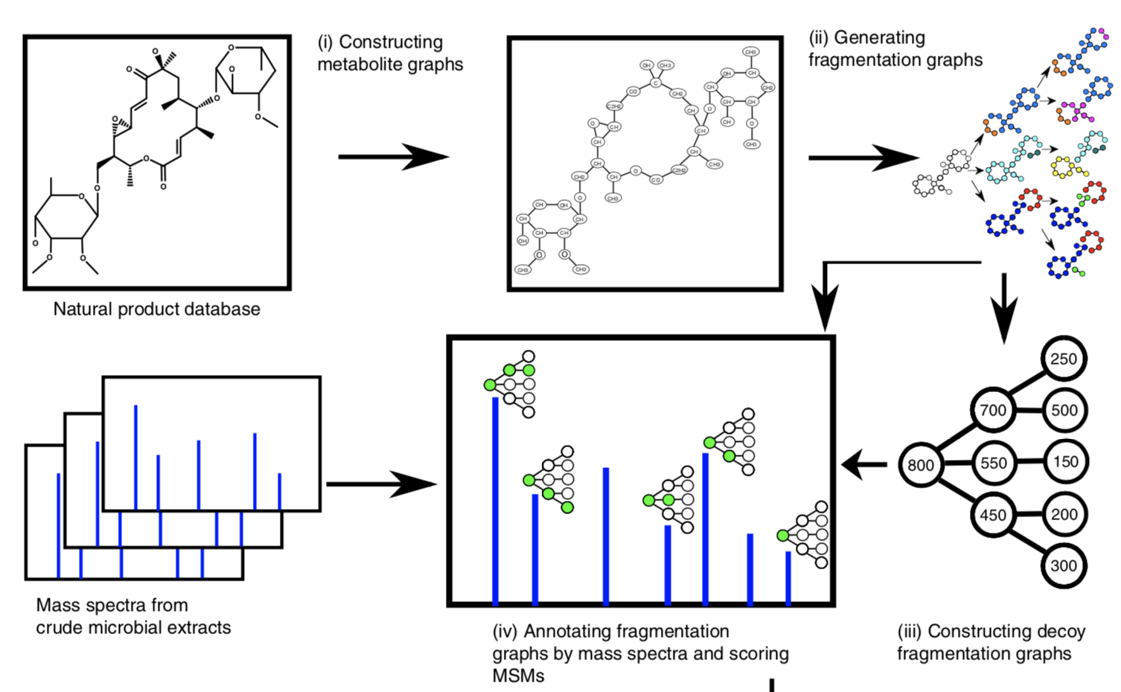
Dereplicator+

Slide 17
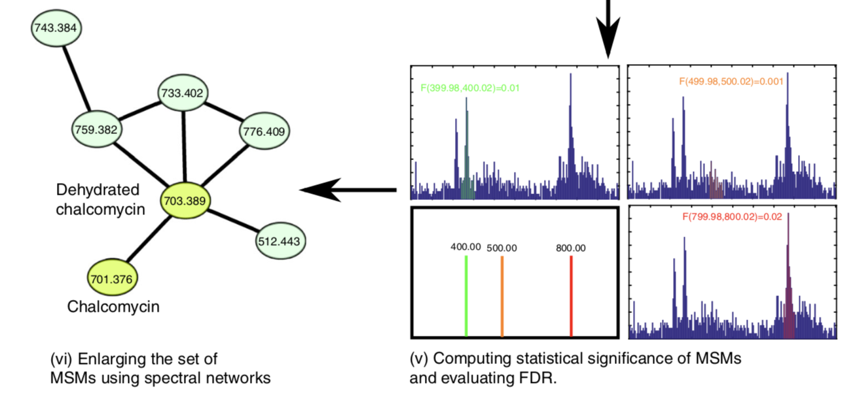
Dereplicator+

Slide 18
Network Annotation Propagation
Molecular network
Molecular networking
Spectral library
N x 10³
entries
Spectral library search
LC-MSMS experiment

Slide 19
Molecular network
Molecular networking
Spectral library
N x 10³
entries
Spectral library search
LC-MSMS experiment
Natural products
structure library
In Silico fragmentation
search
N x 10⁶
entries

Slide 20
Library hit
No hit

Slide 21
Library hit
in silico fragmentation hit
No hit

Slide 22
in silico score
1
0.7
0.3
Library hit
in silico fragmentation hit
No hit

Slide 23
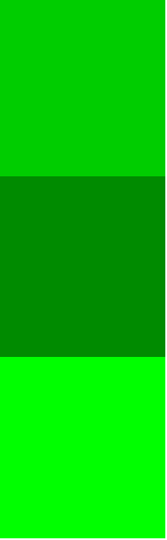
in silico score
1
0.7
0.3
re-ranked score
0.6
1
0.2
Fusion scoring
Fusion scoring
Library hit
in silico fragmentation hit
No hit

Slide 24
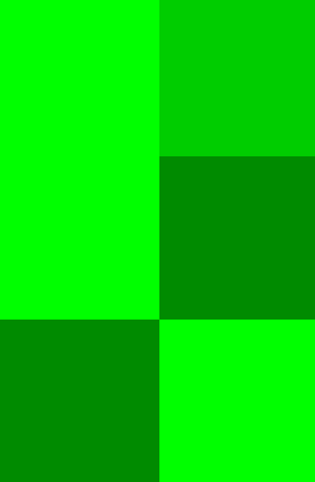
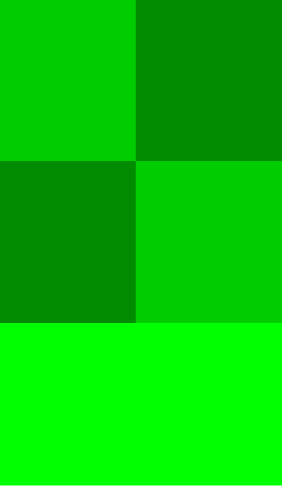
in silico score
1
0.7
0.3
re-ranked score
0.6
1
0.2
Fusion scoring
Consensus scoring
Fusion scoring
Library hit
in silico fragmentation hit
No hit

Slide 25
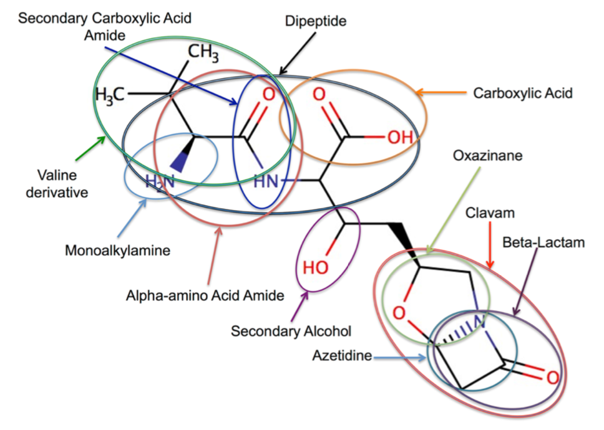
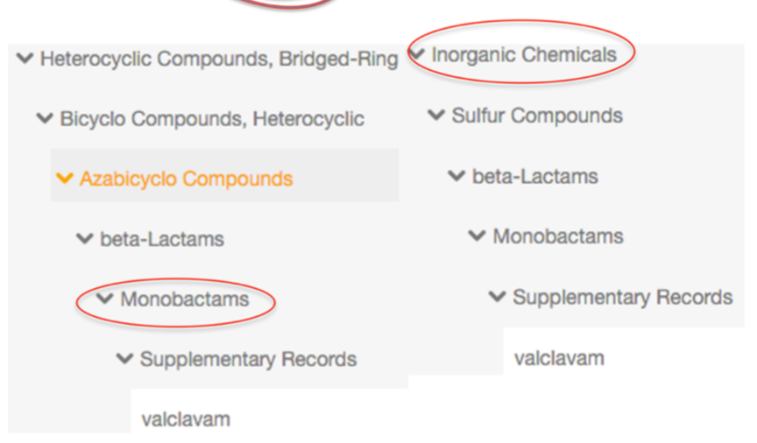
ClassyFire

Slide 26
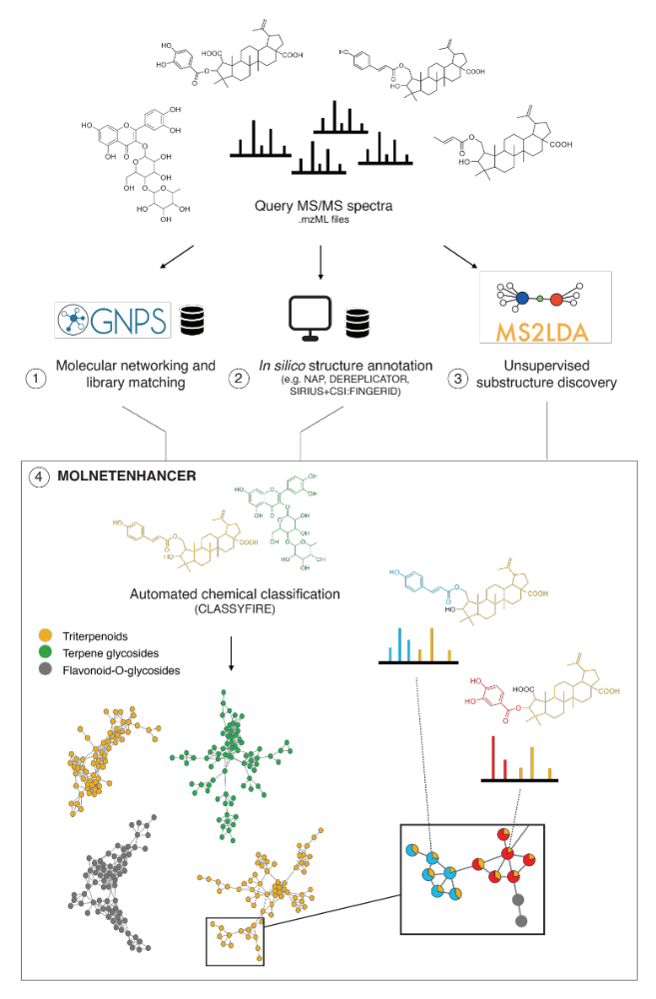
MolNetEnhancer
Ernst et al., Metabolites 2019, 9(7), 144
Enhanced annotation.
Discovery of relevant features.
Network
Annotation
Mining
https://github.com/madeleineernst/pyMolNetEnhancer
https://github.com/madeleineernst/RMolNetEnhancer

Slide 27
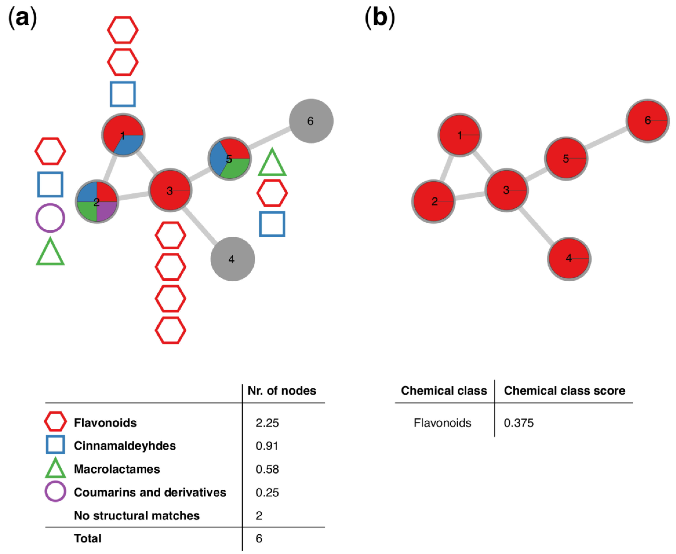
MolNetEnhancer
Ernst et al., Metabolites 2019, 9(7), 144
https://github.com/madeleineernst/pyMolNetEnhancer
https://github.com/madeleineernst/RMolNetEnhancer

Slide 28
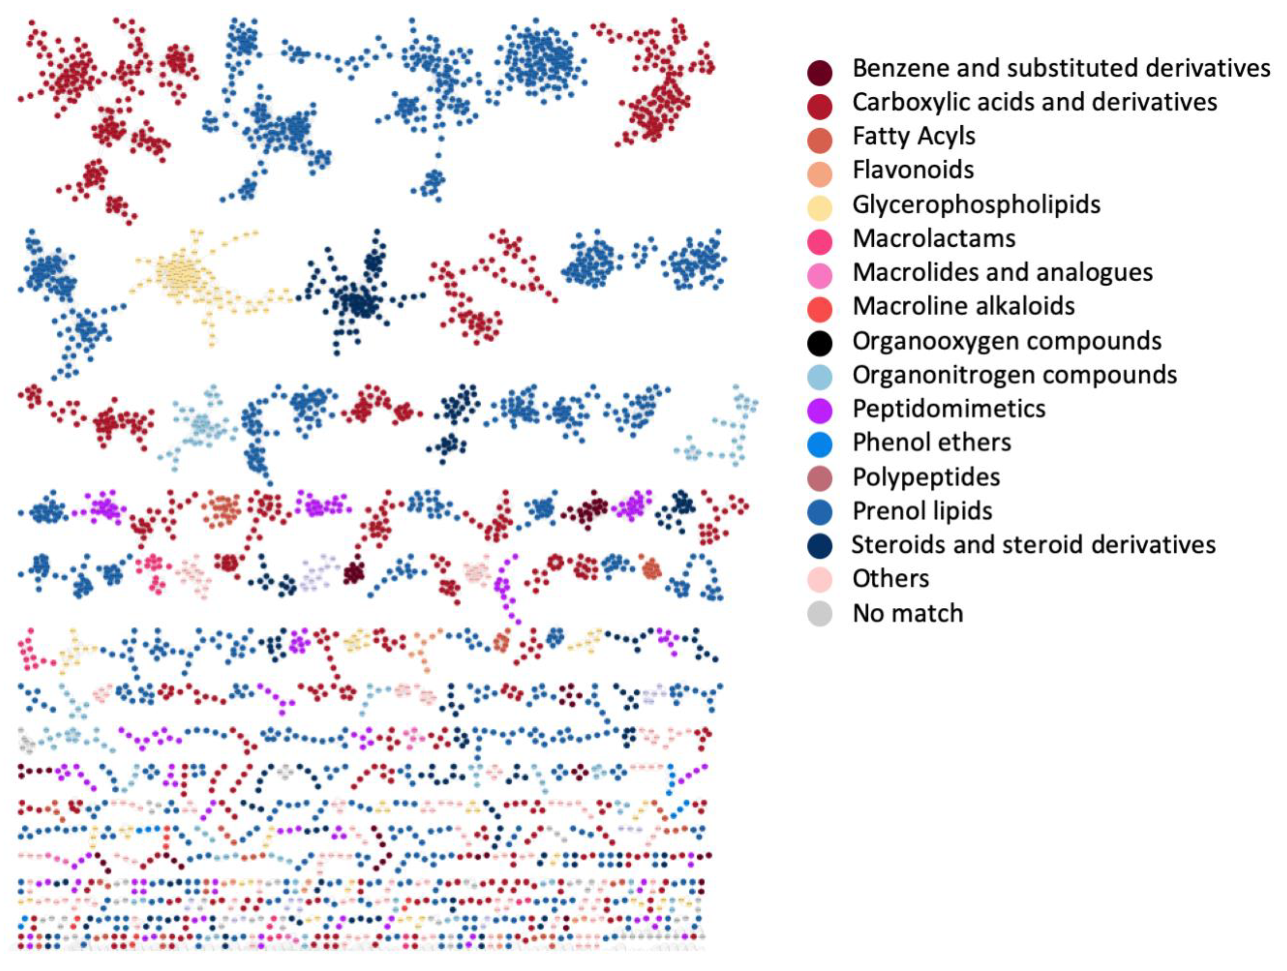
Chemical diversity of marine sediment Salinispora and Streptomyces
Ernst et al., Metabolites 2019, 9(7), 144
https://github.com/madeleineernst/pyMolNetEnhancer
https://github.com/madeleineernst/RMolNetEnhancer

Slide 29
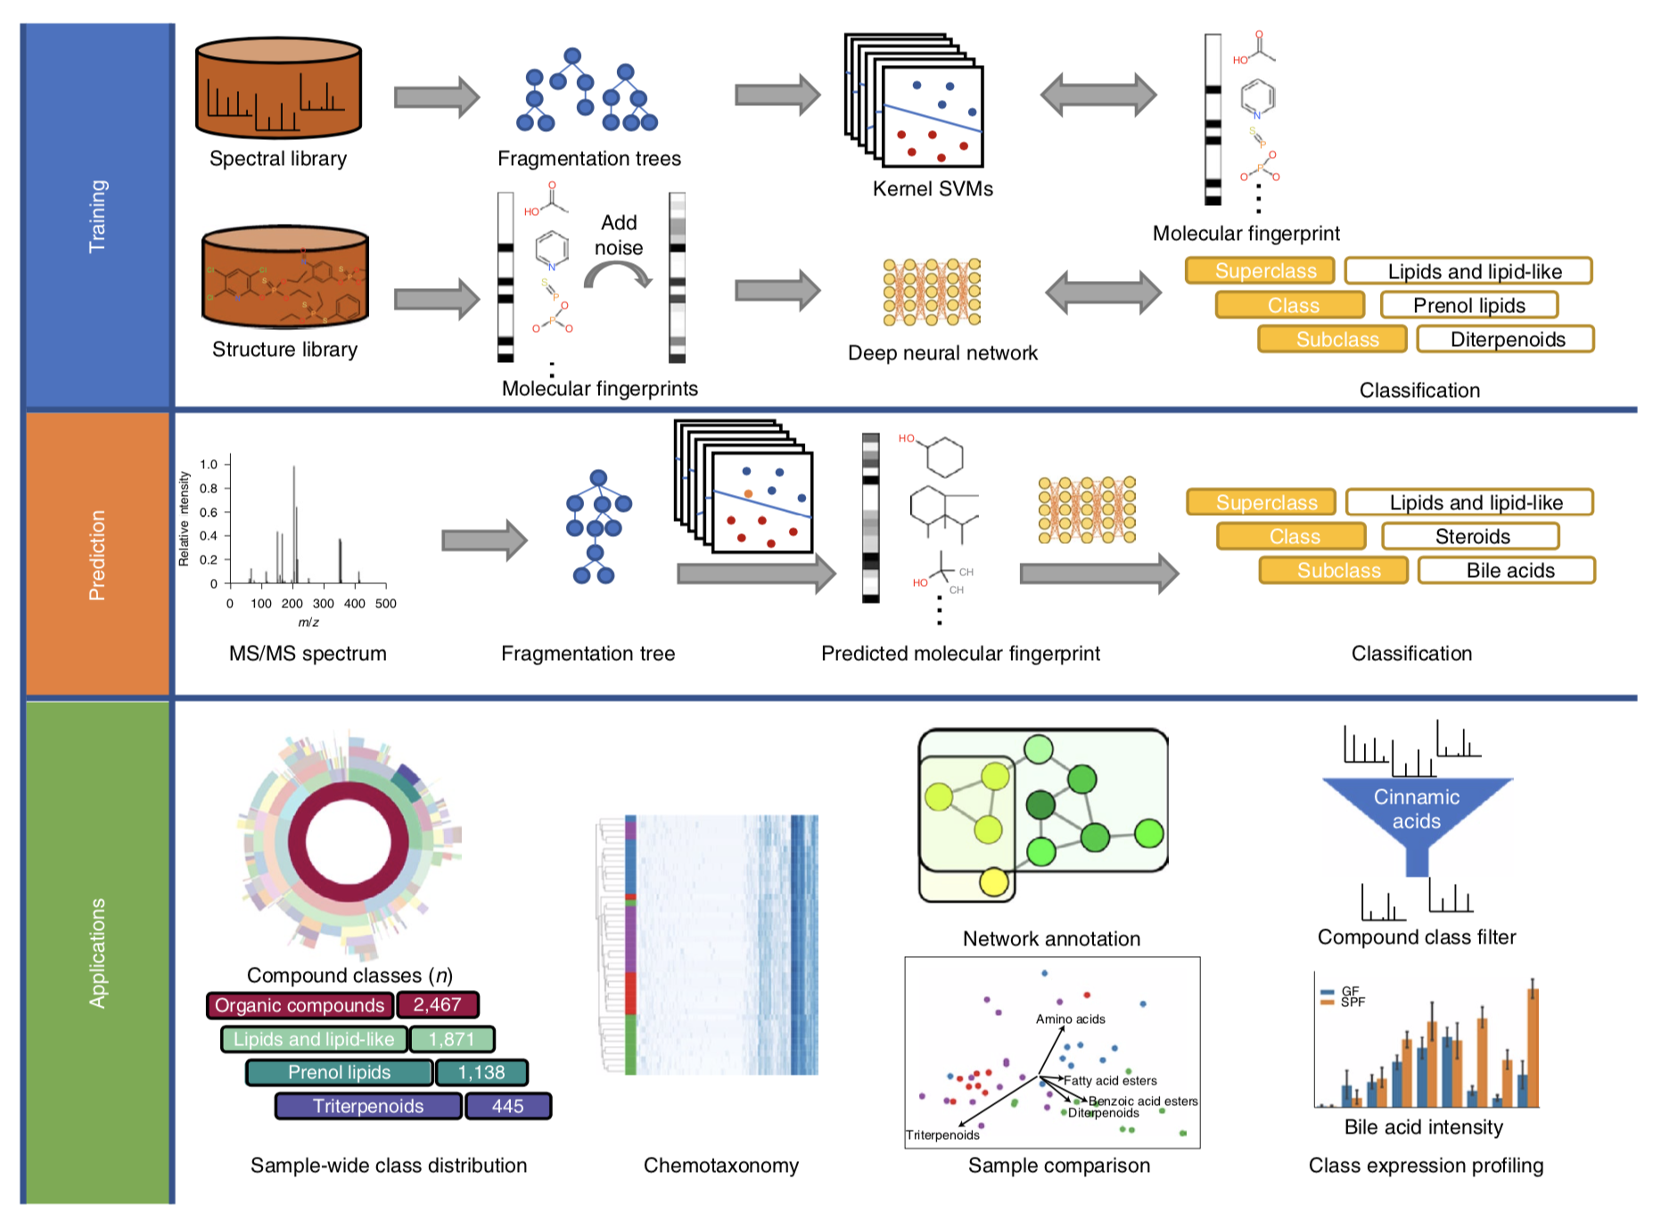
Canopus

Slide 30
Canopus

Slide 31
Canopus

Slide 32
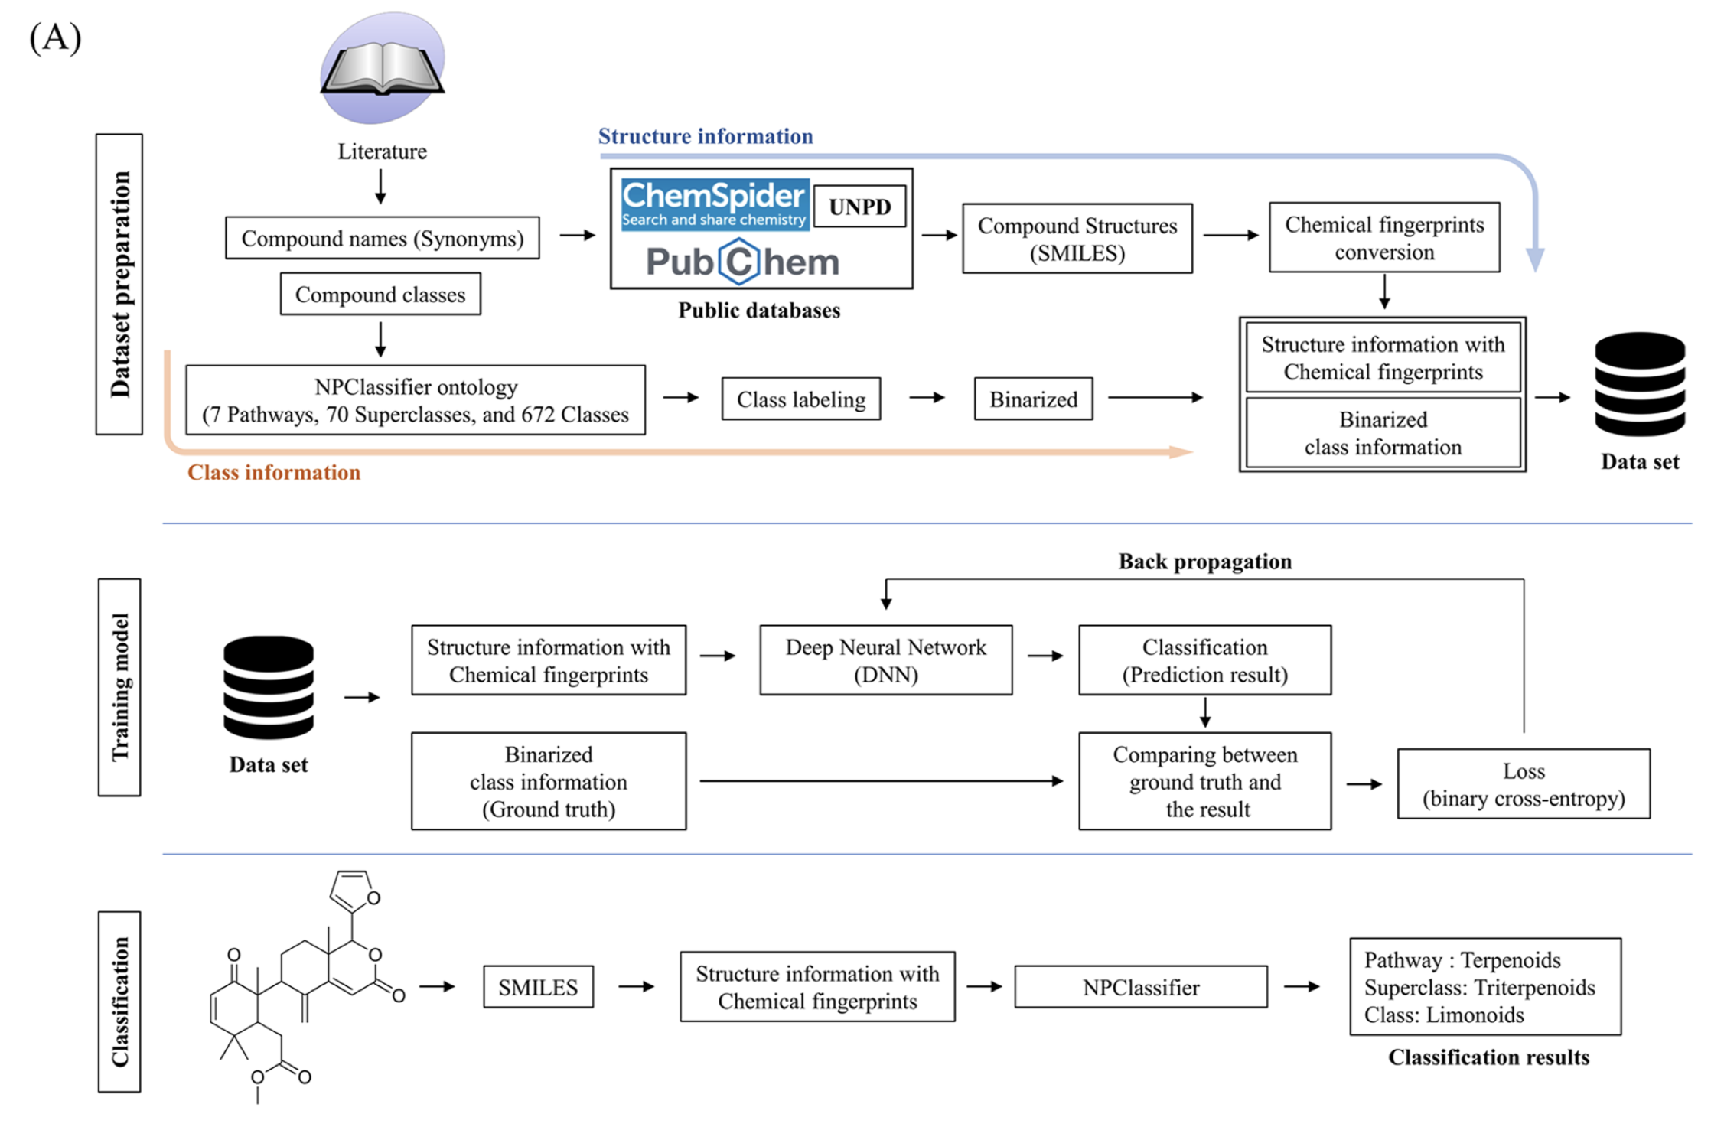
NPClassifier

Slide 33
NPClassifier

Slide 34
NPClassifier

Slide 35

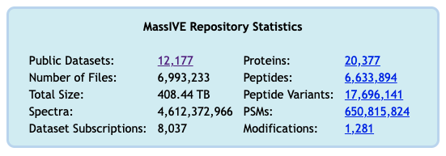
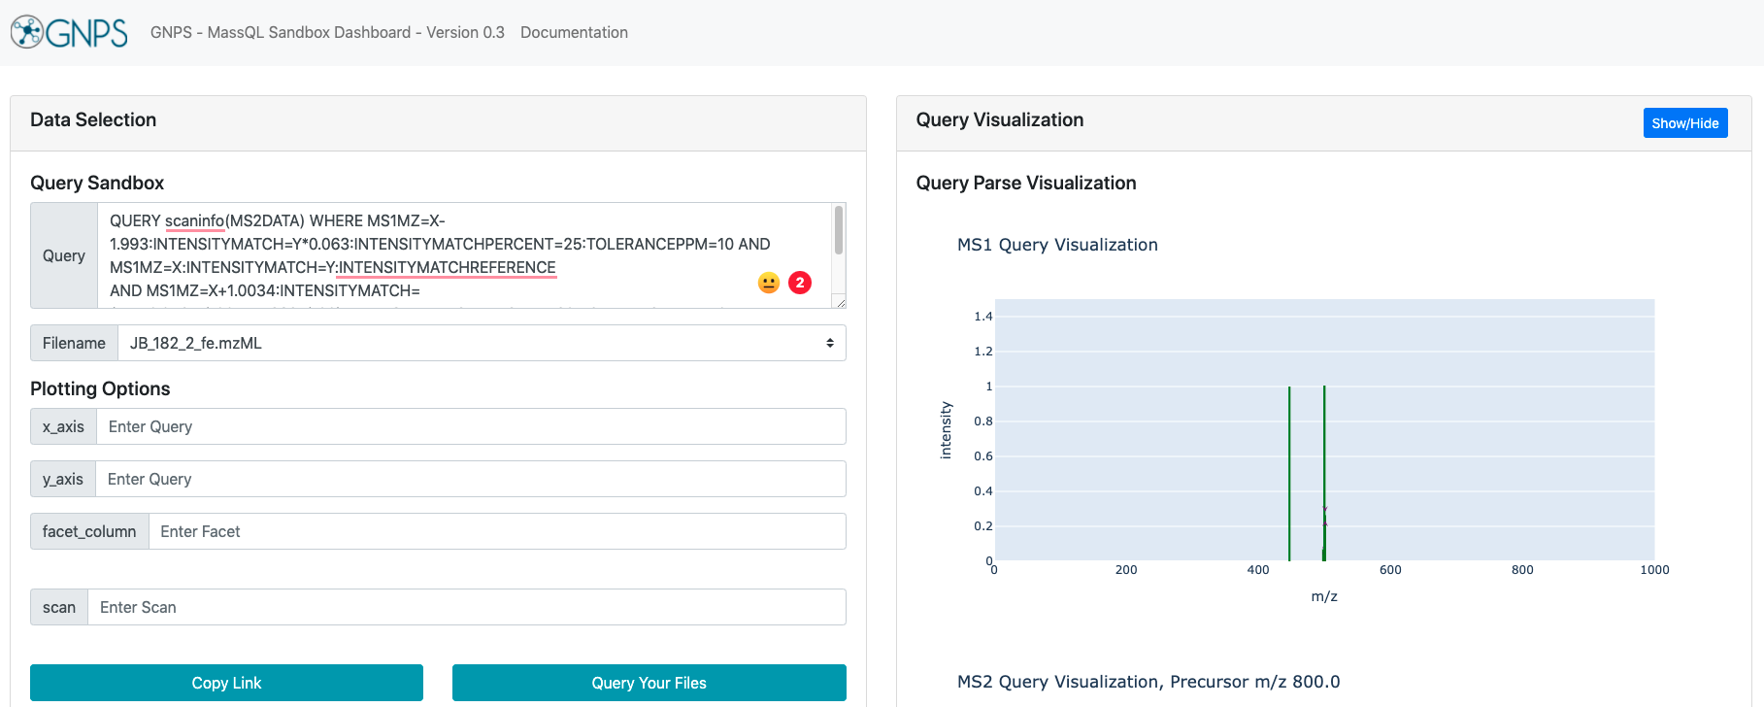
MassQL
How to search for spectra from public data?
Notes:
Development of the native metabolomics method was motivated by my desire to find all small-molecule siderophores when I started my postdoc. One approach to doing this would be mining public data.
My early attempts at this were not fruitful, because it was really challenging to search for MS1 patterns in GNPS.
This also isn’t possible the native metabolomics workflow because most datasets do not have the native metabolomics experimental component with it.
But this question was remained in the back of my mind …
So, when I was chatting with Ming last summer, and he told me about the new tool he was developing – MassQL – I thought, woah! this tool might be perfect for actually answering this question.

Slide 36



Mass Query Language is a powerful new tool
MassQL
  Understandable
    Easy to Read and Write
  Flexible
    Describe complex MS patterns + RT + Mobility
  Scalable
    Full repository scale searches (1B+ MS spectra)
  Reusable
    Sharing and Re-use of Queries
Scalable
Flexible
Reusable
Understandable
Notes:
Ming introduced MassQL, or the Mass query language, a few lab meetings back, but just as a refresher, the Mass Query language is a tool that allows us to search for patterns in mass spectrometry data using a simple set of search terms.
In addition, MassQL is easy to read and write, can be used to describe rather complex patterns (as you’ll see in some of the queries I’ll show you), and is scalable and easy to share.

Slide 37
  QUERY scaninfo(MS2DATA) WHERE
MassQL
Returning the scan information on MS2.
English
Notes:
So this is what a query actually looks like. We can query both MS1 and MS2 data.

Slide 38
  QUERY scaninfo(MS2DATA) WHERE
  MS2PROD=468:TOLERANCEMZ=0.1 AND
MassQL
Returning the scan information on MS2.
The following conditions are applied to find scans in the mass spec data.
Finding MS2 peak at m/z 468.0 with a 0.1 m/z tolerance.
English
Notes:
We can find a peak in the MS2 or the MS1.

Slide 39
  QUERY scaninfo(MS2DATA) WHERE
  MS2PROD=468:TOLERANCEMZ=0.1 AND MS2PROD=660:TOLERANCEMZ=0.1
MassQL
Returning the scan information on MS2.
The following conditions are applied to find scans in the mass spec data.
Finding MS2 peak at m/z 468.0 with a 0.1 m/z tolerance.
Finding MS2 peak at m/z 660.0 with a 0.1 m/z tolerance.
English
Notes:
And then we can find another peak. We can also define tolerances and intensities.

Slide 40
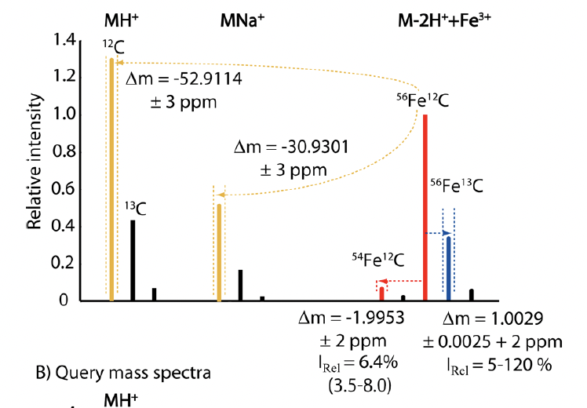
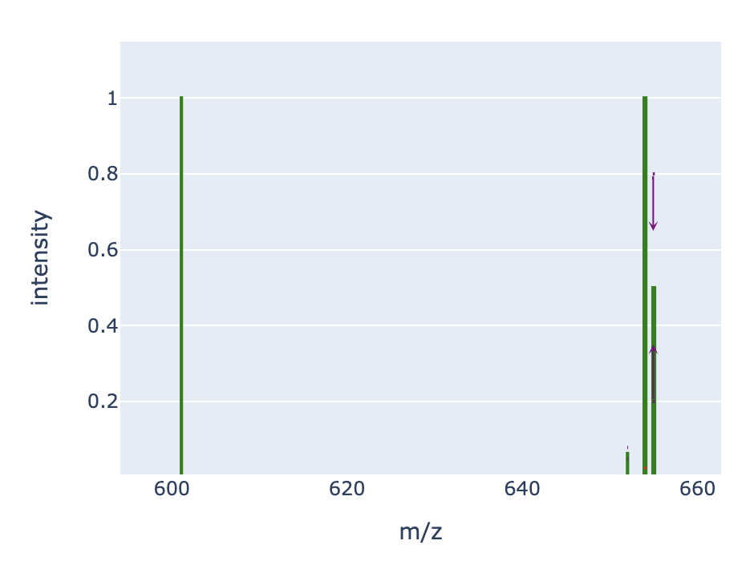
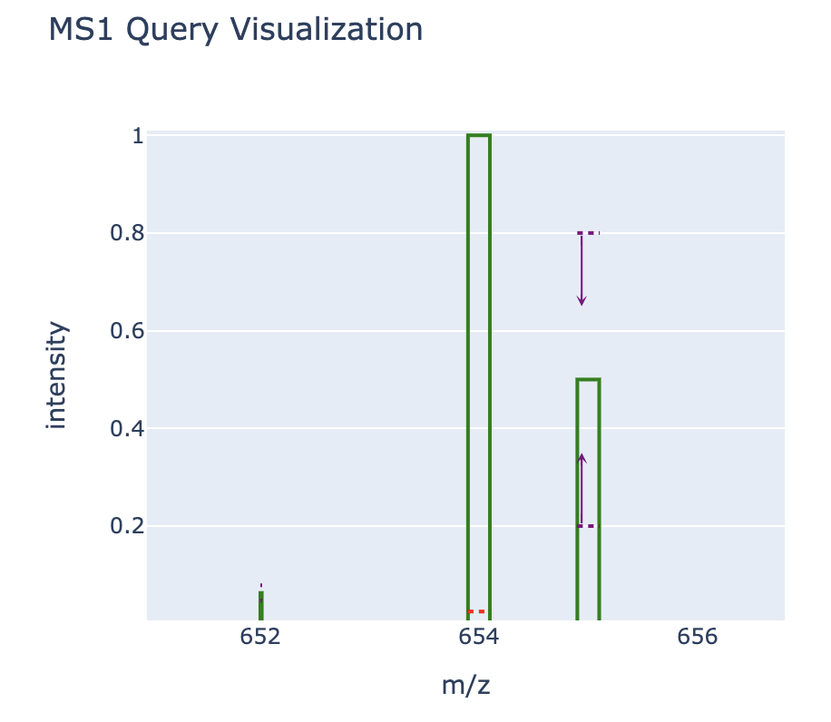
Mass Query Language facilitates search for metal-binders in public data
QUERY scaninfo(MS1DATA) WHERE
MS1MZ=X- 1.993: INTENSITYMATCH=Y*0.063:
AND MS1MZ=X:INTENSITYMATCH=Y:
AND MS1MZ=X+1:INTENSITYMATCH=Y*0.5:
AND MS1MZ=X-52.91:TOLERANCEPPM=10 AND MS2PREC=X
MH⁺
¹²C
M-2H⁺ +Fe³⁺
M-2H⁺ +Fe³⁺
Δm/z = 52.911
⁵⁶Fe¹²C
Relative Intensity
⁵⁶Fe¹³C
¹³C
Δ
m/z = 52.91
⁵⁴Fe¹²C
Δm = 1.995
I_{rel} = 6.3%
Δm = 1.003
I_{rel} = 5-75%
Δ
m/z = 1.993
Δ
m/z =1
Y
Y ^{x} 6.3%
Notes:
I realized that using this tool, we can actually search for a metal-specific isotope patterns and m/z delta in the MS1.
I realized that iron would be a great starting point for this, since it has a unique isotope pattern, with the presence of a diagnostic x-2 peak at 6.3% abundance that corresponds to the 54Fe isotope.
Using the MassQL, we can write a simple query that searches all publicly available data for this very specific iron-diagnostic isotope pattern. We can visualize each part of the query in this plots.

Slide 41
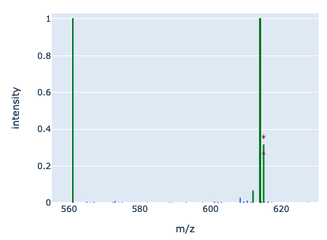
Query 1:
Query for Fe-bound MS2 associated with iron isotope pattern
English translation
Returning the scan information on MS2.
Finding MS1 peak at m/z X-1.993 an expected relative intensity to reference peak of Y*0.063 and accepting variability of 25.0% in relative intensity and a 10.0 PPM tolerance.
Finding MS1 peak at m/z X an expected relative intensity to reference peak of Y and this peak is used as the intensity reference for other peaks in the spectrum.
Finding MS1 peak at m/z X+1.0034 an expected relative intensity to reference peak of Y*X*0.04911/100.0+Y*1.2397/100.0 and accepting variability of 20.0% in relative intensity and a 10.0 PPM tolerance.
Finding MS1 peak at m/z X-52.91 a 10.0 PPM tolerance.
Finding MS2 spectra with a precursor m/z X.
Query language
QUERY scaninfo(MS2DATA) WHERE MS1MZ=X-1.993:INTENSITYMATCH=Y*0.063:INTENSITYMATCHPERCENT=25:TOLERANCEPPM=10 AND MS1MZ=X:INTENSITYMATCH=Y:INTENSITYMATCHREFERENCE
AND MS1MZ=X+1.0034:INTENSITYMATCH=(Y*X*0.04911/100+Y*1.2397/100):INTENSITYMATCHPERCENT=20:TOLERANCEPPM=10 AND MS1MZ=X-52.91:TOLERANCEPPM=10 AND MS2PREC=X
Notes:
I have also been interested in querying for the MS2 associated with the metal-bound species. I am specifically interested in collecting these spectra to see if we can start to better understand how metal-binding affects MS2 fragmentation. The ideal case would be that we are actually able to find patterns that are diagnostic of metal-binding.
The difference between this query and the one in the last slide is again highlighted in pink.

Slide 42
Query 2:
Query for apo MS2 associated with iron isotope pattern
English translation
Returning the scan information on MS2.
Finding MS1 peak at m/z X-1.993 an expected relative intensity to reference peak of Y*0.063 and accepting variability of 25.0% in relative intensity and a 10.0 PPM tolerance.
Finding MS1 peak at m/z X an expected relative intensity to reference peak of Y and this peak is used as the intensity reference for other peaks in the spectrum.
Finding MS1 peak at m/z X+1.0034 an expected relative intensity to reference peak of Y*X*0.04911/100.0+Y*1.2397/100.0 and accepting variability of 20.0% in relative intensity and a 10.0 PPM tolerance.
Finding MS1 peak at m/z X-52.91 a 10.0 PPM tolerance.
Finding MS2 spectra with a precursor m/z X-52.91.
Query language
QUERY scaninfo(MS2DATA) WHERE MS1MZ=X-1.993:INTENSITYMATCH=Y*0.063:INTENSITYMATCHPERCENT=25:TOLERANCEPPM=10 AND MS1MZ=X:INTENSITYMATCH=Y:INTENSITYMATCHREFERENCE
AND MS1MZ=X+1.0034:INTENSITYMATCH=(Y*X*0.04911/100+Y*1.2397/100):INTENSITYMATCHPERCENT=20:TOLERANCEPPM=10 AND MS1MZ=X-52.91:TOLERANCEPPM=10 AND MS2PREC=X-52.91
Notes:
But even with the heavy lifting done on this query, I needed to figure out which scans we specifically wanted to find.
For molecular networking and for finding library matches in GNPS, I realized that we needed to find the MS2 of each proton-bound siderophore. That is what this query searches for – specifically highlighted by the pink part of the query.
The rest of the query was what we optimized using the Siderophore Base and computational isotope patterns that I showed in the last slide.

Slide 43
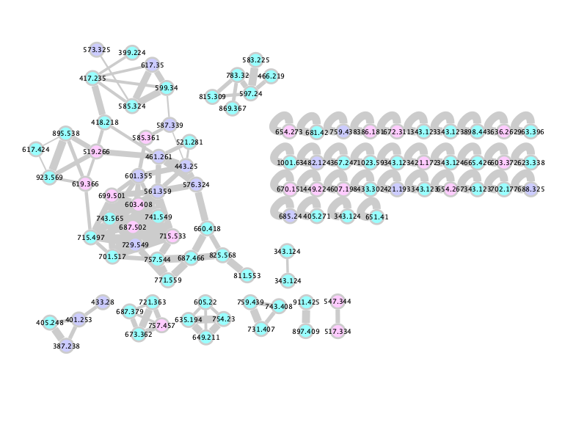
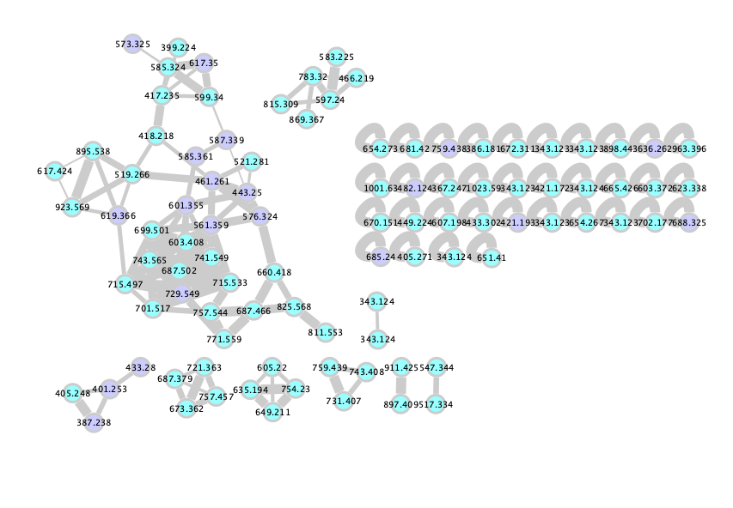
Mining for new siderophores:
Streptomyces strain project with and without iron infusion
Obtain MS2s of known siderophores to add to GNPS library
Discover new metal-binding compounds
Annotated
Unannotated
Unannotated, but exact mass found in Siderophore Base
https://gnps.ucsd.edu/ProteoSAFe/status.jsp?task=02e2bcdbfe7a4c538db00d741680eb02
Notes:
With proof-of-concept searches looking promising, I wanted to use this workflow to mine two datasets for novel siderophores – first, I wanted to look at a dataset containing thousands of streptomyces strains (spearheaded by Mauricio.
Excitingly, applying the MassQL query to this streptomyces dataset yielded siderophore hits. Mauricio and I decided that by comparing MassQL hits from samples run without post-LC iron infusion with samples run with infusion, we could find siderophores and weed out false hits.
We’ve gotten through just 60 isolates thus far, but here’s a network showing the MassQL hits. This workflow works really well – the purple nodes are annotated siderophores in GNPS. The blue nodes are unannotated compounds. The pink nodes are unannotated compounds that have the same exact mass as known siderophores.
I’m really excited to follow up on these pink nodes and add them to GNPS libraries, which promises to significantly increase the number of siderophores in GNPS.
I’m also eager to look through these genomes for biosynthetic machinery that can be linked to these blue nodes, with the goal of finding new metal-binding compounds from these strains.
https://proteomics2.ucsd.edu/ProteoSAFe/status.jsp?task=b1461856b87d4e1b8d4492dbdcefe179#
https://proteomics2.ucsd.edu/ProteoSAFe/status.jsp?task=96f1de96ac2047d8abf68b8962faccdf
https://proteomics2.ucsd.edu/ProteoSAFe/status.jsp?task=62c6433498d549a3b1853fe7c033b2b6

Slide 44
Session 8: Outlook toward integrative omics mining

Slide 45
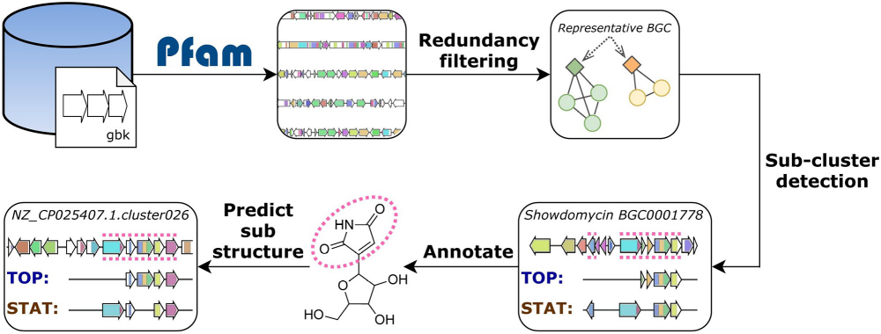
iPRESTO for substructure prediction
Louwen et al., PLOS Computational Biology, 2023;19(2), e1010462
Notes:
Each gene in a BGC is assigned a Pfam domain (a “protein family” assigned based on sequence alignments with a purported function)
Redundant BGCs are filtered
Sub-clusters are detected within BGCs using two methods
Statistical approach “PRESTO-STAT”: finds sub-clusters (from which sub-structures can be predicted) based on genes that co-occur in a statistically significant fashion across a collection of BGCs
Topic modelling algorithm “PRESTO-TOP”: learns a set of sub-cluster motifs from a collection of BGCs
The resulting subclusters can then be annotated/dereplicated with the MiBIG database and used to predict substructures encoded by BGCs

Slide 46
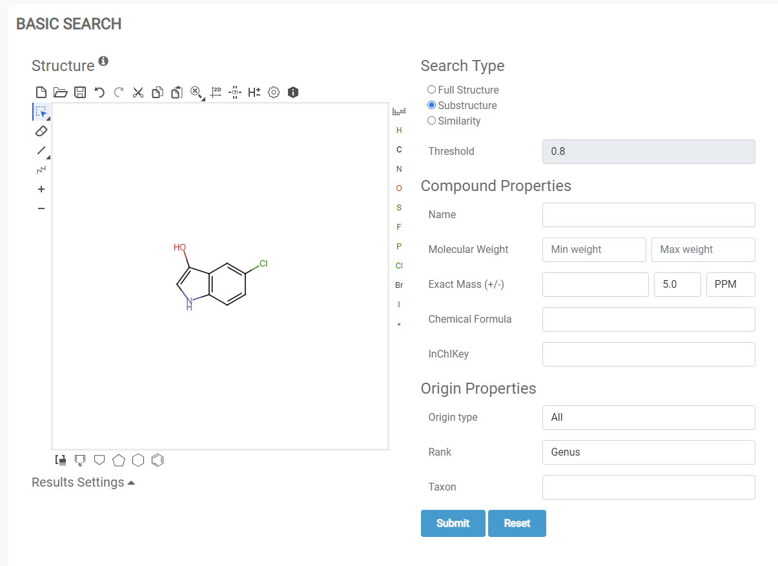

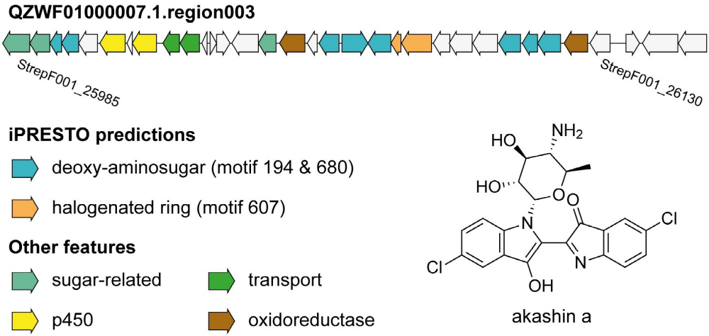
iPRESTO can identify BGCs of orphan metabolites through sub-cluster presence
Louwen et al., PLOS Computational Biology, 2023;19(2), e1010462
Notes:
iPRESTO generated substructures from BGCs with no known metabolite products put into NPAtlas to find related metabolites
Note: many gene clusters were linked to metabolites this way, but many were known just not in MiBIG, our databases are not updated frequently, limiting progress! Data sharing is data caring ☺
In addition to finding knowns that were not previously on MiBIG, this approach successful linked akashin a, a previous “orphan metabolite” to its BGC

Slide 47
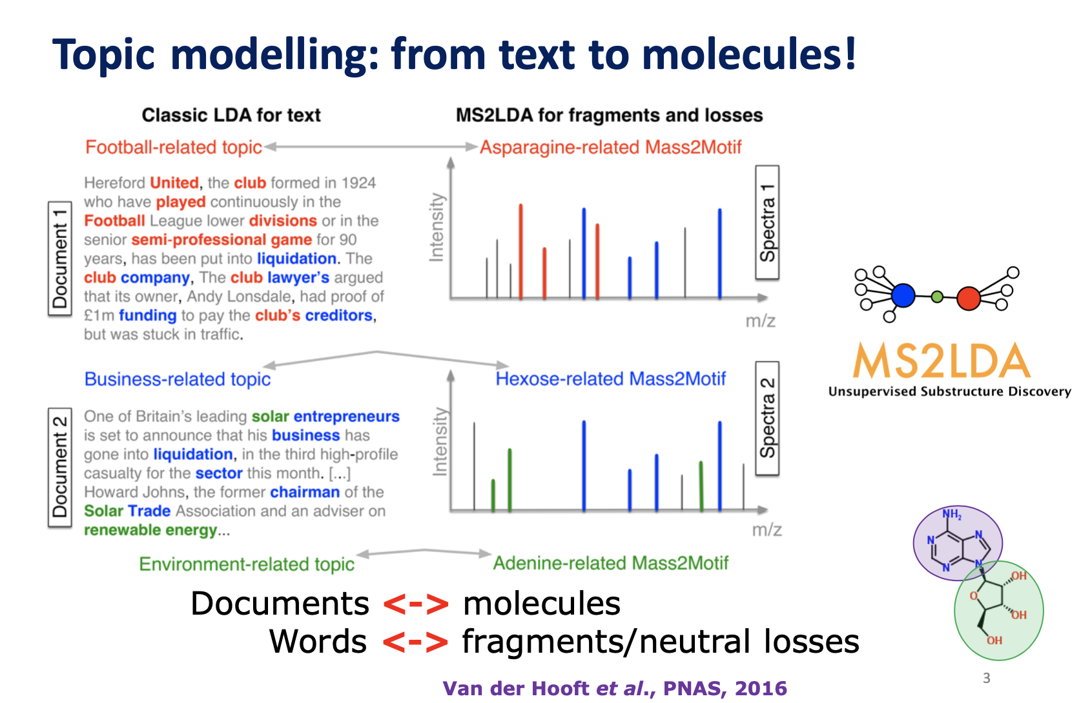

Slide 48
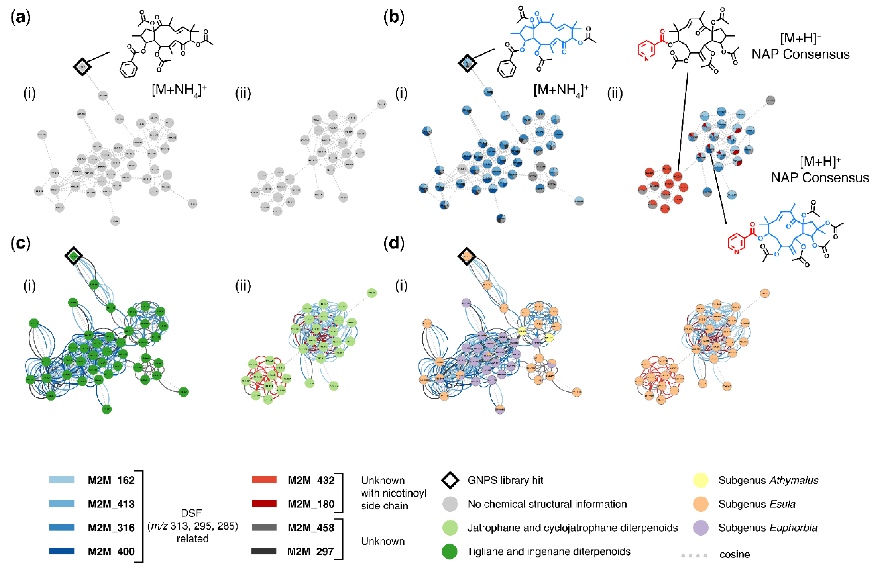
MolNetEnhancer increases chemical structural information obtained for Euphorbia specialized metabolites.
Ernst et al., Metabolites 2019, 9(7), 144
https://github.com/madeleineernst/pyMolNetEnhancer
https://github.com/madeleineernst/RMolNetEnhancer

Slide 49
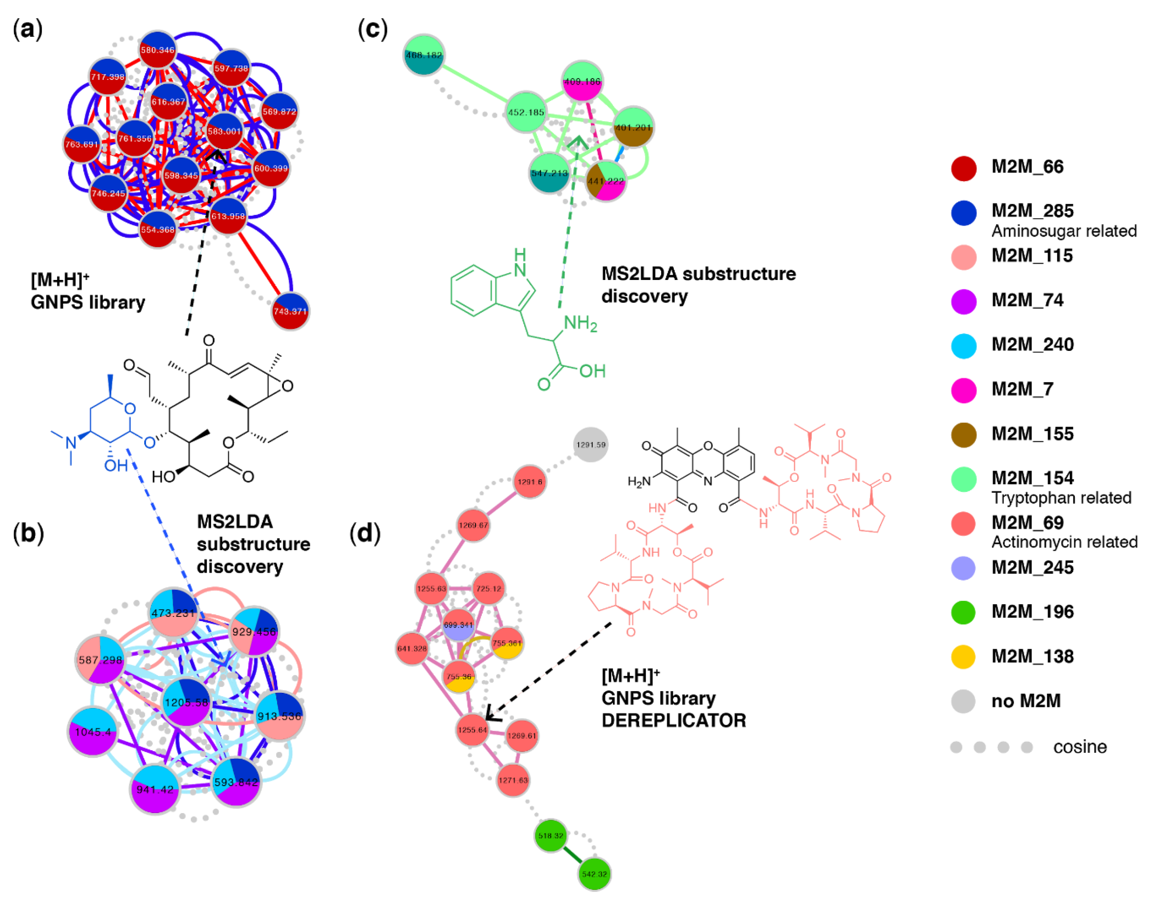
Chemical diversity of marine sediment Salinispora and Streptomyces
Ernst et al., Metabolites 2019, 9(7), 144
https://github.com/madeleineernst/pyMolNetEnhancer
https://github.com/madeleineernst/RMolNetEnhancer

