Slide 1

Competing with Social Networks: Social Platforms
Suman Das(M20DH019)

Slide 2
Case Overview
Concept of Social failure for example, are we to compare a career disappointment (not attaining a desired promotion) with continued and hopeless poverty?
Develop a module that can alleviate social failure
Generate profit from social platform

Slide 3
3 main take aways
effective social solutions overcome both the economic restrictions on offline interactions and the normative constraints
Social products “meet” & “Friend”
social platforms that protect by making smart strategic trade-off

Slide 4
Why Social failure?
Breath Causes (Not enough people interaction)
Display Cause (People can’t display enough information)
Search Failure (People can’t search for information)
Interaction Failure (people can’t initiate interaction with each other)

Slide 5
Platform Analysis
What kind of search solution platform offer?
Allowing people to view personal information ( Facebook)
Whereas mixi platform automatically inform user when someone viewed your profiles.
What is eHarmony doing differently than OkCupid ?
OkCupid
Open-ended interaction is very easy
Overcome normative restriction on interactions
Allows user to interact with many strangers privately
eHarmony
Disallowing Direct contact
Reduce the efficiency of contact on the site
Allows user to interact few strangers privately
eHarmony positioning the marketplace

Slide 6
Platform Analysis
Compare Mixi and Facebook’s design choices? Which Monetization Mixi should pursue
mixi
User can post three- four paragraph diaries detailing what has been happening with them & revealing inner thoughts
elicit deeper and more personal content, they pay a dear price
Facebook
users post short status updates, pictures, and links to external content etc.
It could give users privacy controls, allowing them to display private information to their closest friends,
mixi Monetization strategy Note:
mixi consider to be a “friend” product.
monetized indirectly- such as advertising, customer acquisition or retention

Slide 7
What is LinkedIn social solution model and how it is competitive than others?
LinkedIn offers both “meet” and “friend” products
Individuals can display all of their professional achievements, and make themselves visible to recruiters ( “meet” product)
the employer gets to use the employee’s social network for business purposes.( “friend” product)
behavior seeking interactions -- ethical dangers combining two product in in the context of personal relationships
Friendster- also offer “meet” and “friend” products
-search for privately interact with other people
- people in relationships who used it to search for and privately interact with other people of the opposite gender

Slide 8
What should Twitter do to increase their revenue?
It difficult to generate revenue out of data analytics
Twitter’s data was not representative of the general population
Limited ability to generate revenue.
Advertising Services (represents about 86% of the company’s revenues)
Data Licensing (makes up about 14% of Twitter’s revenues)
Promoted Trends (A topic is considered trending)
Promoted Accounts (to gain more visibility and increase their number of followers)
Note:
Twitter is a kind of “meet” product, so to increase the revenue, we could monetized directly by asking strangers to pay for meeting other people.

Slide 9
Was Meetup Successful in making people meet in real life scenario ?
MeetUp only focused on search functionalities, no interaction
It did not attract many users, which further suppressed its ability to generate profit.
If you are more active on group activities, then it works well for you.
It's also useful if you're looking to expand your social circles.
When it come to Safety option – Meetup has no identity verification process.
Though it is free to use, some organizers will charge group membership fees.

Slide 10
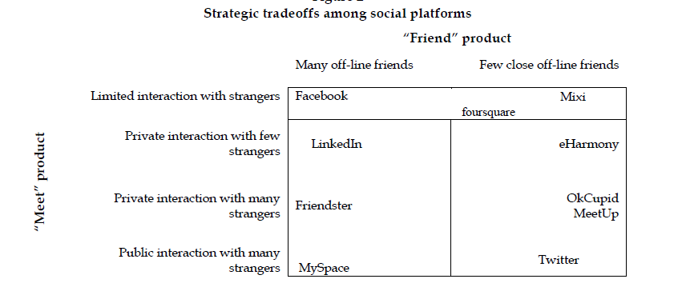
- What is it that makes some Social platforms more appealing to users for long terms and strong enough to withstand the competitive pressure ?
eHarmony vs OkCupid
Facebook vs Mixi
LinkedIn vs Friendster vs Facebook

Slide 11
How can Social Platforms capture the value they create and turn it into profit . Illustrate by examples?
Consumers on an average spend 20% of their time on social media (Fan & Gordon 2014).
technology allows us in today’s world to be “wired” and connected at all times through smart technology. companies have vast amount of information used to generate richer insight about consumers
Facebook:
self-serve advertising enables anyone to create and put up an ad on Facebook
Facebook to sell advertising space to companies and organizations who want to hone in on a specific demographic, like video game players and so on.
Source:https://cacm.acm.org/magazines/2014/6/175163-the-power-of-social-media-analytics/fulltext

Slide 12
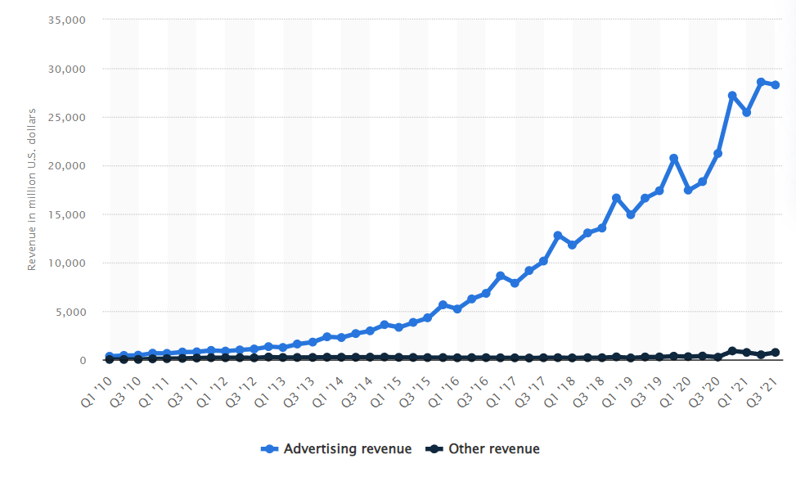
According to Statista report Facebook earns 98% revenue from Ads & remaining 2% comes from other section (selling Oculus and Portal devices etc.)

Slide 13
THANKS!

