Slide 1
Distributed Peer Review (DPR)
Design and implementation of the DPR:
distribution of proposals to reviewers.
Fabio Sogni, Dario Dorigo, Lucas Astolfi
Scientific team: Tereza Jerabkova, Ferdinando Patat
Just start the presentation and keep clicking.

Slide 2



DPR project: where we were
At the end of 2021 we just
completed part of the p1Flow project…
…we had a new proposal submission system…
Proposal submission system
…we had an old distribution mechanism.
Panel 1
Panel 2
Panel 3
Panel 4
…and a new application used for the panel review, but…
Proposal evaluation interface

Slide 3
DPR project: where we were
The Distributed Peer Review Experiment
https://www.eso.org/sci/publications/messenger/archive/no.177-sep19/messenger-no177.pdf
Proposal submission system
Proposal submission system
Reviewer1
Proposal1
Panel 1
Panel 2
R2
P2
R3
P3
R4
P4
Panel 3
Panel 4
R5
P5
In the mean time this article was published…
Proposal evaluation interface
…and after the experience of Alma,
we decided that it was time to implement the Distributed Peer Review
Proposal evaluation interface

Slide 4


The DPR project: risk factors and skills
We were not worried at all.
Time constraints
Lockdown
Algorithms performance unknown
Well, just a bit.
As developer’s team we started making a risk analysis to verify if the project was realistic, given the effort and the resources. Risks were…
Skilled and motivated team
Development infrastructure in place
Project scientists in house
But we had the right skills…

Slide 5
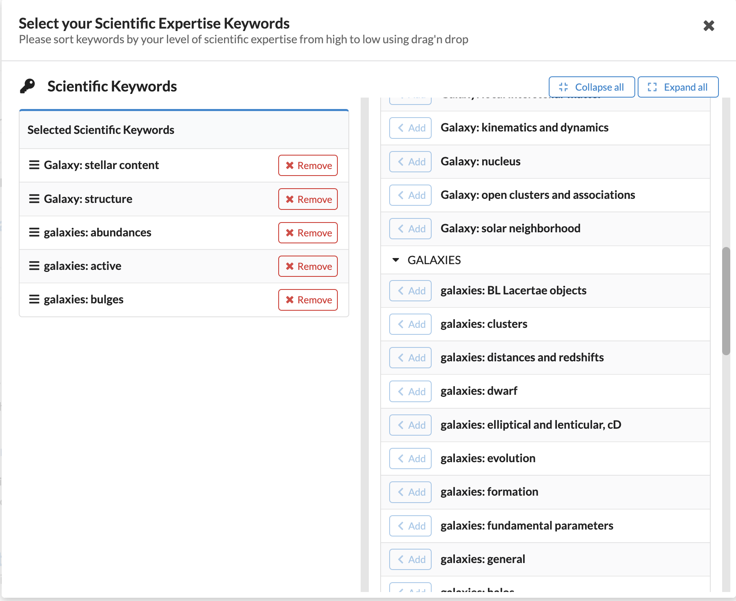
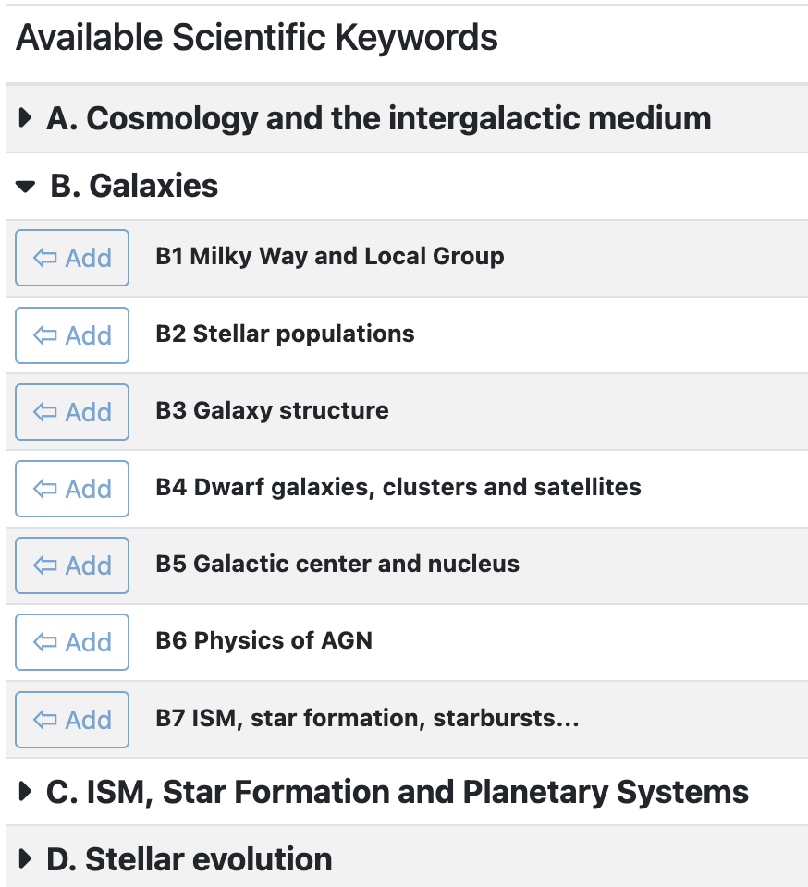
DPR project: what we had available
p1Flow
Old distribution tool
UserPortal
The old distribution
mechanism that we could not use.
Proposal evaluation interface
Proposal submission system
We had the User Portal. We asked the Principal Investigators to register to …
So what we had was the Proposal Evaluation Interface that we could use.

Slide 6
DPR project: what we had available
p1Flow
Old distribution tool
UserPortal
Proposal evaluation interface
Proposal submission system
Sorted by user
…and to specify their expertise.

Slide 7
DPR project: what we had available
p1Flow
Old distribution tool
UserPortal
Proposal evaluation interface
Proposal submission system
The PI would submit their proposals
specifying the scientific keywords.

Slide 8
DPR project: what we had available
p1Flow
Old distribution tool
UserPortal
Proposal evaluation interface
Proposal submission system
Sorted by user

Slide 9
DPR project: what we had available
p1Flow
Old distribution tool
UserPortal
Proposal evaluation interface
Proposal submission system
We needed a new distribution module!

Slide 10
DPR project: what we needed
Powerful computers
p1Flow
UserPortal
proposalDistributor
Proposal evaluation interface
Proposal submission system
proposalManager
…and another one to actually associate reviewers to proposals.
We decided to create two modules.
One to fetch the proposals from the submissions system…

Slide 11
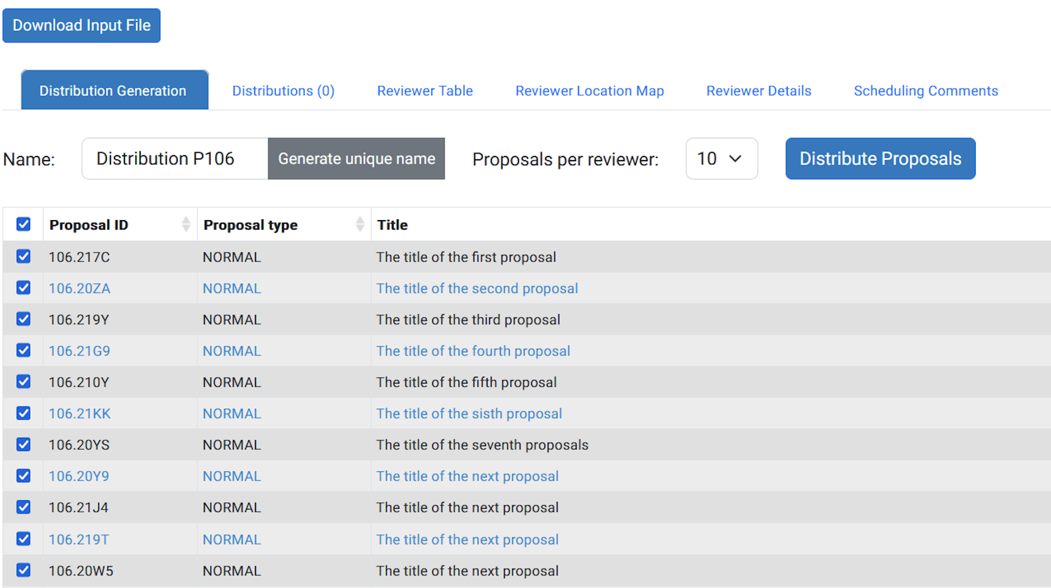
DPR project: what we needed
Powerful computers
p1Flow
UserPortal
proposalDistributor
Proposal evaluation interface
Proposal submission system
proposalManager
The proposal manager would retrieve the proposals from the Proposal submission system

Slide 12
DPR project: what we needed
Powerful computers
p1Flow
UserPortal
proposalDistributor
Proposal evaluation interface
Proposal submission system
proposalManager
…and here the operator would select the algorithm, the number of proposals per reviewer and would push a button.

Slide 13
DPR project: what we needed
Powerful computers
p1Flow
UserPortal
proposalDistributor
Proposal evaluation interface
Proposal submission system
proposalManager
…and send the list of proposals and the list of reviewers to the proposalDistributor.

Slide 14
DPR project: what we needed
Powerful computers
p1Flow
UserPortal
proposalDistributor
Proposal evaluation interface
Proposal submission system
proposalManager
In case, to an external instance of the proposalDistributor, running on a performant machine.

Slide 15
DPR project: algorithms
Hungarian
Algorithm
Stable marriage problem
Transportation problem
Custom (ESO)
Rank-maximal allocation
But what algorithm should we use?!
Auction algorithm
Stable marriage with indifference
No algorithm fits perfectly…
…so we developed our own.

Slide 16
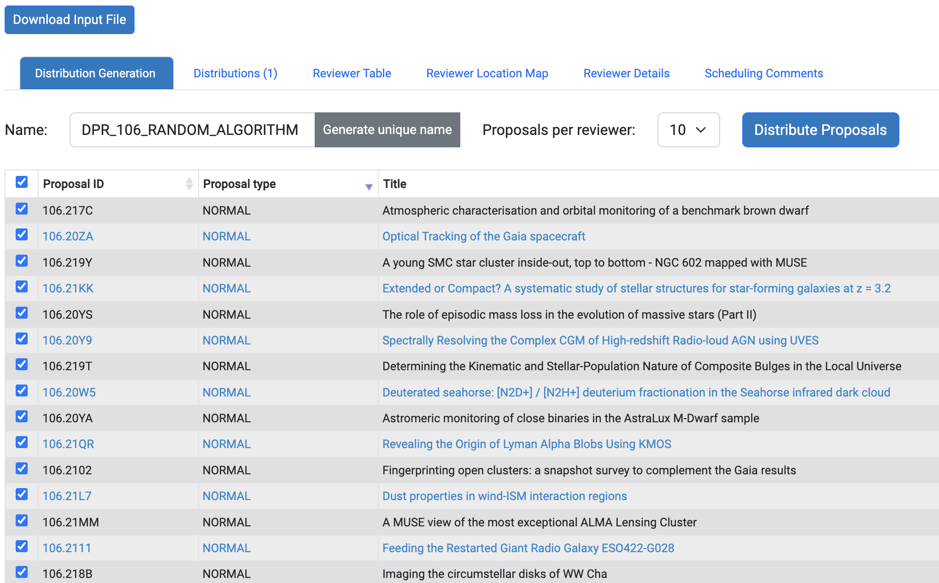
DPR project: what we needed
Powerful computers
p1Flow
p1Flow
 | P1 | P2 | P3 | P4 | P5
R1
R2_1
R3
R4
R2_2
 | P1 | P2 | P3 | P4 | P5
R1
R2
R3
R4
R5
 | P1 | P2 | P3 | P4 | P5
R1 | X | 0.2 | 1.2 | X | 0.5
R2_1 | 0 | X | 0.2 | 0.3 | X
R3 | 1.2 | 0 | X | 1.9 | 0.7
R4 | X | X | 0 | X | 0.3
R2_2 | 1.8 | 0.9 | 1.2 | 0.3 | X
 | P1 | P2 | P3 | P4 | P5
R1 | X |  |  | X
R2_1 |  | X |  |  | X
R3 |  |  | X
R4 | X | X |  | X
R2_2 |  | X |  |  | X
 | P1 | P2 | P3 | P4 | P5
R1 | X | 0.2 | 1.2 | X | 0.5
R2_1 | 0 | X | 0.2 | 0.3 | X
R3 | 1.2 | 0 | X | 1.9 | 0.7
R4 | X | X | 0 | X | 0.3
R2_2 | 1.8 | 0.9 | 1.2 | 0.3 | X
UserPortal
proposalDistributor
proposalDistributor
Proposal evaluation interface
Proposal submission system
proposalManager
…then it identifies the duplicates.
Eg. a PI submitting 2 proposals, will review 20 other proposals.
The first loop starts where for each reviewer the proposal with the highest score is assigned.
The score is computed, based on the scientific keywords:
0 = no match.
1 = only category matches
2 = perfect match
The next loop starts after having sorted the reviewers, ascending, with on top the reviewers with the lowest score, so too give precedence to the difficult couples.
The conflicts are identified: institutional and collaborators.
The diagonal represents their own proposals.
The distributor creates a square matrix of R(eviewers) and P(roposals)…

Slide 17
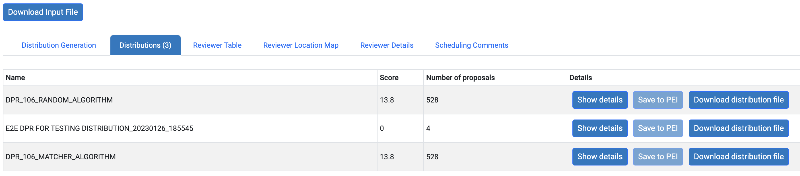
DPR project: what we needed
Powerful computers
p1Flow
UserPortal
proposalDistributor
Proposal evaluation interface
Proposal submission system
proposalManager
The matrix is returned to the proposal manager, together with the total sum of scores

Slide 18
DPR project: what we needed
Powerful computers
p1Flow
UserPortal
proposalDistributor
Proposal evaluation interface
Proposal submission system
proposalManager
The best distribution can be selected and sent to PEI

Slide 19
DPR project: what we needed
Powerful computers
p1Flow
UserPortal
proposalDistributor
Proposal evaluation interface
Proposal submission system
proposalManager
Each distribution could be downloaded and analysed.
For example…

Slide 20
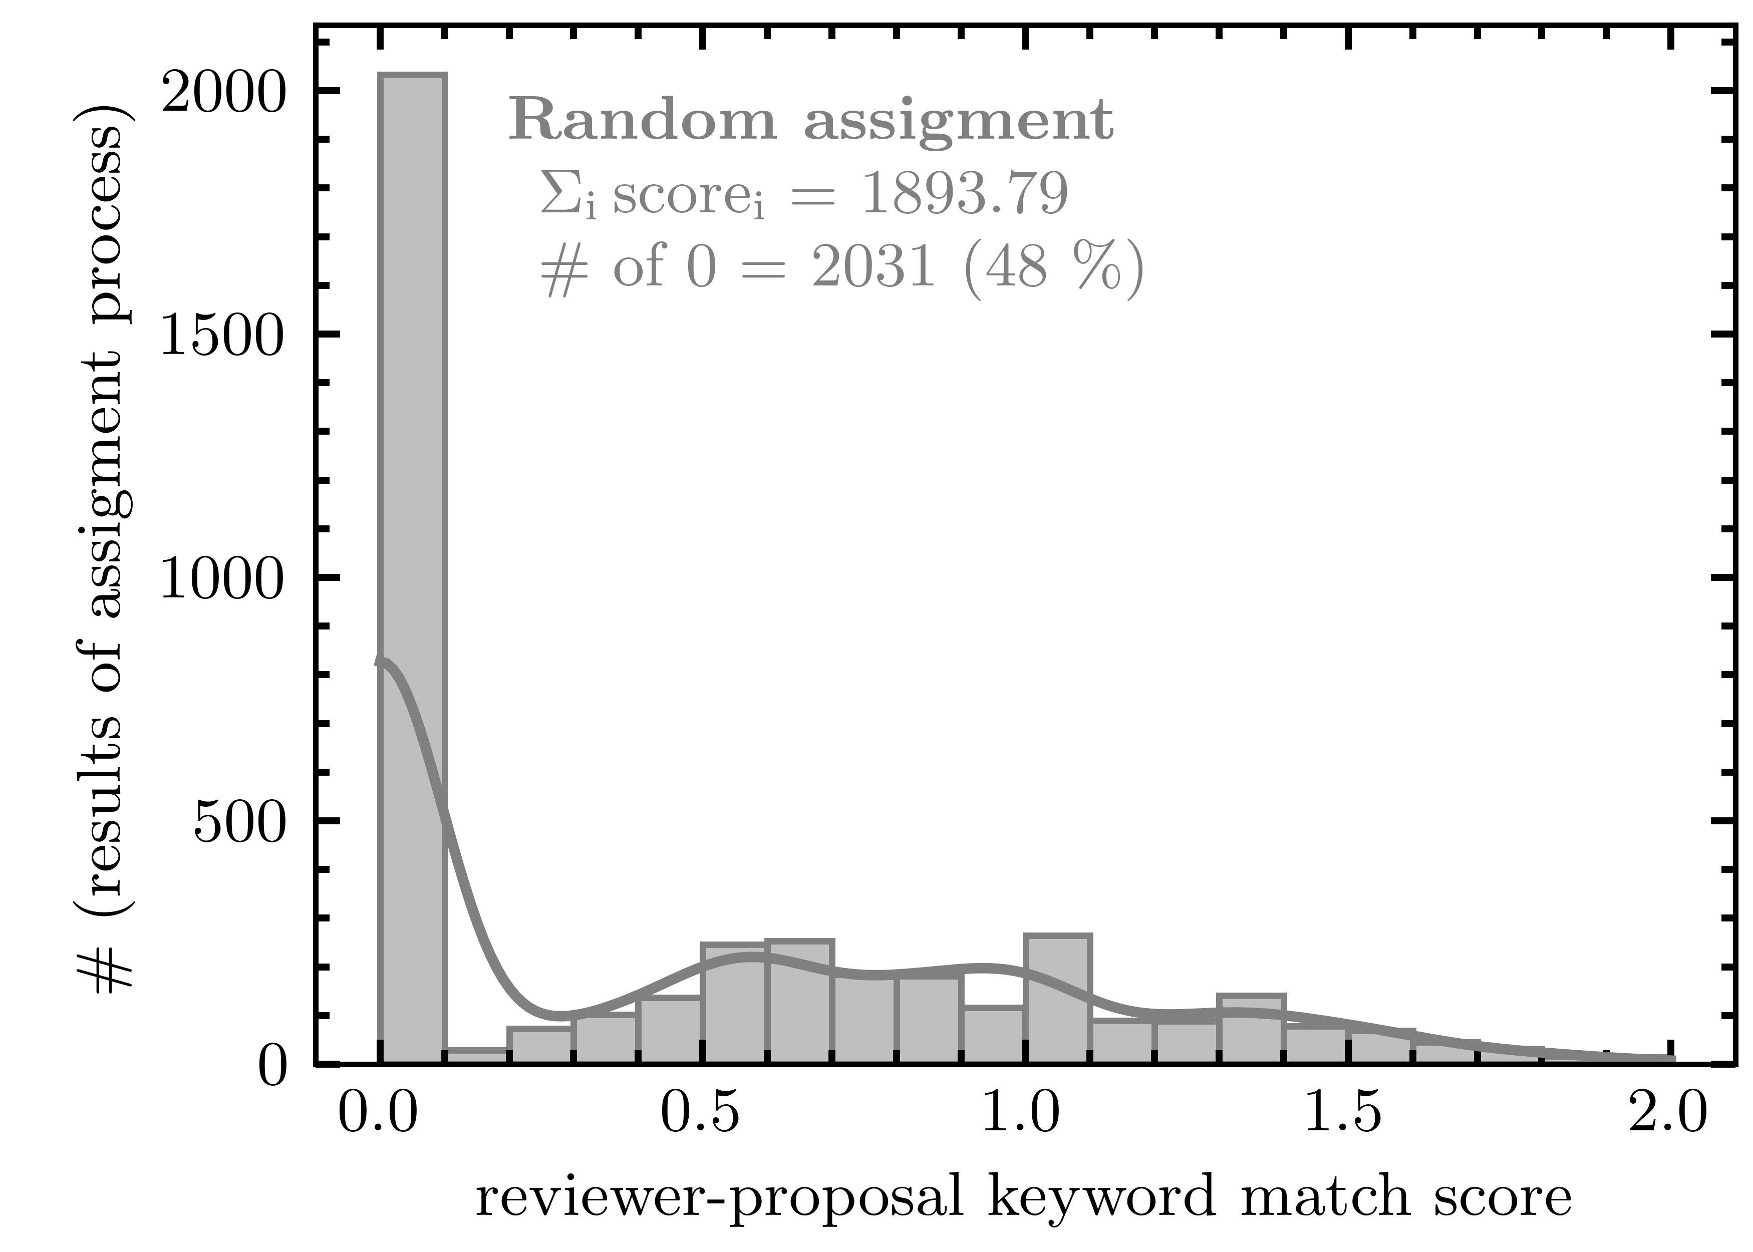
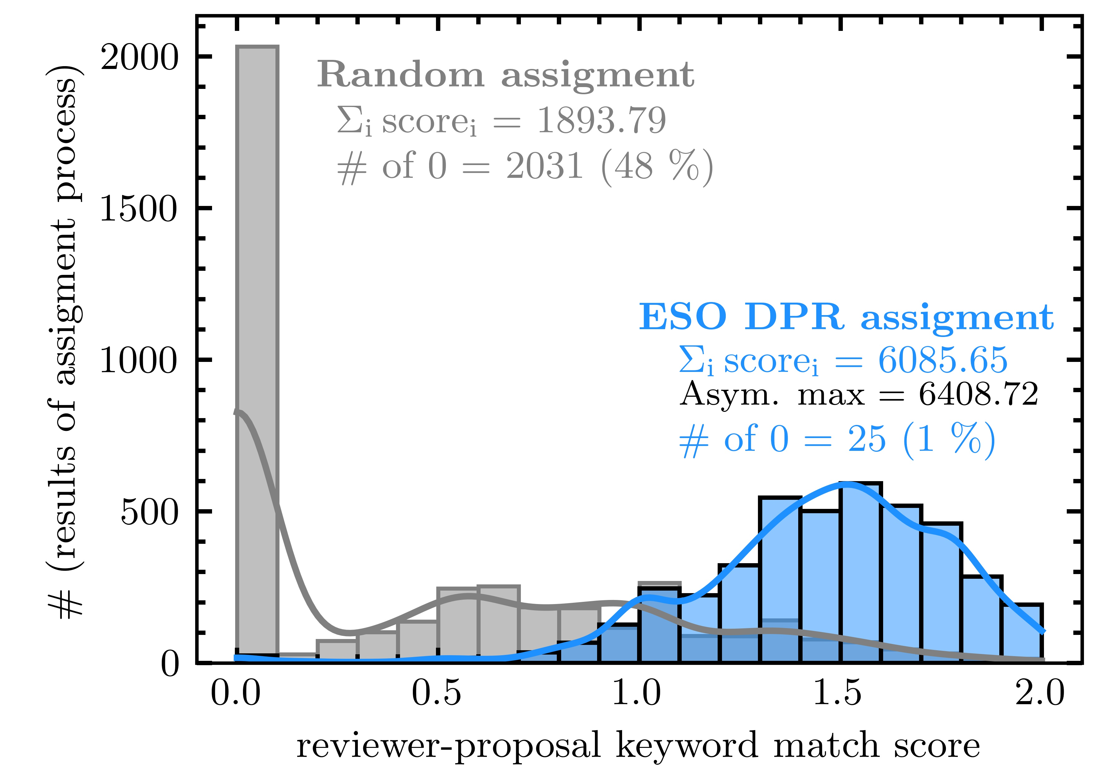
DPR project: statistics
While this is the “asyntotical score” the sum of all theoretical perfect matches.
…and this is the one generated by the algorithm.
This is the distribution for a random assignment…
Jerabkova,Patat,Primas,Dorigo,Sogni,Astolfi,Bierwirth,Prümm (ESO Messenger,submitted)

Slide 21
DPR project: lessons learned
Sinergy between technical a scientifical staff is crucial.
Performance of algorithms helps development process.
Separation of concerns (multi-services) allows scalability.
End-to-end testing and Q&A make us sleep at night.
Thank you for your attention!
Questions can be sent to fsogni@eso.org or ddorigo@eso.org

