Slide 1


Legal Questions
in Open Science
Livia Gertis, Maximilian Heber, Andreas Kirchner
University of Konstanz, September 2022
Image: Steve Buissinne , Pixabay License
This course is part of the Re:ERUA work package Open Science for Transparent Research and Public Engagement and co-funded by the Horizon 2020 programme.
All contents of this presentation are, unless otherwise stated,
licensed under the Creative Commons BY 4.0 International

Slide 2
This course was developed in the Re:ERUA project. The University of Konstanz, University of Paris 8, Roskilde University, University of the Aegean and New Bulgarian University jointly created the course content.

Slide 3
Contents:
Obstacles to Publishing Research Data and Publications
  Freedom of Publication vs. Third-Party Rights
  Legal Ownership of Research Data
Practical Recommendations
  Dealing with the Rights of Third Parties
  Images
Licensing
  Commercial vs. Free Licenses
  Creative Commons Licenses

Slide 4
Freedom of Publication vs. Third-Party Rights
Freedom of Publication: Researchers decide whether and when to publish. However, the rights of third parties must be respected.
Researchers‘ Rights:
Copyrights to own texts/data sets
Third Party Rights:
Copyrights to subsequently used works (e.g. illustrations, texts, data sets)
Self-archiving (Sherpa Romeo)
Data protection rights
Other Obstacles
Planned patenting
Confidentiality agreements

Slide 5
Legal Ownership of Research Data
Researchers‘ Rights
Copyright in self-created data / databases / software (condition: level of creation)
Patent right
Ownership of private computers
University Rights
Sui generis database right if investment costs were borne
Transfer of copyrights to the employer in the case of research bound by instructions
Ownership of company computers / servers
Third Party Rights
Copyrights in the subsequent use of third-party data / databases / software
Co-authors can hold copyrights
Data protection rights, if data contain personal information
Rights of Research Funders
Sui generis database right, if investment costs were borne

Slide 6
Four Recommendations for Dealing with the Rights of Third Parties
1. Seek advice early
  Seek advice early to identify and solve potential legal issues.
  Legal advisor, data protection officer, open science specialists
2. Make agreements with your partners.
  In many cases, potential legal issues can be avoided by reaching legal agreements with all parties involved detailing their respective rights and obligations
3. Obtain consent.
  Obtain consent of all parties whose copyrights or personal data may be affected by your publication
  In particular: Participants in scientific studies, Persons in photographs, owners of reused works, collaborators, coauthors, project partners and third party funding organisations.
4. Use standardized licenses.
  When publishing or archiving research data, the use of standardized licences – such as Creative Commons licenses – is recommended

Slide 7
Images – Recommendations
1. Public Domain / varying terms of protection
  Where possible, use public domain images, for example images from Pixabay
  In the EU, intellectual property is protected until 70 years after the author’s death
2. Images under a free license
  Use images provided under free licenses.
  Attention: Observe conditions of the license. Free license ≠ public domain!
  Collect evidence that what you are using is under a free license
3. Reuse of own images
  Check whether the first publication resulted in the transfer of exclusive rights of use to the publisher.
  If yes: Obtain self-citation / consent of the publisher!
4. Data Protection
  Problematic if living persons are identifiable on images.
  Consent or legal permission required!
When in doubt: Seek legal advice at your institution (legal office, library, open science specialists, law department, etc.)

Slide 8
Commercial vs. Free Licenses
A license is a right of use agreed on in a contract. With it, the rights holder allows the contractual partner to use a work in various ways (e.g., to copy, store, or make it digitally accessible).
Commercial Licenses
e.g. pay-per-view
common with publishers
allow third parties to use the data only against payment of a fee
protect economic interests
Free Licenses
e.g. Creative Commons licenses, Open Data Commons licenses, GNU General Public License
allow anyone to use free of charge
maximize range of potential reuse and visibility

Slide 9
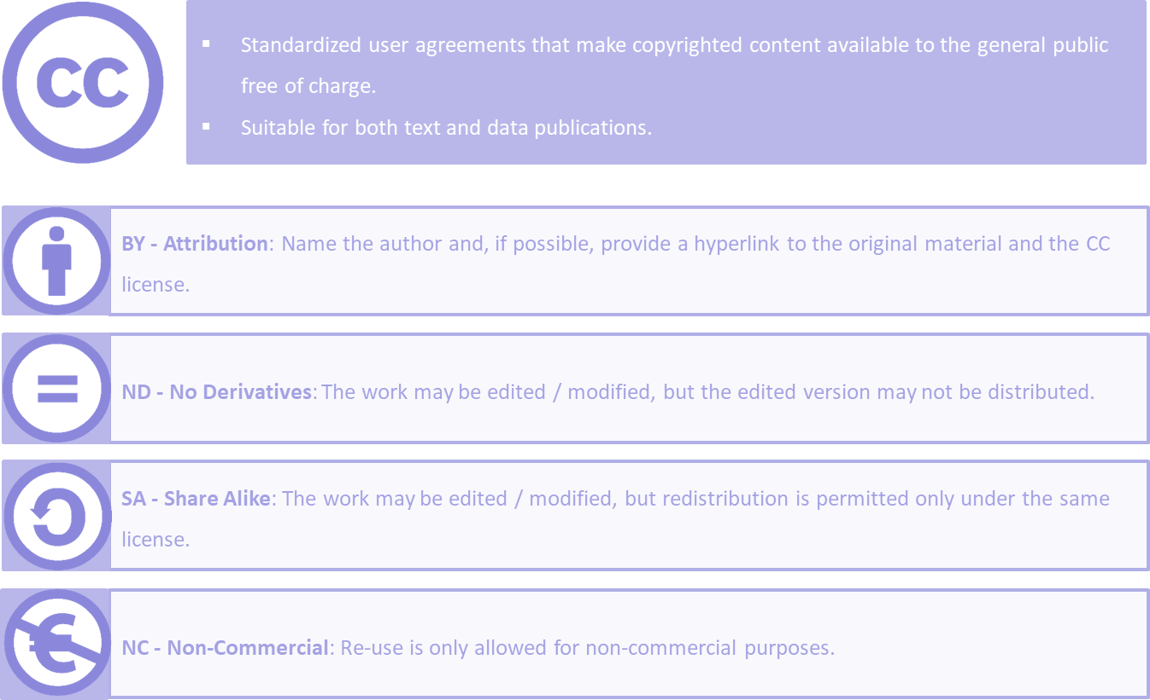
Creative Commons Licenses

Slide 10






Creative Commons Licenses
May edited versions of your work be shared?
Yes
Only under the same license
No
Yes
CC BY
CC BY SA
CC BY ND
May your work be used commercially ?
No
CC BY NC
CC BY NC SA
CC BY NC ND

Slide 11
Sources:
The University of Konstanz‘ Open Science Course. https://www.kim.uni-konstanz.de/openscience/onlinekurs-open-science-von-daten-zu-publikationen/ [29.08.2022].
forschungsdaten.info: Legal Issues. https://forschungsdaten.info/praxis-kompakt/english-pages/legal-issues/
OpenAire: How Do I know if my research data is protected: https://www.openaire.eu/how-do-i-know-if-my-research-data-is-protected
Intersoft Consulting: Art. 7 GDPR Conditions for consent. https://gdpr-info.eu/art-7-gdpr/
open-access.network: Green and Gold. https://open-access.network/en/information/open-access-primers/green-and-gold
open-access.network: Licences. https://open-access.network/en/information/legal-issues/licences

Slide 12
    Slide 1, 12: Steve Buissinne , Pixabay License, edited by P. Helmecke
List of Figures:

Slide 13
Thank you very much!
Livia Gertis, Maximilian Heber, Andreas Kirchner
University of Konstanz, September 2022
Image: Steve Buissinne , Pixabay License
This course is part of the Re:ERUA work package Open Science for Transparent Research and Public Engagement and co-funded by the Horizon 2020 programme.
All contents of this presentation are, unless otherwise stated,
licensed under the Creative Commons BY 4.0 International

