Slide 1
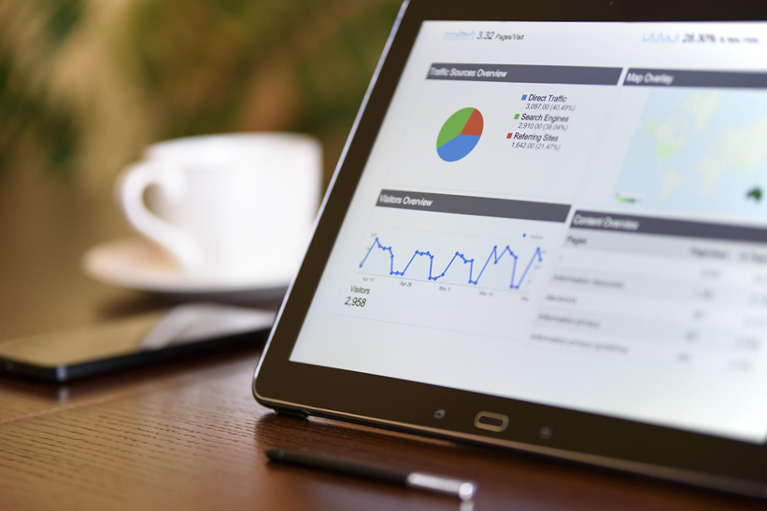

Research Data Management
An Introduction
Maximilian Heber & Gabriel Schneider, Team Open Science
University of Konstanz, September 2022
Image: PhotoMIX-Company, Pixabay License
All contents of this presentation are, unless otherwise stated,
licensed under the Creative Commons BY 4.0 International

Slide 2
This course was developed in the Re:ERUA project. The University of Konstanz, University of Paris 8, Roskilde University, University of the Aegean and New Bulgarian University jointly created the course content.

Slide 3
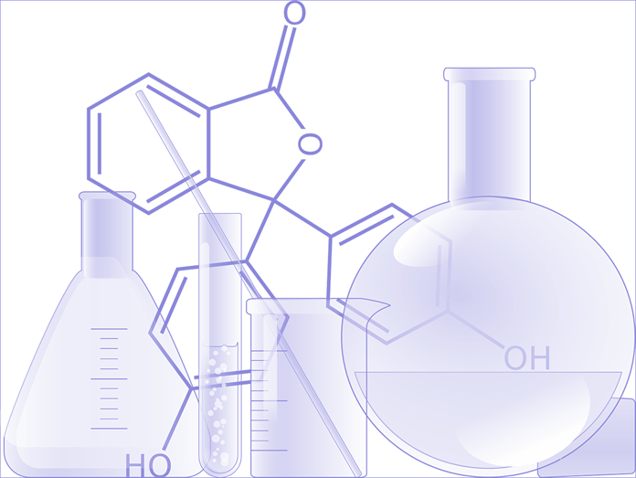
Contents:
What is research data?
Goals of research data management
Benefits of research data management
The research data life cycle
OpenClipart-Vectors, Pixabay License

Slide 4
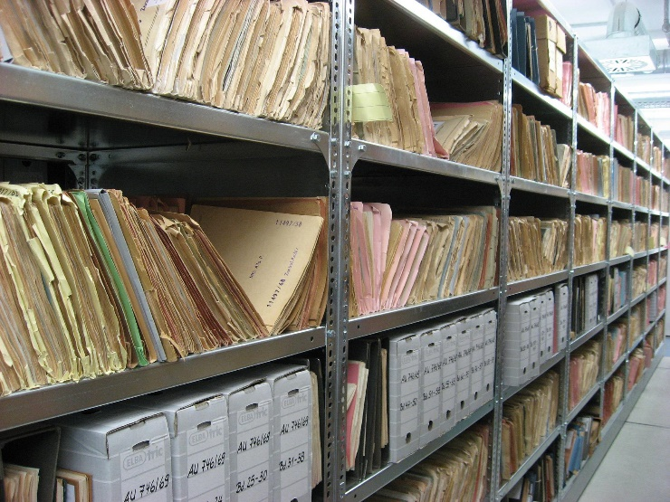
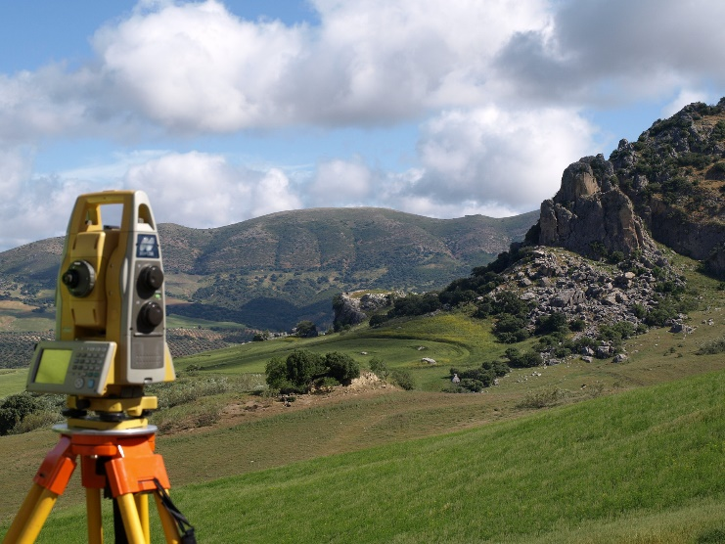
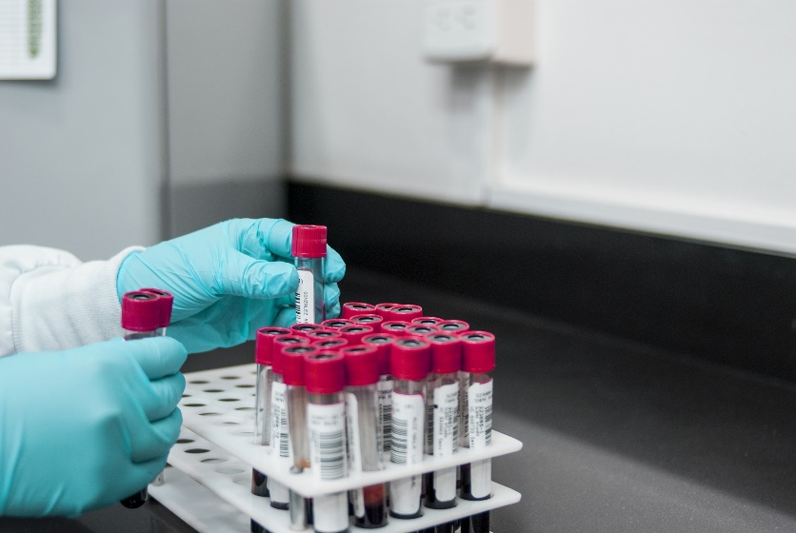
What kinds of data do you work with in your research?
What is Research Data?
Chris Stermitz, Pixabay License
Davidph, Pixabay License
fernando zhiminaicela, Pixabay License

Slide 5
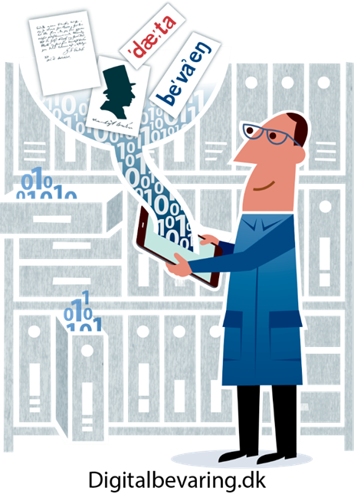
What is a Research Data?
“Data that are a) created through scientific processes/research (for example through measurements, surveys, source work), b) the basis for scientific research (for example digital artefacts), or c) documenting the results of research, can be called research data.”
Research data. Glossary entry at forschungsdaten.info. https://www.forschungsdaten.info/glossary/#c403895 [6.4.2020].

Slide 6
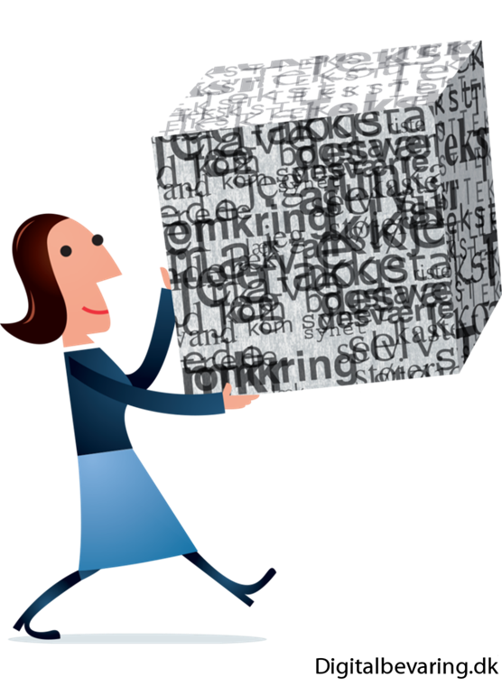
Goals of Research Data Management
Guarantee credible and transparent research, via the responsible handling of data before during and after the research project (scientifically, technically, legally and ethically)

Slide 7
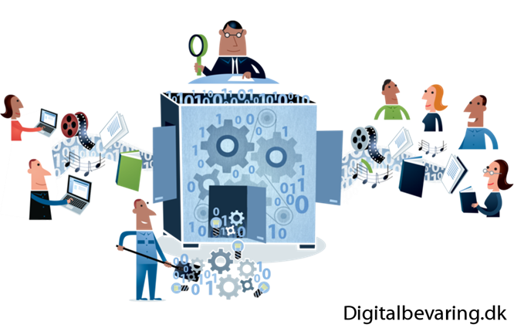
Benefits of Research Data Management
Enhance the findability of data
Prevent data loss
Facilitate collaboration
Reusability of data
Increased visibility of research output
Traceability of research results
Citation of data as an own independent research product
Benefit for the whole public sphere
Guidelines and requirements in institutional research data management policies

Slide 8
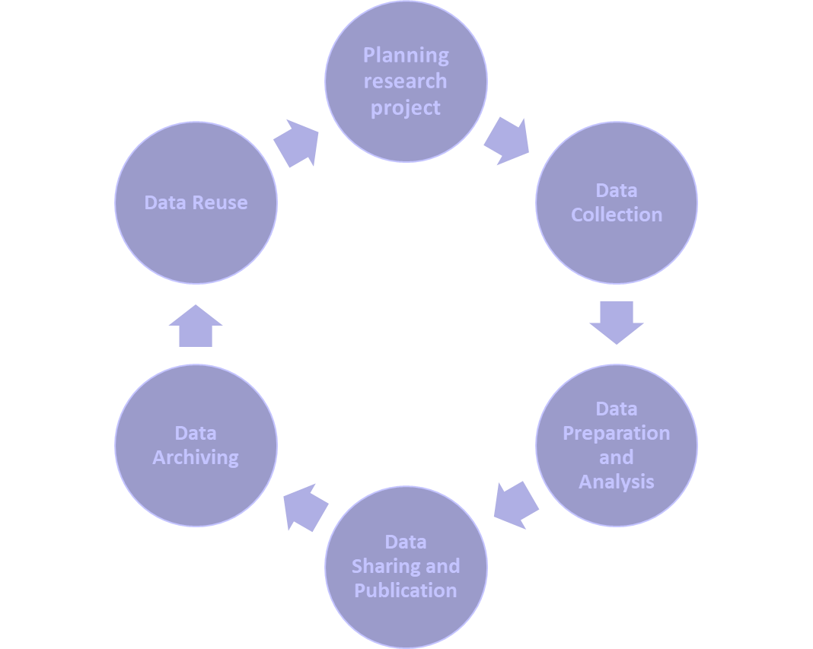
The Research Data Life Cycle

Slide 9
The Research Data Life Cycle
Planning your research
Plan how you intend to work with your data during the whole research project
Topics to think about beforehand
Data management plans (DMP)
  Necessary to acquire grants from certain funding organizations
  Tools such as ARGOS by OpenAIRE or DMPonline, available for free
Will I collect or reuse available data?
How much data will I generate?
Which tools/software will I use to work with the data?
How will I describe and document the data?
Where will I publish the data and under which license?

Slide 10
The Research Data Life Cycle
Collecting your data
First: Check ethical and legal contexts
Highly dependent on your research design and methods
Use methods and tools which are common in your research community
Store your data in a structured way
Who needs access during the following steps?
  Collaborative working platforms such as clouds can be used to grant access to research project members
  Follow the 3-2-1 backup rule →3 copies of a file on 2 different storage mediums with 1 of the copies stored in another spot (e.g. different building)
Follow a consistent pattern when naming your data files
  e.g. include the date of the data collection in its filename („YYMMDD-title“)
  include unambiguous version information („filename_v1.2“)

Slide 11
The Research Data Life Cycle
Data preparation
Prepare the data for further scientific work, e.g. selecting datasets for analysis, removing outliers, converting to different file formats
Use this step to start describing your data with metadata
  metadata are additional information that enable other researchers to understand your data better
  different scientific communities use different metadata schemes and standards
Data analysis
Work with your data to find answers to your research question
  if possible think about what information is needed by other researchers to understand your working steps, document these steps.

Slide 12
The Research Data Life Cycle
Sharing your data
Think about who you want to share your work with before publishing it
depending on the solution you used for sharing your data in your working group you might be able to extend the access to external colleagues
Publishing your data
Repositories offer you the possibility to publish your data
Depending on the service you choose you will have a selection of different possibilities concerning licensing and defining who can access the data
To find a fitting repository you can use re3data.org, a searchable registry of repositories for research data

Slide 13
The Research Data Life Cycle
Long-term archival of your data
Using a repository ensures that your data remain available in the long-term
Check repository guidelines and your funding requirements
Repositories might ask you for rights to transform data formats
Reusing data
With description/documentation and publication of your data other researchers can reuse it
  in the context of other research questions
  for gaining a better understanding of your research
Reusing data leads to citation and more visibility of your work

Slide 14
Sources:
    DFG: Leitlinien zum Umgang mit Forschungsdaten. https://www.dfg.de/download/pdf/foerderung/antragstellung/forschungsdaten/richtlinien_forschungsdaten.pdf [8.4.2020].
    Dolzycka, Dominika; Biernacka, Katarzyna; Helbig, Kerstin und Buchholz, Petra: Train-the-Trainer Konzept zum Thema Forschungsdatenmanagement. Version 2.0. Berlin, 2019. DOI: 10.5281/zenodo.2581292.
    Forschungsdaten. Glossareintrag auf forschungsdaten.info. https://www.forschungsdaten.info/praxis-kompakt/glossar/#c269824 [6.4.2020].
    Forschungsdaten.info https://www.forschungsdaten.info/ [14.4.2020].
    Kindling, Maxi und Schirmbacher, Peter: „Die digitale Forschungswelt“ als Gegenstand der Forschung. Information – Wissenschaft – Praxis 64 (2013): S. 130. https://doi.org/10.1515/iwp-2013-0017.
    Böker, Elisabeth: „Warum Forschungsdatenmanagement?“ Zenodo. 2020. https://doi.org/10.5281/zenodo.3762983.
    Open Science Kurs der Universität Konstanz https://www.kim.uni-konstanz.de/openscience/onlinekurs-open-science-von-daten-zu-publikationen/ [29.08.2022].

Slide 15
List of Figures
      Slide 1, 16: PhotoMIX-Company, Pixabay License
      Slide 2: OpenClipart-Vectors, Pixabay License, edited by P.Helmecke
      Slide 3:
        Chris Stermitz, Pixabay License
        Davidph, Pixabay License
        fernando zhiminaicela, Pixabay License
      Slide 4,5,6: Digitalbevaring.dk - CC BY 2.5. Dänemark Lizenz

Slide 16

Thank you very much!
Maximilian Heber & Gabriel Schneider
University of Konstanz, September 2022
Image: PhotoMIX-Company, Pixabay License
All contents of this presentation are, unless otherwise stated,
licensed under the Creative Commons BY 4.0 International

