Slide 1
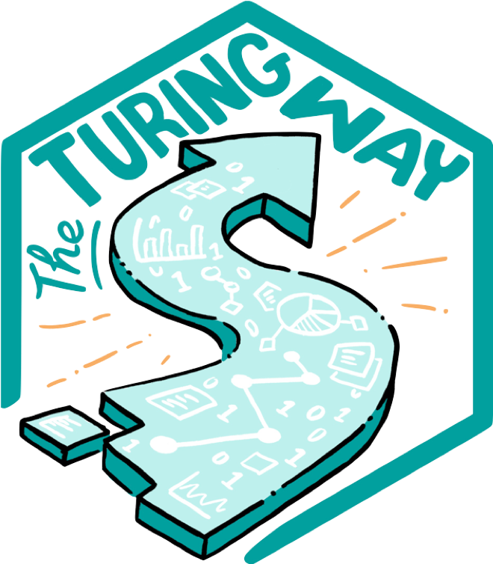
The Turing Way Workshop: Reproducible, Open and FAIR Research
Session 1
Emma Karoune, Eirini Zormpa & Anne Lee Steele
Pronouns: she/her/hers
@turingway, CC-BY 4.0, The Turing Way, DOI: 10.5281/zenodo.7684733
Notes:
TIMING: 0
Shared document - explain how to use hackmd
Add names from line 59

Slide 2




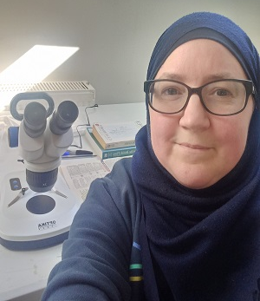

Emma Karoune
Archaeobotanist/Palaeoecologist
  FAIR Phytoliths project
  Open reference collections
Open Researcher & Community Manager
  Tools, practices and systems programme
    Turing Way
    DECOVID/ Turing-RSS Lab
  SSI Fellow/ UK-Elixir FAIR data Fellow
Link to Emma’s SSI Fellows page

Slide 3

Eirini
Community Manager Open Collaboration
AI for Multiple Long-term Conditions Research Support Facility
The Turing Way
The Carpentries
R Ladies
Background
PhD in Psycholinguistics

Slide 4
Learning Objectives
Problem: Scientific errors have real world effect
Define what reproducible research is
Understand what open science practices are
Identify FAIR principles for your research
Differentiate between FAIR and open data/research
Learn how to implement a reproducible workflow
@turingway, CC-BY 4.0, The Turing Way, DOI: 10.5281/zenodo.7684733
Notes:
Emma to start

Slide 5
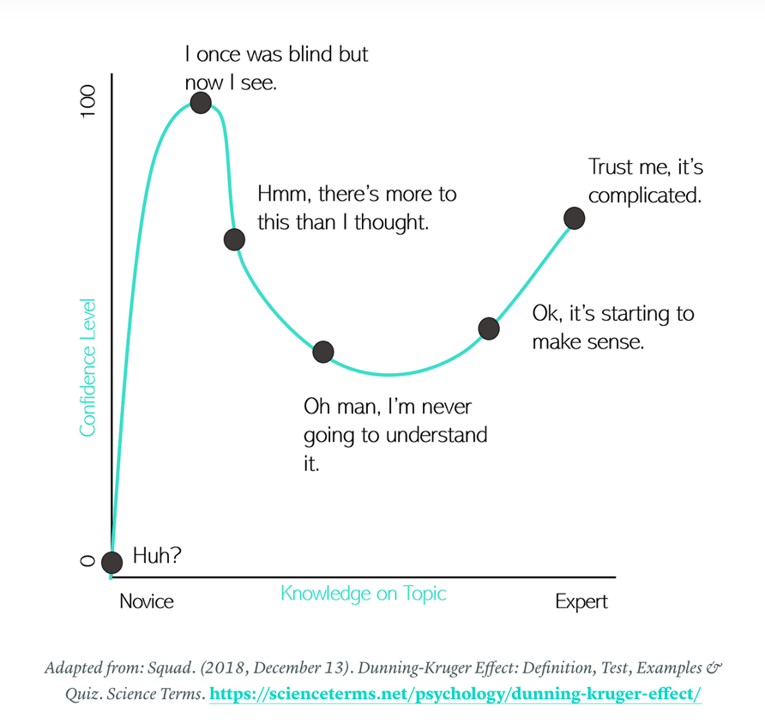
Disclaimer:
You probably already know all about it!
Kaylee Somerville, The Hidden Power of Intellectual Humility - The Decision Lab. 2020.
https://thedecisionlab.com/insights/society/the-hidden-power-of-intellectual-humility
Notes:
You probably already know some things about open and reproducible research but there is always more to learn! And when you actually start to practice it, it can be another thing.
Learning journey’s are not a straight line and especially with reproducibility and open science practices there are many new skills to learn and more than one way to do everything. So we often take a rather windy road to knowing everything we need to know to do open and reproducible research.

Slide 6
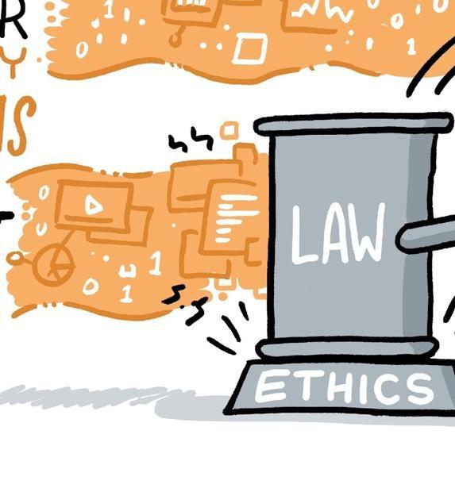
Scientific errors have real world effects
Researchers have an obligation to consider the ethical standards (right actions) and their impact on society.
CC-BY 4.0, https://the-turing-way.netlify.app/ethical-research/ethical-research.html, DOI: 10.5281/zenodo.7684733
Notes:
Taking ethics as the study of what behaviours are right and what behaviours are wrong, ethical research highlights actions we take in research.

Slide 7
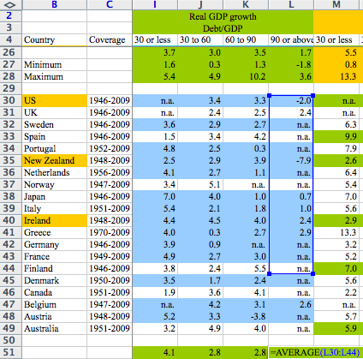
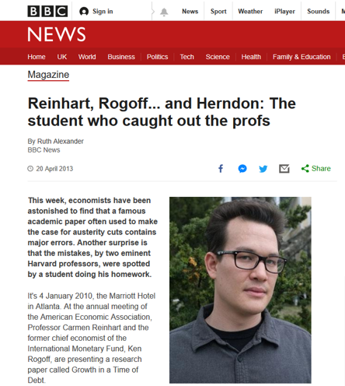
Scientific errors have real world effects
@turingway, CC-BY 4.0,
The Turing Way, DOI: 10.5281/zenodo.7684733
https://statmodeling.stat.columbia.edu/2013/04/16/memo-to-reinhart-and-rogoff-i-think-its-best-to-admit-your-errors-and-go-on-from-there
https://www.bbc.co.uk/news/magazine-22223190
Notes:
This is an example from a famous academic paper by Harvard professors, Carman Reinhart and Ken Rogoff that was often used to make the case for austerity cuts (budget reduction, public tax increase) at the time of economic crisis (to deal with global recession) contains major errors.
Thomas Herndon, a phd student back in 2013, but now a professor was looking at this paper with an intention to replicate the findings. After several failed attempts he got in touch with the author requesting for the original data, which they shared in an excel sheet. He immediately found out
The authors had accidentally only included 15 of the 20 countries under analysis in their key calculation (having excluded Australia, Austria, Belgium, Canada and Denmark);^{[4]}
For some countries, some data was missing;^{[4]}
High debt is correlated with somewhat lower growth, but the relationship is much gentler and there are lots of exceptions to the rule.

Slide 8
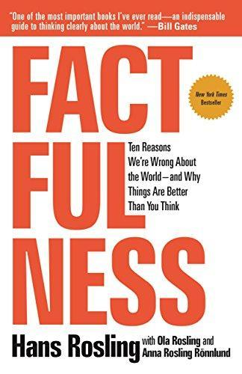
Scientific errors have real world effects
“We will redouble our efforts to avoid such errors in the future …” - Authors
“mistaken way to examine (country specific) data provides an intellectual rationalisation for things that affect how people think about the world.”
- Daniel Hamermesh
@turingway, CC-BY 4.0,
The Turing Way, DOI: 10.5281/zenodo.7684733
https://www.gapminder.org/, Rosling, H., Rönnlund, A. R., & Rosling, O. (2018). Factfulness: Ten Reasons We're Wrong About the World--and Why Things Are Better Than You Think. ‏https://www.bbc.co.uk/news/magazine-22223190
Notes:
In our opinion, low model reproducibility stems mostly from authors' omitting to provide crucial information in scientific papers and we stress that sharing all computer code and data is not a solution.
Author said that “We are grateful to Herndon et al. for the careful attention. We will redouble our efforts to avoid such errors in the future.”
How people think about the world, especially people in power, eventually affects how the world works

Slide 9
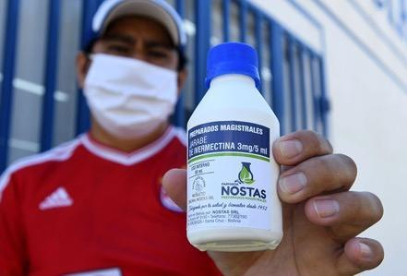
Price of Popularity
Researchers in Australia used unreliable COVID-19 data and misreported that an anti-parasite drug could stop the virus from replicating in cells.
In a desperate attempt to save dying patients, doctors began justifying the drug’s use against COVID-19 as the virus spread aggressively throughout Latin America.
Reardon, S. (2021). Flawed ivermectin preprint highlights challenges of COVID drug studies. Nature, 596, 173–174. doi: 10.1038/d41586-021-02081-w. Mega, E. R. (2020). Latin America’s embrace of unproven COVID treatment hinders drug trials. Nature, 586, 481–482. doi: 10.1038/d41586-020-02958-2, Slides under DOI: 10.5281/zenodo.5568007
Notes:
Ivermectin grabbed attention in April 2020, when scientists were throwing every already-approved drug they could at the coronavirus. Researchers in Australia had noted that high doses of ivermectin could stop the virus from replicating in cells¹. Shortly afterwards, a preprint appeared online that suggested the drug could reduce coronavirus-related deaths in people.
The paper’s irregularities came to light when Jack Lawrence, a master’s student at the University of London, was reading it for a class assignment and noticed that some phrases were identical to those in other published work. When he contacted researchers who specialize in detecting fraud in scientific publications, they found other causes for concern, including dozens of patient records that seemed to be duplicates, inconsistencies between the raw data and the information in the paper, patients whose records indicate they died before the study’s start date, and numbers that seemed to be too consistent to have occurred by chance.
The eagerness to use the treatment only grew as the virus spread aggressively throughout Latin America. The problem is when non-evidence-based public policies are made.

Slide 10
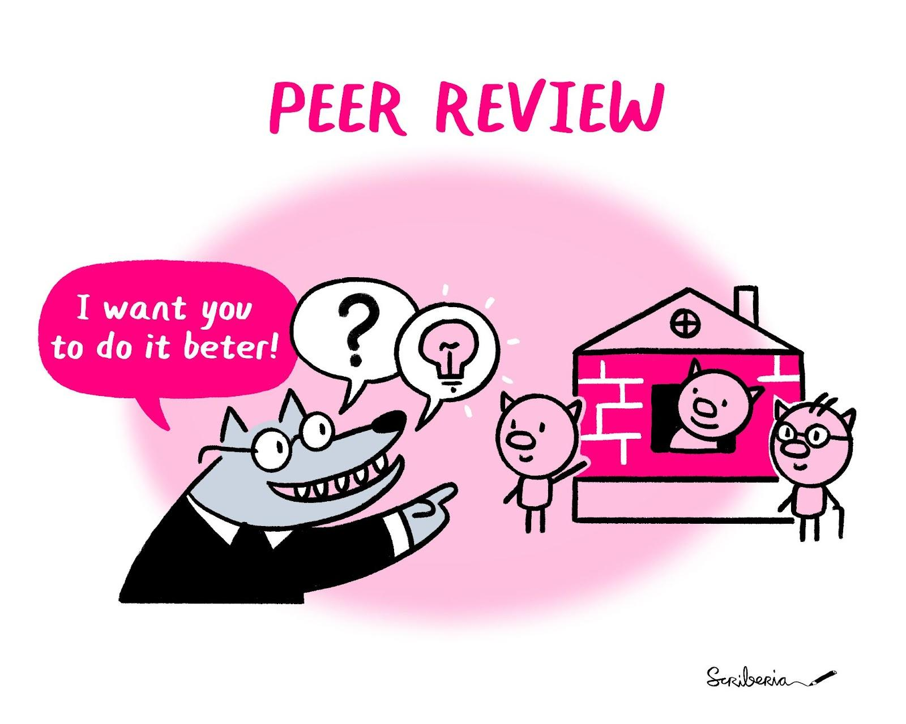
Post-publication Peer Review is Important, But …
To consult the [experts] after an experiment is finished is often merely to ask to conduct a post mortem examination. […] can perhaps say what the experiment died of. - Ronald Fisher
@turingway, CC-BY 4.0,
The Turing Way, DOI: 10.5281/zenodo.7684733
https://statmodeling.stat.columbia.edu/2013/04/16/memo-to-reinhart-and-rogoff-i-think-its-best-to-admit-your-errors-and-go-on-from-there
https://www.bbc.co.uk/news/magazine-22223190
Notes:
https://www.ncbi.nlm.nih.gov/pmc/articles/PMC4831566/
So we can avoid publishing mistakes through the usual peer review system so although I advocate for the use of pre-printing to increase the accessibility and transparency of research, pre-prints should always be viewed with caution, whoever releases them.
But we think there is a better way of doing scientific research and that is to think carefully about your experiments, project design and work transparently to enable open, ethical and reproducible research.

Slide 11
Avoid Errors Before the Harm Occurs
Mistaken research design or analysis processes
  Project design for open, FAIR & reproducible research
@turingway, CC-BY 4.0,
The Turing Way, DOI: 10.5281/zenodo.7684733
Allison, D. B., Brown, A. W., George, B. J., & Kaiser, K. A. (2016). Reproducibility: A tragedy of errors. Nature, 530(7588), 27. doi: 10.1038/530027a
Notes:
https://www.ncbi.nlm.nih.gov/pmc/articles/PMC4831566/
So what we want is to avoid error before the harm occurs and to avoid:
1 Mistake research design or analysis process - we can do high quality project design for open, FAIR and reproducible research

Slide 12
Avoid Errors Before the Harm Occurs
Mistaken research design or analysis processes
  Project design for open, FAIR & reproducible research
Wrong choices of tools and methods
  Data handling, data management, collaboration process
@turingway, CC-BY 4.0,
The Turing Way, DOI: 10.5281/zenodo.7684733
Allison, D. B., Brown, A. W., George, B. J., & Kaiser, K. A. (2016). Reproducibility: A tragedy of errors. Nature, 530(7588), 27. doi: 10.1038/530027a
Notes:
https://www.ncbi.nlm.nih.gov/pmc/articles/PMC4831566/
So what we want is to avoid error before the harm occurs and to avoid:
1 Mistake research design or analysis process - we can do high quality project design for open, FAIR and reproducible research
2. To avoid the wrong choices of tools and methods - we can employ version control in our data management to aid collaboration and transparency of our research

Slide 13
Avoid Errors Before the Harm Occurs
Mistaken research design or analysis processes
  Project design for open, FAIR & reproducible research
Wrong choices of tools and methods
  Data handling, data management, collaboration process
Inappropriate baseline comparison
  Lack of technical understanding (we won’t discuss this!)
@turingway, CC-BY 4.0,
The Turing Way, DOI: 10.5281/zenodo.7684733
Allison, D. B., Brown, A. W., George, B. J., & Kaiser, K. A. (2016). Reproducibility: A tragedy of errors. Nature, 530(7588), 27. doi: 10.1038/530027a
Notes:
https://www.ncbi.nlm.nih.gov/pmc/articles/PMC4831566/
So what we want is to avoid error before the harm occurs and to avoid:
1 Mistake research design or analysis process - we can do high quality project design for open, FAIR and reproducible research
2. To avoid the wrong choices of tools and methods - we can employ version control in our data management to aid collaboration and transparency of our research
3. And thirdly, we can make sure we have a high level of technical understand and background to the research we are doing - we won’t cover this today.

Slide 14
Session 1 - Reproducible, Open and FAIR research
What is reproducible research
What is open research
Concerns about opening up research
Understanding FAIR data/research
Making your research FAIR
Setting up repositories and working collaboratively
@turingway, CC-BY 4.0, The Turing Way, DOI: 10.5281/zenodo. 10.5281/zenodo.7684733
Notes:
So what we are going to cover is how you can do reproducible, open and fair research
Starting with what these terms means and then starting to look at how you can practices this type of research.

Slide 15
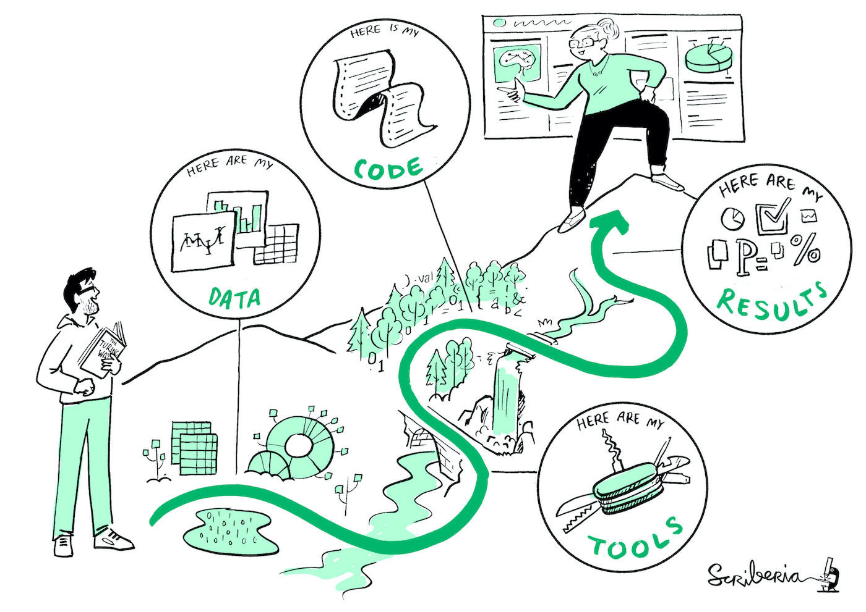
Research Reproducibility
Reproducible research saves valuable time in verifying and building upon existing solutions.
@turingway, CC-BY 4.0, The Turing Way, DOI: 10.5281/zenodo. 10.5281/zenodo.7684733
Notes:
So let’s start with reproducibility
Think about all the research that is wasted because we don’t fully understand how it was done, you could never build on this type of research.

Slide 16
 |  | Data
 |  | Same | Different
 | Same | Reproducible | Replicable
 | Different | Robust | Generalisable
Analysis
https://the-turing-way.netlify.app/reproducible-research/
overview/overview-definitions.html
@turingway, CC-BY 4.0, The Turing Way,
DOI: 10.5281/zenodo. 10.5281/zenodo.7684733
Notes:
So what is reproducible research? - I have borrowed the definition from The Turing Way - which is a guide to reproducible research - they state that reproducible research is work that can be independently recreated from the same data and the same code that the original team used.
As you can see here it is distinct from replication that involves using different data but the same analysis and also different from robust that uses both different data and analysis to address the same question.
These words are often used in different ways in different disciplines and also can be used interchangeably so it’s worth thinking about what you are trying to achieve in your own research.
Really the idea is to make every stage of your research transparent so that other researchers could reproduce or replicate any part of it.

Slide 17
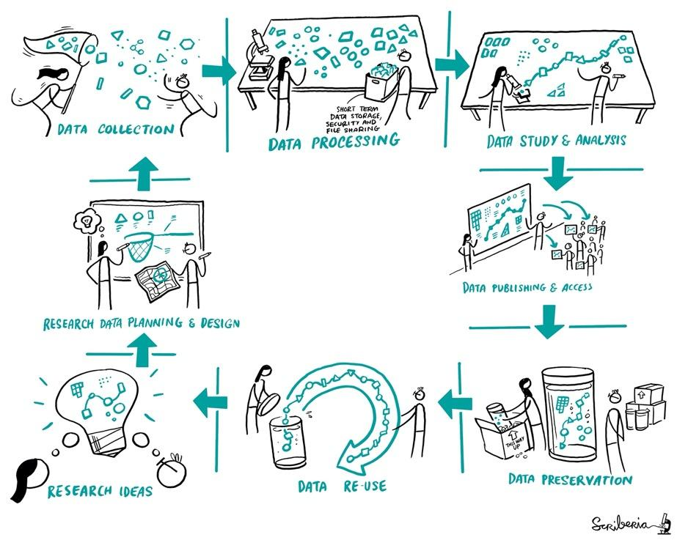
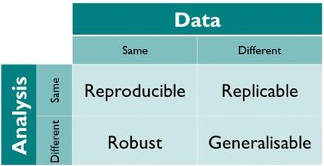
Reproducible Research Workflows
CC-BY 4.0, CC-BY image by The Turing Way and Scriberia, , DOI: 10.5281/zenodo.7684733
Notes:
It starts right when you have a research idea. You want to communicate with others, plan and design your work. Then you will describe your protocol and collect data sets. Then, you start processing and wrangling your data, conduct your studies and analysis, publishing your data, and other research components so everybody can access it. Then comes the archiving that can ensure that your data is reusable, meaning, that someone else can go through this whole process of reproducing or building upon your work.
That's quite an overwhelming process and we will talk about it more later.

Slide 18
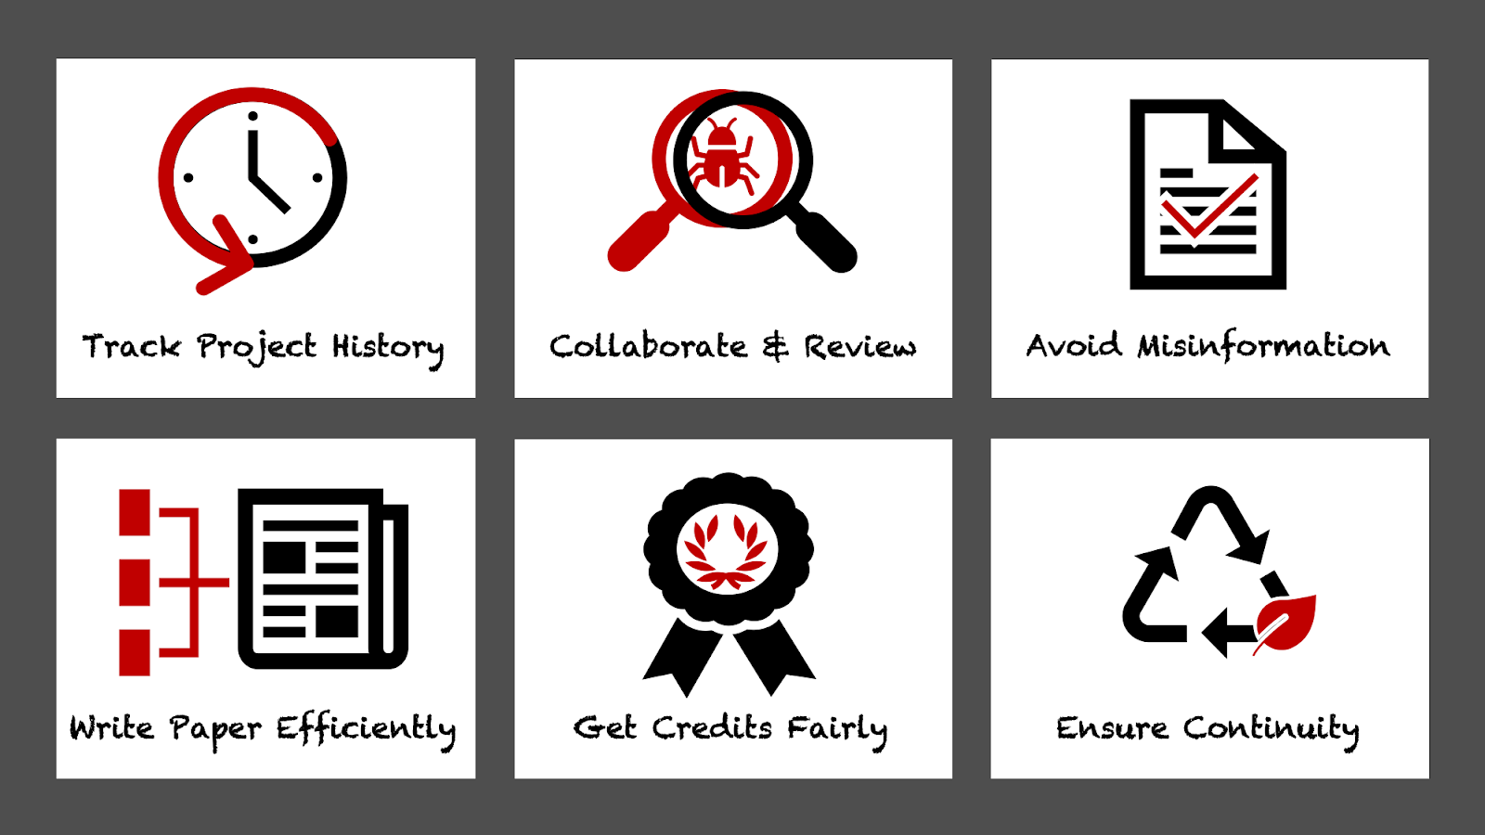
Why do reproducible research?
https://the-turing-way.netlify.app/reproducible-research/overview/overview-benefit.html, DOI: 10.5281/zenodo.7684733
Notes:
I think it is important to think more about why you would want to do reproducible research so there are many benefits for you, the scientific community and wider public:
There are many benefits in doing reproducible research:
Tracking the history of your research – this includes data, tools, methods, codes and documentation used in the project. This ensures research sustainability, fair acknowledgement of contributors and maximum usefulness to others. For me, keeping thorough records of what I am doing helps me to remember where to start when I’ve had a break from a certain research activity.
To facilitate collaboration and the review process – reproducible workflows enable other researchers and reviewers to have full access to all the different parts of the project that are necessary for validation of the research outcomes. This means that you will publish validated research and avoid misinformation.
Write papers and other research outputs efficiently – documenting the project throughout will make writing up easier and you are likely to already meet the highest-level journal guidelines for availability of datasets and metadata. I am structuring my projects to be reproducible from the outset so I am building a research compendium as I go along.
Credit work fairly – other researchers can use and reproduce different parts of your project such as data, code and protocols. All these parts will have DOI’s and therefore are individually citable pieces of work. This means you will get fair recognition for this work and your research is likely to have more impact as you will get cited more – articles that include statements that link their data have a 25% higher citation impact on average.
Ensuring continuity of your work – progress of reproducible projects can easily be tracked and continued allowing you and others to build on your research. It’s a more sustainable approach to research.

Slide 19
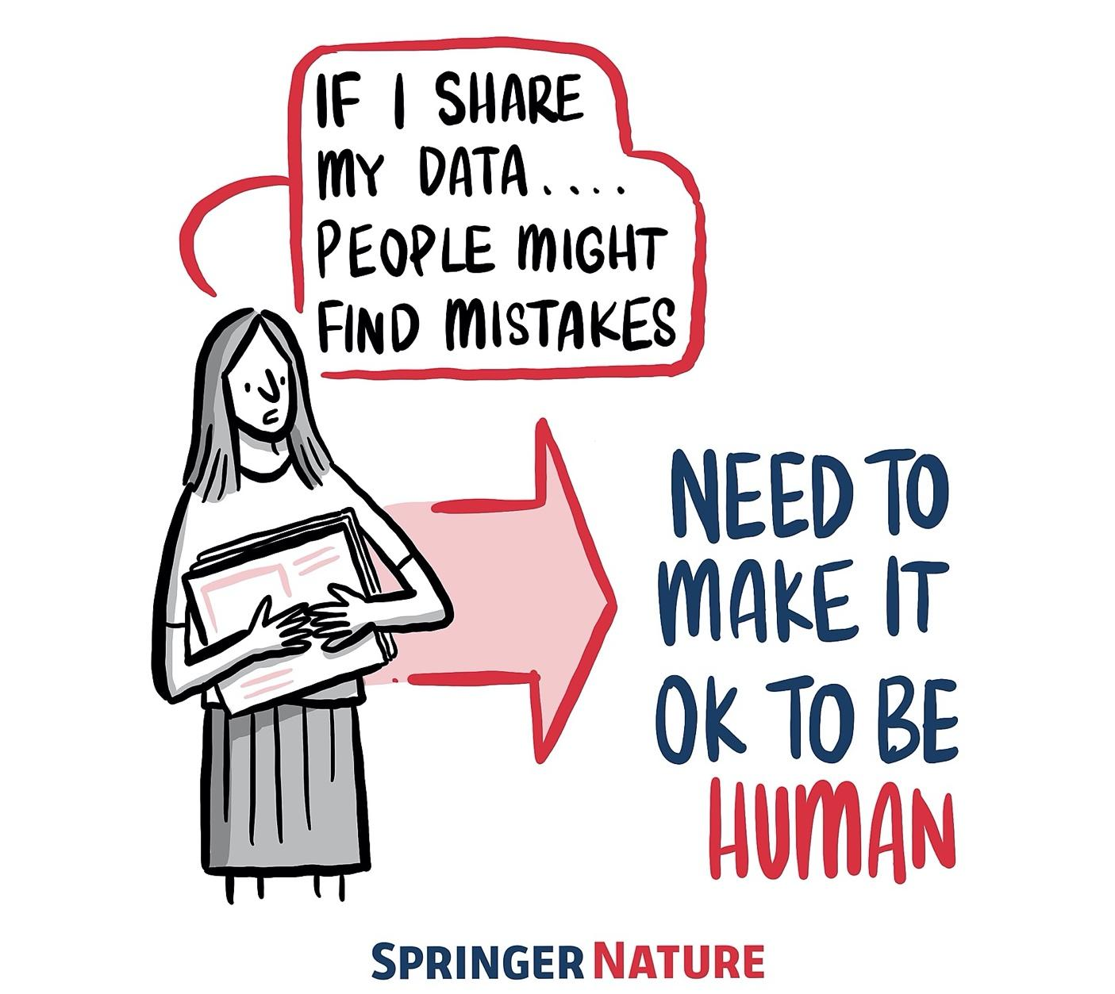
Applying best practices in our research requires intention, resources, time and collaboration, which can be overwhelming.
Blog post: https://www.software.ac.uk/blog/2020-12-17-ten-arguments-against-open-science-you-can-win
Notes:
TIMING: 4
So of course there are barriers to this way of working

Slide 20

Reflection exercise 1
What are some barriers to reproducibility?
Notes:
Write in the shared document from line 99

Slide 21
🌻
Held to higher standards than others
Is not considered for promotion
Publication bias towards novel findings
Barriers to reproducible research
Requires additional skills
Takes time
Support additional users
https://doi.org/10.6084/m9.figshare.5537101
#TuringWay @turingway, DOI: 10.5281/zenodo.7684733
Notes:
Eirini

Slide 22

The Turing Way
An Open Source project that involves and supports its diverse community to make data science reproducible, ethical, collaborative and inclusive for everyone.
https://github.com/alan-turing-institute/the-turing-way,
@turingway, CC-BY 4.0, The Turing Way, DOI: 10.5281/zenodo.7684733
Notes:
Part 1: About The Turing Way
The Turing Way is an open source project that involves and supports its diverse community in making data science reproducible, ethical, collaborative and inclusive for everyone. We believe that to make our project truly beneficial and comprehensible we need to collaborate with people with diverse skills, backgrounds and domain knowledge.

Slide 23
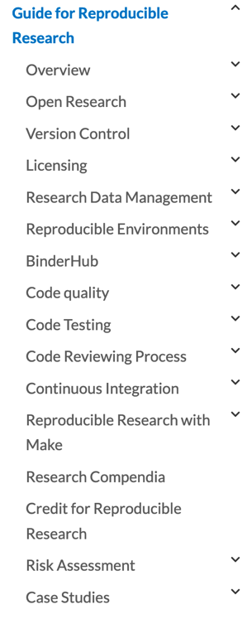
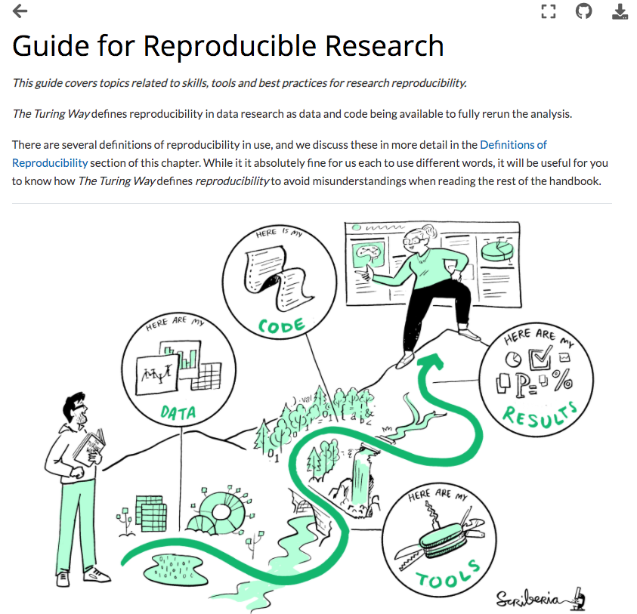
Book: https://the-turing-way.netlify.app/welcome, @turingway, CC-BY 4.0, DOI: 10.5281/zenodo.7684733
Notes:
Today’s focus and the starting point for the turing way: reproducibility. Chapters contain background information, some step by step guides and also case studies from researchers that have used these practices and tools.

Slide 24
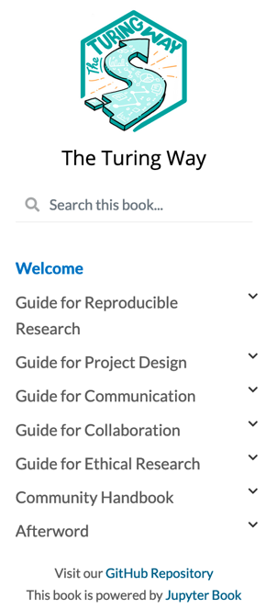
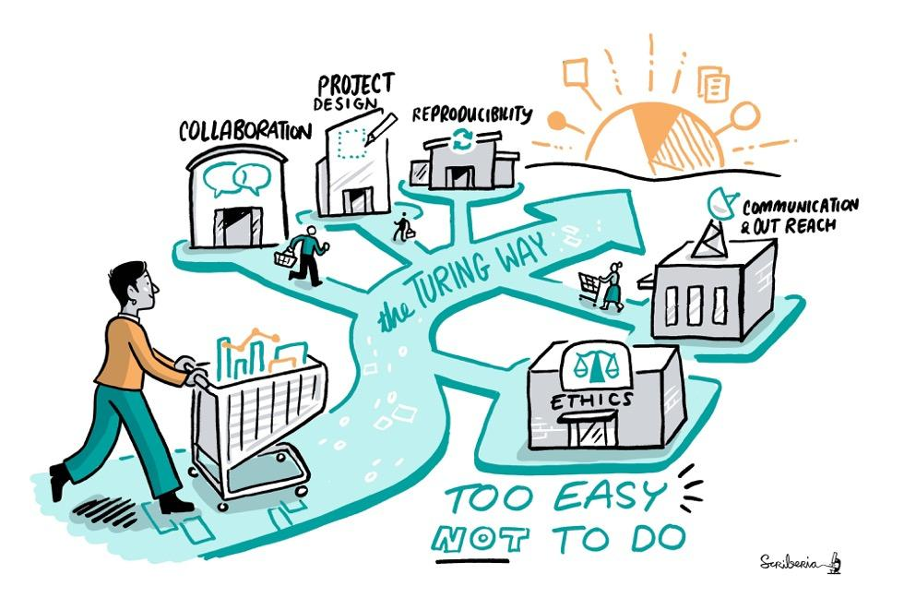
A book: “Work in Progress”
Book: https://the-turing-way.netlify.app/welcome, @turingway, CC-BY 4.0, DOI: 10.5281/zenodo.7684733
Notes:
The book is always a work in progress and reproducibility was only the first step. Science also needs to be ethical, collaborative and inclusive. In addition to the guide for reproducible research: project design, communication, collaboration and ethical research.
We also record all the community practices that we are developing and practising within the Turing Way in our community handbook.

Slide 25
Reproducible workflows
Applying reproducibility principles throughout the project’s lifecycle
Open source vs. “Inner” source
Notes:
Today we’ll talk about reproducibility and specifically reproducible workflows, i.e. applying reproducibility principles throughout your project’s lifecycle. You need need to think about recording your whole workflow transparently so that means every part needs to be documented and accessible in some way.
Emma will talk more about this later, but I want to already draw your attention to the differences between working reproducibly and working in an open source manner. In open source you work openly from the start of your project.
Many research projects are only made open at the end or some elements of the project may never be fully open and accessible due to their sensitive nature. However, this does not mean that the research can’t be reproducible. You can take this reproducible approach within your team so in an inner source way.

Slide 26
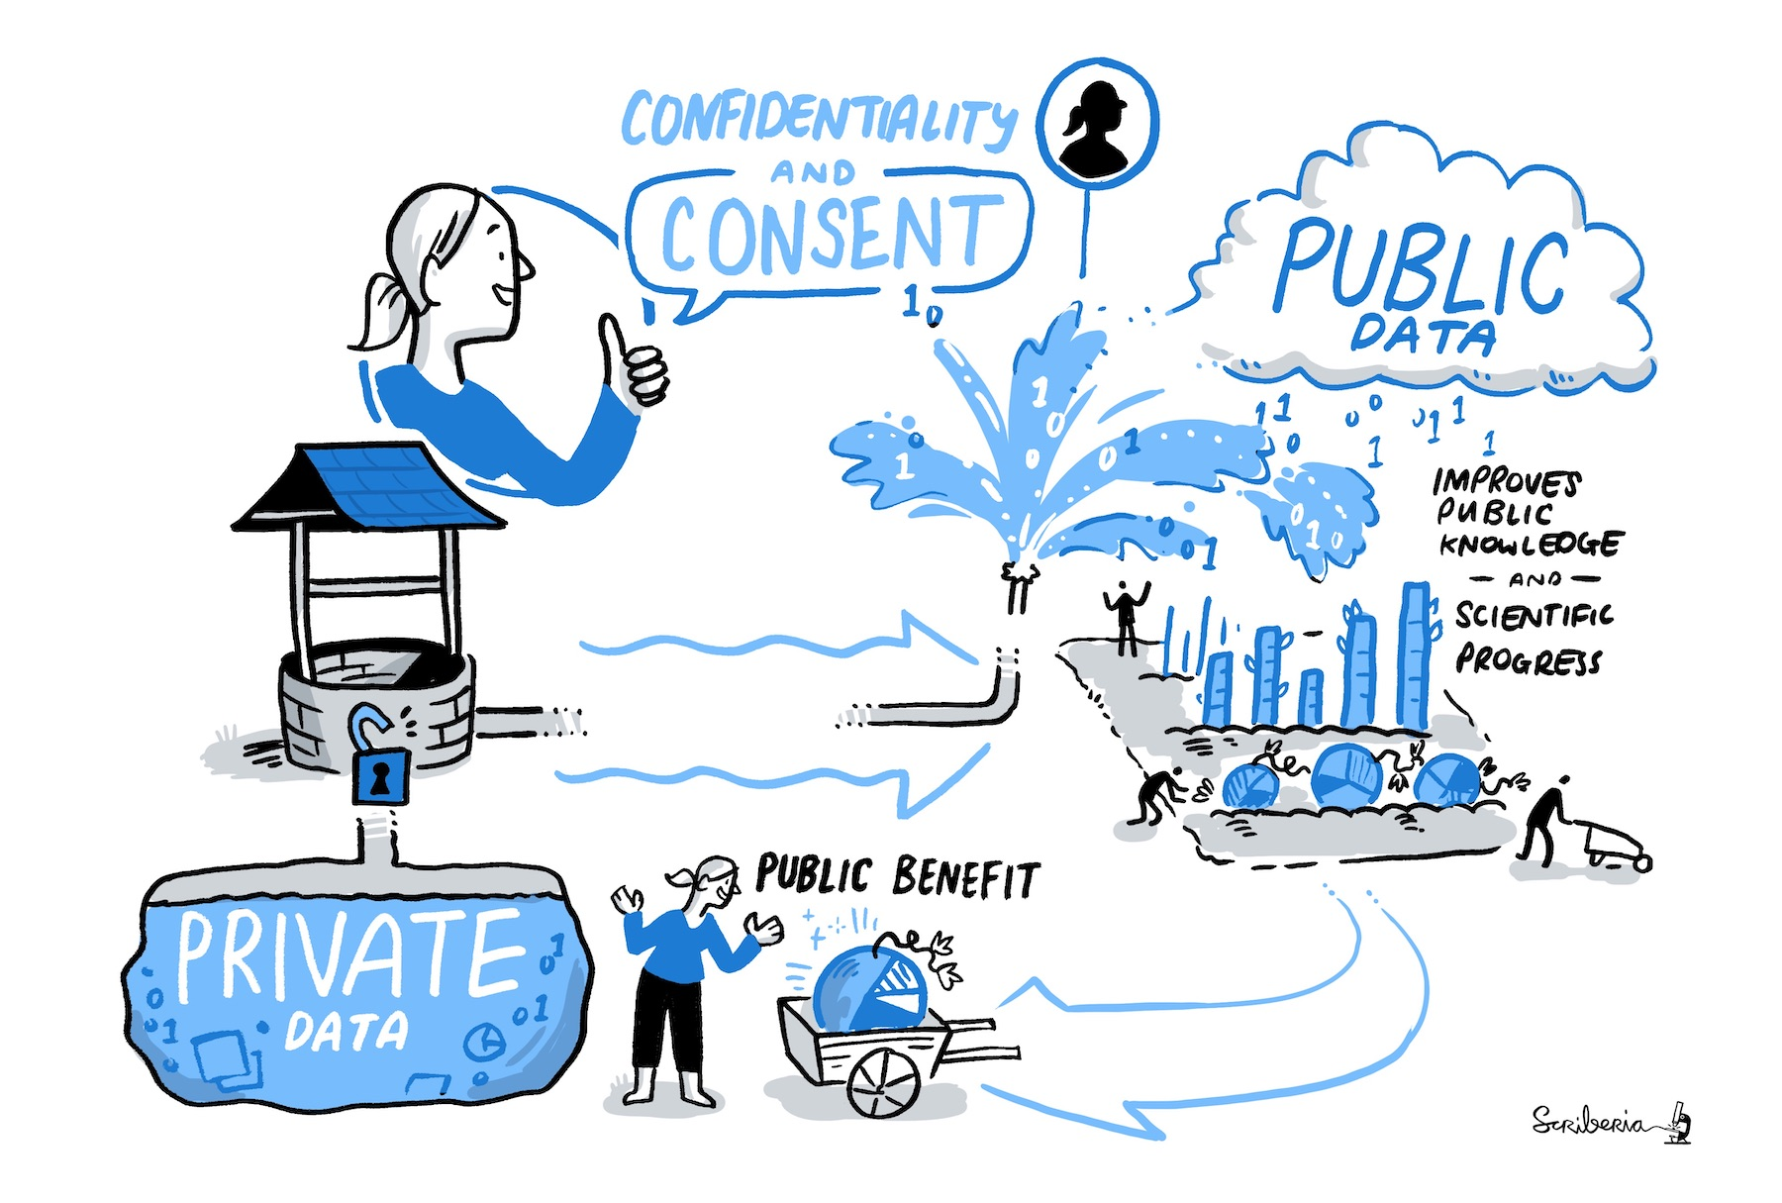
Privacy and sensitivity concerns
Is the data too sensitive?
Do I have permission to share openly?
I don’t want others to see all my work
I don’t know how to share my work
Notes:
Consider are the privacy and sensitivity of your project and the researchers involved.
Often researchers have concerns about reproducible ways of working as it is often more open
Things you might be concerned about are that:
Some forms of data can be sensitive in terms of the personal information or things like information about the geographic location We must consider these sensitivities when working reproducibly but this does not need to stop you having a fully reproducible workflow. There are ways to anonymise data or only publishing certain outputs.
You need to consider if you have permission to openly share data and other research outputs.
But you can still work reproducibly without having open data - this is being done currently on projects that deal with personal data such as electronic health records. So there are tools in place and ways of working for this.
There is hesitancy about being more open with all parts of our research, in terms of ownership of data, ideas and the presumption that these will be scooped.
When you learn more about working openly, it becomes clear that using the right licenses to tell others how they can reuse your work, putting digital object identifiers on all your research outputs to make it easier for others to cite you, and also promoting your work openly actually means scooping becomes less likely as you are staking a claim early on in your project to the research you are doing.
It then becomes much harder for others to say it is theirs without giving you credit.
You also establish a date and time stamped record of your work, so you can show when you have done something, if others are trying to claim credit for your ideas or other work.
In terms of time and how to share your work - this is something that you have to learn to do and then plan for in your next project - it becomes a normal part of your work so eventually will not take any longer.

Slide 27
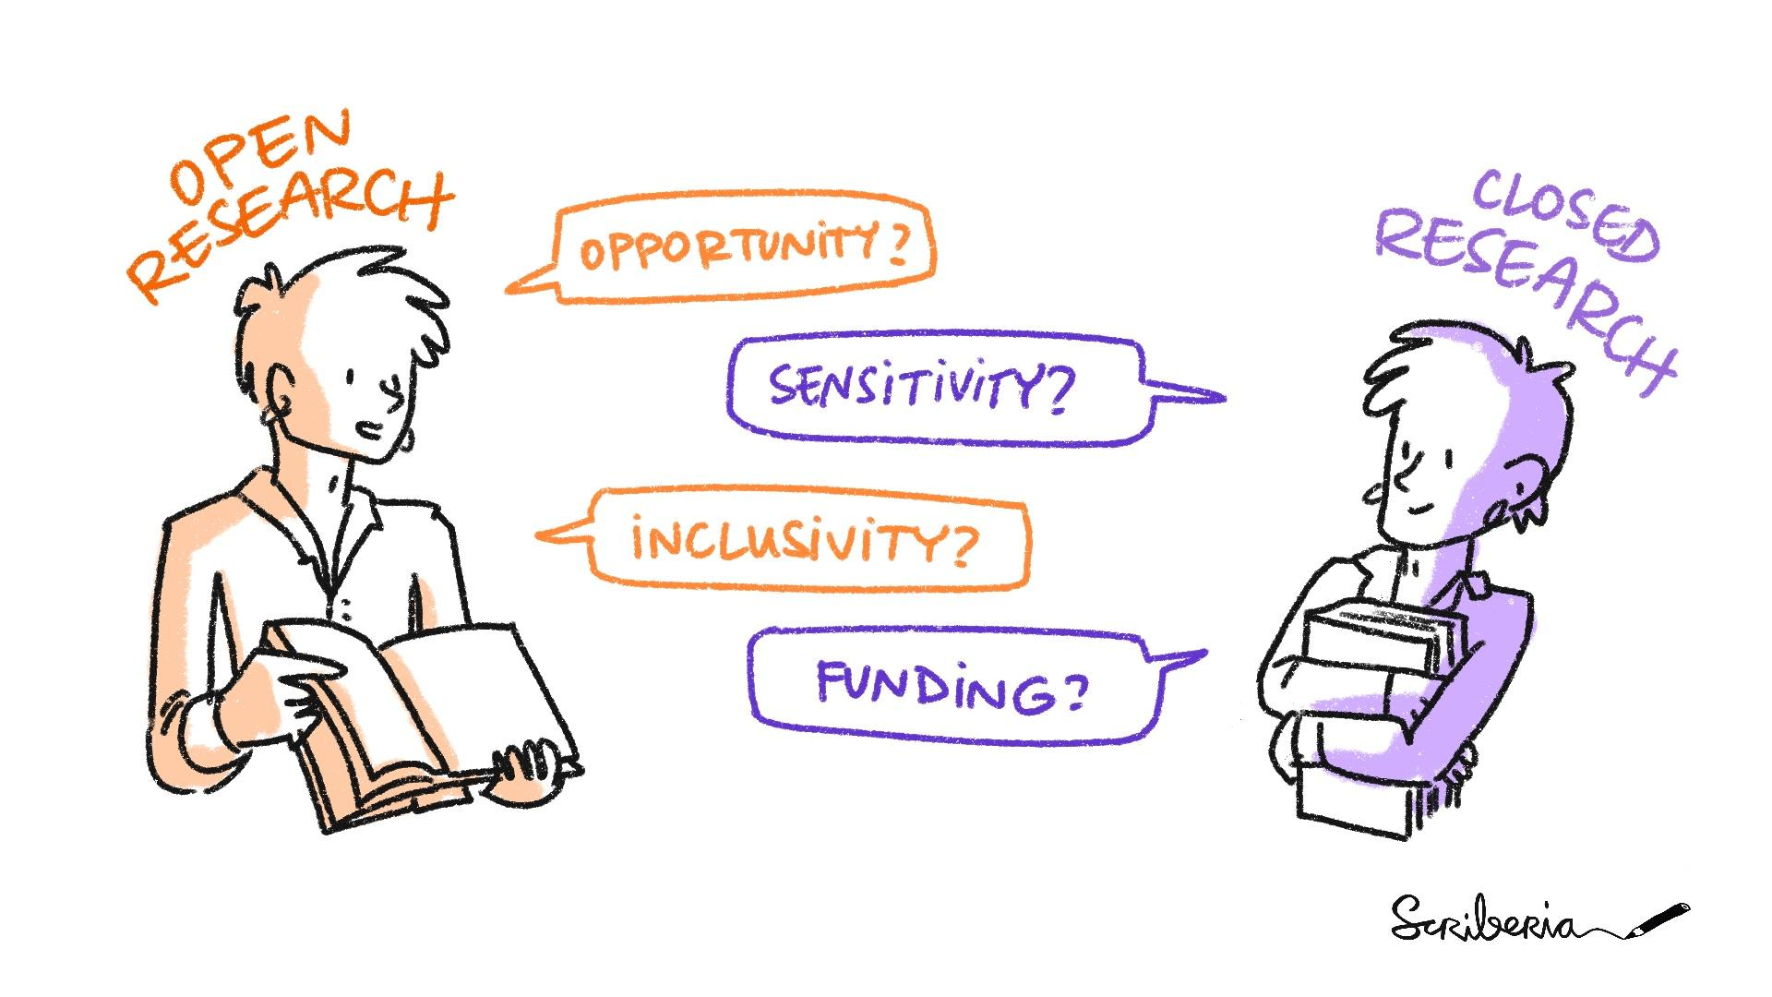
Reflection exercise 2
What motivates you to share your work?
What concerns you about sharing your work?

Slide 28
Breakout room: 10 minutes
What do you need to consider to ensure your work is reproducible?
Research object: (1) Data, (2) code, (3) workflow, (4) documentation
Practices: Version control, licensing, data management, communication, collaboration, reusability, long-term archiving
Instructions: (i) Each room is assigned a research object. (ii) Nominate a notetaker in your room. (iii) Select 1 or 2 practices. (iv) Discuss at what stages of research cycle these practices are applied. (v) Report!

Slide 29
Breakout Room: 15 Minutes
What do you need to consider to ensure your work is reproducible?
Research object: (1) Data, (2) code, (3) workflow, (4) documentation
Practices: Version control, licensing, data management, communication, collaboration, reusability, long-term archiving
Instructions: (i) Each room is assigned a research object. (ii) Nominate a notetaker in your room. (iii) Select 1 or 2 practices. (iv) Discuss at what stages of research cycle these are practices applied. (v) Report!
Notes:
Eirini

Slide 30
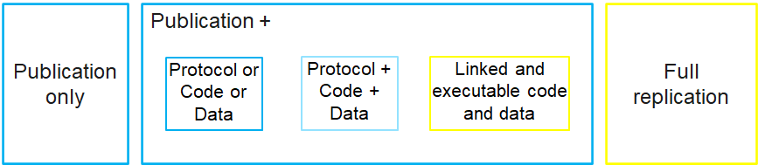
Reproducible Research Spectrum
Not reproducible
Gold standard
Adapted from Peng 2011
https://www.science.org/doi/abs/10.1126/science.1213847
Notes:
What should we be aiming for and how do we do this?
We tend to publish research as stand alone research articles to present the results and our interpretations - these on their own are not reproducible.
There are many other outputs that could be included in your article or linked to your article that would make your work reproducible such as the methods you used, the raw data, the analytical code and details of the software you used for analysis.
Having all of that information within or linked to your article makes it a reproducible piece of research.
You don’t want to let perfect be the enemy of the good here! All movement along this axis is progress towards better science.
you may have experienced the challenge of actually EXECUTING someone else’s code…..

Slide 31
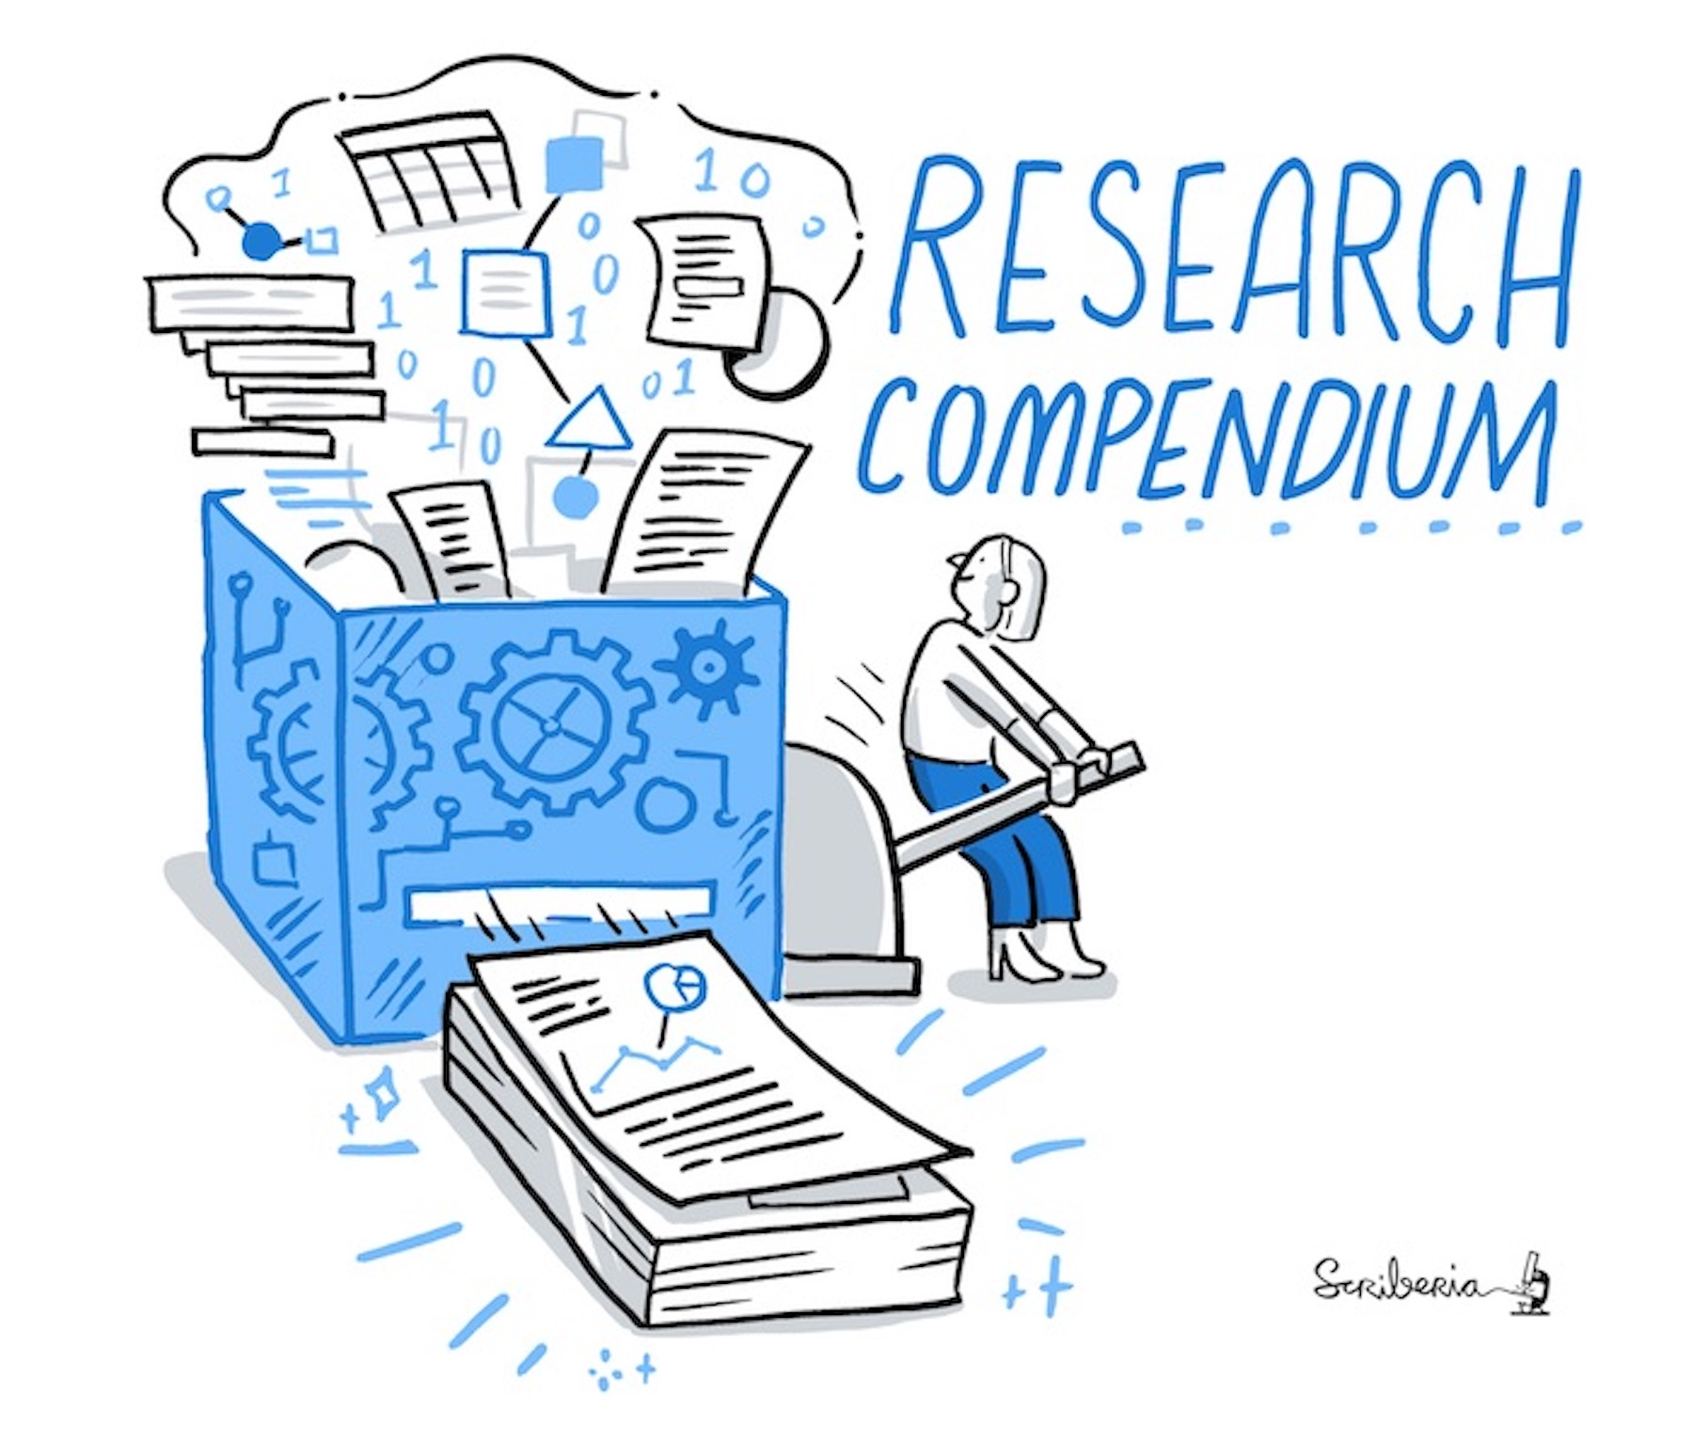
Reproducibility: Where should we start?
Reproducible research workflow:
Collaboration
Using collaborative, version controlled and open ways to work with others.
Transparency
Clear documentation of methods, data, code - openly shared research compendium.
Notes:
How do you build this into your research workflow?
You need to think about two things:
Transparency - this is done by clearly documenting your workflow - this can be done in a research compendium and published linked to your research article.
You also need to think about collaboration - so we often work in teams and it is important to think about how you can work in this open way as a team.
You can achieve this by using version control.

Slide 32
Three computational skill levels for reproducibility
Transparent recording
Research compendium
Executable compendium
Data
Methods
Analysis steps
+code
+ computational environment
Karoune, E., and Plomp, E.(2022) Removing Barriers to Reproducible Research in Archaeology. Zenodo, ver. 5 peer-reviewed and recommended by Peer Community in Archaeology.https://doi.org/10.5281/zenodo.7320029.
@PhDtoothFAIRy, @ekaroune, Slides: https://doi.org/10.5281/zenodo.6784277
Notes:
I think what is important to remember is that we are all at different stages of our reproducible journeys so this means we all have different skills and different knowledge of open science practices.
Also sometimes the member of a project or an organisation may dictate how you conduct parts of your research so you may not have some of these choices available.
We are trying to present here three different skill levels for reproducibility to show that what is most important with reproducible research is the recording of a transparent workflow at all stages and that this can be achieved with any level of computer skills and different types of software and tools.
The lowest skill level, we have called transparent recording as this means documenting simply all of the data collection methods and analysis to accompany the dataset that you use or produce. This can all be linked to your research paper.
The middle level is using a research compendium - this does involve adding analysis code along with methodological information and data - and structuring this in folders within a repository.
The third skill level is creating an executable compendium - this will mean that with a click of a button your analysis is reproduced so this does mean you need code, data and methods to all be linked using a particular tool such as Binder.
We are now going to take you through these three skill levels to show you come examples of how this can be done.

Slide 33
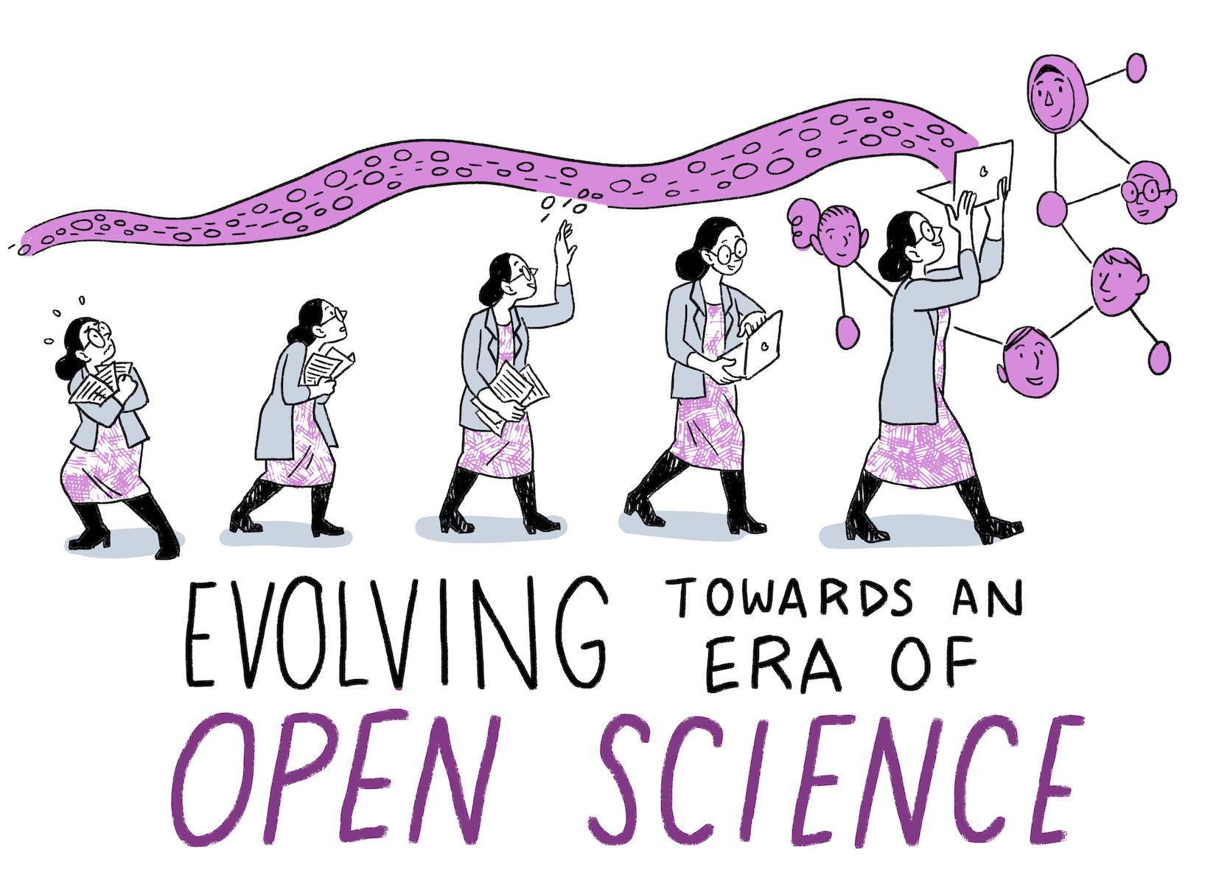
Open Science to enable Collaboration and Transparency
Open Science practices remove barriers from sharing and using scientific resources at all stages of research.
Make research findings accessible to all rather than keeping them locked away (for example, behind a paywall).
@turingway, CC-BY 4.0, https://www.fosteropenscience.eu/, DOI: 10.5281/zenodo.7684733

Slide 34
Open Science aims to transform research by making it more transparent → accessible → reliable → reproducible → reusable → collaborative → beneficial to society.
To achieve this openness in research, we need to make each element of the research process ...
publicly available,
with permission to view, use, modify and distribute, and
description for how one can collaborate.
@turingway, CC-BY 4.0, The Turing Way, DOI: 10.5281/zenodo.4609987
Notes:
So what actually is open science?
If we define open science - it aims to transform research by making it more reproducible, transparent, reusable, collaborative, accountable, and accessible to society’.
So it pushes for change in the way that research is carried out and disseminated by digital tools.
To achieve this openness in research, each element of the research process should:
Be publicly available: It is difficult to use and benefit from knowledge hidden behind barriers such as passwords and paywalls.
Be reusable: Research outputs need to be licensed appropriately, so that prospective users know any limitations on re-use.
Be transparent: With appropriate metadata to provide clear statements of how research output was produced and what it contains.

Slide 35
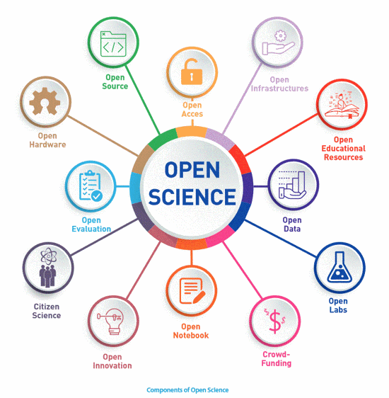
Open Science is an umbrella term for open research practices
Image from UNESCO Open Science brochure, available under the CC-BY 4.0 license, DOI: 10.5281/zenodo.7684733
Notes:
Open Science is an umbrella term that involves various approaches and movements aiming to remove the barriers for sharing any kind of output at any stage of the research process. As such, open access to publications, open research data, open source software, open collaboration, open peer review, open notebooks, open educational resources, open monographs, citizen science, or research crowdfunding, fall into the boundaries of Open Science.

Slide 36
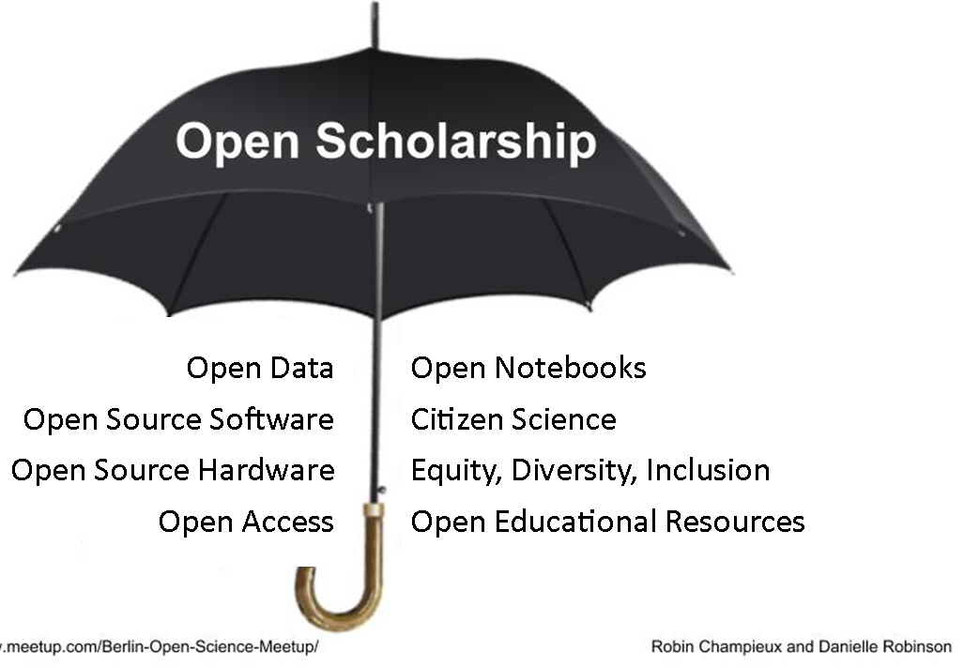
What are some barriers we should work to remove?
Transparency →
Reproducibility →
Research Quality →
Sustainability
+
/ methods
Collaboration →
Inclusive Research →
Equity and Diversity →
Global Accessibility
/ participatory
@turingway, CC-BY 4.0, The Turing Way, DOI: 10.5281/zenodo.7684733
Notes:
Open Research is made up of lots of different practices that you can see here under the umbrella.
Thinking about and implementing all of these different practices can be overwhelming and you do not have to start doing them all at once. Some might not relate to the work you do and some take quite a bit of training to achieve. So I’m going to give an overview of all these practices so you can see what might be something you could start to do.
I’m going to explain these different practices in a bit and give you some examples of them.
When we think about the outcomes of all of these practices, they can be grouped into two areas, so really the outcomes of doing open science are:
Firstly - sustainability so the transparency of opening up research leads to the ability to reproduce research and this then increases the overall quality of research leading to more sustainable research. So more researchers can reuse the methods you publish, open data can be further explored etc.
And secondly, the openness and consideration for inclusive practice leads to an overall increase of equity, diversity and inclusion in research for researchers, the wider scientific community and the general public.
And these outcomes are related to the motivations that researchers have for adopting open research.

Slide 37

Open Science
Open Research
Open Scholarship
We are going to use these terms interchangeably today to cover important considerations for you!
Notes:
So one thing I found a bit confusing when I started learning about Open Science was that there are many umbrella terms such as Open science, open research, and open scholarship. They are all essentially defining the same thing - an approach to more open ways of working in research. And today I am going to use these words interchangeably to mean the whole approach of open working.

Slide 38
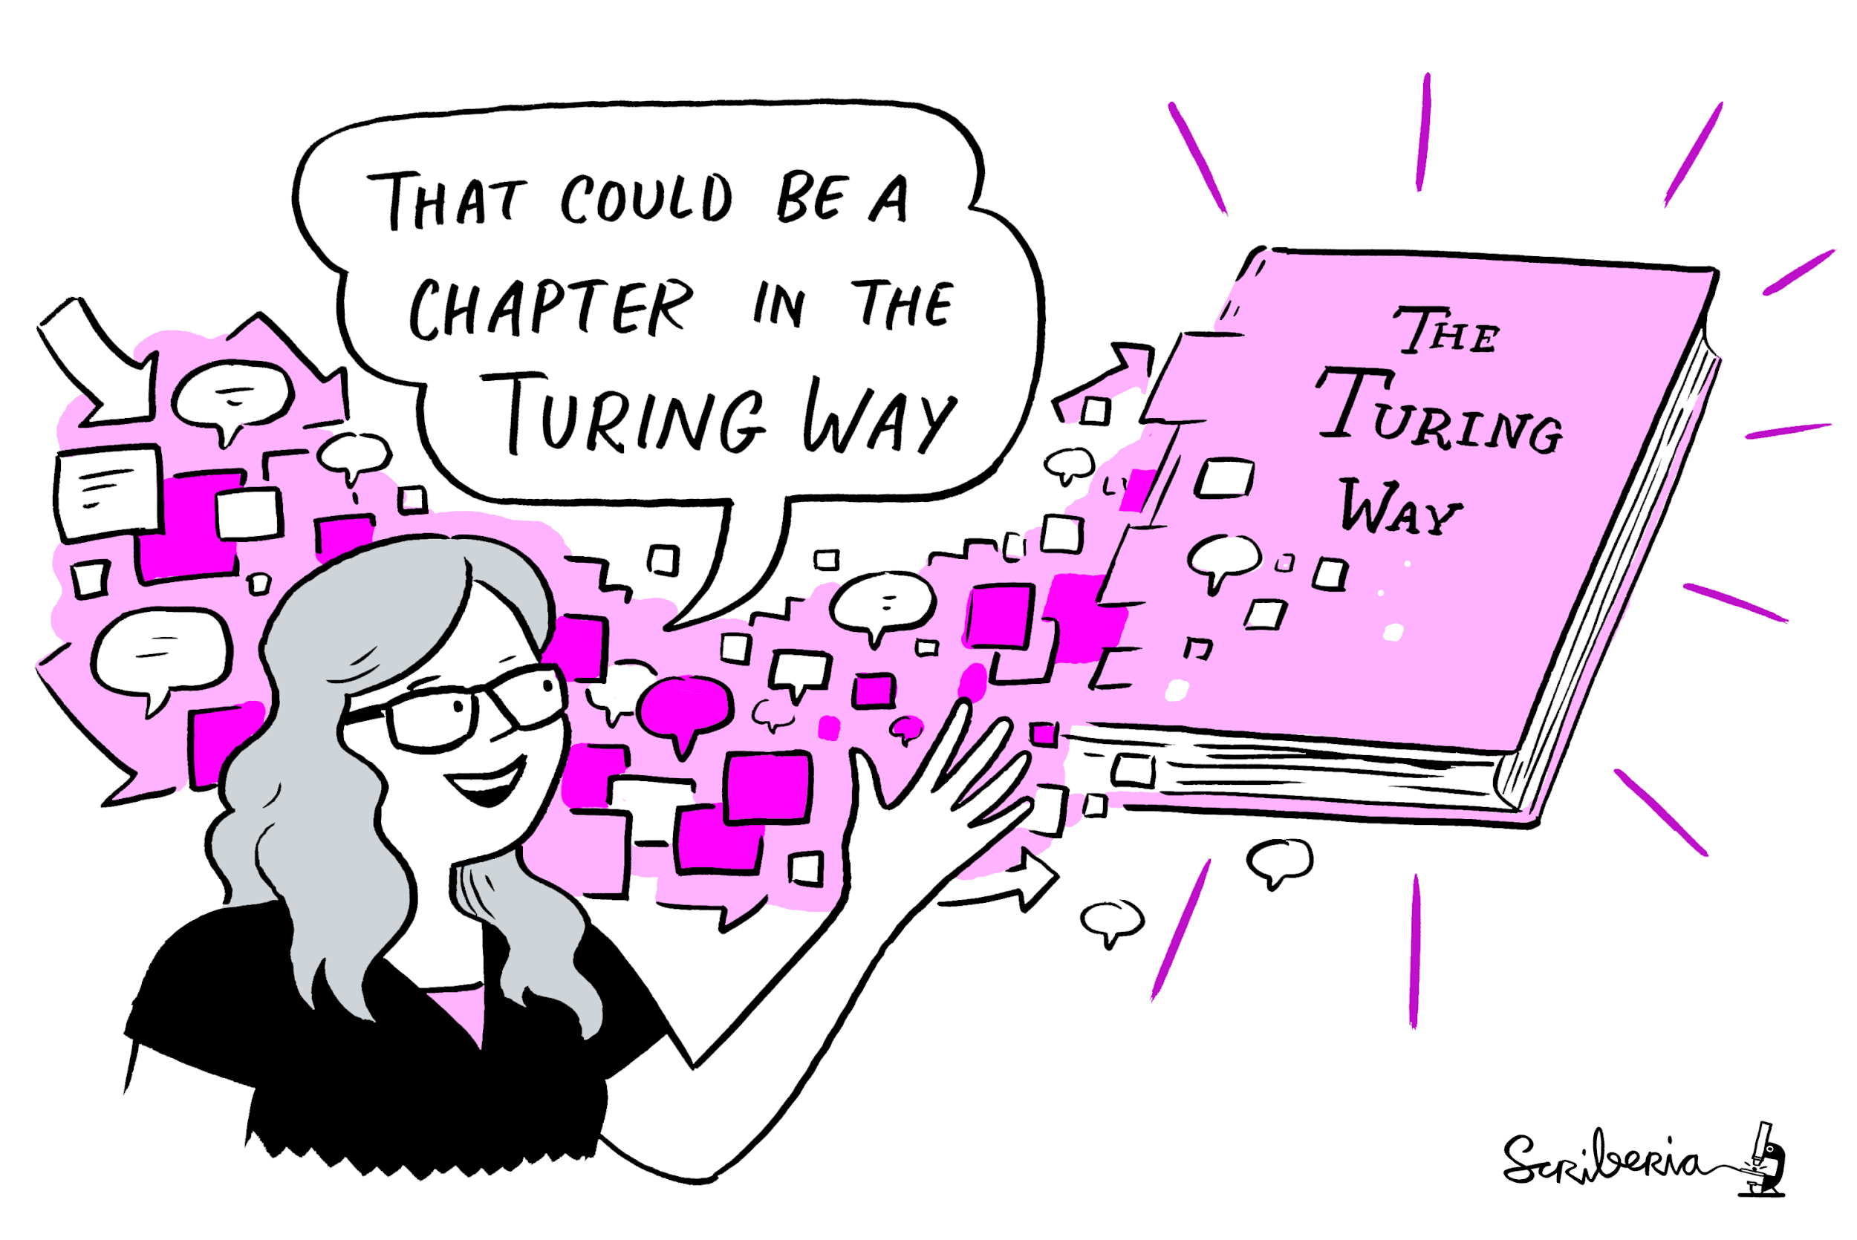
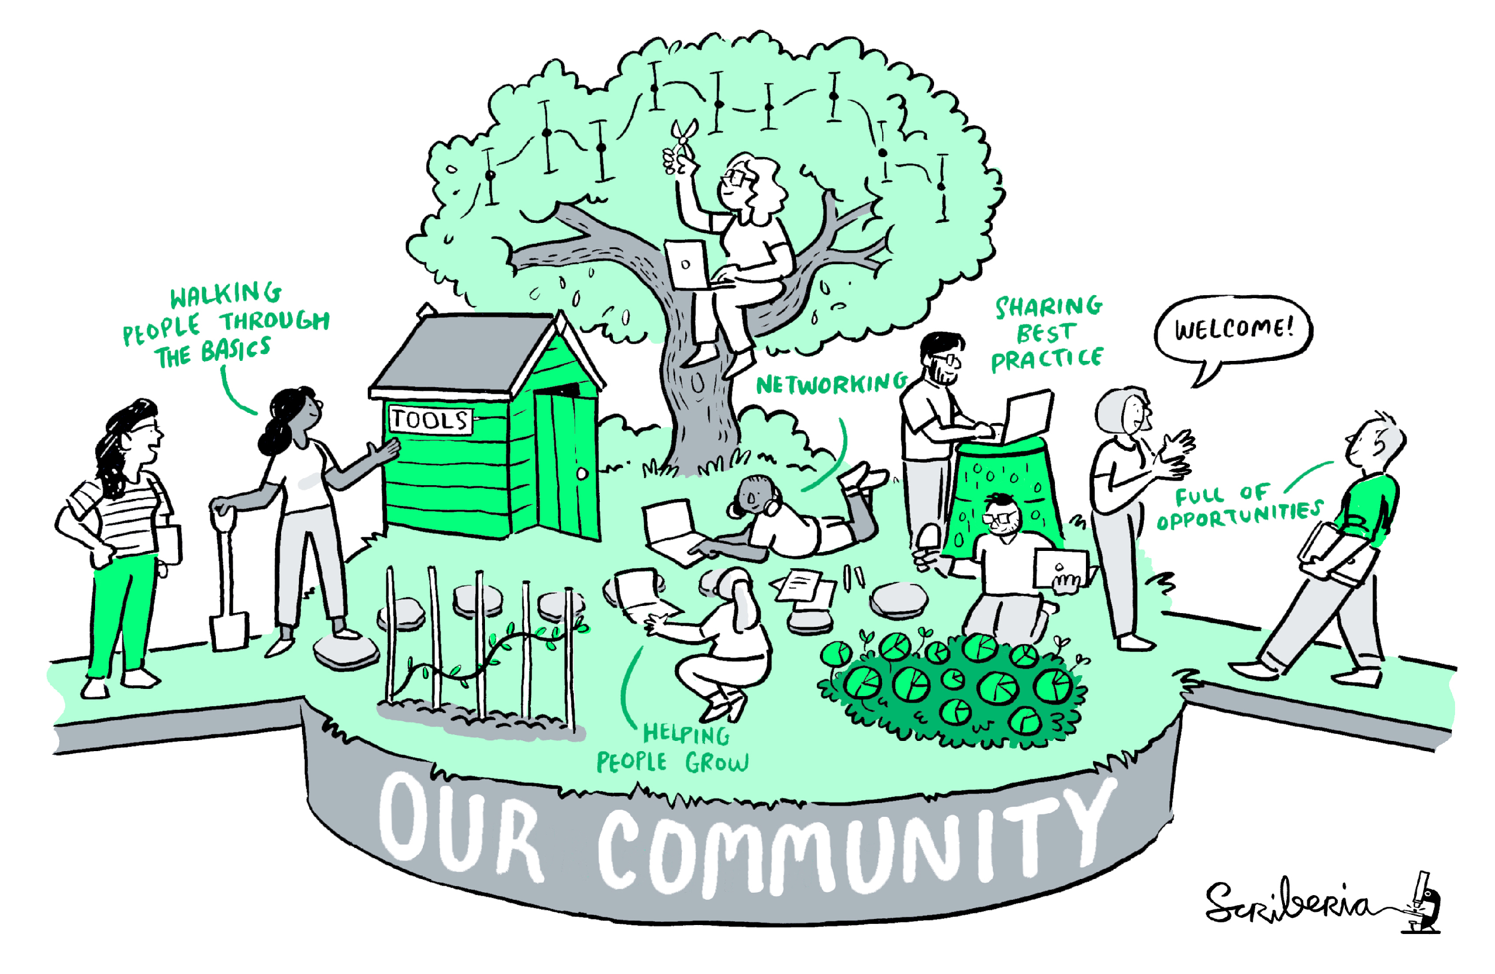
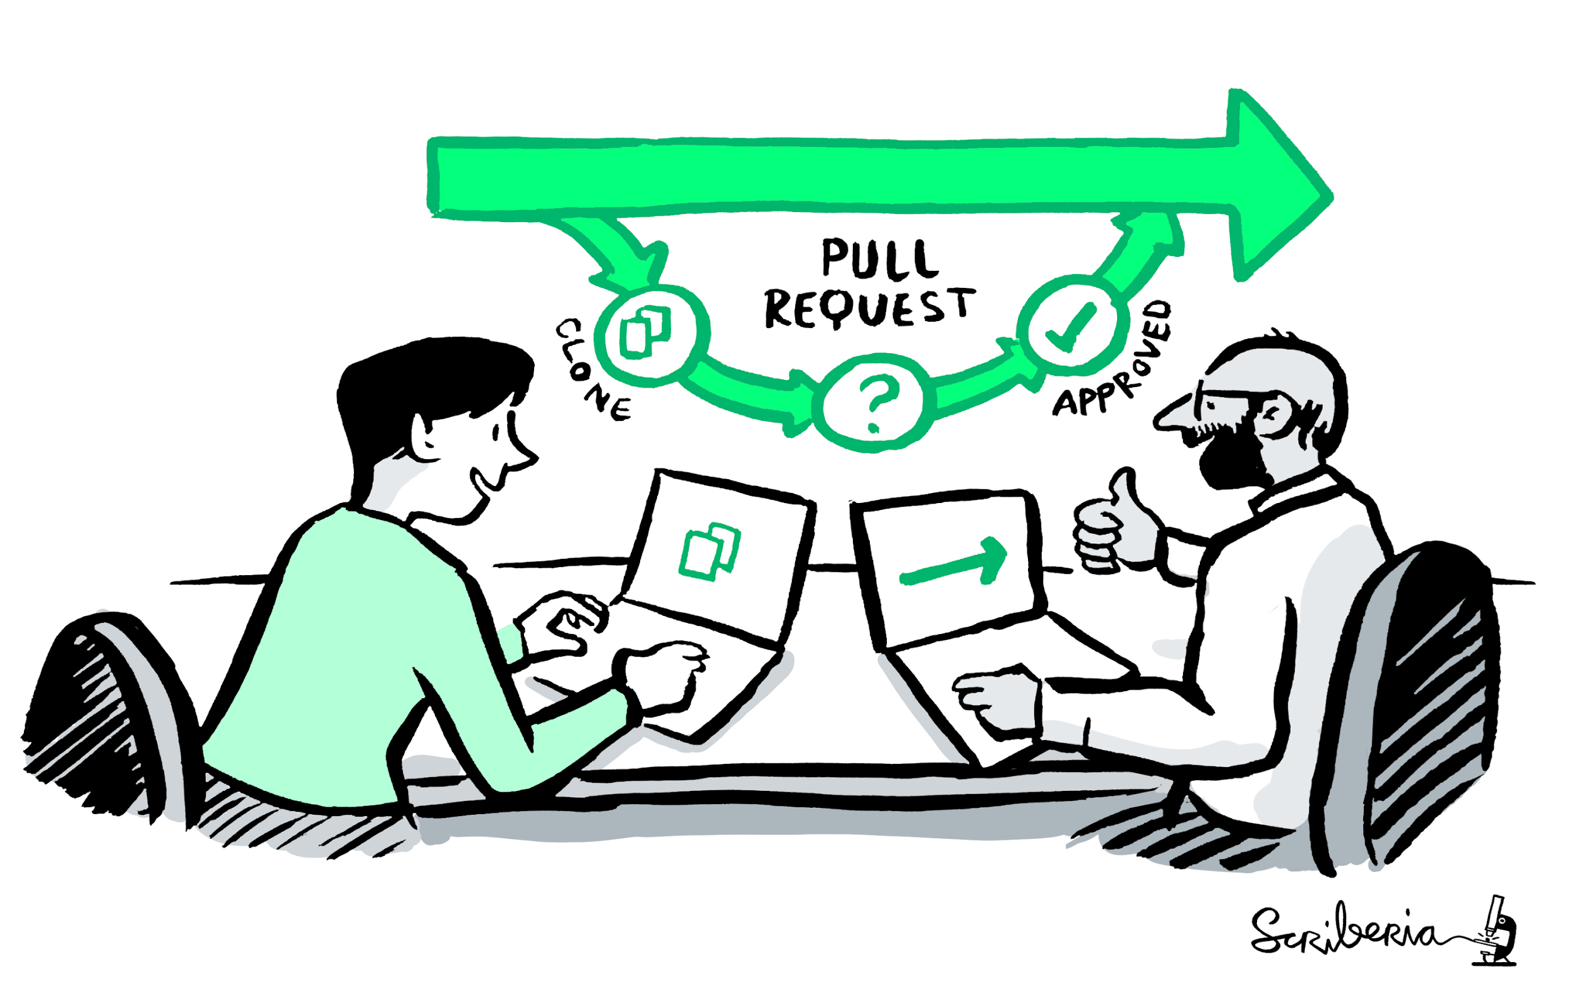
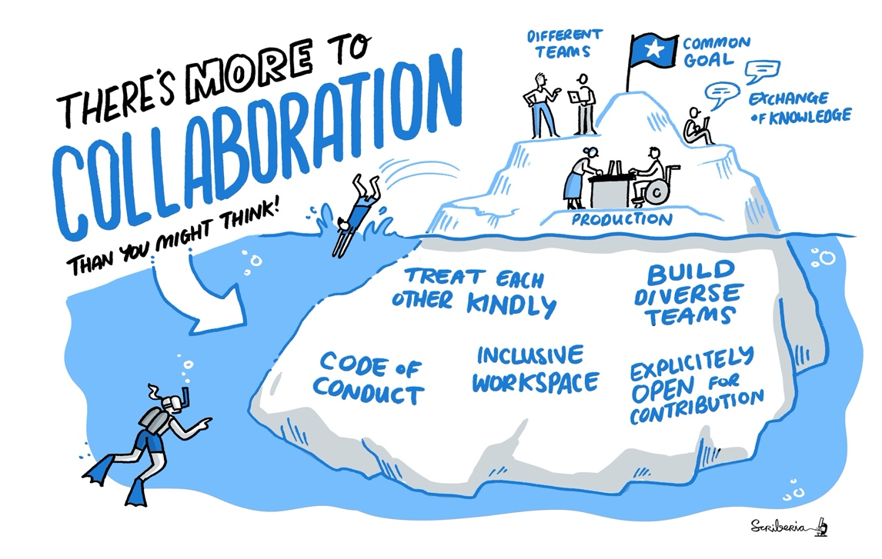

A Book
A Community
Book:
the- turing-way.netlify.app/
GitHub:
github.com/alan-turing-
institute/the- turing-way
Twitter:
twitter.com/turingway
Email:
theturingway@gmail.com
CC-BY 4.0, The Turing Way
An Open Source Project
A Culture of Collaboration
Notes:
The Turing Way is a Book.
A community where people come together to collaboratively write chapters, build and maintain resources, share their skills and ideas around best practices in data science and research.
We apply open source principles in the development and maintenance of this project.
And finally, it's built on the culture of collaboration, which is the process and the backbone of our project.
As a community-developed resource, The Turing Way is always a work in progress.

Slide 39
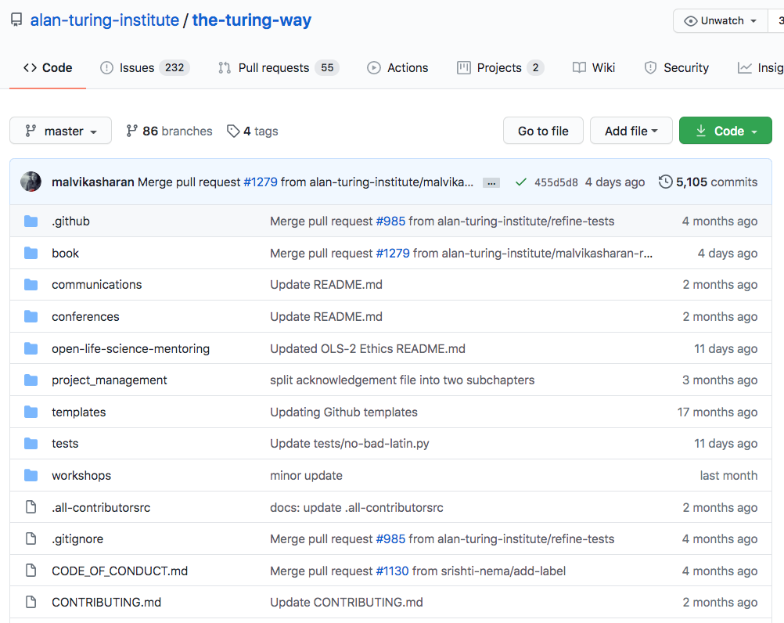
A Collaborative, Version Controlled and Open Project
Shared online
Designed for open collaboration
Hosted on GitHub with history and versions
Described with open license
Community oriented
@turingway, CC-BY 4.0, The Turing Way, DOI: 10.5281/zenodo.7684733

Slide 40
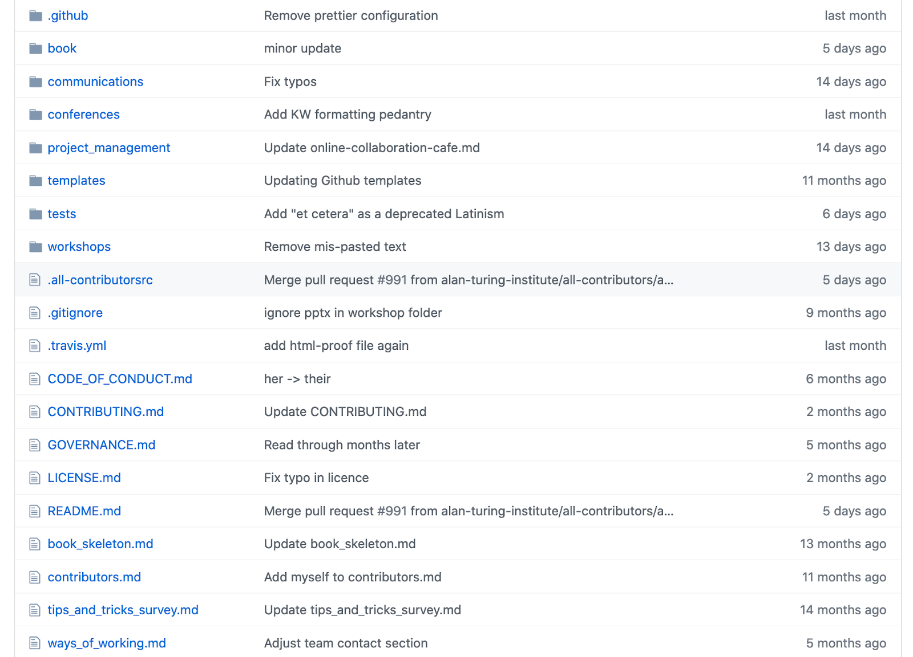


Slide 41
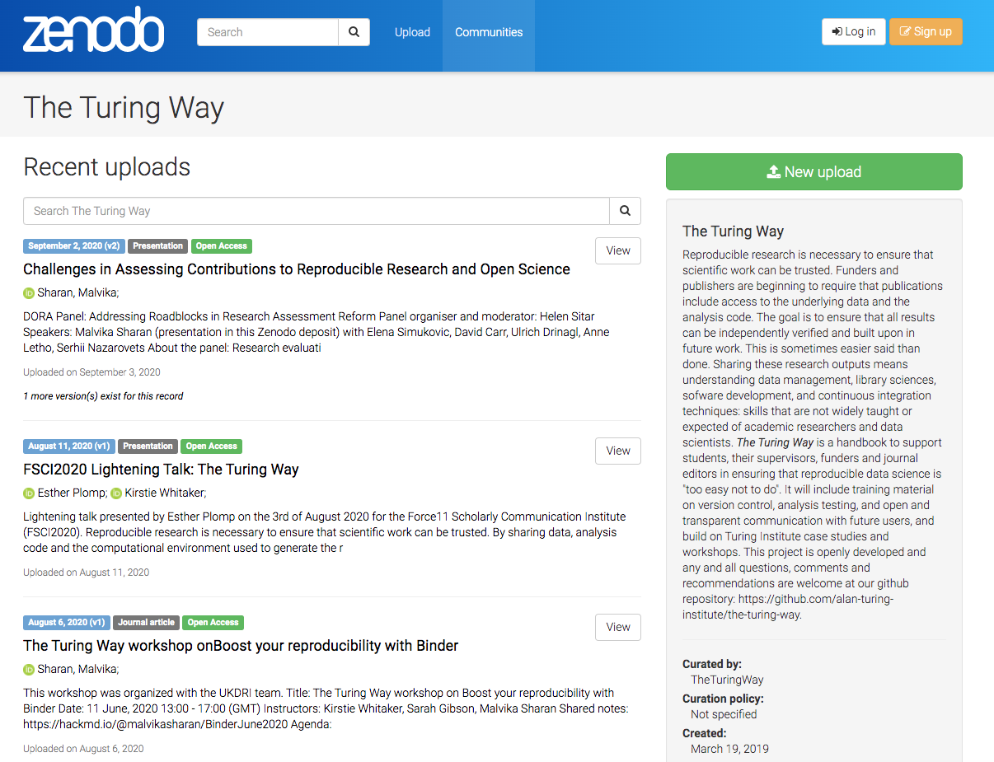
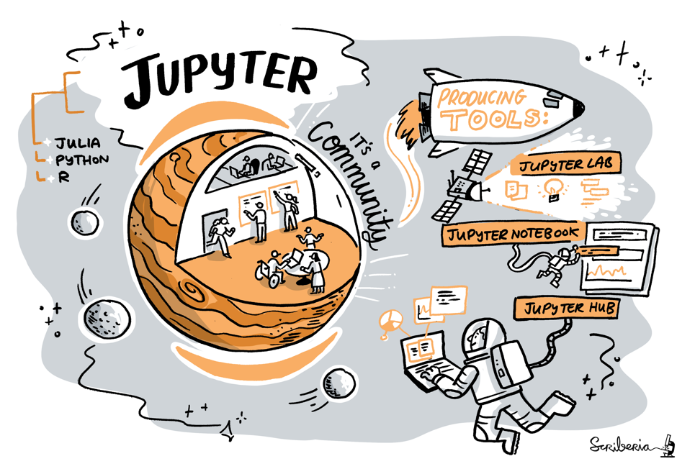
An Open Science project
everyone can freely read, reuse, distribute, modify and help develop
the project belongs to the research community (CC-BY license)
Builds in collaboration with other projects
@turingway, CC-BY 4.0, The Turing Way, DOI: 10.5281/zenodo.7684733

Slide 42
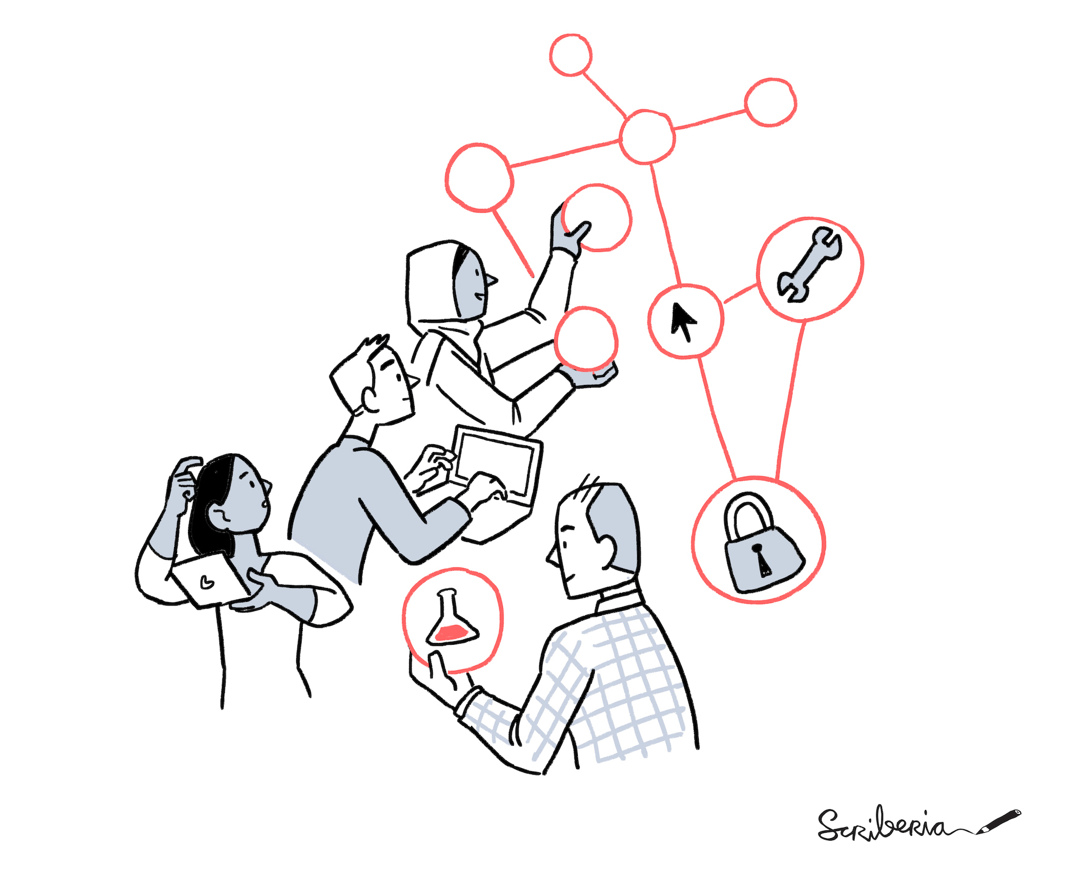
Open Science:
Where should we start?
CC-BY 4.0, CC-BY image by The Turing Way and Scriberia, DOI: 10.5281/zenodo.7684733
Notes:
So how can you start to think about producing this Reproducible research workflow?
One of the things you can use is open science.

Slide 43
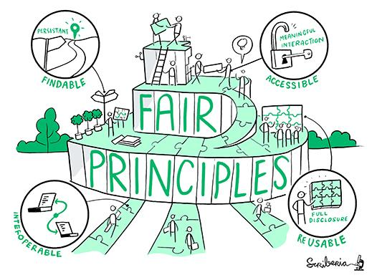
FAIR principles
Findable,
Accessible
Interoperable
Reusable
Notes:
The FAIR principles are considered the gold standard for data management and stewardship, and are being implemented across many different disciplines.
FAIR stands for: Findable, Accessible, Interoperable,Reusable
There is currently a large focus and drive towards using FAIR particularly within European funded research.

Slide 44
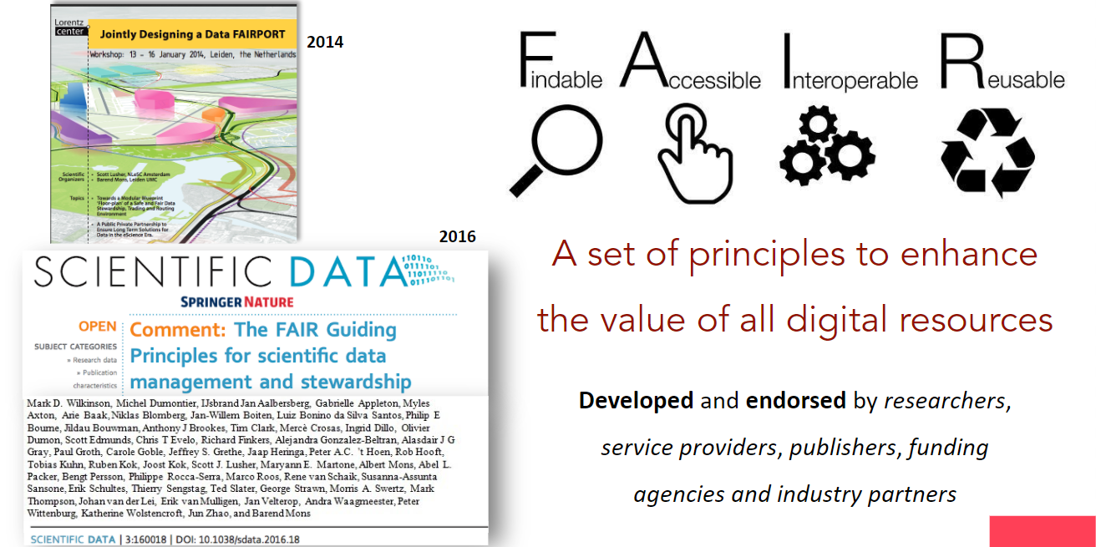
FAIR principles from Wilkinson et al. (2016)
DOI: 10.1038/sdata.2016.18
Notes:
The FAIR principles was developed for data management but it is now used for many different purposes such as sharing software, educational materials, workflows and even physical samples.
It is a simple set of principles but it’s implementation can take time and must be considered separately by each discipline, as it can’t be applied in exactly the same way in every discipline
So Implementing FAIR is a journey that each domain has to go down for greater reproducibility and sustainability of research.

Slide 45
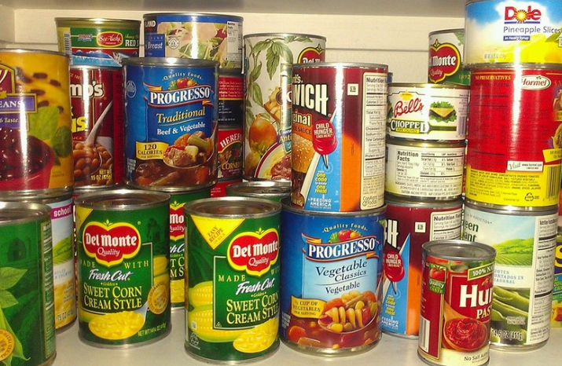
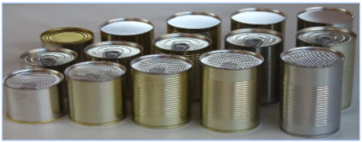
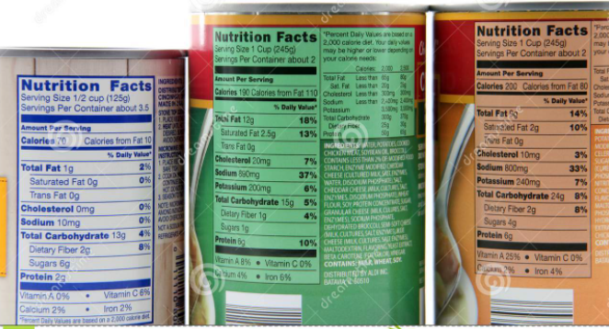
FAIR data analogy
Annotation makes it easier to find important things
You would not buy food with no labels!
Labels make different foods easier to find and access in stores, combine with other foods (interoperable) and use in different ways.
Adapted from talk by Philippe Rocca-Serra (2020)
Notes:
To give you an analogy to explain the FAIR principles, I’m going to use food cans to represent data.
You would not be happy if you went to the supermarket and it was filled with cans that had no labels.
Food cans are packaged in many different ways and contain important information on the outside about their contents.
The annotations on the labels are important to help us find the products we want, to improve the accessibility of the products (so to have it on the right shelf in the right aisle), to have information that the contents meets certain food standards.
The labels also often contain information about how to combine that product with others to cook our favourite recipes (interoperable) and storage information to be able to use or reuse it.
So that is the idea with the Fair principles – your data needs to be somewhere others can find it easily so we need to tell other researchers where it is or how to get hold of it, it needs to be accessible, or at least the metadata does, so ideally shared openly in an open repository, it needs to be easily combined with other datasets so there must be agreed standards such as methods and nomenclature, and it needs to be in a format that can be reused – so ideally raw data with well described metadata and in a file type that can be used by others such as csv files.

Slide 46
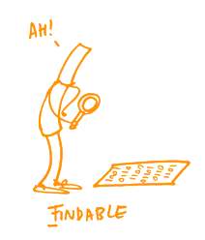
What is the meaning of F A I R data ?
F = Findable
in an online data catalogue / archive / portal
findable by humans and by machines
ENA for DNA sequences
GBif and OBIS for biodiversity data
BioImage Archive for images of biological material
Zenodo as a a general-purpose open-access repository
Standardised and rich discovery Metadata explaining:
Who: is the author / contact person for questions
How: were the data created --> procedures / protocols
How: to access the data, consider licenses
What: keywords describe the data
What: parameters were measured, species & geography covered
When: were the data and updates created
✓
✓
✓
✓
✓
✓
Notes:
If we look at each of the elements of FAIR in more detail now.

Slide 47
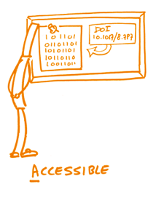
What is the meaning of F A I R data ?
A = Accessible
Data & Metadata
from catalogue/archive/portal
via machine to machine and human interfaces
Web interfaces for human searches & downloads
APIs for searching & accessing
Clear instructions for access (download, request access,.)
Keeping metadata when data is deleted
Metadata update when updating data / information
All data levels should be archived: raw data is the most important and at a minimum must be provided

Slide 48
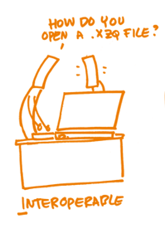
What is the meaning of F A I R data ?
I = Interoperable
readable & understandable by humans / code :
Community-accepted data formats & file types
  open (non-proprietary)
  sustainable (think in 10 years from now)
Clear, controlled vocabulary for data & metadata
  describing all relevant terms/values/units
  specific → data/metadata “dictionary”
Your data should be standalone, packaged up with
  all necessary information and files to allow the data to be understood by anyone at any time
Readable by code:
  machine readable descriptions of data: files and format

Slide 49
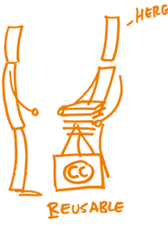
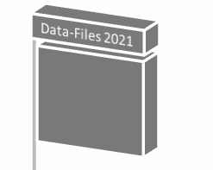
What is the meaning of F A I R data ?
R = Re-usable
Know how I can trust, repeat, re-analyse, re-use the data.
Necessary to provide:
time
year 20XX
Data usage licence --> full terms & conditions
Data provenance --> metadata and information on:
  every data life-cycle stage
  documentation / protocols / references
  link to accompanying data and publications
  instruments & software used
Relationship between the different levels of data you provide is documented:
raw--> quality controlled -->processed-->published
Notes:
Provenance granularity depends on the stage of the data in the data life-cycle (raw, processed, published), and on the purpose for which you are providing the provenance - what is the provenance information supposed to allow the data re-user or just the data searcher do?
So provenance to support the traceability of objects will contain different information than provenance to support full reproducibility of experiments.

Slide 50
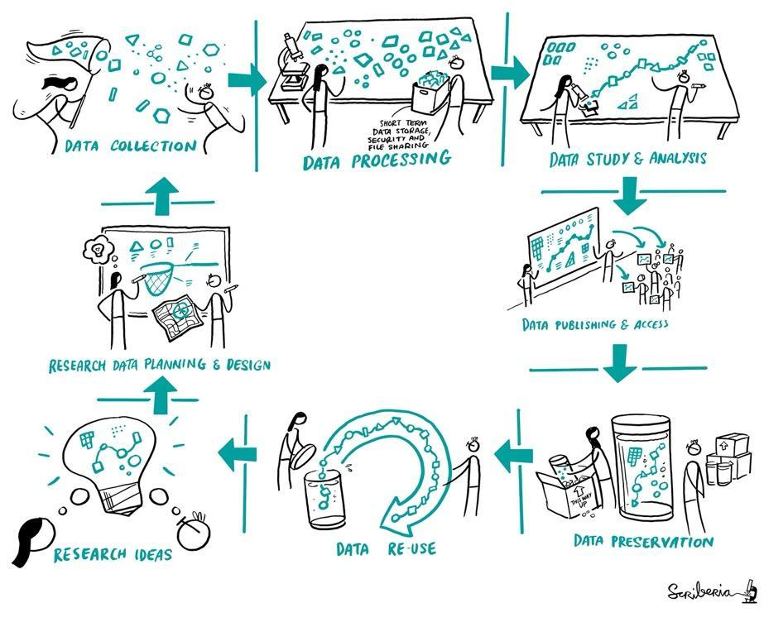
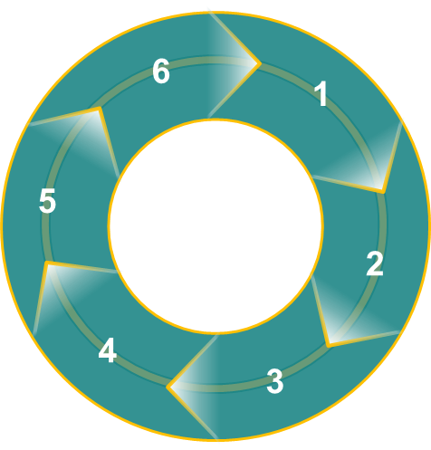
What is a data life-cycle?
Data provenance
Data Life-Cycle:
- covers the entire period of time over which data exists
- encompasses all the stages: first Capture → data re-use
1. Sample acquisition → raw data:
sample preparation, experimental settings / parameters, raw data acquisition
2. Data quality control: checking and updating of collected data
documentation of QC procedures
3. Data processing & analysis: guided by scientific question
documentation of processing steps, analysis methodology
4. Archiving & publication: data are placed in an online catalogue
discovery metadata, provenance metadata, provenance files, references and links
5. Data dissemination / integration: adding data to well known portals, brokers
6. Data reuse: only possible with sufficient provenance information!
Notes:
It is important to realise that data re-use IS ALSO part of the data life-cycle.

Slide 51
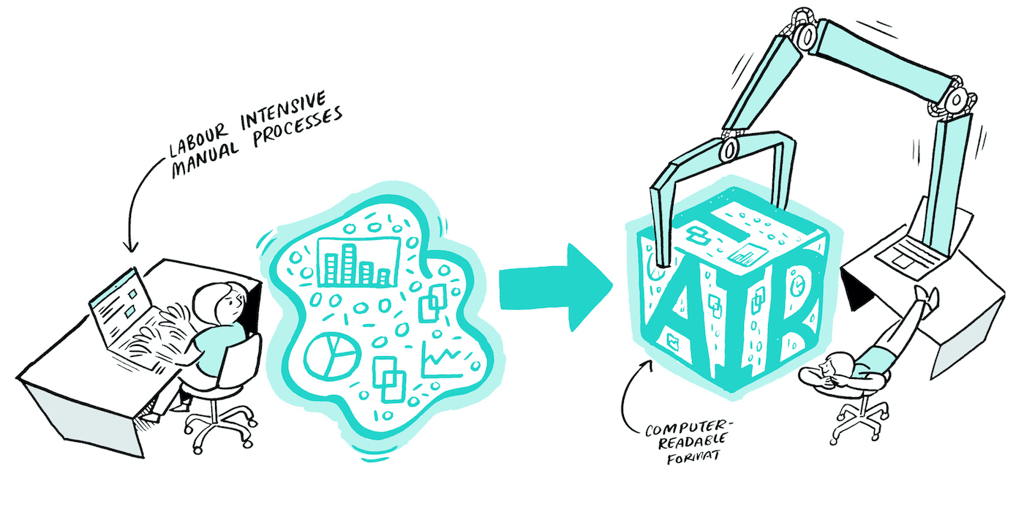
Breakout Room: FAIR Reflection
What part of your research lifecycle/outputs can be made open?
What you will have to do in your project to maintain "this" aspect of FAIR.
Room 1: Findable
Room 2: Accessible
Room 3: Interoperable
Room 4: Reusable

Slide 52
Reproducible research doesn’t always mean open
Reproducibility can be facilitated by open, but open is a choice
Reproducibility needs to be considered at all stages
As open as possible, as closed as necessary
  Open principles should be applied when you can
  NEVER for private, confidential or sensitive data
Always apply FAIR (Findable, Accessible, Interoperable, Reusable)
@turingway, CC-BY 4.0, The Turing Way, DOI: 10.5281/zenodo.7684733

Slide 53
Reproducibility
Open Source
Is my code correct?
Can others read and test it?
Is my workflow robust?
Have I provided guidance?
Is my work citable?
Is my code freely available?
Can others modify and share it?
Is my workflow reusable?
Have I provided permission?
Is my work open for collaboration?
Reproducibility should ensure higher scientific standards allowing others to test and reuse your work ...
… and Open Source should allow anyone to reuse, report errors, fix issues, build on and collaborate
CC-BY 4.0, The Turing Way, DOI: 10.5281/zenodo.7684733

Slide 54
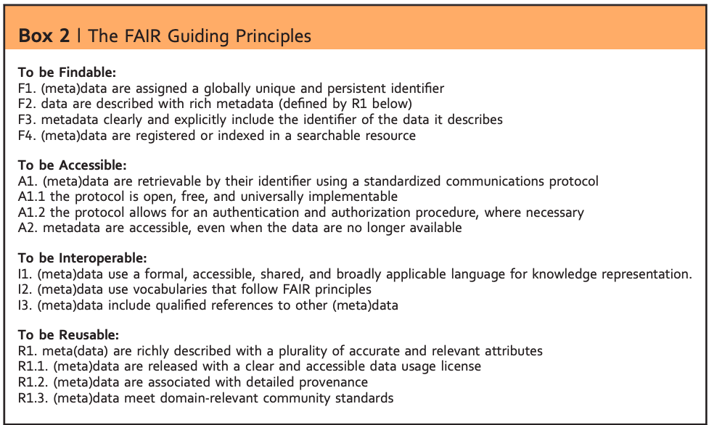
FAIR doesn’t need to be open
- FAIR does not require data to be open
- FAIR requires open metadata
- Detailed information about research/data should be open
- FAIR applies open standards for interoperability
Metadata: information about the “data descriptors” that facilitate cataloguing data and data discovery
@turingway, CC-BY 4.0, The Turing Way, DOI: 10.5281/zenodo.7684733

Slide 55
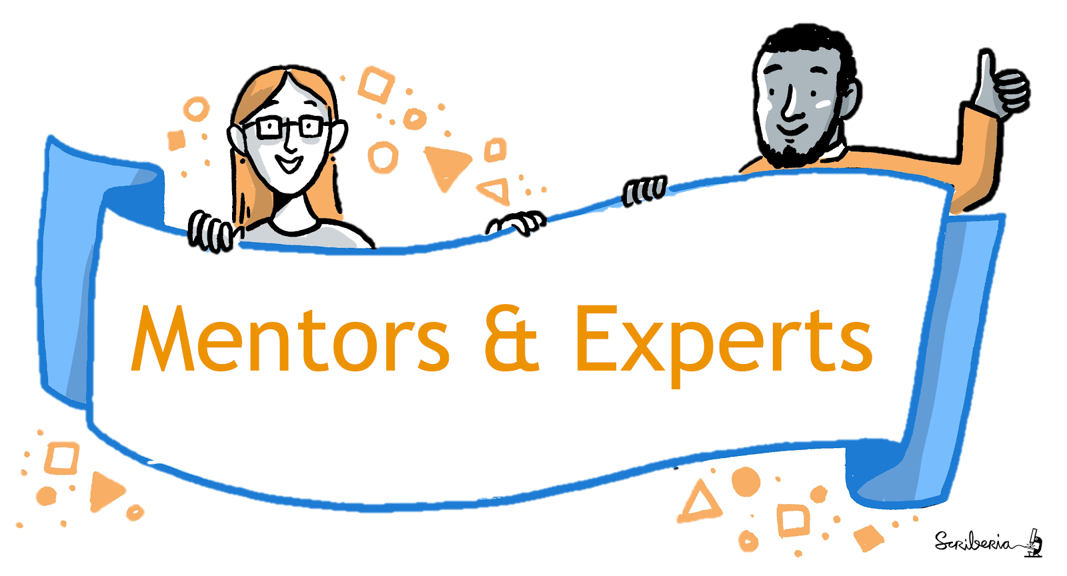
Is this Reproducible, Open or FAIR?
TARO
TARO is a PhD researcher in a health data science team
Collaborates with people in their team of engineers and data scientists
They have written Python code for a commonly used dataset
Their supervisor suggested them to publish their work online
Created a public repository to share their code, data and documentation
Sent out an email to their team members to use their code
Image by The Turing Way and Scriberia, available under the CC-BY 4.0 license, DOI: 10.5281/zenodo.7684733
Notes:
Use as an example of a project but not discussion

Slide 56
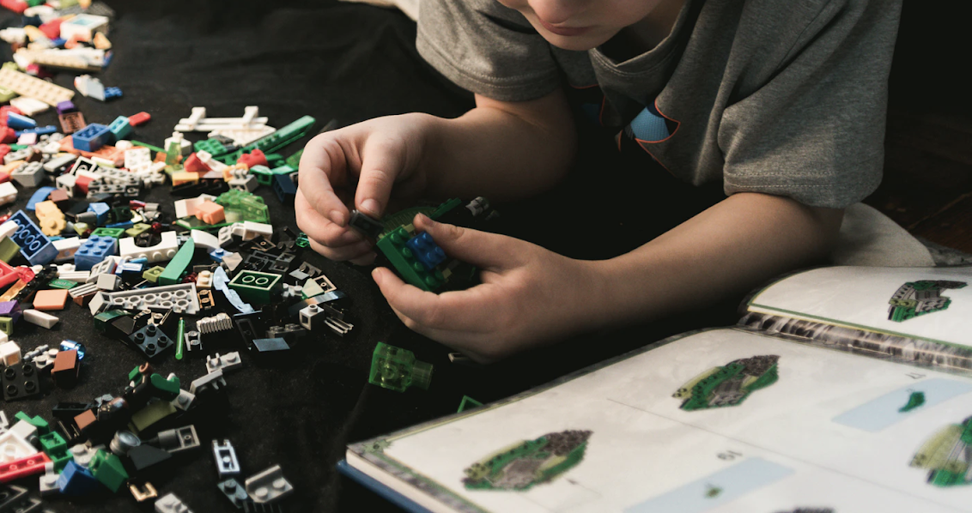
The question is not "Should I share my work?", but "How can my work benefit other collaborators?"
Image on Unsplash by @iankosky, @openlifesci, CC-BY 4.0, The Turing Way, DOI: 10.5281/zenodo.4609987

Slide 57

You are your number one collaborator!
Good practices benefit (future) you!
Illustration by The Ludic Group LLP from Kirstie Whitaker’s keynote presentation at Scientific Data in 2017. Used under a CC-BY 4.0 license. DOI: 10.6084/m9.figshare.5577340.v1, @turingway, DOI: 10.5281/zenodo.7684733

Slide 58


Open Science path is self defined!
Reproducibility is essential.
Open Science involves many concepts - take the steps that are possible.
FAIR provides guidance for actionable steps that make your work reproducible.
Ask for feedback and help whenever you can.
CC-BY image by The Turing Way and Scriberia, @turingway, https://www.fosteropenscience.eu/, DOI: 10.5281/zenodo.7684733

Slide 59
Several ways to practice Open Science
Develop sustainable tools/resources
Make your research objects accessible to more people
Create learning materials so others can learn
Teach a skill so you can upskill yourself as well as others
Contribute to collaborative projects, invite collaborations
Publish pre-prints so you can share your work early on
All of these while you gain visibility and credit for your work

Slide 60








Reproducible & Open Science Projects
Online Repository
License/Permission
Documentation
Version Control
Dependencies and data
Review & Verify
Report/Fix Bugs
Release & Cite
@openlifesci, CC-BY 4.0, The Turing Way, DOI: 10.5281/zenodo.7684733

Slide 61
Is this Reproducible, Open or FAIR?
TARO
TARO is a PhD researcher in a health data science team
Collaborates with people in their team of engineers and data scientists
They have written Python code for a commonly used dataset
Their supervisor suggested them to publish their work online
Created a public repository to share their code, data and documentation
Sent out an email to their team members to use their code
Image by The Turing Way and Scriberia, available under the CC-BY 4.0 license, DOI: 10.5281/zenodo.7684733

Slide 62

Ensure Use and Reuse
TARO
Create a project repository
Create a README file with information on their scripts
Add an open license in their repository for reuse
Make it easy to test
Add a minimum guideline for reporting errors
Release citable versions of documentation/code/data
@openlifesci, CC-BY 4.0, The Turing Way, DOI: 10.5281/zenodo.7684733

Slide 63
READMEs for Open and Collaborative Projects
Motivation:
Learn how to communicate your project effectively.
Method:
Write clear description of the project in README file.
@openlifesci, CC-BY 4.0, The Turing Way, DOI: 10.5281/zenodo.7684733

Slide 64

Why READMEs?
@openlifesci, CC-BY 4.0, The Turing Way, DOI: 10.5281/zenodo.4609987
Notes:
The readme is a very important document! This is the first thing anyone sees when they come to the project and helps them understand what the project is about and whether it’s useful to them. As such it should provide a clear description of your project

Slide 65
What is a README file?
A clear and accessible description of your project
Found in the root directory of your repository
First stop for your collaborators and potential users
Could also be: website landing page, wiki
@openlifesci, CC-BY 4.0, The Turing Way, DOI: 10.5281/zenodo.7684733

Slide 66
What should a good README include?
In your README file, make sure to include:
what you're doing, what your motivation is
what makes your project special and exciting
who your collaborators are and how each has contributed. It’s also a good idea to tell people how they can contribute to your project!
where the key resources are
@openlifesci, CC-BY 4.0, The Turing Way, DOI: 10.5281/zenodo.7684733
Notes:
so, what should your readme file do for this DIVERSE audience?
this is your chance to hook potential contributors and users! show the value of your project.

Slide 67

README example
Welcome message!
Project description & vision
How to:
  Test and verify
  Fix errors
  Use (license)
  Get involved
  Report issues
Source: STEMM Role Models App
@openlifesci, CC-BY 4.0, The Turing Way, DOI: 10.5281/zenodo.7684733

Slide 68


README example
project description
list of authors & contributors
contact information
links to related material
installation instructions
tutorials and requirements
how to run associated tests
@openlifesci, CC-BY 4.0, The Turing Way, DOI: 10.5281/zenodo.4609987

Slide 69
Assignment: create a project repository
Create a GitHub repository for your project
Add a README file to communicate about your work
Optional: try to add a usage licence to your repository.
  - This allows others to reuse, modify, and build upon your work
  - We will cover licences in the next session)
Use The Turing Way chapter on README files to guide your assignment: https://the-turing-way.netlify.app/project-design/project-repo/project-repo-readme.html
@openlifesci, CC-BY 4.0, The Turing Way, DOI: 10.5281/zenodo.7684733
Notes:
https://ha0ye.github.io/CW21-README-tips/template_README.html

Slide 70



Create a GitHub Repository with README file
@openlifesci, CC-BY 4.0, The Turing Way, DOI: 10.5281/zenodo.7684733

Slide 71
End of Part 1: Further Reading and Examples
The Turing Way README
Open Life Science README
Purple Booth’s README Template
Thoughtbot’s Blog on How to Write a Good README
Matias Singer’s curated List of Awesome READMES
@openlifesci, CC-BY 4.0, The Turing Way, DOI: 10.5281/zenodo.7684733

Slide 72
The Turing Way Workshop: Reproducible, Open and FAIR Research
Session 2
Emma Karoune, Eirini Zormpa & Anne Lee Steele
Pronouns: she/her/hers
@turingway, CC-BY 4.0, The Turing Way, DOI: 10.5281/zenodo.7684733
Notes:
TIMING: 0

Slide 73








Anne
Community Manager, The Turing Way
Fellow, Open Knowledge Foundation & Internet Society
Maintainer, Open Source Social Science
Resident, Wikimedia Unlock Program
Ethnographer, OpenStreetMap
Mentor, Open Life Science
Background
Anthropologist/Sociologist by training
Data journalism

Slide 74
Session 2 - Project communication, collaboration and sharing
Review Assignment 1
License to allow reuse of your research outputs in a way YOU want
Make your work citable: Digital Object Identifiers, Zenodo
Setting online repository for collaboration
  CoC, Contributing guidelines, continuous integration
Reproducible environment and sharing to aid reproducibility: Binder
Revisiting how these contribute to implementing FAIR practices
What more you can do.

Slide 75
Assignment: Create a project repository
Add top-level files: README and LICENSE
README to communicate about your work
Also try to add a License - to allow others to use, modify, build upon your work
  - We will cover licenses in the next session in more detail.
Use The Turing Way chapter for README to guide your assignment
https://the-turing-way.netlify.app/project-design/project-repo/project-repo-readme.html
@turingway, CC-BY 4.0, The Turing Way, DOI: 10.5281/zenodo.6346555
Notes:
https://ha0ye.github.io/CW21-README-tips/template_README.html

Slide 76
Create a GitHub Repository with README file
@turingway, CC-BY 4.0, The Turing Way, DOI: 10.5281/zenodo.7684733

Slide 77
End of Part 1: Further Reading and Examples
The Turing Way README
Open Life Science README
Purple Booth’s README Template
Thoughtbot’s Blog on How to Write a Good README
Matias Singer’s curated List of Awesome READMES
@turingway, CC-BY 4.0, The Turing Way, DOI: 10.5281/zenodo.6346555

Slide 78
Assignment: Create a project repository
Add top-level files: README and LICENSE
README to communicate about your work
Also try to add a License - to allow others to use, modify, build upon your work
  - We will cover licenses in the next session in more detail.
Use The Turing Way chapter for README to guide your assignment
https://the-turing-way.netlify.app/project-design/project-repo/project-repo-readme.html
@turingway, CC-BY 4.0, The Turing Way, DOI: 10.5281/zenodo.6346555
Notes:
https://ha0ye.github.io/CW21-README-tips/template_README.html

Slide 79

https://github.com/malvikasharan/2022-03-project-example
@turingway, CC-BY 4.0, The Turing Way, DOI: 10.5281/zenodo.6346555

Slide 80

Copy Template: https://raw.githubusercontent.com/ha0ye/CW21-README-tips/main/template_README.md
  Another example from The Turing: https://github.com/alan-turing-institute/reproducible-project-template
Add your project information
@turingway, CC-BY 4.0, The Turing Way, DOI: 10.5281/zenodo.6346555
Notes:
https://raw.githubusercontent.com/ha0ye/CW21-README-tips/main/template_README.md

Slide 81




Bonus: Badges and Additional Information
https://shields.io/, @turingway, CC-BY 4.0, The Turing Way, DOI: 10.5281/zenodo.7684733
Notes:
so, what should your readme file do for this DIVERSE audience?
this is your chance to hook potential contributors and users! show the value of your project.

Slide 82
Session 2 - Project communication, collaboration and sharing
Review Assignment 1
License to allow reuse of your research outputs in a way YOU want
Make your work citable: Digital Object Identifiers, Zenodo
Setting online repository for collaboration
  CoC, Contributing guidelines, continuous integration
Reproducible environment and sharing to aid reproducibility: Binder
Revisiting how these contribute to implementing FAIR practices
What more you can do.

Slide 83
Open Licenses
Motivation: Allow others to use, remix and share your work.
Process: Add an open license for use, remixing and sharing.
References: Licensing Chapter in The Turing Way
Disclaimer: We are not lawyers - always consult your data officer.
@openlifesci, CC-BY 4.0, The Turing Way, DOI: 10.5281/zenodo.7684733
Notes:
objectives for this content: {slide content}
How does this relate to us?

Slide 84



Truly Open Licenses: common elements
use
Anyone can use the work for any purpose
modify
Anyone can modify the work
share
Anyone can redistribute both the original and modified work
“Open source software is software that can be freely used, modified, and shared (in both modified and unmodified form) by anyone.“
- GitHub Glossary, Open Source
@openlifesci, CC-BY 4.0, The Turing Way, DOI: 10.5281/zenodo.7684733
Notes:
As Open Leaders, we want to be as permissive as possible, and allow others to freely use, modify, and share our work.

Slide 85
Attribution
Most open licenses require crediting the authors of the work.
Non-copyleft: Permissive, non-reciprocal - CC BY, MIT, BSD
do not require derivative works to shared with the same license
Copyleft: Viral, reciprocal - CC BY-SA, GPLv3, MPL-2.0
require derivative works to shared with the same license
Exception: CC0 (public domain, no copyright holder)
@openlifesci, CC-BY 4.0, The Turing Way, DOI: 10.5281/zenodo.7684733
Notes:
Copyleft is a general method for making a program (or other work) free (in the sense of freedom, not “zero price”), and requiring all modified and extended versions of the program to be free as well. The simplest way to make a program free software is to put it in the public domain, uncopyrighted.
Copyleft is a general method for making a program (or other work) free (in the sense of freedom, not “zero price”), and requiring all modified and extended versions of the program to be free as well. The simplest way to make a program free software is to put it in the public domain, uncopyrighted.
A copyright is a type of intellectual property that gives its owner the exclusive right to copy, distribute, adapt, display, and perform a creative work, usually for a limited time. The creative work may be in a literary, artistic, educational, or musical form

Slide 86

Licenses
@openlifesci, CC-BY 4.0, The Turing Way, DOI: 10.5281/zenodo.7684733

Slide 87

Licenses
@turingway, CC-BY 4.0, The Turing Way, DOI: 10.5281/zenodo.7684733

Slide 88

Licenses
@openlifesci, CC-BY 4.0, The Turing Way, DOI: 110.5281/zenodo.7684733

Slide 89

Licenses
@turingway, CC-BY 4.0, The Turing Way, DOI: 10.5281/zenodo.7684733

Slide 90
Licenses
@openlifesci, CC-BY 4.0, The Turing Way, DOI: 10.5281/zenodo.7684733

Slide 91

Licenses
https://the-turing-way.netlify.app/reproducible-research/licensing/licensing-data.html
@openlifesci, CC-BY 4.0, The Turing Way, DOI: 10.5281/zenodo.7684733

Slide 92

Licenses
https://the-turing-way.netlify.app/reproducible-research/licensing/licensing-ml.html
@openlifesci, CC-BY 4.0, The Turing Way, DOI: 10.5281/zenodo.7684733

Slide 93

Licenses are context-dependent
Use a different license for content, code and data. For example
Writing/docs/images/metadata: CC-BY
Code: MIT License
Data will also have different license based on what you can/can’t share!
@openlifesci, CC-BY 4.0, Image: Shaddim; Original CC license icons licensed under CC BY 4.0, DOI: 10.5281/zenodo.7684733

Slide 94
Addressing Common Concerns
Sharing something on online does NOT automatically make it reusable.
Sharing with a license does NOT give away your rights to publish, sell, etc.
Work shared with an open license NOT to be used without attribution.
Not attributing to authors violates academic ethics.
@openlifesci, CC-BY 4.0, The Turing Way, DOI: 10.5281/zenodo.7684733

Slide 95

How to Apply License
Place the full text of the license in a file named LICENSE in the root directory.
Apply licenses to all components, content: CC-BY, software: MIT, data: CC0
Describe in README which license applies to which parts of your work.
@openlifesci, CC-BY 4.0, The Turing Way, DOI: 10.5281/zenodo.7684733

Slide 96
GitHub can add a license for you
@openlifesci, CC-BY 4.0, The Turing Way, DOI: 10.5281/zenodo.7684733

Slide 97

GitHub can add a license for you, Part 2
when adding a new file named LICENSE...
@openlifesci, CC-BY 4.0, The Turing Way, DOI: 10.5281/zenodo.7684733

Slide 98
Further Reading
Licensing Chapter in The Turing Way
The Open Source Definition (10 Criteria) | opensource.org
Legal Matters | producingoss.com
Open Source Guide | opensource.guide
Software: Choose an Open Source License | choosealicense.com
Content: Choose a License | creativecommons.org
@openlifesci, CC-BY 4.0, The Turing Way, DOI: 10.5281/zenodo.7684733

Slide 99

Contribution Guideline
CONTRIBUTING.md
how to file a bug report
how to suggest a feature
how to contribute changes
roadmap & project vision
how contributors should ask for help and guidance
@openlifesci, CC-BY 4.0, The Turing Way, DOI: 10.5281/zenodo.7684733

Slide 100

Code of Conduct
CODE_OF_CONDUCT.md
What is expected of the contributors
What culture do we want to promote
What if something should be reported
@openlifesci, CC-BY 4.0, The Turing Way, DOI: 10.5281/zenodo.7684733

Slide 101

Continuous Integration
Practice of integrating changes to a project made by individuals into a main, shared version
-- frequently
@openlifesci, CC-BY 4.0, The Turing Way, DOI: 10.5281/zenodo.7684733

Slide 102
Breakout
Make sure that you have done the following:
Set up a project repository
Add a minimal README
Add a License
Add a License badge
You can use part of your project to use as example for this workshop!
You can fork: https://github.com/malvikasharan/2022-03-project-example
If you have already done this, you could add:
Contributing guide
Code of conduct
Discuss these in your group!
Have you seen any good examples you can share?
@openlifesci, CC-BY 4.0, The Turing Way, Image: Shaddim; Original CC license icons licensed under CC BY 4.0
Notes:
Now you add a license

Slide 103

Making your work citable
A digital object identifier (DOI) is a persistent identifier used to identify research objects uniquely.
Zenodo, Figshare
Preprint servers
Docker (env)
ORCID (researchers)
https://guides.github.com/activities/citable-code/, The Turing Way, DOI: 10.5281/zenodo.7684733
Notes:
Emma from here

Slide 104






Upload to free openly accessible online repositories
Not a TDR
cannot ensure long-term access
Trustworthy digital repository (TDR)
Allows to generate shareable DOI - Digital Object Identifier
Notes:
If you do want to archive your data, whether open or restricted - you need to use a trusted digital repository - so this means one that is going to around for a long time such the four here. You also want your data to have a DOI - digital object identifier, which is a persistent identifier for that data.
the mission of TDR is to provide reliable, long-term access to managed digital resources to its designated community, now and in the future. A DOI is a unique alphanumeric string that identifies content and provides a persistent link to its location on the internet

Slide 105









Zenodo
GitHub
Citable DOI
Zenodo
https://guides.github.com/activities/citable-code/, @turingway, CC-BY 4.0, The Turing Way, DOI: 10.5281/zenodo.7684733

Slide 106

All these aspects enhance collaboration in your project!
How to make your code easy to test?
@malvikasharan, @turingway, CC-BY 4.0, The Turing Way, DOI: 10.5281/zenodo.7684733
Notes:
TIMING: 21

Slide 107
Reproducible computational environment
@turingway, CC-BY 4.0, The Turing Way, DOI: 10.5281/zenodo.7684733
Notes:
Says slides are available

Slide 108

Reproducible research
same analysis steps on the same dataset produces same answer
https://the-turing-way.netlify.app/reproducible-research/overview/overview-definitions.html
@turingway, CC-BY 4.0, The Turing Way, DOI: 10.5281/zenodo.7684733
Notes:
Reproducible research is important to ensure scientific outputs can be trusted and built upon in future work.
Explain the differences
Many people think others could reproduce our results if we give the data and our code

Slide 109
“An article about computational science in a scientific publication is not the scholarship itself, it is merely advertising of the scholarship. The actual scholarship is the complete software development environment and the complete set of instructions which generated the figures.”
— Buckheit and Donoho (paraphrasing John Claerbout)
WaveLab and Reproducible Research, 1995
(slide courtesy of Chris Holdgraf and the Jupyter Team)
@turingway, CC-BY 4.0, The Turing Way, DOI: 10.5281/zenodo.7684733
Notes:
Read quote
Sharing the code and the data only is like giving a poorly specified recipe, like one that is missing at which temperature we should set the oven, or which type of flour we should use. Those details can completely change the outcome of our recipe.

Slide 110

Take home message
sharing your code and data isn’t enough
@turingway, CC-BY 4.0, The Turing Way, DOI: 10.5281/zenodo.7684733
Notes:
These are really important steps and better than nothing! But they are not enough to achieve full reproducibility

Slide 111

You need the computational environment too
Peng, 2011, doi: 10.1126/science.1213847
@turingway, CC-BY 4.0, The Turing Way, DOI: 10.5281/zenodo.7684733
Notes:
Illustration from Peng in 2011 about how code and data aren’t enough to do a full replication.
You don’t want to let perfect be the enemy of the good here! All movement along this axis is progress towards better science.
you may have experienced the challenge of actually EXECUTING someone else’s code…..

Slide 112

You need the computational environment too
Peng, 2011, doi: 10.1126/science.1213847
@turingway, CC-BY 4.0, The Turing Way, DOI: 10.5281/zenodo.7684733
Notes:
…..And its really hard!
Your experience of not being able to get someone else’s code to run on their machine is extremely common!
Why? If our computational environment differs from the original creator of the code, these differences might prevent the code from working.

Slide 113
What is a computational environment?
hardware (e.g. CPU)
software
  operating system
  programming languages
  packages
https://the-turing-way.netlify.app/reproducible-research/renv.html
@turingway, CC-BY 4.0, The Turing Way, DOI: 10.5281/zenodo.7684733
Notes:
A difference in any of these components between the original computational environment of the project we are trying to execute and ours, can cause problems

Slide 114
What is a computational environment?
hardware (e.g. CPU)
software
  operating system
  programming languages
  packages
their versions and their configuration
https://the-turing-way.netlify.app/reproducible-research/renv.html
@turingway, CC-BY 4.0, The Turing Way, DOI: 10.5281/zenodo.7684733
Notes:
A difference in any of these components between the original computational environment of the project we are trying to execute and ours, can cause problems

Slide 115
What is a computational environment?
hardware (e.g. CPU)
software
  operating system
  programming languages
  packages
and their interaction
their versions and their configuration
https://the-turing-way.netlify.app/reproducible-research/renv.html
@turingway, CC-BY 4.0, The Turing Way, DOI: 10.5281/zenodo.7684733
Notes:
A difference in any of these components between the original computational environment of the project we are trying to execute and ours, can cause problems

Slide 116
What is Binder?
@turingway, CC-BY 4.0, The Turing Way, DOI: 10.5281/zenodo.7684733

Slide 117

What is Binder?
https://discourse.jupyter.org/t/about-the-binder-category/200
@turingway, CC-BY 4.0, The Turing Way, DOI: 10.5281/zenodo.7684733

Slide 118

Courtesy of Juliette Taka: https://twitter.com/mybinderteam/status/1082556317842264064
@turingway, CC-BY 4.0, The Turing Way, DOI: 10.5281/zenodo.7684733
Notes:
talk them through the comic

Slide 119
Binder tutorial
Use the zero to binder workshop:
Python - https://github.com/alan-turing-institute/the-turing-way/blob/main/workshops/boost-research-reproducibility-binder/workshop-presentations/zero-to-binder-python.md
R - https://github.com/alan-turing-institute/the-turing-way/blob/main/workshops/boost-research-reproducibility-binder/workshop-presentations/zero-to-binder-r.md
@turingway, CC-BY 4.0, The Turing Way, DOI: 10.5281/zenodo.4609987

Slide 120

What it looks like in GitHub
To run code, you need:
Hardware on which to run the code
Software, including:
  The code itself
  The programming language (e.g. Python, R, Julia, and so on)
  Relevant packages (e.g. pandas, matplotlib, tidyverse, ggplot)
Press the launch button

Slide 121


Slide 122


Slide 123

An adapted reproducible spectrum (Peng 2011) with the addition of protocols.
Karoune, E., and Plomp, E.(2022) Removing Barriers to Reproducible Research in Archaeology. Zenodo, ver. 5 peer-reviewed and recommended by Peer Community in Archaeology.https://doi.org/10.5281/zenodo.7320029.
@PhDtoothFAIRy, @ekaroune, Slides: https://doi.org/10.5281/zenodo.6784277

Slide 124
Other things you can do to make your work more FAIR and reproducible?
Data and code in a repository with DOI
Write a clear data and code availability statement
Write a data paper/article
Cite your data and code in your article
Write a clear method/protocol
  Use protocols.io
@turingway, CC-BY 4.0, The Turing Way, DOI: 10.5281/zenodo.7684733

Slide 125





What is a data paper?
Describes a dataset
Does not include analysis or findings
Data usually in an open repository
Use a template to write it
Data journals
@turingway, CC-BY 4.0, The Turing Way, DOI: 10.5281/zenodo.7684733

Slide 126


FAIR in action
Dataset archived in IsoArcH
Detailed description of the dataset (data article)
Scripts of the figures in the data article on GitHub/Zenodo
@turingway, CC-BY 4.0, The Turing Way, DOI: 10.5281/zenodo.7684733

Slide 127

FAIR in action
Data article cites data and software
@turingway, CC-BY 4.0, The Turing Way, DOI: 10.5281/zenodo.7684733

Slide 128
Don’t forget your methods!
Include a full method
  Summaries aren’t good enough
  Use one reference if you followed that method exactly or state how you modified it.
Put your method
  Supplementary files are not good enough
  In a repository with data and code
  Protocols.io

Slide 129

Using protocols.io
Gives a DOI
Versions
@turingway, CC-BY 4.0, The Turing Way, DOI: 10.5281/zenodo.7684733

Slide 130


Using protocols.io
@turingway, CC-BY 4.0, The Turing Way, DOI: 10.5281/zenodo.7684733

Slide 131

Case Studies & Resources
There are lots of resources to check out in the open ecosystem… Explore these projects and find out what might work best for you!
@turingway, CC-BY 4.0, The Turing Way, DOI: 10.5281/zenodo.7684733
Notes:
https://miro.com/app/board/uXjVONTviD8=/?share_link_id=872992321145

Slide 132


Environmental Data Science Book
Mission
Support the publication of data, research and open-source tools for collaborative, reproducible and transparent Environmental Science
Features
Community-based model for improving software practices in Environmental science
Collaborative publication of executable and reproducible jupyter notebooks
Promoting scalable tools in python (current), R & Julia (future) using cloud-optimized resources
Learnings from The Turing Way
Community & translation of Open Science concepts
the-environmental-ds-book.netlify.app
@turingway, CC-BY 4.0, The Turing Way, DOI: 10.5281/zenodo.7684733

Slide 133



2i2c
Mission
Make interactive computing more impactful through community-centered open infrastructure services
Features
Non-profit based model for increasing openness and reproducibility in research
Open source operations/dev-ops as a service
Working with the tech industry (cloud providers) to democratise interoperable interactive computing
Learnings from The Turing Way
Emerging (engineers, product manager, community) roles & transparent communication (all documents)
2i2c.org
@turingway, CC-BY 4.0, The Turing Way, DOI: 10.5281/zenodo.7684733

Slide 134

FAIR Cookbook
Mission
An online, open and live resource for the Life Sciences with recipes that help you to make and keep data Findable, Accessible, Interoperable and Reusable;
Features
Recipes for working with data in a FAIR and open way
Open platform for contribution
Learnings from The Turing Way
Open contribution methods, Github repository format, Scriberia images for demonstrating process of using FAIR principles
https://faircookbook.elixir-europe.org/content/home.html
@turingway, CC-BY 4.0, The Turing Way, DOI: 10.5281/zenodo.7684733

Slide 135


Lab Handbooks & Reports
https://very-good-science.github.io/our-handbook/guide/what-is-our-handbook.html
https://report.opensustain.tech/chapters/index.html
@turingway, CC-BY 4.0, The Turing Way, DOI: 10.5281/zenodo.7684733

Slide 136


Open Life Science
openlifesci.org/

Slide 137


Frictionless Data
https://frictionlessdata.io/

Slide 138


AutSPACEs
https://github.com/alan-turing-institute/AutSPACEs

Slide 139


Computational Communities
@turingway, CC-BY 4.0, The Turing Way, DOI: 10.5281/zenodo.7684733

Slide 140






The Turing Way Guides
Reproducibility
Project design
Communication
Collaboration
Ethical research
Community handbook
@turingway, CC-BY 4.0, The Turing Way, DOI: 10.5281/zenodo.7684733
Notes:
In order to accommodate all these requirements in research and data science, the project expanded to include four more guides: in addition to the guide for reproducible research, we have guides for project design, communication, collaboration and ethical research.
We also record all the community practices that we are developing and practising within the Turing Way in our community handbook so that it can be adopted by other open source communities.

Slide 141

The Turing Way Events
- Collaboration Cafes
    1st & 3rd Wednesdays (14:00 UTC)
- Coworking Calls
    Mondays (10:00 UTC)
- Fireside Chats
    Monthly on Friday
- More ways to connect
    bit.ly/turingway
CC-BY image by The Turing Way & Scriberia,
@turingway, CC-BY 4.0, The Turing Way, DOI: 10.5281/zenodo.7684733
Notes:
We have multiple community events and calls weekly and you are invited to join us.
I host collaboration cafes every month, and coworking call each week. There is also an onboarding call for folks new to the project.
You can find details in the shared notes - bit.ly/turingway.

Slide 142

Fireside Chat: Bi-monthly Informal Events
Coming soon:
Community care and maintenance
3 March 2023
4pm BST
bit.ly/turingway
@turingway, CC-BY 4.0, The Turing Way, DOI: 10.5281/zenodo.7684733

Slide 143

Attend a Book Dash
Virtual week-long Hackathon-like event to work with others on The Turing Way:
22 - 26 May 2023
@turingway, CC-BY 4.0, The Turing Way, DOI: 10.5281/zenodo.7684733
Notes:
We have multiple community events and calls weekly and you are invited to join us.
I host collaboration cafes every month, and coworking call each week. There is also an onboarding call for folks new to the project.
You can find details in the shared notes - bit.ly/turingway.

Slide 144
Open Discussion / Reflection Questions
Any questions on what we have covered?
What have you found most useful or valuable for your own work or research?
What would you like to learn more about?
Do you need more help with your repository?
Any other questions about Reproducible, Open and FAIR research?
@turingway, CC-BY 4.0, The Turing Way, DOI: 10.5281/zenodo.7684733
Notes:
Now you add a license

Slide 145

Acknowledgements:
The Turing Way team, Kirstie Whitaker, Malvika Sharan
The Turing Way community, contributors & collaborators
Book: the-turing-way.netlify.com
Twitter: twitter.com/turingway
Fosstodon: fosstodon.org/@turingway
Newsletter: tinyletter.com/TuringWay
Slack: theturingway.slack.com/
GitHub: github.com/alan-turing-institute/the-turing-way
Original artwork by Scriberia: https://doi.org/10.5281/zenodo.3332807
@turingway, CC-BY 4.0, The Turing Way, DOI: 10.5281/zenodo.7684733
Notes:
Thanks to Kirstie Whitaker for starting this project. All our resources including this presentation are available online. With that, I am happy to take any question.

