Slide 1
How to write a
README file
Maisam M. Dadkan
Geo Data Team (GDT)
Faculty of GeoScience

Slide 2

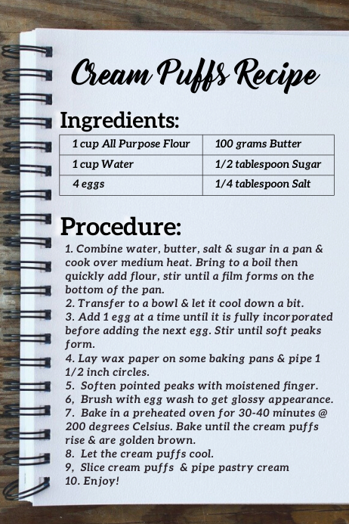
Introduction
Show others how to cook the food
Keep the quality of the results high
Produce consistent results
Help you and others to not forget
…

Slide 3
W5 README?!
What: A text file contains information that is required to understand what the data/code is about
Why: Help you to keep track of and others to understand and reuse the data/code or collaborate with you
Who: The main person(s) who collect and analyze data
When: Better as the project is going on, should be ready before sharing or publishing data/code
Where: In the main folder of the data/code & in each subfolders where details need to be provided

Slide 4
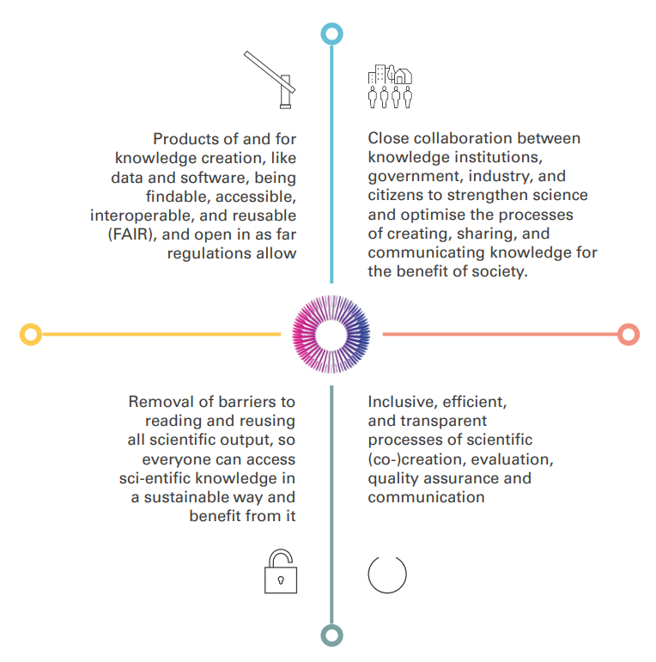
FAIR data
National Program Open Science (NPOS) strategic goals 2030
Findable
Accessible
Interoperable
Reusable

Slide 5

A good README!
READ ME
README

Slide 6
A good README!
READ ME
README
Up-To-Date
Brief & Clear
Detailed
Self Explanatory
Written in an open text file format

Slide 7
A good README!
READ ME
Project/dataset/code title
A short description
Corresponding name(s)
Contact info of the corresponding persons
License
Date of data collection
The folder structure of the dataset
etc…
README
Up-To-Date
Brief & Clear
Detailed
Self Explanatory
Written in an open text file format

Slide 8
A good README!
General information
Data and file overview
Sharing and accessing information
Methodological information
Data-specific information

Slide 9
General Information:
Provide a title for the dataset
Name/institution/address/email information for
  Principal investigator (or person responsible for collecting the data)
  Associate or co-investigators
  Contact persons for questions
Date of data collection (can be a single date or a range)
Information about the geographic location of data collection
Keywords used to describe the data topic
Information about funding sources that supported the collection of the data
A good README!

Slide 10
Data and file overview:
For each filename, a short description of what data it contains
Format of the file if not obvious from the file name
If the data set includes multiple files that relate to one another, the relationship between the files or a description of the file structure that holds them (possible terminology might include "dataset" or "study" or "data package")
Date that the file was created
Date(s) that the file(s) was updated (versioned) and the nature of the update(s), if applicable
Information about related data collected but that is not in the described dataset
A good README!

Slide 11
Sharing and accessing information:
Licenses or restrictions placed on the data
Links to publications that cite or use the data
Links to other publicly accessible locations of the data
Recommended citation for the data
A good README!

Slide 12
Methodological information:
Description of methods for data collection or generation (include links or references to publications or other documentation containing experimental design or protocols used)
Description of methods used for data processing (describe how the data were generated from the raw or collected data)
Any software or instrument-specific information needed to understand or interpret the data, including software and hardware version numbers
Standards and calibration information, if appropriate
Describe any quality-assurance procedures performed on the data
Definitions of codes or symbols used to note or characterize low quality/questionable/outliers that people should be aware
People involved with sample collection, processing, analysis and/or submission
A good README!

Slide 13
Data-specific information:
*Repeat this section as needed for each dataset (or file, as appropriate)*
Count of number of variables, and number of cases or rows
Variable list, including full names and definitions (spell out abbreviated words) of column headings for tabular data
Units of measurement
Definitions for codes or symbols used to record missing data
Specialized formats or other abbreviations used
A good README!

Slide 14
Text format (.txt)
Windows users:
  Notepad
  Notepad++
  Linux users:
    gedit
    Emacs
    Mac users:
      TextEdit
README file format!

Slide 15
Text format (.txt)
Windows users:
  Notepad
  Notepad++
  Linux users:
    gedit
    Emacs
    Mac users:
      TextEdit
README file format!
Markdown format (.md)
Windows users:
  Install another text editor
  e.g., Nextpad
  Linux users:
    gedit
    Emacs
    Mac users:
      Install another text editor
      e.g., Markdown Editor
      Or
      Online Markdown editors

Slide 16

Let’s do some practice

Slide 17
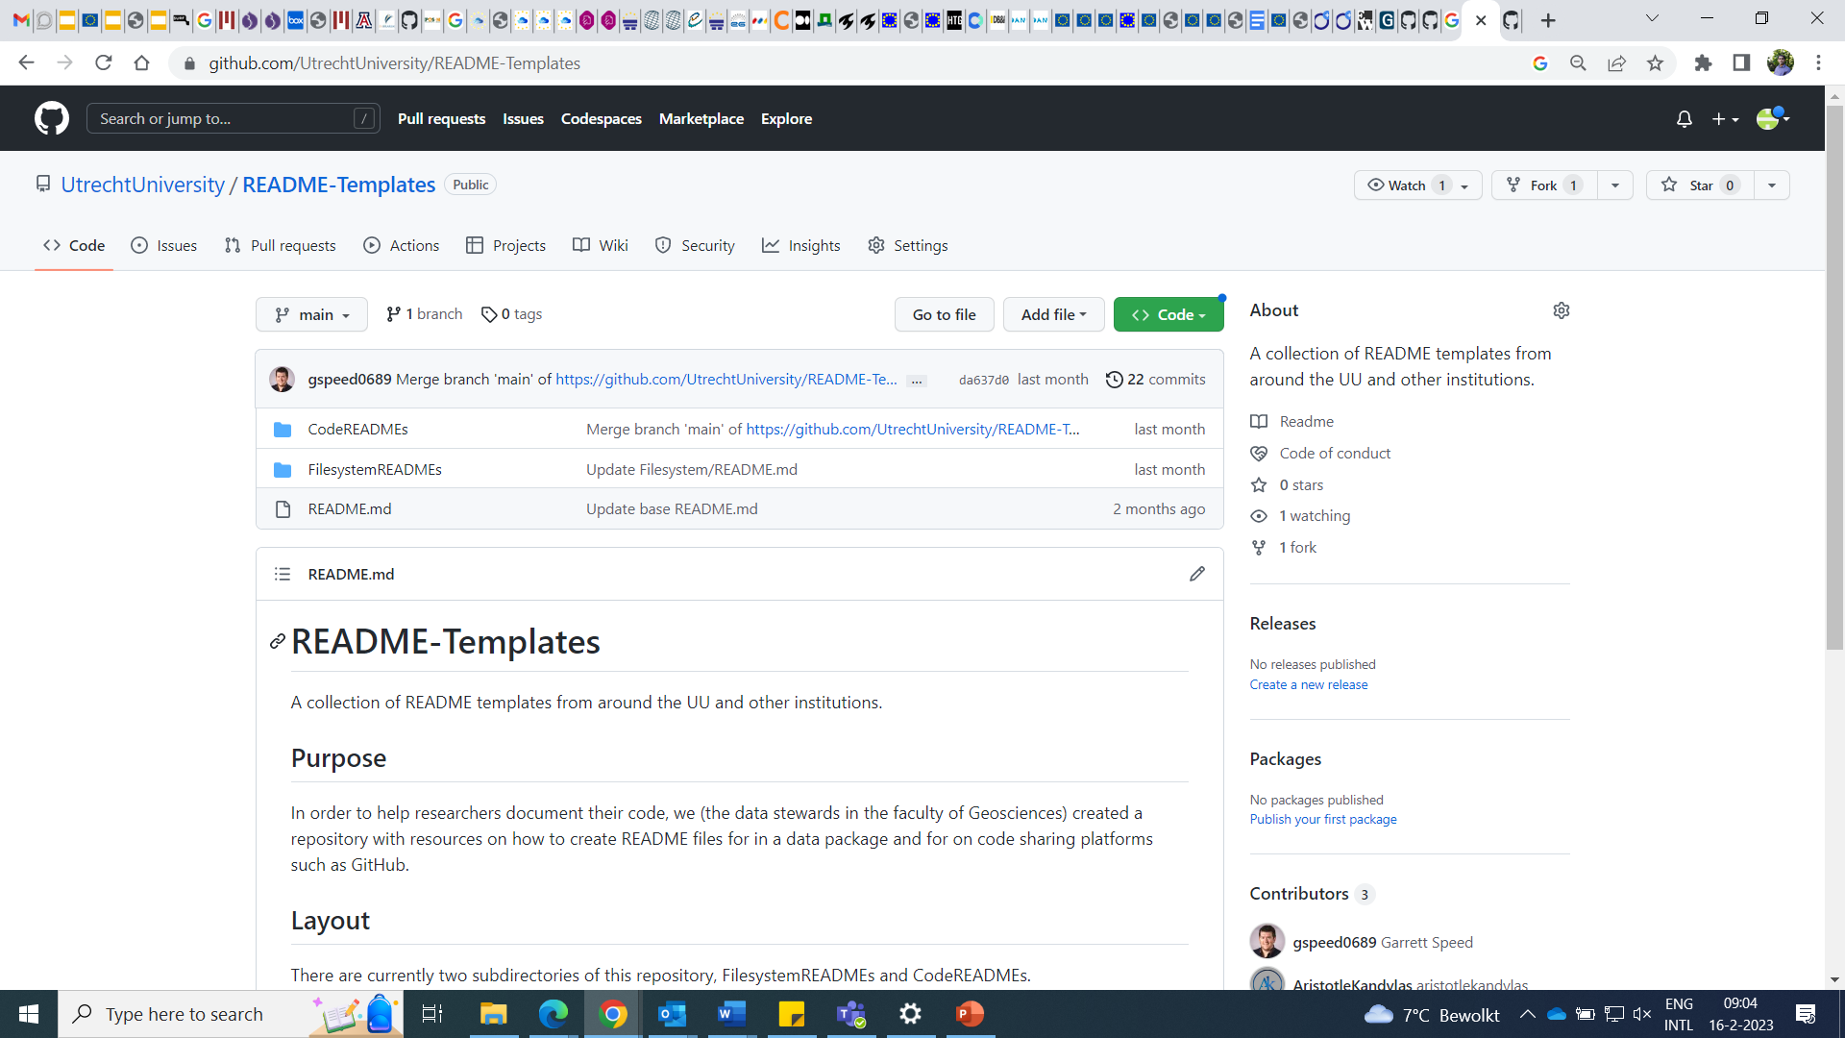
Our README templates
https://github.com/UtrechtUniversity/README-Templates.git

Slide 18

Q&A
Contact us via:
datateam.geo@uu.nl

