Slide 1

Revolutionising Team Science with Research Infrastructure Roles
Kirstie Whitaker
Pronouns: she/her
@TuringWay @kirstie_j
https://doi.org/10.5281/zenodo.7647783
Notes:
TIMING: 0

Slide 2

What is your job title?
@TuringWay @kirstie_j
https://doi.org/10.5281/zenodo.7647783
Notes:
TIMING: 5

Slide 3
What does a quantitative researcher do?
@TuringWay @kirstie_j
https://doi.org/10.5281/zenodo.7647783
Notes:
TIMING: 5

Slide 4
Attend / chair meetings
Manage (cloud) compute resources
Commercialise a product
Peer review
Promote EDI and work-life balance
Deliver trainings
Archive data & code
Read literature
Write papers
Apply for funding
What does a quantitative researcher do?
Give talks
Share work with the public
Design experiments
Collect / access data
Set strategy
Maintain
ethical &
legal principles
Testing & quality control
Track impact
Mentor colleagues
Manage budgets
Run statistical analyses
Promote work to decision makers
Host events
Scope user requirements
Generalise code to software
Visualisation
@TuringWay @kirstie_j
https://doi.org/10.5281/zenodo.7647783
Report on progress
Manage a team
Interpret results
Notes:
TIMING: 5

Slide 5
Attend / chair meetings
Manage (cloud) compute resources
Commercialise a product
Peer review
Promote EDI and work-life balance
Deliver trainings
Archive data & code
Read literature
Write papers
Apply for funding
What does a quantitative researcher do?
Give talks
Share work with the public
Design experiments
Collect / access data
Set strategy
Maintain
ethical &
legal principles
Testing & quality control
Track impact
Mentor colleagues
Manage budgets
Run statistical analyses
Promote work to decision makers
Host events
Scope user requirements
Generalise code to software
Visualisation
@TuringWay @kirstie_j
https://doi.org/10.5281/zenodo.7647783
Report on progress
Manage a team
Interpret results
Notes:
TIMING: 5

Slide 6
Attend / chair meetings
Manage (cloud) compute resources
Commercialise a product
Peer review
Promote EDI and work-life balance
Deliver trainings
Archive data & code
Read literature
Write papers
Apply for funding
What does a quantitative researcher do?
Give talks
Share work with the public
Design experiments
Collect / access data
Set strategy
Maintain
ethical &
legal principles
Testing & quality control
Track impact
Mentor colleagues
Manage budgets
Run statistical analyses
Promote work to decision makers
Host events
Scope user requirements
Generalise code to software
Visualisation
@TuringWay @kirstie_j
https://doi.org/10.5281/zenodo.7647783
Report on progress
Manage a team
Interpret results
Notes:
TIMING: 5

Slide 7
Attend / chair meetings
Manage (cloud) compute resources
Commercialise a product
Peer review
Promote EDI and work-life balance
Deliver trainings
Archive data & code
Read literature
Write papers
Apply for funding
What does a quantitative researcher do?
Give talks
Share work with the public
Design experiments
Collect / access data
Set strategy
Maintain
ethical &
legal principles
Testing & quality control
Track impact
Mentor colleagues
Manage budgets
Run statistical analyses
Promote work to decision makers
Host events
Scope user requirements
Generalise code to software
Visualisation
@TuringWay @kirstie_j
https://doi.org/10.5281/zenodo.7647783
Report on progress
Manage a team
Interpret results
Notes:
TIMING: 5

Slide 8
Attend / chair meetings
Manage (cloud) compute resources
Commercialise a product
Peer review
Promote EDI and work-life balance
Deliver trainings
Archive data & code
Read literature
Write papers
Apply for funding
What does a quantitative researcher do?
Give talks
Share work with the public
Design experiments
Collect / access data
Set strategy
Maintain
ethical &
legal principles
Testing & quality control
Track impact
Mentor colleagues
Manage budgets
Run statistical analyses
Promote work to decision makers
Host events
Scope user requirements
Generalise code to software
Visualisation
@TuringWay @kirstie_j
https://doi.org/10.5281/zenodo.7647783
Report on progress
Manage a team
Interpret results
Notes:
TIMING: 5

Slide 9
Attend / chair meetings
Manage (cloud) compute resources
Commercialise a product
Peer review
Promote EDI and work-life balance
Deliver trainings
Archive data & code
Read literature
Write papers
Apply for funding
What does a quantitative researcher do?
Give talks
Share work with the public
Design experiments
Collect / access data
Set strategy
Maintain
ethical &
legal principles
Testing & quality control
Track impact
Mentor colleagues
Manage budgets
Run statistical analyses
Promote work to decision makers
Host events
Scope user requirements
Generalise code to software
Visualisation
@TuringWay @kirstie_j
https://doi.org/10.5281/zenodo.7647783
Report on progress
Manage a team
Interpret results
Notes:
TIMING: 5

Slide 10
Attend / chair meetings
Manage (cloud) compute resources
Commercialise a product
Peer review
Promote EDI and work-life balance
Deliver trainings
Archive data & code
Read literature
Write papers
Apply for funding
What does a quantitative researcher do?
Give talks
Share work with the public
Design experiments
Collect / access data
Set strategy
Maintain
ethical &
legal principles
Testing & quality control
Track impact
Mentor colleagues
Manage budgets
Run statistical analyses
Promote work to decision makers
Host events
Scope user requirements
Generalise code to software
Visualisation
@TuringWay @kirstie_j
https://doi.org/10.5281/zenodo.7647783
Report on progress
Manage a team
Interpret results
Notes:
TIMING: 5

Slide 11
Attend / chair meetings
Manage (cloud) compute resources
Commercialise a product
Peer review
Promote EDI and work-life balance
Deliver trainings
Archive data & code
Read literature
Write papers
Apply for funding
What does a quantitative researcher do?
Give talks
Share work with the public
Design experiments
Collect / access data
Set strategy
Maintain
ethical &
legal principles
Testing & quality control
Track impact
Mentor colleagues
Manage budgets
Run statistical analyses
Promote work to decision makers
Host events
Scope user requirements
Generalise code to software
Visualisation
@TuringWay @kirstie_j
https://doi.org/10.5281/zenodo.7647783
Report on progress
Manage a team
Interpret results
Notes:
TIMING: 5

Slide 12
Attend / chair meetings
Manage (cloud) compute resources
Commercialise a product
Peer review
Promote EDI and work-life balance
Deliver trainings
Archive data & code
Read literature
Write papers
Apply for funding
What does a quantitative researcher do?
Give talks
Share work with the public
Design experiments
Collect / access data
Set strategy
Maintain
ethical &
legal principles
Testing & quality control
Track impact
Mentor colleagues
Manage budgets
Run statistical analyses
Promote work to decision makers
Host events
Scope user requirements
Generalise code to software
Visualisation
@TuringWay @kirstie_j
https://doi.org/10.5281/zenodo.7647783
Report on progress
Manage a team
Interpret results
Notes:
TIMING: 5

Slide 13
Attend / chair meetings
Manage (cloud) compute resources
Commercialise a product
Peer review
Promote EDI and work-life balance
Deliver trainings
Archive data & code
Read literature
Write papers
Apply for funding
What does a quantitative researcher do?
Give talks
Share work with the public
Design experiments
Collect / access data
Set strategy
Maintain
ethical &
legal principles
Testing & quality control
Track impact
Mentor colleagues
Manage budgets
Run statistical analyses
Promote work to decision makers
Host events
Scope user requirements
Generalise code to software
Visualisation
@TuringWay @kirstie_j
https://doi.org/10.5281/zenodo.7647783
Report on progress
Manage a team
Interpret results
Notes:
TIMING: 5

Slide 14
Attend / chair meetings
Manage (cloud) compute resources
Commercialise a product
Peer review
Promote EDI and work-life balance
Deliver trainings
Archive data & code
Read literature
Write papers
Apply for funding
What does a quantitative researcher do?
Give talks
Share work with the public
Design experiments
Collect / access data
Set strategy
Maintain
ethical &
legal principles
Testing & quality control
Track impact
Mentor colleagues
Manage budgets
Run statistical analyses
Promote work to decision makers
Host events
Scope user requirements
Generalise code to software
Visualisation
@TuringWay @kirstie_j
https://doi.org/10.5281/zenodo.7647783
Report on progress
Manage a team
Interpret results
Notes:
TIMING: 5

Slide 15
Attend / chair meetings
Manage (cloud) compute resources
Commercialise a product
Peer review
Promote EDI and work-life balance
Deliver trainings
Archive data & code
Read literature
Write papers
Apply for funding
What does a quantitative researcher do?
Give talks
Share work with the public
Design experiments
Collect / access data
Set strategy
Maintain
ethical &
legal principles
Testing & quality control
Track impact
Mentor colleagues
Manage budgets
Run statistical analyses
Promote work to decision makers
Host events
Scope user requirements
Generalise code to software
Visualisation
@TuringWay @kirstie_j
https://doi.org/10.5281/zenodo.7647783
Report on progress
Manage a team
Interpret results
Notes:
TIMING: 5

Slide 16
Attend / chair meetings
Manage (cloud) compute resources
Commercialise a product
Peer review
Promote EDI and work-life balance
Deliver trainings
Archive data & code
Read literature
Write papers
Apply for funding
What does a quantitative researcher do?
Give talks
Share work with the public
Design experiments
Collect / access data
Set strategy
Maintain
ethical &
legal principles
Testing & quality control
Track impact
Mentor colleagues
Manage budgets
Run statistical analyses
Promote work to decision makers
Host events
Scope user requirements
Generalise code to software
Visualisation
@TuringWay @kirstie_j
https://doi.org/10.5281/zenodo.7647783
Report on progress
Manage a team
Interpret results
Notes:
TIMING: 5

Slide 17
Attend / chair meetings
Manage (cloud) compute resources
Commercialise a product
Peer review
Promote EDI and work-life balance
Deliver trainings
Archive data & code
Read literature
Write papers
Apply for funding
What does a quantitative researcher do?
Give talks
Share work with the public
Design experiments
Collect / access data
Set strategy
Maintain
ethical &
legal principles
Testing & quality control
Track impact
Mentor colleagues
Manage budgets
Run statistical analyses
Promote work to decision makers
Host events
Scope user requirements
Generalise code to software
Visualisation
@TuringWay @kirstie_j
https://doi.org/10.5281/zenodo.7647783
Report on progress
Manage a team
Interpret results
Notes:
TIMING: 5

Slide 18
Attend / chair meetings
Manage (cloud) compute resources
Commercialise a product
Peer review
Promote EDI and work-life balance
Deliver trainings
Archive data & code
Read literature
Write papers
Apply for funding
What does a quantitative researcher do?
Give talks
Share work with the public
Design experiments
Collect / access data
Set strategy
Maintain
ethical &
legal principles
Testing & quality control
Track impact
Mentor colleagues
Manage budgets
Run statistical analyses
Promote work to decision makers
Host events
Scope user requirements
Generalise code to software
Visualisation
@TuringWay @kirstie_j
https://doi.org/10.5281/zenodo.7647783
Report on progress
Manage a team
Interpret results
Notes:
TIMING: 5

Slide 19
Attend / chair meetings
Manage (cloud) compute resources
Commercialise a product
Peer review
Promote EDI and work-life balance
Deliver trainings
Archive data & code
Read literature
Write papers
Apply for funding
What does a quantitative researcher do?
Give talks
Share work with the public
Design experiments
Collect / access data
Set strategy
Maintain
ethical &
legal principles
Testing & quality control
Track impact
Mentor colleagues
Manage budgets
Run statistical analyses
Promote work to decision makers
Host events
Scope user requirements
Generalise code to software
Visualisation
@TuringWay @kirstie_j
https://doi.org/10.5281/zenodo.7647783
Report on progress
Manage a team
Interpret results
Notes:
TIMING: 5

Slide 20
Attend / chair meetings
Manage (cloud) compute resources
Commercialise a product
Peer review
Promote EDI and work-life balance
Deliver trainings
Archive data & code
Read literature
Write papers
Apply for funding
What does a quantitative researcher do?
Give talks
Share work with the public
Design experiments
Collect / access data
Set strategy
Maintain
ethical &
legal principles
Testing & quality control
Track impact
Mentor colleagues
Manage budgets
Run statistical analyses
Promote work to decision makers
Host events
Scope user requirements
Generalise code to software
Visualisation
@TuringWay @kirstie_j
https://doi.org/10.5281/zenodo.7647783
Report on progress
Manage a team
Interpret results
Notes:
TIMING: 5

Slide 21
Attend / chair meetings
Manage (cloud) compute resources
Commercialise a product
Peer review
Promote EDI and work-life balance
Deliver trainings
Archive data & code
Read literature
Write papers
Apply for funding
What does a quantitative researcher do?
Give talks
Share work with the public
Design experiments
Collect / access data
Set strategy
Maintain
ethical &
legal principles
Testing & quality control
Track impact
Mentor colleagues
Manage budgets
Run statistical analyses
Promote work to decision makers
Host events
Scope user requirements
Generalise code to software
Visualisation
@TuringWay @kirstie_j
https://doi.org/10.5281/zenodo.7647783
Report on progress
Manage a team
Interpret results
Notes:
TIMING: 5

Slide 22
Attend / chair meetings
Manage (cloud) compute resources
Commercialise a product
Peer review
Promote EDI and work-life balance
Deliver trainings
Archive data & code
Read literature
Write papers
Apply for funding
What does a quantitative researcher do?
Give talks
Share work with the public
Design experiments
Collect / access data
Set strategy
Maintain
ethical &
legal principles
Testing & quality control
Track impact
Mentor colleagues
Manage budgets
Run statistical analyses
Promote work to decision makers
Host events
Scope user requirements
Generalise code to software
Visualisation
@TuringWay @kirstie_j
https://doi.org/10.5281/zenodo.7647783
Report on progress
Manage a team
Interpret results
Notes:
TIMING: 5

Slide 23
Attend / chair meetings
Manage (cloud) compute resources
Commercialise a product
Peer review
Promote EDI and work-life balance
Deliver trainings
Archive data & code
Read literature
Write papers
Apply for funding
What does a quantitative researcher do?
Give talks
Share work with the public
Design experiments
Collect / access data
Set strategy
Maintain
ethical &
legal principles
Testing & quality control
Track impact
Mentor colleagues
Manage budgets
Run statistical analyses
Promote work to decision makers
Host events
Scope user requirements
Generalise code to software
Visualisation
@TuringWay @kirstie_j
https://doi.org/10.5281/zenodo.7647783
Report on progress
Manage a team
Interpret results
Notes:
TIMING: 5

Slide 24
Attend / chair meetings
Manage (cloud) compute resources
Commercialise a product
Peer review
Promote EDI and work-life balance
Deliver trainings
Archive data & code
Read literature
Write papers
Apply for funding
What does a quantitative researcher do?
Give talks
Share work with the public
Design experiments
Collect / access data
Set strategy
Maintain
ethical &
legal principles
Testing & quality control
Track impact
Mentor colleagues
Manage budgets
Run statistical analyses
Promote work to decision makers
Host events
Scope user requirements
Generalise code to software
Visualisation
@TuringWay @kirstie_j
https://doi.org/10.5281/zenodo.7647783
Report on progress
Manage a team
Interpret results
Notes:
TIMING: 5

Slide 25
Attend / chair meetings
Manage (cloud) compute resources
Commercialise a product
Peer review
Promote EDI and work-life balance
Deliver trainings
Archive data & code
Read literature
Write papers
Apply for funding
What does a quantitative researcher do?
Give talks
Share work with the public
Design experiments
Collect / access data
Set strategy
Maintain
ethical &
legal principles
Testing & quality control
Track impact
Mentor colleagues
Manage budgets
Run statistical analyses
Promote work to decision makers
Host events
Scope user requirements
Generalise code to software
Visualisation
@TuringWay @kirstie_j
https://doi.org/10.5281/zenodo.7647783
Report on progress
Manage a team
Interpret results
Notes:
TIMING: 5

Slide 26
Attend / chair meetings
Manage (cloud) compute resources
Commercialise a product
Peer review
Promote EDI and work-life balance
Deliver trainings
Archive data & code
Read literature
Write papers
Apply for funding
What does a quantitative researcher do?
Give talks
Share work with the public
Design experiments
Collect / access data
Set strategy
Maintain
ethical &
legal principles
Testing & quality control
Track impact
Mentor colleagues
Manage budgets
Run statistical analyses
Promote work to decision makers
Host events
Scope user requirements
Generalise code to software
Visualisation
@TuringWay @kirstie_j
https://doi.org/10.5281/zenodo.7647783
Report on progress
Manage a team
Interpret results
Notes:
TIMING: 5

Slide 27
Attend / chair meetings
Manage (cloud) compute resources
Commercialise a product
Peer review
Promote EDI and work-life balance
Deliver trainings
Archive data & code
Read literature
Write papers
Apply for funding
What does a quantitative researcher do?
Give talks
Share work with the public
Design experiments
Collect / access data
Set strategy
Maintain
ethical &
legal principles
Testing & quality control
Track impact
Mentor colleagues
Manage budgets
Run statistical analyses
Promote work to decision makers
Host events
Scope user requirements
Generalise code to software
Visualisation
@TuringWay @kirstie_j
https://doi.org/10.5281/zenodo.7647783
Report on progress
Manage a team
Interpret results
Notes:
TIMING: 5

Slide 28
Attend / chair meetings
Manage (cloud) compute resources
Commercialise a product
Peer review
Promote EDI and work-life balance
Deliver trainings
Archive data & code
Read literature
Write papers
Apply for funding
What does a quantitative researcher do?
Give talks
Share work with the public
Design experiments
Collect / access data
Set strategy
Maintain
ethical &
legal principles
Testing & quality control
Track impact
Mentor colleagues
Manage budgets
Run statistical analyses
Promote work to decision makers
Host events
Scope user requirements
Generalise code to software
Visualisation
@TuringWay @kirstie_j
https://doi.org/10.5281/zenodo.7647783
Report on progress
Manage a team
Interpret results
Notes:
TIMING: 5

Slide 29
Attend / chair meetings
Manage (cloud) compute resources
Commercialise a product
Peer review
Promote EDI and work-life balance
Deliver trainings
Archive data & code
Read literature
Write papers
Apply for funding
What does a quantitative researcher do?
Give talks
Share work with the public
Design experiments
Collect / access data
Set strategy
Maintain
ethical &
legal principles
Testing & quality control
Track impact
Mentor colleagues
Manage budgets
Run statistical analyses
Promote work to decision makers
Host events
Scope user requirements
Generalise code to software
Visualisation
@TuringWay @kirstie_j
https://doi.org/10.5281/zenodo.7647783
Report on progress
Manage a team
Interpret results
Notes:
TIMING: 5

Slide 30
Attend / chair meetings
Manage (cloud) compute resources
Commercialise a product
Peer review
Promote EDI and work-life balance
Deliver trainings
Archive data & code
Read literature
Write papers
Apply for funding
What does a quantitative researcher do?
Give talks
Share work with the public
Design experiments
Collect / access data
Set strategy
Maintain
ethical &
legal principles
Testing & quality control
Track impact
Mentor colleagues
Manage budgets
Run statistical analyses
Promote work to decision makers
Host events
Scope user requirements
Generalise code to software
Visualisation
@TuringWay @kirstie_j
https://doi.org/10.5281/zenodo.7647783
Report on progress
Manage a team
Interpret results
Notes:
TIMING: 5

Slide 31
Attend / chair meetings
Manage (cloud) compute resources
Commercialise a product
Peer review
Promote EDI and work-life balance
Deliver trainings
Archive data & code
Read literature
Write papers
Apply for funding
What does a quantitative researcher do?
Give talks
Share work with the public
Design experiments
Collect / access data
Set strategy
Maintain
ethical &
legal principles
Testing & quality control
Track impact
Mentor colleagues
Manage budgets
Run statistical analyses
Promote work to decision makers
Host events
Scope user requirements
Generalise code to software
Visualisation
@TuringWay @kirstie_j
https://doi.org/10.5281/zenodo.7647783
Report on progress
Manage a team
Interpret results
Notes:
TIMING: 5

Slide 32
Attend / chair meetings
Manage (cloud) compute resources
Commercialise a product
Peer review
Promote EDI and work-life balance
Deliver trainings
Archive data & code
Read literature
Write papers
Apply for funding
What does a quantitative researcher do?
Give talks
Share work with the public
Design experiments
Collect / access data
Set strategy
Maintain
ethical &
legal principles
Testing & quality control
Track impact
Mentor colleagues
Manage budgets
Run statistical analyses
Promote work to decision makers
Host events
Scope user requirements
Generalise code to software
Visualisation
@TuringWay @kirstie_j
https://doi.org/10.5281/zenodo.7647783
Report on progress
Manage a team
Interpret results
Notes:
TIMING: 5

Slide 33
Attend / chair meetings
Manage (cloud) compute resources
Commercialise a product
Peer review
Promote EDI and work-life balance
Deliver trainings
Archive data & code
Read literature
Write papers
Apply for funding
What does a quantitative researcher do?
Give talks
Share work with the public
Design experiments
Collect / access data
Set strategy
Maintain
ethical &
legal principles
Testing & quality control
Track impact
Mentor colleagues
Manage budgets
Run statistical analyses
Promote work to decision makers
Host events
Scope user requirements
Generalise code to software
Visualisation
@TuringWay @kirstie_j
https://doi.org/10.5281/zenodo.7647783
Report on progress
Manage a team
Interpret results
Notes:
TIMING: 5

Slide 34
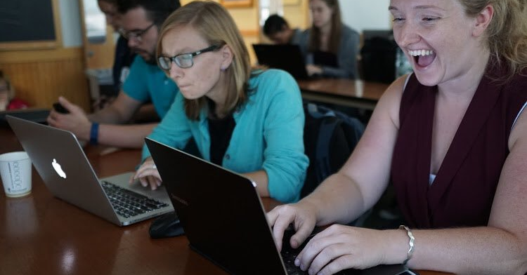
Picture credit: Chris Gorgolewski
@TuringWay @kirstie_j
https://doi.org/10.5281/zenodo.7647783
Notes:
TIMING: 3

Slide 35
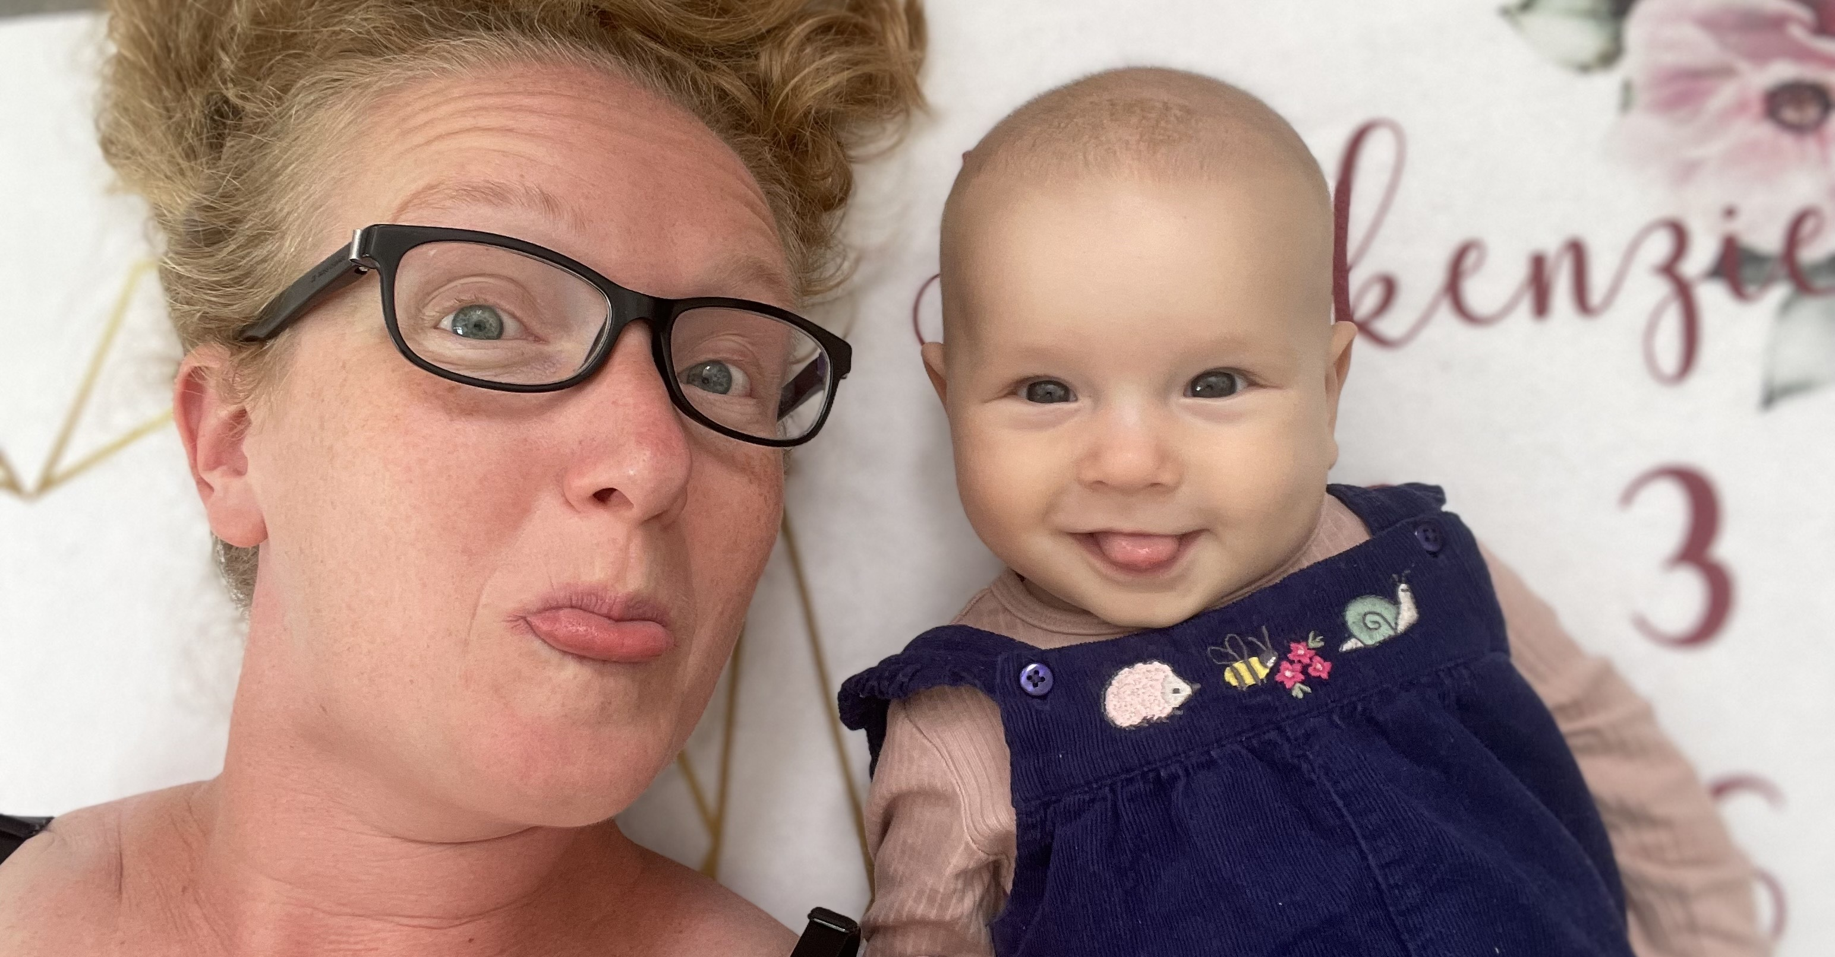
@TuringWay @kirstie_j
https://doi.org/10.5281/zenodo.7647783
Notes:
TIMING: 3

Slide 36
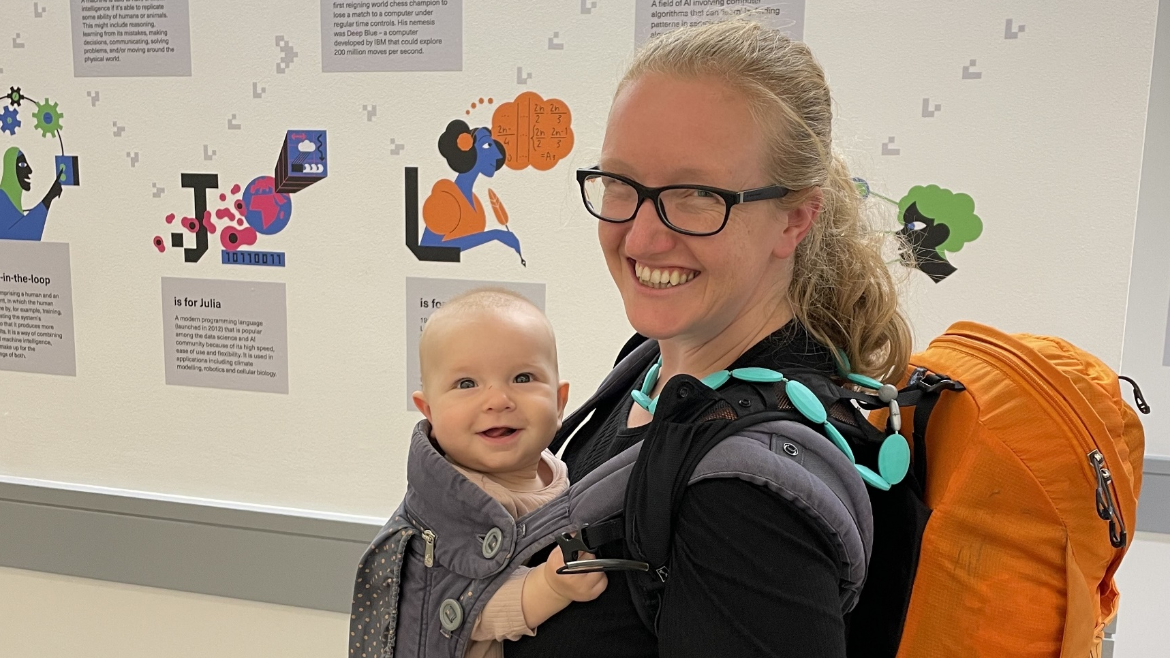
@TuringWay @kirstie_j
https://doi.org/10.5281/zenodo.7647783
Notes:
TIMING: 3

Slide 37
Research Programme Director for Tools, Practices & Systems
The Alan Turing Institute
@TuringWay @kirstie_j
https://doi.org/10.5281/zenodo.7647783
Notes:
TIMING: 3

Slide 38
Attend / chair meetings
Manage (cloud) compute resources
Commercialise a product
Peer review
Promote EDI and work-life balance
Deliver trainings
Archive data & code
Read literature
Write papers
Apply for funding
What does a programme director do?
Give talks
Share work with the public
Design experiments
Collect / access data
Set strategy
Maintain
ethical &
legal principles
Testing & quality control
Track impact
Mentor colleagues
Manage budgets
Run statistical analyses
Promote work to decision makers
Host events
Scope user requirements
Generalise code to software
Visualisation
@TuringWay @kirstie_j
https://doi.org/10.5281/zenodo.7647783
Report on progress
Manage a team
Interpret results
Notes:
TIMING: 5

Slide 39
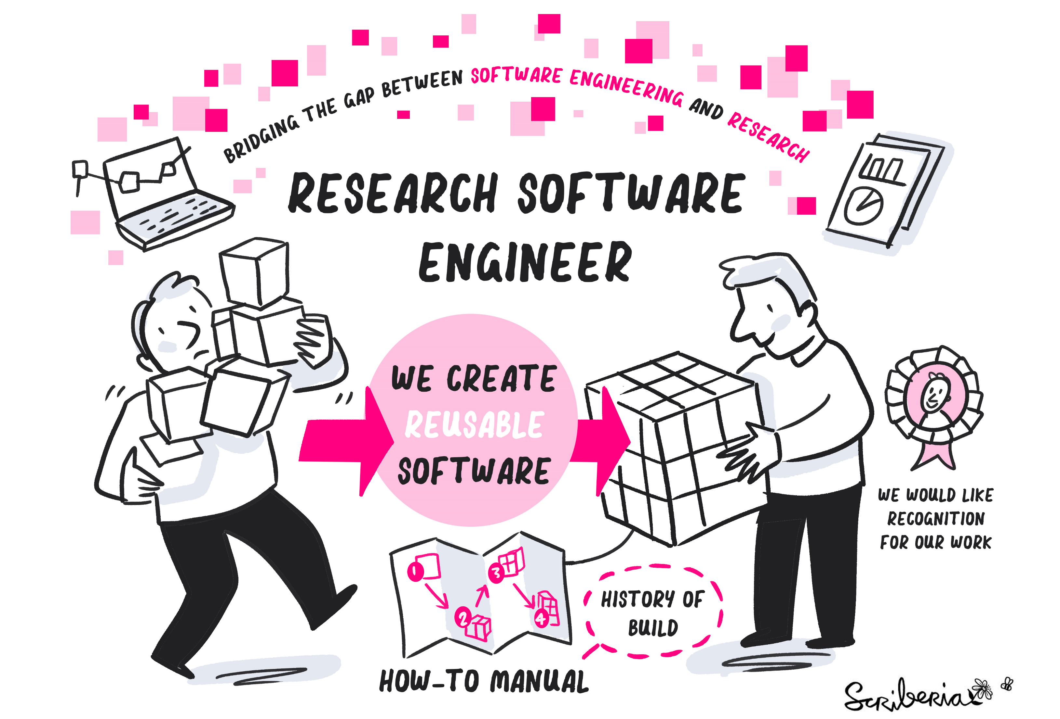

@TuringWay @kirstie_j
https://doi.org/10.5281/zenodo.7647783
https://the-turing-way.netlify.app/collaboration/research-infrastructure-roles/rse.html
https://society-rse.org/about
Notes:
TIMING: 5

Slide 40
Our mission is to establish a research environment that recognises the vital role of software in research. We work to increase software skills across everyone in research, to promote collaboration between researchers and software experts, and to support the creation of an academic career path for Research Software Engineers.
@TuringWay @kirstie_j
https://doi.org/10.5281/zenodo.7647783
https://the-turing-way.netlify.app/collaboration/research-infrastructure-roles/rse.html
https://society-rse.org/about
Notes:
TIMING: 5

Slide 41
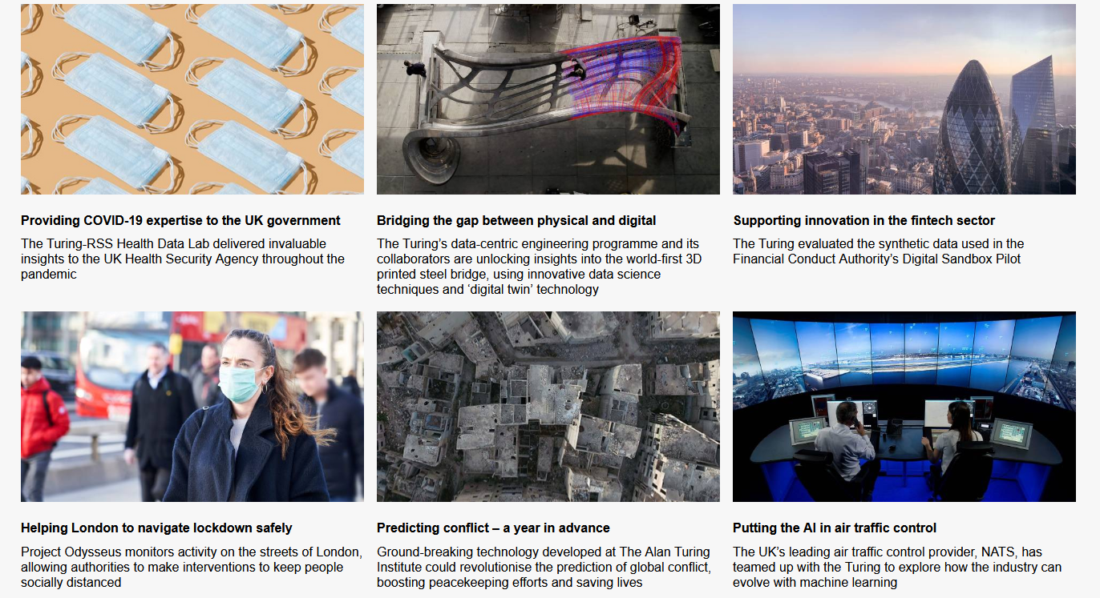
@TuringWay @kirstie_j
https://doi.org/10.5281/zenodo.7647783
https://www.turing.ac.uk/research/
research-engineering/reg-impact-stories
Notes:
TIMING: 5

Slide 42
Attend / chair meetings
Manage (cloud) compute resources
Commercialise a product
Peer review
Promote EDI and work-life balance
Deliver trainings
Archive data & code
Read literature
Write papers
Apply for funding
What does
an RSE do?
Give talks
Share work with the public
Design experiments
Collect / access data
Set strategy
Maintain
ethical &
legal principles
Testing & quality control
Track impact
Mentor colleagues
Manage budgets
Run statistical analyses
Promote work to decision makers
Host events
Scope user requirements
Generalise code to software
Visualisation
@TuringWay @kirstie_j
https://doi.org/10.5281/zenodo.7647783
Report on progress
Manage a team
Interpret results
Notes:
TIMING: 5

Slide 43
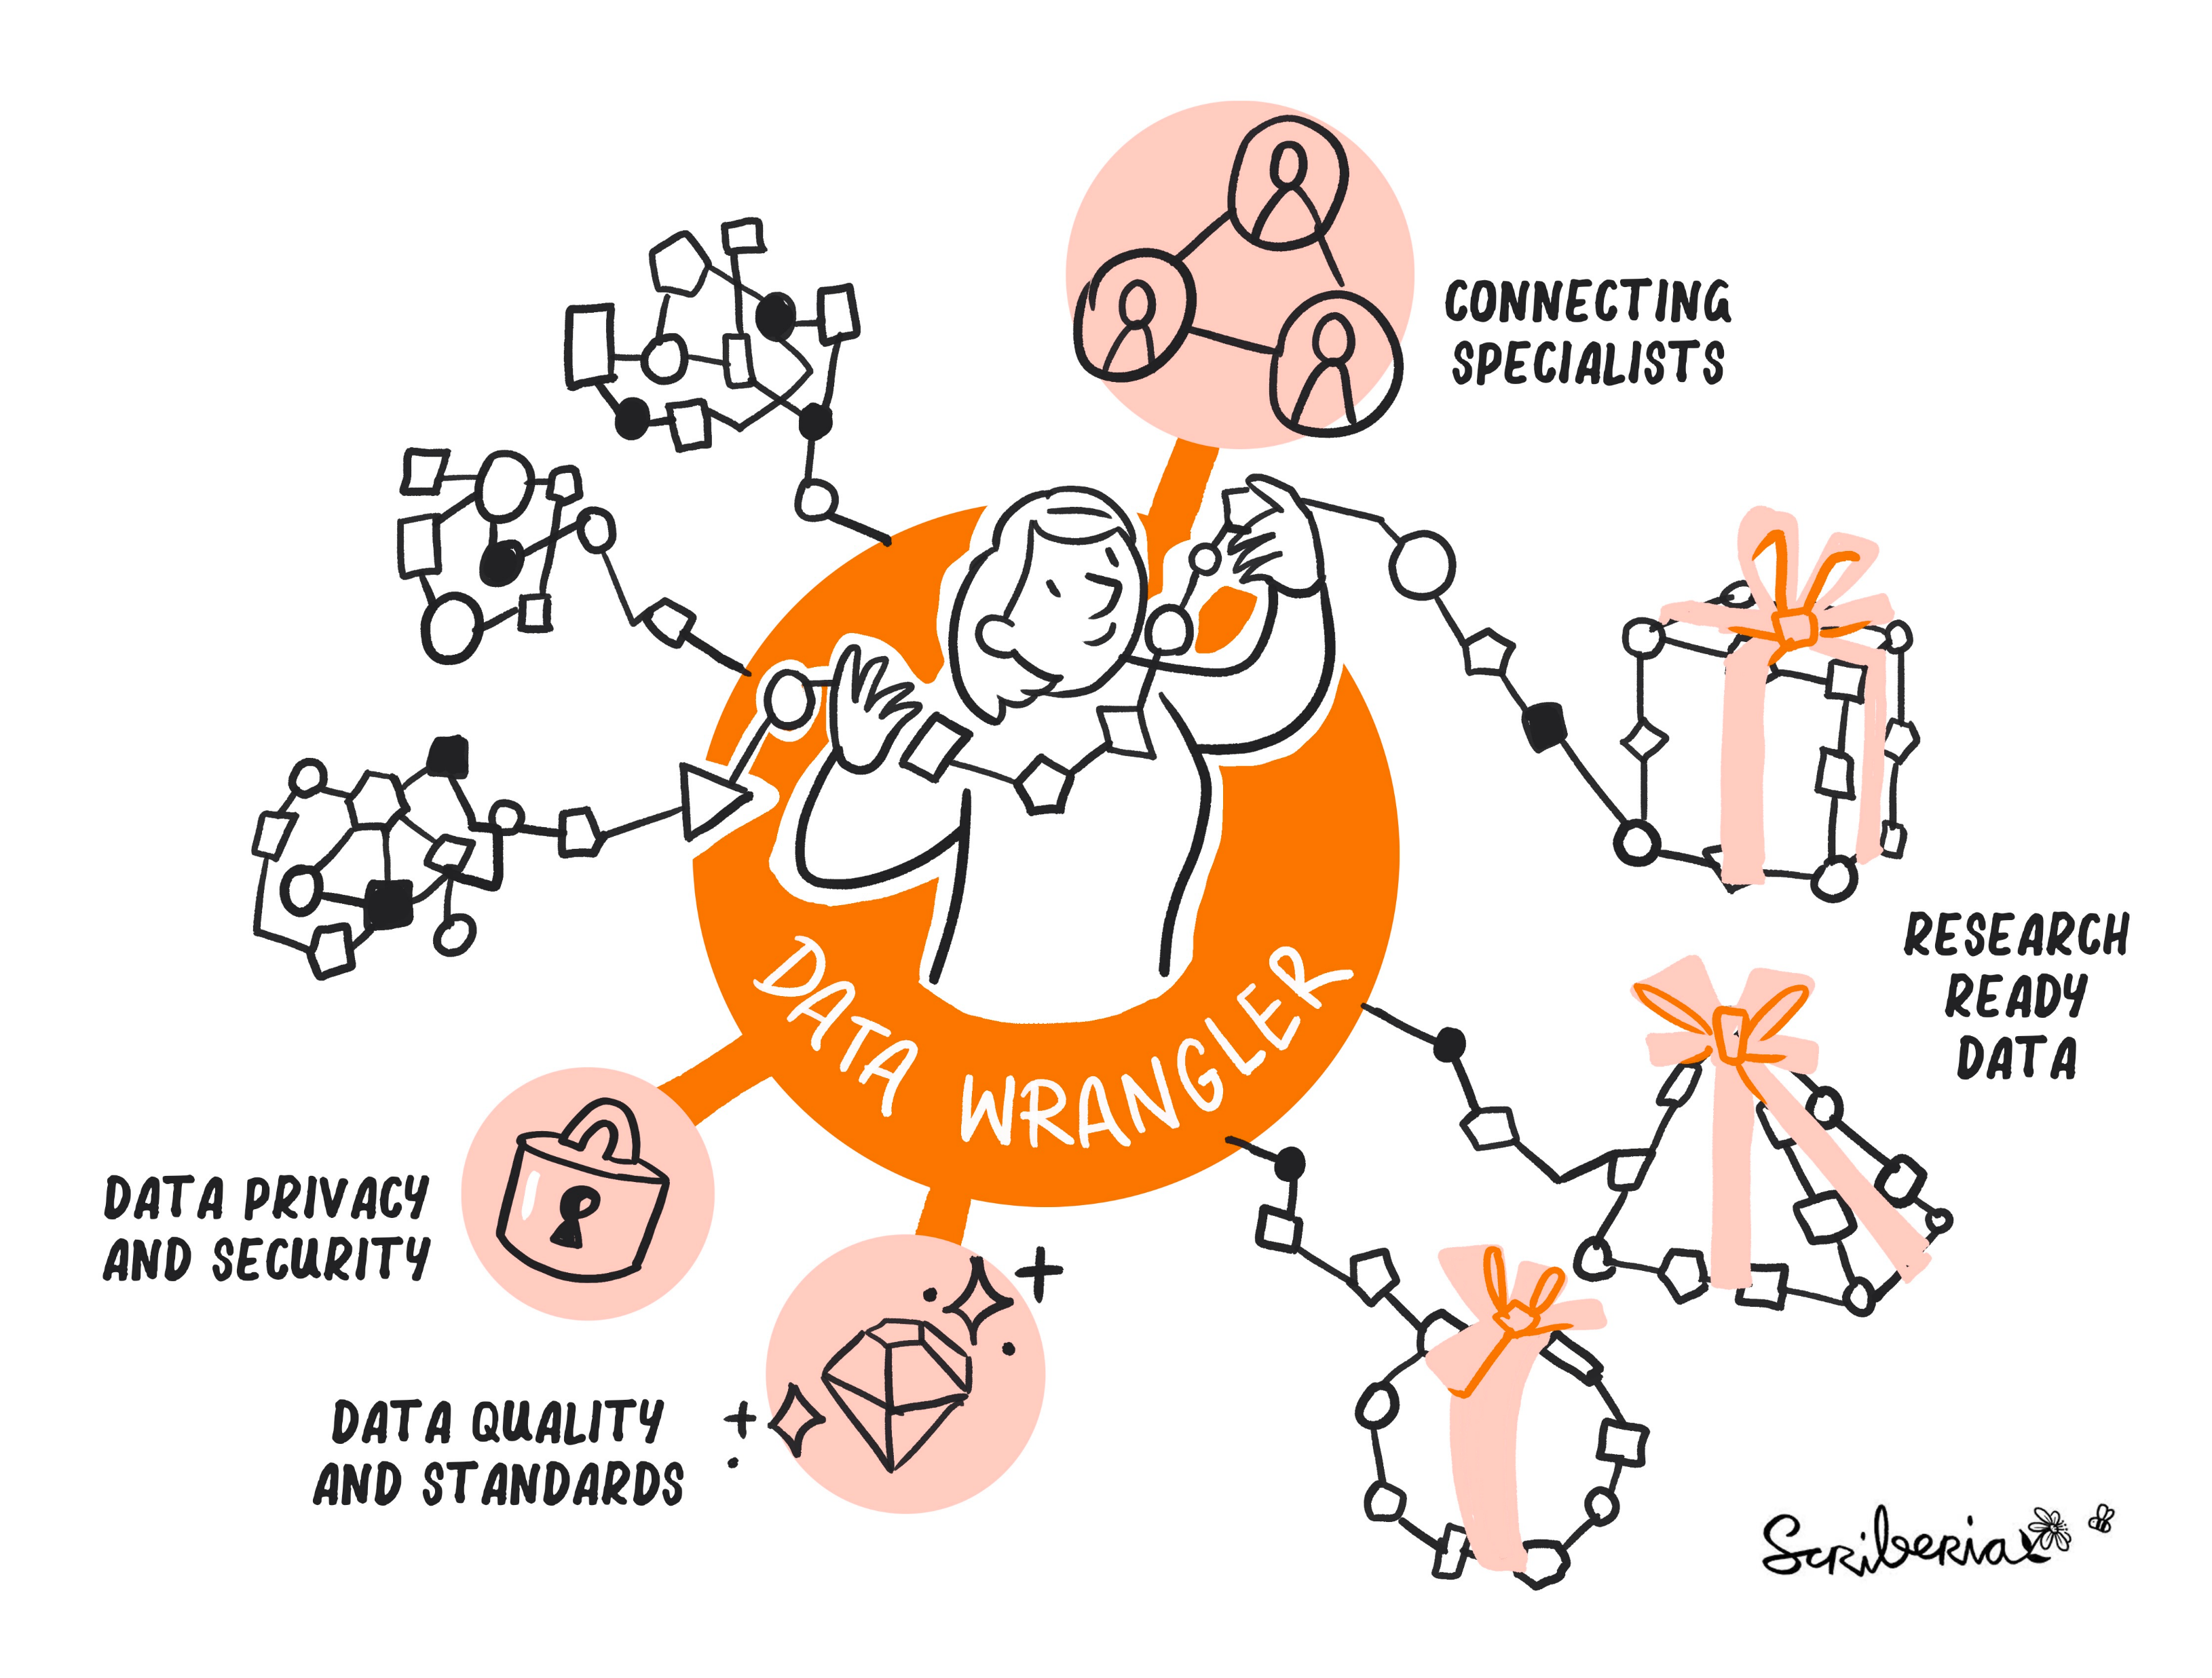
@TuringWay @kirstie_j
https://doi.org/10.5281/zenodo.7647783
https://the-turing-way.netlify.app/collaboration/
research-infrastructure-roles/data-wrangler.html
Notes:
TIMING: 5

Slide 44
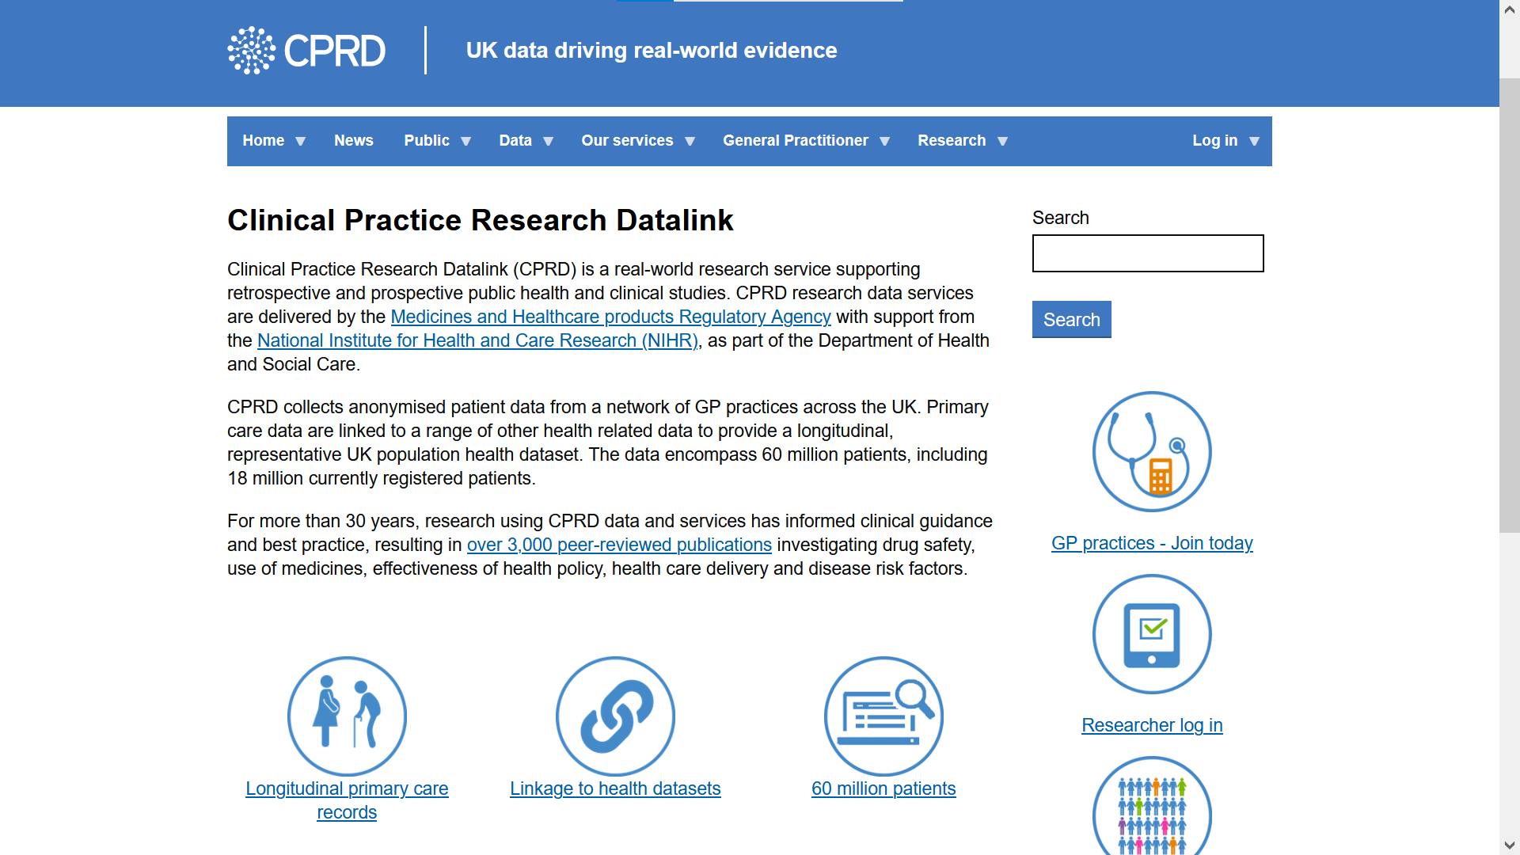
@TuringWay @kirstie_j
https://doi.org/10.5281/zenodo.7647783
https://cprd.com
Notes:
TIMING: 5

Slide 45
To access synthetic data a data wrangler needs to:
Read and understand lengthy data specifications with domain specific and technical terms
Understand or create metadata data dictionaries
Articulate specific research motivation
Negotiate and understand data license agreements
@TuringWay @kirstie_j
https://doi.org/10.5281/zenodo.7647783
https://cprd.com
Notes:
TIMING: 5

Slide 46
Attend / chair meetings
Manage (cloud) compute resources
Commercialise a product
Peer review
Promote EDI and work-life balance
Deliver trainings
Archive data & code
Read literature
Write papers
Apply for funding
What does
a data
wrangler do?
Give talks
Share work with the public
Design experiments
Collect / access data
Set strategy
Maintain
ethical &
legal principles
Testing & quality control
Track impact
Mentor colleagues
Manage budgets
Run statistical analyses
Promote work to decision makers
Host events
Scope user requirements
Generalise code to software
Visualisation
@TuringWay @kirstie_j
https://doi.org/10.5281/zenodo.7647783
Report on progress
Manage a team
Interpret results
Notes:
TIMING: 5

Slide 47
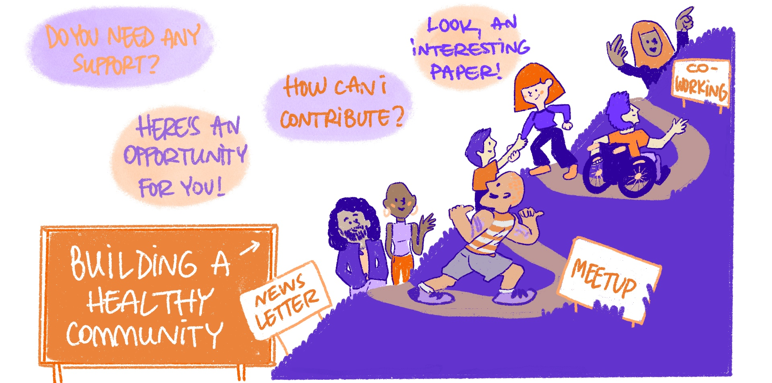
@TuringWay @kirstie_j
https://doi.org/10.5281/zenodo.7647783
https://the-turing-way.netlify.app/collaboration/
research-infrastructure-roles/community-manager.html
Notes:
TIMING: 5

Slide 48
The Turing Way is an open source book project that involves and supports a diverse research community in ensuring that reproducible and ethical data science is accessible and comprehensible for everyone.
@TuringWay @kirstie_j
https://doi.org/10.5281/zenodo.7647783
Notes:
TIMING: 1

Slide 49

@TuringWay @kirstie_j
https://doi.org/10.5281/zenodo.7647783
https://the-turing-way.netlify.app/community-handbook/
coworking/coworking-collabcafe.html
Notes:
TIMING: 5

Slide 50
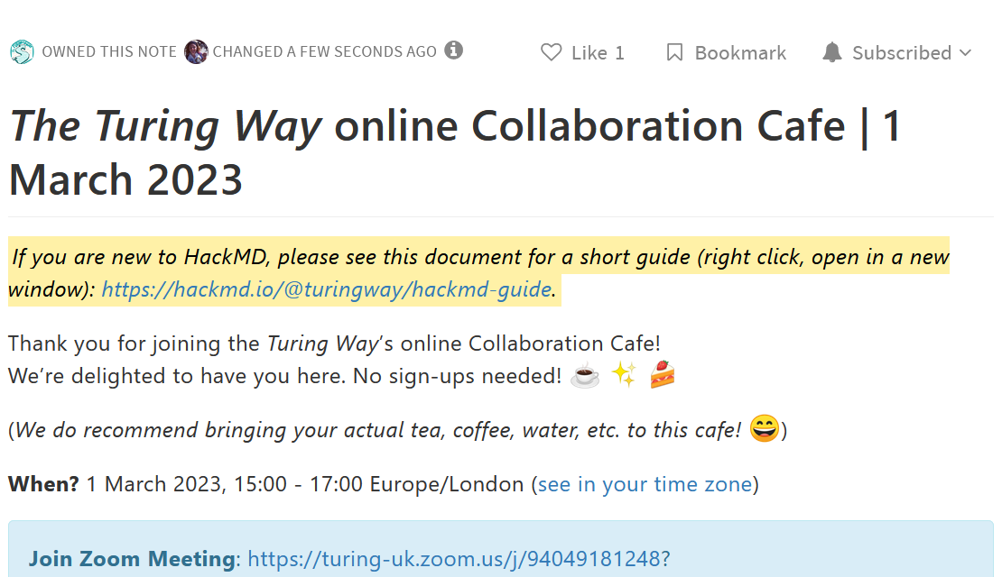
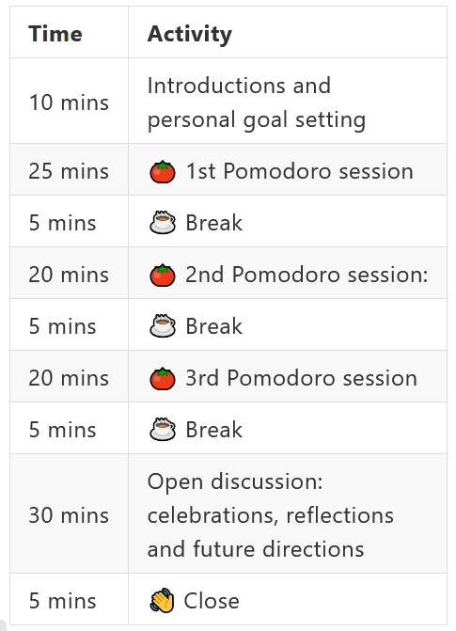
@TuringWay @kirstie_j
https://doi.org/10.5281/zenodo.7647783
https://the-turing-way.netlify.app/community-handbook/
coworking/coworking-collabcafe.html
Also found in the AIM RSF, Scivision, Data Hazards,
Environmental Data Science Book and JupyterHub communities
Notes:
TIMING: 5

Slide 51
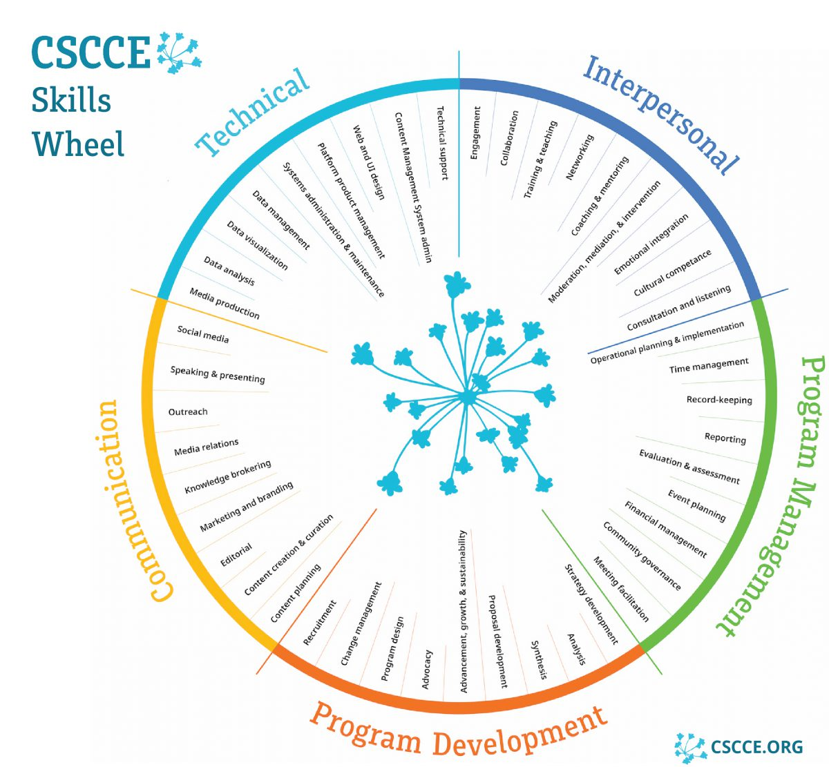
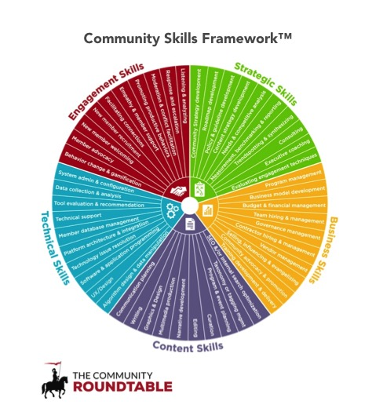
CSCCE Skills Wheel, Woodley et al, 2021, 10.5281/zenodo.4437294
https://communityroundtable.com/what-we-do/
models-and-frameworks/community-skills-framework/
@TuringWay @kirstie_j
https://doi.org/10.5281/zenodo.7647783
Notes:
TIMING: 5

Slide 52
Attend / chair meetings
Manage (cloud) compute resources
Commercialise a product
Peer review
Promote EDI and work-life balance
Deliver trainings
Archive data & code
Read literature
Write papers
Apply for funding
What does a community manager do?
Give talks
Share work with the public
Design experiments
Collect / access data
Set strategy
Maintain
ethical &
legal principles
Testing & quality control
Track impact
Mentor colleagues
Manage budgets
Run statistical analyses
Promote work to decision makers
Host events
Scope user requirements
Generalise code to software
Visualisation
@TuringWay @kirstie_j
https://doi.org/10.5281/zenodo.7647783
Report on progress
Manage a team
Interpret results
Notes:
TIMING: 5

Slide 53
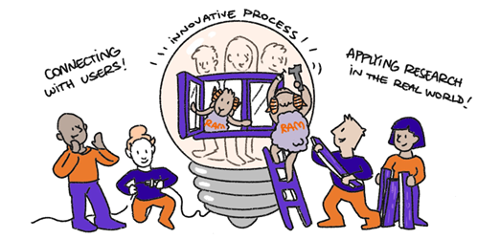
@TuringWay @kirstie_j
https://doi.org/10.5281/zenodo.7647783
https://the-turing-way.netlify.app/collaboration/
research-infrastructure-roles/ram.html
Notes:
TIMING: 5

Slide 54
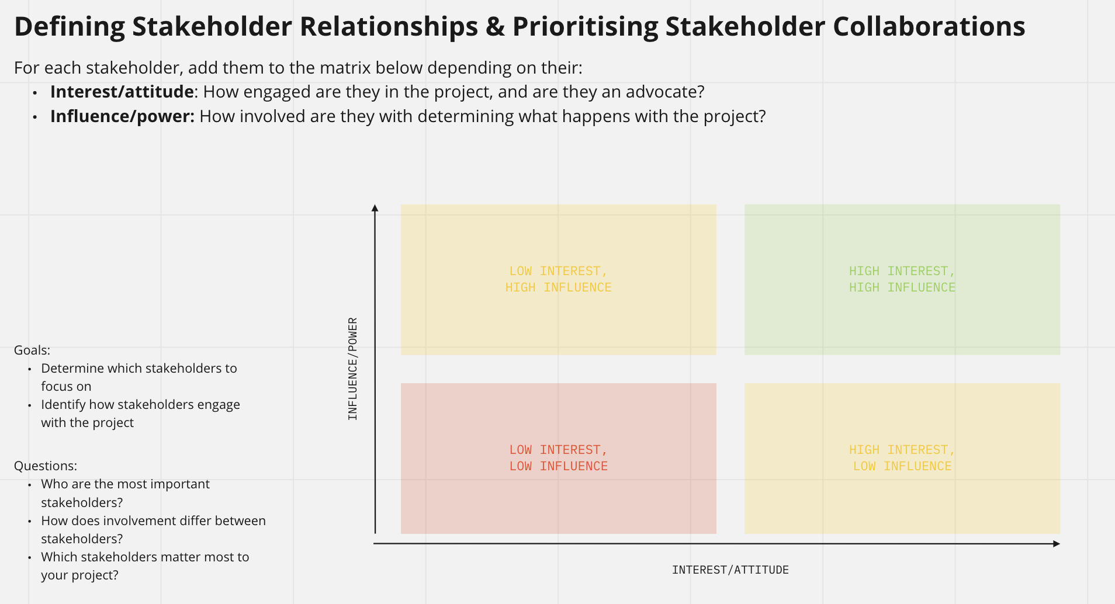
@TuringWay @kirstie_j
https://doi.org/10.5281/zenodo.7647783
https://the-turing-way.netlify.app/collaboration/
research-infrastructure-roles/ram.html
Notes:
TIMING: 5

Slide 55
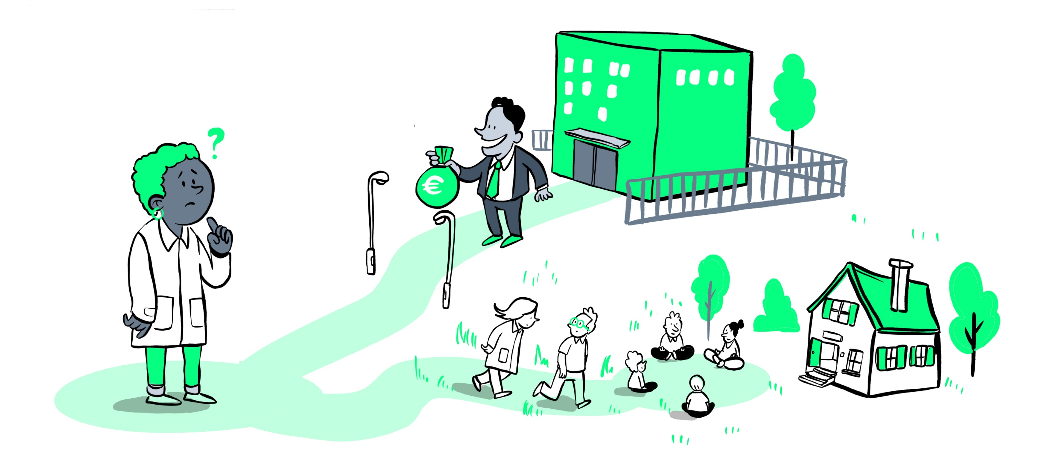
@TuringWay @kirstie_j
https://doi.org/10.5281/zenodo.7647783
https://the-turing-way.netlify.app/collaboration/
oss-sustainability/oss-sustainability-challenges.html
Notes:
TIMING: 5

Slide 56
One of the most common beliefs about Open Source is that it simply means “free” and therefore an open source project can never generate revenue or profit.
The definition used by The Turing Way states that OSS should be publicly available.
@TuringWay @kirstie_j
https://doi.org/10.5281/zenodo.7647783
https://the-turing-way.netlify.app/collaboration/
oss-sustainability/oss-sustainability-challenges.html
Notes:
TIMING: 5

Slide 57
Attend / chair meetings
Manage (cloud) compute resources
Commercialise a product
Peer review
Promote EDI and work-life balance
Deliver trainings
Archive data & code
Read literature
Write papers
Apply for funding
What does a RAM do?
Give talks
Share work with the public
Design experiments
Collect / access data
Set strategy
Maintain
ethical &
legal principles
Testing & quality control
Track impact
Mentor colleagues
Manage budgets
Run statistical analyses
Promote work to decision makers
Host events
Scope user requirements
Generalise code to software
Visualisation
@TuringWay @kirstie_j
https://doi.org/10.5281/zenodo.7647783
Report on progress
Manage a team
Interpret results
Notes:
TIMING: 5

Slide 58
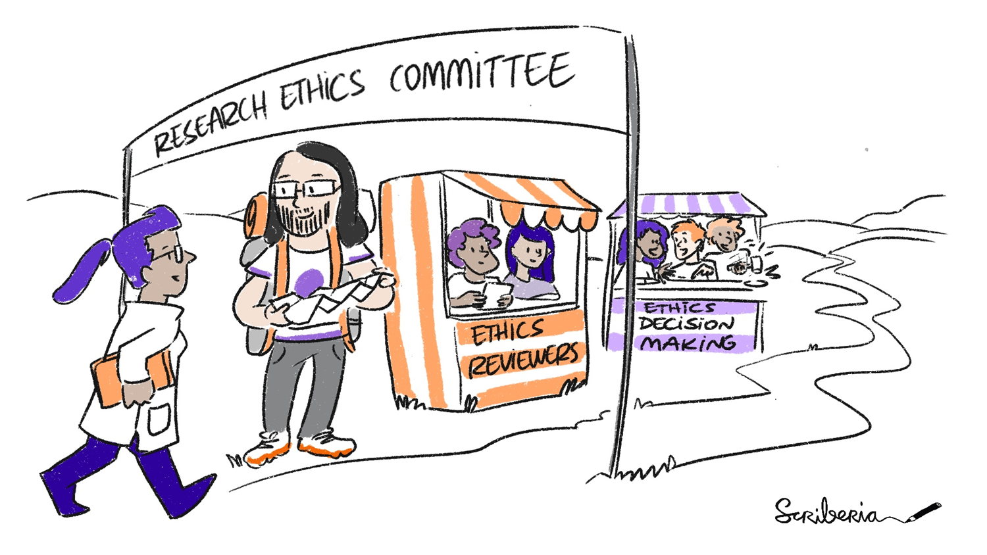
@TuringWay @kirstie_j
https://doi.org/10.5281/zenodo.7647783
https://the-turing-way.netlify.app/ethical-research/ethics-intro.html
Notes:
Corporate Governance Research Ethics Manager

Slide 59
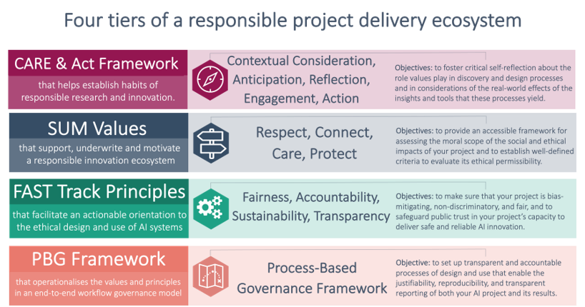
@TuringWay @kirstie_j
https://doi.org/10.5281/zenodo.7647783
Understanding artificial intelligence ethics and safety, Leslie, 2019
10.5281/zenodo.3240529
Notes:
TIMING: 5

Slide 60
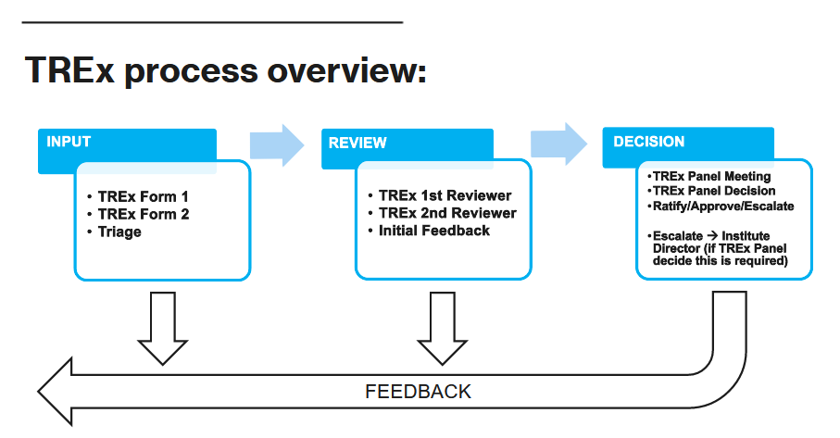
@TuringWay @kirstie_j
https://doi.org/10.5281/zenodo.7647783
Understanding artificial intelligence ethics and safety, Leslie, 2019
10.5281/zenodo.3240529
Notes:
TIMING: 5

Slide 61
Attend / chair meetings
Manage (cloud) compute resources
Commercialise a product
Peer review
Promote EDI and work-life balance
Deliver trainings
Archive data & code
Read literature
Write papers
Apply for funding
What does a CGREM do?
Give talks
Share work with the public
Design experiments
Collect / access data
Set strategy
Maintain
ethical &
legal principles
Testing & quality control
Track impact
Mentor colleagues
Manage budgets
Run statistical analyses
Promote work to decision makers
Host events
Scope user requirements
Generalise code to software
Visualisation
@TuringWay @kirstie_j
https://doi.org/10.5281/zenodo.7647783
Report on progress
Manage a team
Interpret results
Notes:
TIMING: 5

Slide 62
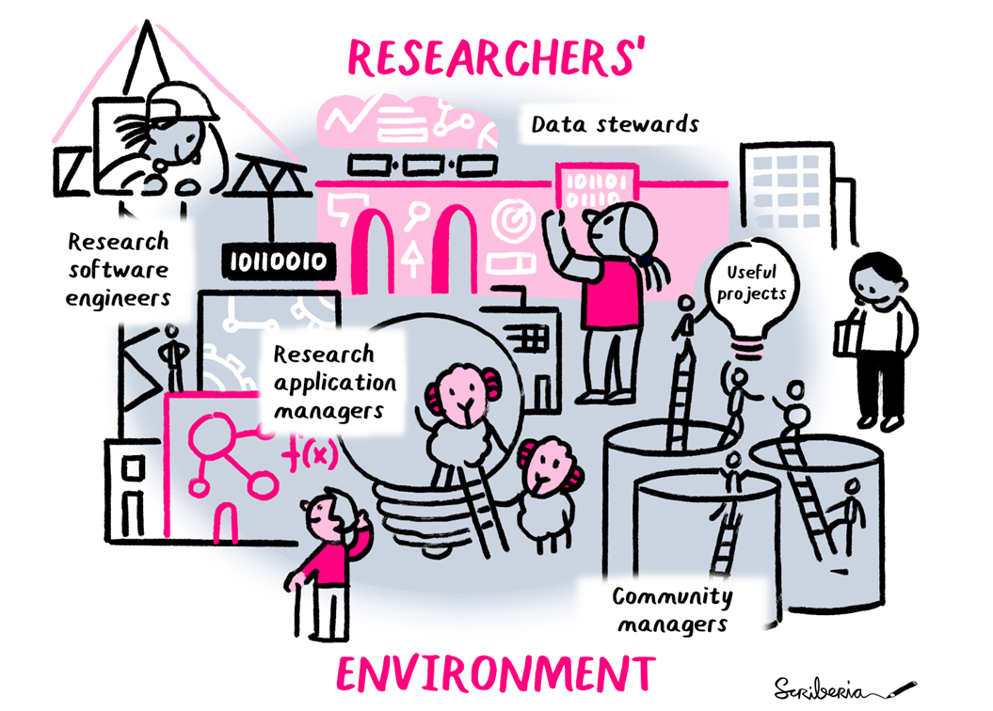
Partnerships development
manager
Participatory research coordinators
Research infrastructure developer
Research project managers
Professors, Readers, Lecturers
Programme managers
Corporate governance research ethics managers
Postdoctoral research associates
Doctoral students
Data wranglers
Ethics advisors
Librarians
@TuringWay @kirstie_j
https://doi.org/10.5281/zenodo.7647783
https://the-turing-way.netlify.app/
collaboration/research-infrastructure-roles.html
Notes:
Corporate Governance Research Ethics Manager

Slide 63
Partnerships development
manager
Participatory research coordinators
Research infrastructure developer
Research project managers
Professors, Readers, Lecturers
Programme managers
Physical or digital facilities, resources, expert workforces and specialised services available towards research and for the use of research communities are called Research Infrastructure.
Corporate governance research ethics managers
Postdoctoral research associates
Data wranglers
Ethics advisors
Librarians
@TuringWay @kirstie_j
https://doi.org/10.5281/zenodo.7647783
https://the-turing-way.netlify.app/
collaboration/research-infrastructure-roles.html
Notes:
Corporate Governance Research Ethics Manager

Slide 64

@TuringWay @kirstie_j
https://doi.org/10.5281/zenodo.7647783
https://www.ukri.org/publications/ukri-strategy-2022-to-2027
Notes:
TIMING: 5

Slide 65
@TuringWay @kirstie_j
https://doi.org/10.5281/zenodo.7647783
https://www.ukri.org/publications/ukri-strategy-2022-to-2027
Notes:
TIMING: 5

Slide 66
@TuringWay @kirstie_j
https://doi.org/10.5281/zenodo.7647783
https://www.ukri.org/publications/ukri-strategy-2022-to-2027
Notes:
TIMING: 5

Slide 67
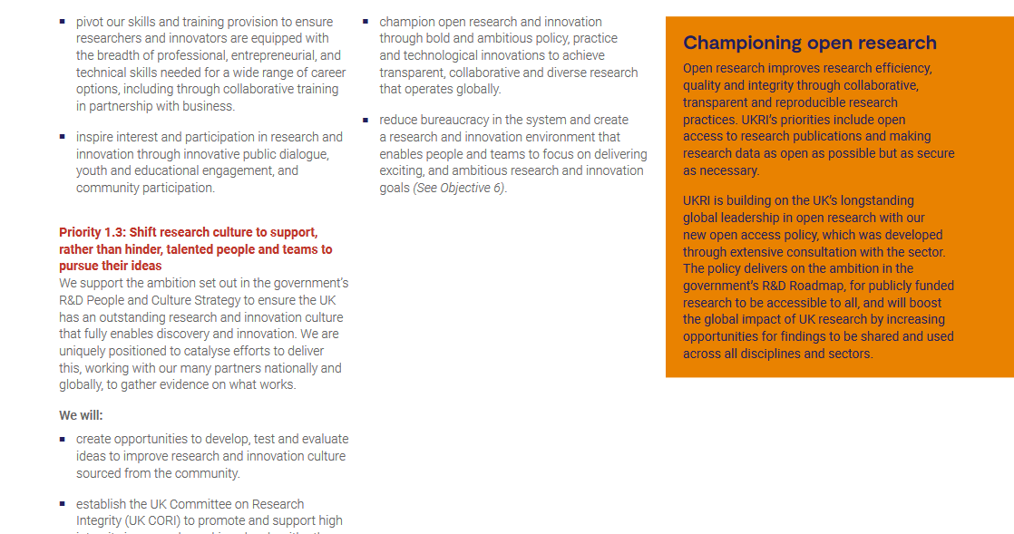
@TuringWay @kirstie_j
https://doi.org/10.5281/zenodo.7647783
https://www.ukri.org/publications/ukri-strategy-2022-to-2027
Notes:
TIMING: 5

Slide 68
Open research improves research efficiency, quality and integrity through collaborative, transparent and reproducible research practices.
@TuringWay @kirstie_j
https://doi.org/10.5281/zenodo.7647783
https://www.ukri.org/publications/ukri-strategy-2022-to-2027
Notes:
TIMING: 5

Slide 69
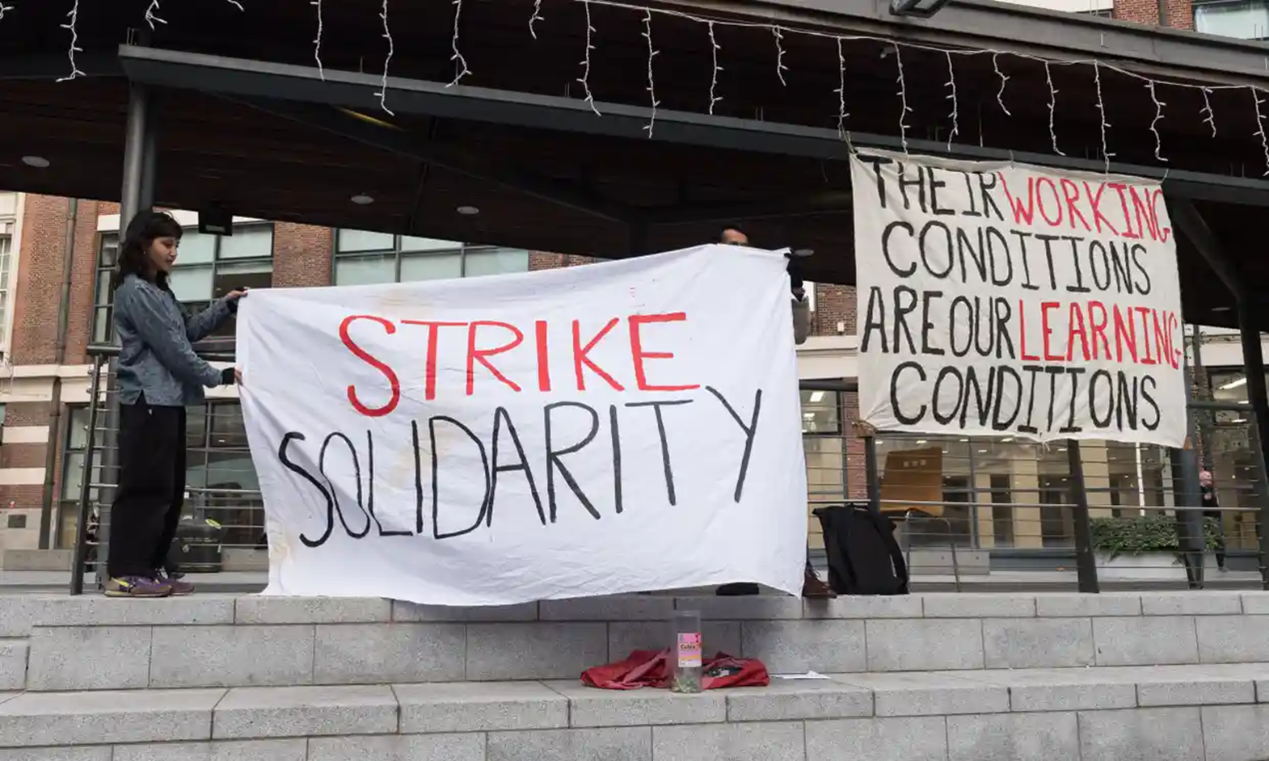
@TuringWay @kirstie_j
https://doi.org/10.5281/zenodo.7647783
https://www.theguardian.com/politics/2022/nov/25/
strike-action-who-is-walking-out-and-when
Notes:
TIMING: 5

Slide 70
Attend / chair meetings
Manage (cloud) compute resources
Commercialise a product
Peer review
Promote EDI and work-life balance
Deliver trainings
Archive data & code
Read literature
Write papers
Apply for funding
What does a programme director do?
Give talks
Share work with the public
Design experiments
Collect / access data
Set strategy
Maintain
ethical &
legal principles
Testing & quality control
Track impact
Mentor colleagues
Manage budgets
Run statistical analyses
Promote work to decision makers
Host events
Scope user requirements
Generalise code to software
Visualisation
@TuringWay @kirstie_j
https://doi.org/10.5281/zenodo.7647783
Report on progress
Manage a team
Interpret results
Notes:
TIMING: 5

Slide 71
Attend / chair meetings
Manage (cloud) compute resources
Commercialise a product
Peer review
Promote EDI and work-life balance
Deliver trainings
Archive data & code
Read literature
Write papers
Apply for funding
What does
an RSE do?
Give talks
Share work with the public
Design experiments
Collect / access data
Set strategy
Maintain
ethical &
legal principles
Testing & quality control
Track impact
Mentor colleagues
Manage budgets
Run statistical analyses
Promote work to decision makers
Host events
Scope user requirements
Generalise code to software
Visualisation
@TuringWay @kirstie_j
https://doi.org/10.5281/zenodo.7647783
Report on progress
Manage a team
Interpret results
Notes:
TIMING: 5

Slide 72
Attend / chair meetings
Manage (cloud) compute resources
Commercialise a product
Peer review
Promote EDI and work-life balance
Deliver trainings
Archive data & code
Read literature
Write papers
Apply for funding
What does
a data
wrangler do?
Give talks
Share work with the public
Design experiments
Collect / access data
Set strategy
Maintain
ethical &
legal principles
Testing & quality control
Track impact
Mentor colleagues
Manage budgets
Run statistical analyses
Promote work to decision makers
Host events
Scope user requirements
Generalise code to software
Visualisation
@TuringWay @kirstie_j
https://doi.org/10.5281/zenodo.7647783
Report on progress
Manage a team
Interpret results
Notes:
TIMING: 5

Slide 73
Attend / chair meetings
Manage (cloud) compute resources
Commercialise a product
Peer review
Promote EDI and work-life balance
Deliver trainings
Archive data & code
Read literature
Write papers
Apply for funding
What does a community manager do?
Give talks
Share work with the public
Design experiments
Collect / access data
Set strategy
Maintain
ethical &
legal principles
Testing & quality control
Track impact
Mentor colleagues
Manage budgets
Run statistical analyses
Promote work to decision makers
Host events
Scope user requirements
Generalise code to software
Visualisation
@TuringWay @kirstie_j
https://doi.org/10.5281/zenodo.7647783
Report on progress
Manage a team
Interpret results
Notes:
TIMING: 5

Slide 74
Attend / chair meetings
Manage (cloud) compute resources
Commercialise a product
Peer review
Promote EDI and work-life balance
Deliver trainings
Archive data & code
Read literature
Write papers
Apply for funding
What does a RAM do?
Give talks
Share work with the public
Design experiments
Collect / access data
Set strategy
Maintain
ethical &
legal principles
Testing & quality control
Track impact
Mentor colleagues
Manage budgets
Run statistical analyses
Promote work to decision makers
Host events
Scope user requirements
Generalise code to software
Visualisation
@TuringWay @kirstie_j
https://doi.org/10.5281/zenodo.7647783
Report on progress
Manage a team
Interpret results
Notes:
TIMING: 5

Slide 75
Attend / chair meetings
Manage (cloud) compute resources
Commercialise a product
Peer review
Promote EDI and work-life balance
Deliver trainings
Archive data & code
Read literature
Write papers
Apply for funding
What does a CGREM do?
Give talks
Share work with the public
Design experiments
Collect / access data
Set strategy
Maintain
ethical &
legal principles
Testing & quality control
Track impact
Mentor colleagues
Manage budgets
Run statistical analyses
Promote work to decision makers
Host events
Scope user requirements
Generalise code to software
Visualisation
@TuringWay @kirstie_j
https://doi.org/10.5281/zenodo.7647783
Report on progress
Manage a team
Interpret results
Notes:
TIMING: 5

Slide 76
It does not matter how the roles differ.
We all have overlapping skills and motivations.
What matters is that career pathways are appropriately incentivised to support a diverse ecosystem.
@TuringWay @kirstie_j
https://doi.org/10.5281/zenodo.7647783
https://www.theguardian.com/politics/2022/nov/25/
strike-action-who-is-walking-out-and-when
Notes:
TIMING: 5

Slide 77
It does not matter how the roles differ.
We all have overlapping skills and motivations.
What matters is that career pathways are appropriately incentivised to support a diverse ecosystem.
@TuringWay @kirstie_j
https://doi.org/10.5281/zenodo.7647783
https://www.theguardian.com/politics/2022/nov/25/
strike-action-who-is-walking-out-and-when
Notes:
TIMING: 5

Slide 78

@TuringWay @kirstie_j
https://doi.org/10.5281/zenodo.7647783
Notes:
TIMING: 5

Slide 79
Do not cede the researcher in you or your role.
@TuringWay @kirstie_j
https://doi.org/10.5281/zenodo.7647783
Notes:
TIMING: 5

Slide 80
Lean in. Demonstrate what team science can be.
@TuringWay @kirstie_j
https://doi.org/10.5281/zenodo.7647783
Notes:
TIMING: 5

Slide 81
Attend / chair meetings
Manage (cloud) compute resources
Commercialise a product
Peer review
Promote EDI and work-life balance
RSE answers
Deliver trainings
Archive data & code
Read literature
Write papers
Apply for funding
All the tasks covered by
a team
Give talks
Share work with the public
Design experiments
Collect / access data
Set strategy
Maintain
ethical &
legal principles
Testing & quality control
Track impact
Mentor colleagues
Manage budgets
Run statistical analyses
Promote work to decision makers
Host events
Scope user requirements
Generalise code to software
Visualisation
@TuringWay @kirstie_j
https://doi.org/10.5281/zenodo.7647783
Report on progress
Manage a team
Interpret results
Notes:
TIMING: 5

Slide 82
Thank you
Programme management: Arielle Bennett, Dave Chapman, Davide Sarmiento Perez, Batool Almarzouq & Alexandra Araujo Alvarez
Research associates and fellows: Georgia Aitkenhead, Giulia Tomba, Priscilla Canizares
Corporate governance research ethics manager: Victoria Kwan
Open Infrastructure lead: Zeynep Engin
TPS Senior Researchers: Malvika Sharan, Aida Mehonic, Alden Conner, Jennifer Ding, Bastian Greshake Tzovaras & Christopher Burr
Research Community Managers: Emma Karoune, Arron Lacey, Vicky Hellon, Anne Lee Steele, Sophia Batchelor & Eirini Zormpa
Research Application Managers: Hari Sood & Shakir Laher
@TuringWay @kirstie_j
https://doi.org/10.5281/zenodo.7647783
Notes:
TIMING: 18

Slide 83
Thank you
Partnerships Development Lead: Shane Conneely
REG liaison: Jim Madge
Executive assistant: Ann Hendy
Data wrangling team: Annie Mallon, Dan Delbarre, Steve Gardiner, Mahwish Mohammad, Luis Santos & Rachael Stickland
TREx team: Vanessa Forster & Tony Sanderson
Georgia Aitkenhead, Batool Almarzouq, Alexandra Araujo Alvarez, Sophia Batchelor, Arielle Bennett, Christopher Burr, Priscilla Canizares, Dave Chapman, Alden Conner, Jennifer Ding, Zeynep Engin, Bastian Greshake Tzovaras, Vicky Hellon, Emma Karoune, Victoria Kwan, Arron Lacey, Shakir Laher, Anne Lee Steele, Aida Mehonic, Davide Sarmiento Perez, Malvika Sharan, Hari Sood, Giulia Tomba & Eirini Zormpa
@TuringWay @kirstie_j
https://doi.org/10.5281/zenodo.7647783
Notes:
TIMING: 18

Slide 84

We’re HIRING!
TPS Senior Research Associate to lead collaborative and interdisciplinary research for The Turing Way Practitioners Hub.
https://cezanneondemand.intervieweb.it/turing/en/career#vacancies
Deadline: 23:59 on 12 March 2023
Salary: £51,025 pa + excellent benefits and flexible working
We can sponsor a visa for the right candidate, moving expenses covered to a pre-agreed limit
2 days/month in the office, can work from anywhere in the UK
Contact: msharan@turing.ac.uk or kwhitaker@turing.ac.uk
@TuringWay @kirstie_j
https://doi.org/10.5281/zenodo.7647783
Notes:
TIMING: 18

Slide 85
Thank you
Book: https://the-turing-way.netlify.com
Newsletter: https://tinyletter.com/TuringWay
GitHub: https://github.com/alan-turing-institute/the-turing-way
Slack: https://tinyurl.com/jointuringwayslack
Next Collaboration Café: 1 March at 3pm UK, 4pm CET, 10am EST
Original artwork by Scriberia: https://doi.org/10.5281/zenodo.3332807
This work was supported by The UKRI Strategic Priorities Fund under the EPSRC Grant EP/T001569/1, particularly the "Tools, Practices and Systems" theme within that grant, and by The Alan Turing Institute under the EPSRC grant EP/N510129/1.
@TuringWay @kirstie_j
https://doi.org/10.5281/zenodo.7647783
Notes:
TIMING: 18

Slide 86
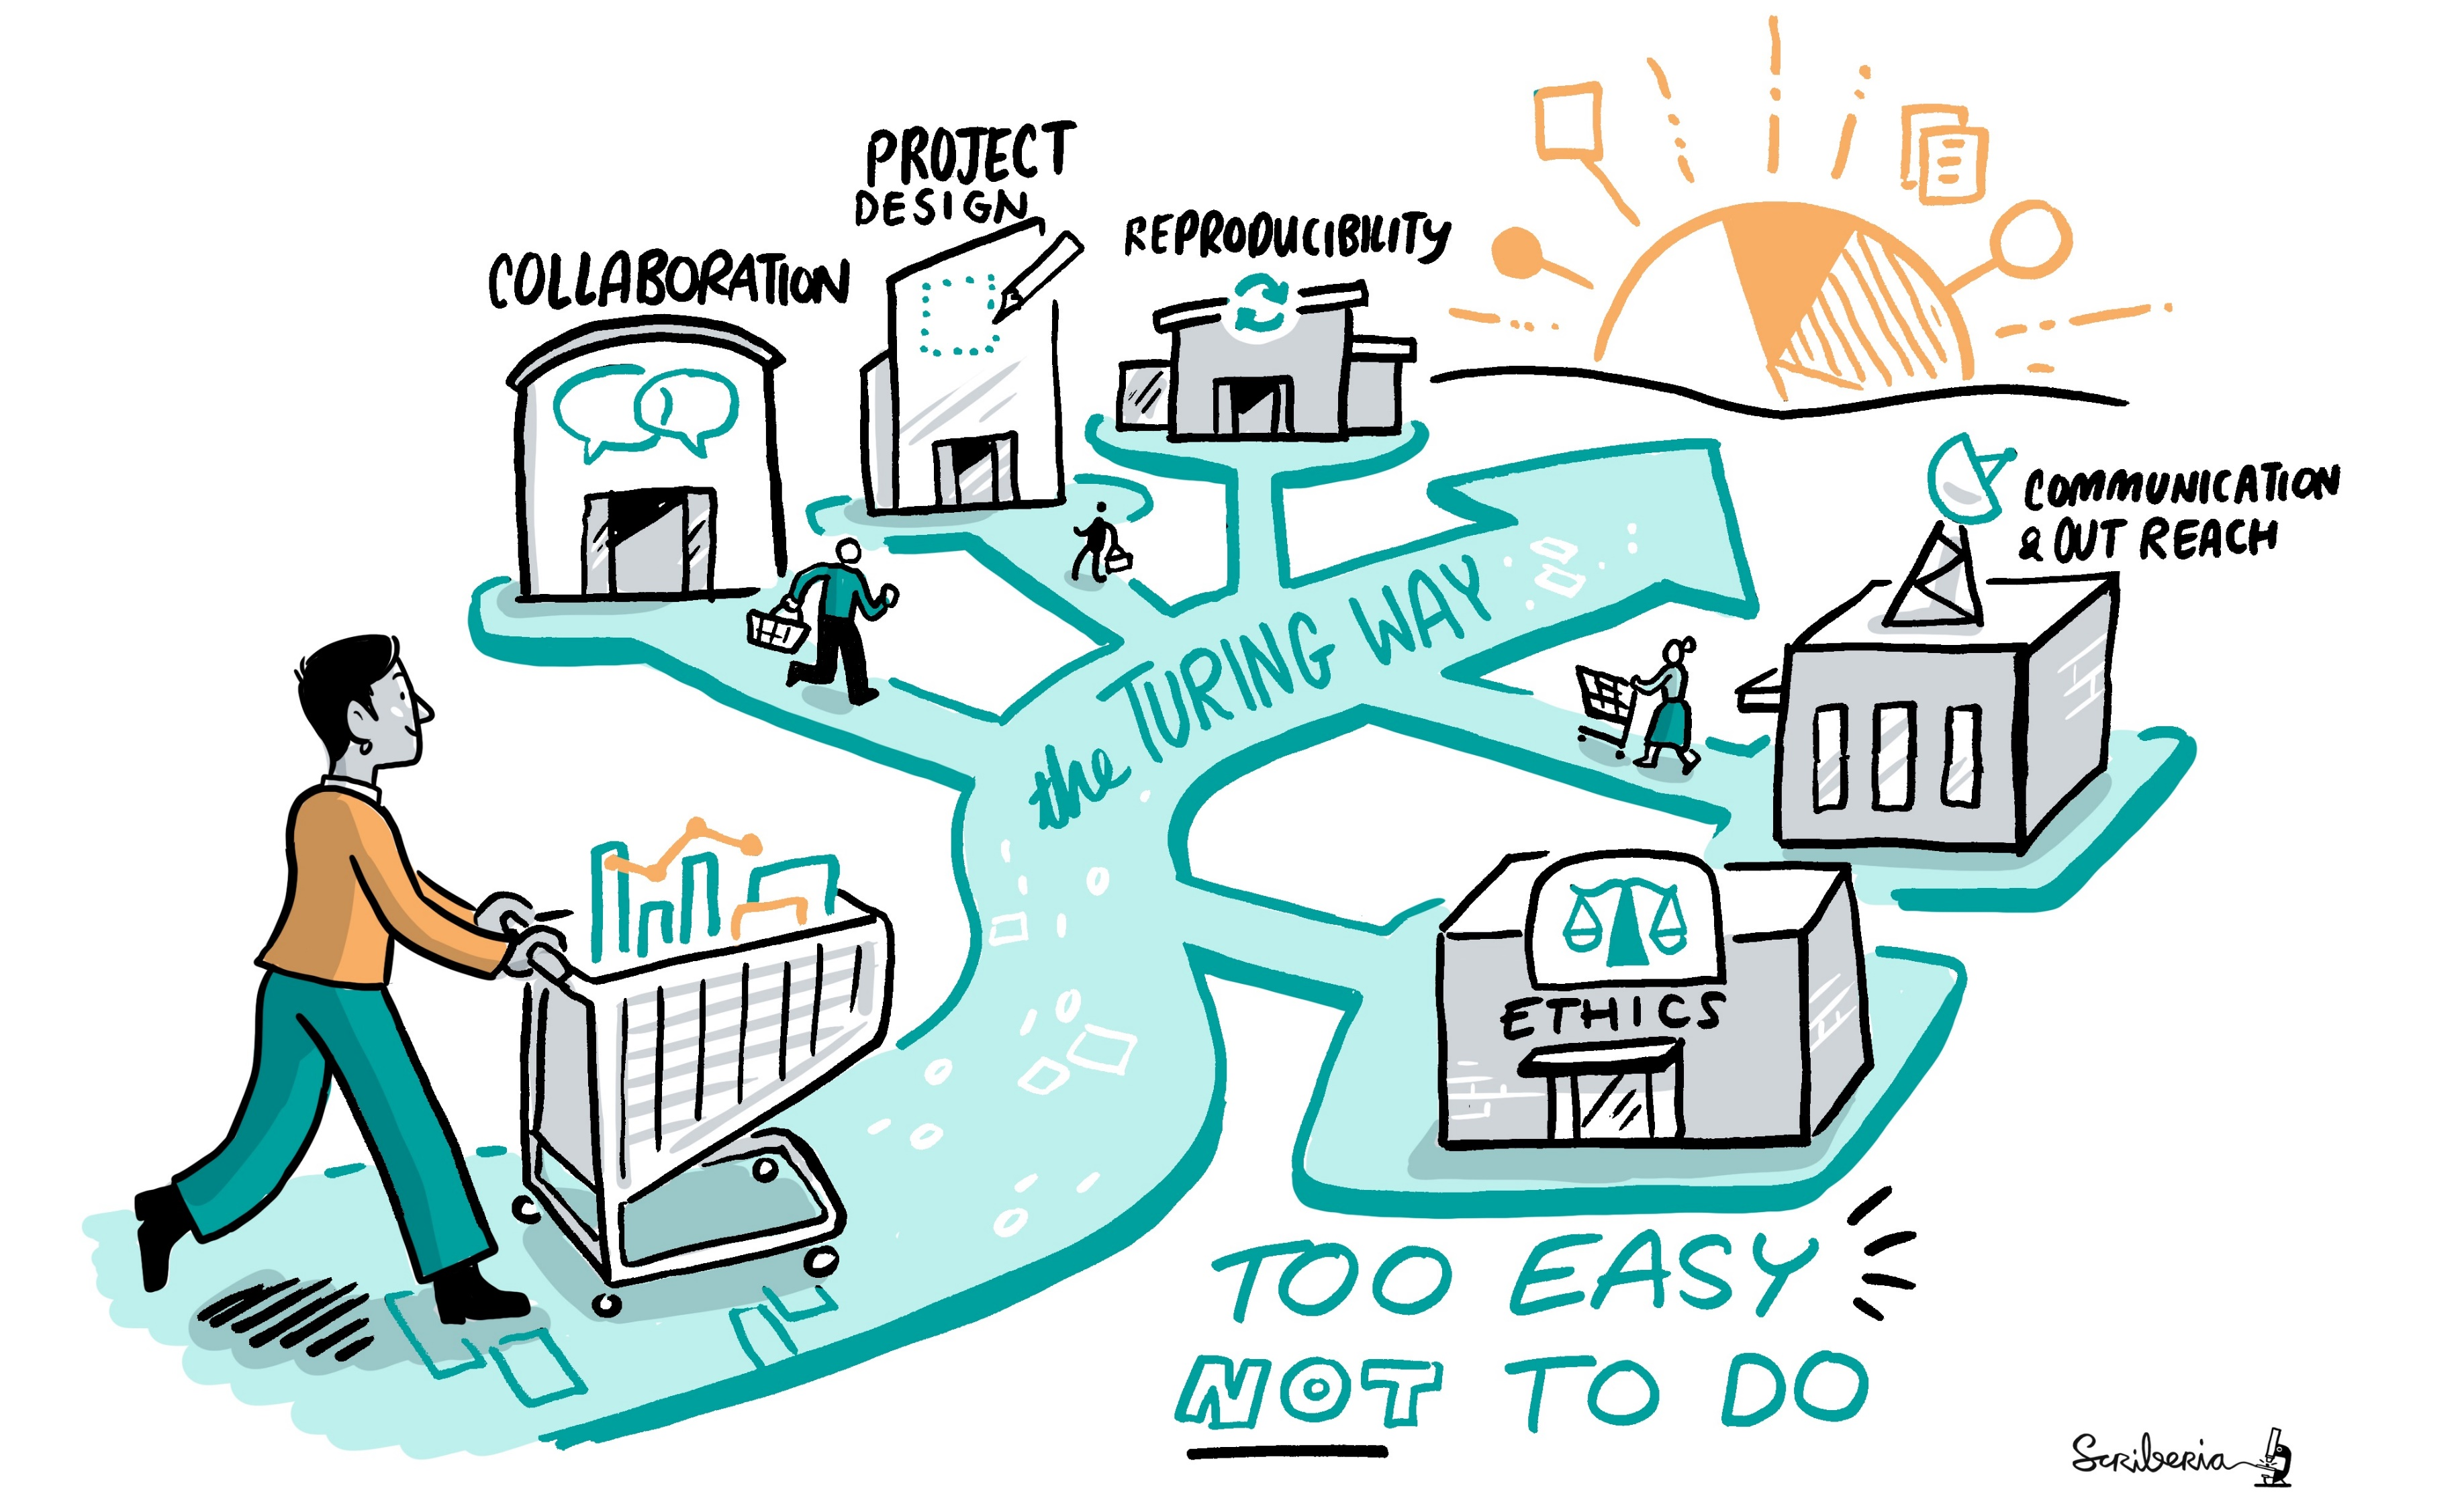
@TuringWay @kirstie_j
https://doi.org/10.5281/zenodo.7647783
Notes:
TIMING: 10

