Slide 1





Unravelling the mysteries of arsenic in the Zenne River (Belgium): sources, distribution, geochemistry, and bioavailability
Vendula Smolikova, Tianhui Ma, Vincent Perrot, Natacha Brion, Yue Gao, Pavlina Pelcova, Andrea Ridoskova, Martine Leermakers

Slide 2
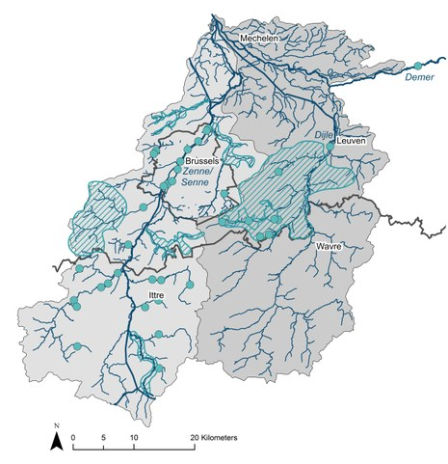
Zenne River
Originates in Walloon part of Belgium
Average length (105 km) and basin coverage (1160 km²)
Environmental status:
  agricultural activities vs. urabnization and industrialization,
  indirect tributary of the Scheldt estuary,
  poor water quality before 2000,
  WWTP Brussels South 2000
  WWTP Brussels North 2007
    Decreased pollutant loads
    Increased oxygen and nitrate levels¹
    Concentrations of As remained unchanged^{2,3}
*VMM, Belini project, 2017.
¹ Brion et al. Environ. Sci. Pollut. Res. 2015, 22, 12720-12736.
²Baeyens et al. Sci. Tot. Environ. 2007, 384, 409-419.
³Andreae & Andreae. Estuar. Coast. Shelf Sci. 1989, 29, 421-433.

Slide 3
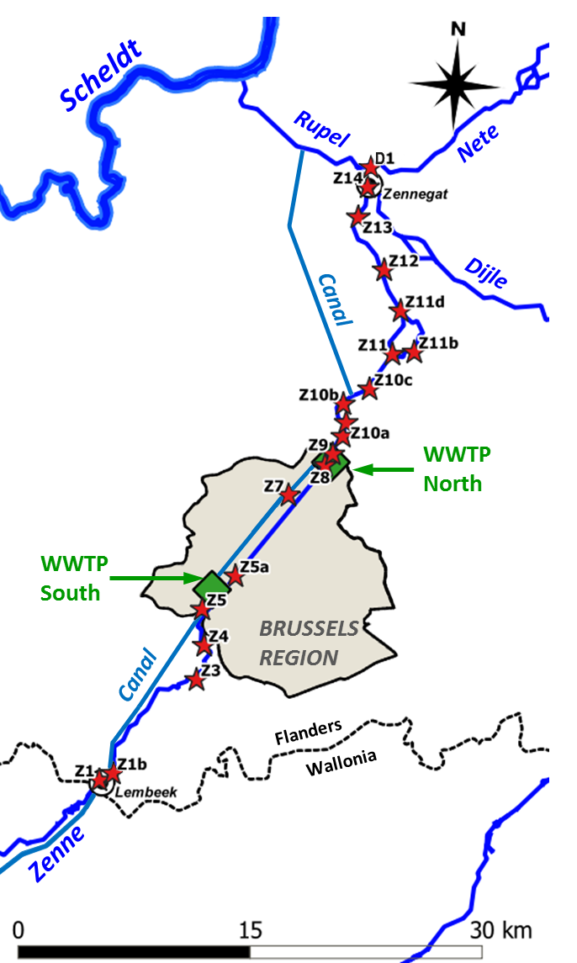
Study site
Z14
Z14
Tidal influence
Downstream
Z11
Z10a
Z9
Brussels area
Z5
Z4
Upstream
Z1
Sampling station
Wastewater treatment plant

Slide 4
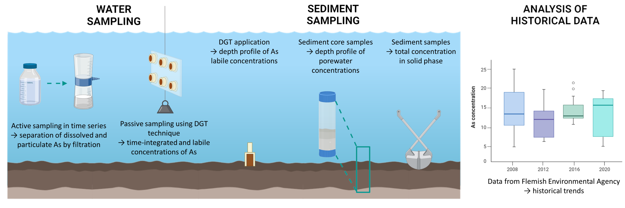
Methodology

Slide 5
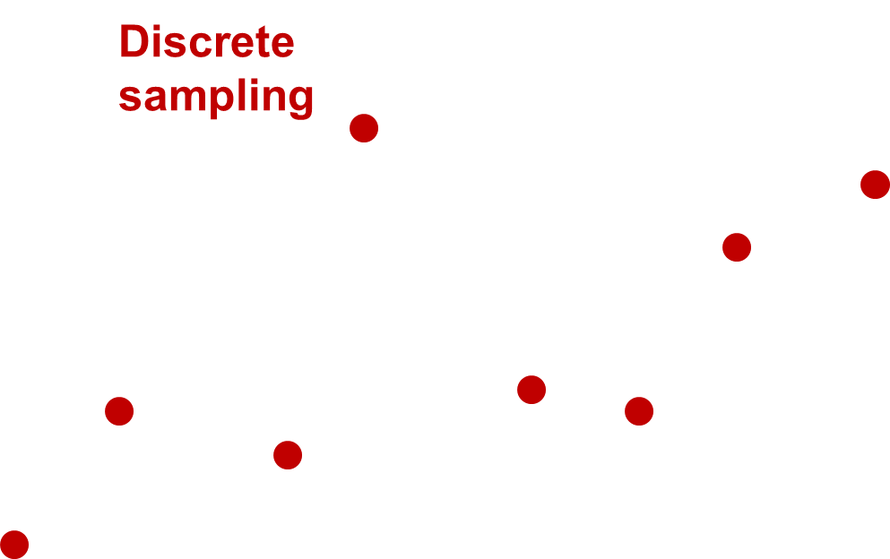
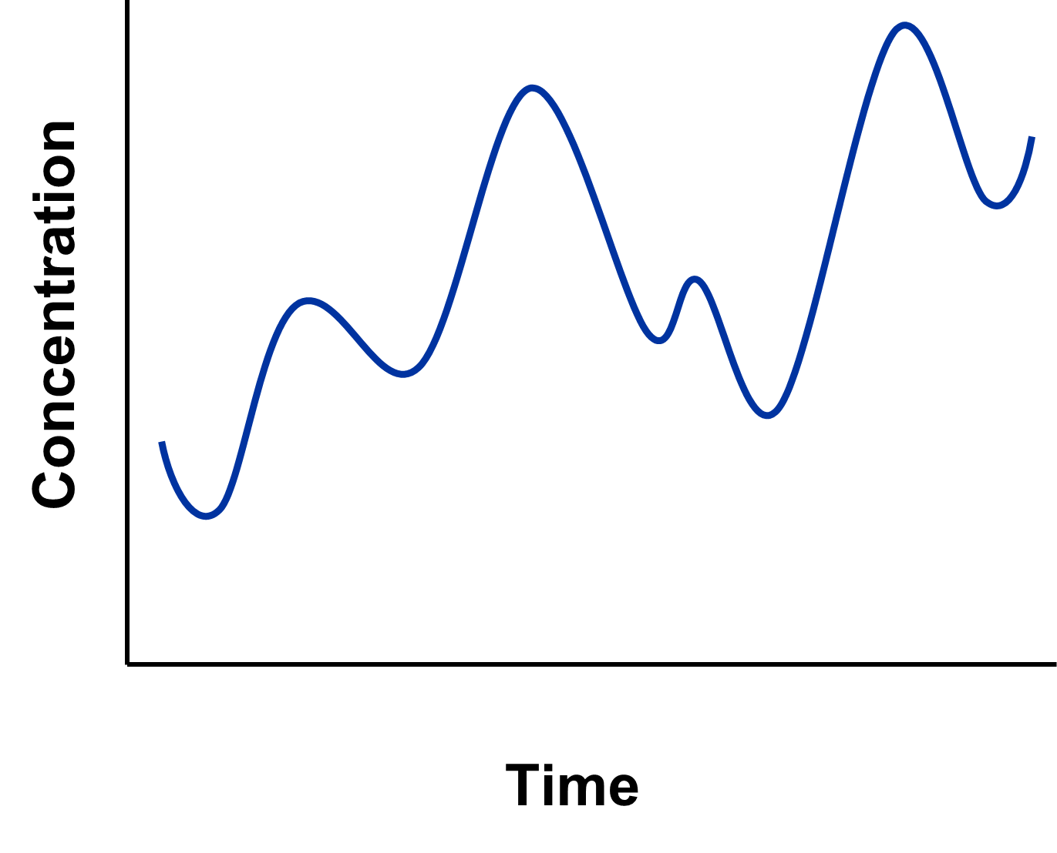
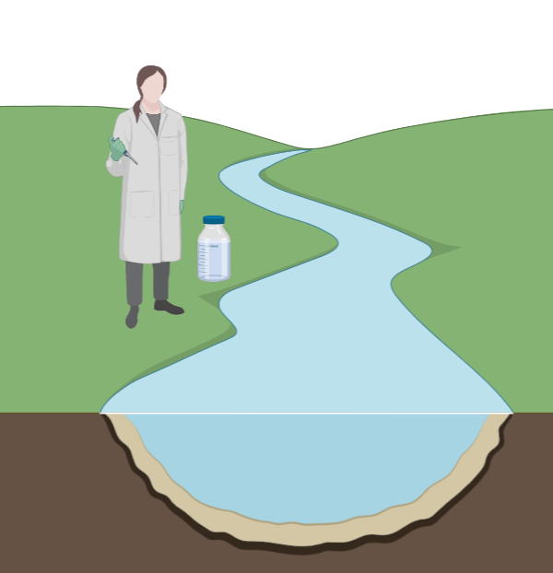
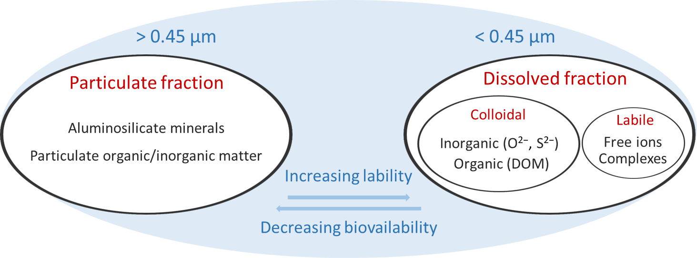
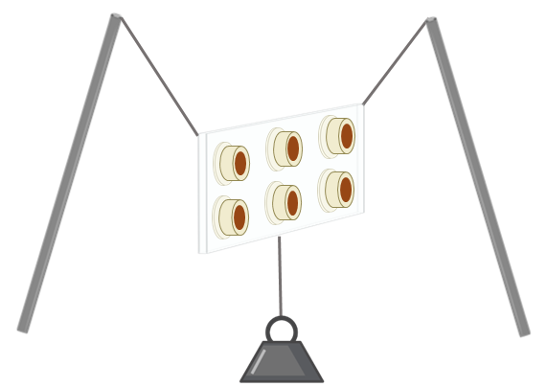
Active vs. passive sampling
Conventional monitoring
  particulate and dissolved fraction,
  may provide misleading results (e.g., in dynamic environments),
  discrete sampling in time series.
Diffusive Gradients in Thin films (DGT)
  pre-concentration of analytes in-situ,
  conservation of analytes,
  labile fraction - may provide information about element‘s bioavailability and speciation.
DISTRIBUTION OF ELEMENTS IN THE SOLUTION
* Created with BioRender.com
5

Slide 6
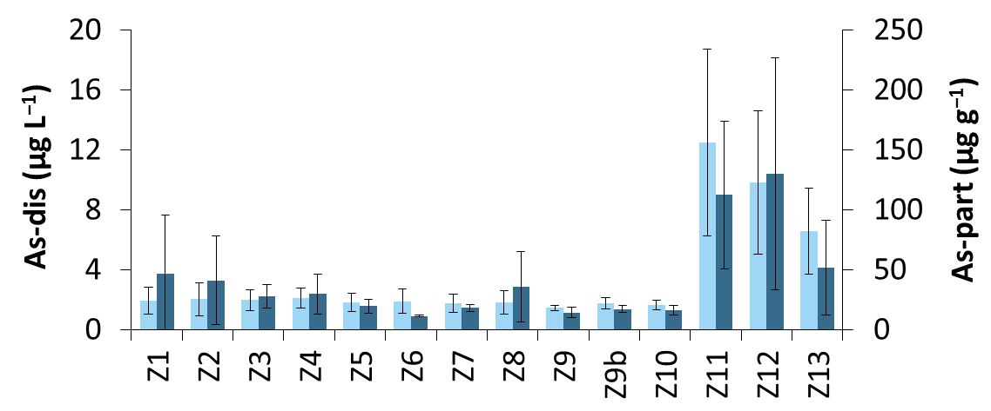
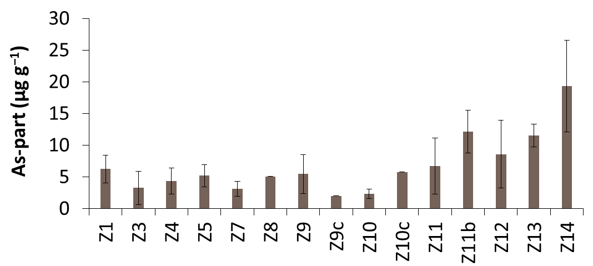
Longitudinal profile of As in the of Zenne
As-dis
As-part
Water
10 μg L⁻¹
3 μg L⁻¹
*
* WHO, 2011.
VLAREM II, Belgian Official Gazette, 2019.
9.4 μg g⁻¹
Sediment
*
* FOREGS, 2005.
Fig. 1 Longitudinal profiles of the dissolved and particulate (A) As concentrations in water along the Zenne River and total As concentrations in sediments (B) (compiled data between 2010–2021).
6

Slide 7
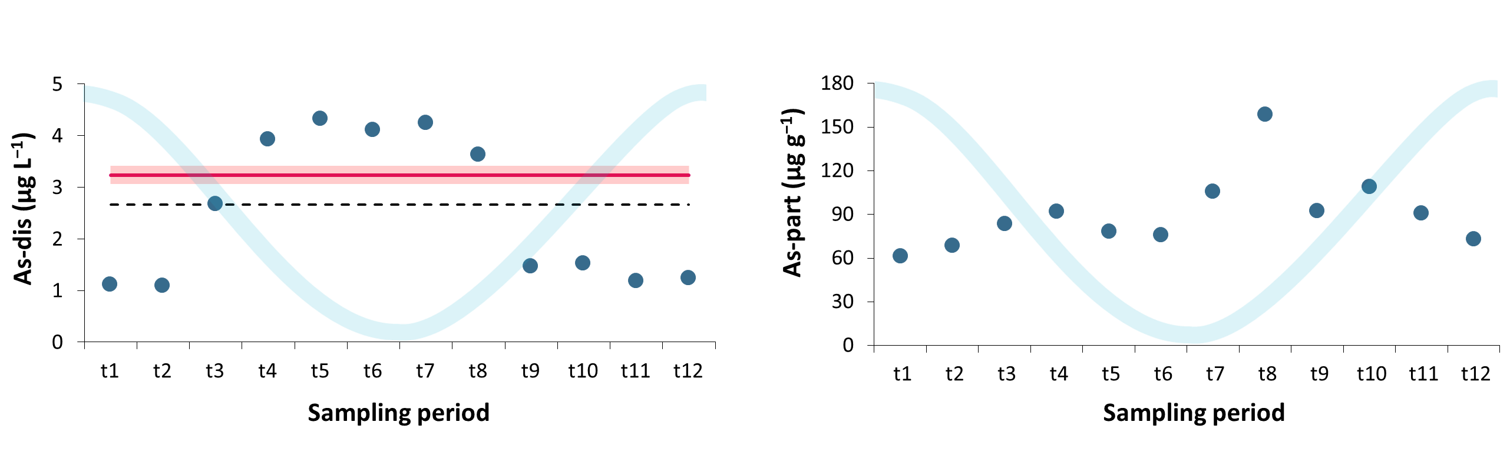
Temporal variability of As in the downstream part of the Zenne
Fig. 2 Variations in dissolved As concentrations during a tidal cycle and the comparison of their time-weighted average with DGT-determined concentrations (left) and variations in particulate As concentrations (right) measured at station Z14, March 2021.

Slide 8
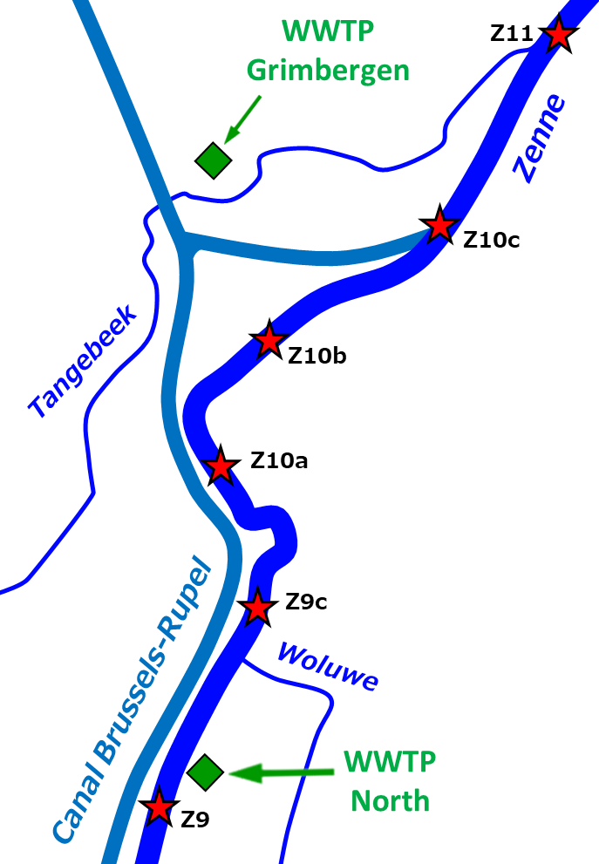
Source of As elevated concentrations in the downstream part of the Zenne
Fig. 3 Average daily fluxes of dissolved arsenic (in g day⁻¹) in the Zenne between stations Z9 and Z11 (values are averages for the period 2010–2016 with standard deviations in brackets; CSO – combined sewer overflow; WWTP – wastewater treatment plant).

Slide 9
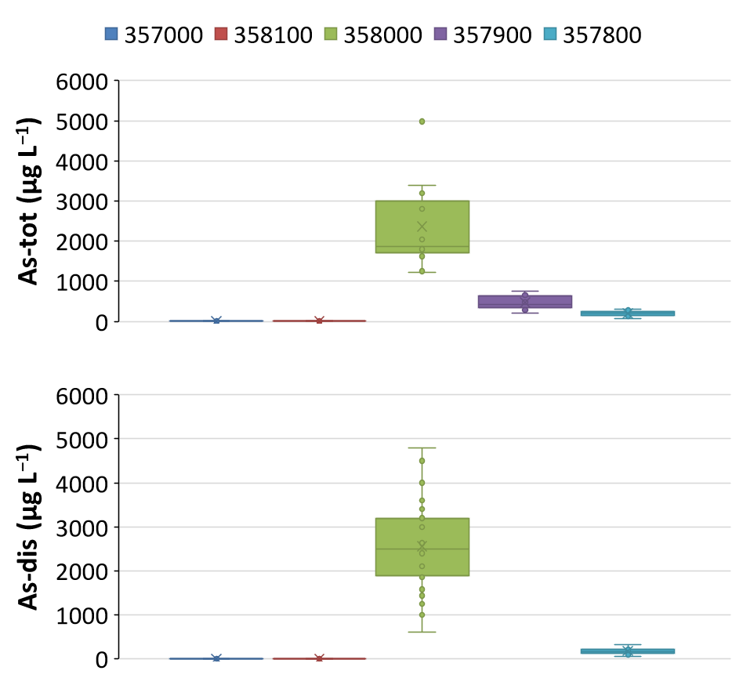
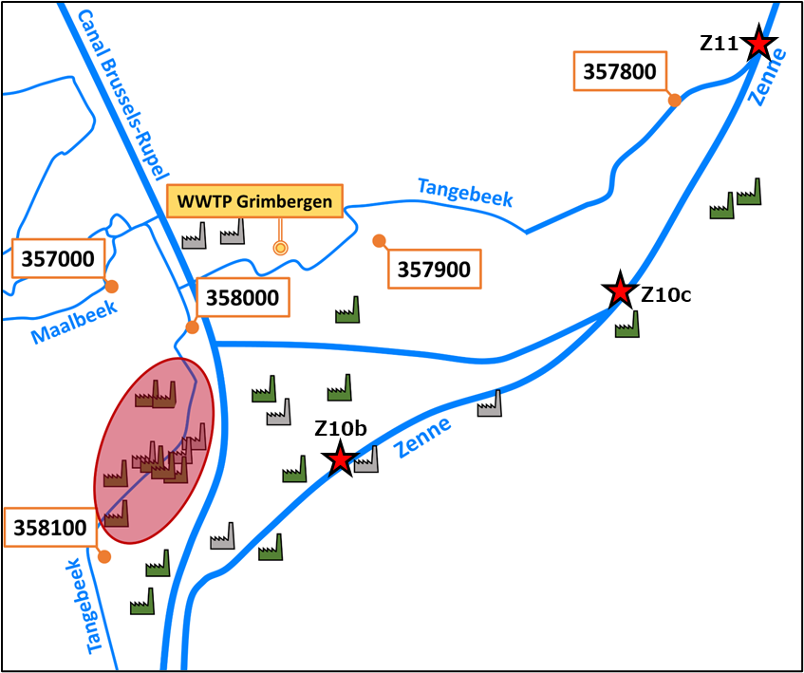
Source of As elevated concentrations in the downstream part of the Zenne
Fig. 4 Monitoring stations along Tangebeek with the industrial area where source of As is located (highlighted in red) (left). Box plots of total and dissolved As concentrations reported at these stations (2009–2020) based on data from Flemish Environmental Agency online database.

Slide 10
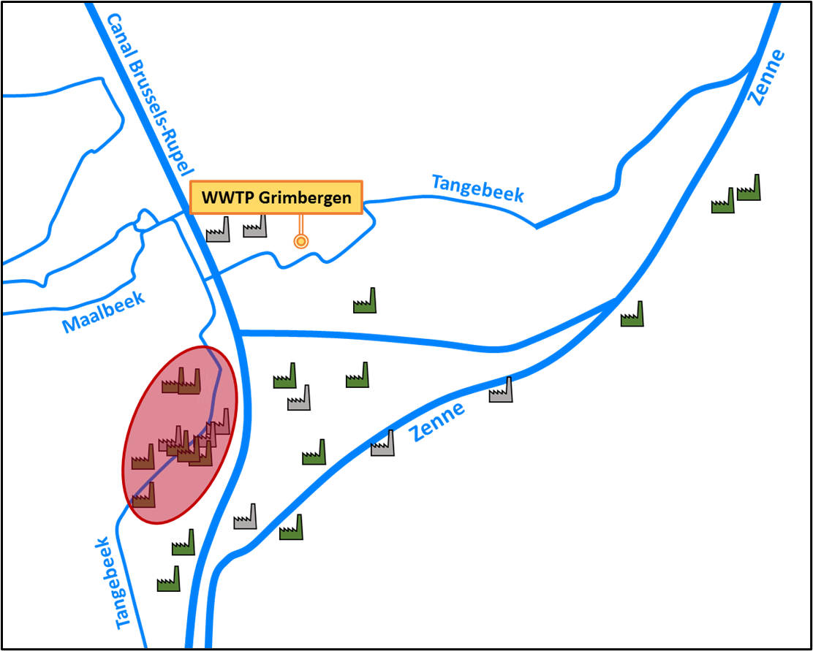
Focus on Tangebeek
None of the present industries report a significant release of As.
Hypothesis:
  sulphuric acid factory (1928 and 1992–1993),
  pyrite roasting,
  contamination by waste ashes^{1,2},
  possible contamination of groundwater sources.
Perspectives:
  sampling of water and sediments of Tangebeek,
  speciation of As – HPLC and DGT.
61 μg L⁻¹
1783 μg L⁻¹
1.5 μg L⁻¹
¹Yang et al. J. Hazard. Mater., 2009, 167, 835-845.
²Baragaño et al. Environ. Sci. Pollut. Res., 2020, 27, 10672-10684.

Slide 11
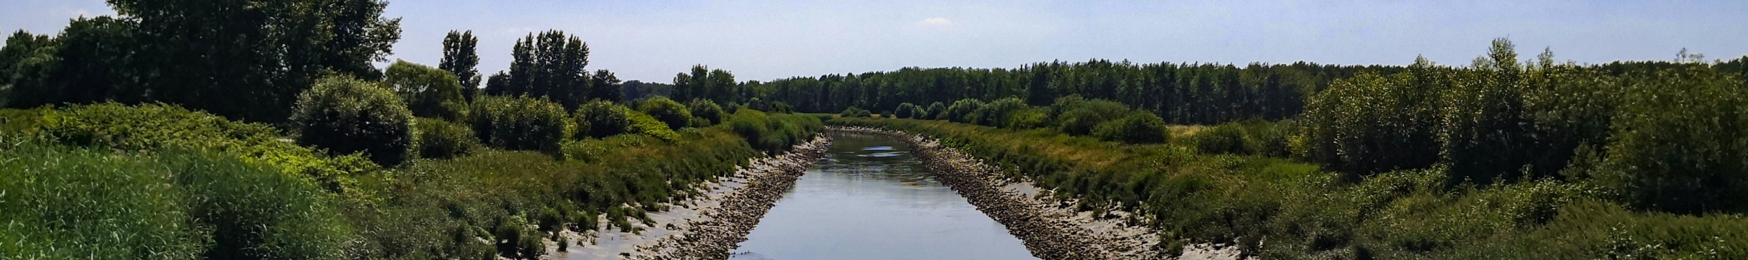
Conclusions
Concentrations of As in water and sediments sharply increase in the downstream part of the Zenne River.
Large temporal variability in this area is caused by the tidal influence.
The point source of As was found in the small tributary Tangebeek – the stream contributes to the Zenne water discharge by 5%, but it brings 87% of the As load.

Slide 12




Interested in more details? Manuscript here
Thank you for your attention
vendula.smolikova@vub.be
Or check out
our team!

