Slide 1


Describing the practical – equity and parity in metadata for practice research
Adam vials moore – product specialist – persistent identifiers, jisc
Jenny Evans – Research Environment and Scholarly Comms Lead - University of Westminster
Alan stone – Senior Manager, Global Operations – CAYUSE
Rachael kotarski – Head of research infrastructure services – british library
Practice Research Voices (PRVoices) Project team
Notes:
Funded under AHRC’s Scoping Future Data Services call (July 2021)
Under their National Infrastructure for Digital Innovation and Curation for Arts and Humanities (iDAH)
Programme referenced in the AHRC’s Strategic Delivery Report 2022-2025 (p13)

Slide 2
Overview
We will describe our recent work on evolving a metadata schema within a repository that includes rich support for practice research.
This work was performed in a coproduction with researchers and infrastructure stakeholders.
Key findings have produced recommendations
Addressing these recommendations will ensure a better environment for research, not just practice.
Following on from describing the project and these recommendations we will facilitate a discussion on capturing the attendees’ own perspectives and experiences to further enrich approaches and inform work arising from relevant initiatives.
Notes:
Agreeing on and articulating a standard for sharing practice research objects will increase the perception of their value in research recognition and evaluation mechanisms, and the wider scholarly landscape. Improving their capture, preservation and discovery will underwrite an improved sharing culture in the community
A Practice Research platform needs to be an interactive service that reflects form and function (beauty) and enables discoverability, citation and preservation of practice research. It must be embedded in the community and the digital spaces that they work within

Slide 3
Questions / Issues
How do we ensure there is a pragmatic synthesis from the rich descriptive information in A&H repositories to a common ontology in global metadata?
How do we ensure metadata schema embrace parity for al research, across disciplines?
How do we take these schema and enable repositories to be places where research is preserved, accessed, discovered, and most importantly, used and built upon?

Slide 4

Building the foundations
For practice research voices (prvoices)

Slide 5
Features of a ‘non-traditional’ research output?
Often (not always) non-text
Attempts to represent performance or other live event (remediation)
The research element is embodied in the work or needs evidencing by a narrative
Process as significant as product
Time-based
Often involves a range of contributors that deserve acknowledgement and recognition
Notes:
This the result of existing research rewards and recognition systems
However there is recognition that diversity of outputs is a more equitable way forward (Metric Tide revisited, the UK’s REF framework)
Text-based
A static object
A single file (often a PDF)
The ‘product’ of research
Work often left out of the metadata stream…(often falls under ‘OTHER’) or if it is included it isn’t properly represented
Can be ongoing and/or change over time

Slide 6
Practice research some: definitions
Practice research
“An umbrella term that describes all manners of research where practice is the significant method of research conveyed in a research output. This includes numerous discipline-specific formulations of practice research, which have distinct and unique balances of practice, research narrative and complementary methods within their projects.”
Research narrative
“In a practice research output, a research narrative may be conjoined with, or embodied in, practice. A research narrative articulates the research enquiry that emerges in practice.”
Bulley, James and Şahin, Özden. Practice Research - Report 1: What is practice research? P1. London: PRAG-UK, 2021. https://doi.org/10.23636/1347.
Notes:
Various permutations – practice based research, practice as research

Slide 7
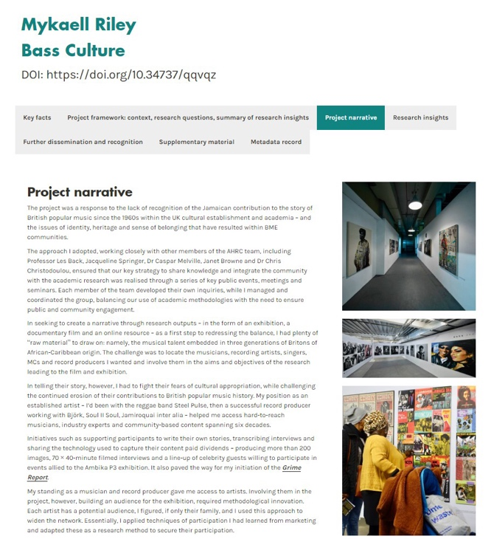
University of Westminster repository: working with community – a co-design approach
Worked with Haplo (now Cayuse) to build a single open source repository that meets the ‘FAIR’ principles and captures all research (outputs)
Approach to development involved collaboration with community (art and design and architecture) – starting with their requirements – not what the technology offered (Co-Design) – to understand their needs
Developed a single repository that captures publications, data and practice research outputs and the associated narrative
https://doi.org/10.34737/qqvqz
Notes:
Using flexible repository technology
Informed by previous work
Not retrofitted onto a STEM focussed platform / repository
Findable, accessibile, interoperable and re-usable (Fair) ≠ OPEN - https://www.go-fair.org/resources/faq/ask-question-difference-fair-data-open-data/
https://insights.uksg.org/articles/10.1629/uksg.582/
“Making research open and FAIR in practice research disciplines is not as straightforward as in disciplines primarily publishing traditional text-based outputs. Sharing and making research ‘open’ is a combination of traditional open access where content can be licensed for reuse and data sharing where ownership of data varies.”
Underpinned by inclusive (enabling) institutional policy landscape and language
Challenges identified included:
Discoverability and interoperability landscape was born of scientific research
IP, copyright, licensing issues
Sharing and making research ‘open’ for practice research: a combination of traditional open access (content can be licensed for reuse) and data sharing where ownership of data varies (FAIR ≠ Open)

Slide 8
What does practice research look like in
The haplo (by cayuse) repository at Westminster?
Non-text (artefact) output
Exhibition output
Dynamic Collection (Portfolio) including a research narrative
Contributor roles
Language reflects discipline
Read about this work in our case study: https://insights.uksg.org/articles/10.1629/uksg.582/
Notes:
Repositories have worked to collect different ‘types’ of outputs – annotations,
Art/Design Item; Article; Audio; Book; Book Section; Conference Papers /Posters; Conference Proceedings; Conference or Workshop Item – Other; Dataset; Exam Paper; Image; Learning Object; Moving Image; Music/Musical Composition; Other; Patent; Performance; Preprint; Report; Show/Exhibition; Text; Thesis or Dissertation; Unknown; Website; Working Paper. (IRUS-UK)
Dynamic, multi-component portfolio (or collection) of (text-based and non-text based) items that are connected by a narrative documenting underpinning research processes
Creator (not author)
Collaborators (including a list)
Description (not abstract)
Publisher (or commissioning body)
Media type was part of the output (rather than ‘being’ the output)
Open for practice research some content can be licensed for reuse + some content (data) can be shared (FAIR ≠ Open)
Sharing and making research ‘open’ is a combination of traditional open access where content can be licensed for reuse and data sharing where ownership of data varies.”

Slide 9
PRAG-UK REPORT 2 RECOMMENDATIONs: project (Collection, portfolio), edition (version)
A single practice research item type – called ‘project’ which represents the multi-component nature of practice research (p13)
A singular research component file and multiple subset research compoenents (p15-16)
Use of ’edition’ to deal with changes to outputs that are developed over time (p17)
It could include (p6):
Summary/Abstract
Context / Introduction
Research inquiry / Questions in practice
Method statements
Practice, description of practice, or documentation of practice (as a proxy)
Insights / Discussion of ways of knowing
Conclusion and references
Bulley, James and Şahin, Özden. Practice Research - Report II: How can practice research be shared? London: PRAG-UK, 2021. https://doi.org/10.23636/1347.
Notes:
Cf
RAiD – capturing a narrative
octopus, decomposing the scholarly activities

Slide 10
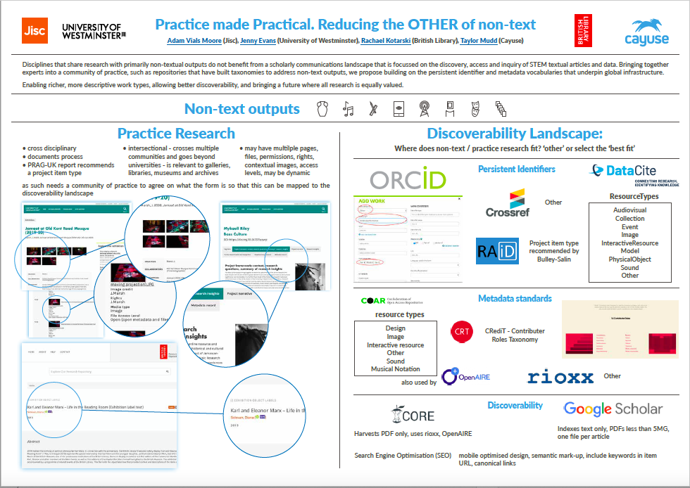
Discoverability landscape
Google Scholar
Indexes text only, PDFs less than 5MG, one file per article
Persistent Identifiers (PIDs) and metadata standards
‘Other’ or ‘best-fit’
Don’t reflect the the complexities of practice research
Read more about this work: https://zenodo.org/record/5767095#.YxtyIy8w28U
Notes:
Don’t benefit from the interoperability and discoverability
Things are improving
COAR vocabulary captures some of this
design
industrial design
layout design
image
moving image
video
still image
interactive resource
Website
musical notation
sound
musical composition
text
Annotation

Slide 11
Niso plus 2022: composing for the non-text infrastructure dance - calls to action
ORCID
RAiD
Crossref
CRediT
COAR
Research Outputs Metadata Schema (rioxx)
Datacite
bring together community to outline use case / user story for non-text outputs category and new resource type
bring together community to outline use case / user story for practice research requirements
identify changes needed to enable RAiDs to better reflect practice research
propose a content advisory group for practice research
recognition of collaborator and other practice research roles
propose addition of practice resource type
broaden vocabulary for works
Find out more at: https://doi.org/10.34737/vv0z9
Notes:
The Discoverability and interoperability is enabled by an open standards landscape assuming that a research output is…
Call to action at NISO Plus 2022 – composing for the non-text infrastructure dance
ORCID
If not artistic performance then OTHER
That there is a publisher
One date
Contributors based on the CRediT taxonomy
Datacite resource types – making progress
COAR – some representation
rioxx - none
Google scholar
CORE search engine
The Research Outputs Metadata Schema (rioxx) http://rioxx.net/profiles/v2-0-final/#rioxxterms:type

Slide 12


Practice research voices (pr voices)
Jenny Evans (University of Westminster), Dr Adam Vials Moore (Jisc), Rachael Kotarski (British Library), Prof Helen Bailey (KCL), Prof Neal White, Nina Watts, Dr Holly Ranger and Joshua Mead (Westminster) and Alan Stone (Cayuse)

Slide 13
Practice Research Voices (@PRVoices)
Scoping a national practice research repository using (as a foundation) the Haplo (now Cayuse) repository that embedded practice research (primarily in art and design) from the beginning
Moving to a repositories, discoverability and interoperability landscape in which practice research disciplines are embedded rather than an afterthought (OTHER)
Bringing together voices from many interested communities to form the PR Voices Choir and working with them to identify what Findable, Accessible, Interoperable and Re-usable (FAIR) and transparent research (which may also be open) looks like for these disciplines and which respects all contributors and their intellectual property
Notes:
Project team:
Prof Neal White: Co-Director of the Centre for Research and Education in Arts and Media at UoW
Prof Helen Bailey: Deputy Vice President Global Business Development KCL
Dr Adam Vials Moore: Product Specialist for Persistent Identifiers at Jisc
Rachael Kotarski, Head of Research Infrastructure Services at the British Library
Nina Watts, Repository and Open Access Manager, UoW
Dr Holly Ranger, RDM Officer, UoW
Dr Jenny Basford, Repository Services Lead, British Library
Joshua Mead, formerly Researcher Development Officer at UoW
Not just creative and performing arts
Engineering, medicine, education

Slide 14
Pr voices Project overview
1. Repositories
2. Metadata & Persistent Identifiers
3. Creating a Practice Research Community of Practice
Notes:
Repositories
Review UoW work - articulate the underpinning ’schema’ and map this to the British Library’s Shared Repository (while the primary use case was the AHRC repository – we strongly felt that all repositories should benefit from this work)
The metadata and PIDs workstream was key to improving existing open source standards – and so really is underpinned by the Haplo (by Cayuse) schema
While we began with a rather idealistic list of standards we wanted to looked at (based on the past three or so years of work some of the team had done) – it became clear that it made sense to focus on three – DataCite, RAiD and the CRediT taxonomy
The entire project has been underpinned by building an intersectional community – bringing together many different existing communities – different researcher and practitioner communities – and – archivists, curators, funders, librarians, records managers, research data managers, research data managers, software developers – who work with researchers and practitioners to enable them to capture and share their research
The project has highlighted the need for a permissive space for the community to engage

Slide 15
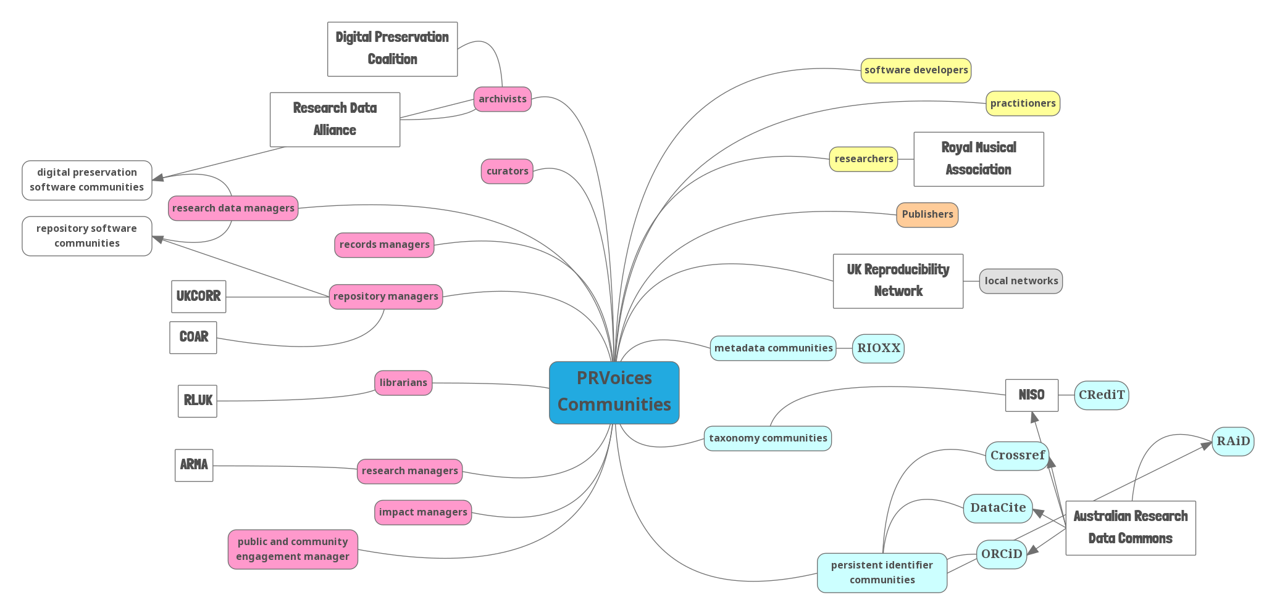
the PR Voices community of practice
Notes:
Working in co-design with community absolutely key to progress this work
Hope to publish our report soon

Slide 16
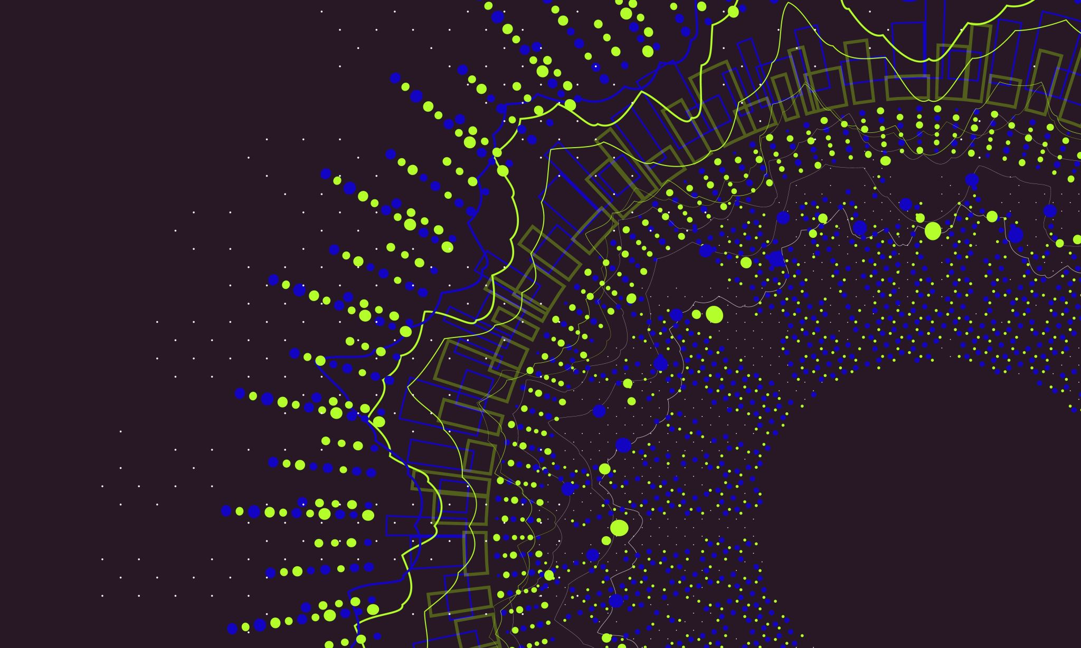
Practice research voices project metadata workstream

Slide 17
Metadata, persistent identifiers (PIDs) and a taxonomy workshop
Work with existing open standards (rather than creating new ones)
Prioritised – advisory group / community - DataCite, RAiD and CRediT
Had presentations from all three at the workshop AND the researcher/practitioner perspective (see https://blog.westminster.ac.uk/prvoices/workshop-metadata-persistent-identifiers-pids-and-a-taxonomy/ for the details and links to presentations)

Slide 18

Researcher perspective
“The…main…idea…here is…that the ecosystems built within these projects are multidisciplinary and interdisciplinary and that the outputs can integrate in multiple domains. That the practice in and of itself within any given project is often iterative. So I think the beauty of the portfolio model for me and probably where, you know, I’m hoping that we can think about development is that the practice itself is very rarely complete and there’s often a kind of intersection between research that then allows for further insights.”
Professor Helen Bailey, Kings College London
https://blog.westminster.ac.uk/prvoices/workshop-metadata-persistent-identifiers-pids-and-a-taxonomy/

Slide 19



metadata, persistent identifiers (& a taxonomy)

Slide 20

How do practice research output types map to the current DataCite schema?
What schema changes could be made to support practice research better?
resourceTypeGeneral – 28 permitted values and other plus free text
Creator vs Contributor – where does collaborator map? Work with CRediT on this rather than try and change within DataCite?
relationType – 34 relation types – do they adequately reflect what is needed?
Exhibition (now Event) = resourceTypeGeneral mapping: Event?
Portfolio / Collection = resourceTypeGeneral mapping: Collection
How is the portfolio item type conceptualised? Is it a document itself, or a collection of other records? Or some combination?
How does a portfolio record evolve over time?
  Can a portfolio be conceptualised as a research activity/project (i.e. use RAiD, not DOI)?
    RAiD specifically designed as an "envelope" to group together other outputs/activities

Slide 21
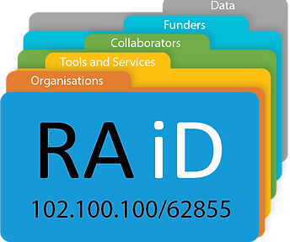
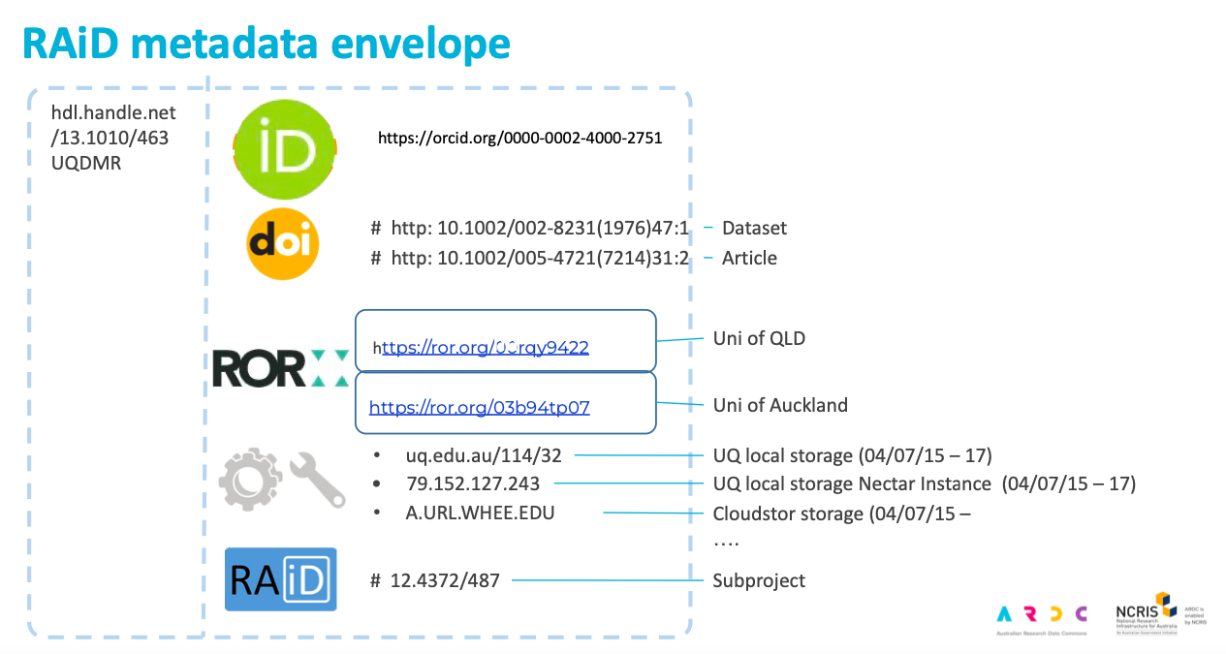
Research activity identifier (RAiD)
“RAiD is a unique and persistent identifier for research projects. It acts as a container for research project activities by collecting identifiers for the people, publications, instruments and insitutions that are involved.”
https://www.raid.org.au
RAiD metadata envelope slide from https://blog.westminster.ac.uk/prvoices/wp-content/uploads/sites/97/2022/07/RAiD_-Tracking-research-projects-for-UK-PRVoices-May-2022.pdf

Slide 22
CONTRIBUTOR ROLES TAXONOMY (Credit)
Conceptualization
Data curation
Formal analysis
Funding acquisition
Investigation
Methodology
Project administration
Resources
Software
Supervision
Validation
Visualization
Writing - original draft
Writing - review & editing

Slide 23

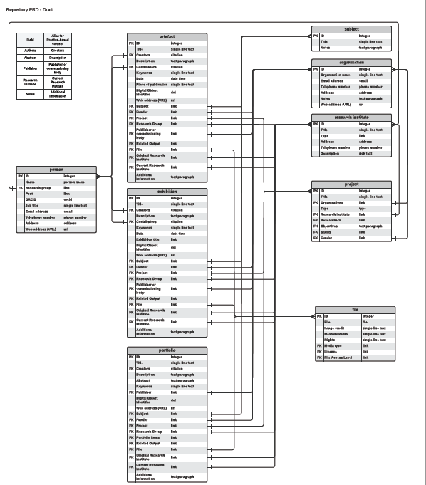
Haplo / cayuse schema
Working on the articulation of the schema – due to the flexibility of the software –taken much longer than anticipated
Identifying what isn’t in the schema that needs to be vs what can be included in the enhanced template text (display)
Mapped across to the BL’s Shared Research Repository for cultural and heritage organisations

Slide 24

Pr voices metadata findings (with a little sparkle)

Slide 25
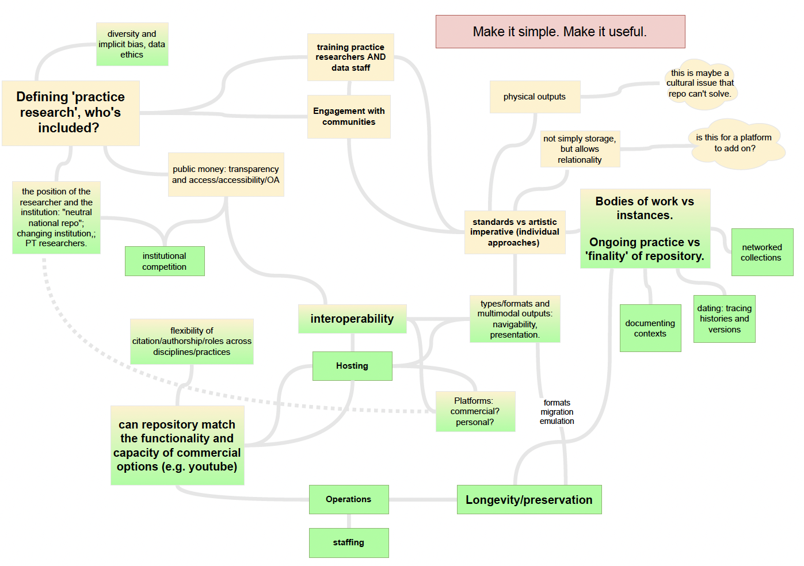
Sustaining Practice Assets for Research, Knowledge, Learning and Education (Sparkle)
Professor Tom Jackson, Dr Scott McLaughlin, Claire Knowles (University of Leeds), Rachael Kotarski (British Library), Digital Preservation Coalition and EDINA (University of Edinburgh)

Slide 26
PR Voices findings and recommendations
Findings
Ongoing community engagement is key to success
Platform needs to interactive, embedded in community, respect form and function, enable discoverability, citation and preservation, recognize contributors
Open standards must underpin this work
Challenges include sustainability, expertise, preservation
Recommendations
Co-design with community
Embed PR in open standards
More than retrospective archive
Training programme
Investment in capacity, people and infrastructure

Slide 27
Features of a ‘non-traditional’ research output?
Often (not always) non-text
Attempts to represent performance or other live event (remediation)
The research element is embodied in the work or needs evidencing by a narrative
Process as significant as product
Time-based
Often involves a range of contributors that deserve acknowledgement and recognition
Notes:
This the result of existing research rewards and recognition systems
However there is recognition that diversity of outputs is a more equitable way forward (Metric Tide revisited, the UK’s REF framework)
Text-based
A static object
A single file (often a PDF)
The ‘product’ of research
Work often left out of the metadata stream…(often falls under ‘OTHER’) or if it is included it isn’t properly represented
Can be ongoing and/or change over time

Slide 28
Findings: metadata, persistent identifiers (PidS) and a taxonomy discussions
Prioritised DataCite, Research Activity iDentifier (RAiD) and Contributor Roles Taxonomy (CRediT)
Identified some potential updates to DataCite
Work with CRediT on contributor roles
Is a portfolio the same as a collection?
Portfolio maps better to RAiD?
https://blog.westminster.ac.uk/prvoices/workshop-metadata-persistent-identifiers-pids-and-a-taxonomy/
Notes:
Work with existing standards rather than creating new ones
Had presentations from all three at the workshop AND the researcher/practitioner perspective (see https://blog.westminster.ac.uk/prvoices/workshop-metadata-persistent-identifiers-pids-and-a-taxonomy/ for the details and links to presentations)

Slide 29
Findings: The PRVoices framework
We investigated the suggestion recommended by the PRAG-UK 2 Report: How can practice research be shared of a project item type - also known as a collection or portfolio (p15).
We have identified the need to
capture individual objects on an ongoing basis
bring those together (collection) and that
a portfolio (theme) builds on the idea of a collection, and overlays narrative and context.
“I think something about that, that iterative process and how the portfolio kind of almost sits alongside you as you’re undertaking your your research, perhaps it’s not, necessarily a retrospective activity and there’s something perhaps about the way in which you develop it, that’s helpful in terms of understanding the insights that you’ve gained.”
Professor Helen Bailey, Kings College London
Notes:
Additional standards – international image interoperability framework (thanks to the Sustaining Practice Assets for Research, Knowledge, Learning and Education – aka SPARKLE – the other PR funded project with whom we have collaborated, the Oxford Common File Layout specification

Slide 30
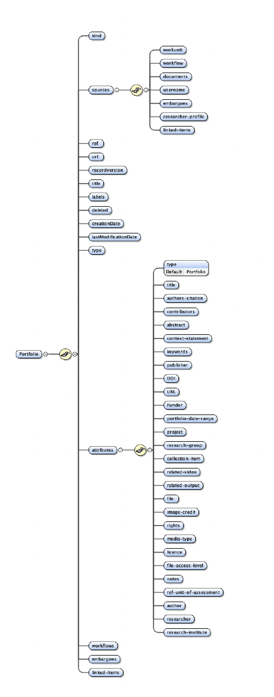
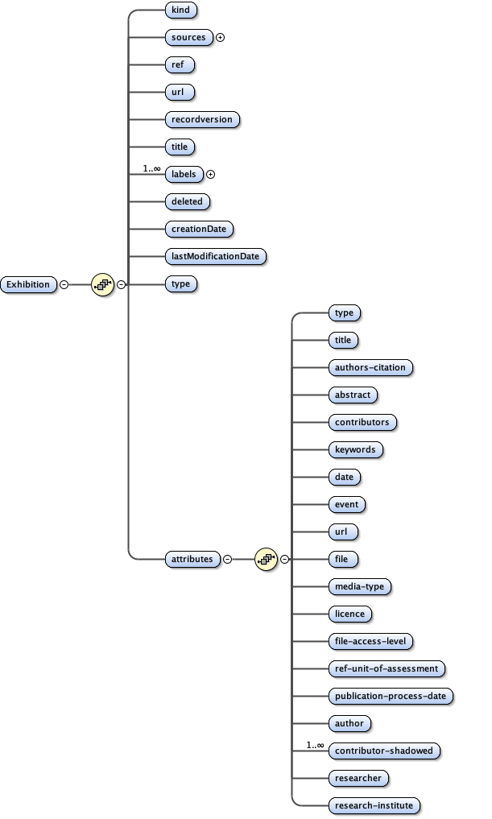
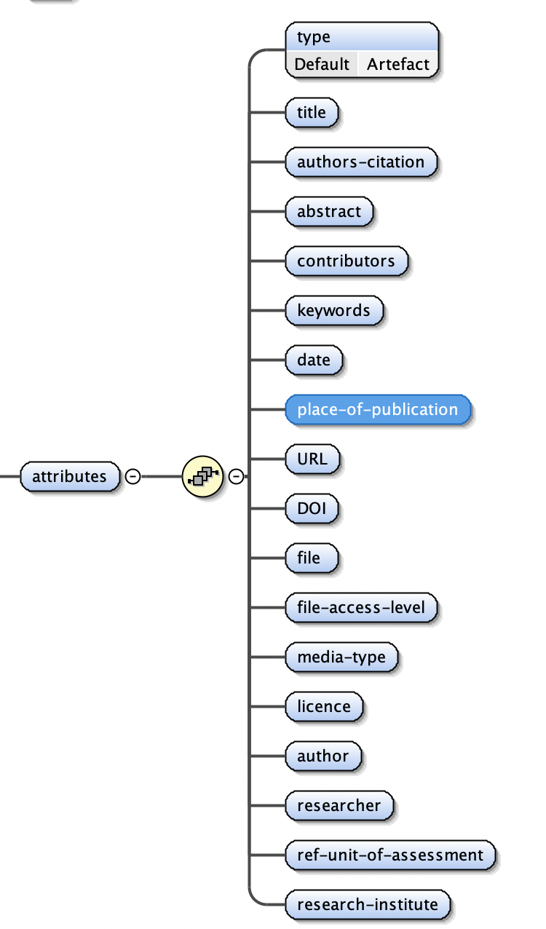
Cayuse repository schema diagrams

Slide 31
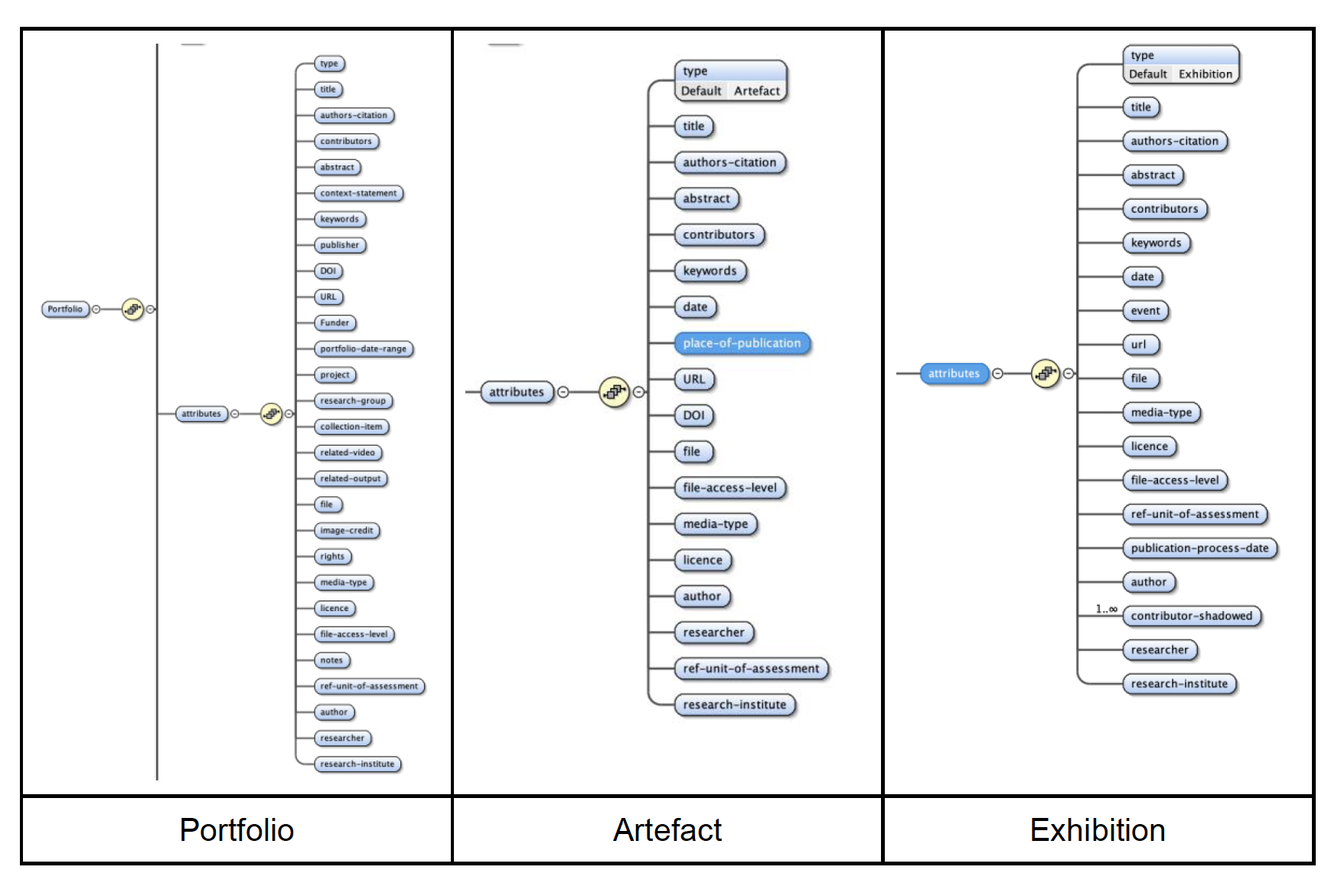
Schema Validation with British library infrastructure
British Library’s IRO repository, A Samvera Hyku instance.
Portfolios
  BL-IRO repository has collections, they are not doing the same job as portfolios (collection of outputs)
  Portfolios a unique strength of the Haplo repository and a practice / object that merited wider adoption
  Time elements and narrative explanation attributes valuable.
The exhibition object was broadly similar to the BL-IRO object
BL-IRO – no Artefact object
Mismatches a mixture of platform and culture
Valuable additional type and other meta information sourced from the BL - not been widely validated – future potential
Agreed Haplo schema work was both appropriate and met existing needs

Slide 32
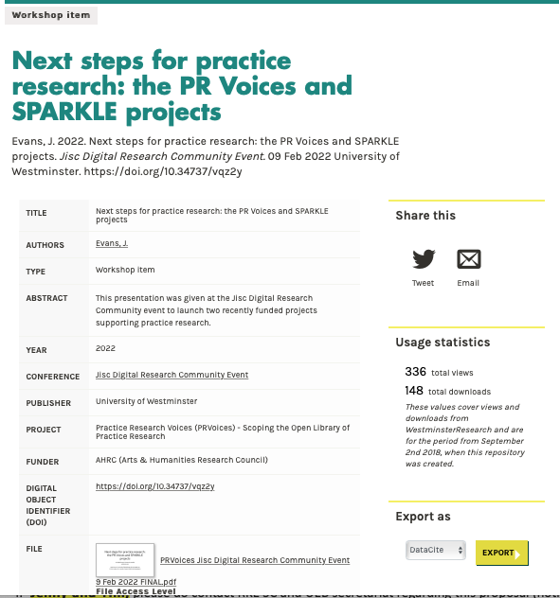
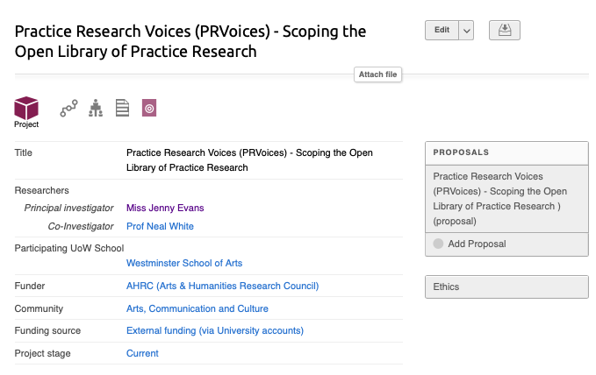
PR Voices informing raid discussions
Portfolio (theme) builds on the idea of a collection, and overlays narrative and context
What PRAG-UK report and RAiD call a project
Definition of a project in the Haplo by Cayuse repository and CRIS

Slide 33
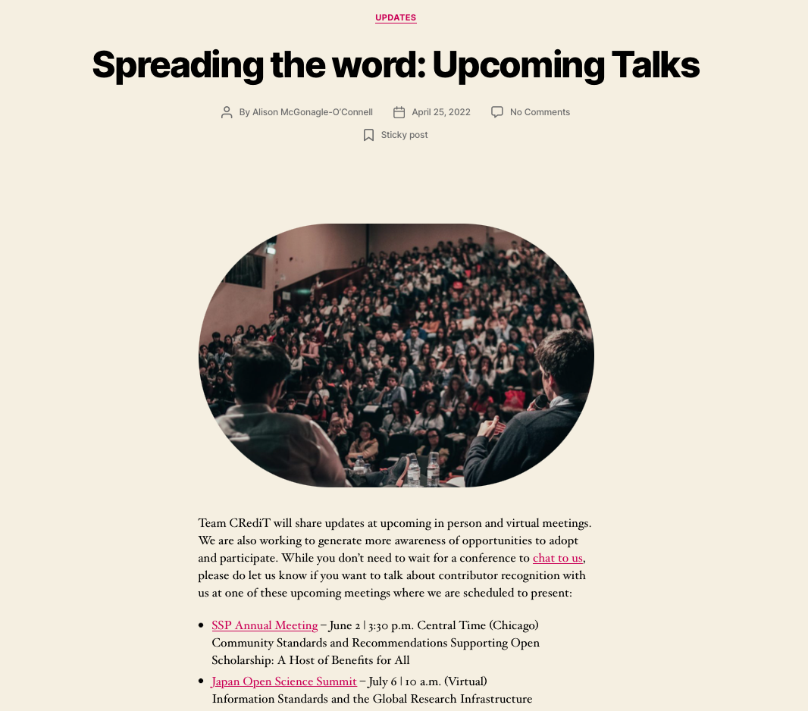
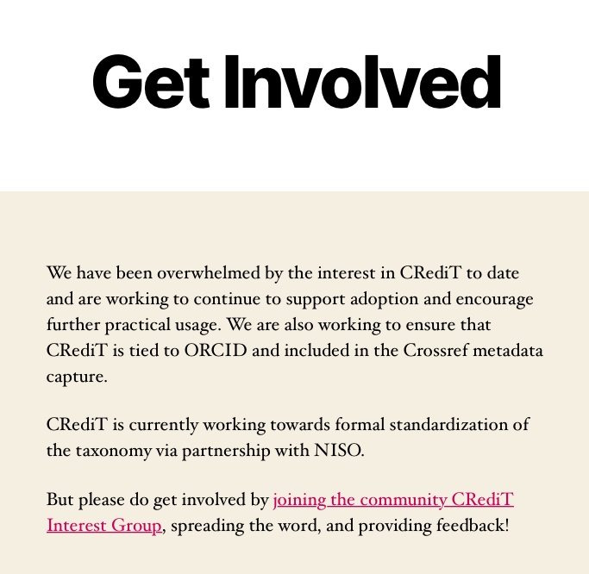
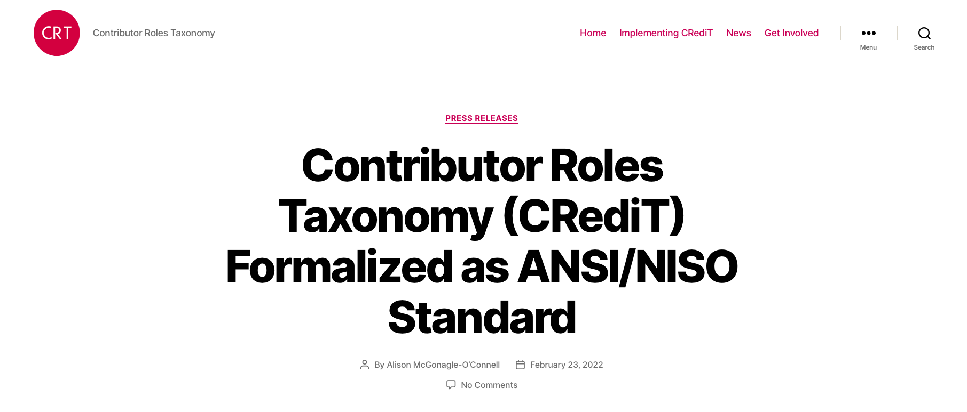
Engaging with the Credit community: contributors within practice research
Part of community working to expand the taxonomy beyond it’s foundations in STEM research
Got technical infrastructure and community led/engaged user stories

Slide 34

Call to action
How do we ensure there is a pragmatic synthesis from the rich descriptive information in A&H repositories to a common ontology in global metadata?
How do we ensure metadata schema embrace parity for al research, across disciplines?
How do we take these schema and enable repositories to be places where research is preserved, accessed, discovered, and most importantly, used and built upon?

Slide 35
contact us
@prvoices
https://blog.westminster.ac.uk/prvoices/
J.Evans2@westminster.ac.uk
adam.vialsmoore@jisc.ac.uk
rachael.kotarski@bl.uk
alan.stone@cayuse.com

