Slide 1


- part of the Open Social Science Handbook project
Re-using and repurposing other peoples data
Timothy Monteath (UCL/LSE) and Patrick Dunleavy (LSE)
10 November 2022

Slide 2
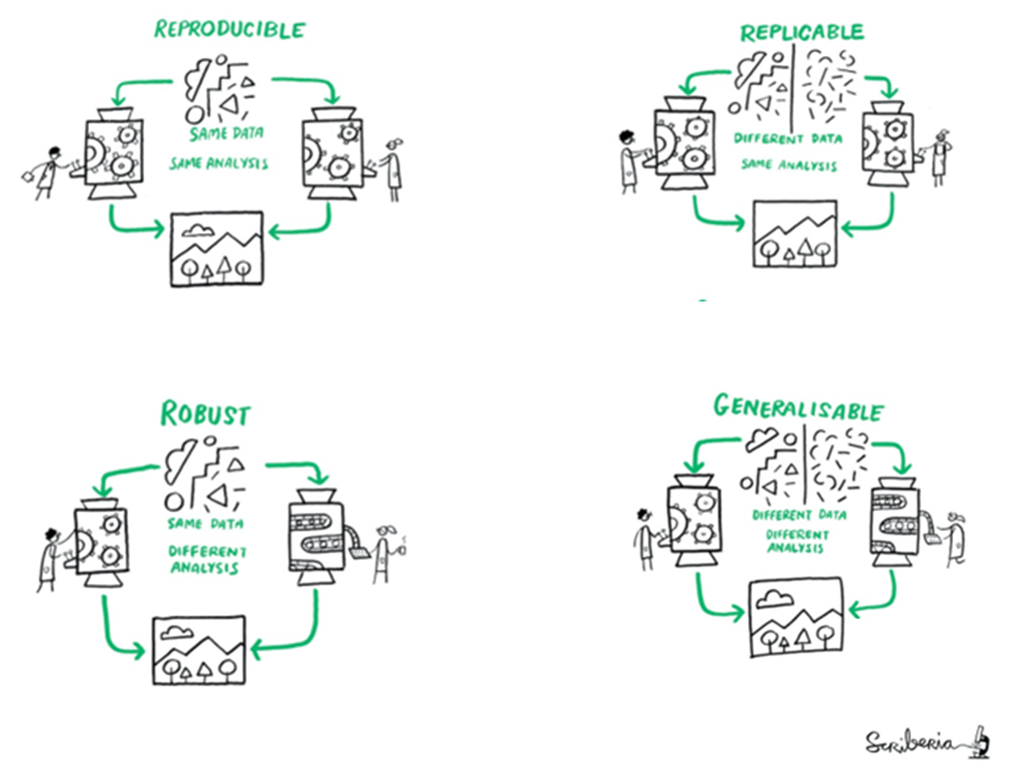
Finding and Re-using Data are key for open social science
Reasons
Source: Turing Way project
Illustration by Scriberia. DOI: 10.5281/zenodo.3332807 Used under a CC-BY 4.0 licence. The component pictograms are slightly re-spaced here.

Slide 3
Commonly used reactive data sources
Reactive measures depend on how the research subjects respond to questions or experimental stimuli. The unit of analysis is the individual person or organization responding
Unique survey dataset, collected by an individual researcher or team and either self-deposited (but not in an archive) or supplied directly in an article annex or via email
Similar but deposited at a formal research archive
Single team, unique in-person experimental dataset
Over time, repeated single-country dataset series, chiefly common
question wordings & demographics, consultation on questions
Cross-national, concerted dataset series, including common
common question wordings, set by committee

Slide 4
Questions to ask about reactive data sources
RELEVANCE to your research question – centrality for your work, importance for your conclusions, level of your dependence once started
MEANINGS of variables to be used – critically check how closely a detailed question wording, or a precise demographic code, or combinations of them, identify your key phenomena. If they are proxy variables, how good or imperfect a proxy are they?
LIMITATIONS of the survey/experiment in terms of who respondents are, how many are involved, statistical power of analysis
PROVENANCE – how was the survey or experimental data created, using what methods and level of care in research?
REPUTATION – how is the original source person or organization regarded in academia? Are they seen as biased by other ‘tribes’

Slide 5
Most used non-reactive data sources
Non-reactive measures track the behaviour of research subjects’ objective or other objective indices, without depending on their responses or involvement (may be ‘unobtrusive measures’)
Unique dataset of statistics/codings, collected by an individual researcher or team and self-deposited (not in an archive) or supplied directly in an article annex or via email
Similar dataset deposited at a formal research archive
Social media data downloaded from the APIs of key firms
Administrative data produced by firms or agencies
Data from an official statistics organization

Slide 6
Questions to ask about non-reactive data sources
RELEVANCE to your research question – centrality for your work, importance for your conclusions, level of your dependence once started
MEANINGS of variables to be used – critically check how closely the detailed measurement of a behaviour, or accompanying contextual or demographic data, identify your key phenomena. If they are proxy variables, how good or imperfect a proxy are they?
LIMITATIONS of the dataset in terms of the size and coverage of the data involved, time/context shaping ecology factors, breadth of unit or country coverage, statistical power of analysis
PROVENANCE – how was the data created, using what methods and with what coding accuracy?
REPUTATION – how is the original source person or organization regarded in academia? Are they seen as biased by other ‘tribes’

Slide 7
Finding Data
Speak to librarians
Ask around amongst researchers
Ask on Twitter or other social media

Slide 8
Developing a research question
What can you do with the dataset?
AND
How can this fit with my research interests and trajectory?

Slide 9
Finding Data 1 – As an explorer
See what data is available, keep an open mind
Start by looking for datasets rather than with a specific research question
Search widely !
Where possible download the datasets and explore them before deciding on your research question
How could datasets speak to other research in your field?
Think about how datasets could be combined with other data

Slide 10
Finding Data 2 – As a Reverse engineer
Picture your perfect dataset:
  What does it contain?
  How was the data been collected?
  How would you use it?
The perfect dataset will never exist!
Search for things that approximate or are similar to your perfect dataset
How can you modify, combine or add to existing datasets to get them as close as is (reasonably possible) to your perfect dataset
What compromises can you make? What compromises would undermine your research?

Slide 11
Exploring a dataset
How big is the dataset?
  Is it human sized?
  Does it need to be parsed programmatically?
How well is it documented?
  Has it been used by other researchers?
  Is the data collection process documented?
  Are the variables and what they mean explained?
What’s missing?
  How does the dataset deal with missing values?
  Do missing values matter to you?
  Can they be corrected?

Slide 12
Working with a dataset
Descriptive
Causal
Predictive
Methodological

Slide 13
Data Cleaning
This will take up most of your time!
As a rubric you will spend:
  80% of your time getting and cleaning the data
  15% analyzing the data
  5% turning this into a research output
Data cleaning is the most important part of the work
Without clean, useable and reliable data there is no research!

Slide 14
Data Merging
Dataset A
Dataset B
Point of Convergence
New Data

Slide 15
Data Merging
Dataset A
Dataset B
Point of Convergence
New Data

Slide 16
Data Merging
Dataset A
Dataset B
Dataset C
Dataset D
New Data

Slide 17
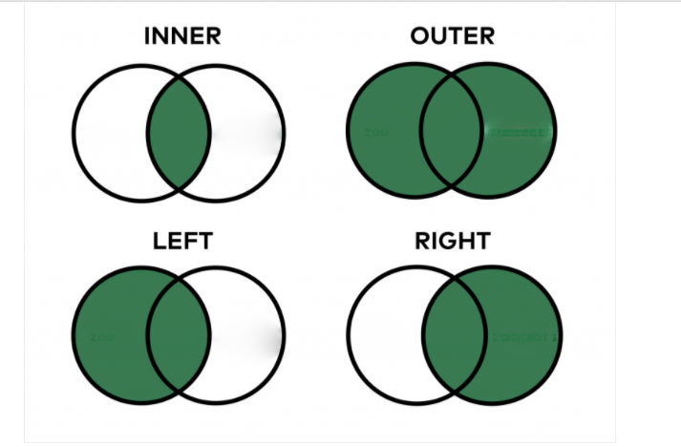
Merging – Types of merging

Slide 18
Merging Data – Multiple Iterations
Sometimes there can be multiple possible different ways to merge a dataset
You do not have to pick one, you can try all of them
Before the merge assign a unique identifier to each row
Then try all combinations of the merge
Once complete use the unique identifier to keep only one of the matches

Slide 19
Merging Data – Multiple Iterations
For example:
Dataset 1 – Merge on | Dataset 2 – Merge om
Address 1 | Full Address
Address 2 | Full Address
Address 3 | Full Address
Address 1 + 2 | Full Address
Address 1 + 3 | Full Address
Address 2 + 3 | Full Address
Address 1 + 2 + 3 | Full Address

Slide 20
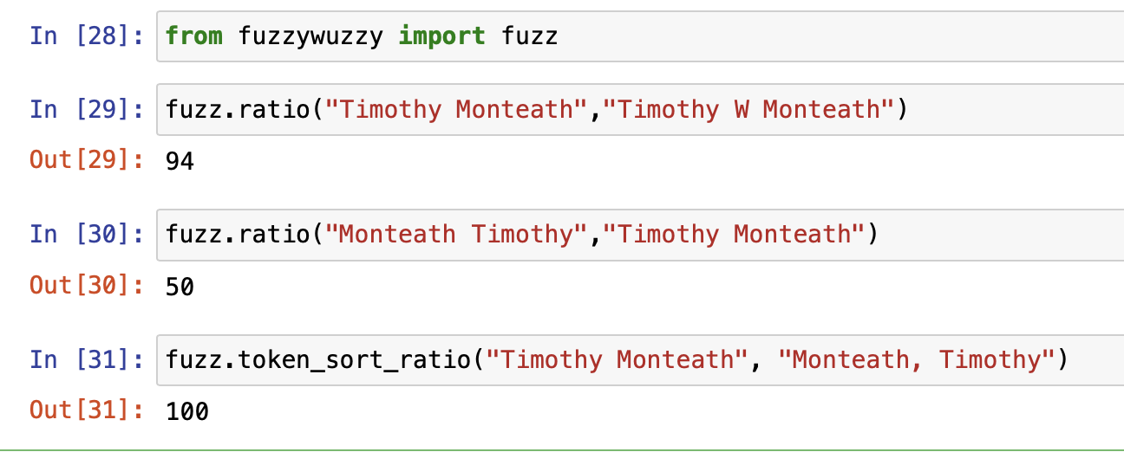
Fuzzy Matching
Fuzzy matching is a way to match data points that are similar but not identical
Can be useful for words/names/places with different spellings or mistakes in data input

Slide 21
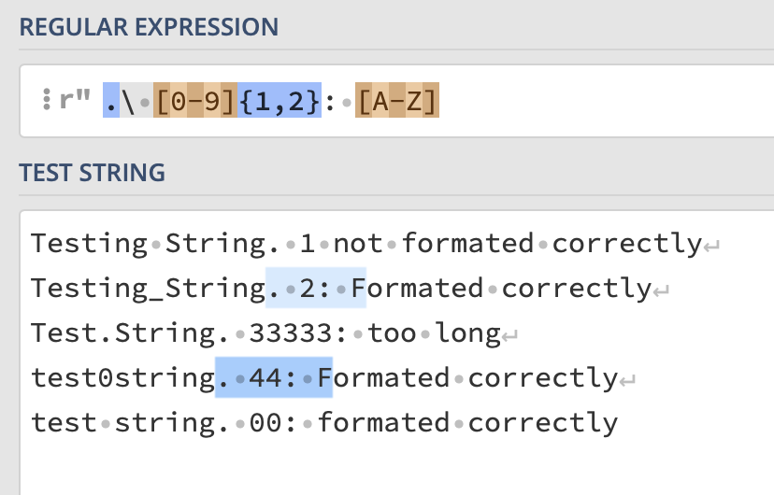
Regular Expressions
Extremely powerful!
Allow you to match and modify any form of text based based on complex expressions
After a full stop match between one and two digits – no more - followed by a colon a space and an upper case character
Many sites to help you build regex’s for example: https://regex101.com

Slide 22
Example - Investigating the super-rich
Sunday Times Rich List of 1000 wealthiest individuals in the UK
Charity Commission data on all trustees of UK charities
  100,000 plus names, no standardization
Word count analysis of names fields to spot common non-name patterns i.e. Mr, Miss, Doctor, Rev etc
Regular expression to match common non-name patterns but not catch names that may contain same matters, i.e. Missthorpe
Fuzzy matching to names on the rich list, calibrate metric by testing
Resulting in 6,000 matches that were then hand checked for accuracy

Slide 23
Upscaling
Grouping together variables to align them between datasets by aggregating them
Works well for temporal and spatial variables
For spatial variables think about the many different scales and areas you can work within to make the data fit together

Slide 24
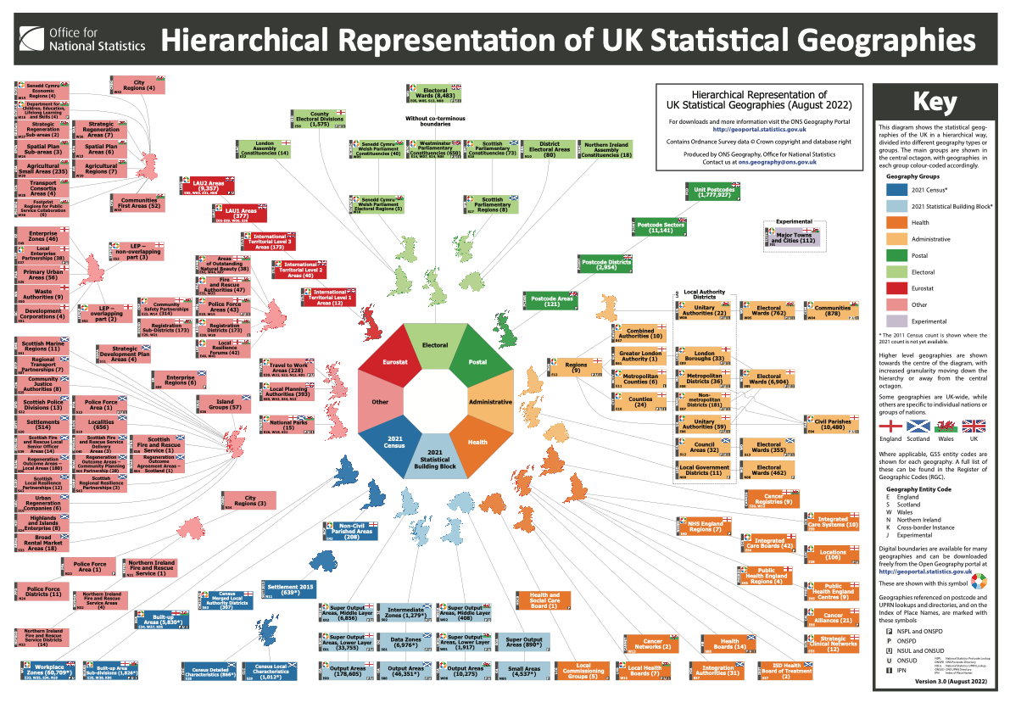
Upscaling

Slide 25
Downscaling
Is it appropriate? Is it ethical?
For example, our dataset may only have a region coded as a geographic variable but other geographic information may be contained within the dataset.
What different variables can be used to infer or deduce smaller units?
Can we merge in other data that will allow us to do this?

Slide 26
Infilling
Can assumptions reasonably be made about the data?
Can missing data be brought in from other datasources?
  API’s can be a great source of parsing variables for more information
Can missing data be estimated?
  Machine Learning techniques
  Can be unsupervised or semi-supervised

Slide 27
- part of the Open Social Science Handbook project
Re-using and repurposing other peoples data
Timothy Monteath (UCL/LSE) and Patrick Dunleavy (LSE)
10 November 2022

